Slide 1
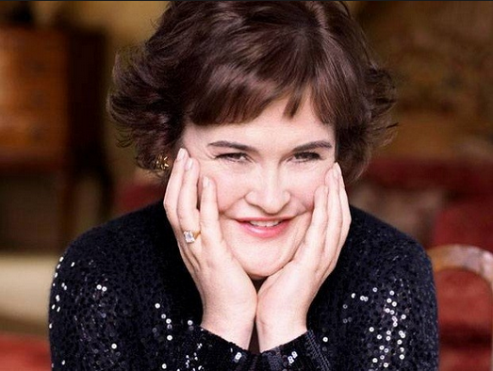

You’ ll see

Slide 2
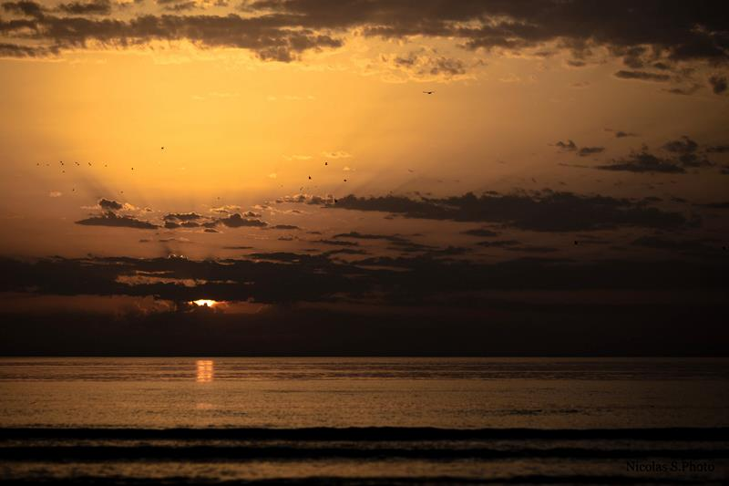
You think that I can't live without your love

Slide 3
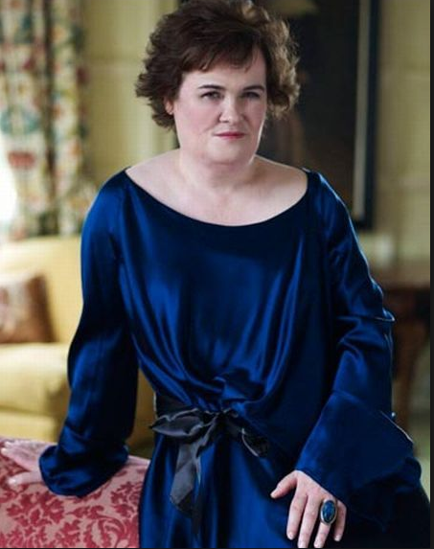
You'll see,
You think I can't go on another day.

Slide 4
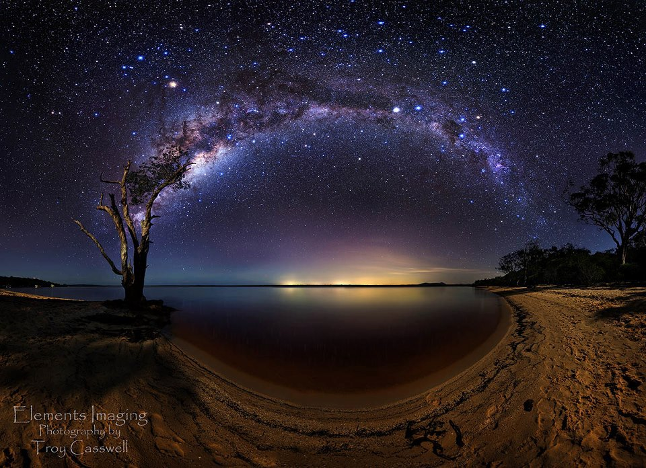
You think I have nothing

Slide 5
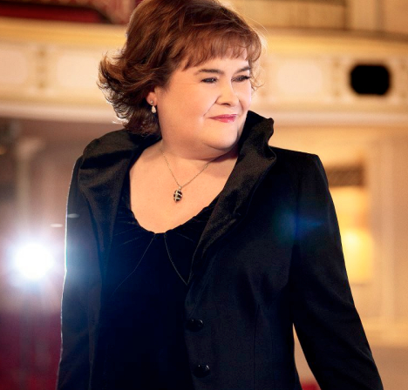
Without you by my side,
You'll see

Slide 6
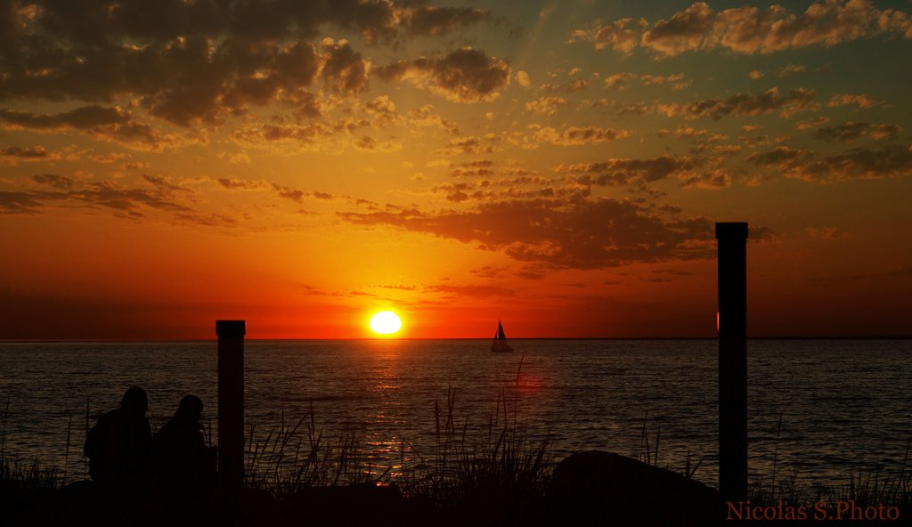
Somehow, someday

Slide 7
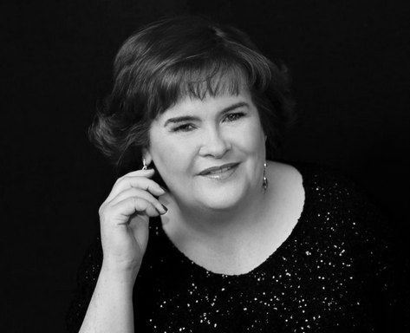
You think that I can never laugh again
You'll see

Slide 8
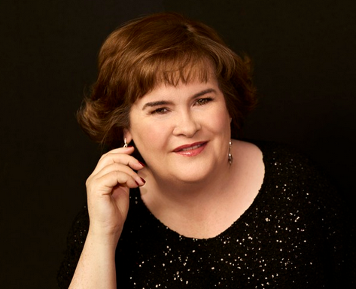
You think that you destroyed my faith in love.
You think after all you've done

Slide 9
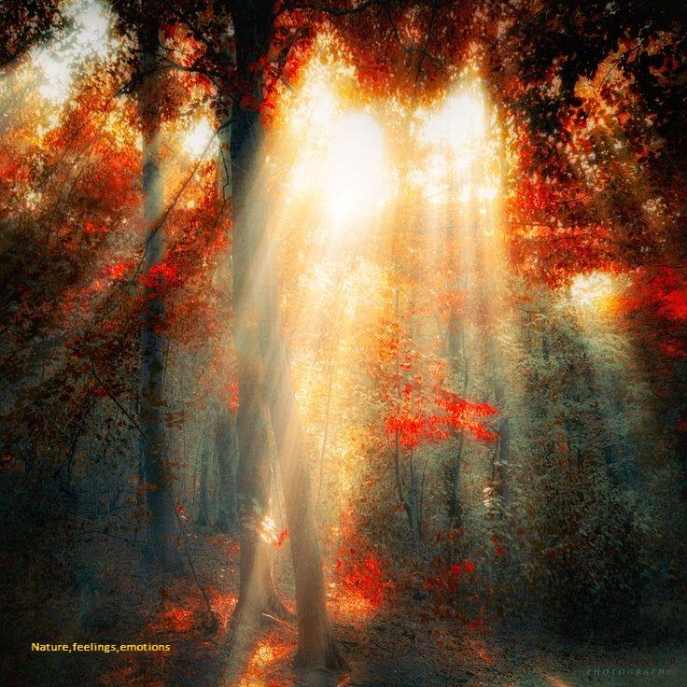
I'll never find my way back home,

Slide 10
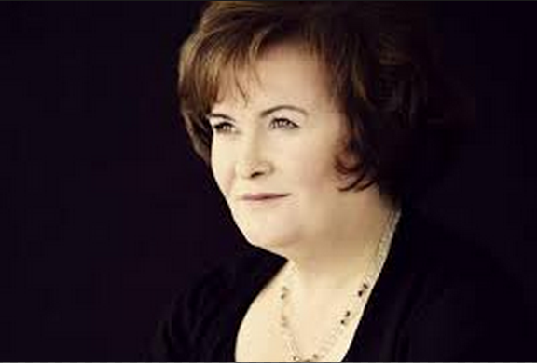
You'll see
Somehow, someday

Slide 11
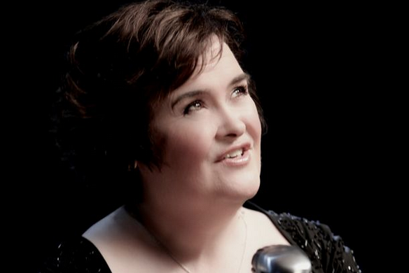
All by myself
I don't need anyone at all
I know I'll survive
I know I'll stay alive,

Slide 12

All on my own
I don't need anyone this time

Slide 13
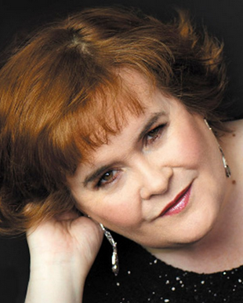
It will be mine
No one can take it from me
You'll see

Slide 14
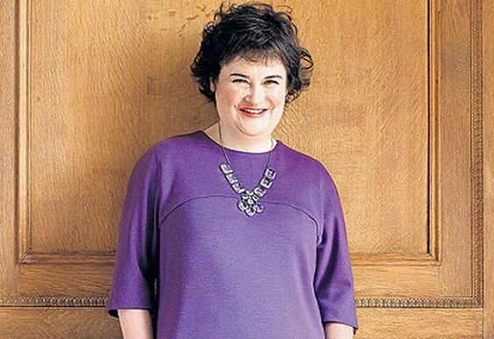
You think that you are strong, but you are weak
You'll see

Slide 15

It takes more strength to cry, admit defeat.
I have truth on my side

Slide 16
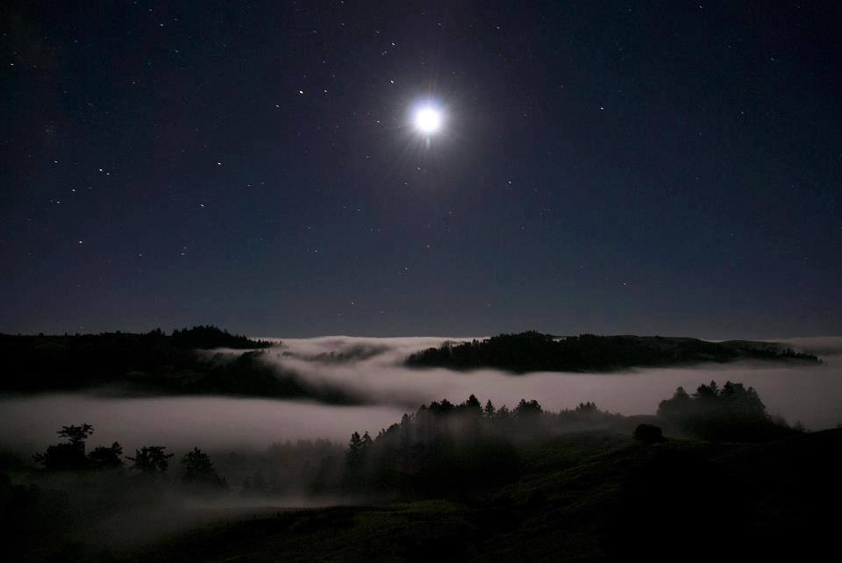
You only have deceit
You'll see, somehow, someday

Slide 17
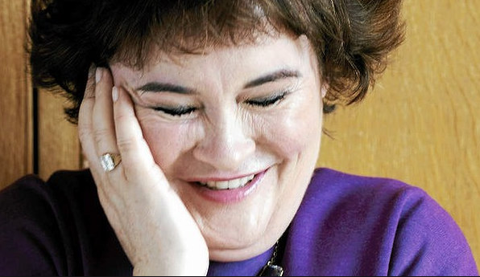
All by myself
I don't need anyone at all

Slide 18
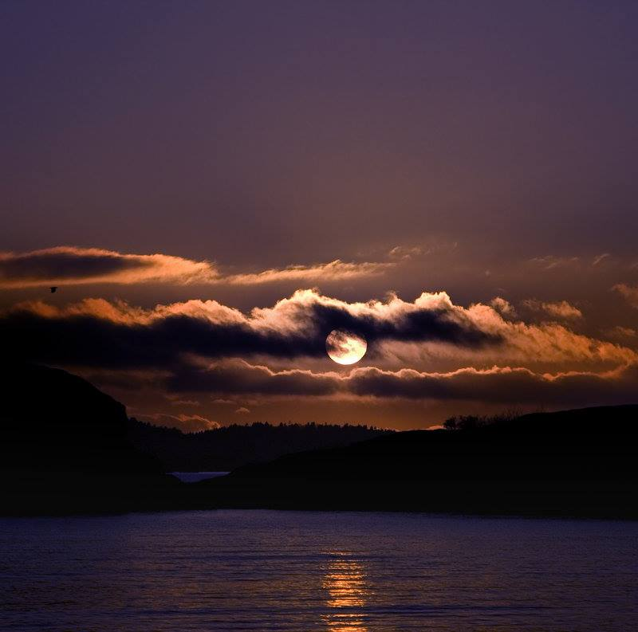
I know I'll survive
I know I'll stay alive,
I'll stand on my own

Slide 19

I won't need anyone this time
It will be mine
No one can take it from me
You'll see

Slide 20
You'll see, you'll see
You'll see………….

Slide 21



Accede a la sección que desees desde aquí:
Propia Creación
De la Red
Dedicatorias | Fechas Especiales | Graciosos
Historia y Arte | Lugares | Musicales
Naturaleza y Ciencias | Política | Reflexión
Religiosos | Románticos | Salud
Dedicatorias | Fechas Especiales | Graciosos
Historia y Arte | Lugares | Musicales
Naturaleza y Ciencias | Política | Reflexión
Religiosos | Románticos | Salud
Si deseas recibir pps periódicamente en tu correo electrónico subscríbete aquí:

