Slide 1


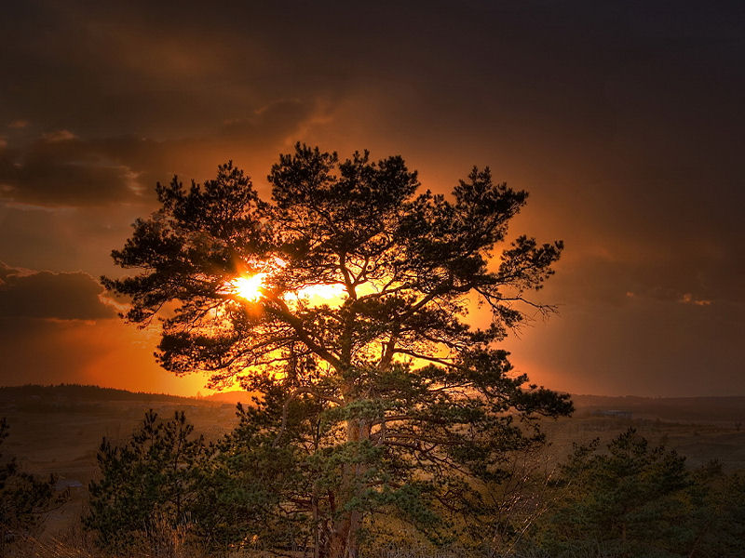


Love at dawn
Amor de madrugada

Slide 2
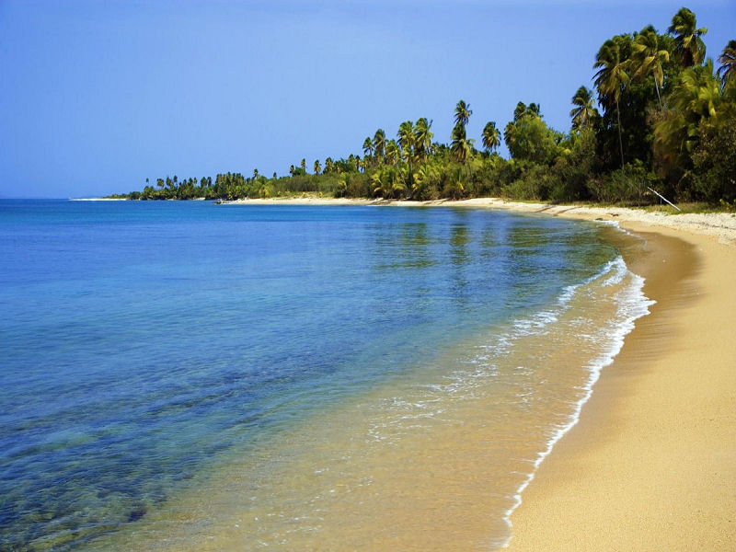
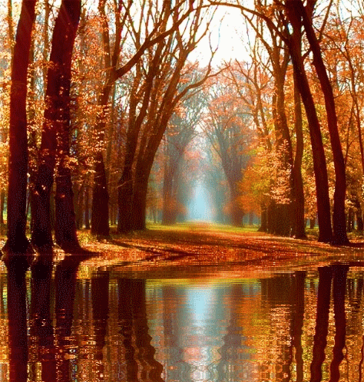



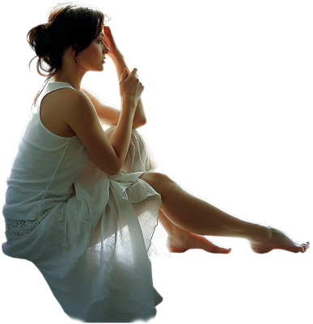
Love, love, love, love, love, love
Early morning love let me your cry recorded on the pillow
Love, love, love
Love, love, love, love, love, love
Few hours love, leave me your cry recorded on the pillow

Slide 3
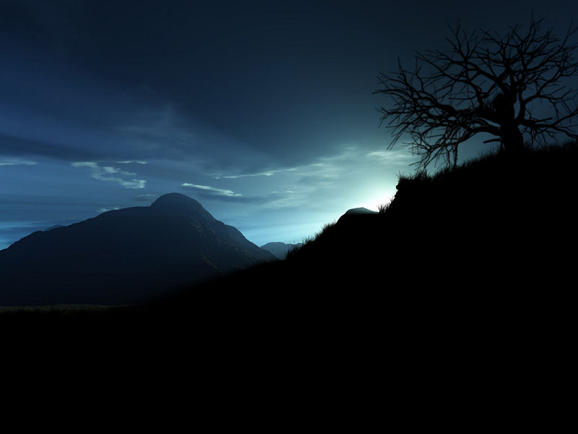

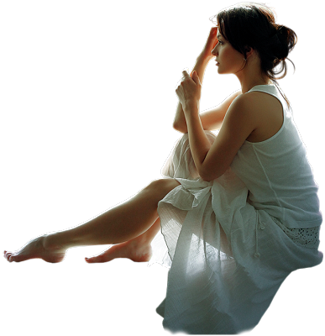
The day began as many days
With the eternal longing for cold mornings

Slide 4


People are confused as lost shadows
And the hours as others walked many days
As the eternal fatigue of known things

Slide 5
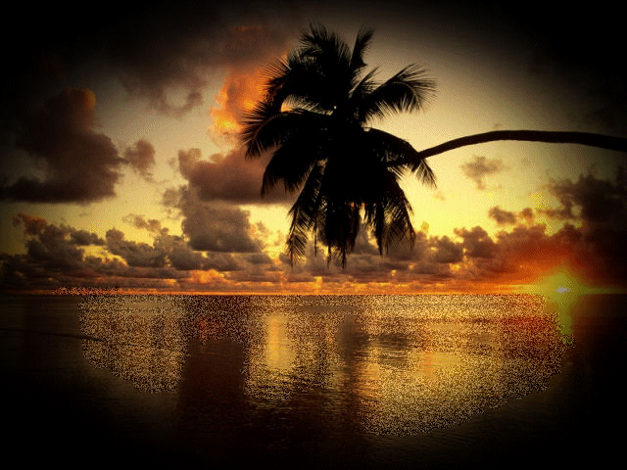
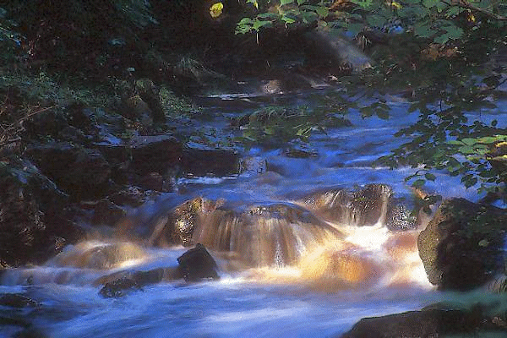


The afternoon I go slowly, as the soul... shrinking
At that moment you got to my life

Slide 6
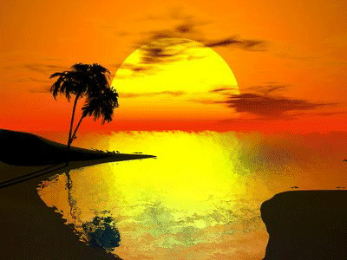
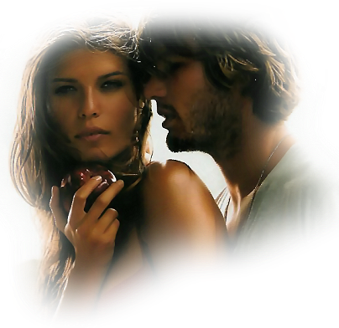

Feeling the touch of your skin on mine
All of a sudden change in the empty house
No, I couldn't say with known phrases

Slide 7

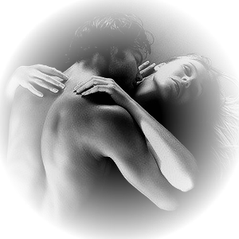

And in the new sheets shout I love you!
Love, love, love, love, love, love
Few hours love, leave me your cry recorded on the pillow
Love, love, love, love, love, love
Early morning love let me your cry recorded on the pillow
Love, love, love

Slide 8


De España para el mundo
From Spain to the world
Manolo Otero cantante español
Que nació el 25 de junio de 1942
en Madrid España y falleció el
1 Junio 2011, São Paulo, São Paulo, Brasil
Descanse en paz.
Spanish singer Manolo Otero
Who was born on June 25, 1942
Madrid Spain and died on
June 1, 2011, São Paulo, Brazil
Rest in peace.

Slide 9
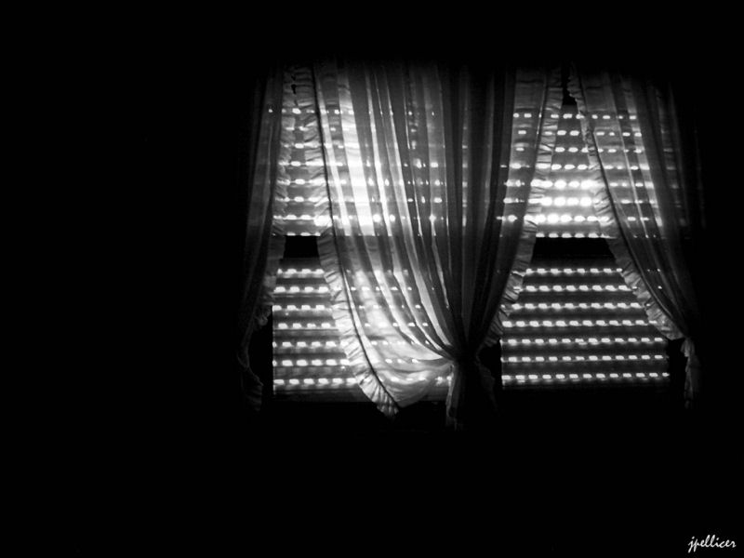

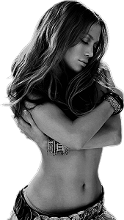


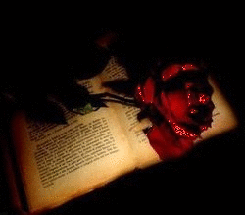
All of a sudden change in the empty house
Feeling the touch of your skin on mine
At that moment you got to my life

Slide 10


No, I could not say with known phrases
and in the new sheets shout I love you!
Love, love, love, love, love, love

Slide 11
Few hours love, leave me your cry recorded on the pillow
Love, love, love, love, love, love
Early morning love let me your cry recorded on the pillow.

Slide 12
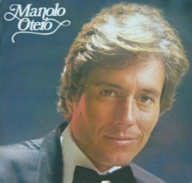
Canta Manolo Otero
Imágenes de la red
Sin lucro.
Creaciones Yuls.

Slide 13



Accede a la sección que desees desde aquí:
Propia Creación
De la Red
Dedicatorias | Eróticos | Fechas Especiales
Graciosos | Historia y Arte | Lugares
Naturaleza y Ciencias | Política | Reflexión
Salud | Románticos | Religiosos
Dedicatorias | Eróticos | Fechas Especiales
Graciosos | Historia y Arte | Lugares
Naturaleza y Ciencias | Política | Reflexión
Salud | Románticos | Religiosos
Si deseas recibir pps periódicamente en tu correo electrónico subscríbete aquí:

