Slide 1

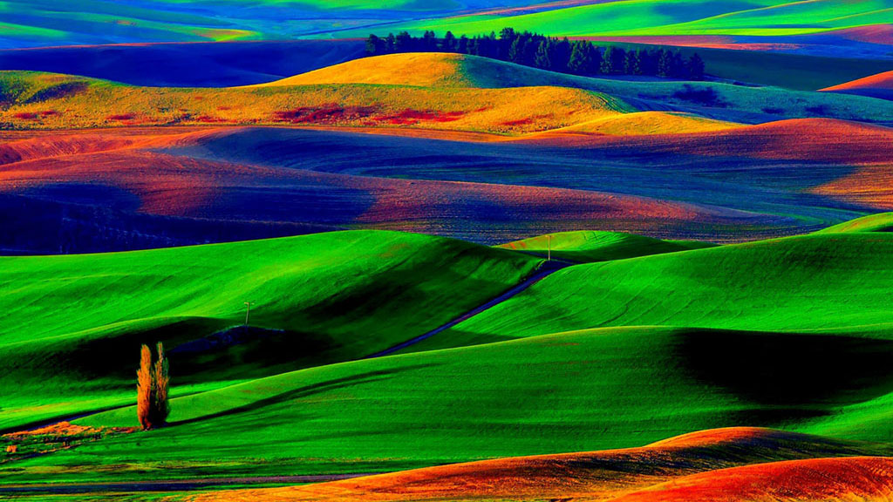


PHOTOMIX FOR YOUR THOUGHTS
Is there anything more beautiful than to cherish simple natural scenery and prominent images?
Here are a collection of mixed pictures to brighten anyone’s spirit. We strongly believe that despite our fast paced world with all it’s modern gadgets and lifestyles, unless one truly appreciate the environment, the simplicities and beauty of nature and have that care for the real needy ones - only then can we say that “WE ARE TRULY HUMAN”.
Following are pictures with thoughts for your pondering mind.
Enjoy viewing this slideshow and have a nice day.
Compiled by two free thinking humans with love for humanity.
Tony Chacko and Steve Rumpler

Slide 2
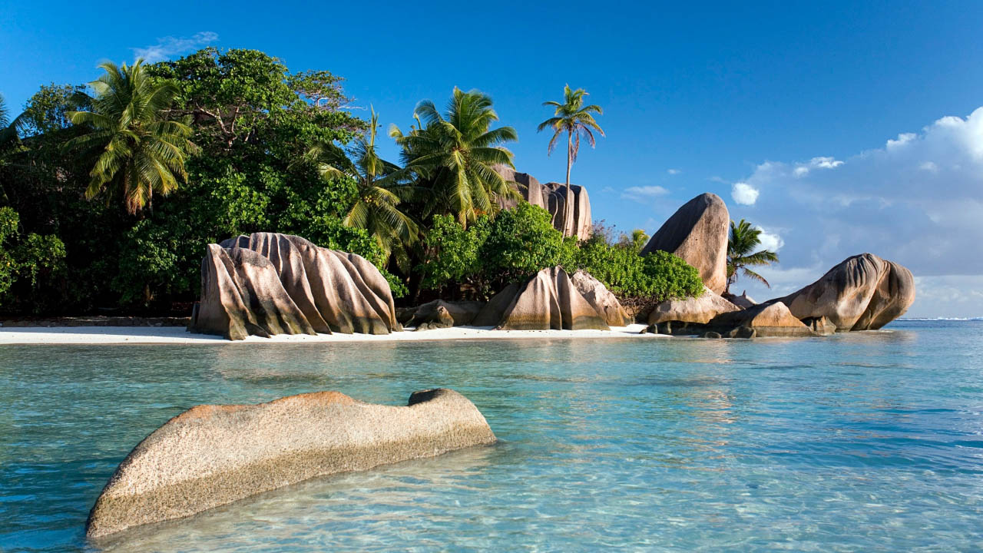

The doctor of the future will give no medicine, but will interest her or his patients in the care of the human frame, in a proper diet, and in the cause and prevention of disease.
- Thomas Alva Edison

Slide 3
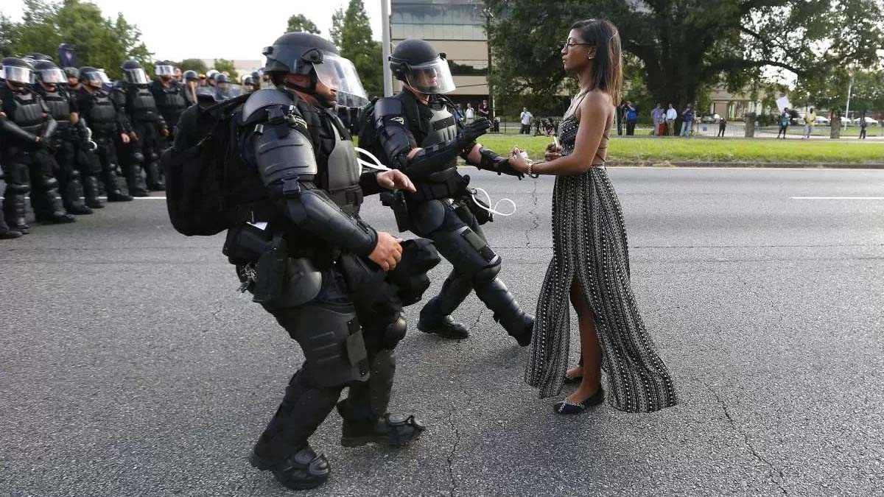
Demonstrator Iesha Evans is detained by law enforcement as she protests the shooting death of Alton Sterling near the headquarters of the Baton Rouge Police Department in LA. USA.

Slide 4

PURPOSE OF LIFE
The TWO most IMPORTANT DAYS in your LIFE ARE the day you are BORN… and the DAY you FIND out WHY.
Death is certain. Life is uncertain. Be AWARE. Be good. Be Kind Hearted. Be Grateful. Be Compassionate. Be Loving. Be Gentle. Be Helpful. Be Humble. Be Wise ~ Live your life as if you were to die to tomorrow.
And to all doubters of a Creator and God - I believe in God not because of my parents or the church but because I have experienced His goodness and mercy myself.

Slide 5
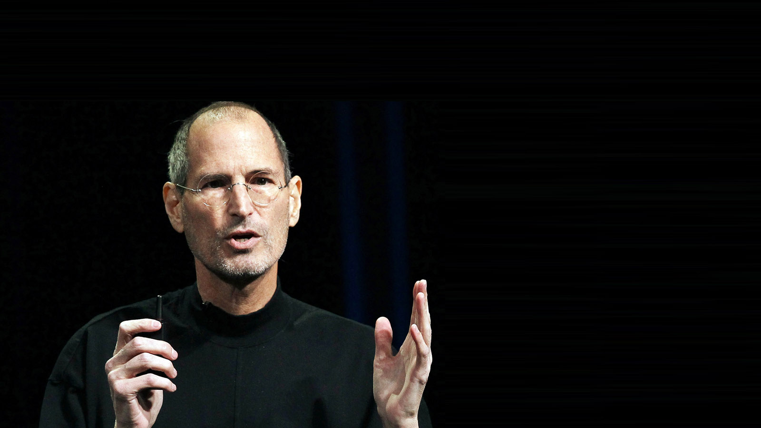
"Being the richest man in the cemetery doesn't matter to me. Going to bed at night saying we've done something wonderful, that's what matters to me."
Steve Jobs

Slide 6
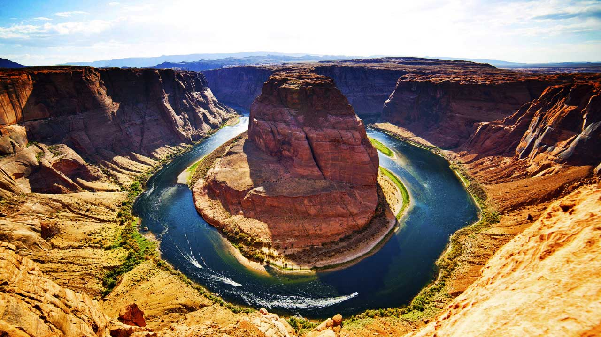

Slide 7
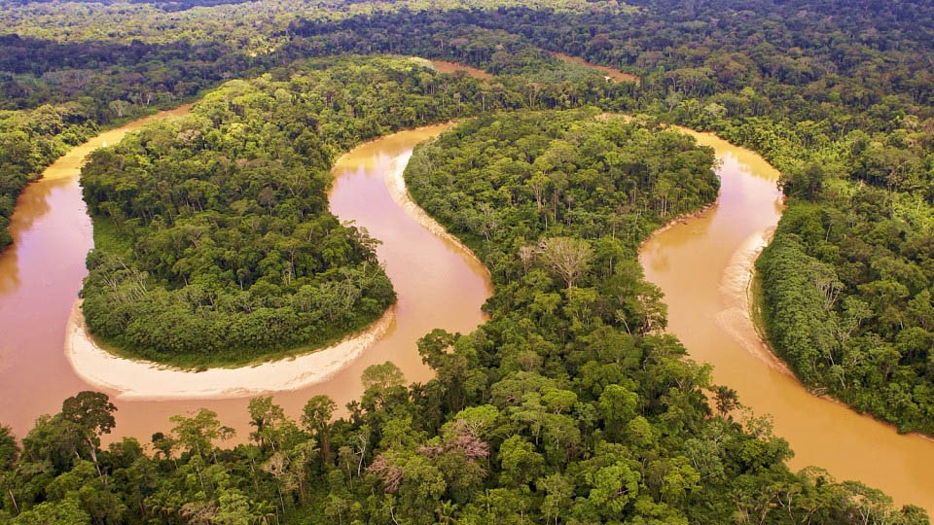
The Amazon Rainforest (Amazonia or Amazon Jungle), is the world’s greatest natural resources and covers most of the Amazon Basin of South America. Because its vegetation continuously recycles carbon dioxide into oxygen, it has been described as the “Lungs of our Planet“. About 20% of earth’s oxygen is produced by the Amazon rainforest. Yet there is no consensus by nations of the world to limit deforestation in a planned manner with the result that there is reduced green vegetation and more world pollution.

Slide 8
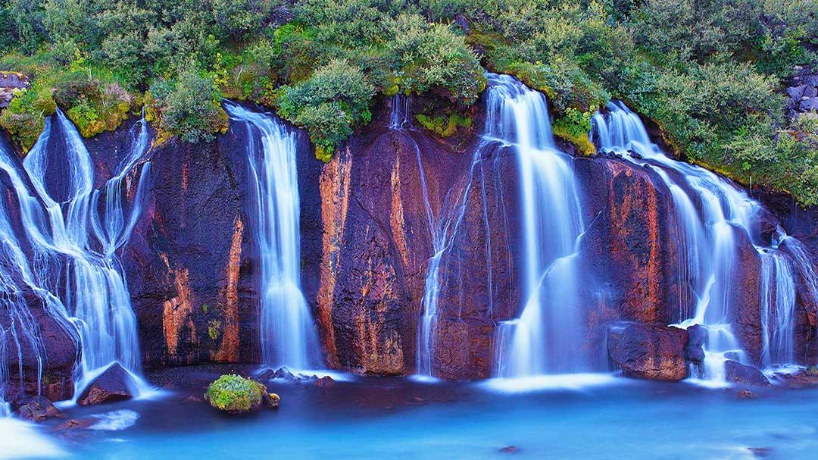
Manipulators can lie, cheat, treat you badly, make use of you and somehow manage to make it all seem like it is your fault. These envious hypocrites are mostly relatives, and it would be best to avoid their relationship even if you loose any assets - as you gain in having peace of mind and other life attainments.

Slide 9
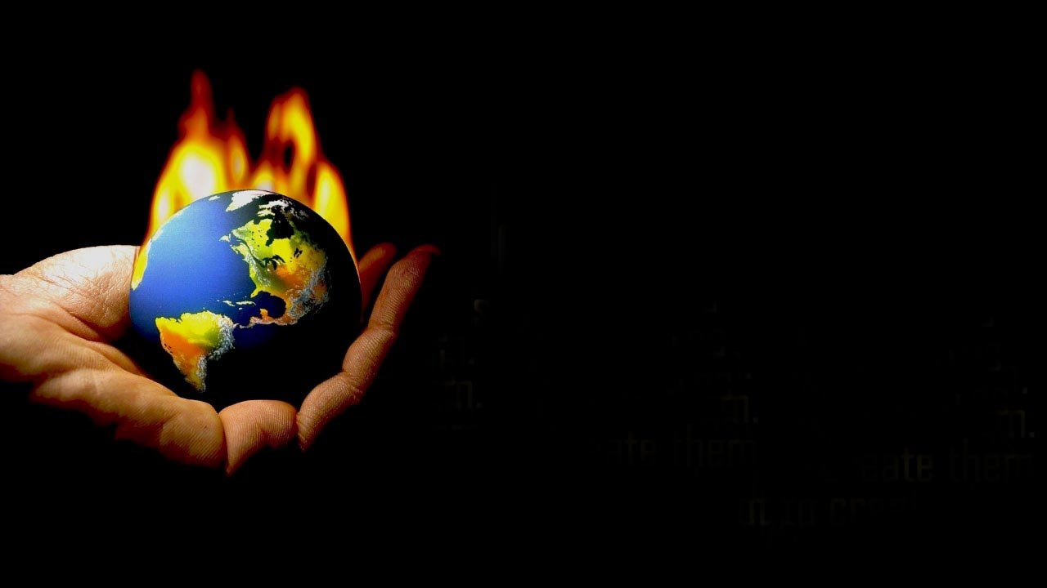
GOD doesn't expect us to
solve all the world's problems.
He expects us not to create them.

Slide 10
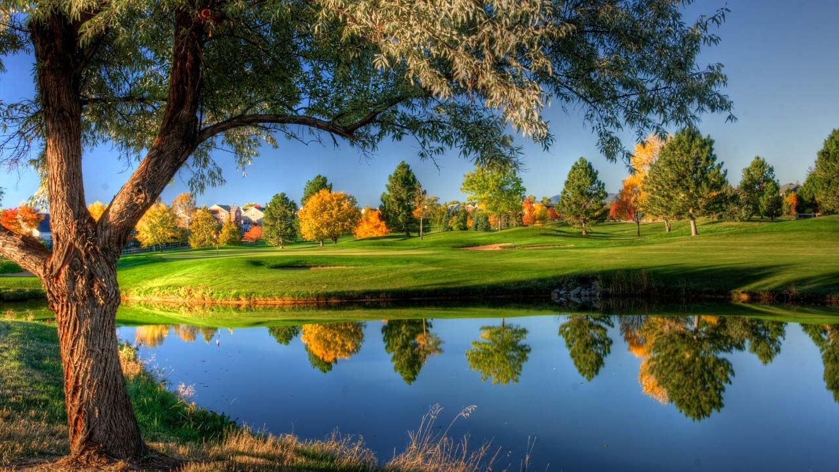
“The most beautiful people we have known are those who have known defeat, known suffering, known struggle, known loss, and have found their way out of the depths. These persons have an appreciation, a sensitivity, and an understanding of life that fills them with compassion, gentleness, and a deep loving concern. Beautiful people do not just happen.” - Elisabeth Kübler-Ross

Slide 11
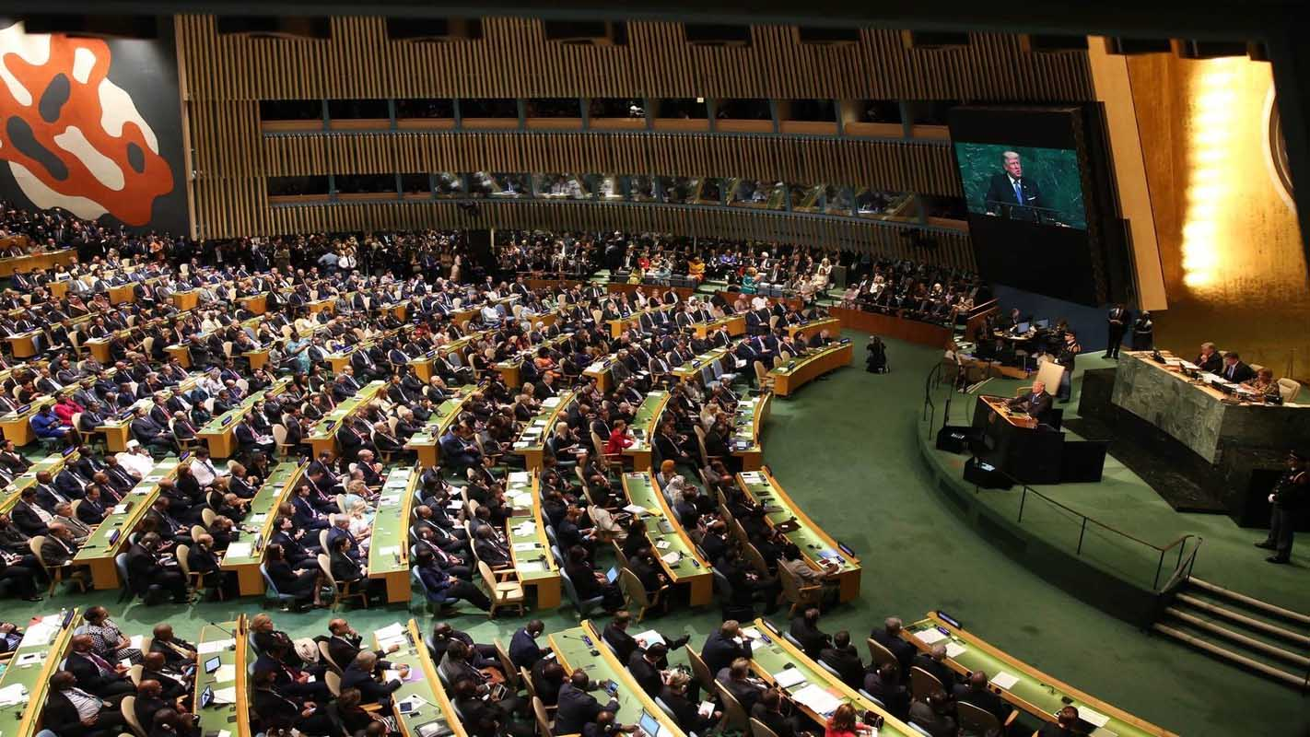
In general our world today has professions that destroy and control the people of nations. They are :-
1. Politicians - Who make laws that suit their needs and stifle citizens from amenities and freedom.
2.Bureaucrats - Who implement laws and makes money on the sly from citizens, thereby sharing it with politicians.
3.Godmen - Who aspire for maximum followers and with these followers threaten Government and citizens to obey their diktats.
Yet we vote them to power and enable Godmen and Bureaucrats to flourish by giving contributions for destroying the ethos of humanity.
(- critical thoughts of Tony Chacko)

Slide 12
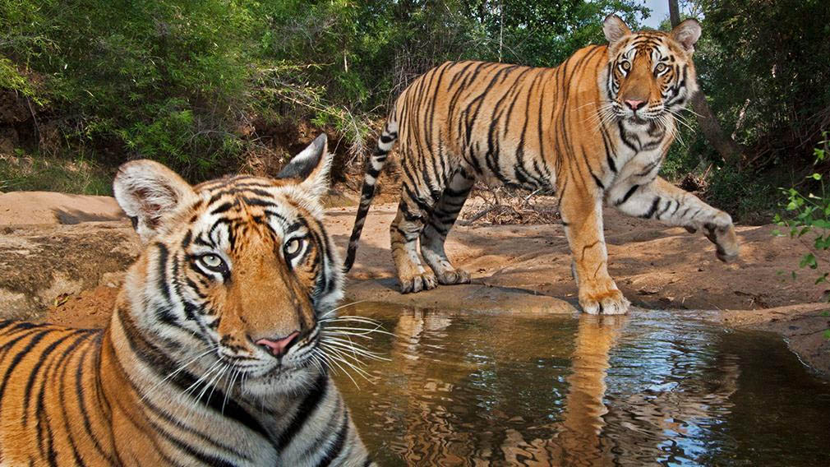
“I envy animals for two things – their ignorance of evil to come, and their ignorance of what is said about them.” - Voltaire

Slide 13
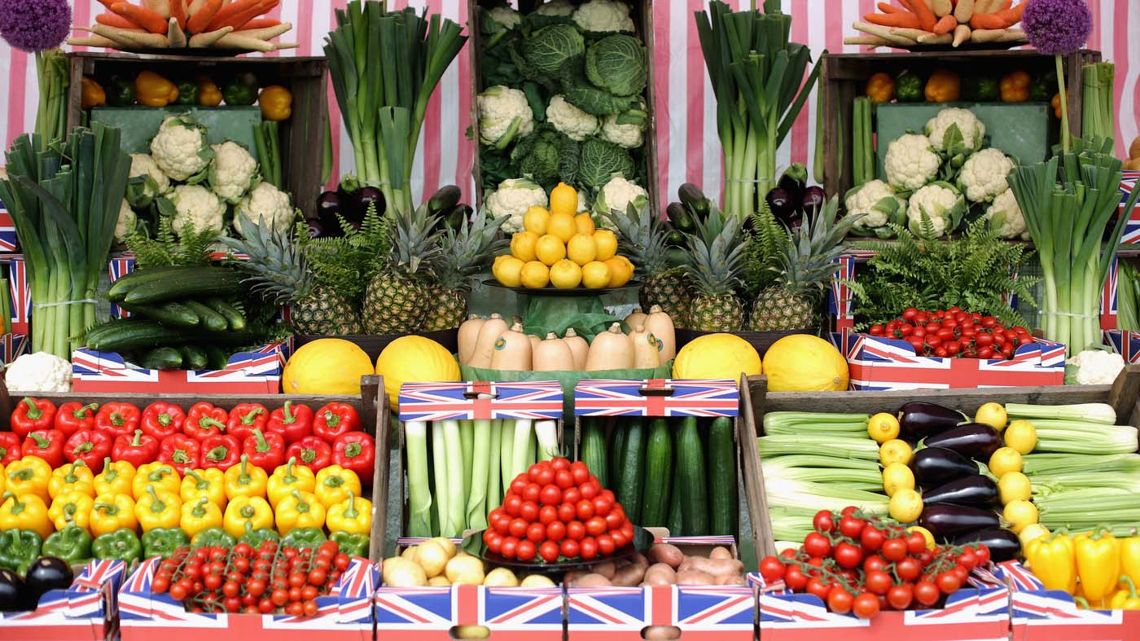
There is sufficiency in this world for man’s need, but not for man’s greed.

Slide 14
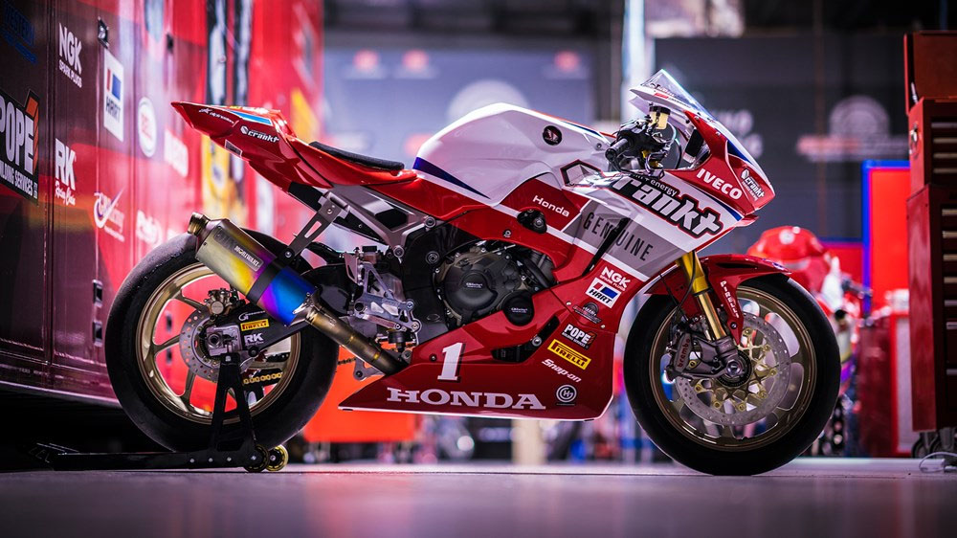
“God will never adjust His agenda to fit ours. He will not speed up His pace to catch up with ours; we need to slow our pace in order to recover our walk with Him. God will not scream and shout over the noisy clamor; He expects us to seek quietness, where His still small voice can be heard again.” - Charles R. Swindoll

Slide 15
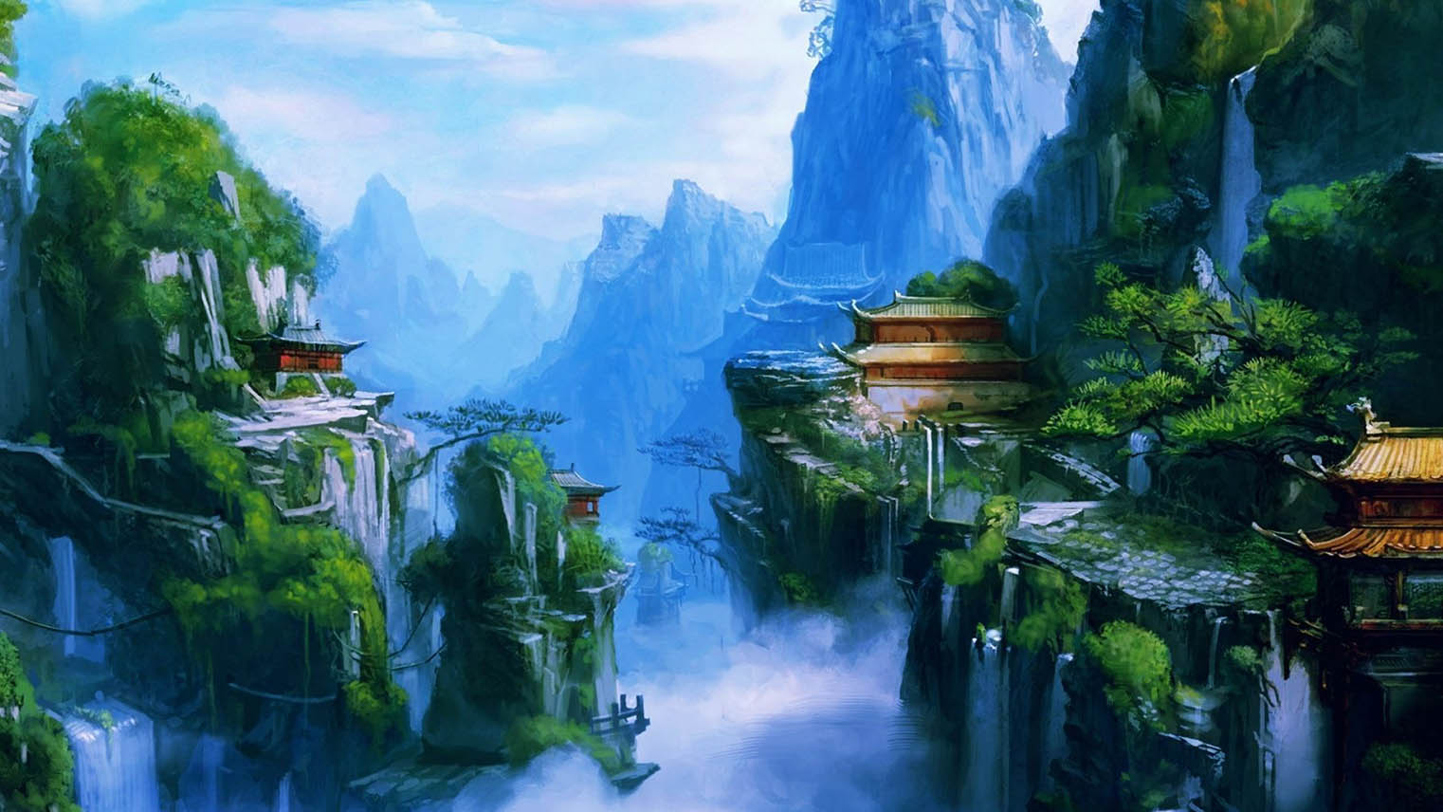
Prayers, dreams and seeds are similar in nature. They all have nothing within but they have the potential of creating everything.

Slide 16
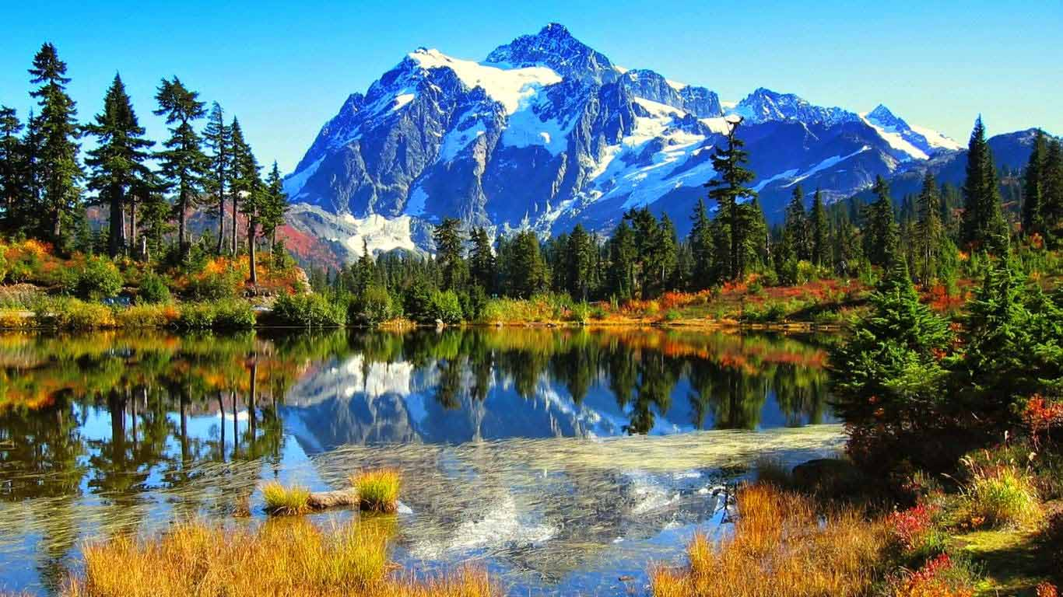
To sit in the shade on a fine day and look upon verdure is the most perfect refreshment.

Slide 17
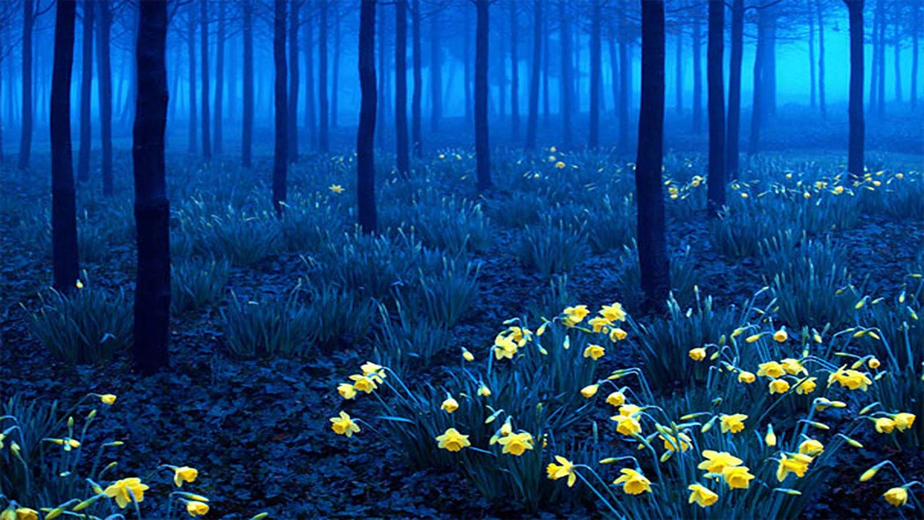
WORLD VISION
The only answer to the world’s problem of wars, poverty, communal hatred, repressive governments, religious fanaticism, epidemics, environmental pollution and natural calamities like earthquakes, drought, floods, tsunami-hurricanes and famine lie in the creation of a STRONG WORLD GOVERNMENT of ethically service oriented people with the vision and will to render worldwide economic, technological and medical development, to ensure that every human being is given basic education, to harness maximum land area for agricultural development such that there is enough food for every world citizen, to retain sufficient forest cover and environmental protection, to distribute resources worldwide, to establish ethical business practices, to decisively restrain radically destructive people ensuring that law and order prevails, and to teach mankind of truly harmonious co-existence so that there is freedom of speech, freedom of cultural and religious practices, equal opportunity for every world citizen and value for human life.
Many cults and religions teach that salvation is only for their believers thereby invoking fear on people of other religious faiths in their states for fear of conversion. Due to poverty and illiteracy, martyrdom vide suicide attacks and ambushing innocent citizens in the names of religions are encouraged by these ethnic leaders. This is wrong and all world citizens must oppose such persons and groups. Any territorial or wealth dispute must be resolved on the basis of discussions with the will to resolve issues than standing by unreasonable patriotic or religious adamancies.
Governments in the form of monarchy, dictatorship, communism, socialism, and democracy are not able to bring peace and order to this world. These ‘isms’ and ‘theocracies’ must be abolished with space only for proven ethical humble people to lead nations.
Yes, the answer for these problems is for national leaders to set aside egos, elect a world government, and agree to abide by the rules set by such a body as federated states. This world government must have men and women who will stand for the right even though the heavens may fall and will have the following ideals in carrying out their duties. ---->>

Slide 18
WORLD VISION
We shall be fair in our dealings to all concerned.
We shall convince people of the need for a common code of world ethics considering the cultural and religious values of all people.
We shall always aspire to attain the goodwill and trust of all people.
We shall constantly strive for the equilateral development of the world.
None of these leaders must have excessive possessions - they would have one home per person and children who are living under their support.
The immediate need is that weapons and military arms of all nations must be given to the care of the world government with a global law that no human being has the right to possess any weapon. The only organization to carry weapons is the police force of the world government
to implement law and order guided by a global judiciary system to impart justice to all.
"ONLY THEN CAN WE FEEL AND HEAR GOD TELL US WELL DONE MY CHILDREN.“
- thoughts by Tony Chacko

Slide 19
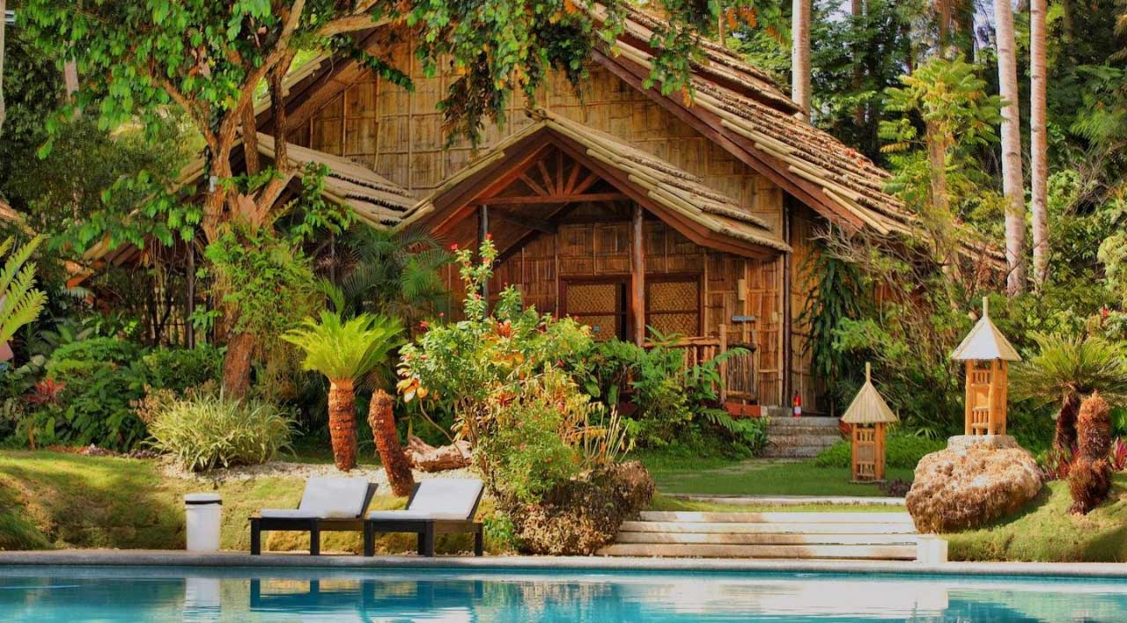
Live intensely, live totally here and now . Paradise is not some place somewhere. It is home sweet home where you can live and sleep peacefully. - Tony Chacko

Slide 20
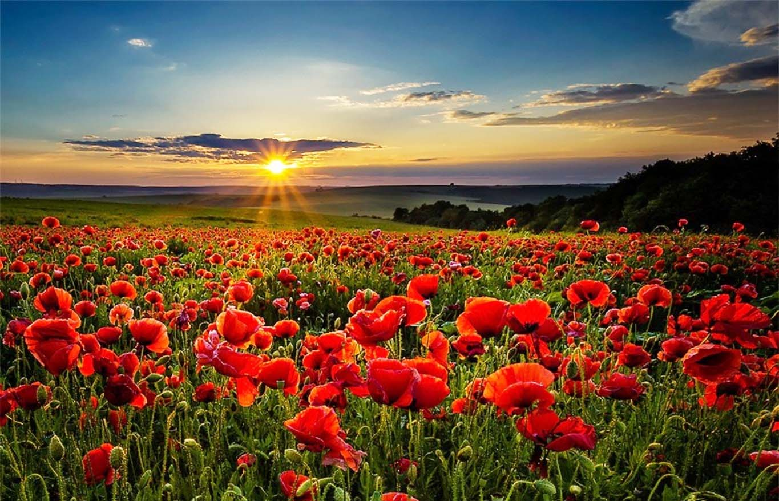
Wars will never end until the “My religion is better than your religion” insanity stops.

Slide 21
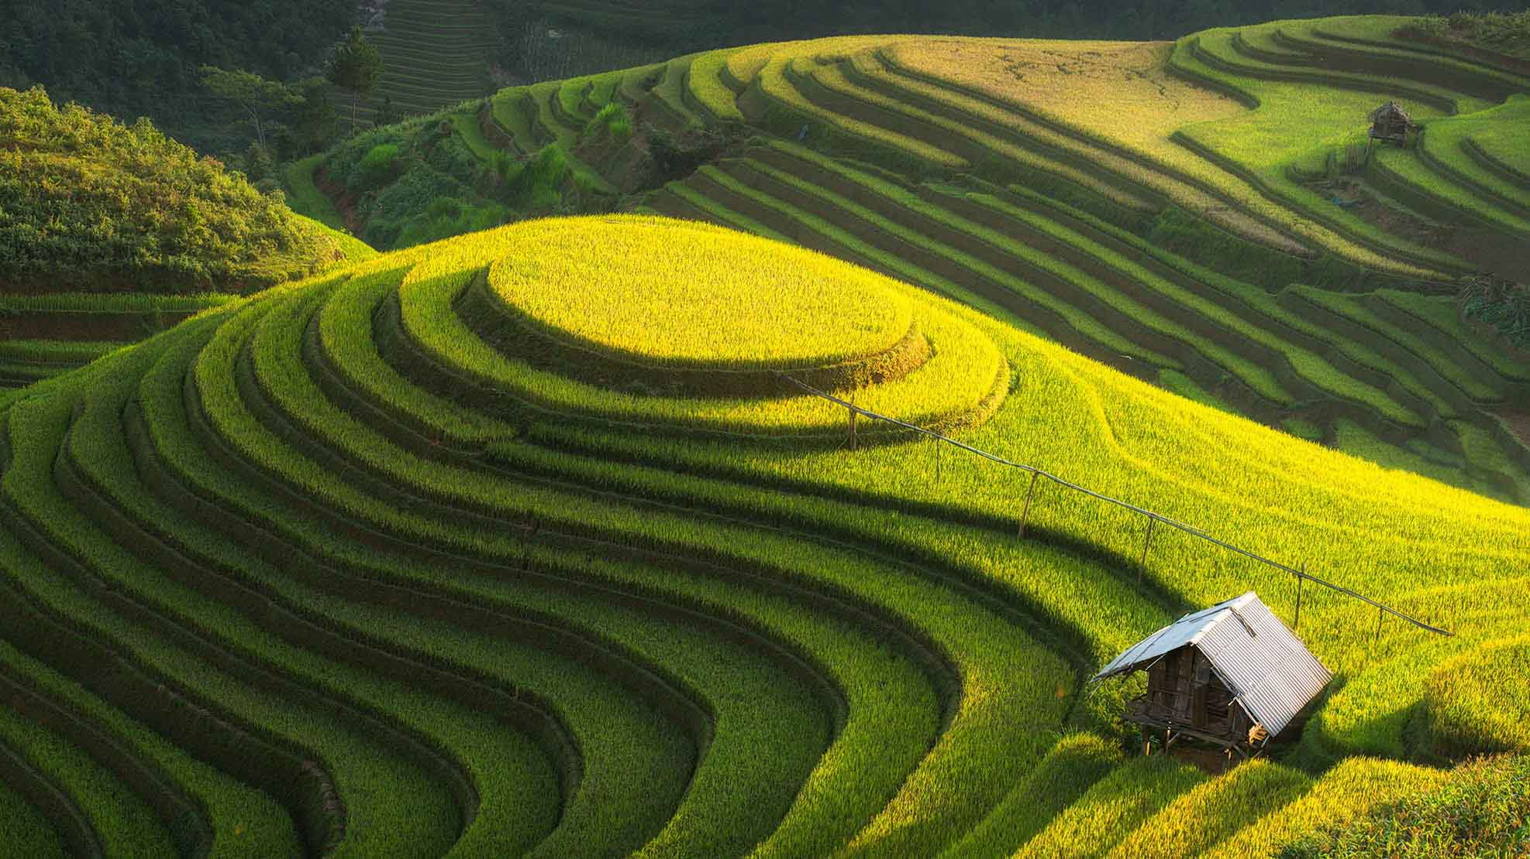
PRAYER : Prayer is the best communication process one has with God in solving everyone’s personal problems. There is only one living God and He expects us to remember Him everyday. Daily prayer enables one to have a personal understanding of God (the Creator, Provider and Guide). To ensure something worthwhile happening, first pray about it and put it in into God’s Hands. Then visualize a picture of the expected resolution as happening, holding this picture firmly in your consciousness. Your desires in life should be genuinely good, which does not prejudice any other person/ people as God will not acknowledge any harmful wishes. Surrender this picture of your need into God’s Hands. Practice believing and continue to hold the vision of your expected desires firmly in your thoughts. You will be surprised that this picture of your aspiration will actualize in your life (at a later time). - Tony’s perception of prayer

Slide 22
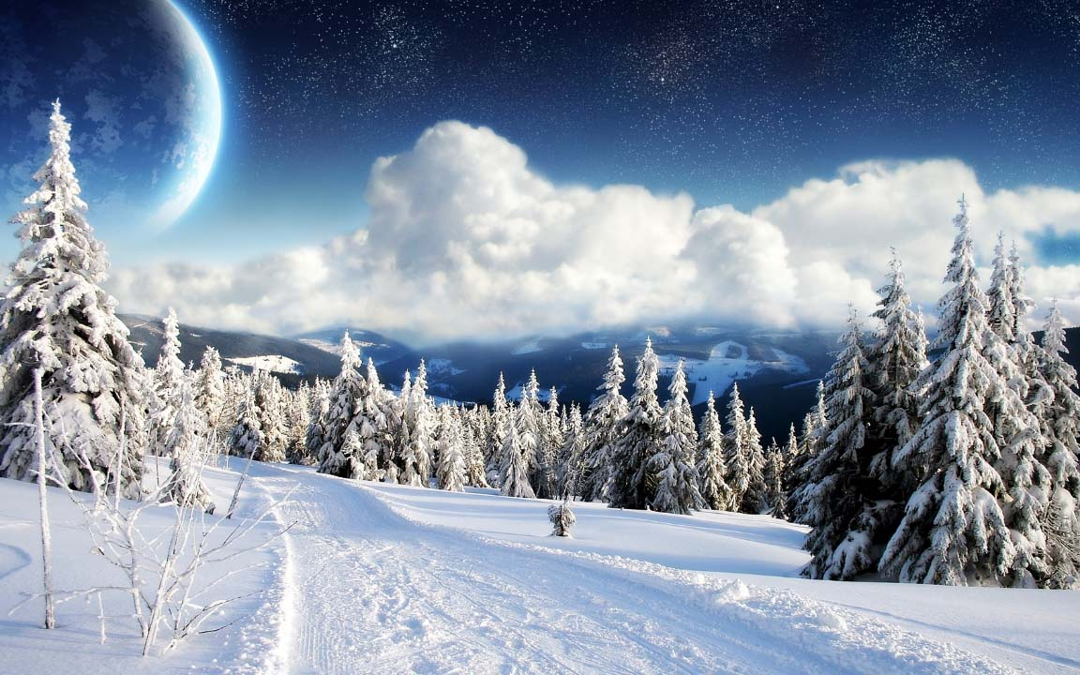
The more chances you give someone, the less respect they'll start to have for you. They'll begin to ignore the standards that you've set because they'll know another chance will be given. They're not afraid to lose you because they know you won't walk away. They get comfortable depending on your forgiveness. Never let a person get comfortable in disrespecting you.

Slide 23
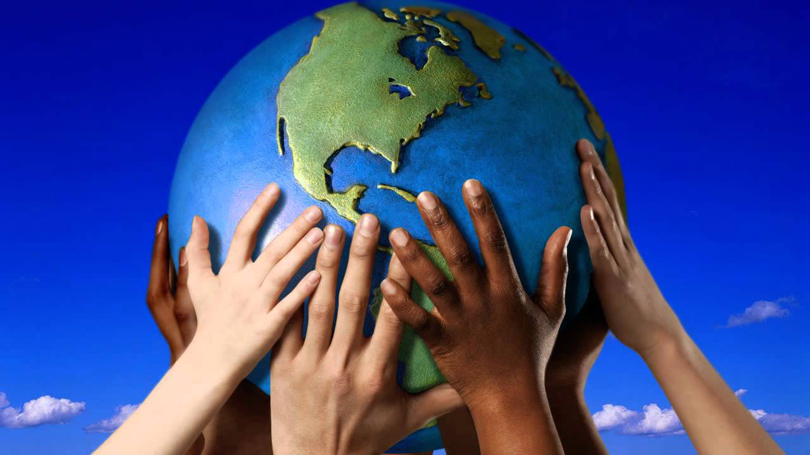
We may have different countries, religions, cultures, beliefs and of late hateful religious ideologue groups.
But we all belong to one Human Race with the same blood and human perceptions.
OH FOR A BORDERLESS WORLD WITH FREEDOM AND EQUALITY FOR EVERY HUMAN OF THIS WORLD!!!

Slide 24
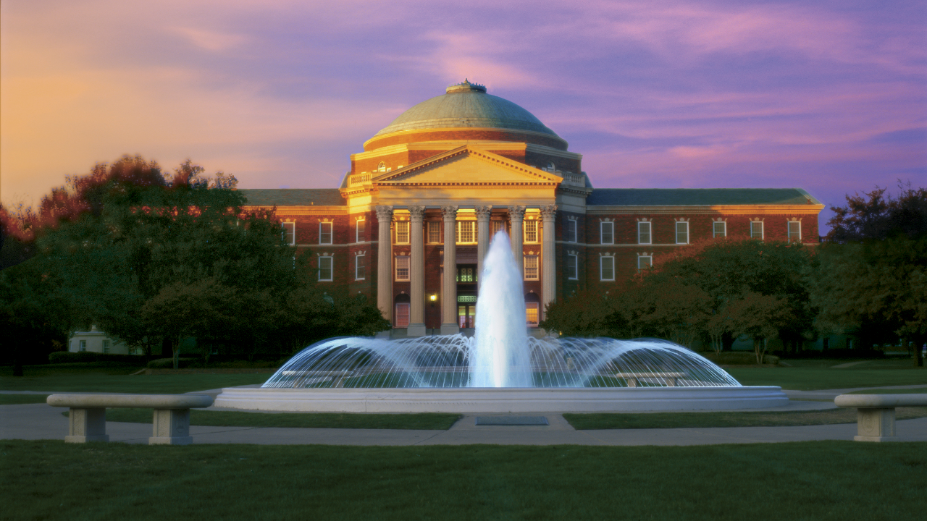
"A university stands for humanism, for tolerance, for reason, for progress, for the adventure of ideas and for the search of truth.
It stands for the onward march of the human race towards even higher objectives. If the universities discharge their duty adequately, then' it is well with the nation and the people.” - Jawaharlal Nehru

Slide 25
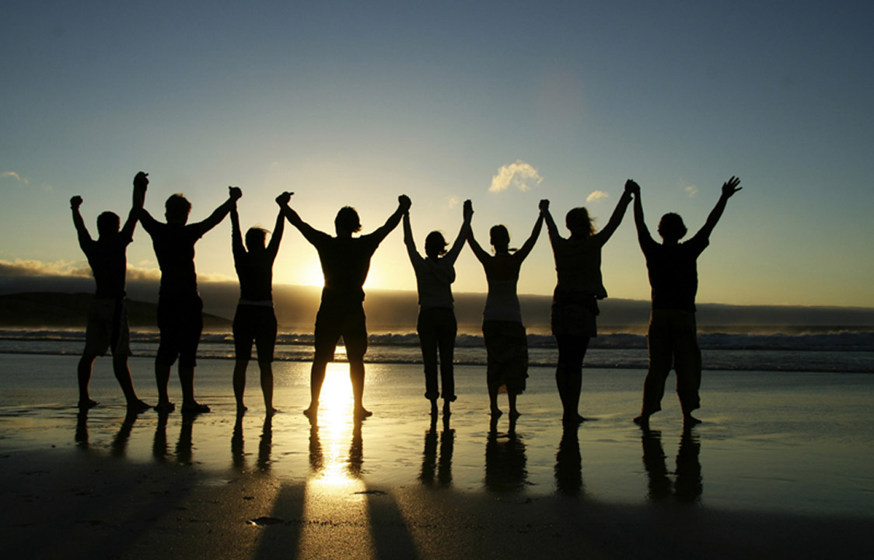
There is nothing on this earth more to be prized than True Friendship

Slide 26
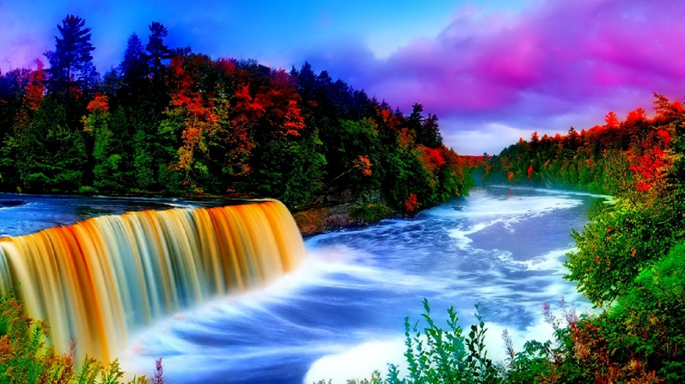
“The beauty of life is, while we cannot undo what is done, we can see it, understand it, learn from it and change so that every new moment is spent not in regret, guilt, fear or anger but in wisdom, understanding and love.”
- Jennifer Edwards

Slide 27
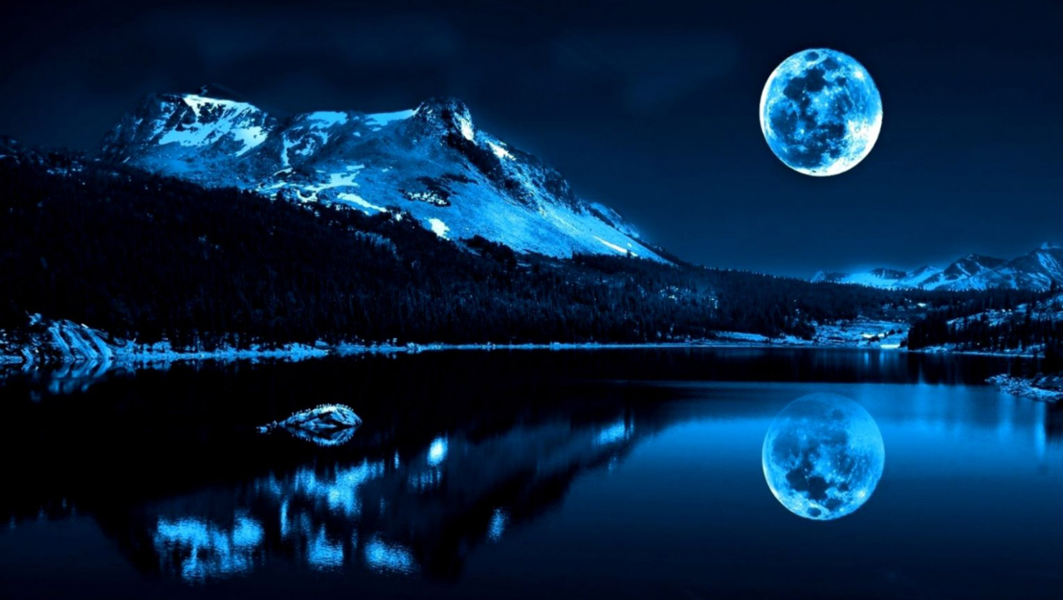
Hope you have enjoyed this slideshow with some thoughts of concern for all humans.
Do let us know of your viewpoints and suggestions which are most welcome.
With the best regards
TONY CHACKO and STEVE RUMPLER
(tonychacko2000@gmail.com / pista2011@gmail.com)
2017
Music : ‘Wonderful Tonight’ by Guitar Sensation

Slide 28







¿Te ha gustado?
Puedes ver más entrando
Aquí
Además puedes recibir powerpoints en tu correo electrónico suscribiéndote aquí:
F I N

