Slide 1
RaúlTM

Slide 2


Mi
perro
y
yo
RaúlTM

Slide 3
Te has preguntado
porqué los perros viven menos
que las personas ?
RaúlTM
Notes:
Custom animation effects: sparkle
(Basic)
To reproduce the text on this slide, do the following:
On the Home tab, in the Slides group, click Layout, and then click Blank.
On the Insert tab, in the Text group, click Text Box. On the slide, drag to draw a text box.
Enter text and select it. On the Home tab, in the Font group, in the Font list select Franklin Gothic Heavy, and then in the Font Size box, select 96 pt.
On the Home tab, in the Paragraph group, click Center.
Select the text box, and then under Drawing Tools, on the Format tab, in the WordArt Styles group, click Text Effects, point to Reflection, and under Reflection Variations select Tight Reflection, Touching (first row, the first option from the left).
With the text box still selected, under Drawing Tools, on the Format tab, in the bottom right corner of the WordArt Styles group, click the Format Text Effects: Text Box dialog box launcher. In the Format Text Effects dialog box, click Text Fill in the left pane, select Gradient fill in the Text Fill pane, and then do the following:
Click the button next to Preset colors, and then click Ocean (second row, second option from the left).
In the Type list, select Linear.
Click the button next to Direction, and then click Linear Up (second row, second option from the left).
Also in the Format Text Effects dialog box, click 3-D Format in the left pane. In the 3-D Format pane, under Bevel, click the button next to Top, and then under Bevel click Circle (first row, first option from the left).
To reproduce the first star on this slide, do the following:
On the Home tab, in the Drawing group, click Shapes, and then under Stars and Banners click 4-Point Star (first row, third option from the left). On the slide, drag to draw a star.
On the slide, drag the star onto the top of the first letter (in the example slide, it is “S”) in the text box.
With the star still selected, drag the yellow diamond adjustment handle down to make the points thinner.
On the Home tab, in the bottom right corner in the Drawing group, click the Format Shape dialog box launcher. In the Format Shape dialog box, click Fill in the left pane, select Gradient fill in the Fill pane, and then do the following:
In the Type list, select Radial.
Click the button next to Direction, and then click From Center (third option from the left).
Under Gradient stops, click Add or Remove until two stops appear in the drop-down list.
Also under Gradient stops, customize the gradient stops that you added as follows:
Select Stop 1 from the list, and then do the following:
In the Stop position box, enter 0%.
Click the button next to Color, and then under Theme Colors click White, Background 1 (first row, first option from the left).
Select Stop 2 from the list, and then do the following:
In the Stop position box, enter 100%.
Click the button next to Color, and then under Theme Colors click White, Background 1 (first row, first option from the left).
In the Transparency box, enter 100%.
Also in the Format Shape dialog box, click Line Color in the left pane, and in the Line Color pane click No line.
Under Drawing Tools, on the Format tab, in the bottom right corner of the Size group, click the Size and Position dialog box launcher. In the Size and Position dialog box, on the Size tab, under Size and rotation do the following:
In the Height box, enter 0.51”.
In the Width box, enter 0.51”.
In the Rotation box, enter 15°.
To reproduce the other stars on this slide, do the following:
On the slide, select the star. On the Home tab, in the Clipboard group, click the arrow under Paste, and then click Duplicate.
On the slide, drag the second star until it slightly overlaps the edge of a letter in the text box.
Change the size of the star in the Drawing Tools, on the Format tab, in the Size group.
Repeat steps 1-3 for a total of five stars.
To reproduce the animation effects on this slide, do the following:
On the Animations tab, in the Animations group, click Custom Animation.
On the slide, select the first star from the left. In the Custom Animation task pane, do the following:
Click Add Effect, point to Entrance, and then click More Effects. In the Add Entrance Effect dialog box, under Moderate, click Grow & Turn.
Select the animation effect (grow & turn entrance effect for the first star). Under Modify: Grow & Turn, do the following:
In the Start list, select With Previous.
In the Speed list, select Very Fast.
On the slide, select the first star from the left. In the Custom Animation task pane, do the following:
Click Add Effect, point to Exit, and then click More Effects. In the Add Exit Effect dialog box, under Moderate, click Grow & Turn.
Select the second animation effect (grow & turn exit effect for the first star). Click the arrow to the right of the selected effect, and then click Effect Options. In the Grow & Turn dialog box, on the Timing tab, do the following:
In the Start list, select With Previous.
In the Delay box enter 0.7.
In the Speed list, select 0.5 seconds (Very Fast).
On the slide, select the second star from the left. In the Custom Animation task pane, do the following:
Click Add Effect, point to Entrance, and then click More Effects. In the Add Entrance Effect dialog box, under Moderate, click Grow & Turn.
Select the third animation effect (grow & turn entrance effect for the second star). Click the arrow to the right of the selected effect, and then click Effect Options. In the Grow & Turn dialog box, on the Timing tab, do the following:
In the Start list, select With Previous.
In the Delay box enter 0.2.
In the Speed list, select 0.5 seconds (Very Fast).
On the slide, select the second star from the left. In the Custom Animation task pane, do the following:
Click Add Effect, point to Exit, and then click More Effects. In the Add Exit Effect dialog box, under Moderate, click Grow & Turn.
Select the fourth animation effect (grow & turn exit effect for the second star). Click the arrow to the right of the selected effect, and then click Effect Options. In the Grow & Turn dialog box, on the Timing tab, do the following:
In the Start list, select With Previous.
In the Delay box enter 0.9.
In the Speed list, select 0.5 seconds (Very Fast).
On the slide, select the third star from the left. In the Custom Animation task pane, do the following:
Click Add Effect, point to Entrance, and then click More Effects. In the Add Entrance Effect dialog box, under Moderate, click Grow & Turn.
Select the fifth animation effect (grow & turn entrance effect for the third star). Click the arrow to the right of the selected effect, and then click Effect Options. In the Grow & Turn dialog box, on the Timing tab, do the following:
In the Start list, select With Previous.
In the Delay box enter 0.4.
In the Speed list, select 0.5 seconds (Very Fast).
On the slide, select the third star from the left. In the Custom Animation task pane, do the following:
Click Add Effect, point to Exit, and then click More Effects. In the Add Exit Effect dialog box, under Moderate, click Grow & Turn.
Select the sixth animation effect (grow & turn exit effect for the third star). Click the arrow to the right of the selected effect, and then click Effect Options. In the Grow & Turn dialog box, on the Timing tab, do the following:
In the Start list, select With Previous.
In the Delay box enter 1.1.
In the Speed list, select 0.5 seconds (Very Fast).
On the slide, select the fourth star from the left. In the Custom Animation task pane, do the following:
Click Add Effect, point to Entrance, and then click More Effects. In the Add Entrance Effect dialog box, under Moderate, click Grow & Turn.
Select the seventh animation effect (grow & turn entrance effect for the fourth star). Click the arrow to the right of the selected effect, and then click Effect Options. In the Grow & Turn dialog box, on the Timing tab, do the following:
In the Start list, select With Previous.
In the Delay box enter 0.8.
In the Speed list, select 0.5 seconds (Very Fast).
On the slide, select the fourth star from the left. In the Custom Animation task pane, do the following:
Click Add Effect, point to Exit, and then click More Effects. In the Add Exit Effect dialog box, under Moderate, click Grow & Turn.
Select the eighth animation effect (grow & turn exit effect for the fourth star). Click the arrow to the right of the selected effect, and then click Effect Options. In the Grow & Turn dialog box, on the Timing tab, do the following:
In the Start list, select With Previous.
In the Delay box enter 1.4.
In the Speed list, select 0.5 seconds (Very Fast).
On the slide, select the fifth star from the left. In the Custom Animation task pane, do the following:
Click Add Effect, point to Entrance, and then click More Effects. In the Add Entrance Effect dialog box, under Moderate, click Grow & Turn.
Select the ninth animation effect (grow & turn entrance effect for the fifth star). Click the arrow to the right of the selected effect, and then click Effect Options. In the Grow & Turn dialog box, on the Timing tab, do the following:
In the Start list, select With Previous.
In the Delay box enter 0.9.
In the Speed list, select 0.5 seconds (Very Fast).
On the slide, select the fifth star from the left. In the Custom Animation task pane, do the following:
Click Add Effect, point to Exit, and then click More Effects. In the Add Exit Effect dialog box, under Moderate, click Grow & Turn.
Select the 10th animation effect (grow & turn exit effect for the fifth star). Click the arrow to the right of the selected effect, and then click Effect Options. In the Grow & Turn dialog box, on the Timing tab, do the following:
In the Start list, select With Previous.
In the Delay box enter 1.5.
In the Speed list, select 0.5 seconds (Very Fast).
To reproduce the background effects on this slide, do the following:
Right-click the slide background area, and then click Format Background. In the Format Background dialog box, click Fill in the left pane, select Gradient fill in the Fill pane, and then do the following:
In the Type list, select Radial.
Click the button next to Direction, and then click From Center (third option from the left).
Under Gradient stops, click Add or Remove until two stops appear in the drop-down list.
Also under Gradient stops, customize the gradient stops that you added as follows:
Select Stop 1 from the list, and then do the following:
In the Stop position box, enter 0%.
Click the button next to Color, and then under Theme Colors click Black, Text 1, Lighter 35% (third row, second option from the left).
Select Stop 2 from the list, and then do the following:
In the Stop position box, enter 100%.
Click the button next to Color, and then under Theme Colors click Black, Text 1 (first row, second option from the left).

Slide 4
Aquí la respuesta
de un niño de 6 años
RaúlTM
Notes:
Custom animation effects: sparkle
(Basic)
To reproduce the text on this slide, do the following:
On the Home tab, in the Slides group, click Layout, and then click Blank.
On the Insert tab, in the Text group, click Text Box. On the slide, drag to draw a text box.
Enter text and select it. On the Home tab, in the Font group, in the Font list select Franklin Gothic Heavy, and then in the Font Size box, select 96 pt.
On the Home tab, in the Paragraph group, click Center.
Select the text box, and then under Drawing Tools, on the Format tab, in the WordArt Styles group, click Text Effects, point to Reflection, and under Reflection Variations select Tight Reflection, Touching (first row, the first option from the left).
With the text box still selected, under Drawing Tools, on the Format tab, in the bottom right corner of the WordArt Styles group, click the Format Text Effects: Text Box dialog box launcher. In the Format Text Effects dialog box, click Text Fill in the left pane, select Gradient fill in the Text Fill pane, and then do the following:
Click the button next to Preset colors, and then click Ocean (second row, second option from the left).
In the Type list, select Linear.
Click the button next to Direction, and then click Linear Up (second row, second option from the left).
Also in the Format Text Effects dialog box, click 3-D Format in the left pane. In the 3-D Format pane, under Bevel, click the button next to Top, and then under Bevel click Circle (first row, first option from the left).
To reproduce the first star on this slide, do the following:
On the Home tab, in the Drawing group, click Shapes, and then under Stars and Banners click 4-Point Star (first row, third option from the left). On the slide, drag to draw a star.
On the slide, drag the star onto the top of the first letter (in the example slide, it is “S”) in the text box.
With the star still selected, drag the yellow diamond adjustment handle down to make the points thinner.
On the Home tab, in the bottom right corner in the Drawing group, click the Format Shape dialog box launcher. In the Format Shape dialog box, click Fill in the left pane, select Gradient fill in the Fill pane, and then do the following:
In the Type list, select Radial.
Click the button next to Direction, and then click From Center (third option from the left).
Under Gradient stops, click Add or Remove until two stops appear in the drop-down list.
Also under Gradient stops, customize the gradient stops that you added as follows:
Select Stop 1 from the list, and then do the following:
In the Stop position box, enter 0%.
Click the button next to Color, and then under Theme Colors click White, Background 1 (first row, first option from the left).
Select Stop 2 from the list, and then do the following:
In the Stop position box, enter 100%.
Click the button next to Color, and then under Theme Colors click White, Background 1 (first row, first option from the left).
In the Transparency box, enter 100%.
Also in the Format Shape dialog box, click Line Color in the left pane, and in the Line Color pane click No line.
Under Drawing Tools, on the Format tab, in the bottom right corner of the Size group, click the Size and Position dialog box launcher. In the Size and Position dialog box, on the Size tab, under Size and rotation do the following:
In the Height box, enter 0.51”.
In the Width box, enter 0.51”.
In the Rotation box, enter 15°.
To reproduce the other stars on this slide, do the following:
On the slide, select the star. On the Home tab, in the Clipboard group, click the arrow under Paste, and then click Duplicate.
On the slide, drag the second star until it slightly overlaps the edge of a letter in the text box.
Change the size of the star in the Drawing Tools, on the Format tab, in the Size group.
Repeat steps 1-3 for a total of five stars.
To reproduce the animation effects on this slide, do the following:
On the Animations tab, in the Animations group, click Custom Animation.
On the slide, select the first star from the left. In the Custom Animation task pane, do the following:
Click Add Effect, point to Entrance, and then click More Effects. In the Add Entrance Effect dialog box, under Moderate, click Grow & Turn.
Select the animation effect (grow & turn entrance effect for the first star). Under Modify: Grow & Turn, do the following:
In the Start list, select With Previous.
In the Speed list, select Very Fast.
On the slide, select the first star from the left. In the Custom Animation task pane, do the following:
Click Add Effect, point to Exit, and then click More Effects. In the Add Exit Effect dialog box, under Moderate, click Grow & Turn.
Select the second animation effect (grow & turn exit effect for the first star). Click the arrow to the right of the selected effect, and then click Effect Options. In the Grow & Turn dialog box, on the Timing tab, do the following:
In the Start list, select With Previous.
In the Delay box enter 0.7.
In the Speed list, select 0.5 seconds (Very Fast).
On the slide, select the second star from the left. In the Custom Animation task pane, do the following:
Click Add Effect, point to Entrance, and then click More Effects. In the Add Entrance Effect dialog box, under Moderate, click Grow & Turn.
Select the third animation effect (grow & turn entrance effect for the second star). Click the arrow to the right of the selected effect, and then click Effect Options. In the Grow & Turn dialog box, on the Timing tab, do the following:
In the Start list, select With Previous.
In the Delay box enter 0.2.
In the Speed list, select 0.5 seconds (Very Fast).
On the slide, select the second star from the left. In the Custom Animation task pane, do the following:
Click Add Effect, point to Exit, and then click More Effects. In the Add Exit Effect dialog box, under Moderate, click Grow & Turn.
Select the fourth animation effect (grow & turn exit effect for the second star). Click the arrow to the right of the selected effect, and then click Effect Options. In the Grow & Turn dialog box, on the Timing tab, do the following:
In the Start list, select With Previous.
In the Delay box enter 0.9.
In the Speed list, select 0.5 seconds (Very Fast).
On the slide, select the third star from the left. In the Custom Animation task pane, do the following:
Click Add Effect, point to Entrance, and then click More Effects. In the Add Entrance Effect dialog box, under Moderate, click Grow & Turn.
Select the fifth animation effect (grow & turn entrance effect for the third star). Click the arrow to the right of the selected effect, and then click Effect Options. In the Grow & Turn dialog box, on the Timing tab, do the following:
In the Start list, select With Previous.
In the Delay box enter 0.4.
In the Speed list, select 0.5 seconds (Very Fast).
On the slide, select the third star from the left. In the Custom Animation task pane, do the following:
Click Add Effect, point to Exit, and then click More Effects. In the Add Exit Effect dialog box, under Moderate, click Grow & Turn.
Select the sixth animation effect (grow & turn exit effect for the third star). Click the arrow to the right of the selected effect, and then click Effect Options. In the Grow & Turn dialog box, on the Timing tab, do the following:
In the Start list, select With Previous.
In the Delay box enter 1.1.
In the Speed list, select 0.5 seconds (Very Fast).
On the slide, select the fourth star from the left. In the Custom Animation task pane, do the following:
Click Add Effect, point to Entrance, and then click More Effects. In the Add Entrance Effect dialog box, under Moderate, click Grow & Turn.
Select the seventh animation effect (grow & turn entrance effect for the fourth star). Click the arrow to the right of the selected effect, and then click Effect Options. In the Grow & Turn dialog box, on the Timing tab, do the following:
In the Start list, select With Previous.
In the Delay box enter 0.8.
In the Speed list, select 0.5 seconds (Very Fast).
On the slide, select the fourth star from the left. In the Custom Animation task pane, do the following:
Click Add Effect, point to Exit, and then click More Effects. In the Add Exit Effect dialog box, under Moderate, click Grow & Turn.
Select the eighth animation effect (grow & turn exit effect for the fourth star). Click the arrow to the right of the selected effect, and then click Effect Options. In the Grow & Turn dialog box, on the Timing tab, do the following:
In the Start list, select With Previous.
In the Delay box enter 1.4.
In the Speed list, select 0.5 seconds (Very Fast).
On the slide, select the fifth star from the left. In the Custom Animation task pane, do the following:
Click Add Effect, point to Entrance, and then click More Effects. In the Add Entrance Effect dialog box, under Moderate, click Grow & Turn.
Select the ninth animation effect (grow & turn entrance effect for the fifth star). Click the arrow to the right of the selected effect, and then click Effect Options. In the Grow & Turn dialog box, on the Timing tab, do the following:
In the Start list, select With Previous.
In the Delay box enter 0.9.
In the Speed list, select 0.5 seconds (Very Fast).
On the slide, select the fifth star from the left. In the Custom Animation task pane, do the following:
Click Add Effect, point to Exit, and then click More Effects. In the Add Exit Effect dialog box, under Moderate, click Grow & Turn.
Select the 10th animation effect (grow & turn exit effect for the fifth star). Click the arrow to the right of the selected effect, and then click Effect Options. In the Grow & Turn dialog box, on the Timing tab, do the following:
In the Start list, select With Previous.
In the Delay box enter 1.5.
In the Speed list, select 0.5 seconds (Very Fast).
To reproduce the background effects on this slide, do the following:
Right-click the slide background area, and then click Format Background. In the Format Background dialog box, click Fill in the left pane, select Gradient fill in the Fill pane, and then do the following:
In the Type list, select Radial.
Click the button next to Direction, and then click From Center (third option from the left).
Under Gradient stops, click Add or Remove until two stops appear in the drop-down list.
Also under Gradient stops, customize the gradient stops that you added as follows:
Select Stop 1 from the list, and then do the following:
In the Stop position box, enter 0%.
Click the button next to Color, and then under Theme Colors click Black, Text 1, Lighter 35% (third row, second option from the left).
Select Stop 2 from the list, and then do the following:
In the Stop position box, enter 100%.
Click the button next to Color, and then under Theme Colors click Black, Text 1 (first row, second option from the left).

Slide 5
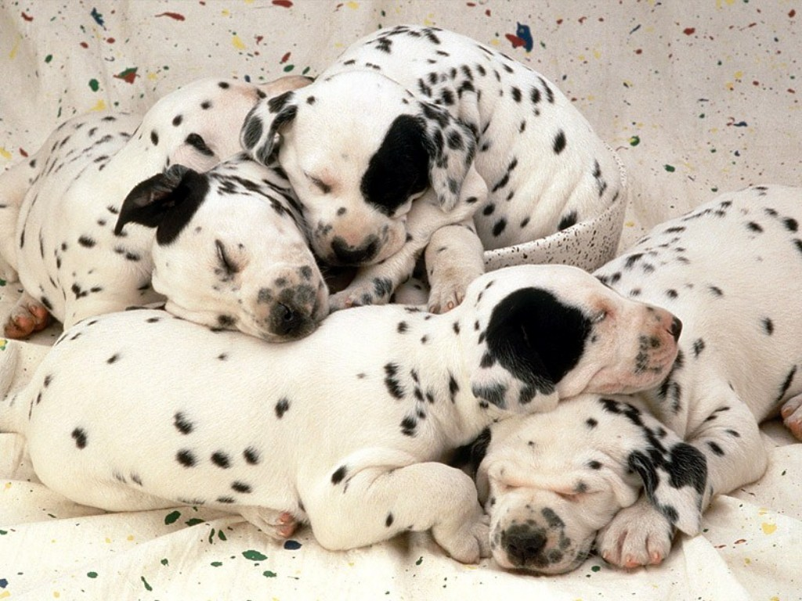
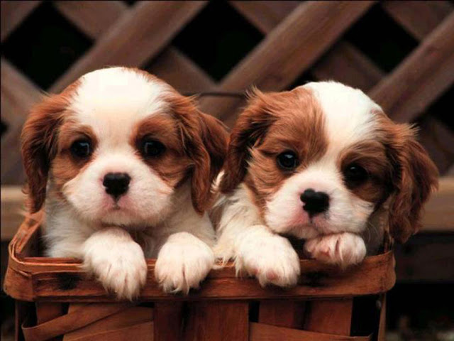
La familia del perro, Ron, su esposa Lisa y su pequeño Shane, estaban muy apegados a Belker, y estaban esperando un milagro.
Me llamo Tom y siendo un veterinario, fui llamado para examinar a un perro Lobero Irlandés de 13 años de edad llamado Belker.
RaúlTM

Slide 6
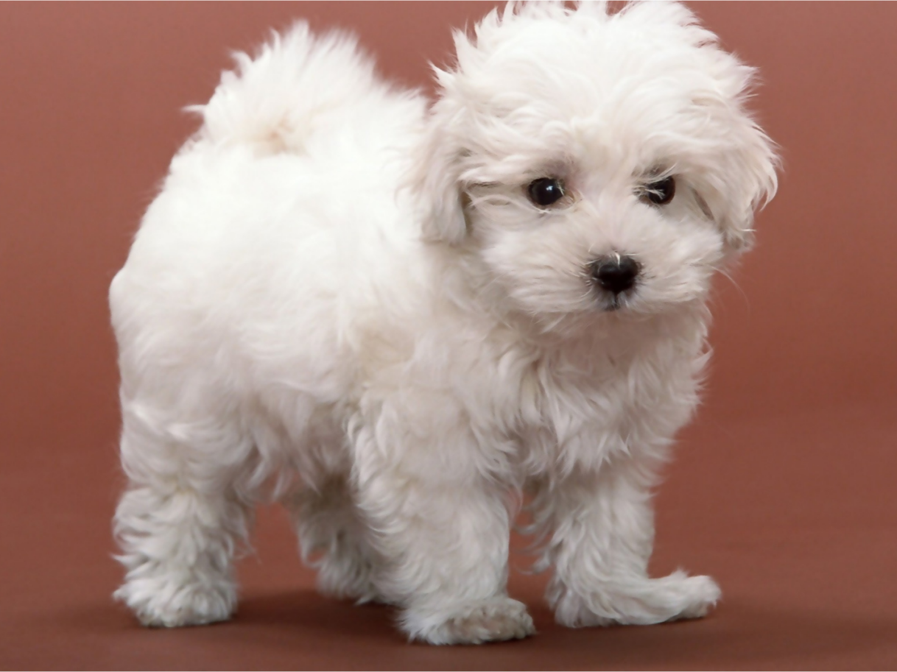

Examiné a Belker y descubrí que estaba muriendo de cáncer. Les dije a su familia que ya no podíamos hacer nada por él.
Me ofrecí para llevar a cabo el procedimiento de eutanasia para el viejo Belker, en su casa.
RaúlTM

Slide 7
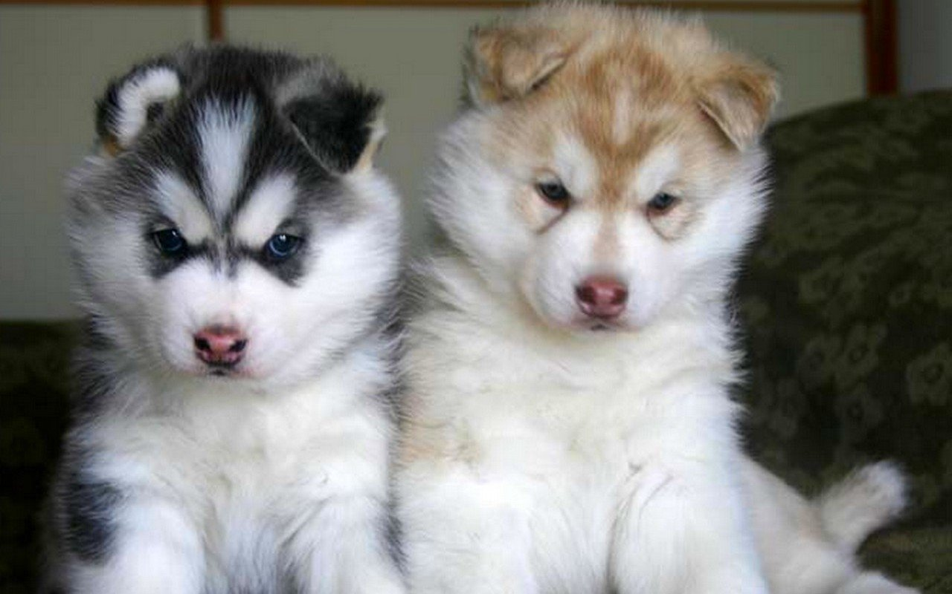
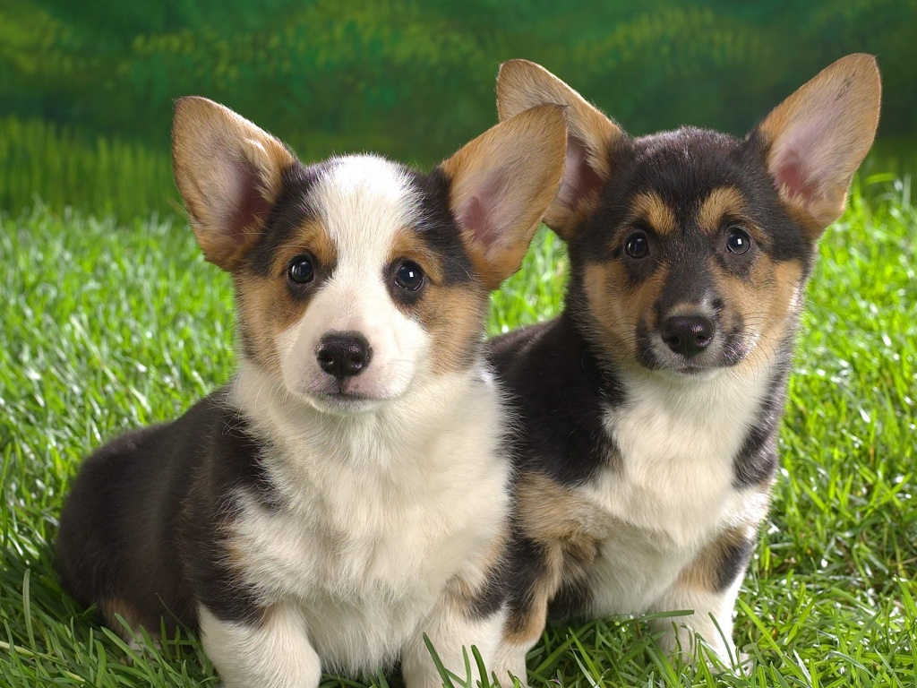
RaúlTM
Cuando hicimos los arreglos para el día siguiente, Ron y Lisa me dijeron que pensaban que sería bueno para Shane observar el procedimiento.
Sentían como si Shane, de 6 años, podría aprender algo de esa experiencia.

Slide 8

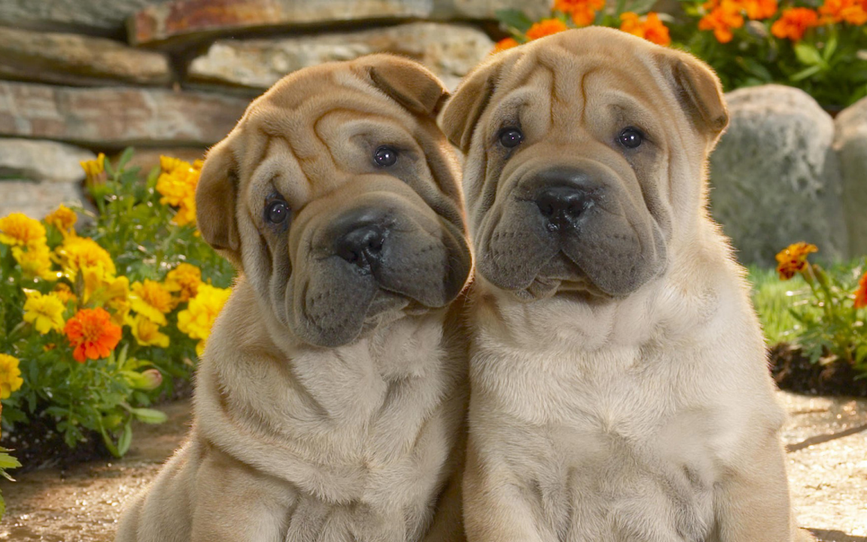
RaúlTM
Shane se veía tranquilo, acariciaba al perro por última vez, y yo me preguntaba si él comprendía lo que estaba pasando.
Al día siguiente, sentí esa familiar sensación en mi garganta cuando Belker fue rodeado por la familia.

Slide 9
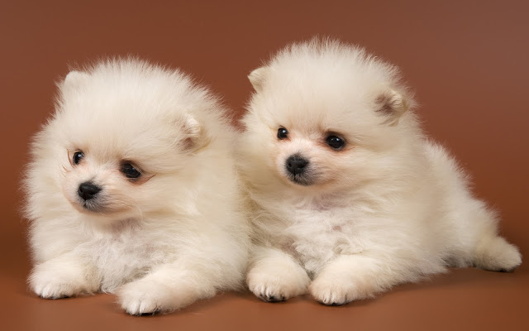
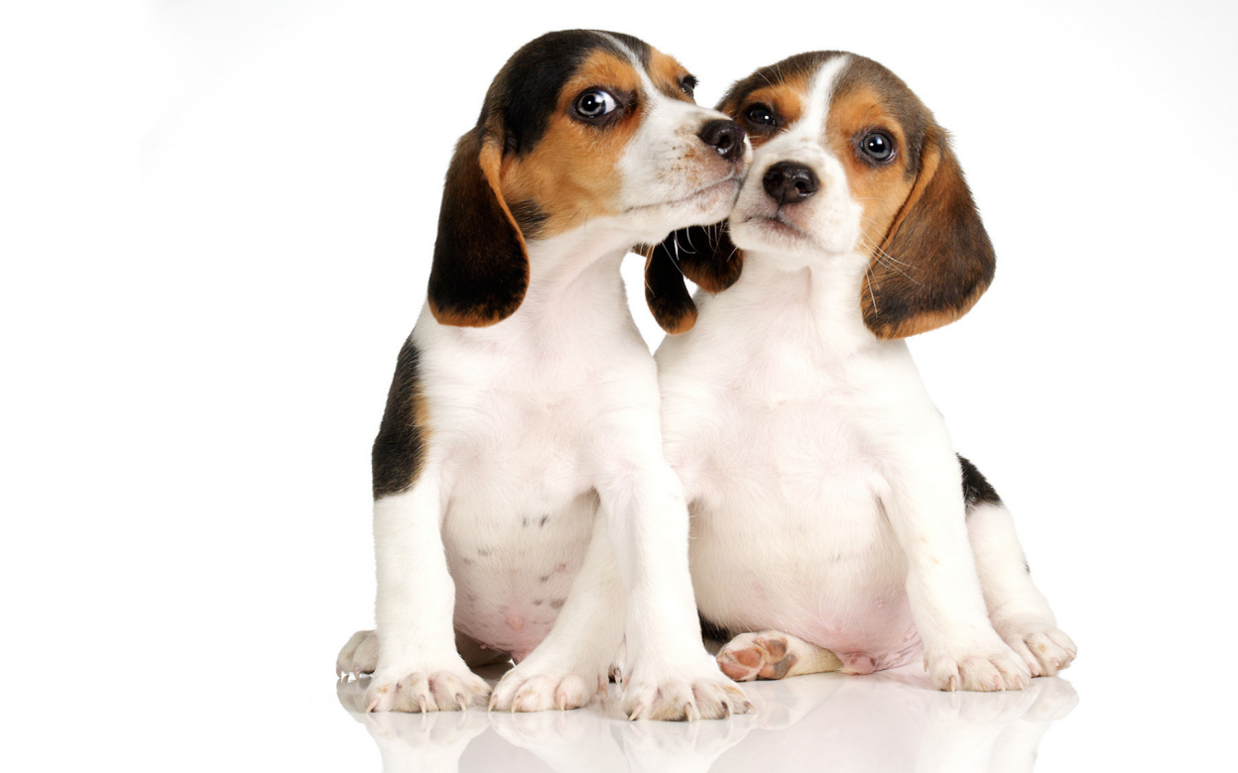
RaúlTM
En unos cuantos minutos Belker
se quedó dormido pacíficamente para ya no despertar.
El pequeño niño pareció aceptar la transición de Belker sin ninguna dificultad o confusión.

Slide 10

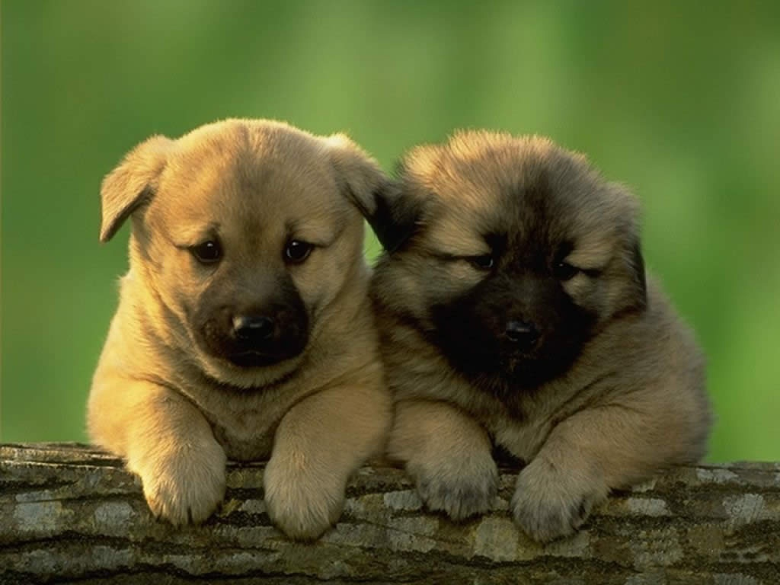
Nos sentamos todos por un momento preguntándonos en voz alta porqué , tristemente, la vida de los perros es más corta que la de los humanos.
Shane, que había estado escuchando atentamente, elevó su voz y dijo:
''yo sé porqué.''
RaúlTM

Slide 11
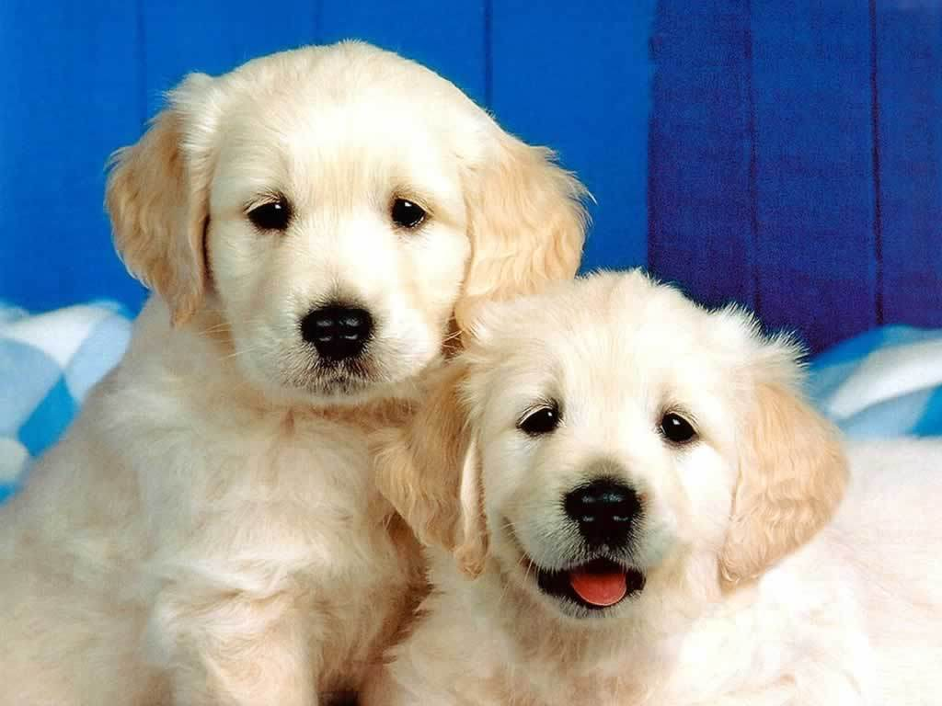

Nunca he escuchado una explicación mas reconfortante que ésta. Este momento cambio mi forma de ver la vida.
RaúlTM
Sobresaltados, todos nos volvimos hacia él. Lo que dijo a continuación me maravilló.

Slide 12
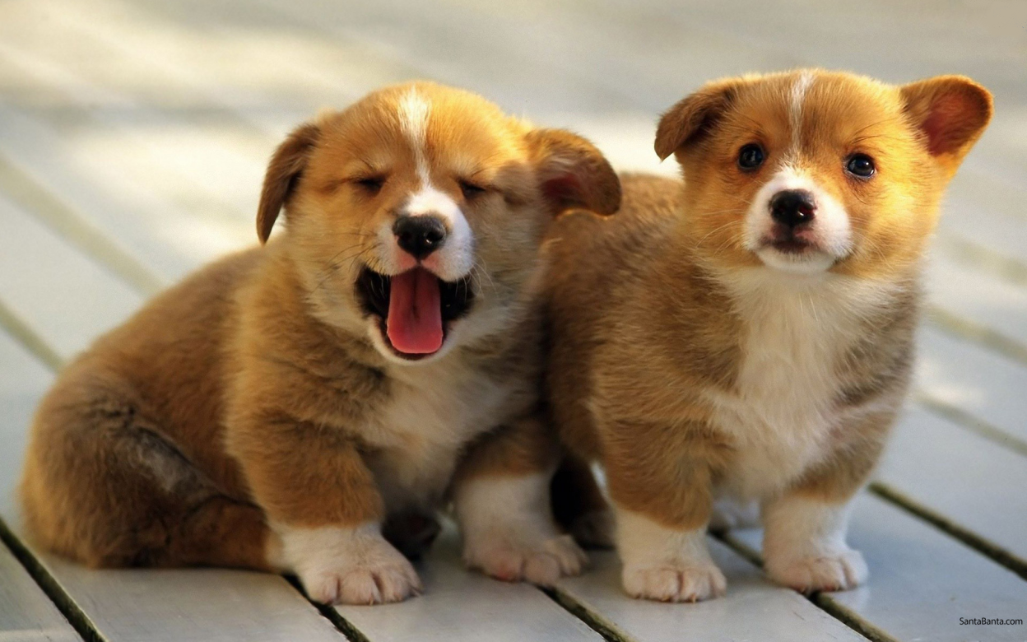
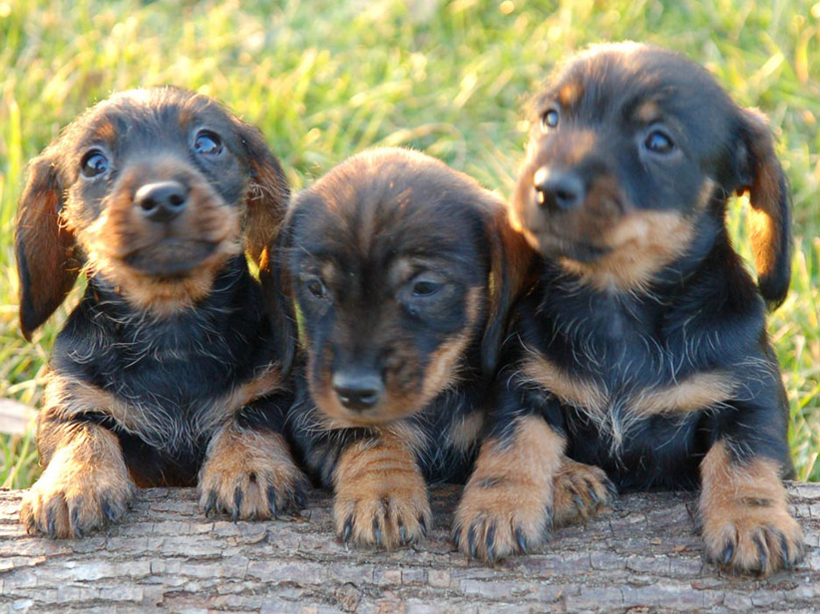
El dijo, “las personas nacen para que puedan aprender cómo vivir una buena vida, cómo amar a los demás todo el tiempo y ser buenas personas, correcto?''
''Bueno, como los perros ya saben cómo hacer todo eso, entonces no tienen que quedarse por tanto tiempo”.
RaúlTM

Slide 13
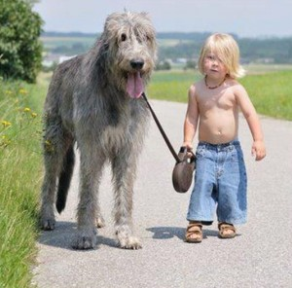
Belker
y
Shane
RaúlTM

Slide 14
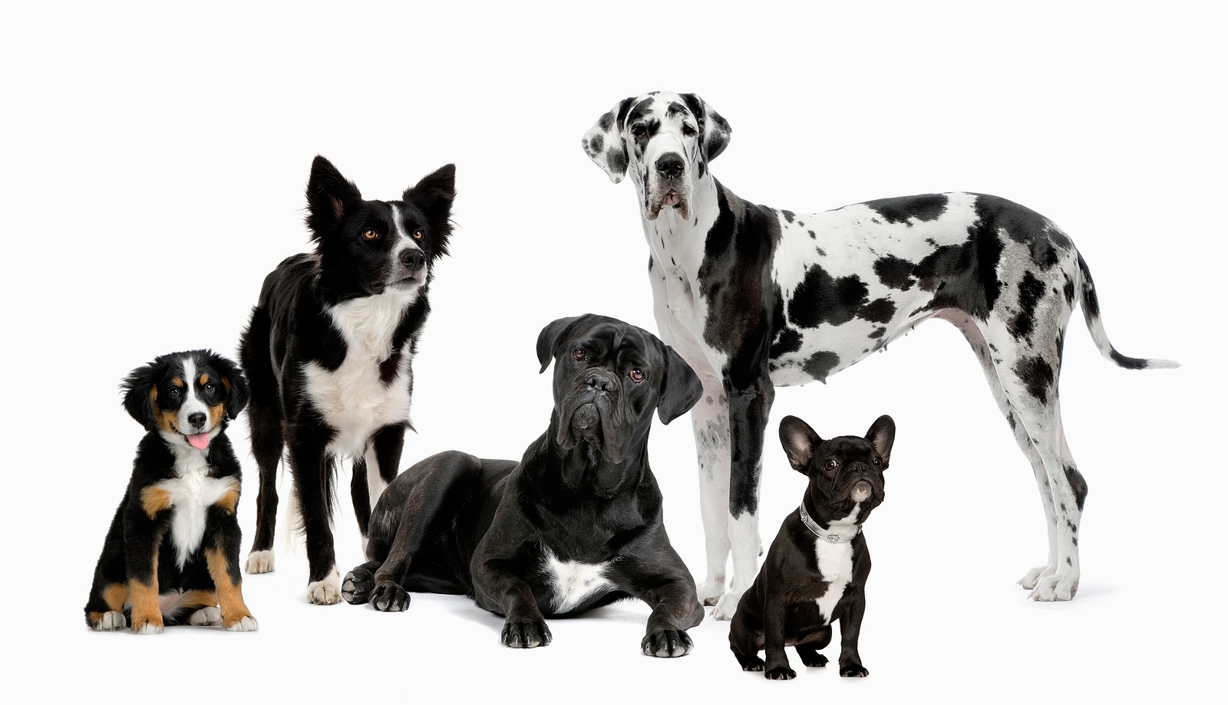
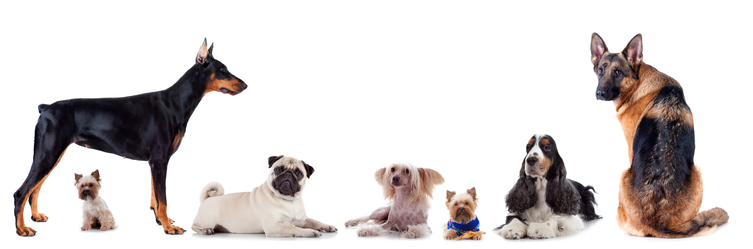
No piden nada
y lo dan todo
¡ Gracias !
RaúlTM

Slide 15
Música: “Con su blanca palidez - RASA
Imágenes: de Internet
RaúlTM
Notes:
Custom animation effects: sparkle
(Basic)
To reproduce the text on this slide, do the following:
On the Home tab, in the Slides group, click Layout, and then click Blank.
On the Insert tab, in the Text group, click Text Box. On the slide, drag to draw a text box.
Enter text and select it. On the Home tab, in the Font group, in the Font list select Franklin Gothic Heavy, and then in the Font Size box, select 96 pt.
On the Home tab, in the Paragraph group, click Center.
Select the text box, and then under Drawing Tools, on the Format tab, in the WordArt Styles group, click Text Effects, point to Reflection, and under Reflection Variations select Tight Reflection, Touching (first row, the first option from the left).
With the text box still selected, under Drawing Tools, on the Format tab, in the bottom right corner of the WordArt Styles group, click the Format Text Effects: Text Box dialog box launcher. In the Format Text Effects dialog box, click Text Fill in the left pane, select Gradient fill in the Text Fill pane, and then do the following:
Click the button next to Preset colors, and then click Ocean (second row, second option from the left).
In the Type list, select Linear.
Click the button next to Direction, and then click Linear Up (second row, second option from the left).
Also in the Format Text Effects dialog box, click 3-D Format in the left pane. In the 3-D Format pane, under Bevel, click the button next to Top, and then under Bevel click Circle (first row, first option from the left).
To reproduce the first star on this slide, do the following:
On the Home tab, in the Drawing group, click Shapes, and then under Stars and Banners click 4-Point Star (first row, third option from the left). On the slide, drag to draw a star.
On the slide, drag the star onto the top of the first letter (in the example slide, it is “S”) in the text box.
With the star still selected, drag the yellow diamond adjustment handle down to make the points thinner.
On the Home tab, in the bottom right corner in the Drawing group, click the Format Shape dialog box launcher. In the Format Shape dialog box, click Fill in the left pane, select Gradient fill in the Fill pane, and then do the following:
In the Type list, select Radial.
Click the button next to Direction, and then click From Center (third option from the left).
Under Gradient stops, click Add or Remove until two stops appear in the drop-down list.
Also under Gradient stops, customize the gradient stops that you added as follows:
Select Stop 1 from the list, and then do the following:
In the Stop position box, enter 0%.
Click the button next to Color, and then under Theme Colors click White, Background 1 (first row, first option from the left).
Select Stop 2 from the list, and then do the following:
In the Stop position box, enter 100%.
Click the button next to Color, and then under Theme Colors click White, Background 1 (first row, first option from the left).
In the Transparency box, enter 100%.
Also in the Format Shape dialog box, click Line Color in the left pane, and in the Line Color pane click No line.
Under Drawing Tools, on the Format tab, in the bottom right corner of the Size group, click the Size and Position dialog box launcher. In the Size and Position dialog box, on the Size tab, under Size and rotation do the following:
In the Height box, enter 0.51”.
In the Width box, enter 0.51”.
In the Rotation box, enter 15°.
To reproduce the other stars on this slide, do the following:
On the slide, select the star. On the Home tab, in the Clipboard group, click the arrow under Paste, and then click Duplicate.
On the slide, drag the second star until it slightly overlaps the edge of a letter in the text box.
Change the size of the star in the Drawing Tools, on the Format tab, in the Size group.
Repeat steps 1-3 for a total of five stars.
To reproduce the animation effects on this slide, do the following:
On the Animations tab, in the Animations group, click Custom Animation.
On the slide, select the first star from the left. In the Custom Animation task pane, do the following:
Click Add Effect, point to Entrance, and then click More Effects. In the Add Entrance Effect dialog box, under Moderate, click Grow & Turn.
Select the animation effect (grow & turn entrance effect for the first star). Under Modify: Grow & Turn, do the following:
In the Start list, select With Previous.
In the Speed list, select Very Fast.
On the slide, select the first star from the left. In the Custom Animation task pane, do the following:
Click Add Effect, point to Exit, and then click More Effects. In the Add Exit Effect dialog box, under Moderate, click Grow & Turn.
Select the second animation effect (grow & turn exit effect for the first star). Click the arrow to the right of the selected effect, and then click Effect Options. In the Grow & Turn dialog box, on the Timing tab, do the following:
In the Start list, select With Previous.
In the Delay box enter 0.7.
In the Speed list, select 0.5 seconds (Very Fast).
On the slide, select the second star from the left. In the Custom Animation task pane, do the following:
Click Add Effect, point to Entrance, and then click More Effects. In the Add Entrance Effect dialog box, under Moderate, click Grow & Turn.
Select the third animation effect (grow & turn entrance effect for the second star). Click the arrow to the right of the selected effect, and then click Effect Options. In the Grow & Turn dialog box, on the Timing tab, do the following:
In the Start list, select With Previous.
In the Delay box enter 0.2.
In the Speed list, select 0.5 seconds (Very Fast).
On the slide, select the second star from the left. In the Custom Animation task pane, do the following:
Click Add Effect, point to Exit, and then click More Effects. In the Add Exit Effect dialog box, under Moderate, click Grow & Turn.
Select the fourth animation effect (grow & turn exit effect for the second star). Click the arrow to the right of the selected effect, and then click Effect Options. In the Grow & Turn dialog box, on the Timing tab, do the following:
In the Start list, select With Previous.
In the Delay box enter 0.9.
In the Speed list, select 0.5 seconds (Very Fast).
On the slide, select the third star from the left. In the Custom Animation task pane, do the following:
Click Add Effect, point to Entrance, and then click More Effects. In the Add Entrance Effect dialog box, under Moderate, click Grow & Turn.
Select the fifth animation effect (grow & turn entrance effect for the third star). Click the arrow to the right of the selected effect, and then click Effect Options. In the Grow & Turn dialog box, on the Timing tab, do the following:
In the Start list, select With Previous.
In the Delay box enter 0.4.
In the Speed list, select 0.5 seconds (Very Fast).
On the slide, select the third star from the left. In the Custom Animation task pane, do the following:
Click Add Effect, point to Exit, and then click More Effects. In the Add Exit Effect dialog box, under Moderate, click Grow & Turn.
Select the sixth animation effect (grow & turn exit effect for the third star). Click the arrow to the right of the selected effect, and then click Effect Options. In the Grow & Turn dialog box, on the Timing tab, do the following:
In the Start list, select With Previous.
In the Delay box enter 1.1.
In the Speed list, select 0.5 seconds (Very Fast).
On the slide, select the fourth star from the left. In the Custom Animation task pane, do the following:
Click Add Effect, point to Entrance, and then click More Effects. In the Add Entrance Effect dialog box, under Moderate, click Grow & Turn.
Select the seventh animation effect (grow & turn entrance effect for the fourth star). Click the arrow to the right of the selected effect, and then click Effect Options. In the Grow & Turn dialog box, on the Timing tab, do the following:
In the Start list, select With Previous.
In the Delay box enter 0.8.
In the Speed list, select 0.5 seconds (Very Fast).
On the slide, select the fourth star from the left. In the Custom Animation task pane, do the following:
Click Add Effect, point to Exit, and then click More Effects. In the Add Exit Effect dialog box, under Moderate, click Grow & Turn.
Select the eighth animation effect (grow & turn exit effect for the fourth star). Click the arrow to the right of the selected effect, and then click Effect Options. In the Grow & Turn dialog box, on the Timing tab, do the following:
In the Start list, select With Previous.
In the Delay box enter 1.4.
In the Speed list, select 0.5 seconds (Very Fast).
On the slide, select the fifth star from the left. In the Custom Animation task pane, do the following:
Click Add Effect, point to Entrance, and then click More Effects. In the Add Entrance Effect dialog box, under Moderate, click Grow & Turn.
Select the ninth animation effect (grow & turn entrance effect for the fifth star). Click the arrow to the right of the selected effect, and then click Effect Options. In the Grow & Turn dialog box, on the Timing tab, do the following:
In the Start list, select With Previous.
In the Delay box enter 0.9.
In the Speed list, select 0.5 seconds (Very Fast).
On the slide, select the fifth star from the left. In the Custom Animation task pane, do the following:
Click Add Effect, point to Exit, and then click More Effects. In the Add Exit Effect dialog box, under Moderate, click Grow & Turn.
Select the 10th animation effect (grow & turn exit effect for the fifth star). Click the arrow to the right of the selected effect, and then click Effect Options. In the Grow & Turn dialog box, on the Timing tab, do the following:
In the Start list, select With Previous.
In the Delay box enter 1.5.
In the Speed list, select 0.5 seconds (Very Fast).
To reproduce the background effects on this slide, do the following:
Right-click the slide background area, and then click Format Background. In the Format Background dialog box, click Fill in the left pane, select Gradient fill in the Fill pane, and then do the following:
In the Type list, select Radial.
Click the button next to Direction, and then click From Center (third option from the left).
Under Gradient stops, click Add or Remove until two stops appear in the drop-down list.
Also under Gradient stops, customize the gradient stops that you added as follows:
Select Stop 1 from the list, and then do the following:
In the Stop position box, enter 0%.
Click the button next to Color, and then under Theme Colors click Black, Text 1, Lighter 35% (third row, second option from the left).
Select Stop 2 from the list, and then do the following:
In the Stop position box, enter 100%.
Click the button next to Color, and then under Theme Colors click Black, Text 1 (first row, second option from the left).

Slide 16



Accede a la sección que desees desde aquí:
Propia Creación
De la Red
Dedicatorias | Fechas Especiales | Graciosos
Historia y Arte | Lugares | Musicales
Naturaleza y Ciencias | Política | Reflexión
Religiosos | Románticos | Salud
Dedicatorias | Fechas Especiales | Graciosos
Historia y Arte | Lugares | Musicales
Naturaleza y Ciencias | Política | Reflexión
Religiosos | Románticos | Salud
Si deseas recibir pps periódicamente en tu correo electrónico subscríbete aquí:

