Slide 1
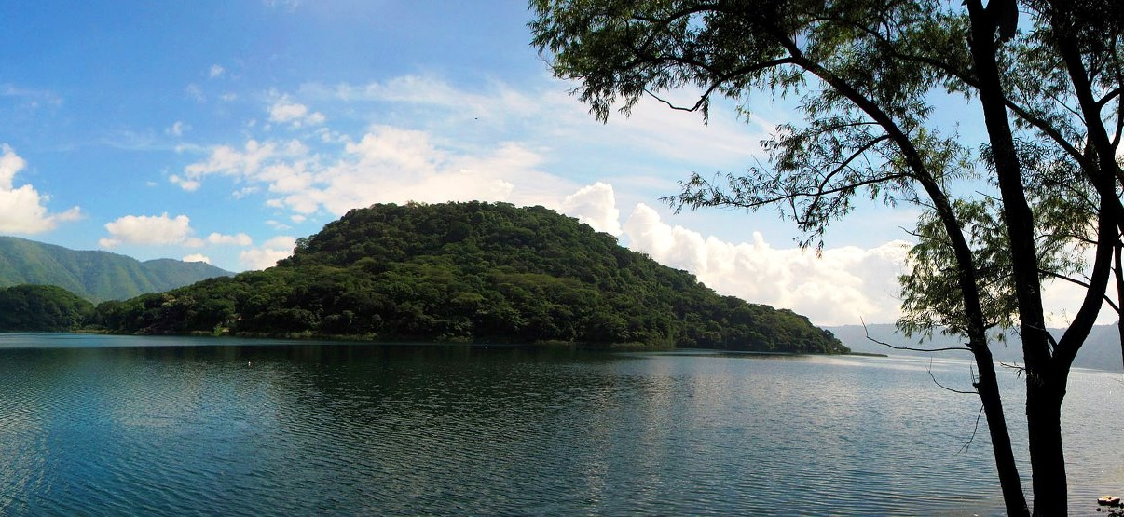
Historia de
los dos que soñaron
RaúlTM
2014
Notes:
Custom animation effects: picture entrance with oval border
(Intermediate)
Tip: You will need to use drawing guides to reproduce the effects in this slide.
To display and set the drawing guides, do the following:
Right-click the slide background and select Grid and Guides. In the Grid and Guides dialog box, under Guide settings, select Display drawing guides on screen, and then click OK. (Note: One horizontal and one vertical guide will display on the slide at 0.00, the default position. As you drag the guides, the cursor will display the new position.)
On the slide, do the following:
Press and hold CTRL, select the vertical guide, and then drag it left to the 2.00 position.
Press and hold CTRL, select the vertical guide, and then drag it left to the 4.00 position.
Press and hold CTRL, select the vertical guide, and then drag it right to the 2.00 position.
Press and hold CTRL, select the vertical guide, and then drag it right to the 4.00 position.
Press and hold CTRL, select the horizontal guide, and then drag it up to the 0.83 position.
Press and hold CTRL, select the horizontal guide, and then drag it up to the 2.42 position.
Press and hold CTRL, select the horizontal guide, and then drag it down to the 0.83 position.
Press and hold CTRL, select the horizontal guide, and then drag it down to the 2.42 position.
To reproduce the background effects on this slide, do the following:
On the Home tab, in the Slides group, click Layout, and then click Blank.
On the Design tab, in the Background group, click the arrow next to Background Styles, and then click Style 5 (second row, first option from the left). (Note: If this action is taken in a PowerPoint presentation containing more than one slide, the background style will be applied to all of the slides.)
To reproduce the picture effects on this slide, do the following:
On the Insert tab, in the Illustrations group, click Picture. In the Insert Picture dialog box, select a picture, and then click Insert.
On the slide, select the picture. Under Picture Tools, on the Format tab, in the bottom right corner of the Size group, click the Size and Position dialog box launcher. In the Size and Position dialog box, on the Size tab, resize or crop the picture as needed so that under Size and rotate, the Height box is set to 4.9” and the Width box is set to 7.92”. Resize the picture under Size and rotate by entering values into the Height and Width boxes. Crop the picture under Crop from by entering values into the Left, Right, Top, and Bottom boxes.
On the Home tab, in the Drawing group, click Arrange, point to Align, and then do the following:
Click Align to Slide.
Click Align Middle.
Click Align Center.
Under Picture Tools, on the Format tab, in the Picture Styles group, click Picture Effects, point to Glow, and then do the following:
Under Glow Variations, click Accent color 1, 8 pt glow (second row, first option from the left).
Point to More Glow Colors, and under Theme Colors click White, Background 1 (first row, first option from the left).
To reproduce the shape effects on this slide, do the following:
On the Home tab, in the Drawing group, click Shapes, and then under Basic Shapes click Oval (first row, second option from the left). On the slide, drag to draw an oval.
Select the oval. Under Drawing Tools, on the Format tab, in the Size group, do the following:
In the Shape Height box, enter 0.5”.
In the Shape Width box, enter 0.5”.
Under Drawing Tools, on the Format tab, in the Shape Styles group, click the arrow next to Shape Outline, and then click No Outline.
On the Home tab, in the bottom right corner of the Drawing group, click the Format Shape dialog box launcher. In the Format Shape dialog box, click Fill in the left pane, select Gradient fill in the Fill pane, and then do the following:
In the Type list, select Radial.
Click the button next to Direction, and then click From Center (third option from the left).
Under Gradient stops, click Add or Remove until three stops appear in the drop-down list.
Also under Gradient stops, customize the gradient stops as follows:
Select Stop 1 from the list, and then do the following:
In the Stop position box, enter 0%.
Click the button next to Color, and then under Theme Colors click White, Background 1 (first row, first option from the left).
In the Transparency box, enter 0%.
Select Stop 2 from the list, and then do the following:
In the Stop position box, enter 50%.
Click the button next to Color, and then under Theme Colors click White, Background 1 (first row, first option from the left).
In the Transparency box, enter 100%.
Select Stop 3 from the list, and then do the following:
In the Stop position box, enter 100%.
Click the button next to Color, and then under Theme click White, Background 1 (first row, first option from the left).
In the Transparency box, enter 100%.
On the slide, select the oval. On the Home tab, in the Clipboard group, click the arrow under Paste and then click Duplicate. Repeat this process until there is a total of 14 ovals.
To arrange the ovals along the top edge of the picture, do the following:
Drag one oval to the intersection of the 4.00 vertical left and 2.42 horizontal top drawing guides, at the top left corner of the picture.
Drag one oval to the intersection of the 2.00 vertical left and 2.42 horizontal top drawing guides, at the left side of the top edge of the picture.
Drag one oval to the intersection of the 0.00 vertical right and 2.42 horizontal top drawing guides, at the center of the top edge of the picture.
Drag one oval to the intersection of the 2.00 vertical right and 2.42 horizontal top drawing guides, at the right side of the top edge of the picture.
Drag one oval to the intersection of the 4.00 vertical right and 2.42 horizontal top drawing guides, at the top right corner of the picture.
To arrange the ovals along the sides of the picture, do the following:
Drag one oval to the intersection of the 4.00 vertical left and 0.83 horizontal top drawing guides, at the top of the left edge of the picture.
Drag one oval to the intersection of the 4.00 vertical left and 0.83 horizontal bottom drawing guides, at the bottom of the left edge of the picture.
Drag one oval to the intersection of the 4.00 vertical right and 0.83 horizontal top drawing guides, at the top of the right edge of the picture.
Drag one oval to the intersection of the 4.00 vertical right and 0.83 horizontal bottom drawing guides, at the bottom of the right edge of the picture.
To arrange the ovals along the bottom edge of the picture, do the following:
Drag one oval to the intersection of the 4.00 vertical left and 2.42 horizontal bottom drawing guides, at the bottom left corner of the picture.
Drag one oval to the intersection of the 2.00 vertical left and 2.42 horizontal bottom drawing guides, at the left side of the bottom edge of the picture.
Drag one oval to the intersection of the 0.00 vertical right and 2.42 horizontal bottom drawing guides, at the center of the bottom edge of the picture.
Drag one oval to the intersection of the 2.00 vertical right and 2.42 horizontal bottom drawing guides, at the right side of the bottom edge of the picture.
Drag one oval to the intersection of the 4.00 vertical right and 2.42 horizontal bottom drawing guides, at the bottom right corner of the picture.
Right-click the slide background area, and then click Grid and Guides. In the Grid and Guides dialog box, under Guide settings, clear Display drawing guides on screen, and then click OK.
To reproduce the picture animation effects on this slide, do the following:
On the Animations tab, in the Animations group, click Custom Animation.
On the slide, select the picture. In the Custom Animation task pane, click Add Effect, point to Entrance, and then click More Effects. In the Add Entrance Effect dialog box, under Subtle, click Fade, and then click OK.
Also in the Custom Animation task pane, select the animation effect (fade effect), and then do the following under Modify: Fade:
In the Start list, select With Previous.
In the Speed list, select Very Slow.
Also the Custom Animation task pane, click the arrow to the right of the animation effect, and then click Effect Options. In the Fade dialog box, on the Timing tab, in the Delay box, enter 0.5, and then click OK.
To reproduce the top oval animation effects on this slide, do the following:
Press and hold CTRL, and then select all the ovals on the top edge of the picture. (Note: For best results, select the ovals in sequence from left to right.) In the Custom Animation task pane, click Add Effect, point to Entrance, and then click More Effects. In the Add Entrance Effect dialog box, under Basic, click Fly In, and then click OK.
Also in the Custom Animation task pane, do the following:
Press and hold CTRL, and then select the second, third, fourth, fifth, and sixth animation effects (fly-in effects for the top ovals), and then do the following under Modify: Fly In:
In the Start list, select With Previous.
In the Direction list, select From Top-Right.
In the Speed list, select Fast.
Note: it may be necessary to check that the delay for the second animation effect is set to 0 seconds. To do so, click the arrow to the right of the effect, and then click Timing. In the Fly In dialog box, on the Timing tab, in the Delay box, enter 0, and then click OK.
Select the third animation effect. Click the arrow to the right of the effect, and then click Timing. In the Fly In dialog box, on the Timing tab, in the Delay box, enter 0.2, and then click OK.
Select the fourth animation effect. Click the arrow to the right of the effect, and then click Timing. In the Fly In dialog box, on the Timing tab, in the Delay box, enter 0.4, and then click OK.
Select the fifth animation effect. Click the arrow to the right of the effect, and then click Timing. In the Fly In dialog box, on the Timing tab, in the Delay box, enter 0.6, and then click OK.
Select the sixth animation effect. Click the arrow to the right of the effect, and then click Timing. In the Fly In dialog box, on the Timing tab, in the Delay box, enter 0.8, and then click OK.
To reproduce the left and right oval animation effects on this slide, do the following:
On the slide, press and hold CTRL, and then select the four ovals in the middle of the left and right edges of the picture. (Note: For best results, select the top right oval first, then the top left oval, then the bottom right oval, and then the bottom left oval.) In the Custom Animation task pane, click Add Effect, point to Entrance, and then click More Effects. In the Add Entrance Effect dialog box, under Basic, click Fly In, and then click OK.
Also in the Custom Animation task pane, do the following:
Press and hold CTRL, and then select the seventh, eighth, ninth, and 10th animation effects (fly-in effects for the left and right ovals), and then do the following under Modify: Fly In:
In the Start list, select With Previous.
In the Direction list, select From Top-Right.
In the Speed list, select Fast.
Press and hold CTRL, and then select the seventh and eighth animation effects (fly-in effects for the top ovals on the left and right edges of the picture). Click the arrow to the right of one of the selected effects, and then click Timing. In the Fly In dialog box, on the Timing tab, in the Delay box, enter 1.0, and then click OK.
Press and hold CTRL, and then select the ninth and 10th animation effects (fly-in effects for the bottom ovals on the left and right edges of the picture). Click the arrow to the right of one of the selected effects, and then click Timing. In the Fly In dialog box, on the Timing tab, in the Delay box, enter 1.2, and then click OK.
To reproduce the bottom oval animation effects on this slide, do the following:
On the slide, press and hold CTRL, and then select all the ovals on the bottom edge of the picture. (Note: For best results, select the ovals in sequence from right to left.) In the Custom Animation task pane, click Add Effect, point to Entrance, and then click More Effects. In the Add Entrance Effect dialog box, under Basic, click Fly In, and then click OK.
Also in the Custom Animation task pane, do the following:
Press and hold CTRL, and then select the 11th, 12th, 13th, 14th, and 15thanimation effects (fly-in effects for the bottom ovals), and then do the following under Modify: Fly In:
In the Start list, select With Previous.
In the Direction list, select From Top-Right.
In the Speed list, select Fast.
Select the 11th animation effect. Click the arrow to the right of the effect, and then click Timing. In the Fly In dialog box, on the Timing tab, in the Delay box, enter 1.4, and then click OK.
Select the 12th animation effect. Click the arrow to the right of the effect, and then click Timing. In the Fly In dialog box, on the Timing tab, in the Delay box, enter 1.6, and then click OK.
Select the 13th animation effect. Click the arrow to the right of the effect, and then click Timing. In the Fly In dialog box, on the Timing tab, in the Delay box, enter 1.8, and then click OK.
Select the 14th animation effect. Click the arrow to the right of the effect, and then click Timing. In the Fly In dialog box, on the Timing tab, in the Delay box, enter 2.0, and then click OK.
Select the 15th animation effect. Click the arrow to the right of the effect, and then click Timing. In the Fly In dialog box, on the Timing tab, in the Delay box, enter 2.2, and then click OK.
On the slide, press and hold CTRL, and then select all the ovals. In the Custom Animation task pane, click Add Effect, point to Exit, and then click More Effects. In the Add Exit Effect dialog box, under Moderate, click Stretchy, and then click OK.
In the Custom Animation task pane, select all the stretchy exit effects (from the 16th to the 30th animation effect in the list), and then do the following under Modify: Stretch:
In the Start list, select With Previous.
In the Speed list, select Medium.
Click the arrow to the right of one of the selected effects, and then click Timing. In the Stretchy dialog box, on the Timing tab, in the Delay box, enter 3, and then click OK.

Slide 2

http://www.amarseaunomismo.com/la-felicidad-aqui-y-ahora/
Todos podemos alcanzar la felicidad plena, aquí y ahora. Aunque resulte
muy difícil hacer de esta idea una experiencia real y permanente,
maestros de distintas tradiciones la expresaron de diferentes maneras,
en todas las épocas.
En cada momento de nuestras vidas, en cada circunstancia, casi sin
excepciones, existen los suficientes elementos maravillosos como para
colmarnos de dicha, de felicidad plena. Pero en lugar de asombrarnos y
de disfrutar de lo que cada instante nos ofrece, damos por hecho esos
pequeños milagros, los consideramos ordinarios, naturales y cotidianos,
y, en cambio, destacamos y nos concentramos en eso de lo que el
momento carece.
A continuación un relato muy breve de Jorge Luis Borges, publicado en el
año 1934, y que es en realidad su versión de uno de las narraciones más
originales y sugestivas de “Las mil y una noches”.
Es una invitación a descubrir los tesoros que tenemos siempre a mano,
como una parábola que propone que la búsqueda del bienestar o
de la felicidad “afuera” de nosotros mismos puede conducirnos a la
comprensión de que ese estado tan anhelado siempre estuvo a nuestro
alcance en nuestro interior… precisamente aquí y ahora.
RaúlTM

Slide 3
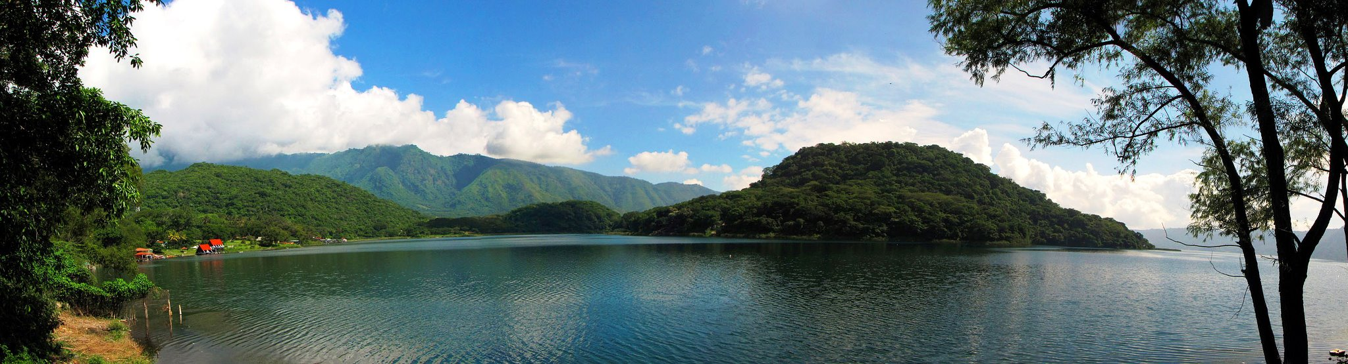

RaúlTM
Cuentan hombres dignos de fe que hubo en El Cairo un hombre poseedor de riquezas, pero tan magnánimo y liberal que todas ellas las perdió, menos la casa de su padre, y que se vio forzado a trabajar para ganarse el pan.
Trabajó tanto que el sueño lo rindió una noche debajo de una higuera de su jardín y vio en el sueño un hombre empapado que se sacó de la boca una moneda de oro y le dijo:
“Tu fortuna está en Persia, en Isfaján; vete a buscarla”
A la madrugada siguiente se despertó y emprendió el largo viaje y afrontó los peligros del desierto, de las naves, de los piratas, de los idólatras, de los ríos, de las fieras y de los hombres.
Llegó al fin a Isfaján, pero en el recinto de esa ciudad lo sorprendió la noche y se tendió a dormir en el patio de una mezquita. Había, junto a la mezquita, una casa y por decreto de Alá Todopoderoso, una pandilla de ladrones atravesó la mezquita y se metió en la casa, y las personas que dormían se despertaron con el estruendo de los ladrones y pidieron socorro. Los vecinos también gritaron, hasta que el Capitán de los serenos de aquel distrito acudió con sus hombres y los bandoleros huyeron por la azotea.
El Capitán hizo registrar la mezquita y en ella dieron con el hombre de El Cairo y le menudearon tales azotes con varas de bambú que estuvo cerca de la muerte. A los dos días recobró el sentido en la cárcel. El Capitán lo mandó buscar y le dijo:
“¿Quién eres y cuál es tu patria?”
El hombre declaró:
“Soy de la ciudad famosa de El Cairo y mi nombre es
Mohamed El Magrebí”
El Capitán le preguntó:
“¿Qué te trajo a Persia?”
El hombre optó por la verdad y le dijo:
“Un hombre me ordenó en un sueño que viniera a Isfaján, porque ahí estaba mi fortuna. Ya estoy en Isfaján y veo que esa fortuna que prometió deben ser los azotes que tan generosamente me diste”
Ante semejantes palabras, el Capitán se rió hasta mostrar sus muelas del juicio y acabó por decirle:
“Hombre desatinado y crédulo, tres veces he soñado con una casa en la ciudad de El Cairo, en cuyo fondo hay un jardín, y en el jardín un reloj de sol y después del reloj de sol una higuera y luego de la higuera una fuente, y bajo la fuente un tesoro. No he dado el menor crédito a esa mentira. Tú, sin embargo, engendro de mula con un demonio, has ido errando de ciudad en ciudad, bajo la sola fe de tu sueño. Que no te vuelva a ver en Isfaján. Toma estas monedas y vete”
El hombre las tomó y regresó a su patria. Debajo de la fuente de su jardín (que era la del sueño del Capitán) encontró el tesoro escondido.
Así Alá le dio bendición y lo recompensó.
Jorge Luis Borges

Slide 4
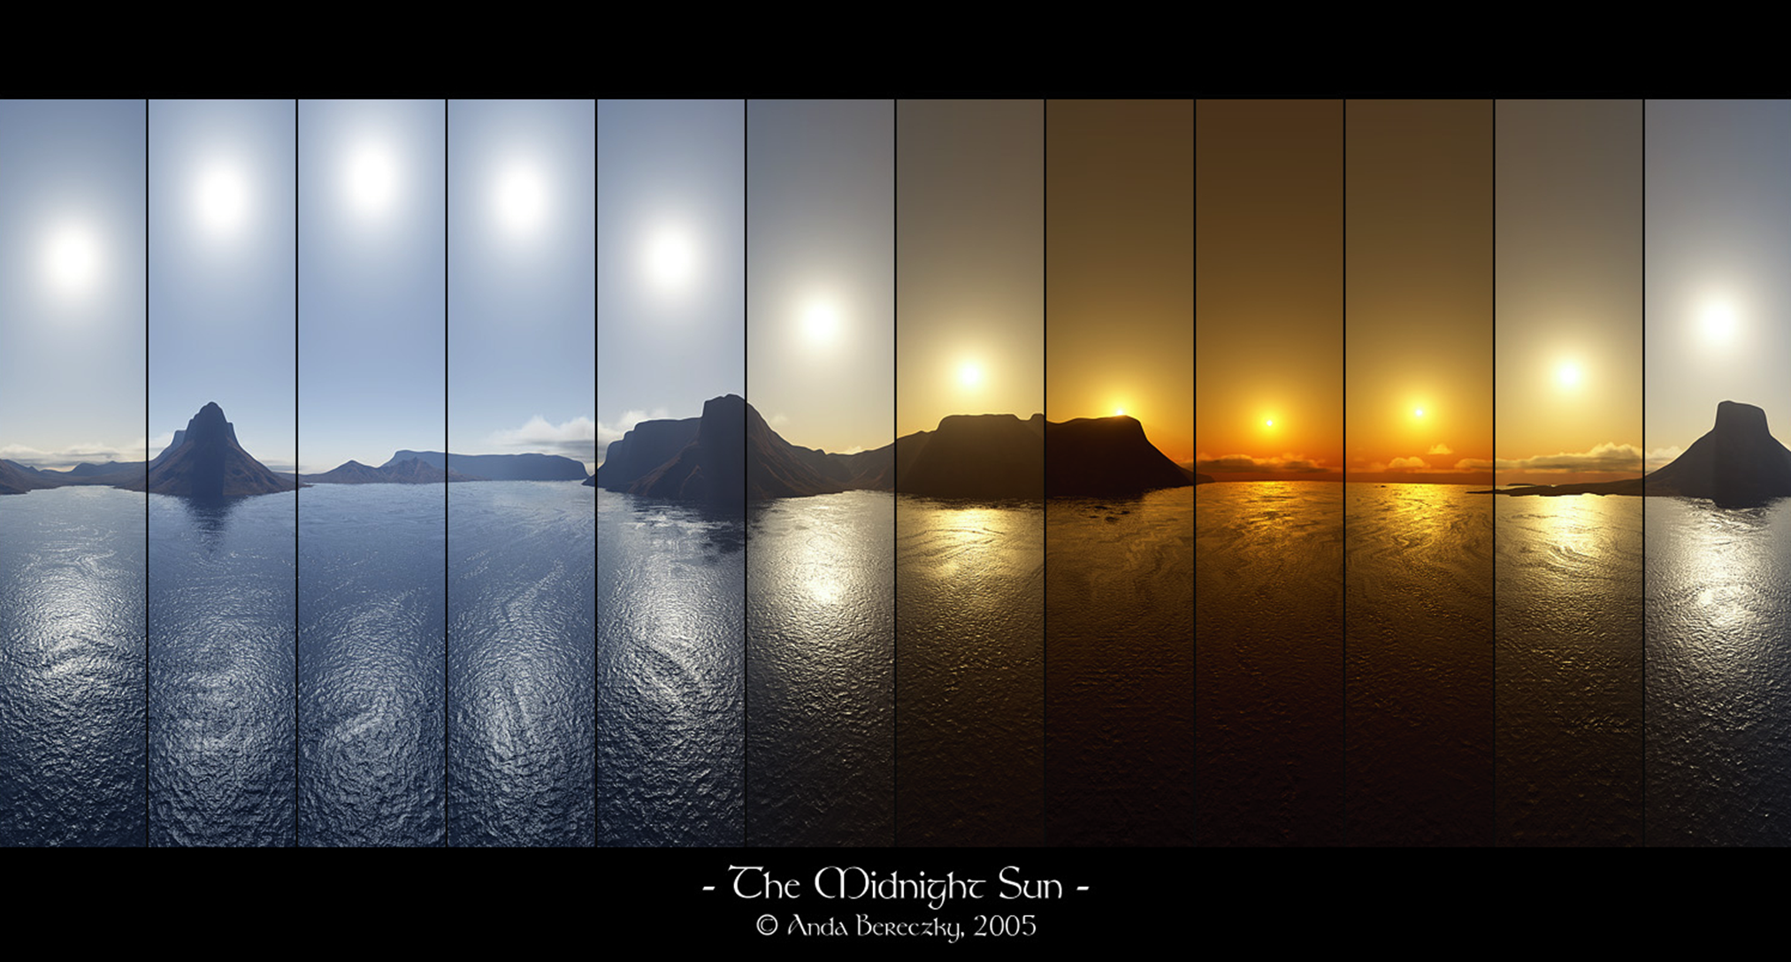
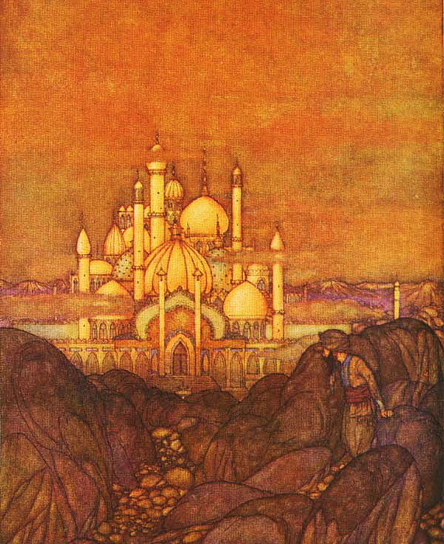
RaúlTM
Ilustración Edmund Dulac

Slide 5
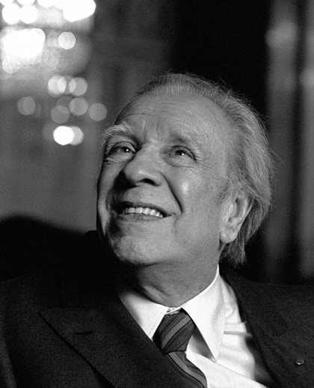

Borges
24 de agosto de 1899
Buenos Aires, Argentina
14 de junio de 1986
Ginebra, Suiza
(86 años)
Jorge Luis
Música: Stolen kiss (Beso robado) - Ernesto Cortazar
RaúlTM

Slide 6



Accede a la sección que desees desde aquí:
Propia Creación
De la Red
Dedicatorias | Fechas Especiales | Graciosos
Historia y Arte | Lugares | Musicales
Naturaleza y Ciencias | Política | Reflexión
Religiosos | Románticos | Salud
Dedicatorias | Fechas Especiales | Graciosos
Historia y Arte | Lugares | Musicales
Naturaleza y Ciencias | Política | Reflexión
Religiosos | Románticos | Salud
Si deseas recibir pps periódicamente en tu correo electrónico subscríbete aquí:

