Slide 1
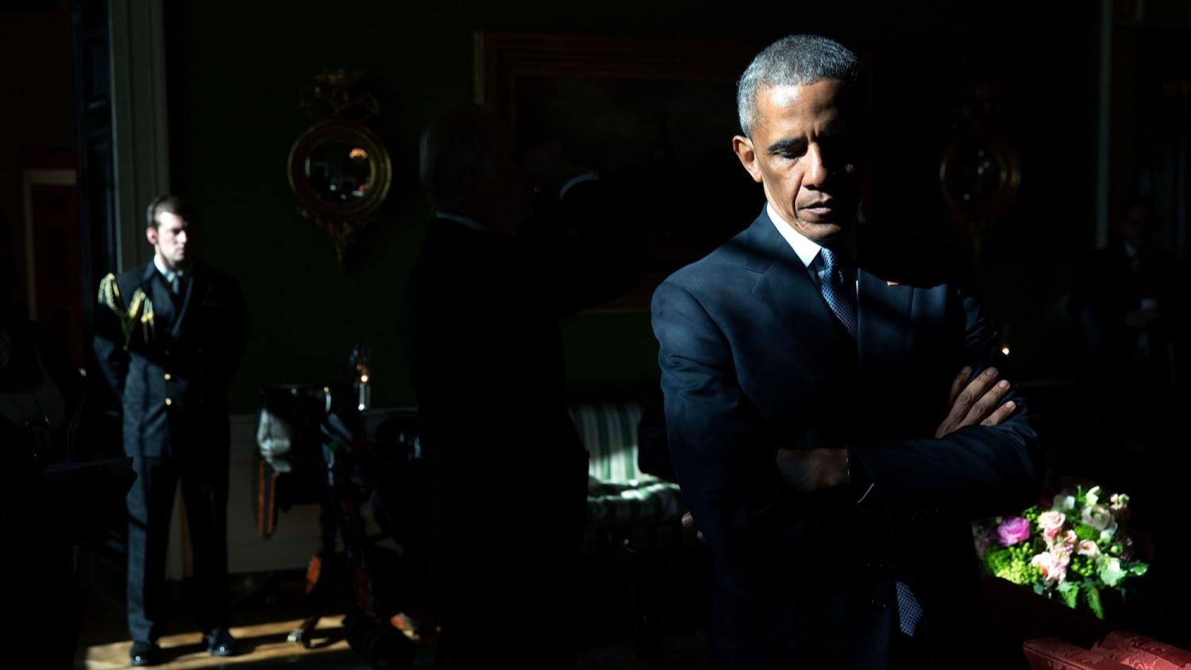
Bye, bye Obama! Best Photos of 2016 from the White House

Slide 2
Obama is being introduced by Mark Barden, whose son was killed during the Sandy Hook Elementary School shooting in 2012. The president later cried during his address on January 5 and called it the worst day of his presidency
All Photos by official White House Photographers

Slide 3
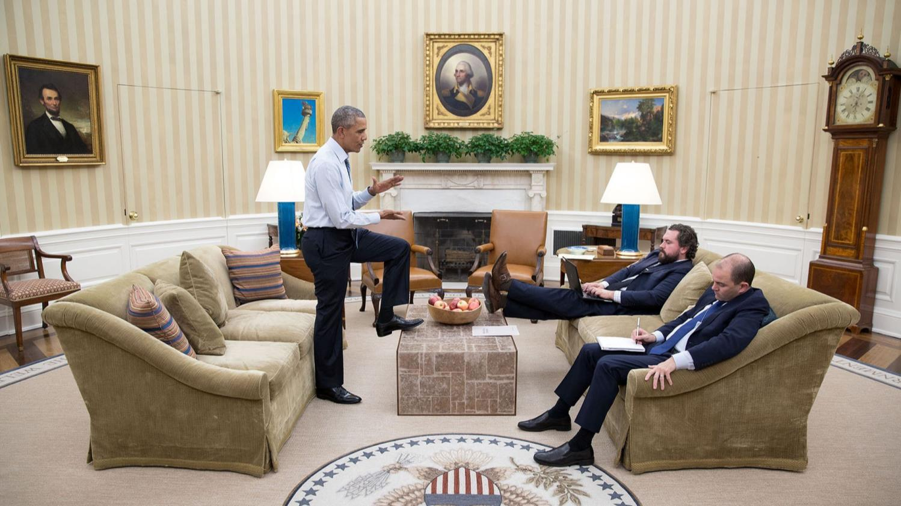
Obama dictates the first draft of his State of the Union speech to Cody Keenan, Director of Speechwriting, and Ben Rhodes, Deputy National Security Advisor for Strategic Communications on January 7, 2016
Chief White House Photographer Pete Souza

Slide 4
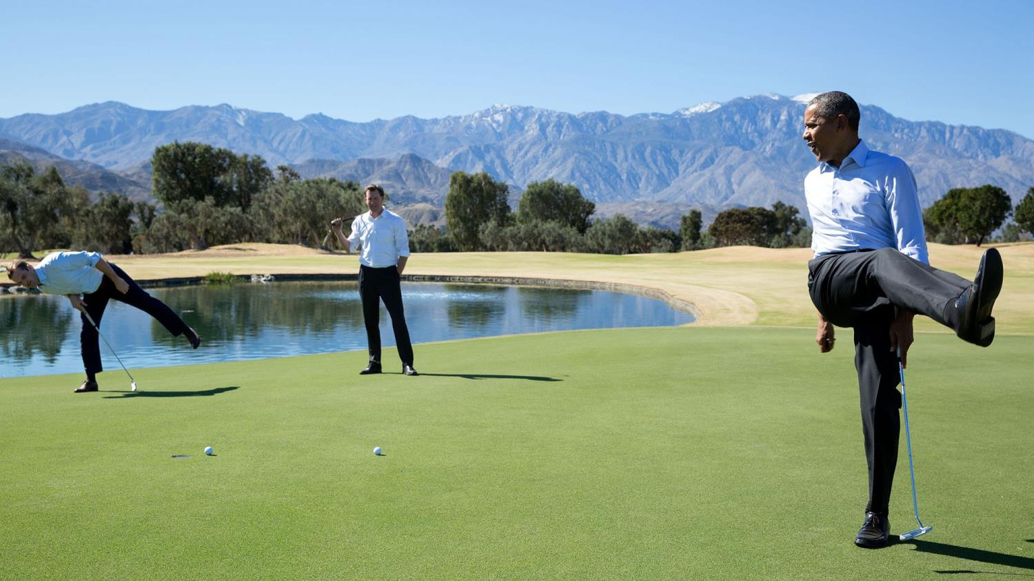
Obama kicks his leg up in disappointment as his golf ball falls short of the hole during an impromptu golf game with White House staffers in Rancho Mirage, California on February 16, 2016

Slide 5
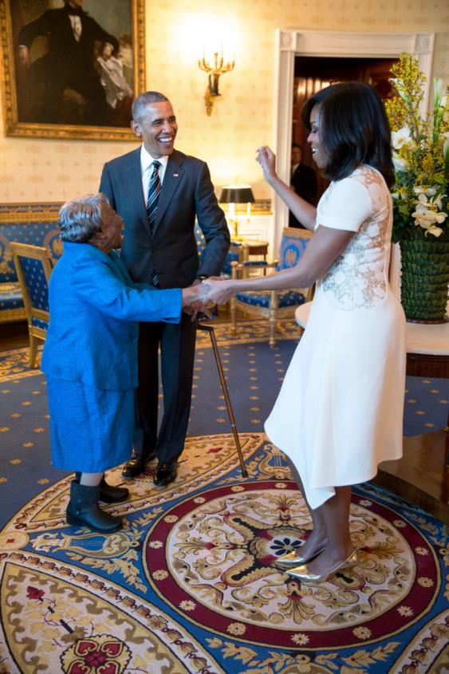
President Obama watches the First Lady dance with 106-year-old Virginia McLaurin in the Blue Room of the White House prior to a reception celebrating African American History Month on Feb. 18, 2016

Slide 6
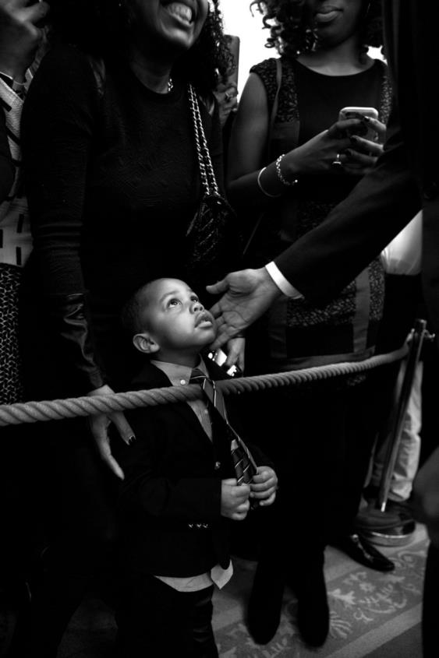
In this official White House photograph, President Barack Obama greets a young guest during a reception celebrating African American history month in the east room of the White House on Feb. 18, 2016.

Slide 7
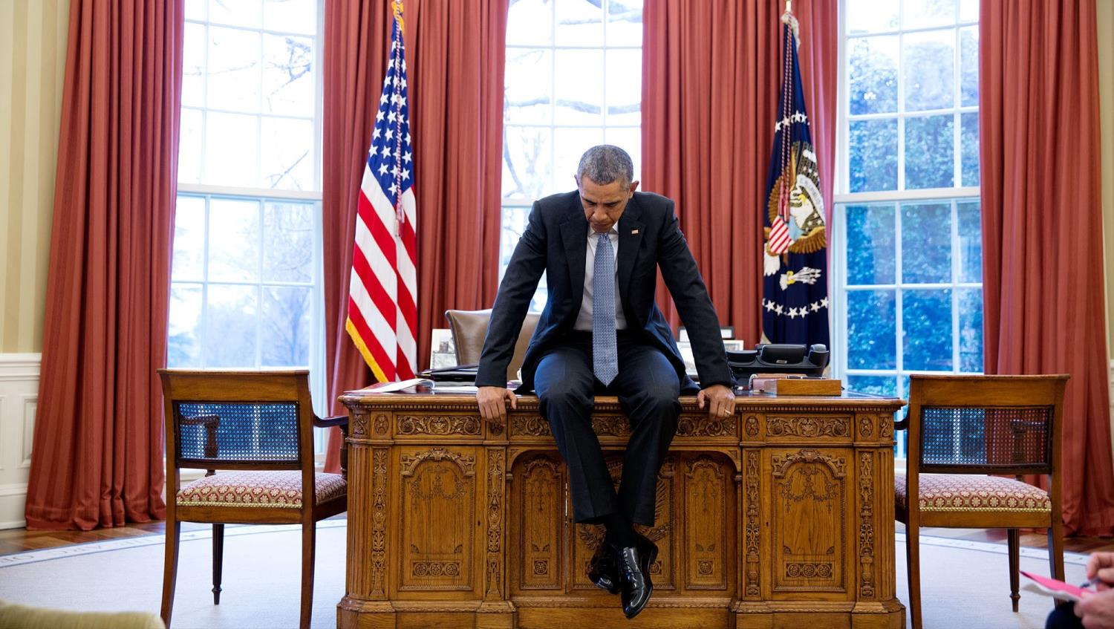
Obama sitting on his desk in deep thought before a conference call with European leaders on February 23, 2016

Slide 8
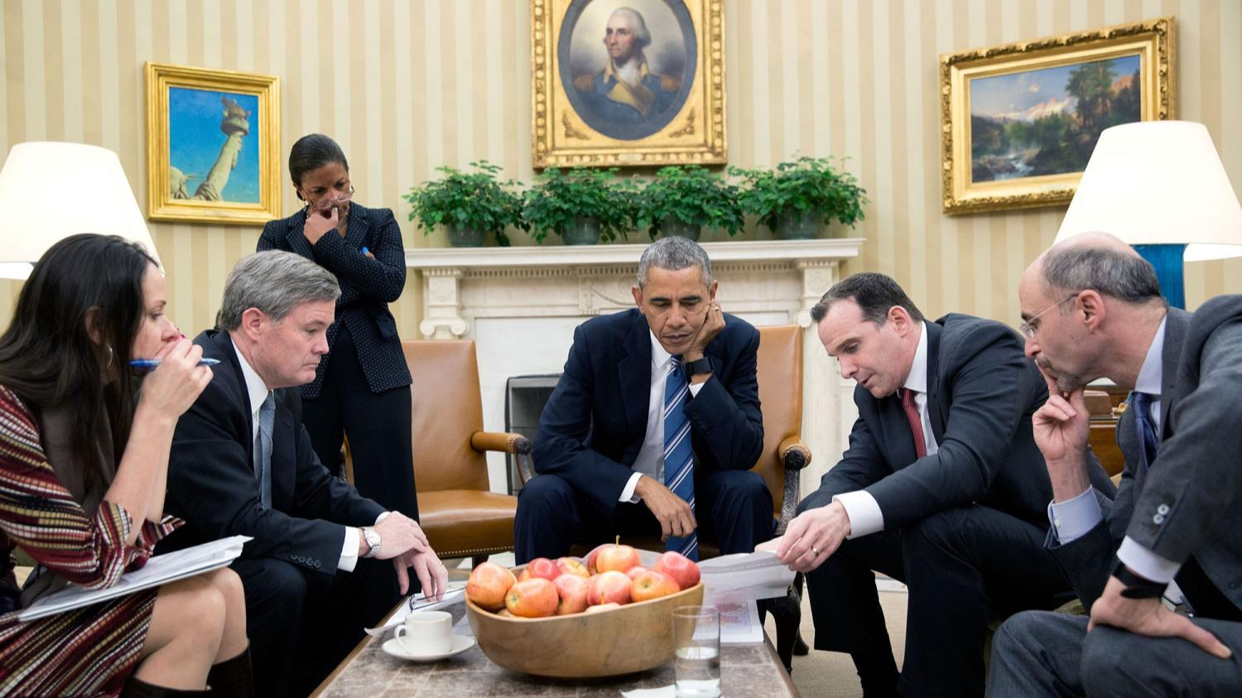
Obama while he was receiving an update from Brett McGurk, Special Presidential Envoy for the Global Coalition to Counter ISIL, on the situation in Syria on Feb. 24, 2016

Slide 9
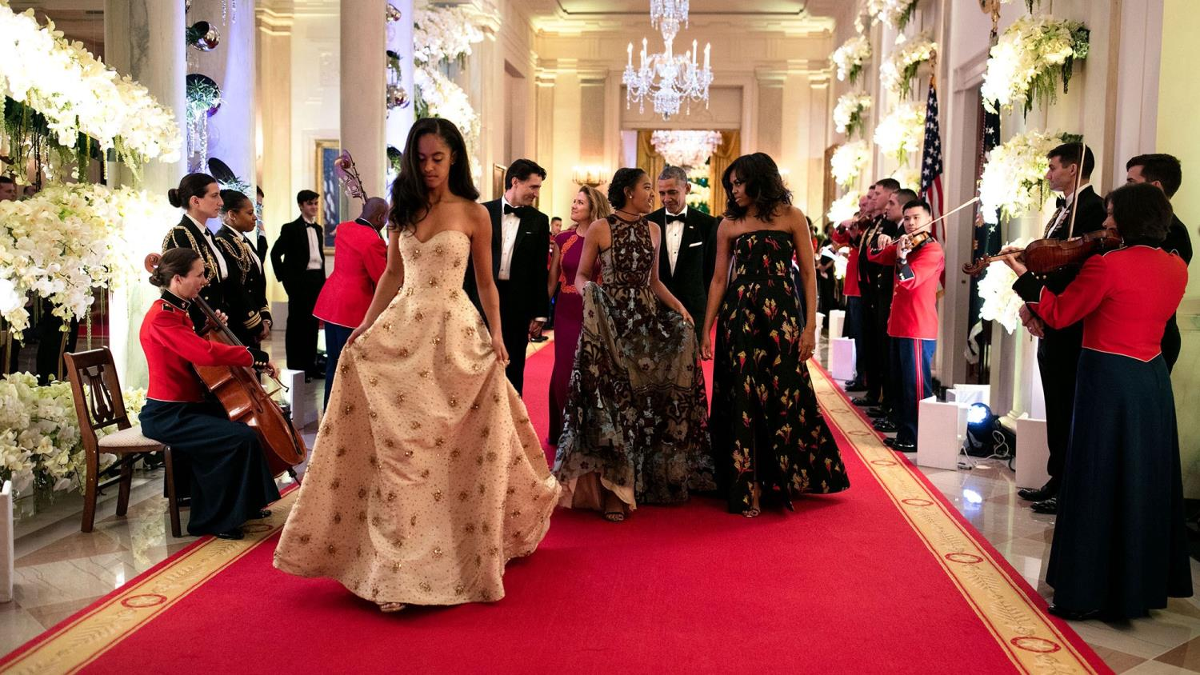
Malia and Sasha attended their first and only State Dinner in honor of Canada's Prime Minister Justin Trudeau and his wife Sophie Grégoire-Trudeau on March 10, 2016.

Slide 10
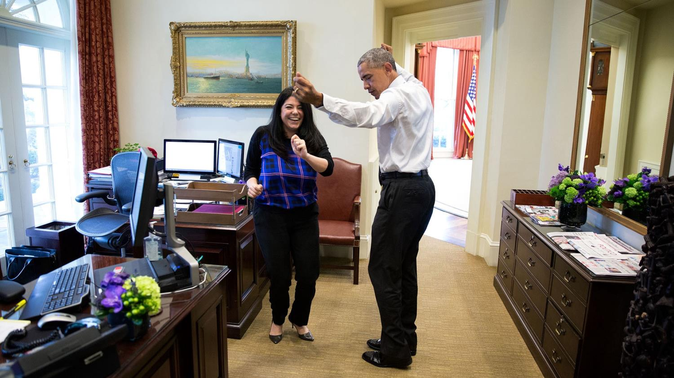
Obama got into the groove during a spontaneous dance with his personal aide Ferial Govashiri on March 16, 2016. the president was helping her prepare for her upcoming wedding

Slide 11
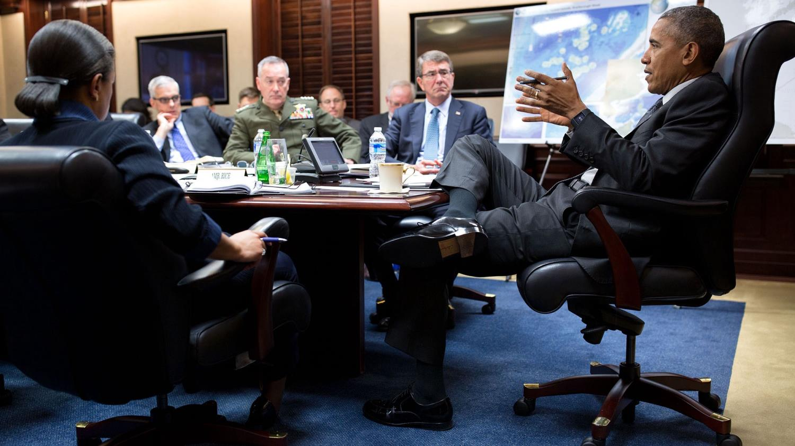
The president meets with the National Security Council in the Situation Room on March 18, 2016.

Slide 12
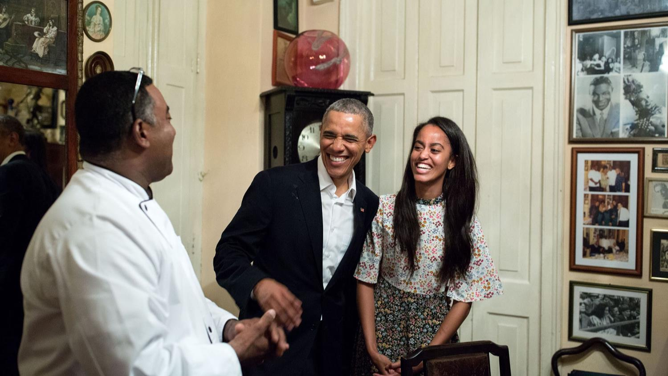
Malia was a Spanish translator for her father during their historic trip to Cuba. Pictured, the president and his daughter sharing a laugh with a restaurateur on March 20, 2016

Slide 13
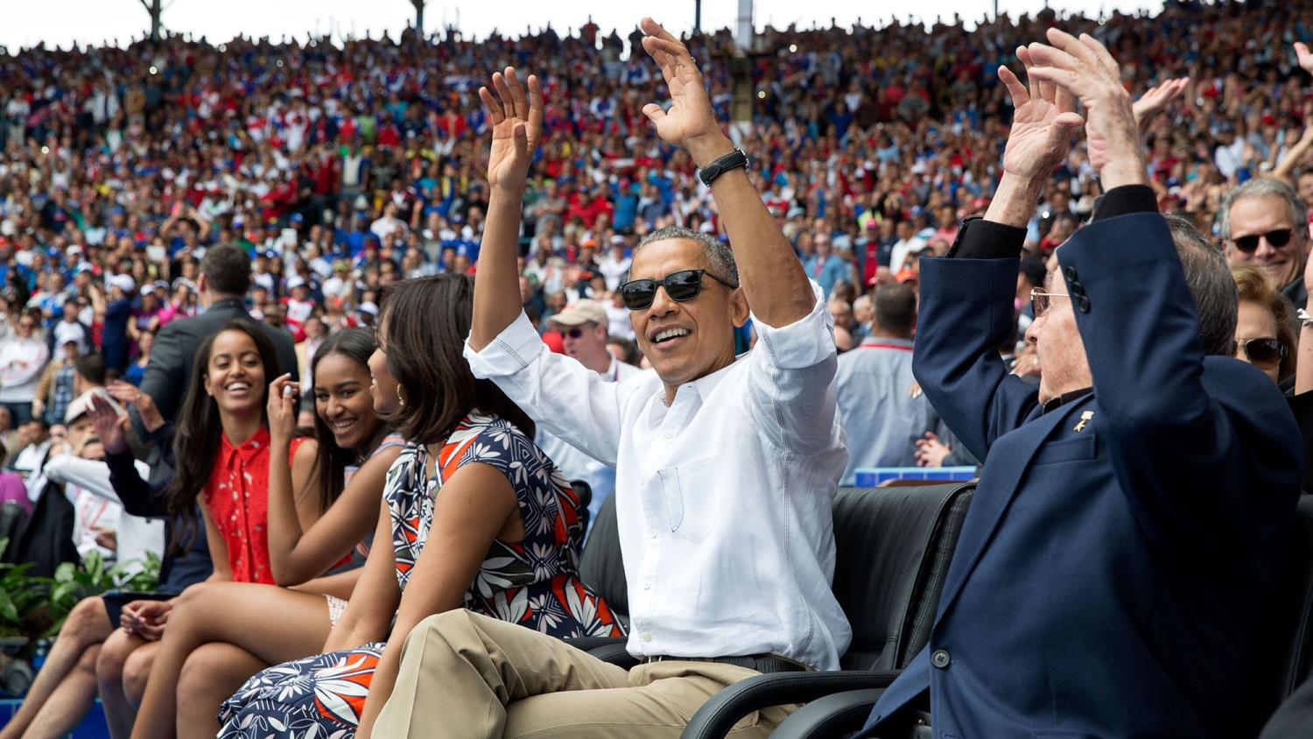
Obama and President Raul Castro of Cuba (right) participate in the wave during an exhibition baseball game between the Tampa Bay Rays and the Cuban National Team in Havana on March 22, 2016

Slide 14
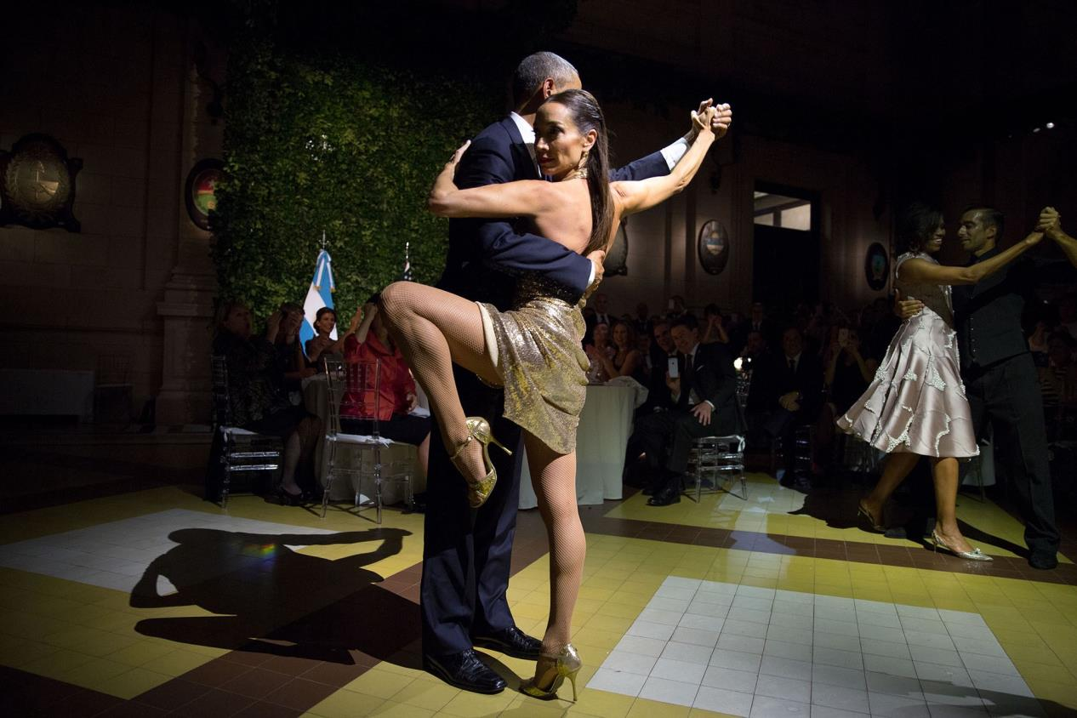
Two renowned tango dancers Mora Godoy and Jose Lugone summoned both the president and the first lady to a dance during a dinner hosted by President Mauricio Macri and Juliana Awada of Argentina in Buenos Aires on March 23, 2016

Slide 15
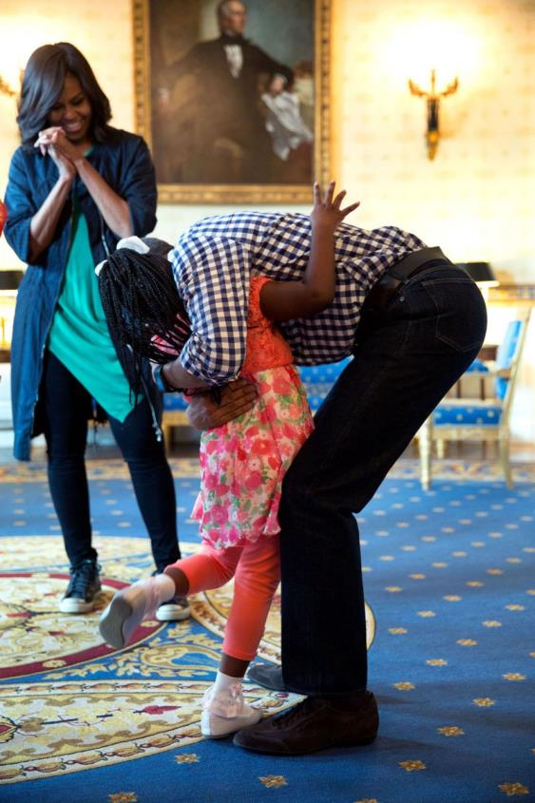
The First Lady Michelle Obama watches as her husband hugs Caprina Harris on March 28, 2016. The young girl was captured in a viral video bursting into tears after her family said Obama would be stepping down.

Slide 16
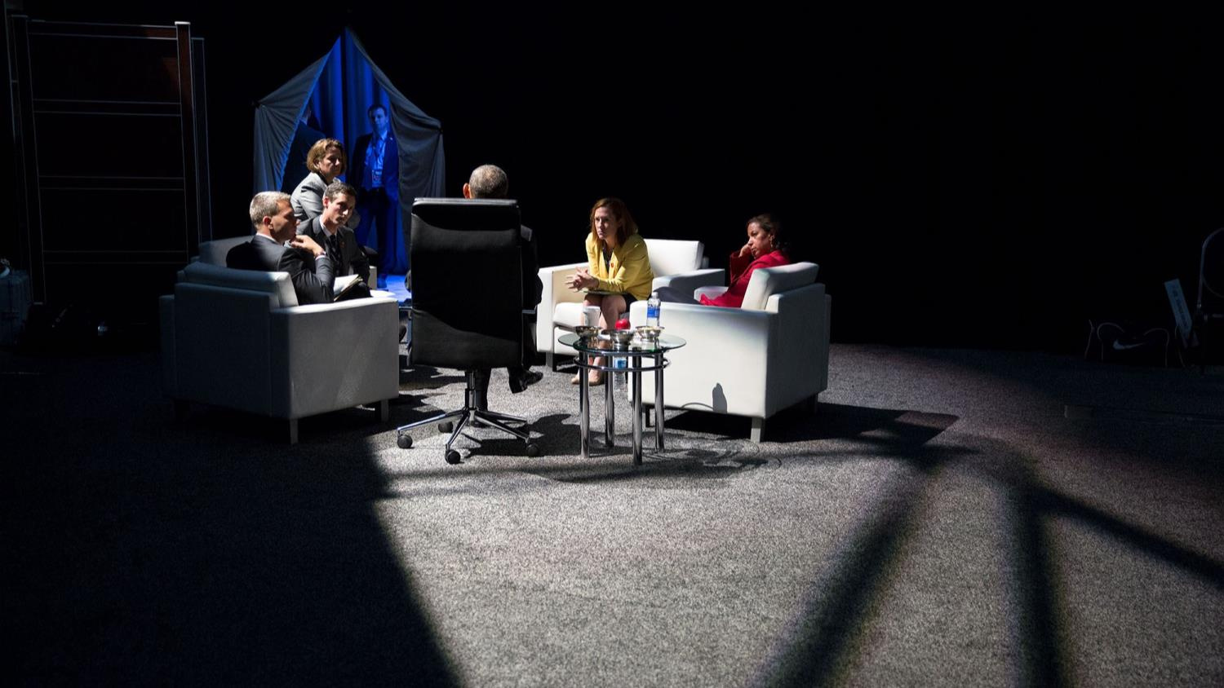
Obama, seated in the office chair with his back to the camera, speaks to his aides before a press conference at the nuclear Security Summit on April 1, 2016

Slide 17
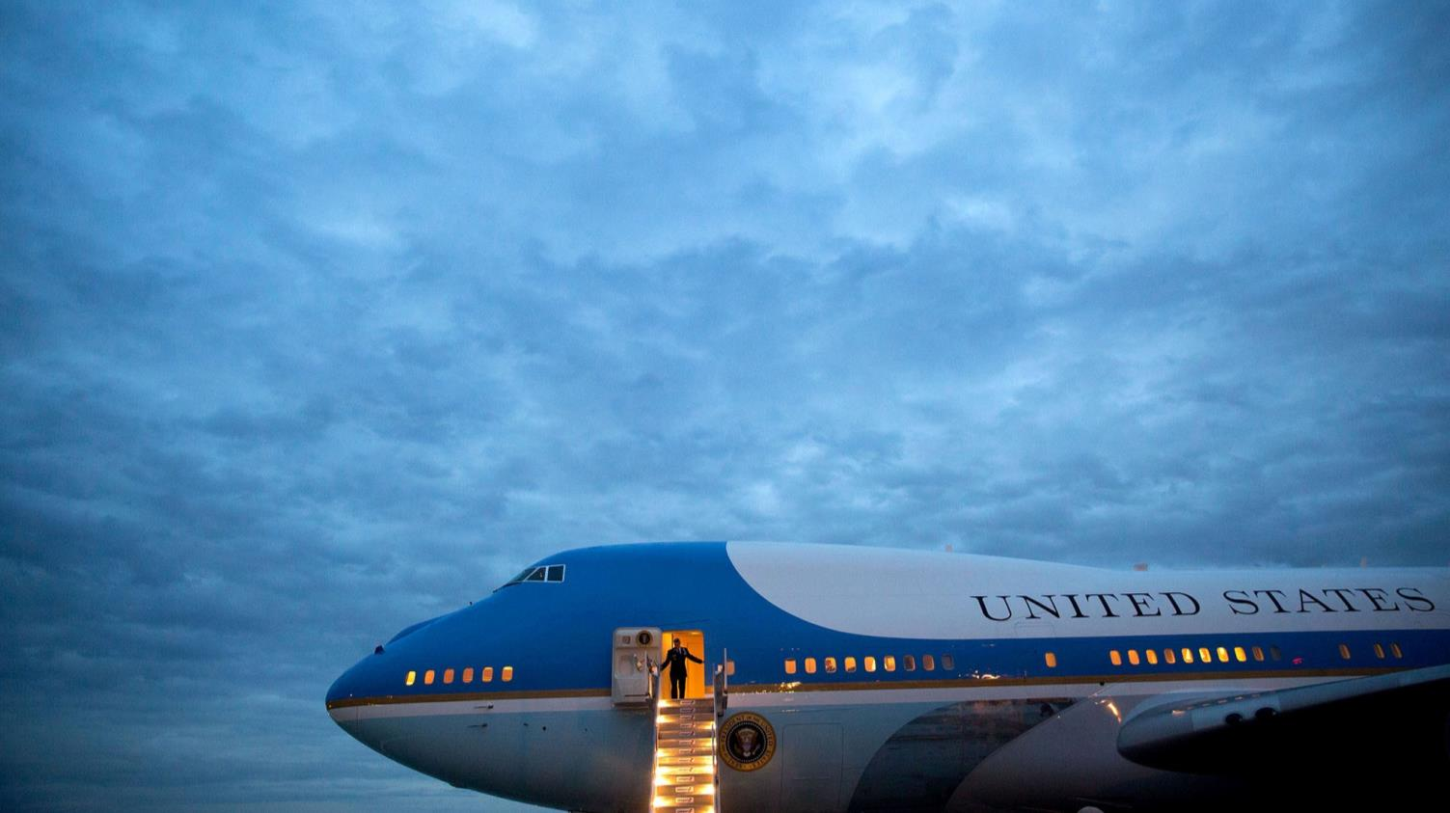
The lit up stairs on the Air Force One offer a sharp contrast to the overcast clouds at the Los Angeles International Airport on April 7, 2016. Obama had flown in from Chicago to speak at a Democratic Congressional Campaign Committee event

Slide 18
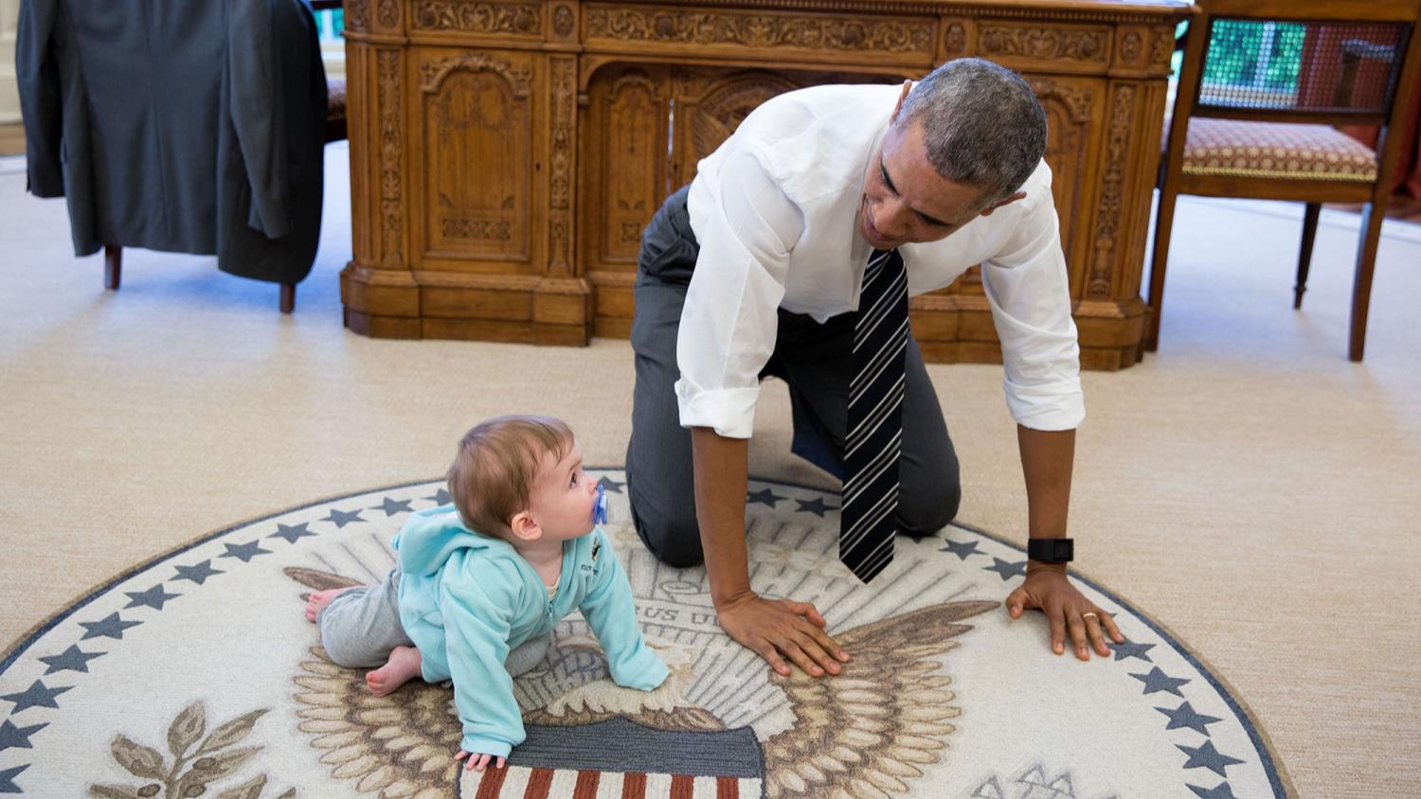
Obama crawls around the Oval Office with Communications Director Jen Psaki's daughter. According to Souza, the president often asked staff members to bring their kids to the White House on April 14, 2016

Slide 19
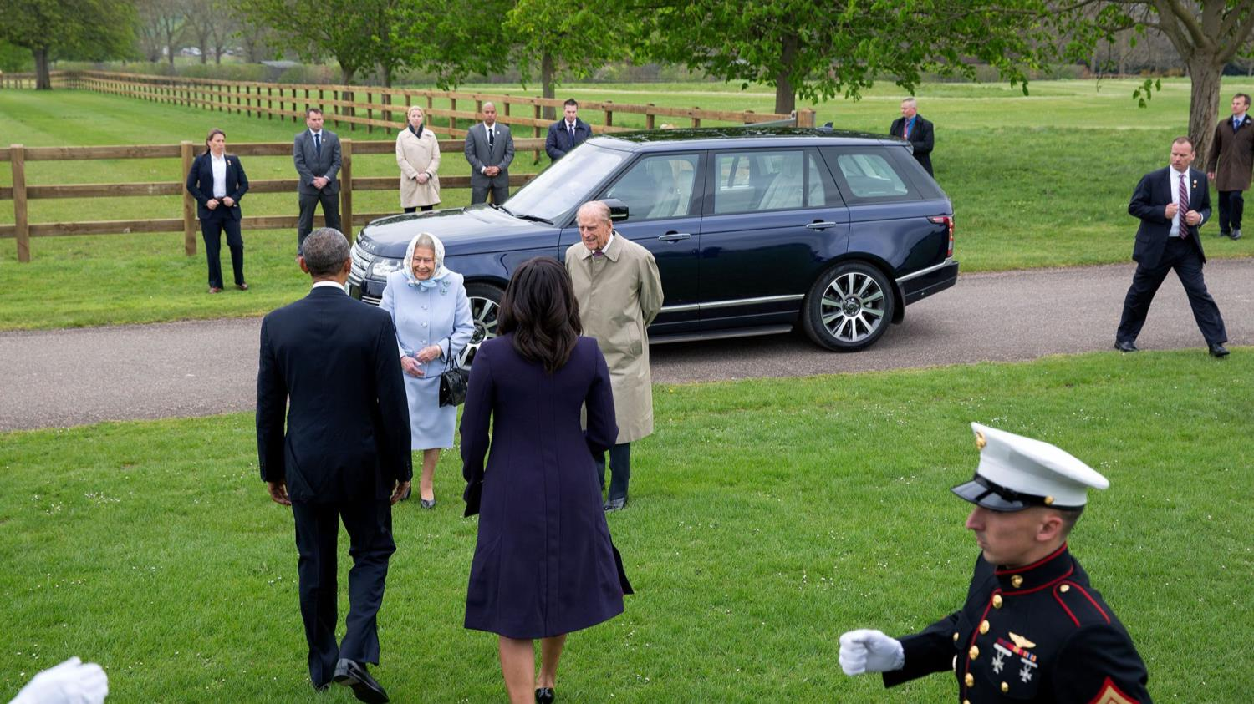
Souza said he was not allowed to exit the helicopter as Queen Elizabeth approached the Obamas on April 22, 2016, so he shot the image from the cockpit. He said: 'It's kind of a disjointed composition but I thought it showed what the scene is like to be welcomed by the Queen at Windsor Castle'

Slide 20
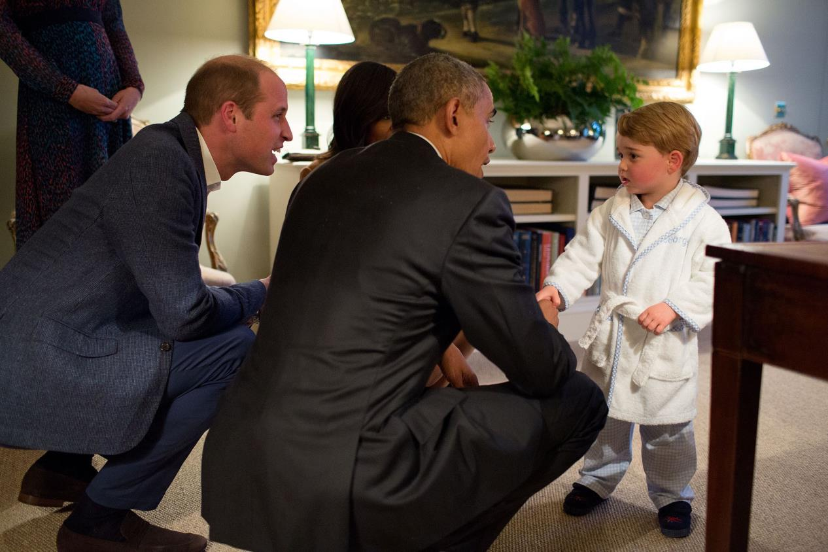
In this official White House photograph, Prince George meets President Obama during a trip to London on April 22, 2016.

Slide 21
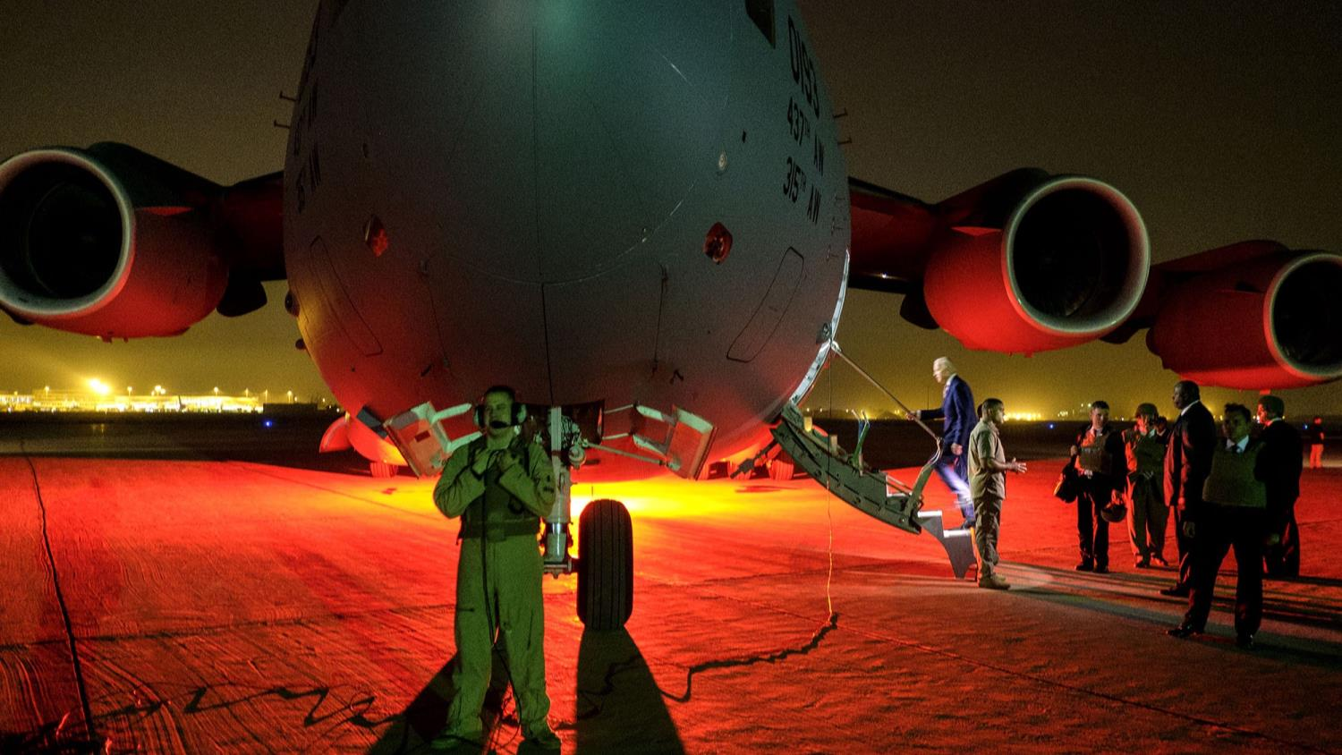
Vice President Joe Biden boards his plane as red and yellow lights shine on the C-17 in Baghdad, Iraq on April 28, 2016

Slide 22
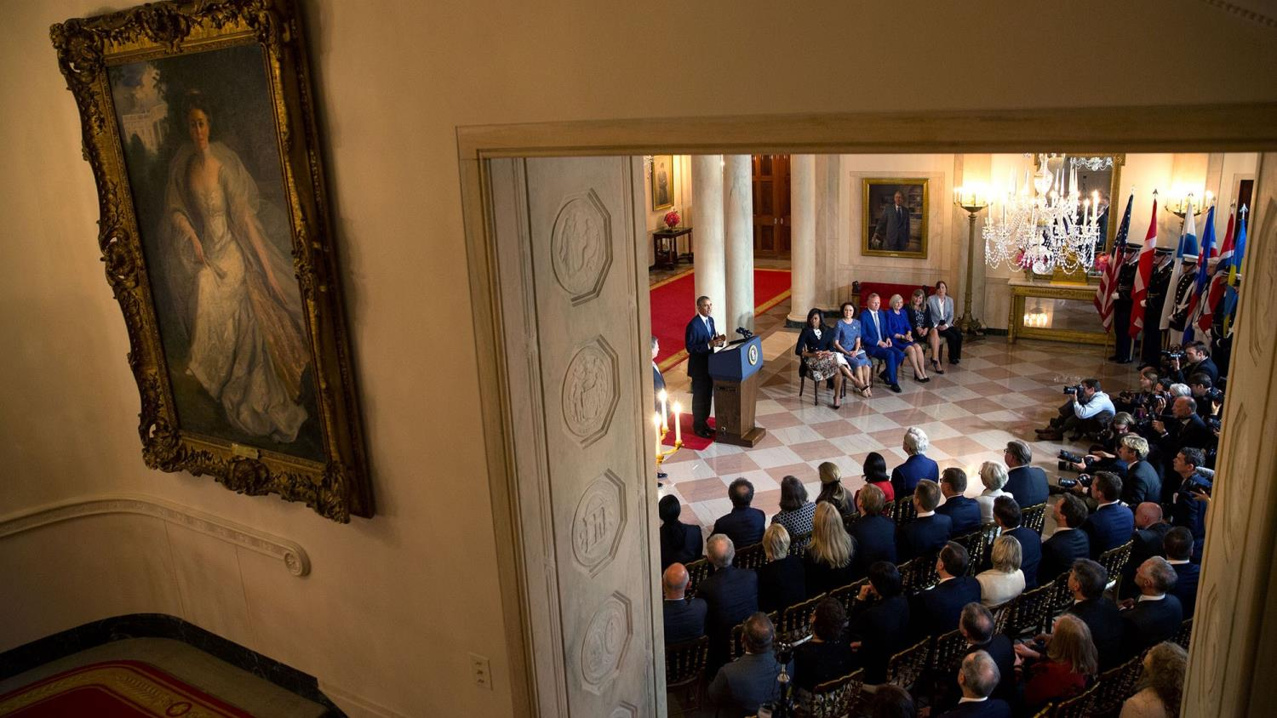
Obama addressed members of the US-Nordic Leaders Summit, which was held indoors because of the rain on May 13, 2016

Slide 23
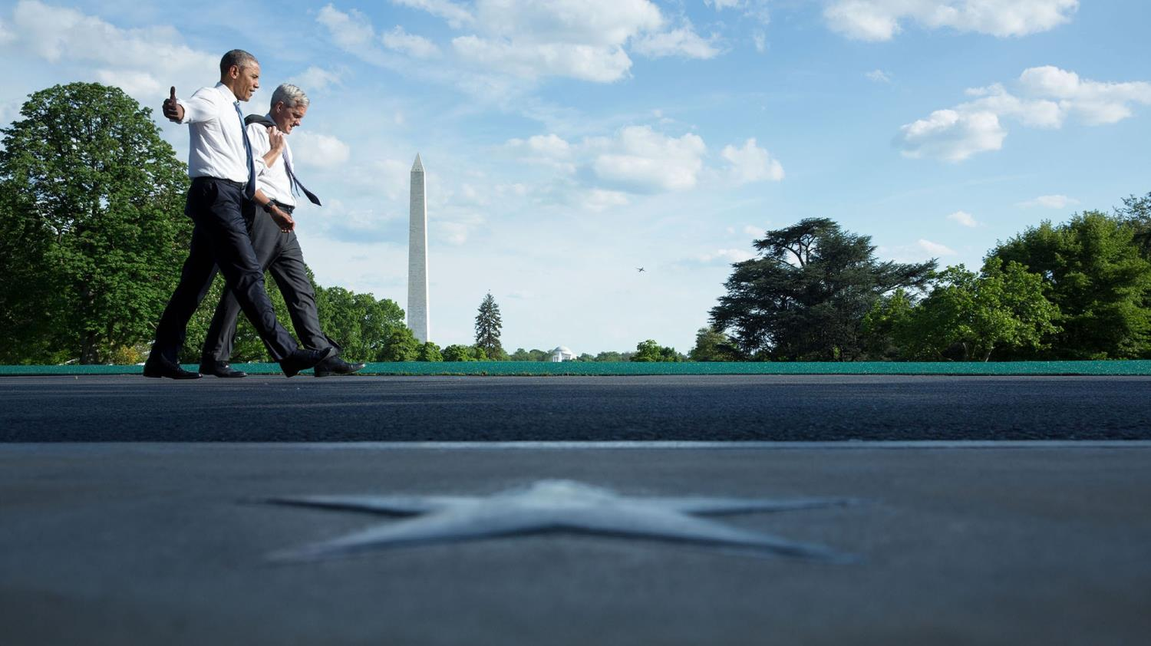
Obama walks across the South Lawn driveway with Chief of Staff Denis McDonough with the Washington Monument in the backdrop on May 13, 2016

Slide 24
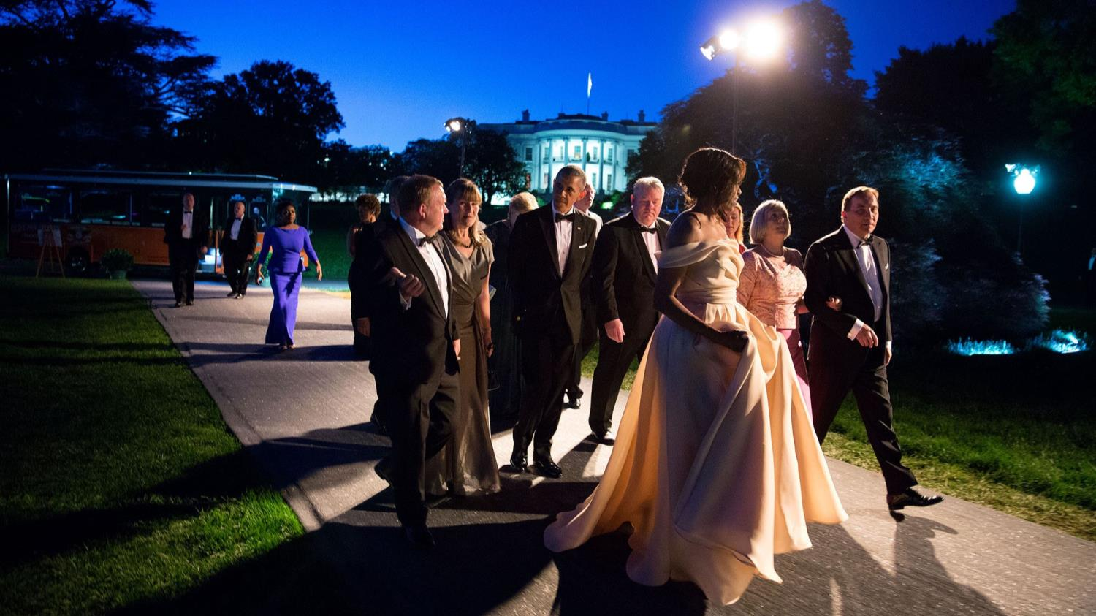
Michelle, dressed in a Naeem Khan gown, escorts the Nordic leaders and their spouses to a State Dinner on May 13, 2016

Slide 25
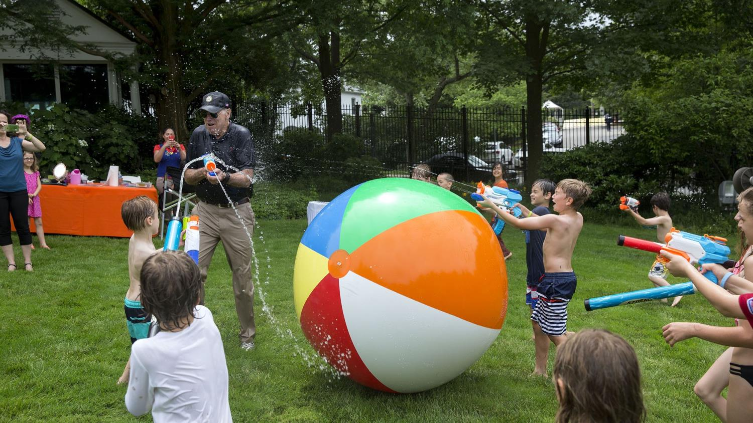
Kids team up against the vice president during the Biden Beach Boardwalk Bash on June 4, 2016

Slide 26
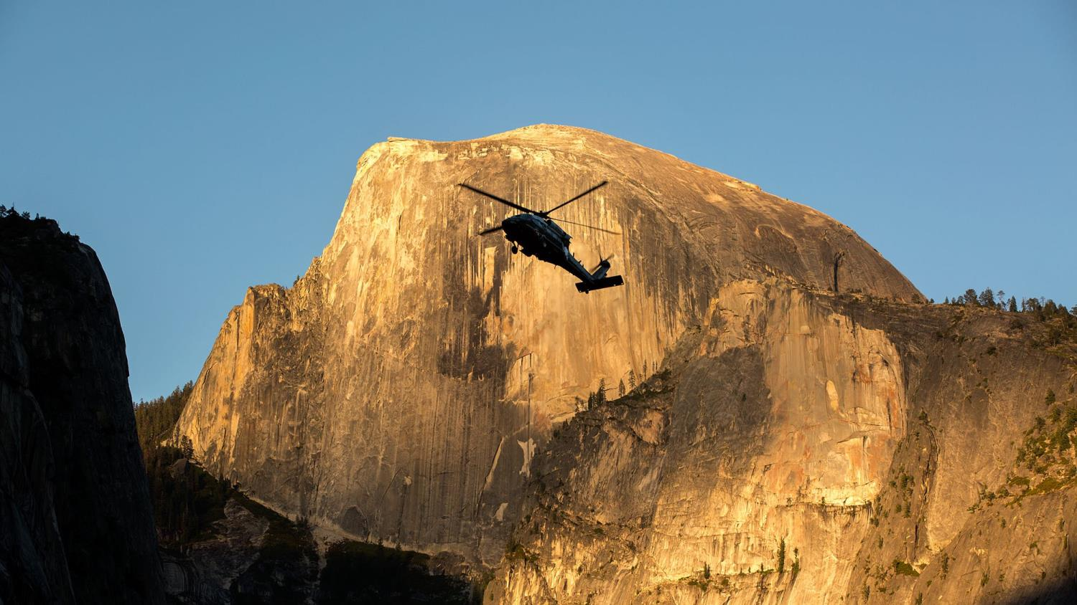
Souza said his helicopter landed minutes before the two others, so he touched down and ran to get this shot at the Yosemite National Park on June 17, 2016

Slide 27
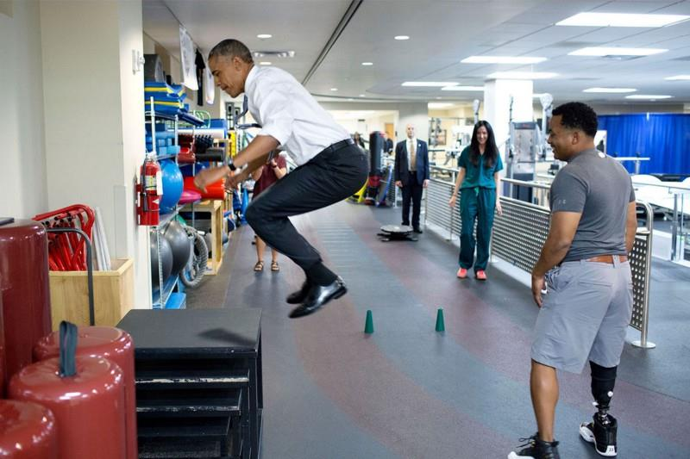
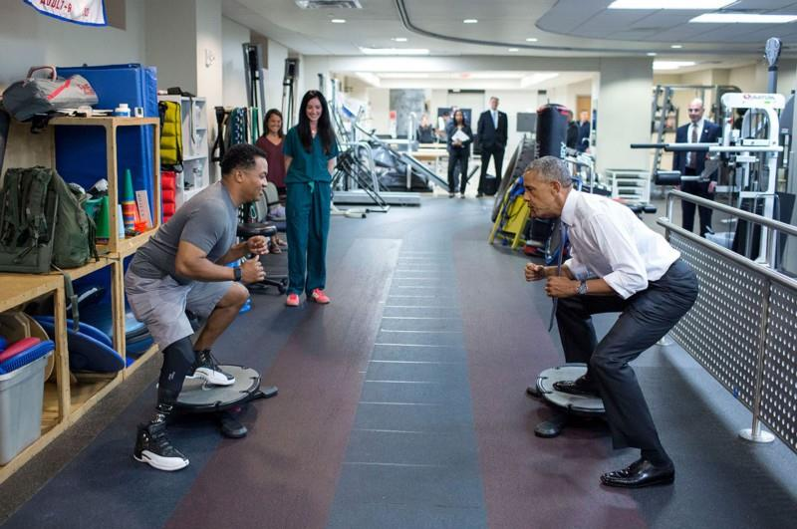
For eight years, President Obama has visited wounded warriors on a regular basis at Walter Reed National Military Medical Center. Here he participates in an agility drill and box jump with Navy Lt. Cmdr. John “Jae” Terry.
On June 21, 2016

Slide 28
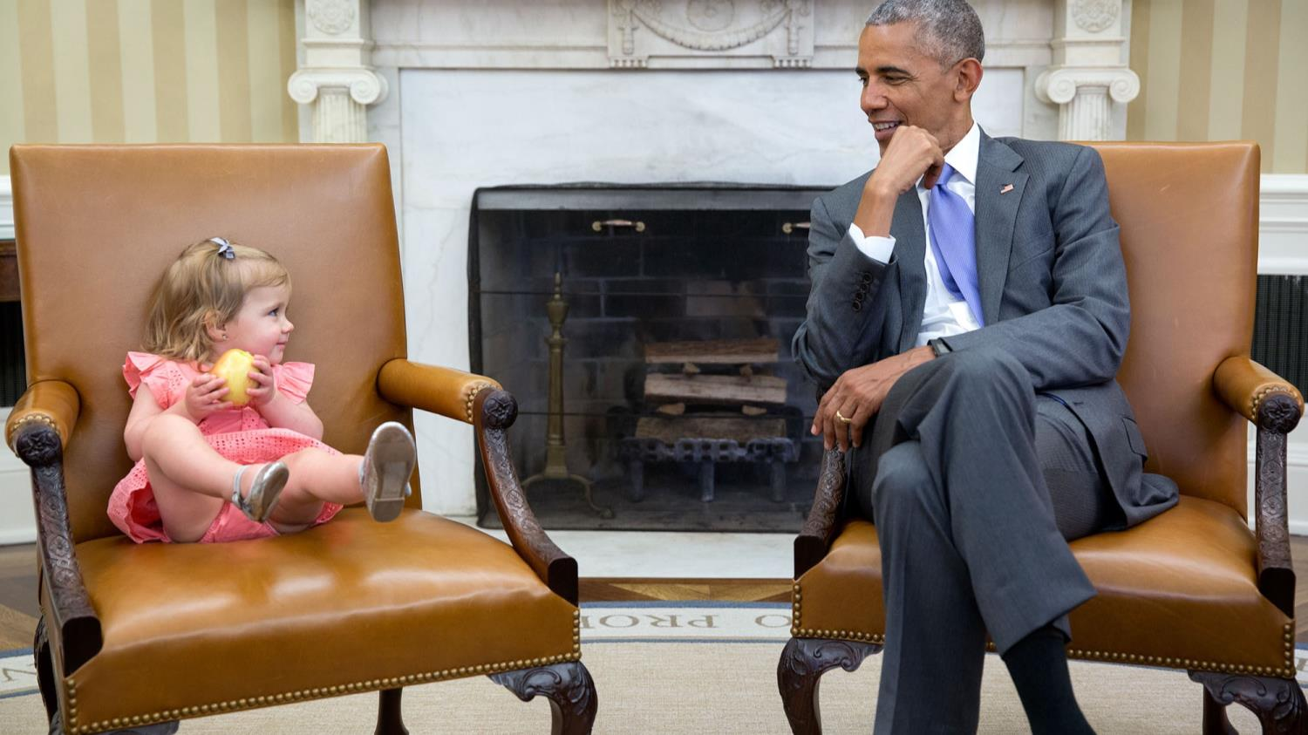
David Axelrod, senior advisor to the president, brought his granddaughter Maelin into the Oval Office. She crawled into the VP's seat and exchanged glances with Obama on June 22, 2016

Slide 29
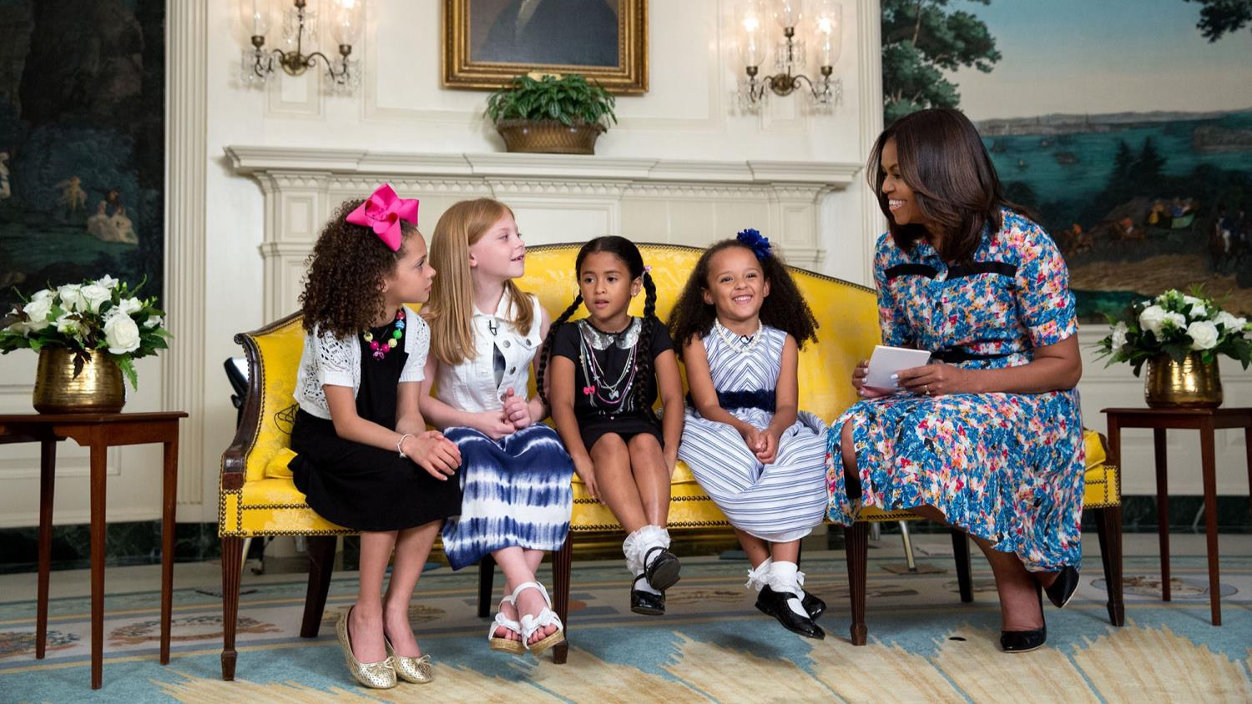
First Lady in this sweet moment interacting with four young girls in the Diplomatic Reception Room on June 22, 2016

Slide 30
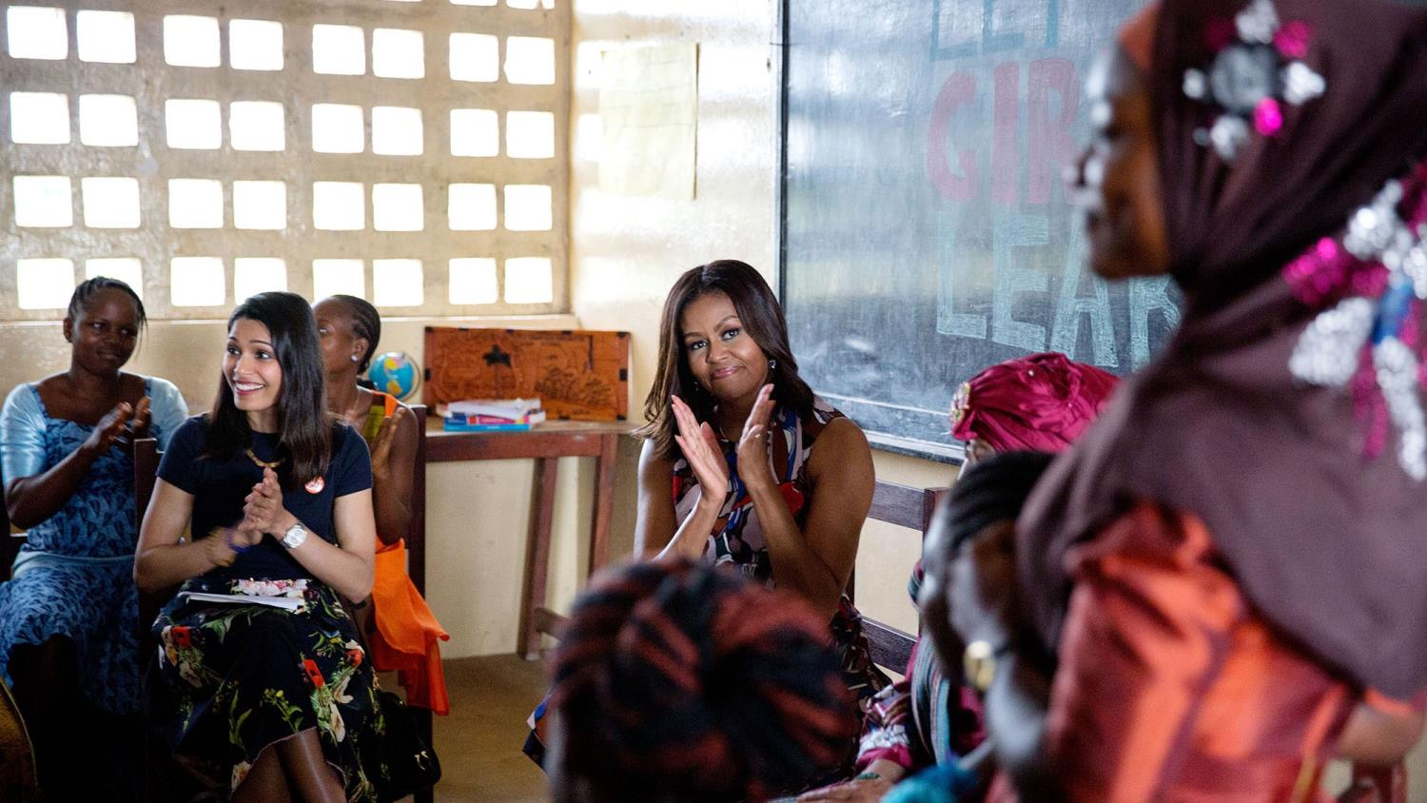
Michelle Obama, who started the Let Girls Learn initiative, visited a high school in Unification Town, Liberia, with the country's president Ellen Johnson Sirleaf and actress Freida Pinto on June 27, 2016

Slide 31
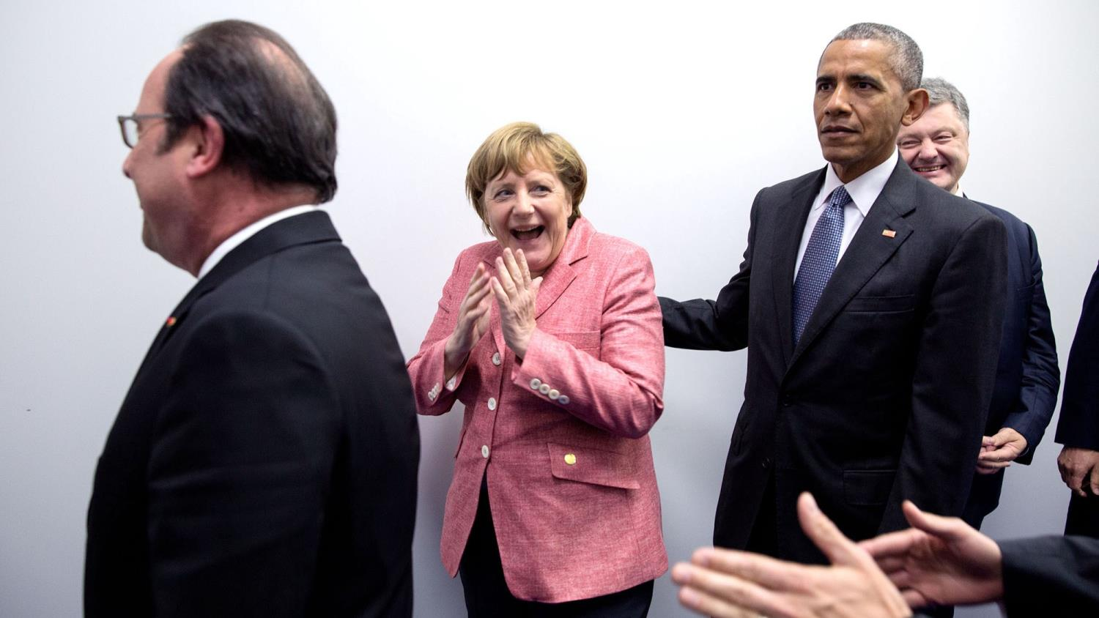
Obama shares a moment with German Chancellor Angela Merkel, who thought an entire press corp was going to be squeezed into a small hallway for a group photo at the NATO Summit in Warsaw, Poland on July 9, 2016

Slide 32
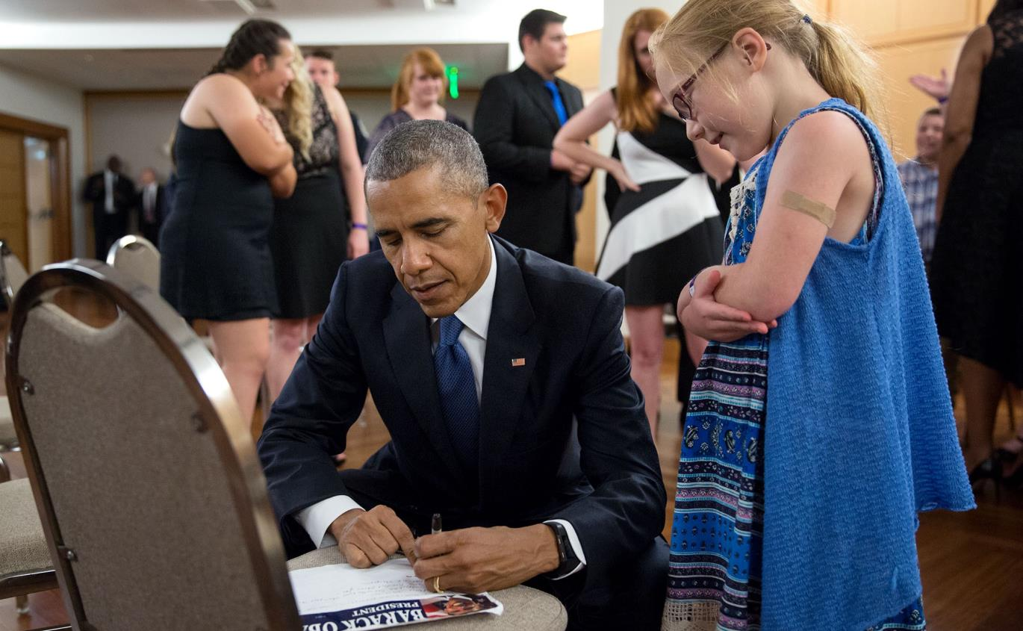
Obama visited families of the officers and victims killed in Dallas, Texas on July 12, 2016

Slide 33
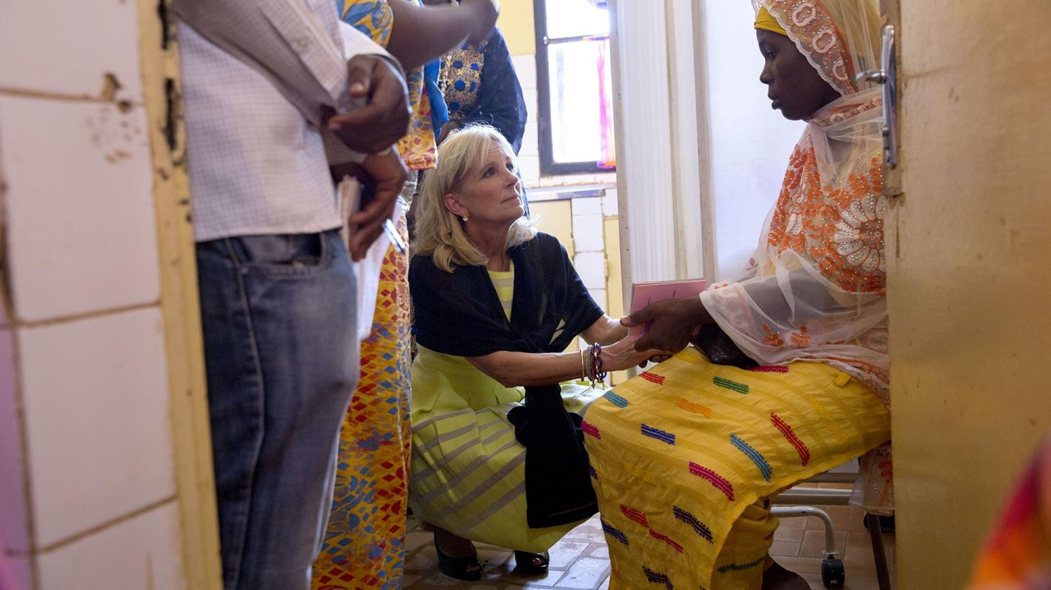
Second Lady Dr. Jill Biden greets a mother of triplets in the maternity room of a women's health clinic in Niger on July 21, 2016

Slide 34
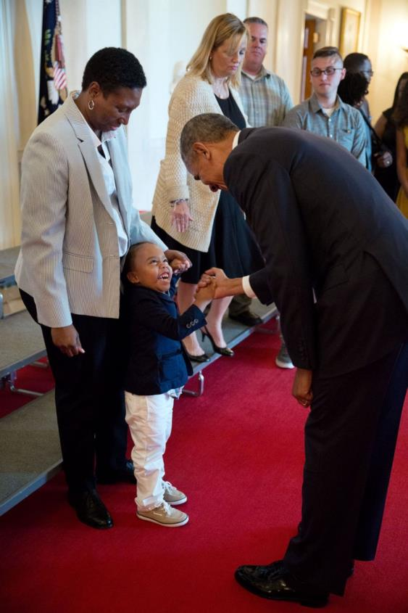
Obama greets three-year-old Armanil Chisolm, who visited the White House with his grandmother Tameca Brown on July 25, 2016

Slide 35
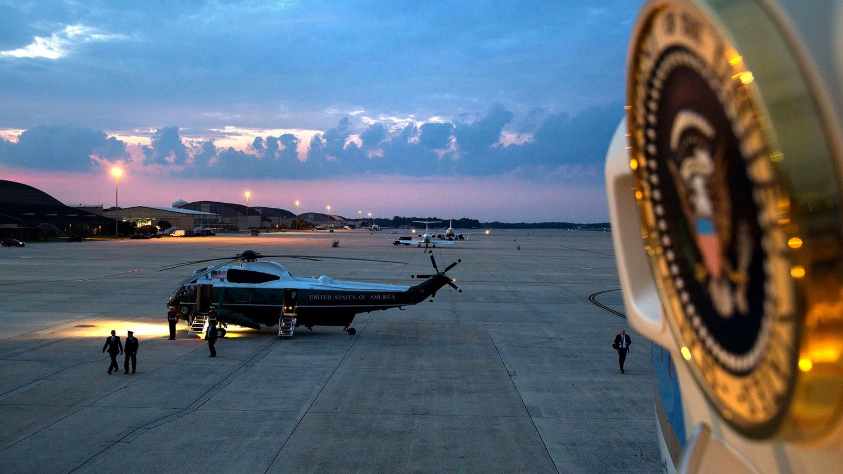
Souza framed the president arriving at Joint Base Andrews in Maryland from inside Air Force One, with the presidential seal on the inside of the plane door in the foreground of the shot. The president was heading to the Democratic National Convention on July 27, 2016

Slide 36
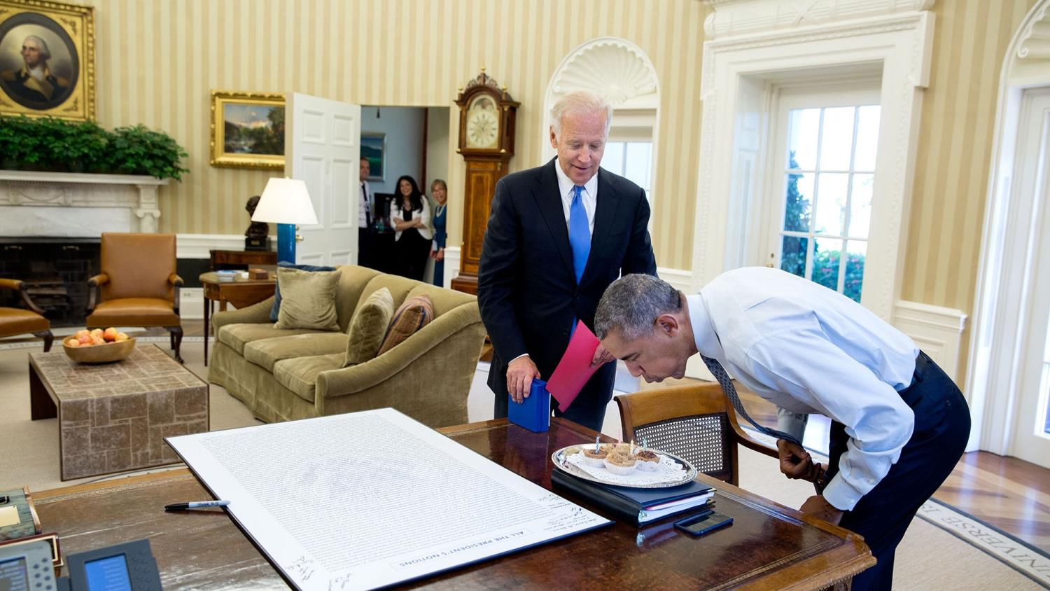
Obama's friendship with Vice President Joe Biden has been well-documented. Pictured, the president blowing at candles after Biden surprised him with cupcakes on his birthday on August 4, 2016

Slide 37
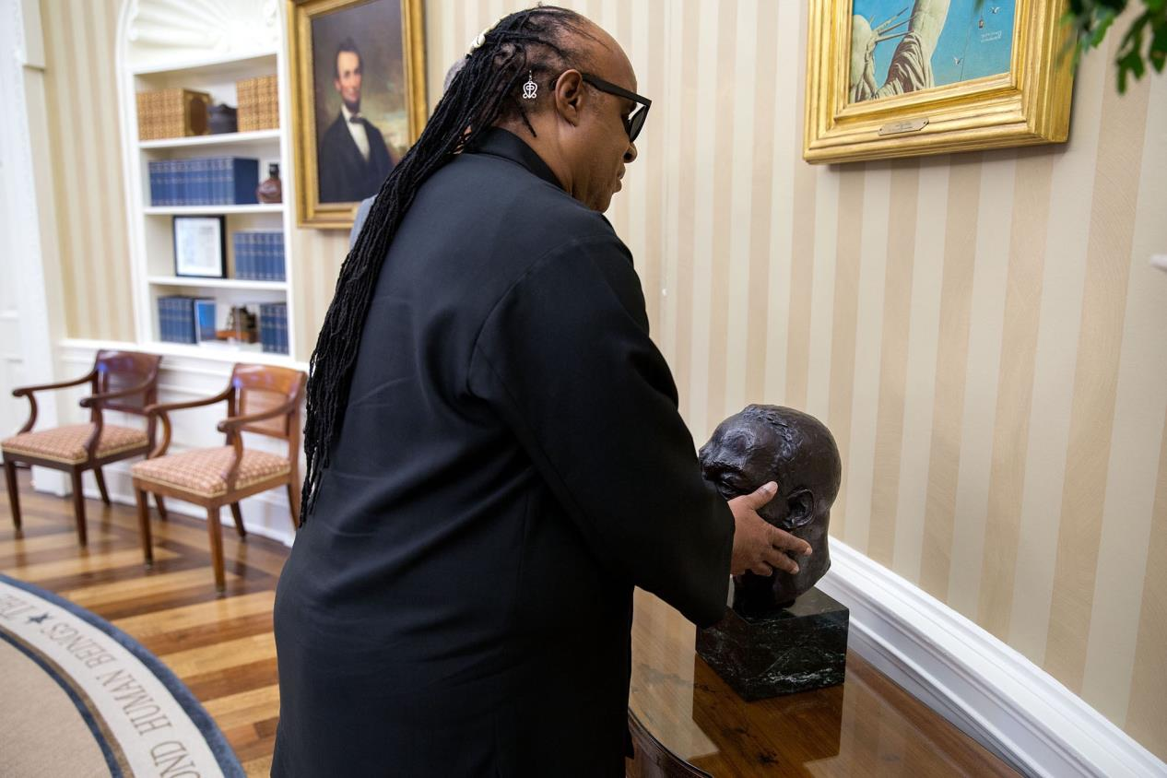
When Stevie Wonder visited the White House on August 5, 2016, the president described the items in his office to the blind musician. Pictured, Wonder feeling the bust of Dr. Martin Luther King

Slide 38
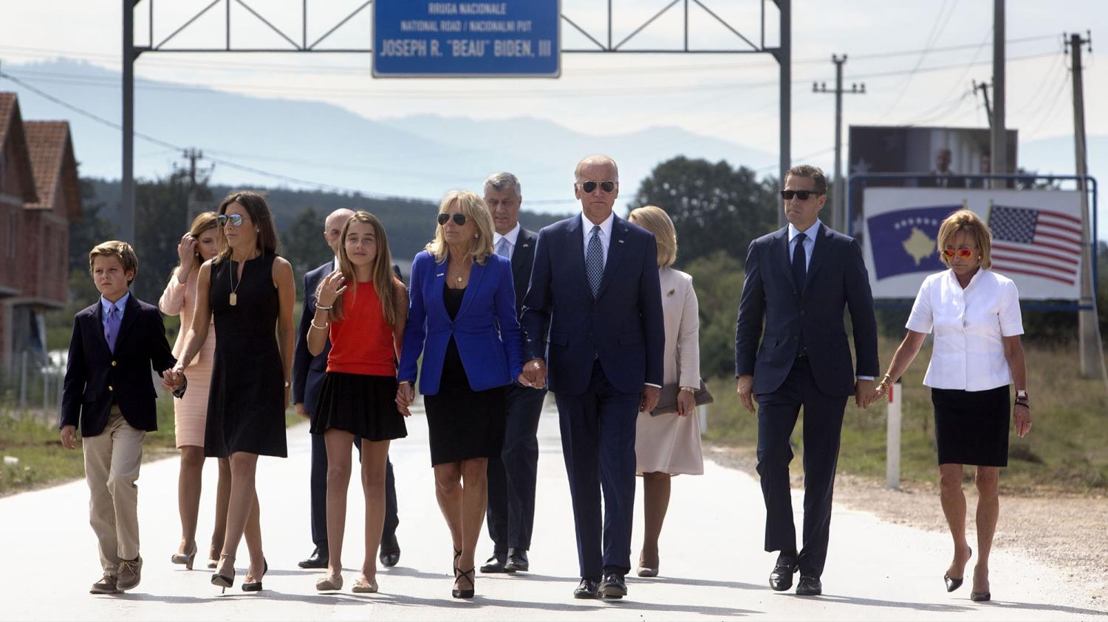
Members of the Biden family cross the highway to a dedication ceremony for a road that was named by the Government of Kosovo in honor of Joseph R. 'Beau' Biden III on Aug. 17, 2016

Slide 39
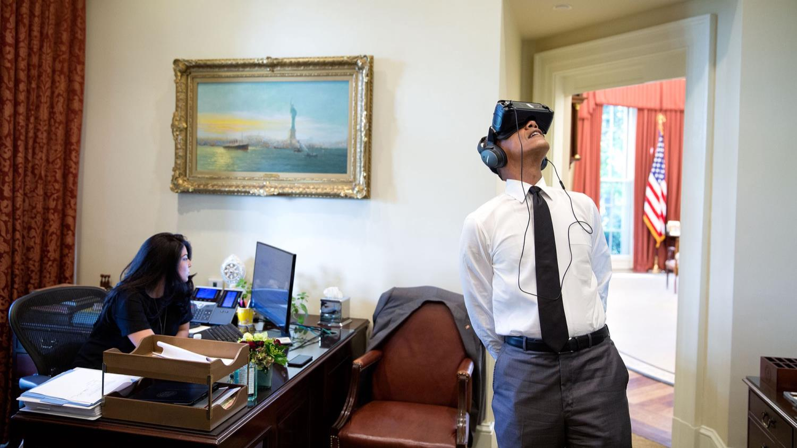
The president watches a virtual reality film of Yosemite National Park as personal aide Ferial Govashiri works at her computer on August 24, 2016

Slide 40
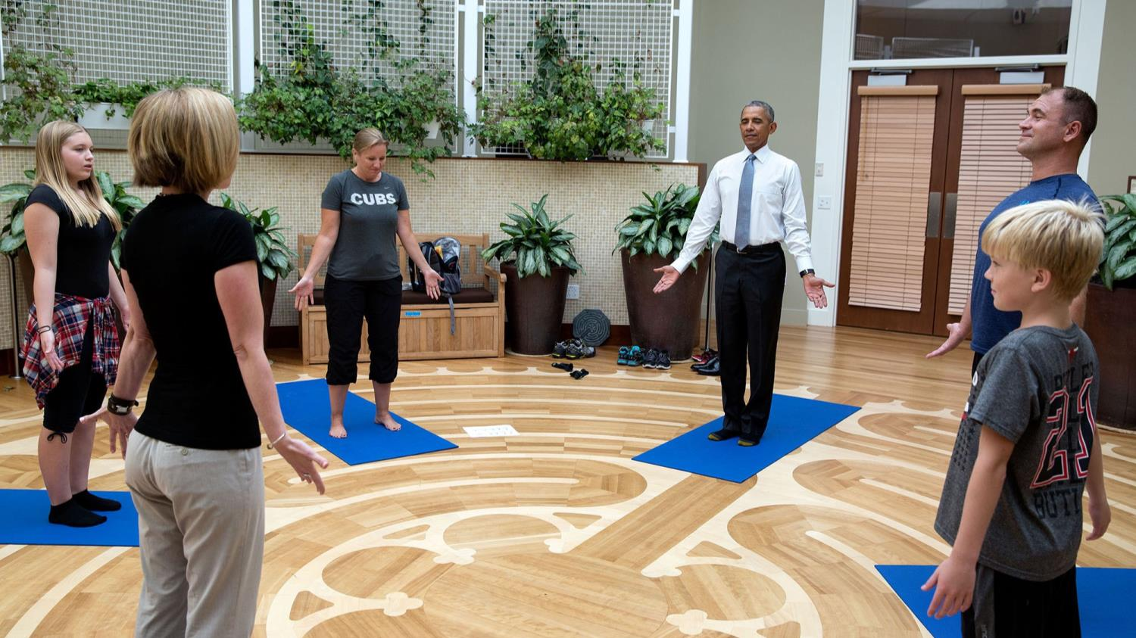
On another visit to the Walter reed National Military Medical Center, Master Chief Petty Officer David Hall asked the President to join him and his family in a yoga therapy session. Hall, a 26-year veteran was injured while deployed to Iraq and Afghanistan on Aug. 26, 2016

Slide 41
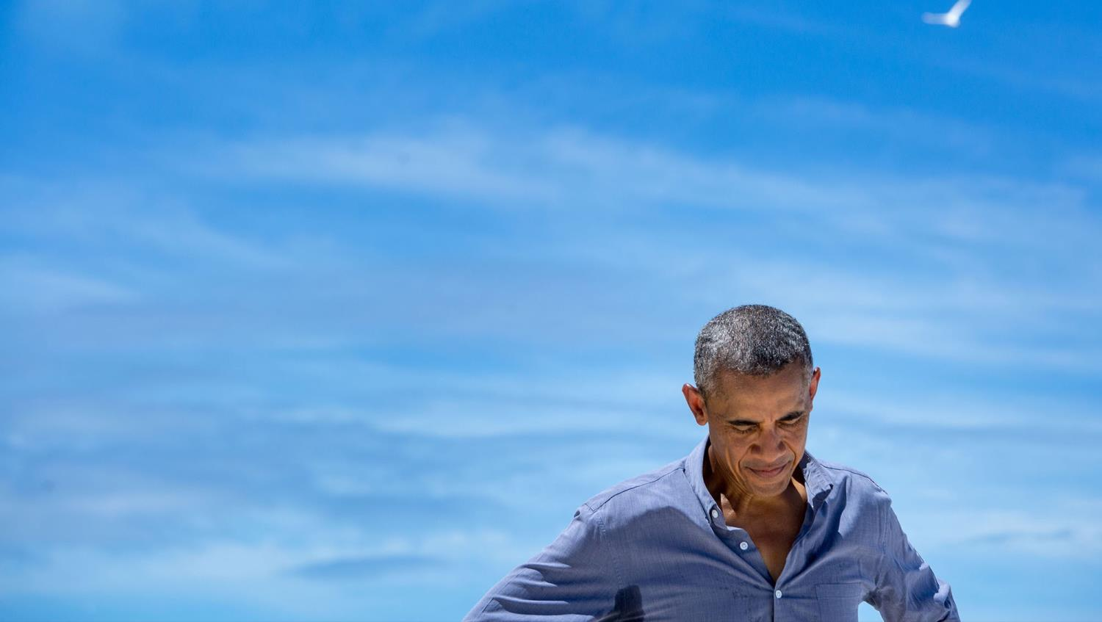
Obama pauses while talking with a writer from National Geographic during his visit to Midway Atoll in the North Pacific Ocean on Sept. 1, 2016

Slide 42
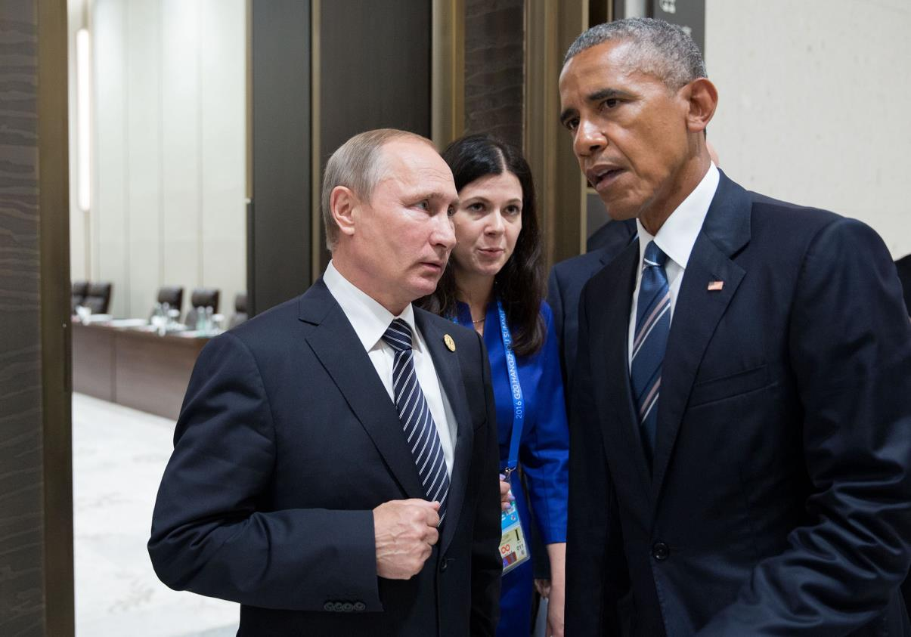
Obama talks with Russian President Vladimir Putin at the G20 Summit in Hangzhou in what appears to be a tense moment on September 5, 2016

Slide 43
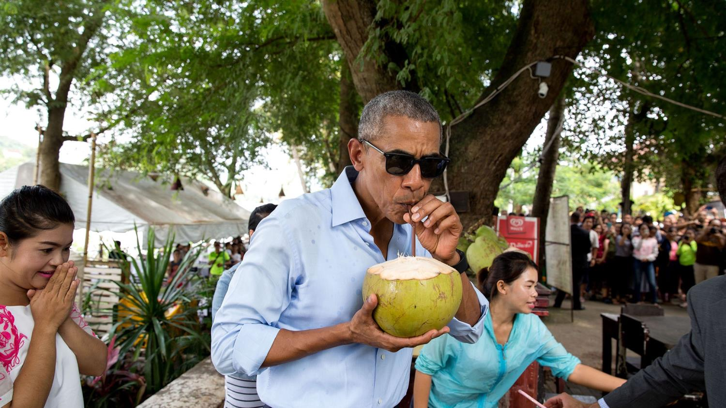
Obama, the first sitting American president to visit Laos. Pictured, the president enjoying a fresh coconut on September 7, 2016, with splatters still visible on his shirt after it was chopped open

Slide 44
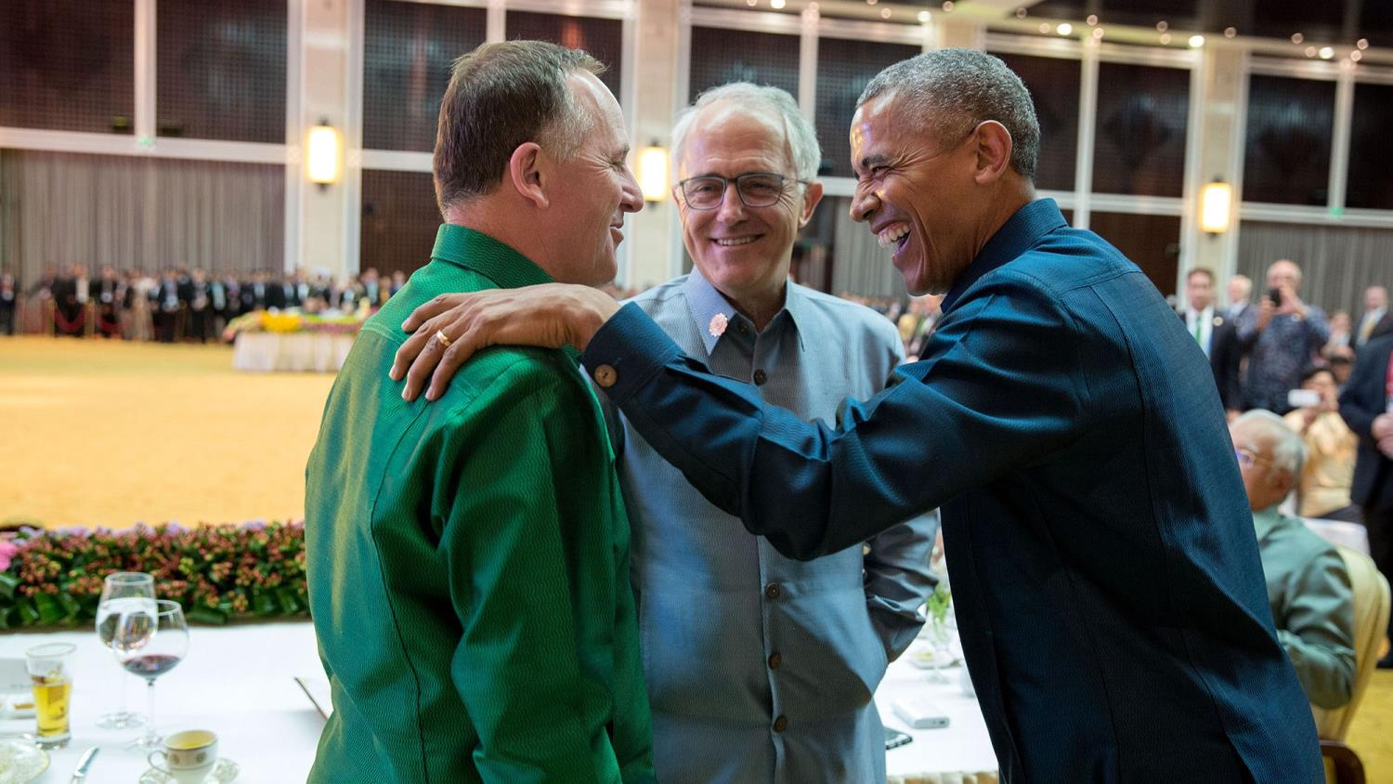
During the ASEAN gala dinner in Laos, Obama hid in a corner of the room next to a couple of Secret Service agents and approached the president while he was speaking to Prime Minister John Key of New Zealand and Prime Minister Malcolm Turnbull of Australia on Sept. 7, 2016

Slide 45
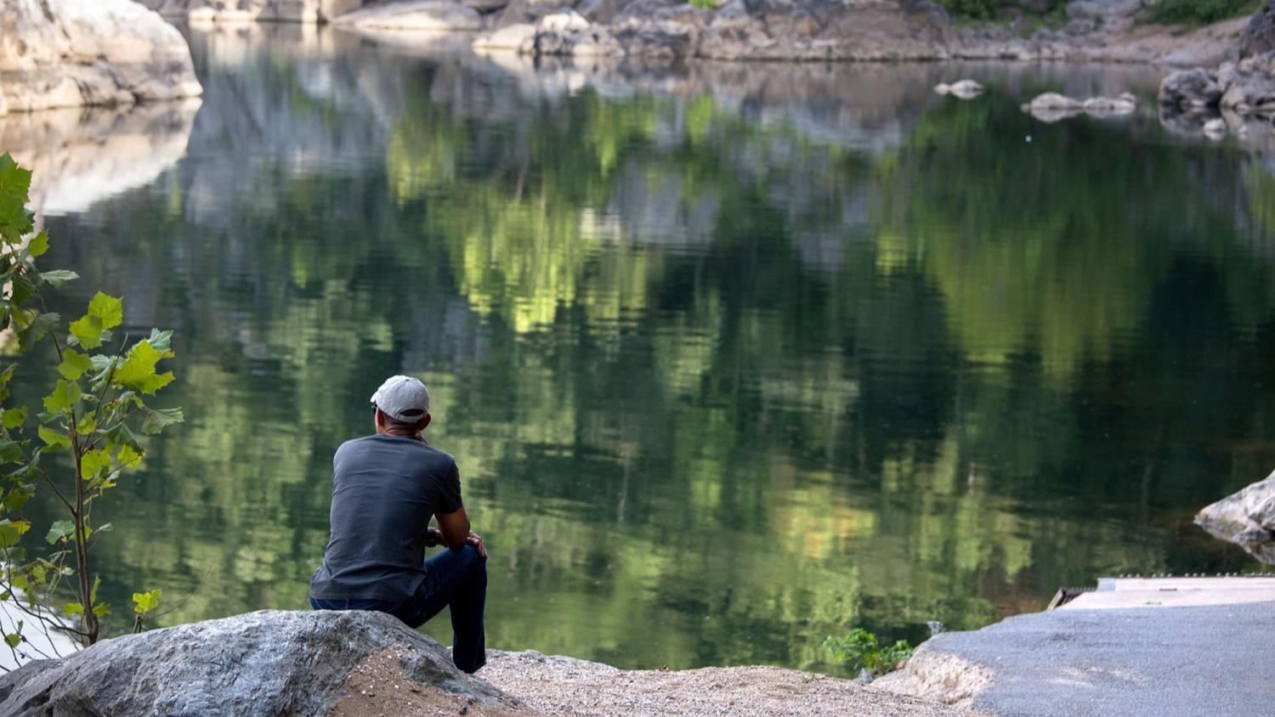
The President had gone for a hike with daughter Malia at Great Falls National Park, Va., and sat down on a rock overlooking the Potomac River on Sept. 11, 2016

Slide 46
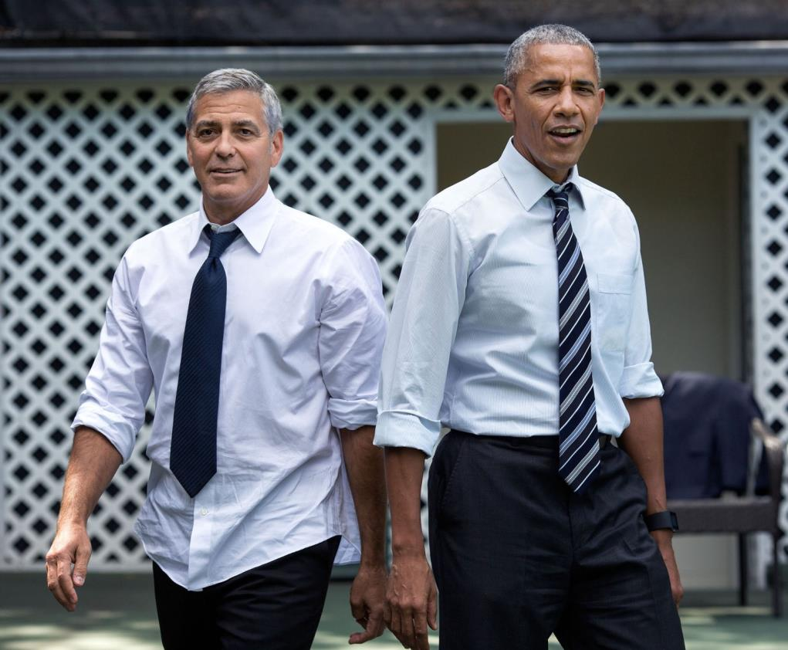
The president and George Clooney rolled up their sleeves and faced off in a game of basketball at the White House on September 12, 2016, after the actor presented a report about the president of South Sudan on Sept. 12, 2016

Slide 47
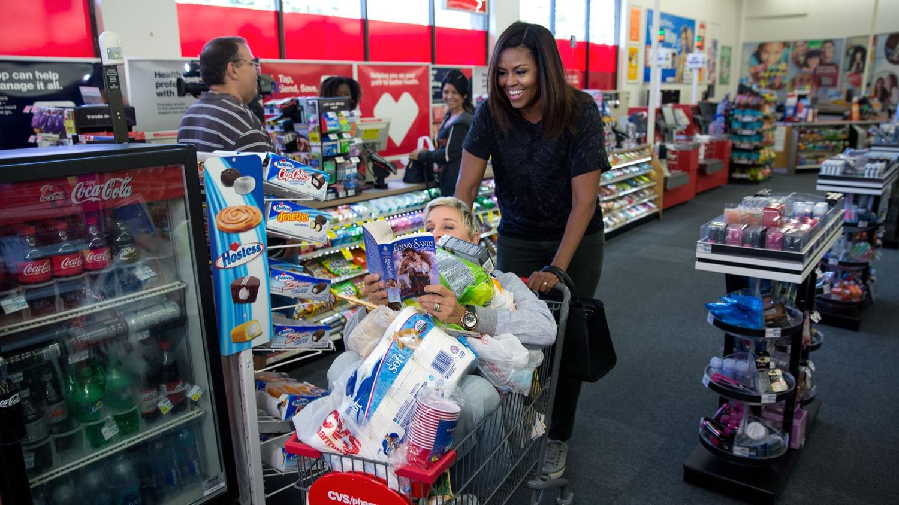
The First Lady goes shopping at a CVS Pharmacy in preparation for life after the White House during the taping for the Ellen DeGeneres Show in Burbank, California on September 12, 2016

Slide 48
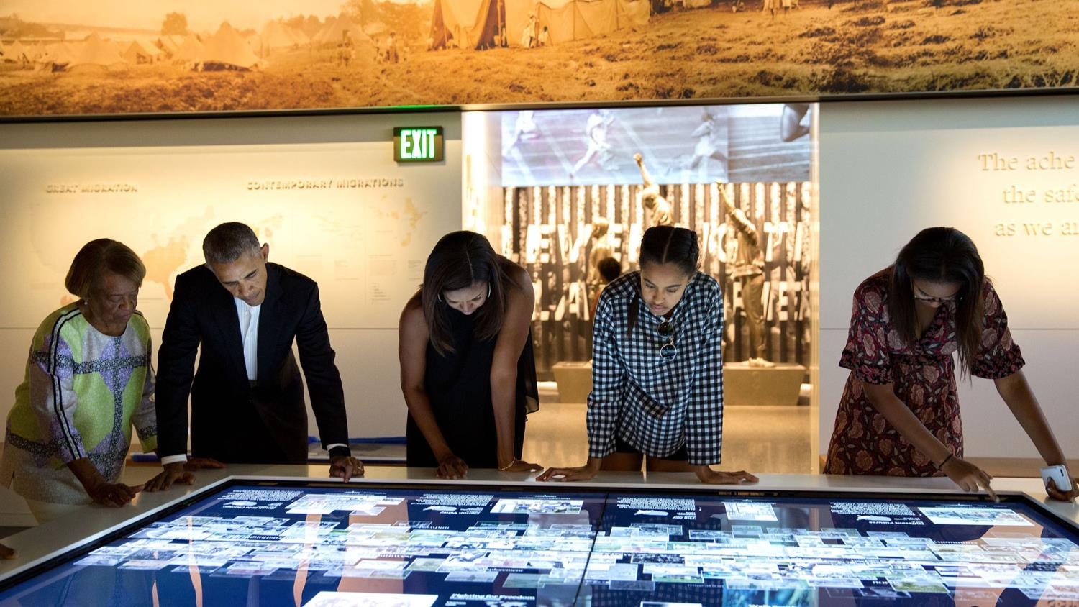
The Obamas tour the new Smithsonian National Museum of African American History and Culture on September 14, 2016

Slide 49
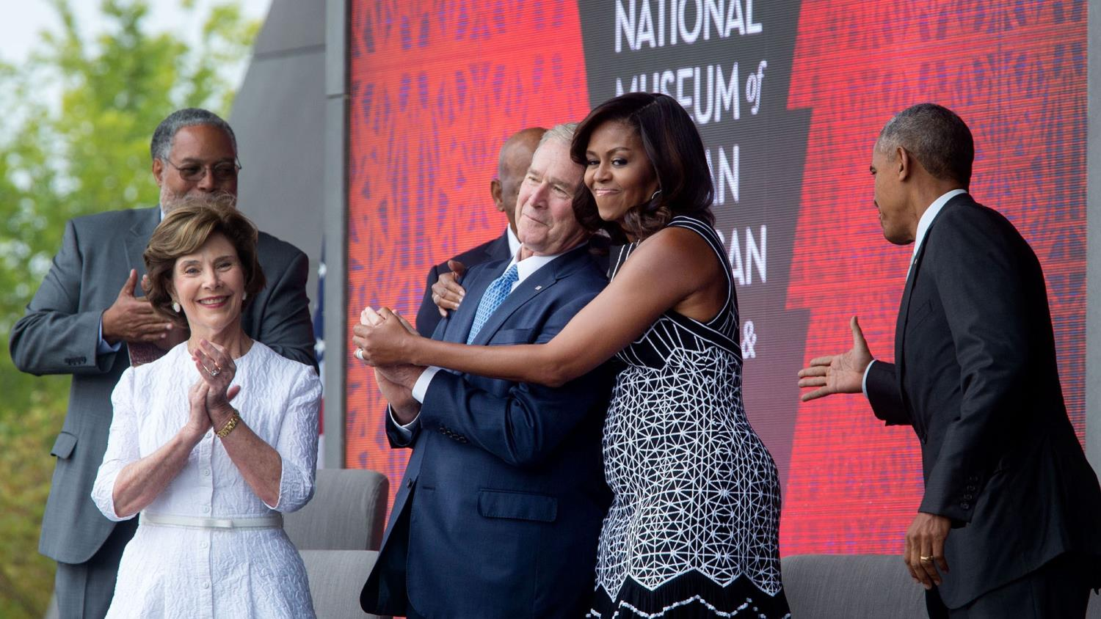
The First Lady hugs George W. Bush on stage during the opening ceremony of the National Museum of African American History and Culture on September 24, 2016

Slide 50
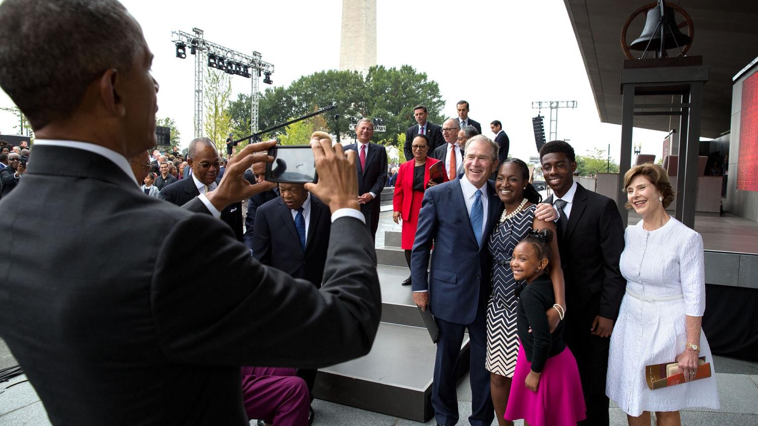
Obama stepped in and took a photo of Bush, former First Lady Laura Bush, and the Bonner family at the museum's opening on Sept. 24, 2016

Slide 51

Lego men were set up during the event South by South Lawn, an event based on the festival South by Southwest. This photo was Obama's idea on Oct. 3, 2016

Slide 52

Souza was excited to learn The Lumineers would be performing at South by South Lawn. The photographer said he wanted to line up the White House in the background, and was caught off guard by guitarist Stelth Ulvang to jump on top of one of the speakers on Oct. 3, 2016

Slide 53

Souza, who snapped this photo on October 14, said: 'My favorite months in the Oval Office are late fall to early winter when occasionally the afternoon light will be at just the right angle to create some interesting backlight if the President is working at the Resolute Desk‘. Oct. 14, 2016

Slide 54

Souza said there was almost no light remaining at the end of the day when Barack and Michelle toasted the White House staff on October 14. But the light creates an interesting silhouette with the Washington Monument between them. Oct. 14, 2016

Slide 55

Vice President Biden and Dr. Jill Biden share a laugh with Attorney General Loretta Lynch and husband Stephen Hargrove while riding a trolley to the Italian State Dinner on Oct. 18, 2016

Slide 56

Bill Murray stopped by the White House to be honored as the recipient of the Mark Twain Prize for American Humor. The president, a Chicago White Sox fan, laughed at Murray's Cubs gear and the two filmed a public service announcement to sign up for the Affordable Care Act on Oct. 21, 2016

Slide 57

The President was about to welcome local children for Halloween trick-or-treating when he ran into Superman Walker Earnest, son of Press Secretary Josh Earnest and told the boy to flex his muscles on Oct. 31, 2016

Slide 58

The president is called on to sign memorabilia at every public event, as he signed a photo at an event for Hillary Clinton in Columbus, Ohio on November 1, 2016

Slide 59

Despite being a Chicago White Sox fan, Obama called Chicago Cubs manager Joe Maddon from Air Force One, congratulating him on the World Series win. Listening in on the call is Deputy Chief of Staff Anita Decker Breckenridge on Nov. 3, 2016

Slide 60

Obama, surrounded by Secret Service agents, walks across the tarmac to greet a crowd at the North Carolina Air National Guard Base in Charlotte during the sunset on November 4, 2016

Slide 61

The president dropped to his hands and knees to play with Evelyn Cushman, daughter of Chase Cushman, Director of Scheduling and Advance on Nov. 8, 2016

Slide 62

This image of the White House, captured on election day, shows the North Portico lit up with the moon in the background Nov. 8, 2016

Slide 63

The president wanted to speak to Press Secretary Josh Earnest the morning after the elections, and told him to bring the team with him, thinking it was just a few people, Instead, he addressed the entire communications, speechwriting and research team, with some members look crestfallen on Nov. 9, 2016

Slide 64

Two days after the election, the President meets with President-elect Donald Trump on Nov. 10, 2016

Slide 65

Obama made time for six-year-old Alex Myteberi, who wrote a letter to the president after seeing a heart-breaking photograph of Syrian refugee Omran Daqneesh covered in blood and dust after an air strike on Aleppo. He asked Obama to bring Daqneesh to his home in a moving letter the president read to the United Nations on Nov. 10, 2016

Slide 66

Bill Mohr, the oldest living World War II veteran at 108 years old, met Obama during a Veterans Day breakfast. Mohr passed away shortly after, and his family said 'meeting a sitting President was the fulfillment of a lifelong dream' for the veteran on Nov. 11, 2016

Slide 67

The president decided to walk instead of motorcade back to his hotel in Berlin, Germany on November 17, 2016. Obama tried to get the Brandenburg Gate in the background as Obama shook hands with local police on Nov. 17, 2016

Slide 68

Souza said the president called him the Azorean, since the photographer's grandparents were born in the Azores, an autonomous region of Portugal. During a visit, Obama said he would disembark so he could take a picture there. souza said: 'This may not be one of the best photographs of the year, but I took some personal license to include it‘ Nov. 18, 2016

Slide 69

Obama brings it in for Bruce Springsteen in the Blue Room before the Presidential Medal of Freedom ceremony on November 22, 2016

Slide 70

President Obama leads a prayer before hosting Thanksgiving dinner for family and friends on the State Floor of the White House on Nov. 24, 2016

Slide 71

Souza captured the 2016 Kennedy Center Honorees in the Green Room. Pictured from left, members of the Eagles, musician James Taylor, gospel and blues singer Mavis Staples, screen and stage actor Al Pacino, and Argentine pianist Martha Argerich on Dec. 4, 2016

Slide 72

Eddie, Yao
Staff members pulled a prank on Obama and moved four snowmen figures closer and closer to the Oval Office after the president admitted he found the decorations 'creepy‘ on Dec. 16, 2016

Slide 73

December 31, 2016 王文堯 Kaohsiung Taiwan R.O.C
All photos were taken from The White House.
Music : Secret Garden - Song At The End Of The Day
President Obama, along with Japan's Prime Minster Shinzo Abe, toss flowers at the wishing well of the USS Arizona Memorial in Pearl Harbor, Hawaii on December 27, 2016
THE END

Slide 74







¿Te ha gustado?
Puedes ver más entrando
Aquí
Además puedes recibir powerpoints en tu correo electrónico suscribiéndote aquí:

