Slide 1
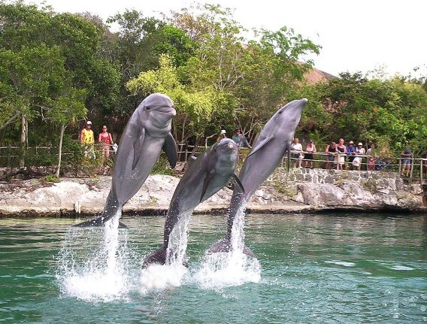


Welcome To My World
Jim Reeves
Welcome To My World
Powerpoint René

Slide 2
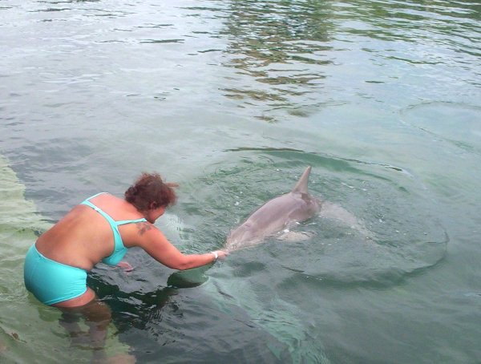
Welkom to my World

Slide 3
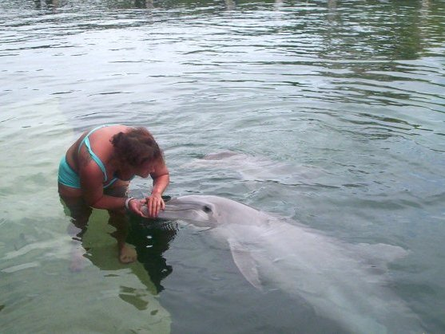
Won’t you come on in

Slide 4
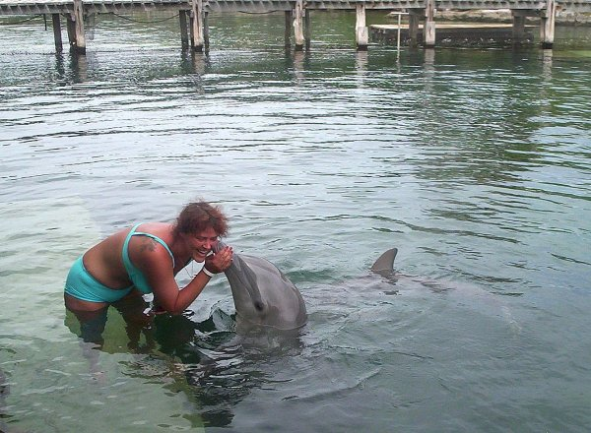
Miracles i guess

Slide 5
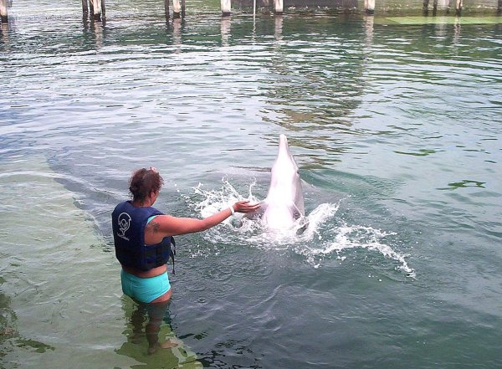
Still happen now and then

Slide 6
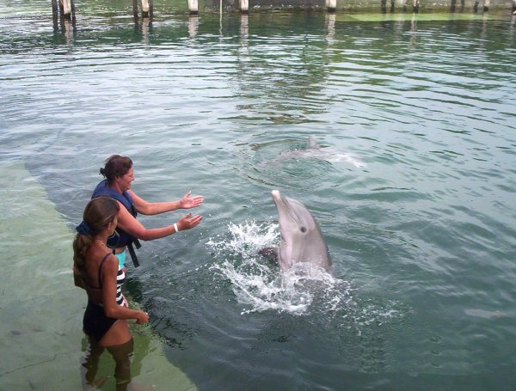
Step into my heart

Slide 7
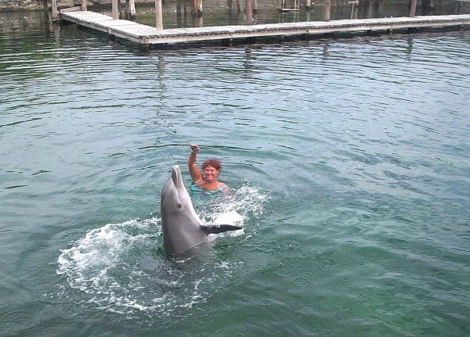
Leave your cares behind

Slide 8
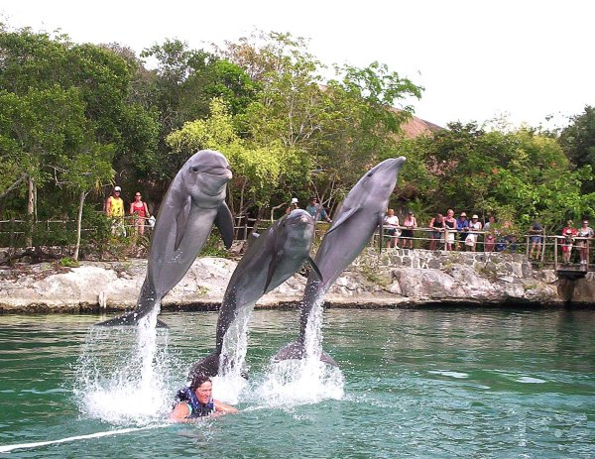
Welcome to my World

Slide 9
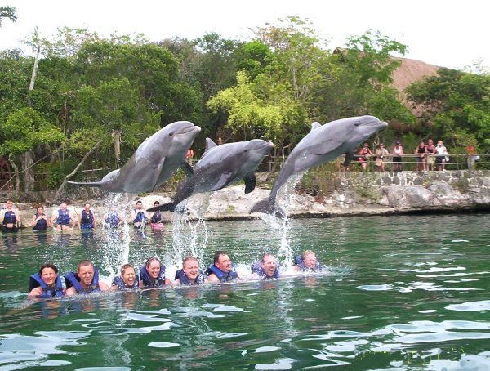
Built with you in mind

Slide 10
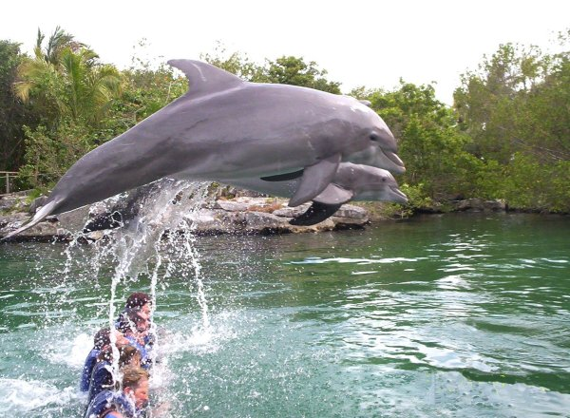
Knock and the door will open

Slide 11
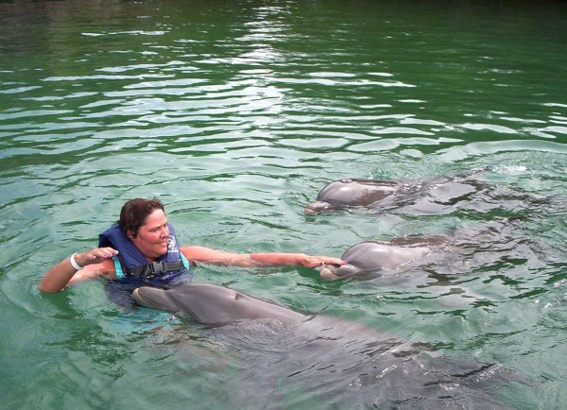
Seek and you will find

Slide 12
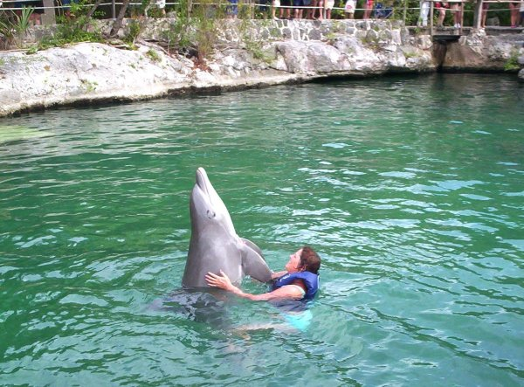
Ask and you will be given

Slide 13
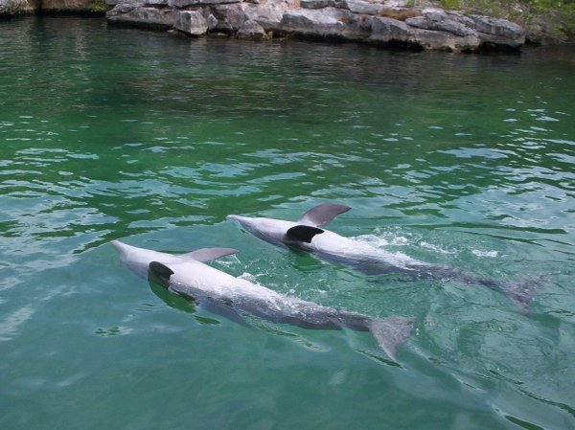
The key to this world of mine

Slide 14
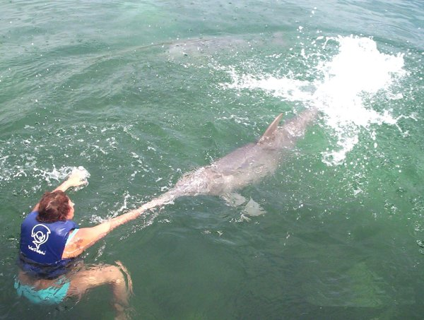
I’ll be waiting here

Slide 15
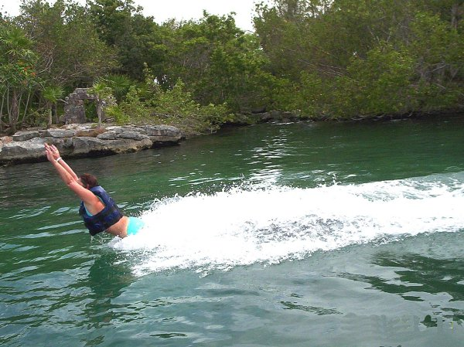
With my arms unfurled

Slide 16
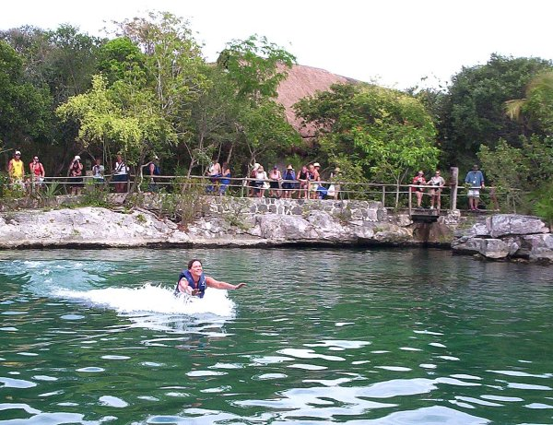
Waiting just for you

Slide 17
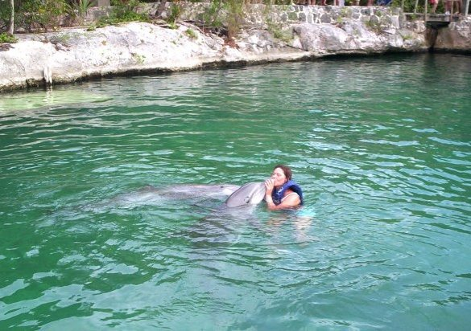
Welcome To My World

Slide 18
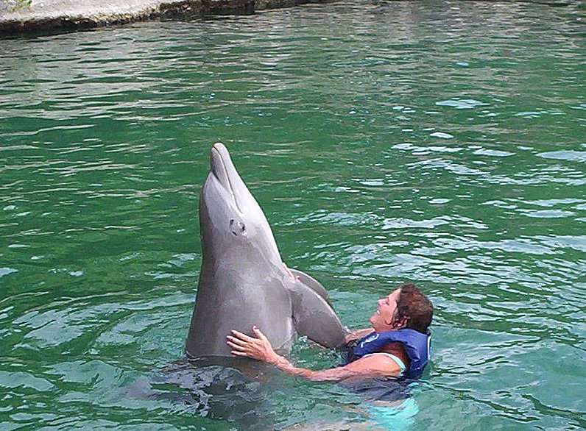

Slide 19
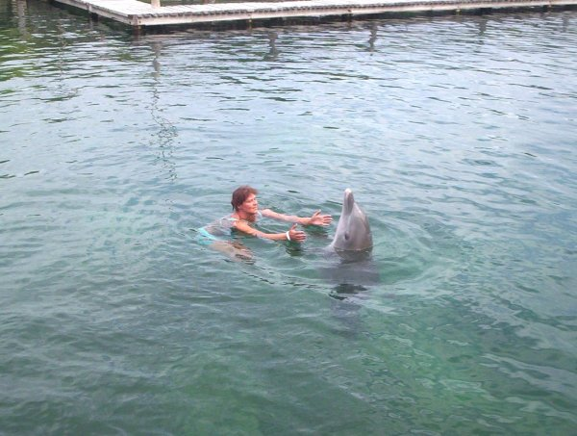

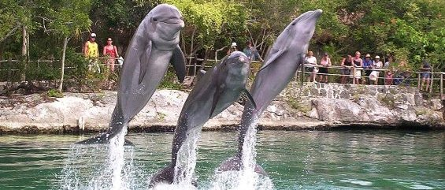
Waiting just for you
Welcome To My World
rb@telenet.be

Slide 20







¿Te ha gustado?
Puedes ver más entrando
Aquí
Además puedes recibir powerpoints en tu correo electrónico suscribiéndote aquí:

