Slide 1


UNDERWATER LIFE
1
CARIBBEAN
STEVE

Slide 2
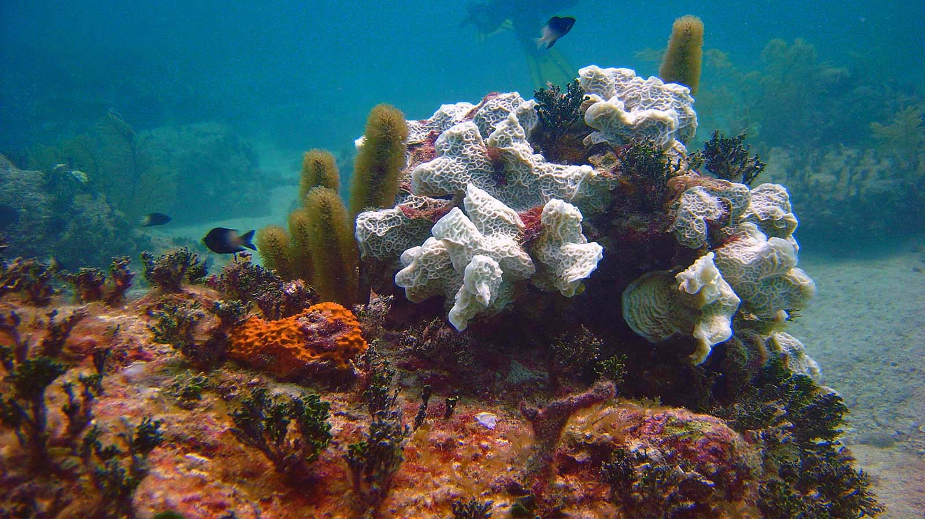

Photo © Matt Kieffer

Slide 3
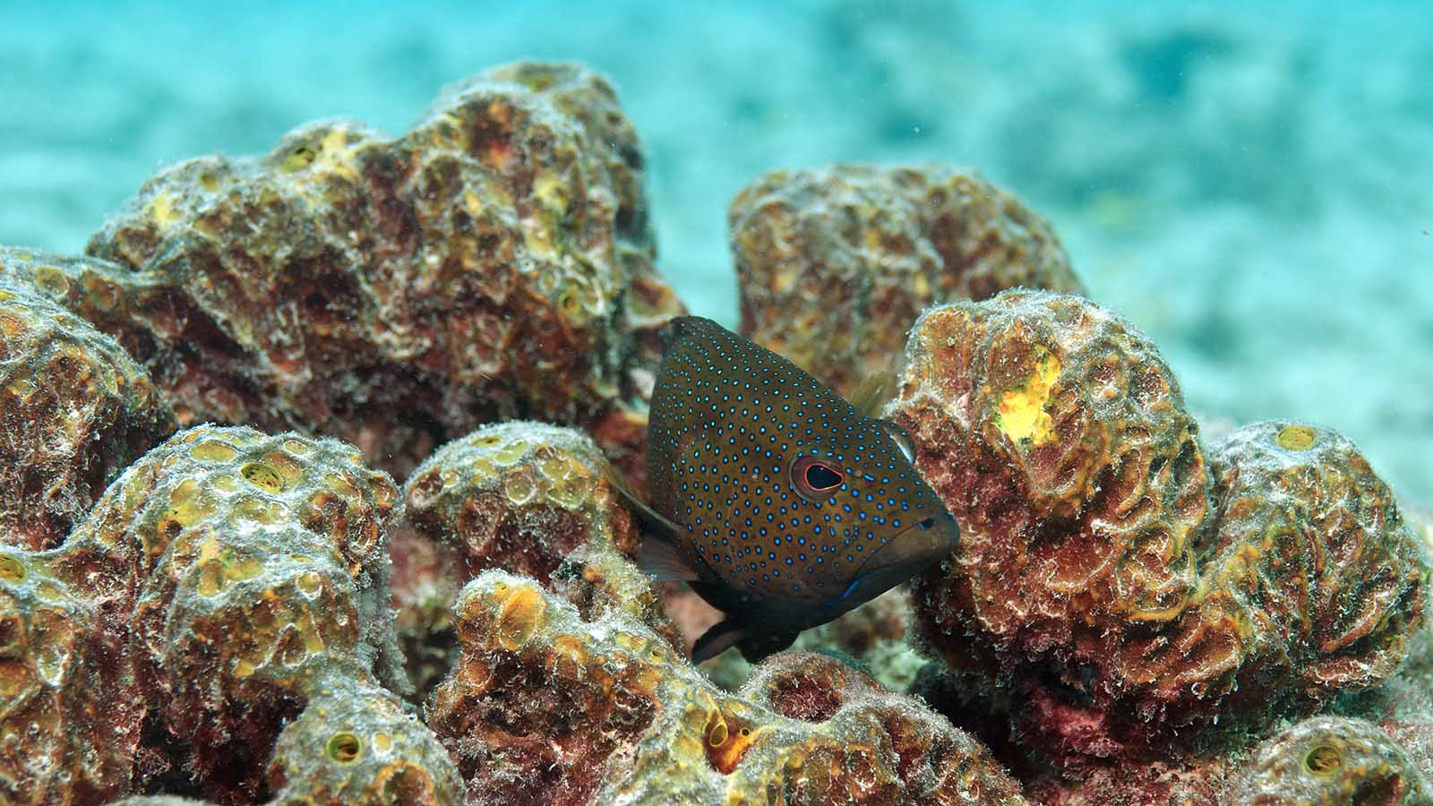
Photo © Carl

Slide 4
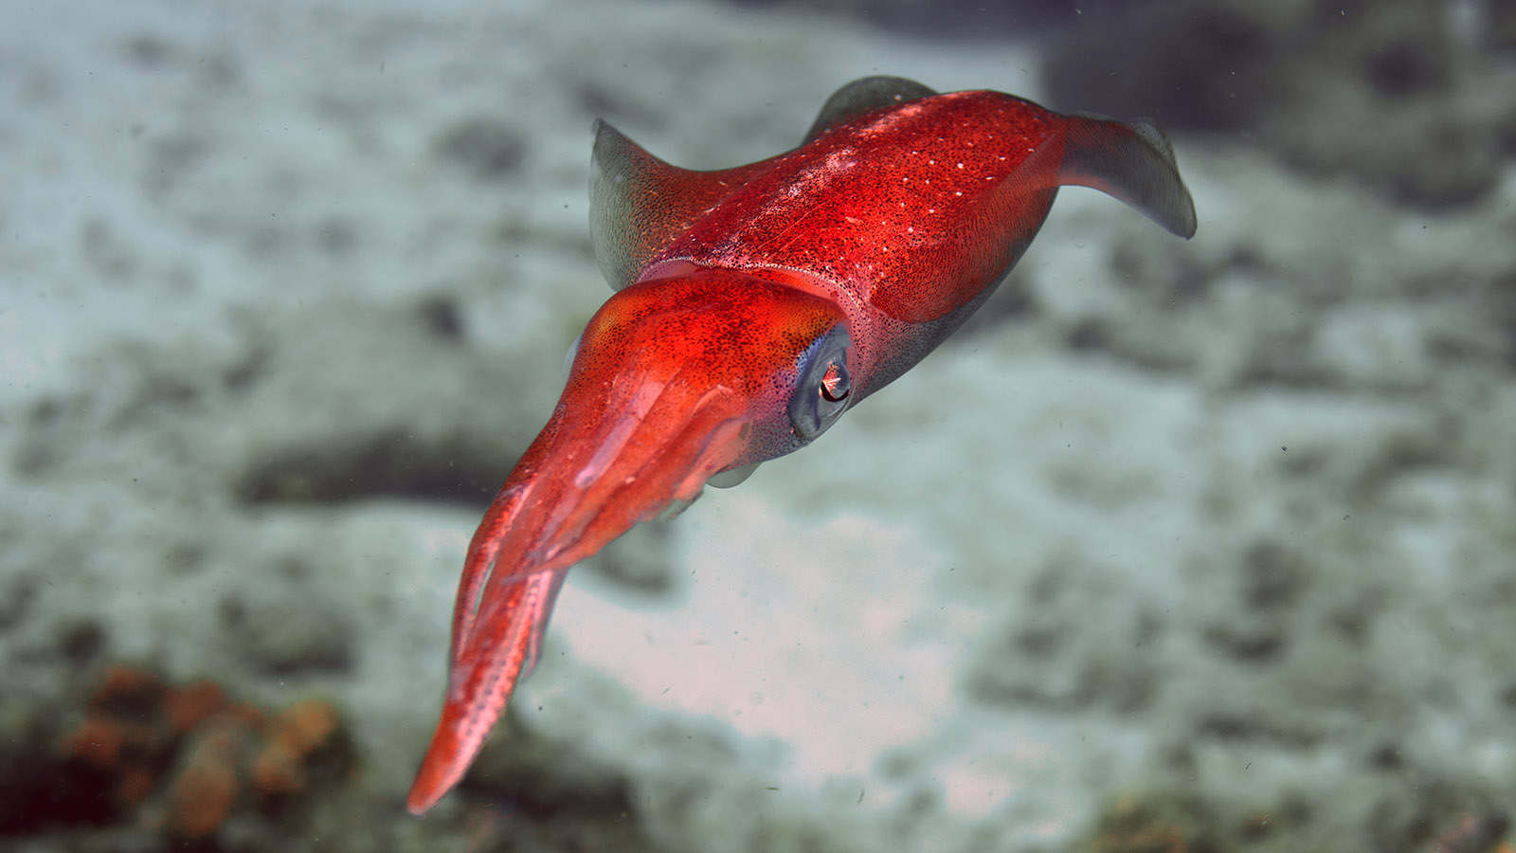
Photo © Carl

Slide 5
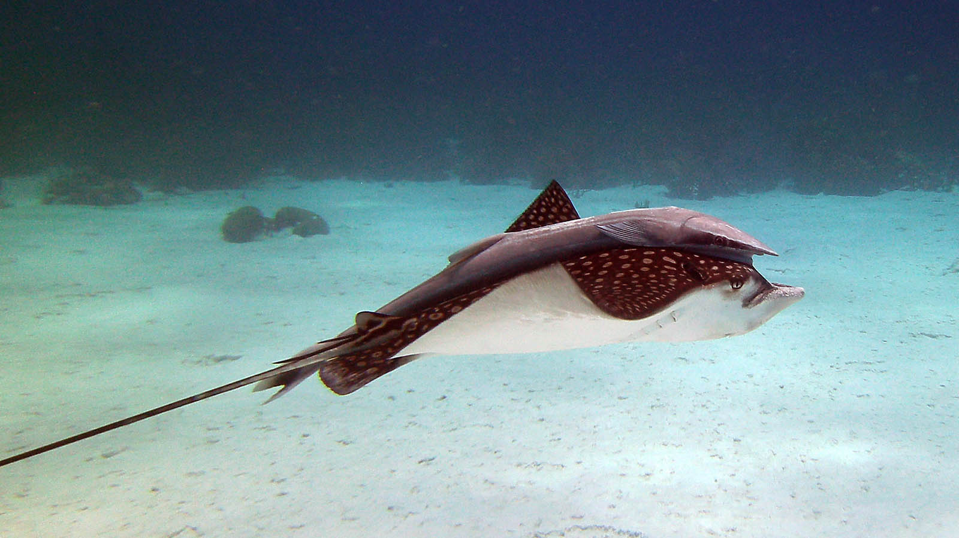
Photo © Amanda Anderson

Slide 6
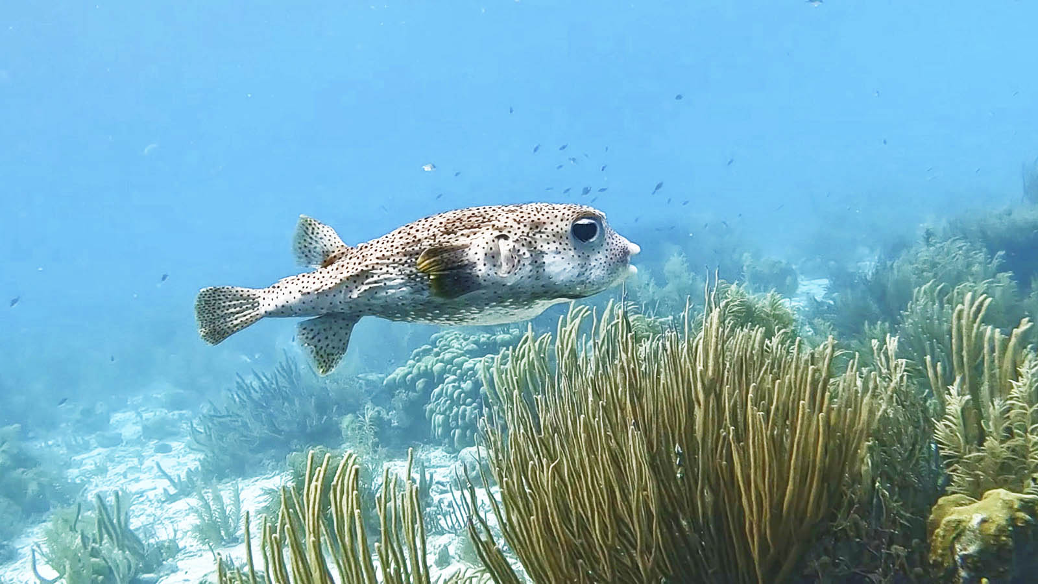
Photo © Amanda Anderson

Slide 7
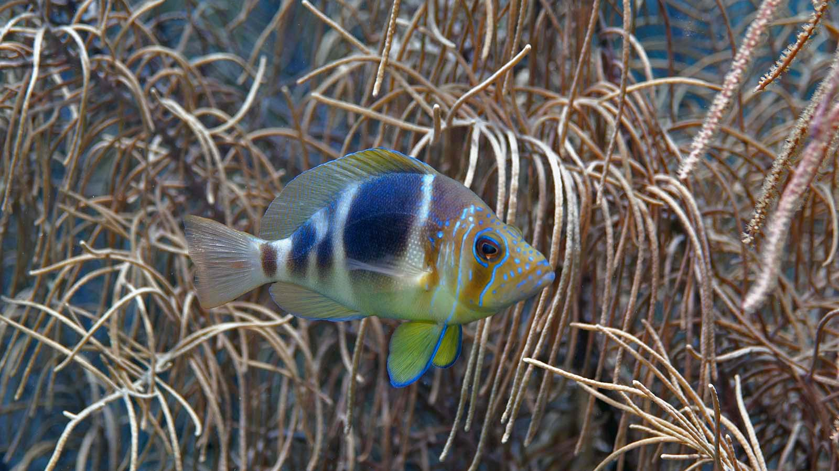
Photo © Carl

Slide 8
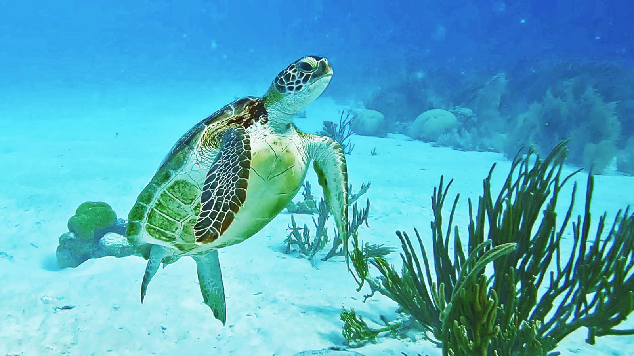
Photo © Amanda Anderson

Slide 9
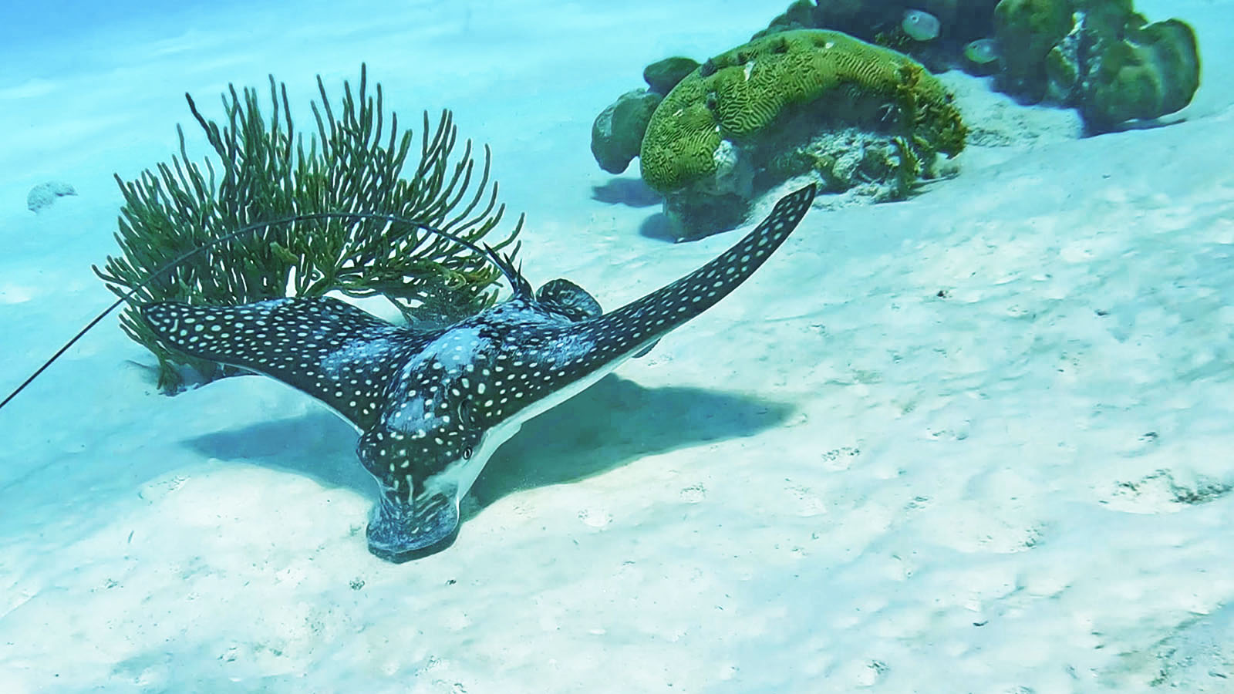
Photo © Amanda Anderson

Slide 10
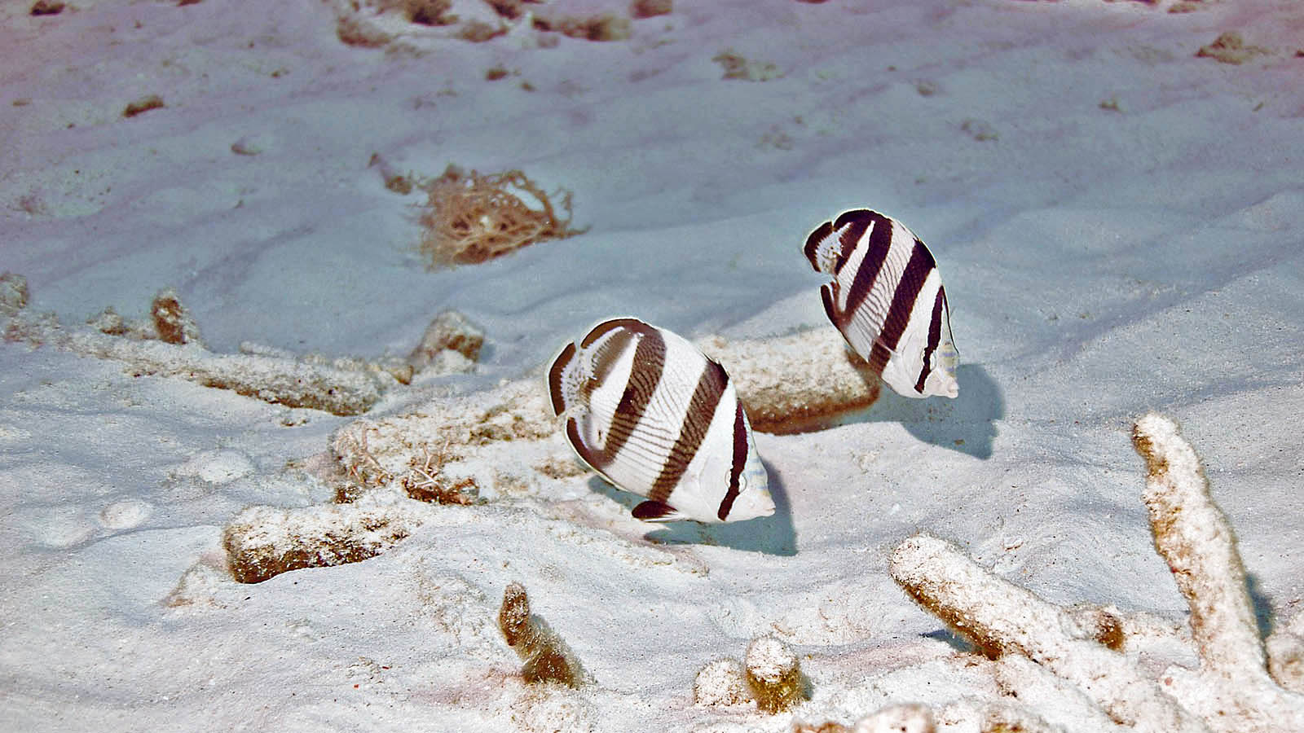
Photo © Carl

Slide 11
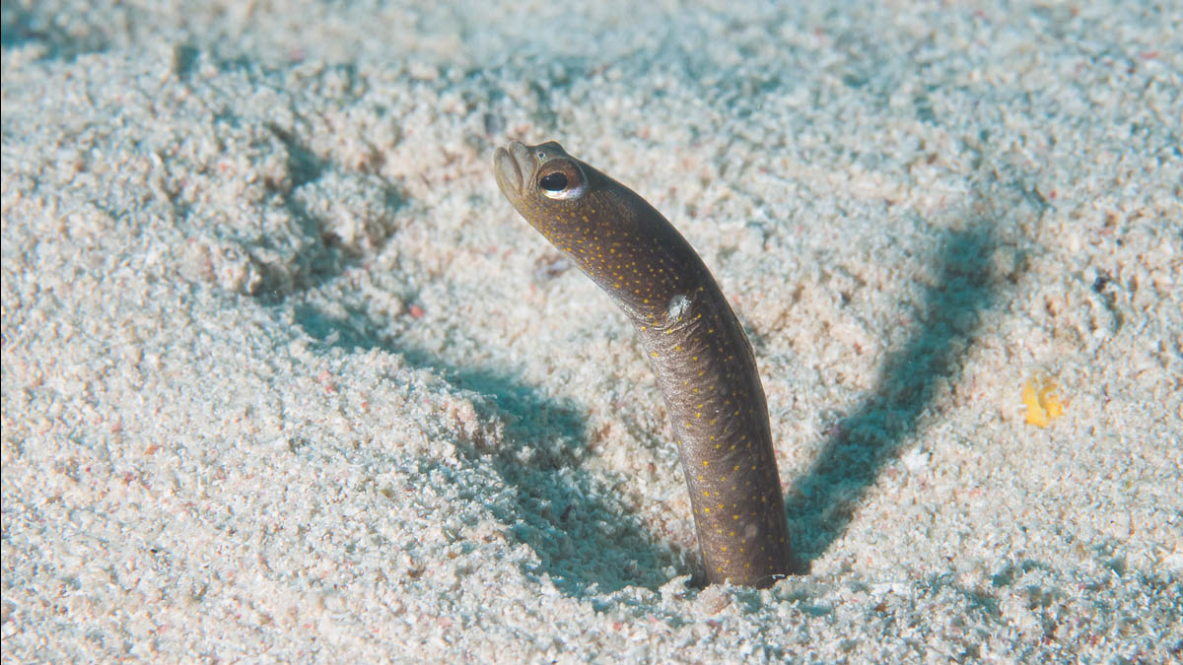
Photo © Dan Hershman

Slide 12
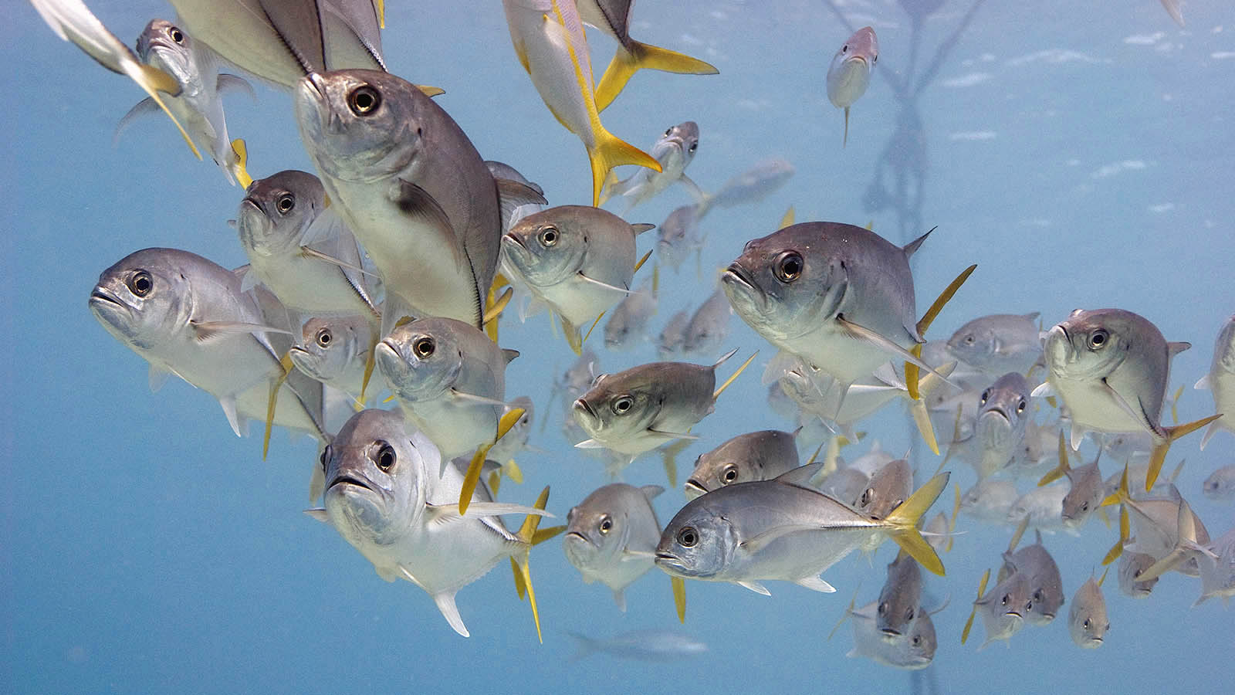
Photo © Carl

Slide 13
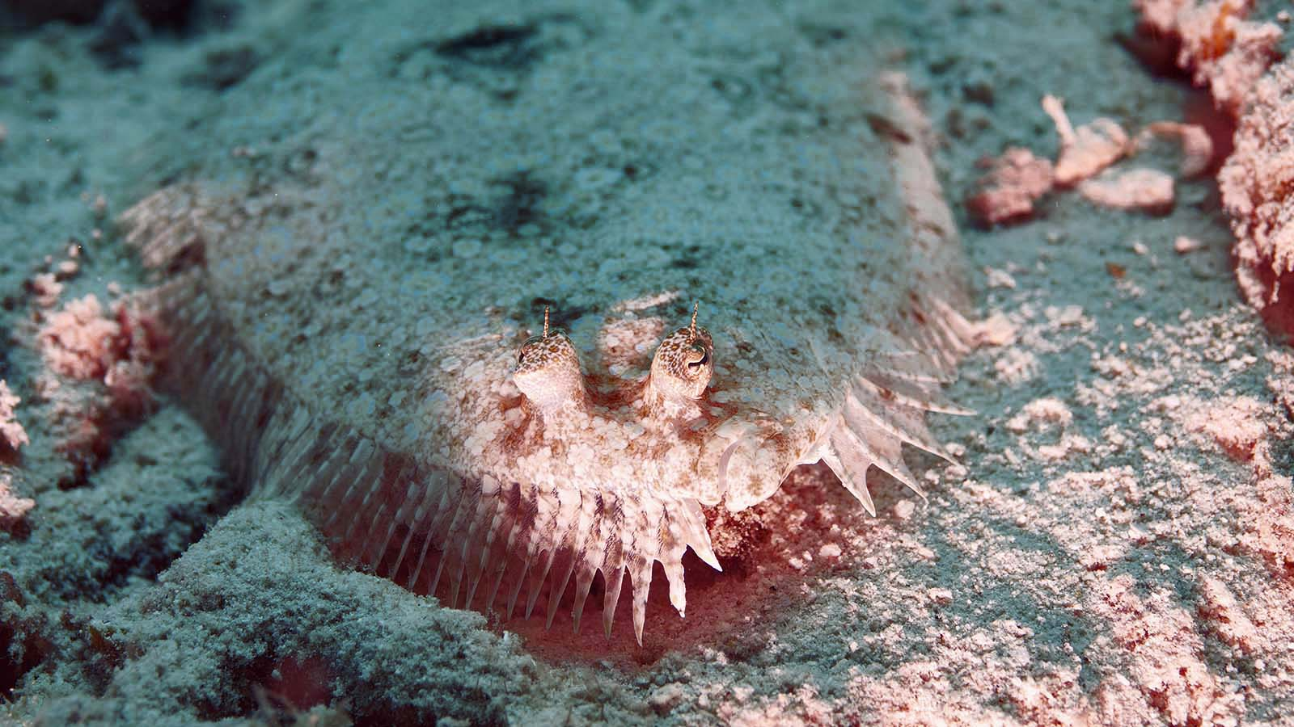
Photo © Carl

Slide 14
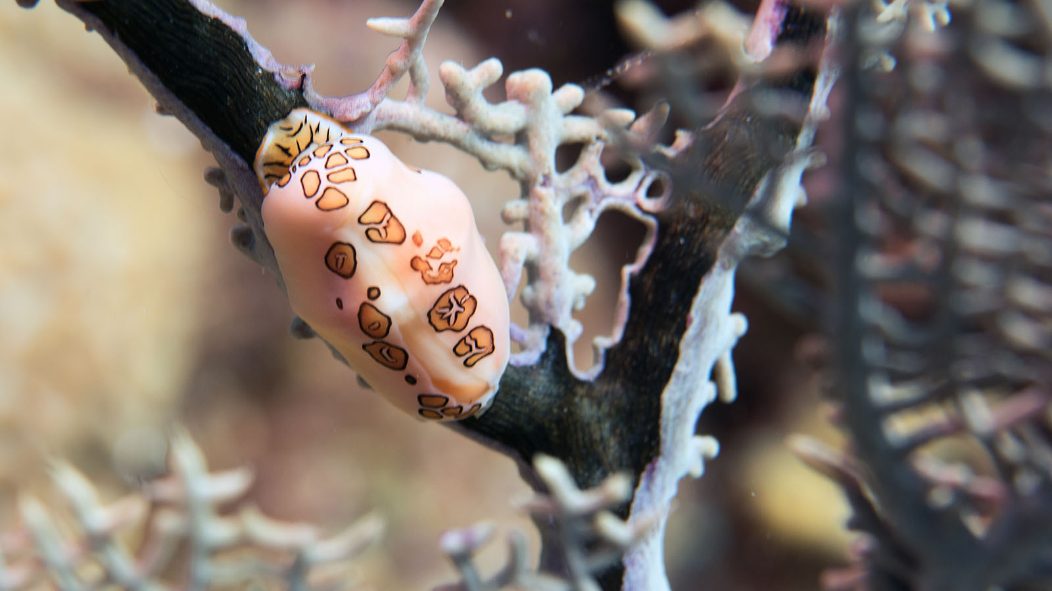
Photo © Carl

Slide 15
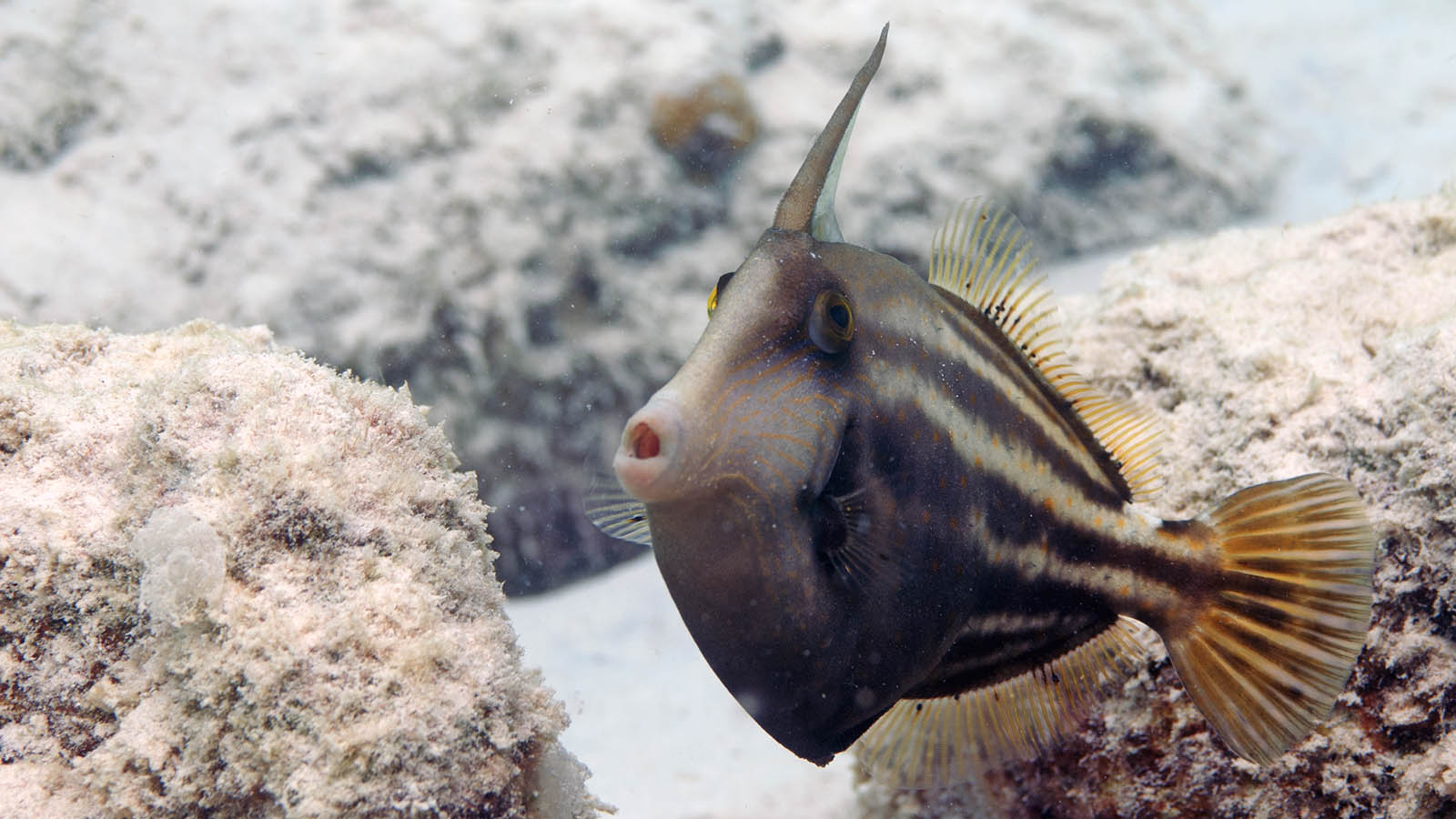
Photo © Carl

Slide 16
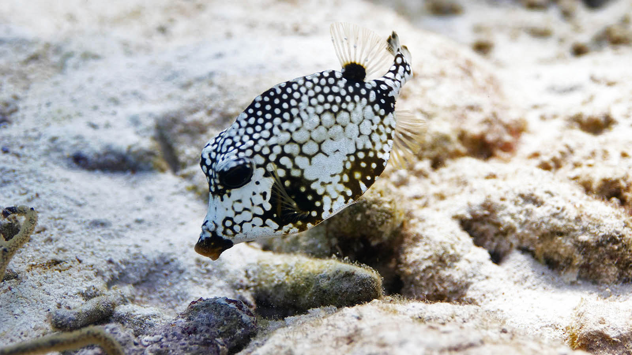
Photo © Carl

Slide 17
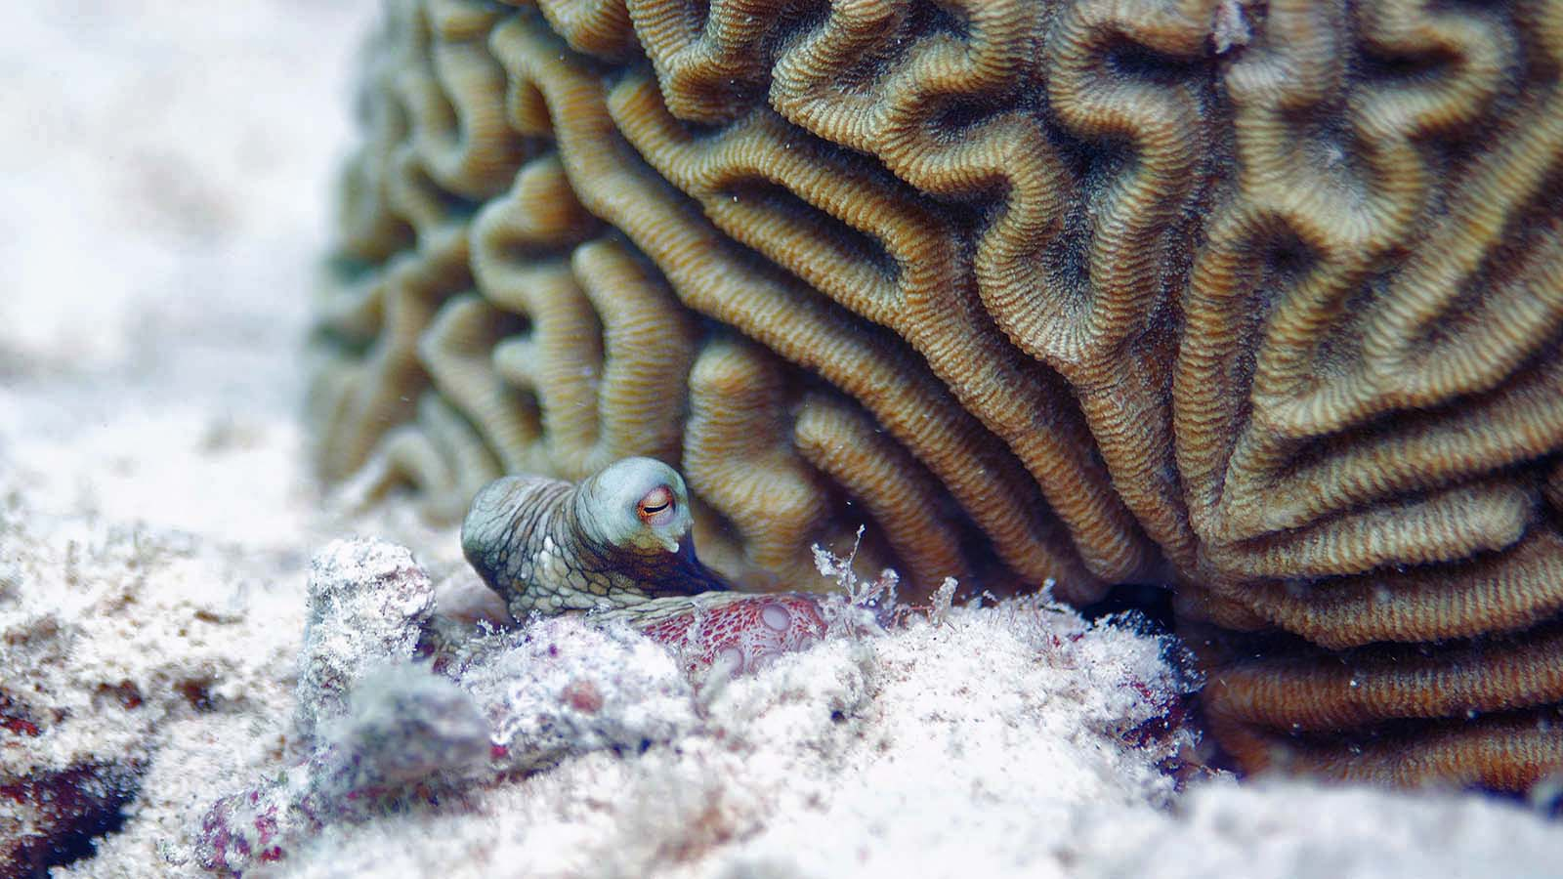
Photo © Carl

Slide 18
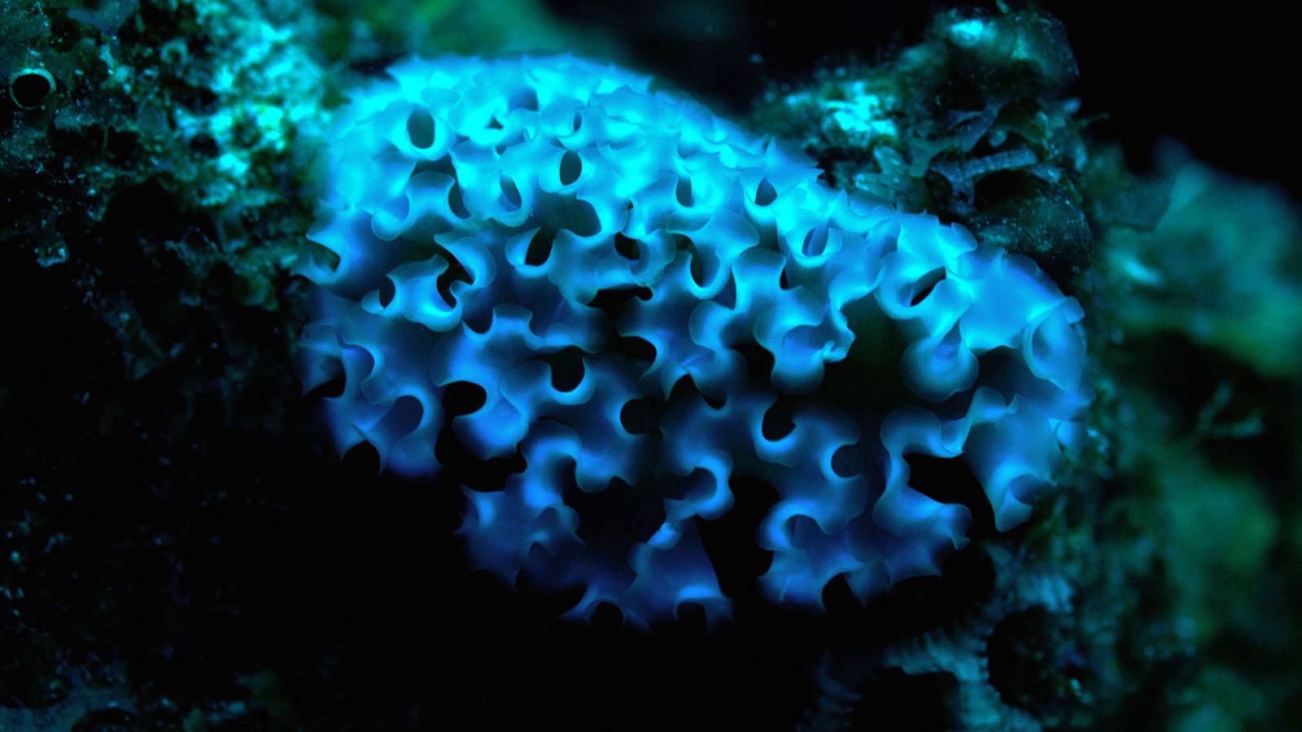
Photo © Carl

Slide 19
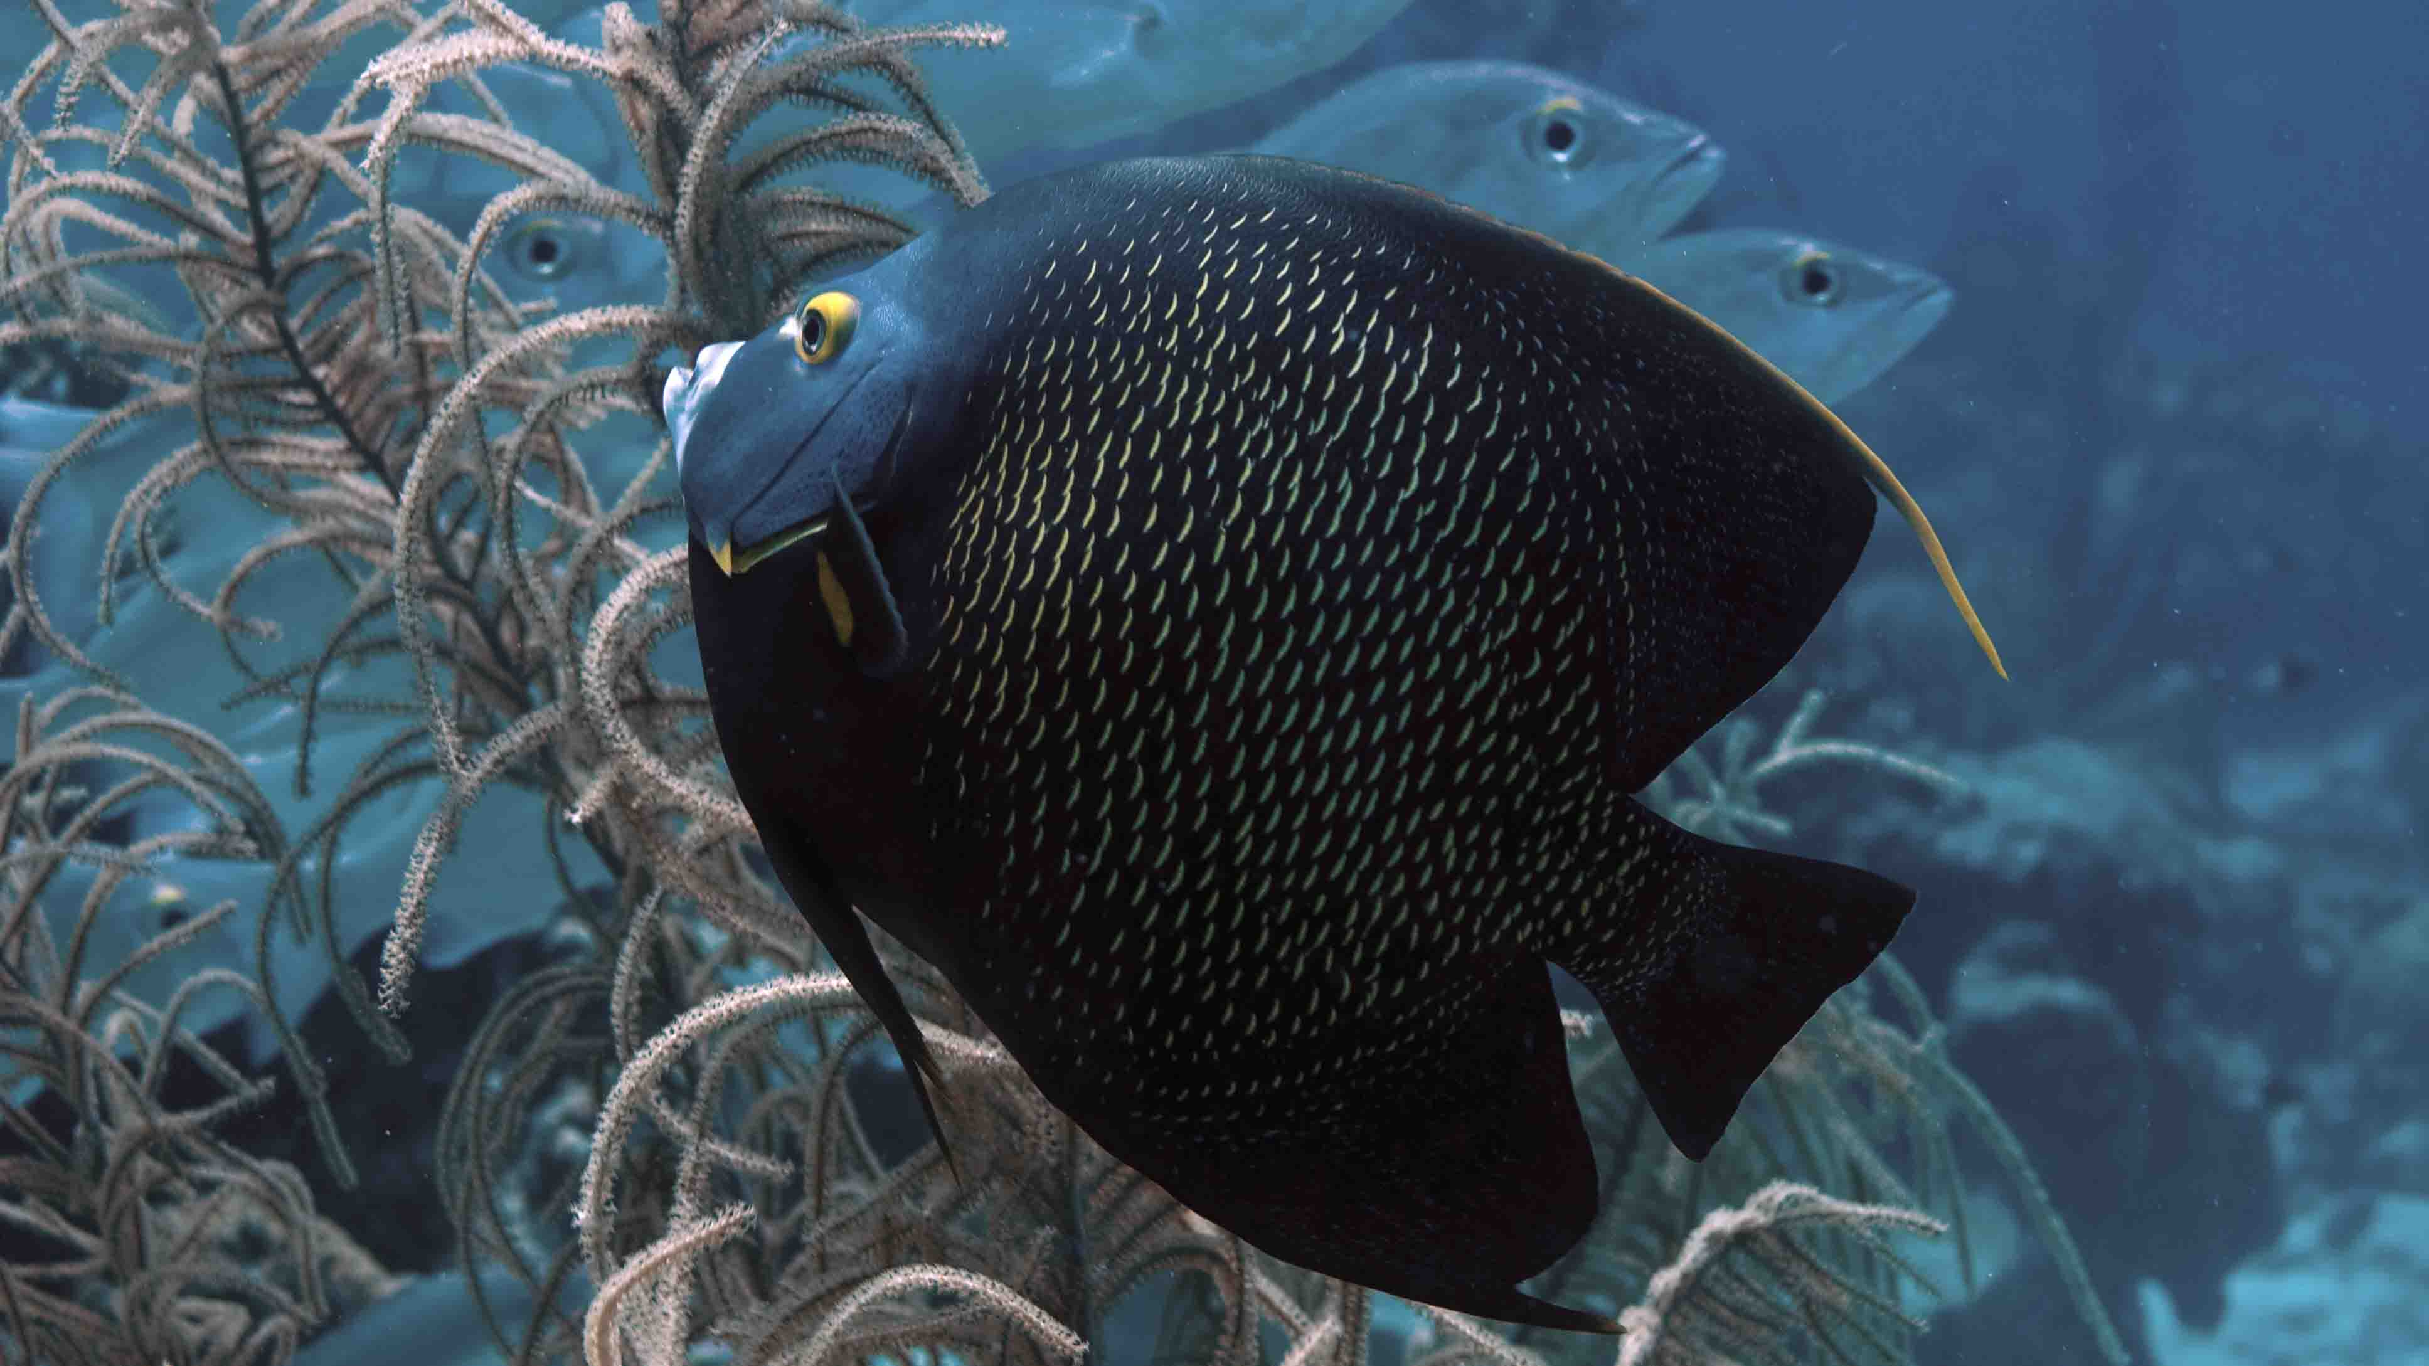
Photo © Carl

Slide 20
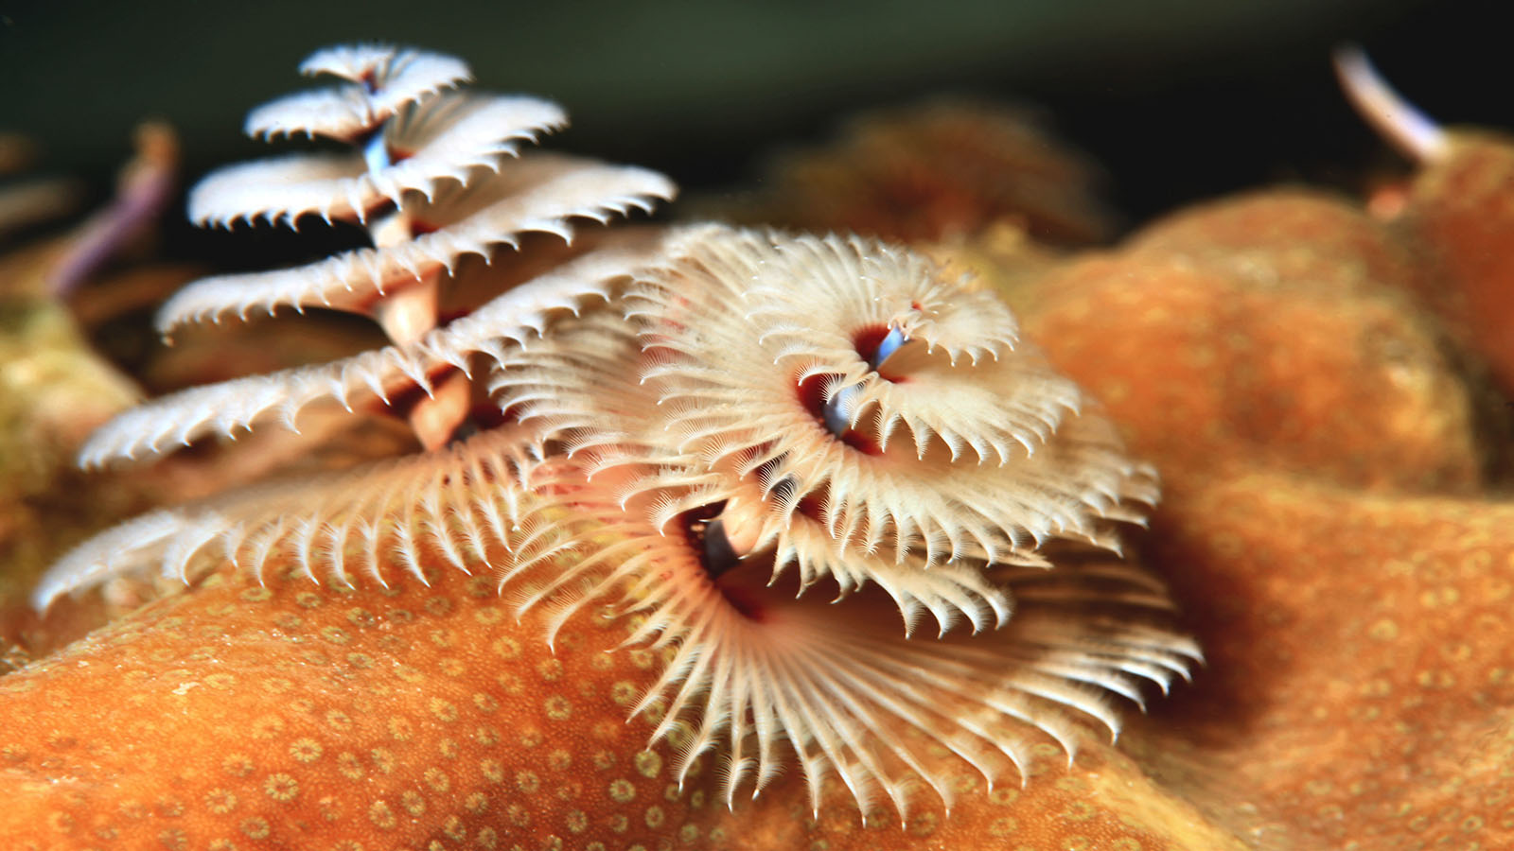
Photo © Laszlo Ilyes

Slide 21
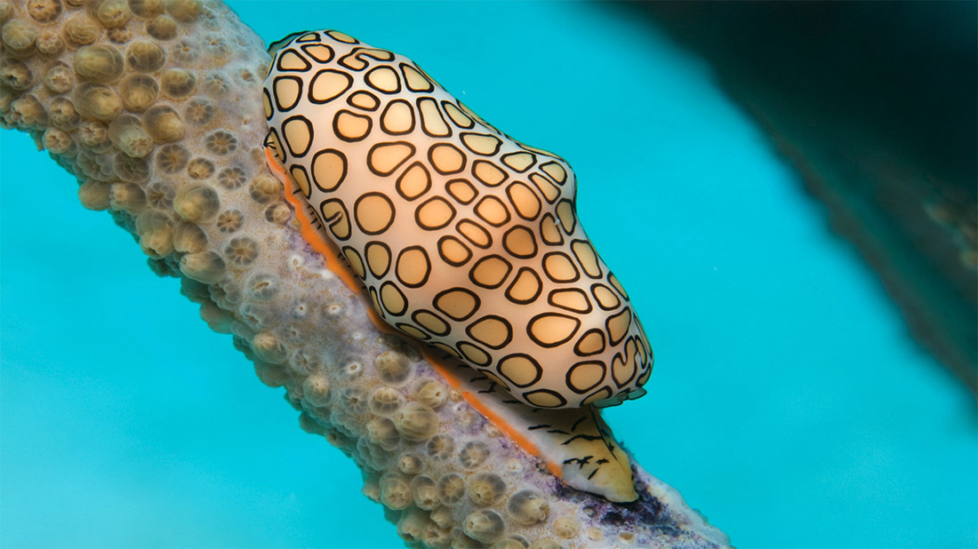
Photo © Dan Hershman

Slide 22
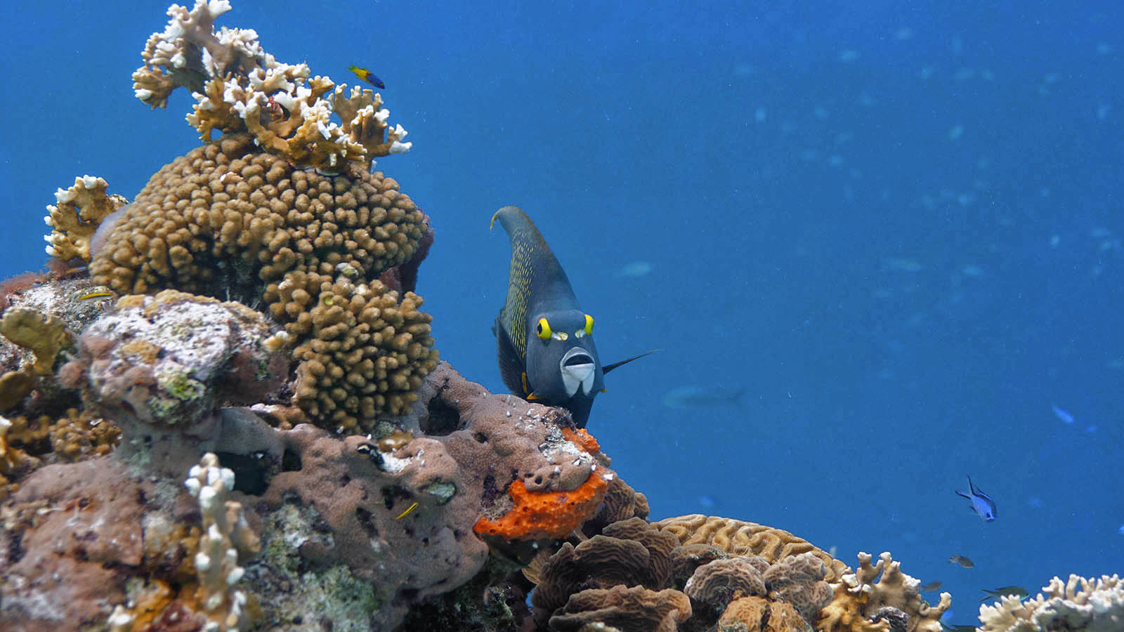
Photo © Carl

Slide 23
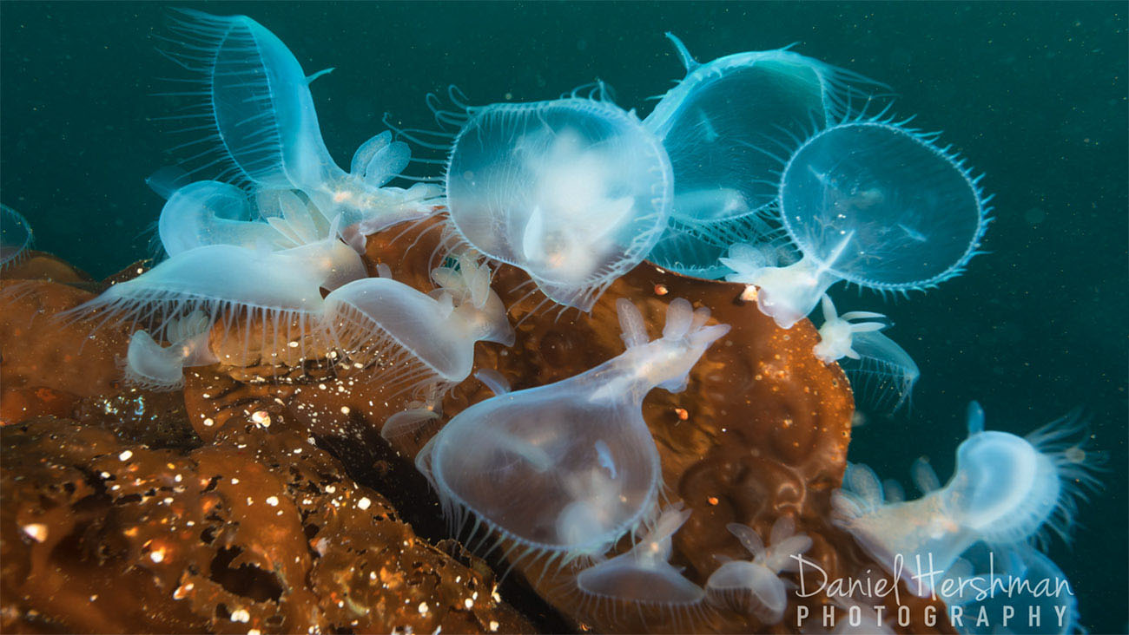
Photo © Dan Hershman

Slide 24
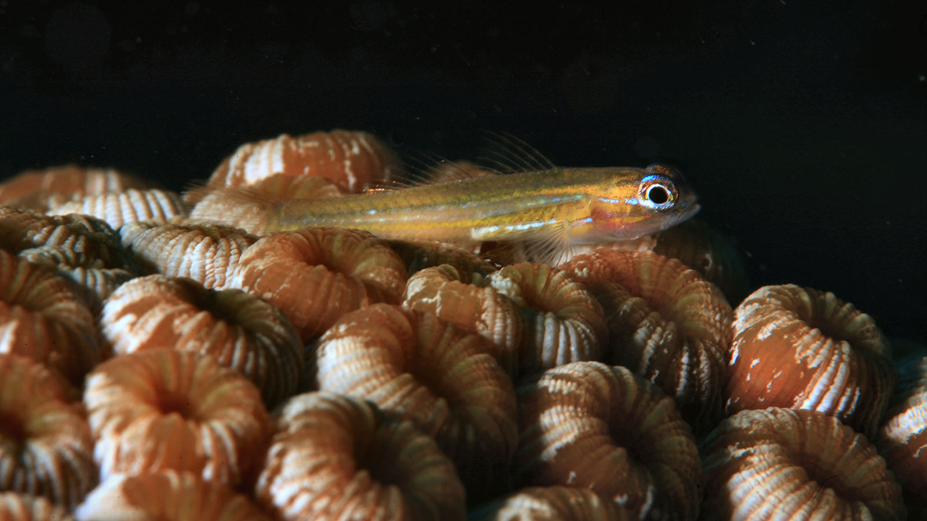
Photo © Laszlo Ilyes

Slide 25
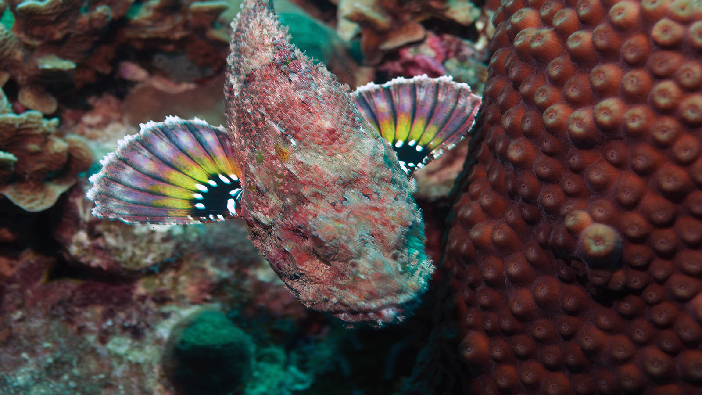
Photo © Carl

Slide 26
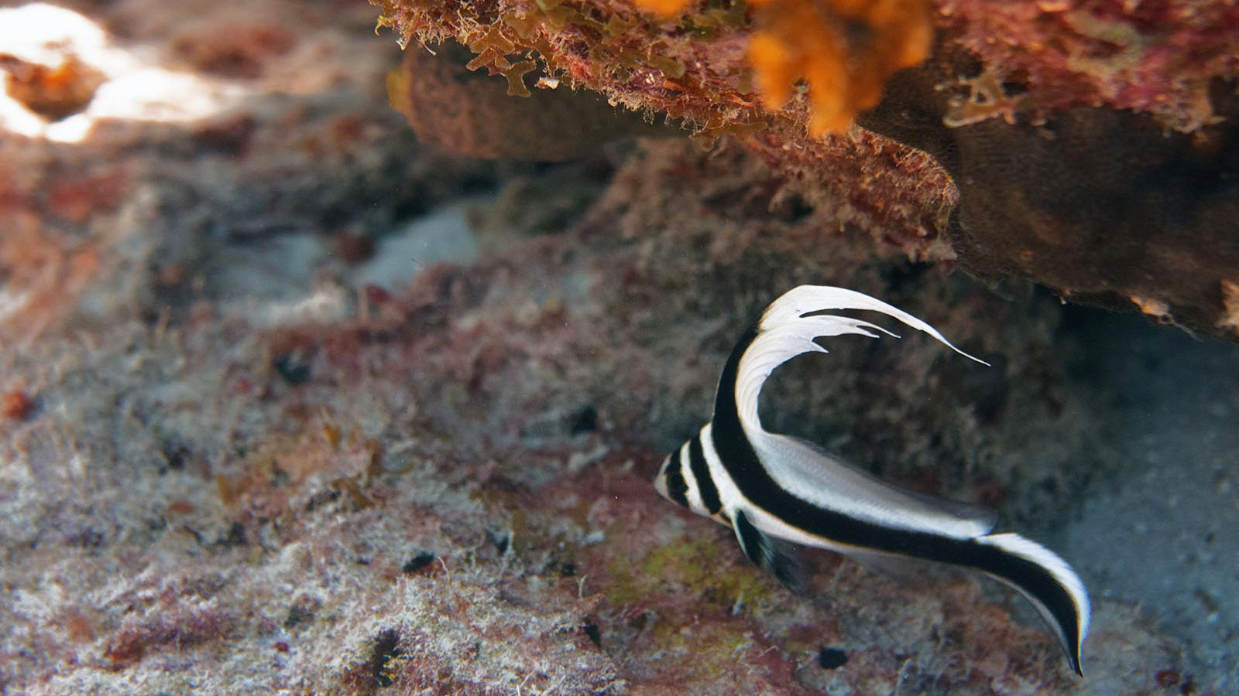
Photo © Carl

Slide 27
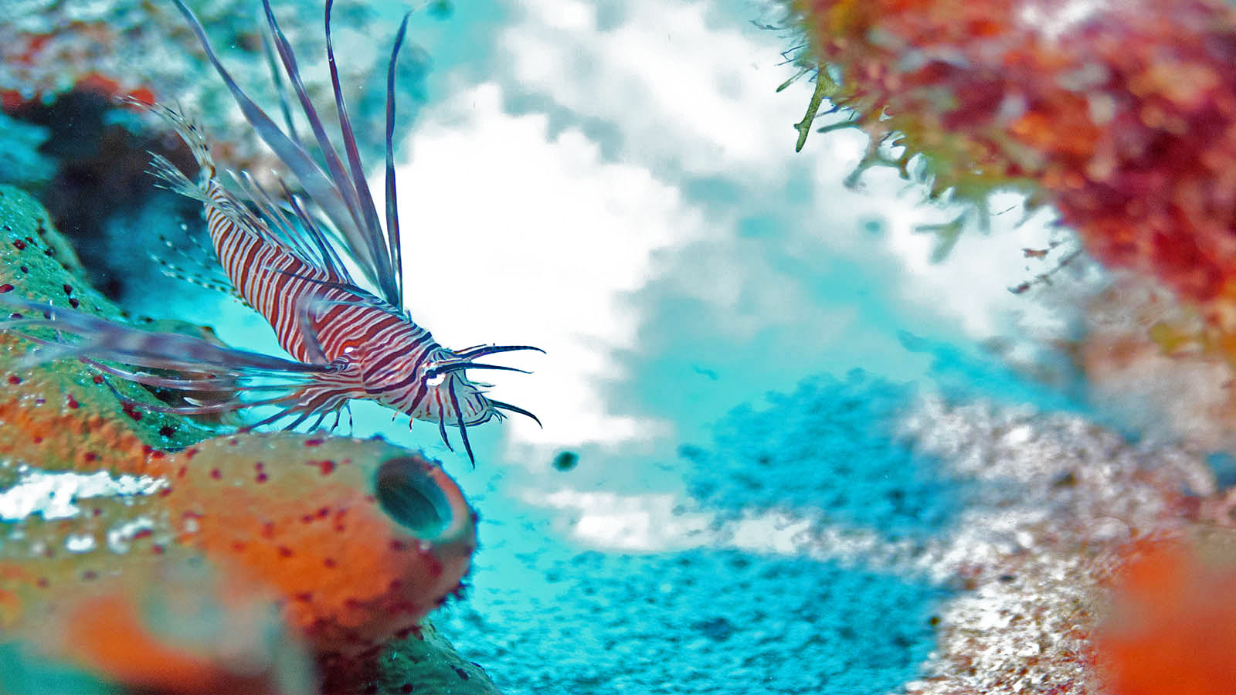
Photo © Carl

Slide 28
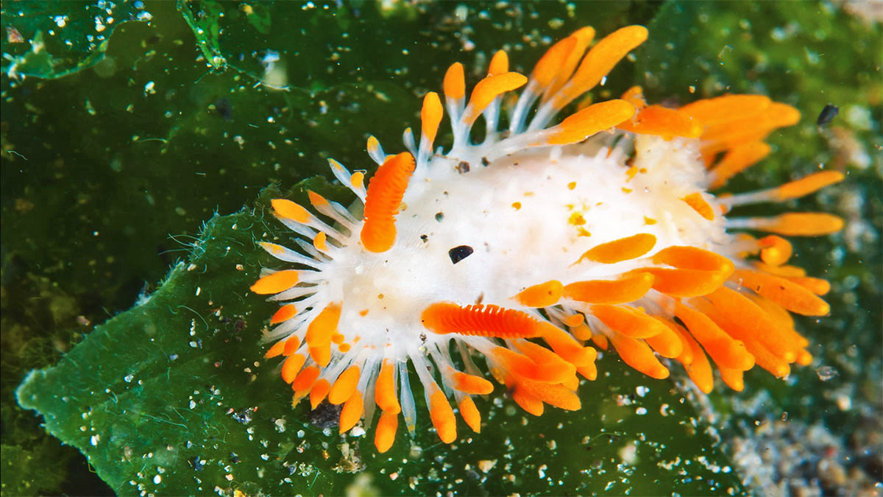
Photo © Dan Hershman

Slide 29
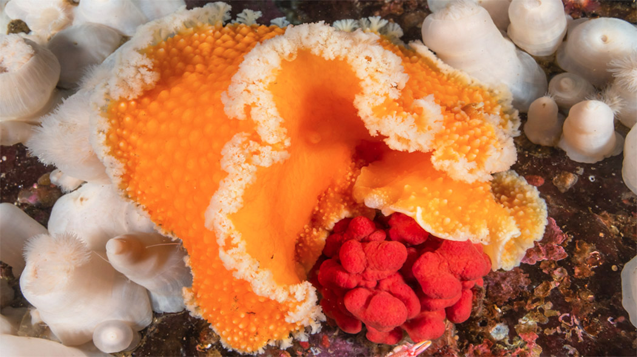
Photo © Dan Hershman

Slide 30
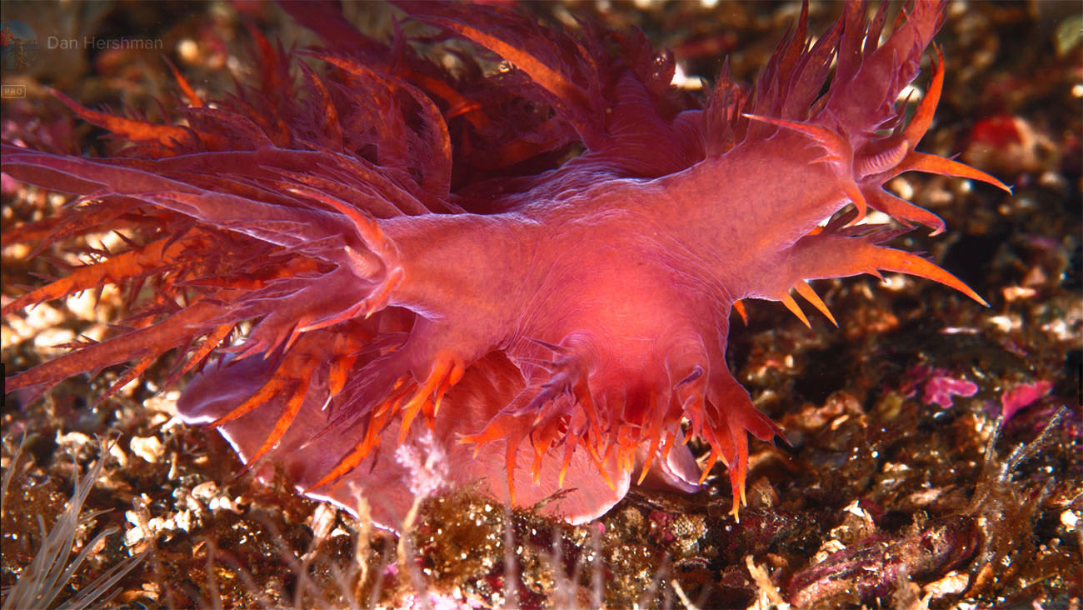
Photo © Dan Hershman

Slide 31
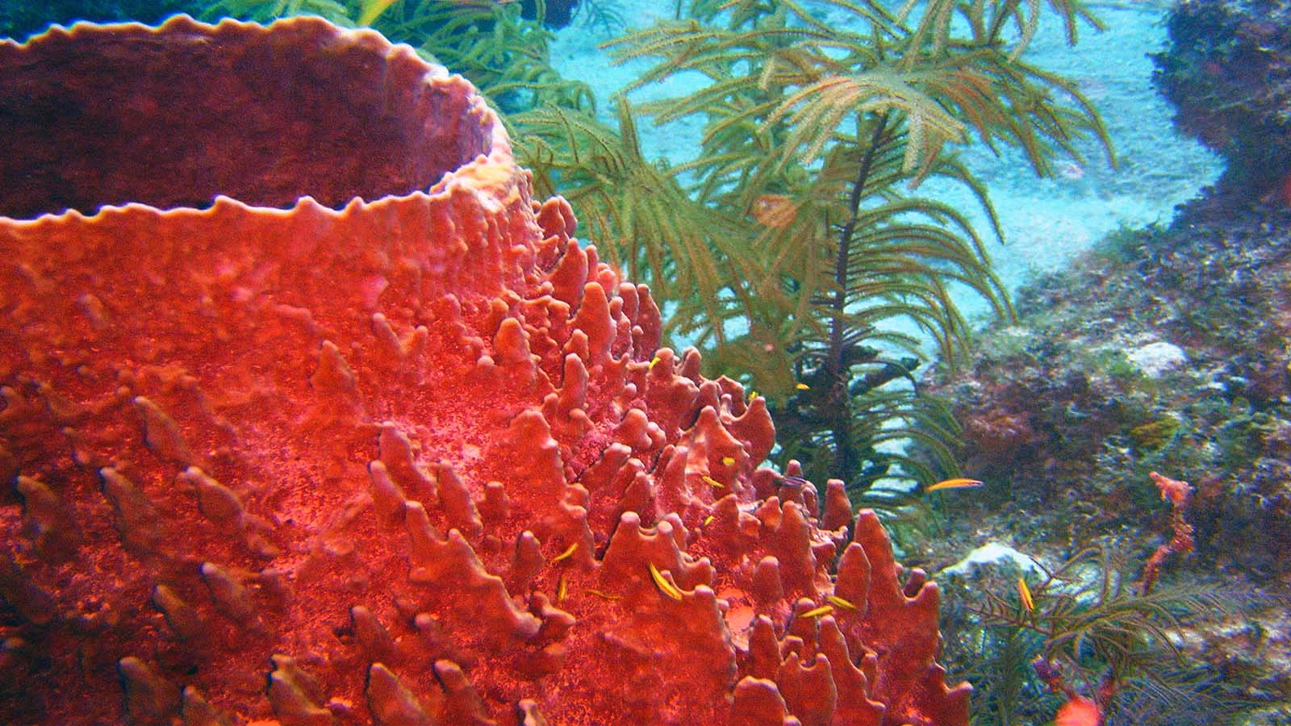
Photo © Matt Kieffer

Slide 32
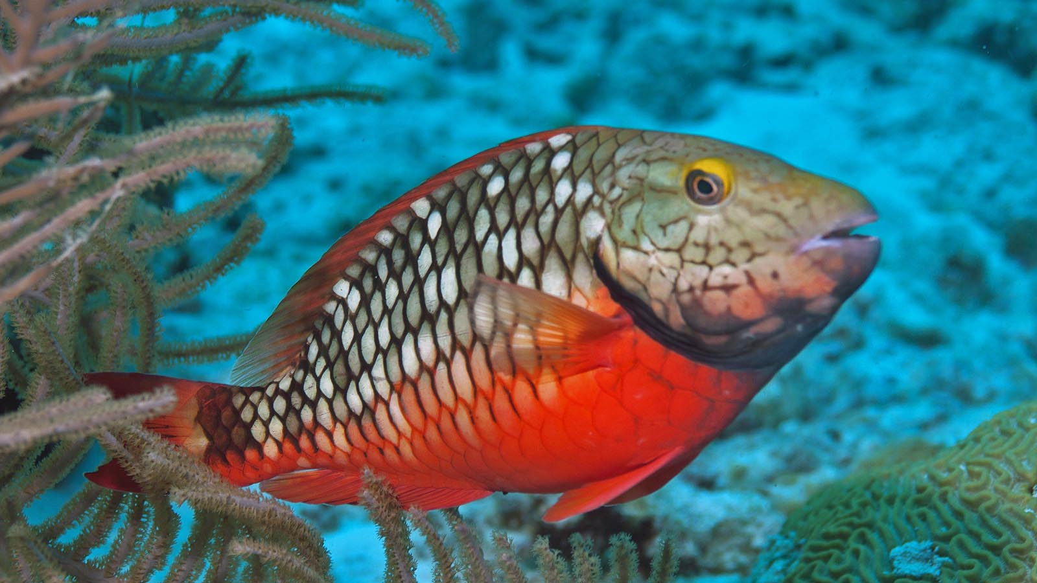
Photo © Carl

Slide 33
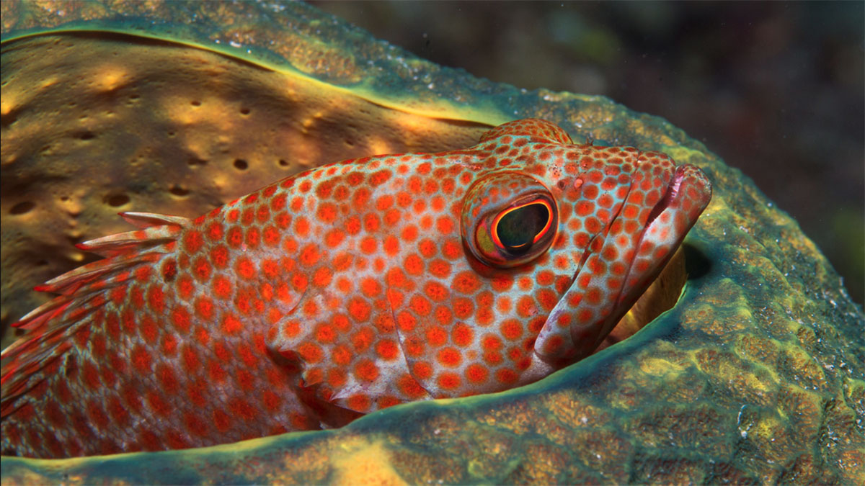
Photo © Dan Hershman

Slide 34
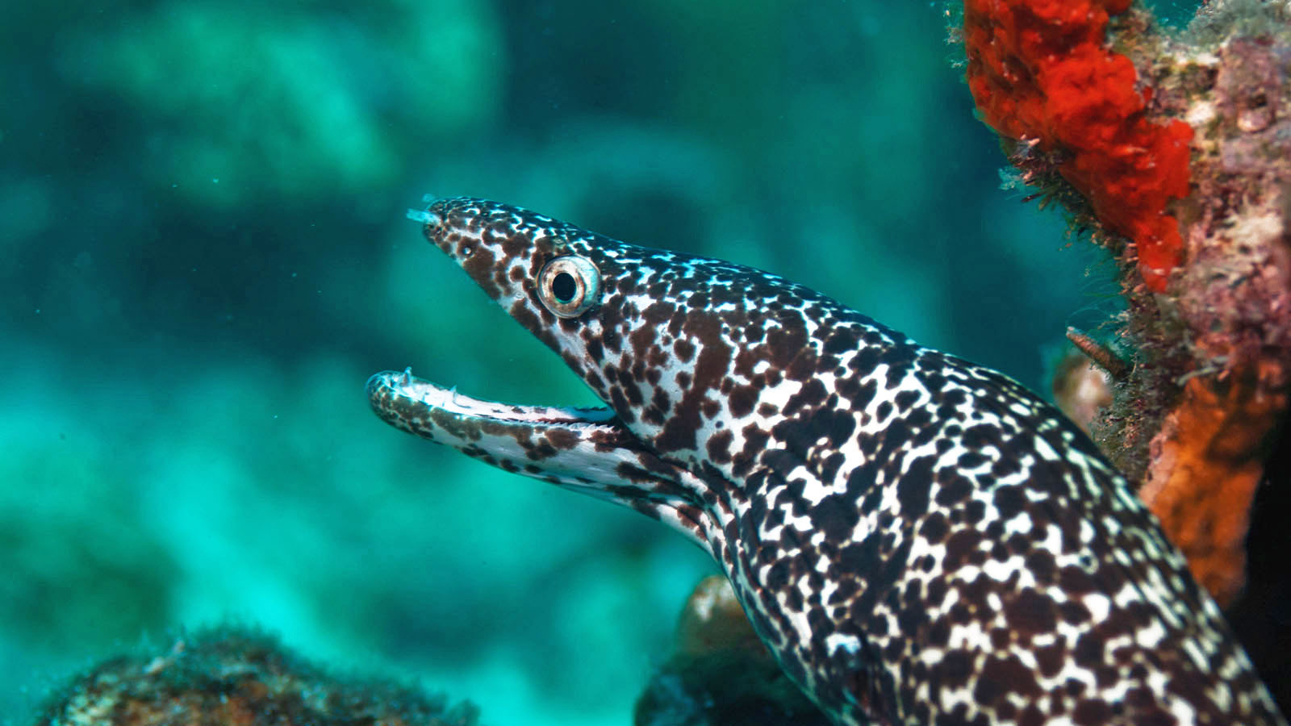
Photo © Carl

Slide 35
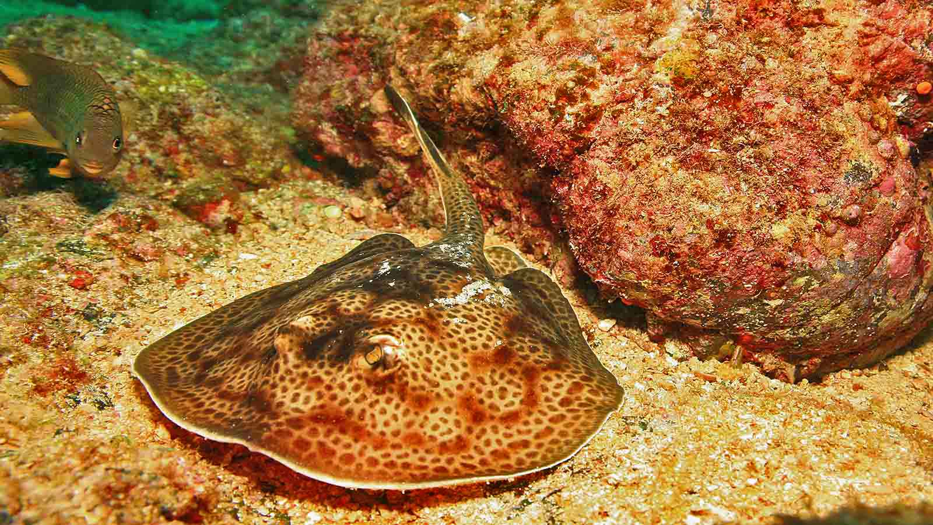
Photo © Laszlo Ilyes

Slide 36
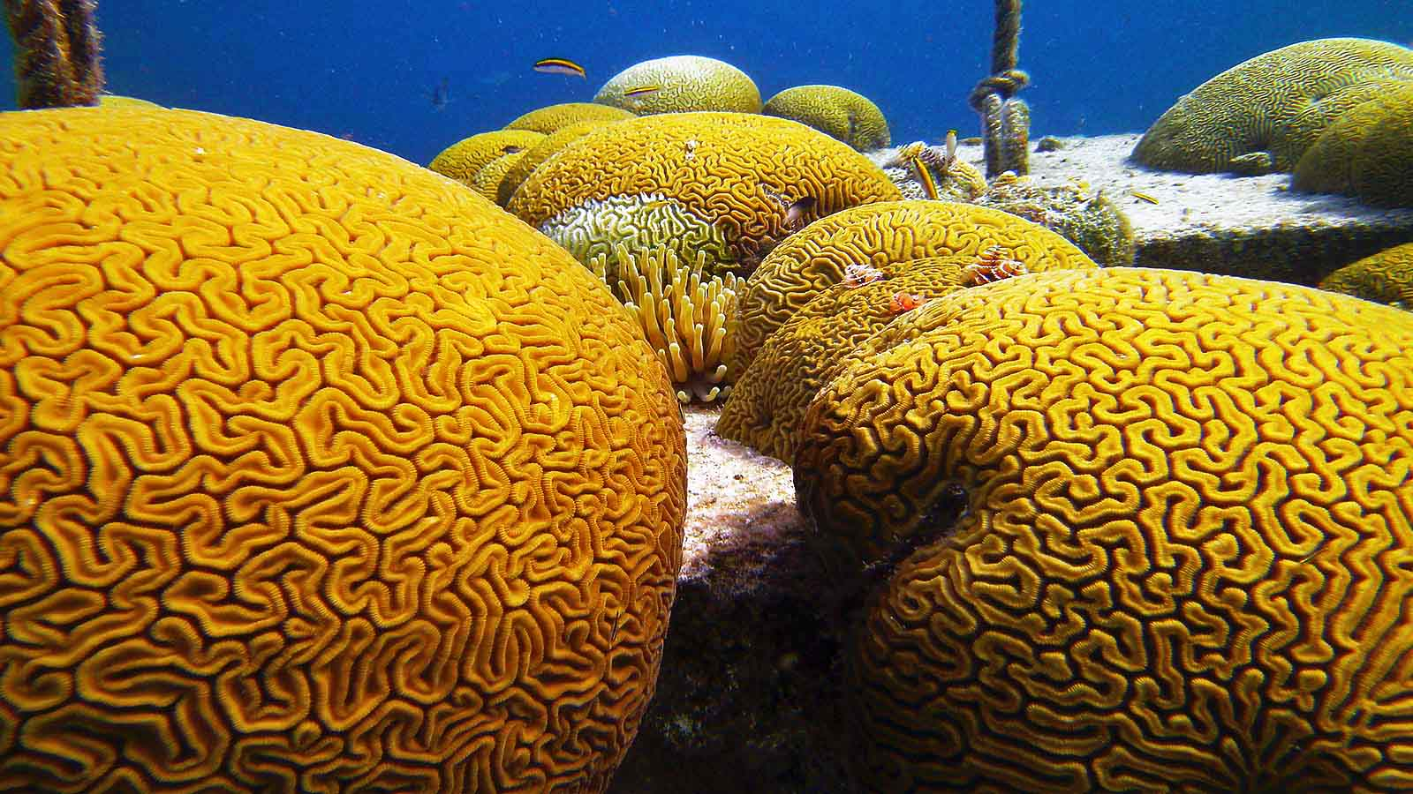
Photo © Amanda Anderson

Slide 37
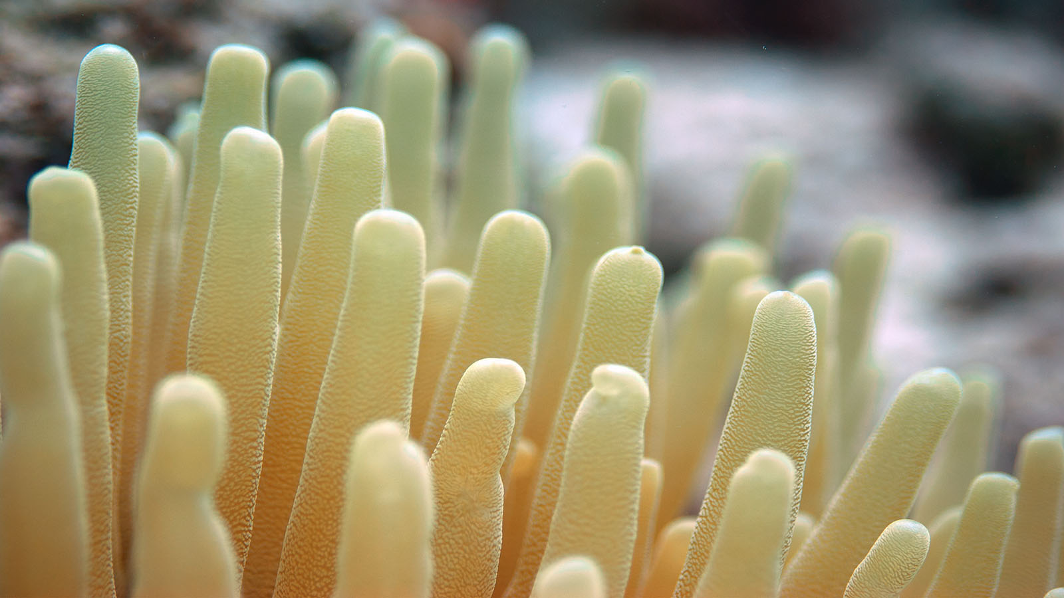
Photo © Carl

Slide 38
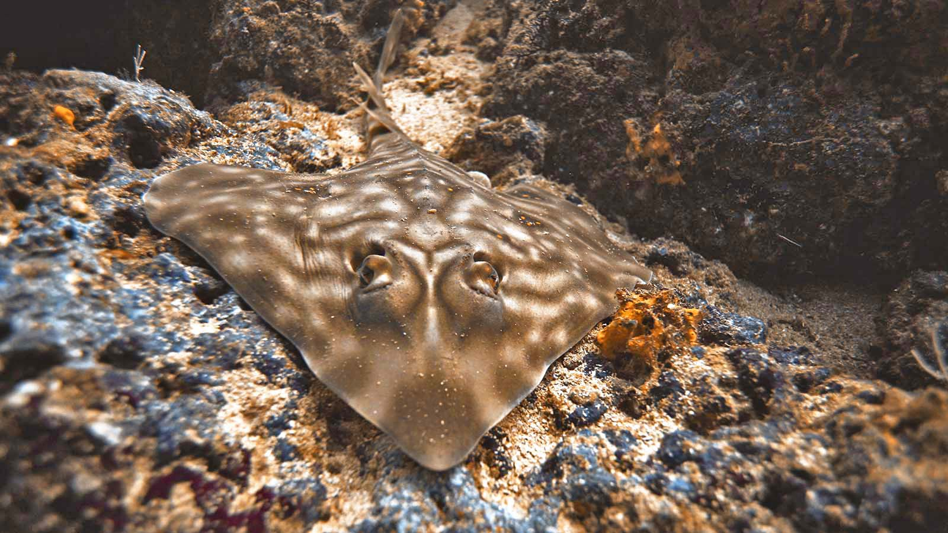
Photo © Laszlo Ilyes

Slide 39
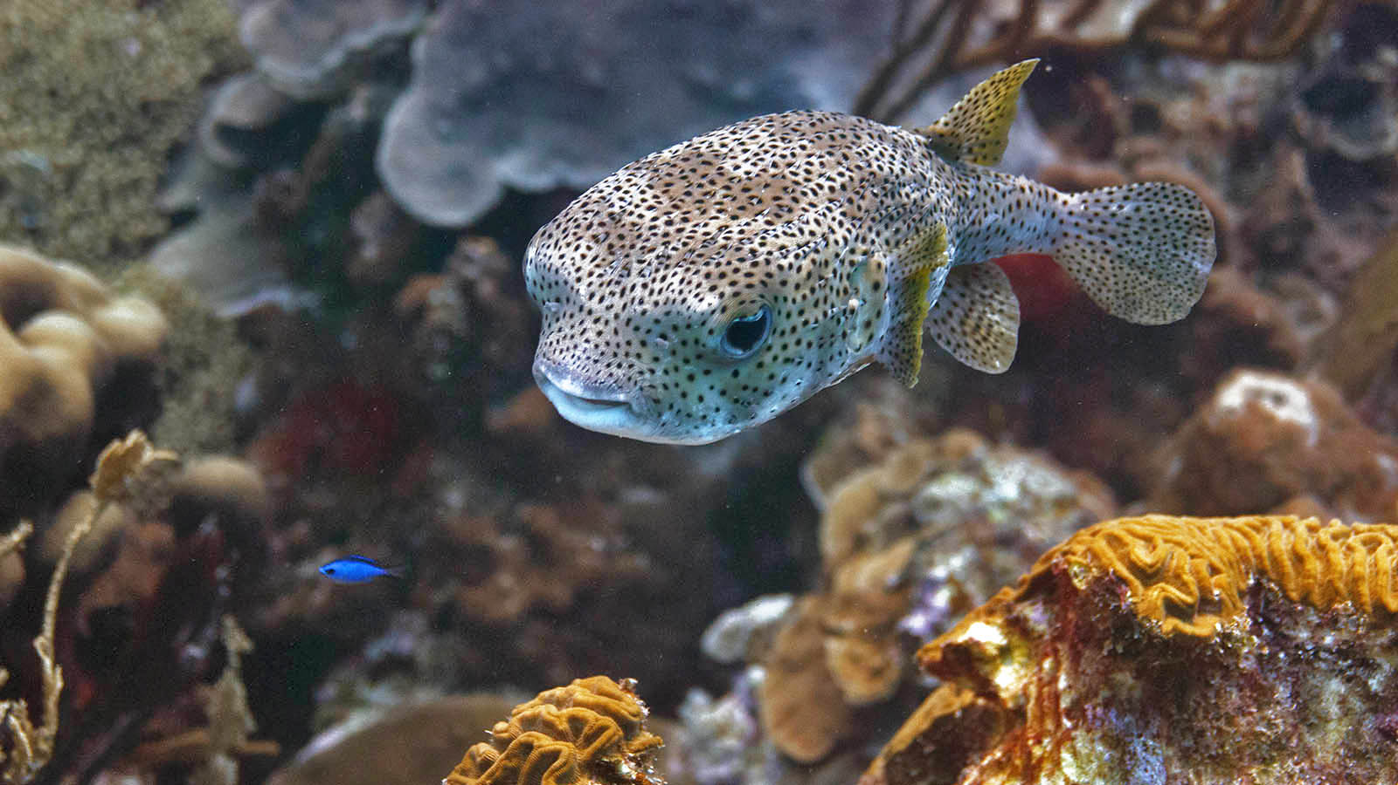
Photo © Carl

Slide 40
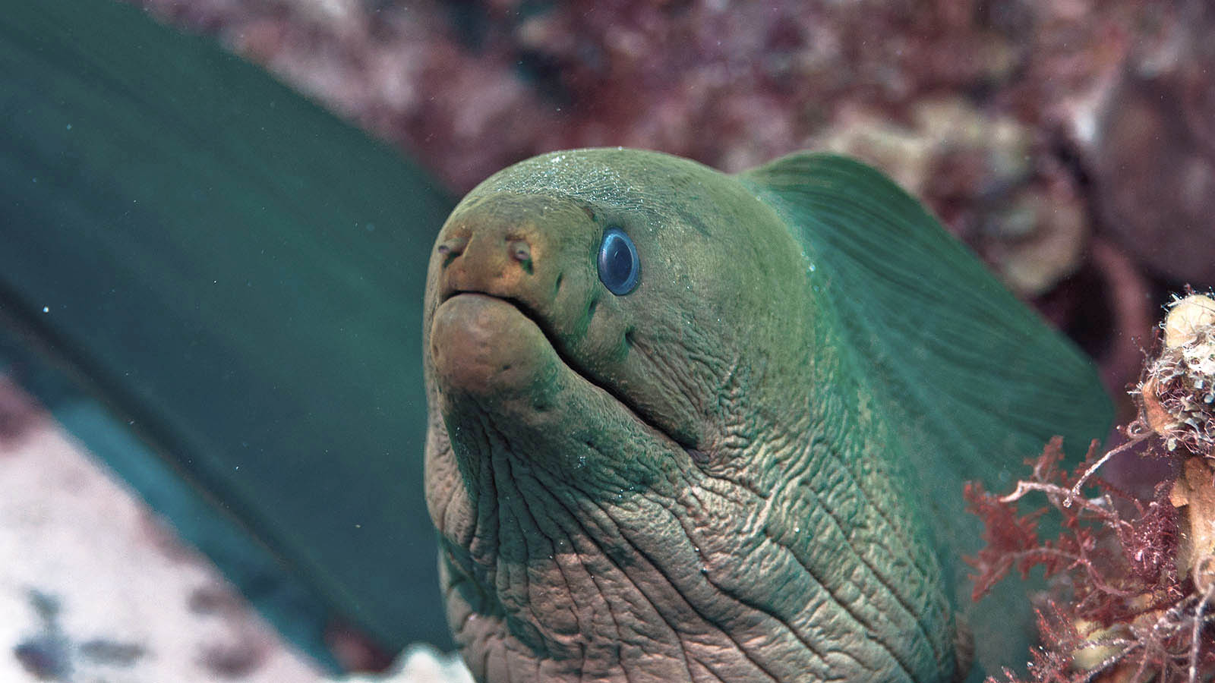
Photo © Carl

Slide 41
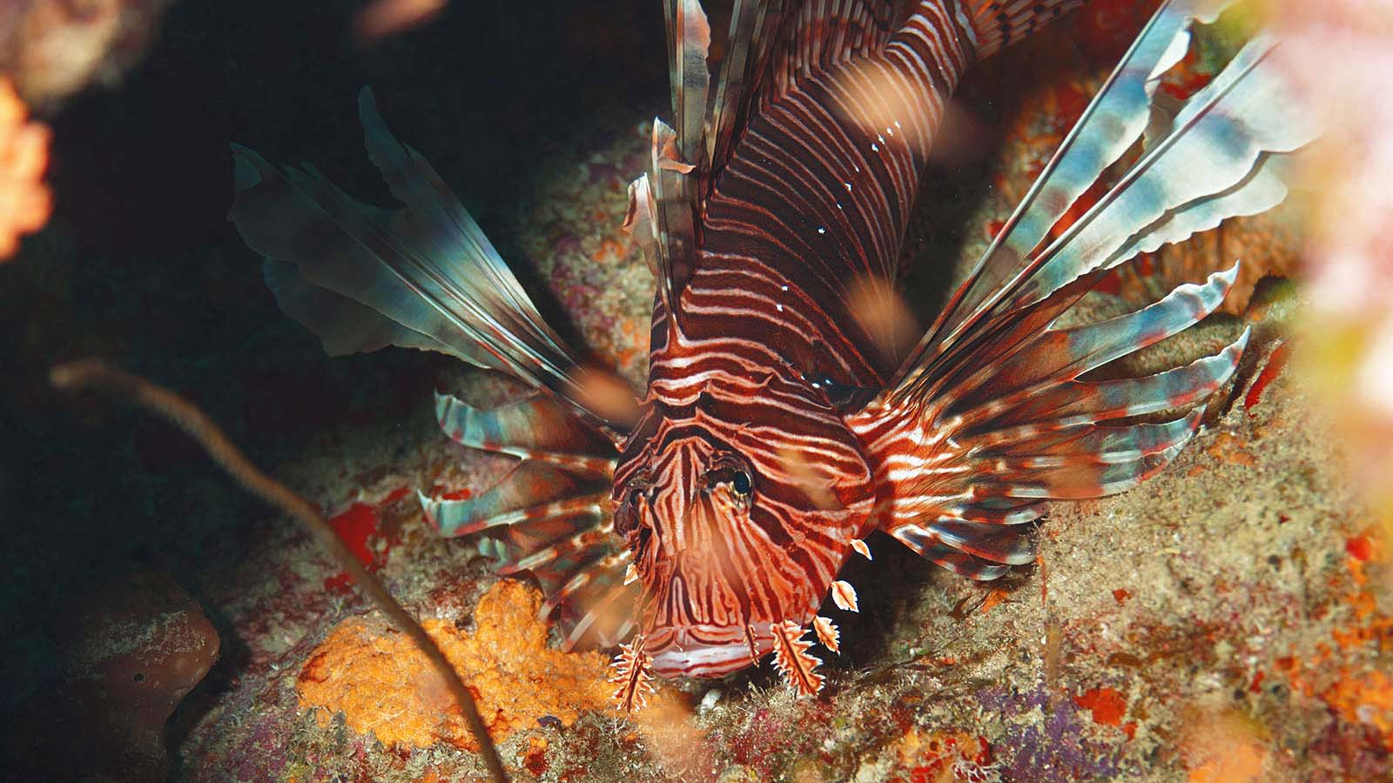
Photo © Carl

Slide 42
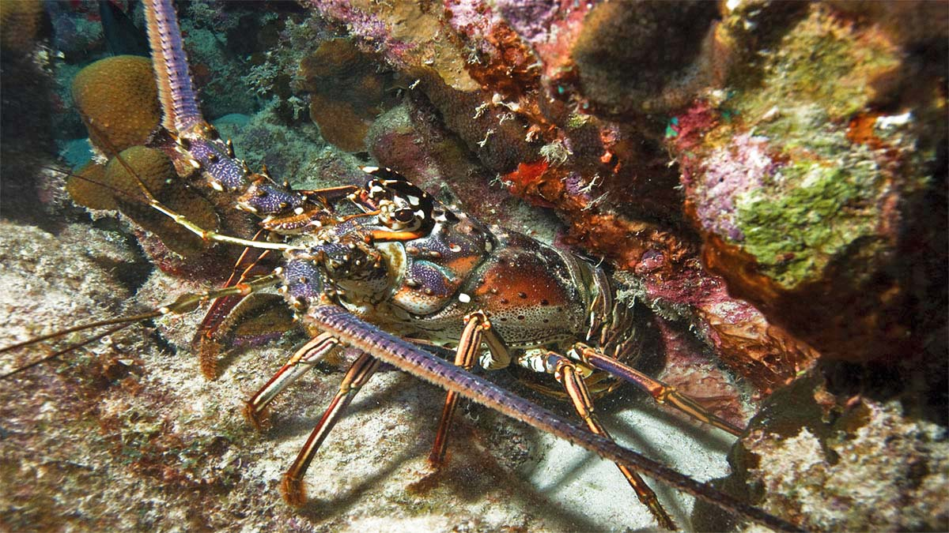
Photo © Dan Hershman

Slide 43
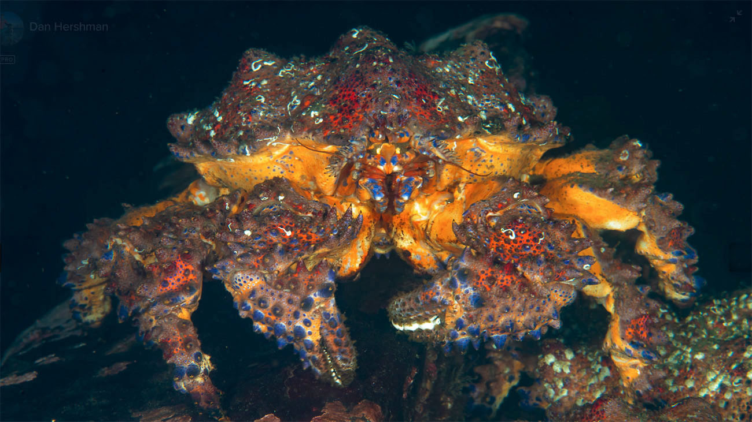
Photo © Dan Hershman

Slide 44
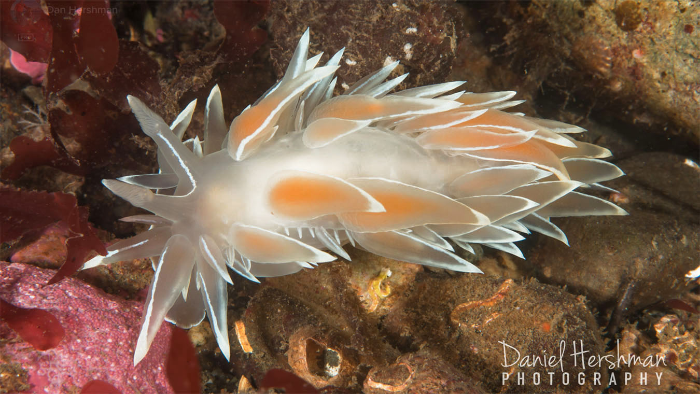
Photo © Dan Hershman

Slide 45
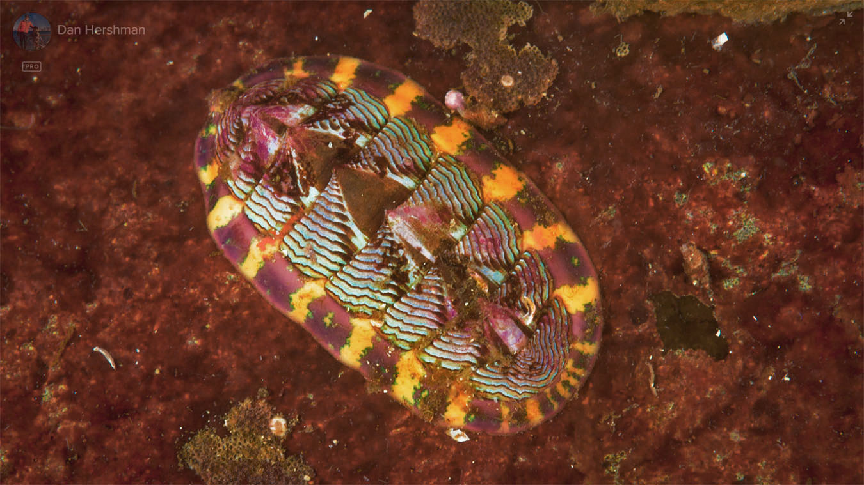
Photo © Dan Hershman

Slide 46
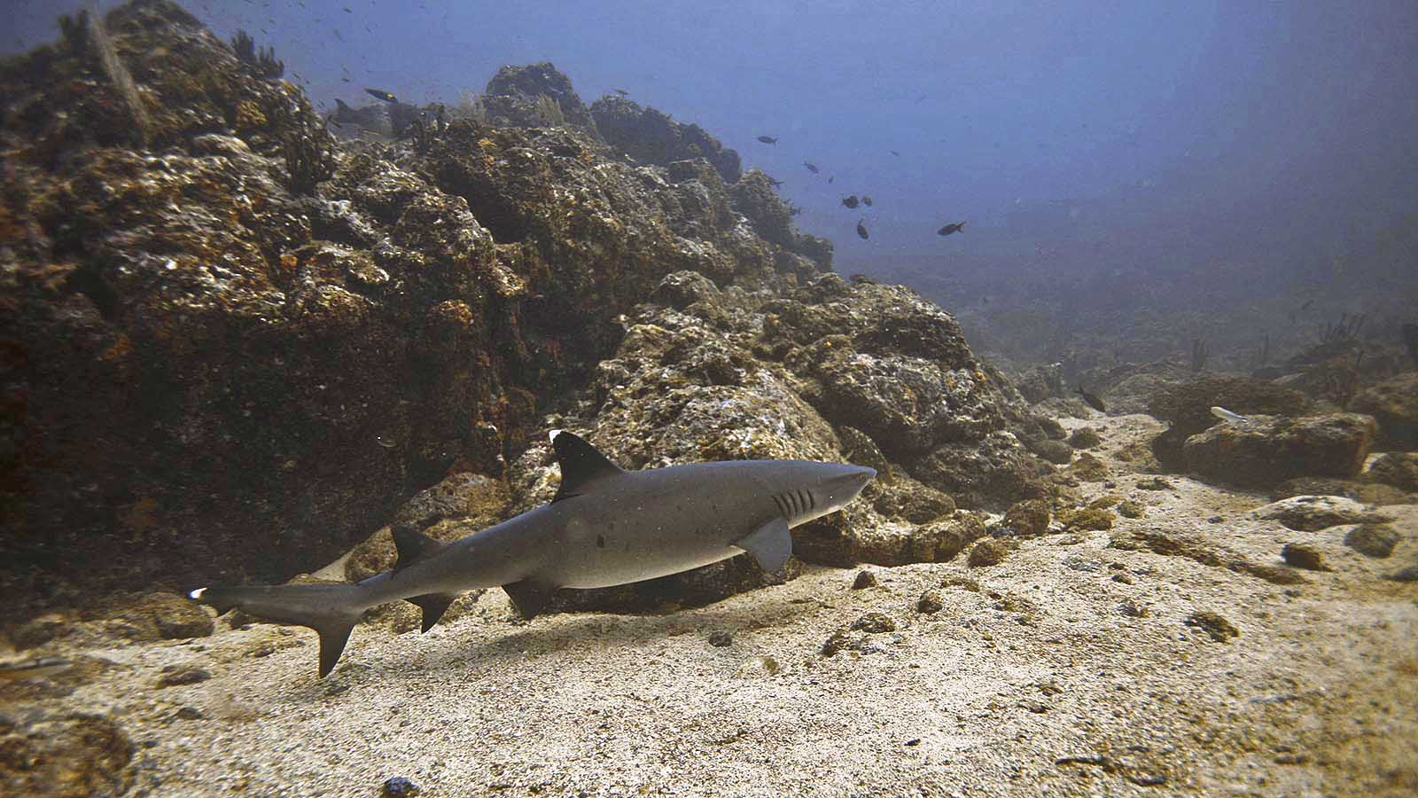
Photo © Laszlo Ilyes

Slide 47
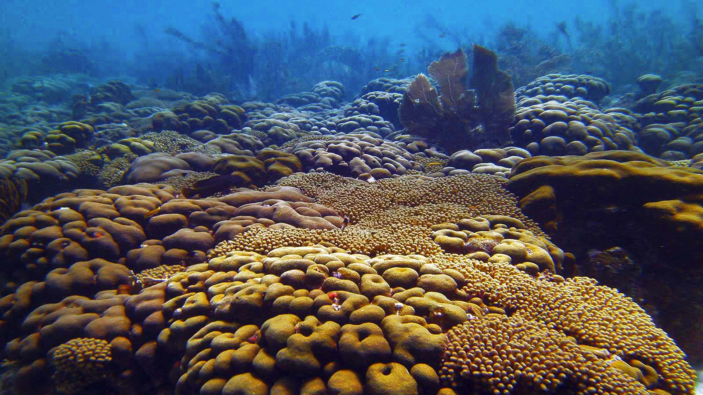
Photo © Amanda Anderson

Slide 48


Non-commercial presentation !
Photos : Carl (USA)
Dan Hershman (USA)
Laszlo Ilyes (USA)
Amanda Anderson (USA)
Matt Kieffer (UK)
Music : Chromatic Player Paul - Blue Bayou
Compiled by : Steve Rumpler (Slovakia)
pista2011©gmail.com
Year : 2023
Thank you for watching our presentation.

Slide 49


Ți-a plăcut prezentarea mea?
Trimite-mi un email. Iti voi trimite inca una.
Gratuit desigur!
Did you like my presentation?
Email me. I will send you another one.
Free of charge!
¿Te gustó mi presentación?
Envíeme un e-mail. Te enviaré otro.
¡Gratis por supuesto!
Tetszett a PPS-diaporámám?
Jelentkezz. Küldök egy uj PPS-t.
Természetesen ingyen!
Páčila sa Vám moja prezentácia?
Napíšte mi. Pošlem Vám ďalšiu.
Samozrejme zadarmo!
Gostou da minha apresentação?
Me mande um e-mail. Vou te enviar outro.
Claro, grátis!
Ti è piaciuta la mia presentazione?
Mandami un'email. Te ne manderò un altro.
Ovviamente gratis!
Hat Ihnen mein Vortrag gefallen?
Maile mir. Ich schicke dir noch eins.
Natürlich kostenlos!
Avez-vous aimé ma présentation?
Envoyez moi un email. Je t'en enverrai un autre.
Gratuit bien sûr!
pista2011@gmail.com

Slide 50







¿Te ha gustado?
Puedes ver más entrando
Aquí
Además puedes recibir powerpoints en tu correo electrónico suscribiéndote aquí:

