Slide 1



South Africa’s Floral Kingdom
South Africa’s Western Cape is more botanically diverse than the richest tropical rainforest in South America, including the Amazon. It has 9,000 plant and flower species, a majority being native fynbos vegetation, which covers the region's magnificent mountains, and lowland valleys and coastal plains.
Though South Africa covers less than 1 percent of the world's total land surface, it accounts for 10 percent of all the known species of flowering plants. Of these, 80 percent are endemic, found only in South Africa. Anyone who loves flowers or gardens will recognize floral "friends" among the most flamboyant of South Africa's native species - the proteas, geraniums, amaryllis, freesias, ice plants, red-hot pokers, bird of paradise plant, gladiolas, and gazanias.
Compiled by - Tony Chacko (tonychacko2000@gmai.com)
Technical Support - Steve Rumpler (pista2011@gmail.com)

Slide 2
South Africa’s Floral Kingdom
The Cape Town wildflowers are known worldwide for its stunning displays in springtime. Especially the northern parts of the Western Cape and the Northern Cape are renowned for their mesmerising beautiful wildflower displays during spring, from August to September.
You will also see wildflowers in an array of colour if you venture a bit out of Cape Town, drive north on the R27, this is where you can see the first vast flower fields just outside Blouberg. Make sure to also visit the many Wildflower Festivals which take place during this period. Various communities celebrate spring by skillfully decorating town halls and church halls displaying the typical spring flowers from the West Coast region. At many flower festivals, there are also art exhibitions, lectures as well as markets with craft and food stalls which complement the unique experience.

Slide 3
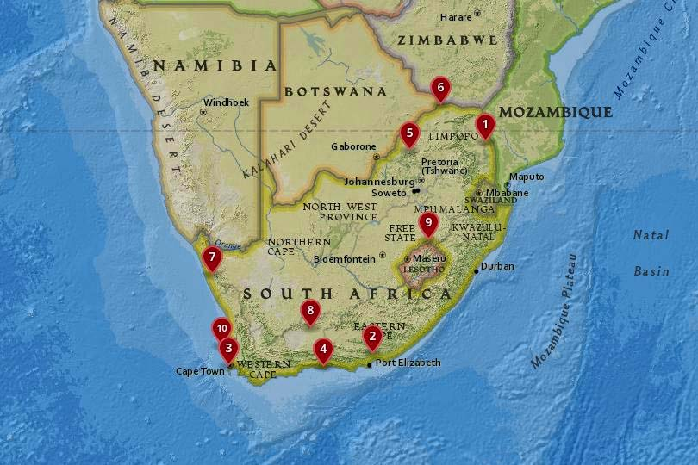


THE NATIONAL PARKS OF SOUTH AFRICA
10. West Coast National Park
9. Golden Gate Highlands National Park
8. Karoo National Park
7. Namaqua National Park
6. Mapungubwe National Park
5. Marakele National Park
4. Garden Route National Park
3.Table Mountain National ark
2. Addo Elephant National Park
1. Kruger National Park
PLACES TO SEE FLOWERS OF SOUTH AFRICA
1. Cosmos Country, Mpumalanga
2. Sunflowers near Kroonstad, Free State
3. Wild flowers in Namaqualand, Northern Cape
4. Daisies in Darling, Western Cape
5. 5. Aloes in Graskop and Lydenburg, Mpumalanga
6. Eastern Cape extravaganza, Port Elizabeth
7. Tankwa Karoo National Park

Slide 4
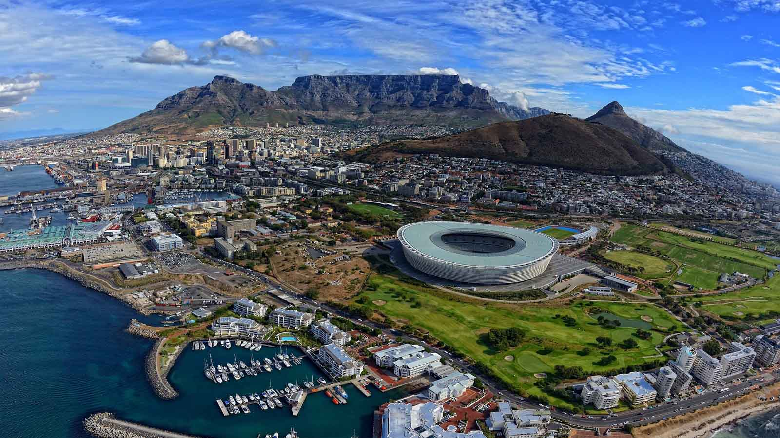
Aerial panoramic view of Cape Town the capital of South Africa

Slide 5
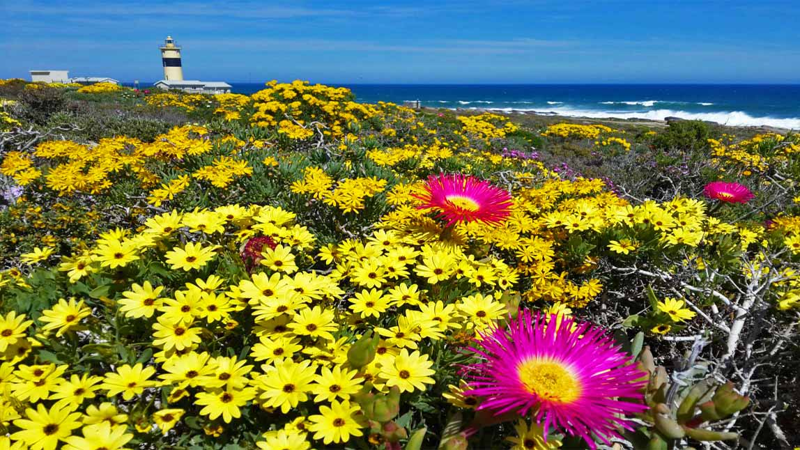
Beautiful Wildflowers of Namaqualand

Slide 6
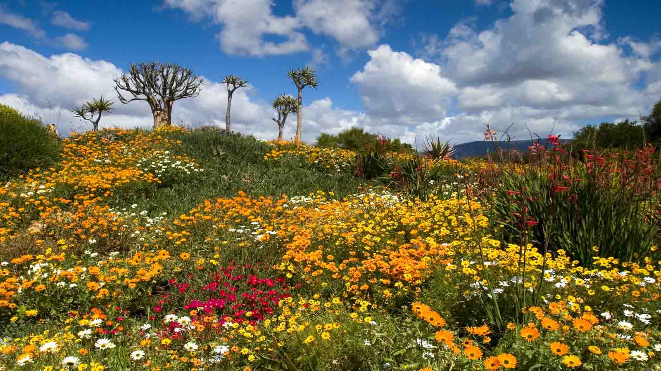
South Africa’s Namaqualand National Park in springtime

Slide 7
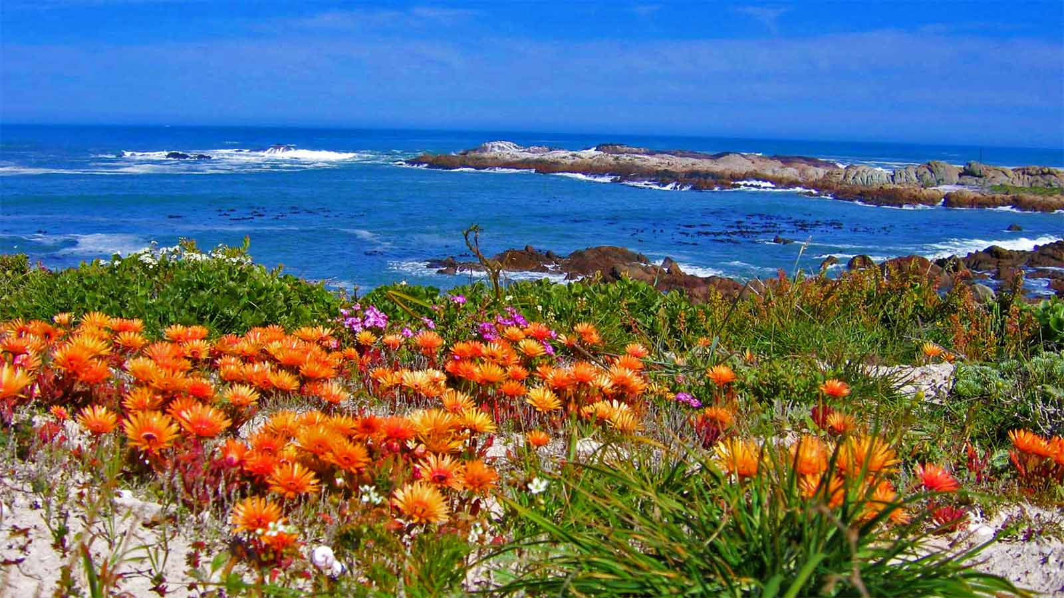
Namaqualand seaside Wildflower Daisies

Slide 8
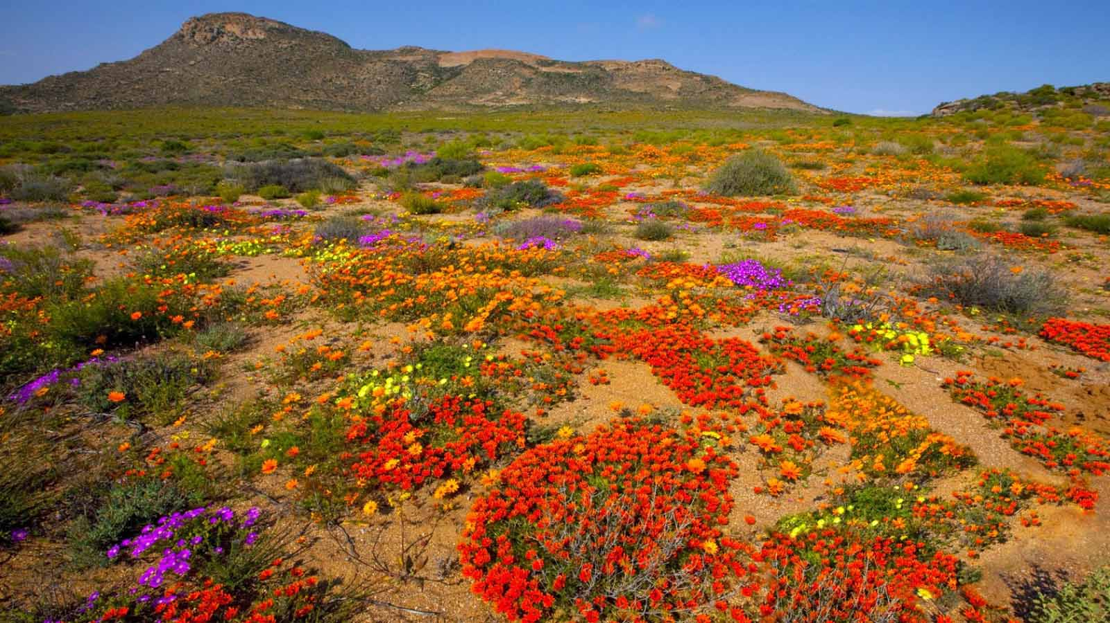
Nature’s flower-fields of beautiful Skilpad Flower reserve in Namaqualand Park during springtime

Slide 9
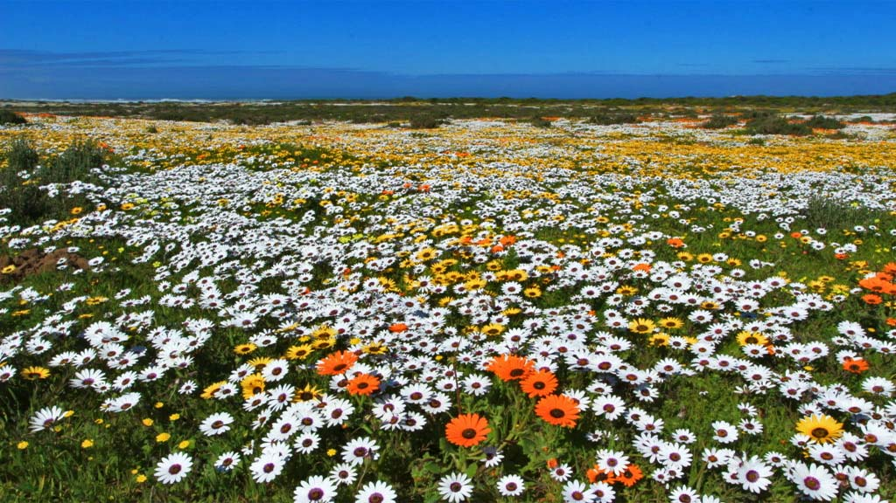
Spring Flowers of West Coast National Park

Slide 10
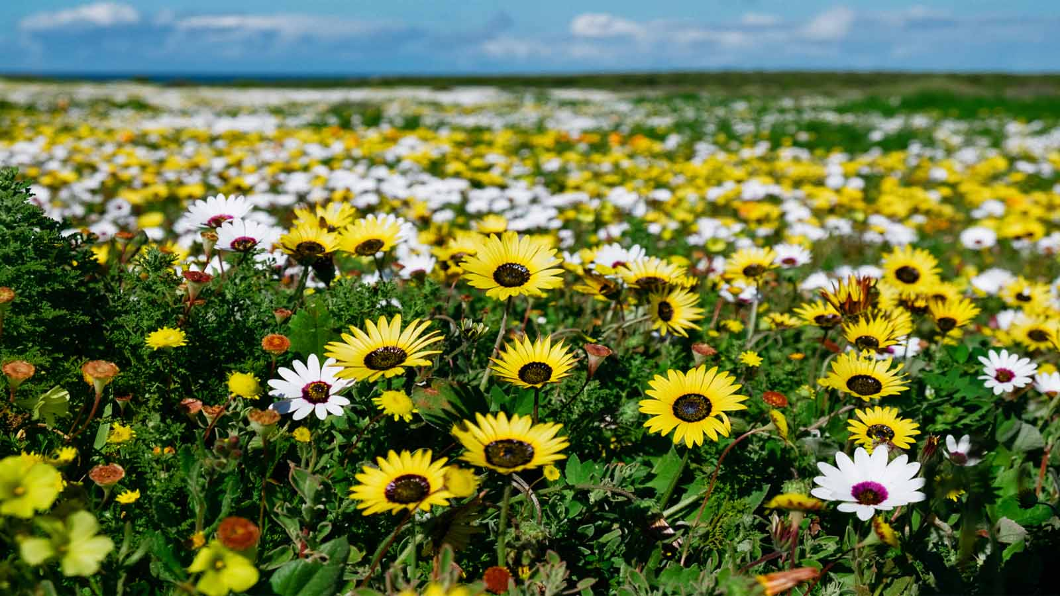

Slide 11
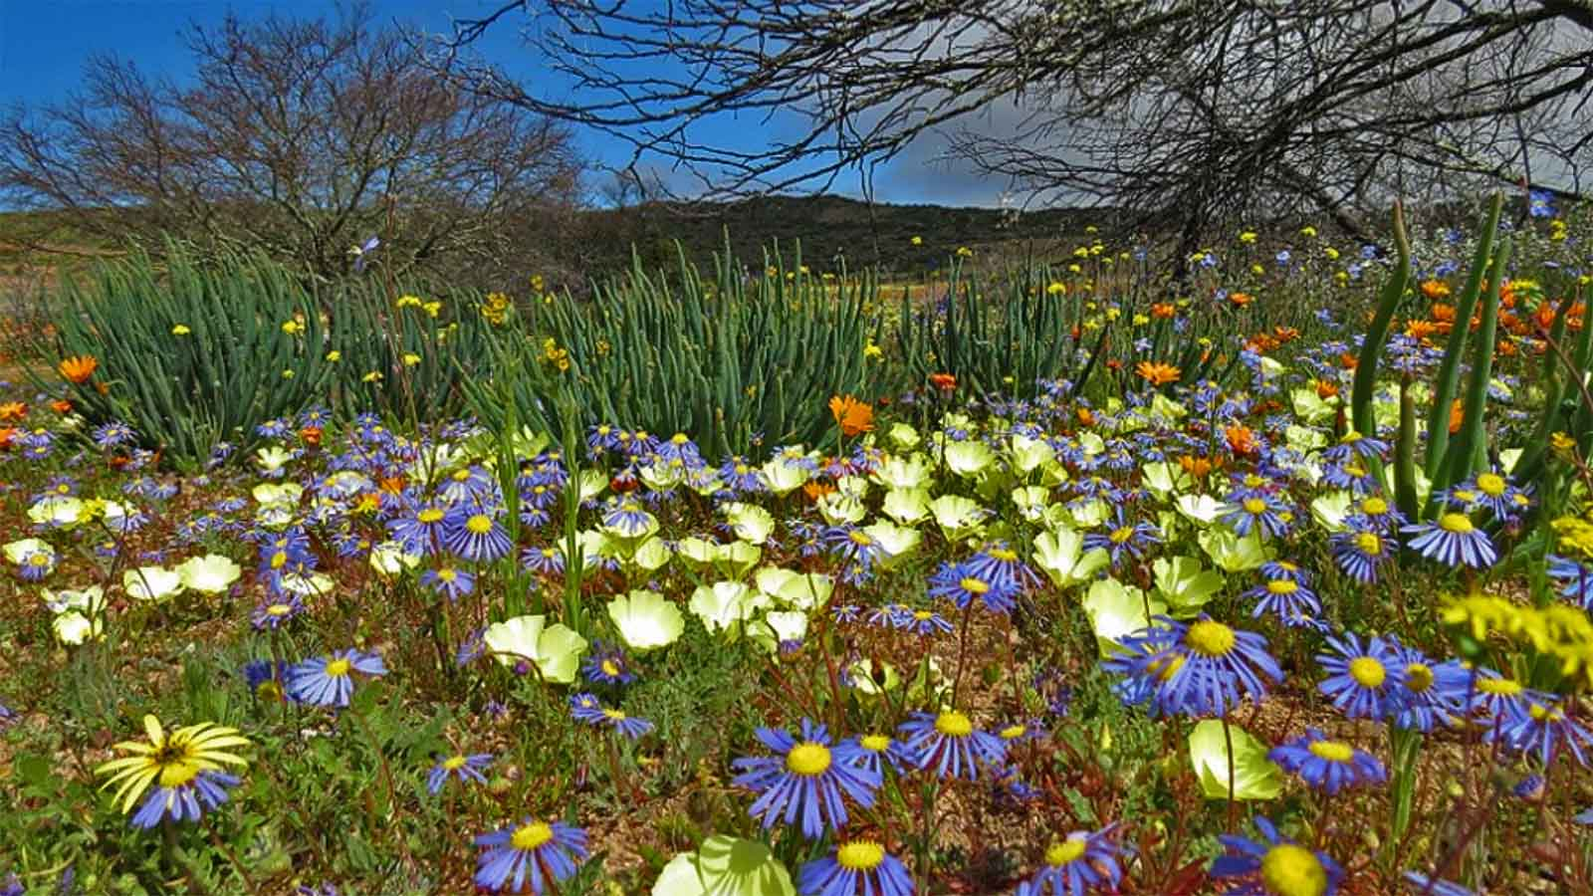
The spectacular wildflowers of the West Coast National Park.

Slide 12
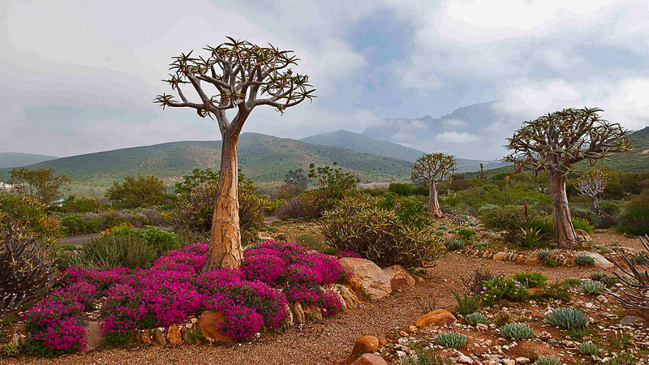

Slide 13
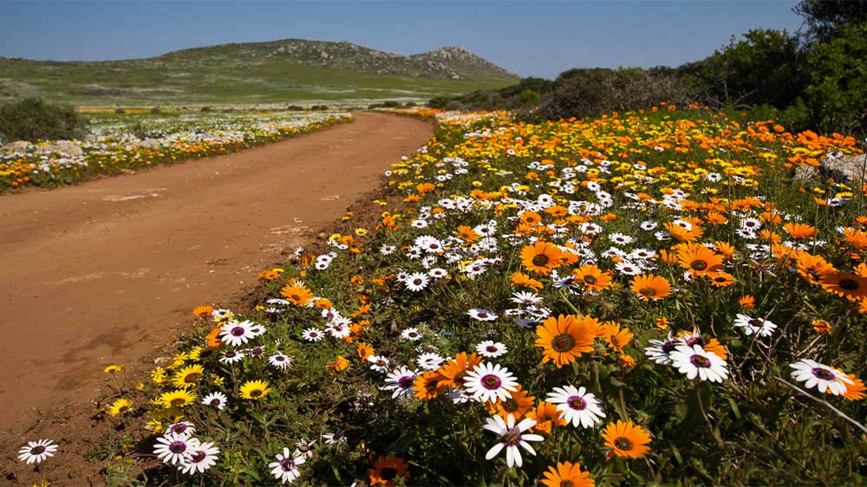
Spring flowers in the Old Mill Lodge in Springbok Namaqualand area

Slide 14
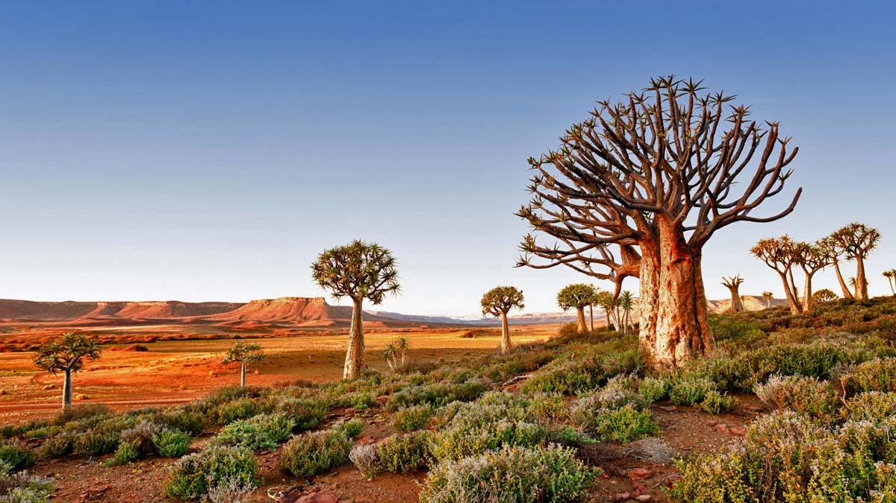
Quiver Tree Forest of Nieuwoudtville, Northern Cape Province

Slide 15
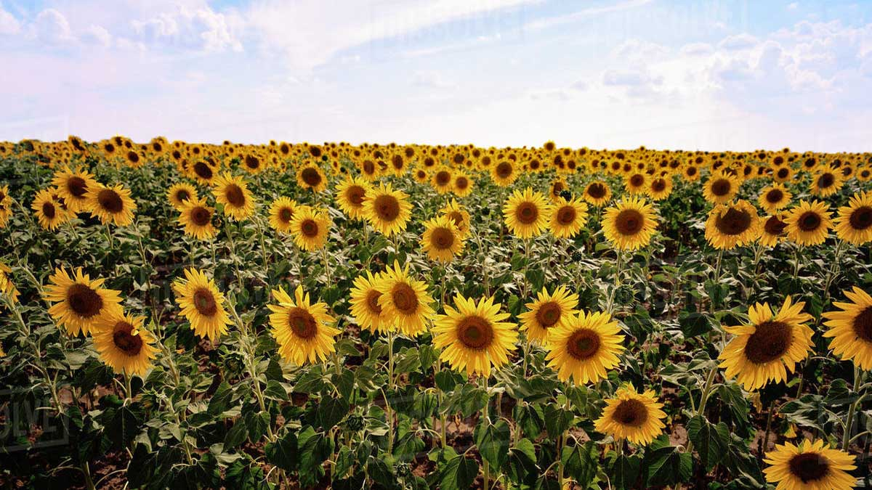
Field of Sunflowers at Bloemfontein, Free State, South Africa

Slide 16
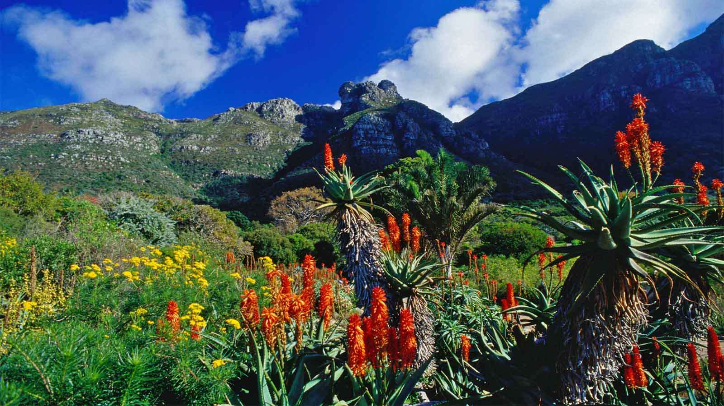

Slide 17
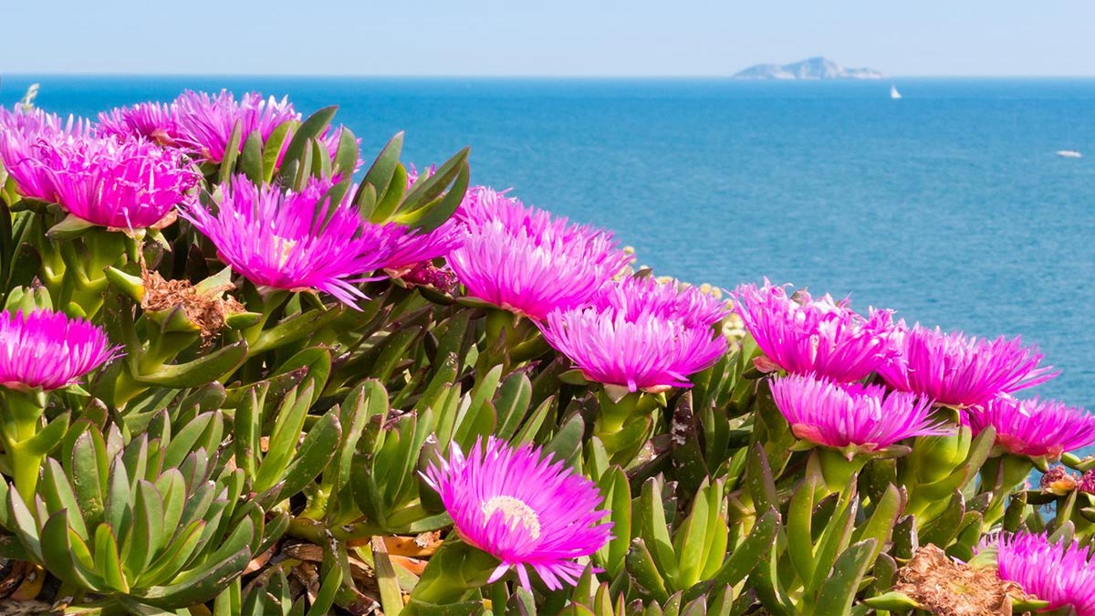
Seaside wildflowers of West Coast National park

Slide 18
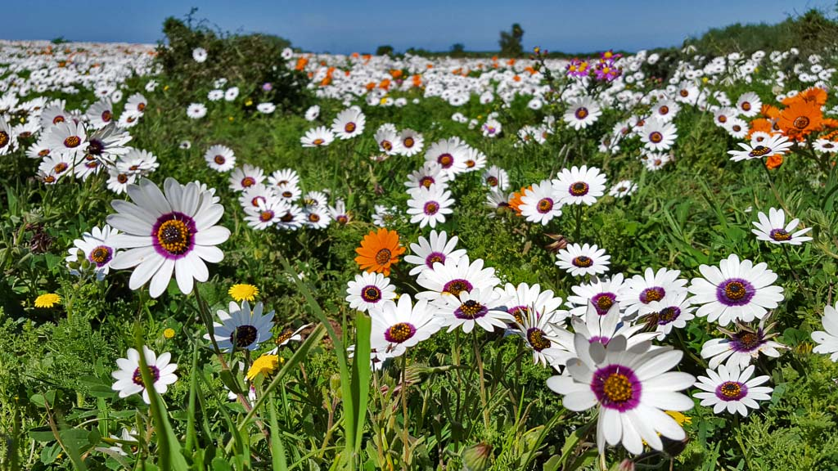
A field of flowers in the West Coast National Park

Slide 19
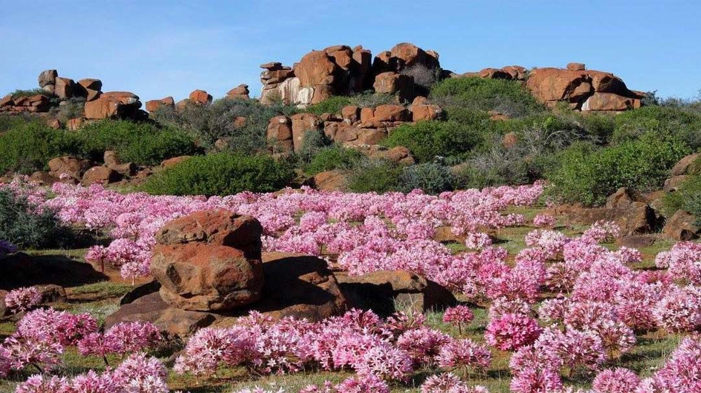
The Candlebra flowers of Nieuwoudtville Flower Reserve

Slide 20
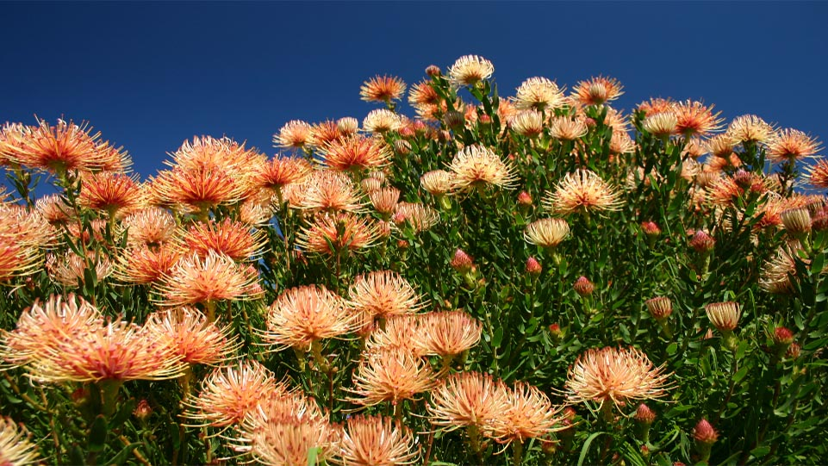
Ribbon pincushion (Leucospermum tottum) at Kirstenbosch National Botanical Garden, Cape Town

Slide 21
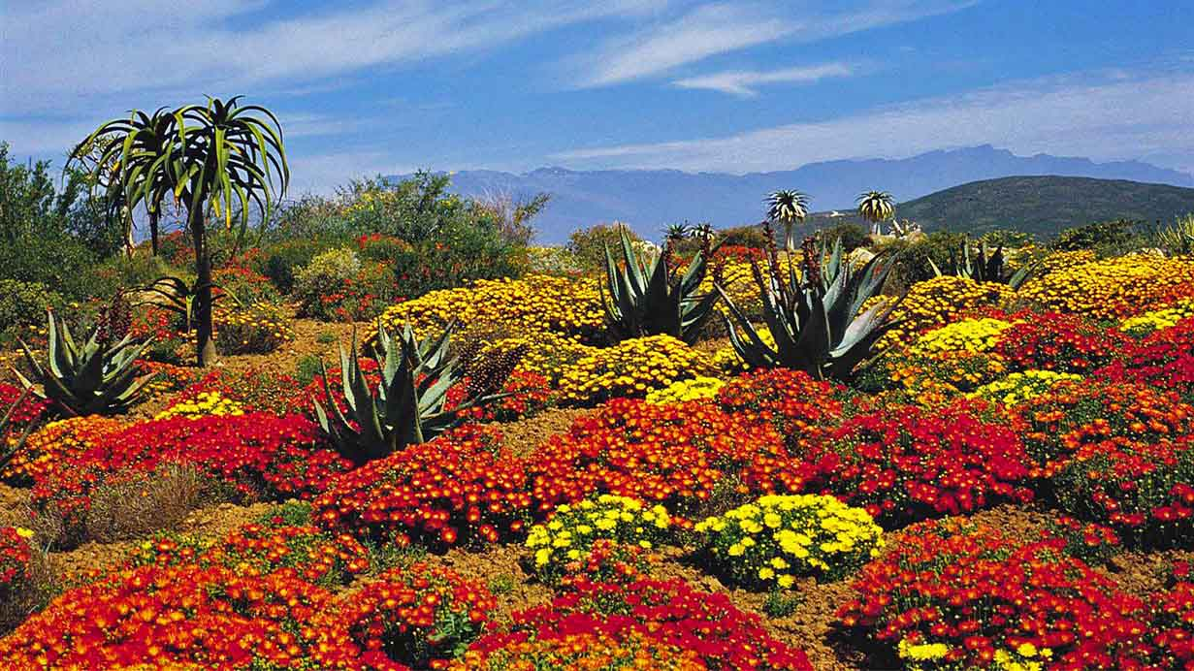
The Karoo Desert National Botanical Garden, Western Cape

Slide 22
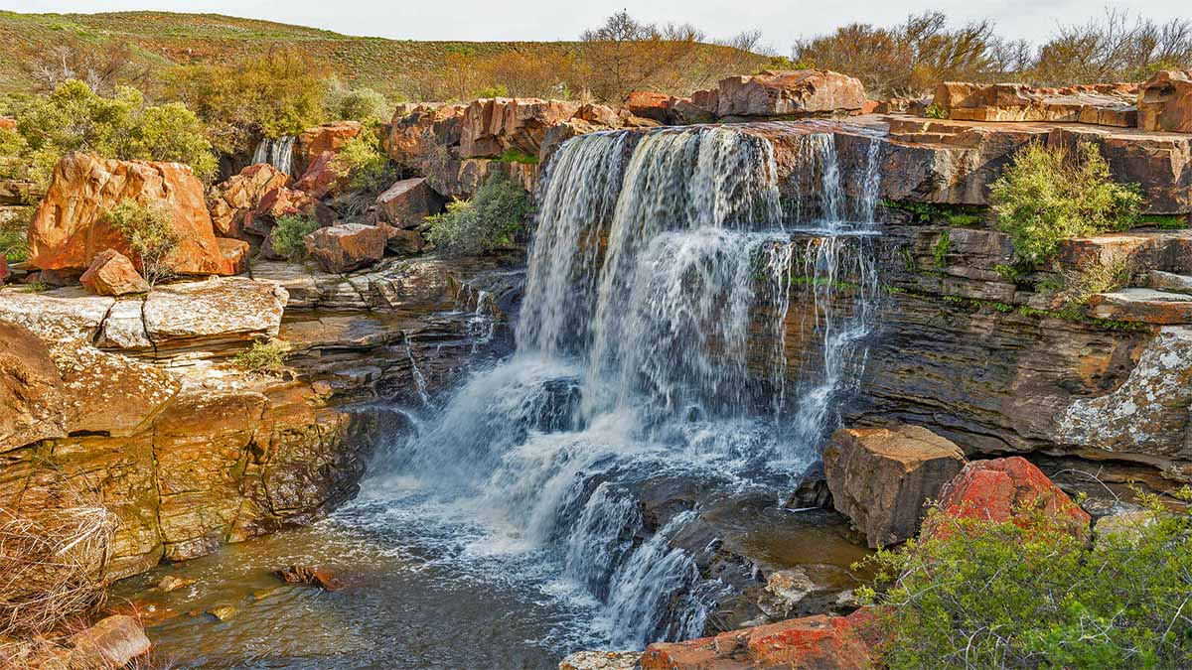
A waterfall at the Nieuwoudtville Wild Flower reserve

Slide 23
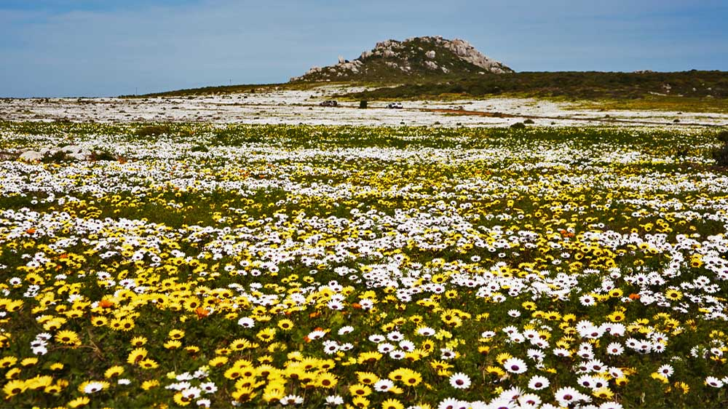
The wildflowers of Namaqualand come to life between July and October every year in a dream-like carpet of color.

Slide 24
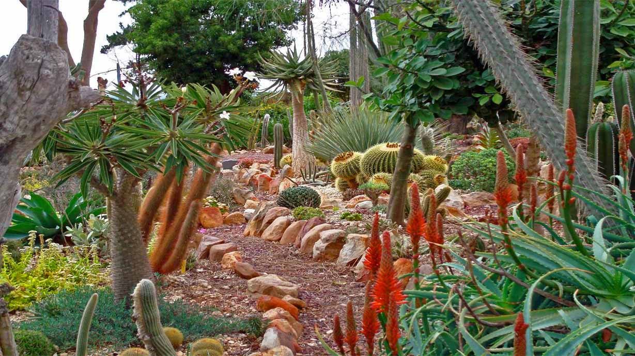
Cacti at the succulent Garden of Soekershof

Slide 25
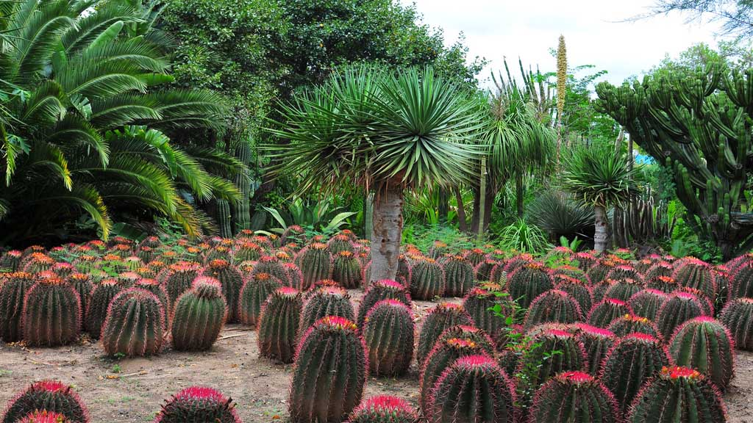
Succulents and Cacti of Graaf Reinet, South Africa

Slide 26
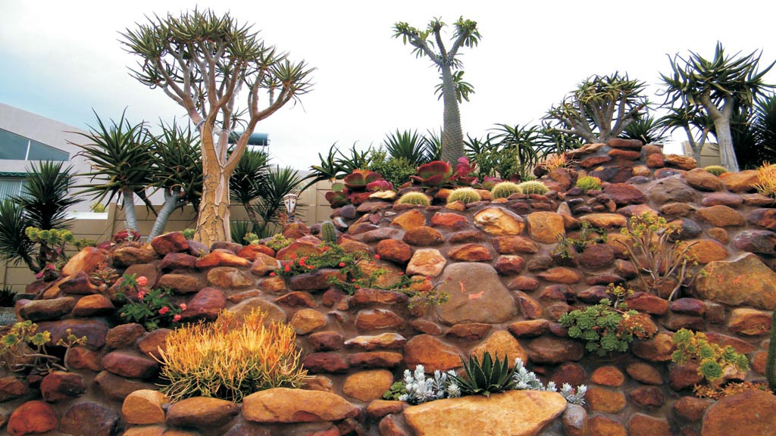

Slide 27
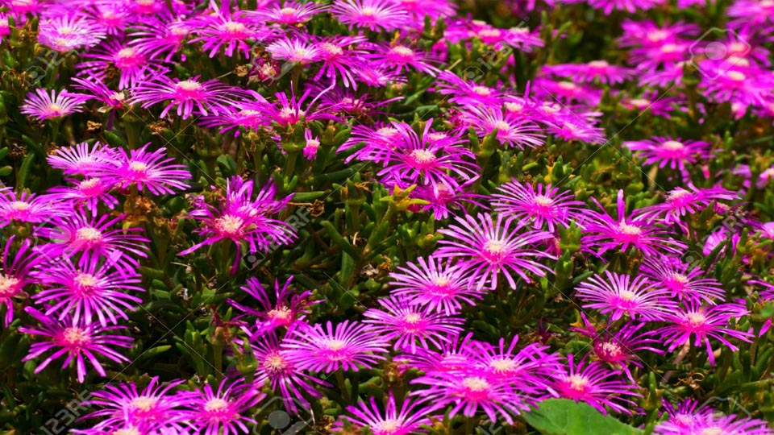
Bright pink Lampranthus flowers, a native flower of Western Cape

Slide 28
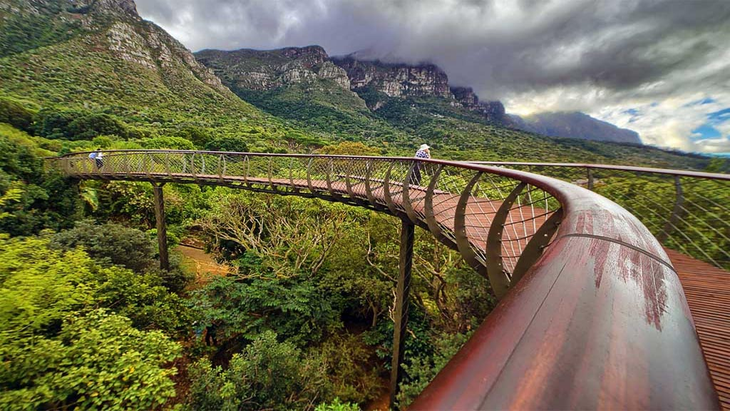
The Boomslang Tree Canopy Walkway at Kirstenbosch National Park

Slide 29
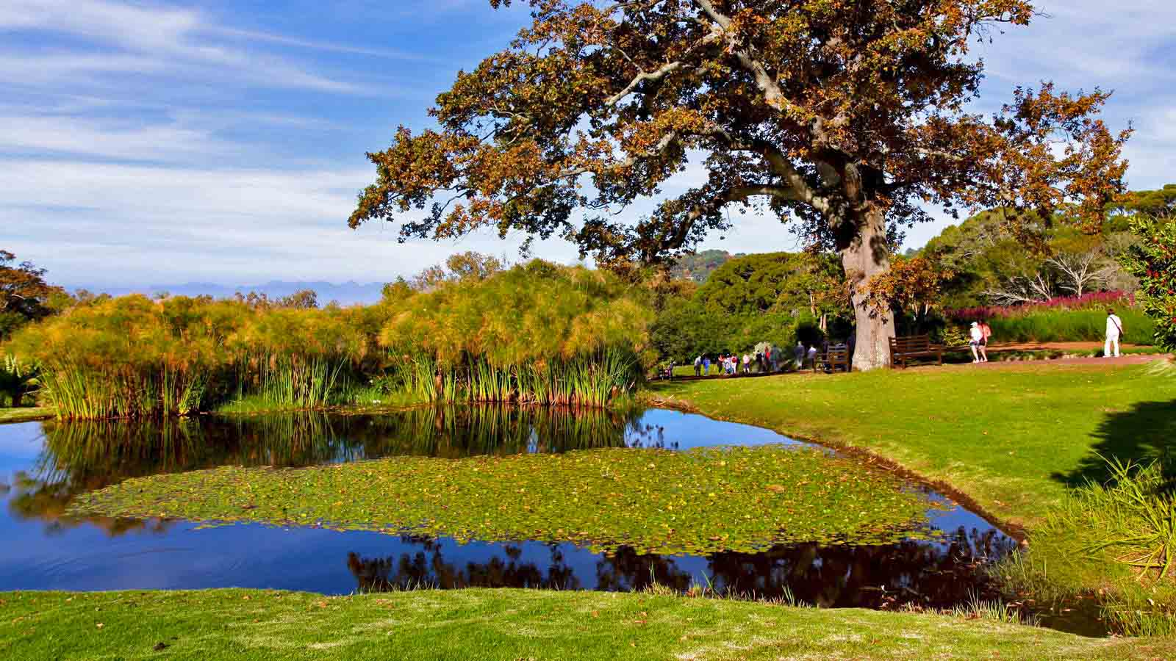
Kirstenbosch National Botanical Garden

Slide 30
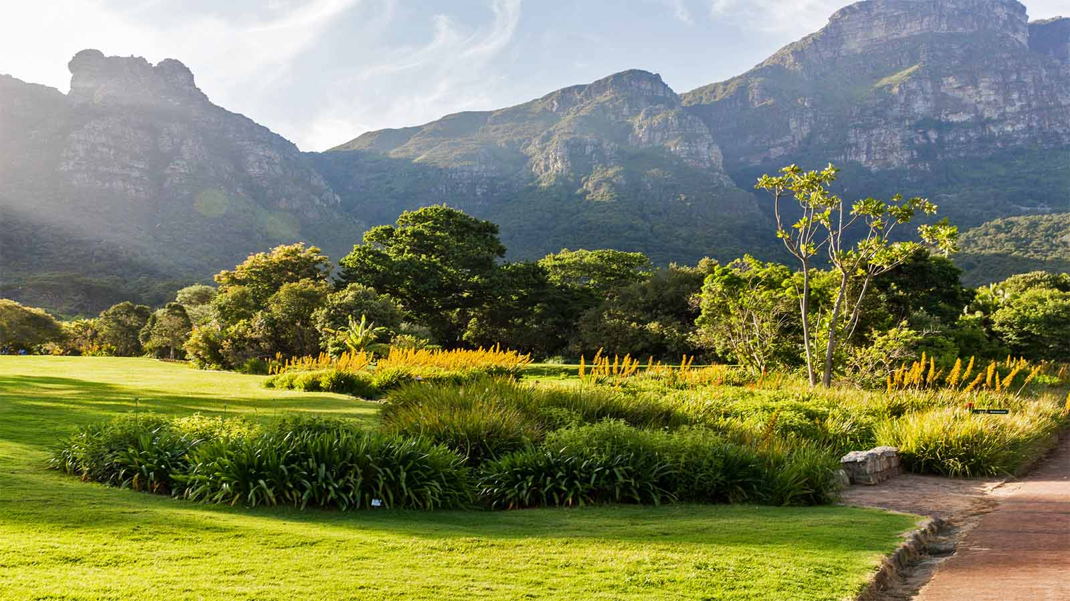
Kirstenbosch National Botanical Garden

Slide 31
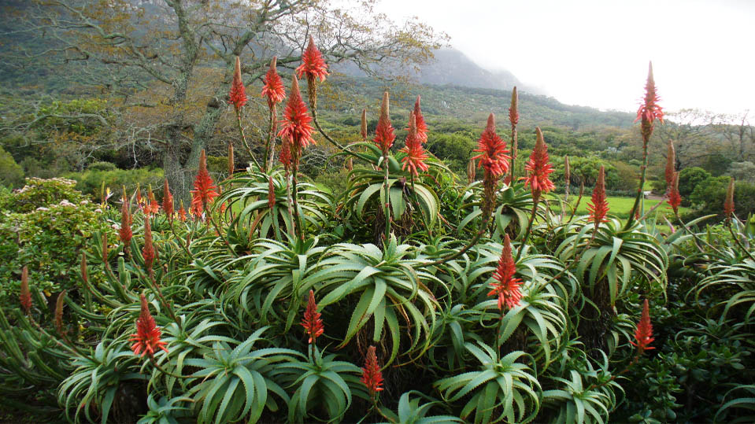
Aloe arborescens of Kirstenbosch Botanical Garden

Slide 32
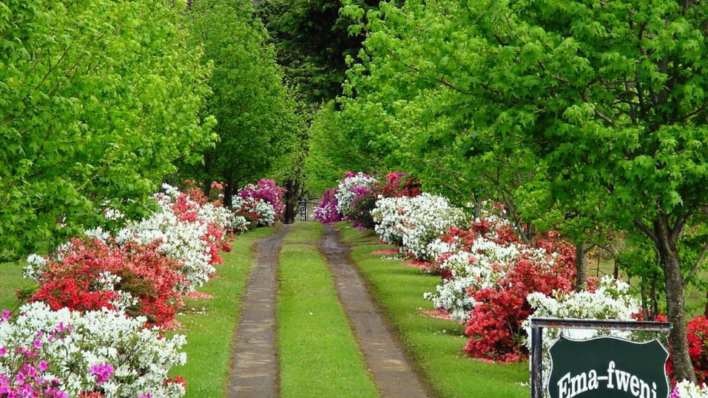
A Private Hotel Garden – Emafweni on Route R600, Cathkin Park

Slide 33
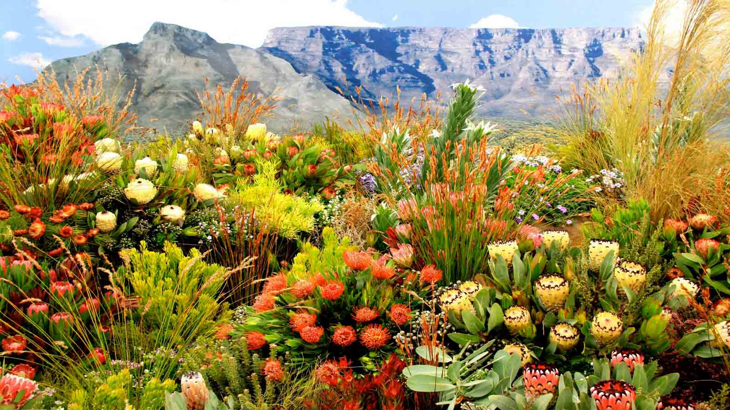

Slide 34
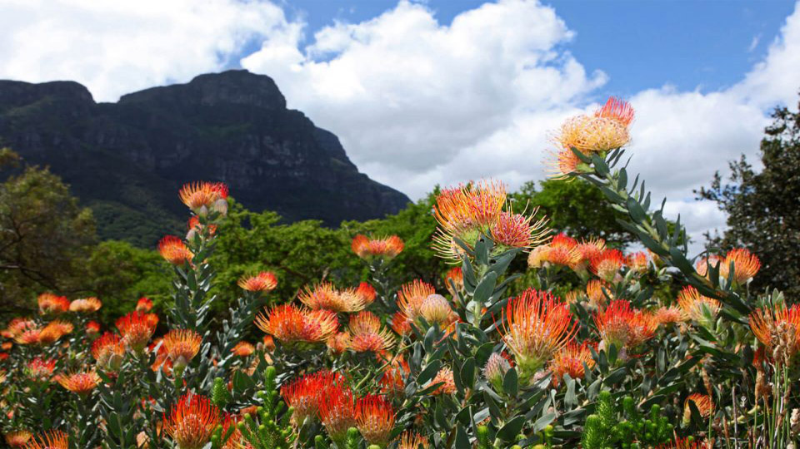

Slide 35
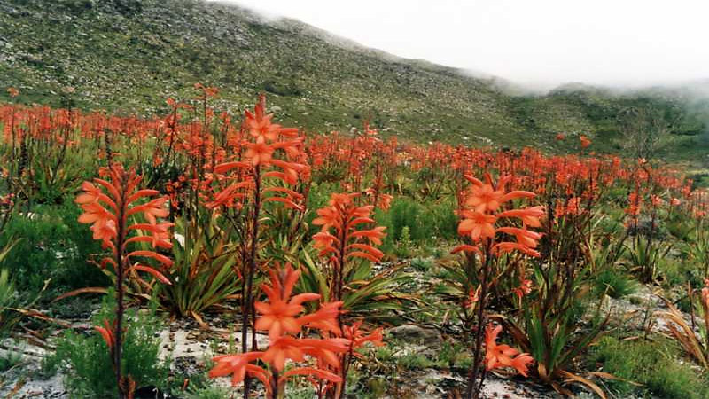
Watsons in Silvermine Nature Reserve in Cape Town

Slide 36
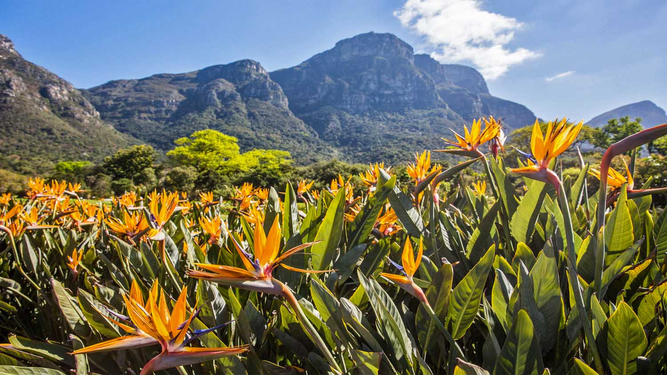

Slide 37
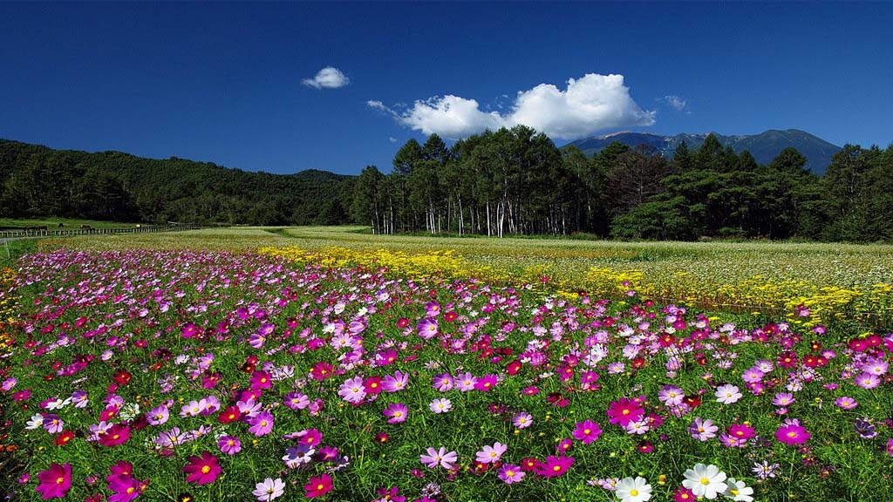
Cosmos Flowerfield in a grassland near Harrysmith, Free State; South Africa

Slide 38
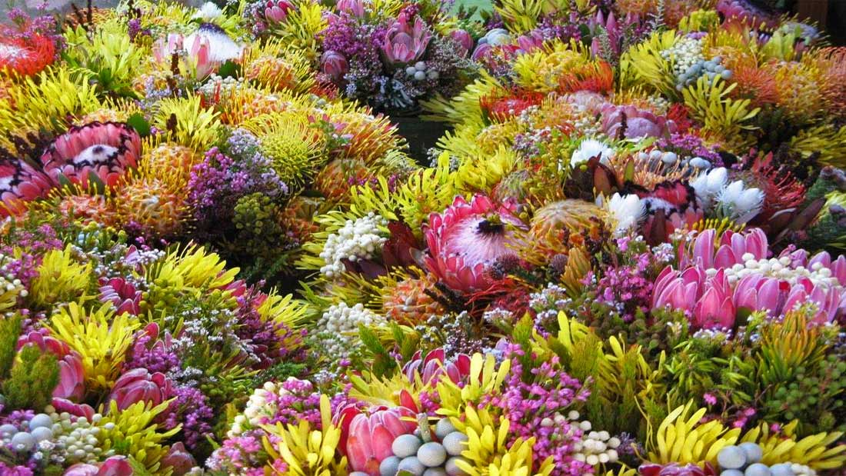
Blooming Fynbos of Cape Floral Kingdom around Cape Town, Hermanus and the Overberg region

Slide 39
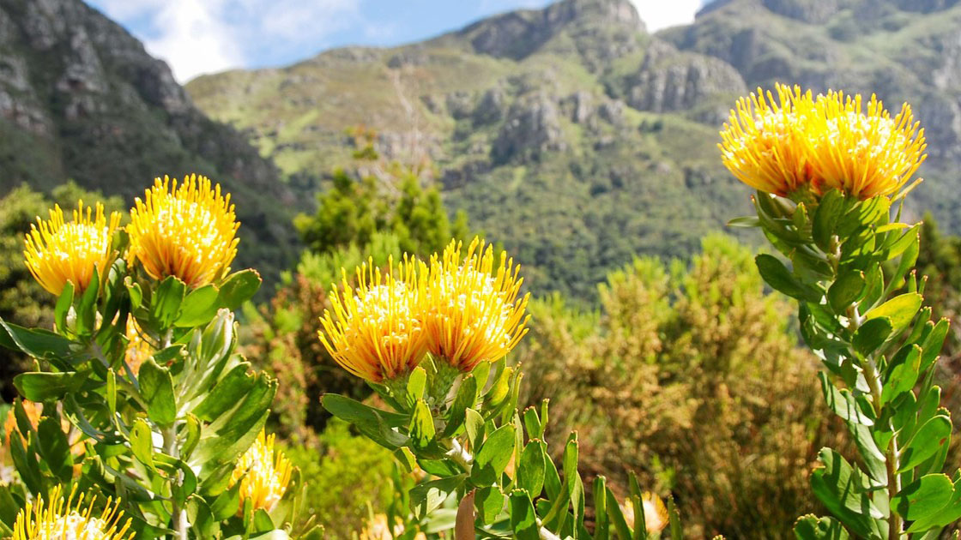
Blooming Fynbos at Kirstenbosch Gardens

Slide 40
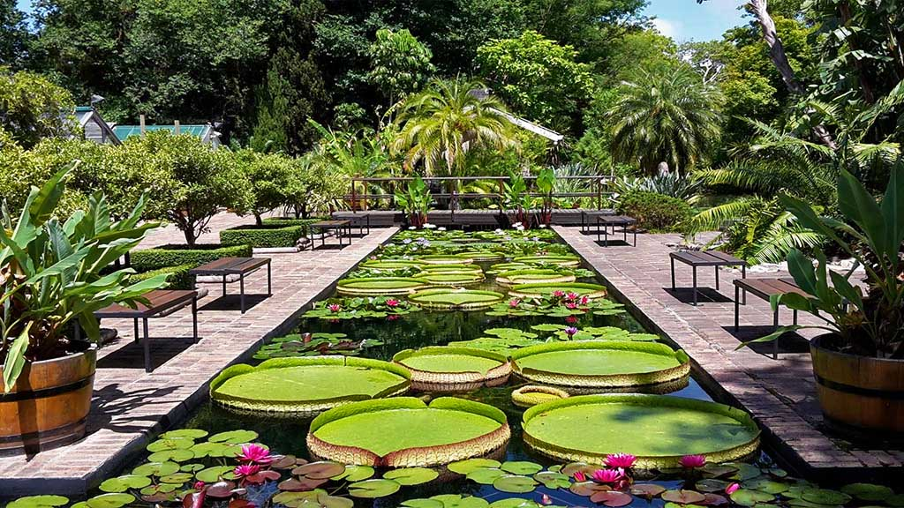
The Stellenbosch University Botanical Garden, located in the historical center
of Stellenbosch, is the oldest university botanical garden near Cape Town.

Slide 41

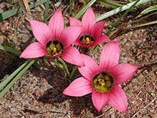
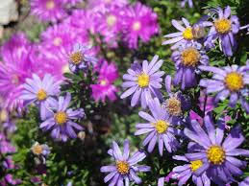
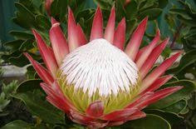
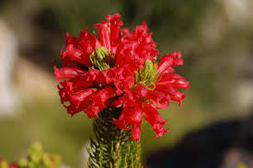
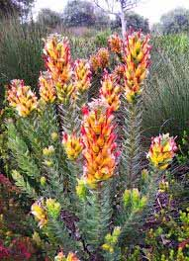
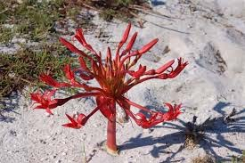
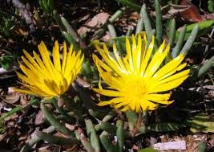
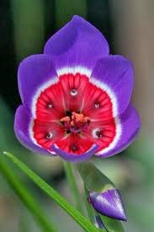
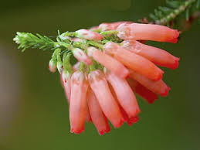
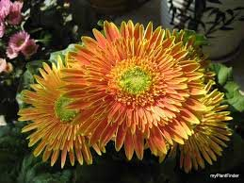
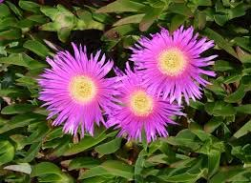
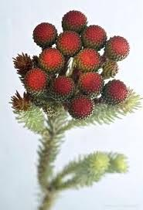




Here is a collection of some of the Fynbos Flowers of South Africa

Slide 42

King Protea Flower – The National Flower Of South Africa

Slide 43

Ending with a panoramic sunset at the South African Kruger National Park

Slide 44

Hope this presentation was interesting.
Have a nice day.
Tony Chacko and Steve Rumpler
WILD
FLOWERS
of
SOUTH
AFRICA

Slide 45







¿Te ha gustado?
Puedes ver más entrando
Aquí
Además puedes recibir powerpoints en tu correo electrónico suscribiéndote aquí:
F I N

