Slide 1


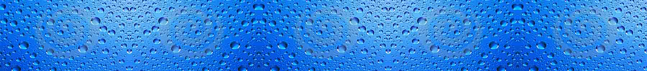
The 16 Most Beautiful
Coral Reefs In The World
The oceans and seas are incredible things of beauty, with a fascinating mix of underwater gardens and marine life. Of particular importance are the stunning coral reefs, which act as a protection mechanism to coastlines and a home to an array of ecosystems. Many of them are, unfortunately, threatened due to man-made causes and in need of preservation. Here are the most beautiful in the world.
Compiled by : Tony Chacko (tonychacko2000@gmail.com)
Technical cooperation : Steve Rumpler (pista2011@gmail.com)

Slide 2
The 16 Most Beautiful
Coral Reefs In The World
The Maldives are made up of 1,200 islands and 26 atolls; the waters feature a beautiful landscape of corals and vibrant array of marine life.
Australia’s Great Barrier Reef (a UNESCO Heritage Site) is one of the most beautiful reefs in the world and it’s also the largest one on Earth. The reef comprises over 3,000 individual reef systems, complete with abundant colorful marine life and 400 types of coral. Situated off the coast of Queensland, it features hundreds of islands, many of which have pristine beaches that locals and tourists alike flock to every year.
The second-largest double barrier reef in the world is the New Caledonian Barrier Reef, an example of Mother Nature at her finest, complete with incredible blue waters in varying shades. Located in the South Pacific off the northeast coast of Australia, this reef is home to a variety of marine life, many of which are still in the process of being discovered and classified, with the Green turtle and 1,000 fish species already documented.
The Red Sea Coral Reef is an amazing undersea world located in between two of the hottest and most arid deserts in the world: the Sahara and the Arabian. Approximately 1,200 miles long, this reef, which is over 5,000 years old, is home to 300 hard coral species and about 1,200 fish, of which 10 percent are found only in this area.

Slide 3
The 16 Most Beautiful
Coral Reefs In The World
Located between Fiji, Vanua Levu and Taveuni Islands is the Rainbow Reef. It features a kaleidoscope of vibrant colors under the water, provided by the hard and soft corals and marine life. It has 230 hard and soft corals and close to 1,200 fish species, creating a feast for the eyes.
Tubbataha Reefs in the Philippines is recognized as a top diving site in the world. Comprising two coral atolls, the reefs feature 600 species of fish, 360 species of coral, 11 species of sharks, 13 species of dolphins and whales, birds, plus Hawksbill and Green sea turtles.
The waters of the Raja Ampat Islands of Indonesia have 450 species of reef-building coral, making it an area with the largest coral reef biodiversity based on its size. Located in the heart of the Coral Triangle with 75 percent of all identifiable coral species, the area also has an impressive 1,427 species of fish. With the abundance of biodiversity, it should come as no surprise that Raja Ampat is a favored spot among divers.
This beautiful hidden Palancar Reef off the coast of the island of Cozumel in Mexico is part of the bigger Mesoamerican reef system, the second-largest on Earth. The dazzling array of coral serves as homes for seahorses, butterfly fish, sea fans, squirrel fish, parrot fish, and many others.

Slide 4
The 16 Most Beautiful
Coral Reefs In The World
The Wakatobi National Park is 1.39 million hectares Reef System, and its blue-green water is home to 750 coral reef species out of the world’s 850, making it a spectacular place to explore. This underwater gem is located off the south-east portion of Sulawesi, Indonesia. It has around 942 species of Fish.
Located in the middle of the Indian Ocean, the Great Chagos Archipelago comprises 55 islands, and the Great Chagos Bank happens to be the largest coral atoll in the world and also the least polluted and the most protected. Half of the world’s coral is located here, with endemic varieties such as the Ctenella chagius, coral that resembles a brain. Add to that the rich fish population, along with turtles, dolphins, whales, and more.
Lord Howe Island is a gorgeous island located in the Pacific Ocean. There is much beauty above the sea, but once you dive into the crystal-clear blue waters, there might be even more allure beneath. A marine park and UNESCO World Heritage Site, its marine biodiversity is unique with over 90 coral species along with 500 different species of fish.
The Belize Barrier Reef Reserve System is a UNESCO Heritage Site. It has the largest barrier reef in the northern hemisphere, plus several other highlights like coastal lagoons and mangrove forests. The reef itself contains 106 hard and soft coral species plus 500 species of fish (East of Central America).

Slide 5
The 16 Most Beautiful
Coral Reefs In The World
At 13 miles long, the Apo Reef, located in the South China Sea on the Mindoro Strait, is the second-longest continuous coral reef on the planet. Underneath deep blue waters are a smashing array of corals in blues and pinks along with marine life such as trigger fish and sea turtles.
Known as ‘The Diver’s Paradise’, the Bonaire Reef is home to a dazzling display of hard and soft corals in bright blues, greens, yellows, purples, and pinks, like an artist’s palette. Located in the Dutch Caribbean, the waters are crystal clear, allowing divers to see clearly the rich marine biodiversity.
The Grand Central Station and Chimneys, located in Fiji, known as the ‘soft coral capital of the world’, is home to an abundance of corals and marine life. The area features 400 corals (that scientists know of) 445 documented marine plants, and over 100 invertebrate species.
Stretching for more than 1200 miles (2000 km) in the Central Pacific, are the Hawaiian Coral Reefs. Even though they may appear to be nothing but rock, reefs are alive. Corals give reefs their structure. About one-fourth of the plants, fish, and invertebrates found in the Hawaiian coral reef are endemic to Hawaii, meaning that they can't be found anywhere else on Earth. Reef fish continue to be a dietary staple for many people inhabiting and visiting Hawaii.

Slide 6
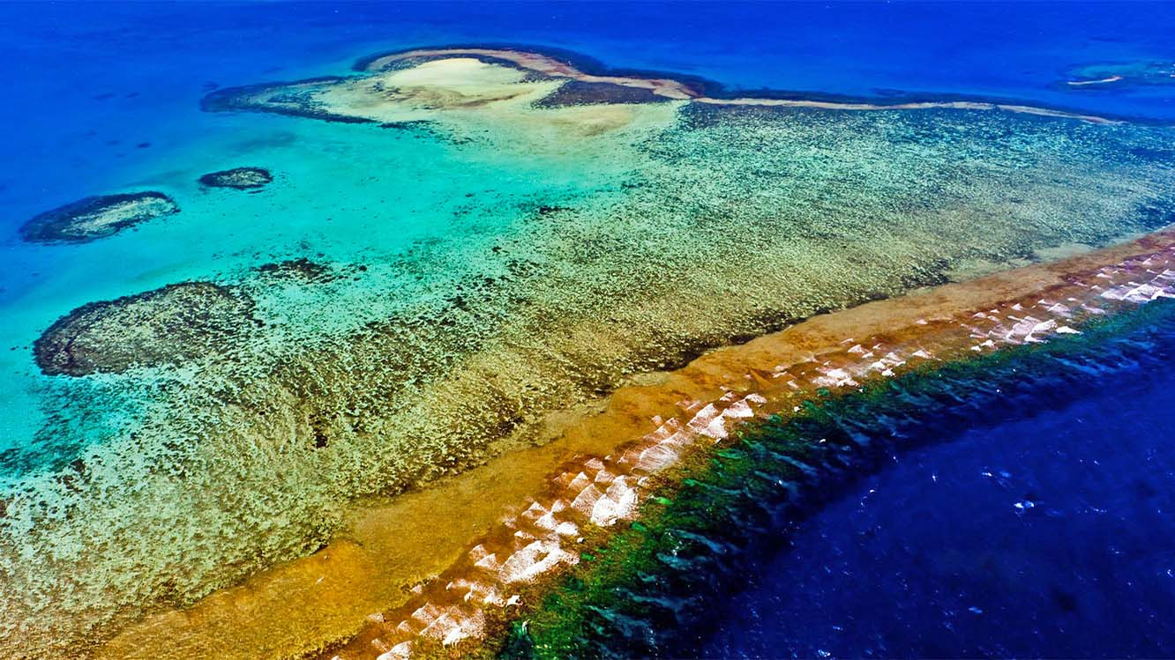
New Caledonian Barrier Reef

Slide 7
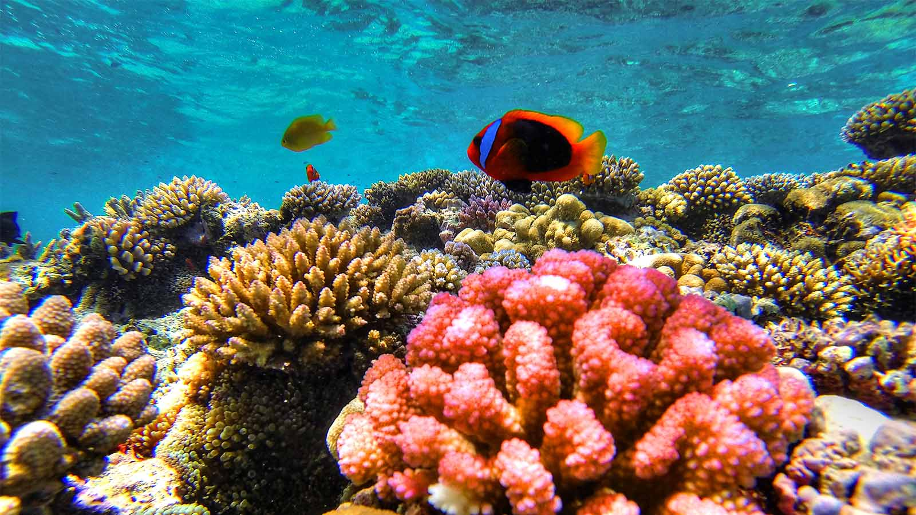
New Caledonian Barrier Reef

Slide 8
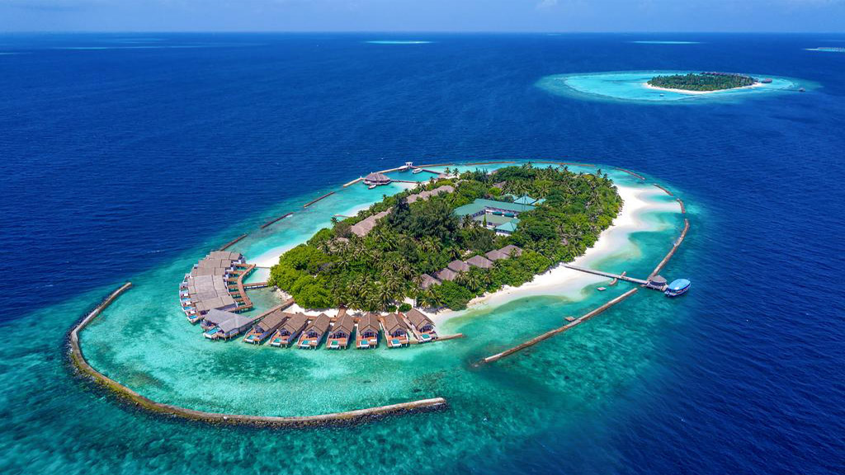
Maldive's Coral Reefs

Slide 9
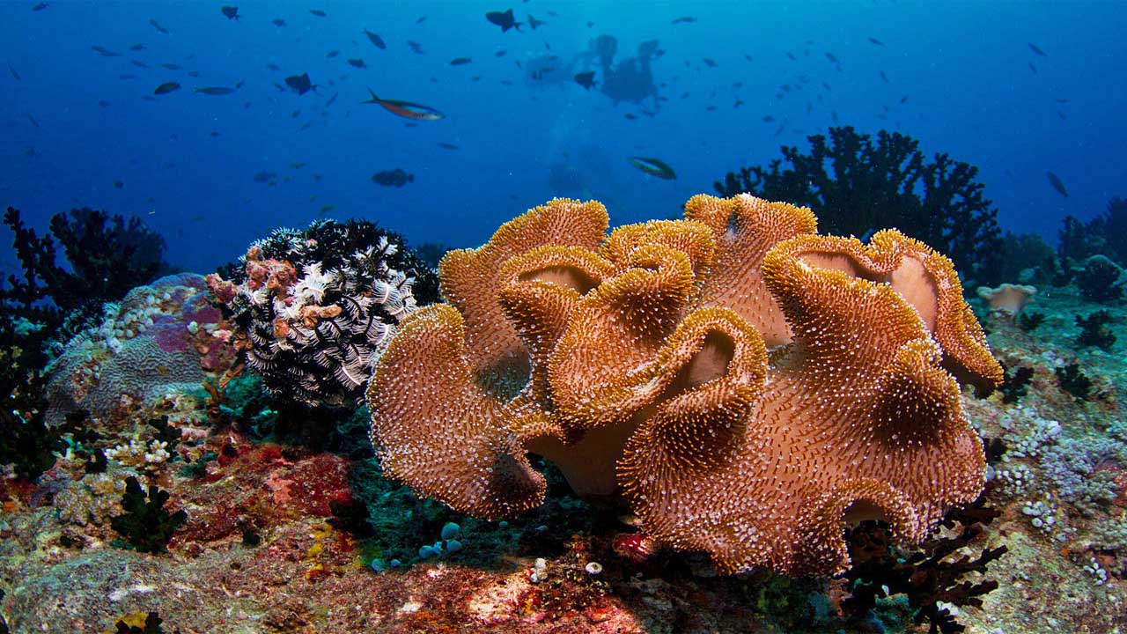
Maldive's Coral Reefs

Slide 10
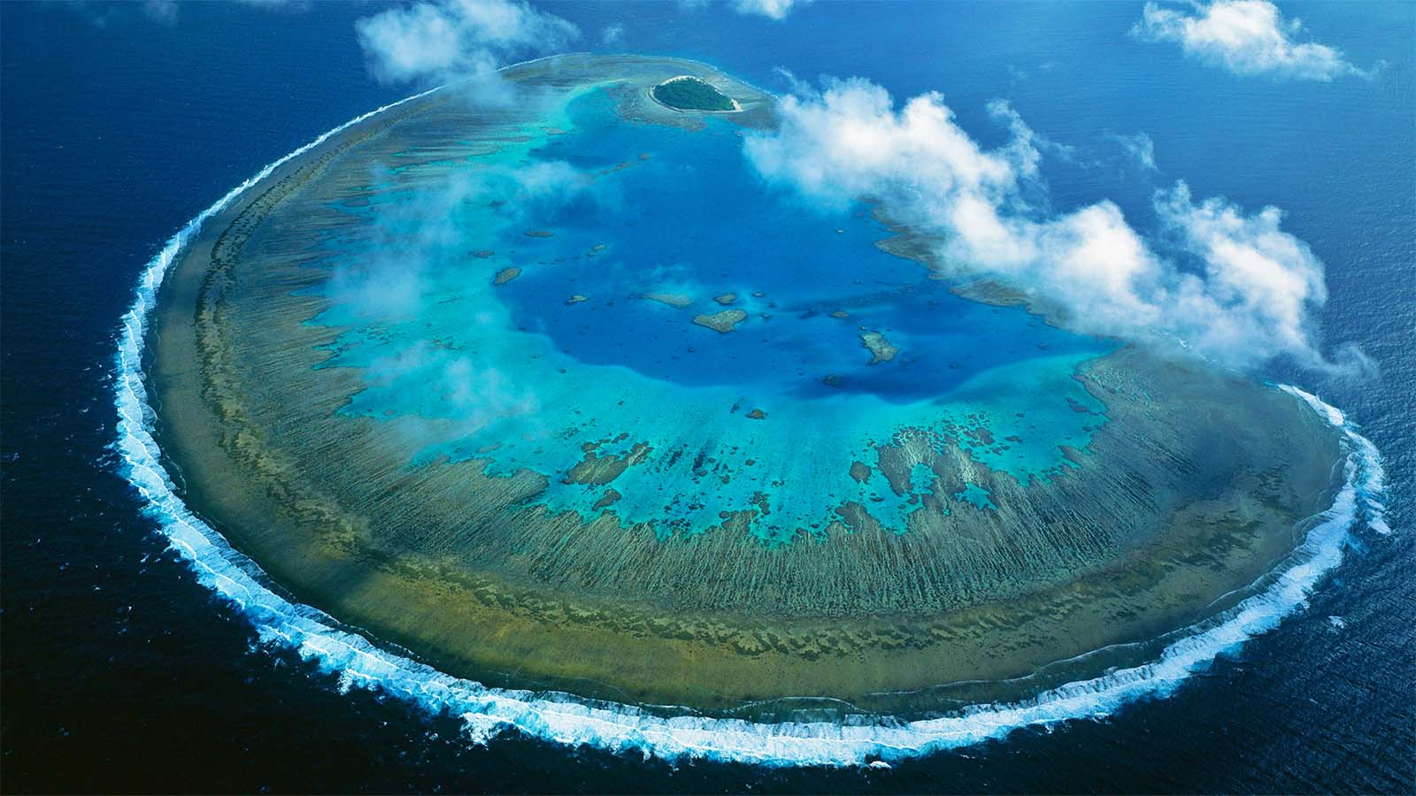
Australia's Great Barrier Reef – Fraser Island

Slide 11
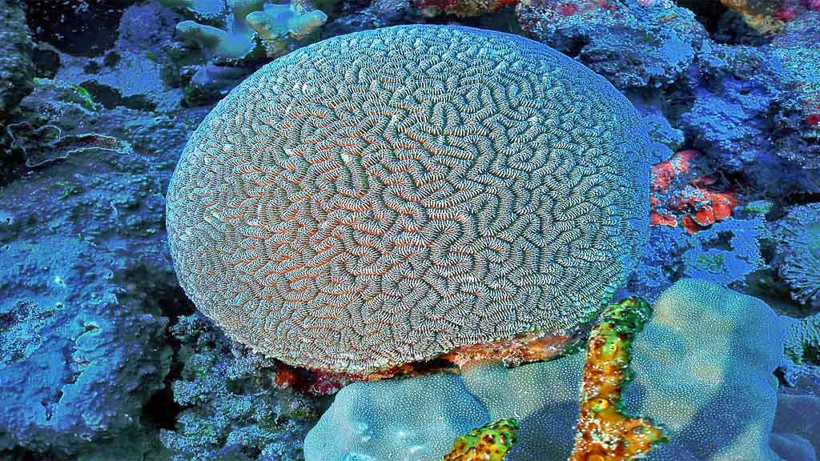
Australia's Great Barrier Reef

Slide 12
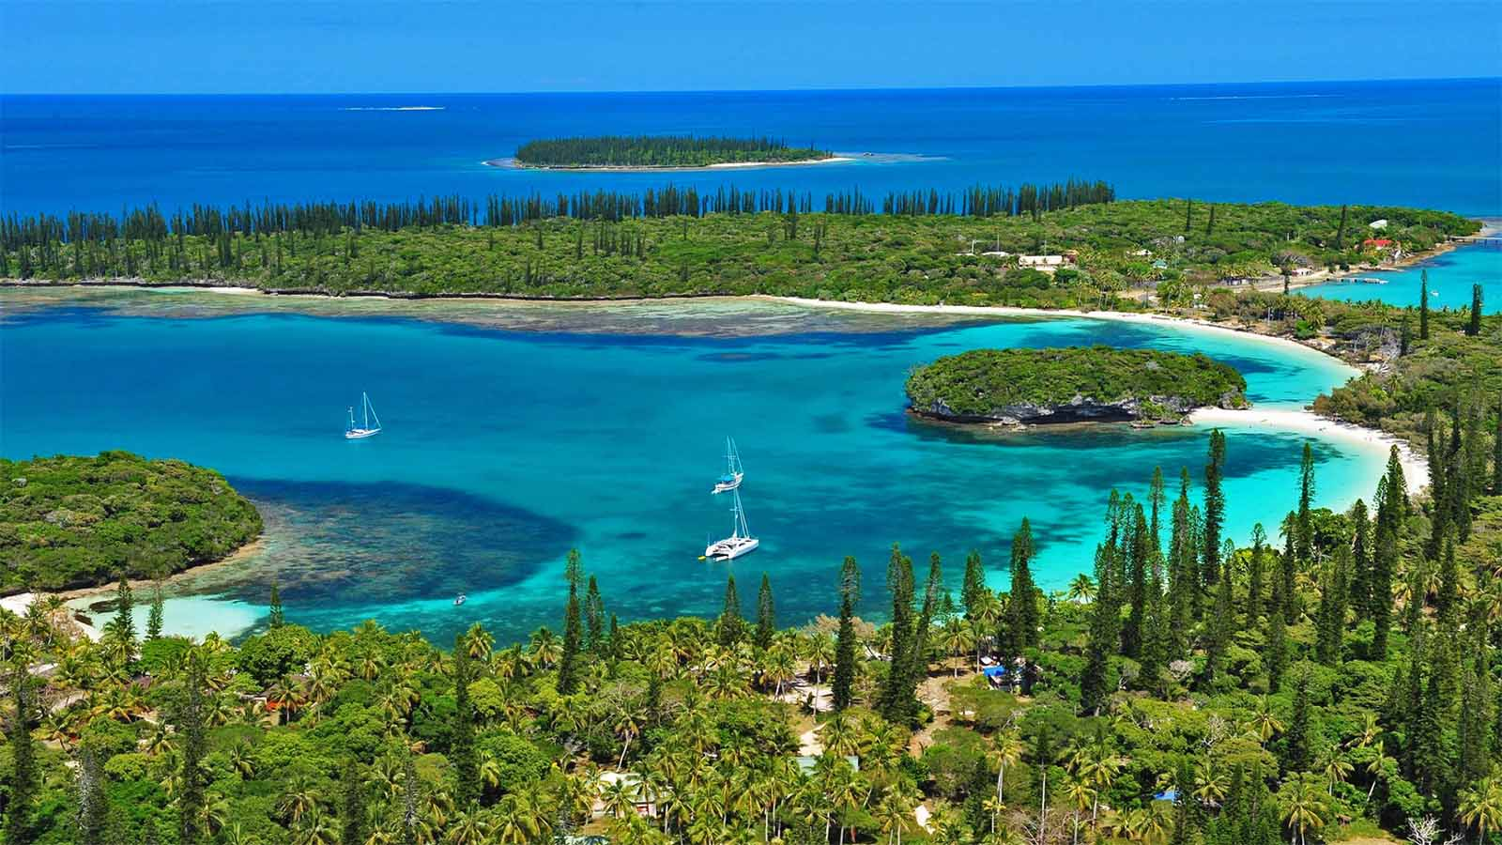
New Caledonian Barrier Reef

Slide 13
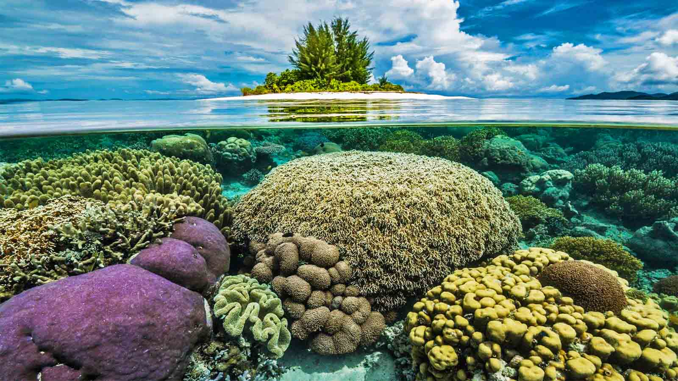
New Caledonian Barrier Reef

Slide 14
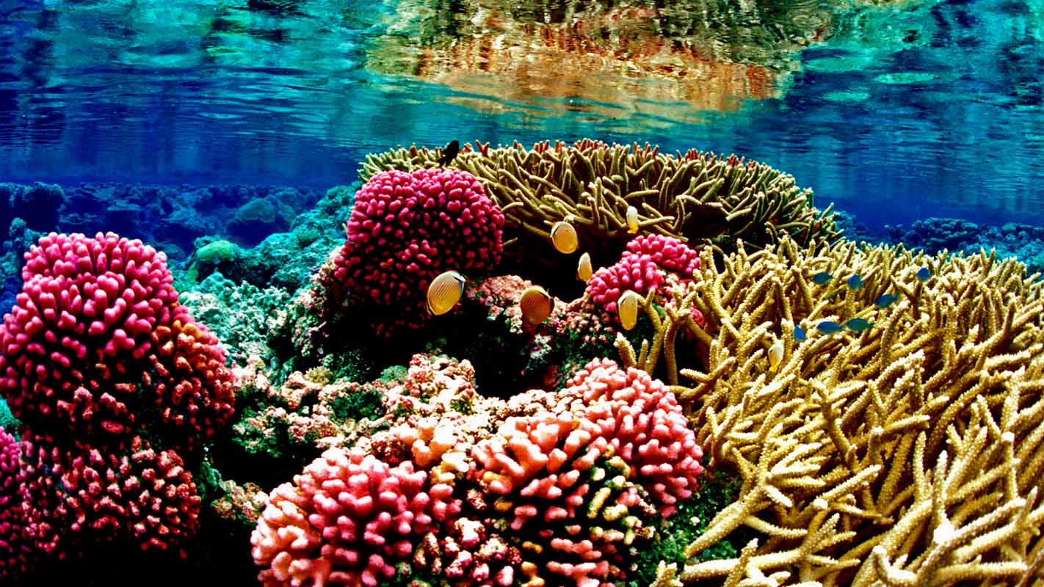
New Caledonian Barrier Reef

Slide 15
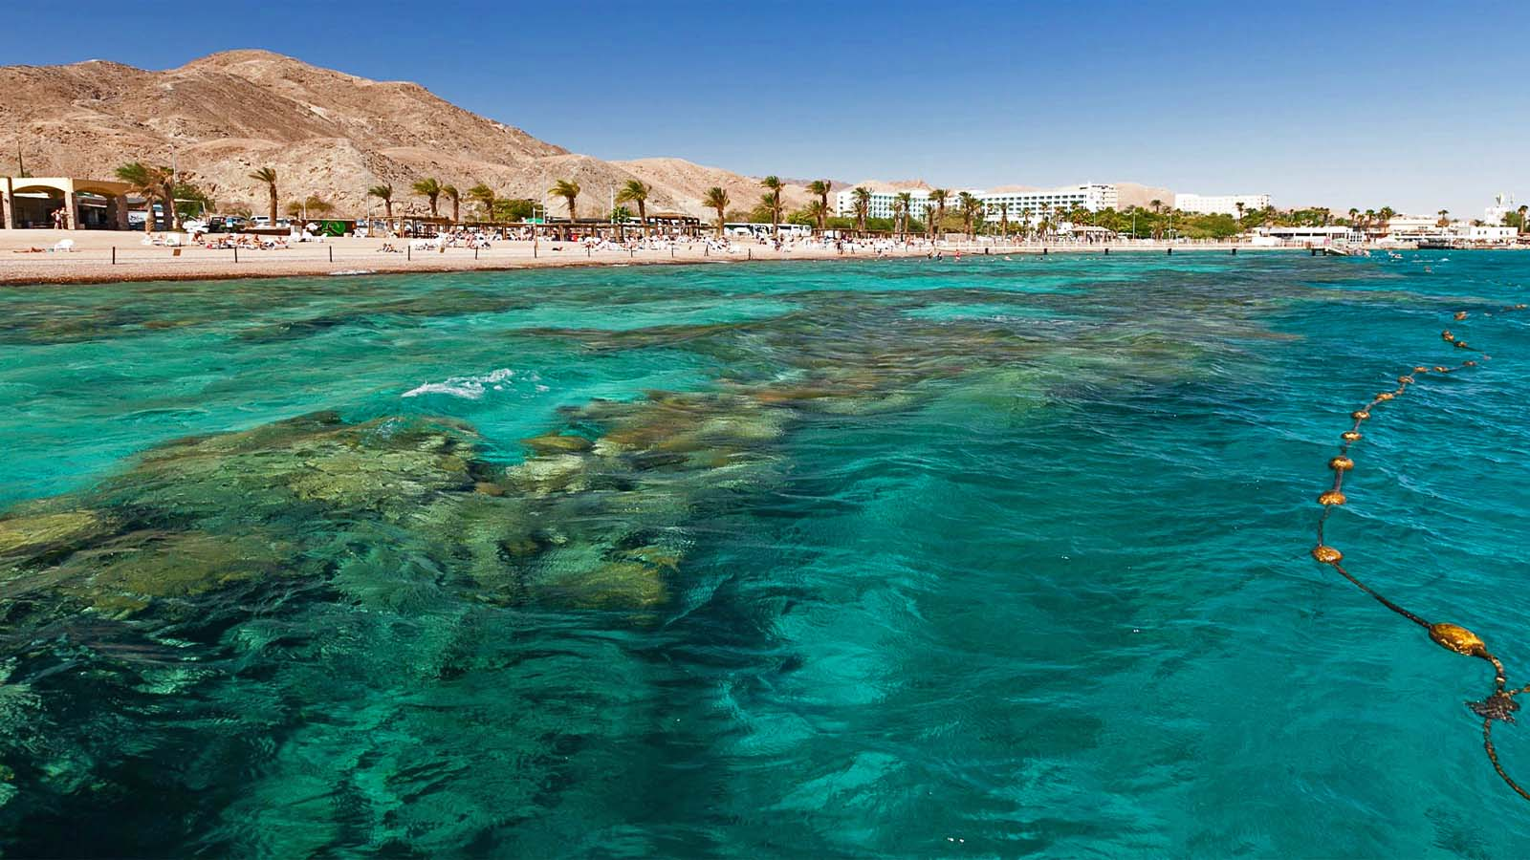
Red Sea Coral Reef

Slide 16
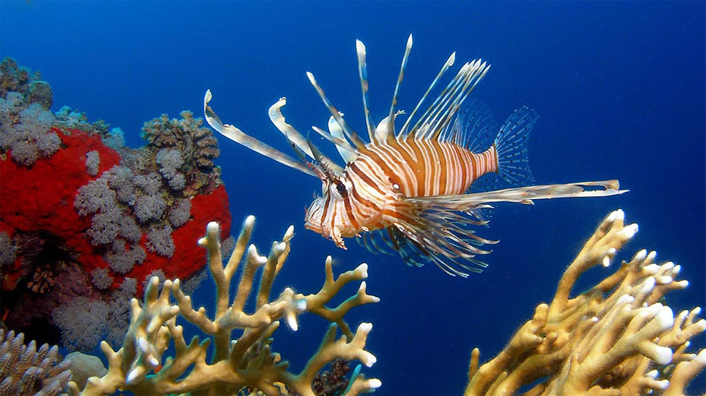
Red Sea Coral Reef

Slide 17
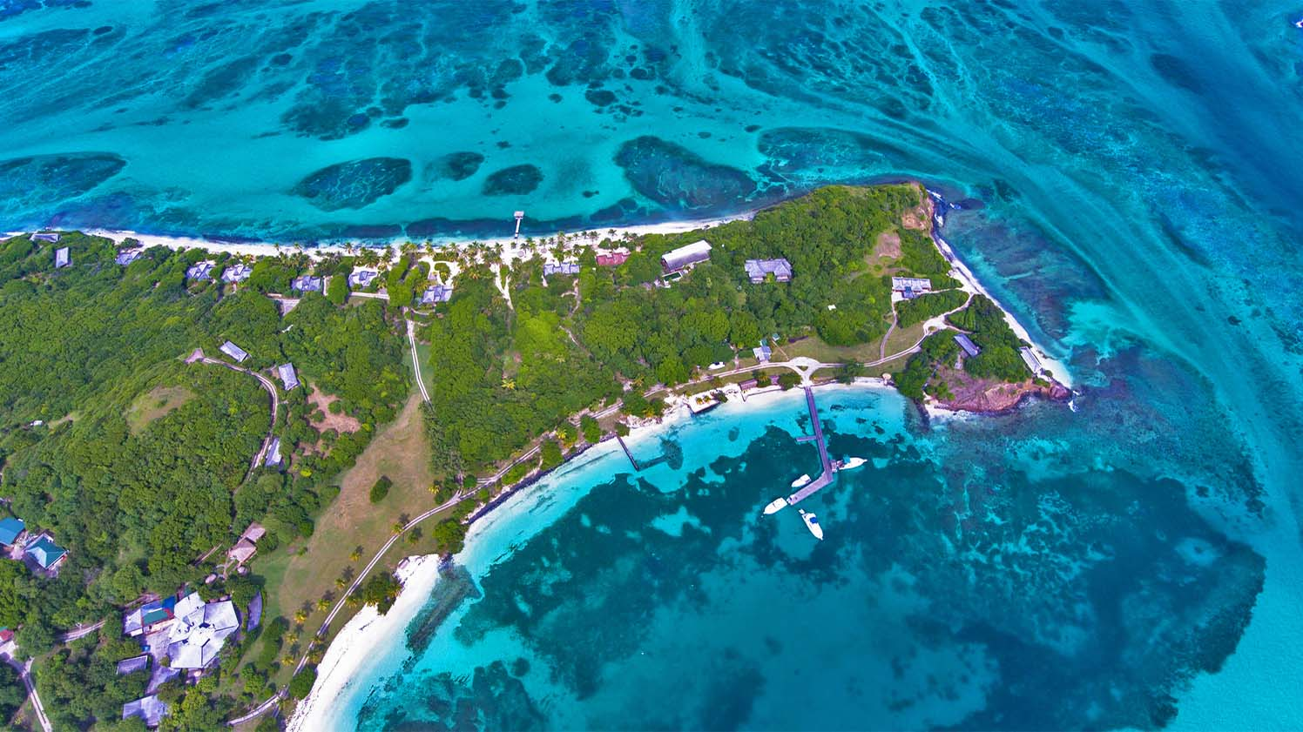
Rainbow Reef in Fiji

Slide 18
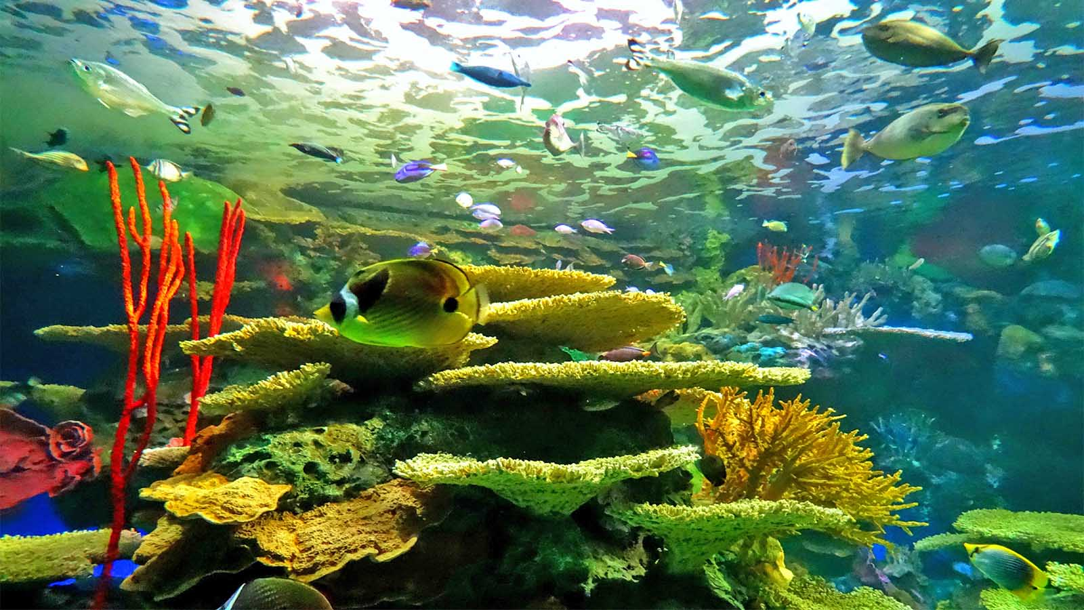
Rainbow Reef in Fiji

Slide 19
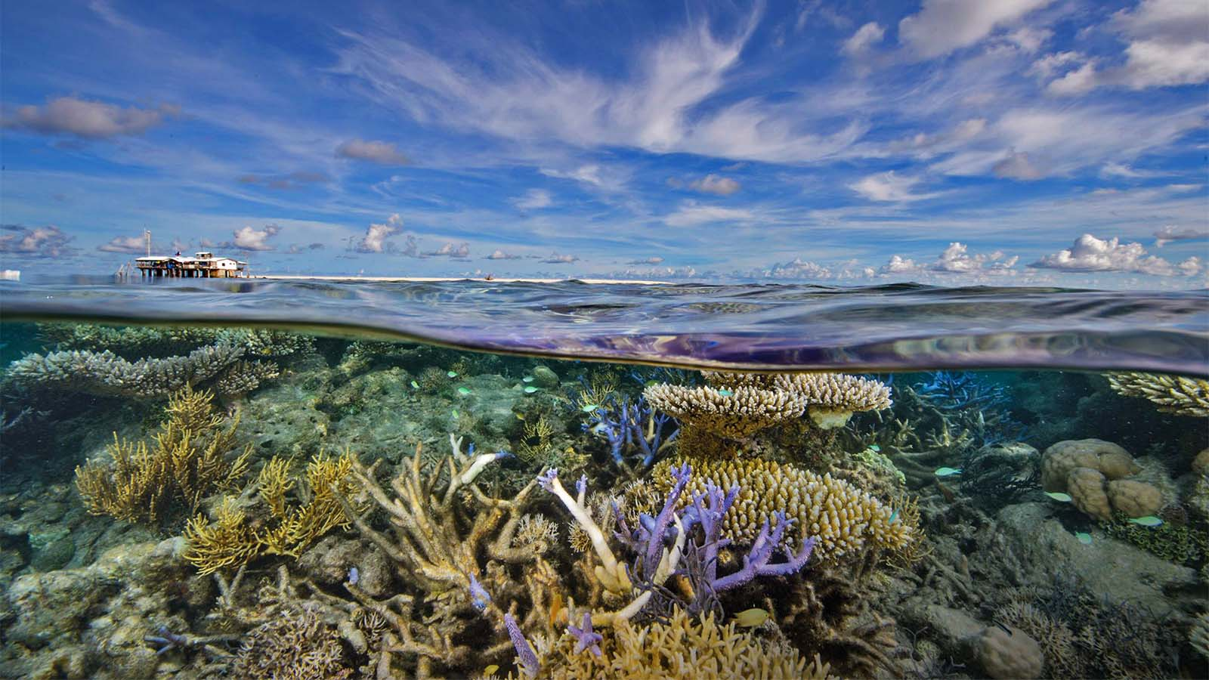
Tubbataha Reefs in Philippines

Slide 20
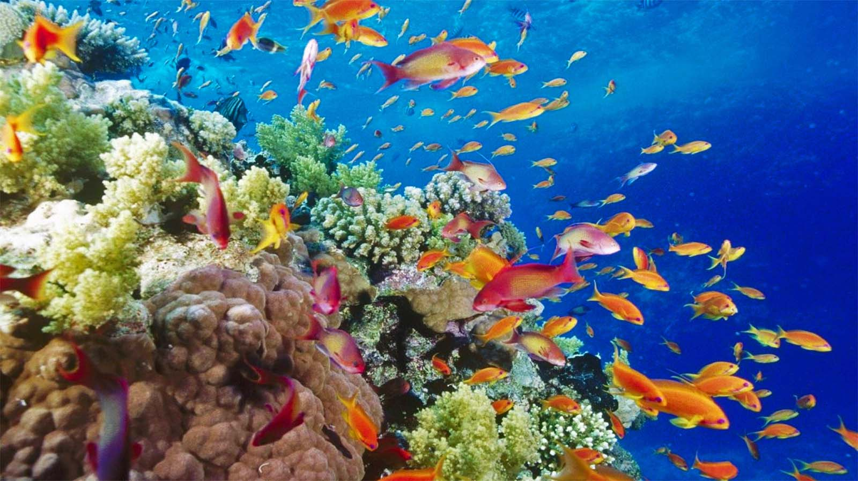
Tubbataha Reefs in Philippines

Slide 21
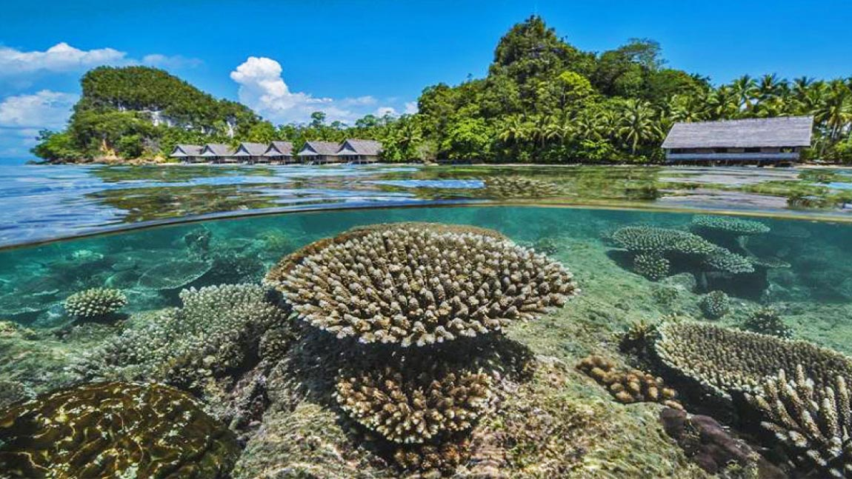
Raja Ampat Coral Reef in Indonesia

Slide 22
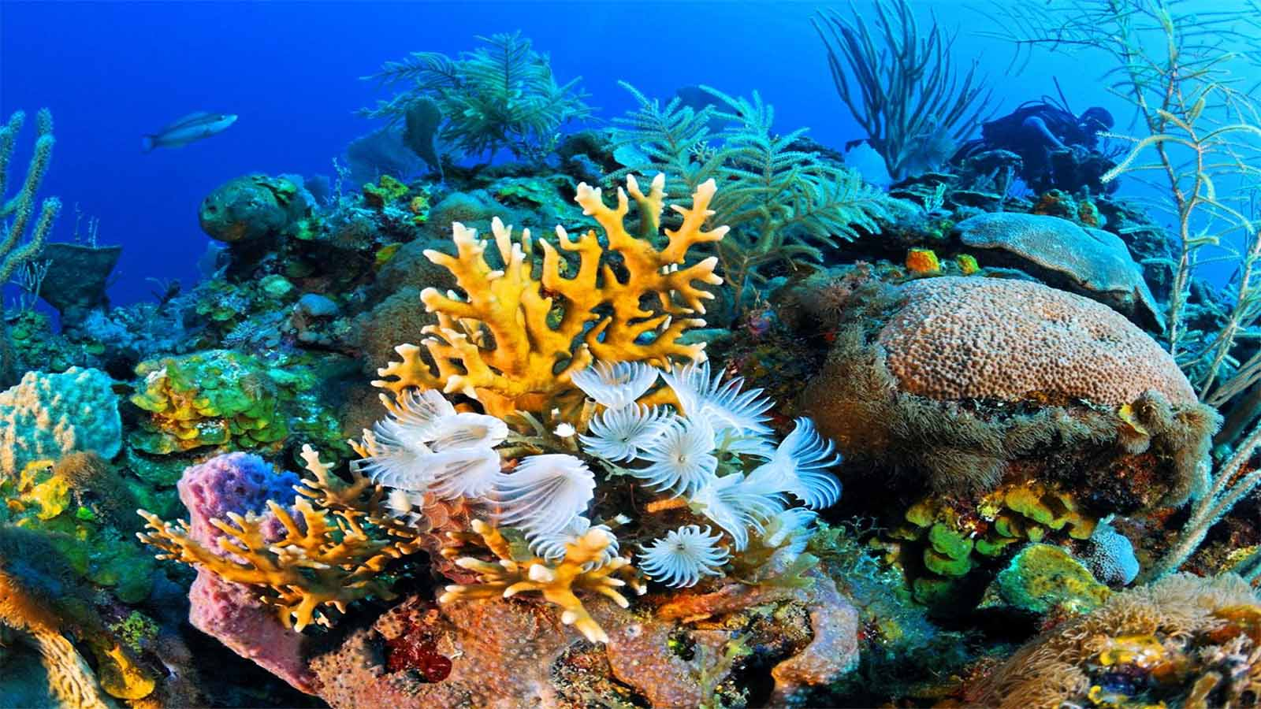
Raja Ampat Coral Reef in Indonesia

Slide 23
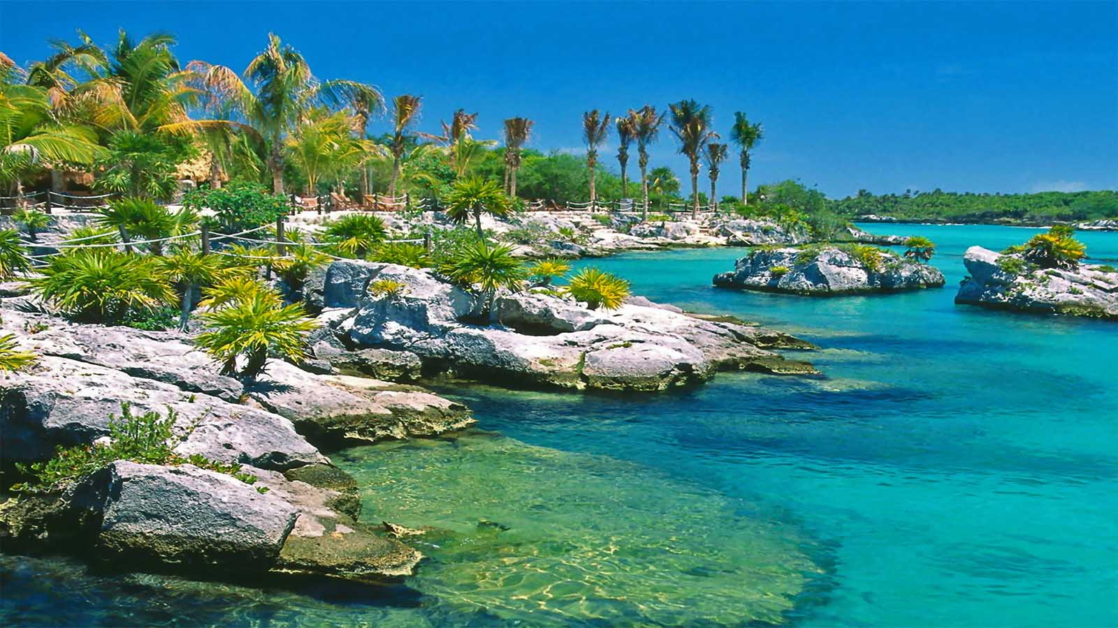
Palancar Reef, Cancún in Mexico

Slide 24
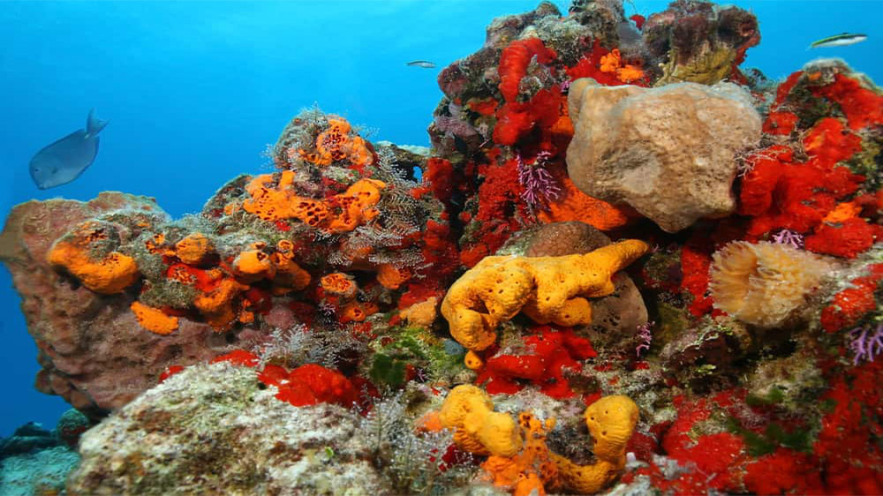
Palancar Reef, Cancún in Mexico

Slide 25
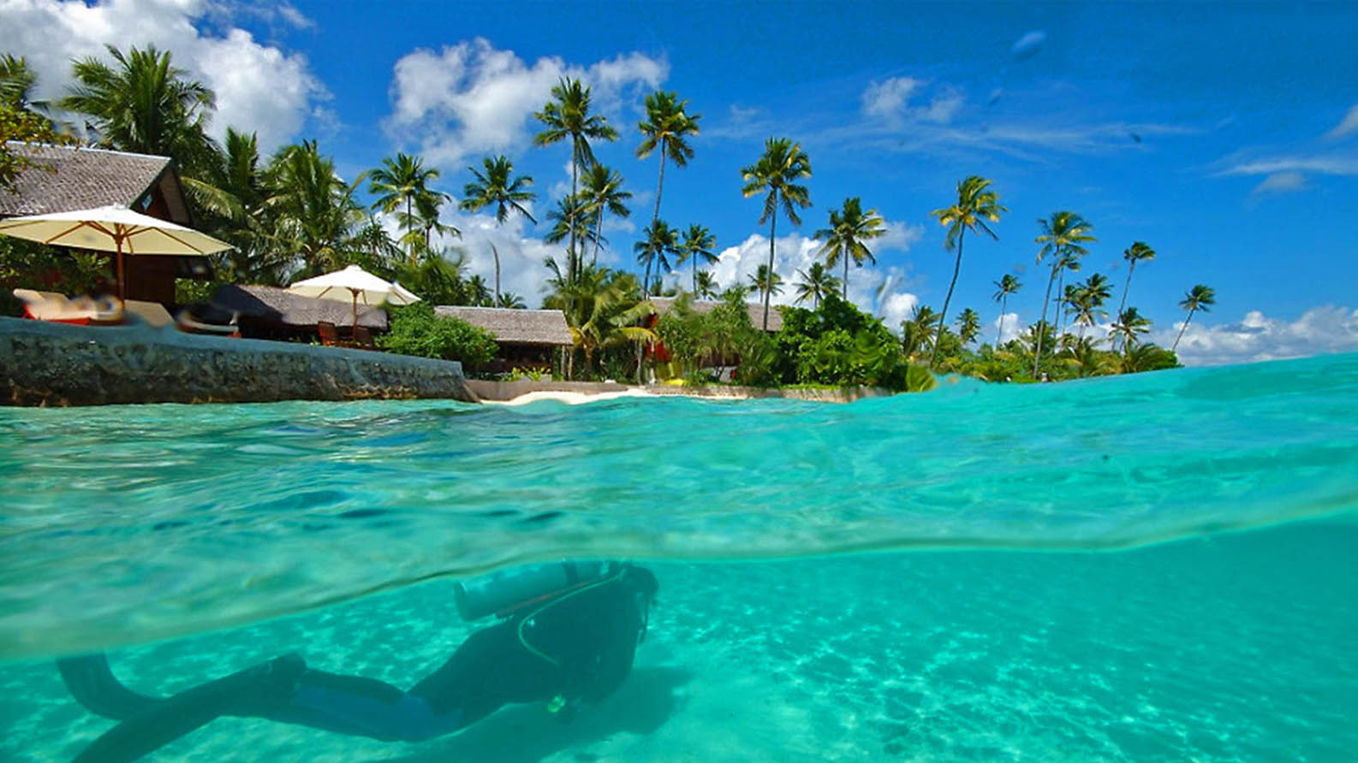
Wakatobi National Park in Indonesia

Slide 26
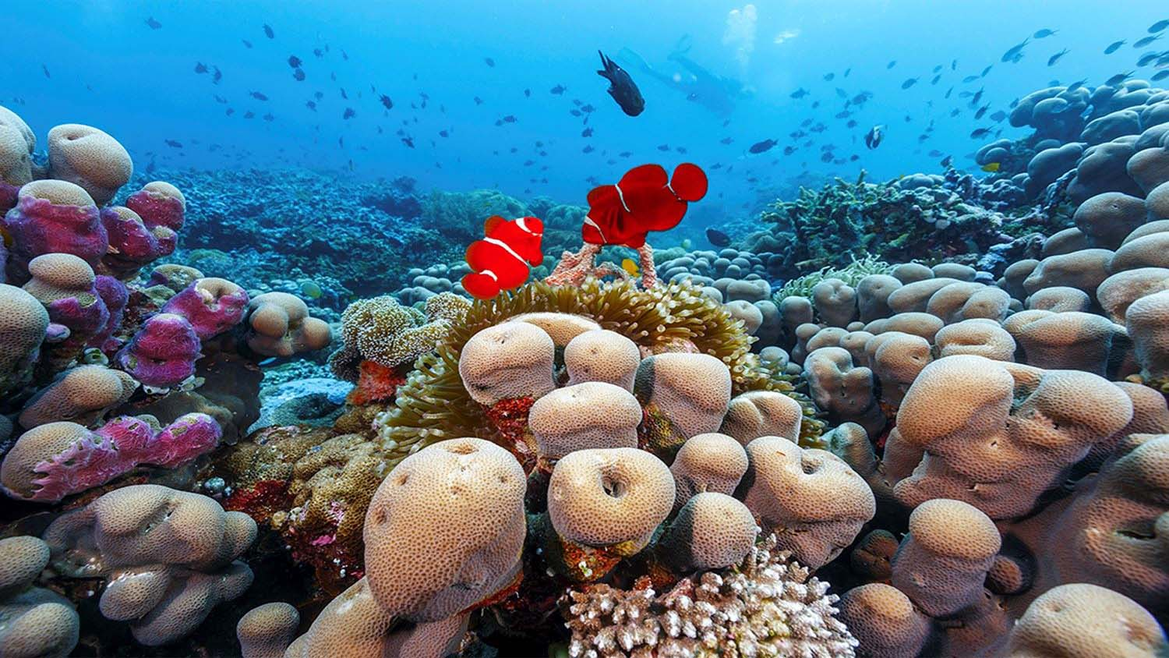
Wakatobi National Park in Indonesia

Slide 27
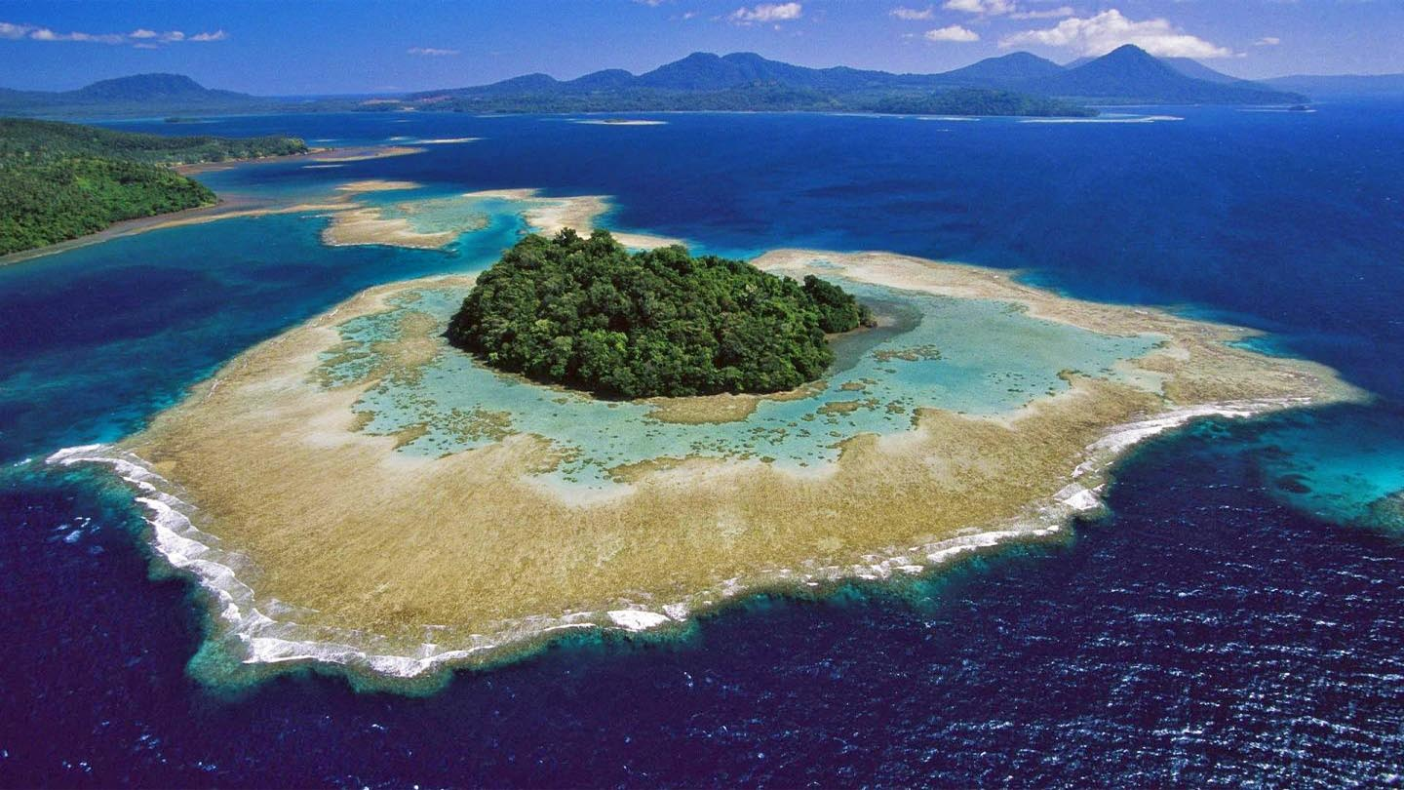
Great Chagos Archipielago in the Indian Ocean

Slide 28
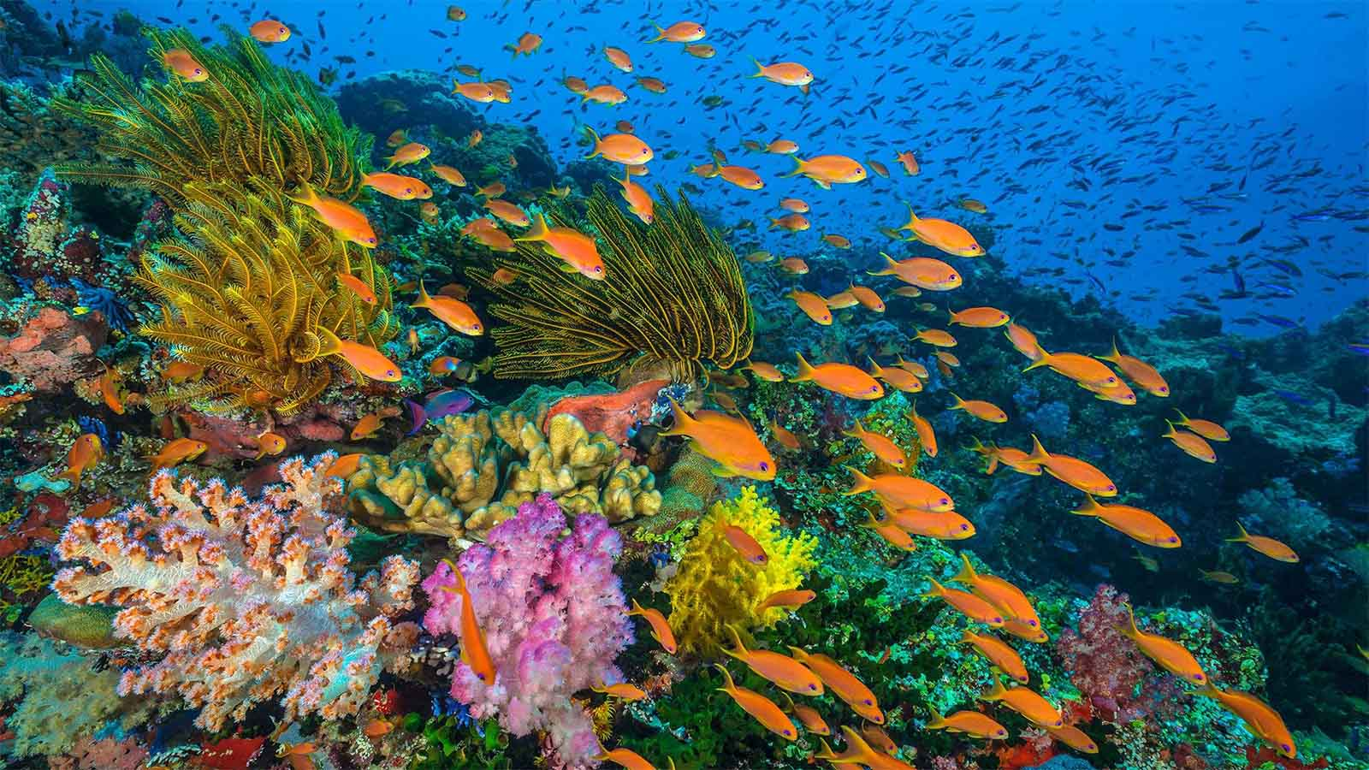
Great Chagos Archipielago in the Indian Ocean

Slide 29
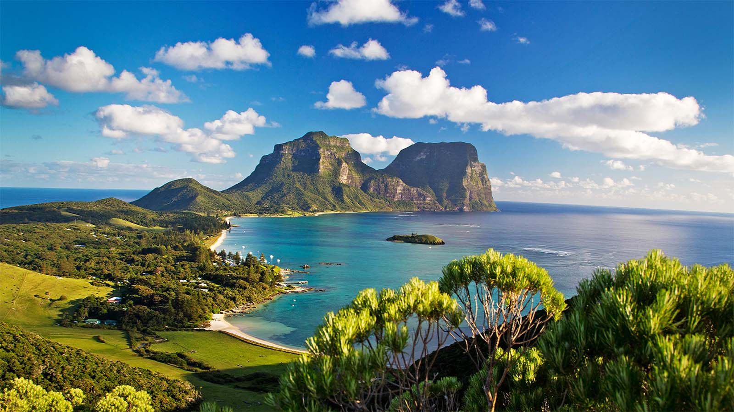
Lord Howe Island in the Pacific Ocean

Slide 30
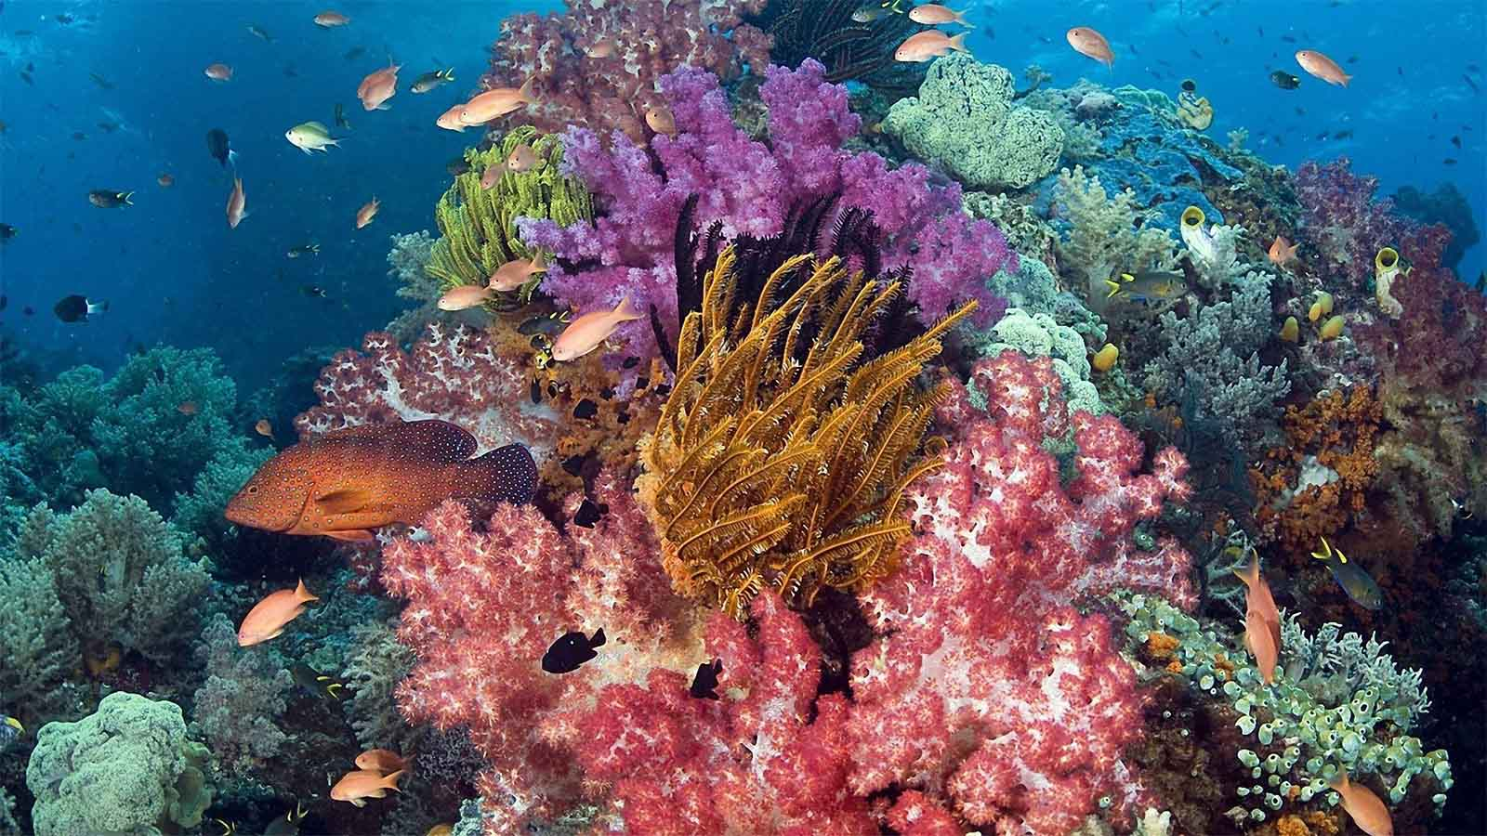
Lord Howe Island in the Pacific Ocean

Slide 31
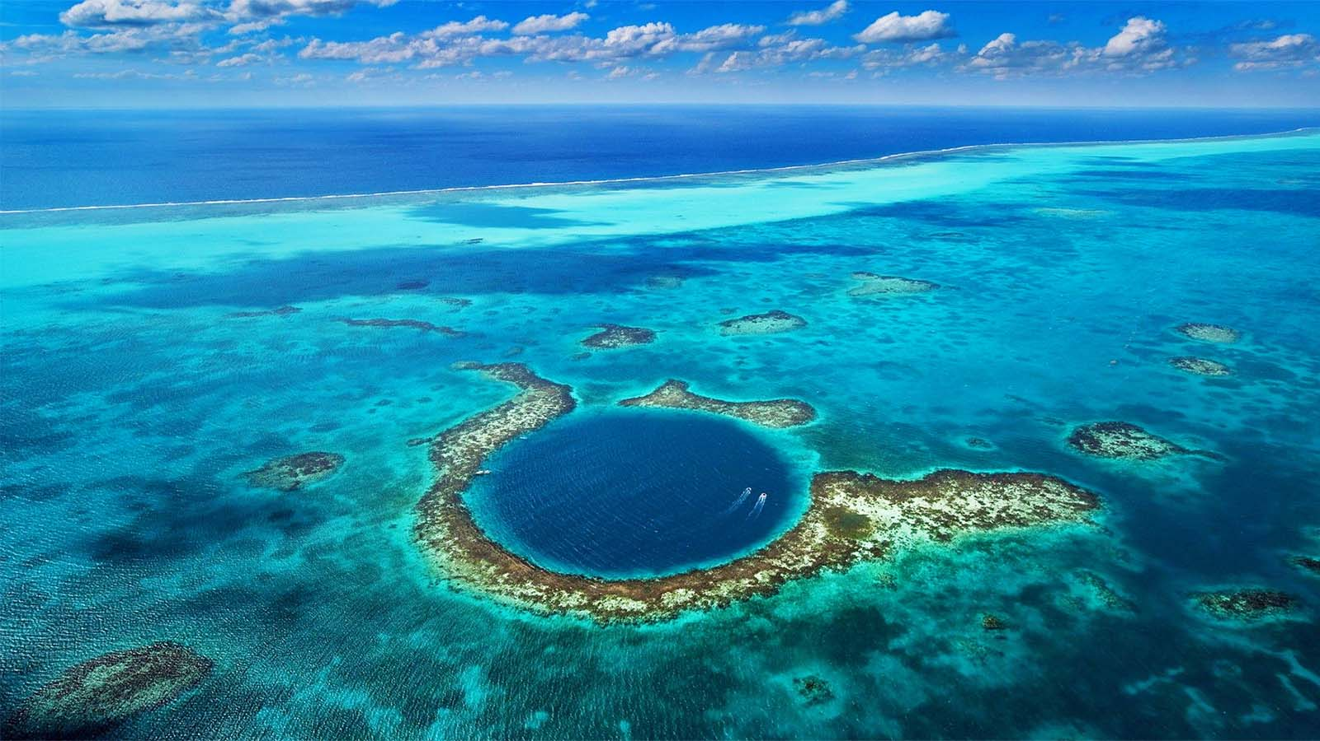
Belize Barrier Reef in the Caribbean Sea

Slide 32
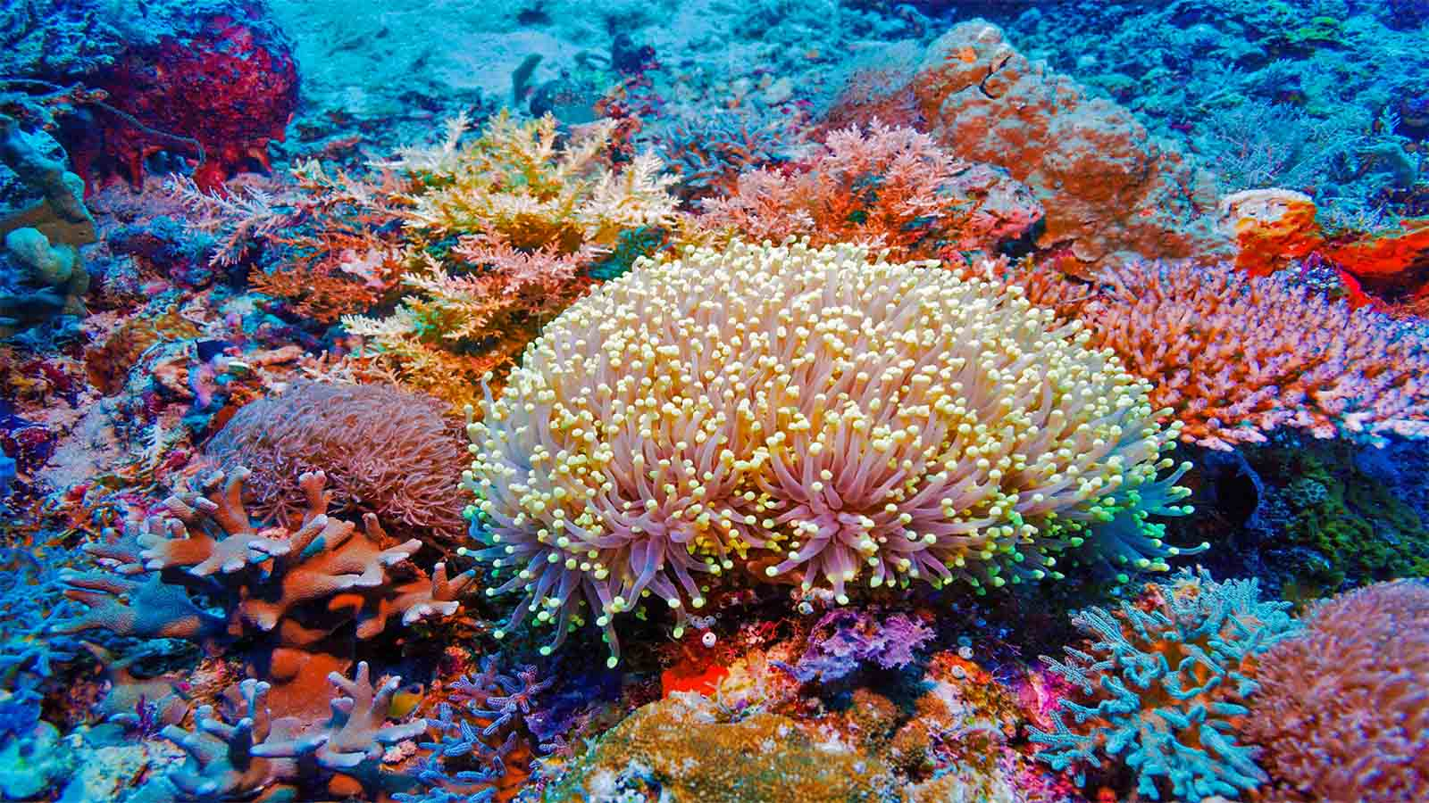
Belize Barrier Reef in the Caribbean Sea

Slide 33
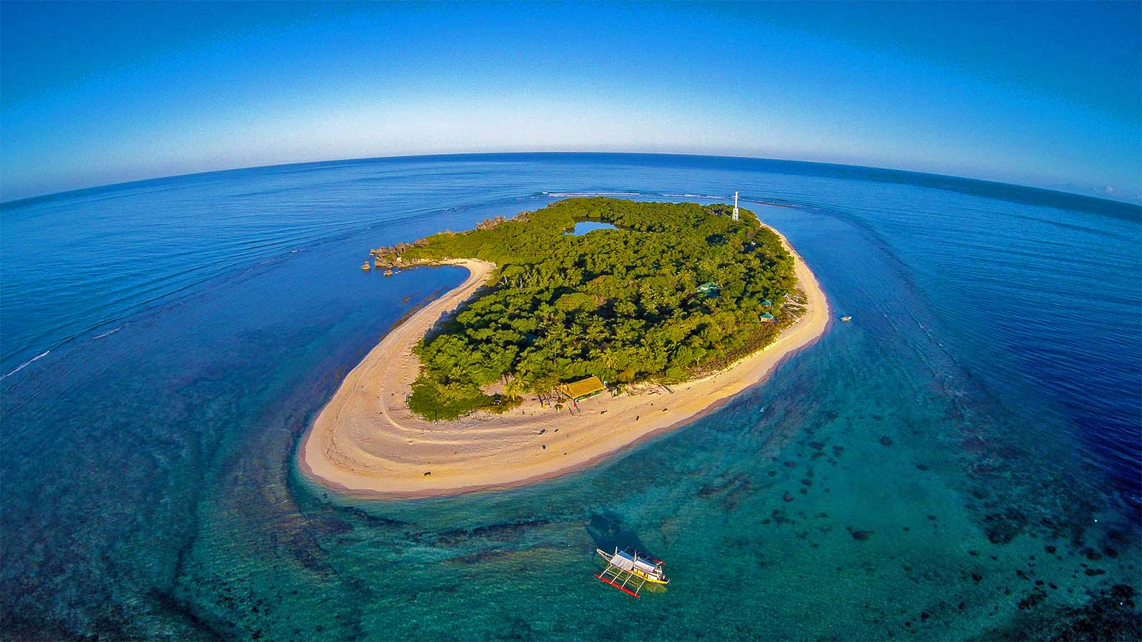
Apo Reef Natural Park in Philippines

Slide 34
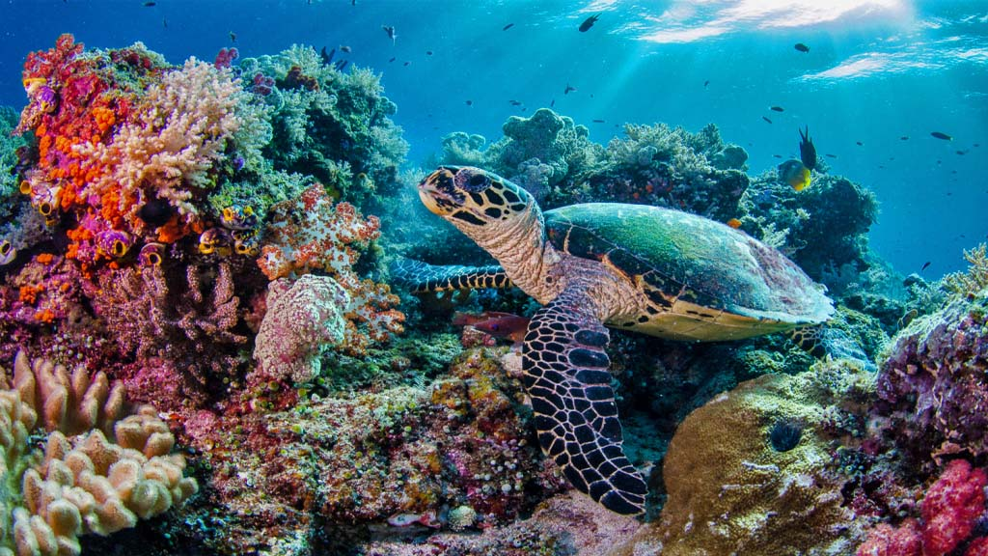
Apo Reef Natural Park in Philippines

Slide 35
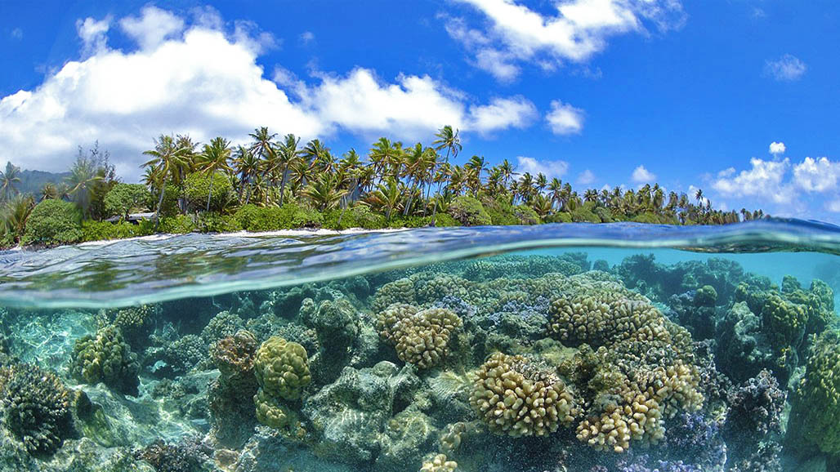
Bonaire Reef in the Dutch Caribbean

Slide 36
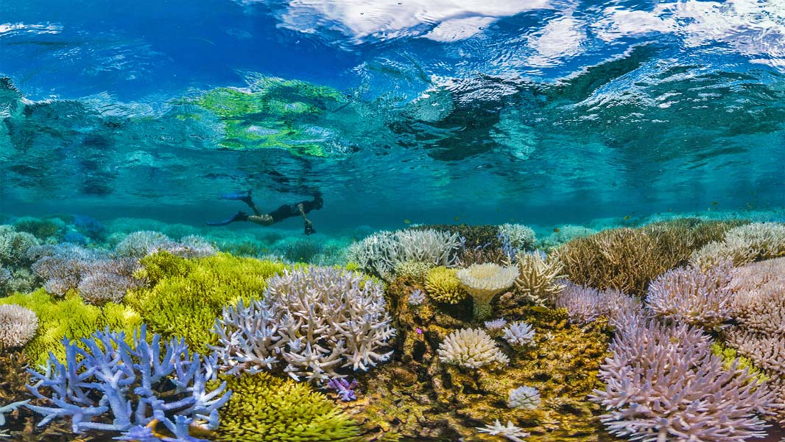
Bonaire Reef in the Dutch Caribbean

Slide 37
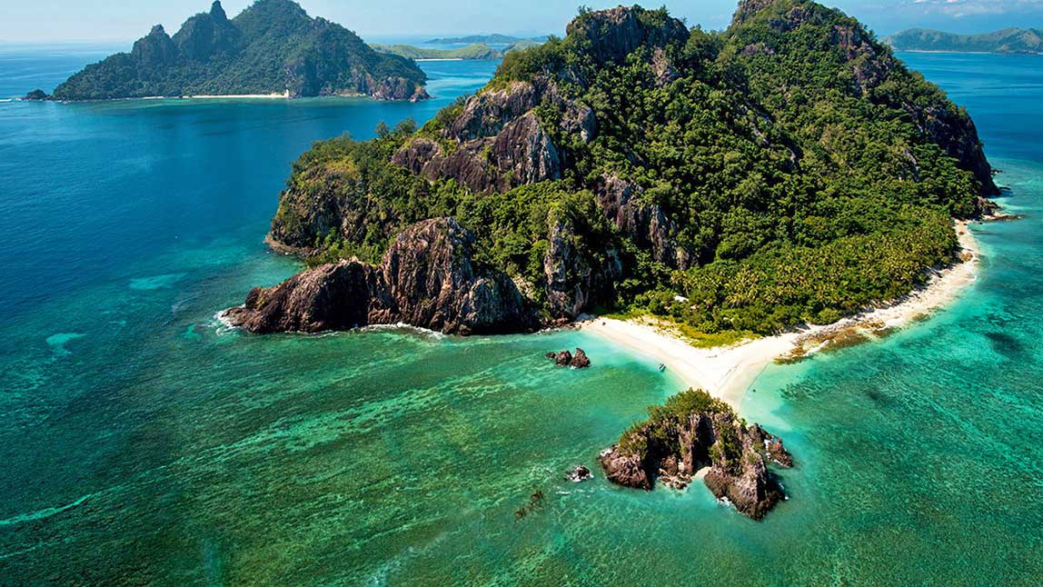
Grand Central Station and Chimneys in Fiji

Slide 38
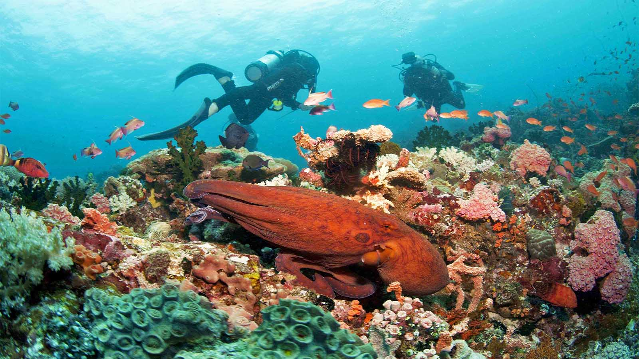
Grand Central Station and Chimneys in Fiji

Slide 39
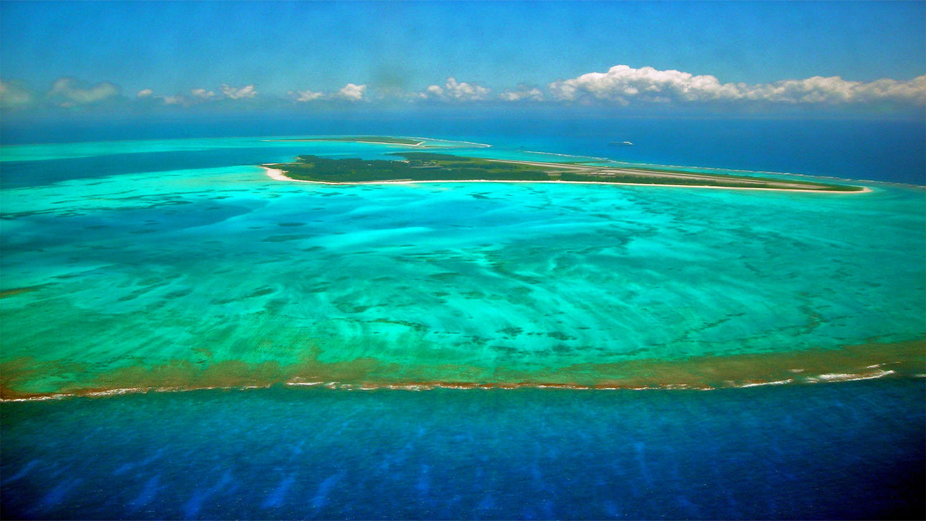
Hawaiian Coral Reefs

Slide 40
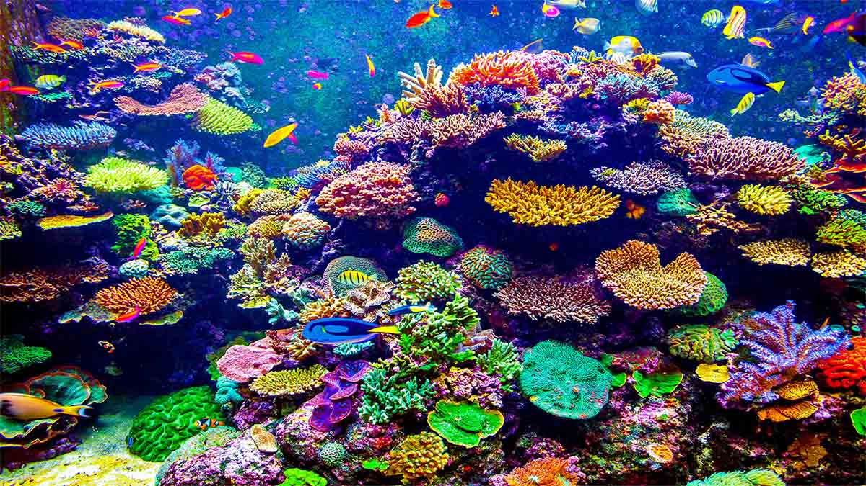
Hawaiian Coral Reefs

Slide 41


Hope you have enjoyed
viewing this presentation.
Music : Gus Teja - Romance
With best regards - Tony Chacko and Steve Rumpler
(tonychacko2000@gmail.com / pista2011@gmail.com)

Slide 42







¿Te ha gustado?
Puedes ver más entrando
Aquí
Además puedes recibir powerpoints en tu correo electrónico suscribiéndote aquí:

