Slide 1





WILDLIFE
of
2020
AUSTRALIA

Slide 2

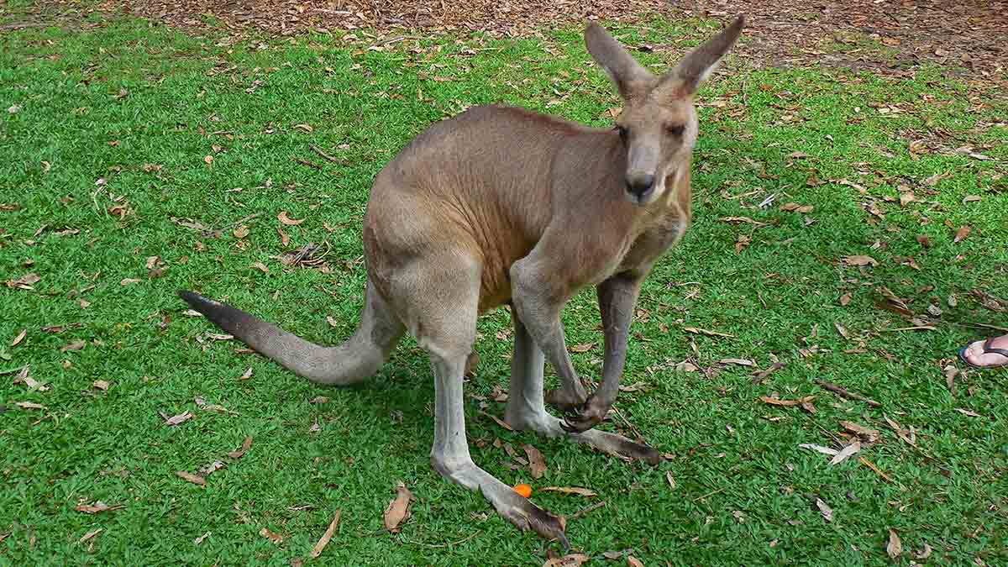
Photo © Hudec Ivan
Kangaroo

Slide 3
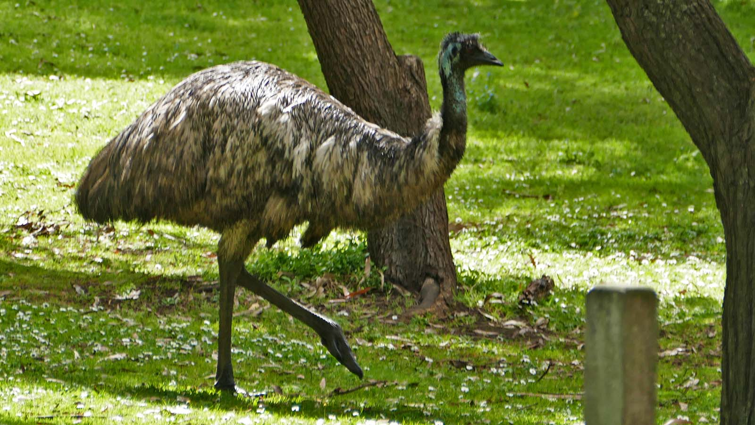
Photo © Sekerka D.
Emu

Slide 4
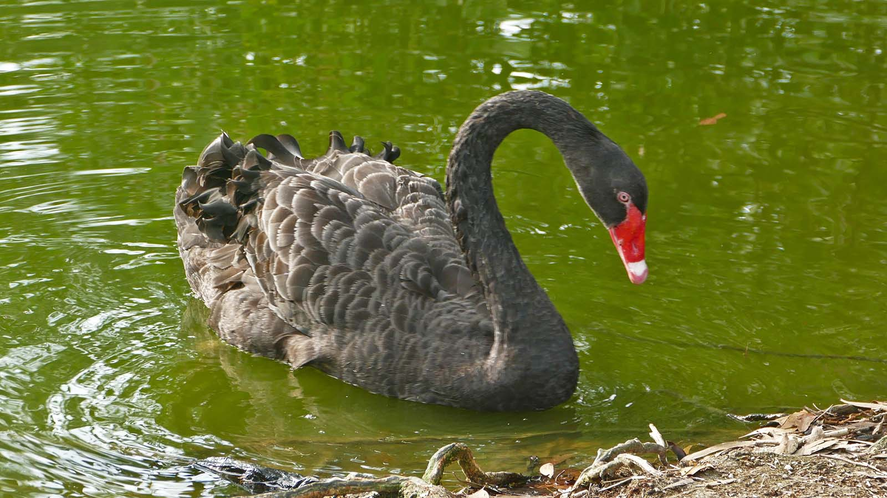
Photo © Sekerka D.
Black Swan

Slide 5
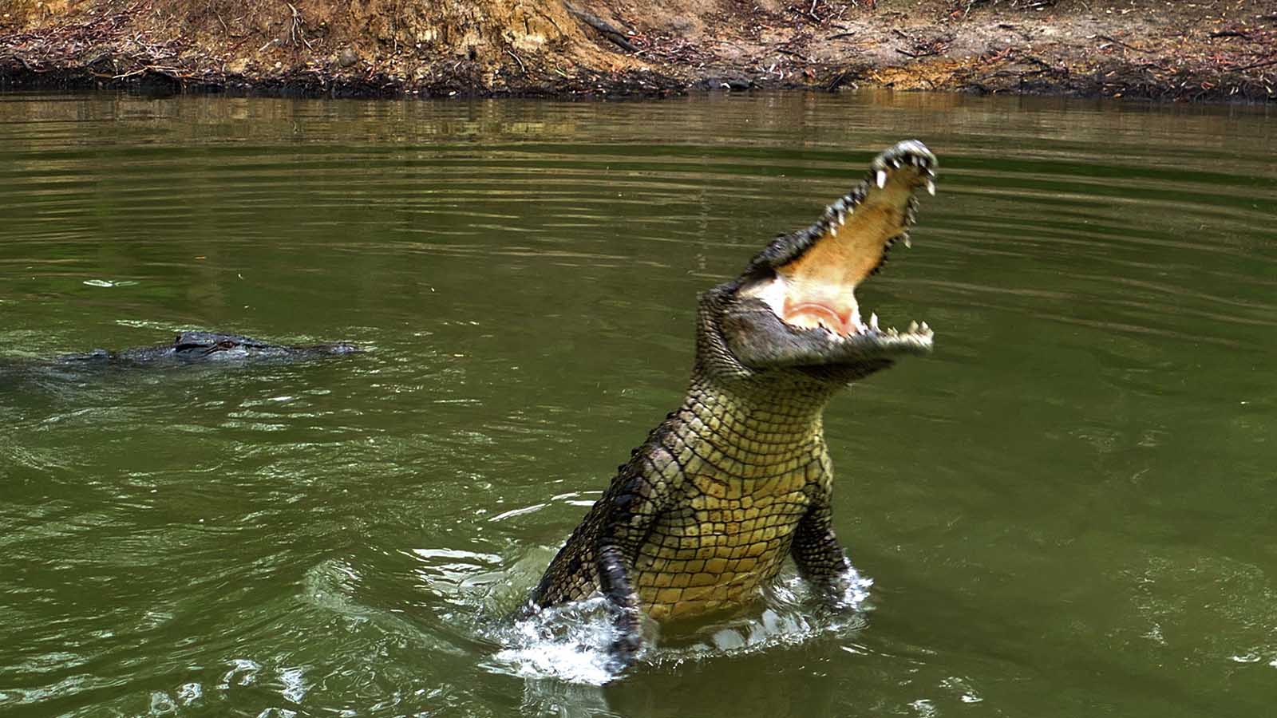
Photo © Sekerka D.
Crocodile

Slide 6
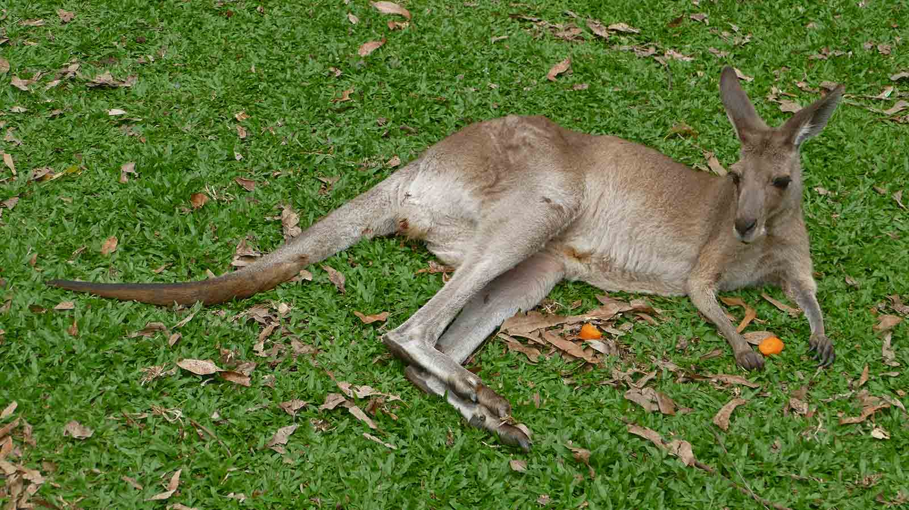
Photo © Sekerka D.
Kangaroo

Slide 7
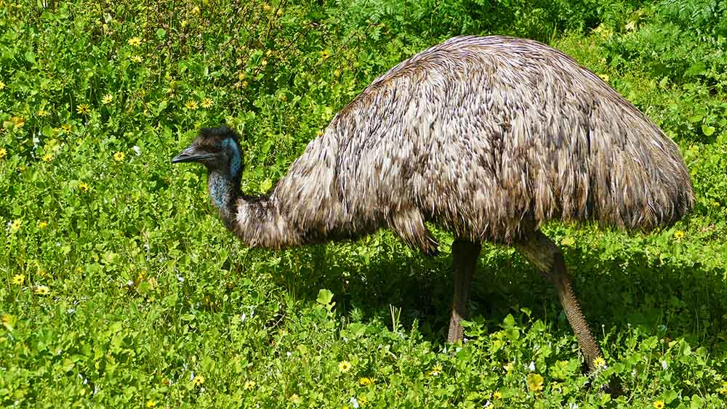
Photo © Sekerka D.
Emu

Slide 8
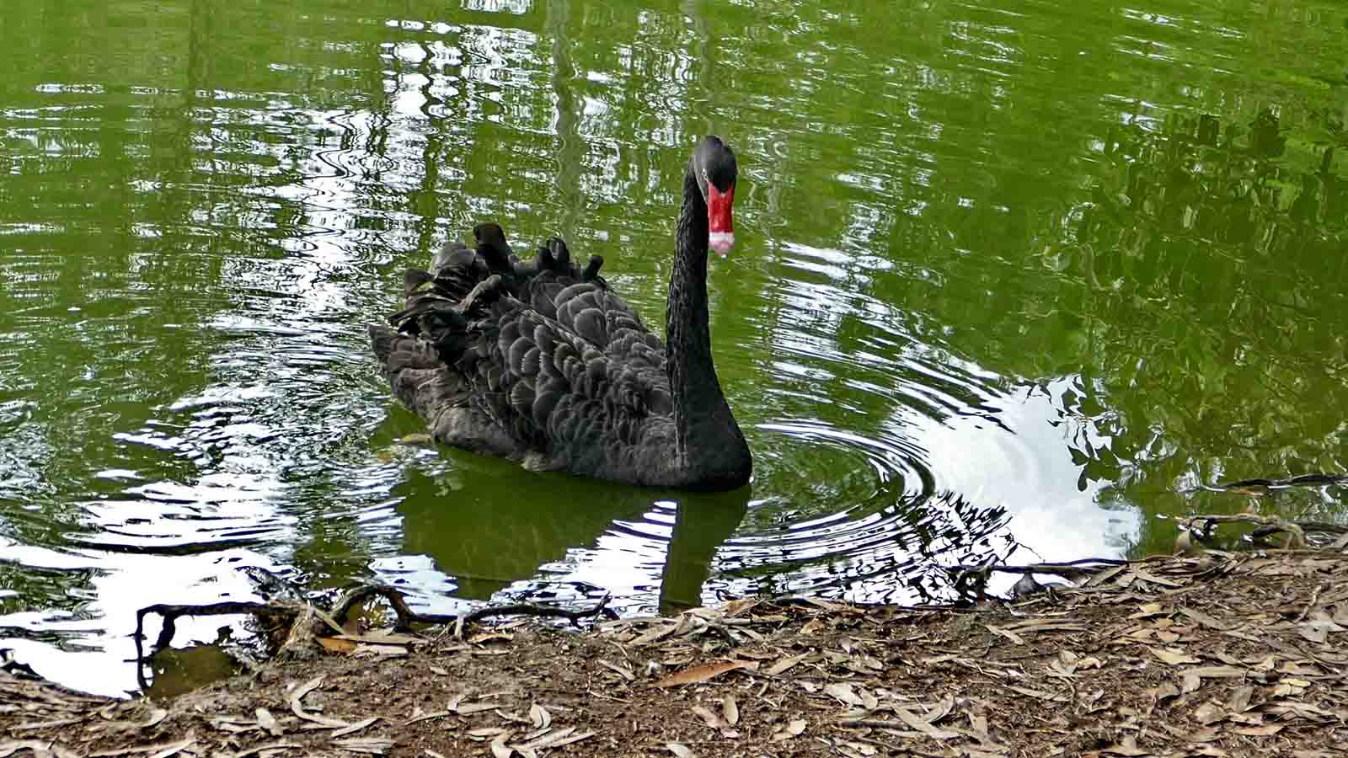
Photo © Sekerka D.
Black Swan

Slide 9
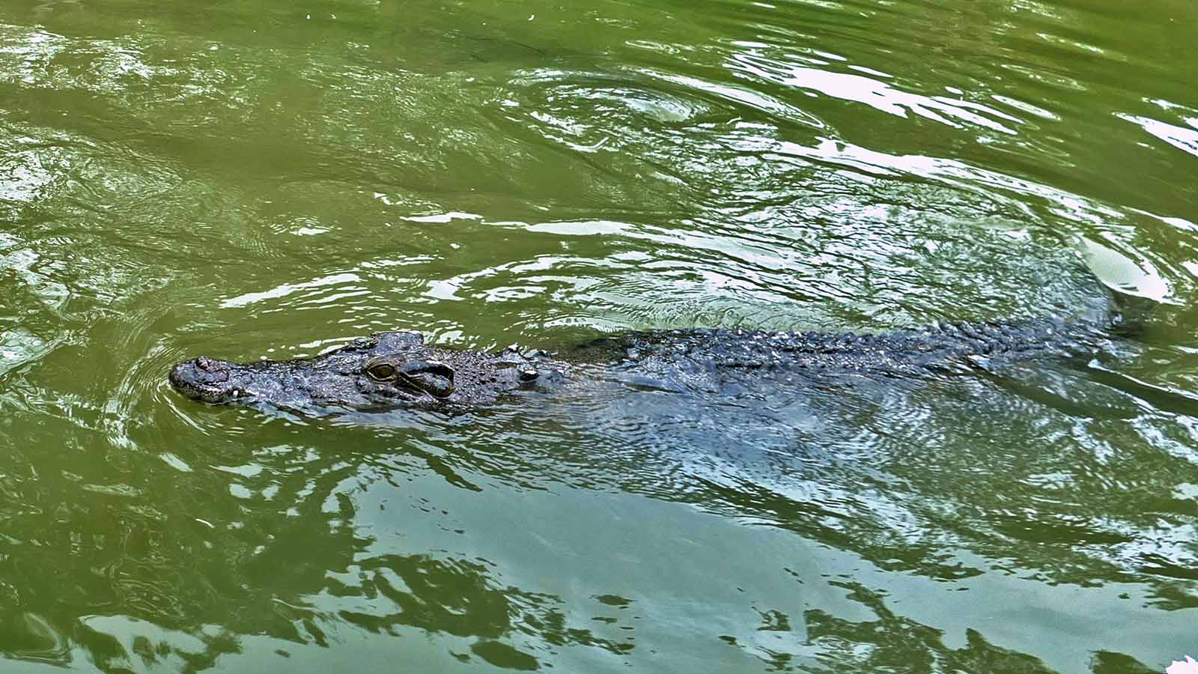
Photo © Sekerka D.
Crocodile

Slide 10
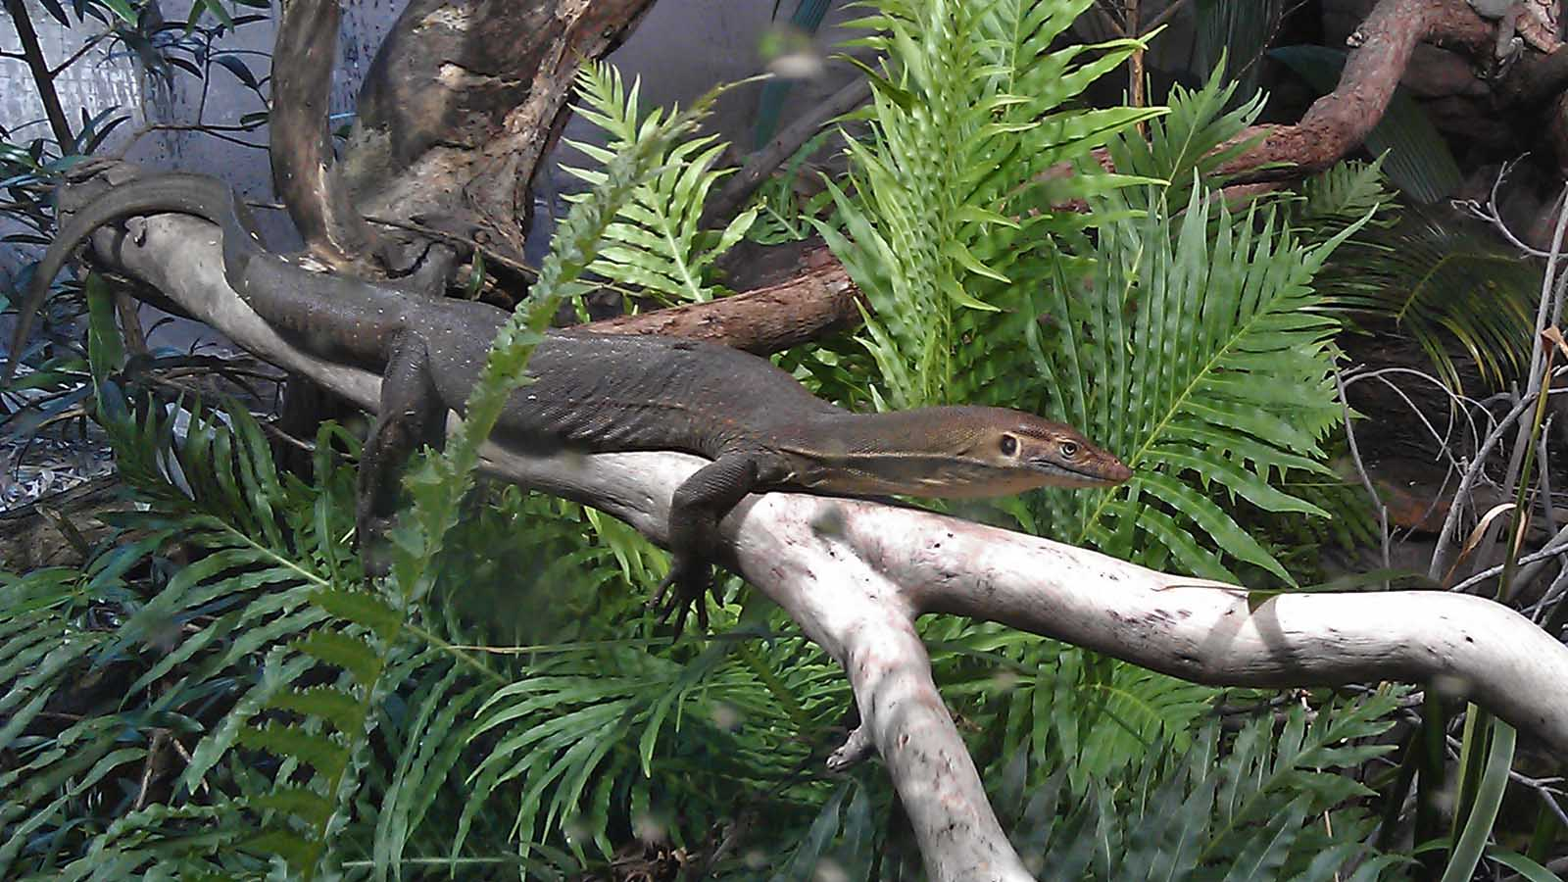
Photo © Steve
Goanna

Slide 11
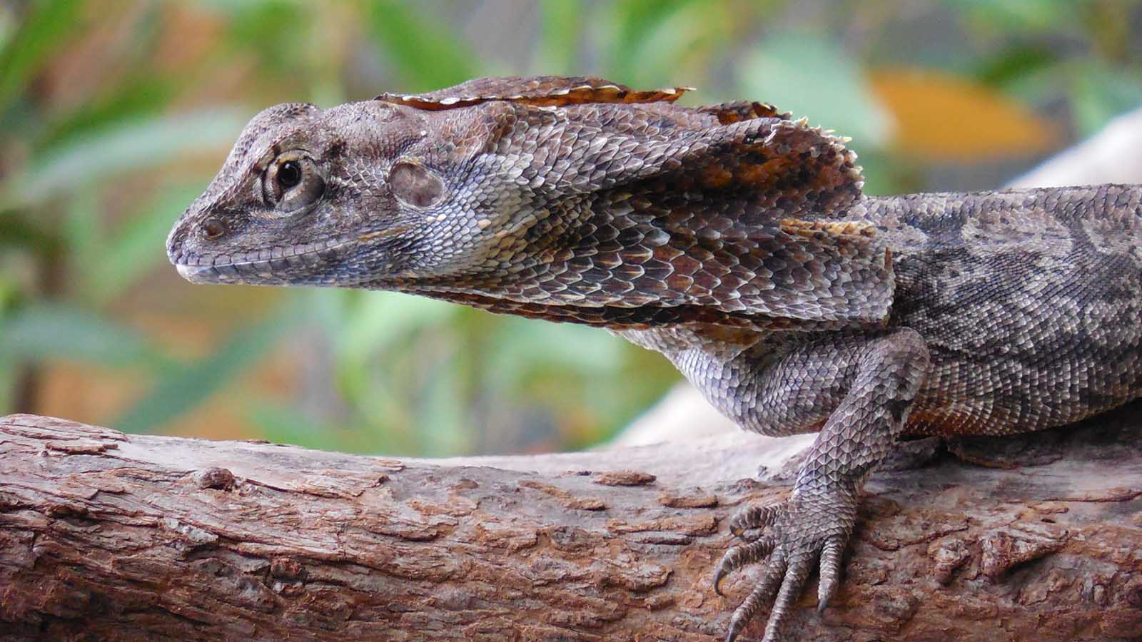
Photo © Hudec Ivan
Bearded Gragon

Slide 12
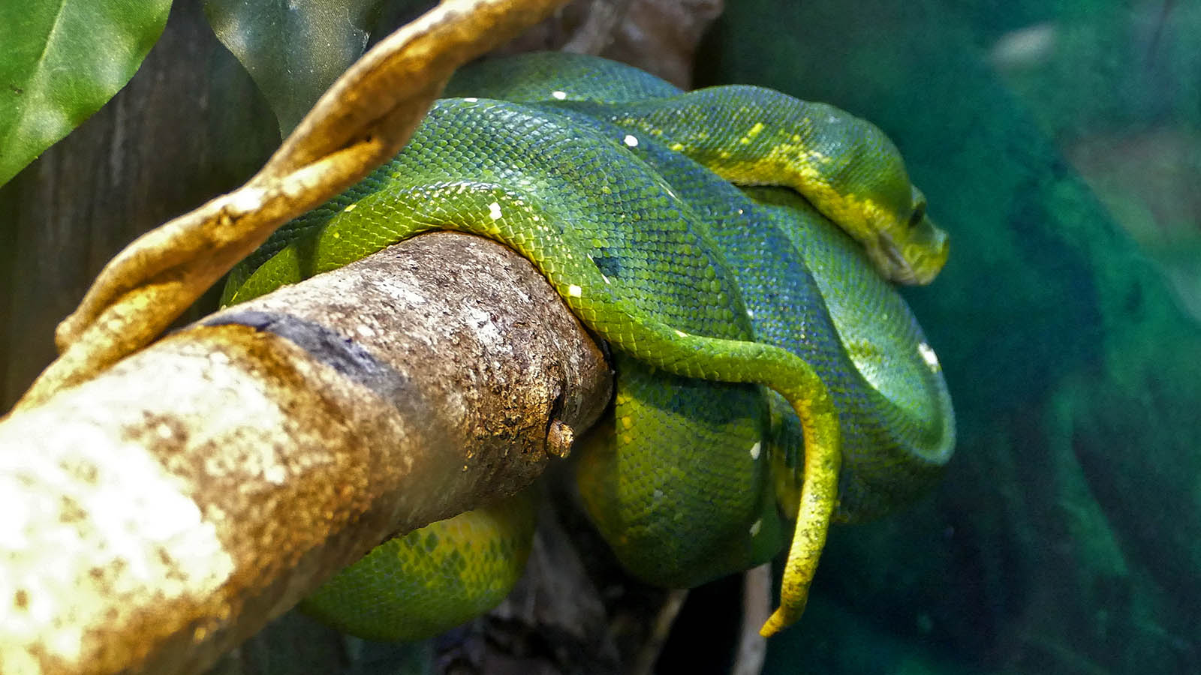
Photo © Sekerka D.
Green Tree Python

Slide 13
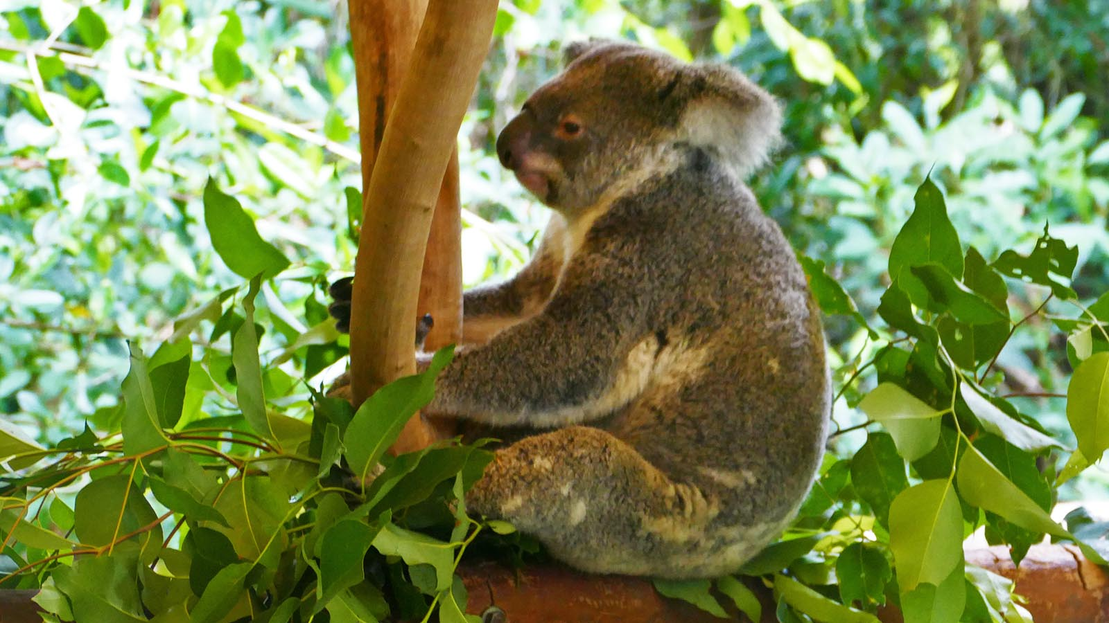
Photo © Sekerka D.
Koala

Slide 14
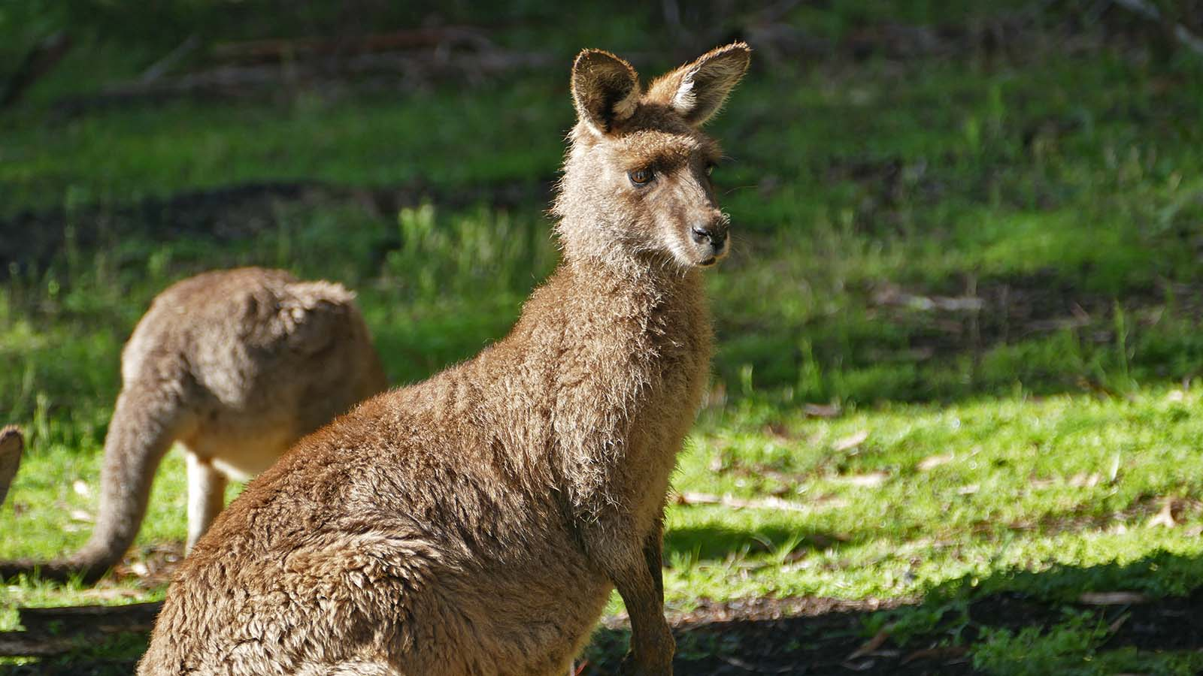
Photo © Sekerka D.
Kangaroo

Slide 15
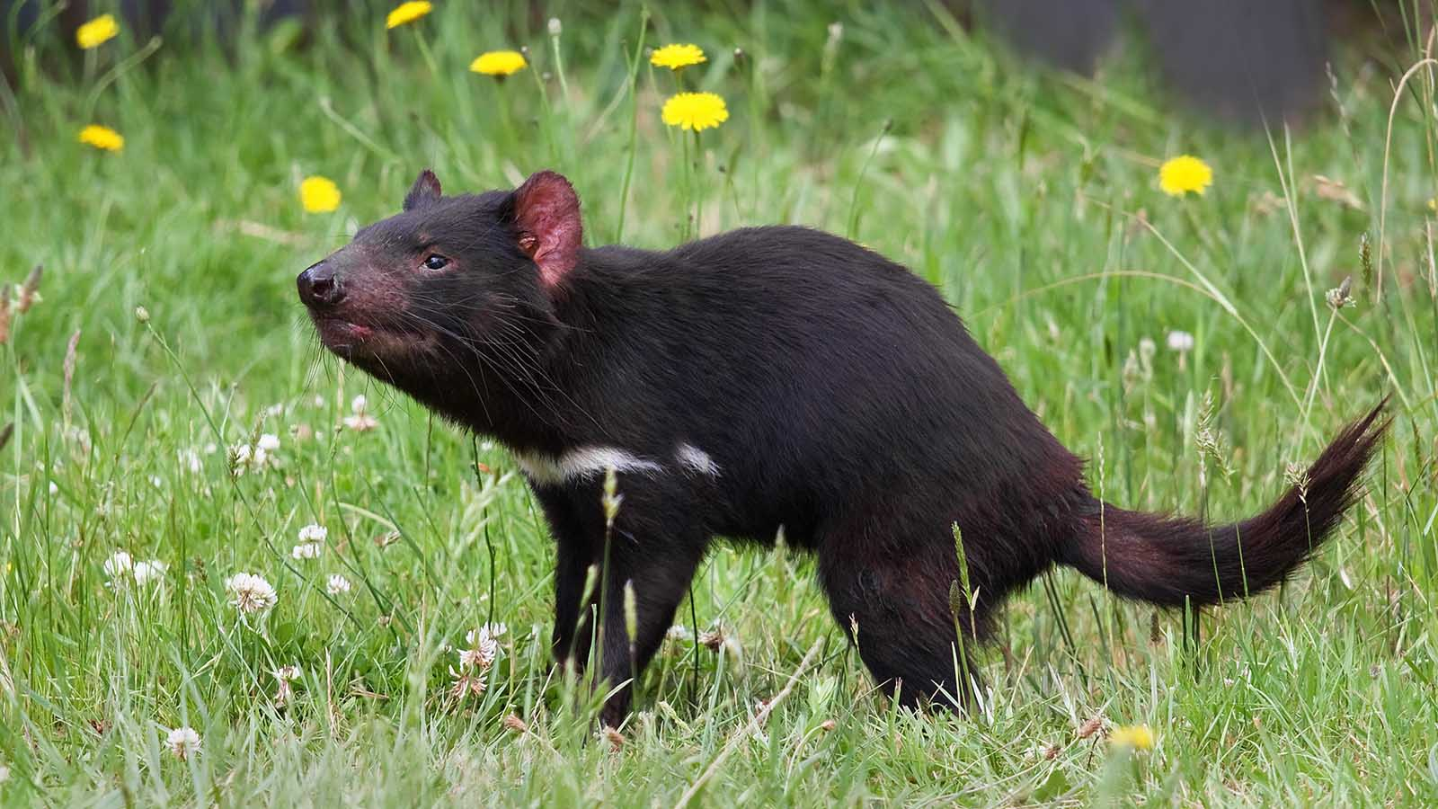
Photo © Wikipedia
Tasmanian Devil

Slide 16
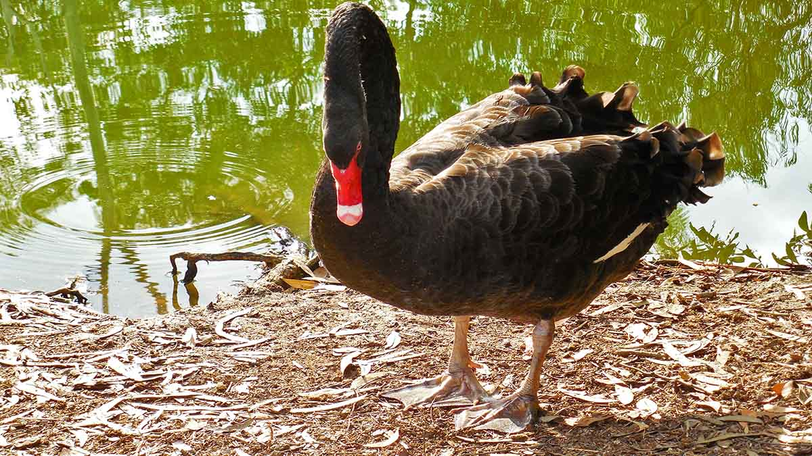
Photo © Hudec Ivan
Black Swan

Slide 17
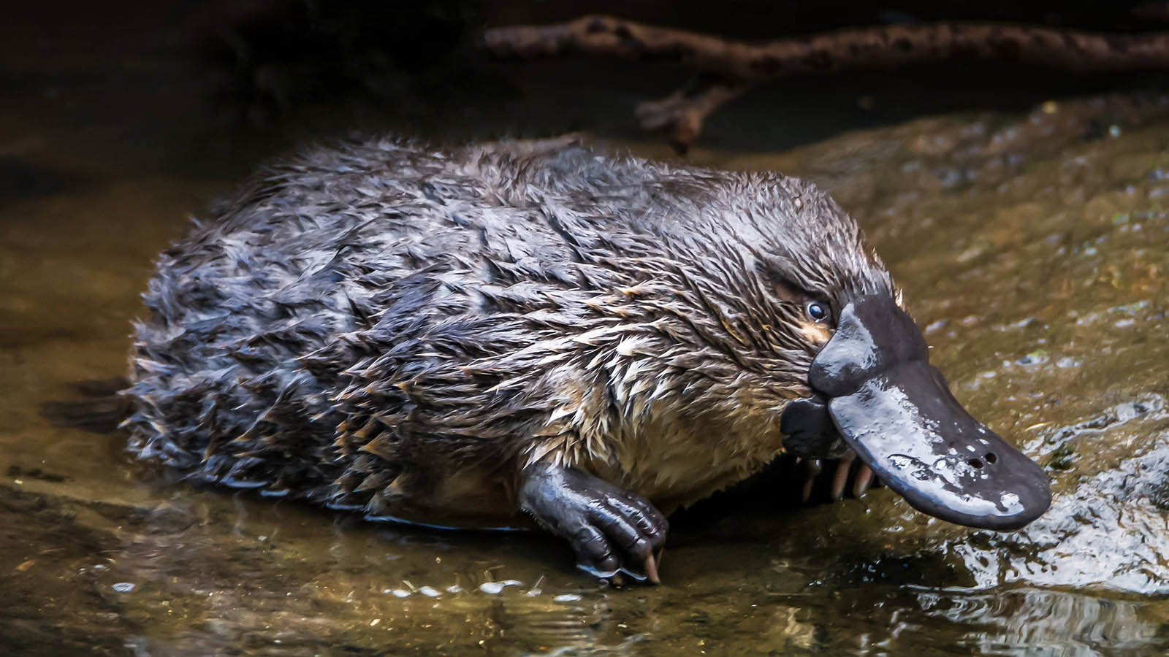
Photo © Southern Trove
Platypus

Slide 18
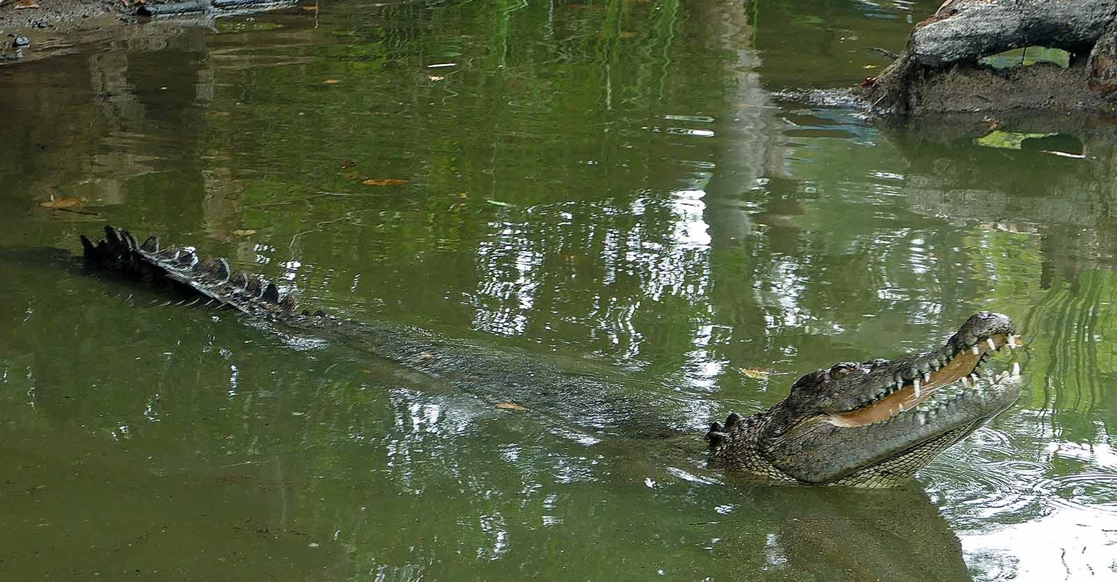
Photo © Hudec Ivan
Crocodile

Slide 19
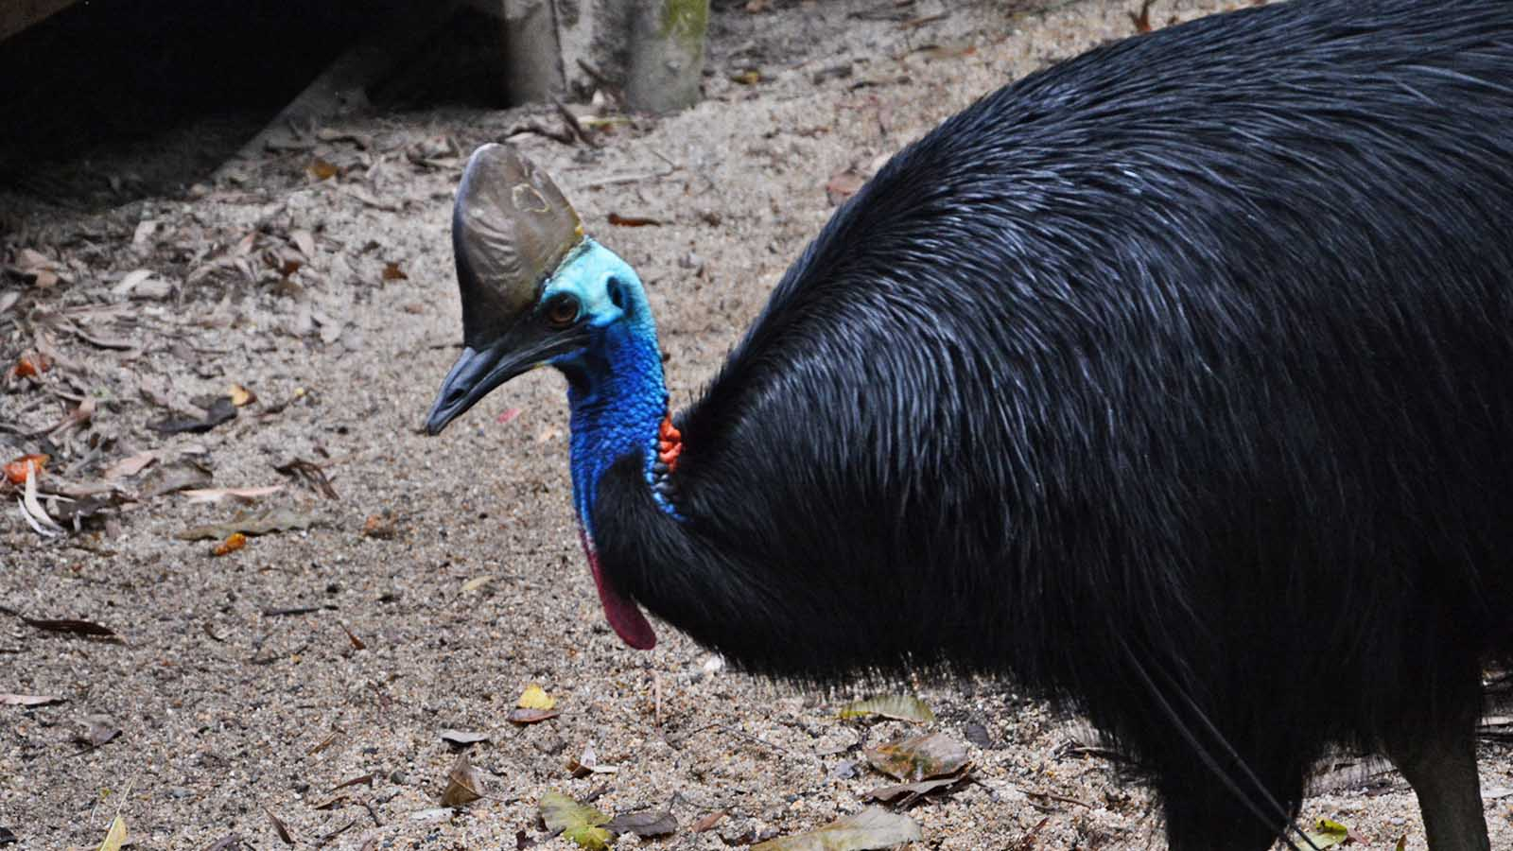
Photo © Hudec Ivan
Cassowary

Slide 20
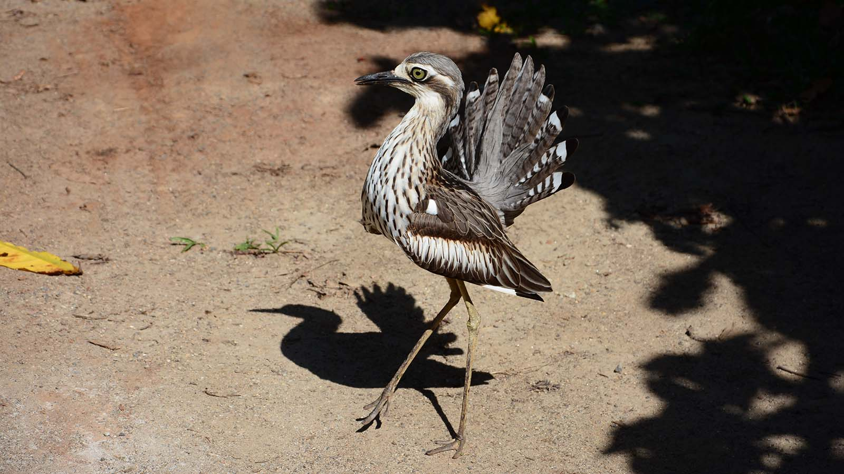
Photo © Hudec Ivan
Bush Stone Curlew

Slide 21
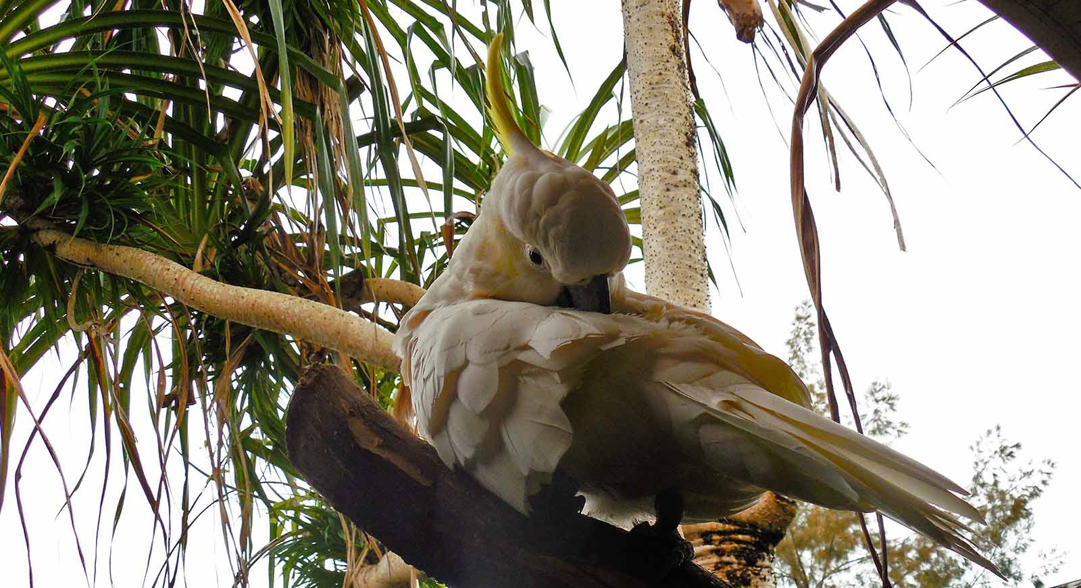
Photo © Hudec Ivan
Cockatoo

Slide 22
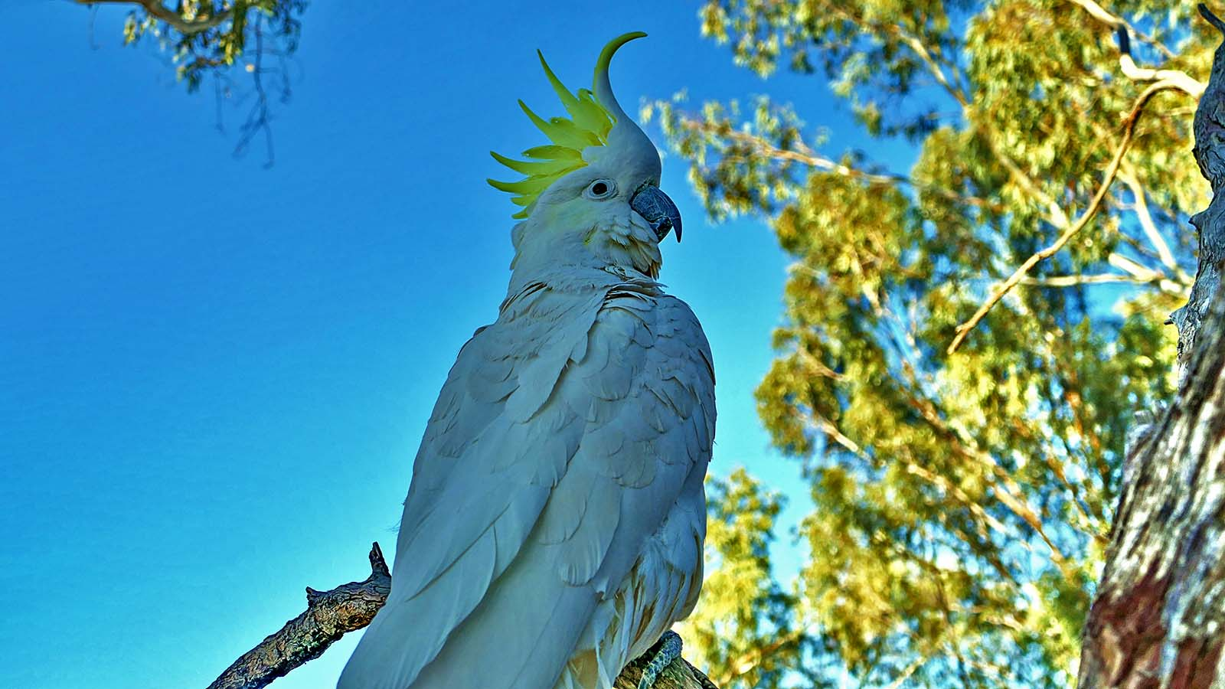
Photo © Sekerka D.
Cockatoo

Slide 23
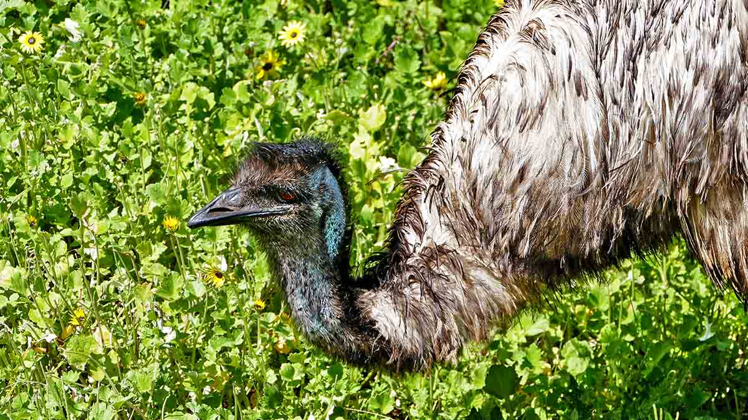
Photo © Sekerka D.
Emu

Slide 24
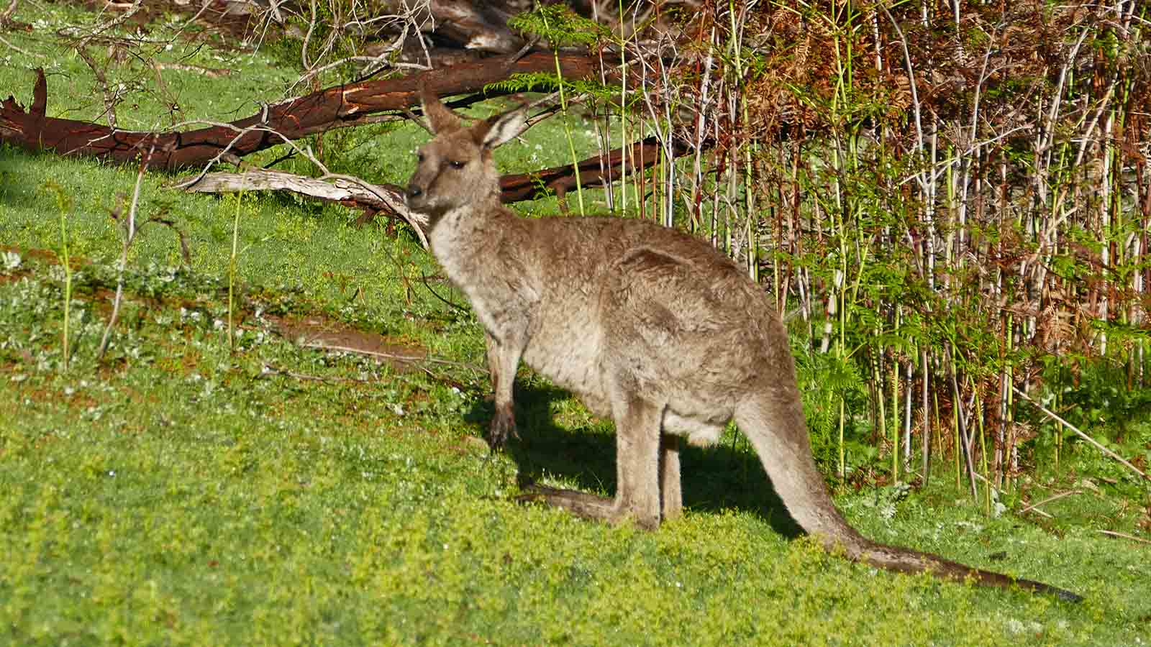
Photo © Sekerka D.
Kangaroo

Slide 25
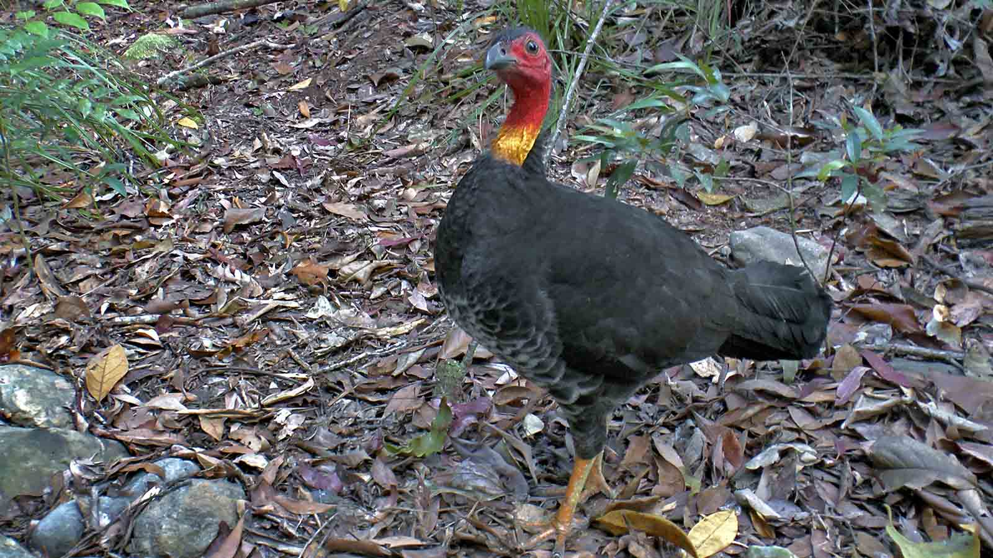
Photo © Hudec Ivan
Scrub Turkey

Slide 26
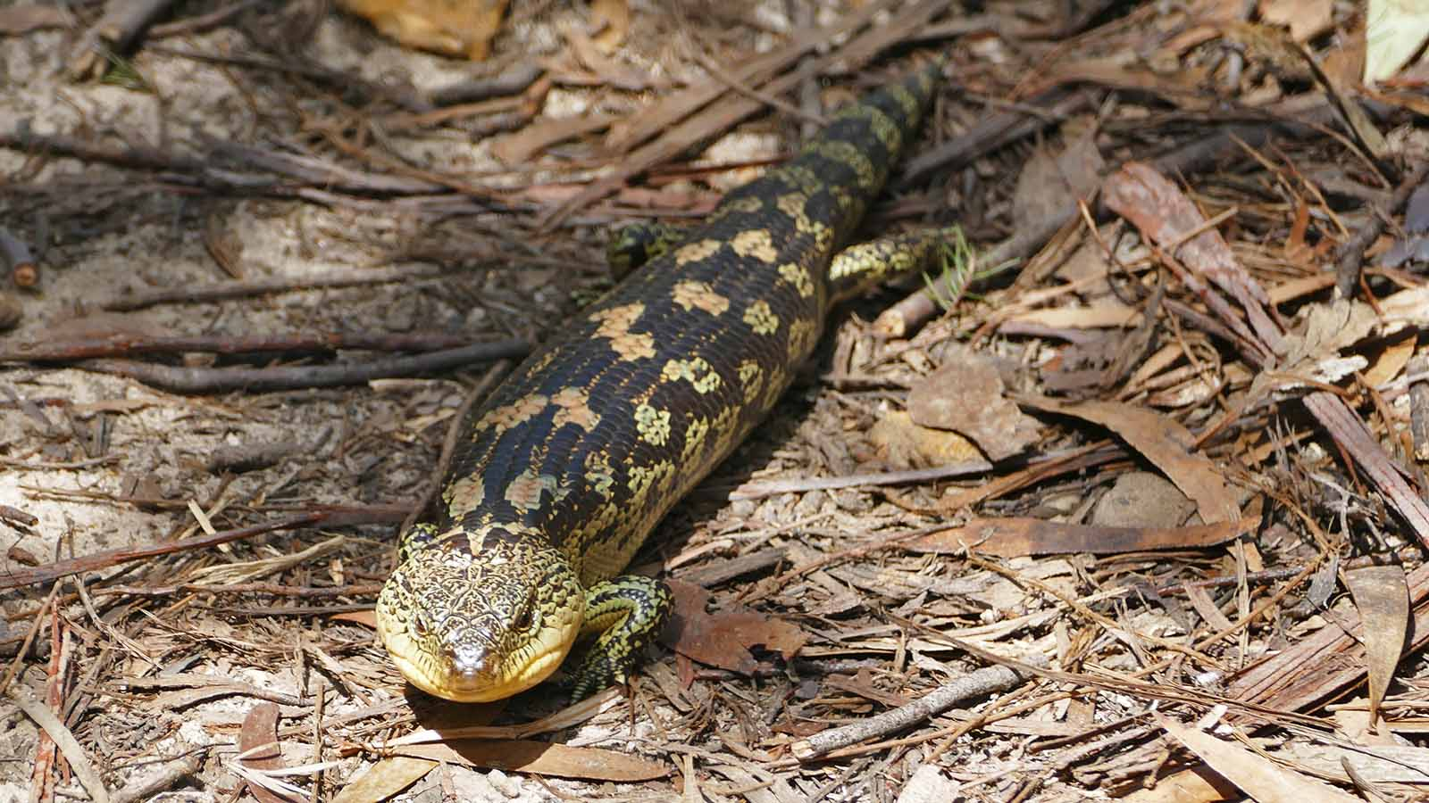
Photo © Sekerka D.
Salamander

Slide 27
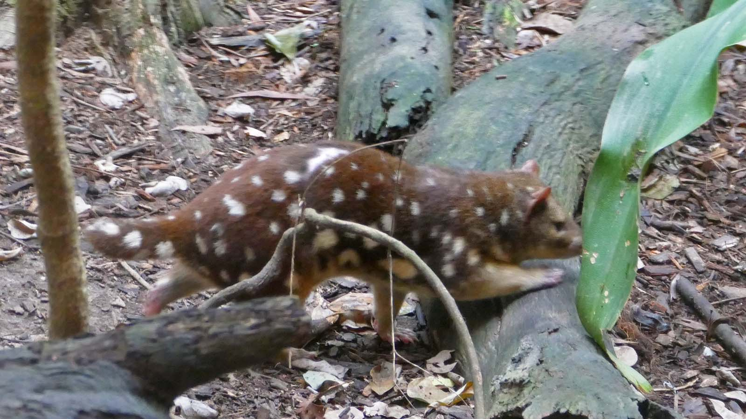
Photo © Sekerka D.
Tiger Quoll

Slide 28
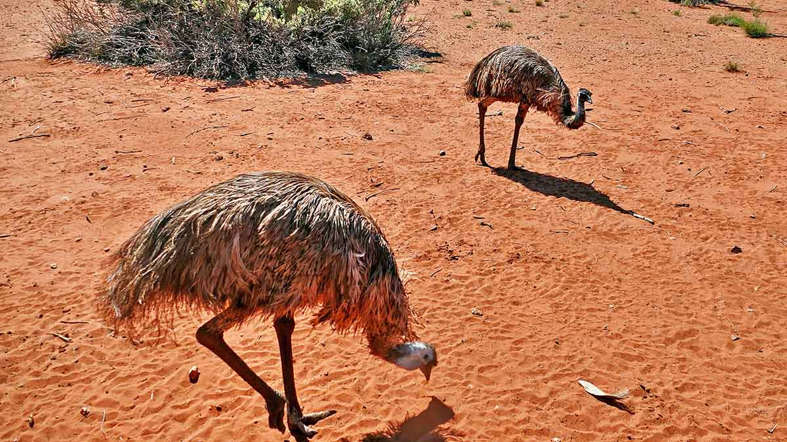
Photo © Hudec Ivan
Emu

Slide 29
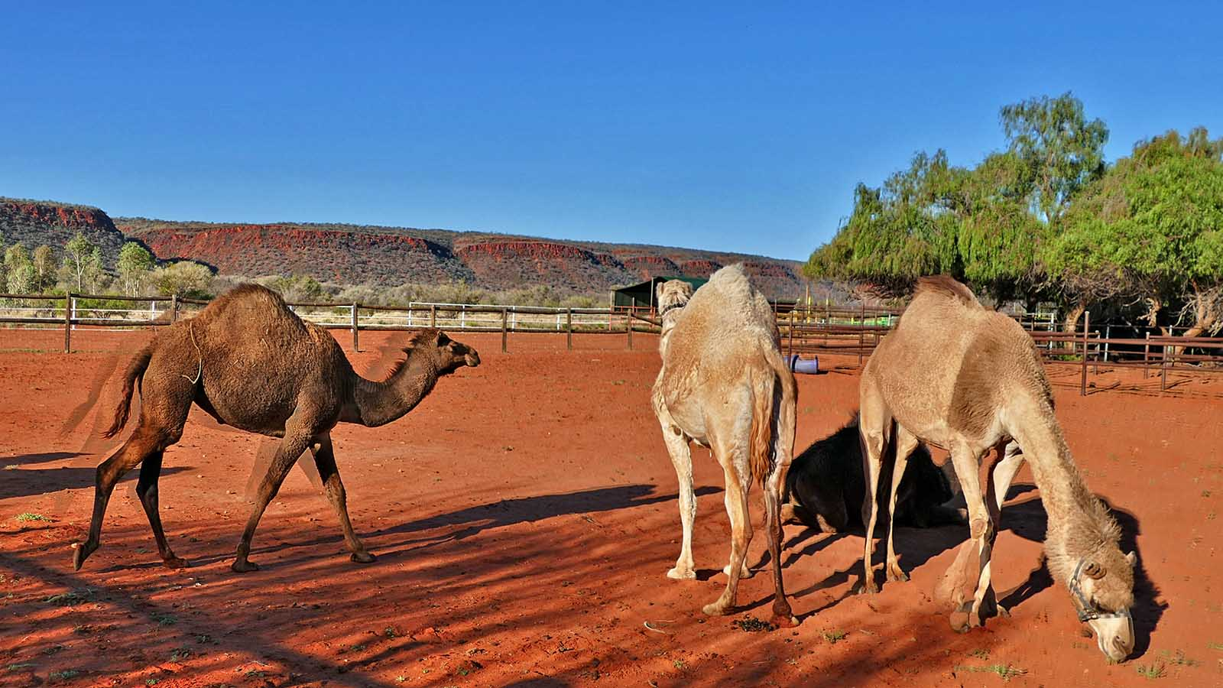
Photo © Hudec Ivan
Dromedary

Slide 30
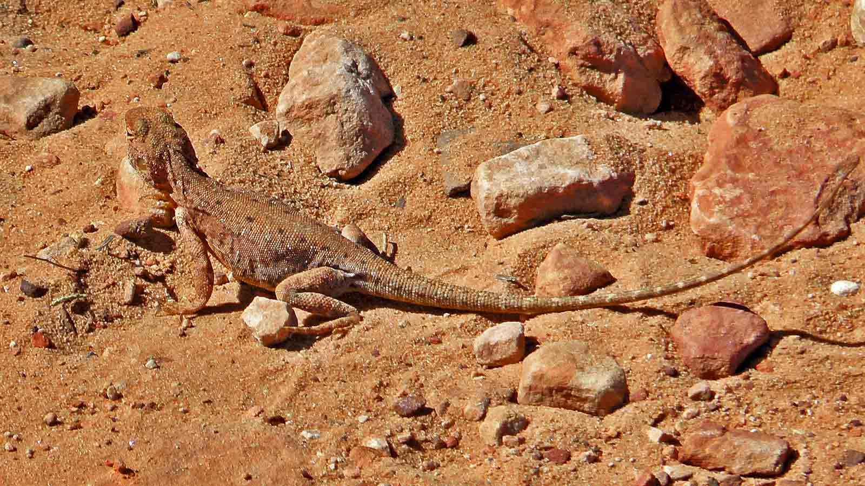
Photo © Hudec Ivan
Bearded Gragon

Slide 31
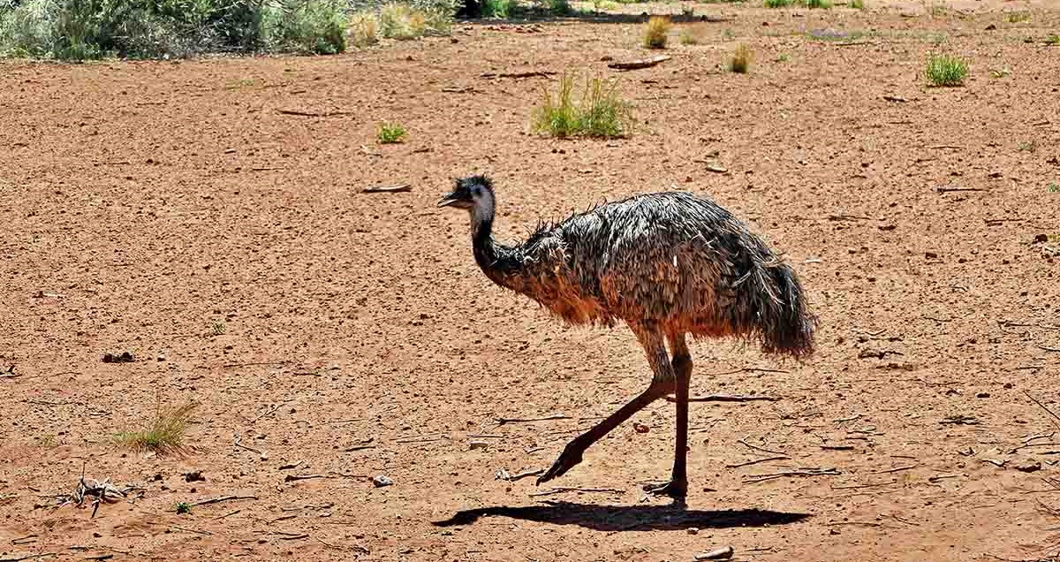
Photo © Hudec Ivan
Emu

Slide 32
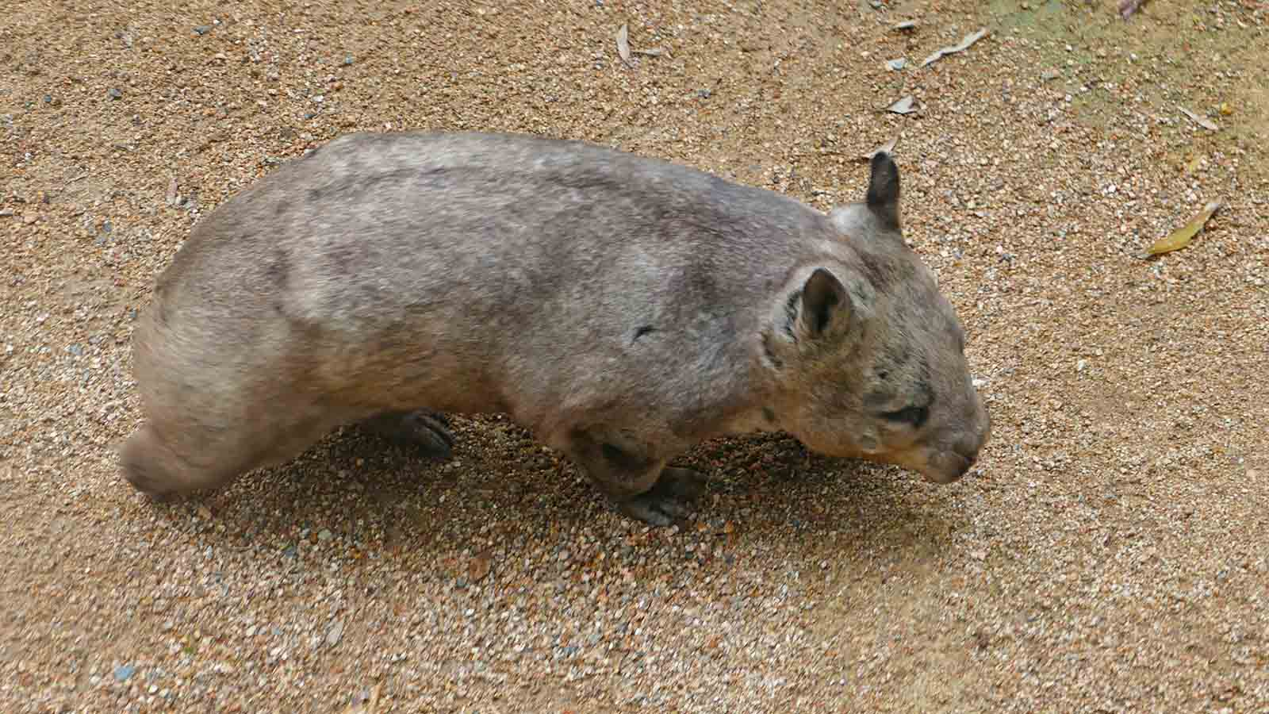
Photo © Sekerka D.
Wombat

Slide 33
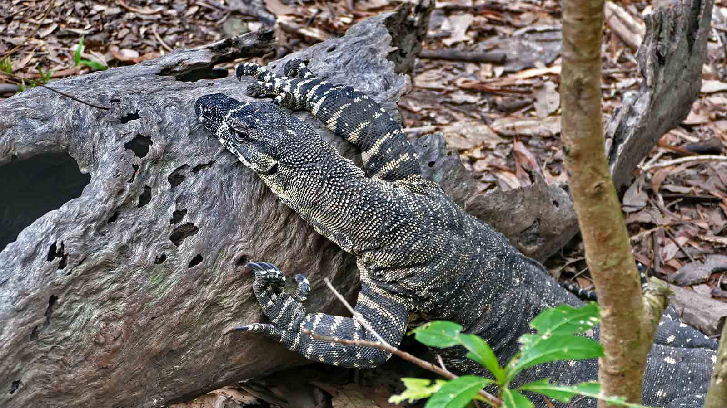
Photo © Hudec Ivan
Goanna

Slide 34
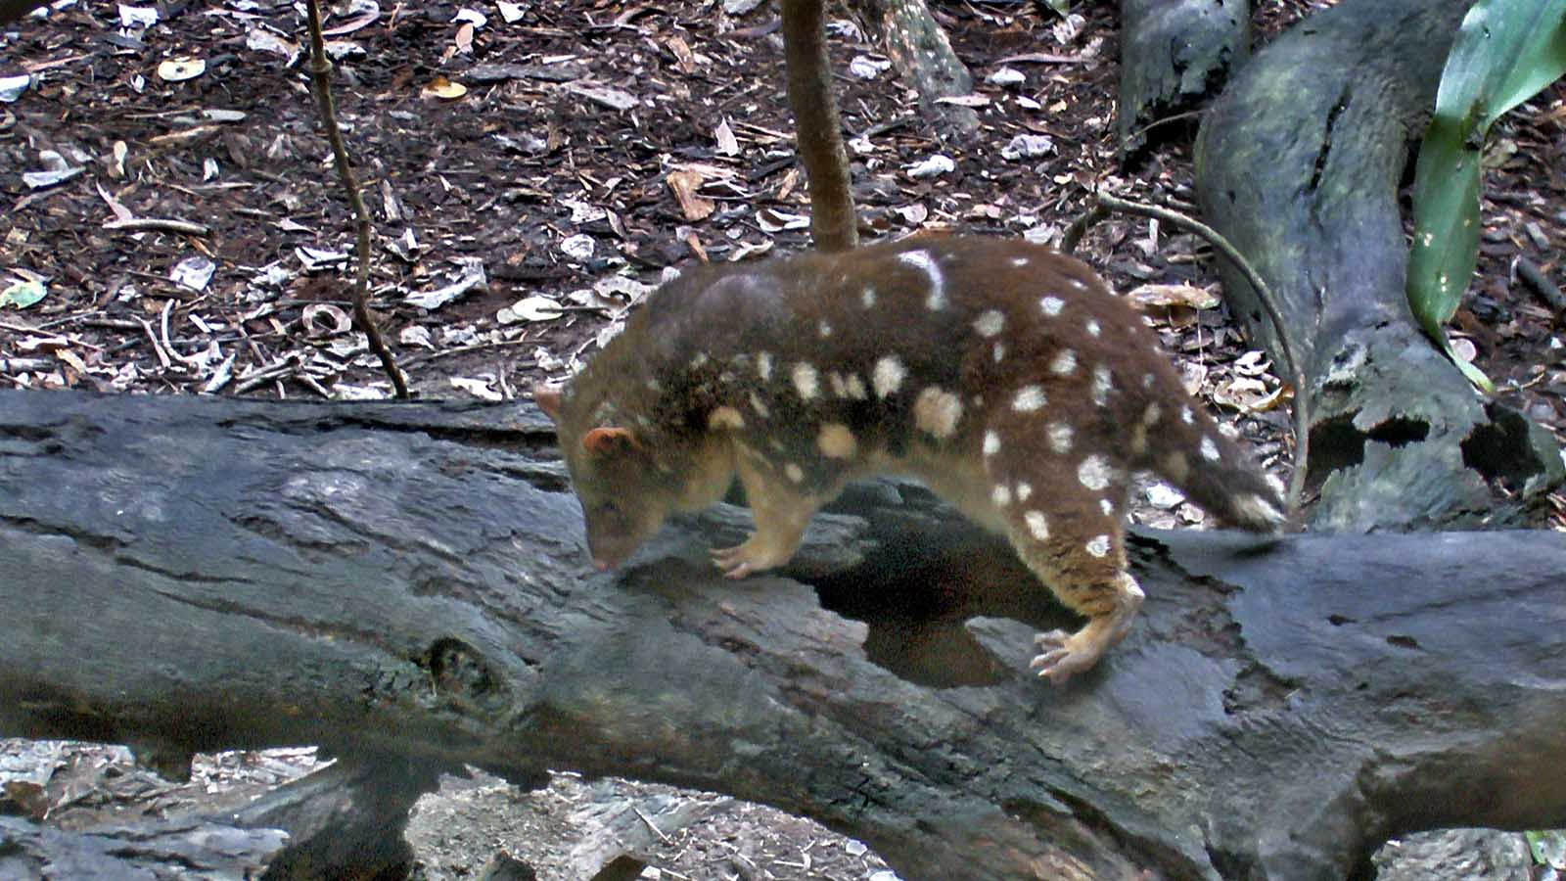
Photo © Hudec Ivan
Tiger Quoll

Slide 35
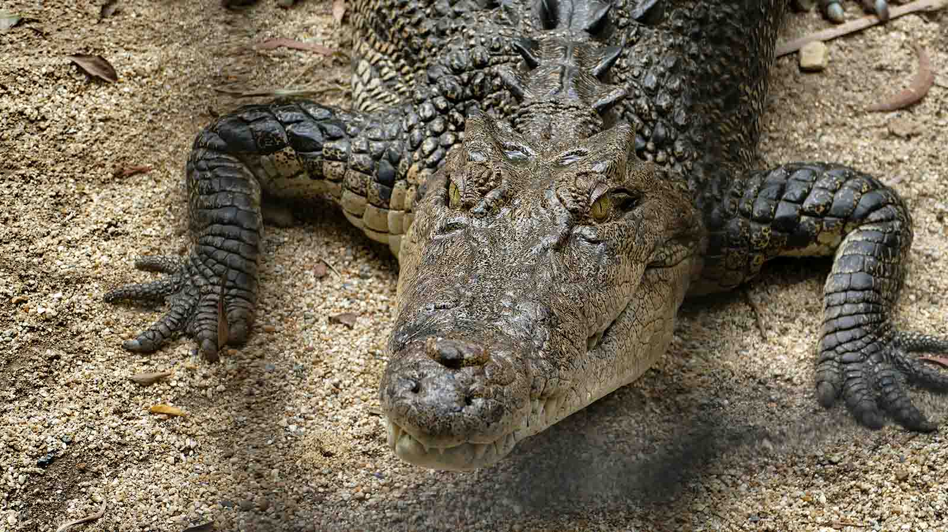
Photo © Hudec Ivan
Crocodile

Slide 36
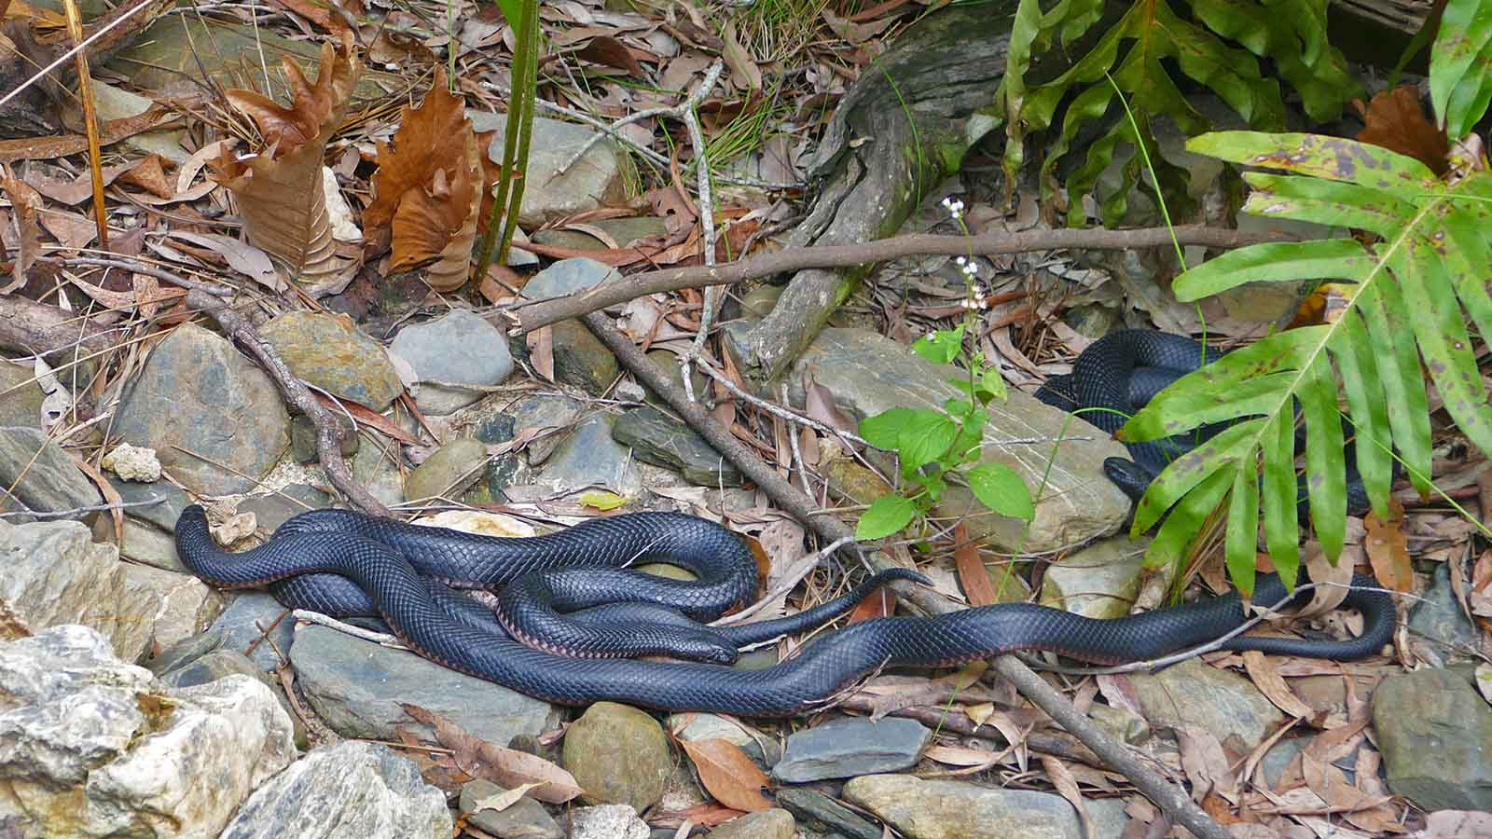
Photo © Sekerka D.
Red-bellied Black Snake

Slide 37
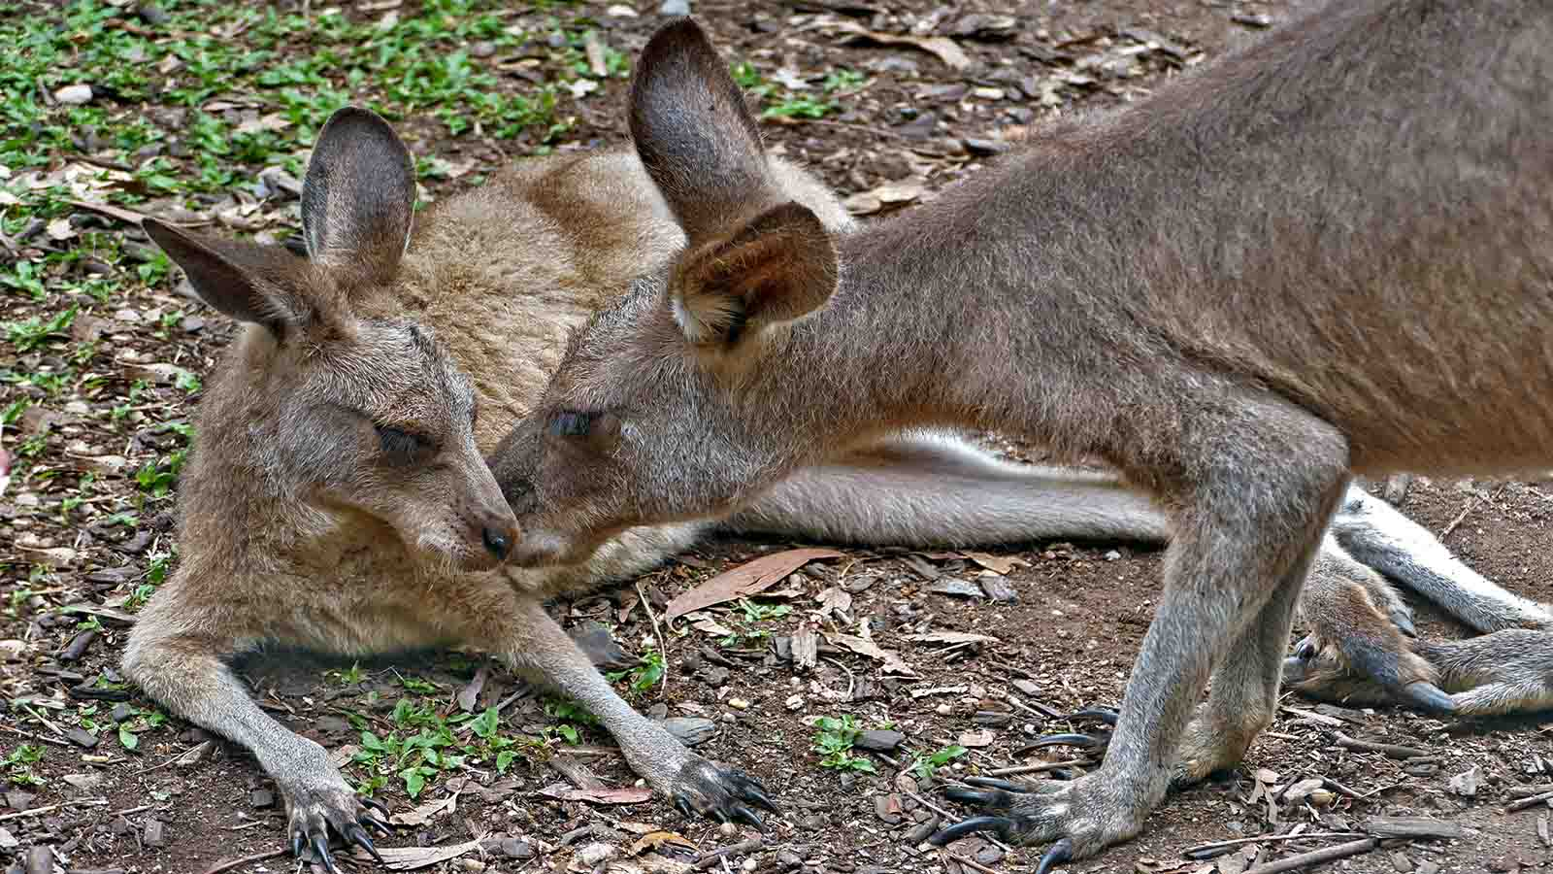
Photo © Hudec Ivan
Kangaroo

Slide 38
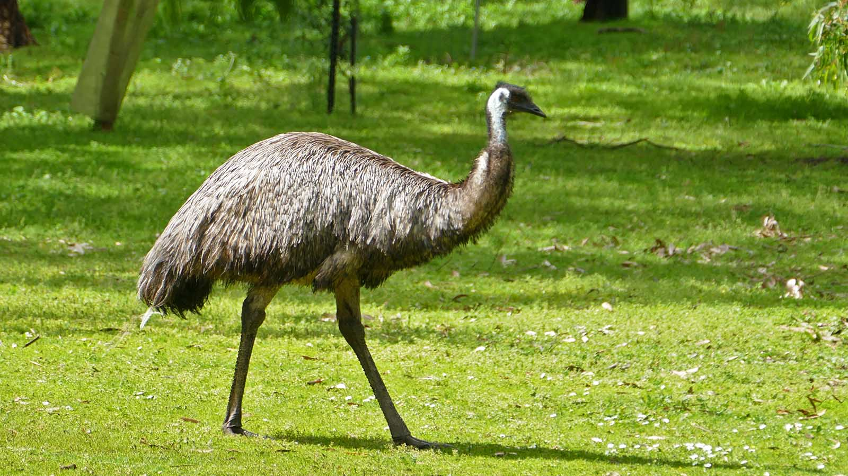
Photo © Sekerka D.
Emu

Slide 39
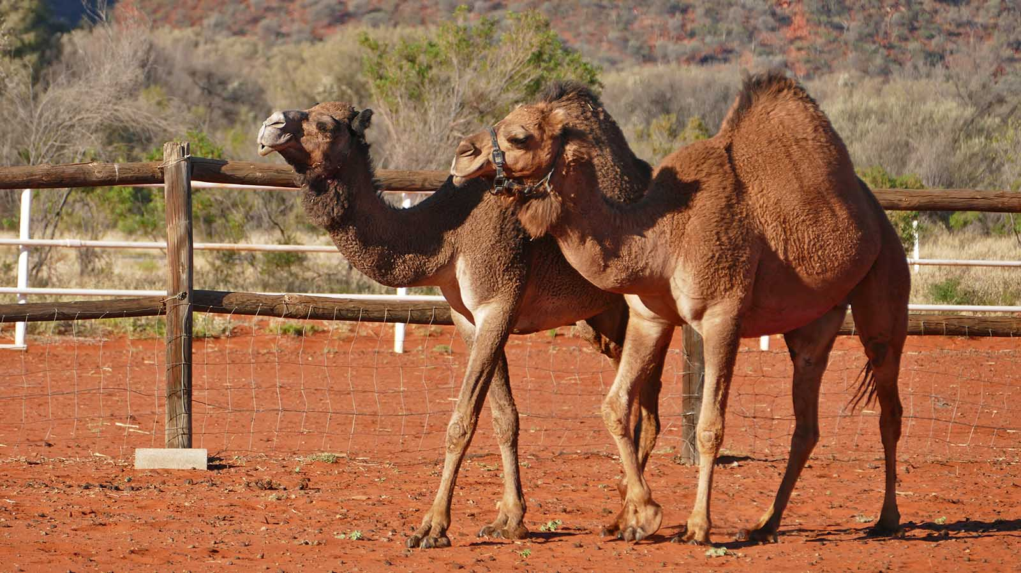
Photo © Sekerka D.
Dromedary

Slide 40
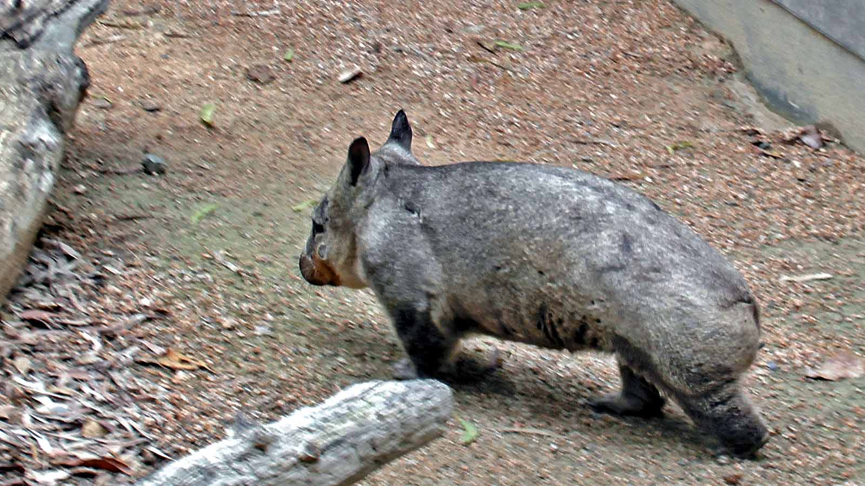
Photo © Hudec Ivan
Wombat

Slide 41
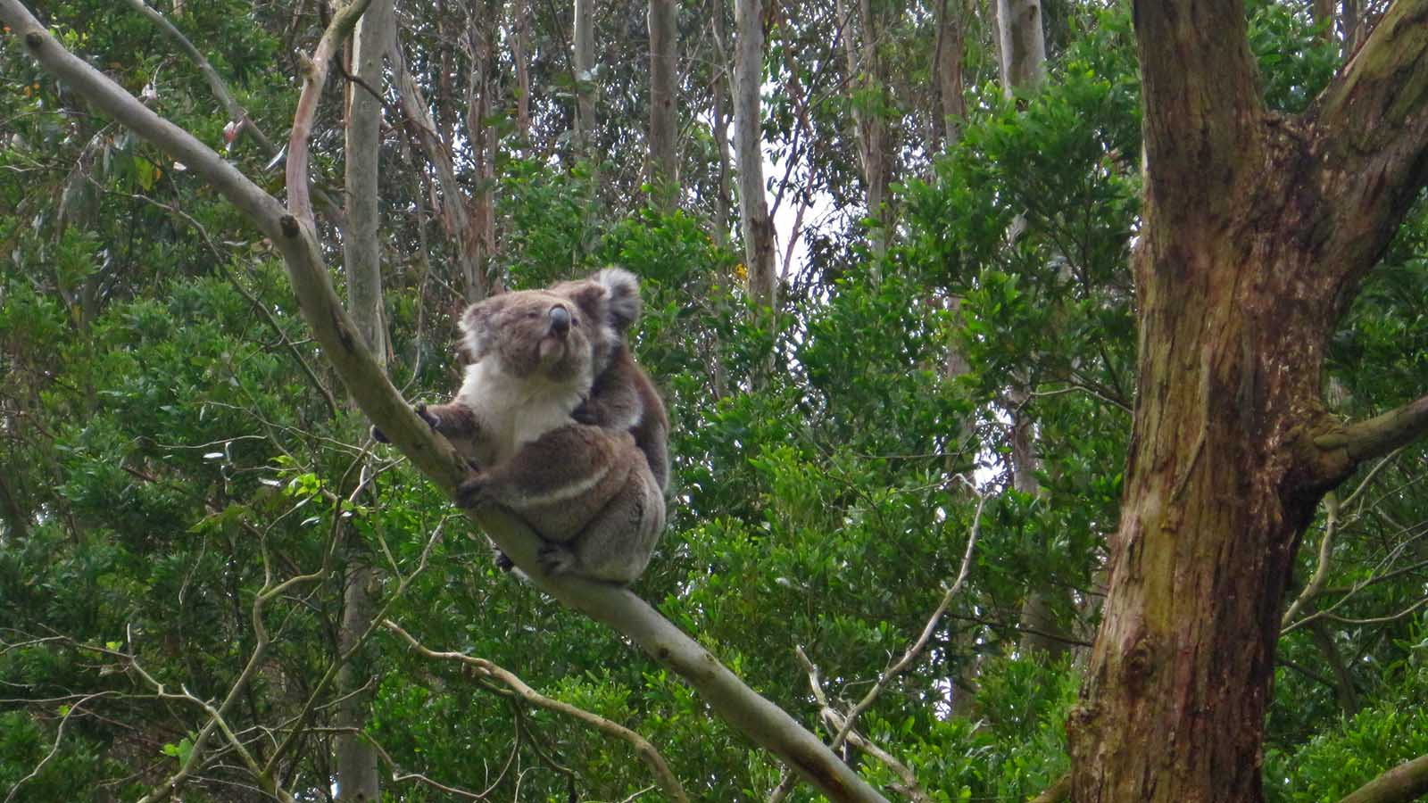
Photo © Steve
Koala

Slide 42
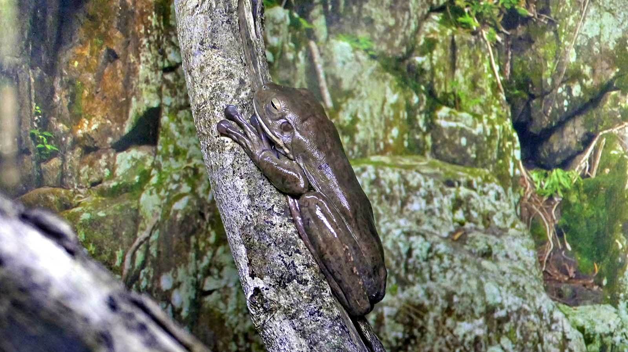
Photo © Hudec Ivan
Tree Frog

Slide 43
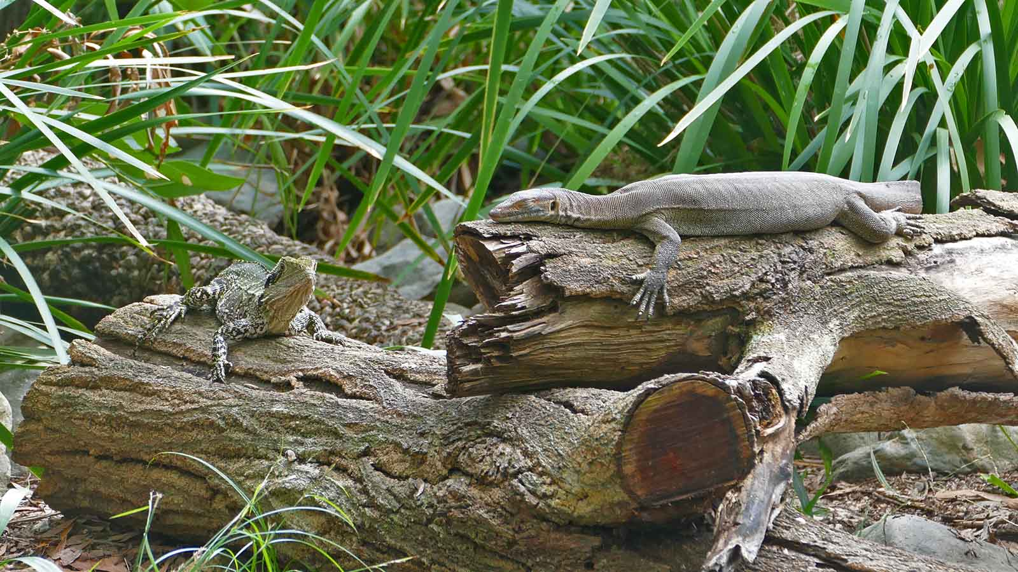
Photo © Sekerka D.
Goanna

Slide 44
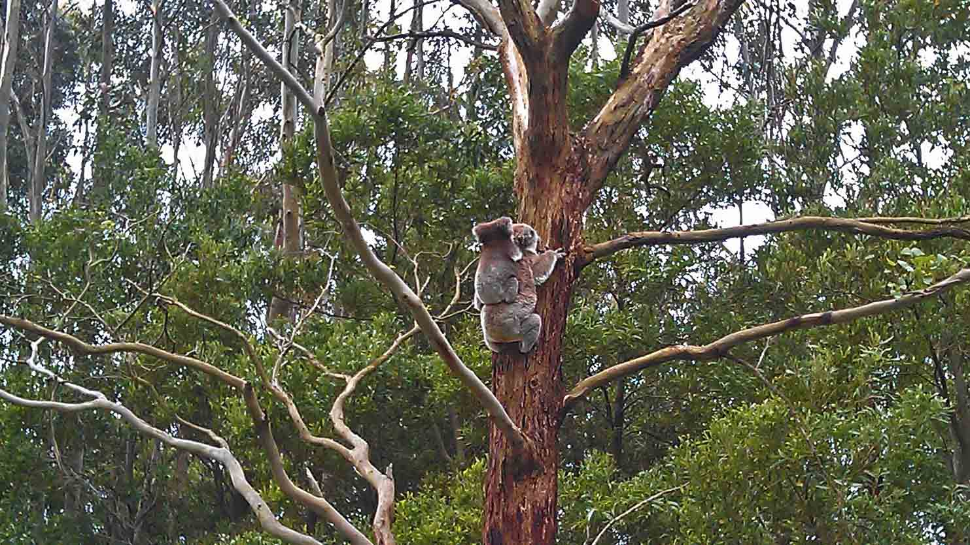
Photo © Steve
Koala

Slide 45
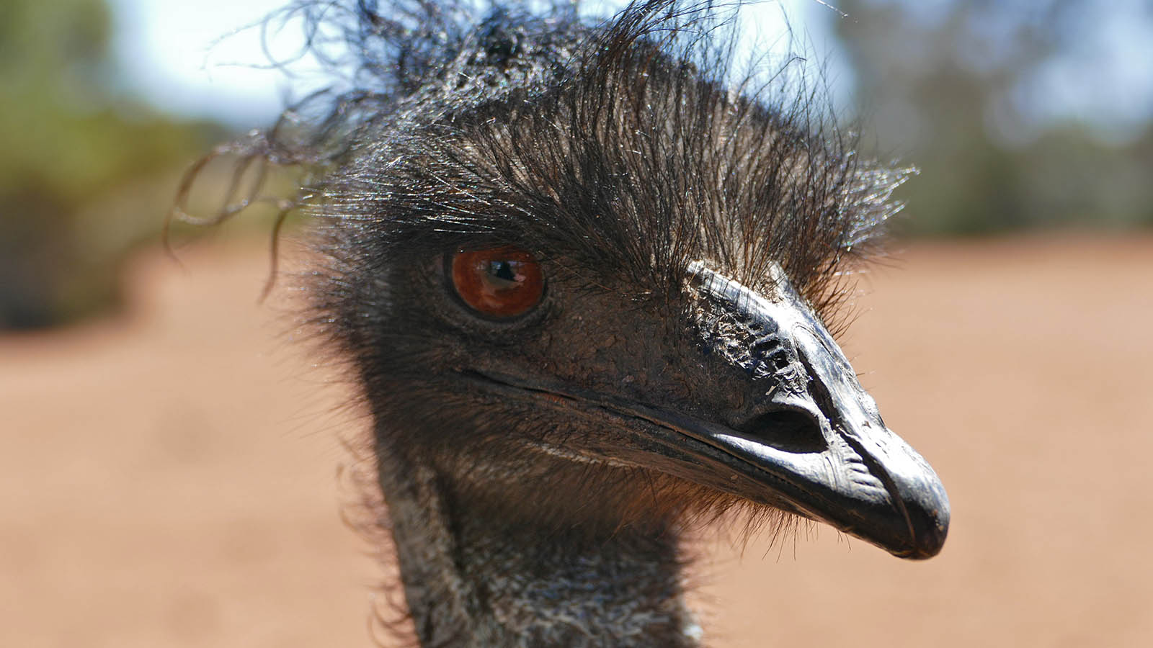
Photo © Sekerka D.
Emu

Slide 46
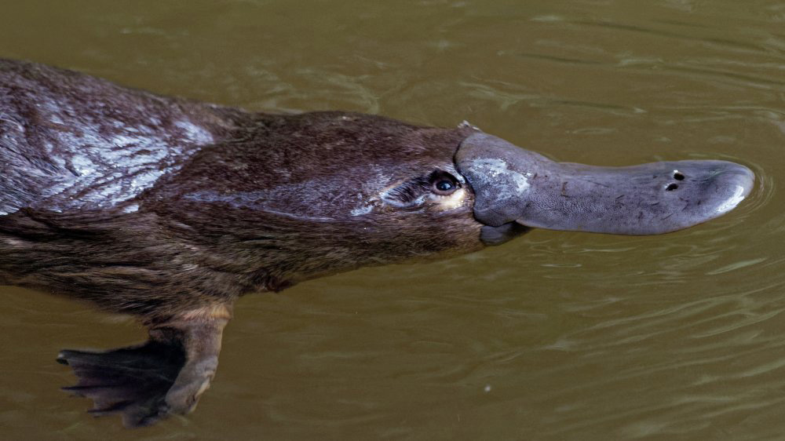
Photo © Jim Dykstra
Platypus

Slide 47





Non-commercial presentation!
Music : Gurrumul - Mala Rrakala
Photos : Hudec Ivan
Sekerka Dušan, Ing. sekerka.dusan@gmail.com
Arranged by : Steve Rumpler
pista2011@gmail.com
Year : 2020
Thank you for watching the presentation.

Slide 48







¿Te ha gustado?
Puedes ver más entrando
Aquí
Además puedes recibir powerpoints en tu correo electrónico suscribiéndote aquí:

