Slide 1
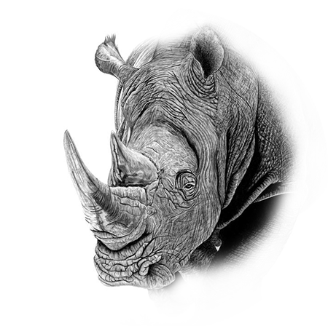

Wildlife
07
Rhino
Of africa

Slide 2
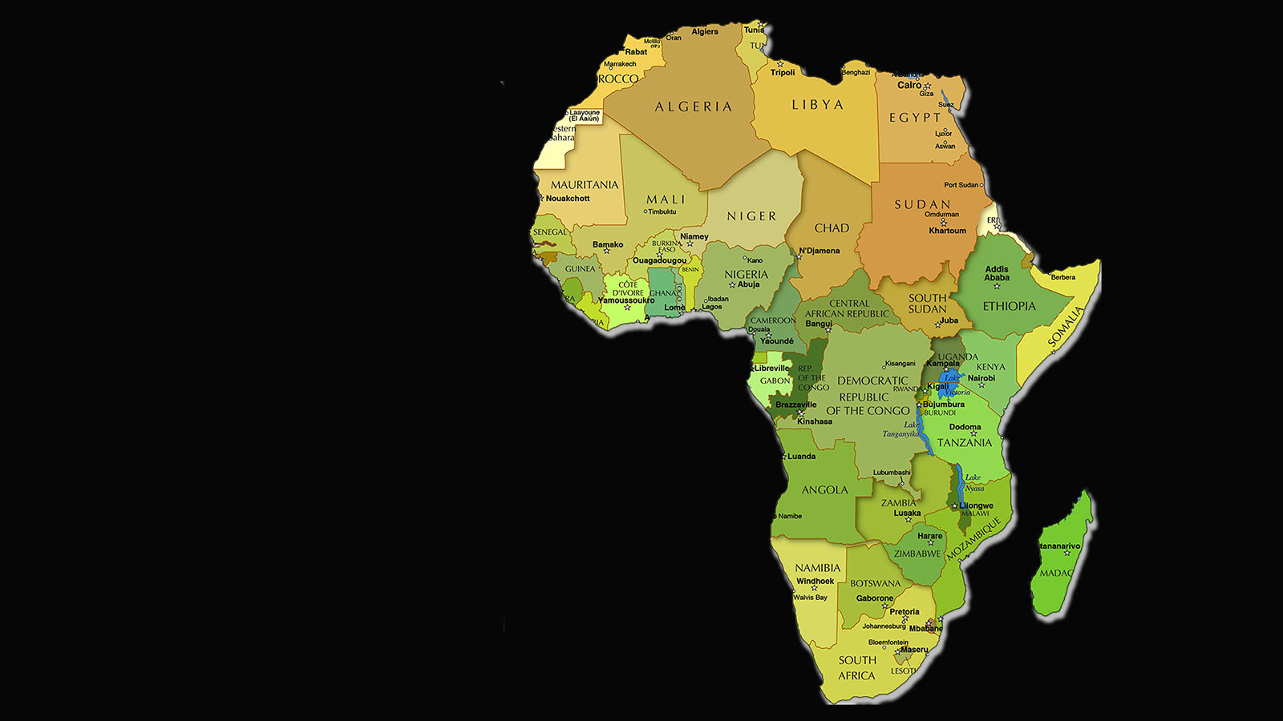
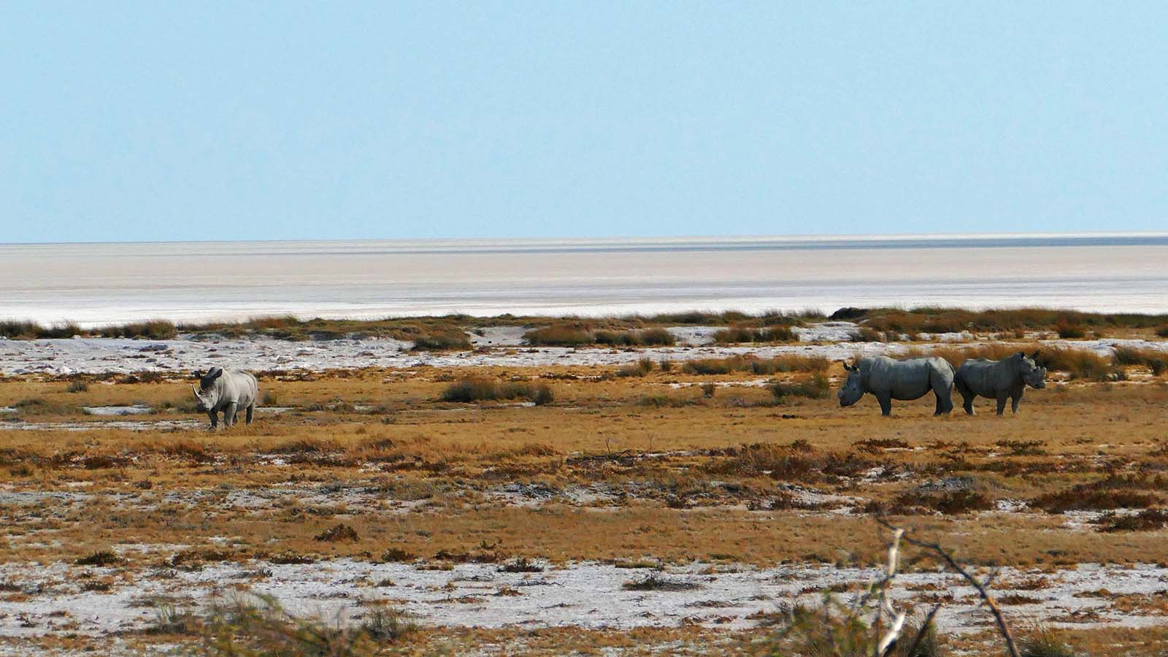


Wildlife
of Africa
Photo © Sekerka D

Slide 3
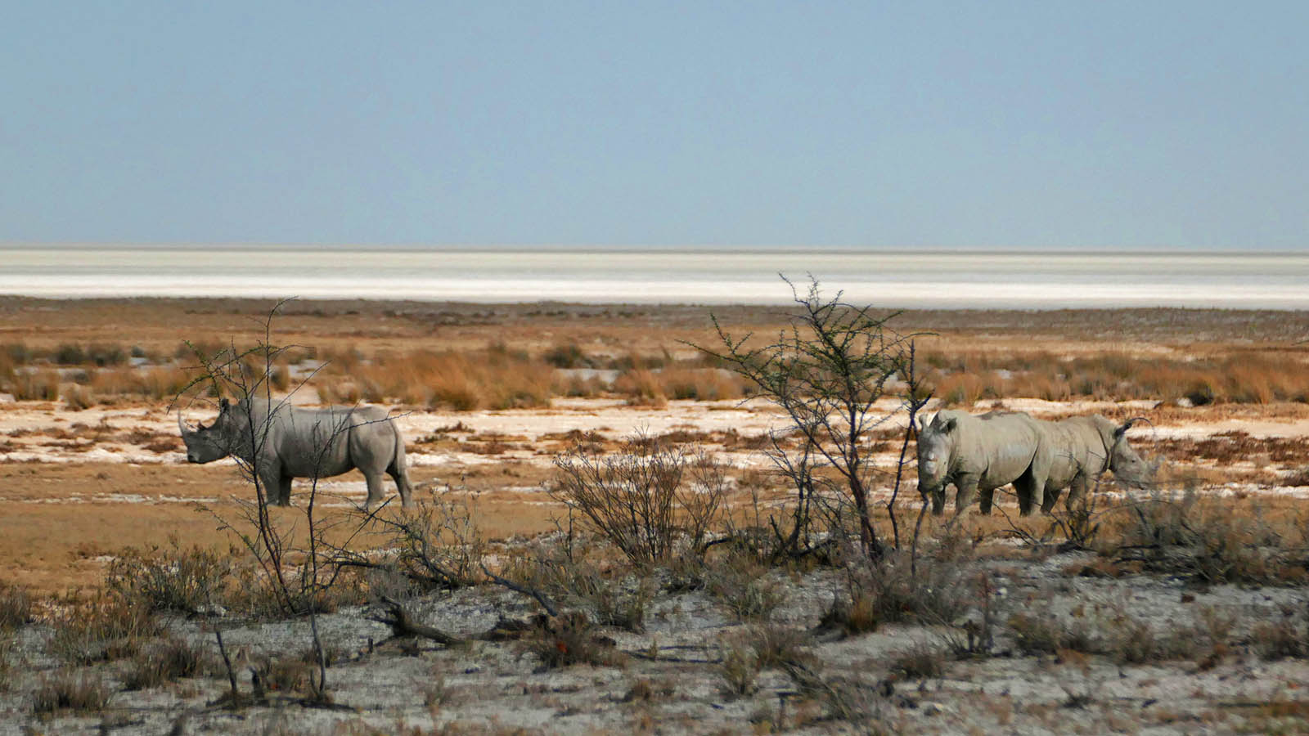
Photo © Sekerka D

Slide 4
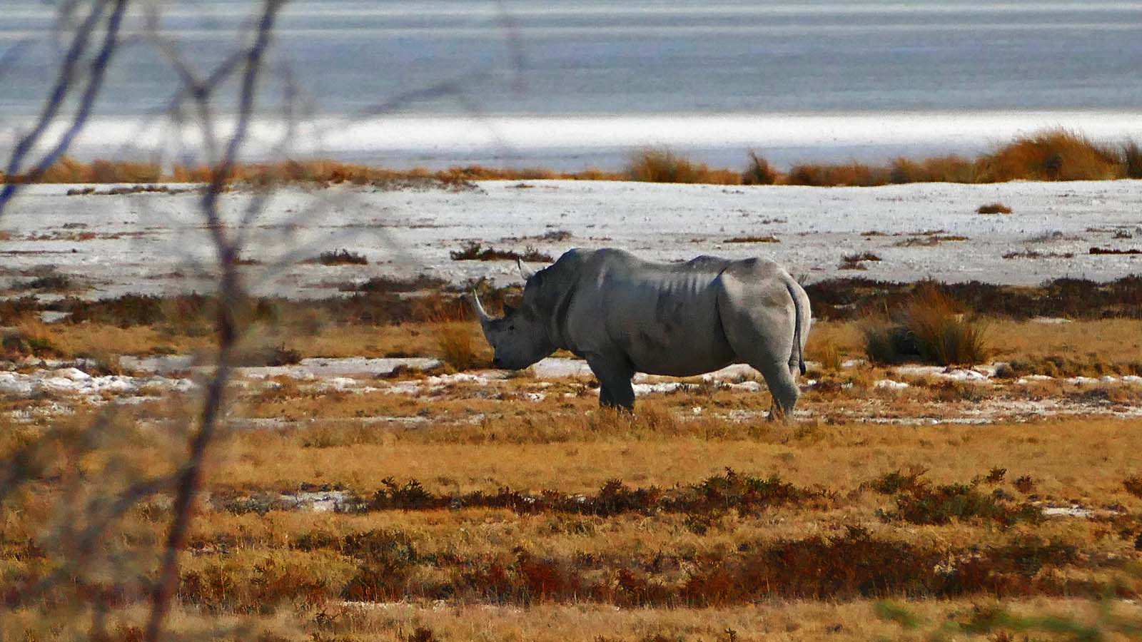
Photo © Sekerka D

Slide 5
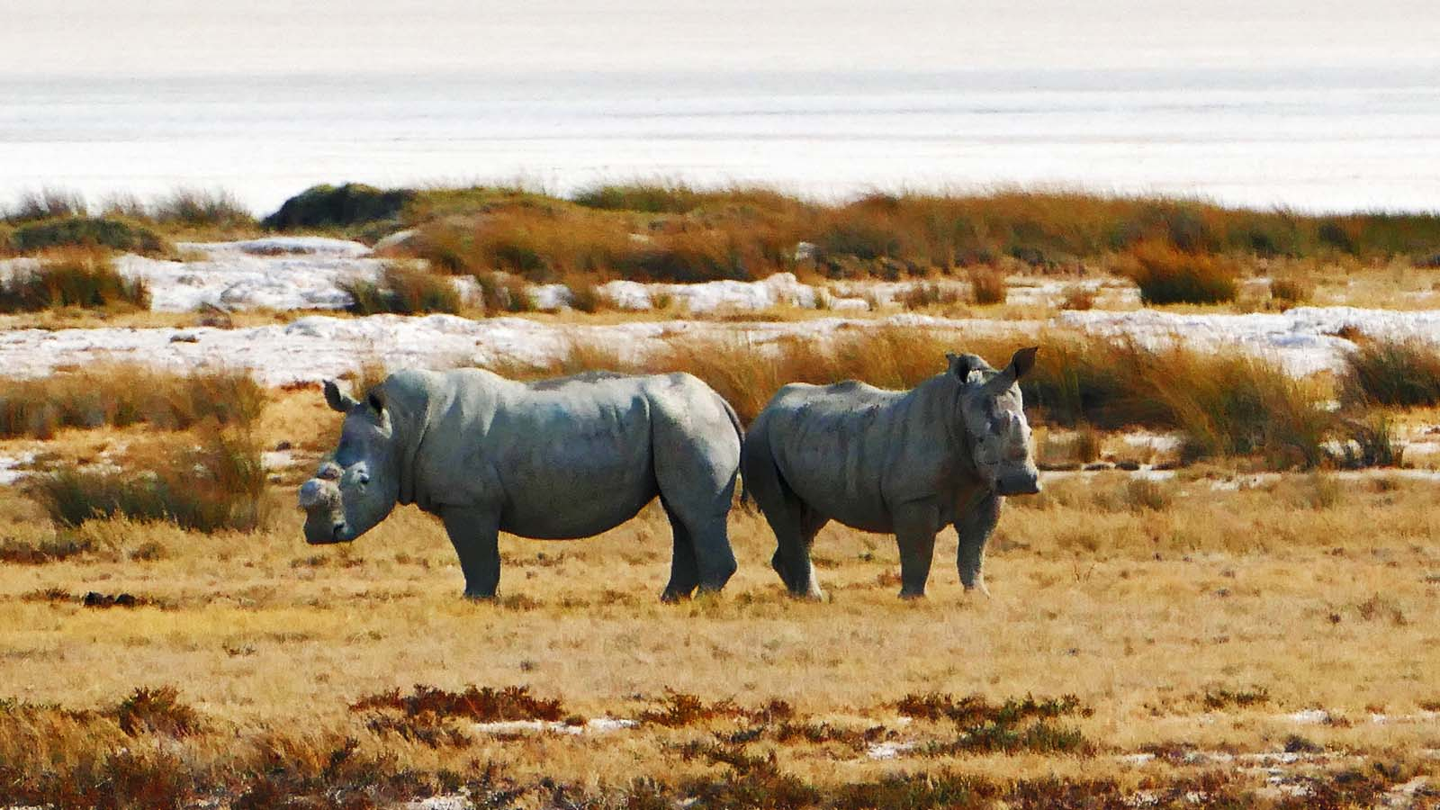
Photo © Sekerka D

Slide 6
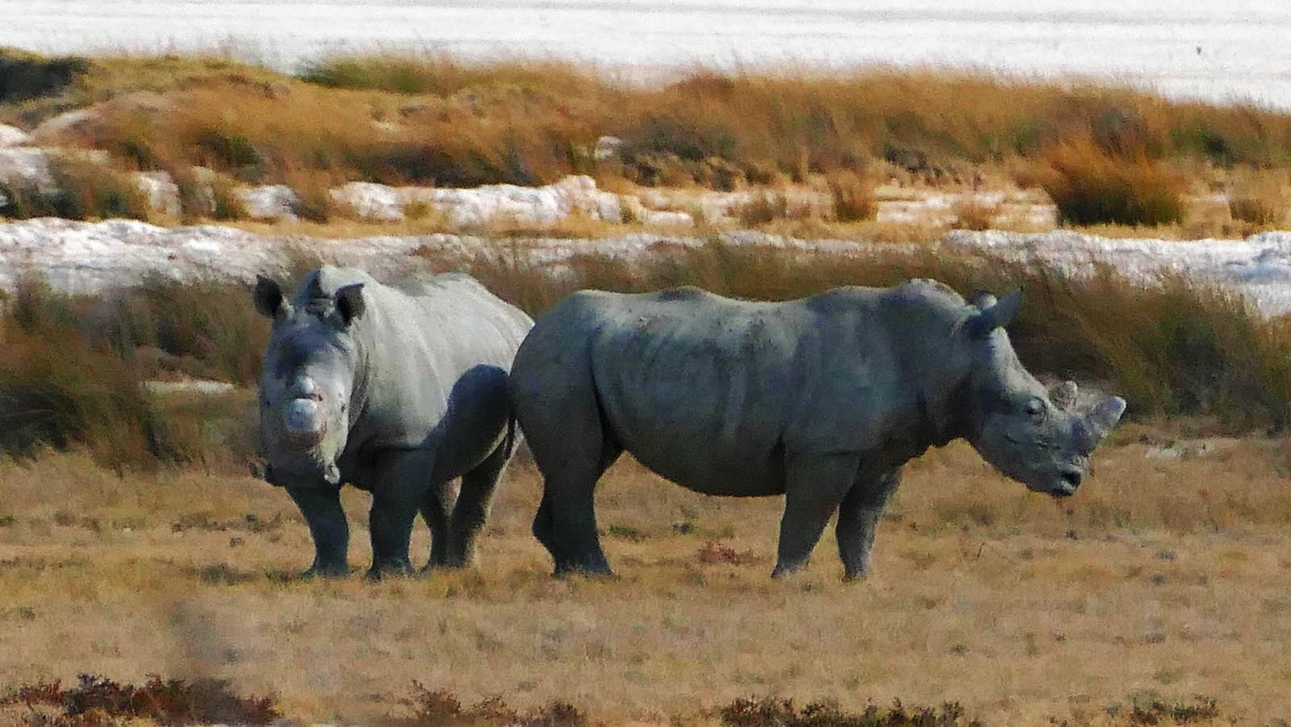
Photo © Sekerka D

Slide 7
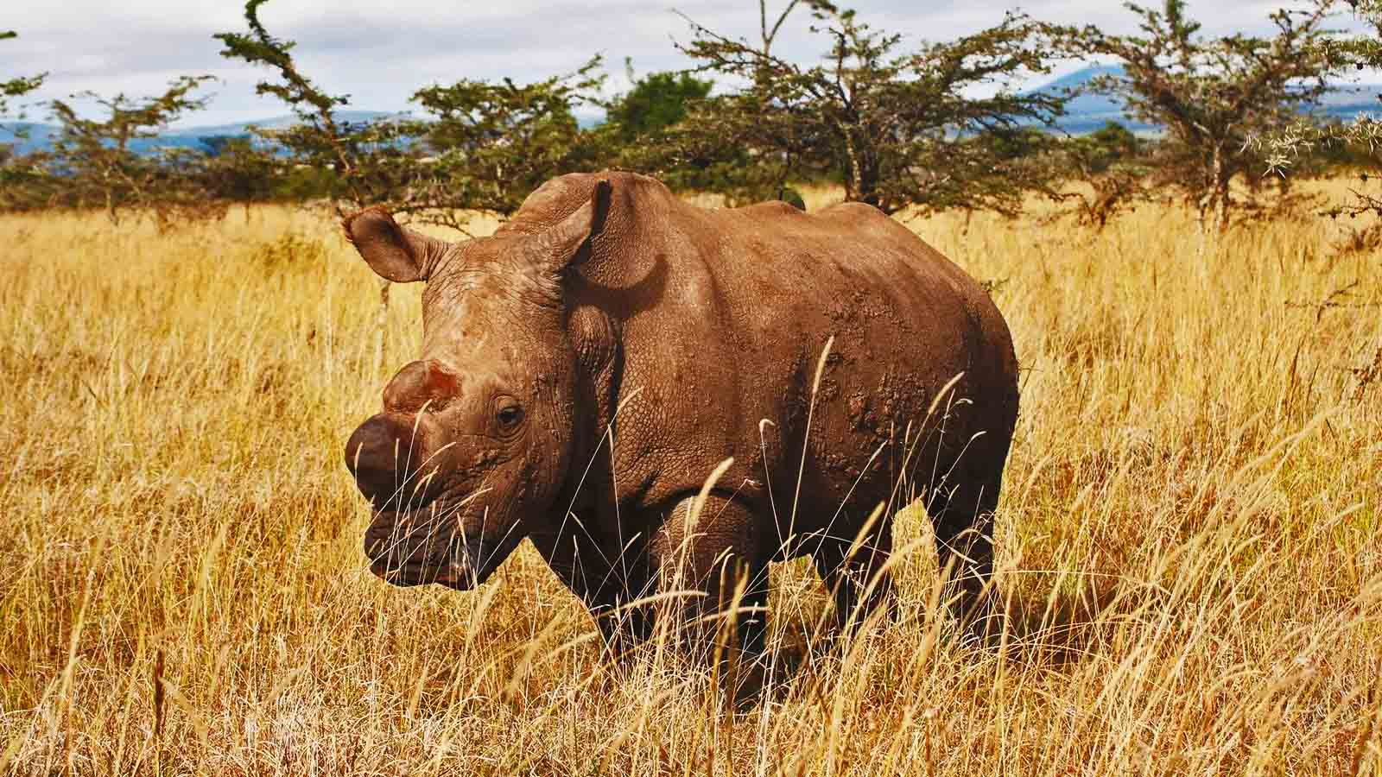
Photo © Jan Stejskal

Slide 8
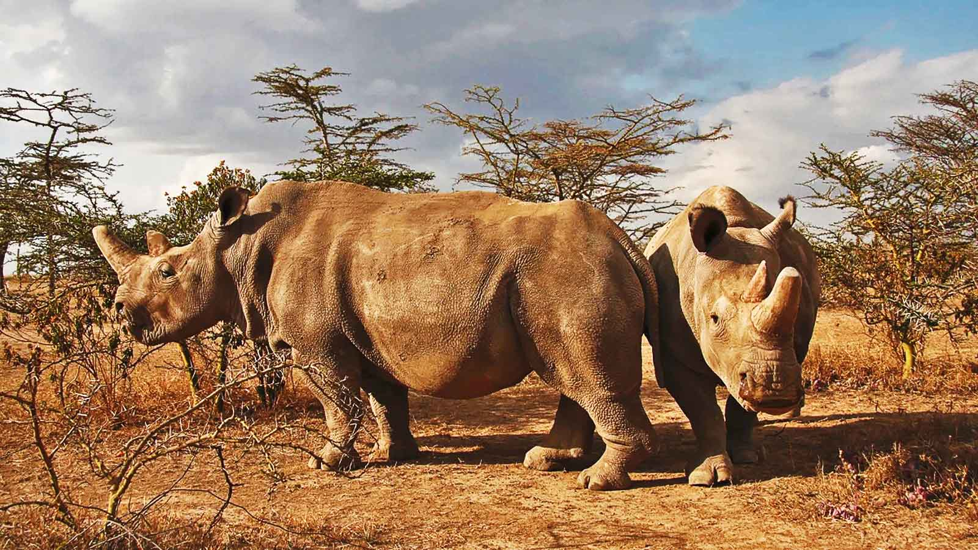
Photo © Jan Stejskal

Slide 9
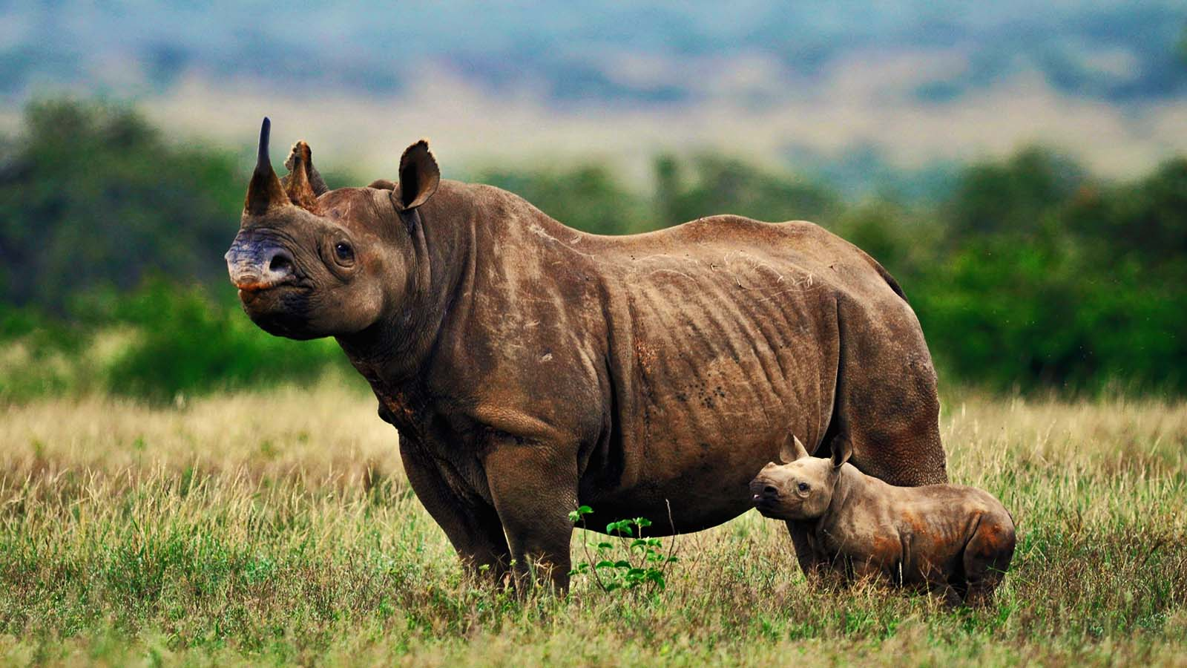
Photo © Stella Kenya

Slide 10
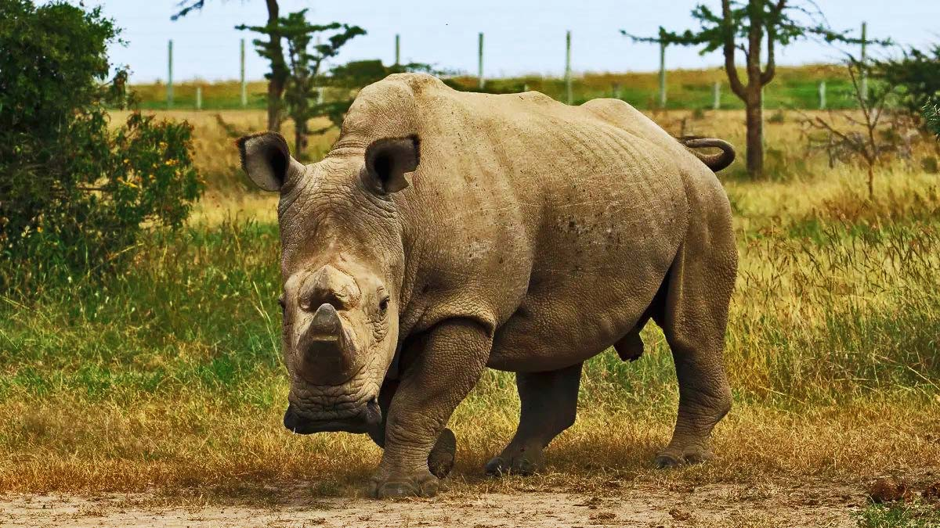
Photo © Helen Pilcher

Slide 11
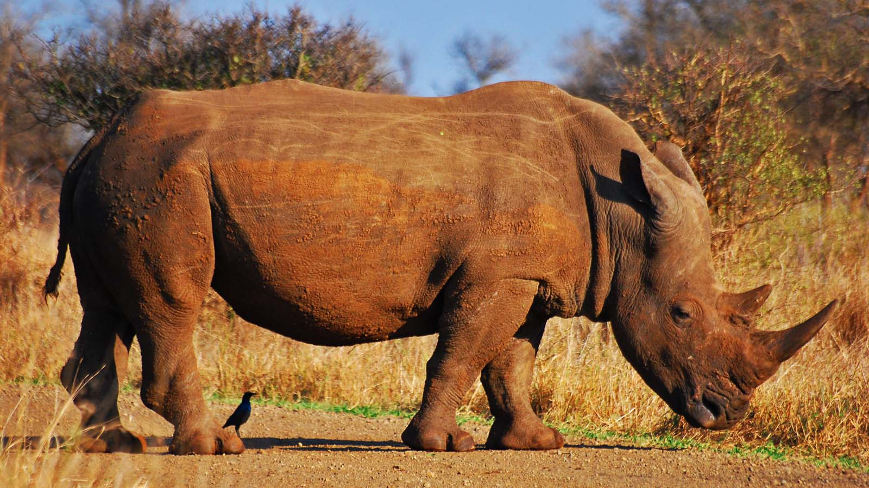
Photo © Wegmann

Slide 12
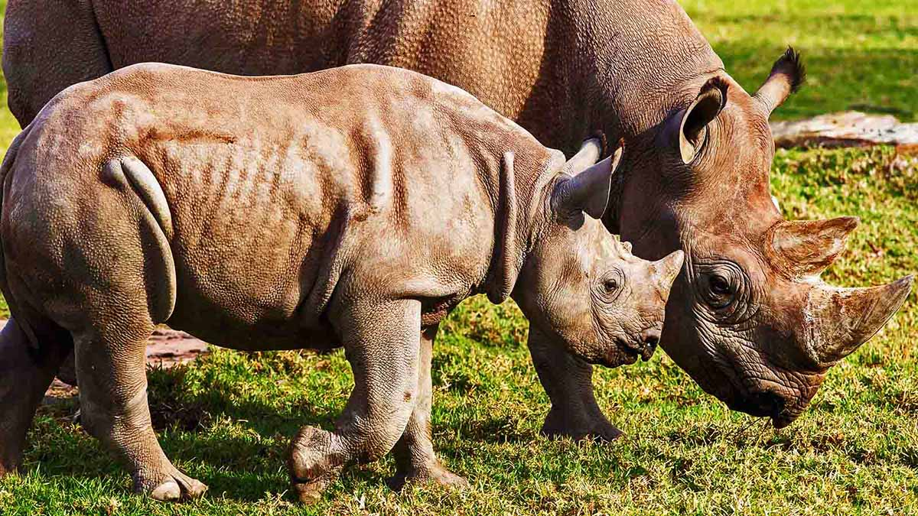
Photo © Rick Stevens

Slide 13
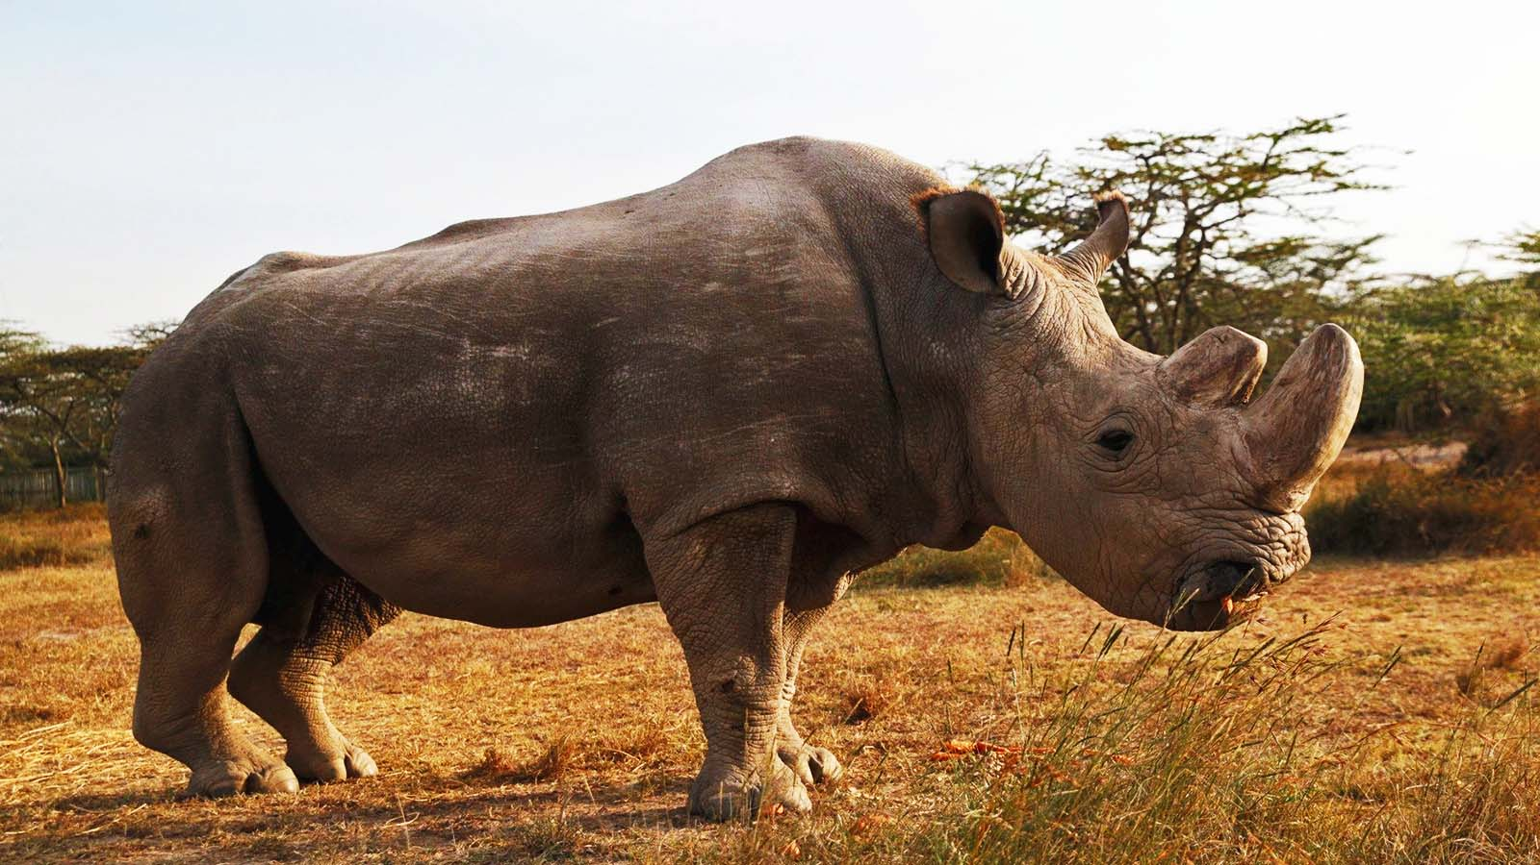
Photo © Thomas Mukoya

Slide 14
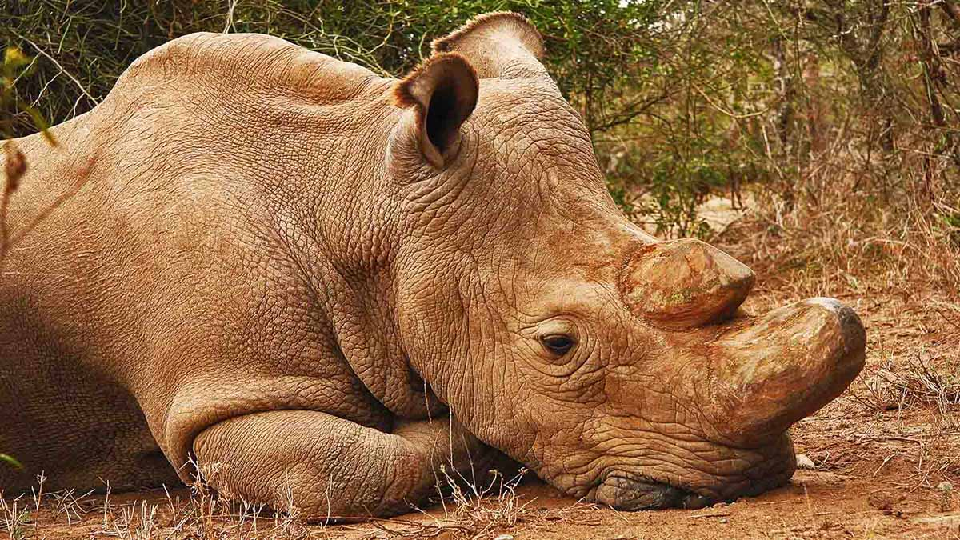
Photo © Jan Stejskal

Slide 15
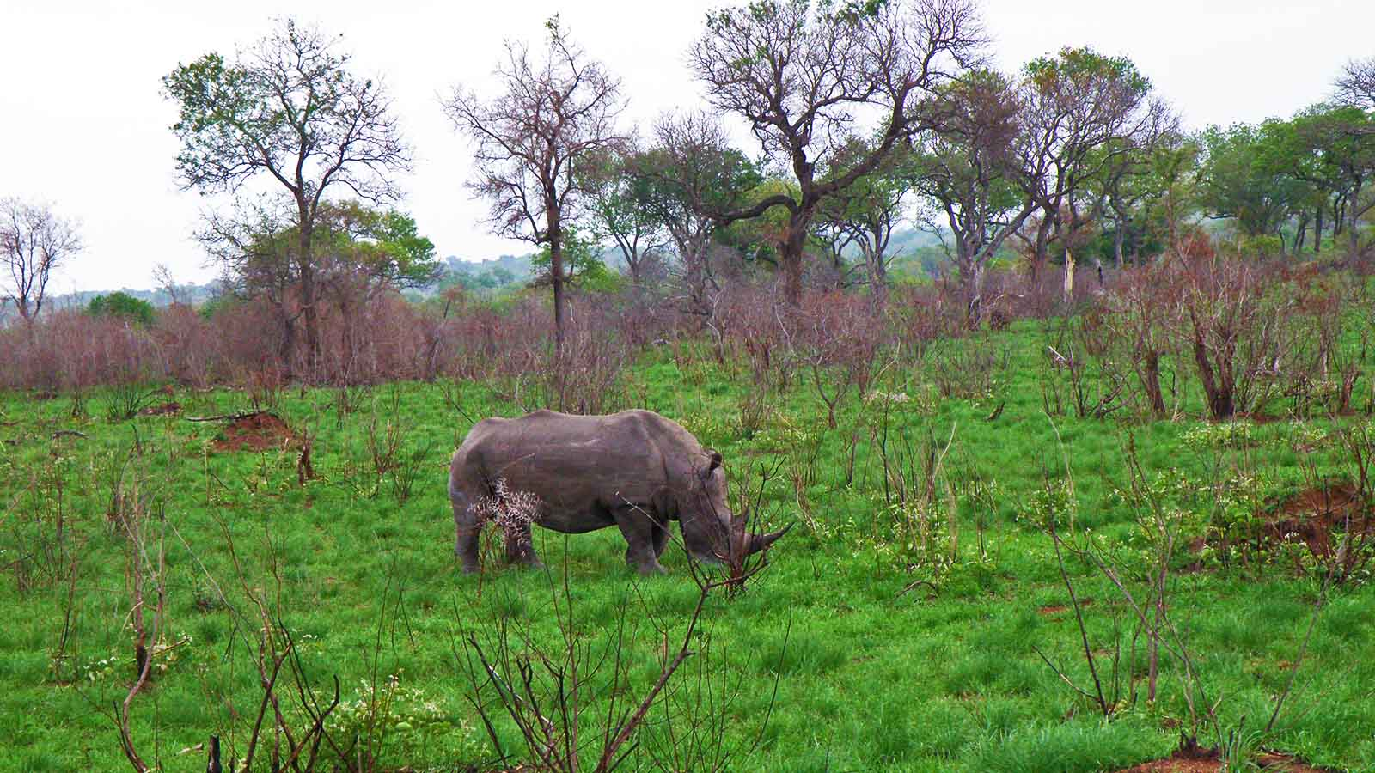
Photo © Hudec Ivan

Slide 16
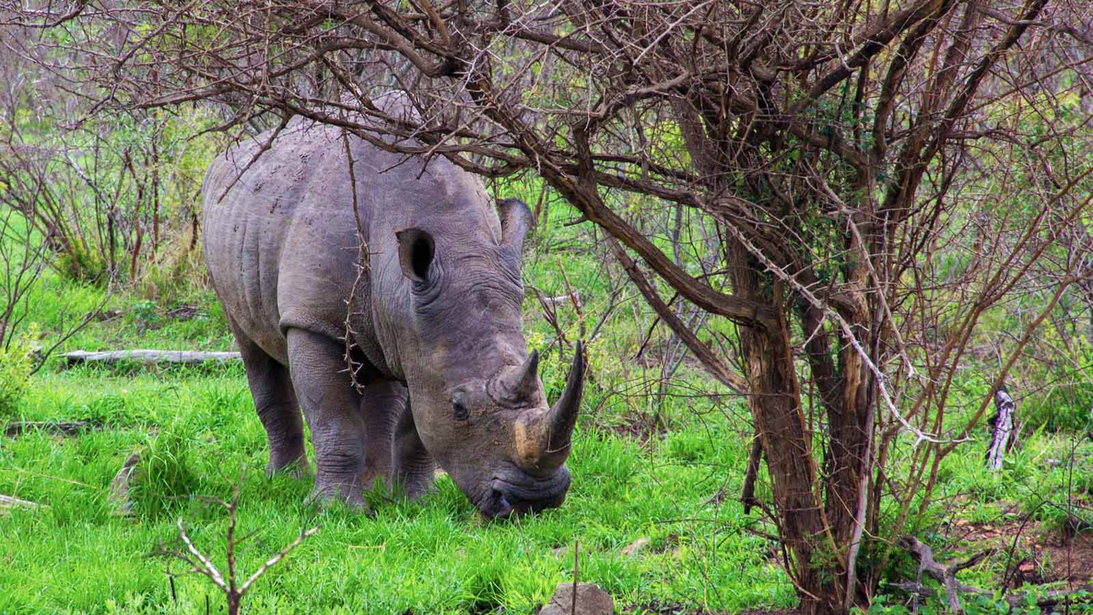
Photo © Hudec Ivan

Slide 17
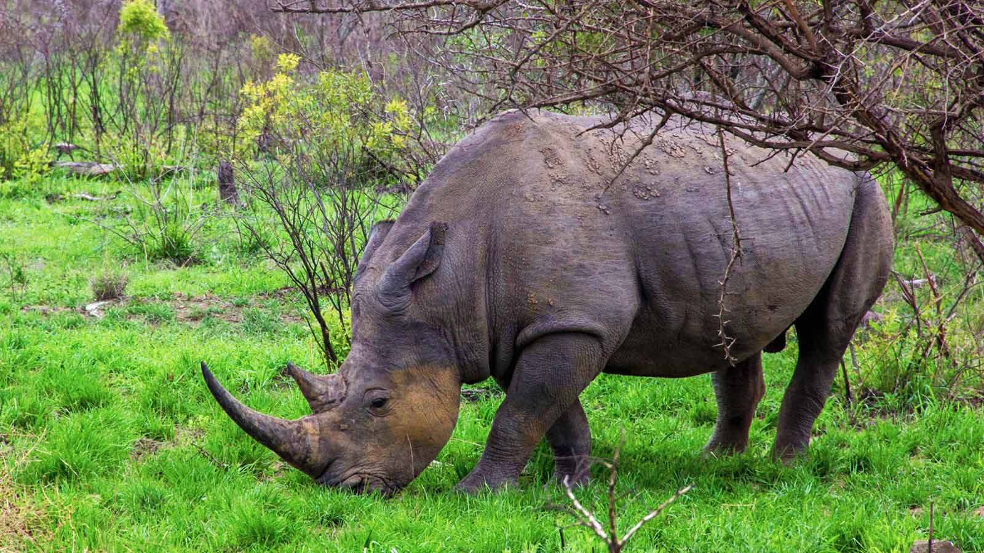
Photo © Hudec Ivan

Slide 18
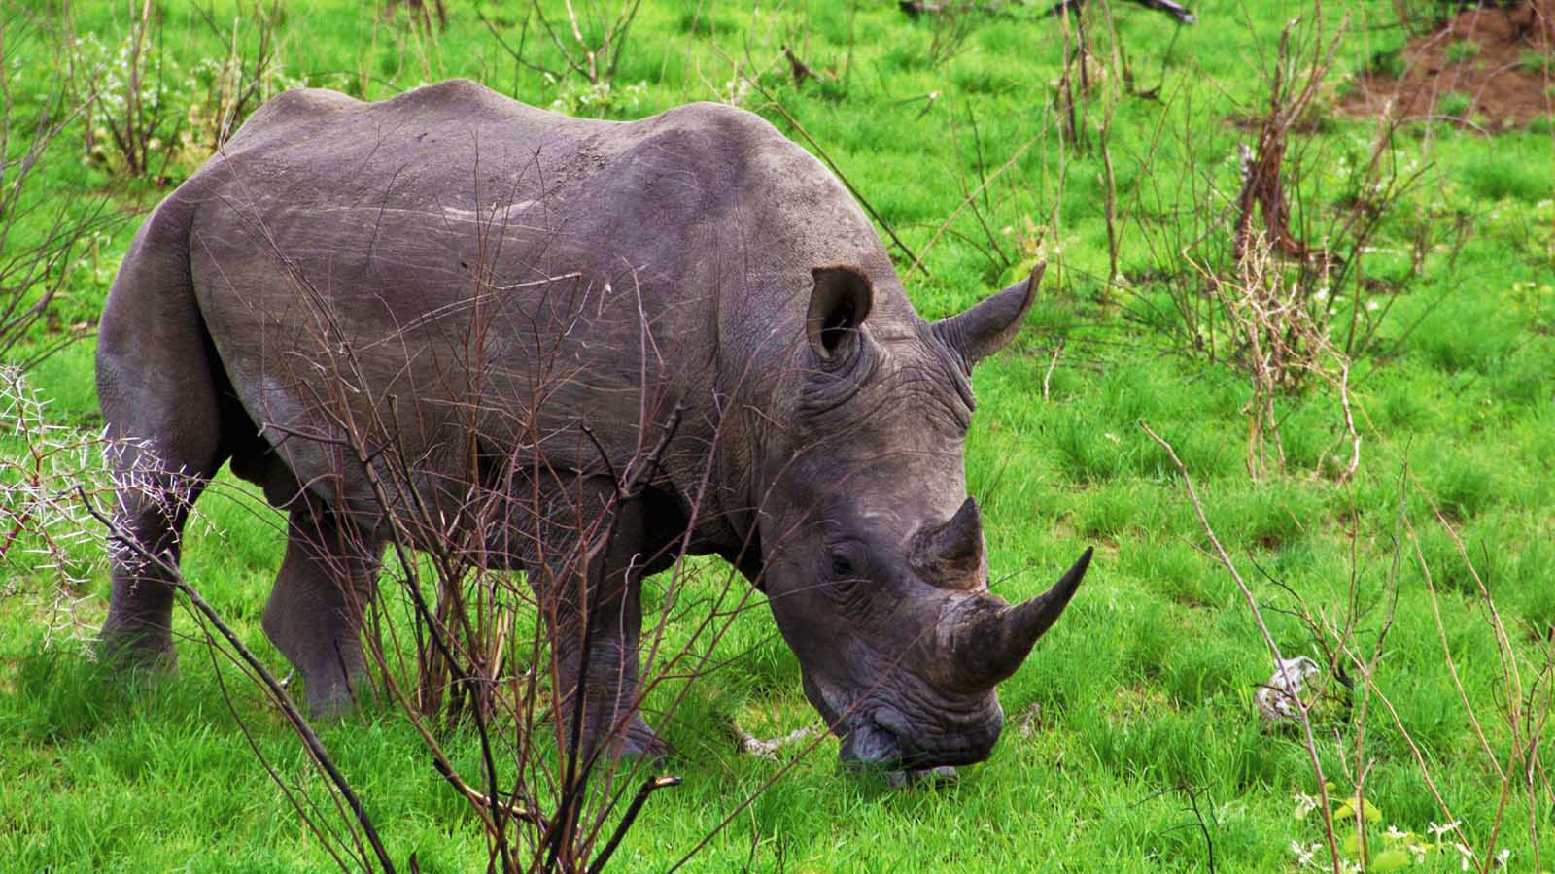
Photo © Hudec Ivan

Slide 19
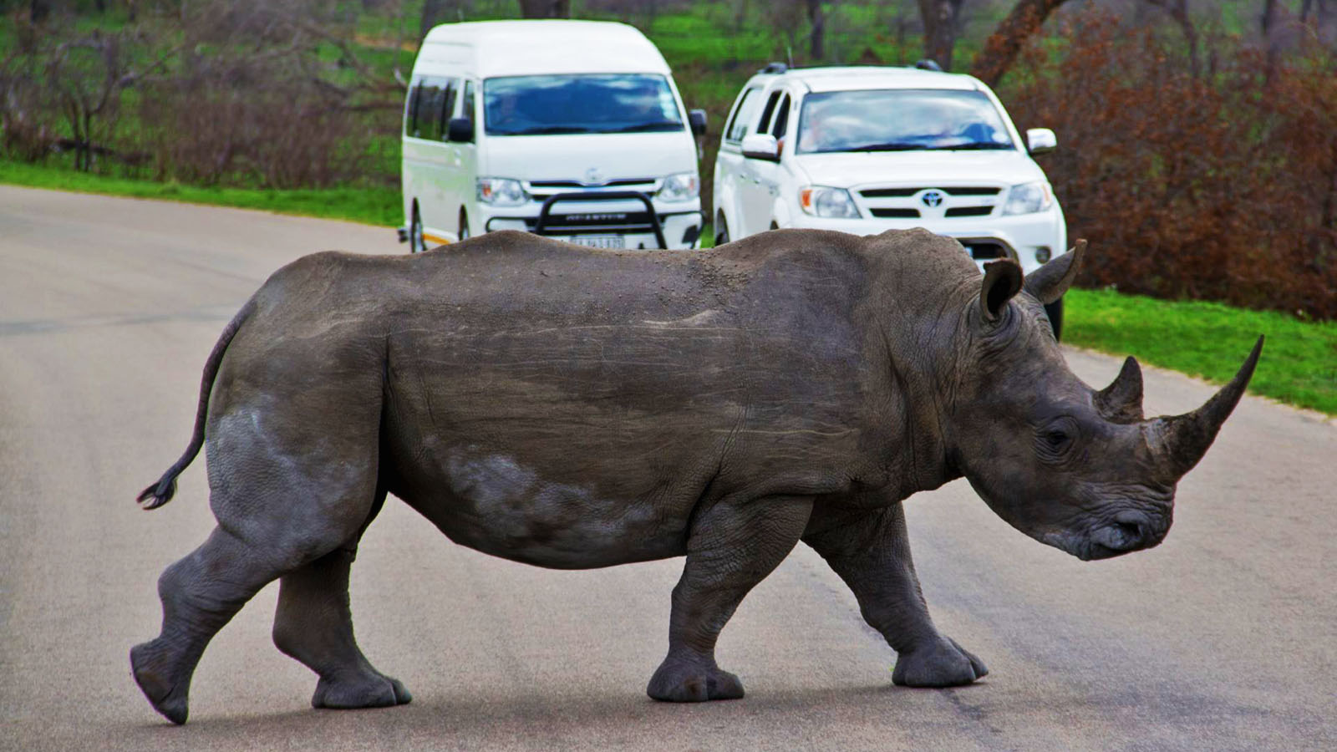
Photo © Hudec Ivan

Slide 20
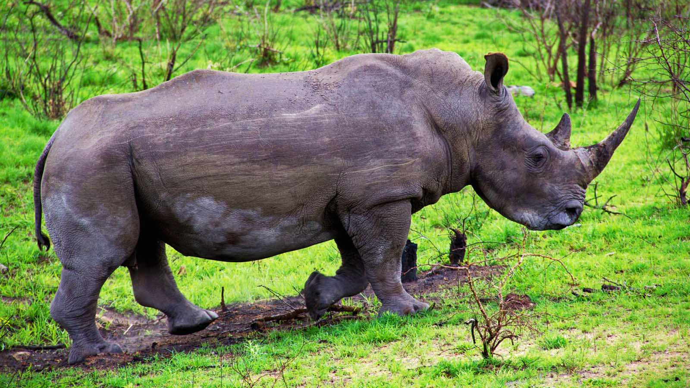
Photo © Hudec Ivan

Slide 21
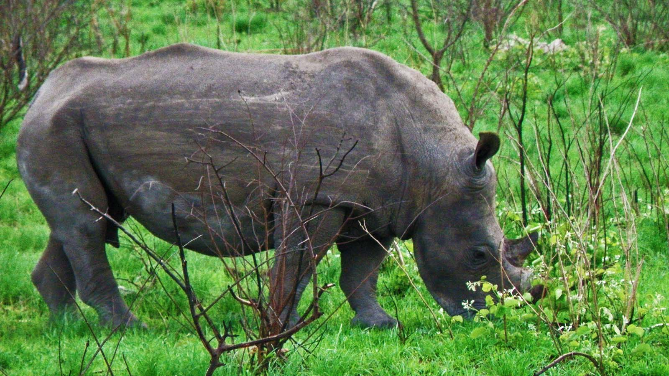
Photo © Hudec Ivan

Slide 22
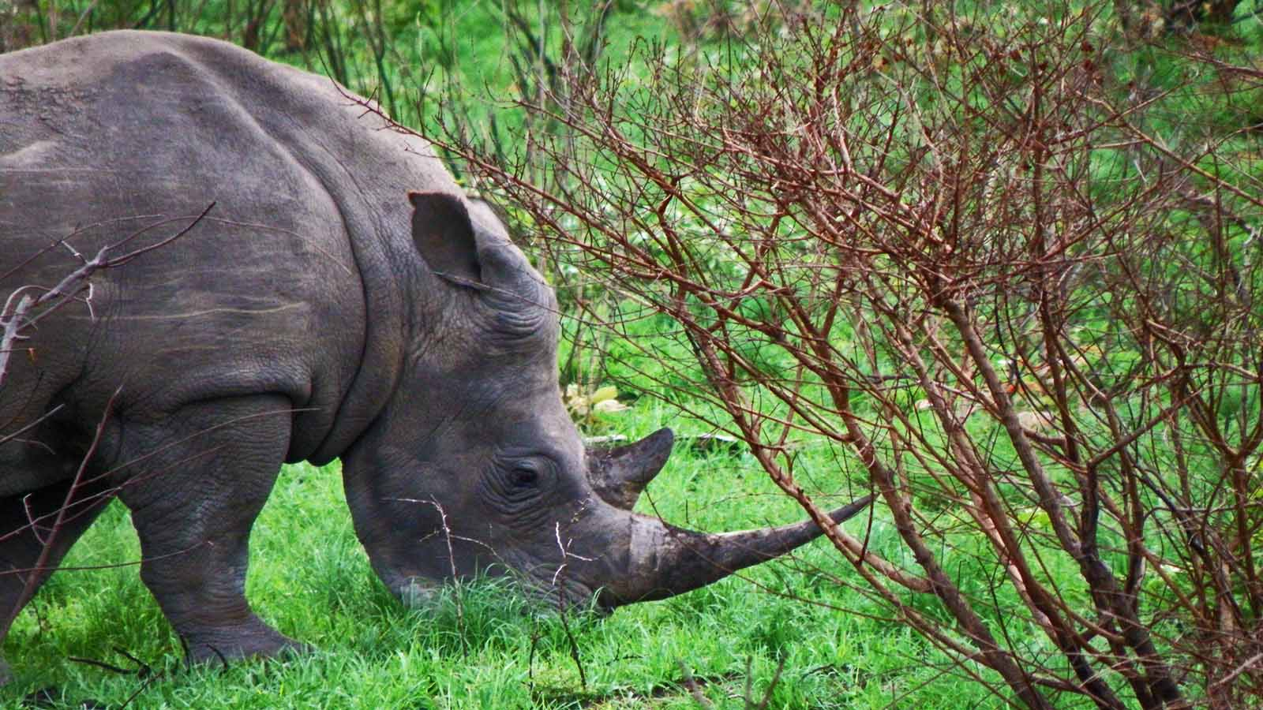
Photo © Hudec Ivan

Slide 23
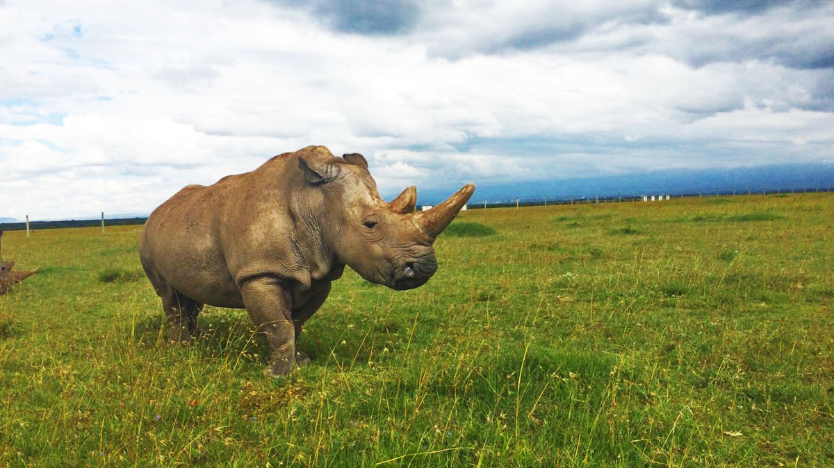
Photo © Lauren Evans

Slide 24
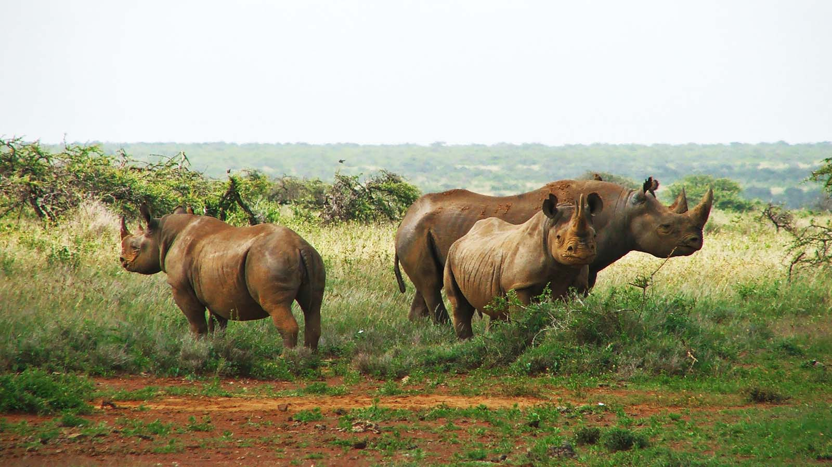
Photo © Stella Kenya

Slide 25
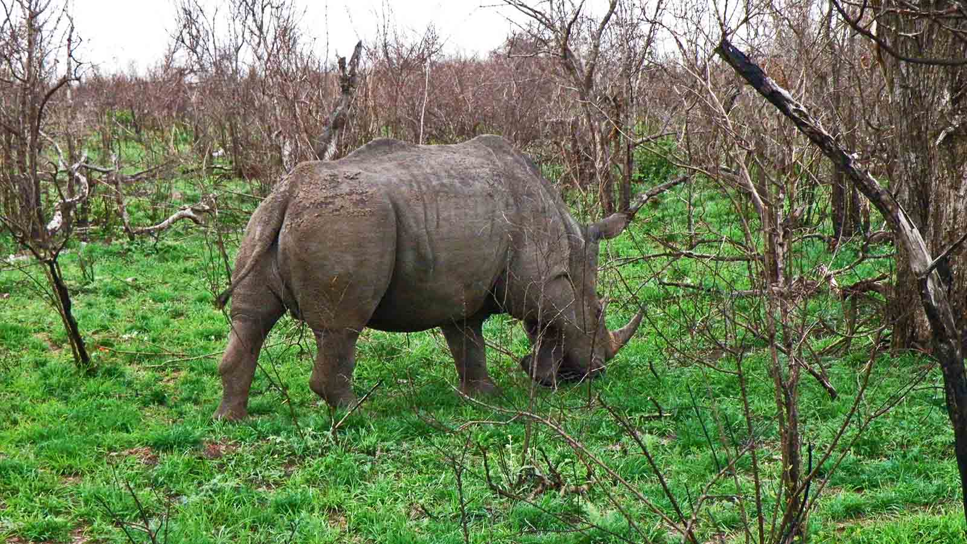
Photo © Hudec Ivan

Slide 26
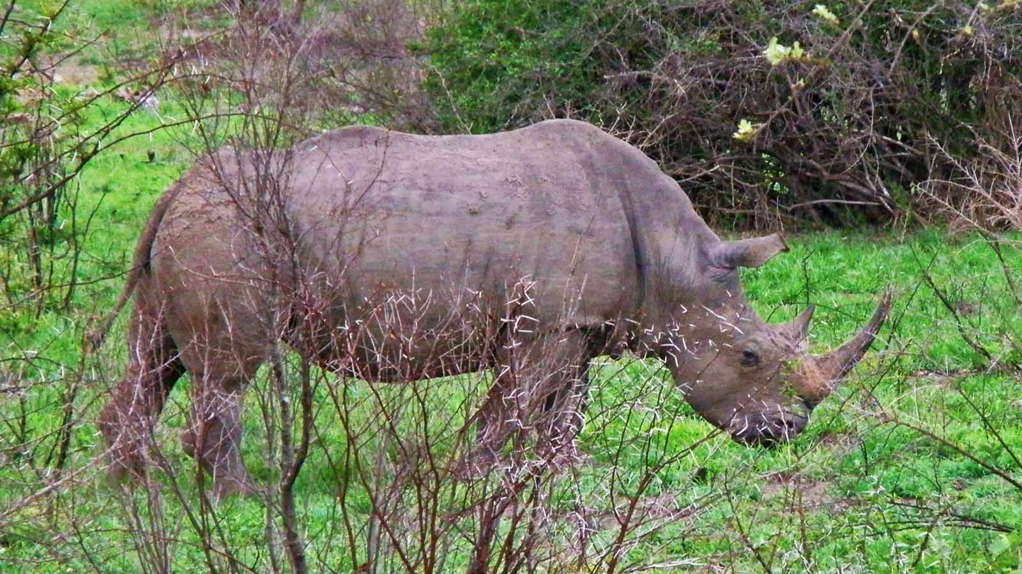
Photo © Hudec Ivan

Slide 27
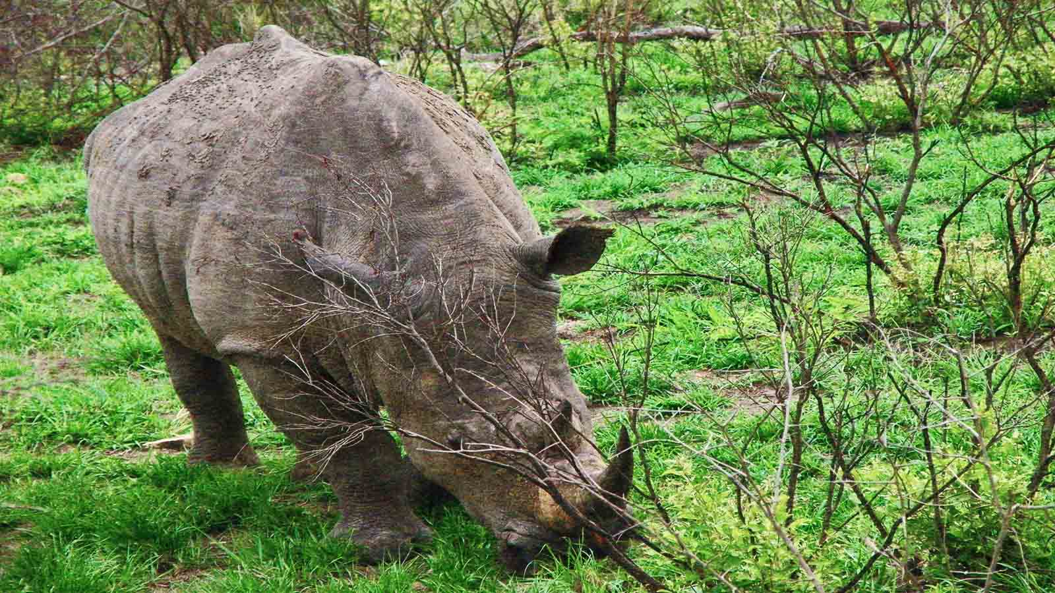
Photo © Hudec Ivan

Slide 28
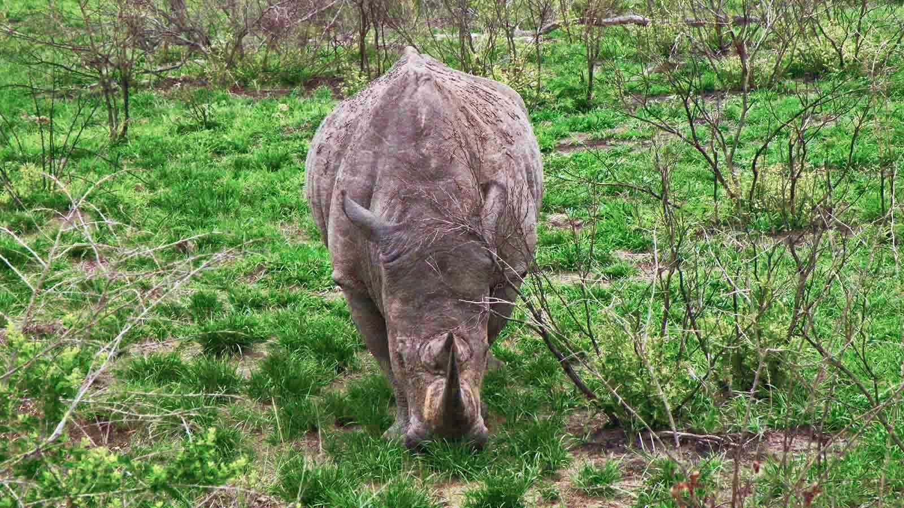
Photo © Hudec Ivan

Slide 29
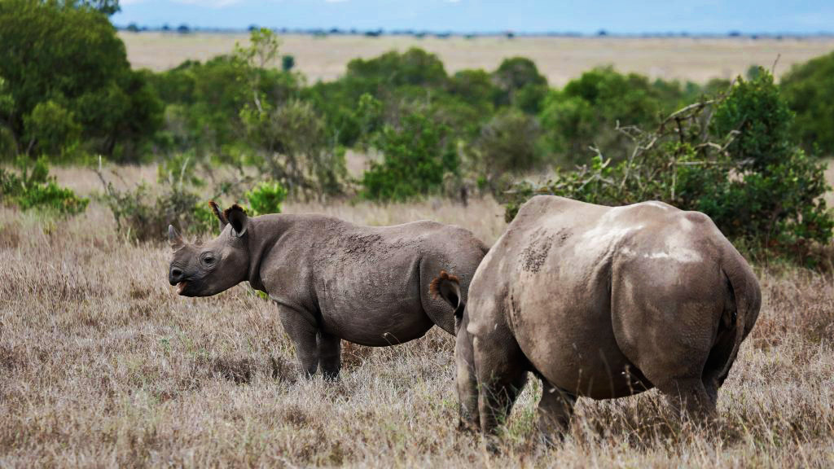
Photo © Baz Ratner

Slide 30
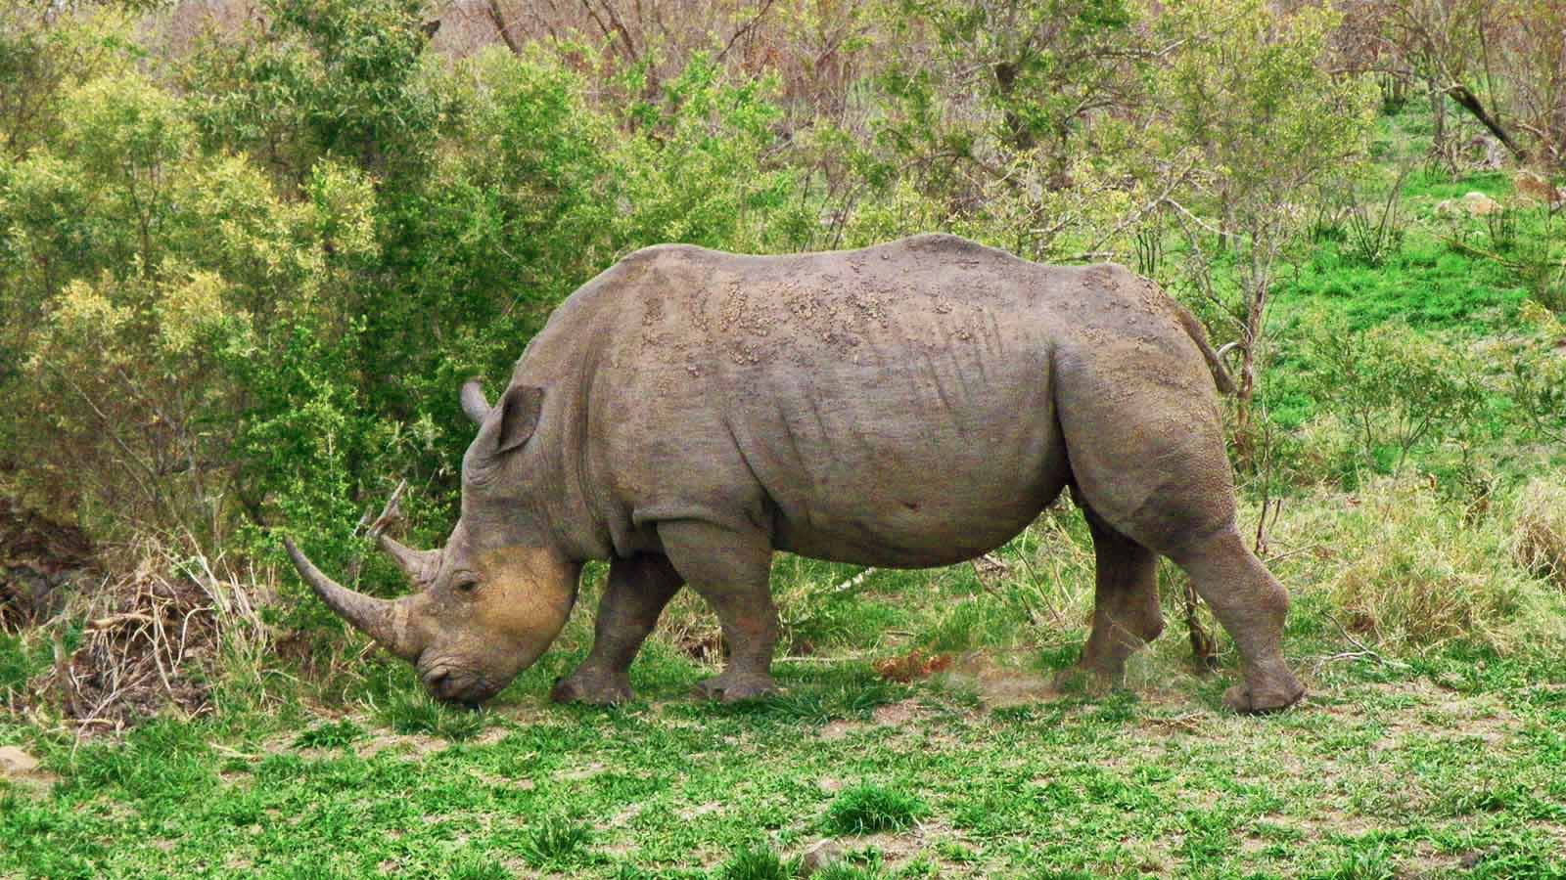
Photo © Hudec Ivan

Slide 31
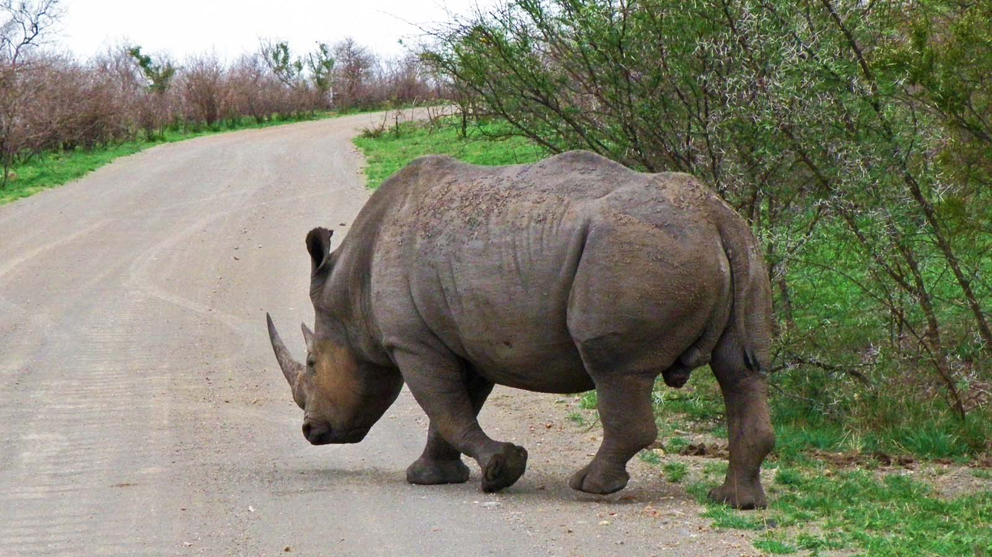
Photo © Hudec Ivan

Slide 32
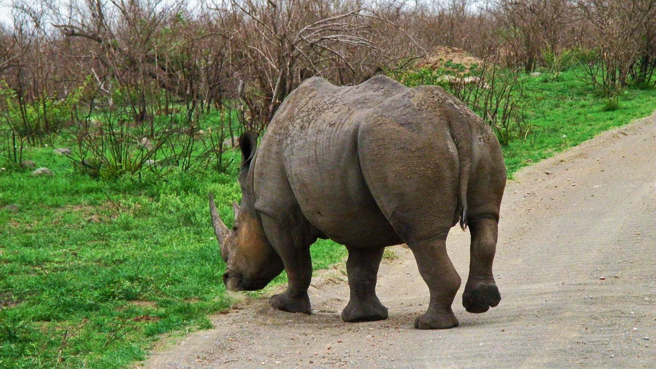
Photo © Hudec Ivan

Slide 33
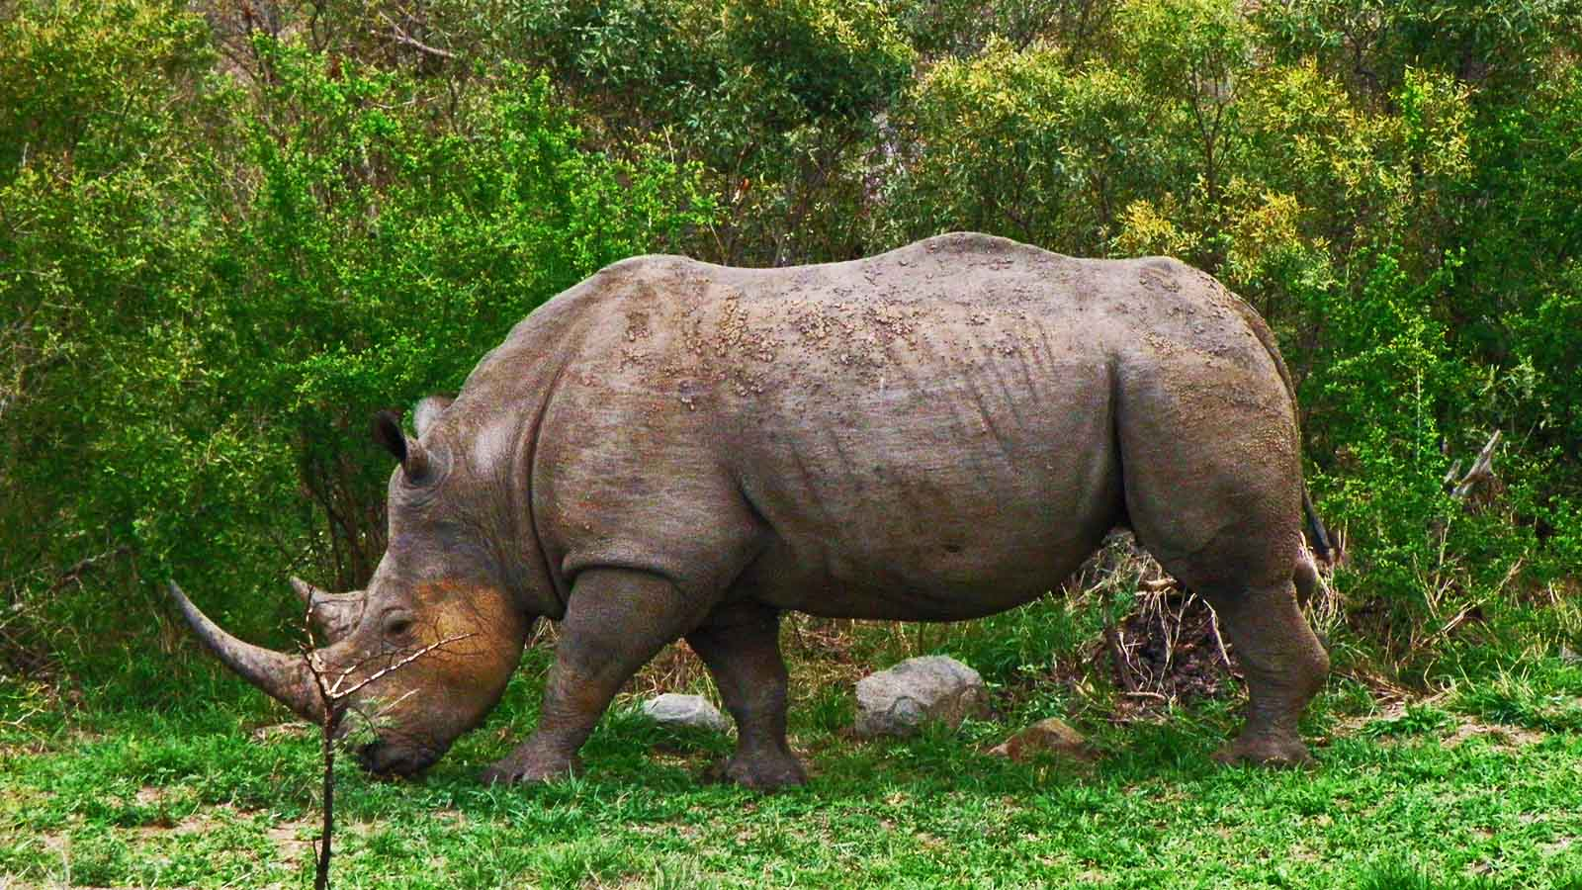
Photo © Hudec Ivan

Slide 34
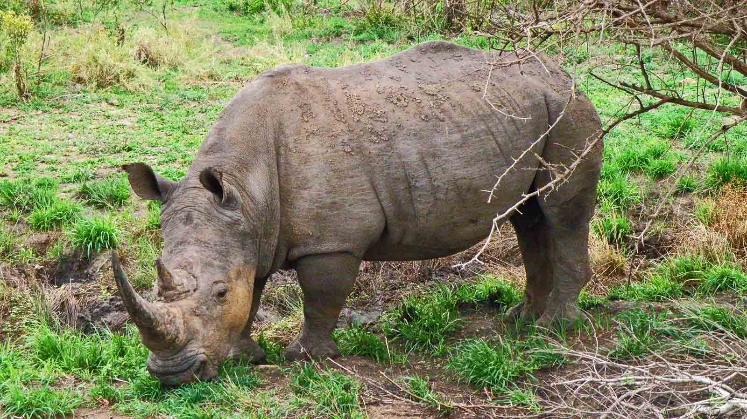
Photo © Hudec Ivan

Slide 35
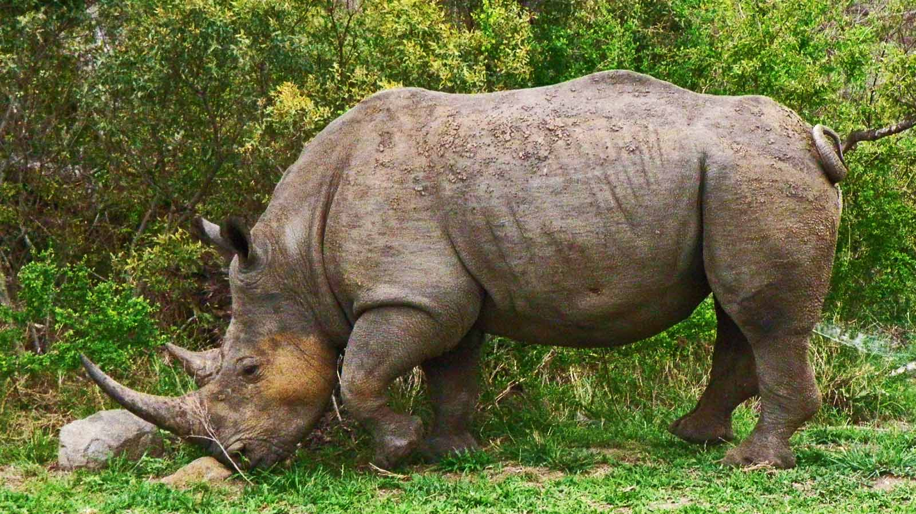
Photo © Hudec Ivan

Slide 36
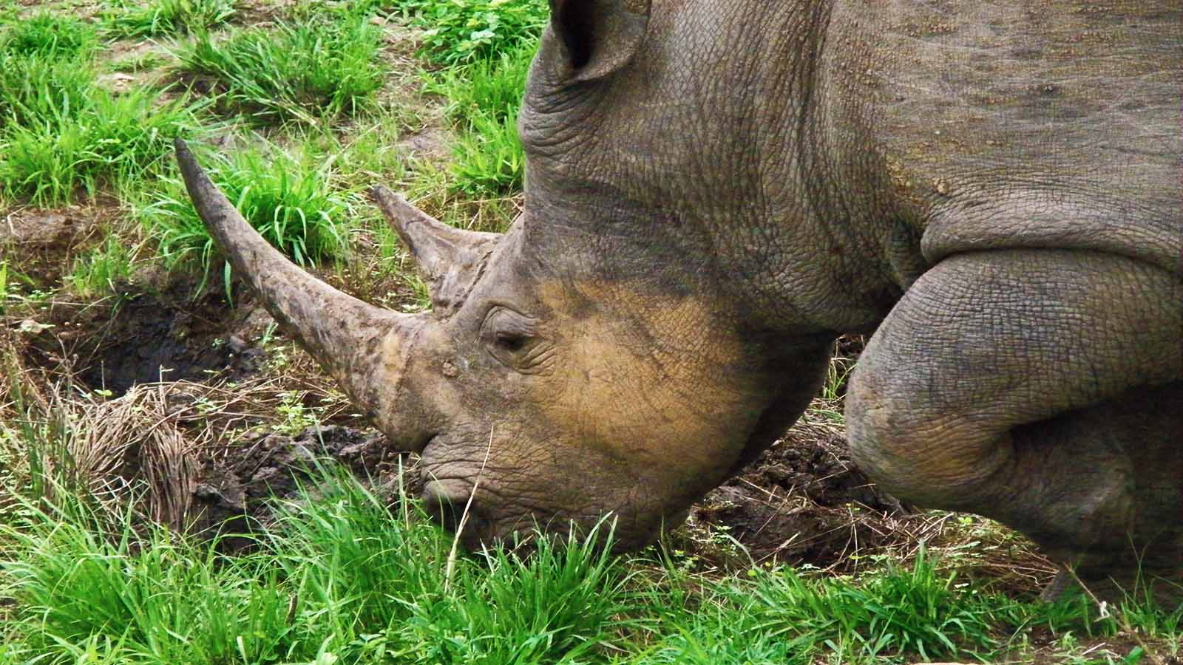
Photo © Hudec Ivan

Slide 37
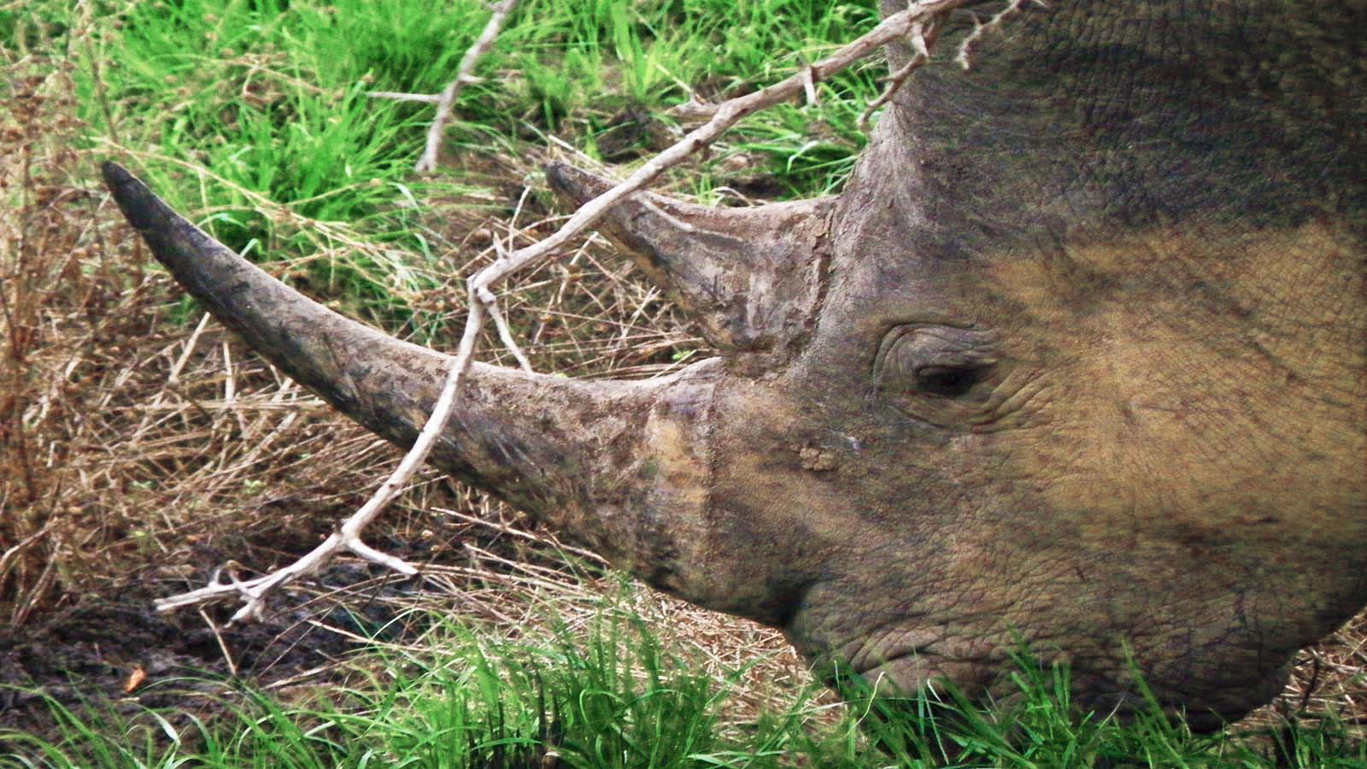
Photo © Hudec Ivan

Slide 38

2021
Music : N-Chant Nguru - Afrique
Photos : Sekerka Dušan, Ing. (Slovakia)
Photos : Hudec Ivan (Slovakia)
Photos : Internet
Created by : Rumpler Štefan (Slovakia)
Contact : pista2011@gmail.com

Slide 39


Welcome in all languages!
I can translate your mails!
pista2011@gmail.com
CLICK FOR MY VIDEOS
CLICK FOR MY PPSX
Thank you for your feedback
Steve

