Slide 1
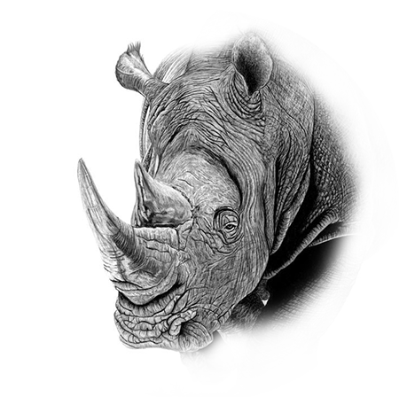

Wildlife
07
Rhino
Of africa

Slide 2
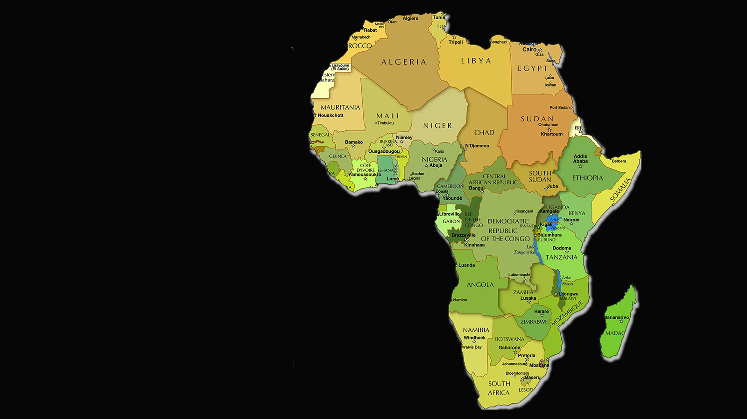
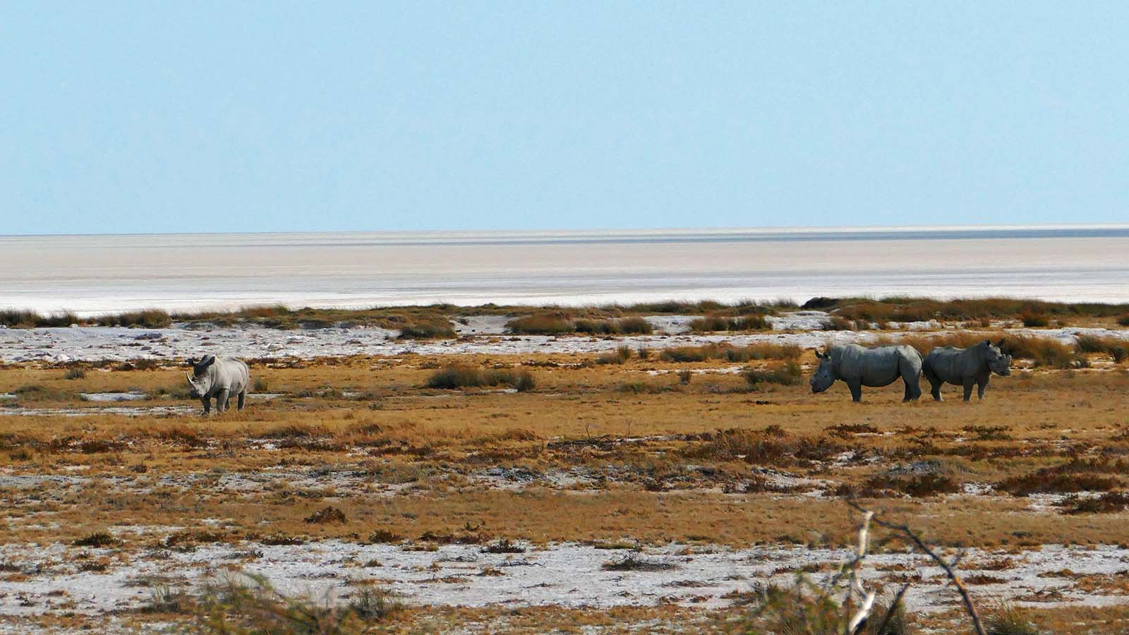


Wildlife
of Africa
Photo © Sekerka D

Slide 3
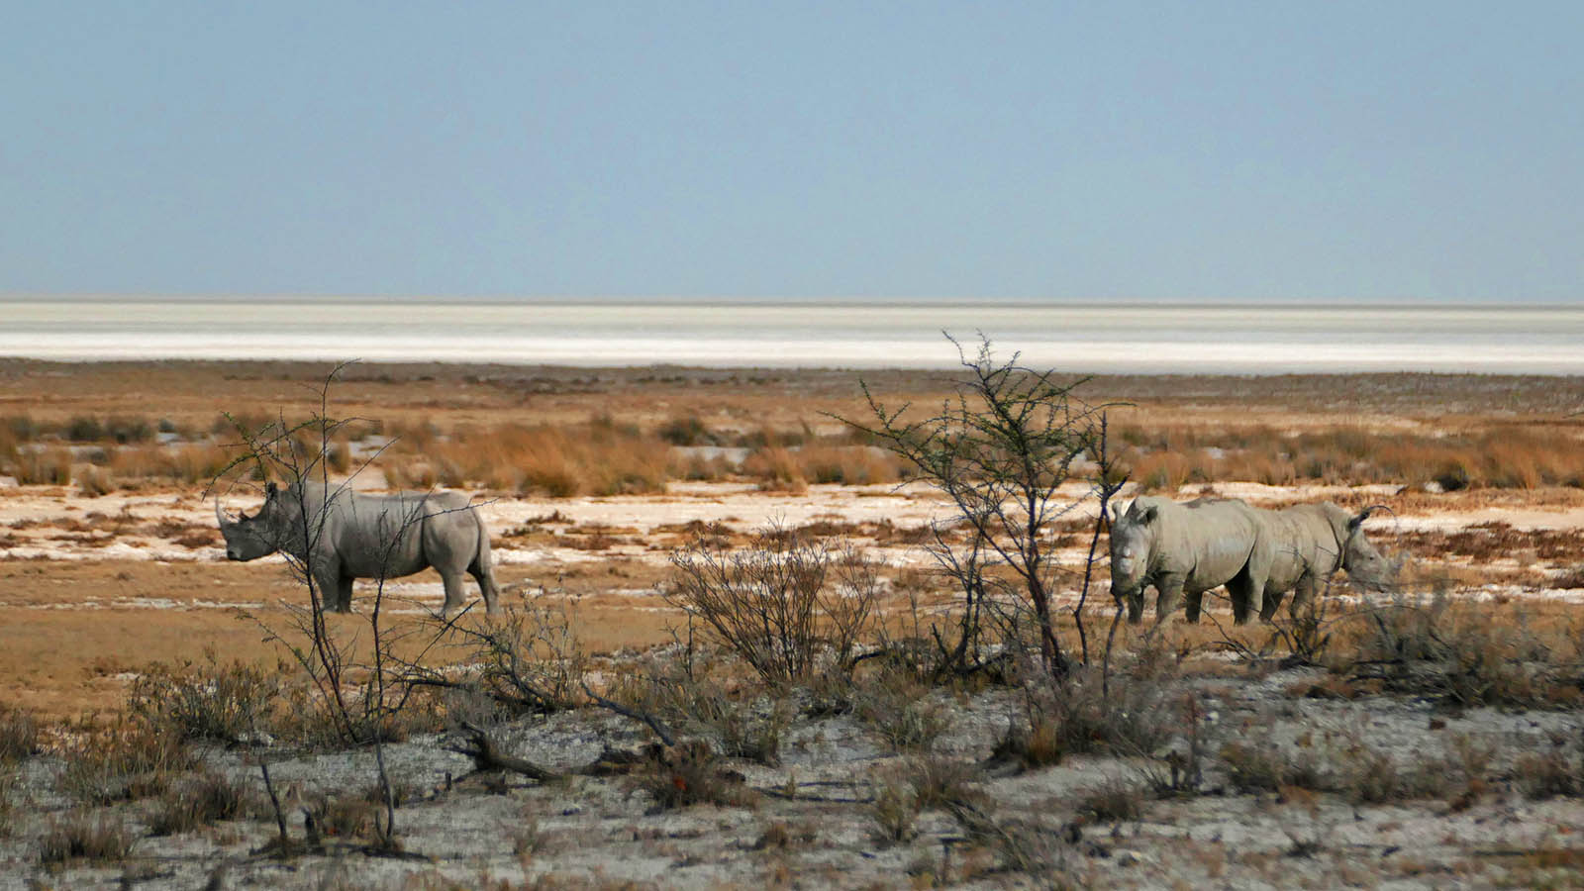
Photo © Sekerka D

Slide 4
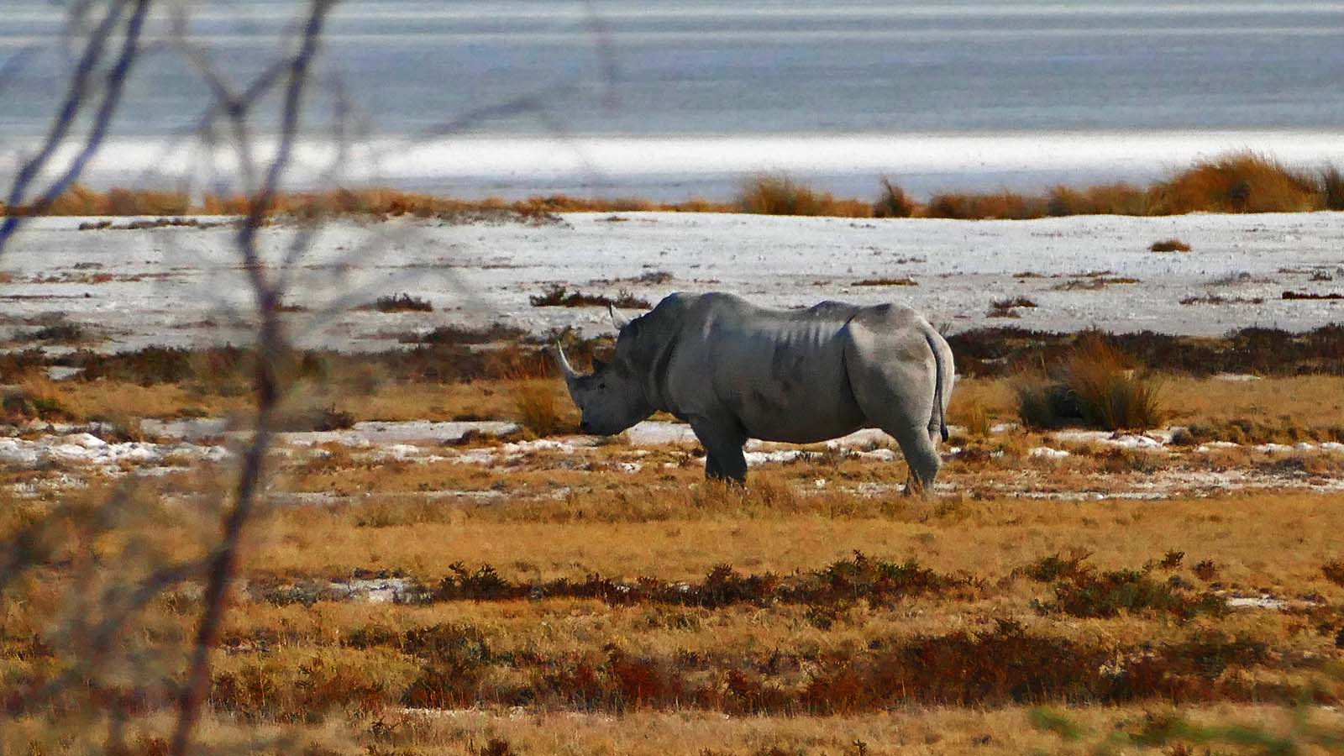
Photo © Sekerka D

Slide 5
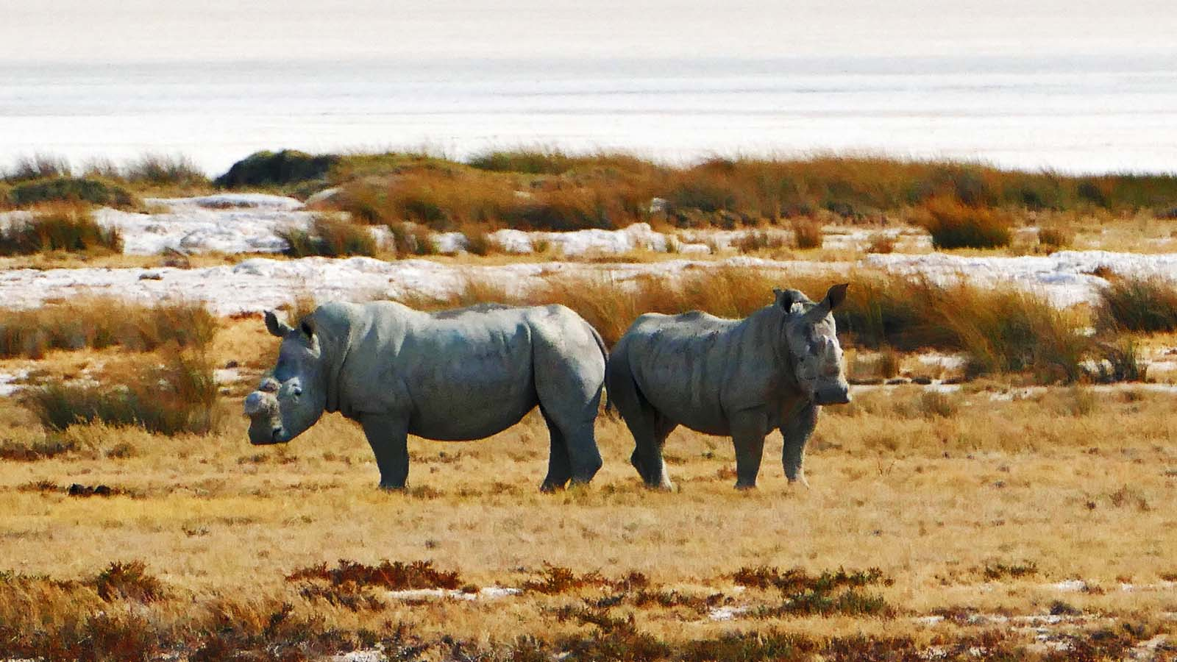
Photo © Sekerka D

Slide 6
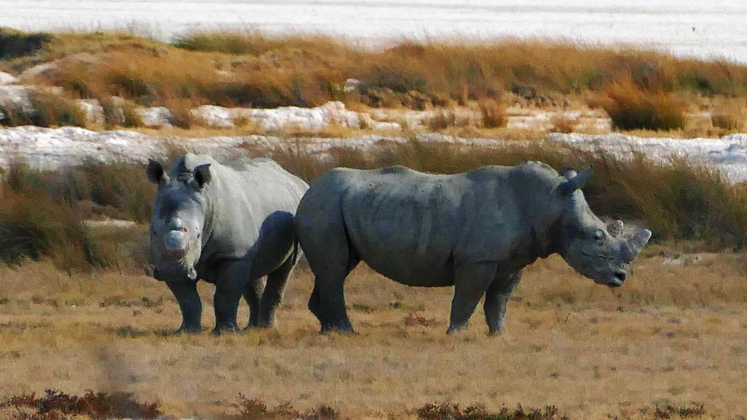
Photo © Sekerka D

Slide 7
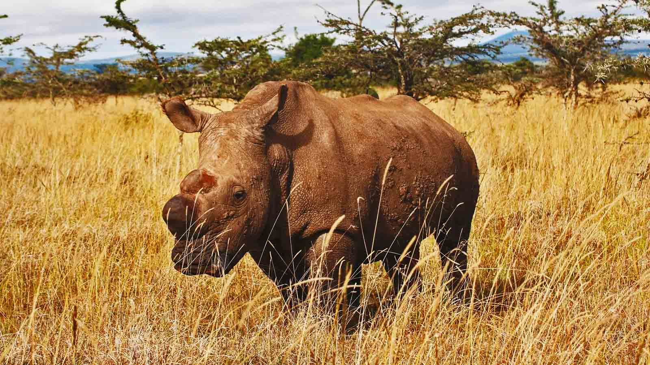
Photo © Jan Stejskal

Slide 8
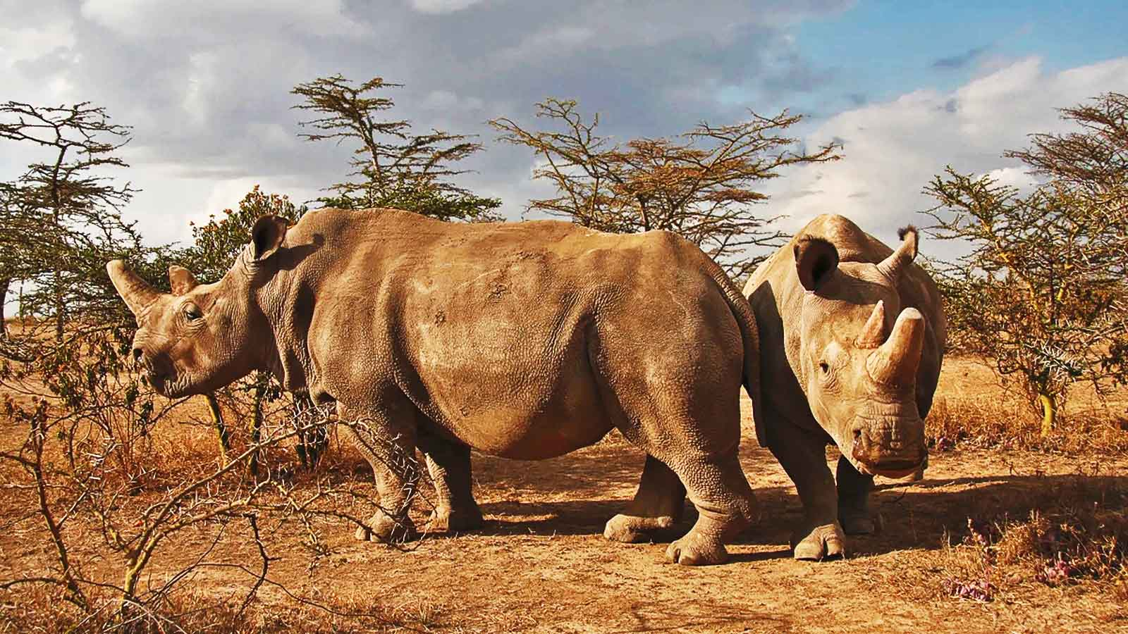
Photo © Jan Stejskal

Slide 9
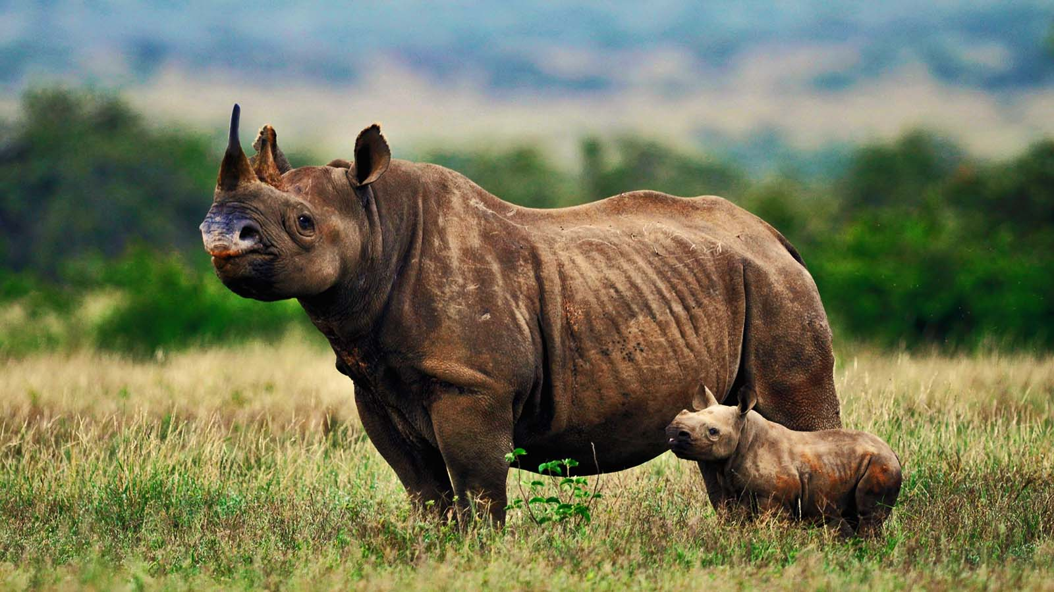
Photo © Stella Kenya

Slide 10
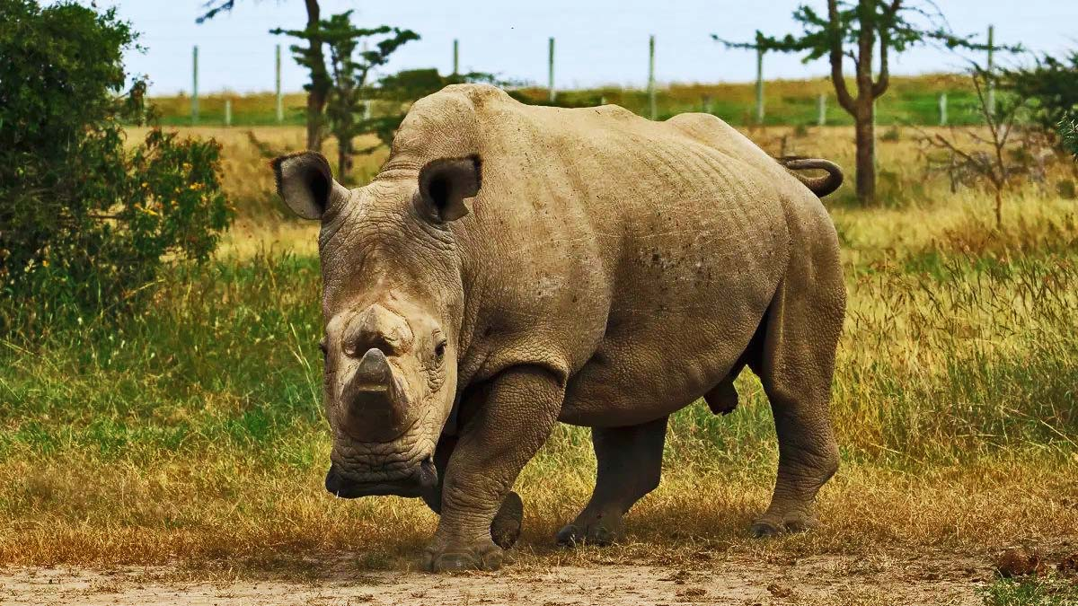
Photo © Helen Pilcher

Slide 11
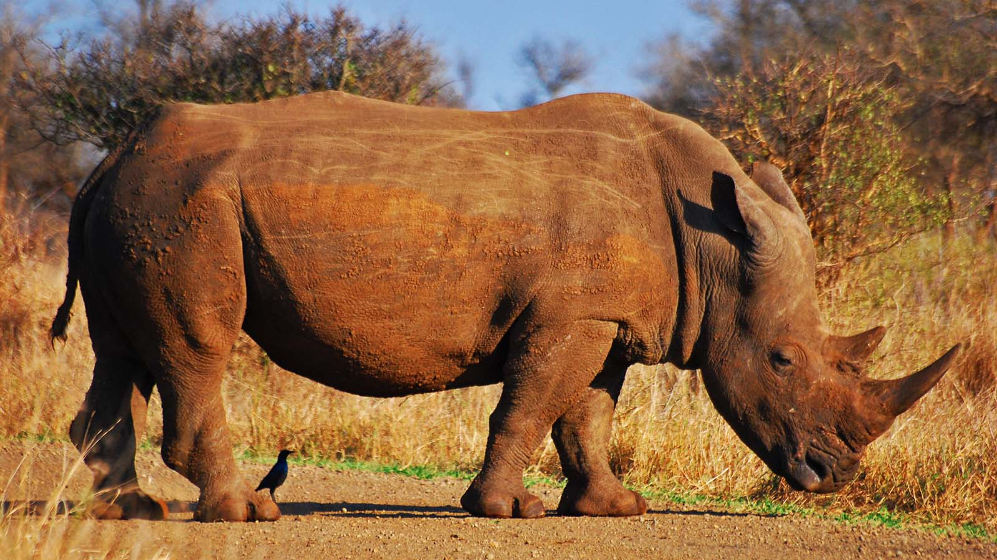
Photo © Wegmann

Slide 12
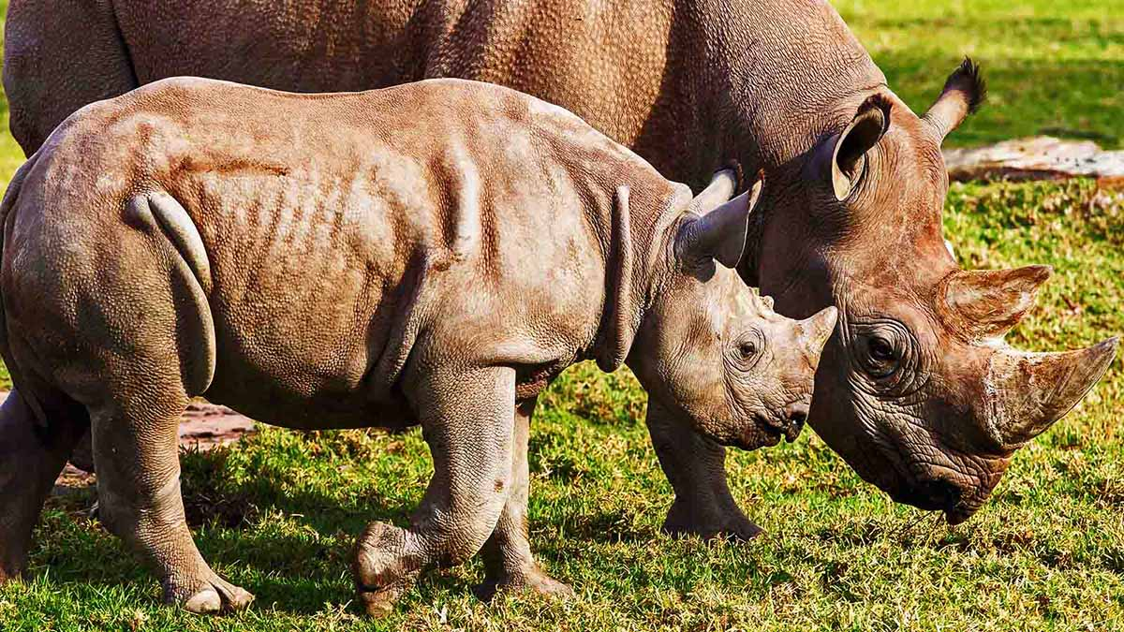
Photo © Rick Stevens

Slide 13
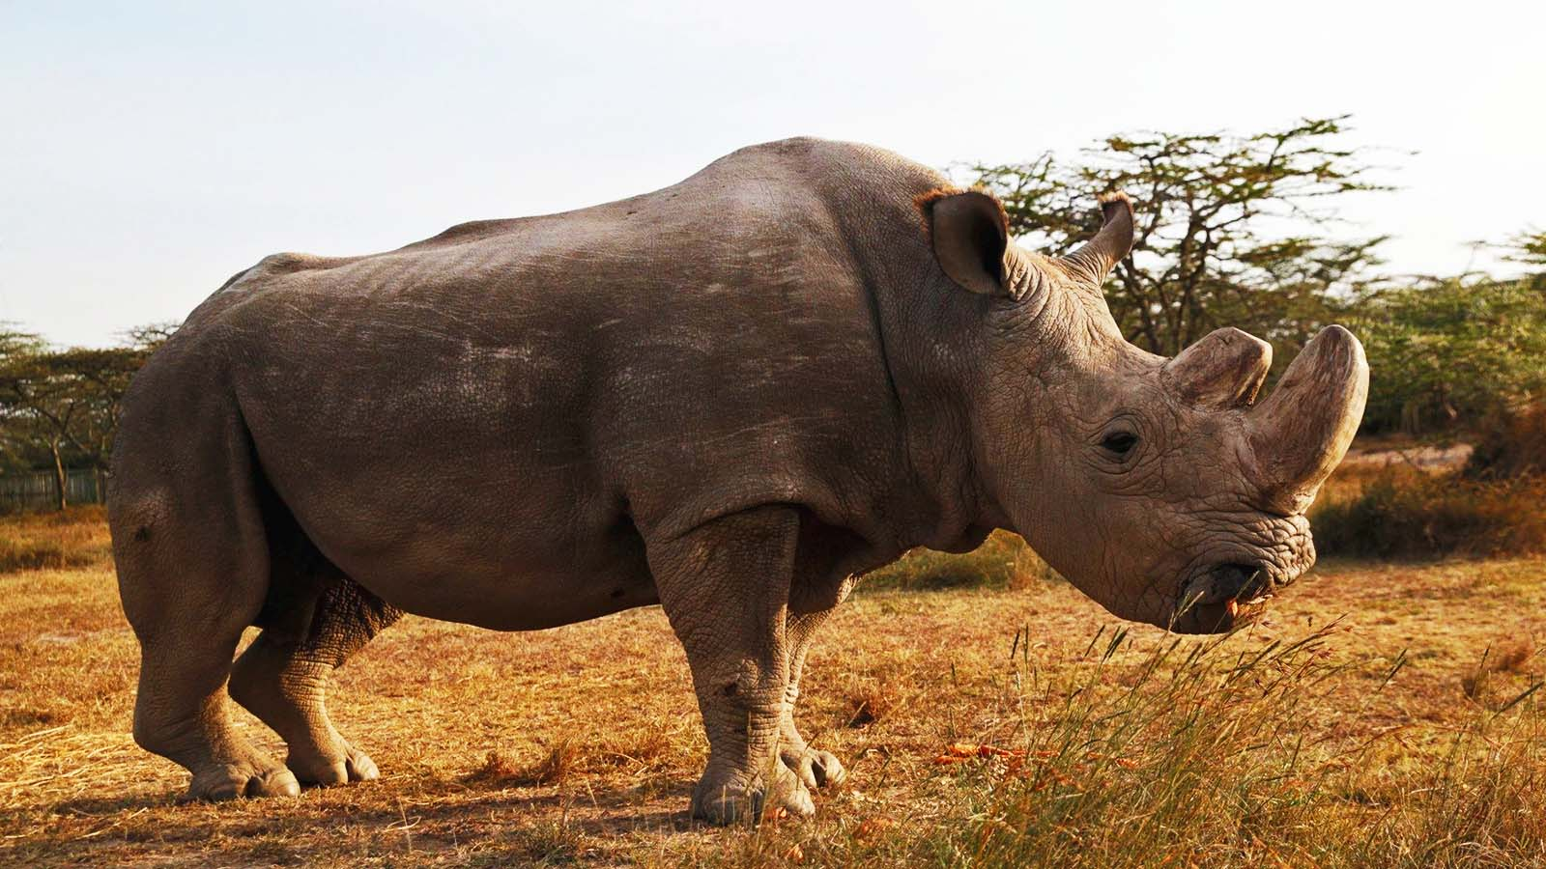
Photo © Thomas Mukoya

Slide 14
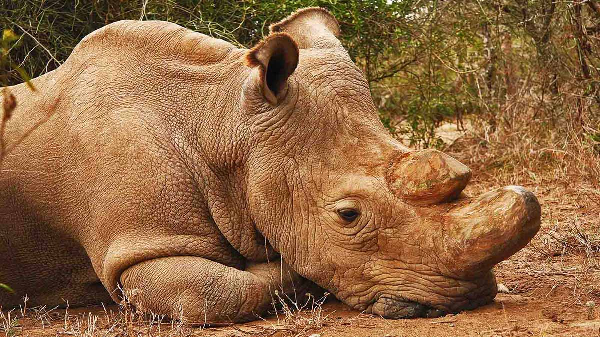
Photo © Jan Stejskal

Slide 15
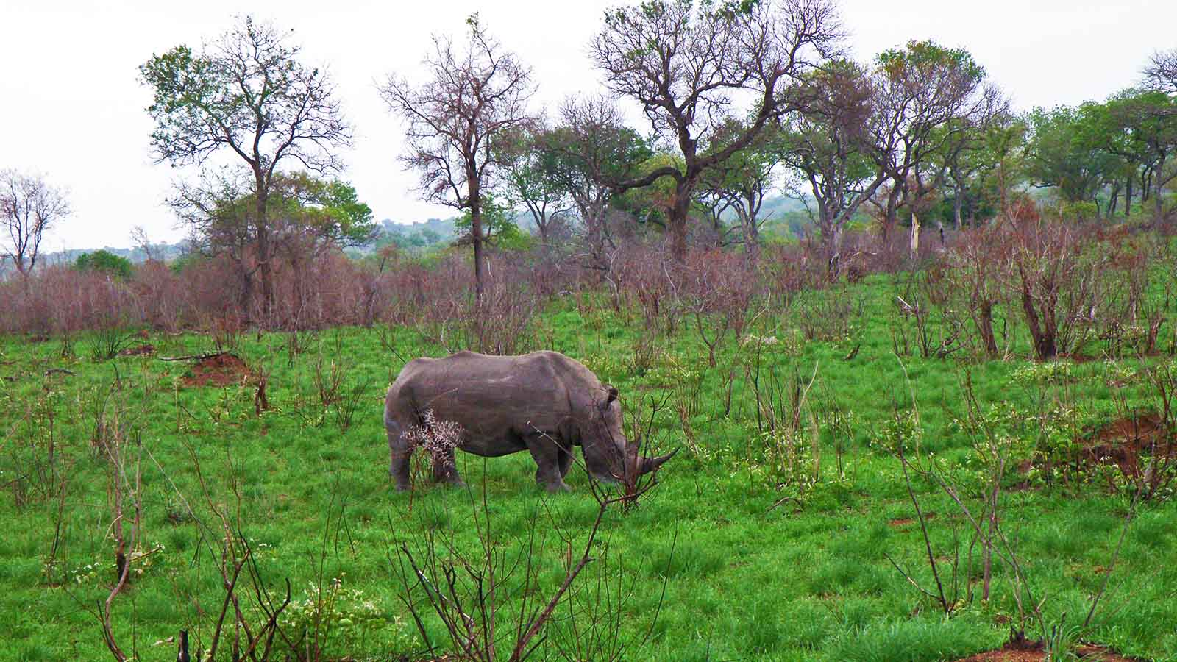
Photo © Hudec Ivan

Slide 16
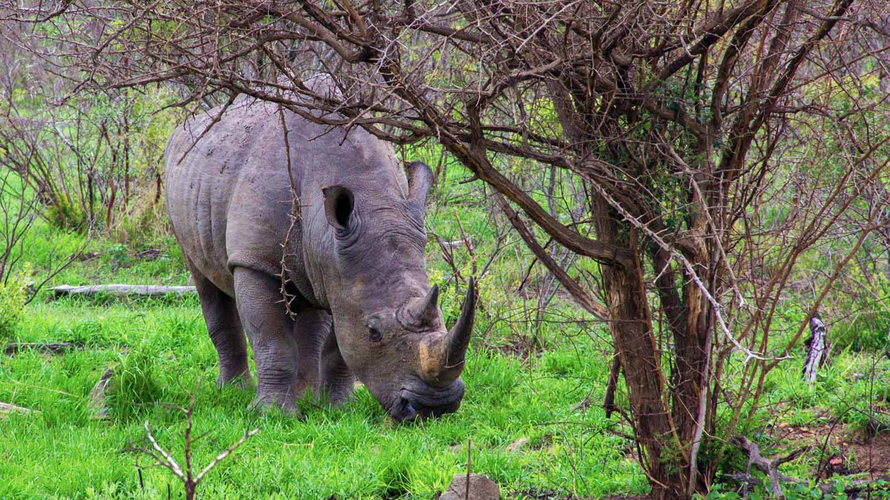
Photo © Hudec Ivan

Slide 17
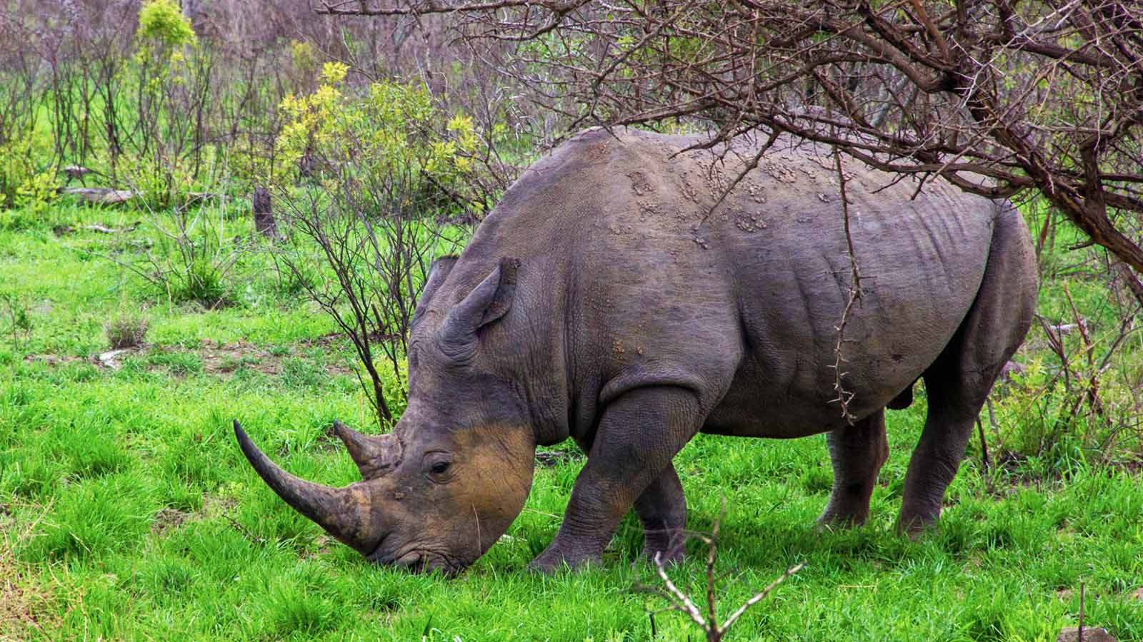
Photo © Hudec Ivan

Slide 18
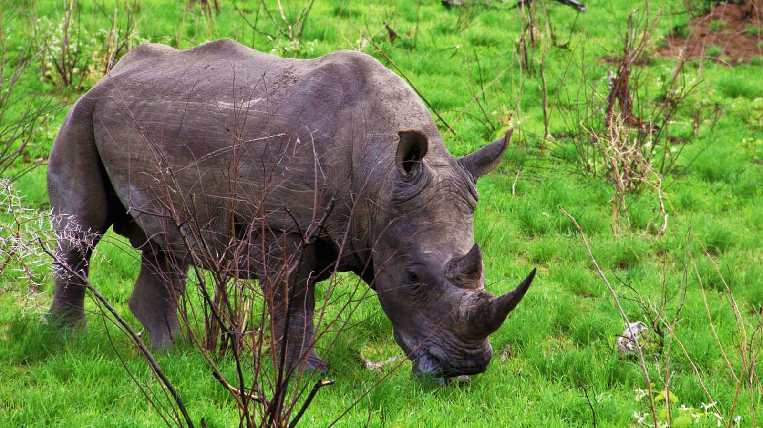
Photo © Hudec Ivan

Slide 19
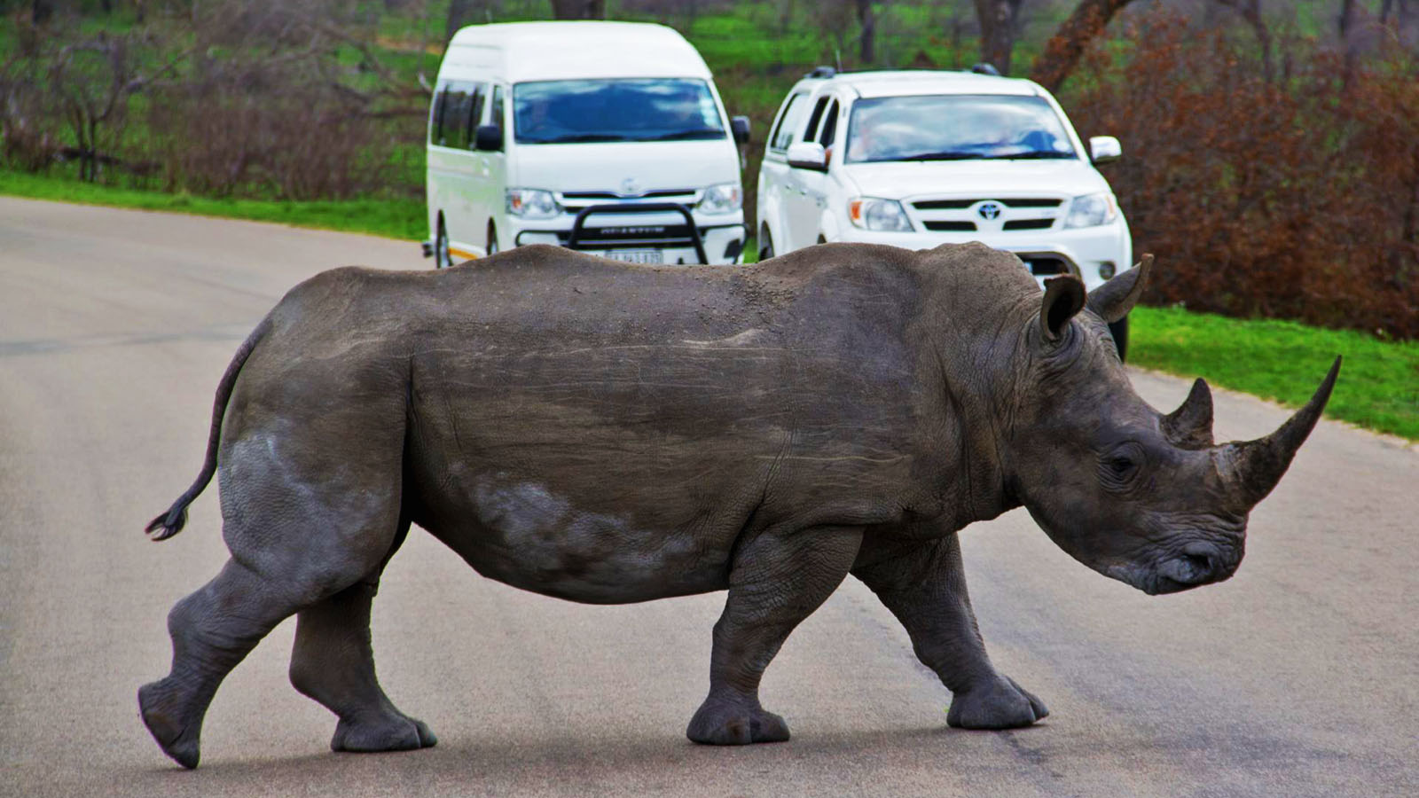
Photo © Hudec Ivan

Slide 20
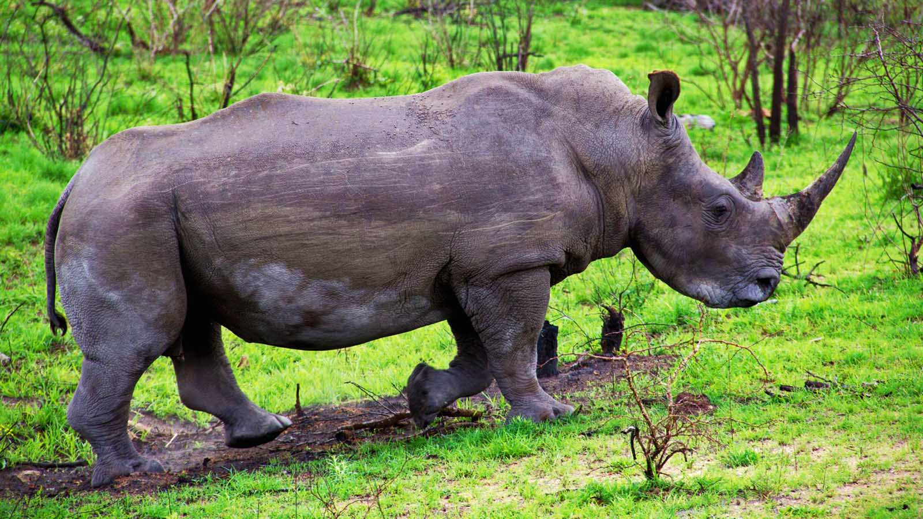
Photo © Hudec Ivan

Slide 21
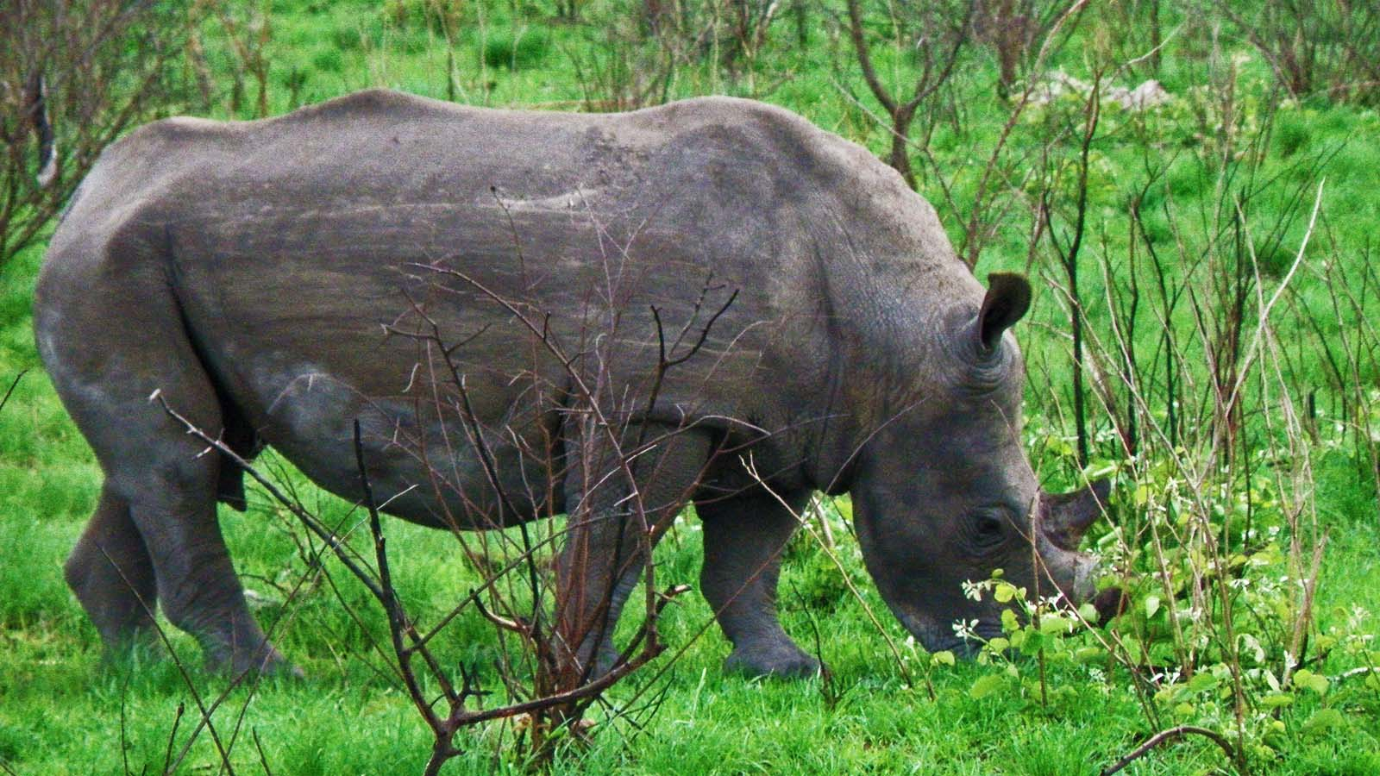
Photo © Hudec Ivan

Slide 22
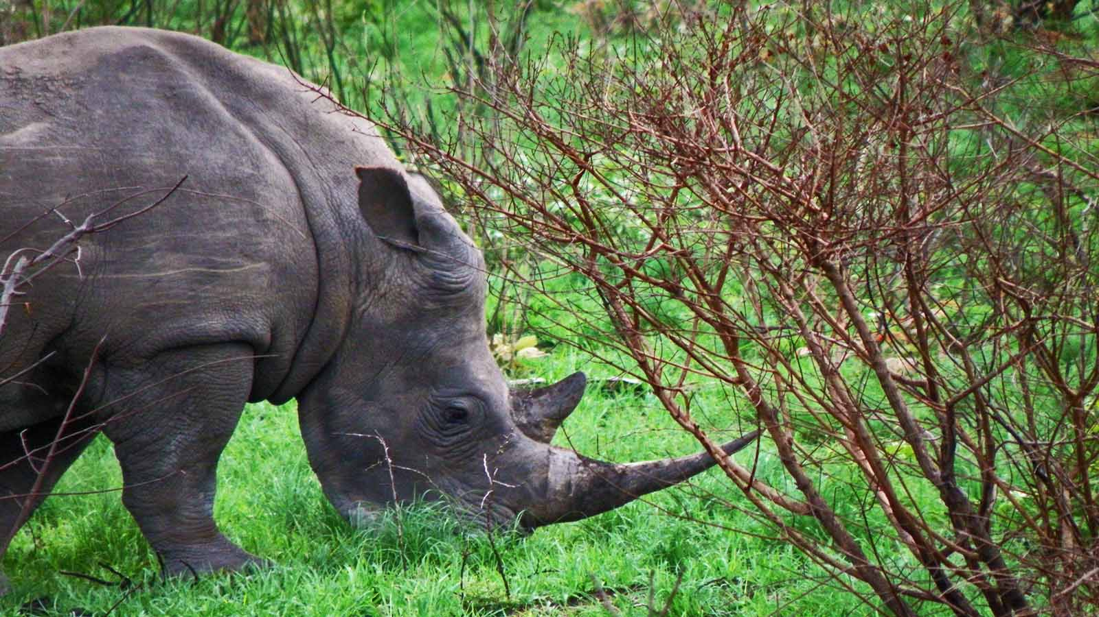
Photo © Hudec Ivan

Slide 23
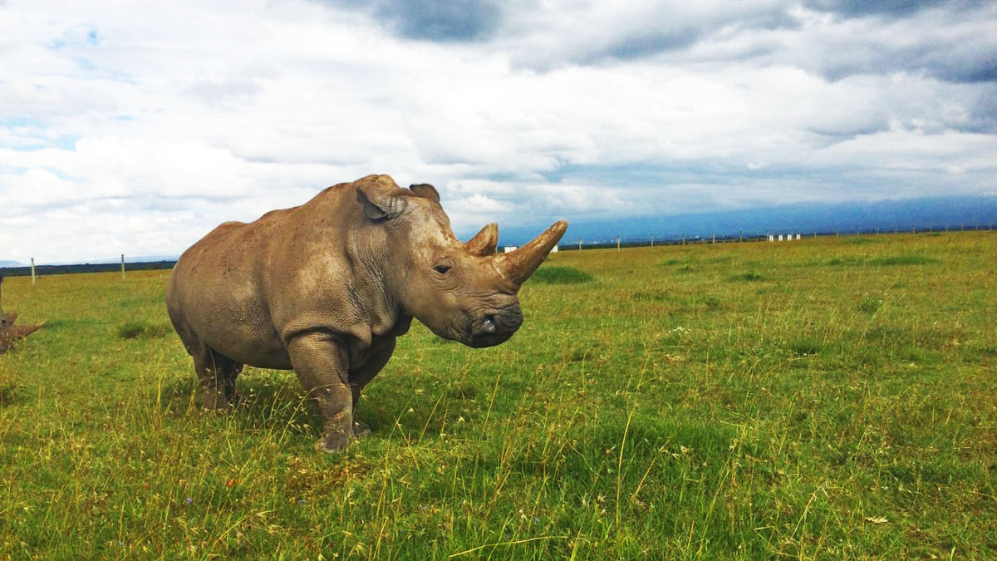
Photo © Lauren Evans

Slide 24
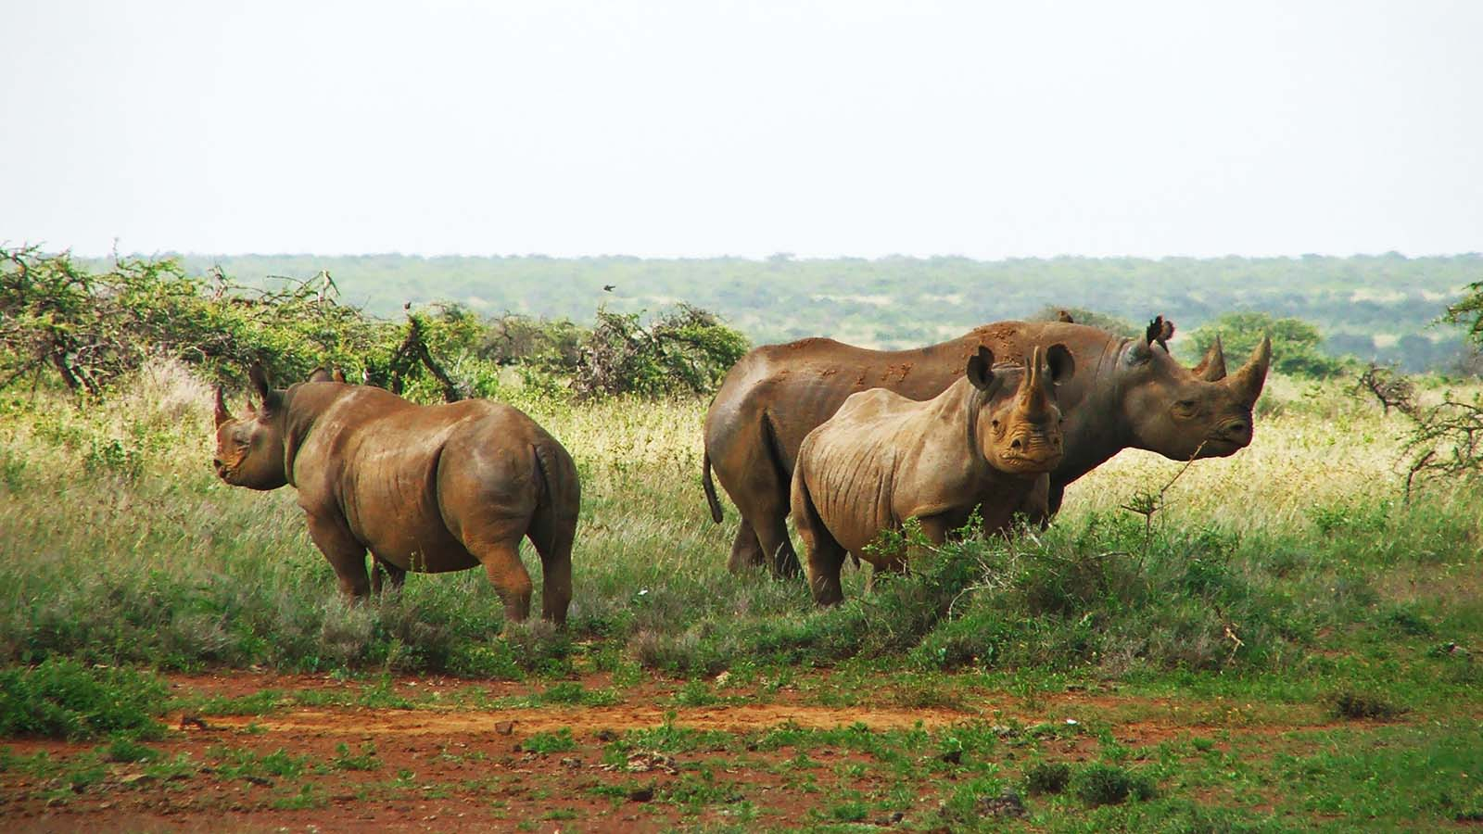
Photo © Stella Kenya

Slide 25
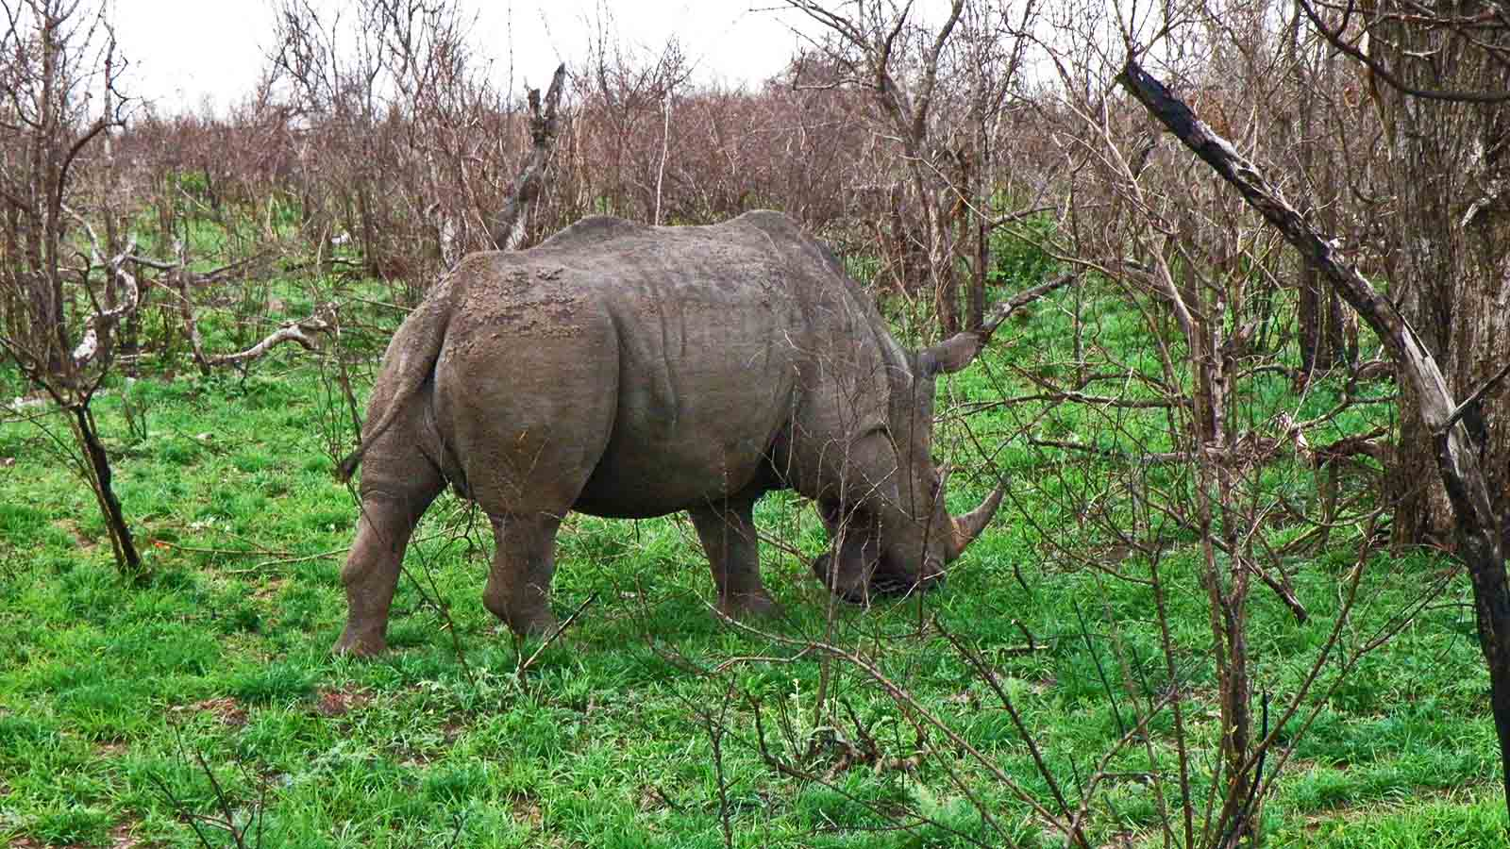
Photo © Hudec Ivan

Slide 26
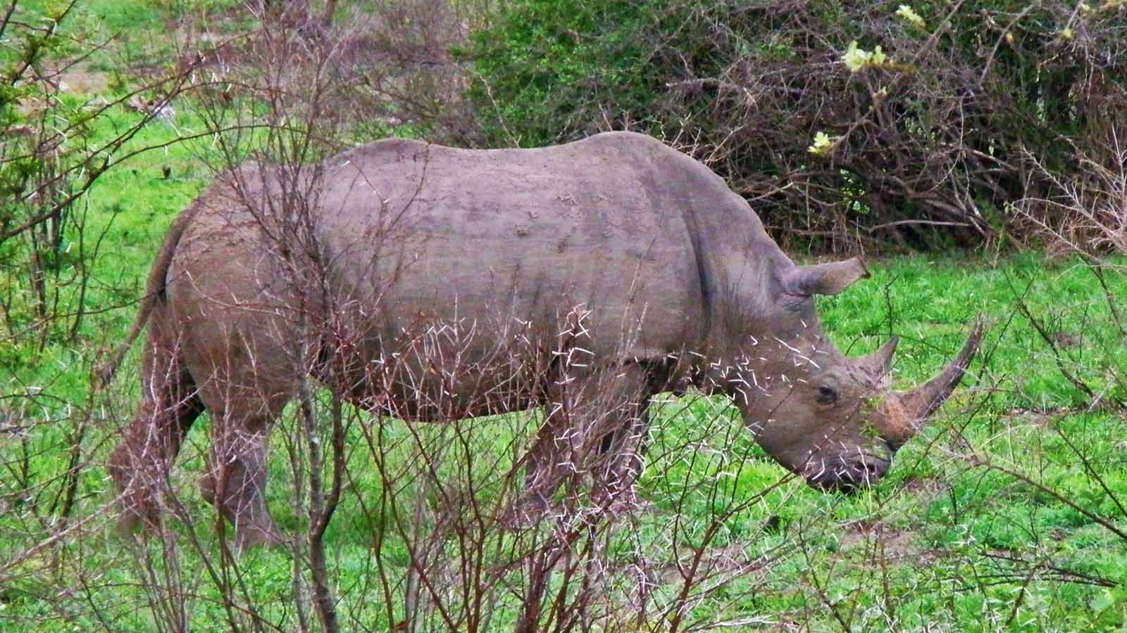
Photo © Hudec Ivan

Slide 27
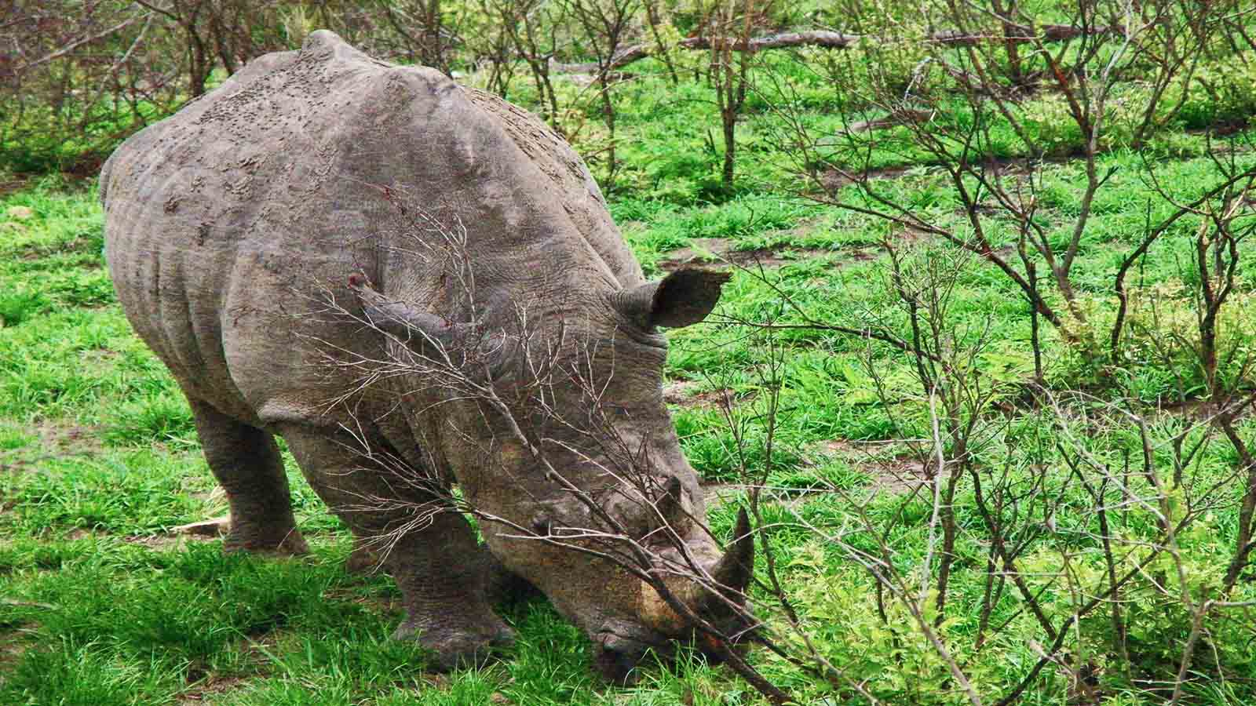
Photo © Hudec Ivan

Slide 28
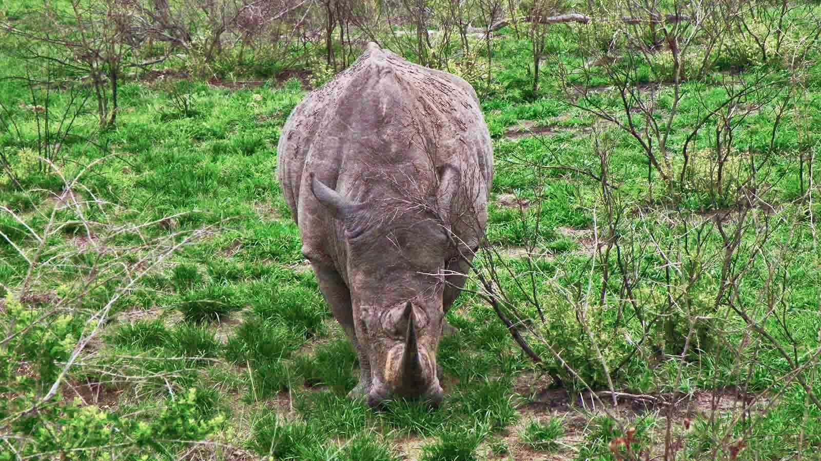
Photo © Hudec Ivan

Slide 29
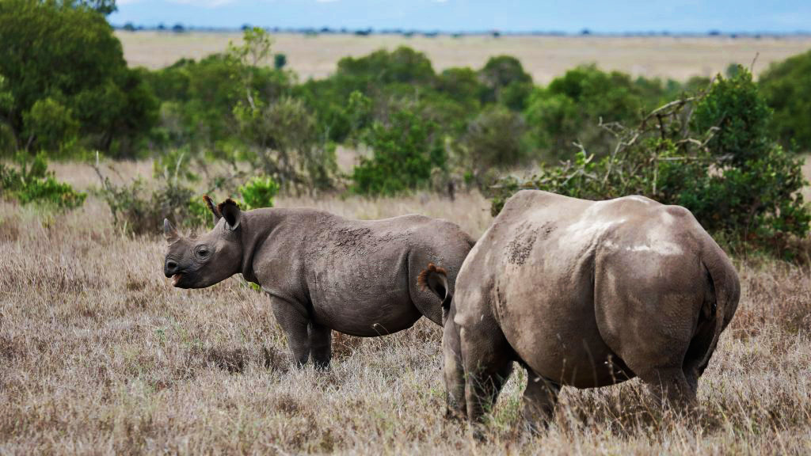
Photo © Baz Ratner

Slide 30
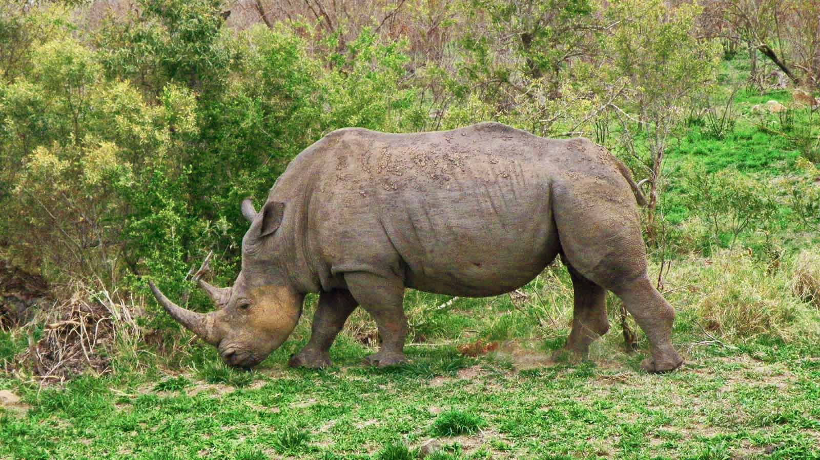
Photo © Hudec Ivan

Slide 31
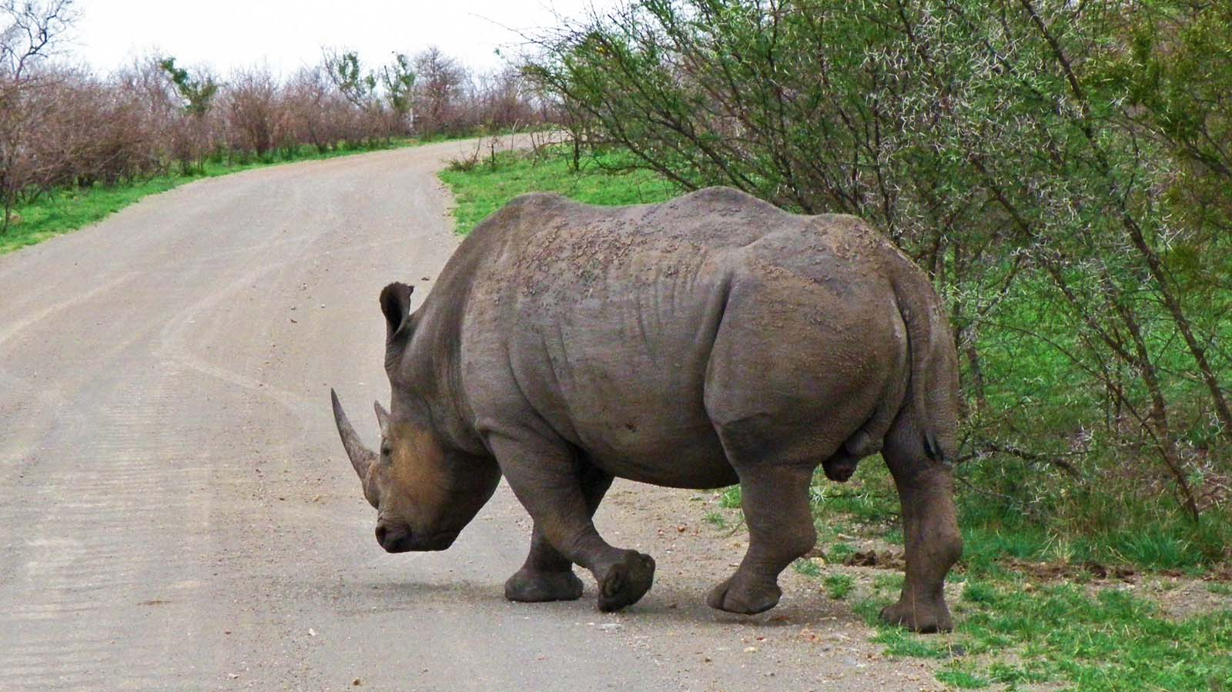
Photo © Hudec Ivan

Slide 32
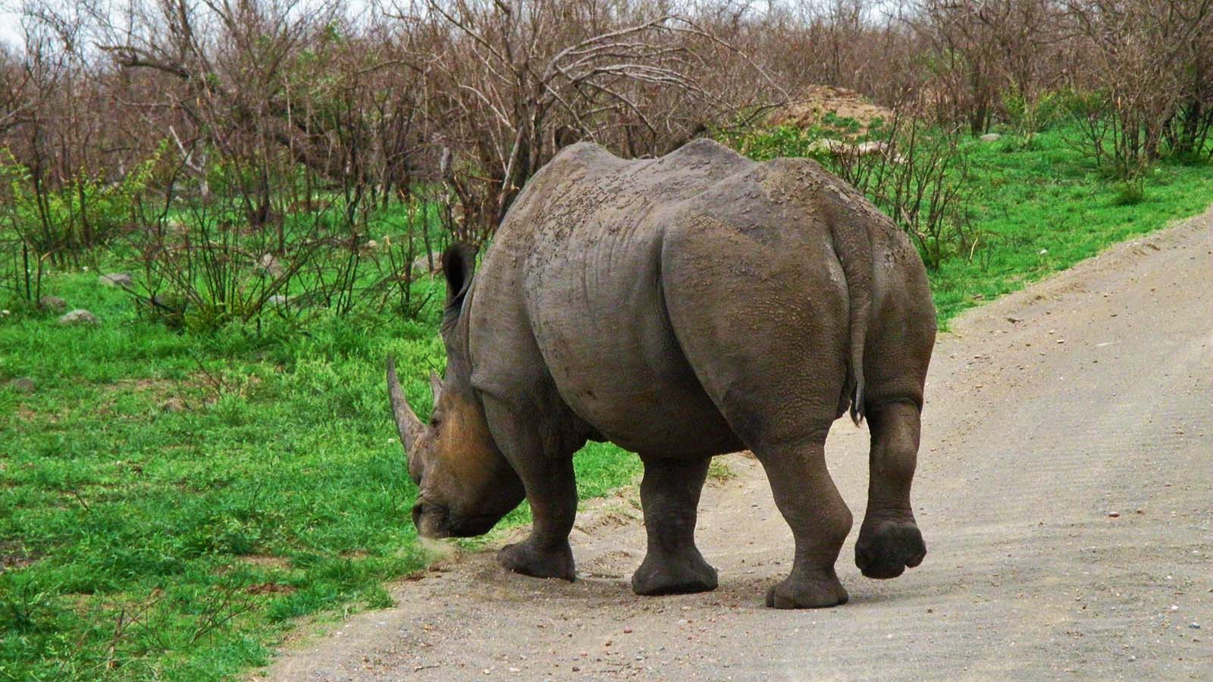
Photo © Hudec Ivan

Slide 33
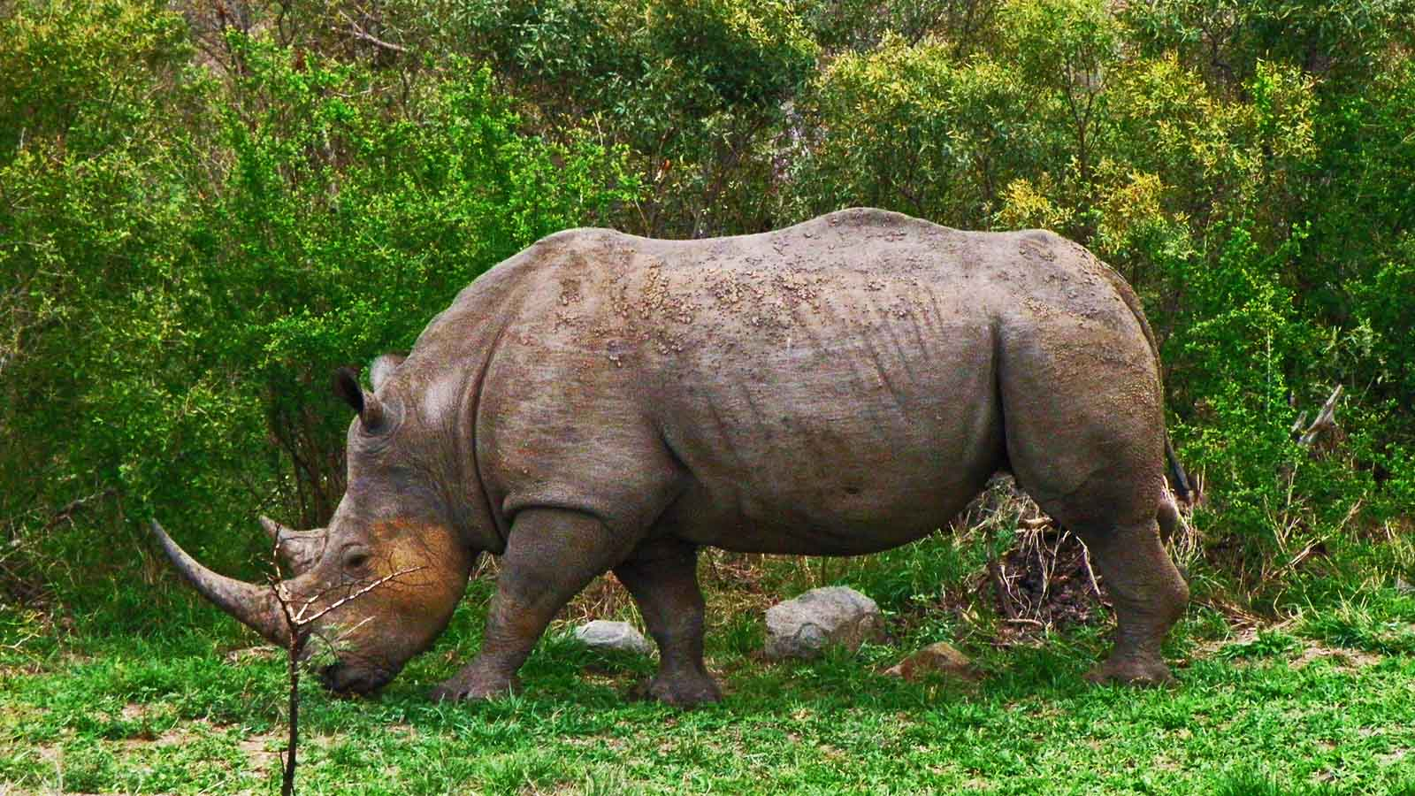
Photo © Hudec Ivan

Slide 34
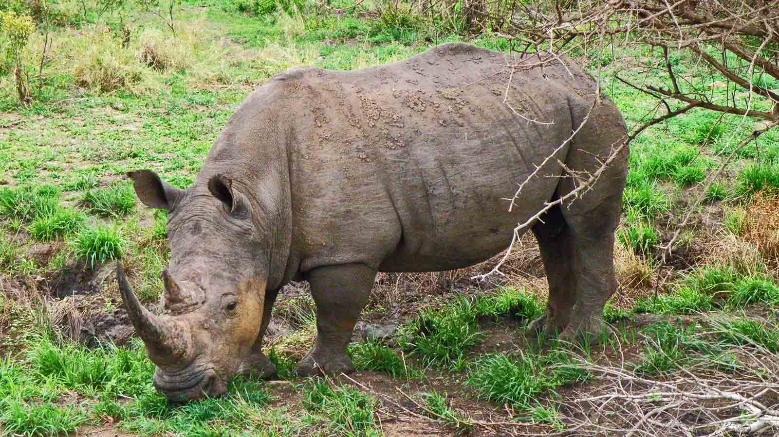
Photo © Hudec Ivan

Slide 35
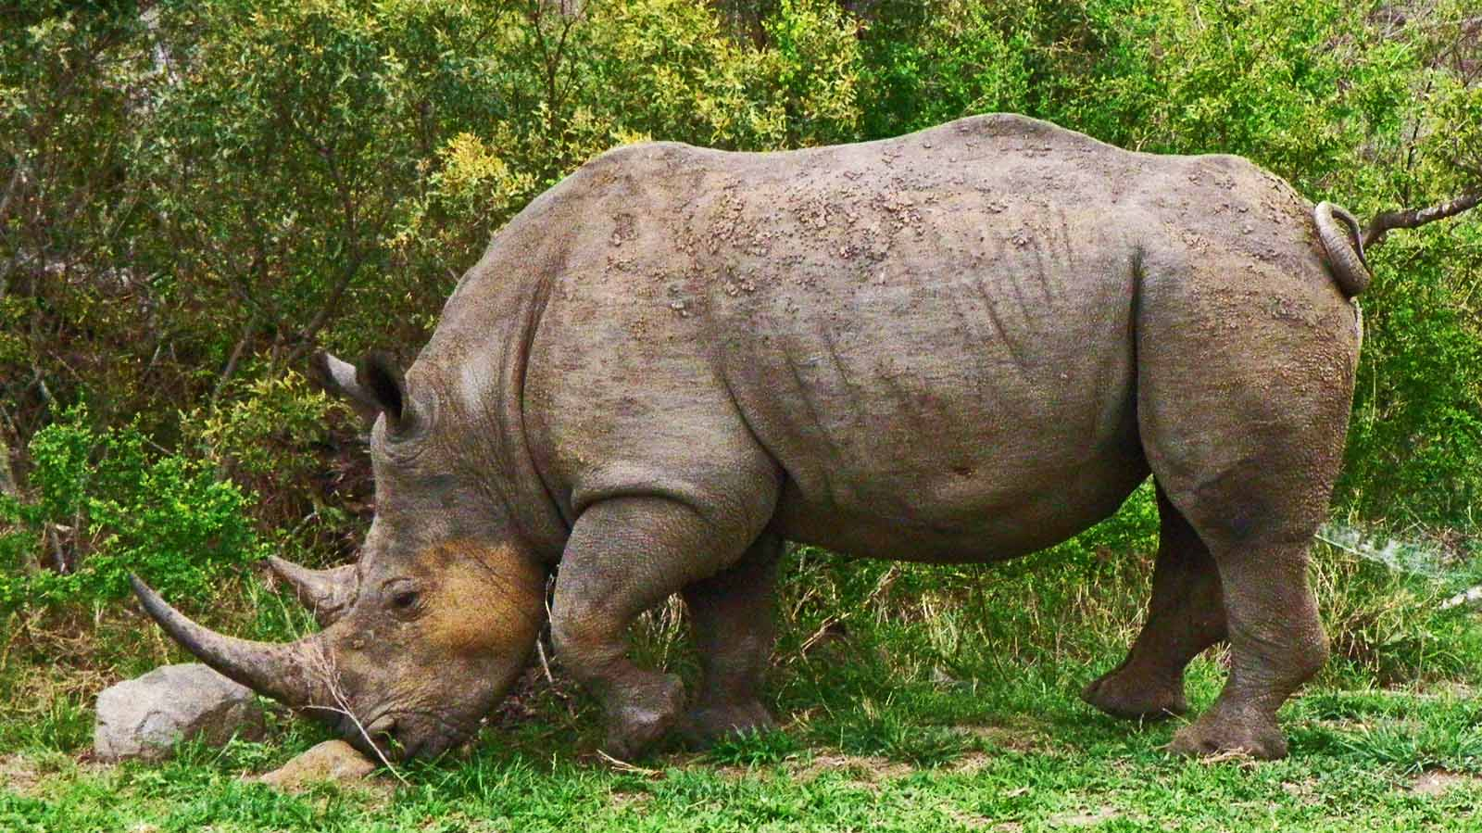
Photo © Hudec Ivan

Slide 36
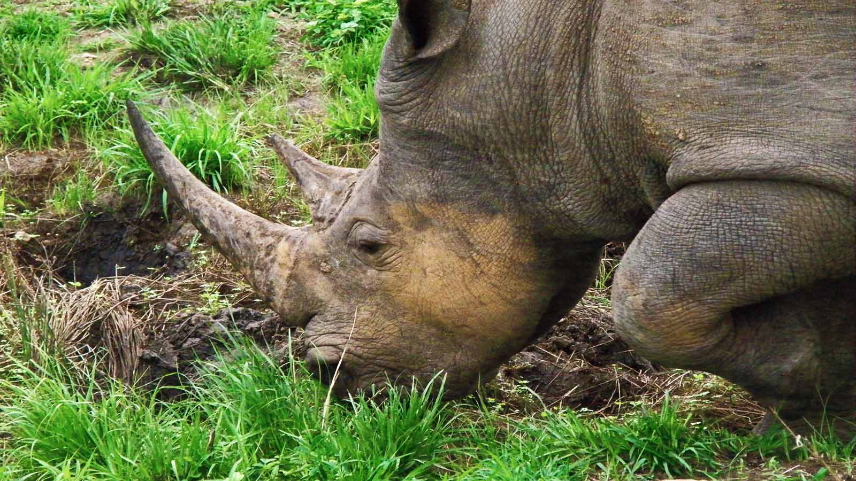
Photo © Hudec Ivan

Slide 37
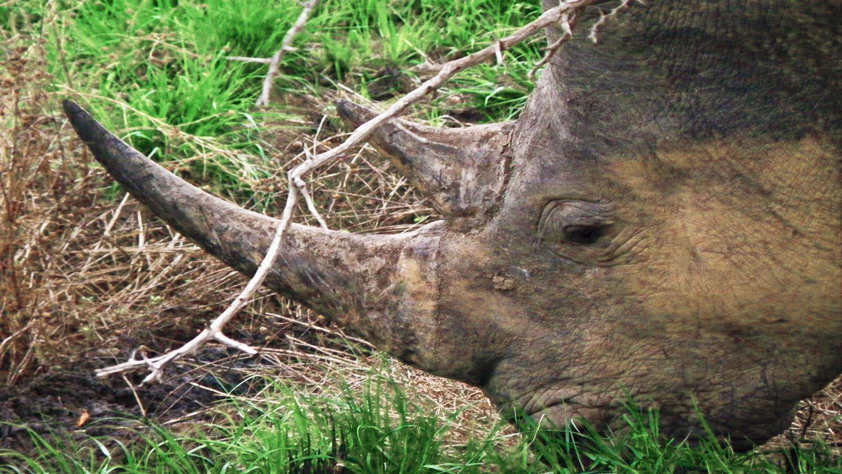
Photo © Hudec Ivan

Slide 38

2021
Music : N-Chant Nguru - Afrique
Photos : Sekerka Dušan, Ing. (Slovakia)
Photos : Hudec Ivan (Slovakia)
Photos : Internet
Created by : Rumpler Štefan (Slovakia)
Contact : pista2011@gmail.com

Slide 39


Welcome in all languages!
I can translate your mails!
pista2011@gmail.com
CLICK FOR MY VIDEOS
CLICK FOR MY PPSX
Thank you for your feedback
Steve

Slide 40







¿Te ha gustado?
Puedes ver más entrando
Aquí
Además puedes recibir powerpoints en tu correo electrónico suscribiéndote aquí:

