Slide 1

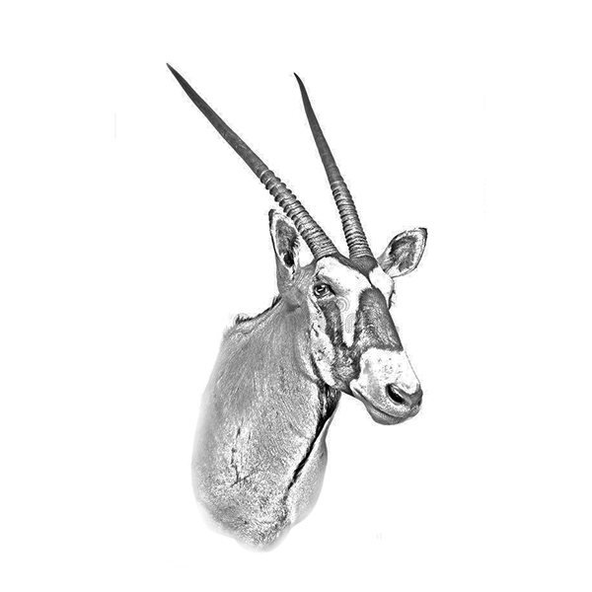

Wildlife
10
Oryx
Of africa

Slide 2
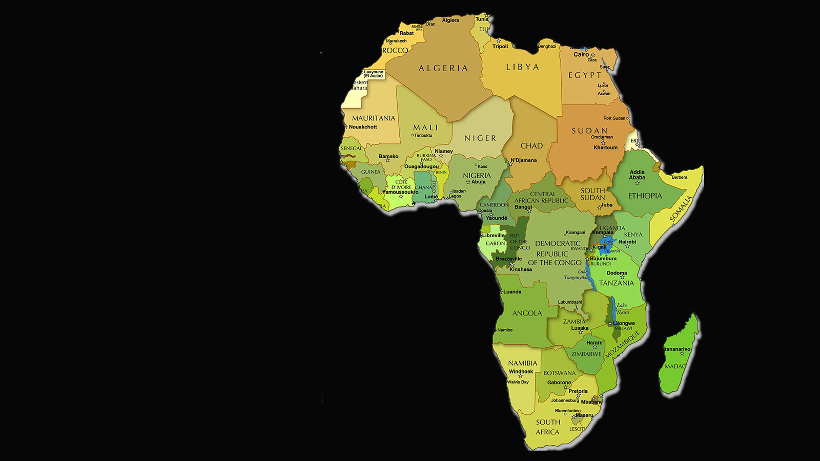

Wildlife
of Africa

Slide 3
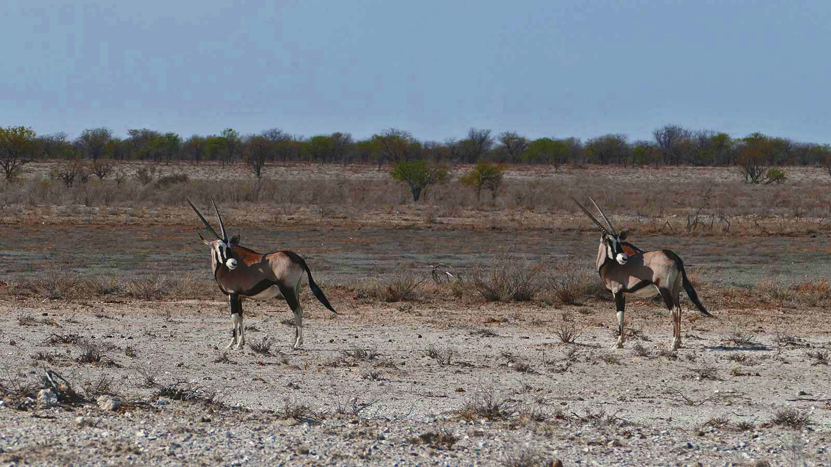

Photo © Sekerka Dušan

Slide 4
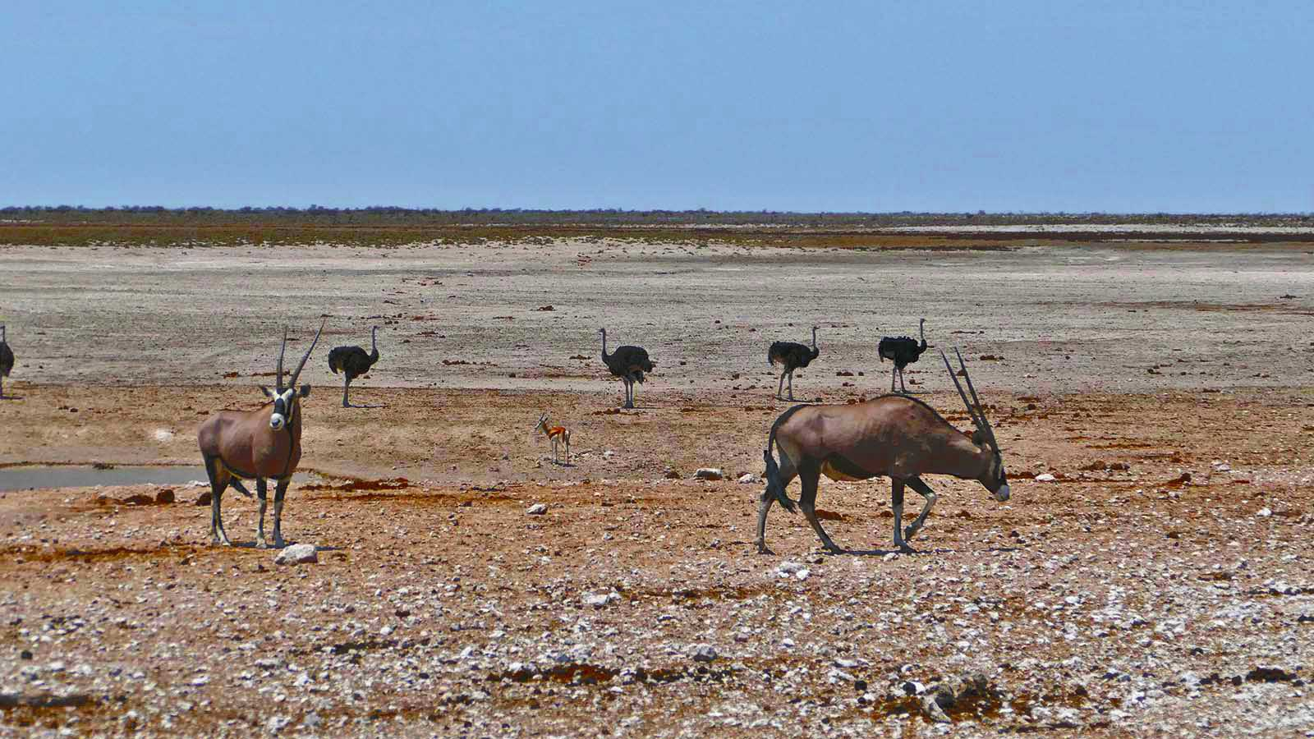
Photo © Sekerka Dušan

Slide 5
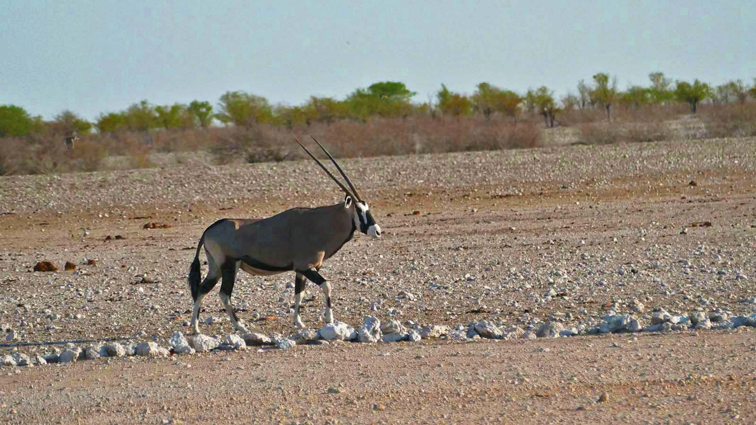
Photo © Sekerka Dušan

Slide 6
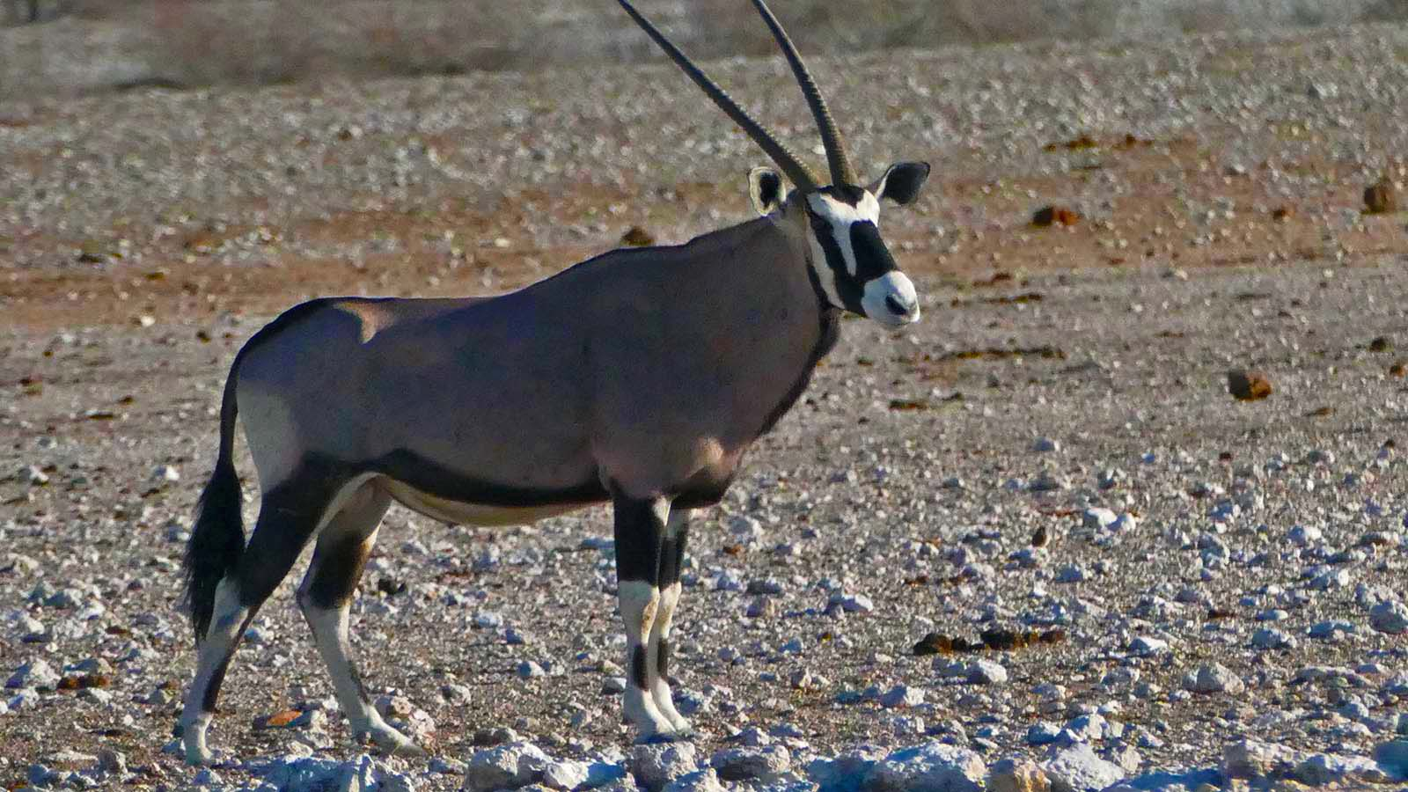
Photo © Sekerka Dušan

Slide 7
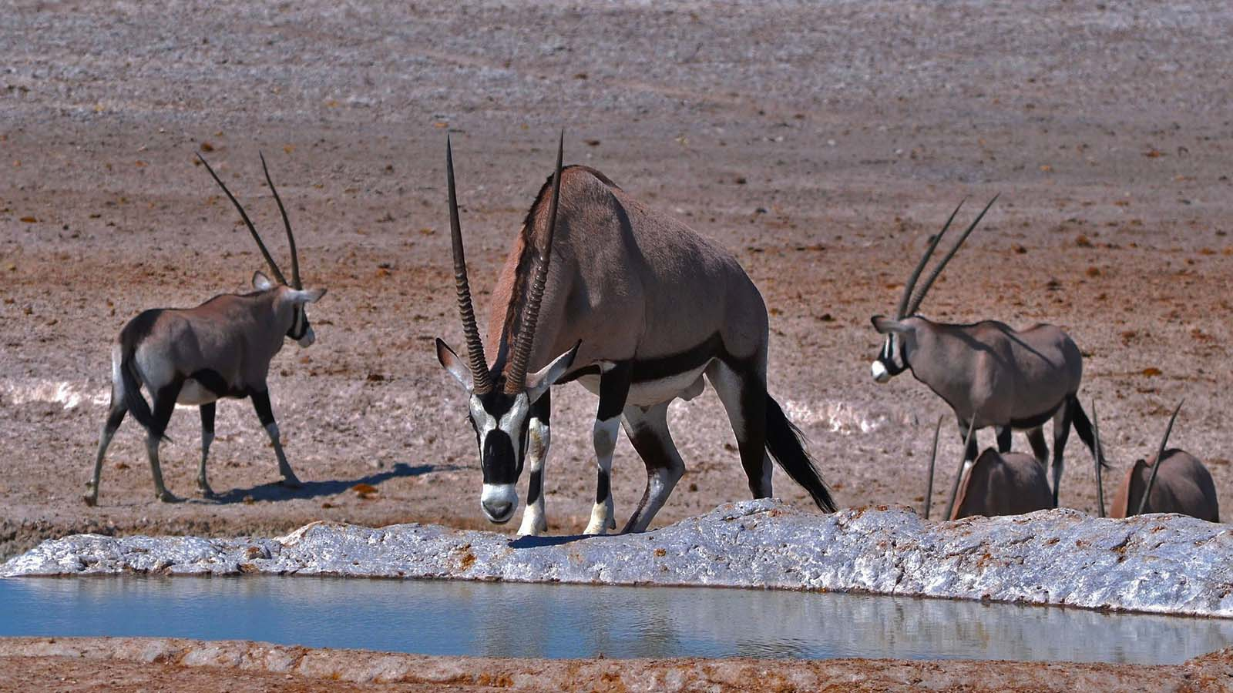
Photo © J.Pata G.

Slide 8
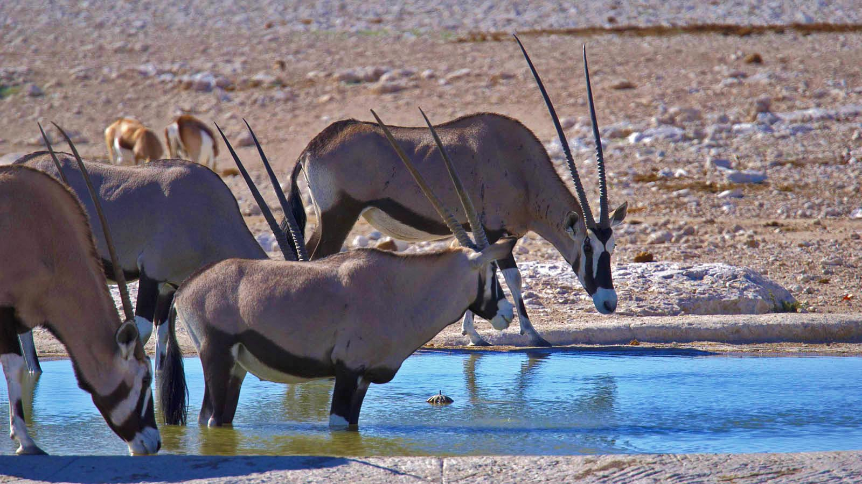
Photo © Jürgen Bierlein

Slide 9
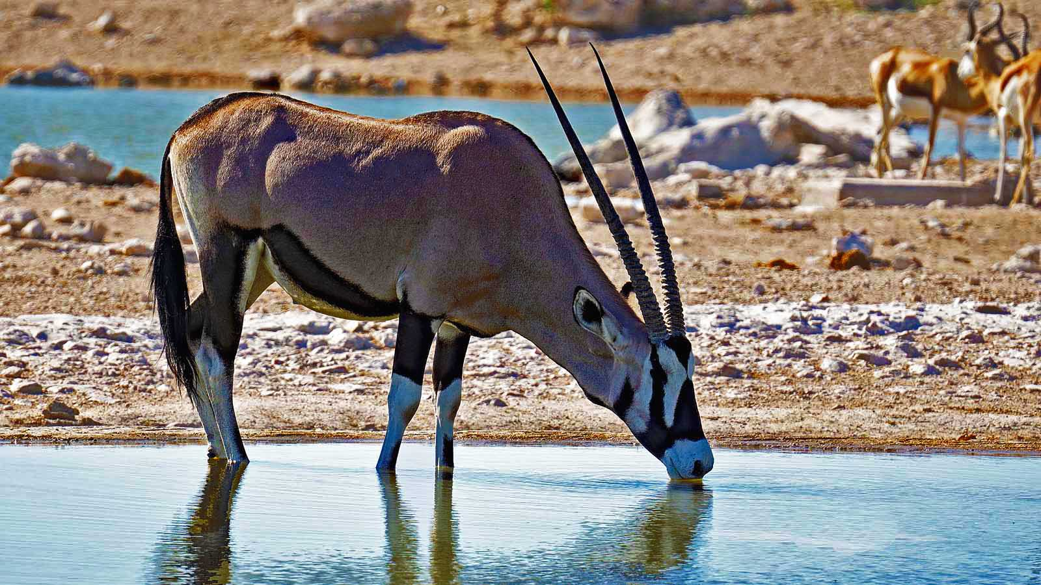
Photo © Jürgen Bierlein

Slide 10
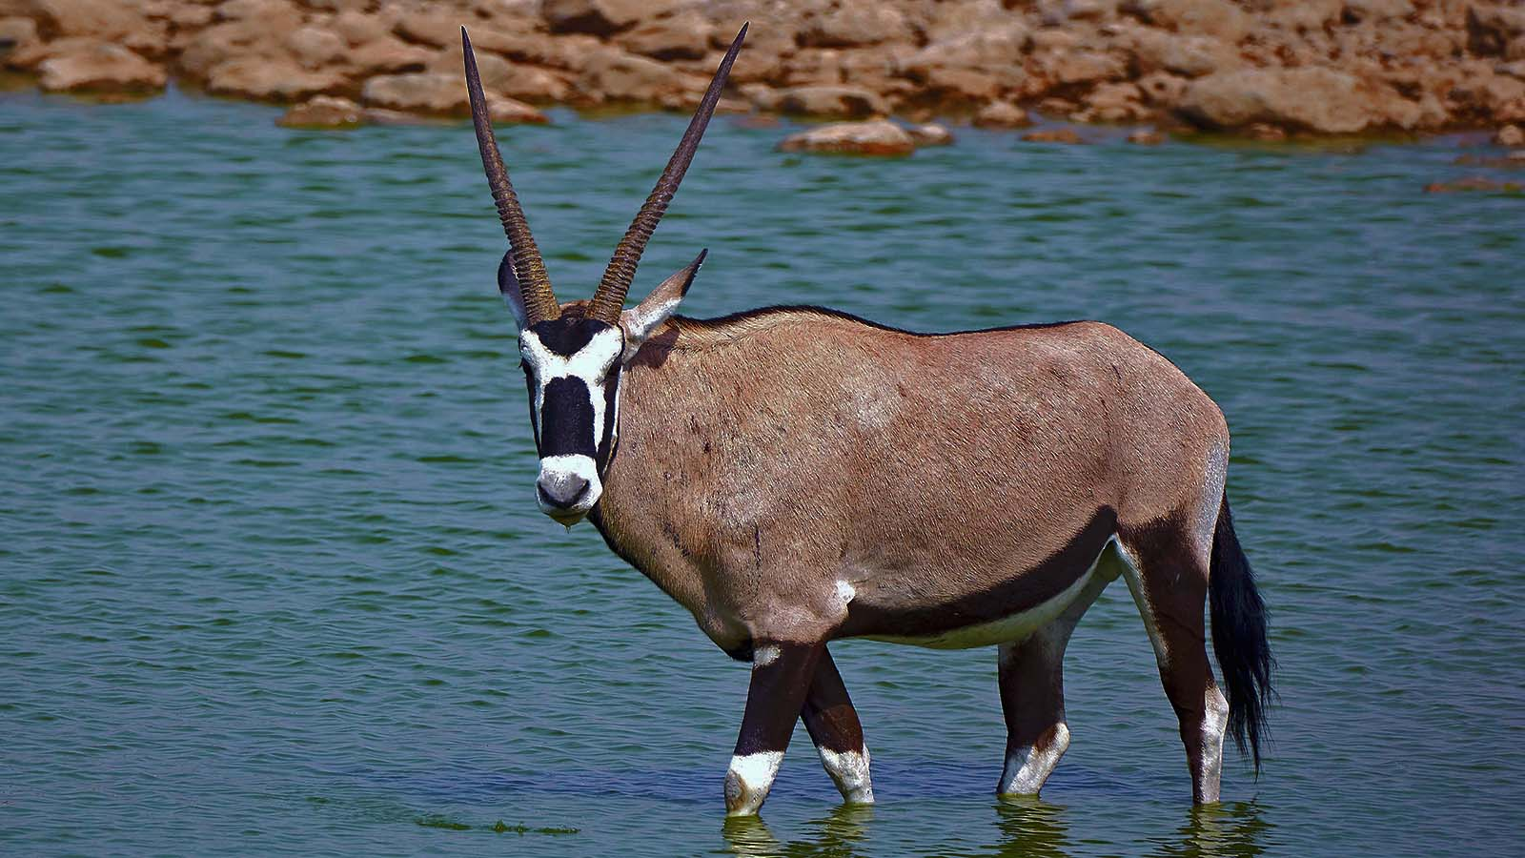
Photo © Axel Tschentscher

Slide 11
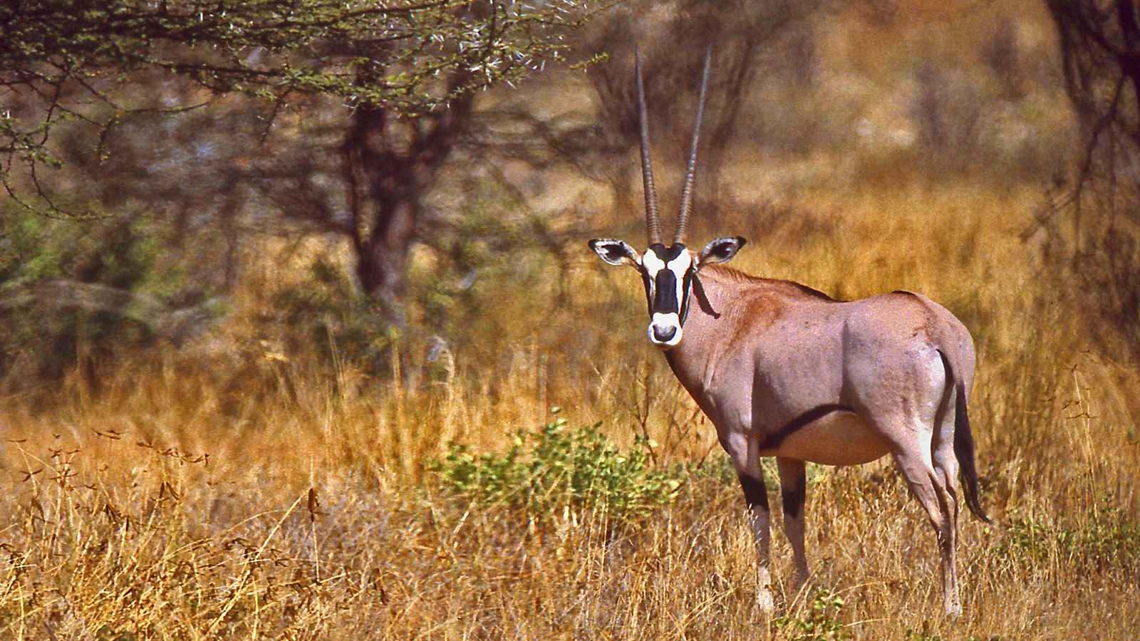
Photo © Bernard Dupont

Slide 12
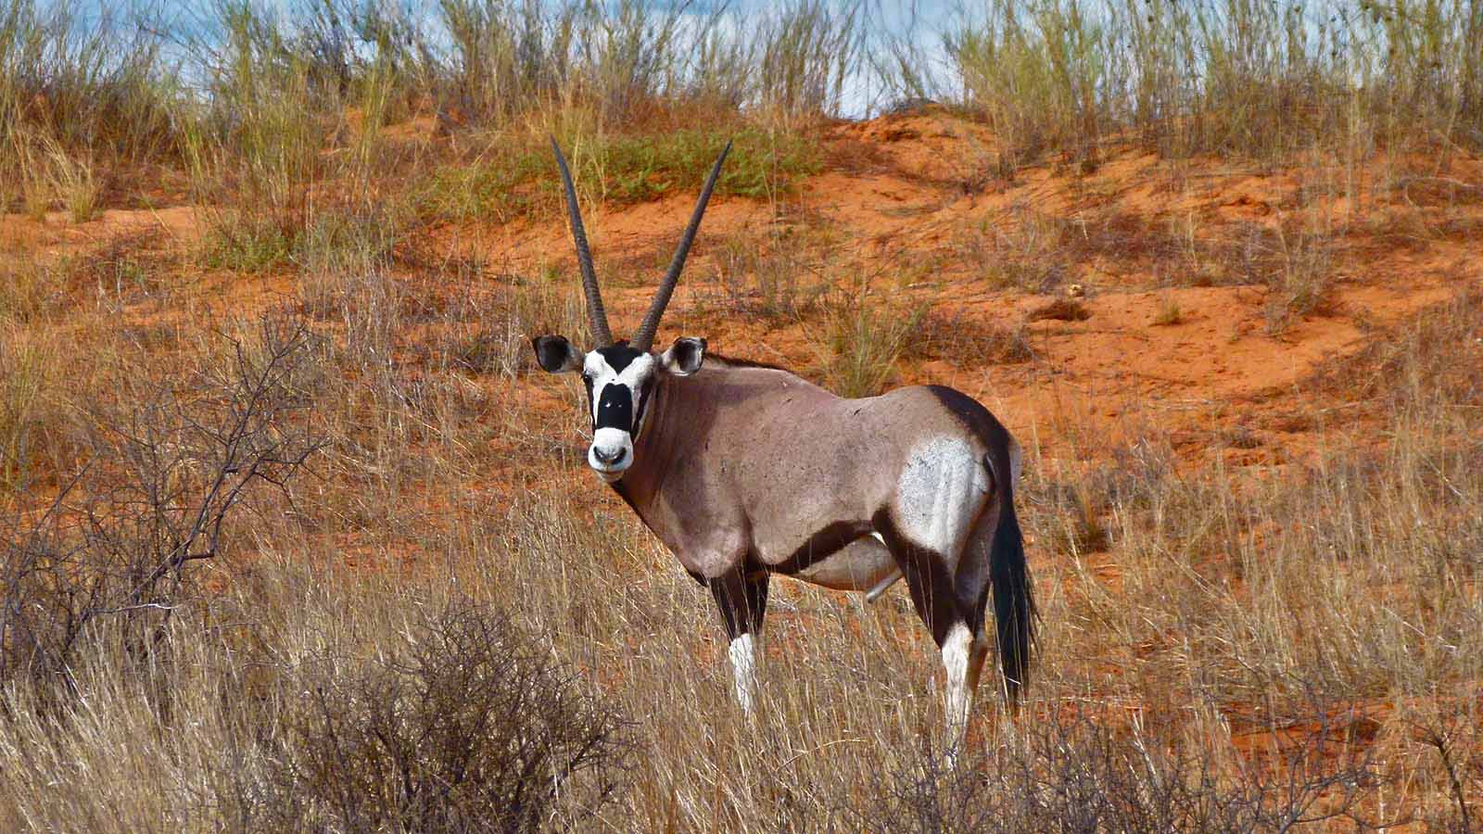
Photo © Bernard Dupont

Slide 13
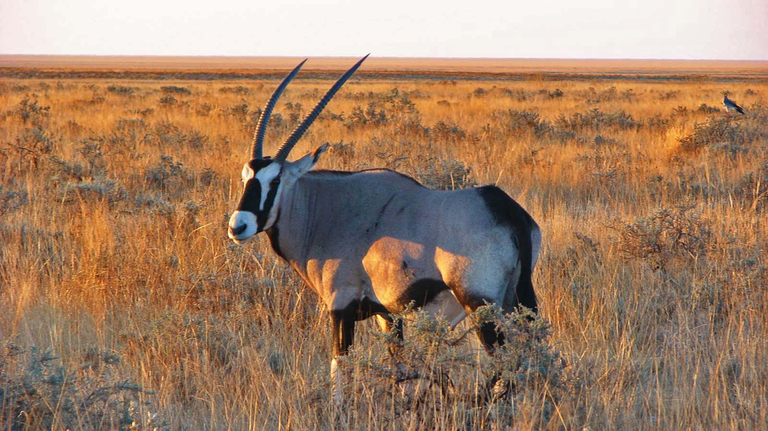
Photo © Hudec Ivan

Slide 14
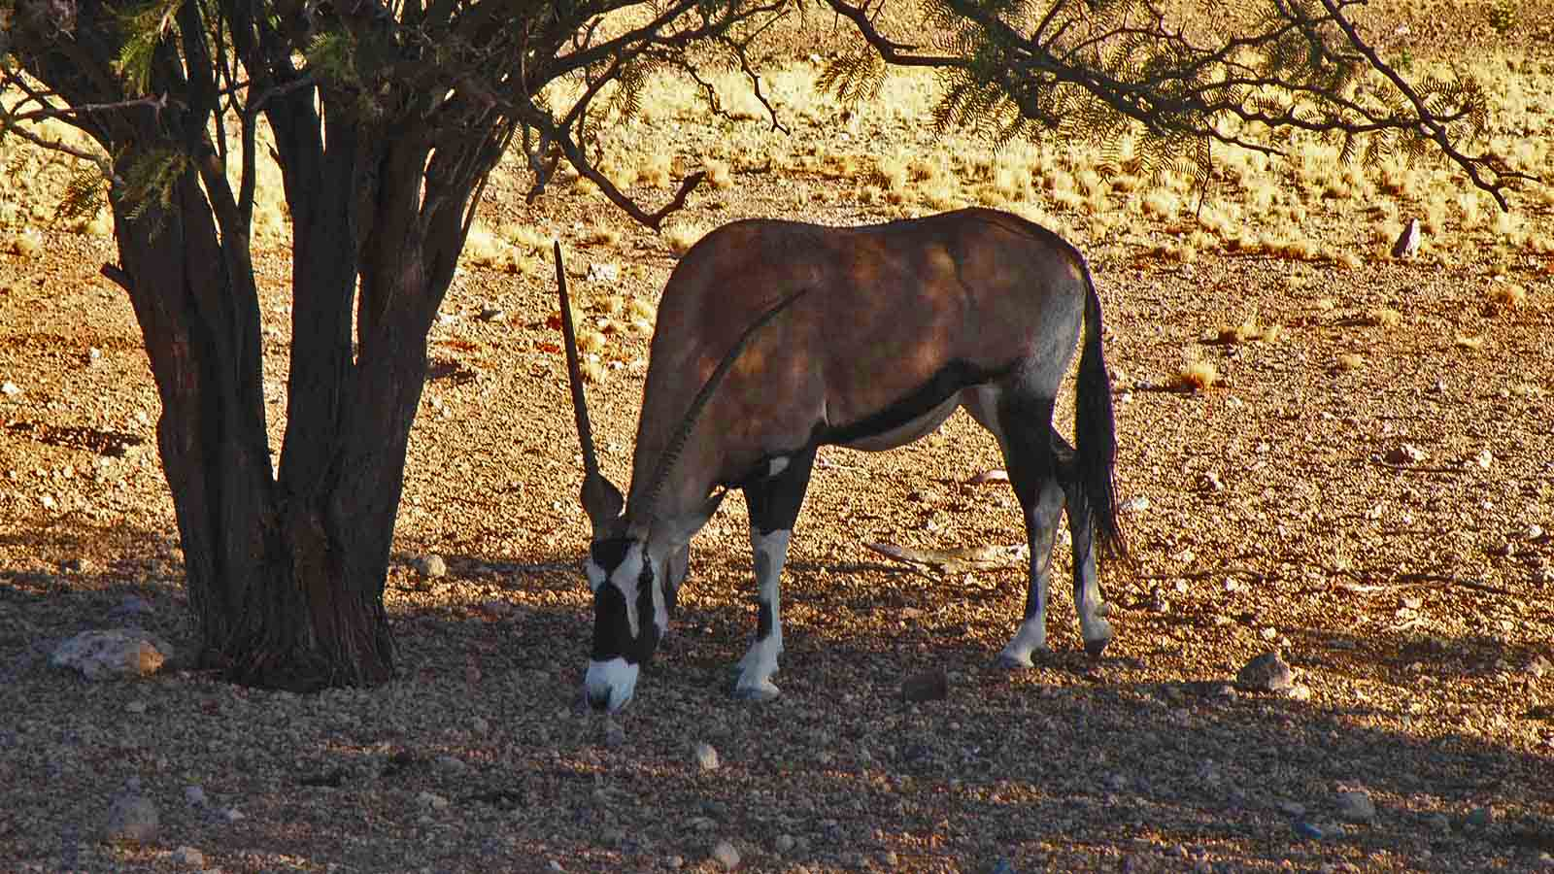
Photo © Hudec Ivan

Slide 15
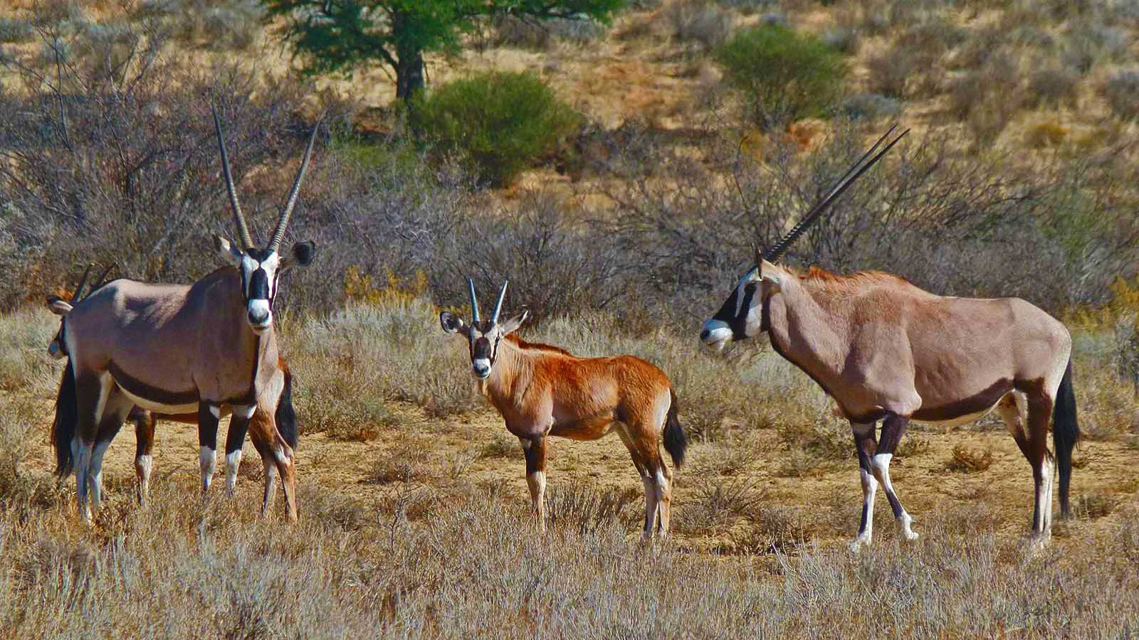
Photo © Bernard Dupont

Slide 16
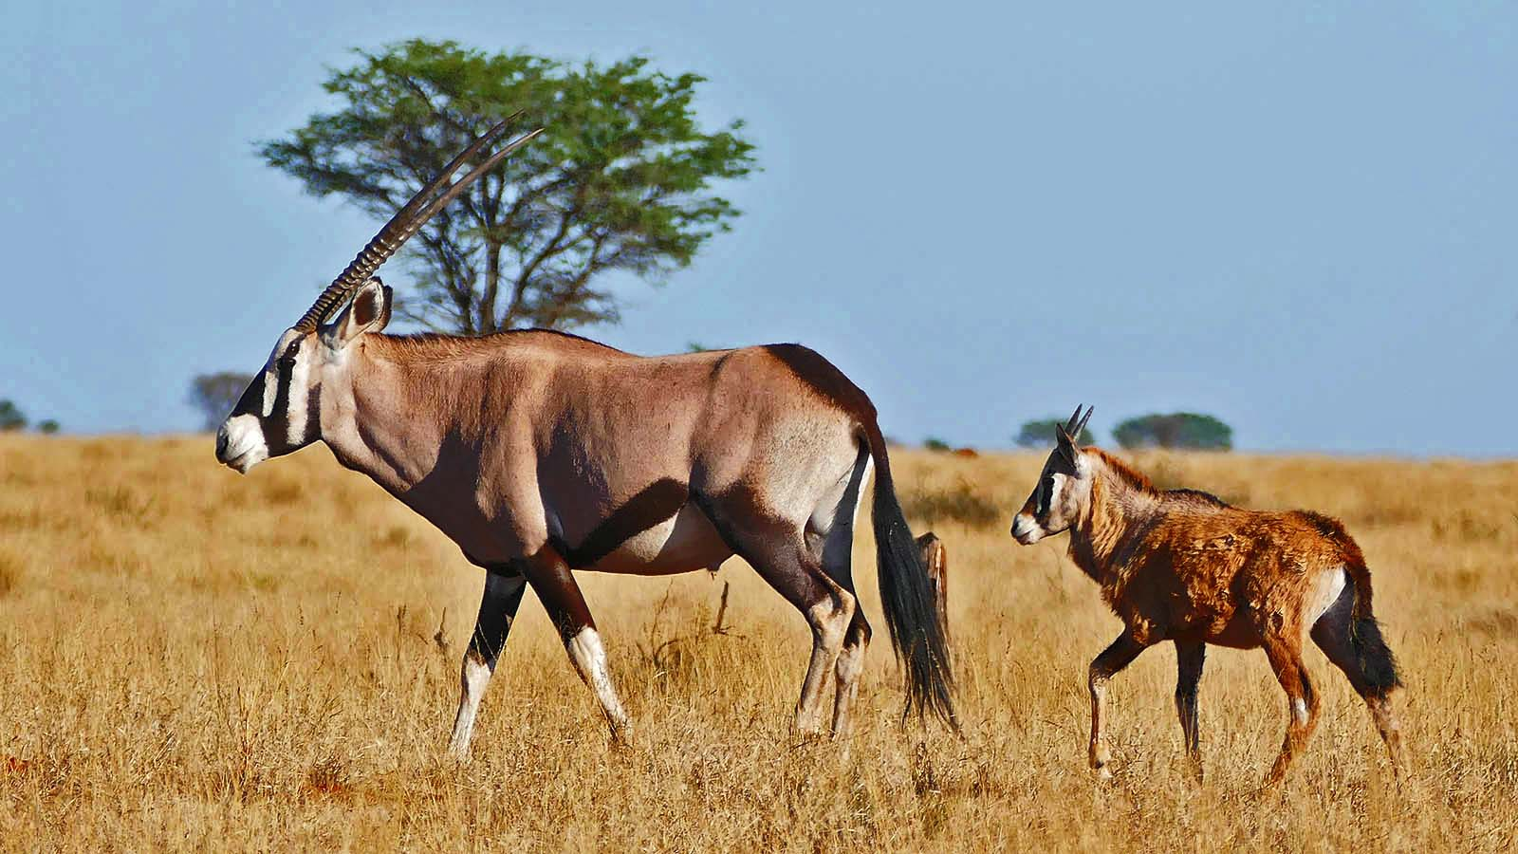
Photo © Bernard Dupont

Slide 17
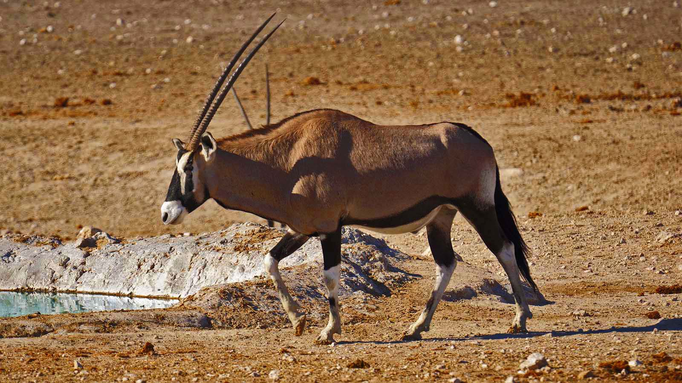
Photo © Jürgen Bierlein

Slide 18
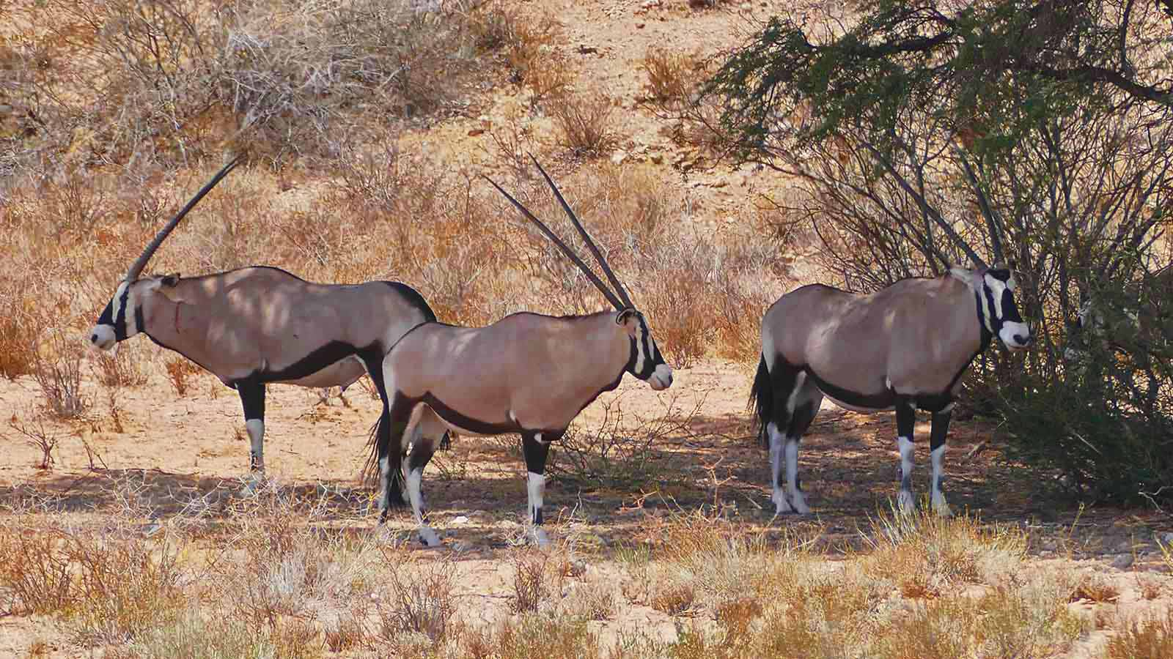
Photo © Bernard Dupont

Slide 19
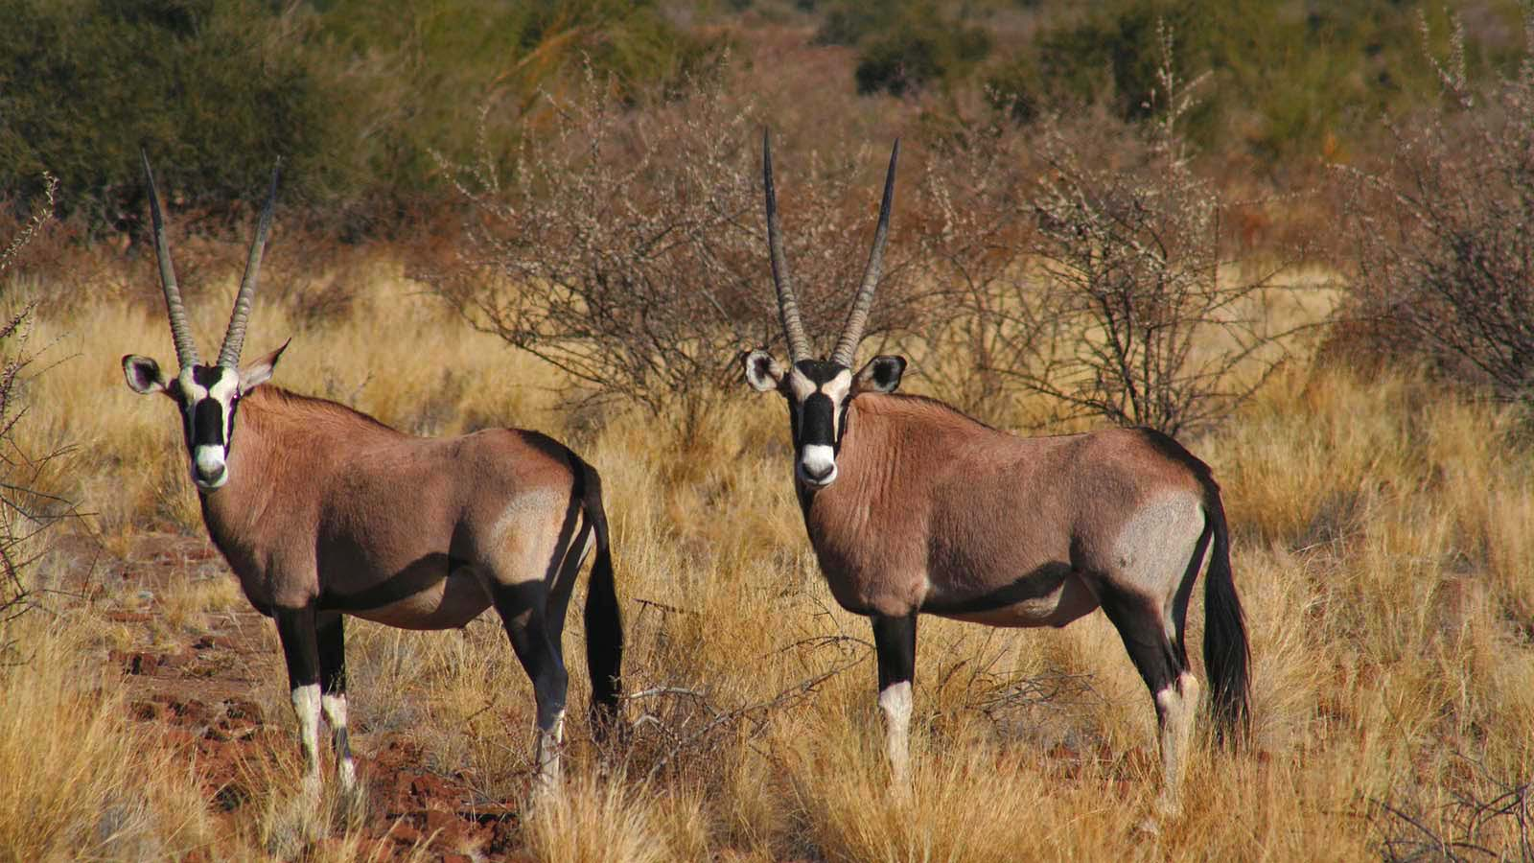
Photo © Carlos Reys

Slide 20
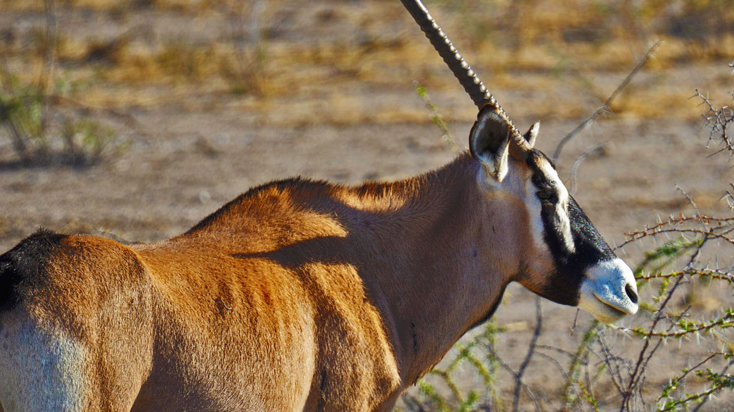
Photo © Jürgen Bierlein

Slide 21
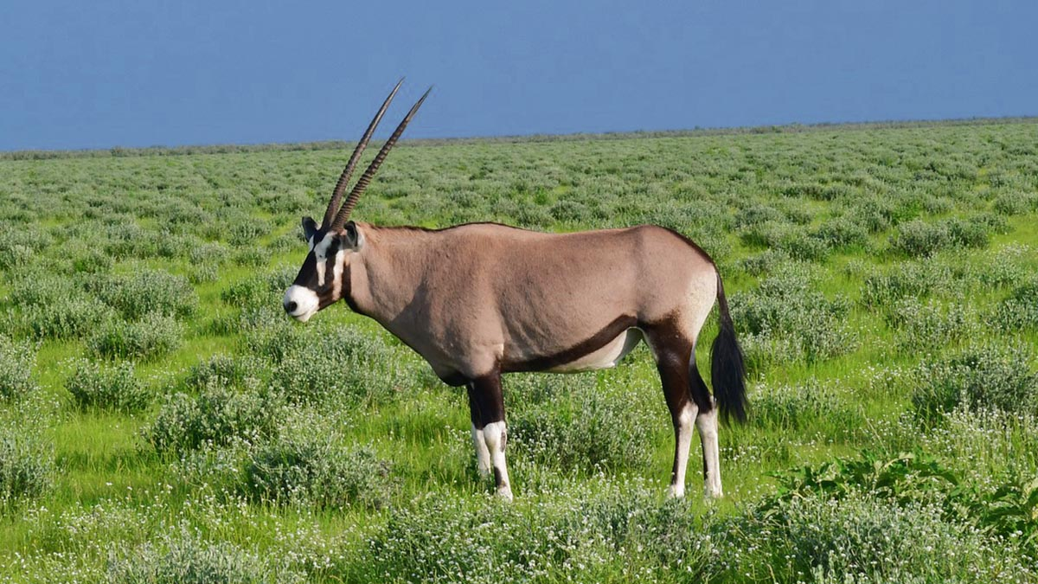
Photo © Dbalor Nnamisom

Slide 22
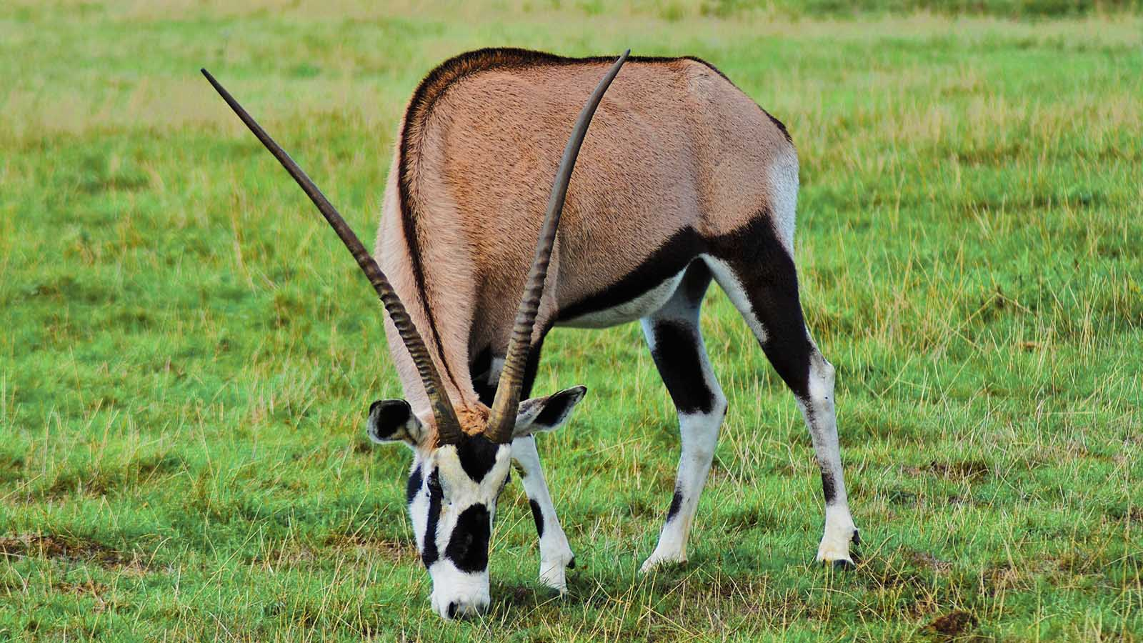
Photo © David Cardinez

Slide 23
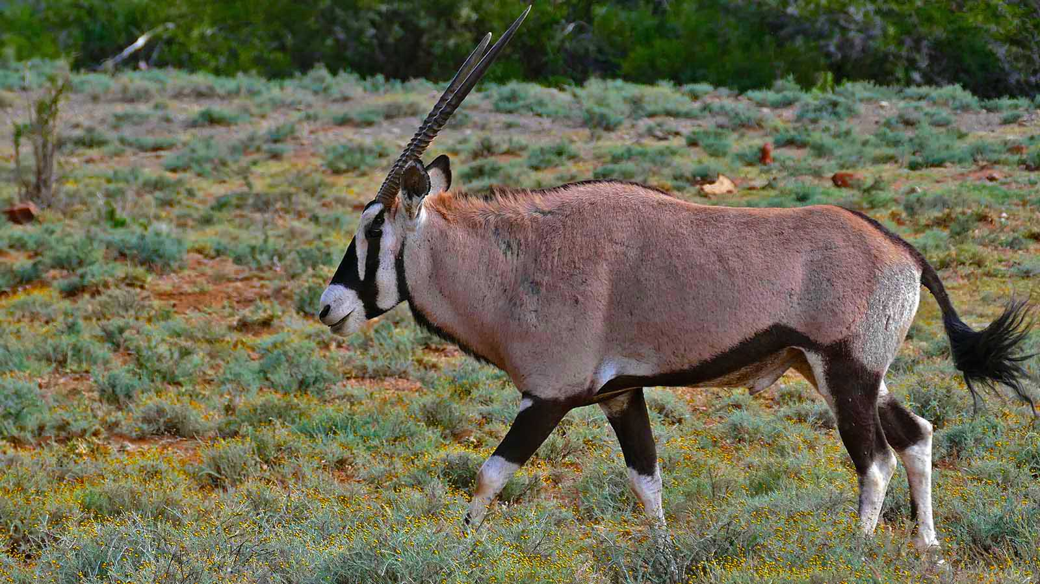
Photo © Bernard Dupont

Slide 24
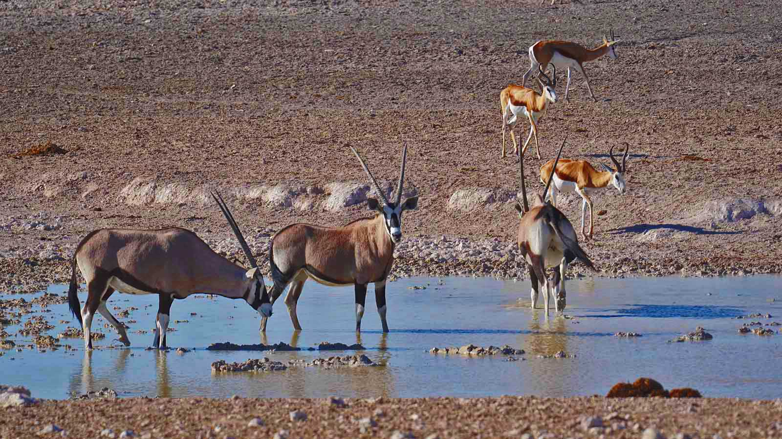
Photo © Jürgen Bierlein

Slide 25
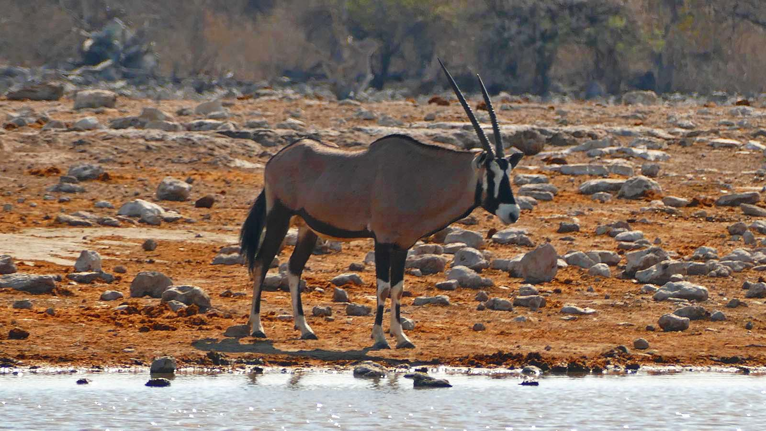
Photo © Sekerka Dušan

Slide 26
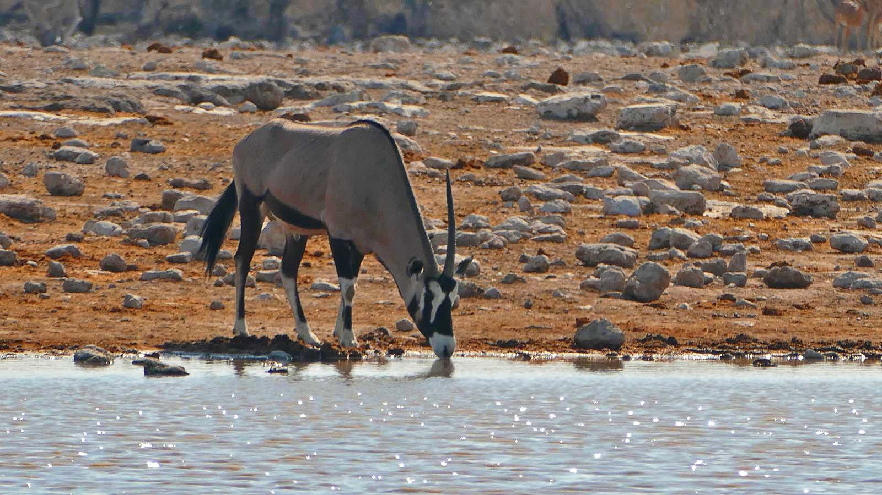
Photo © Sekerka Dušan

Slide 27
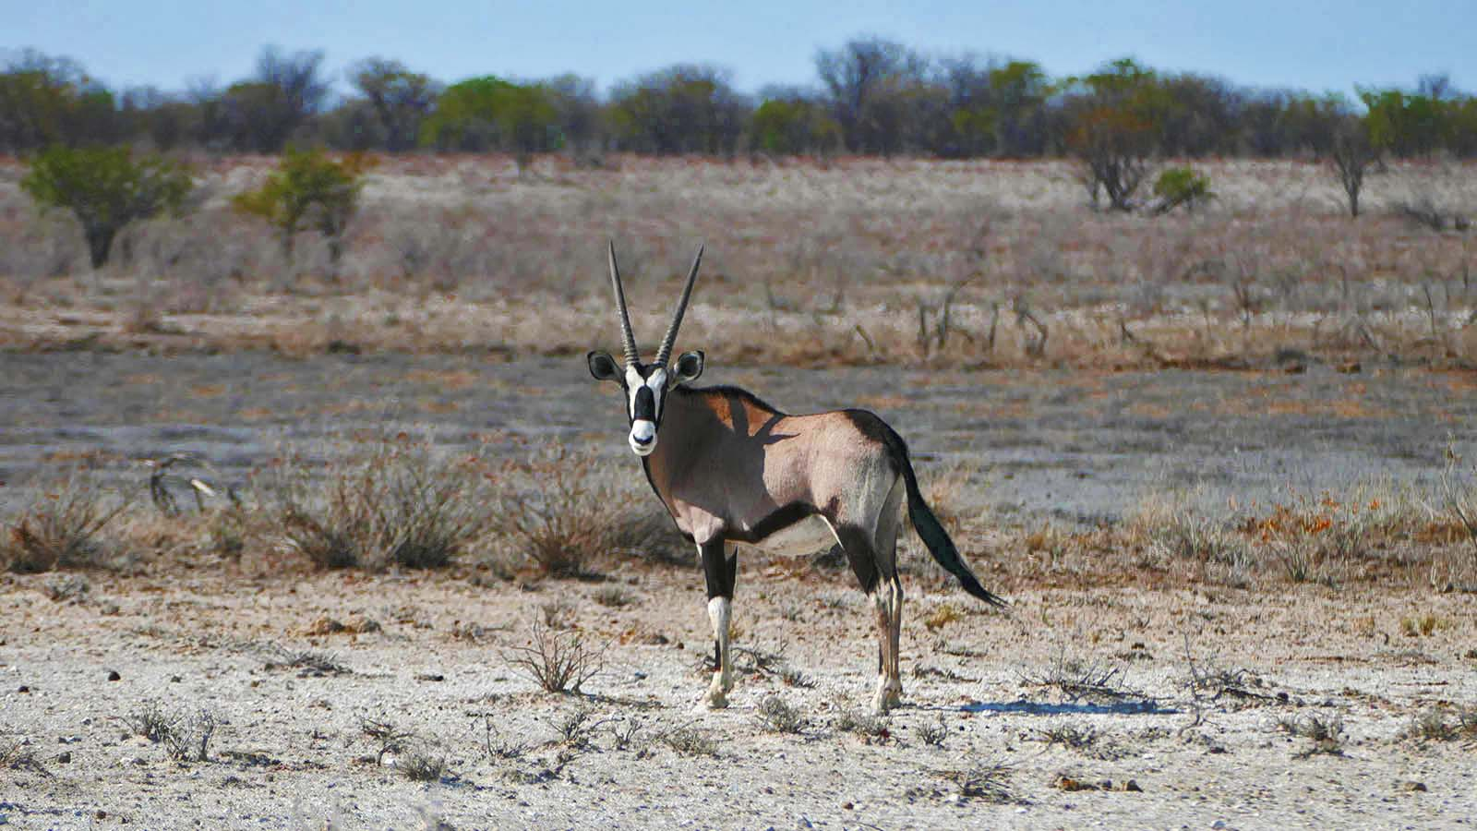
Photo © Sekerka Dušan

Slide 28
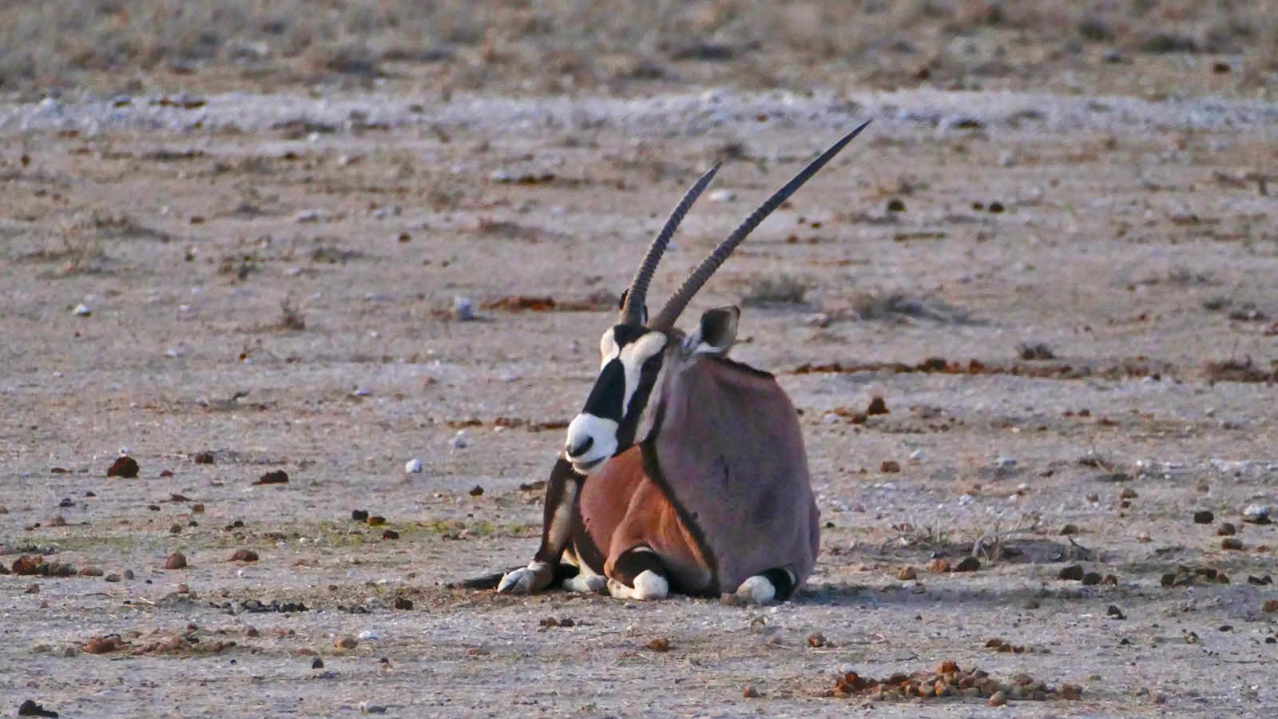
Photo © Sekerka Dušan

Slide 29
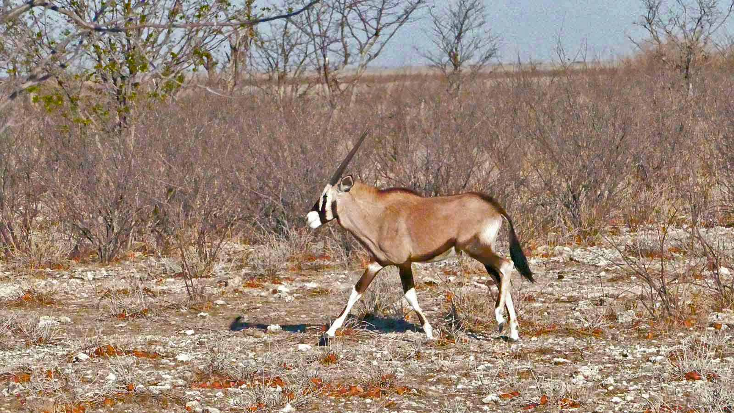
Photo © Sekerka Dušan

Slide 30
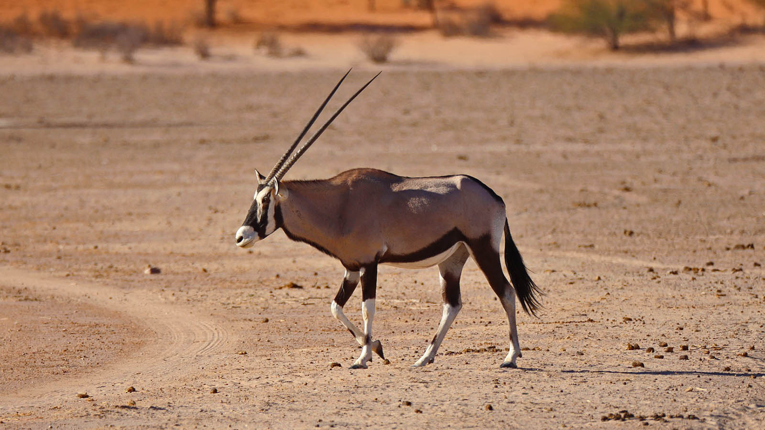
Photo © Patricia van den Berg

Slide 31
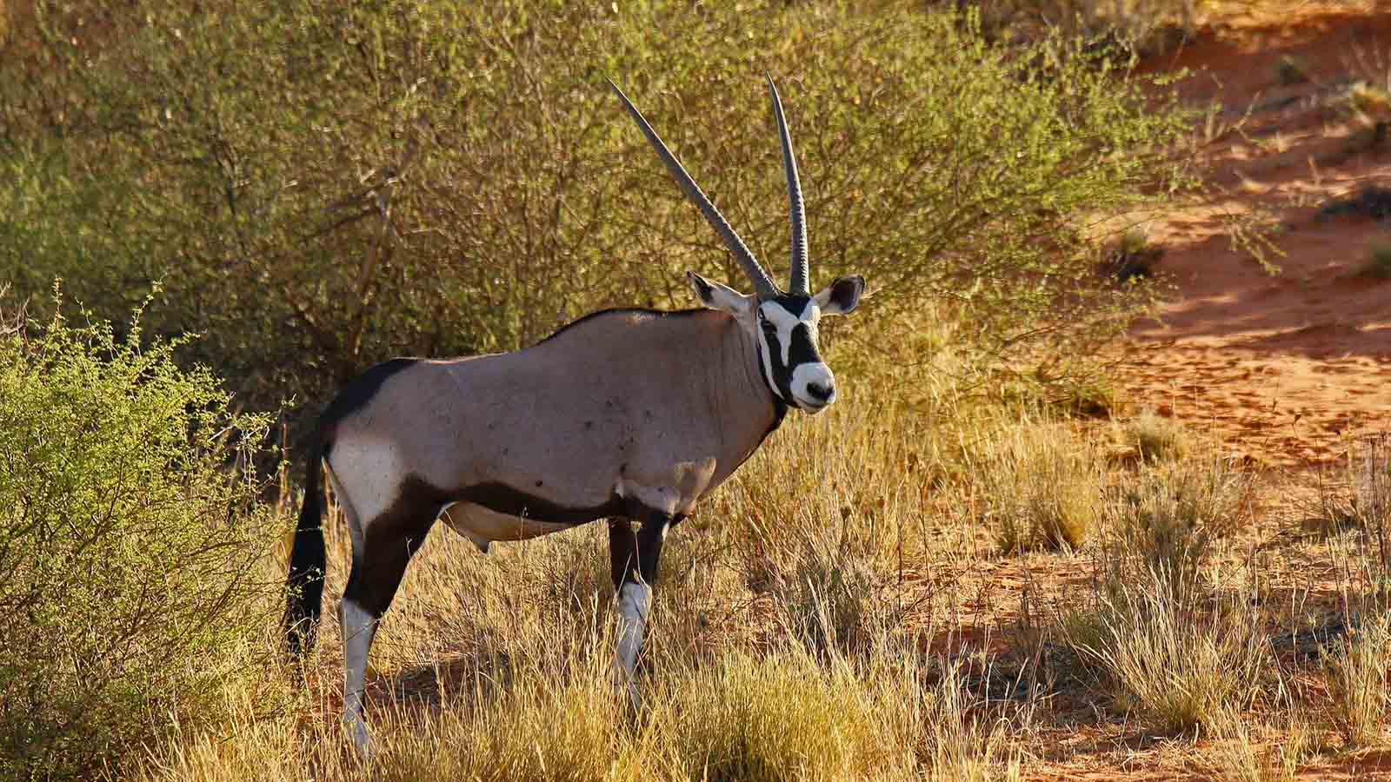
Photo © Josibo

Slide 32
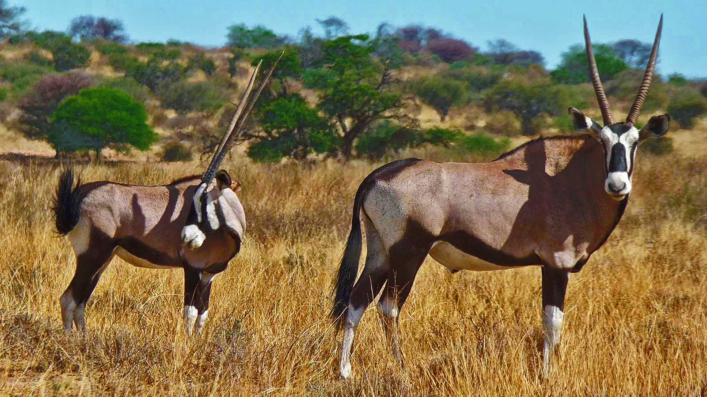
Photo © Bernard Dupont

Slide 33
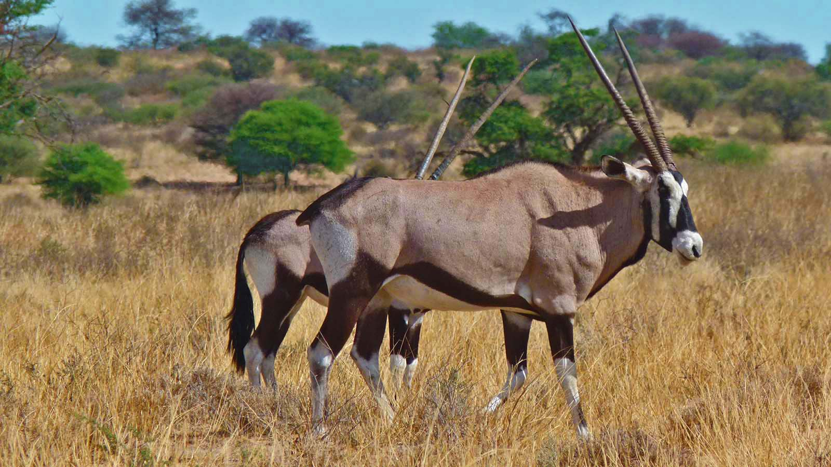
Photo © Bernard Dupont

Slide 34
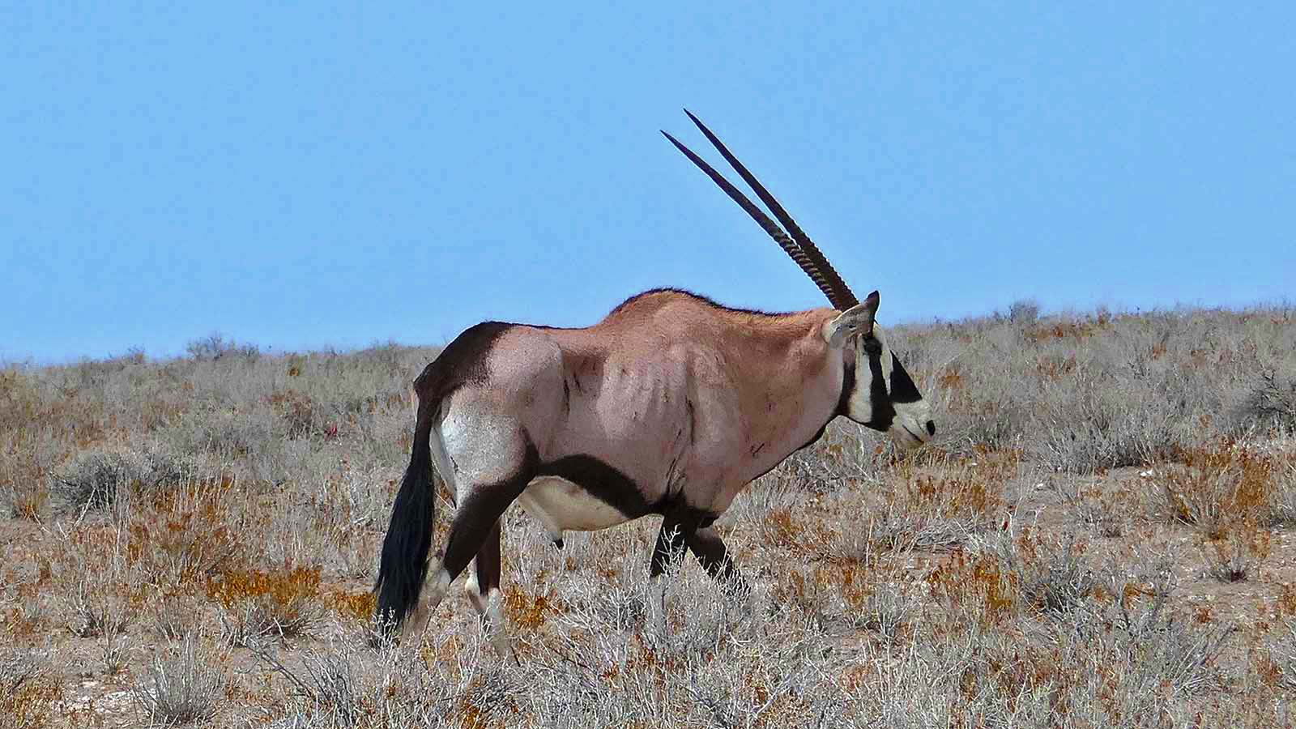
Photo © Ji-Elle

Slide 35
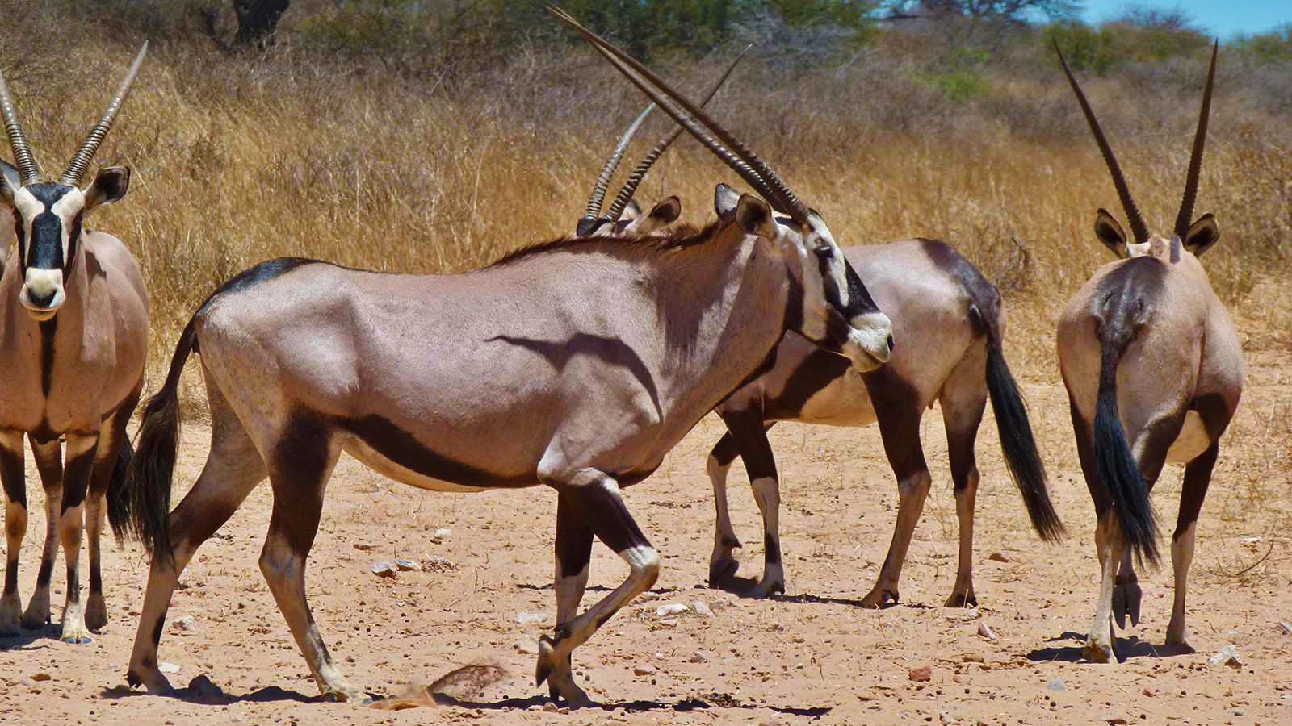
Photo © Bernard Dupont

Slide 36
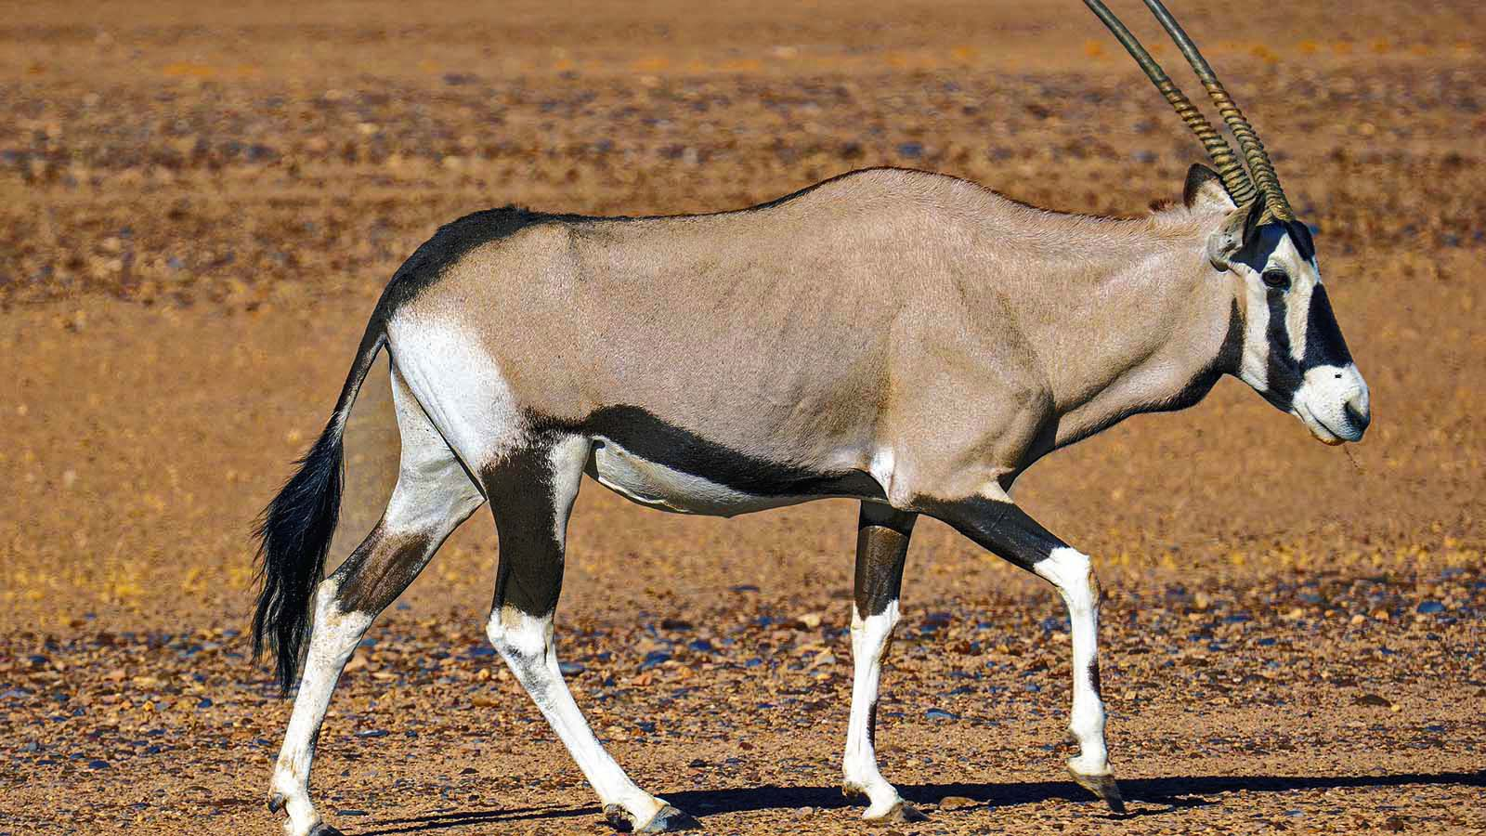
Photo © Jürgen Bierlein

Slide 37
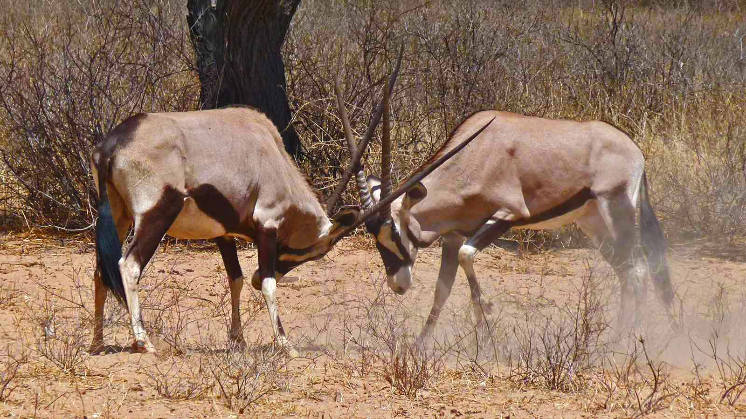
Photo © Bernard Dupont

Slide 38
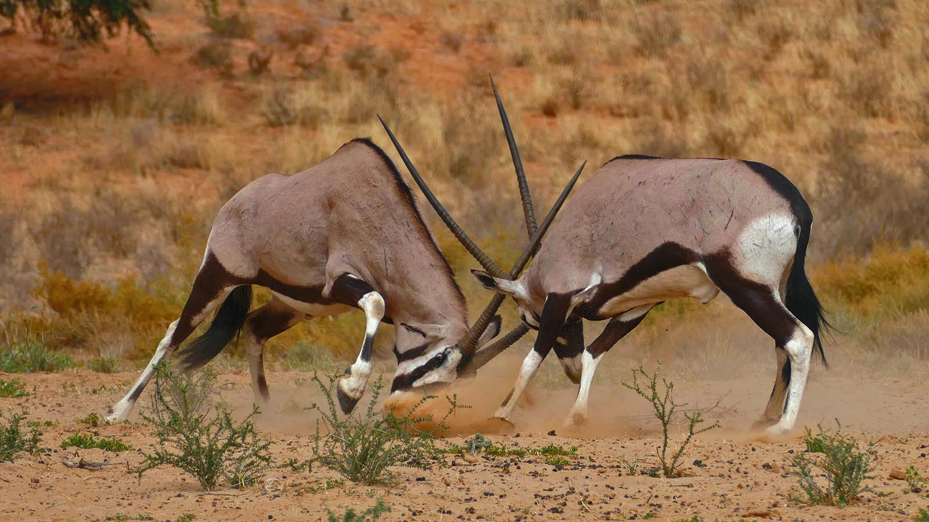
Photo © Bernard Dupont

Slide 39
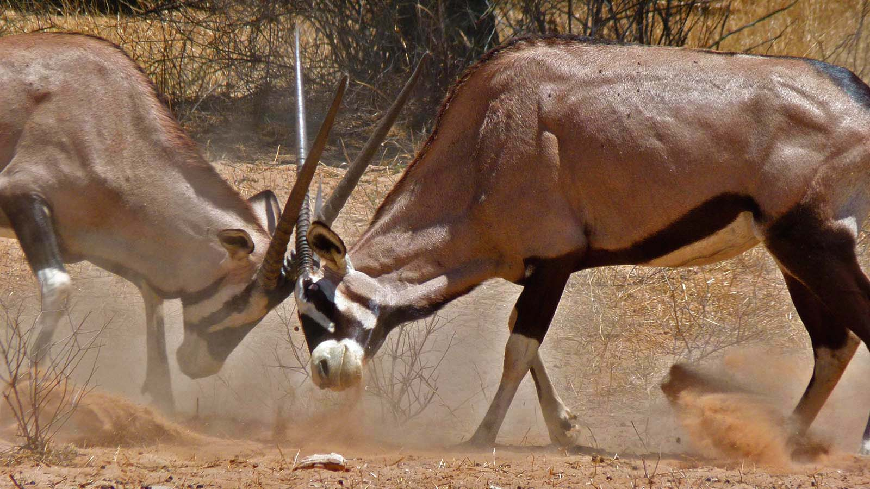
Photo © Bernard Dupont

Slide 40
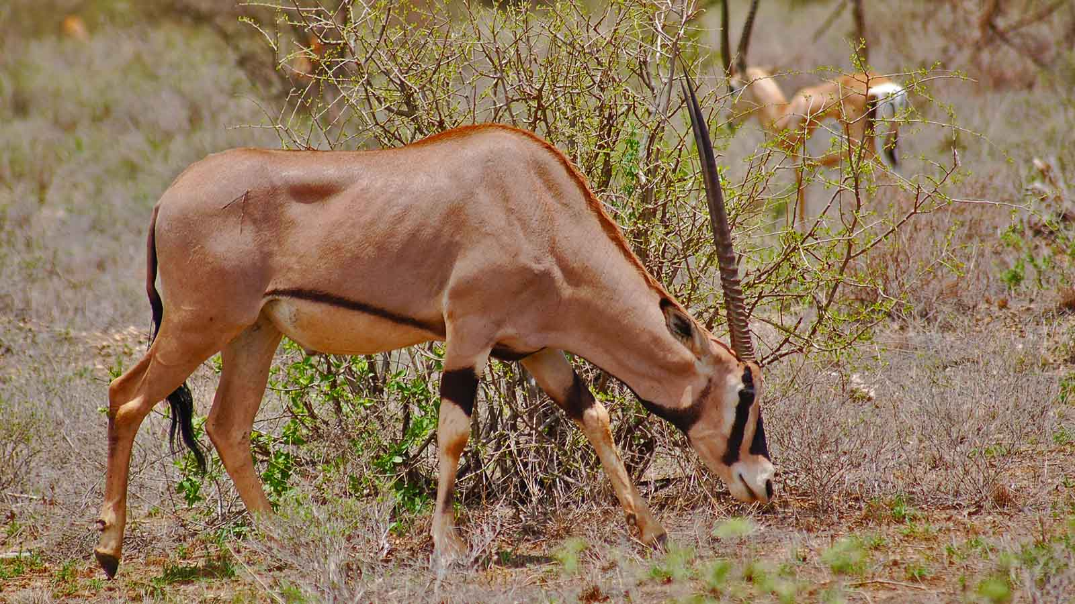
Photo © Ndeithi

Slide 41
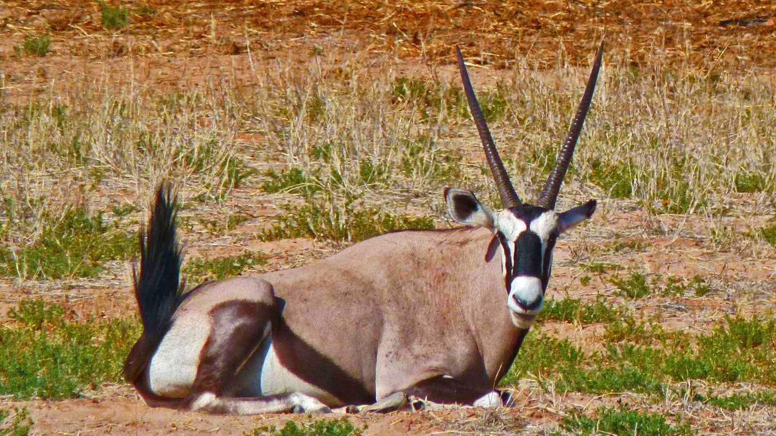
Photo © Bernard Dupont

Slide 42

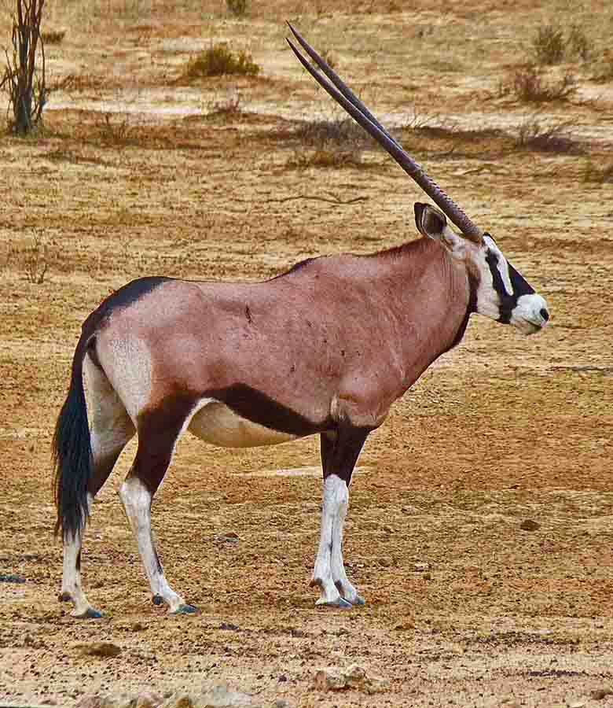
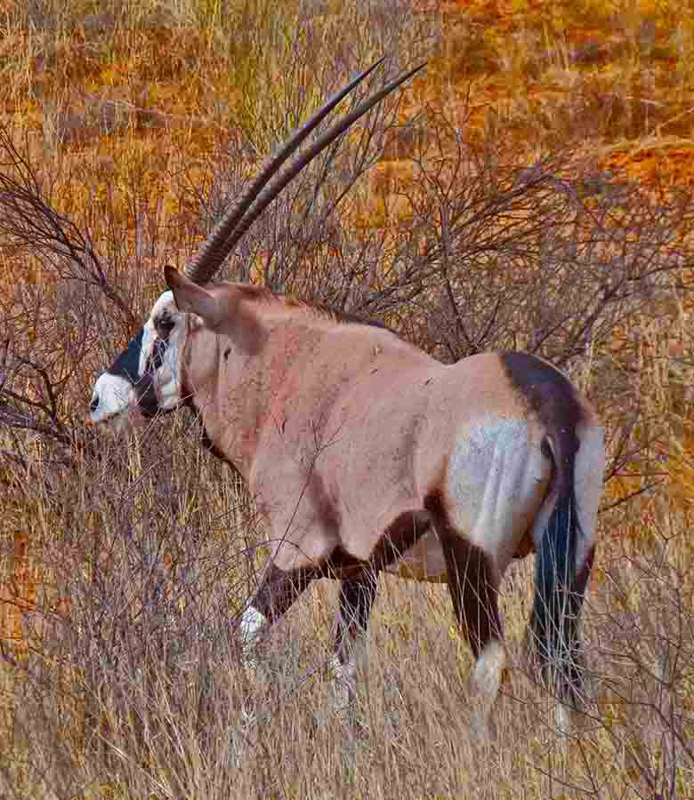
Photo © Bernard Dupont
Photo © Bernard Dupont

Slide 43
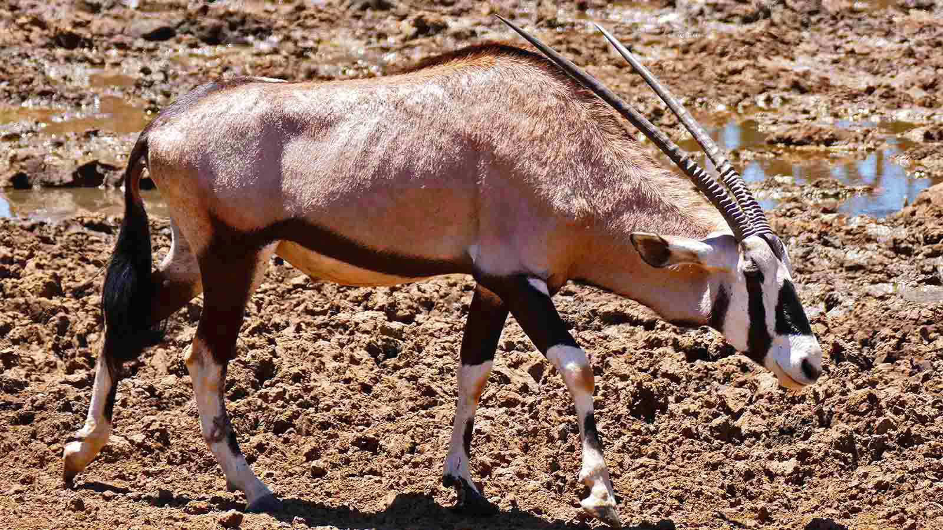
Photo © Bernard Dupont

Slide 44
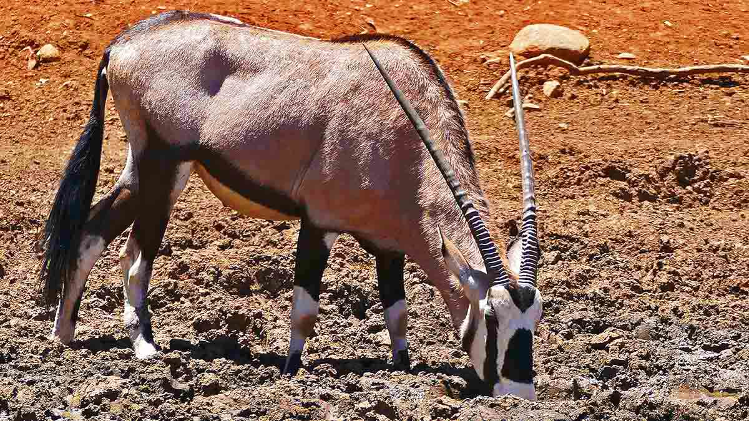
Photo © Bernard Dupont

Slide 45
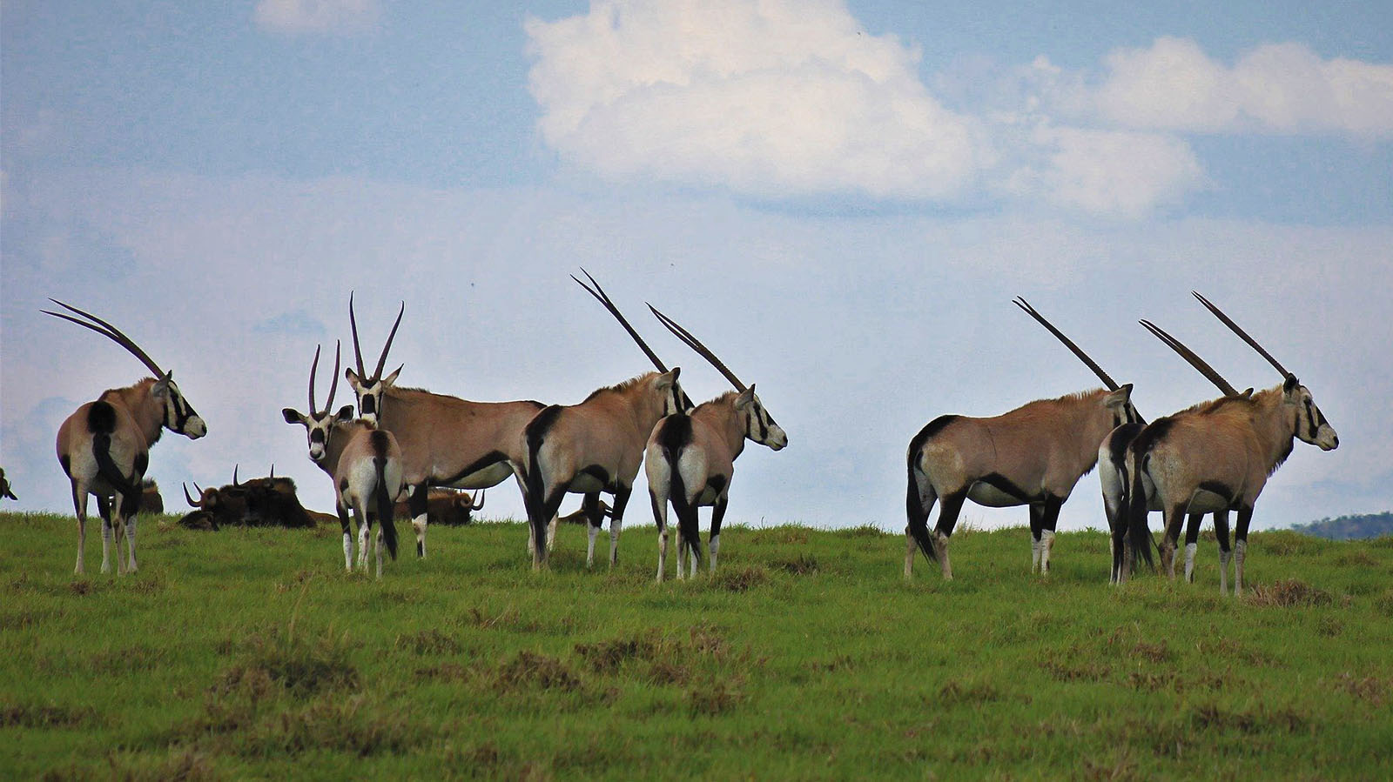
Photo © Nel Botha

Slide 46

2022
Music : N'Chant Nguru - Ilekun d'Africa
Photos : Bernard Dupont (France)
Photos : Sekerka Dušan Ing. (Slovakia)
Thanks to all photo owners for the cooperation.
Created by : Rumpler Štefan (Slovakia)
Contact: pista2011@gmail.com

Slide 47

Ți-a plăcut prezentarea mea?
Trimite-mi un email. Iti voi trimite inca una.
Gratuit desigur!
Did you like my presentation?
Email me. I will send you another one.
Free of charge!
¿Te gustó mi presentación?
Envíeme un e-mail. Te enviaré otro.
¡Gratis por supuesto!
Tetszett a PPS-diaporámám?
Jelentkezz. Küldök egy uj PPS-t.
Természetesen ingyen!
Páčila sa Vám moja prezentácia?
Napíšte mi. Pošlem Vám ďalšiu.
Samozrejme zadarmo!
Gostou da minha apresentação?
Me mande um e-mail. Vou te enviar outro.
Claro, grátis!
Ti è piaciuta la mia presentazione?
Mandami un'email. Te ne manderò un altro.
Ovviamente gratis!
Hat Ihnen mein Vortrag gefallen?
Maile mir. Ich schicke dir noch eins.
Natürlich kostenlos!
Avez-vous aimé ma présentation?
Envoyez moi un email. Je t'en enverrai un autre.
Gratuit bien sûr!
pista2011@gmail.com

Slide 48







¿Te ha gustado?
Puedes ver más entrando
Aquí
Además puedes recibir powerpoints en tu correo electrónico suscribiéndote aquí:

