Slide 1

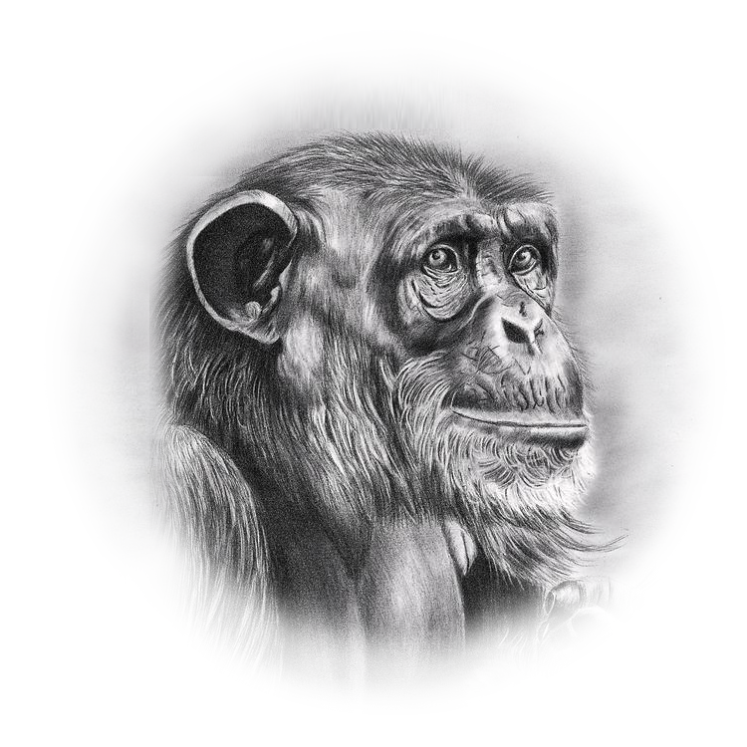

Wildlife
11
Of africa
Monkey

Slide 2
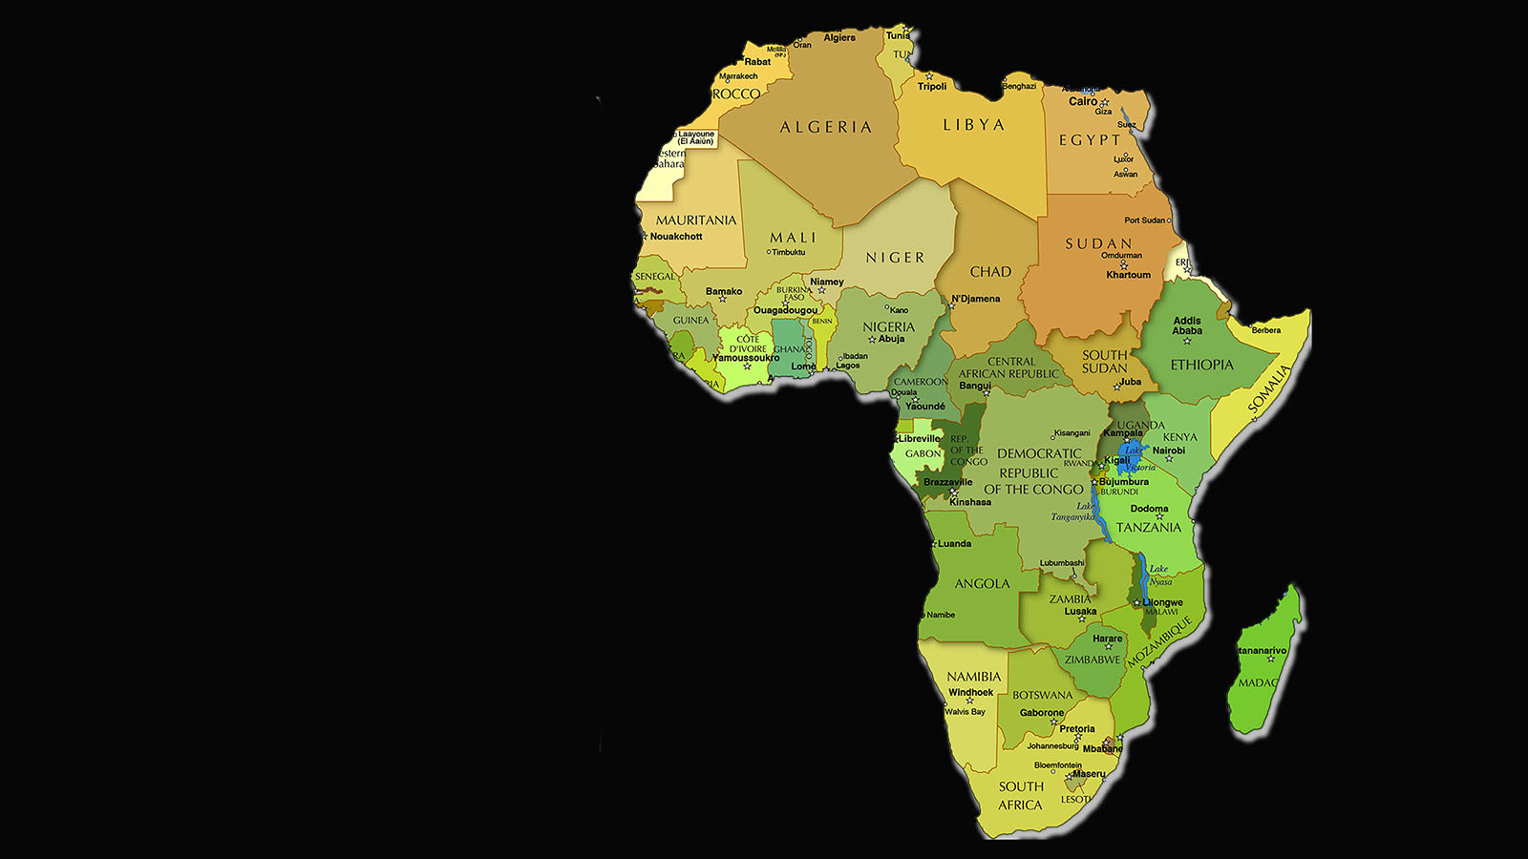

Wildlife
of Africa

Slide 4
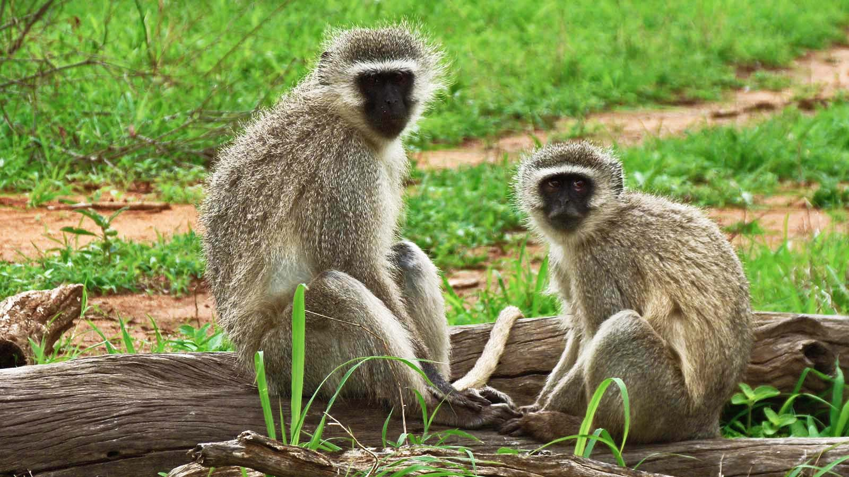

Photo © Bernard Dupont

Slide 5
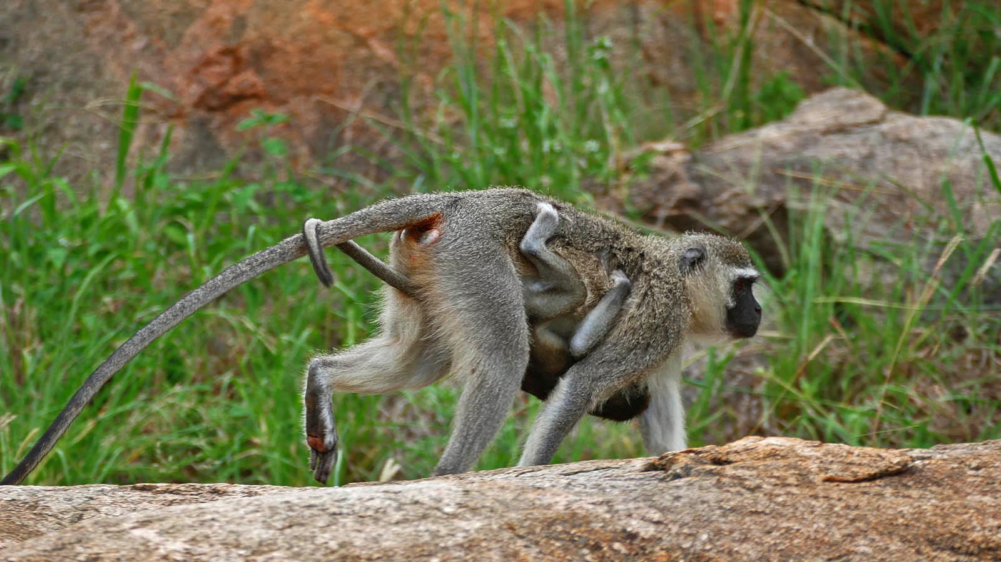
Photo © Bernard Dupont

Slide 6
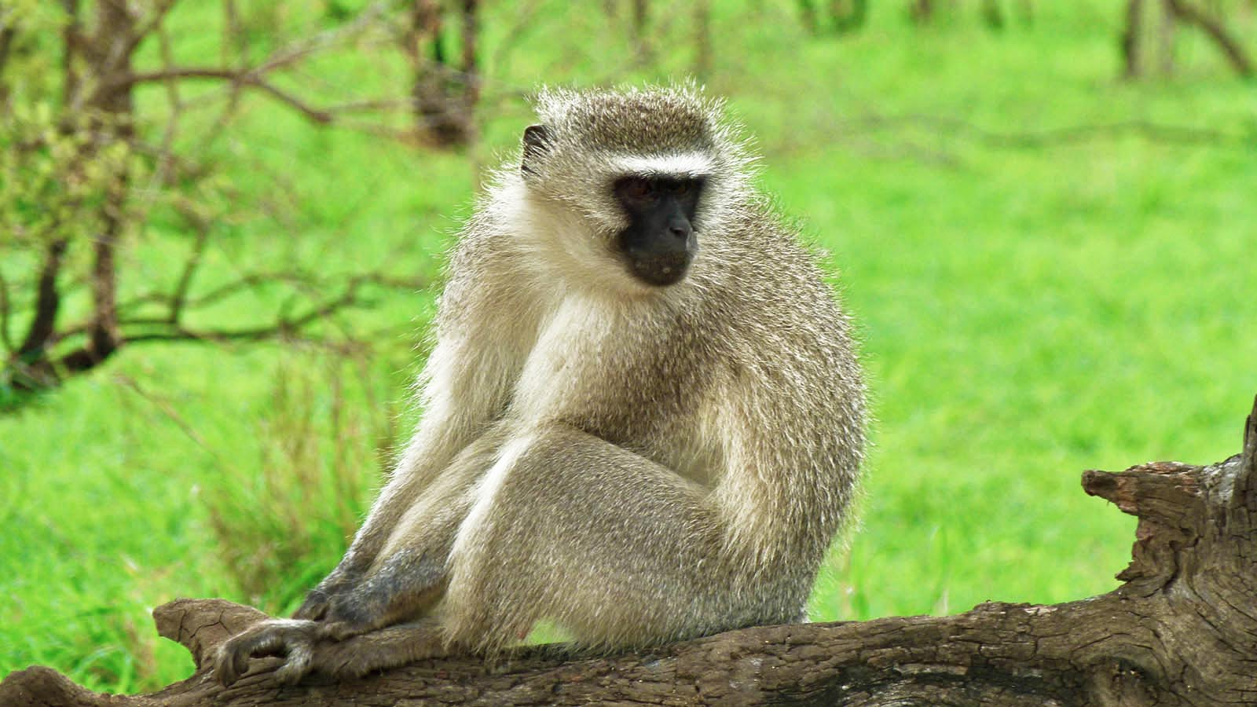
Photo © Bernard Dupont

Slide 7
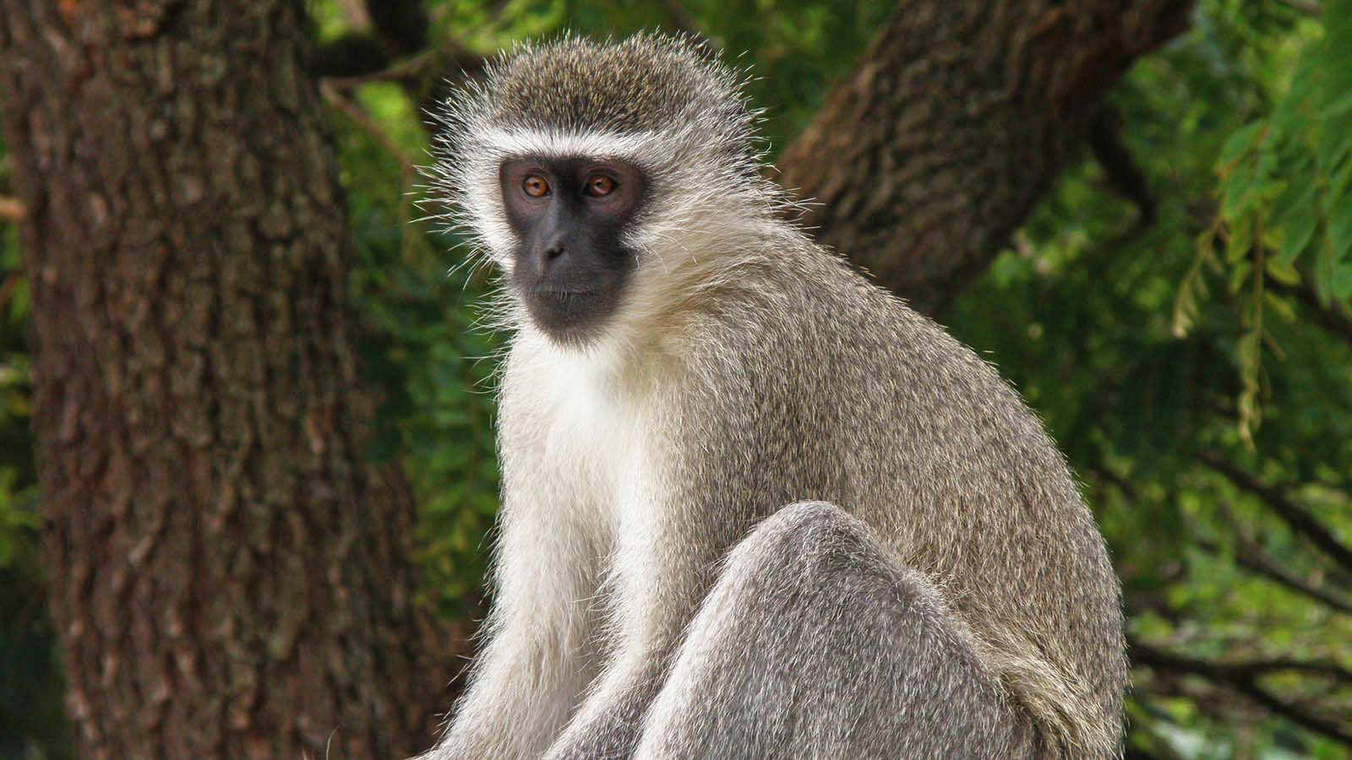
Photo © Hudec Ivan

Slide 8
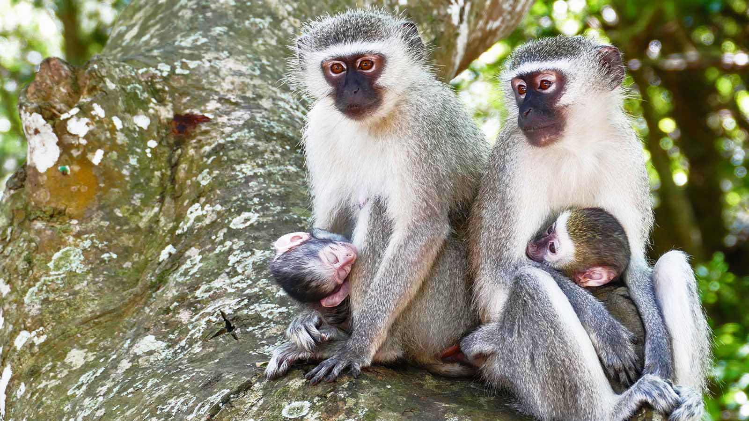
Photo © Bernard Dupont

Slide 9
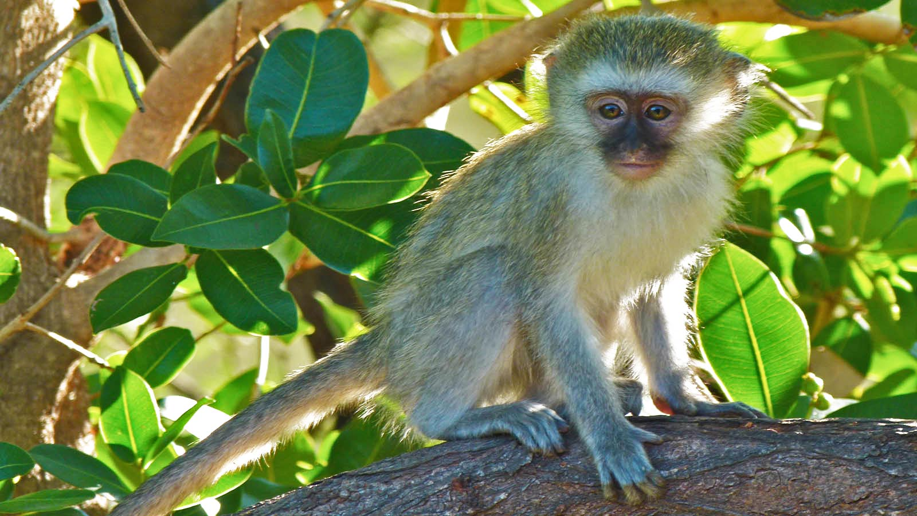
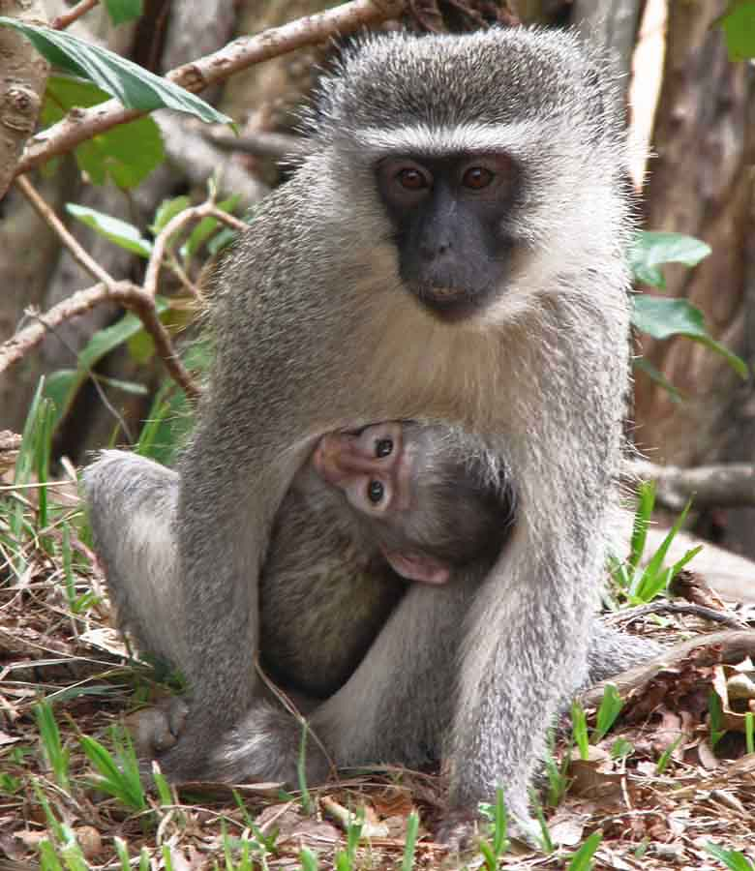

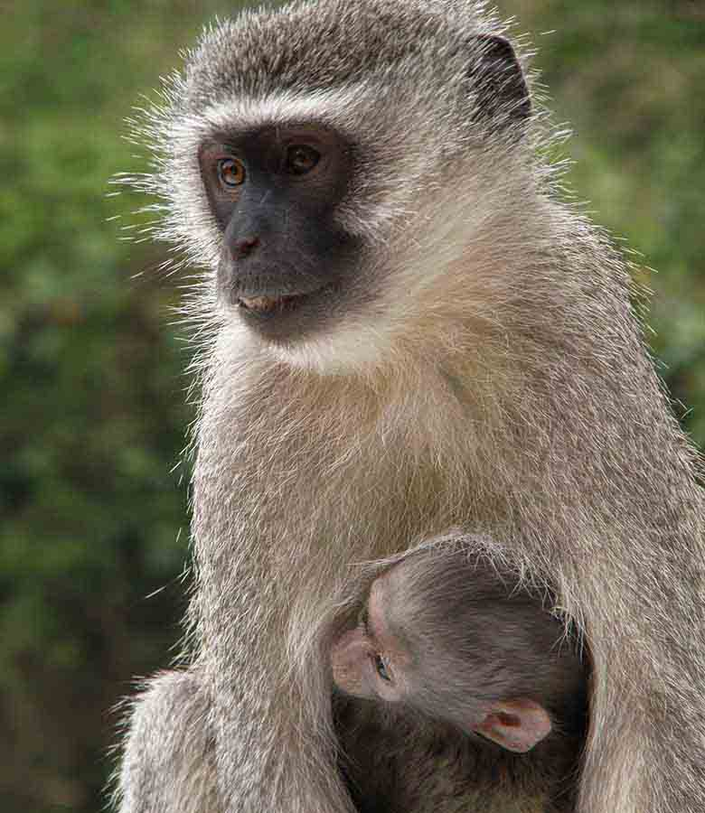
Photo © Bernard Dupont
Photo © Hudec Ivan
Photo © Hudec Ivan

Slide 10
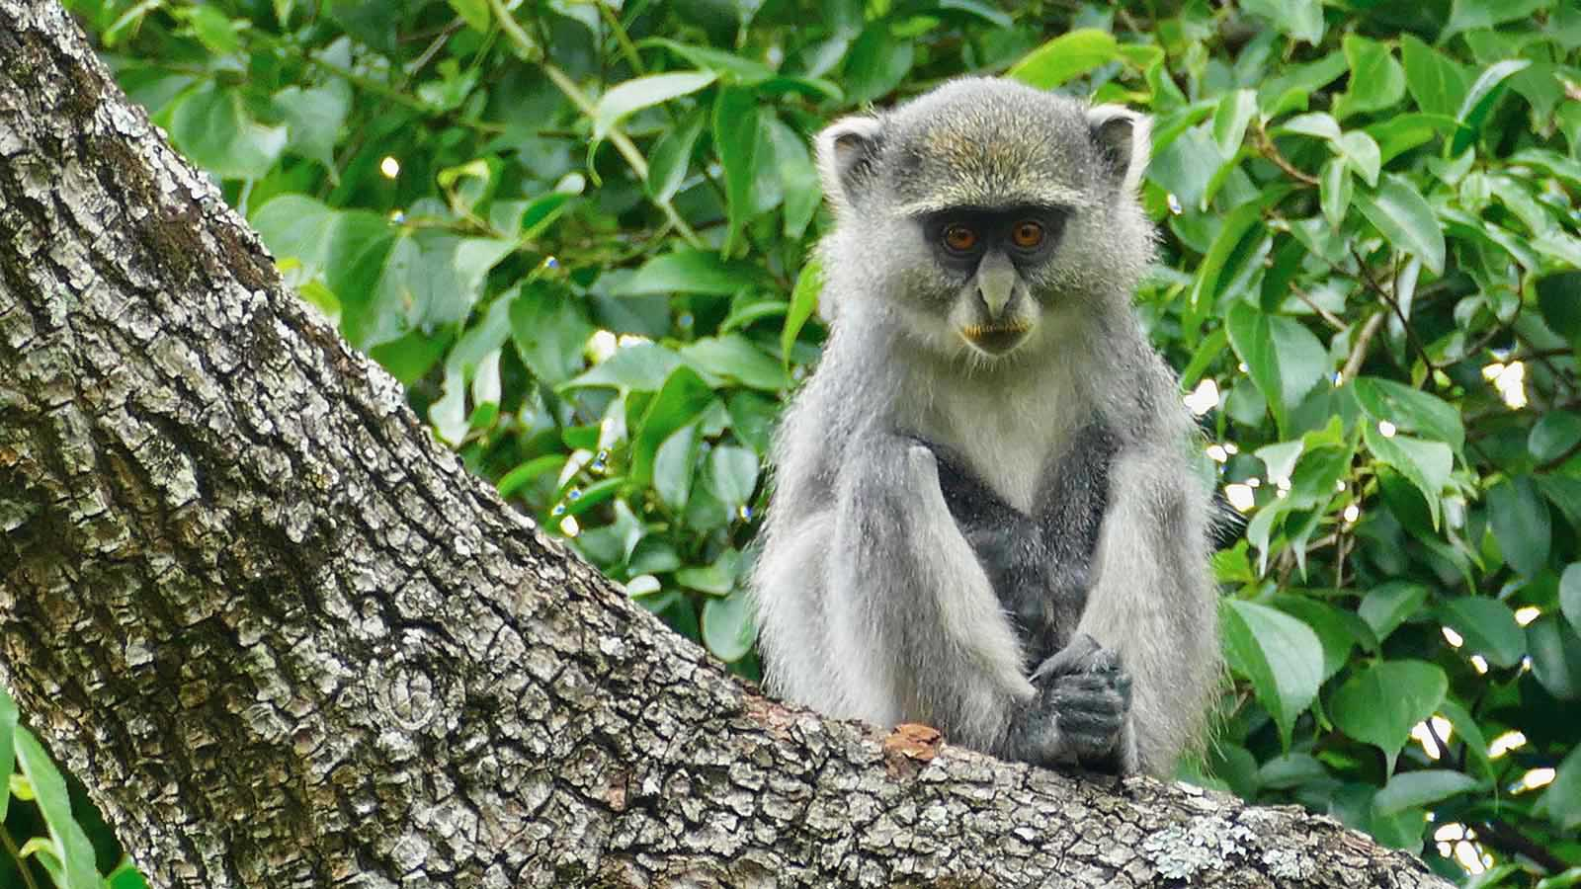
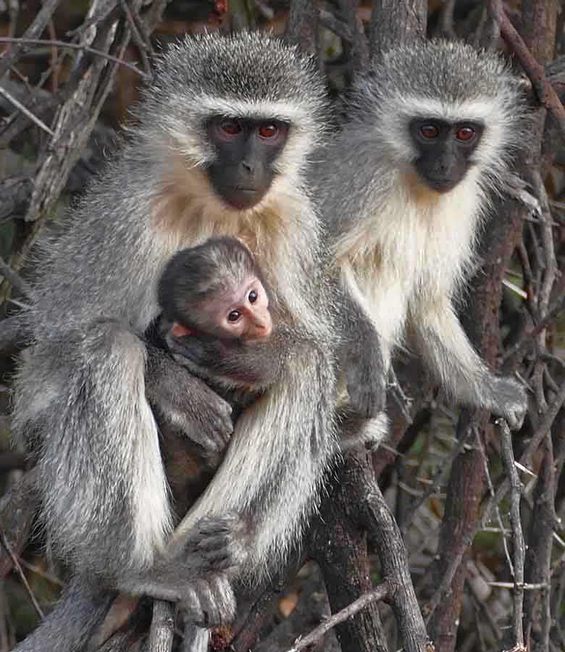
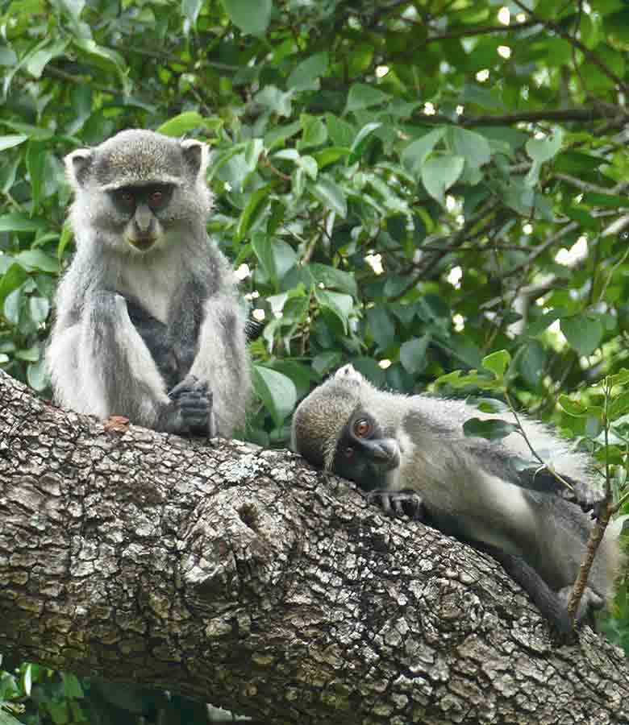
Photo © Bernard Dupont
Photo © Bernard Dupont
Photo © Bernard Dupont

Slide 11
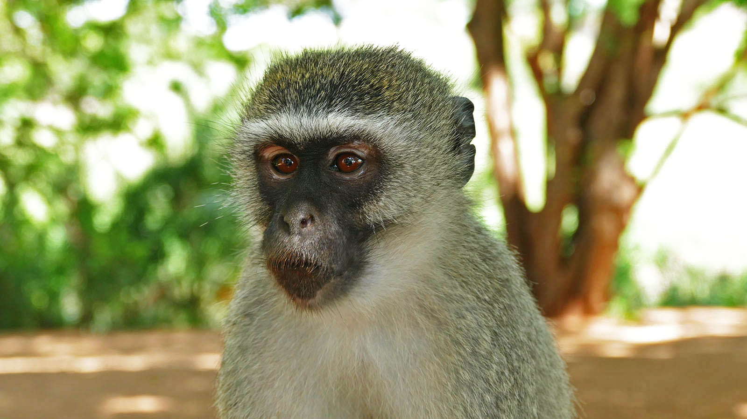
Photo © Bernard Dupont

Slide 12
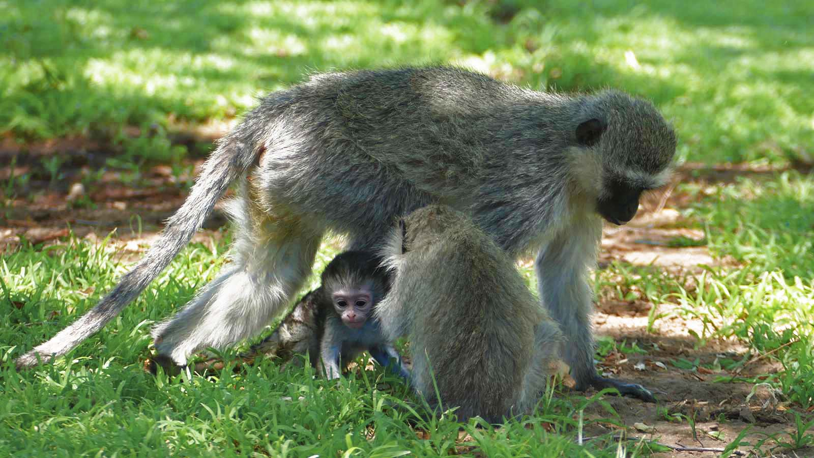
Photo © Bernard Dupont

Slide 13
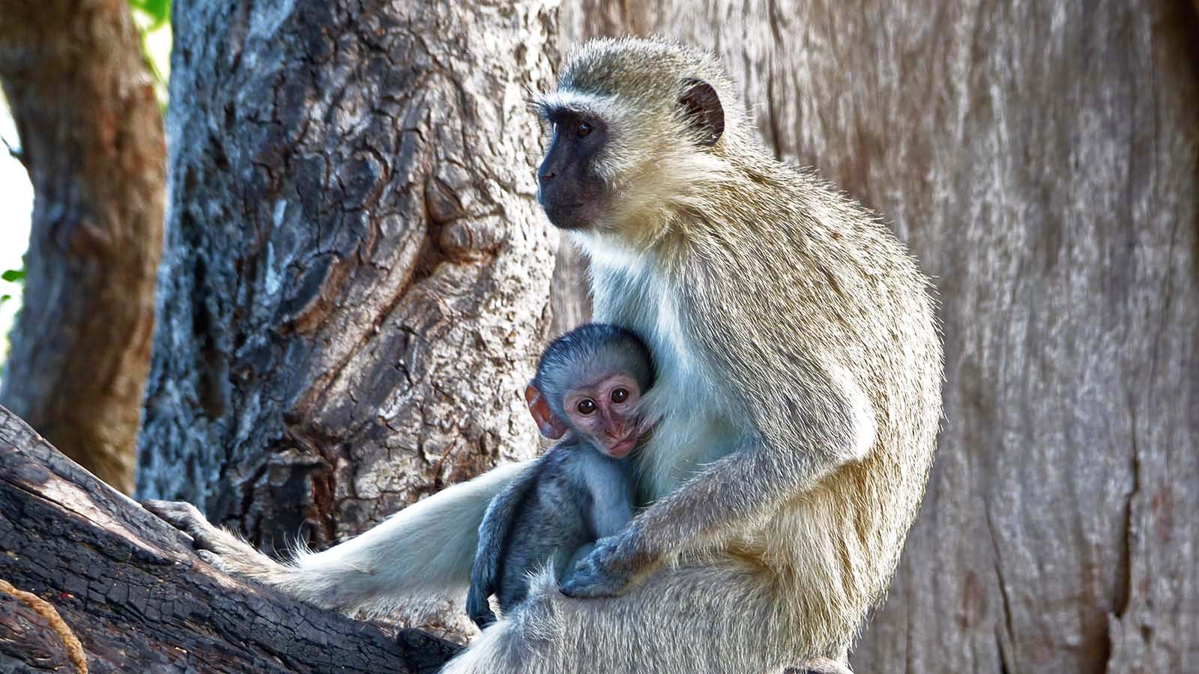
Photo © Bernard Dupont

Slide 14
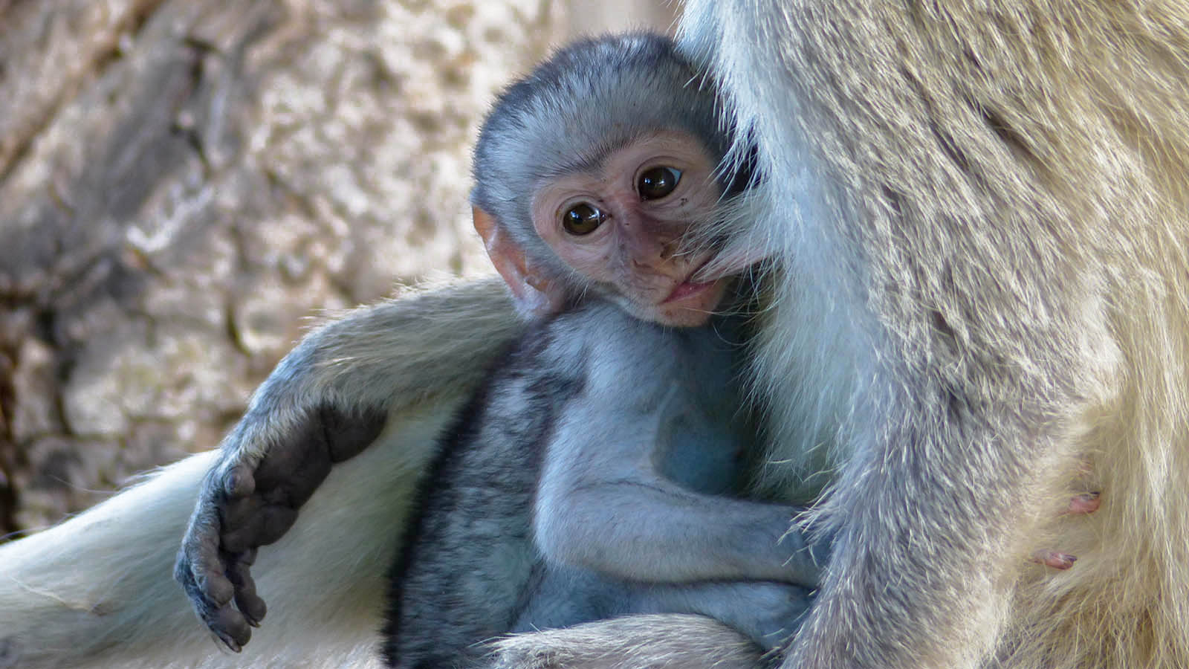
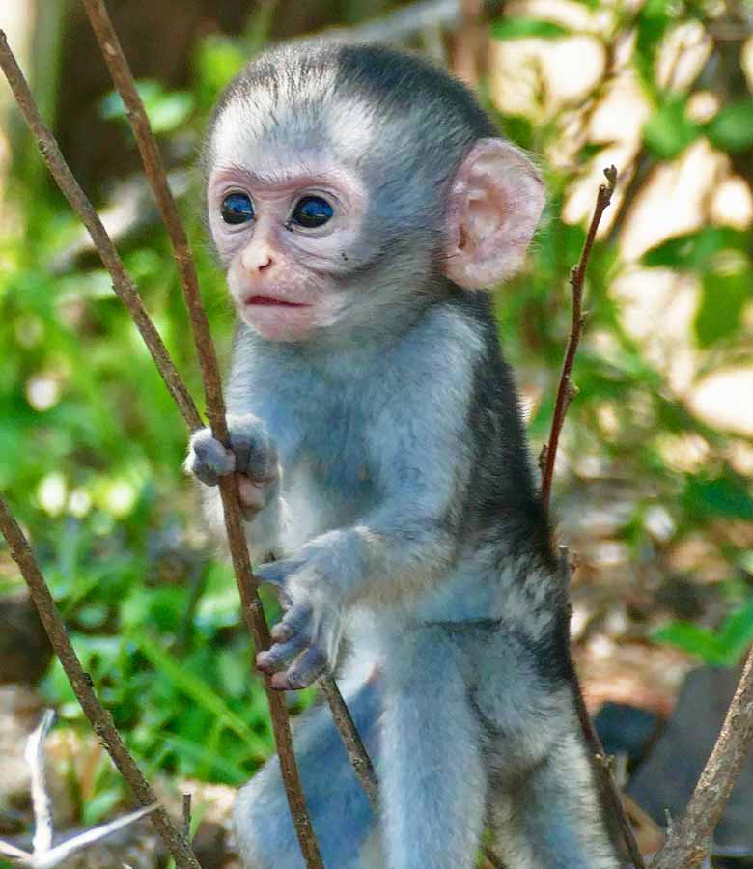
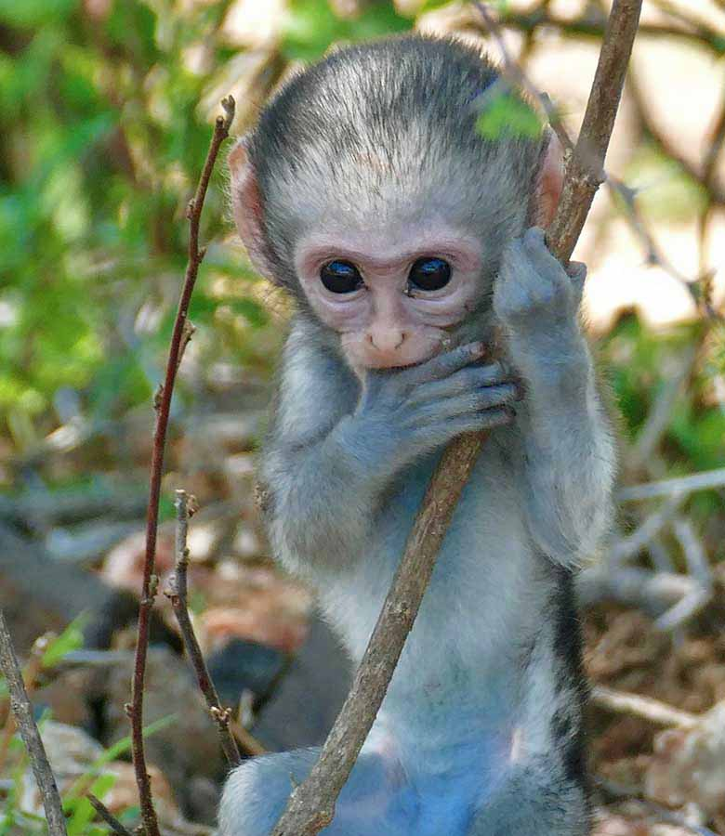
Photo © Bernard Dupont
Photo © Bernard Dupont
Photo © Bernard Dupont

Slide 15
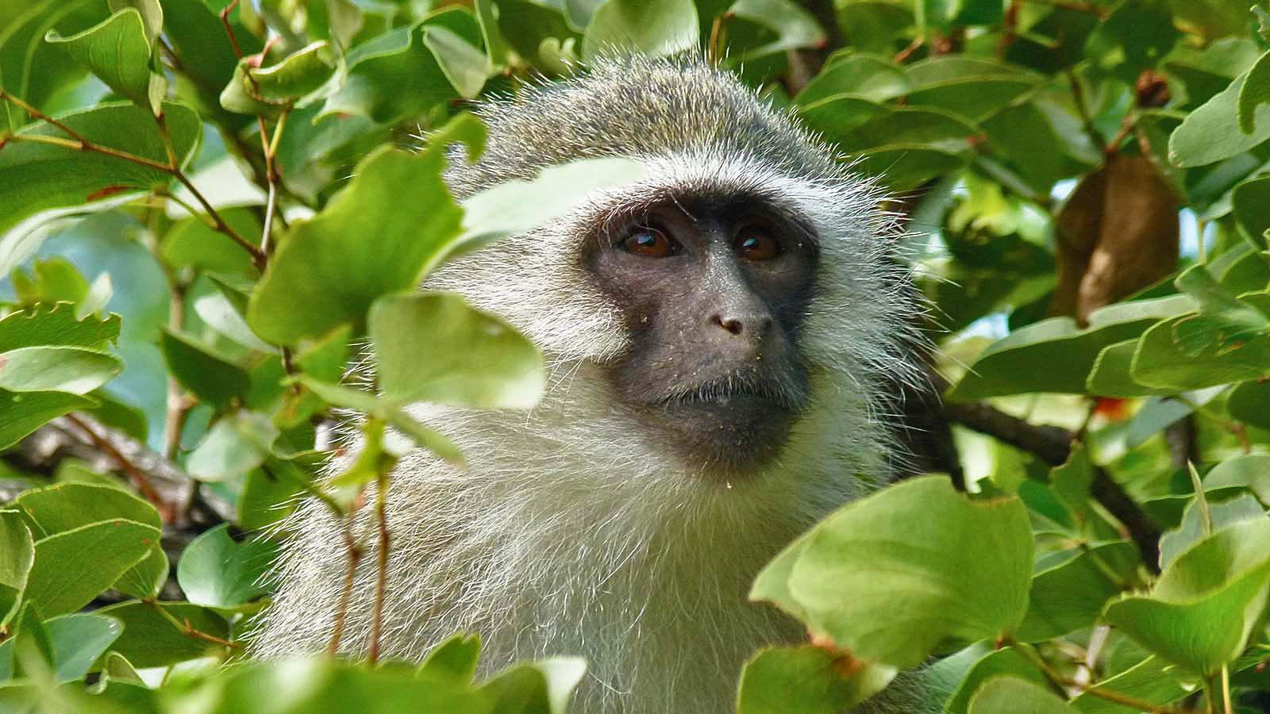
Photo © Bernard Dupont

Slide 16
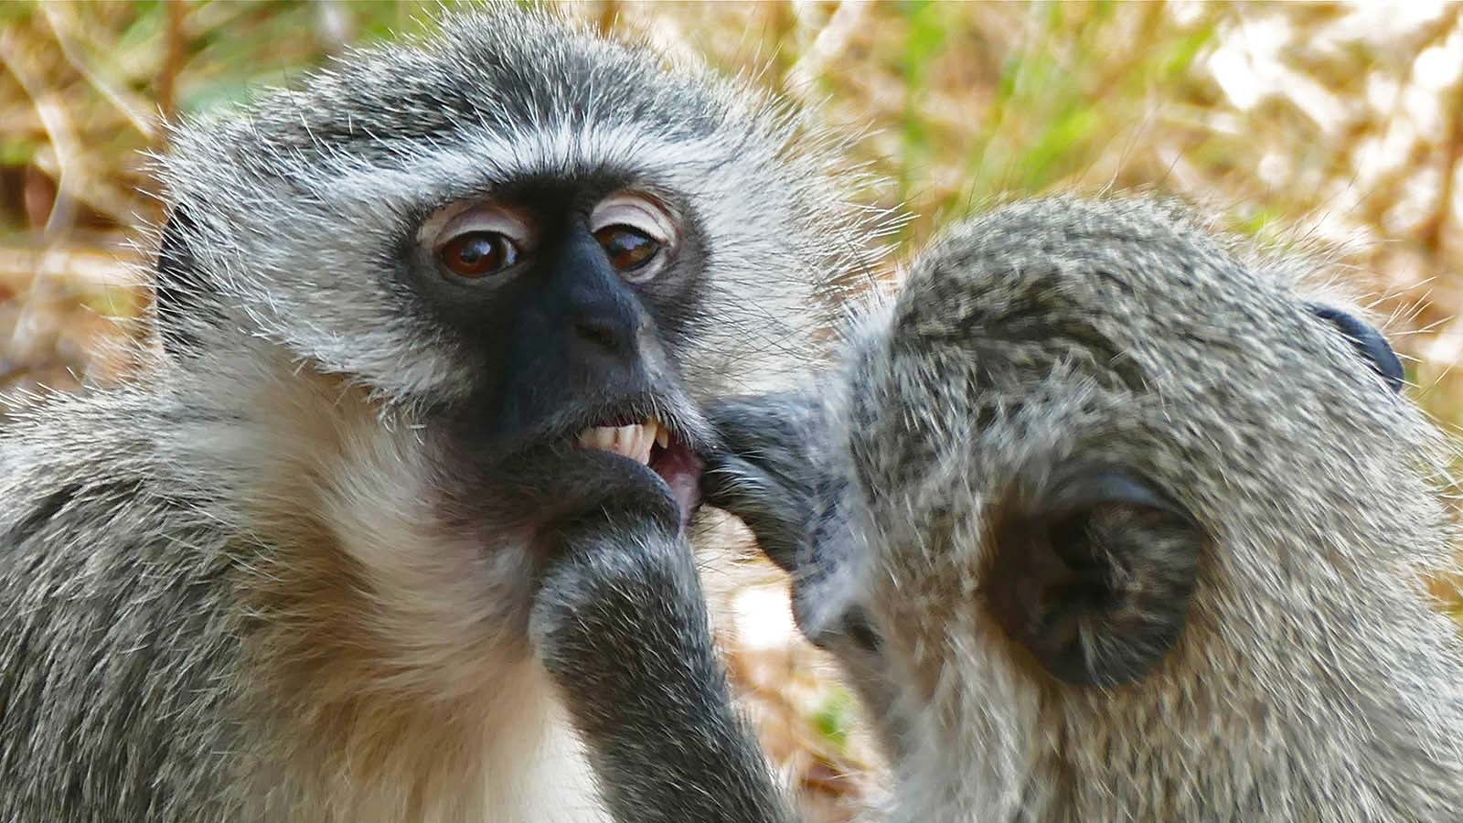
Photo © Bernard Dupont

Slide 17
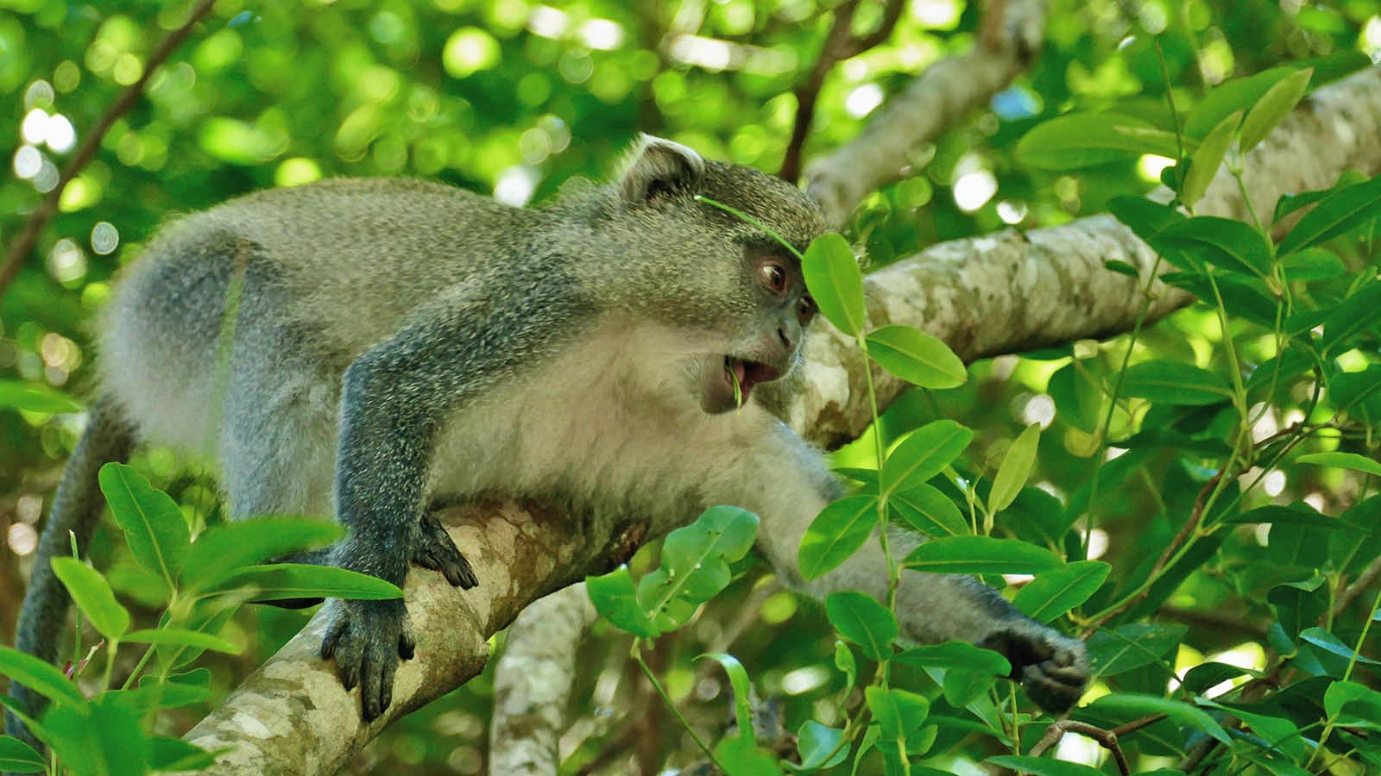
Photo © Bernard Dupont

Slide 18
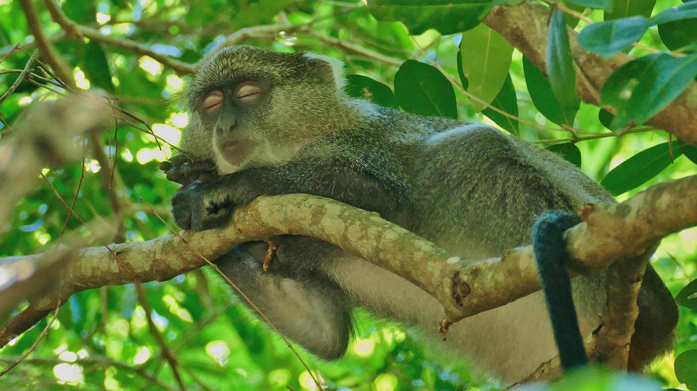
Photo © Bernard Dupont

Slide 19
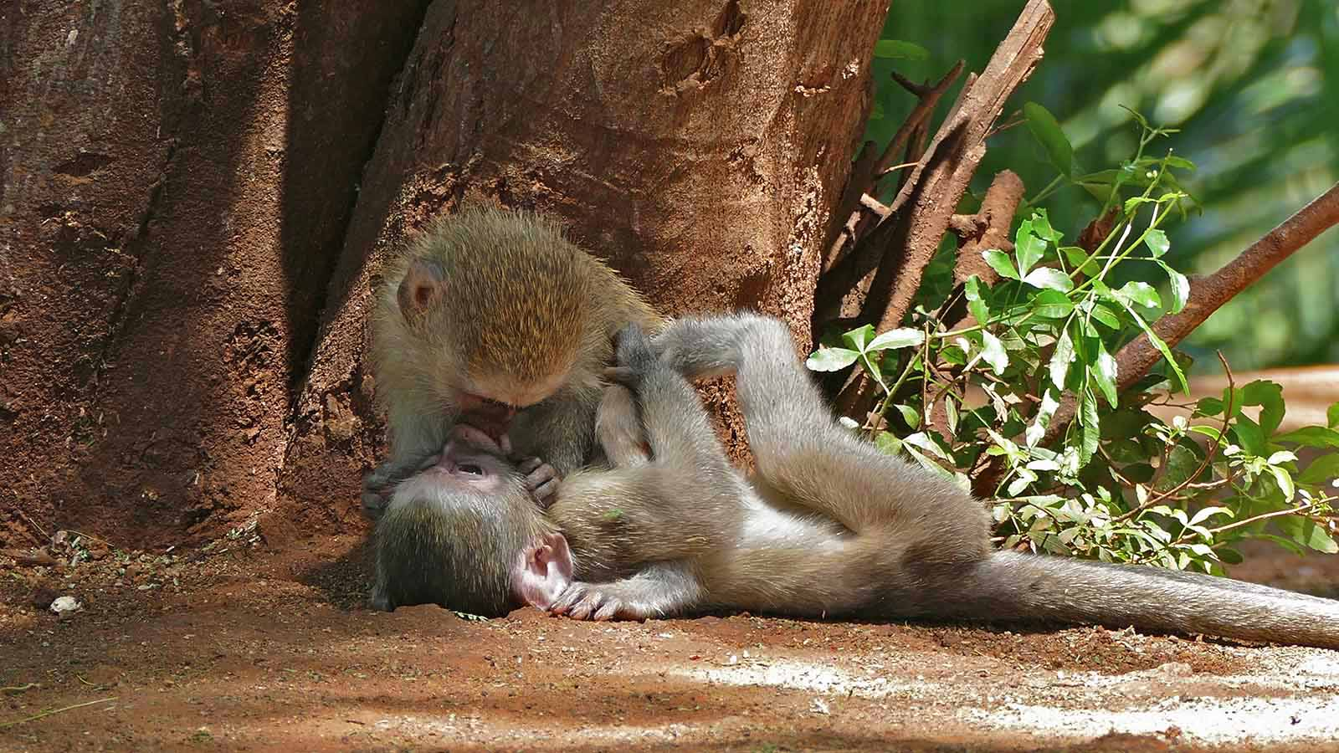
Photo © Bernard Dupont

Slide 20
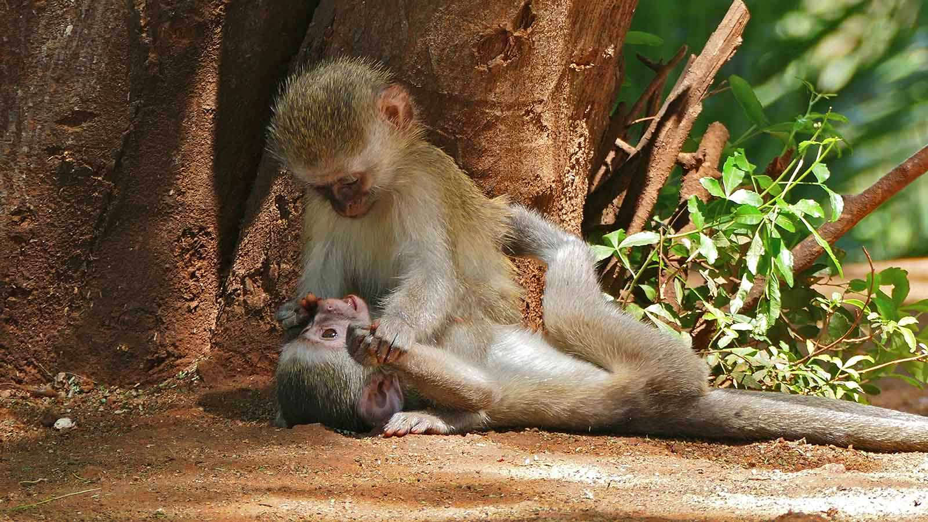
Photo © Bernard Dupont

Slide 21
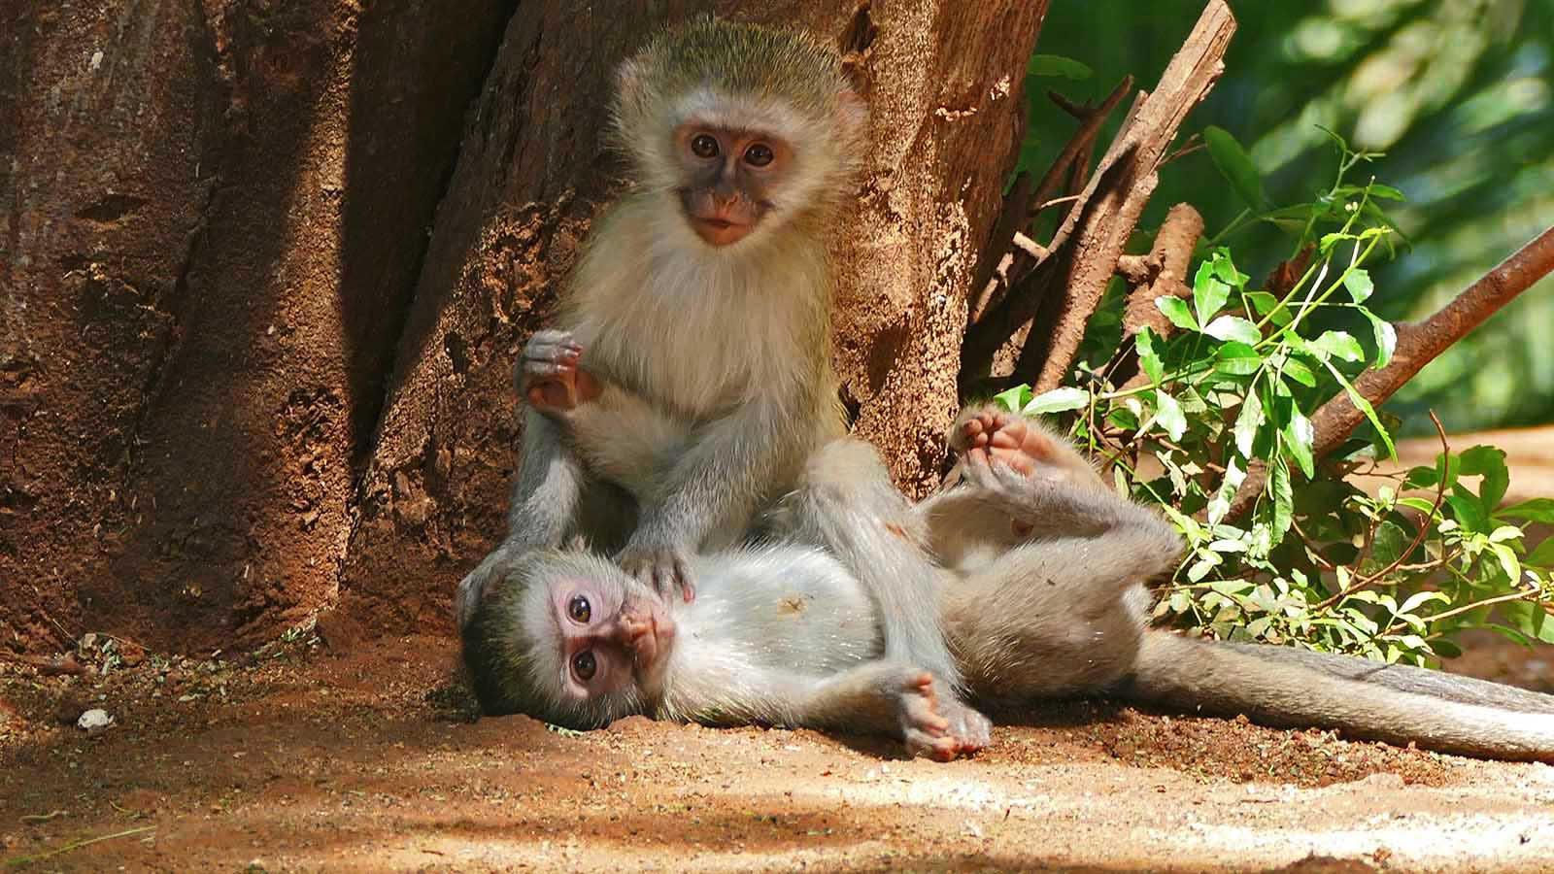
Photo © Bernard Dupont

Slide 22
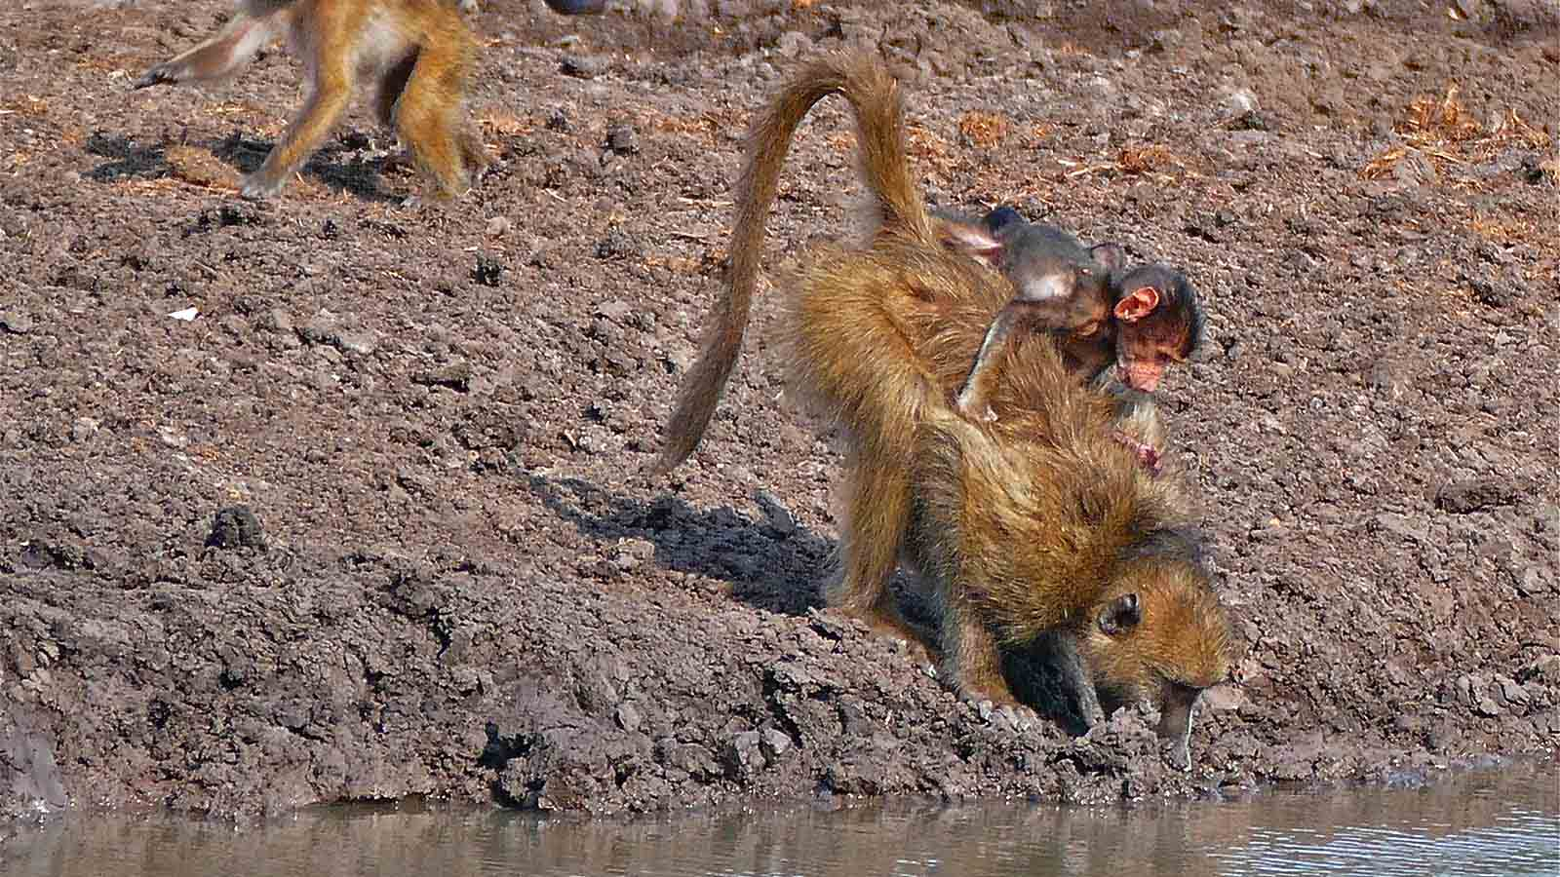
Photo © Bernard Dupont

Slide 23
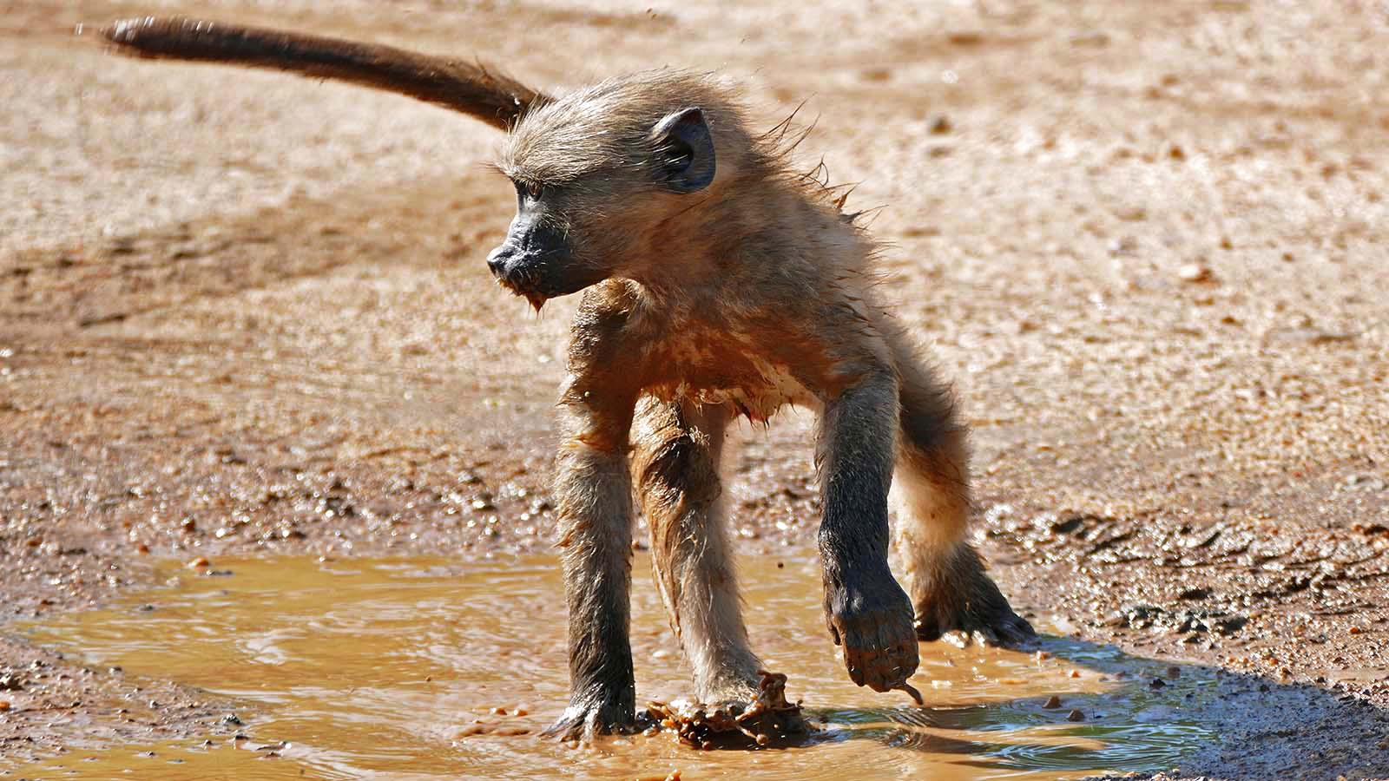
Photo © Bernard Dupont

Slide 24
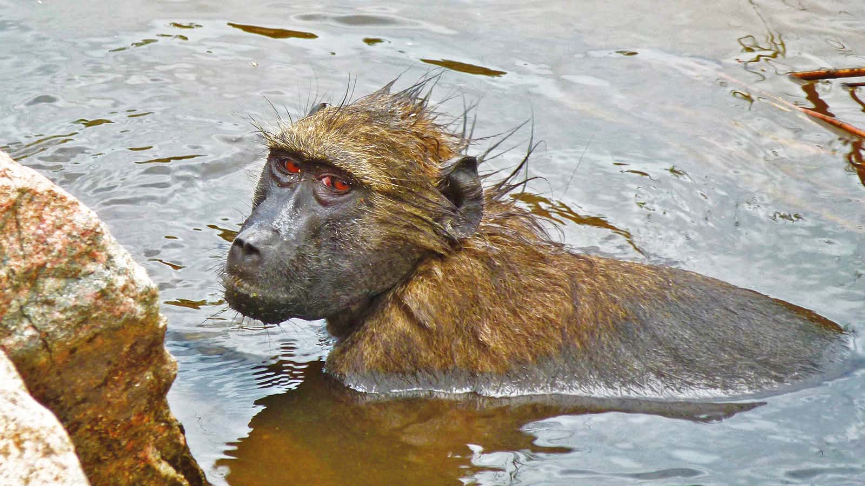
Photo © Bernard Dupont

Slide 25
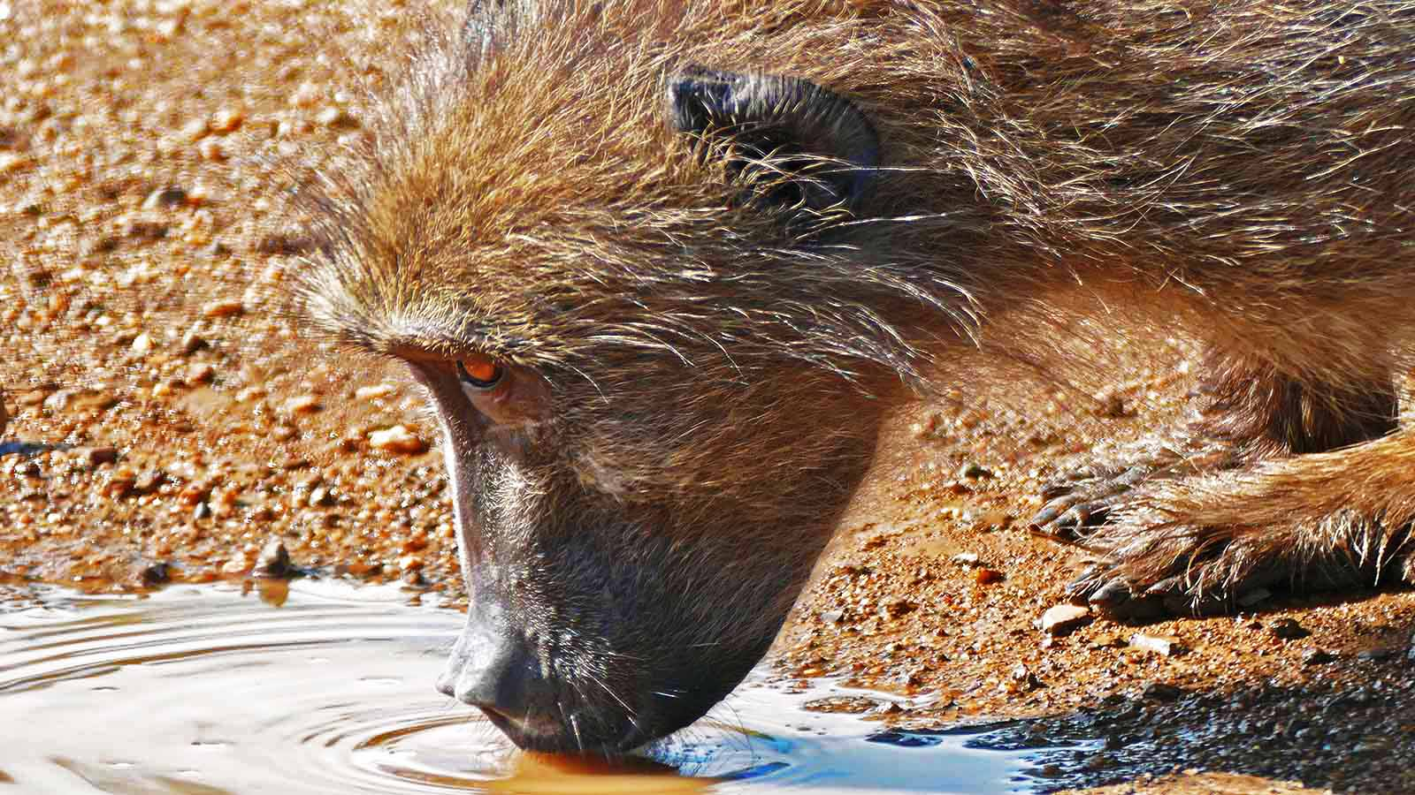
Photo © Bernard Dupont

Slide 26
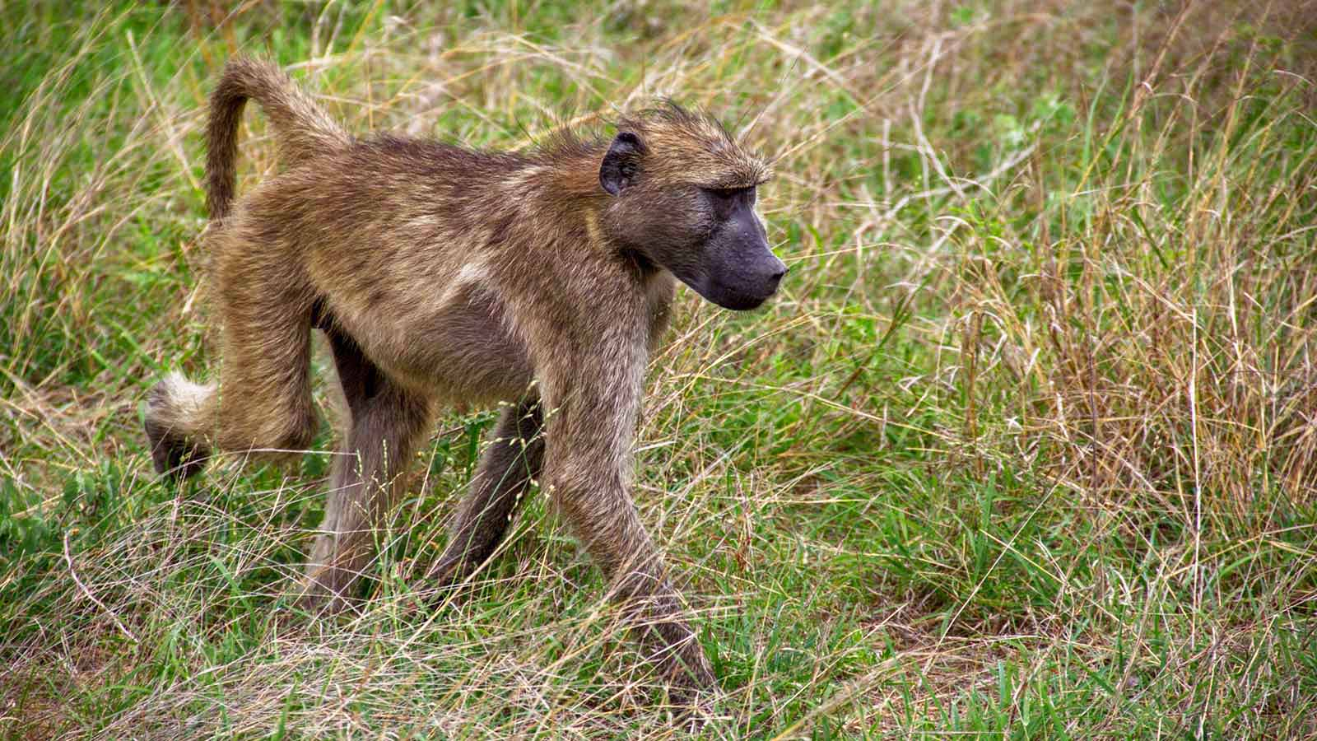
Photo © Hudec Ivan

Slide 27
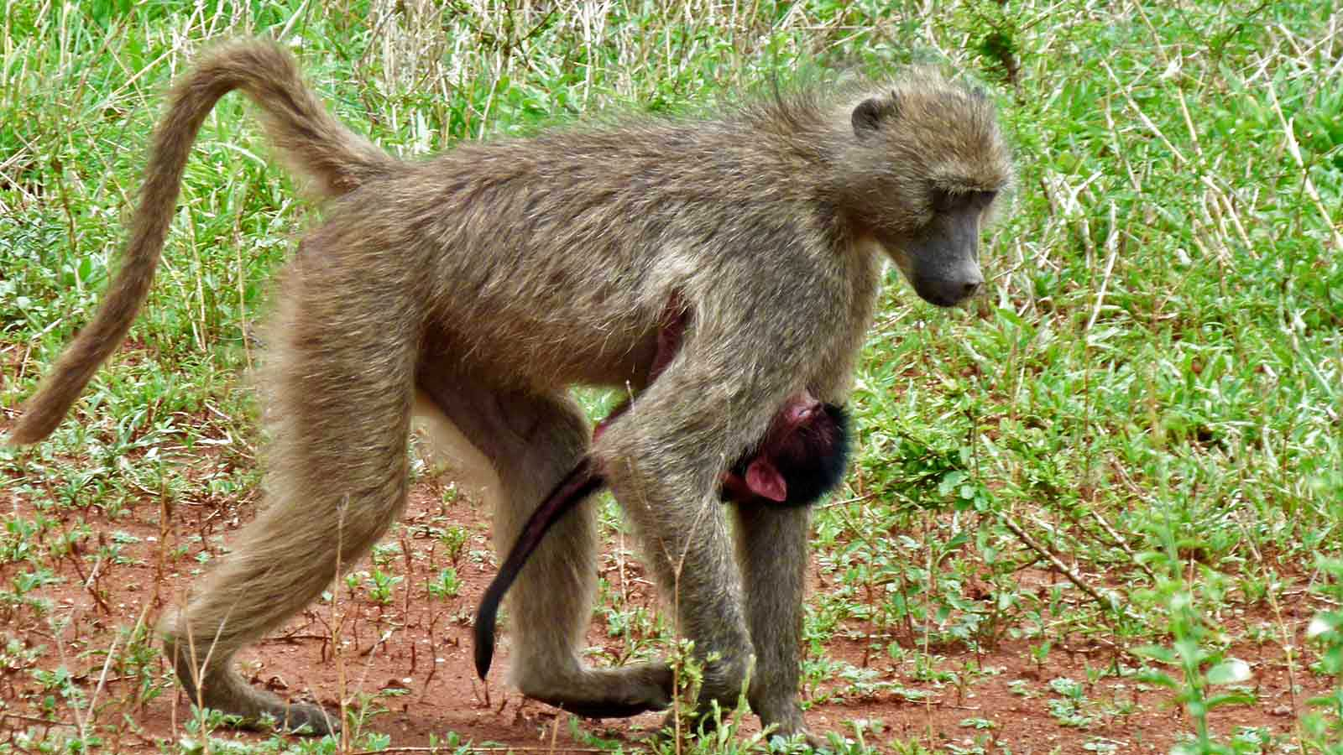
Photo © Bernard Dupont

Slide 28
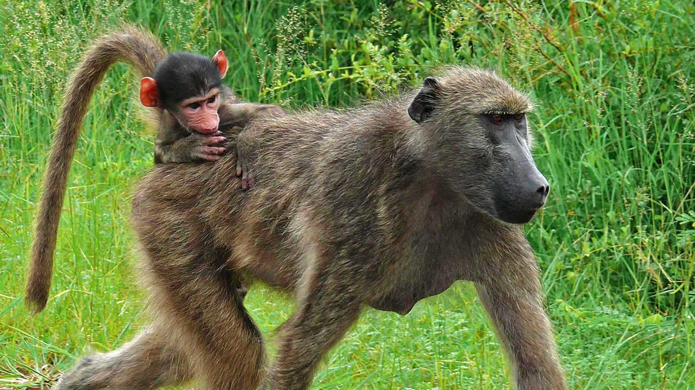
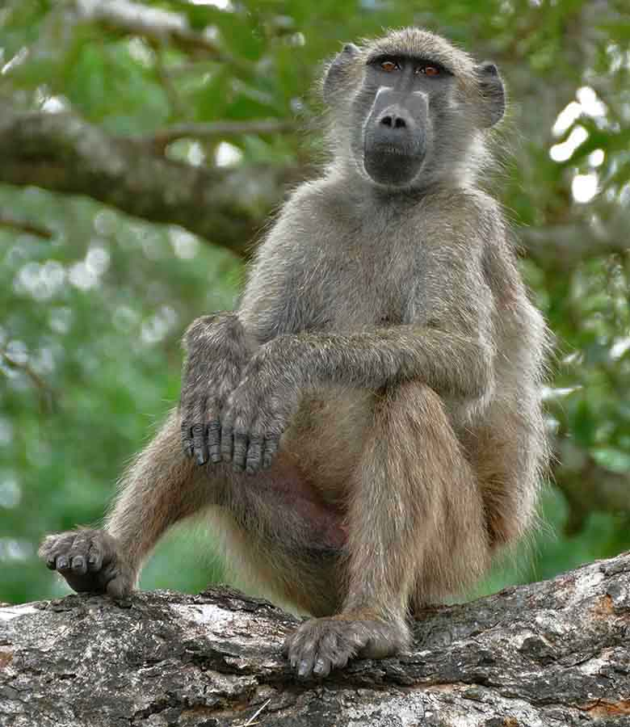
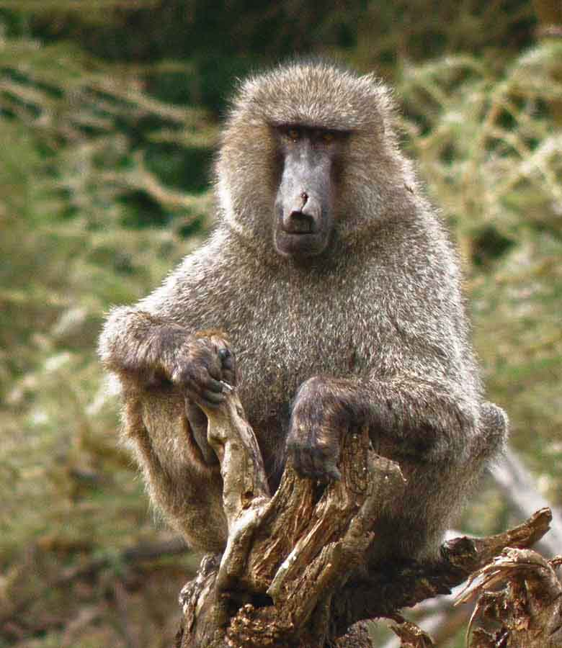
Photo © Bernard Dupont
Photo © Bernard Dupont
Photo © Hudec Ivan

Slide 29
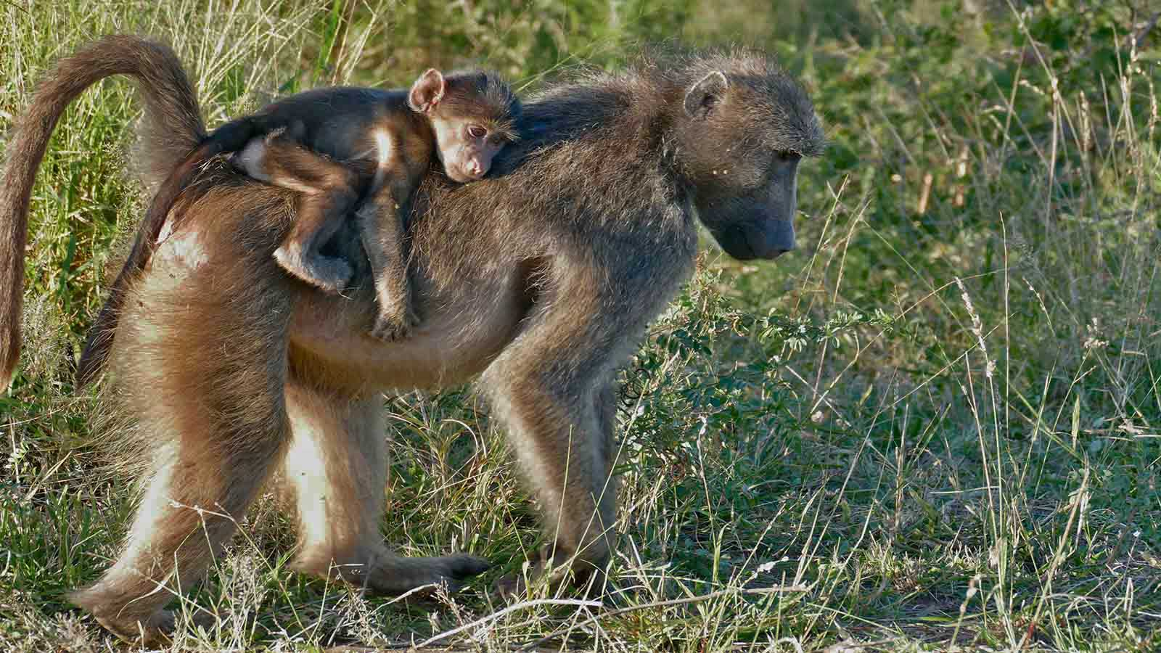
Photo © Bernard Dupont

Slide 30
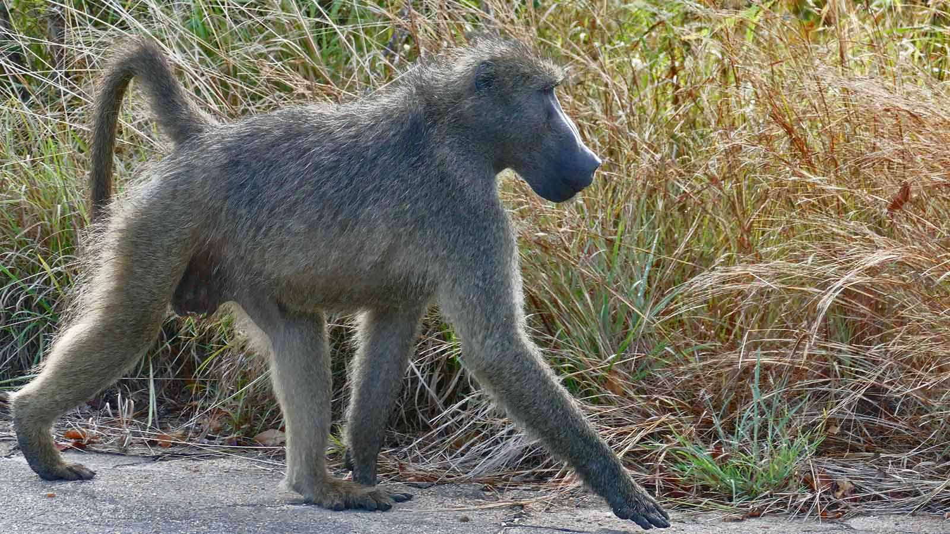
Photo © Bernard Dupont

Slide 31
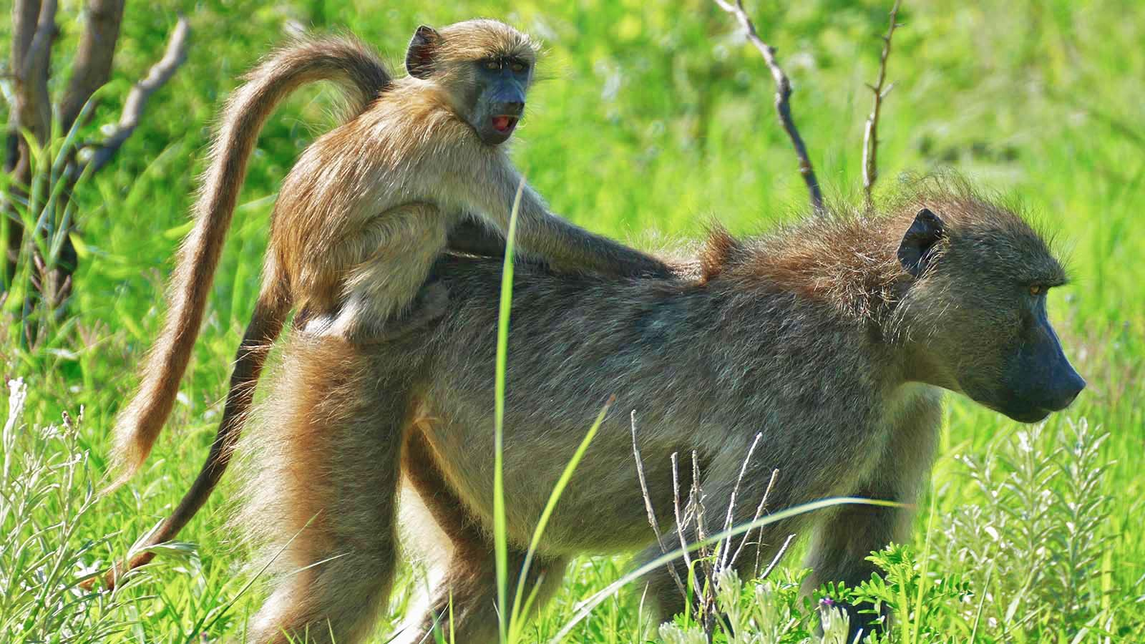
Photo © Bernard Dupont

Slide 32
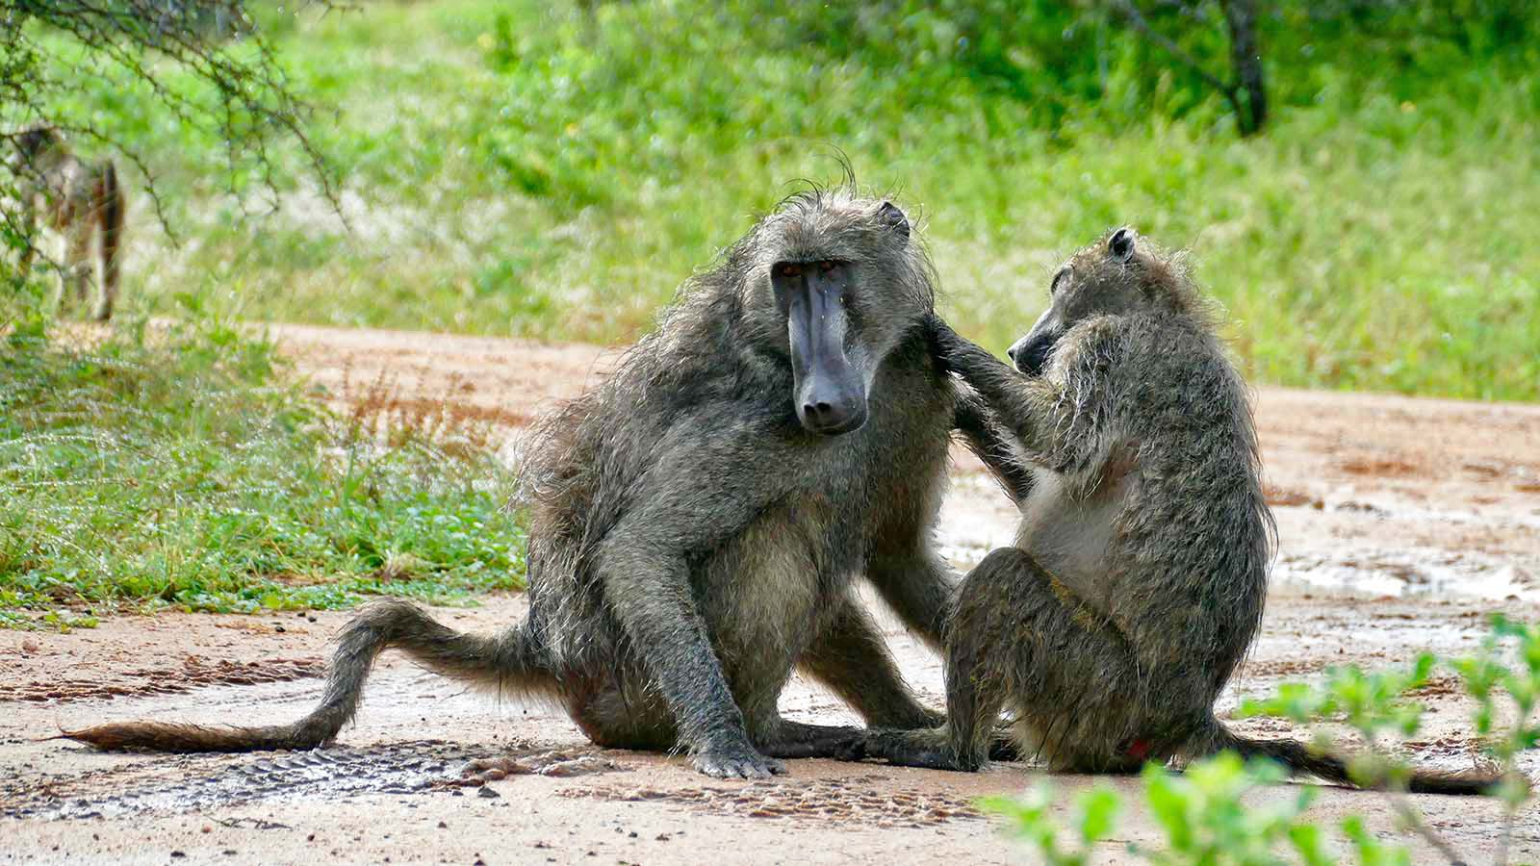
Photo © Bernard Dupont

Slide 33
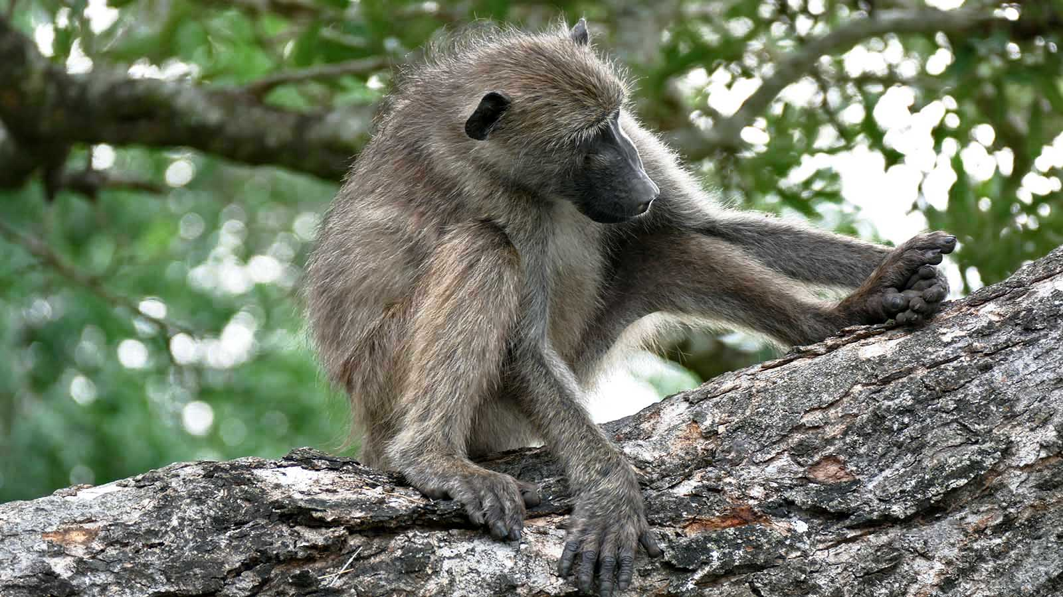
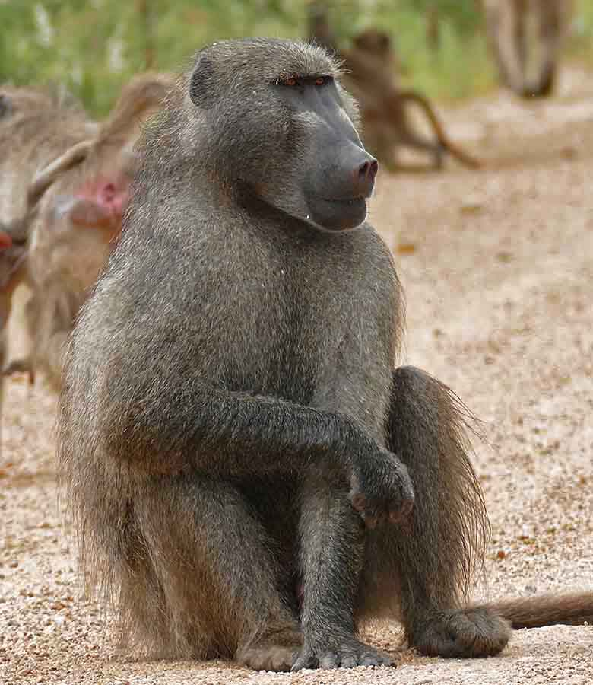
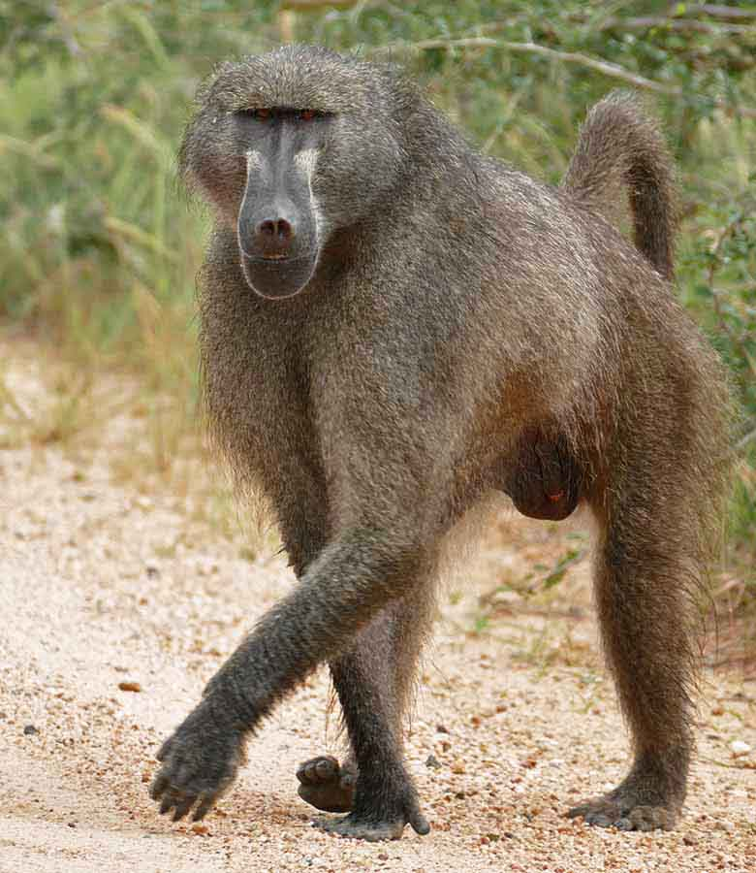
Photo © Bernard Dupont
Photo © Bernard Dupont
Photo © Bernard Dupont

Slide 34
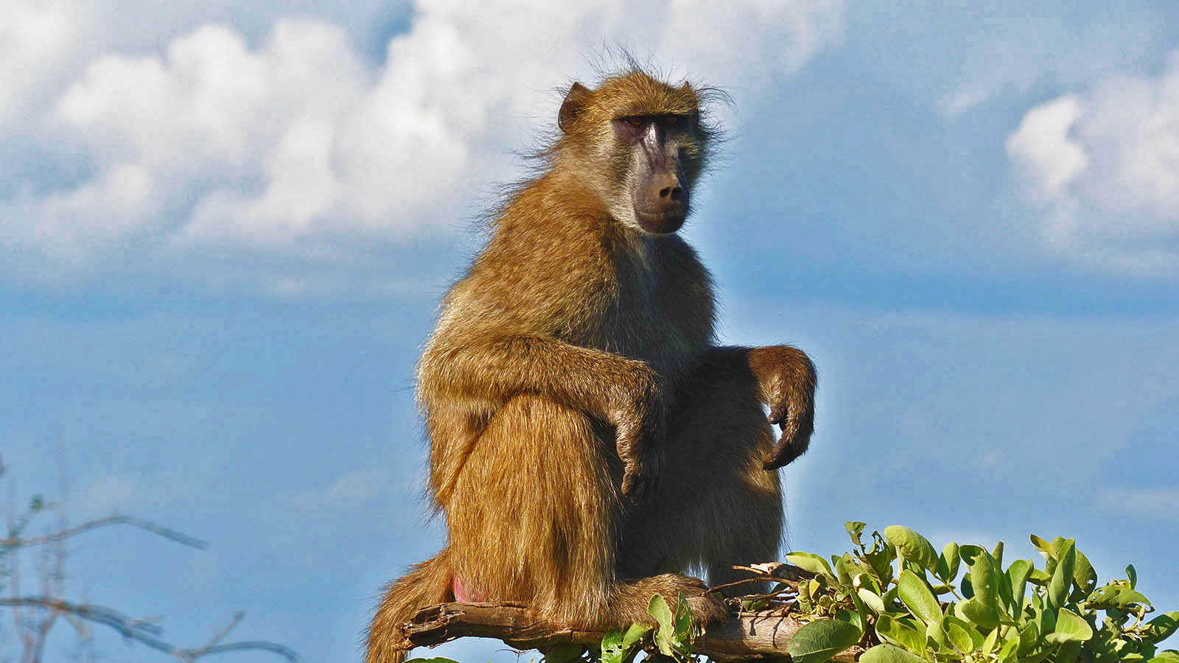
Photo © Bernard Dupont

Slide 35
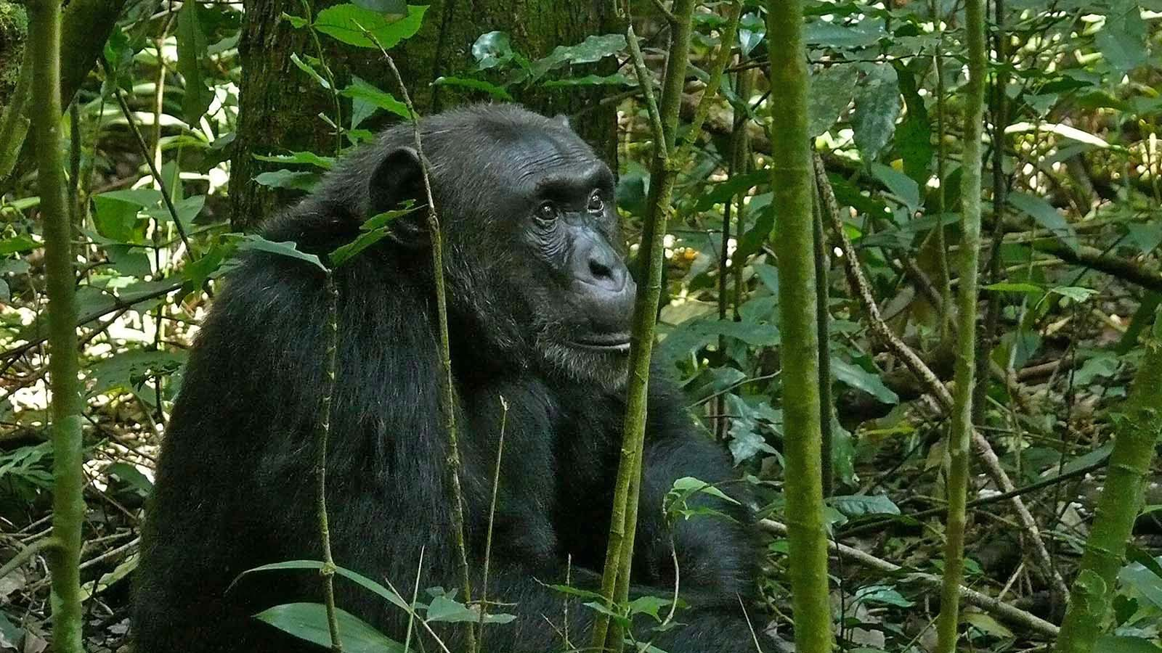
Photo © Bernard Dupont

Slide 36
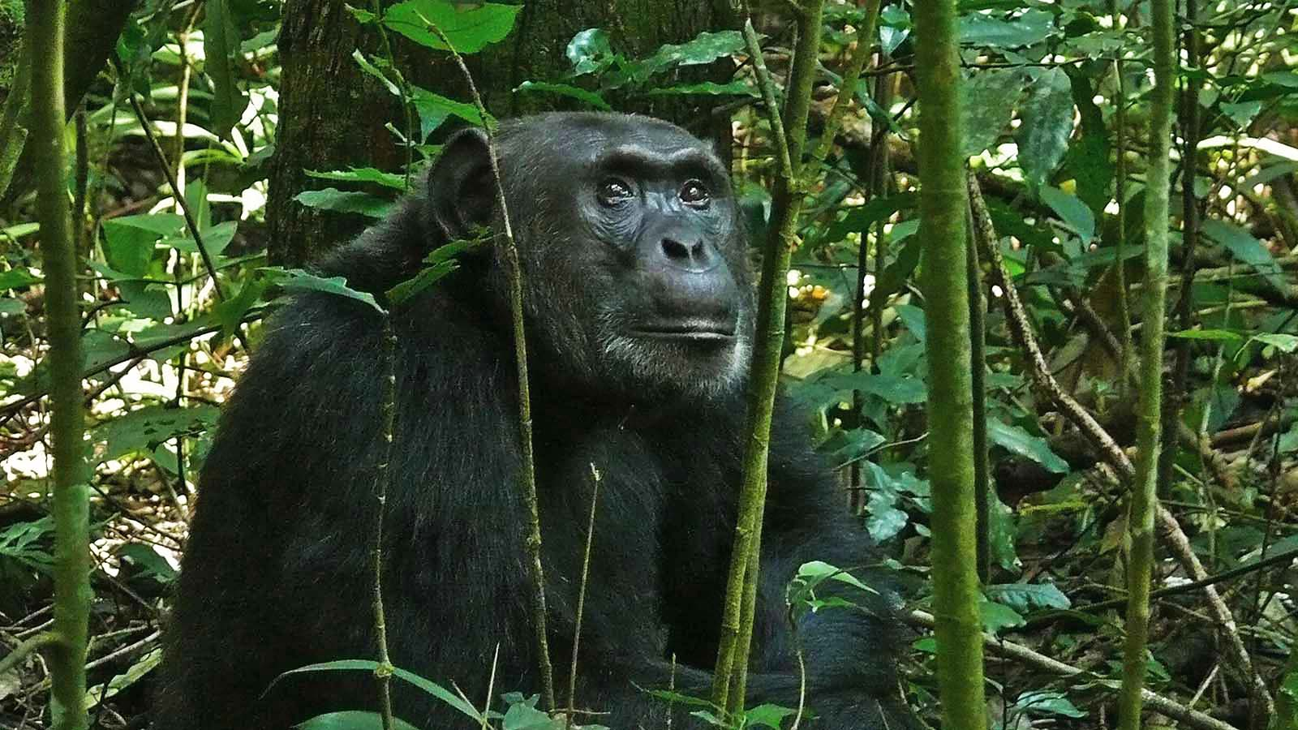
Photo © Bernard Dupont

Slide 37
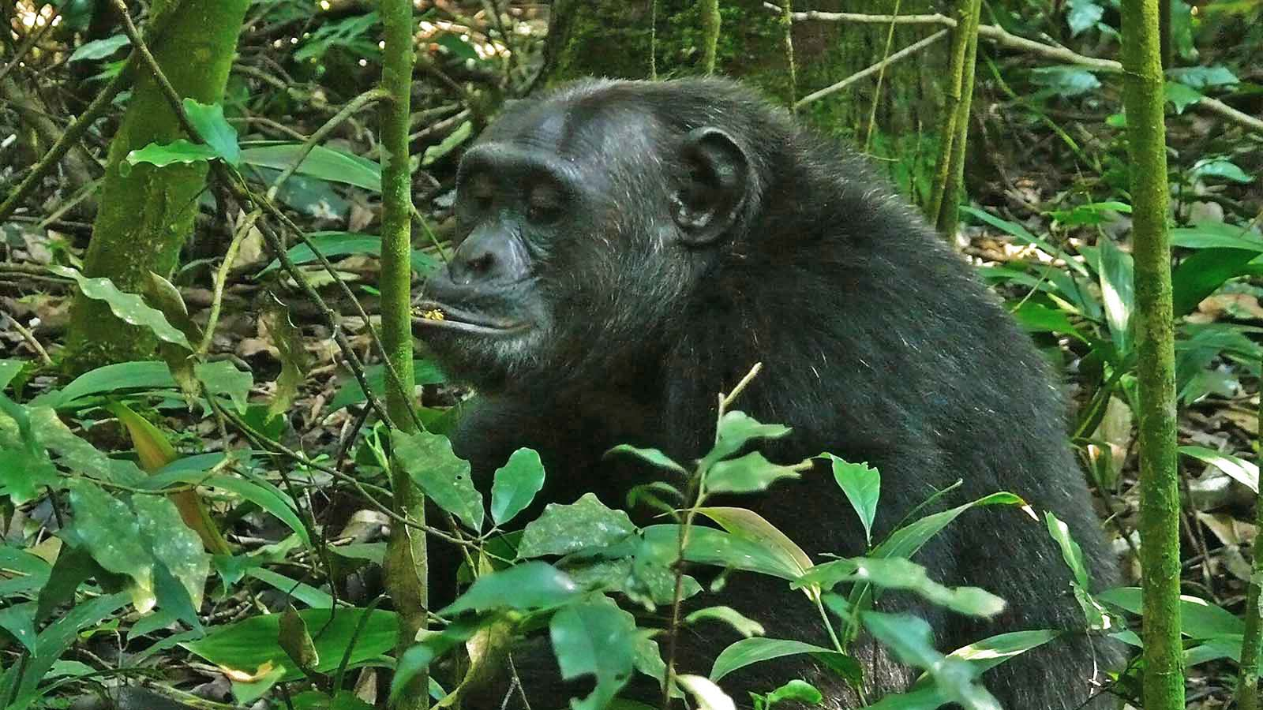
Photo © Bernard Dupont

Slide 38

2022
Music : Giddes Chalamanda - Linny Hoo
Photos : Bernard Dupont (France)
Thanks to all photo owners for the cooperation.
Created by : Rumpler Štefan (Slovakia)
Contact: pista2011@gmail.com

Slide 39

Ți-a plăcut prezentarea mea?
Trimite-mi un email. Iti voi trimite inca una.
Gratuit desigur!
Did you like my presentation?
Email me. I will send you another one.
Free of charge!
¿Te gustó mi presentación?
Envíeme un e-mail. Te enviaré otro.
¡Gratis por supuesto!
Tetszett a PPS-diaporámám?
Jelentkezz. Küldök egy uj PPS-t.
Természetesen ingyen!
Páčila sa Vám moja prezentácia?
Napíšte mi. Pošlem Vám ďalšiu.
Samozrejme zadarmo!
Gostou da minha apresentação?
Me mande um e-mail. Vou te enviar outro.
Claro, grátis!
Ti è piaciuta la mia presentazione?
Mandami un'email. Te ne manderò un altro.
Ovviamente gratis!
Hat Ihnen mein Vortrag gefallen?
Maile mir. Ich schicke dir noch eins.
Natürlich kostenlos!
Avez-vous aimé ma présentation?
Envoyez moi un email. Je t'en enverrai un autre.
Gratuit bien sûr!
pista2011@gmail.com

Slide 40







¿Te ha gustado?
Puedes ver más entrando
Aquí
Además puedes recibir powerpoints en tu correo electrónico suscribiéndote aquí:

