Slide 1



Wildlife
12
Of africa
Leopard

Slide 2
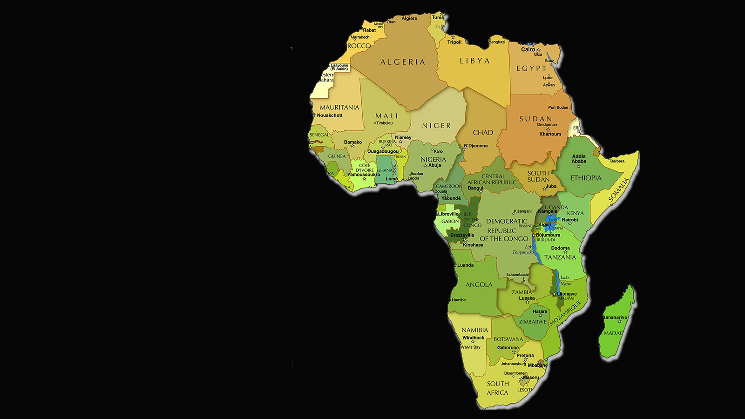

Wildlife
of Africa

Slide 3
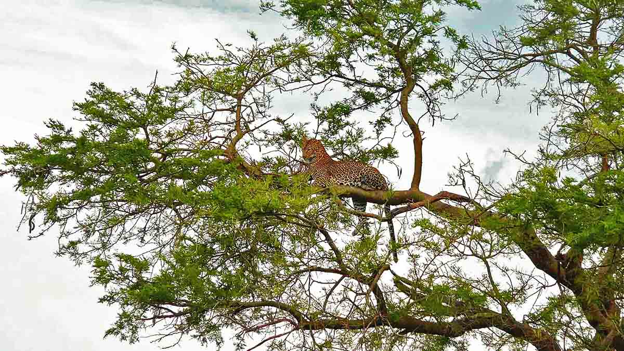

Photo © Bernard Dupont

Slide 4
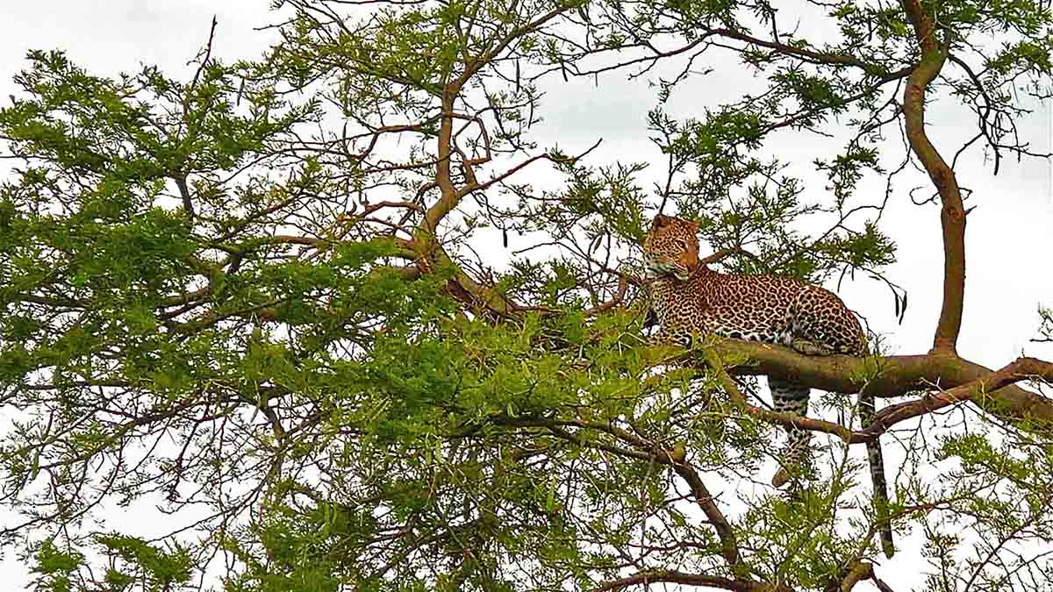

Photo © Bernard Dupont

Slide 5
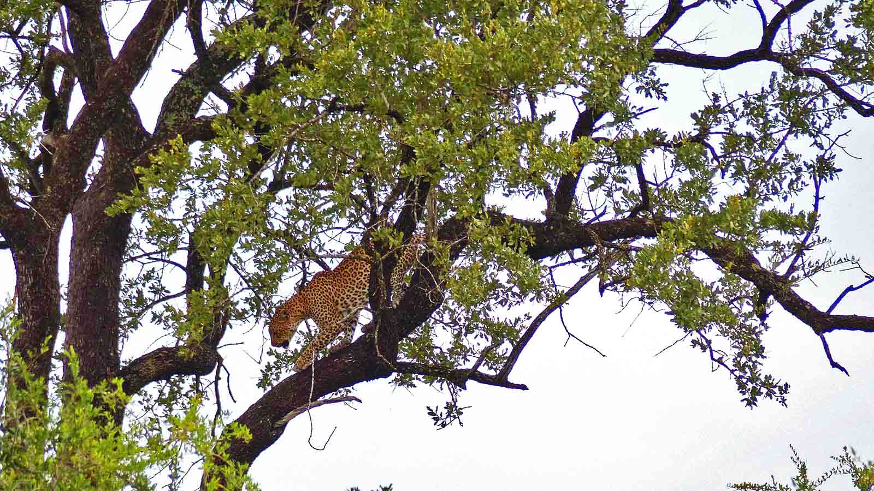
Photo © Bernard Dupont

Slide 6

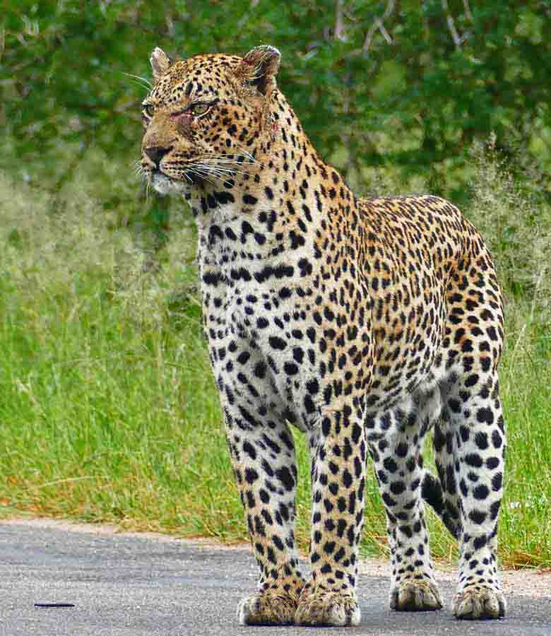
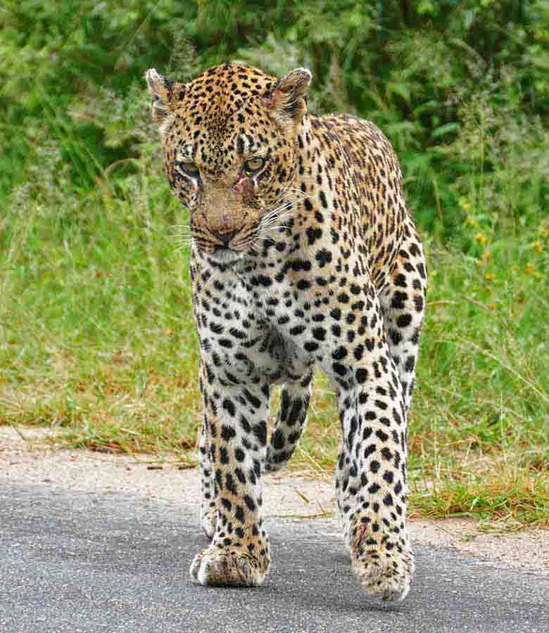
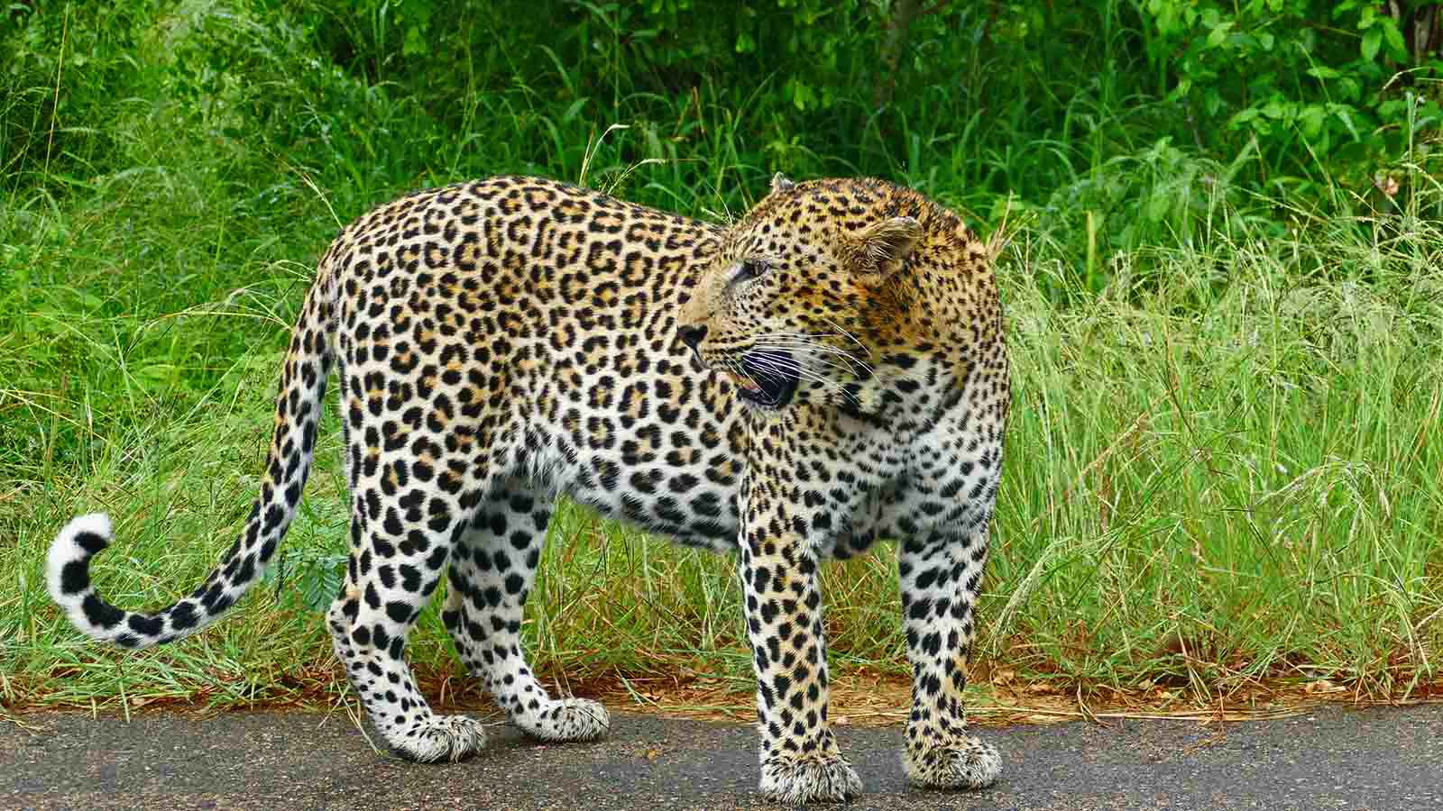
Photo © Bernard Dupont
Photo © Bernard Dupont
Photo © Bernard Dupont

Slide 7
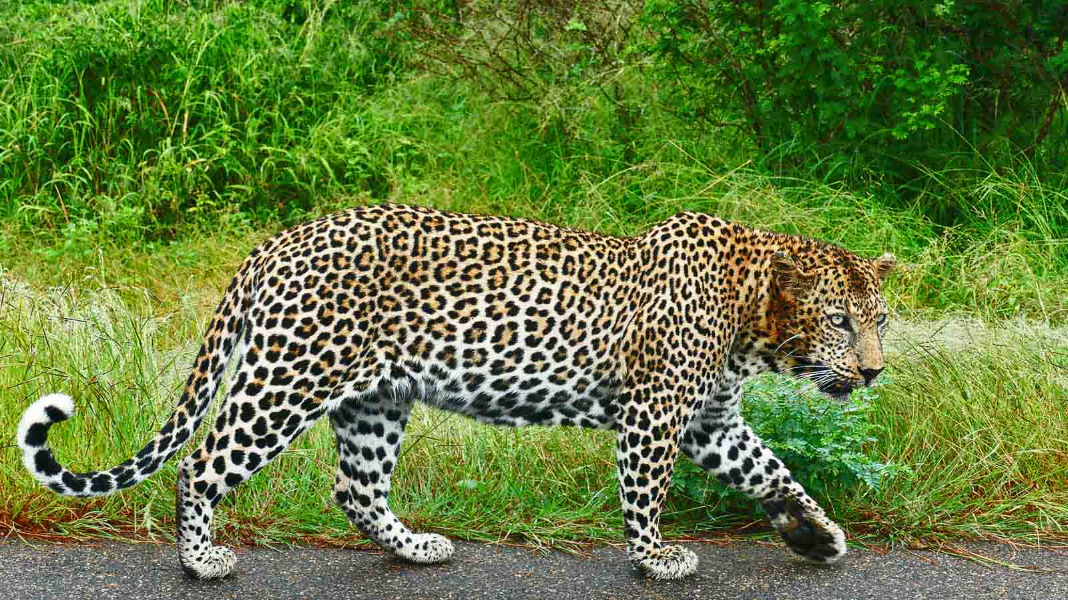
Photo © Bernard Dupont

Slide 8
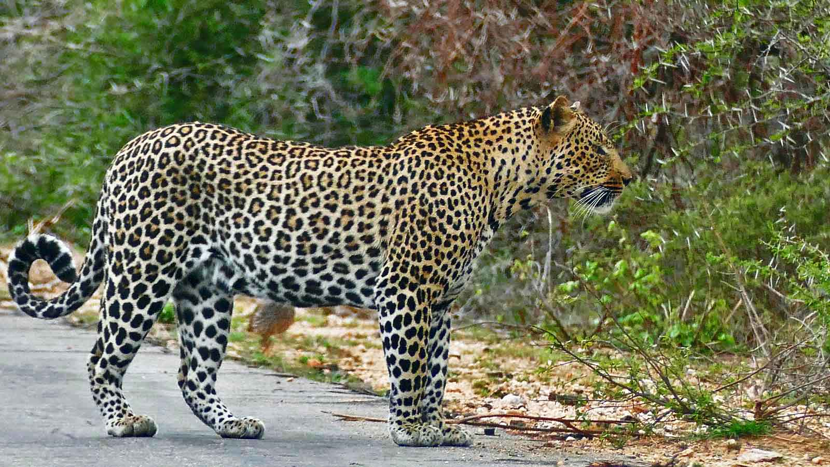
Photo © Bernard Dupont

Slide 9
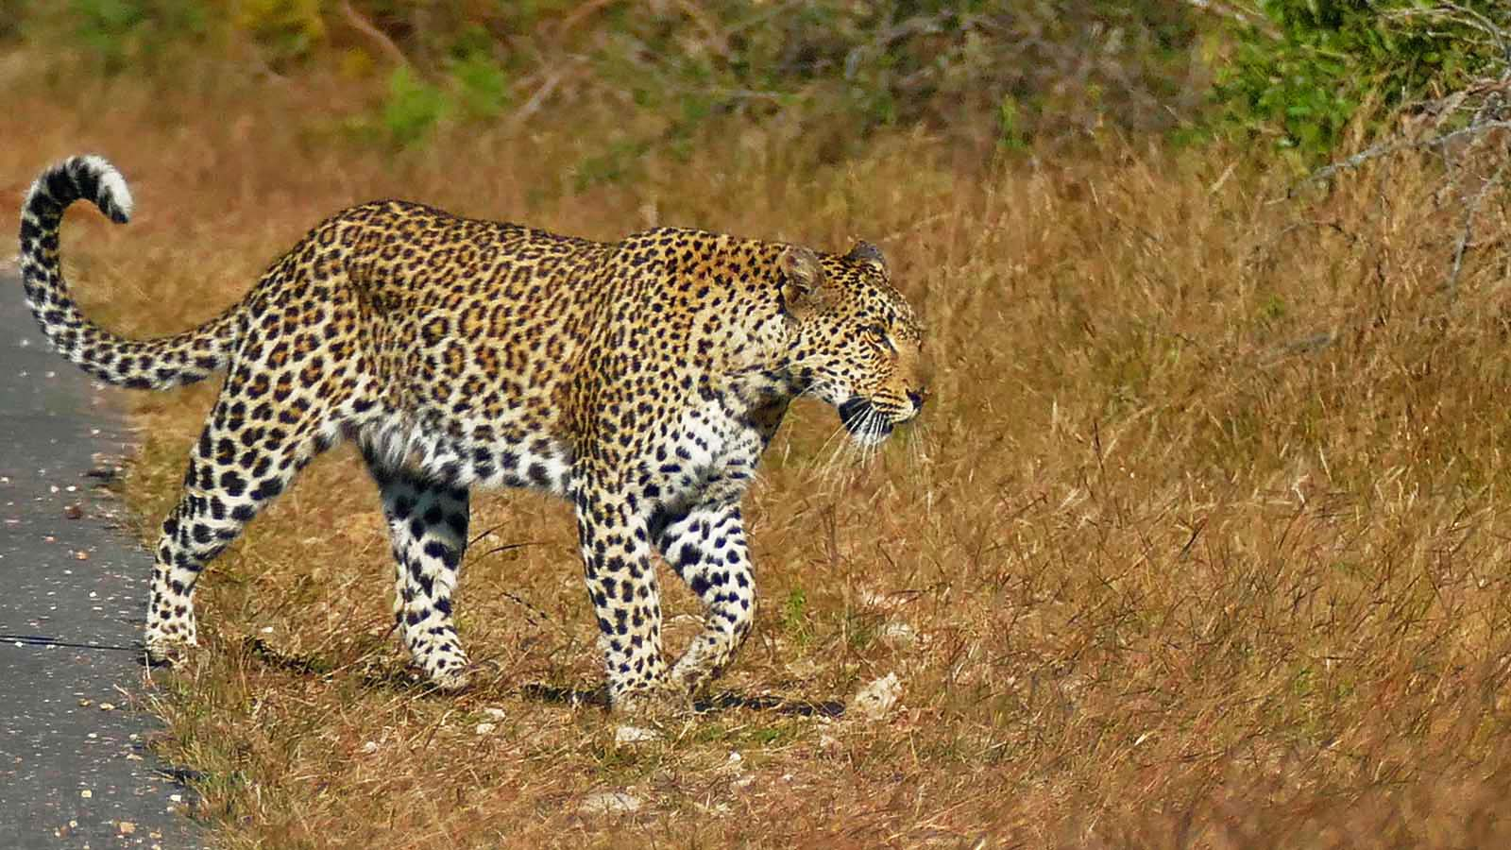
Photo © Bernard Dupont

Slide 10
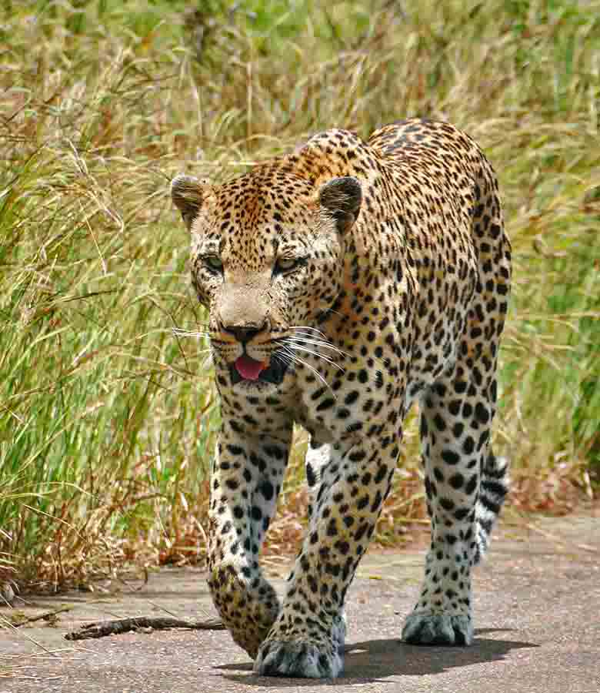
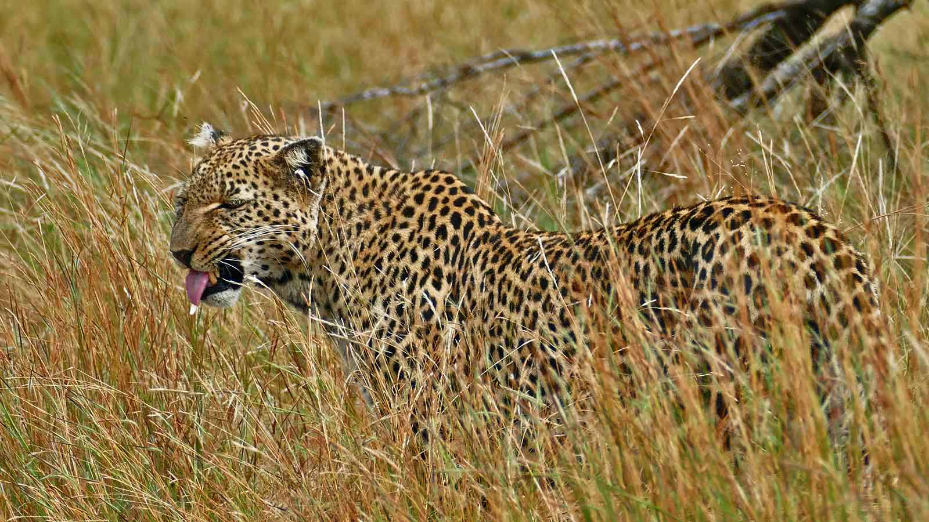
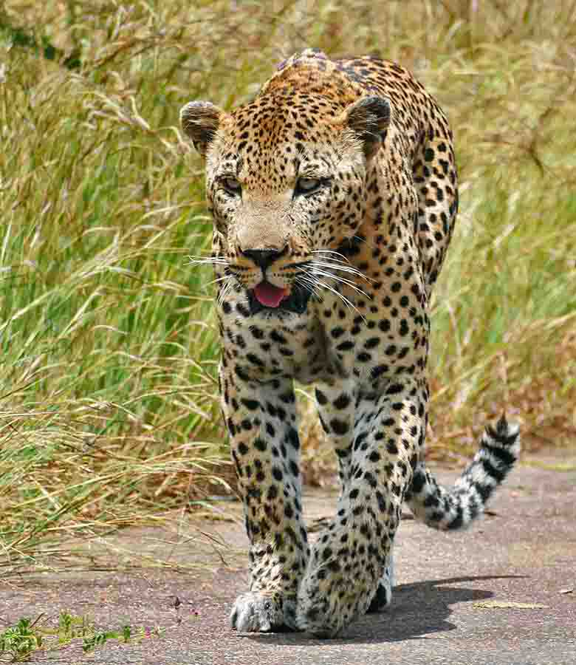
Photo © Bernard Dupont
Photo © Bernard Dupont
Photo © Bernard Dupont

Slide 11
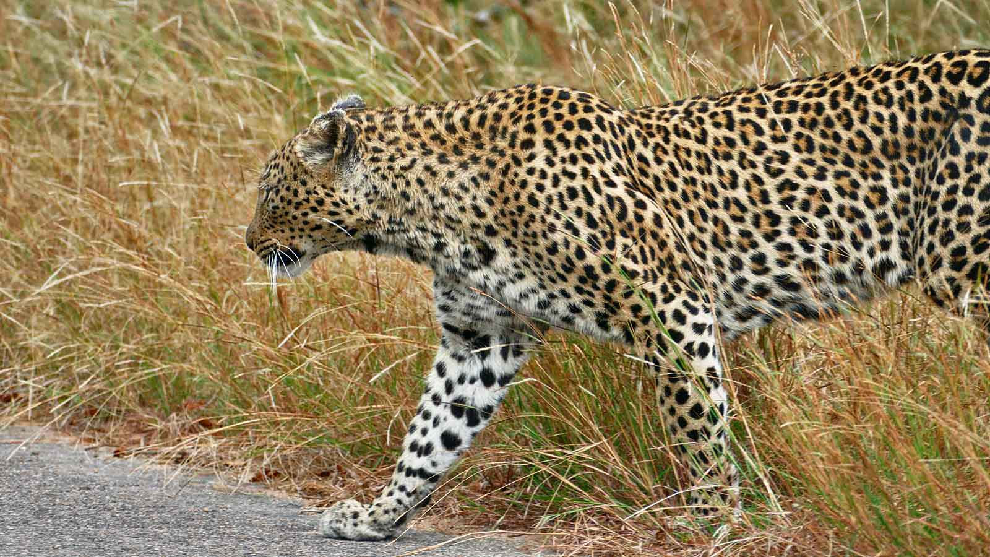
Photo © Bernard Dupont

Slide 12
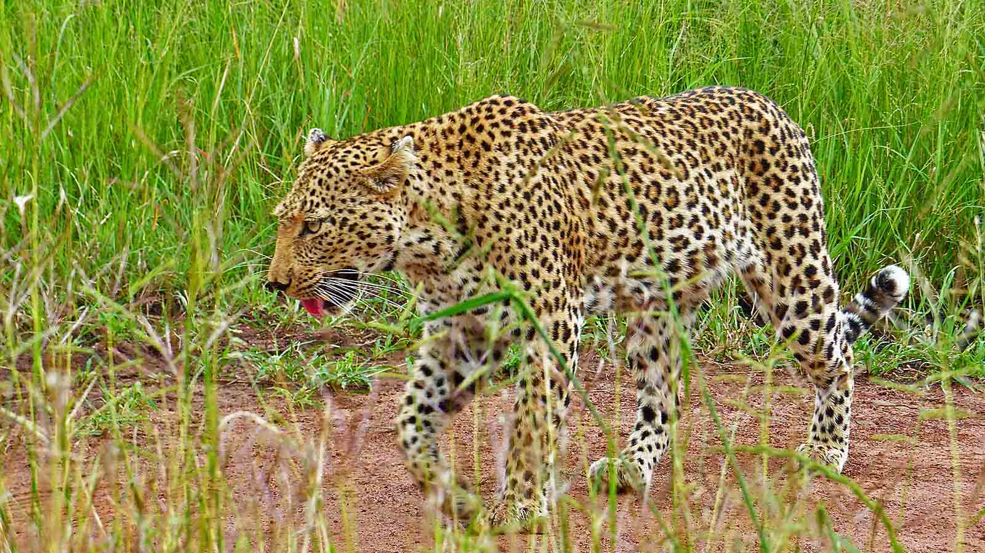
Photo © Bernard Dupont

Slide 13
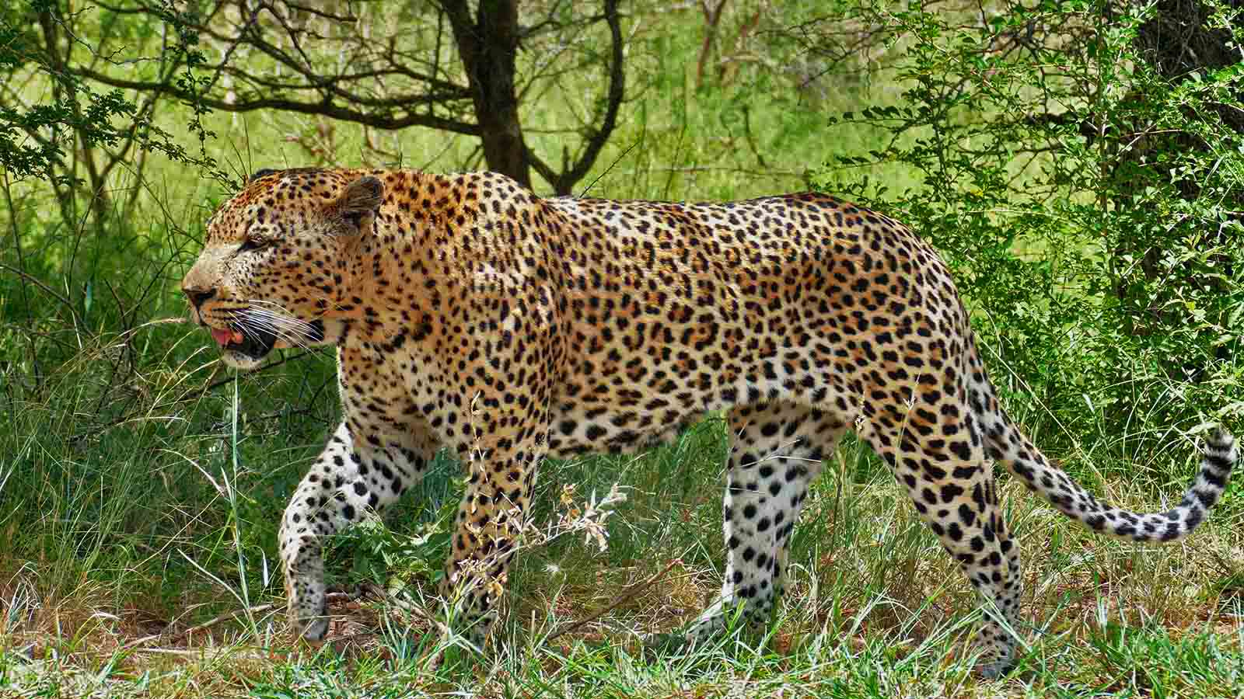
Photo © Bernard Dupont

Slide 14
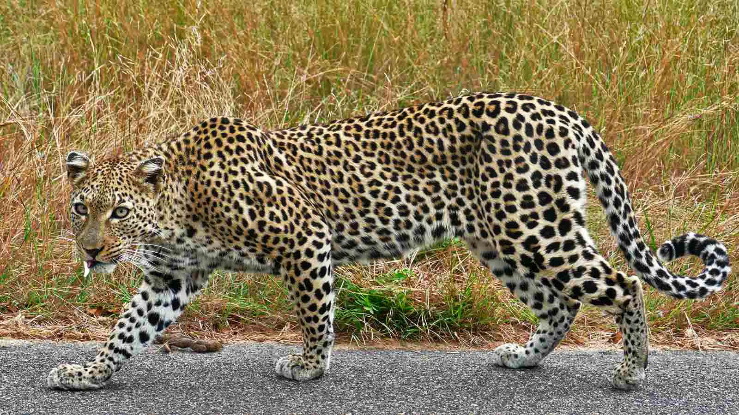
Photo © Bernard Dupont

Slide 15
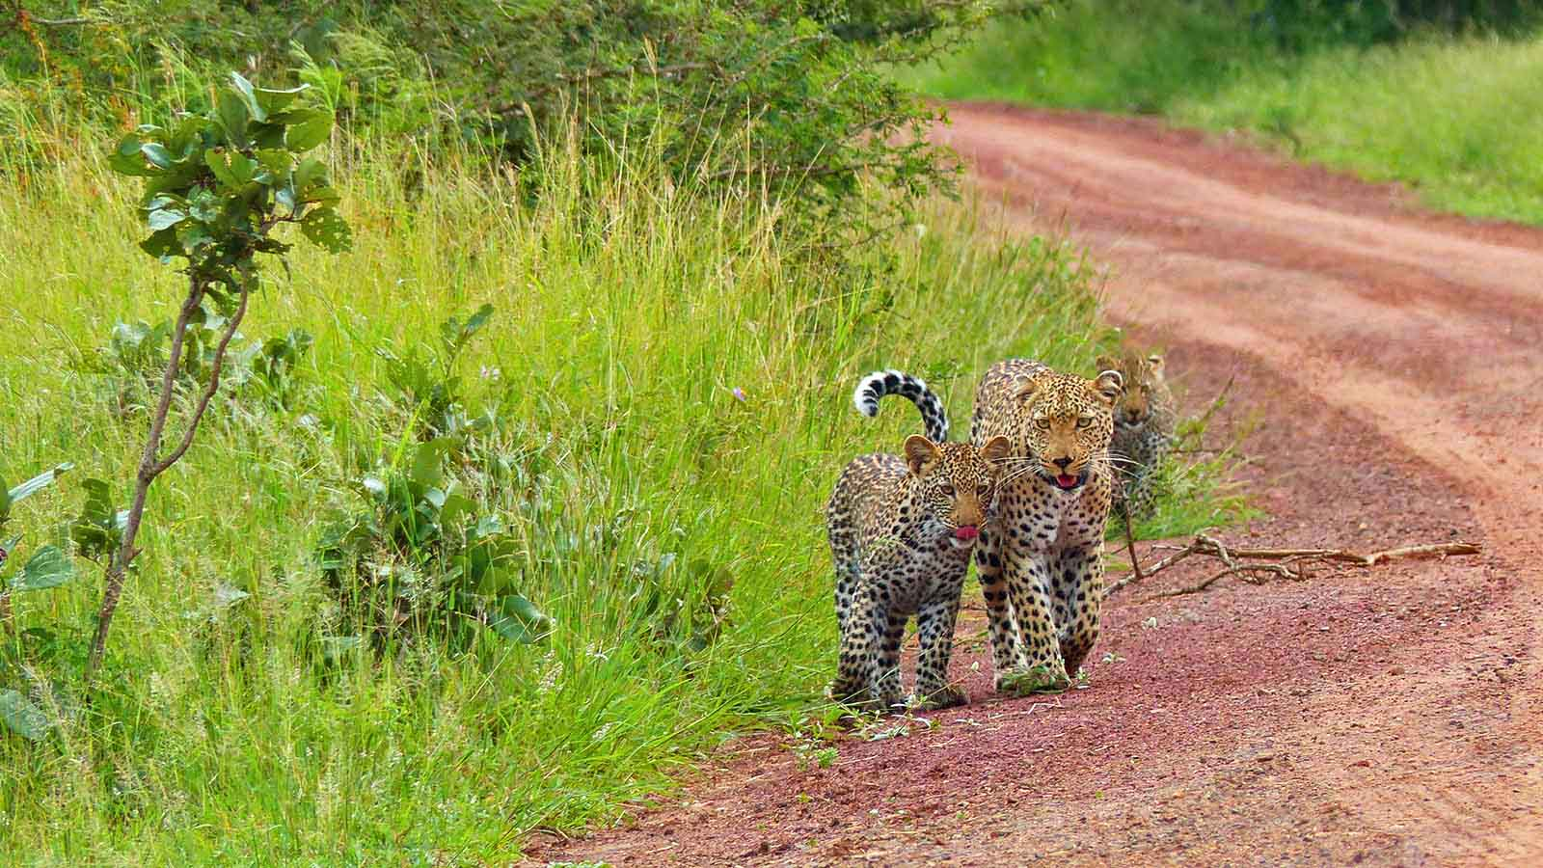
Photo © Bernard Dupont

Slide 16
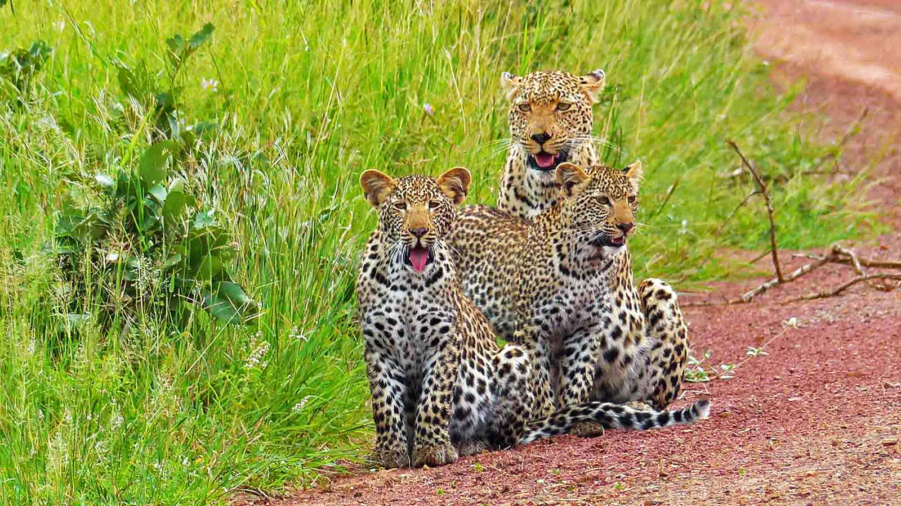
Photo © Bernard Dupont

Slide 17
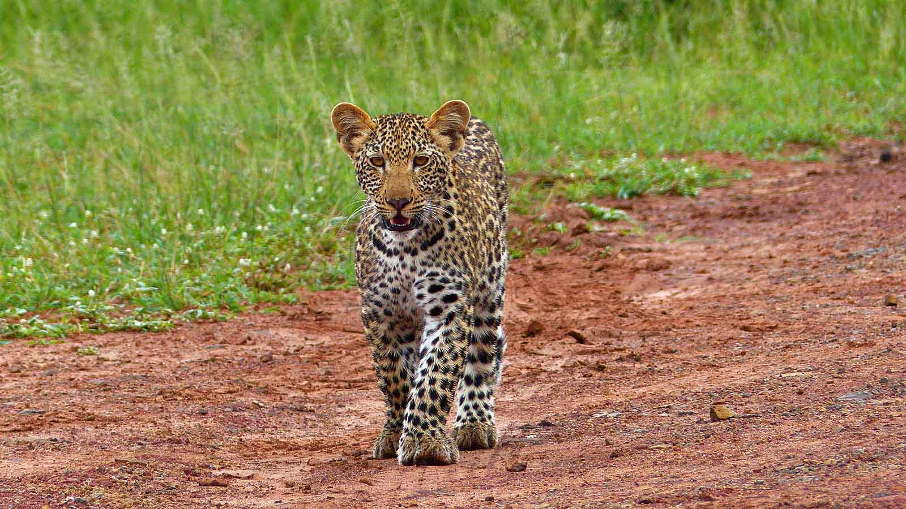
Photo © Bernard Dupont

Slide 18
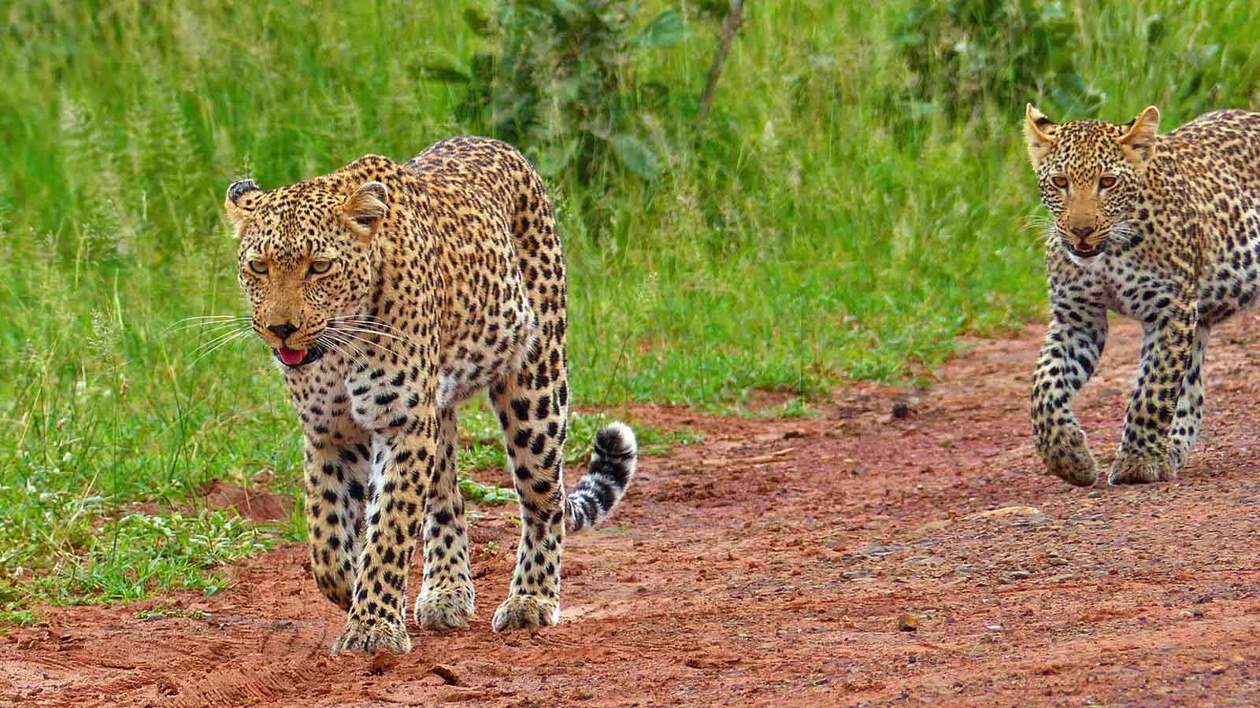
Photo © Bernard Dupont

Slide 19
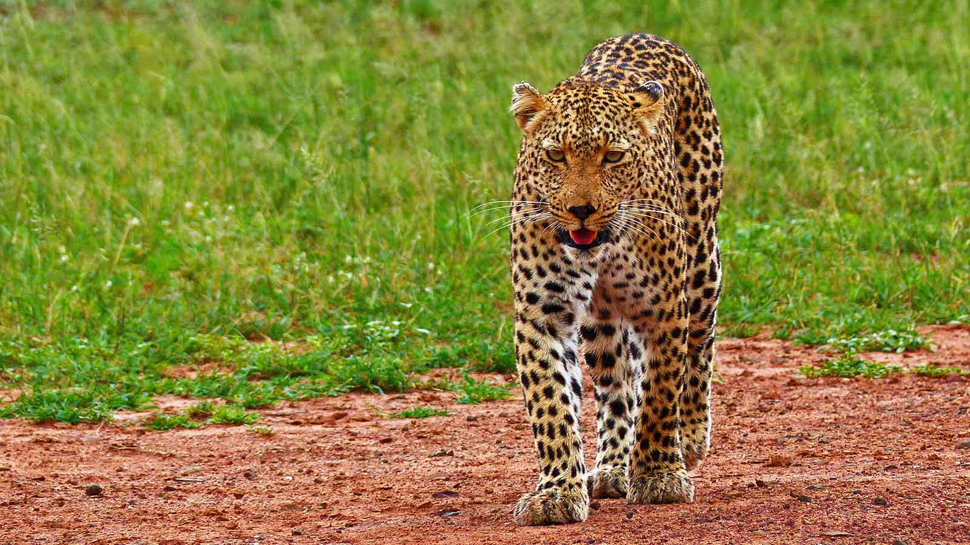
Photo © Bernard Dupont

Slide 20
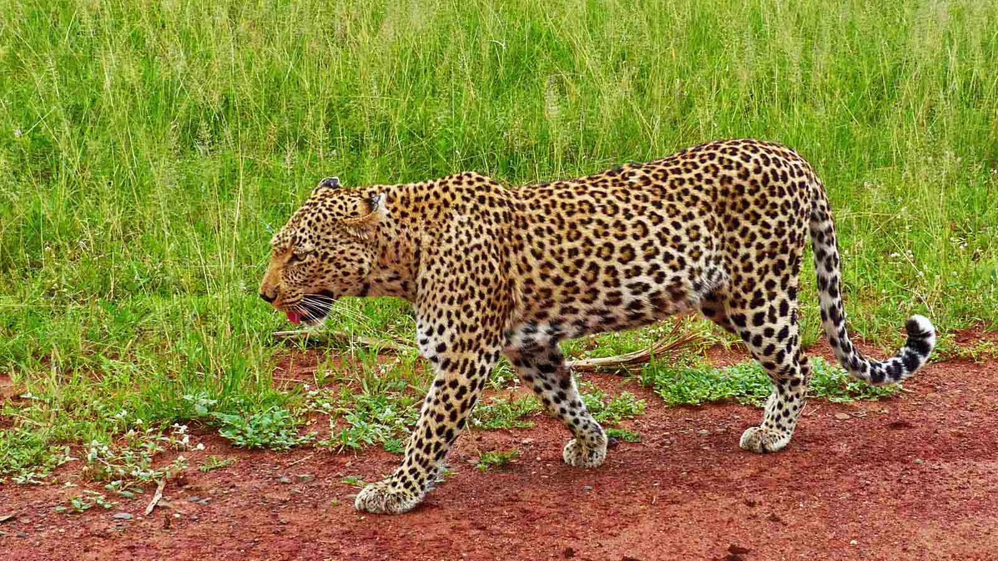
Photo © Bernard Dupont

Slide 21
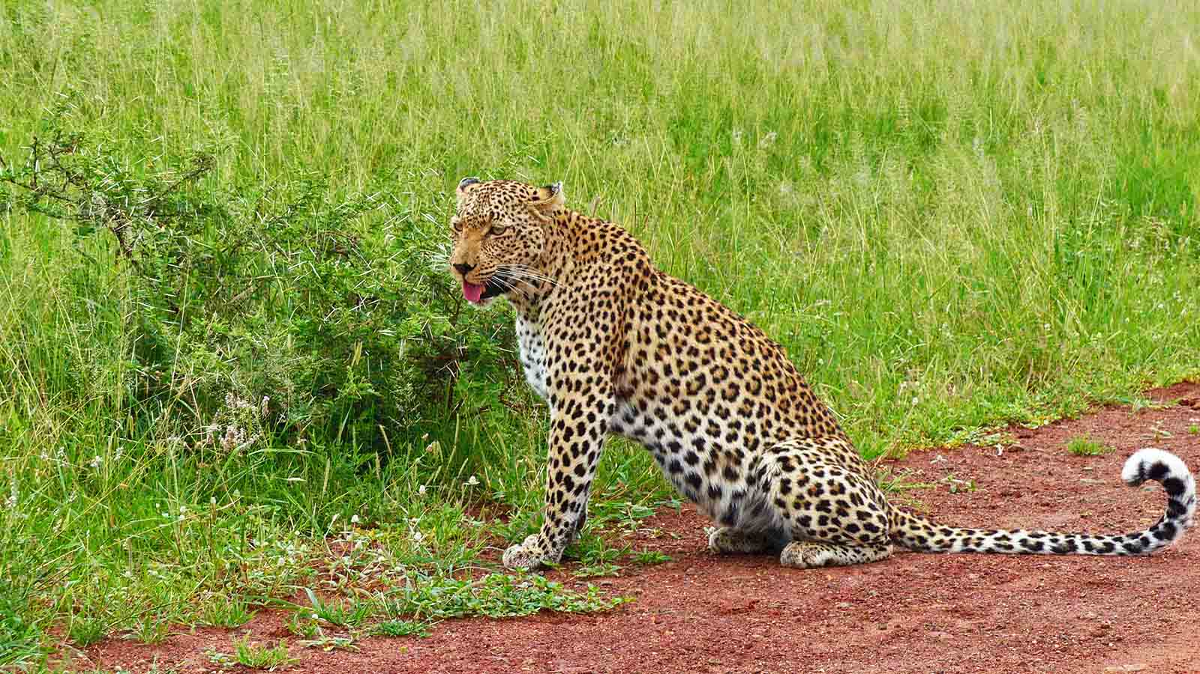
Photo © Bernard Dupont

Slide 22
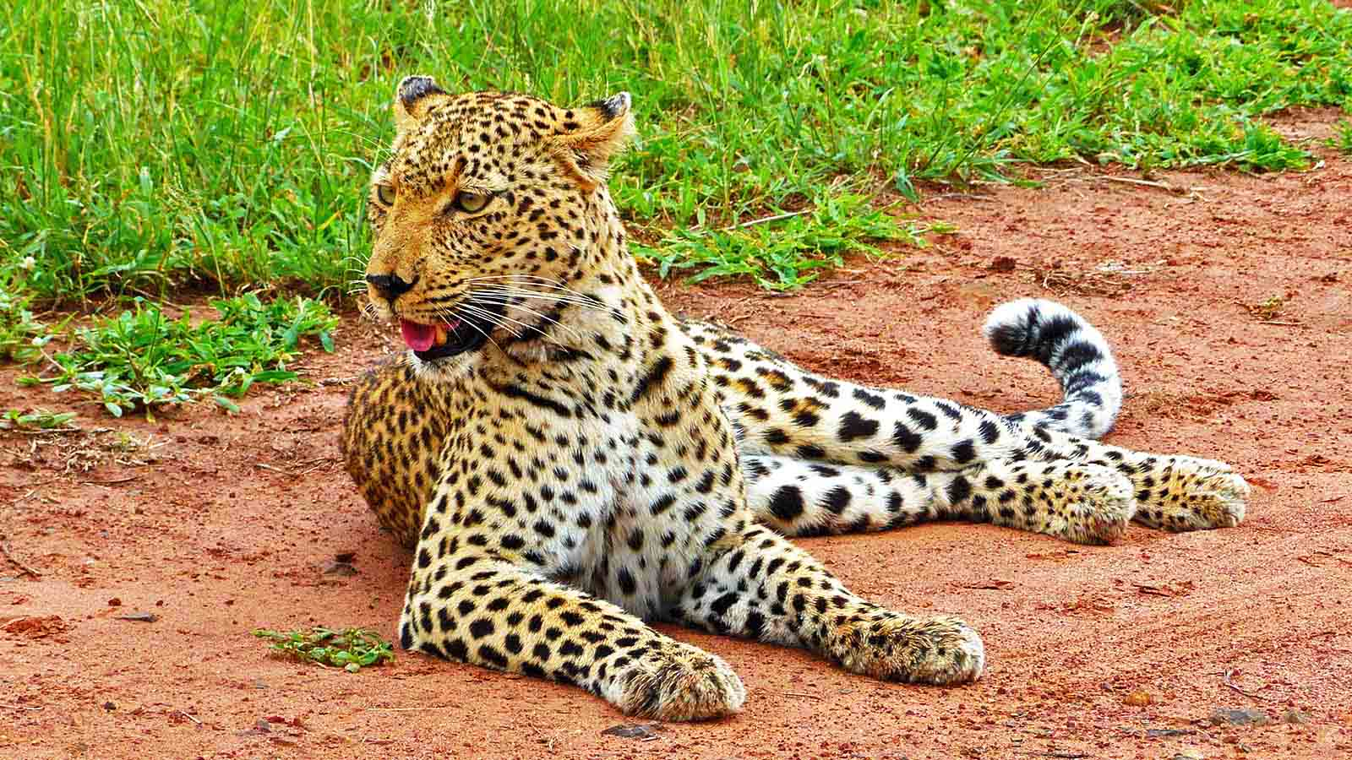
Photo © Bernard Dupont

Slide 23
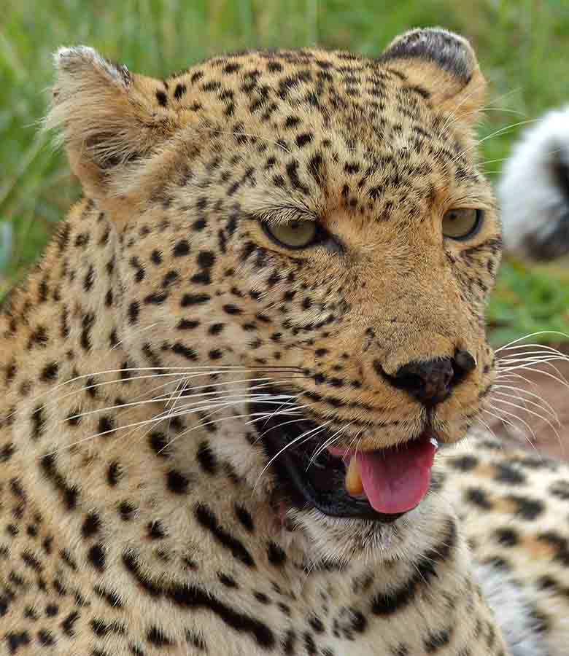
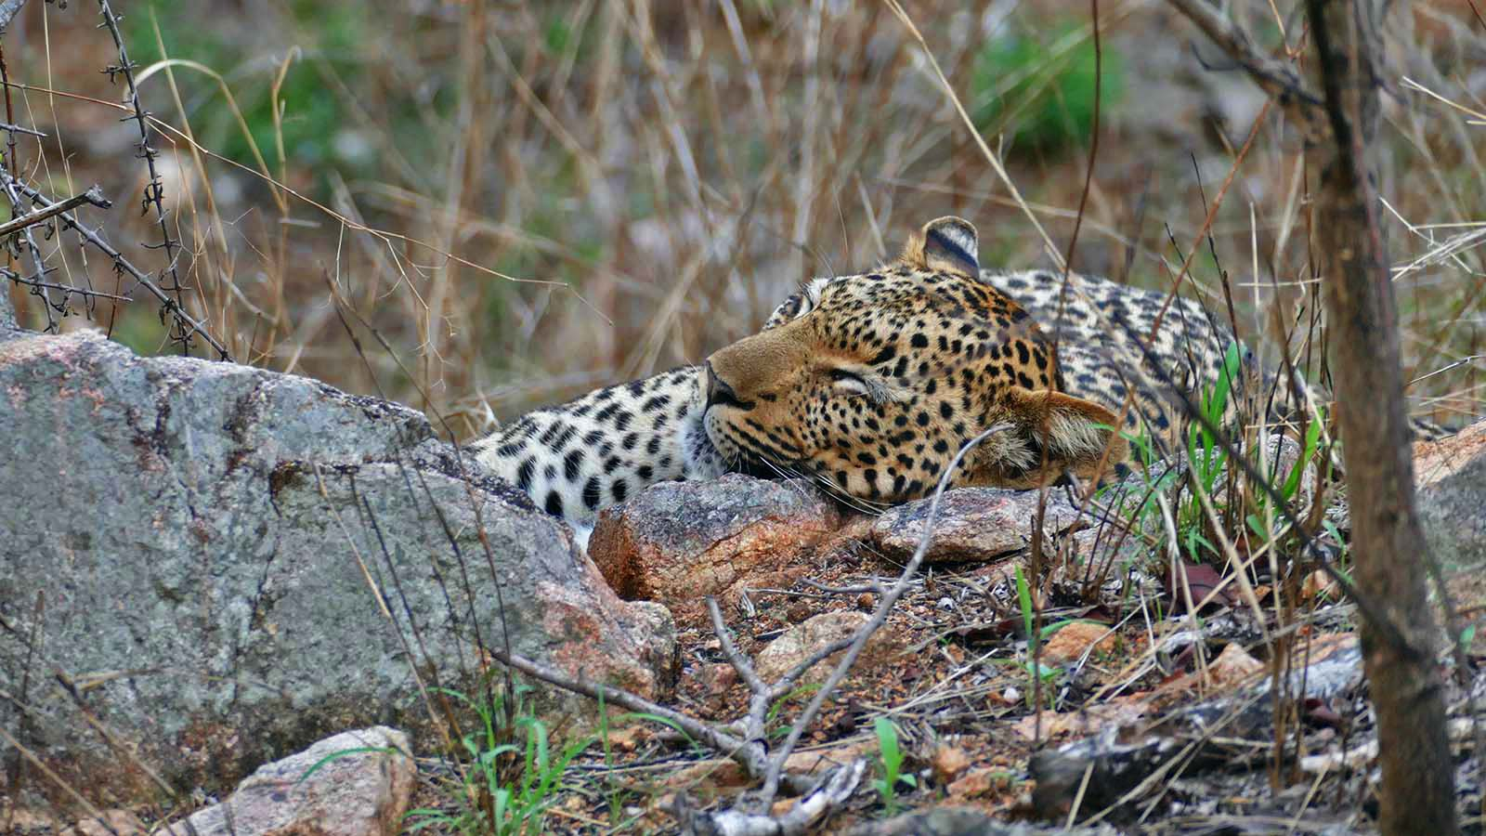
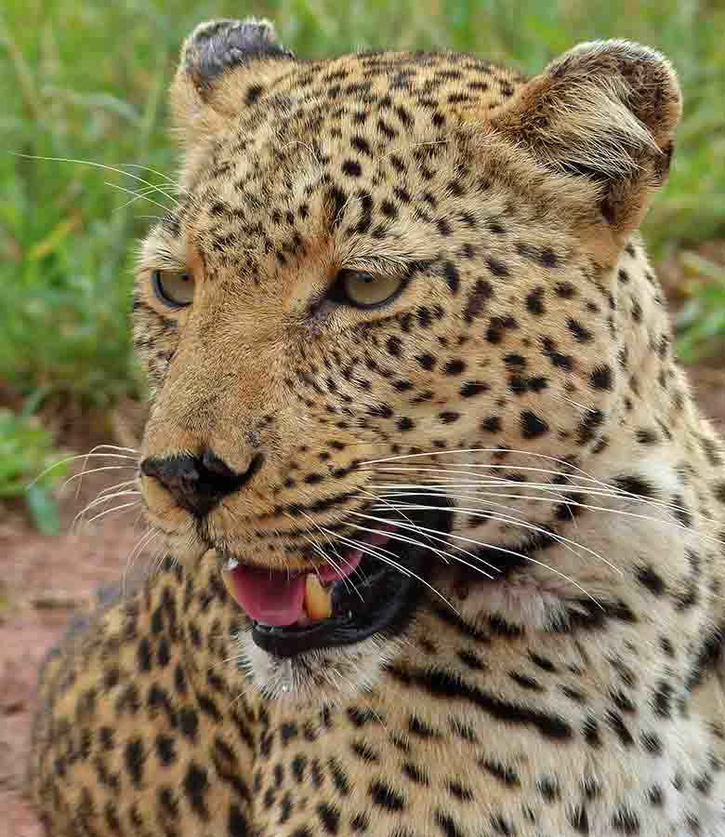
Photo © Bernard Dupont
Photo © Bernard Dupont
Photo © Bernard Dupont

Slide 24
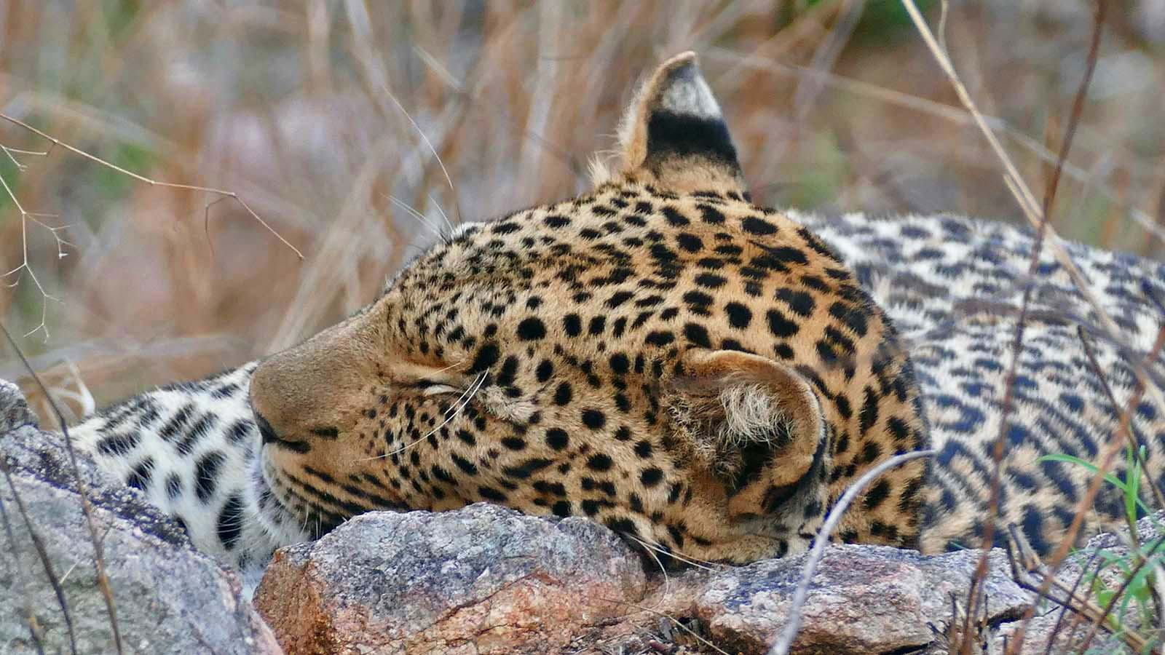
Photo © Bernard Dupont

Slide 25
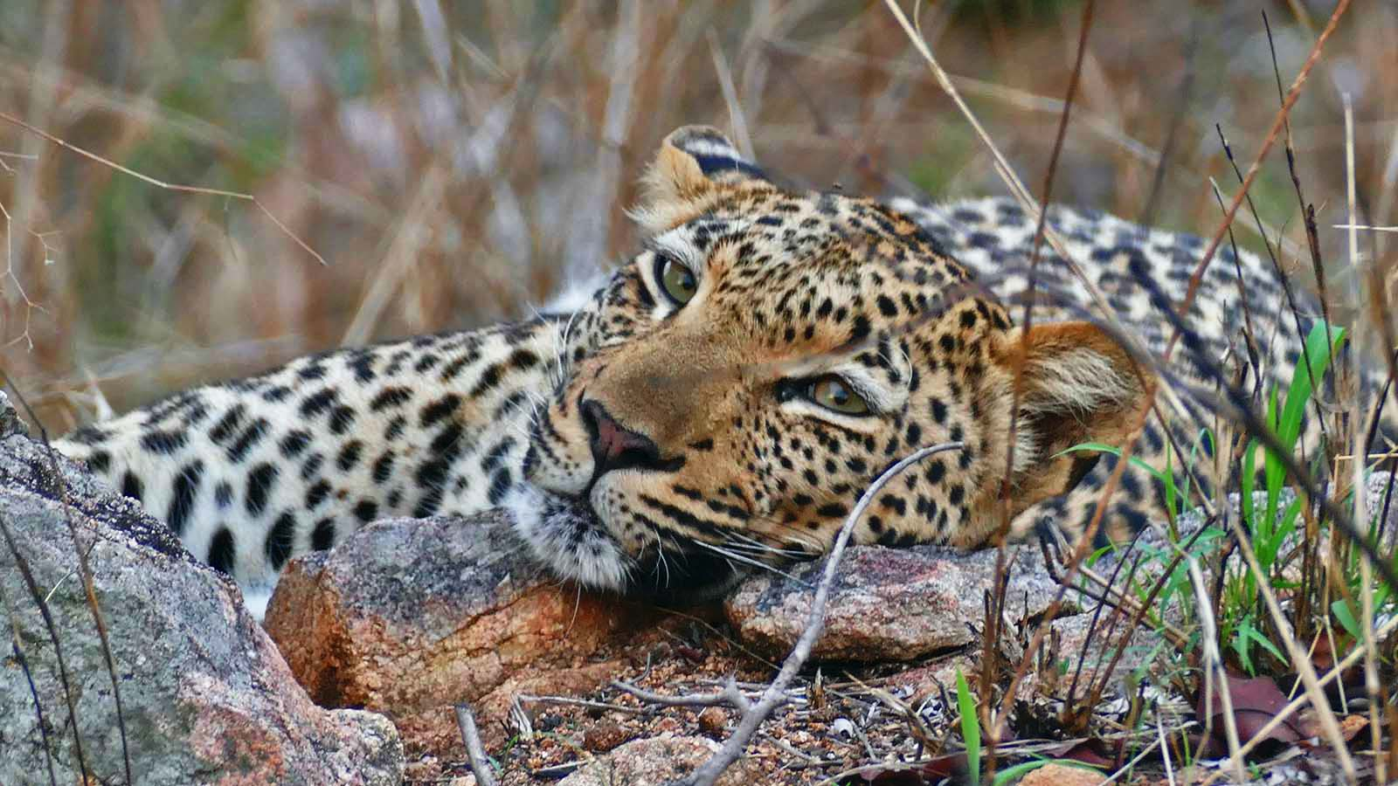
Photo © Bernard Dupont

Slide 26
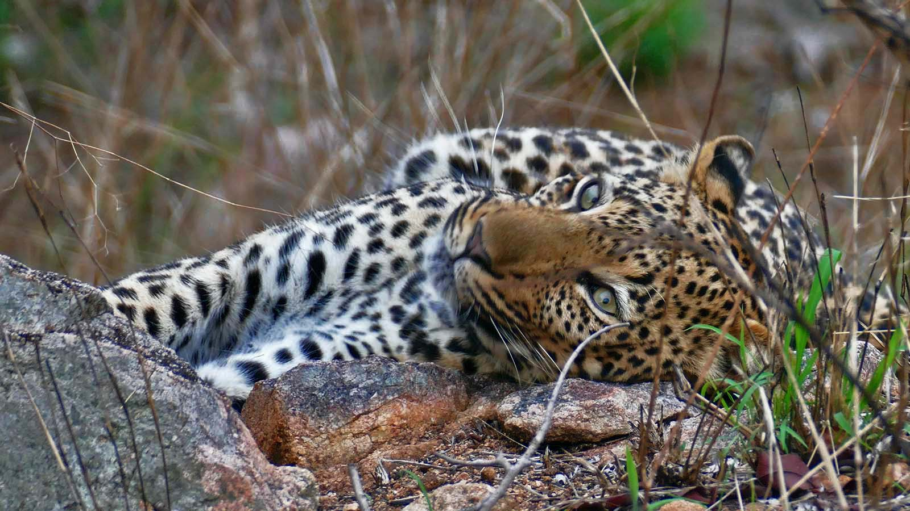
Photo © Bernard Dupont

Slide 27
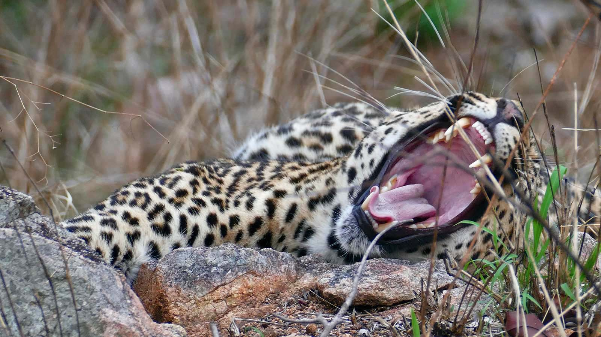
Photo © Bernard Dupont

Slide 28
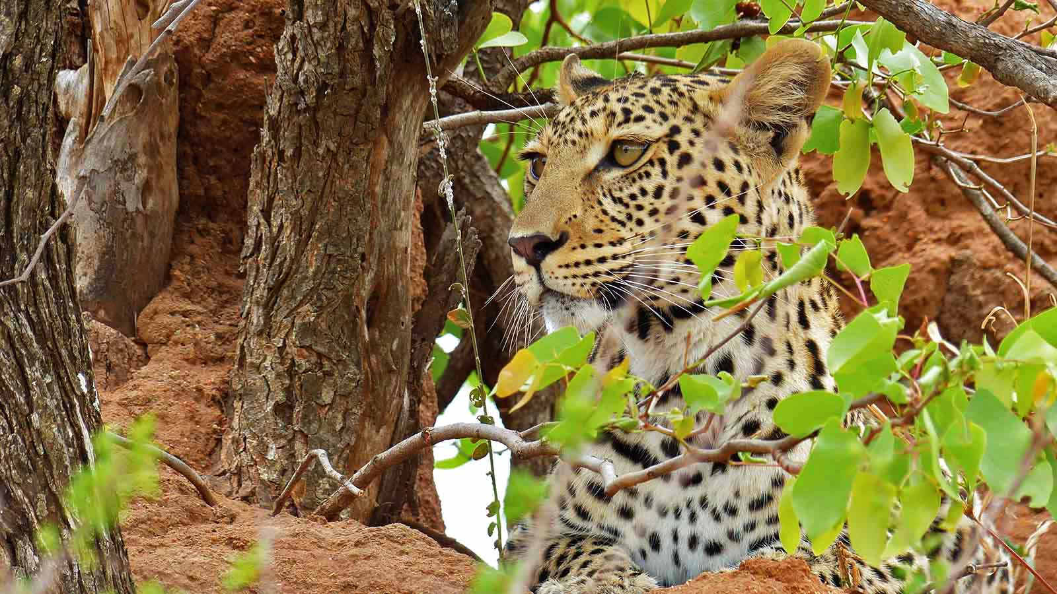
Photo © Bernard Dupont

Slide 29
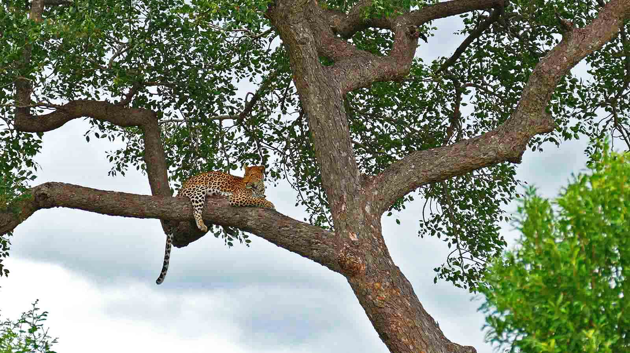
Photo © Bernard Dupont

Slide 30
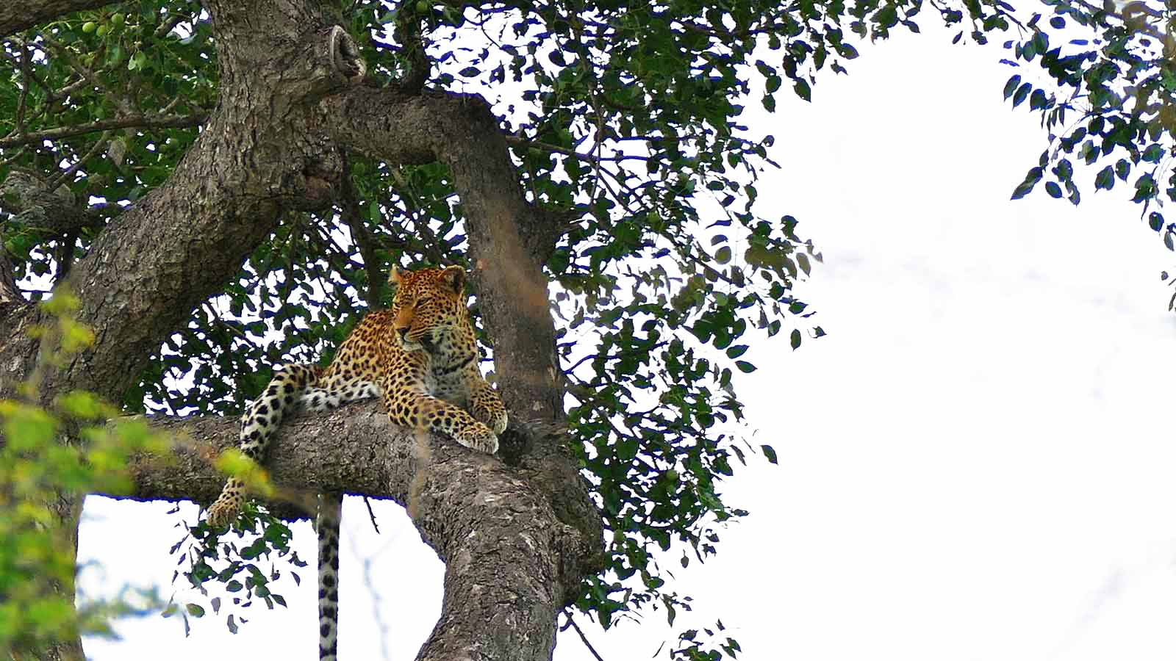
Photo © Bernard Dupont

Slide 31
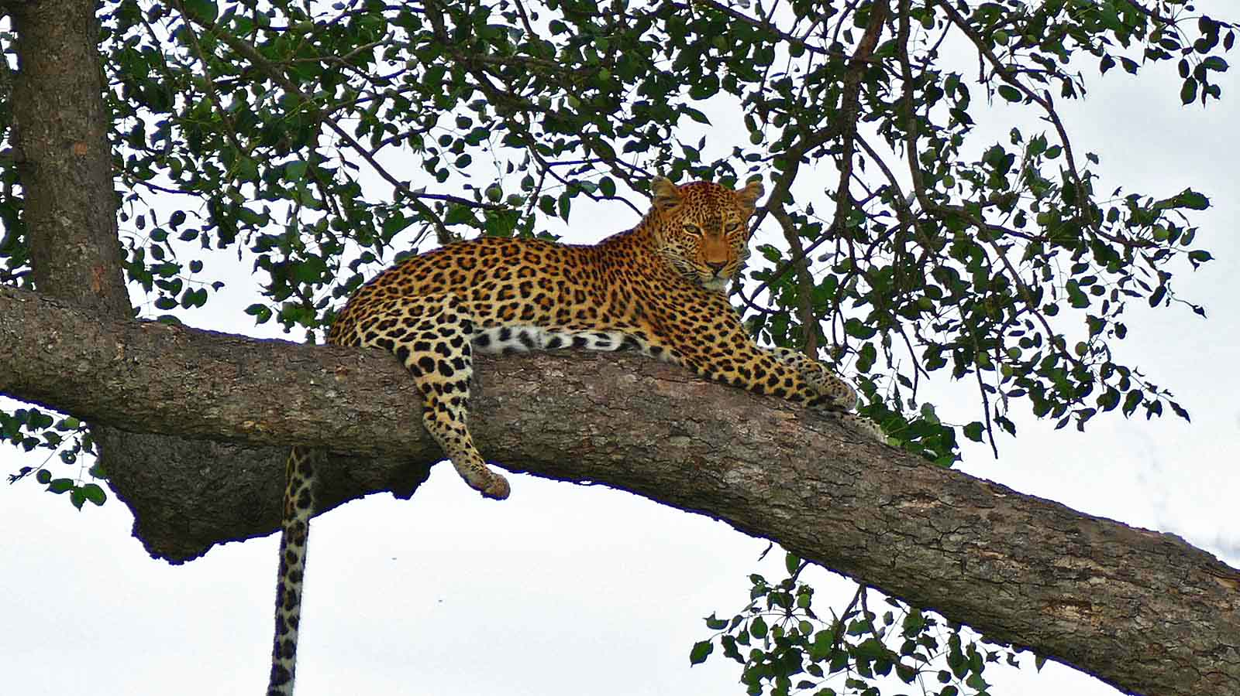
Photo © Bernard Dupont

Slide 32
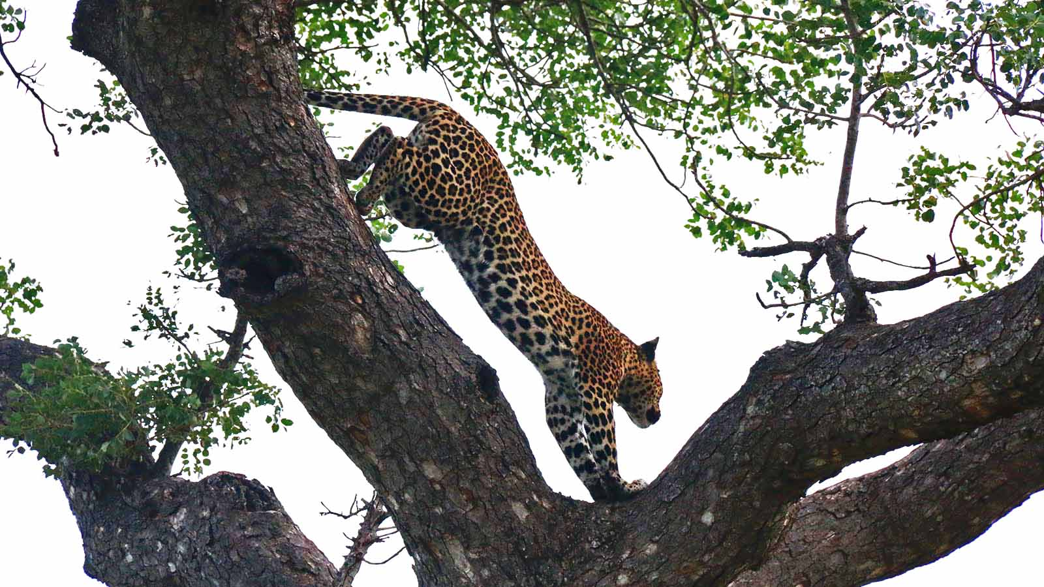
Photo © Carlos Reis

Slide 33
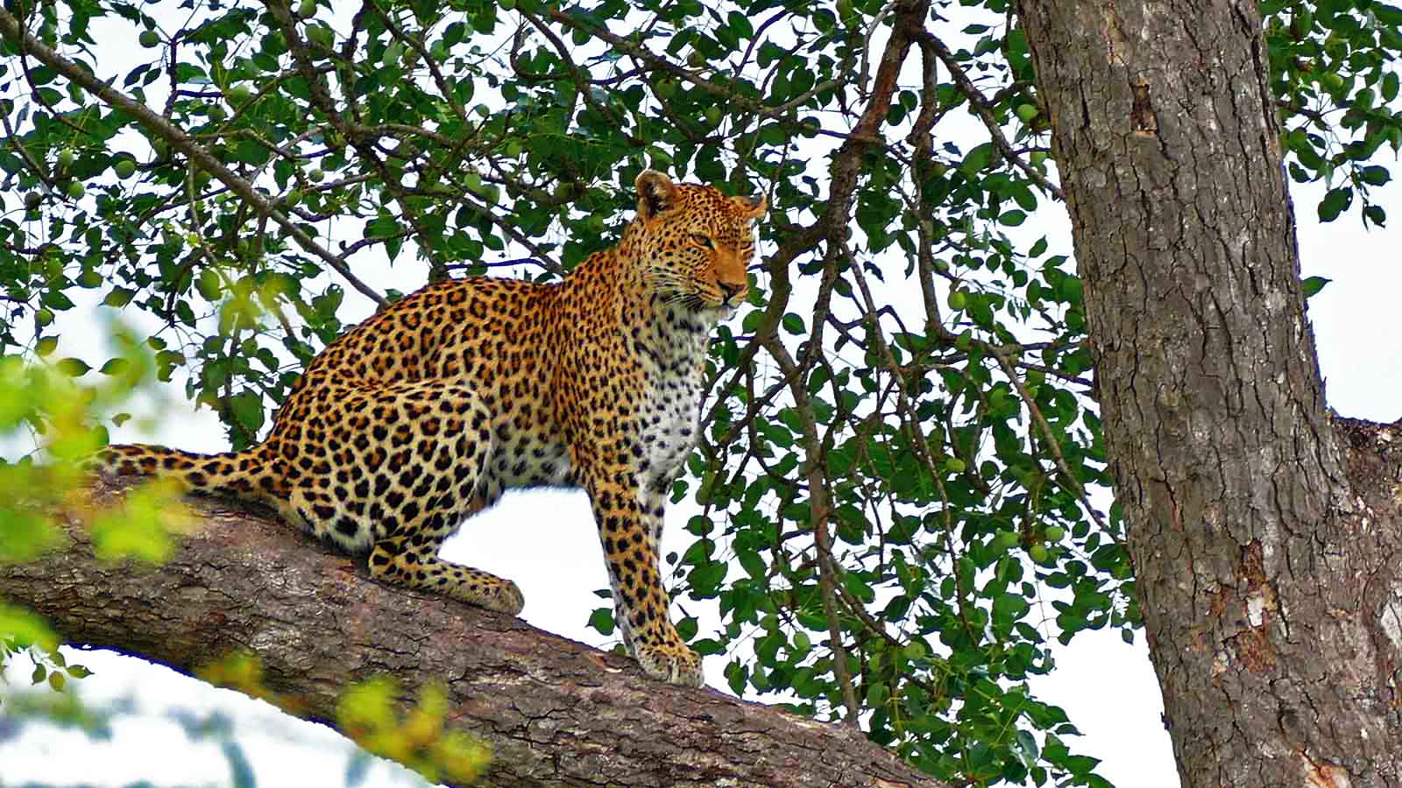
Photo © Bernard Dupont

Slide 34
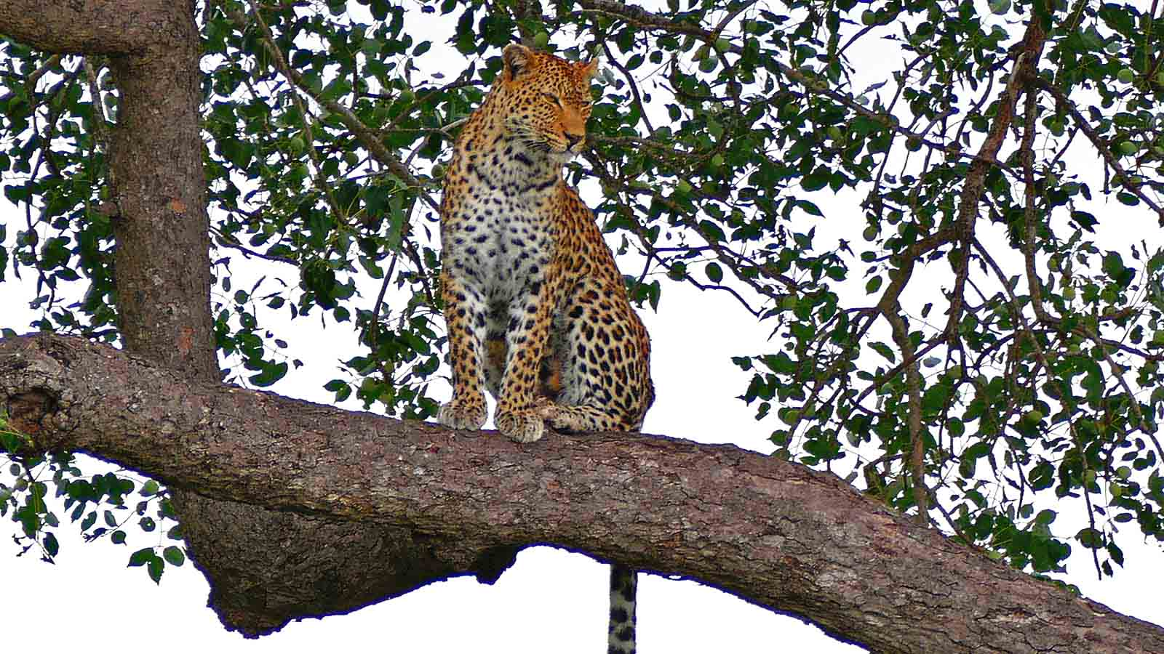
Photo © Bernard Dupont

Slide 35
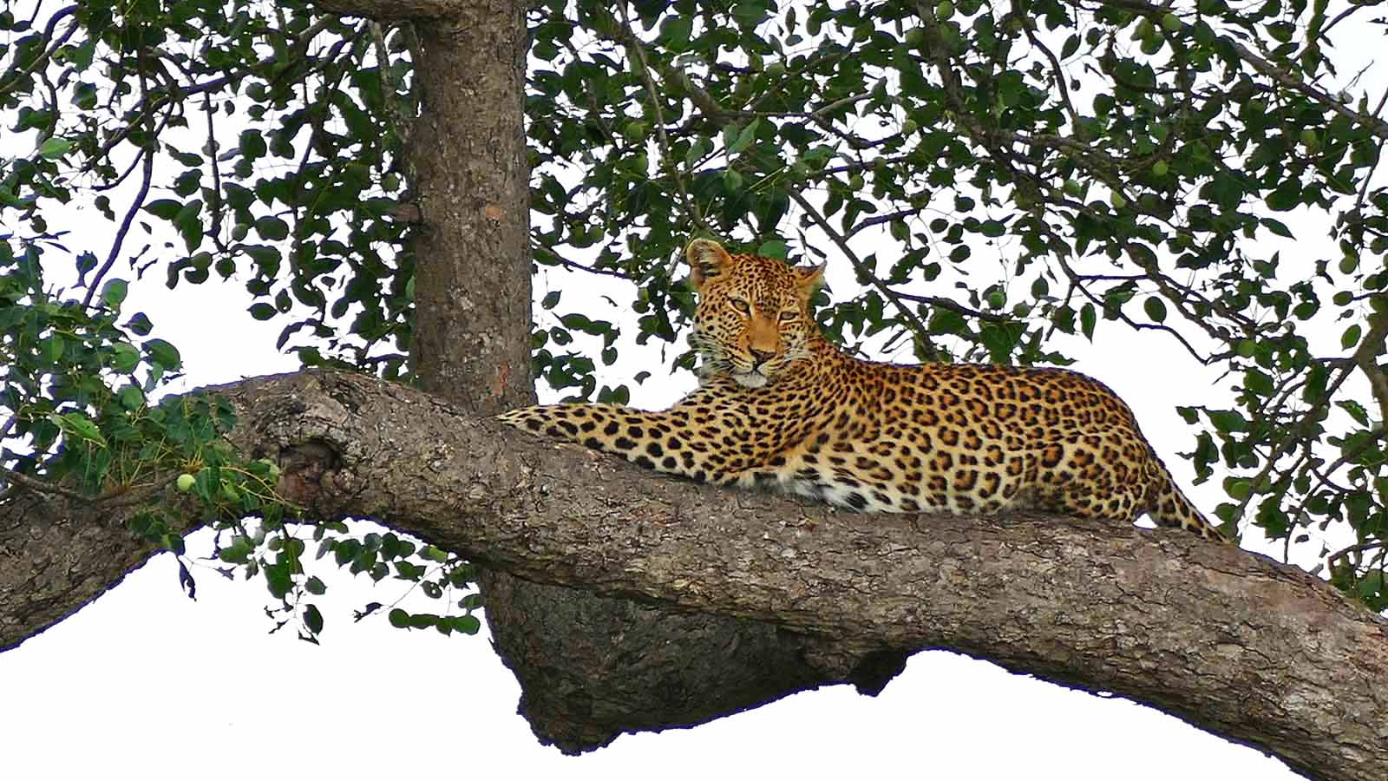
Photo © Bernard Dupont

Slide 36
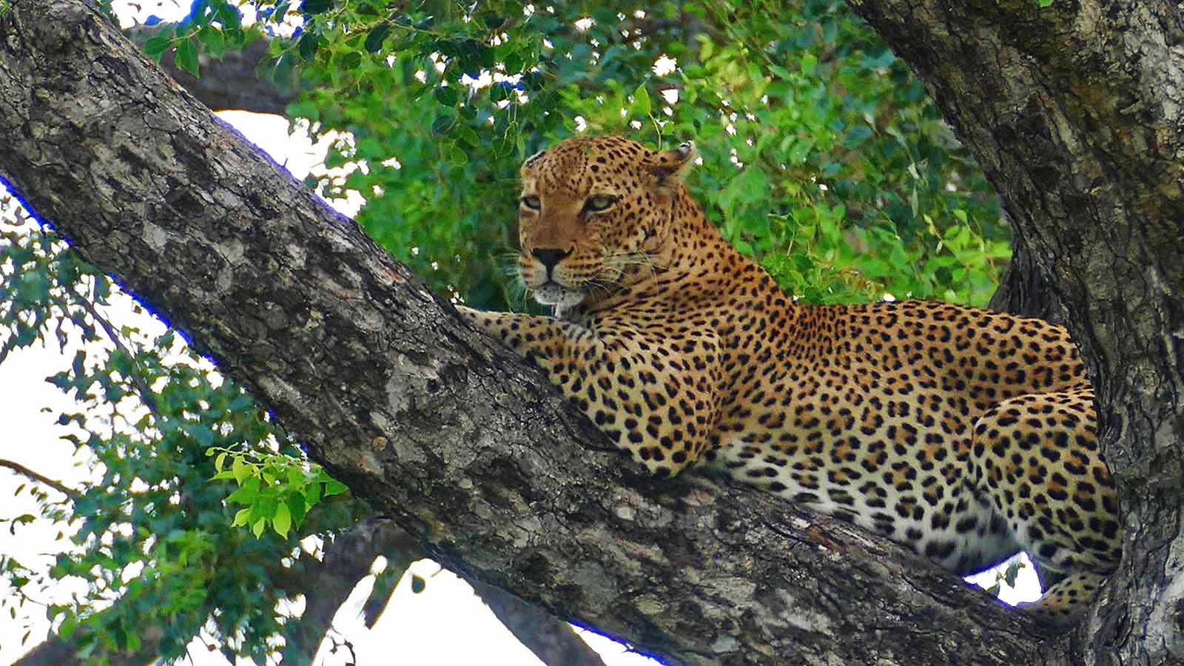
Photo © Bernard Dupont

Slide 37
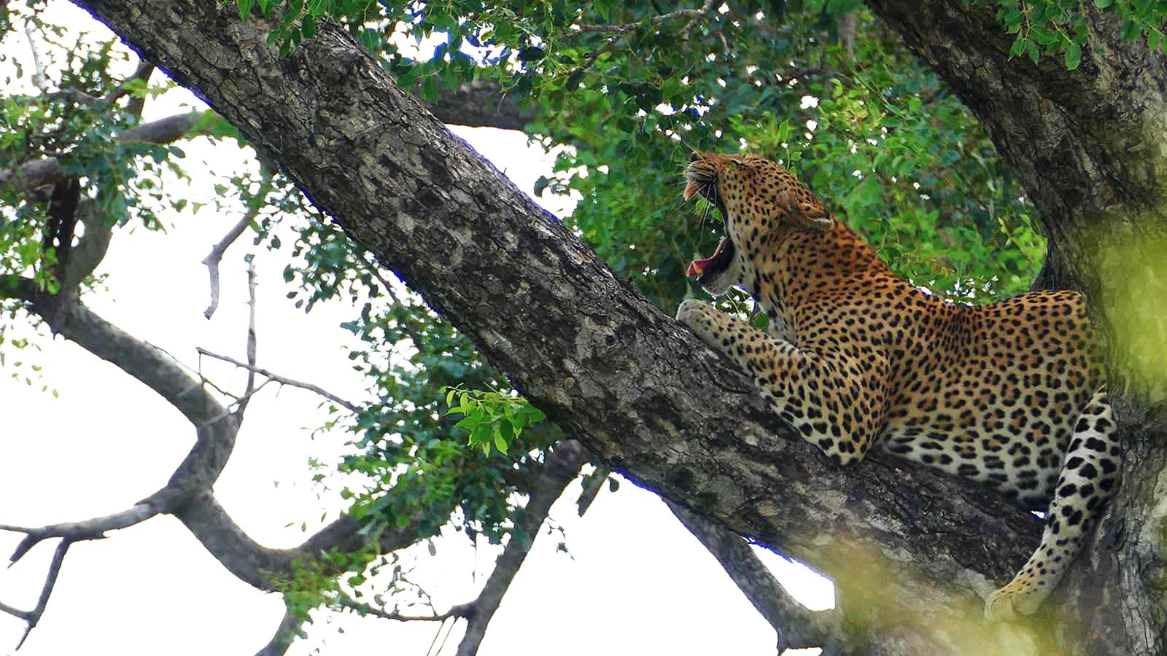
Photo © Bernard Dupont

Slide 38
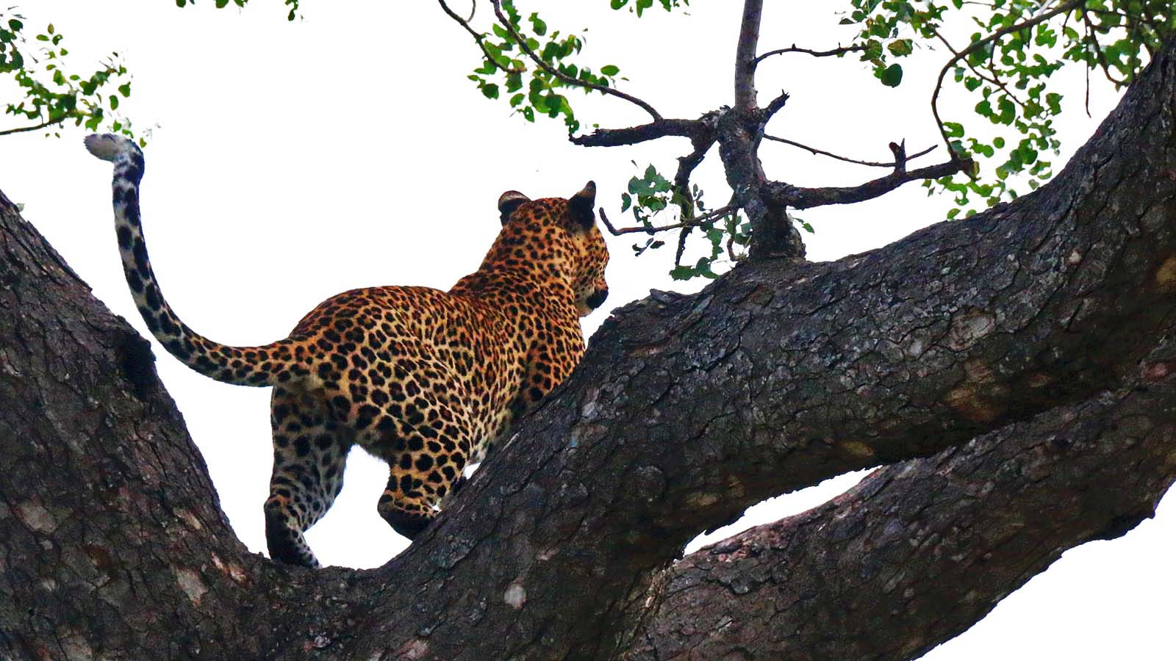
Photo © Carlos Reis

Slide 39
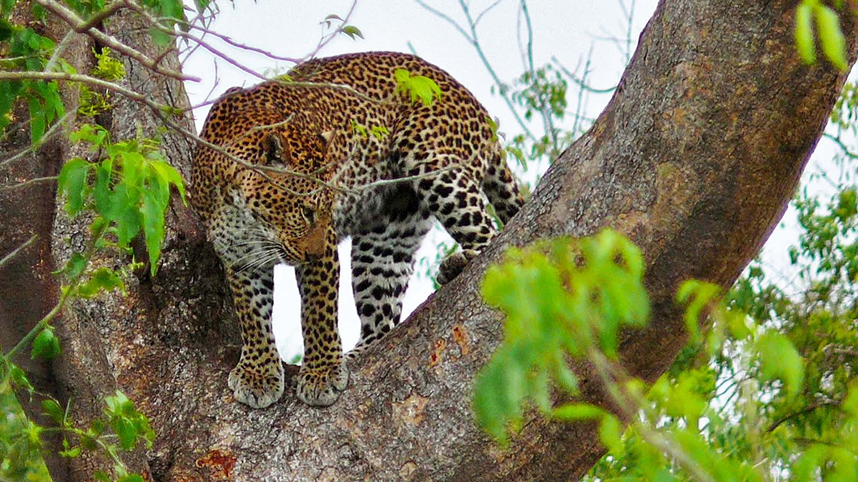
Photo © Bernard Dupont

Slide 40
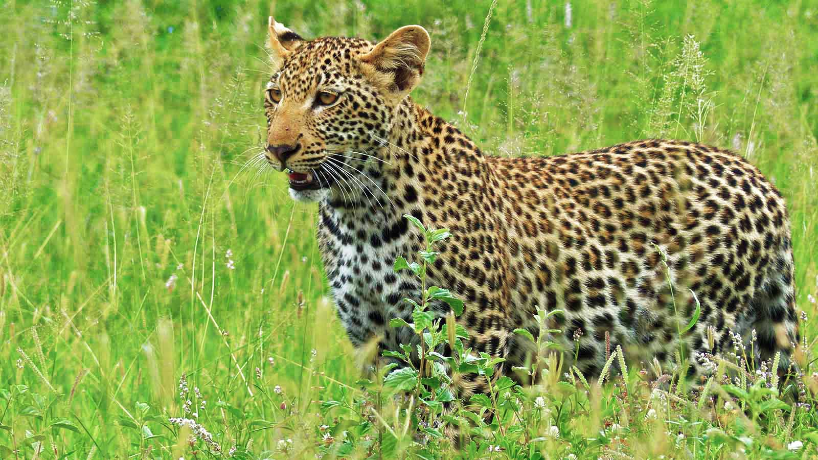
Photo © Bernard Dupont

Slide 41
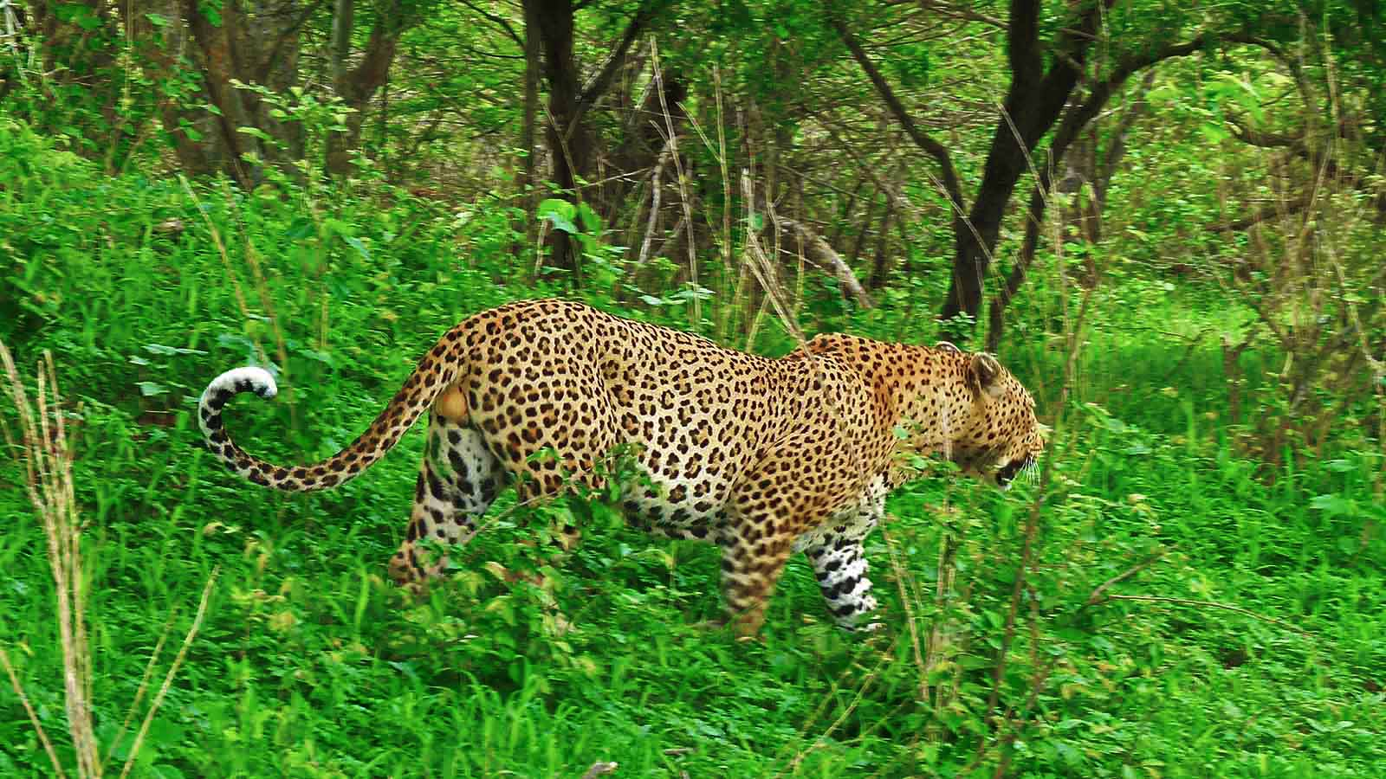
Photo © Bernard Dupont

Slide 42
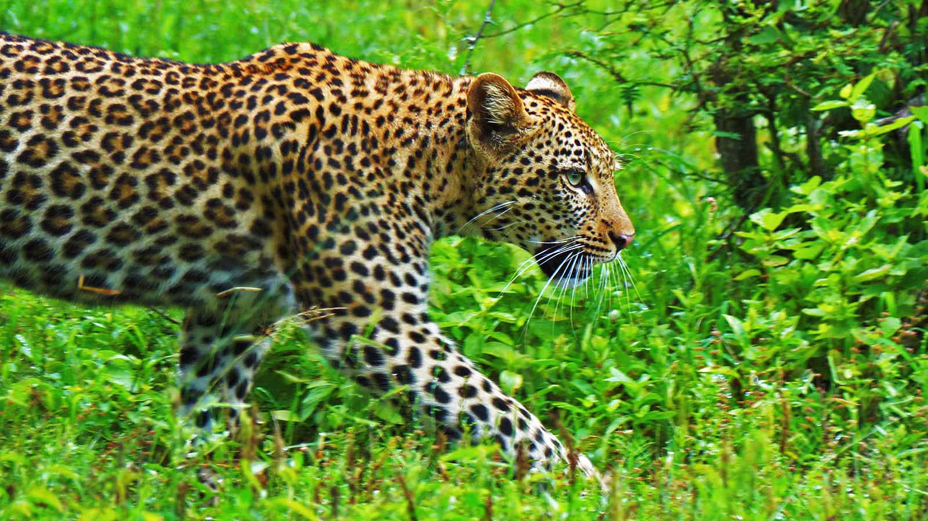
Photo © Bernard Dupont

Slide 43
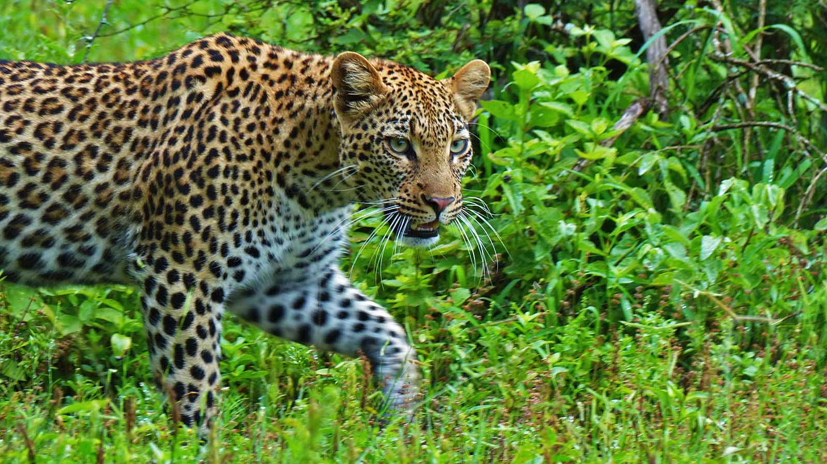
Photo © Bernard Dupont

Slide 44
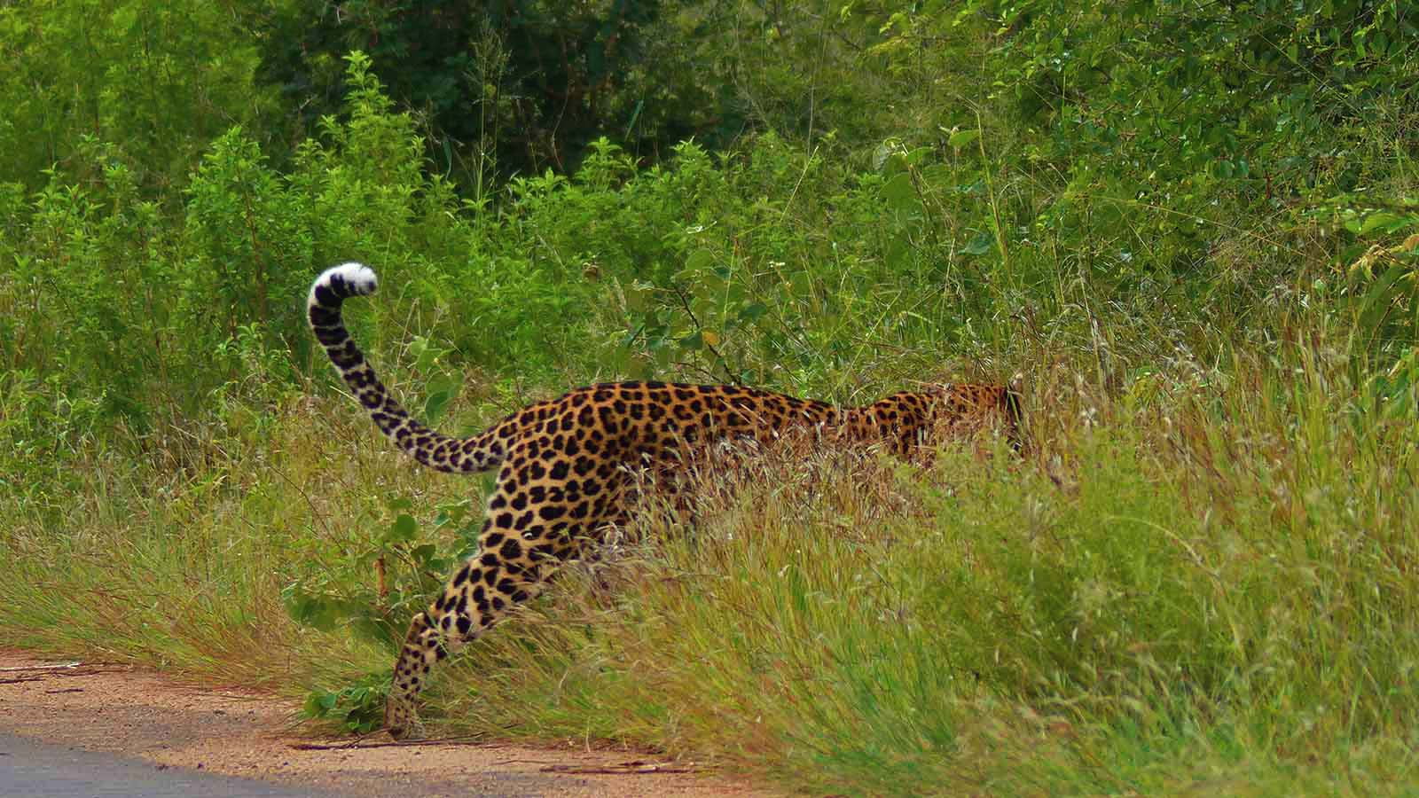
Photo © Bernard Dupont

Slide 45

2022
Music : African Tribal Music
Photos : Bernard Dupont (France)
Thanks to all photo owners for the cooperation.
Created by : Rumpler Štefan (Slovakia)
Contact: pista2011@gmail.com

Slide 46


Welcome in all languages!
I can translate your mails!
pista2011@gmail.com
CLICK for my VIDEOS
CLICK for my PPSX
Thank you for your feedback
Steve

Slide 47







¿Te ha gustado?
Puedes ver más entrando
Aquí
Además puedes recibir powerpoints en tu correo electrónico suscribiéndote aquí:

