Slide 1
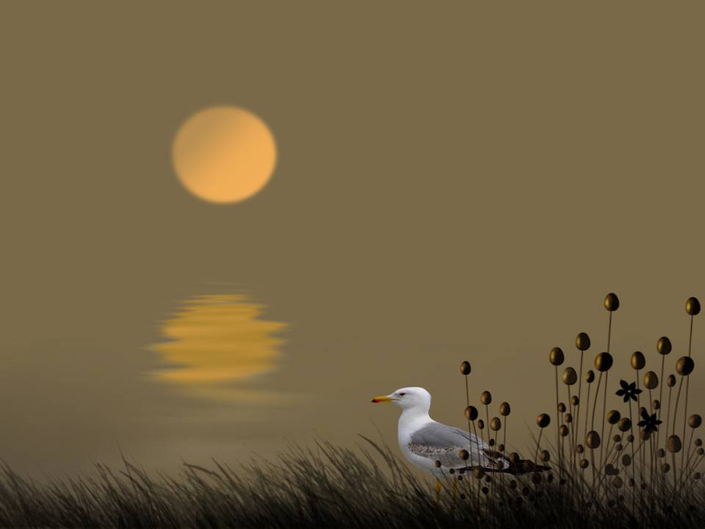

De aves y vuelos…
photographer: Regimantas Cieška

Slide 2
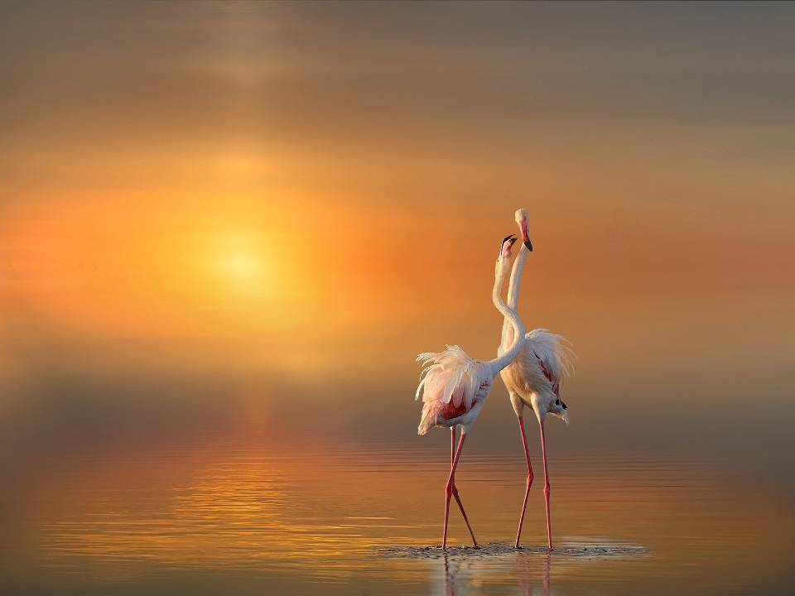
photographer: Regimantas Cieška
Regimantas Cieska

Slide 3
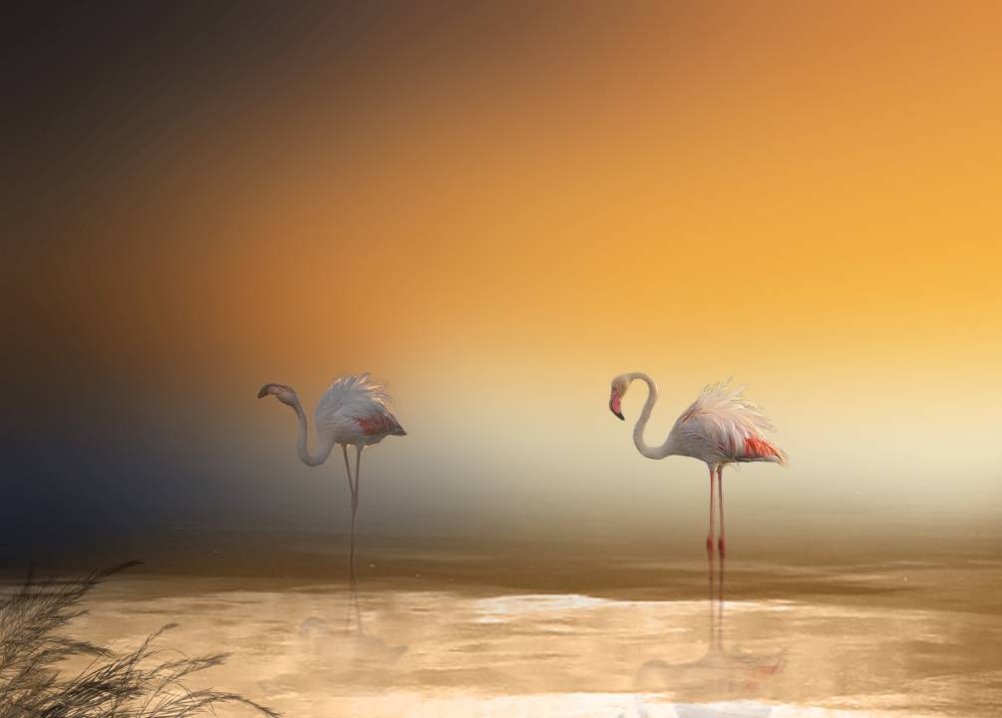
photographer: Regimantas Cieška

Slide 4
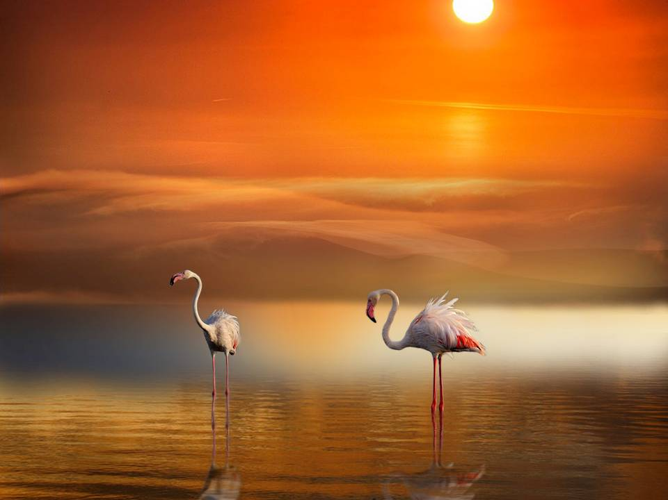
photographer: Regimantas Cieška
Regimantas Cieska

Slide 5
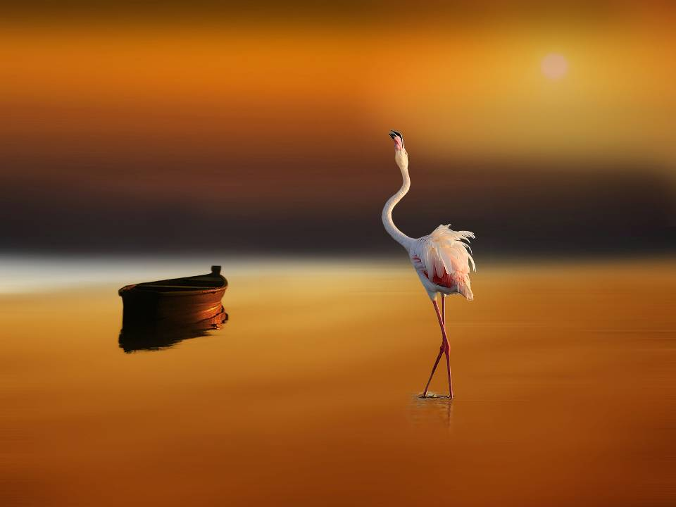
photographer: Regimantas Cieška
Regimantas Cieska

Slide 6
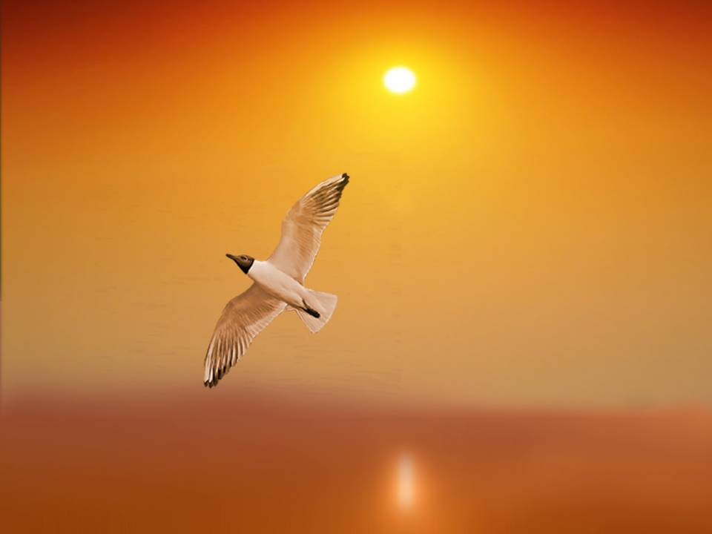
photographer: Regimantas Cieška
Regimantas Cieska

Slide 7
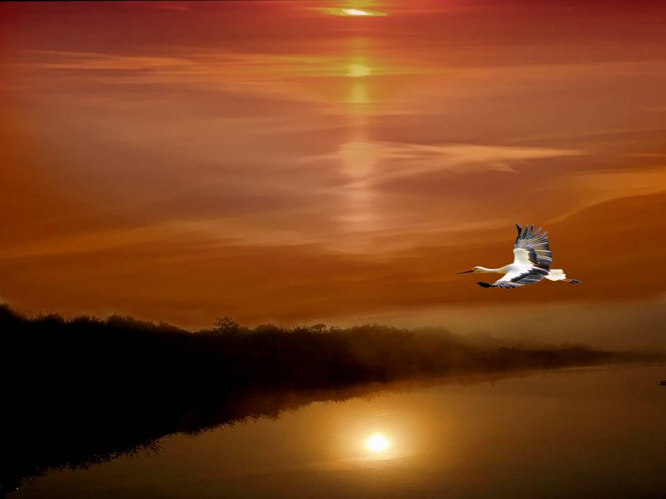
Regimantas Cieska
photographer: Regimantas Cieška

Slide 8
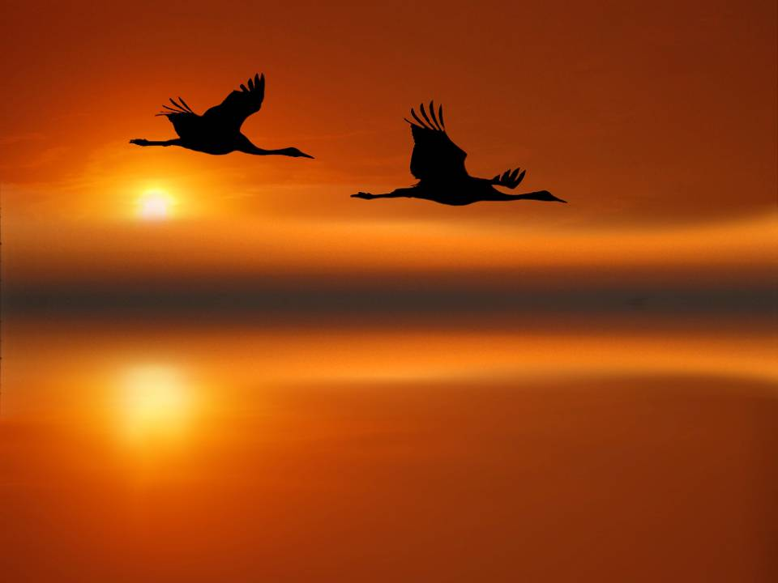
photographer: Regimantas Cieška
Regimantas Cieska

Slide 9
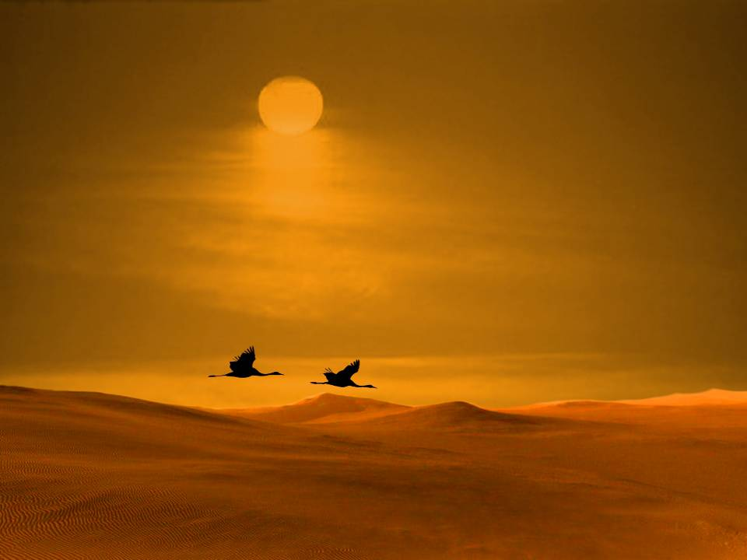
photographer: Regimantas Cieška
Regimantas Cieska

Slide 10
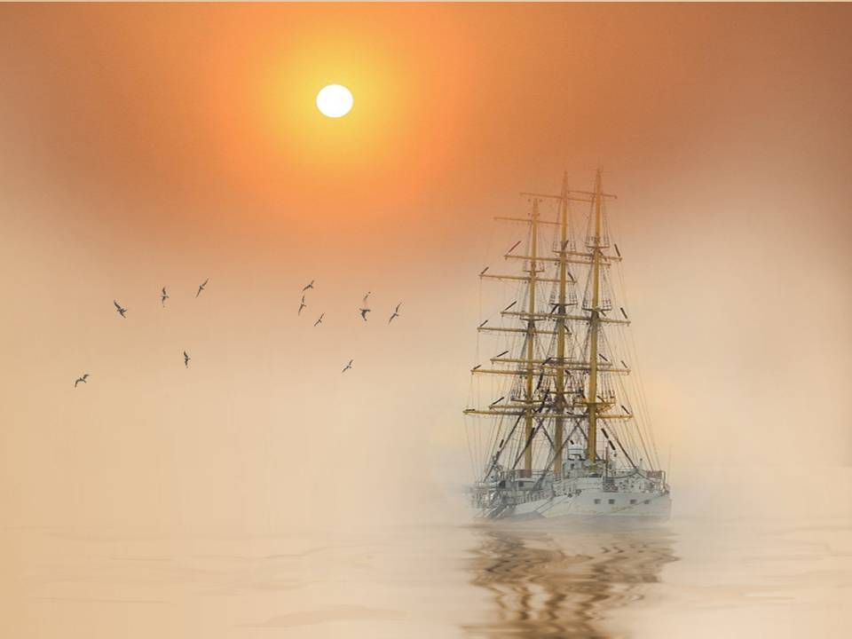
photographer: Regimantas Cieška

Slide 11
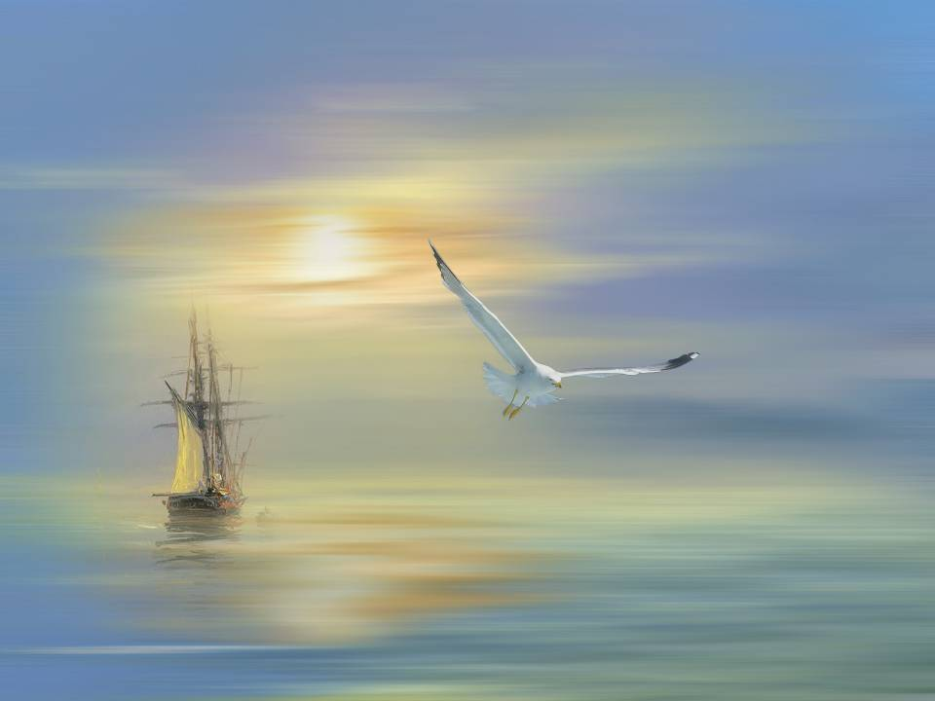
photographer: Regimantas Cieška

Slide 12
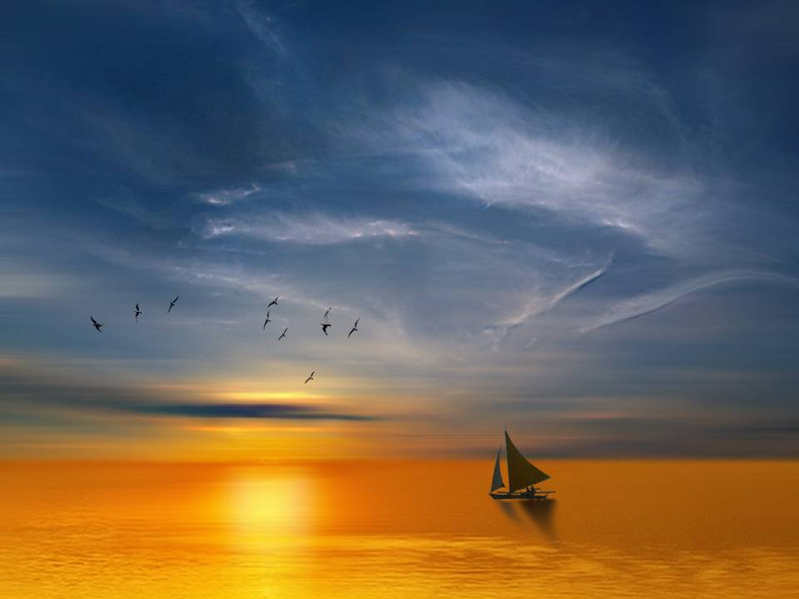
photographer: Regimantas Cieška

Slide 13
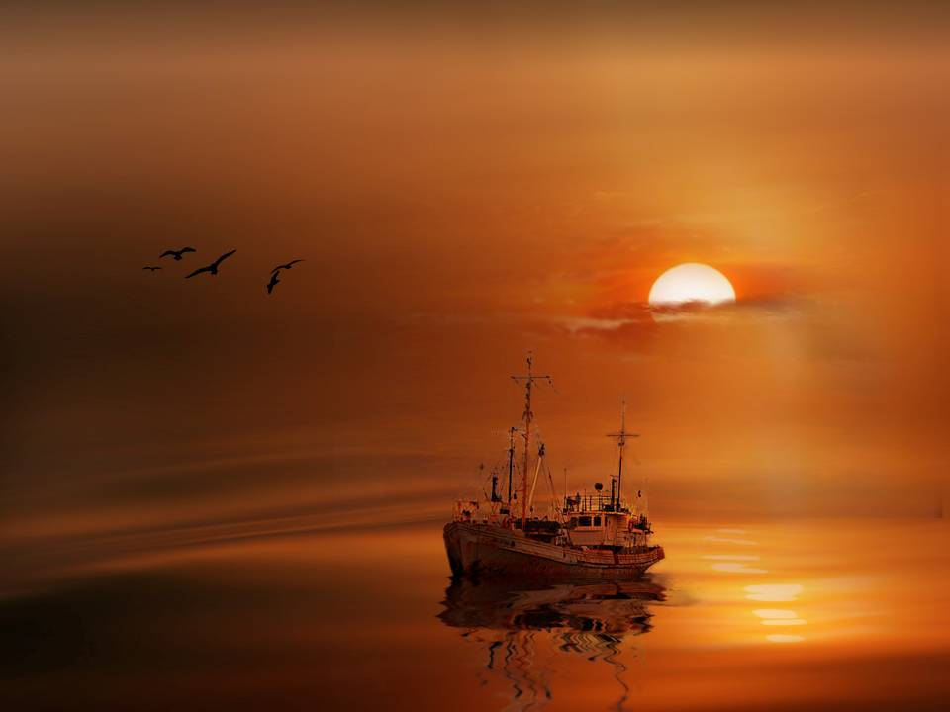
photographer: Regimantas Cieška

Slide 14
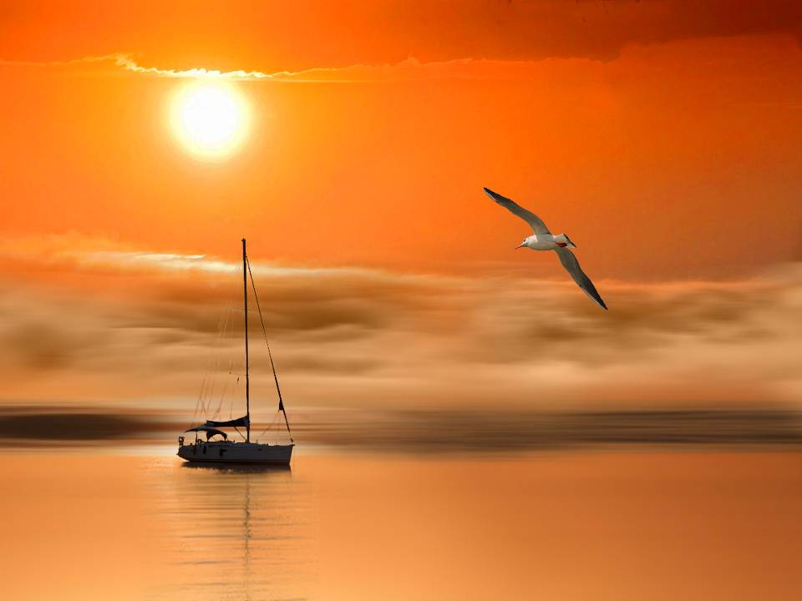
photographer: Regimantas Cieška

Slide 15
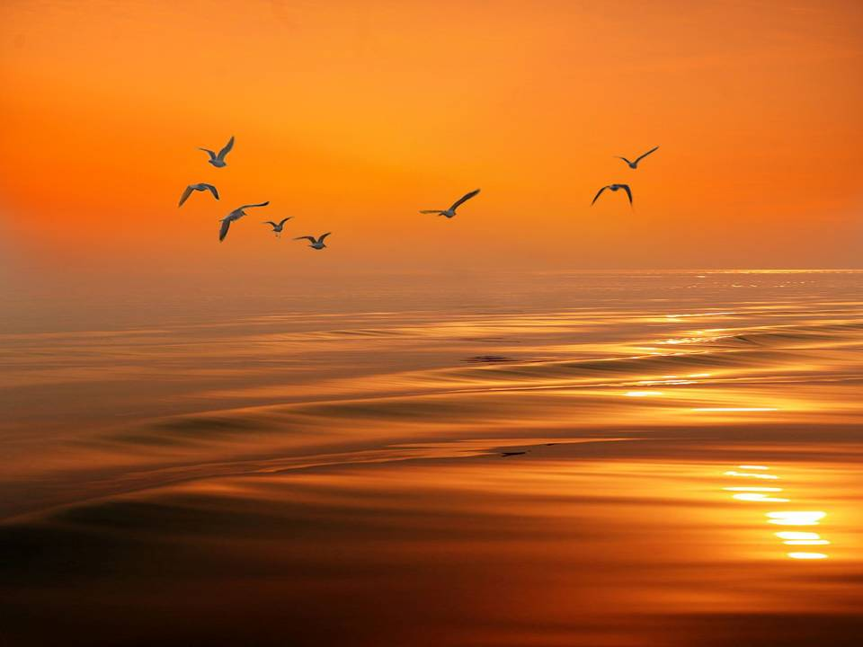
photographer: Regimantas Cieška

Slide 16
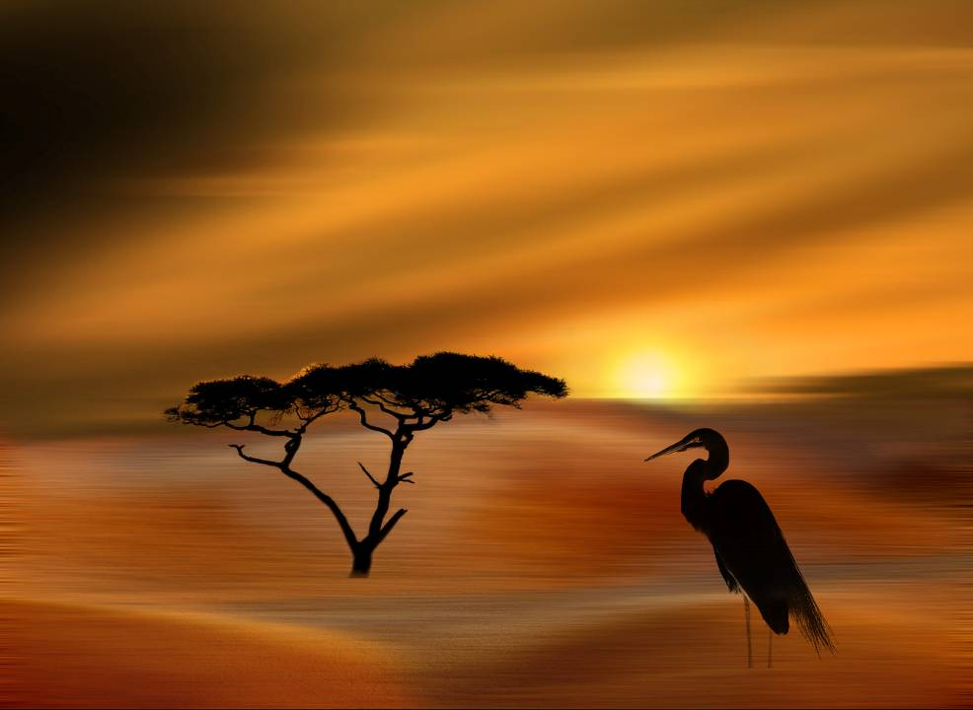
photographer: Regimantas Cieška

Slide 17
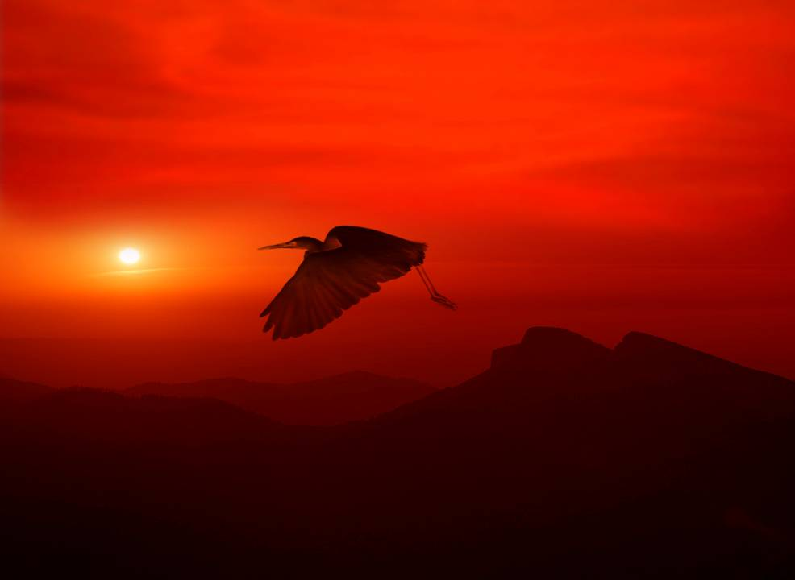
photographer: Regimantas Cieška

Slide 18
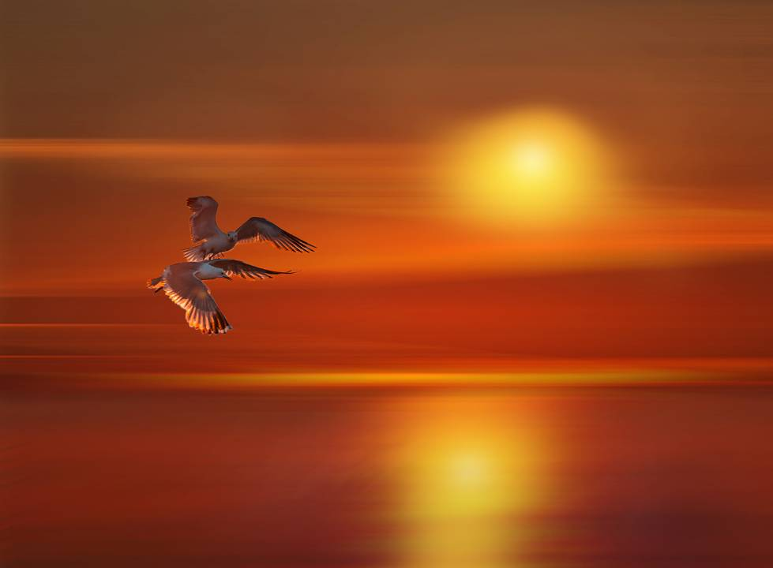
photographer: Regimantas Cieška

Slide 19
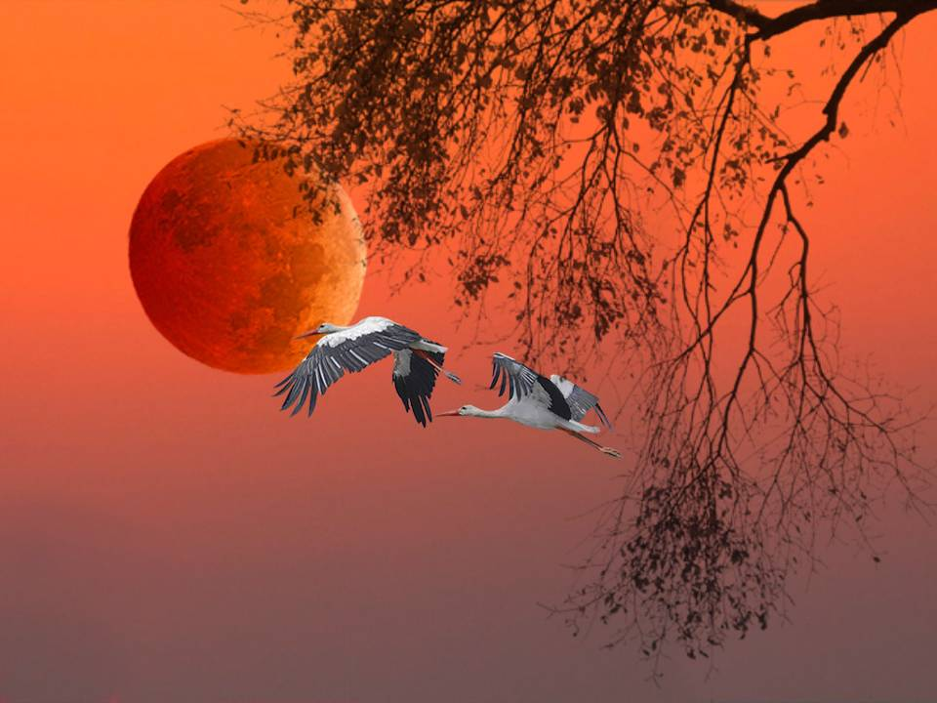
photographer: Regimantas Cieška

Slide 20
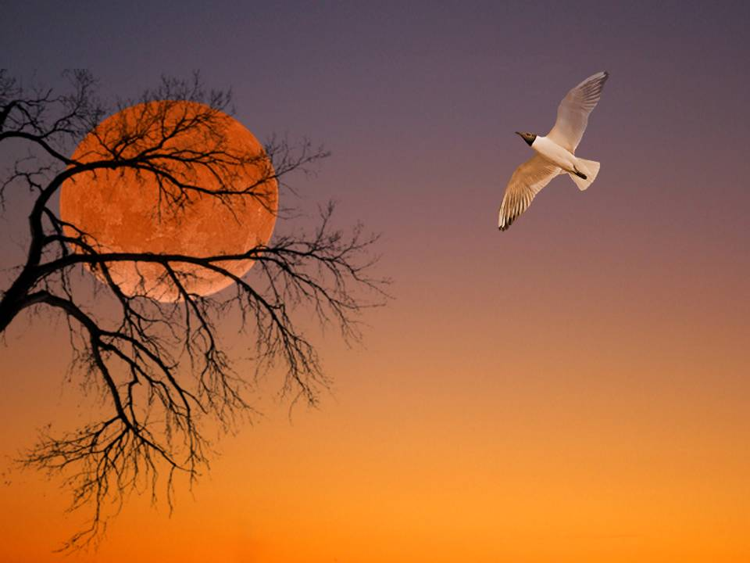
photographer: Regimantas Cieška

Slide 21
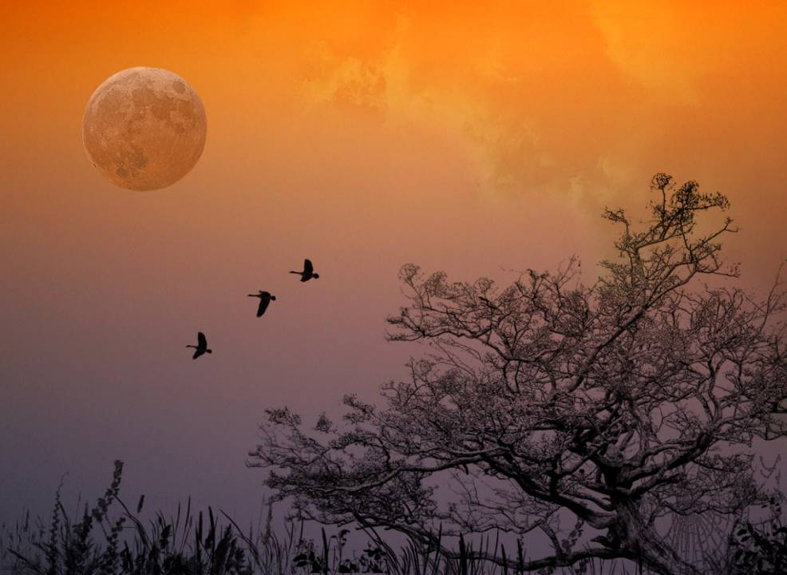
photographer: Regimantas Cieška

Slide 22
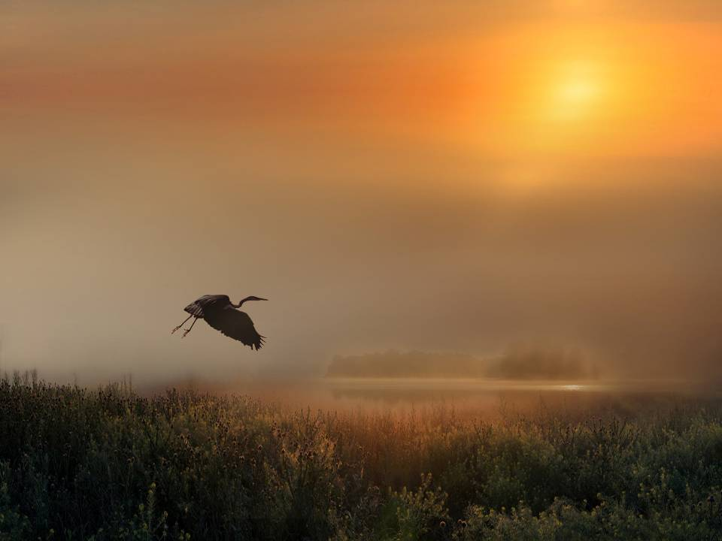
photographer: Regimantas Cieška

Slide 23
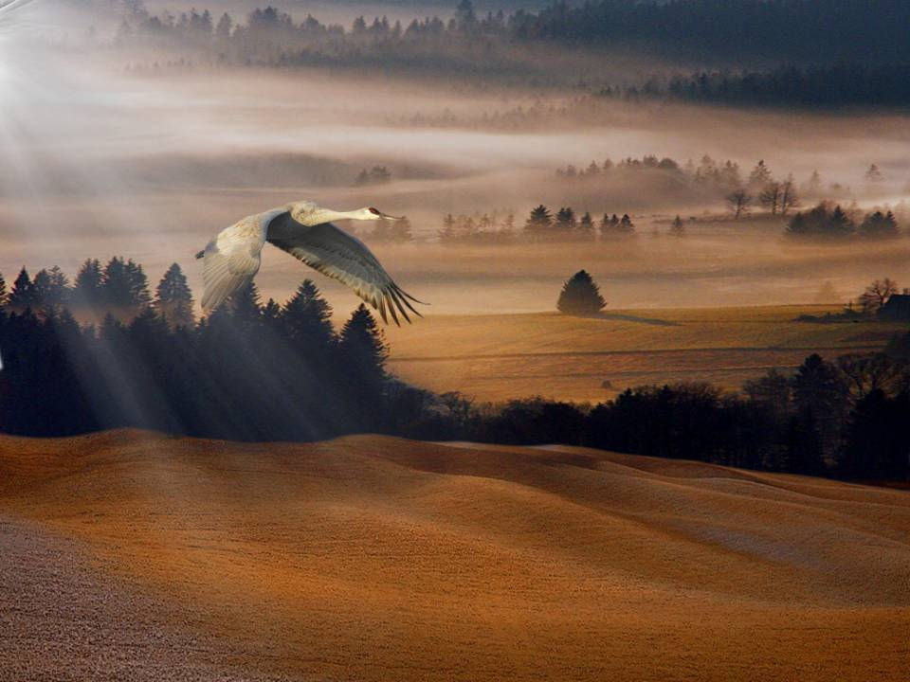
photographer: Regimantas Cieška

Slide 24
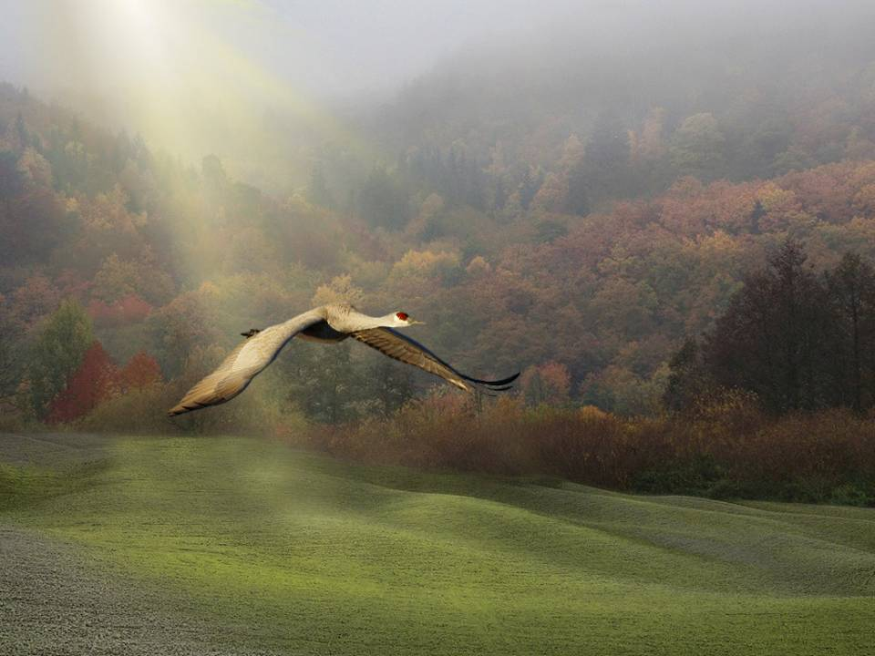
photographer: Regimantas Cieška

Slide 25
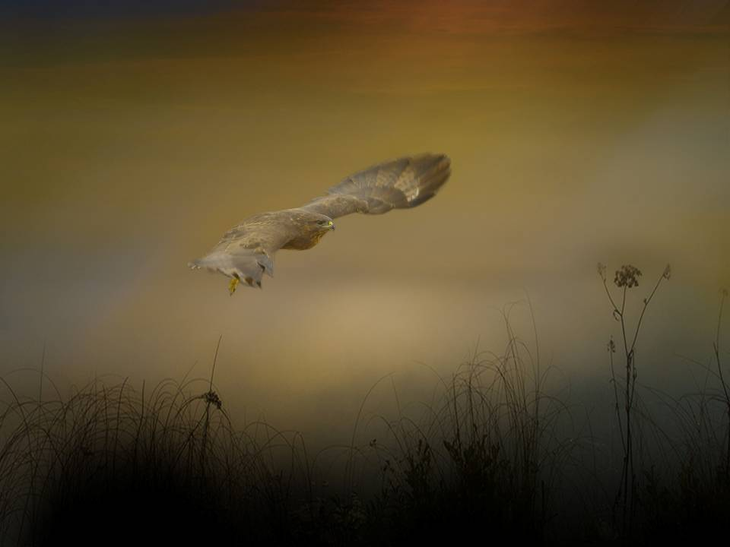
photographer: Regimantas Cieška

Slide 26
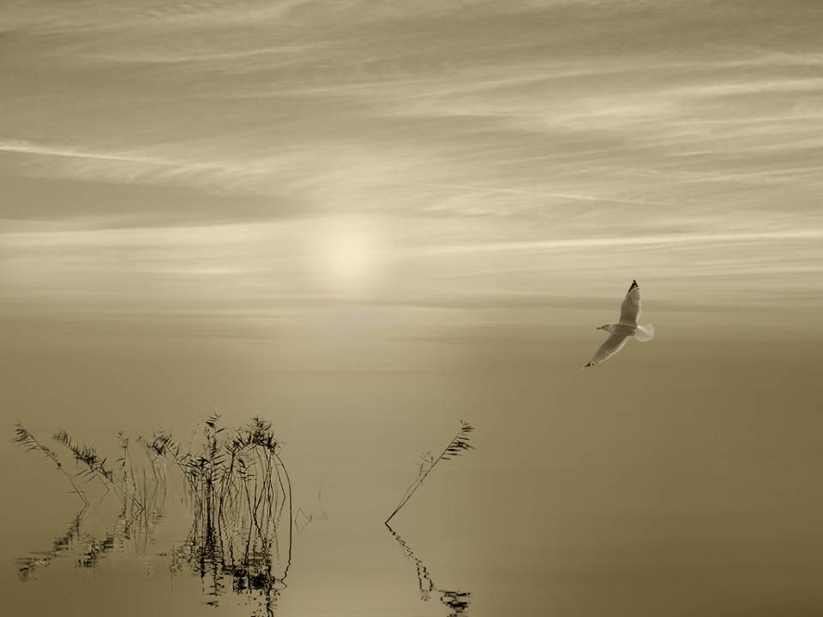
photographer: Regimantas Cieška

Slide 27
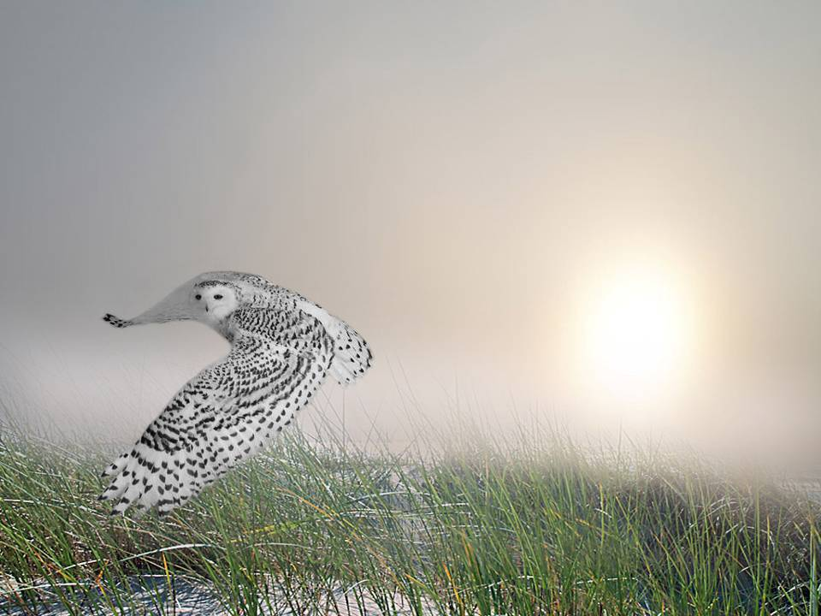
photographer: Regimantas Cieška
FIN

Slide 28







¿Te ha gustado?
Puedes ver más entrando
Aquí
Además puedes recibir powerpoints en tu correo electrónico suscribiéndote aquí:

