Slide 1

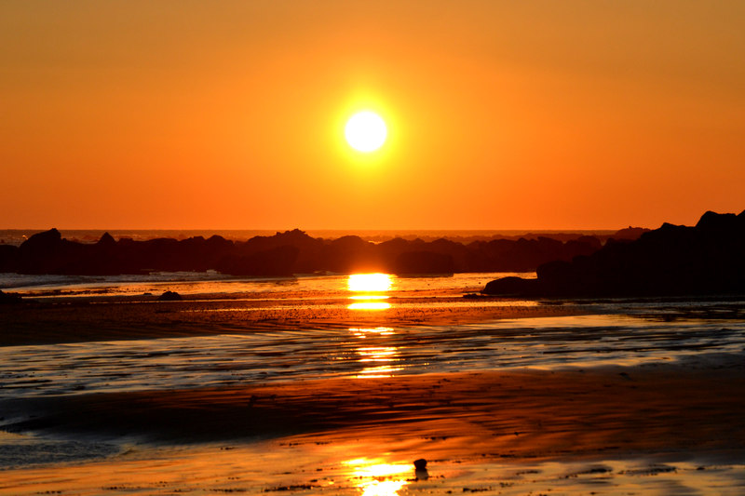
Atardeceres en
Africa

Slide 2
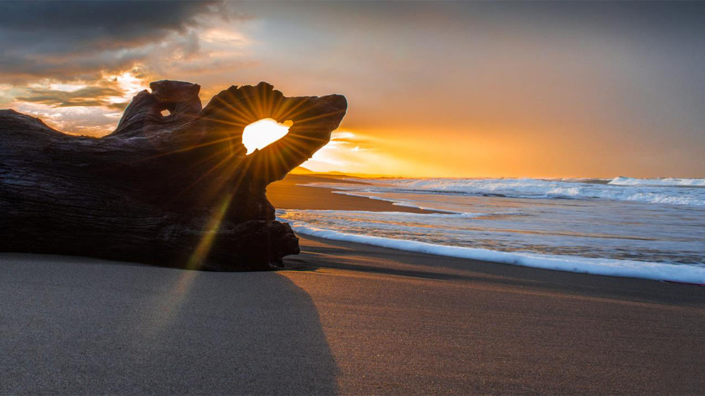
Algeria
Photography © by بواللحم - م on 500px

Slide 3
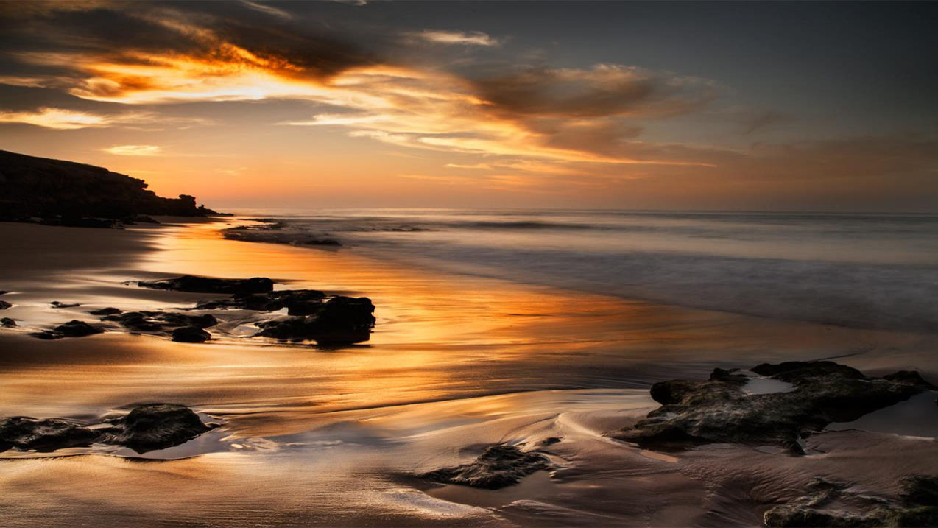
Angola
Photography © by André Silva Pinto on 500px

Slide 4
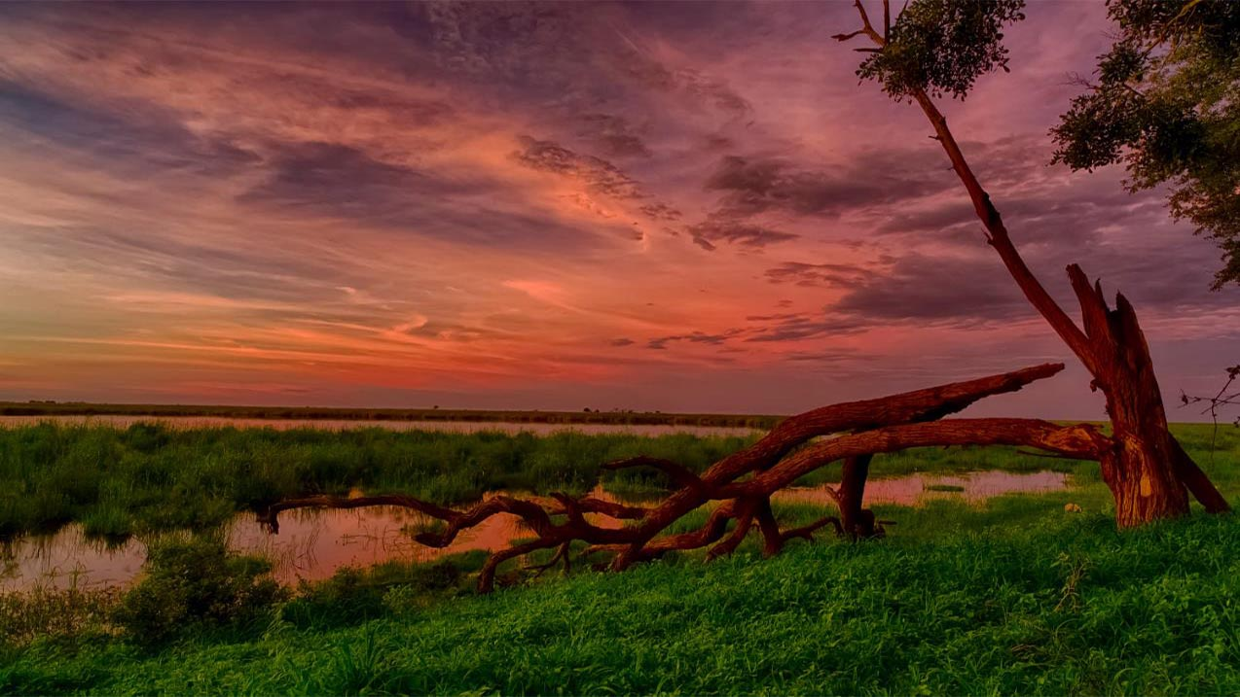
Botswana
Photography © by Peter Negatsch on 500px

Slide 5
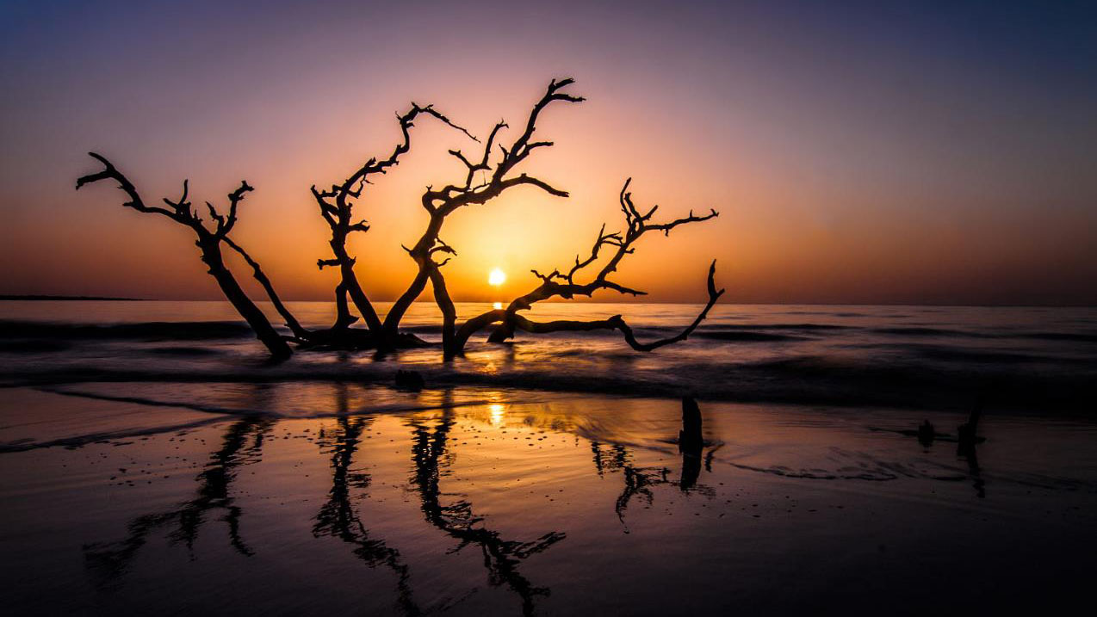
Cameroon
Photography © by Victor Ndende on 500px

Slide 6
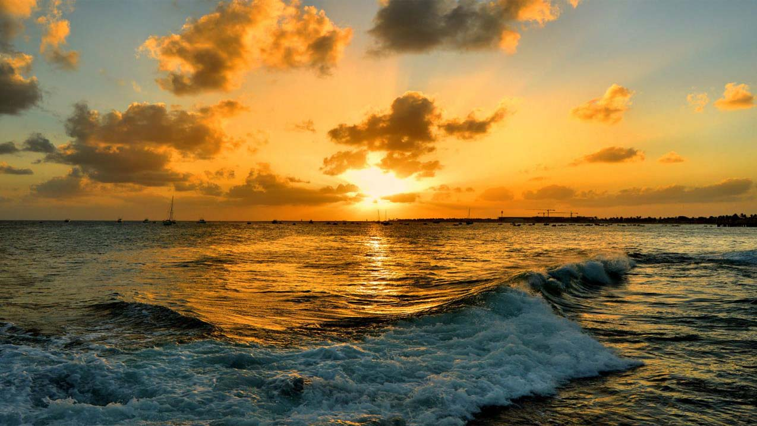
Cape Verde
Photography © by Rose MacAuslan on 500px

Slide 7
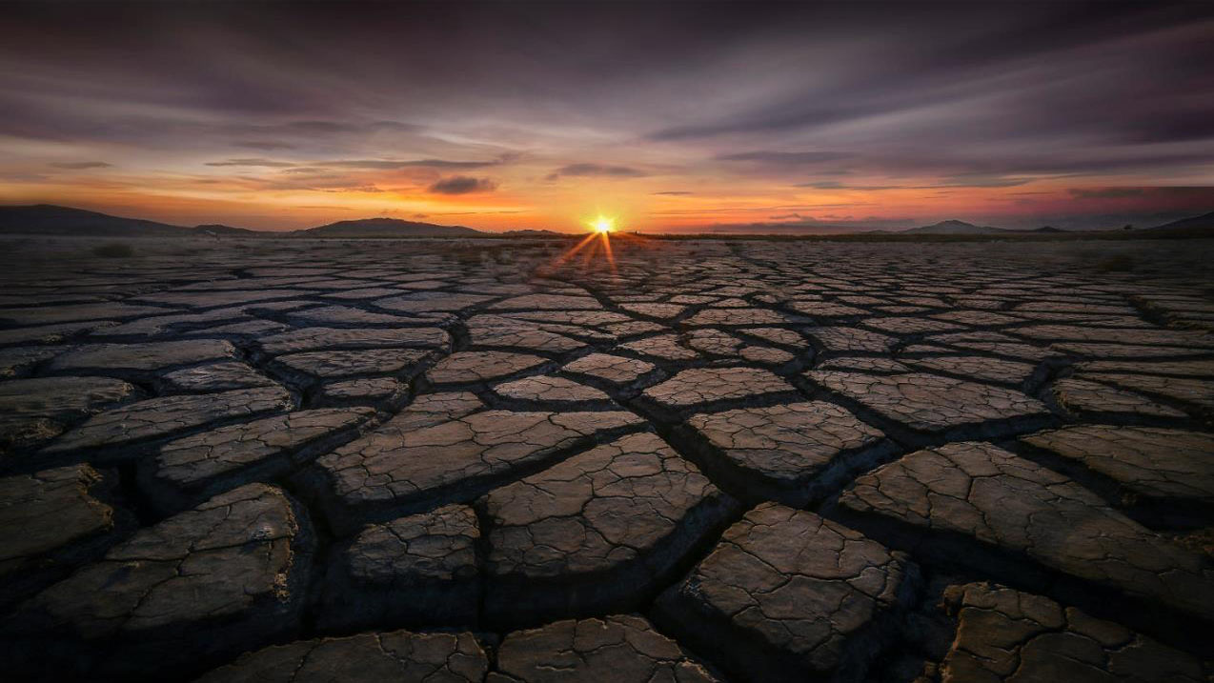
Chad
Photography © by jae youn Ryu on 500px

Slide 8
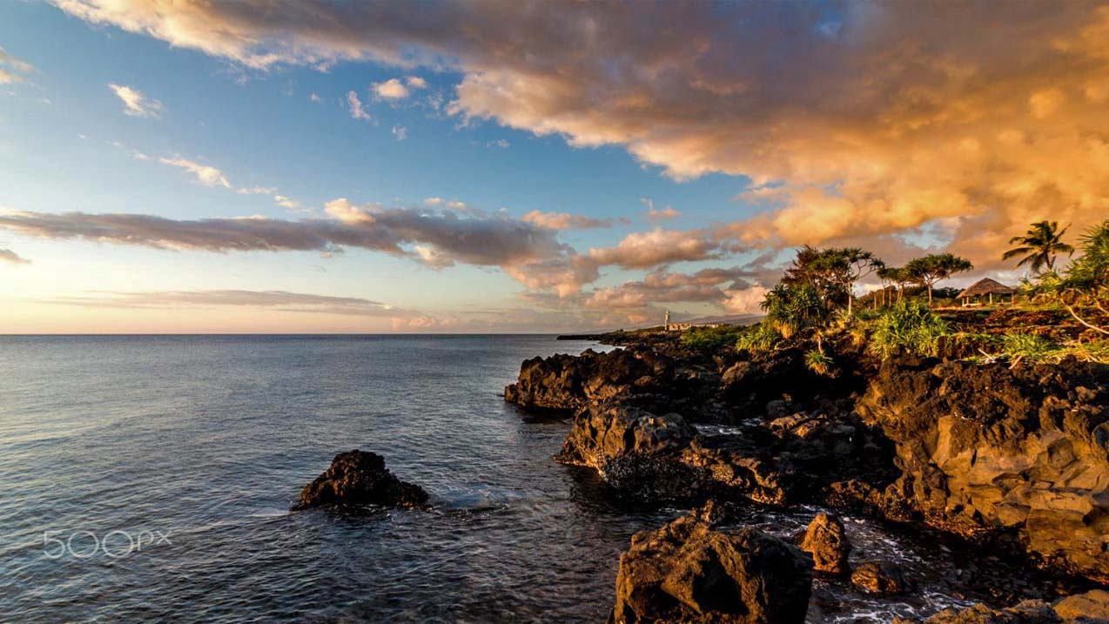
Comoros
Photography © by Flogs

Slide 9
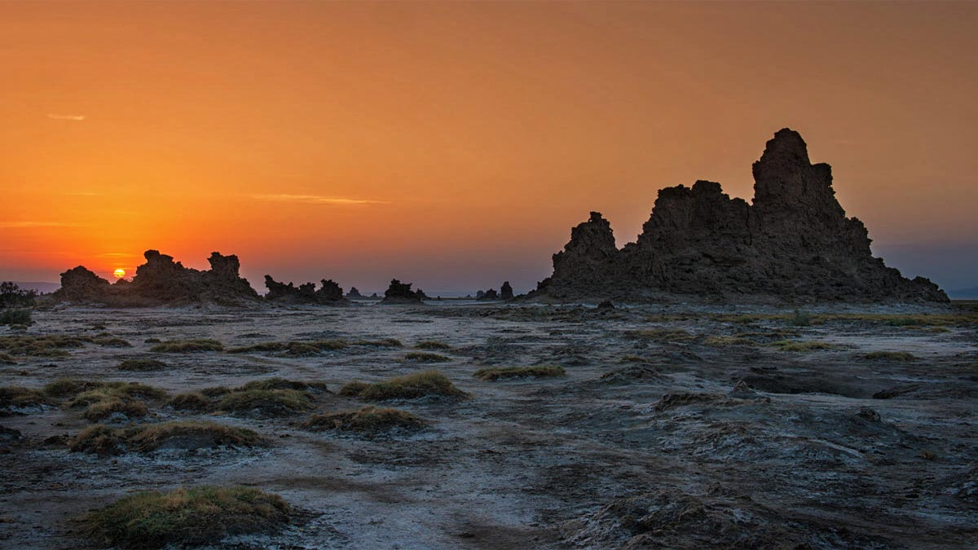
Djibouti
Photography © by Andrew Rosser on 500px

Slide 10
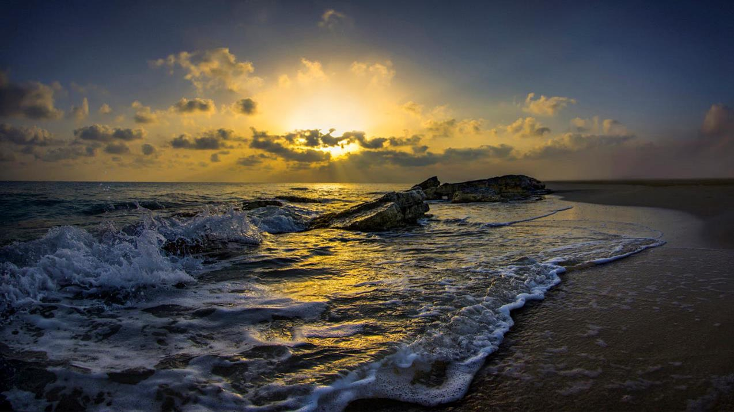
Egypt
Photography © by Nasser Osman on 500px

Slide 11
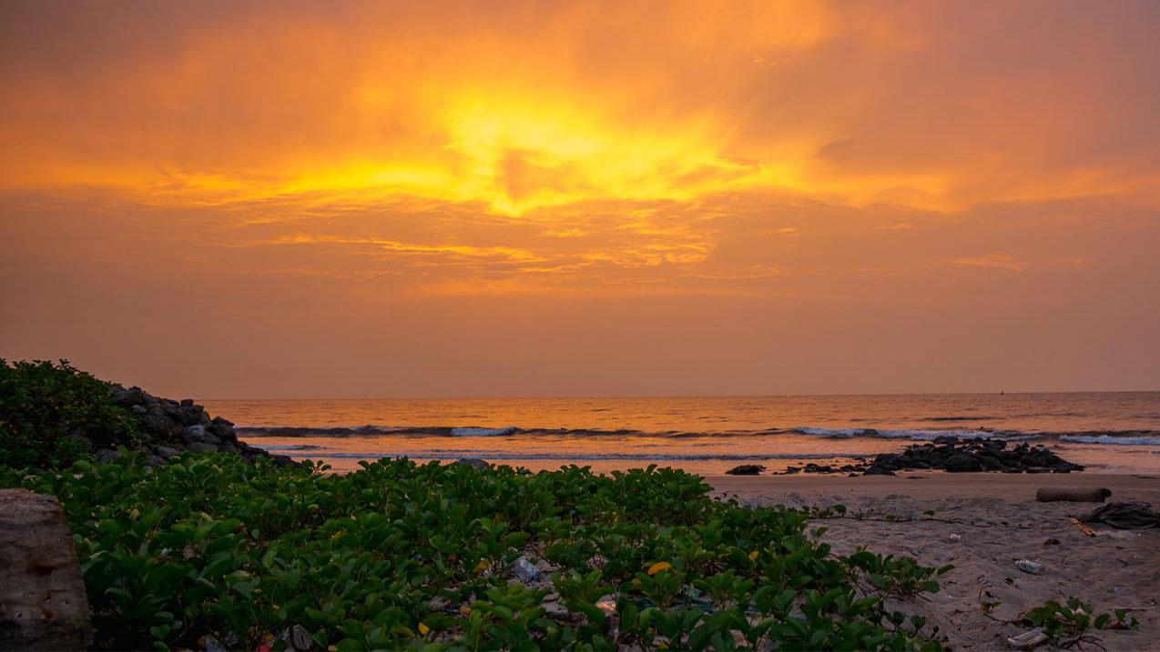
Equatorial Guinea
Photography © by Optical Flows on 500px

Slide 12
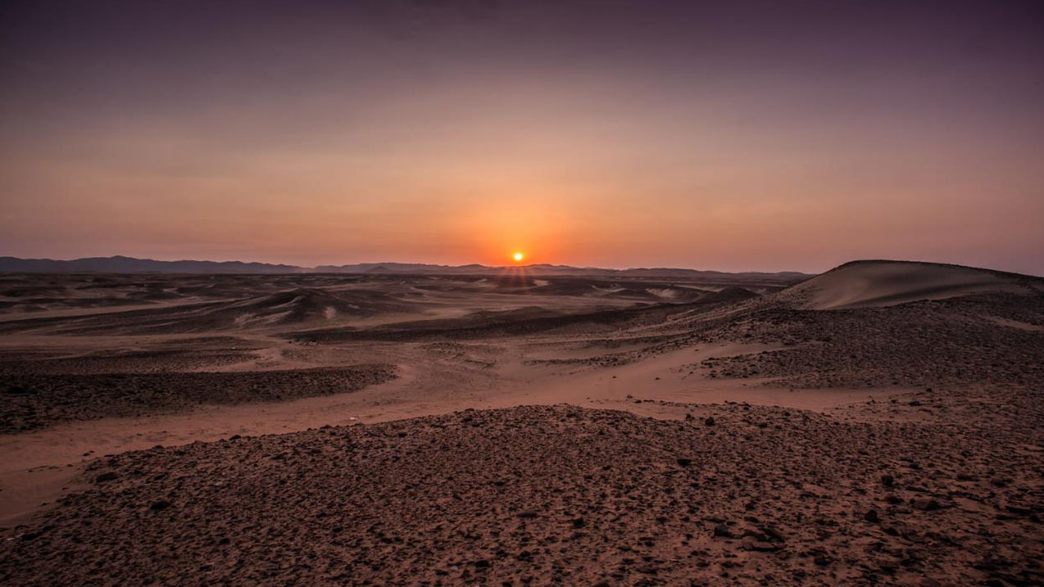
Eritrea

Slide 13
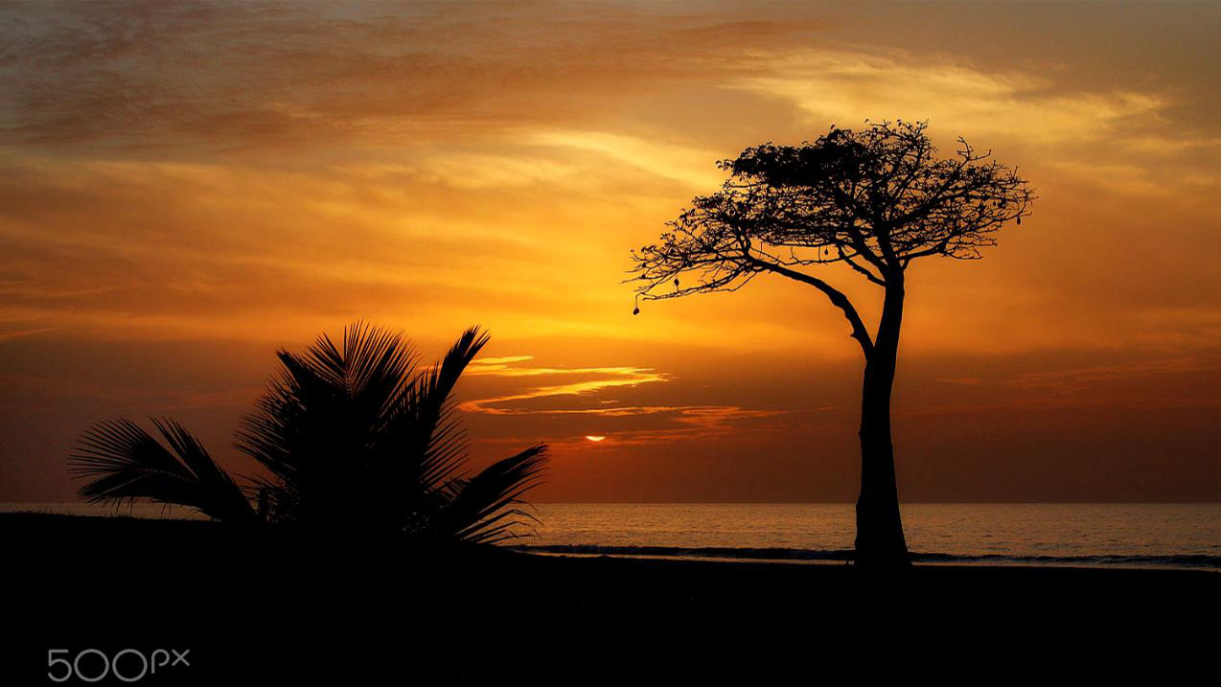
Gambia
Photography © by Wilma Wijers Smeets

Slide 14
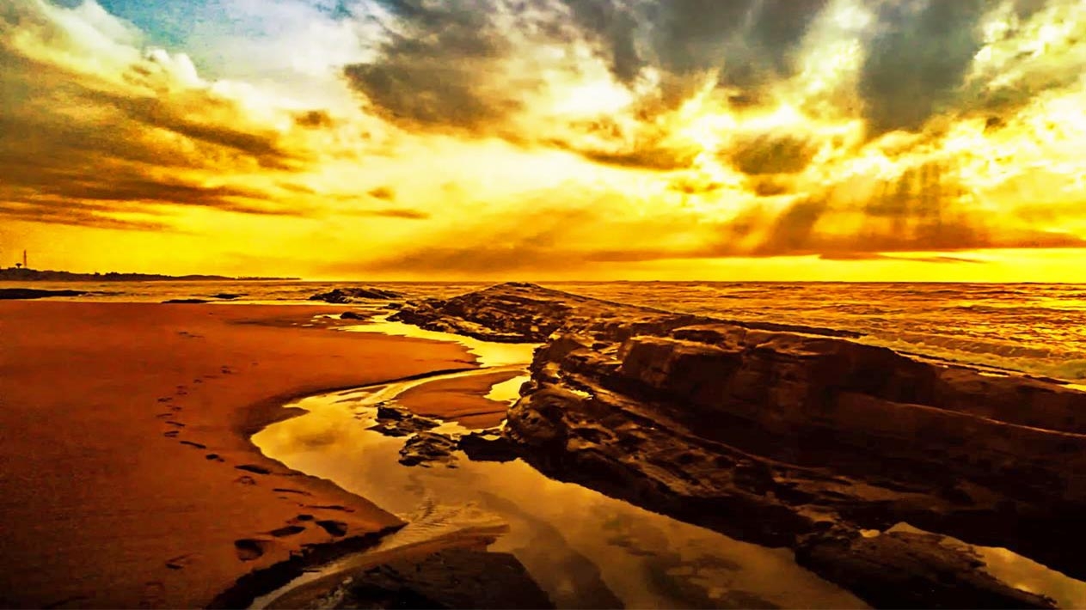
Ghana
Photography © by Ayitey Hammond on 500px

Slide 15
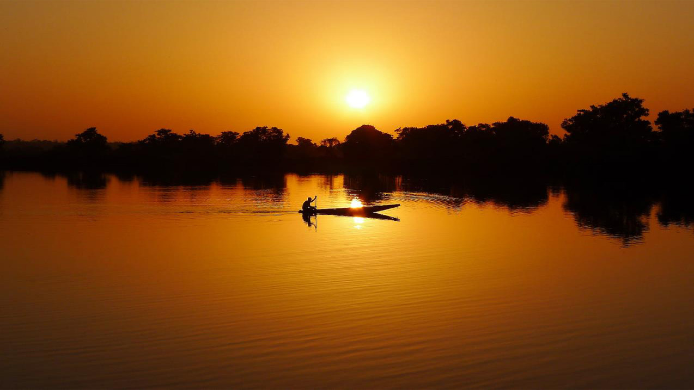
Guinea Bissau
Photography © by Murch TP on 500px

Slide 16
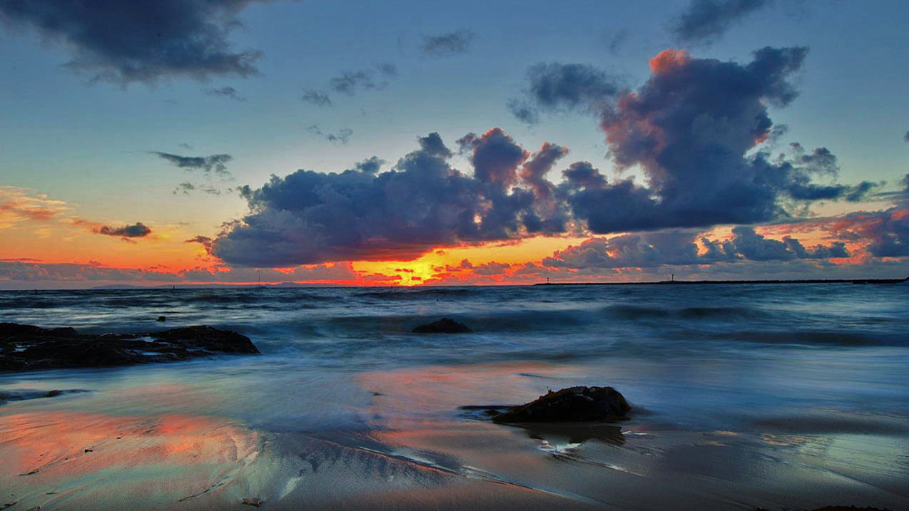
Ivory Coast
Photography © by Mike Alimir on 500px

Slide 17
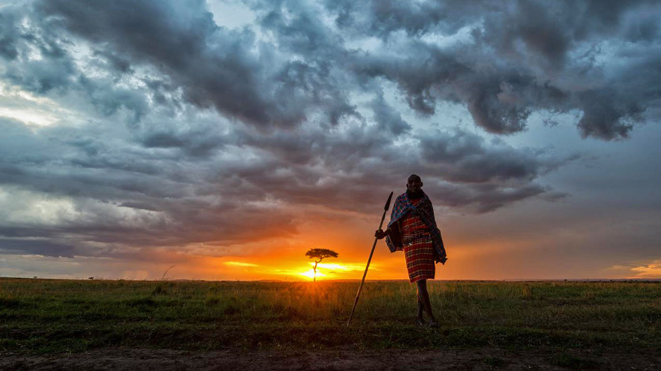
Kenya
Photography © by Dale Johnson on 500px

Slide 18
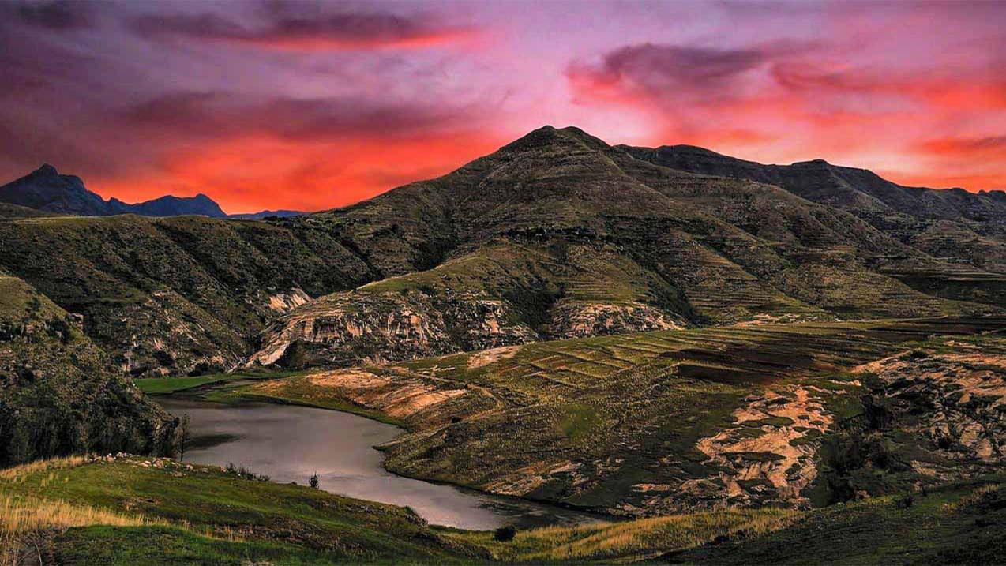
Lesotho
Photography © by Mark van Vuuren on 500px

Slide 19
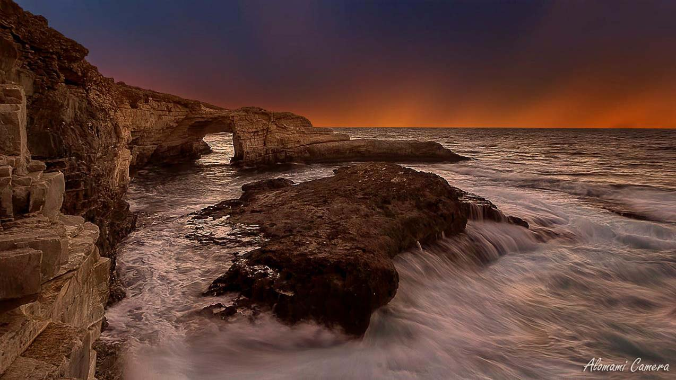
Libya

Slide 20
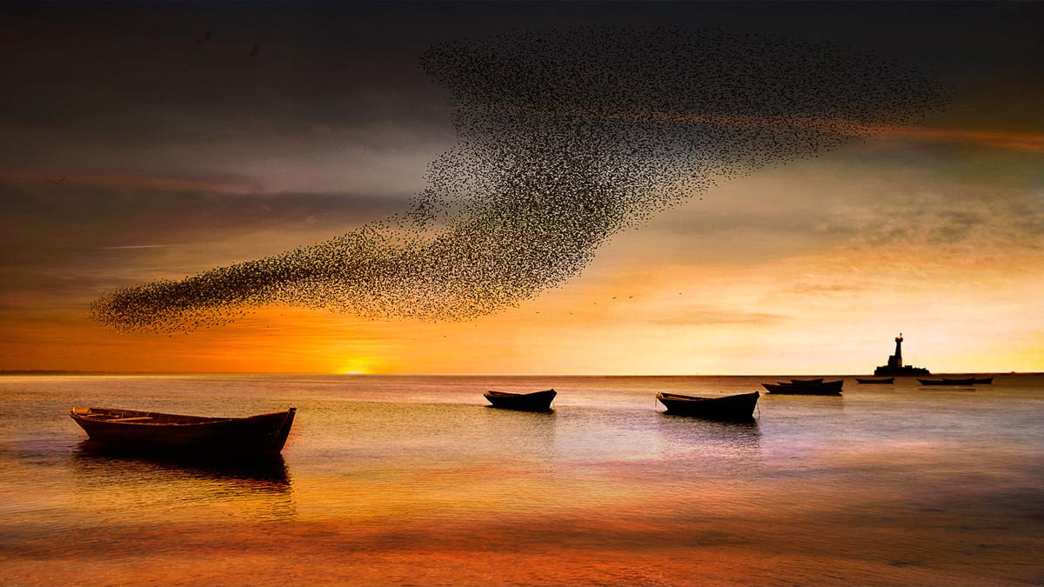
Madagascar
Photography © by riccardo lubrano on 500px

Slide 21
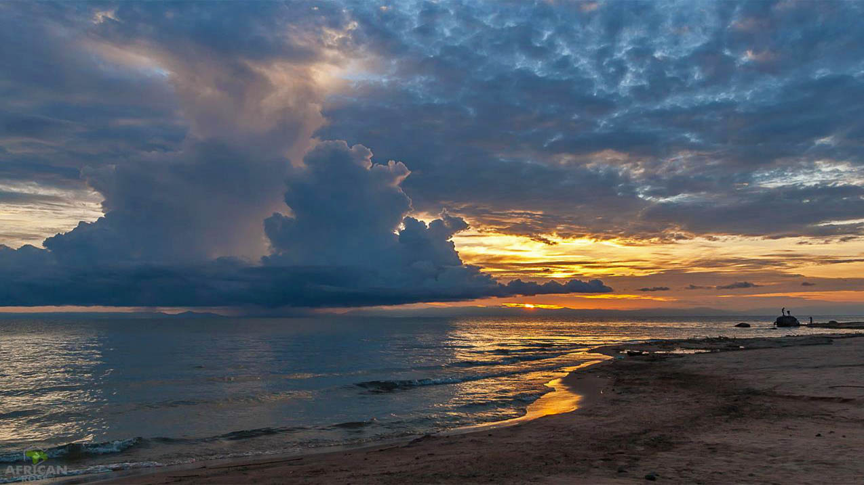
Malawi
Photography © by Robin Learmonth on 500px

Slide 22
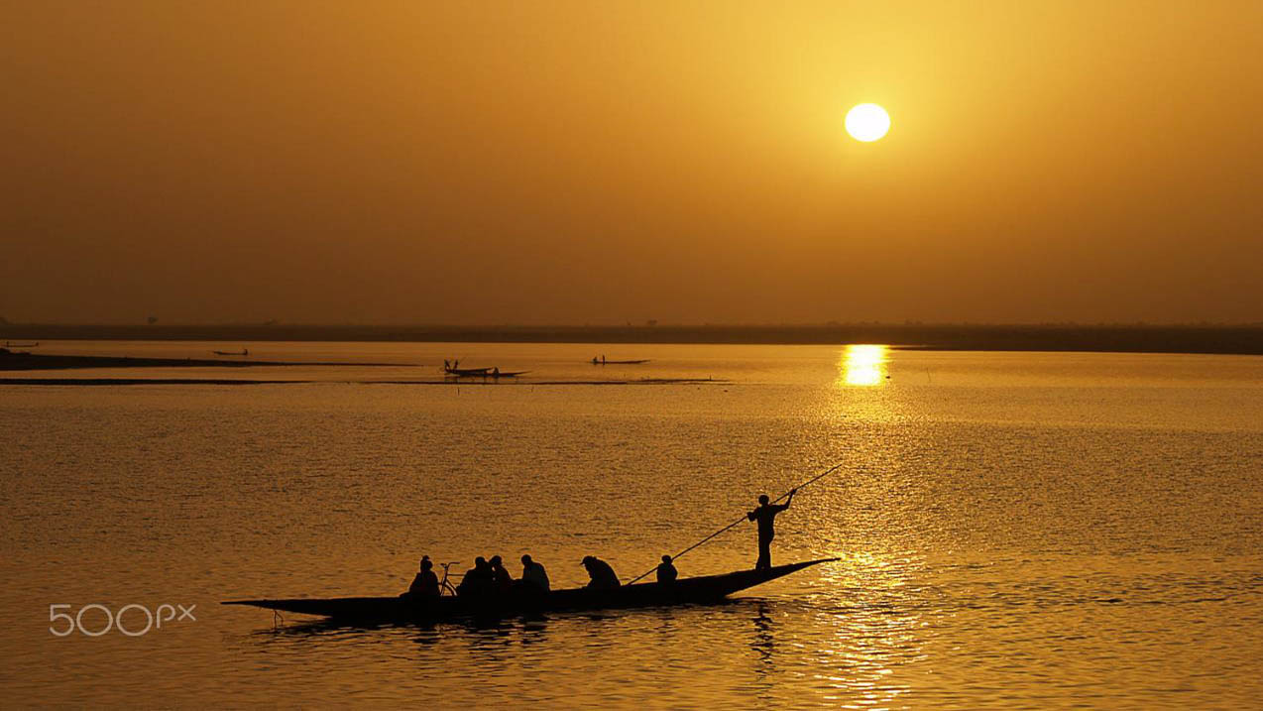
Mali
Photography © by mag brinik

Slide 23
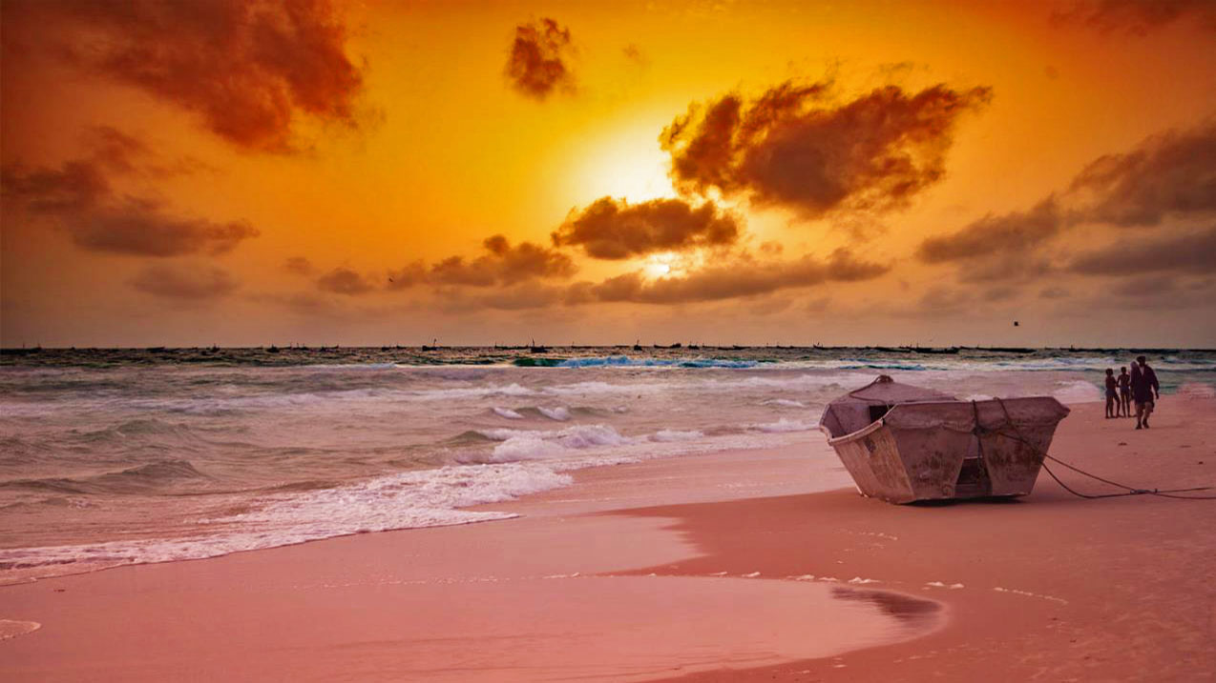
Mauritania
Photography © by Furqan Ali on 500px

Slide 24
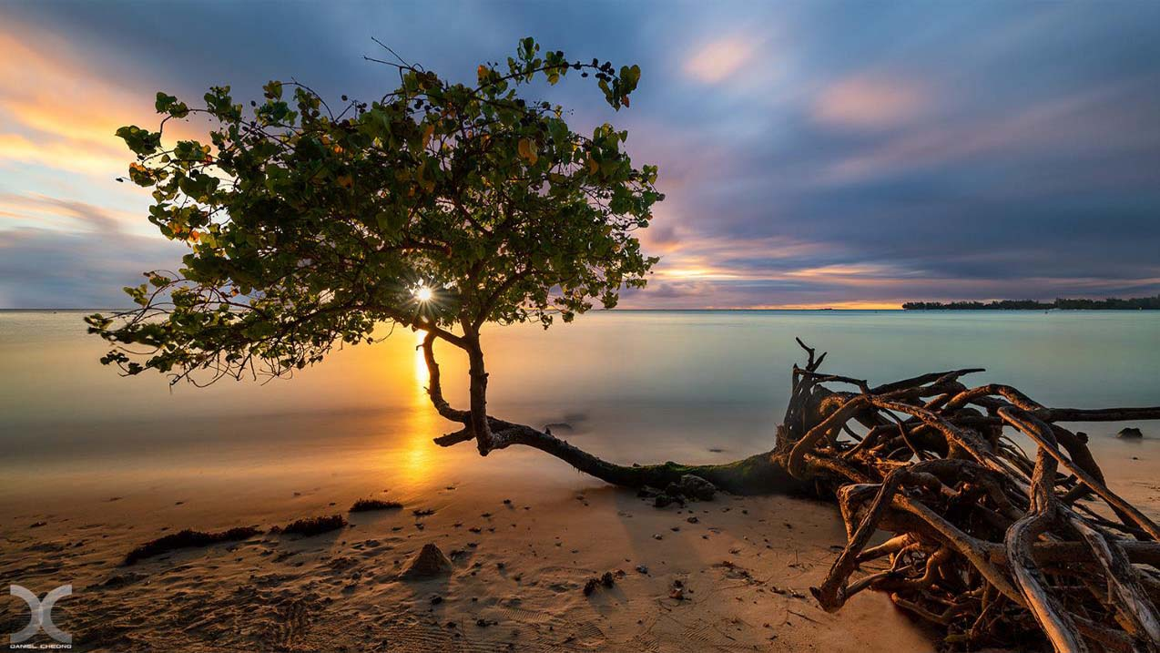
Mauritius

Slide 25
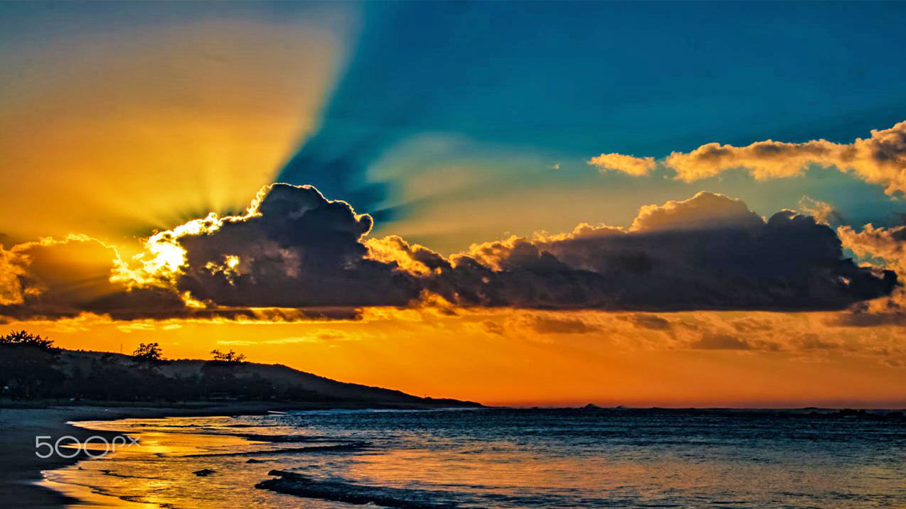
Mozambique
Photography © by Jose Oliveira

Slide 26
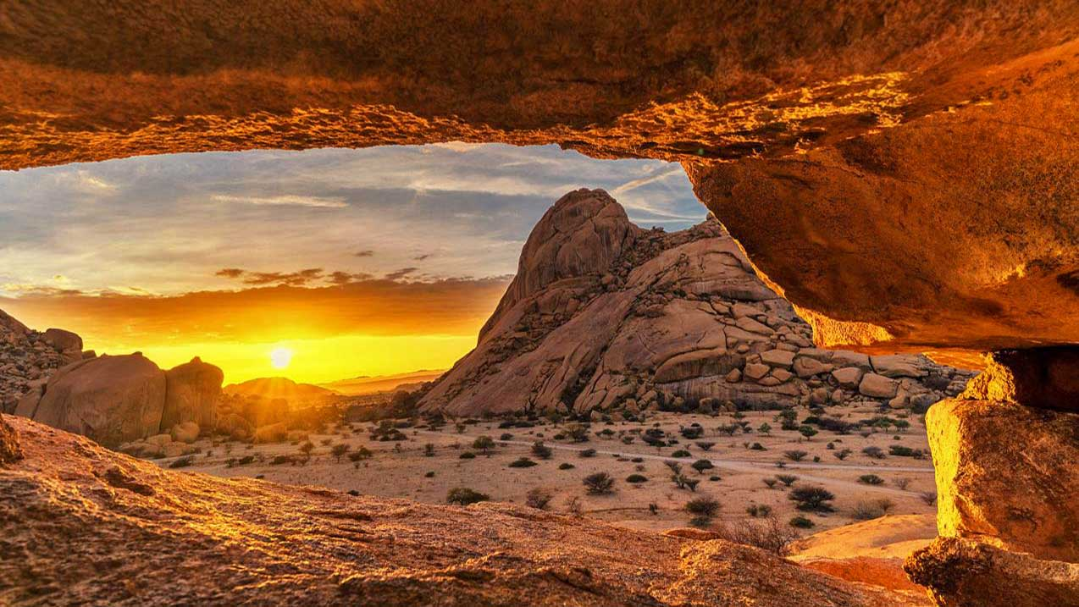
Namibia
Photography © by Oliver O. on 500px

Slide 27
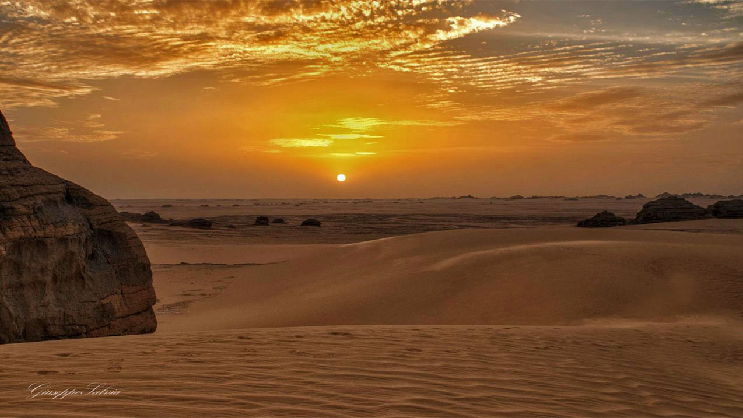
Niger
Photography © by Giuseppe Salvia on 500px

Slide 28
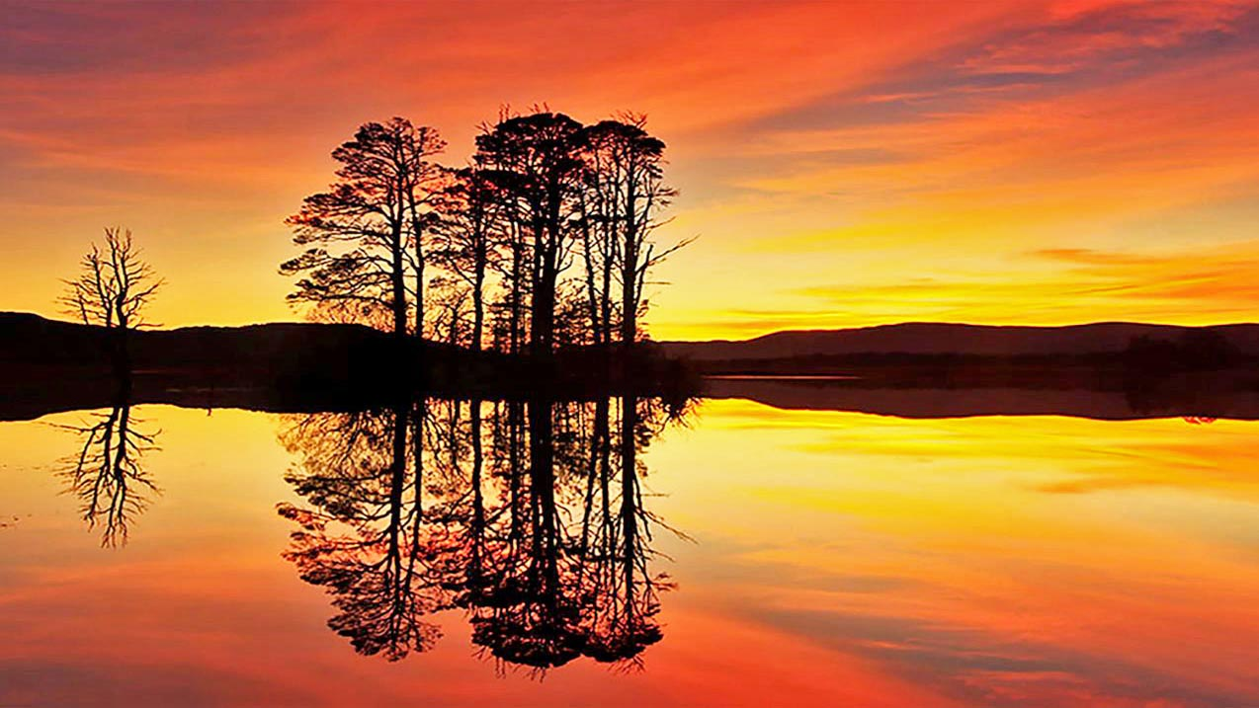
Nigeria
Photography © by Miracle Goodwill on 500px

Slide 29
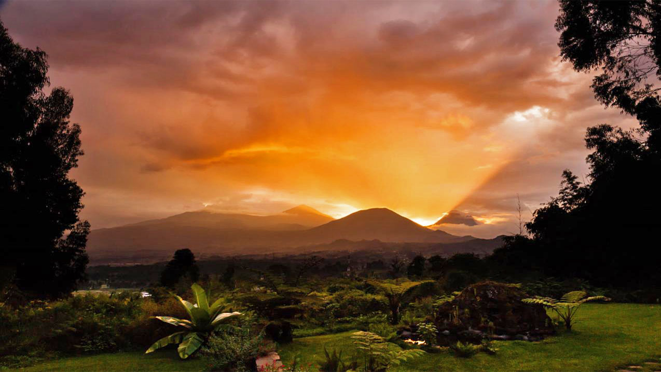
Rwanda
Photography © by Cc1 on 500px

Slide 30
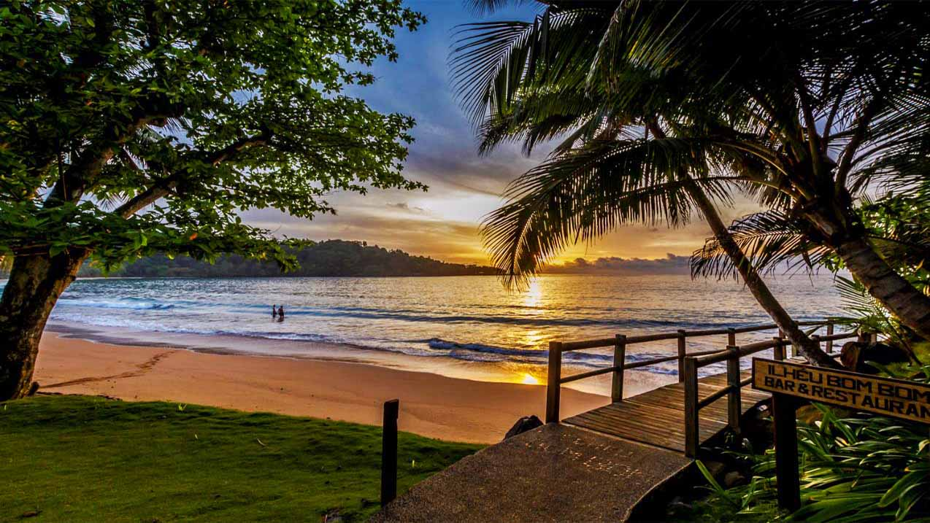
Sao Tomé and Príncipe
Photography © by Rui T Guedes on 500px

Slide 31
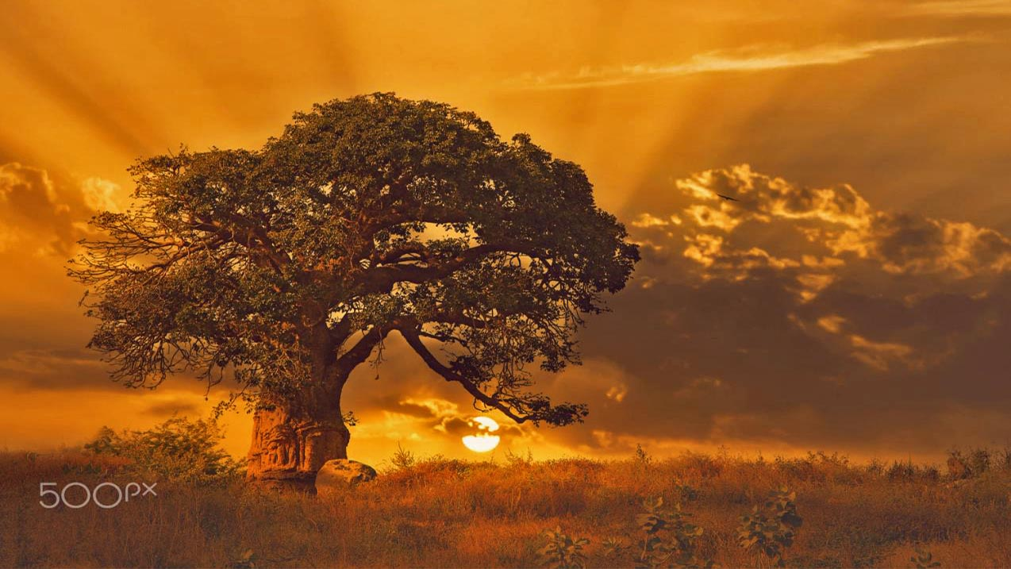
Senegal
Photography © by Mohamed Sabry

Slide 32
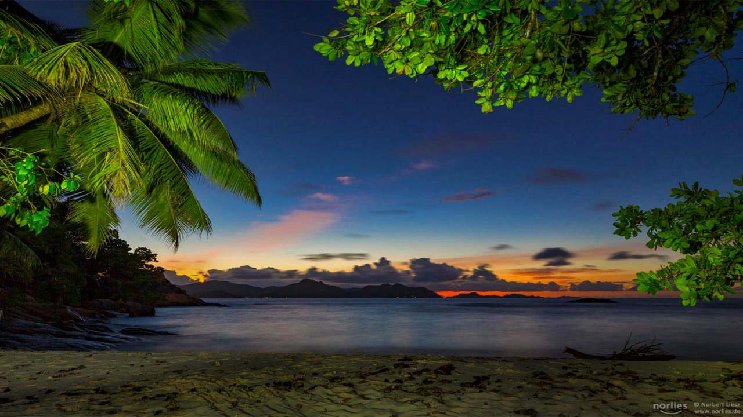
Seychelles

Slide 33
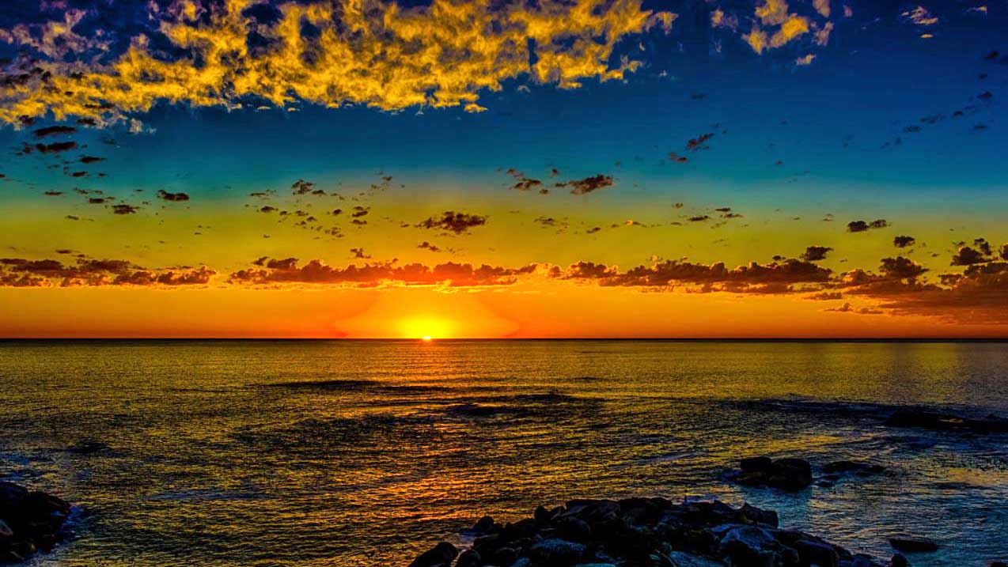
South Africa
Photography © by Olaf Holland on 500px

Slide 34
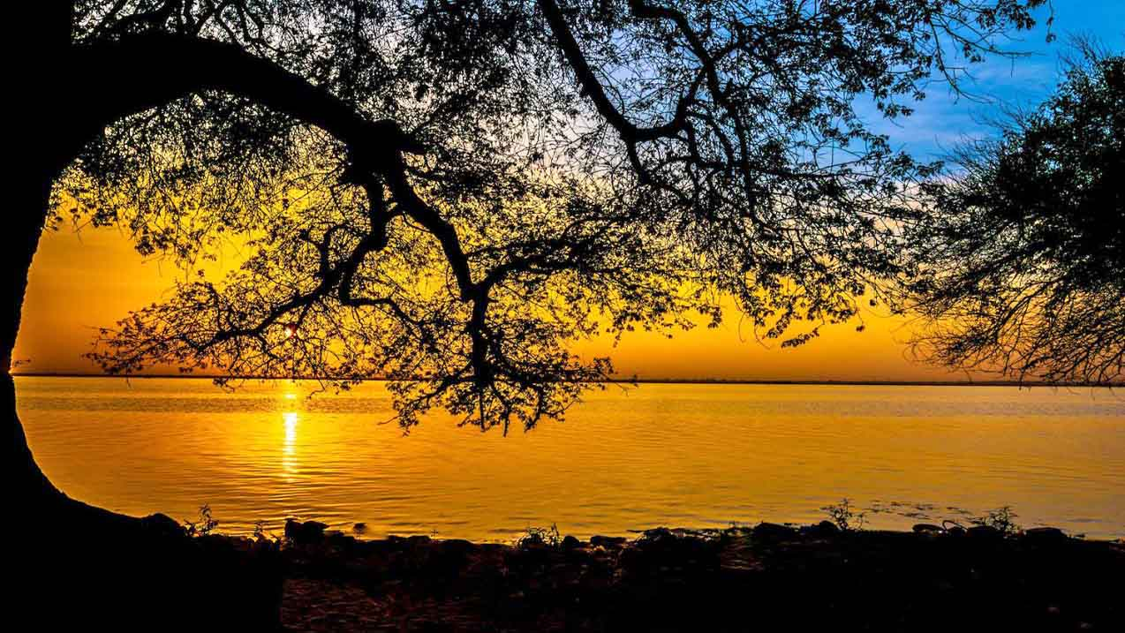
Sudan
Photography © by Suhail Khan on 500px

Slide 35
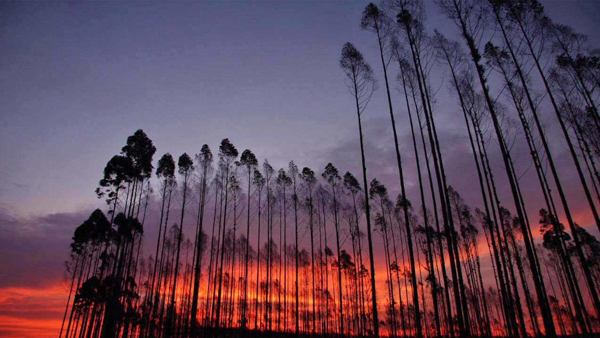
Swaziland
Photography © by Fatima Serrão Gomes on 500px

Slide 36
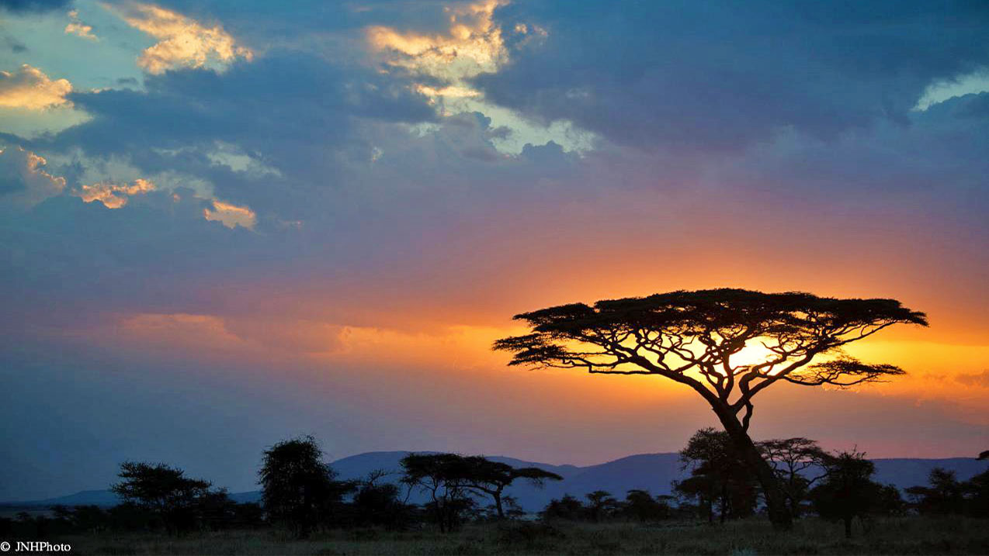
Tanzania
Photography © by John Harrison on 500px

Slide 37
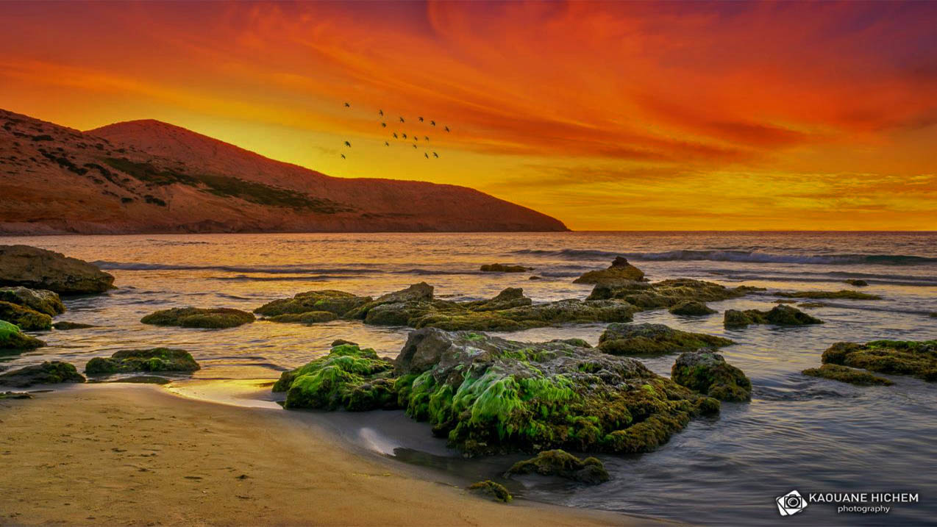
Tunisia
Photography © by Kaouane Hichem on 500px

Slide 38
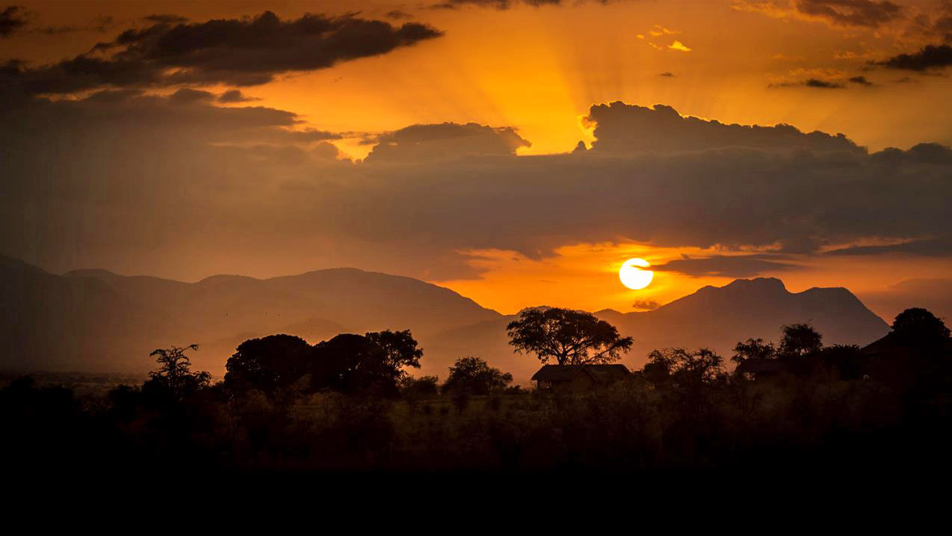
Uganda
Photography © by Liesbet Sanders on 500px

Slide 39
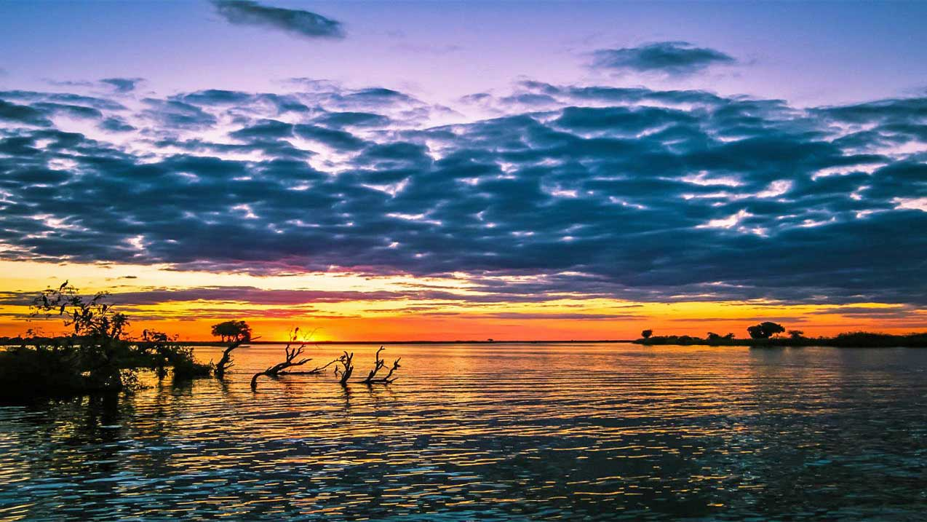
Zambia
Photography © by Kevin Clark on 500px

Slide 40




México 2018
Imágenes de la Web
Música: Busi Mhlongo - Yehlisan
Edición y compilación : Eduardo Gutiérrez y Castro
Cooperacion tecnica : Steve Rumpler
Atardeceres
en
Africa

Slide 41







¿Te ha gustado?
Puedes ver más entrando
Aquí
Además puedes recibir powerpoints en tu correo electrónico suscribiéndote aquí:

