Slide 1










Slide 2





No, I can't forget this evening, or your face as you were leaving, But I guess that's just the way the story goes. You always smile but in your eyes , your sorrow shows es, it shows

Slide 3

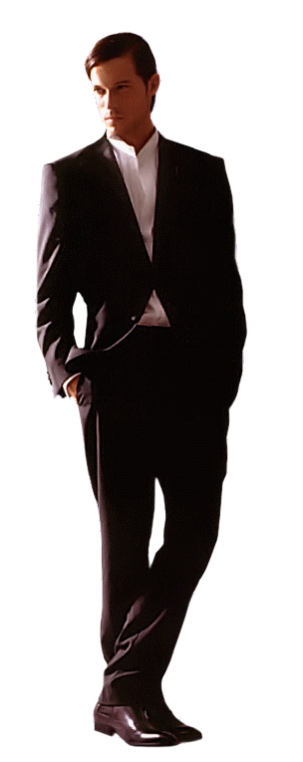



No, I can't forget tomorrow, When I think of all my sorrows When I had you there but then I let you go And now it's only fair that I should let you know what You should know

Slide 4






I can't live, if living is without you, I can't live, I can't give any more. Can't live, if living is without you , I can't give, I can't give anymore

Slide 5








No, I can't forget this evening, or your face as you were leaving But I guess that's just the way the story goes. You always smile but in your eyes your sorrow shows Yes, it shows

Slide 6











Can't live, if living is without you, I can't live, I can't give anymore, I can't live, if living is without you, Can't live, I can't give anymore, Aaaay... Living is without you.

Slide 7


Slide 8


Slide 9


Slide 10


Slide 11


Slide 12



Accede a la sección que desees desde aquí:
Propia Creación
De la Red
Dedicatorias | Fechas Especiales | Graciosos
Historia y Arte | Lugares | Musicales
Naturaleza y Ciencias | Política | Reflexión
Religiosos | Románticos | Salud
Dedicatorias | Fechas Especiales | Graciosos
Historia y Arte | Lugares | Musicales
Naturaleza y Ciencias | Política | Reflexión
Religiosos | Románticos | Salud
Si deseas recibir pps periódicamente en tu correo electrónico subscríbete aquí:

