Slide 1
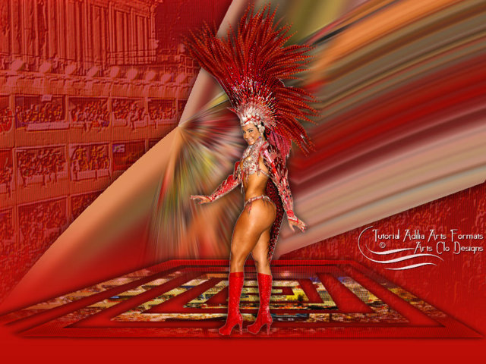

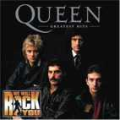

Canción: WE WILL ROCK YOU
Interpretes: Queen
AUTOMATICO
WE WILL ROCK YOU

Slide 2
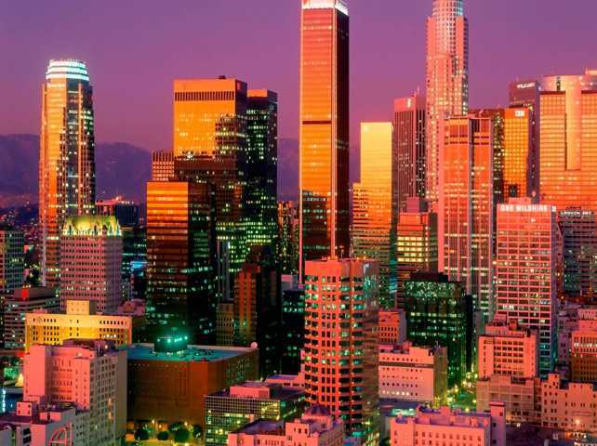

Buddy you’re a boy make a big noise. Playing’ in the street gonna be a big man some day. You got mud on yo’face. You big disgrace. Kickin’ your can all over the place. Singin’

Slide 3

We will we will rock you. We will we will rock you.

Slide 4
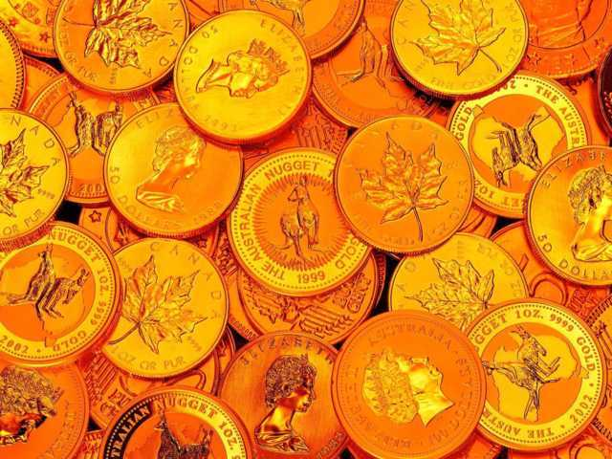
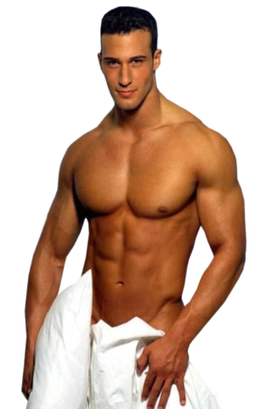
Buddy you’re a young man hard man. Shoutin’ in the street gonna take on the world some day. You got blood on you’ face. You big disgrace. Waving’ your banner all over the place. Singin’

Slide 5

We will we will rock you. We will we will rock you.

Slide 6
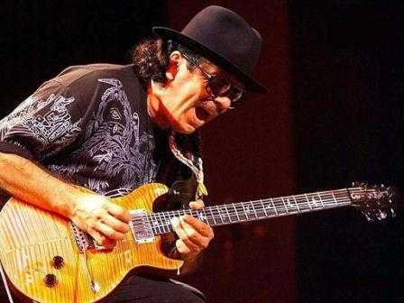
Buddy you’re an old man poor man. Pleading’ with your eyes goanna make, you some peace some day. You got mud on your face. You big disgrace. Somebody goanna put you back in your place.

Slide 7


We will we will rock you. We will we will rock you.

Slide 8
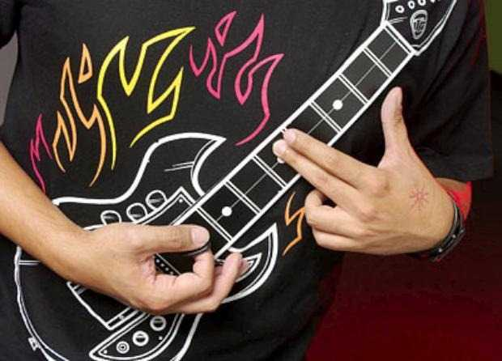
We will we will rock you. We will we will rock you.

Slide 9



Accede a la sección que desees desde aquí:
Propia Creación
De la Red
Dedicatorias | Fechas Especiales | Graciosos
Historia y Arte | Lugares | Musicales
Naturaleza y Ciencias | Política | Reflexión
Religiosos | Románticos | Salud
Dedicatorias | Fechas Especiales | Graciosos
Historia y Arte | Lugares | Musicales
Naturaleza y Ciencias | Política | Reflexión
Religiosos | Románticos | Salud
Si deseas recibir pps periódicamente en tu correo electrónico subscríbete aquí:

