Slide 1
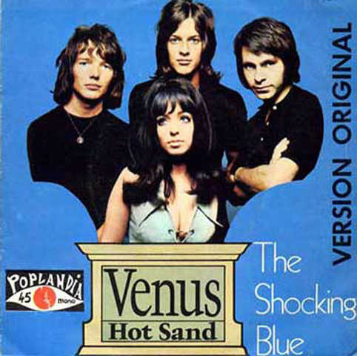



Slide 2
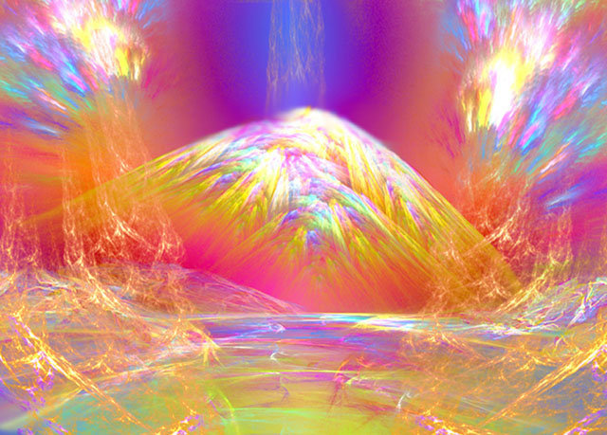


Slide 3


Slide 4
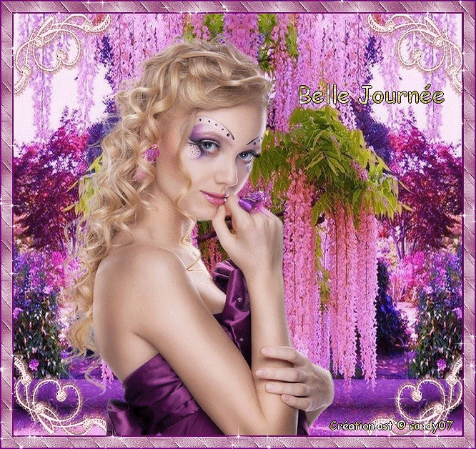

Slide 5


Slide 6
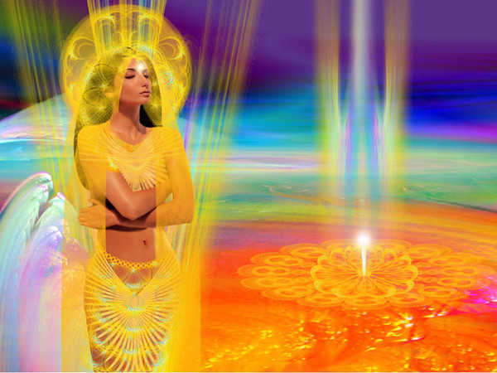


Goddess on the mountain top, Burning like a silver flame, The summit of beauty and love, And Venus was her name

Slide 7
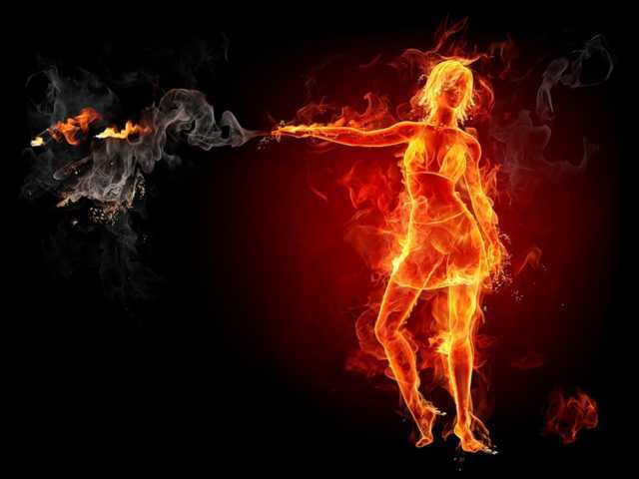
She's got it , Yeah, baby, she's got it, I'm your Venus, I'm your fire, At your desire, Well, I'm your Venus, I'm your fire, At your desire.

Slide 8
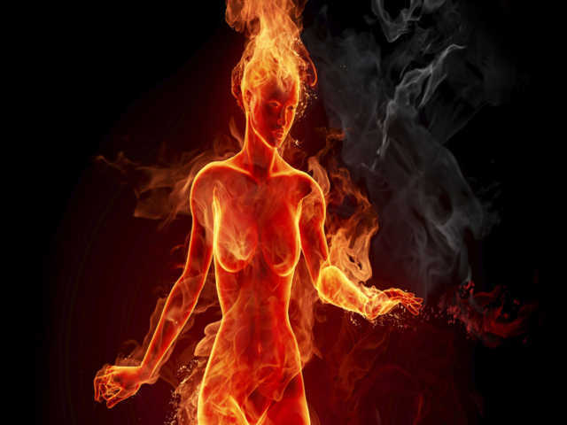

Slide 9
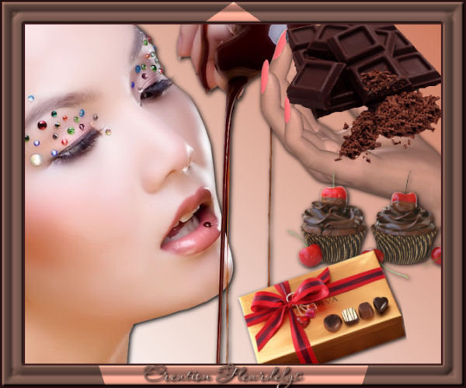

Slide 10
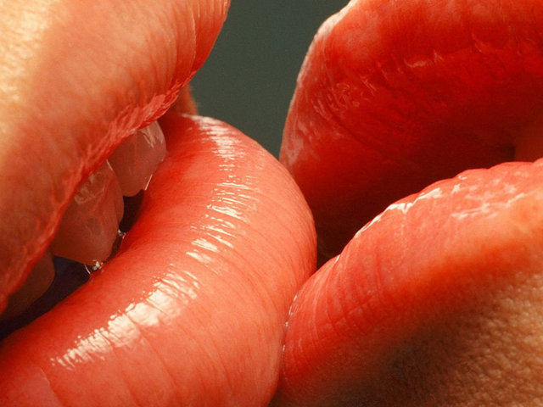

Slide 11
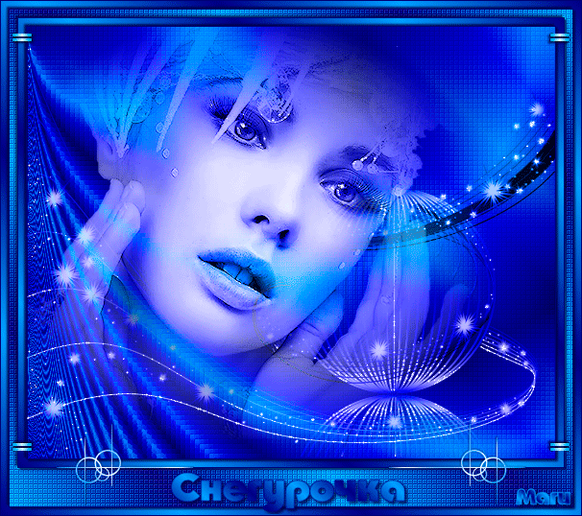

Slide 12


Slide 13

Her weapons were her crystal eyes, Making every man a man, Black as the dark night she was, Got what no-one else had, Wa!

Slide 14

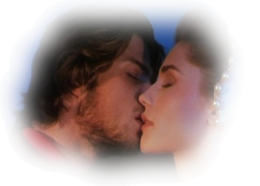
She's got it , Yeah, baby, she's got it, I'm your Venus, I'm your fire, At your desire, Well, I'm your Venus, I'm your fire, At your desire

Slide 15
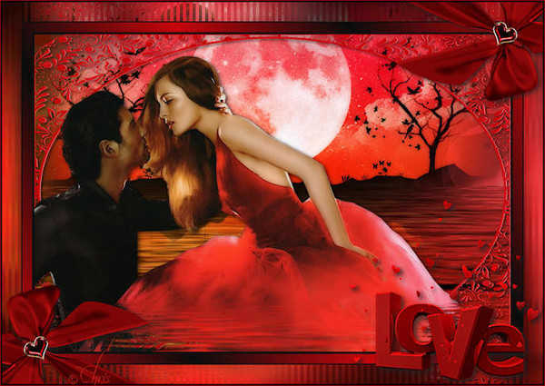

Slide 16


Slide 17


Slide 18
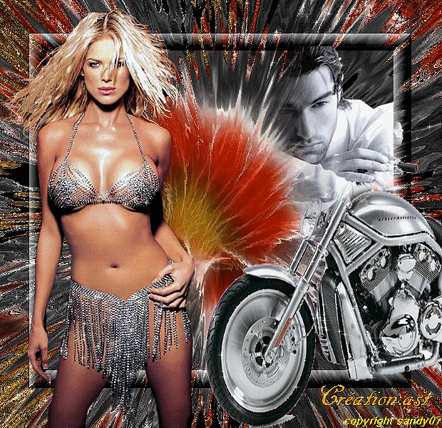

Slide 19


Slide 20
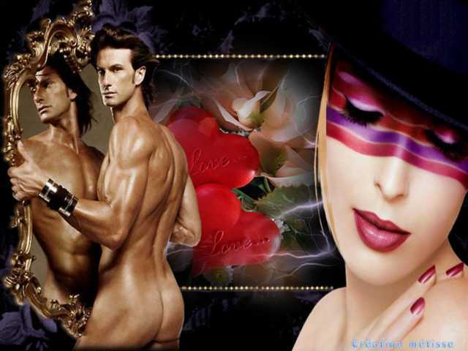

Slide 21
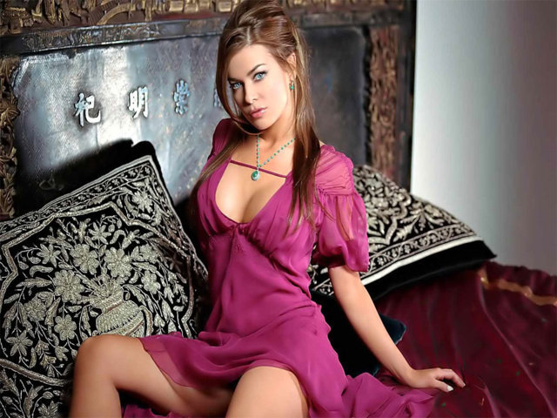
She's got it , Yeah, baby, she's got it, I'm your Venus, I'm your fire, At your desire, Well, I'm your Venus, I'm your fire, At your desire

Slide 22


Slide 23
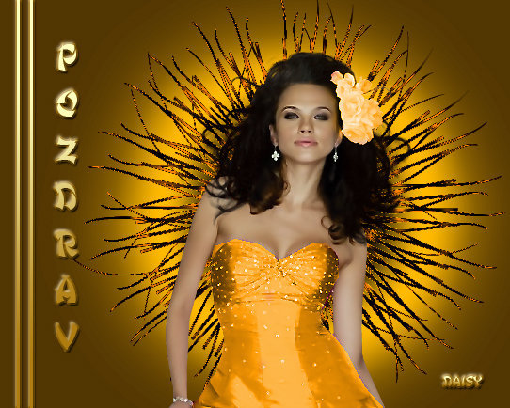

Slide 24
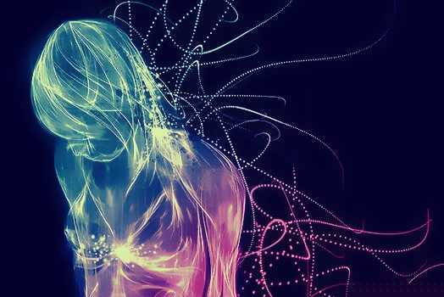

Slide 25
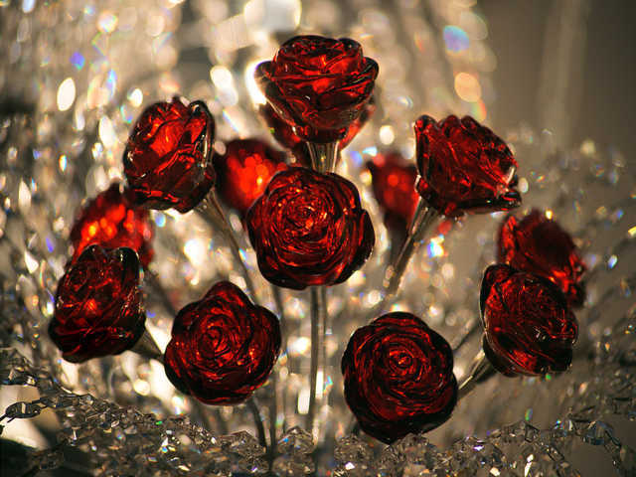

Slide 26
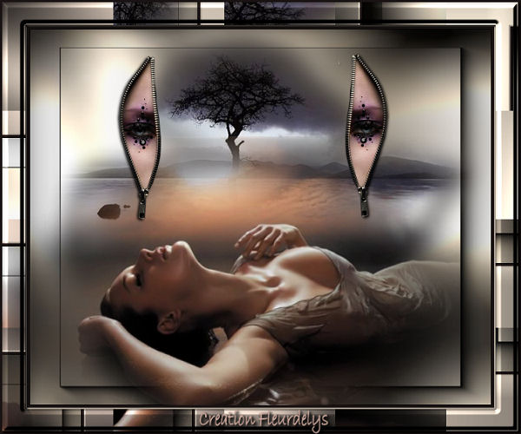

Slide 27
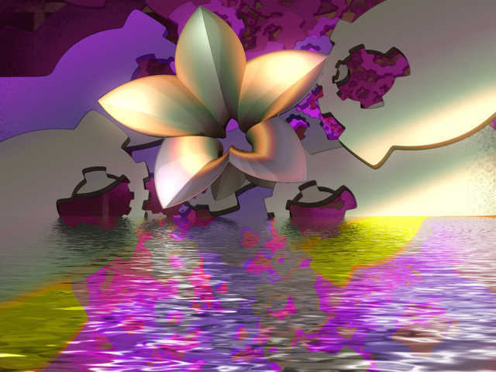


Slide 28


Slide 29
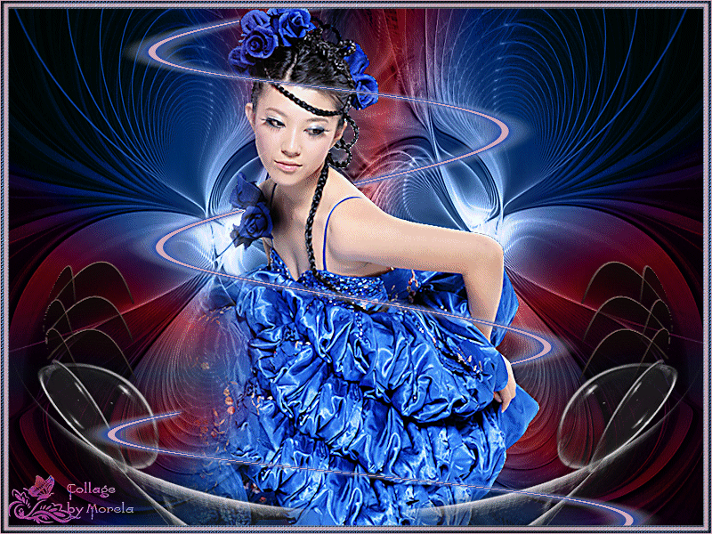

Slide 30



Accede a la sección que desees desde aquí:
Propia Creación
De la Red
Dedicatorias | Fechas Especiales | Graciosos
Historia y Arte | Lugares | Musicales
Naturaleza y Ciencias | Política | Reflexión
Religiosos | Románticos | Salud
Dedicatorias | Fechas Especiales | Graciosos
Historia y Arte | Lugares | Musicales
Naturaleza y Ciencias | Política | Reflexión
Religiosos | Románticos | Salud
Si deseas recibir pps periódicamente en tu correo electrónico subscríbete aquí:

