Slide 1
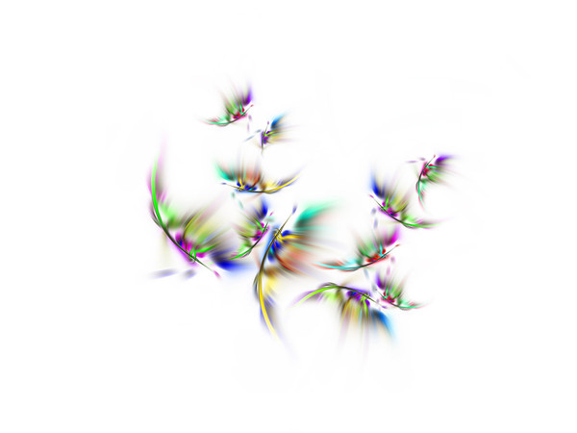









Slide 2
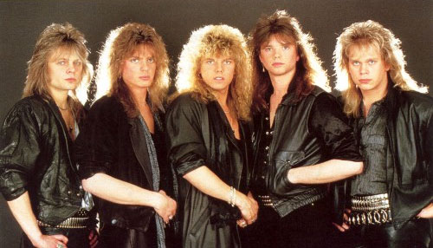


Slide 3


Slide 4

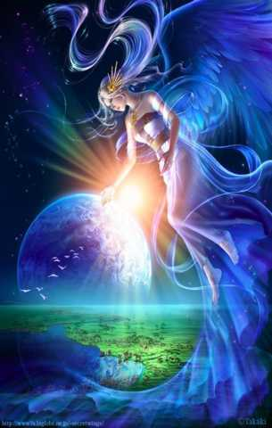

Slide 5
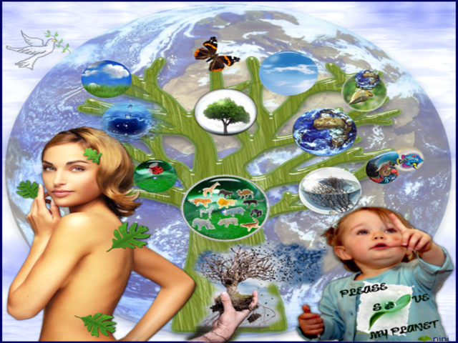

Slide 6
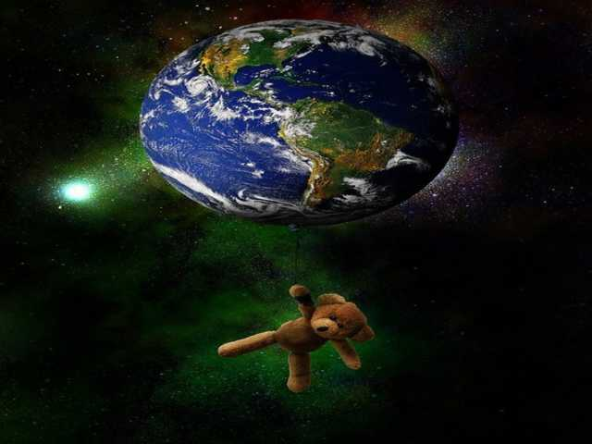

Slide 7
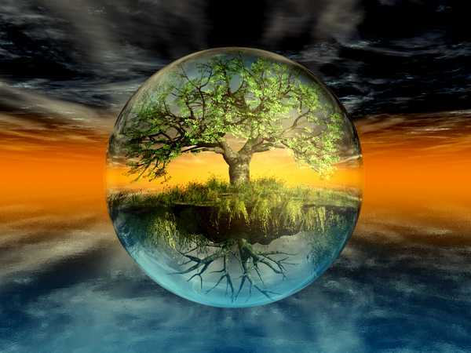

Slide 8
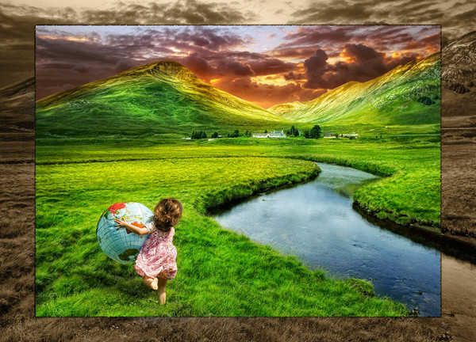

Slide 9
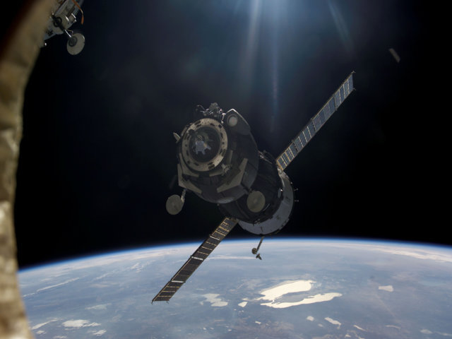
We're leaving together, But still it's farewell, And maybe we'll come back

Slide 10


To earth, who can tell, I guess there is no one to blame, We're leaving ground (leaving ground)

Slide 11
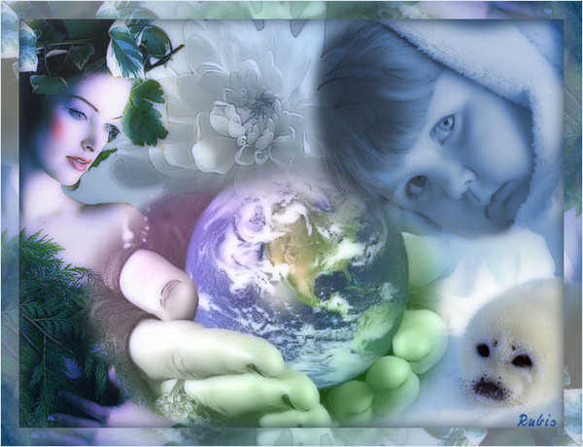
Will things ever be the same again, It's the final countdown... The final countdown, Ooh oh

Slide 12

We're heading for Venus (Venus) And still we stand tall, Cause maybe they've seen us, And welcome us all (yeah)

Slide 13
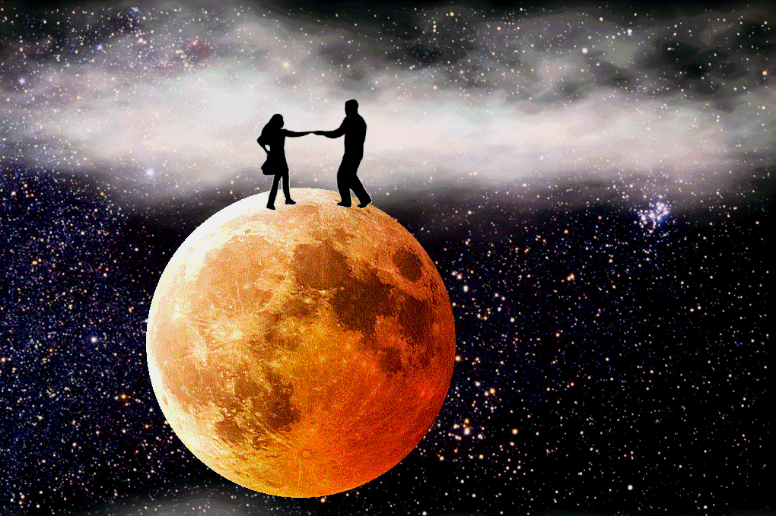
With so many light years to go, And things to be found (to be found), I'm sure that we'll all miss her so, It's the final countdown...

Slide 14
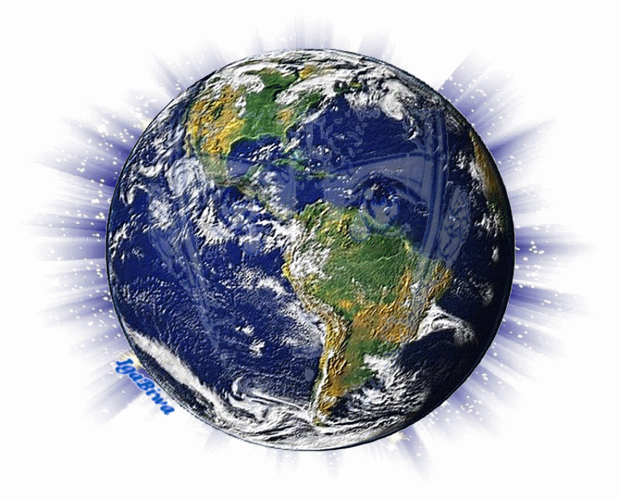
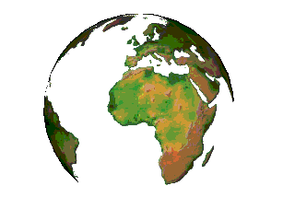
The final countdown, The final countdown (the final, countdown) Ooh ooh oh

Slide 15


Slide 16


Slide 17
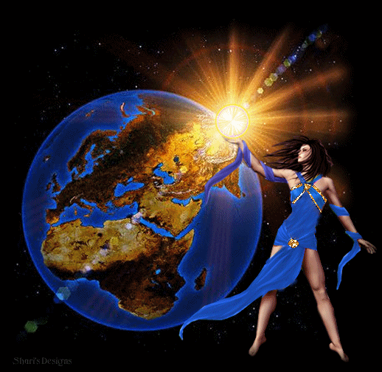

Slide 18
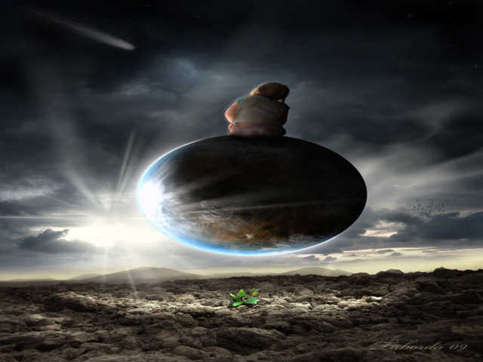
The final countdown, Ooh oh, I'ts the final countdown

Slide 19
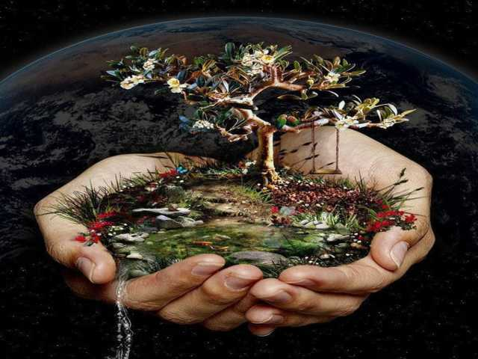
The final countdown, The final countdown (the final countdown) Ooh It's the final countdown, We are leaving together, The final countdown

Slide 20
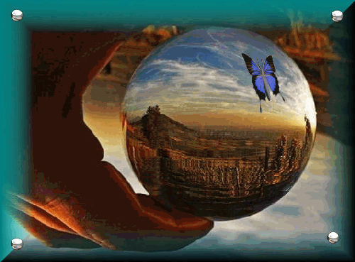
The final countdown
The final countdown
The final countdown

Slide 21



Accede a la sección que desees desde aquí:
Propia Creación
De la Red
Dedicatorias | Fechas Especiales | Graciosos
Historia y Arte | Lugares | Musicales
Naturaleza y Ciencias | Política | Reflexión
Religiosos | Románticos | Salud
Dedicatorias | Fechas Especiales | Graciosos
Historia y Arte | Lugares | Musicales
Naturaleza y Ciencias | Política | Reflexión
Religiosos | Románticos | Salud
Si deseas recibir pps periódicamente en tu correo electrónico subscríbete aquí:

