Slide 1











Slide 2






Though we gotta say goodbye, for the summer, Baby, I promise you this, I´ll send you all my love, Every day in a letter, Sealed with a kiss

Slide 3


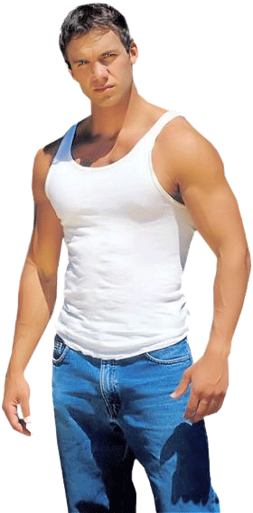


Yes, it´s gonna be a cold, lonely summer, But I´ll fill the emptiness, I´ll send you all my dreams, Every day in a letter, Sealed, with a kiss,

Slide 4




I´ll see you in the sunlight, I´ll hear your voice everywhere, I´ll run to tenderly hold you, But baby, you won´t be there,

Slide 5




I don´t wanna say goodbye, for the summer, Knowing the love we´ll miss, So let us make a pledge, To meet in September, And seal it with a kiss

Slide 6







Slide 7




Yes, it´s gonna be a cold, lonely summer, But I´ll fill the emptiness, I´ll send you all my love, Every day in a letter, Sealed with a kiss,

Slide 8


Sealed with a kiss, Sealed with a kiss. Sealed with a kiss

Slide 9



Accede a la sección que desees desde aquí:
Propia Creación
De la Red
Dedicatorias | Fechas Especiales | Graciosos
Historia y Arte | Lugares | Musicales
Naturaleza y Ciencias | Política | Reflexión
Religiosos | Románticos | Salud
Dedicatorias | Fechas Especiales | Graciosos
Historia y Arte | Lugares | Musicales
Naturaleza y Ciencias | Política | Reflexión
Religiosos | Románticos | Salud
Si deseas recibir pps periódicamente en tu correo electrónico subscríbete aquí:

