Slide 1
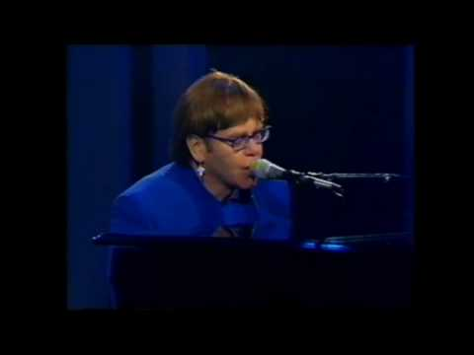

















Slide 2


Slide 3
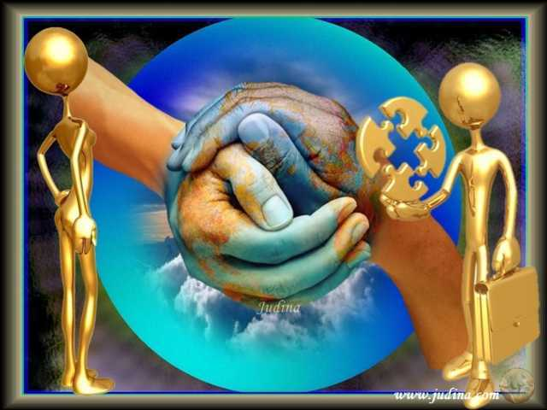

Slide 4
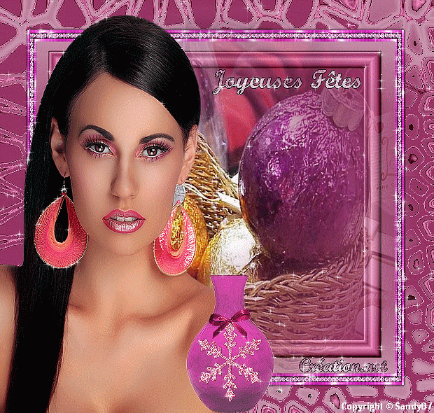
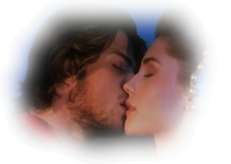

It´s a human sign, when things go wrong, when the scent of her lingers,and temptations come

Slide 5
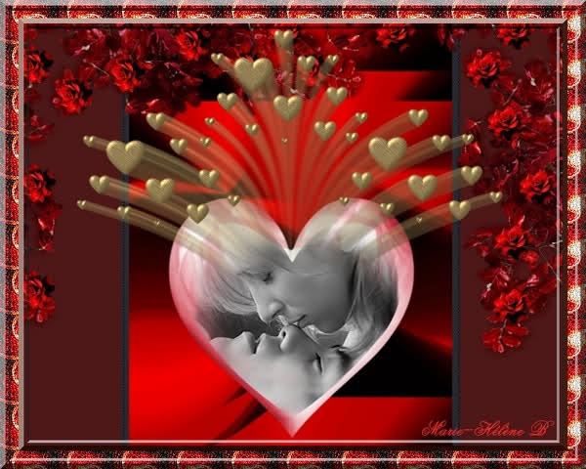
into the boundaries, of each married man, sweet deceits come calling, a negativity lands cold cold heart

Slide 6
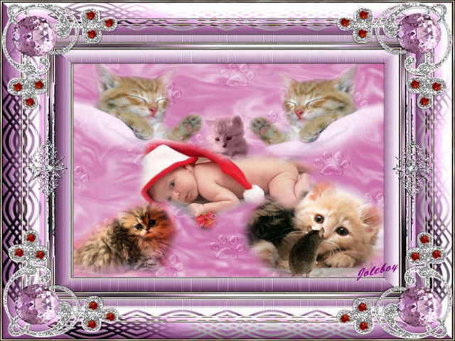
hard done by you, something looking better baby, just passing through

Slide 7
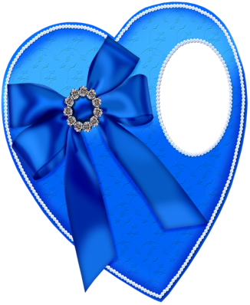


but it´s not sacrifice, just a simple word, it´s two hearts living , into separated worlds

Slide 8
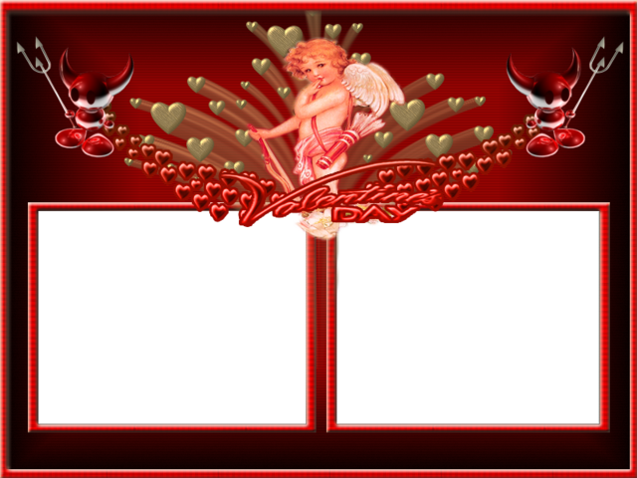




but it´s not sacrifice, it´s not sacrifice, it´s not sacrifice , at all

Slide 9
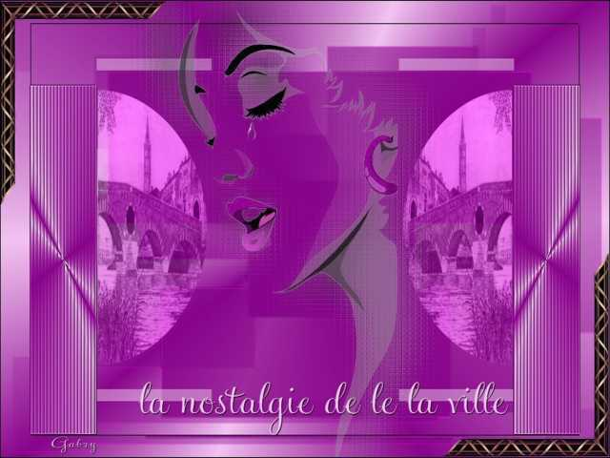
Misunderstanding, after the fact sensitivity builds a poisoning the final act we lose directions stone unturned

Slide 10
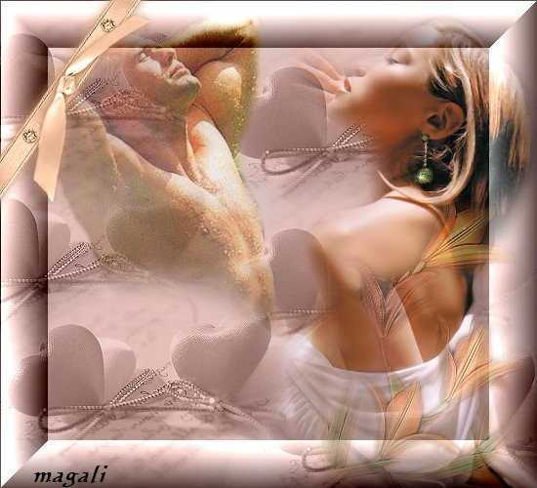
nothing to harm you when jealousy burn scold cold heart hard done by you something looking better baby just passing through

Slide 11
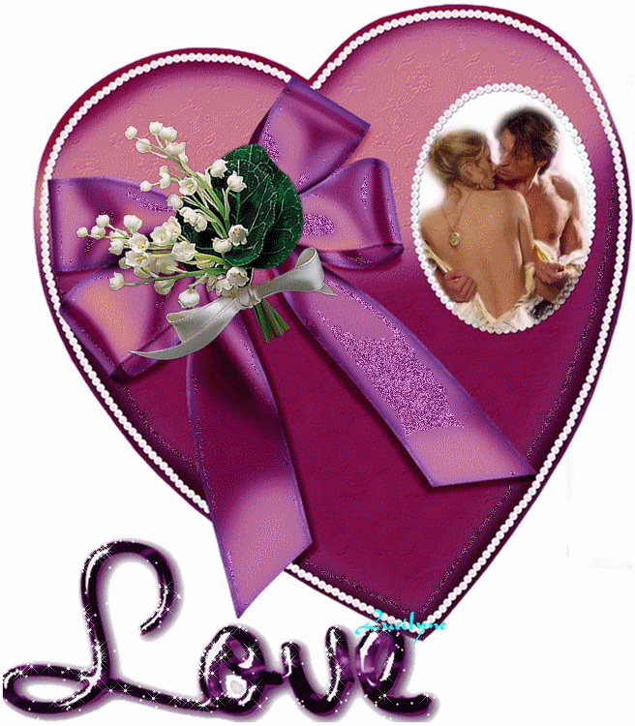
but it´s not sacrifice just a simple word it's two hearts living, into separated worlds

Slide 12
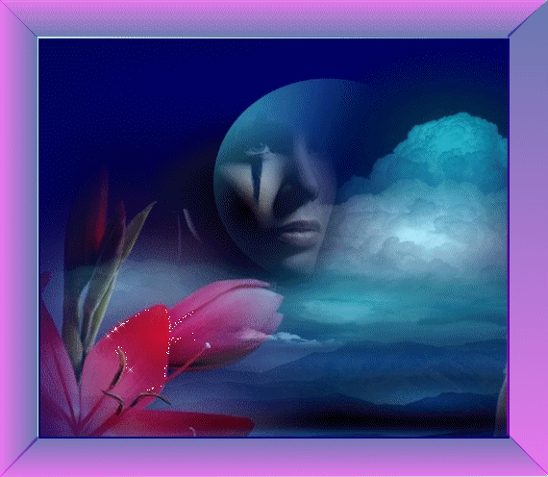
but it´s not sacrifice not sacrifice, it's not sacrifice at all

Slide 13
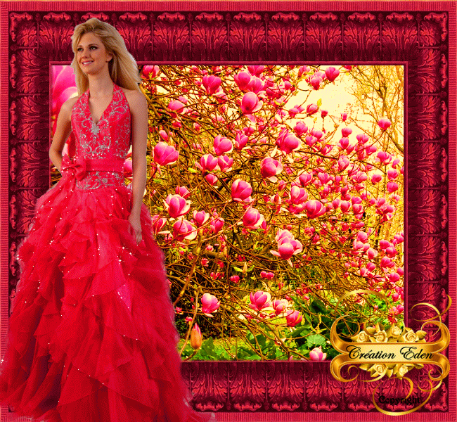

Slide 14
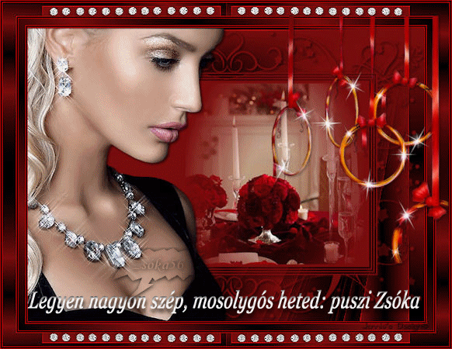

Slide 15
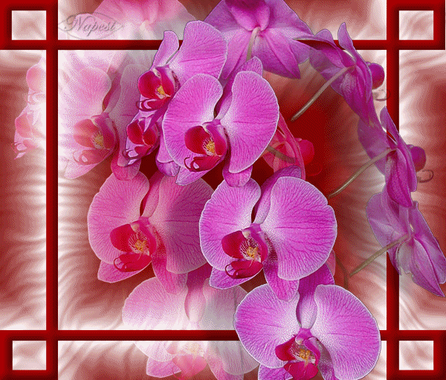

Slide 16
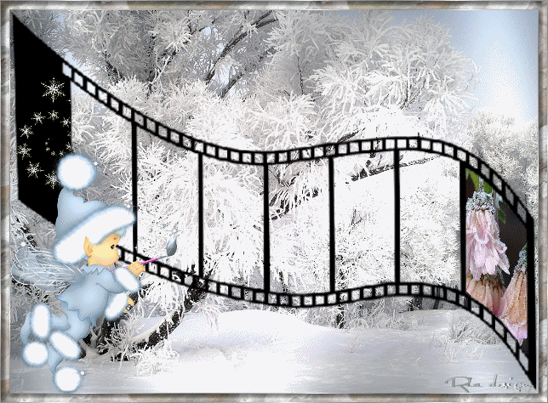

Slide 17
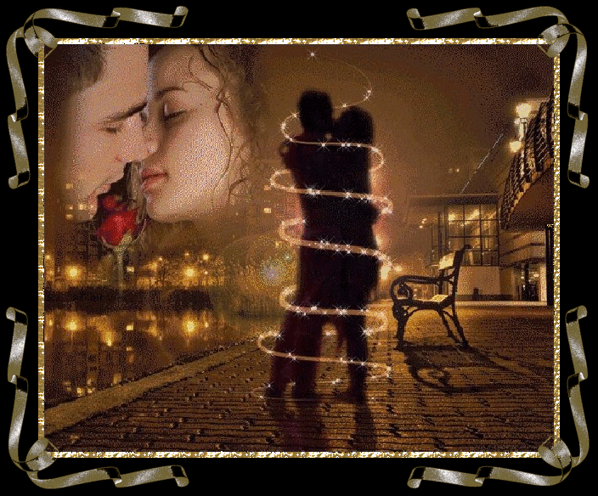

Slide 18
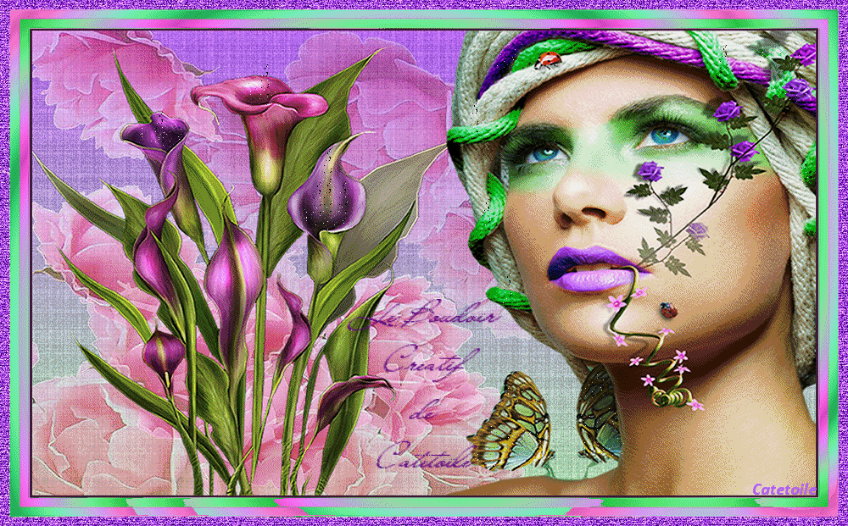

Slide 19
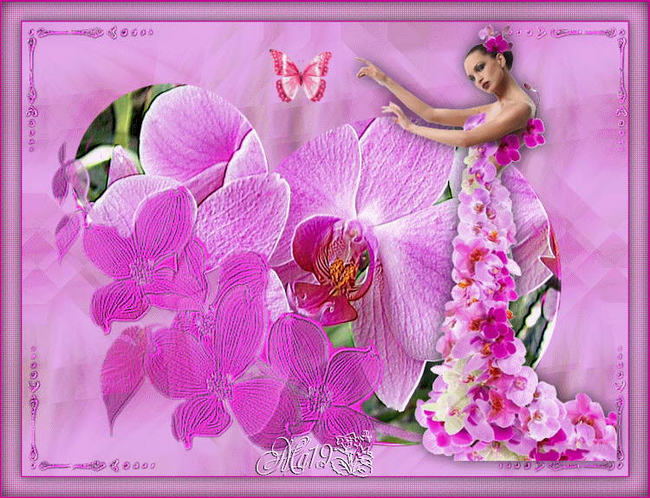

Slide 20
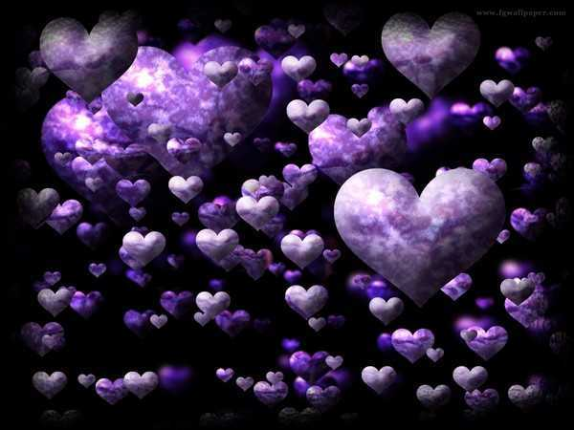
cold cold heart hard done by you some things looking better baby just passing through

Slide 21
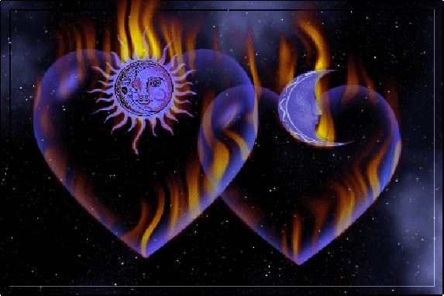
but it´s not sacrifice just a simple word it's two hearts living into separated worlds but it´s not sacrifice it's not sacrifice it's not sacrifice at all

Slide 22
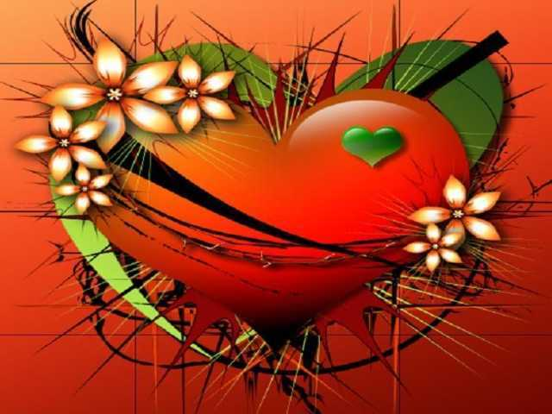
it´s not sacrifice at all, it´s not sacrifice at all, it´s not sacrifice at all, it´s not sacrifice at all,

Slide 23



Accede a la sección que desees desde aquí:
Propia Creación
De la Red
Dedicatorias | Fechas Especiales | Graciosos
Historia y Arte | Lugares | Musicales
Naturaleza y Ciencias | Política | Reflexión
Religiosos | Románticos | Salud
Dedicatorias | Fechas Especiales | Graciosos
Historia y Arte | Lugares | Musicales
Naturaleza y Ciencias | Política | Reflexión
Religiosos | Románticos | Salud
Si deseas recibir pps periódicamente en tu correo electrónico subscríbete aquí:

