Slide 1




Always on My Mind
Powerpoint Hans

Slide 2

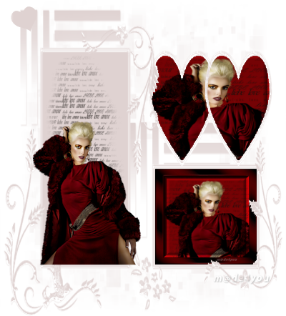
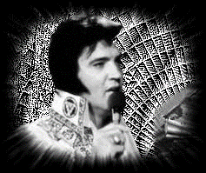
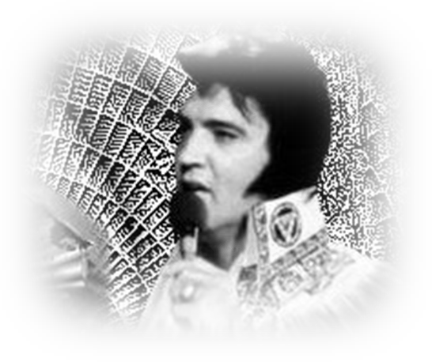
Maybe I didn't treat you
Quite as good as I should have
Maybe I didn't love you
Quite as often as I could have
Little things I should have said and done
I just never took the time

Slide 3
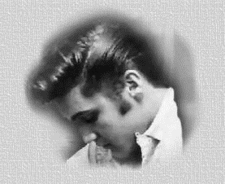
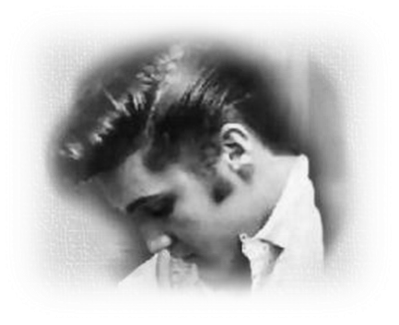

You were always on my mind
You were always on my mind

Slide 4

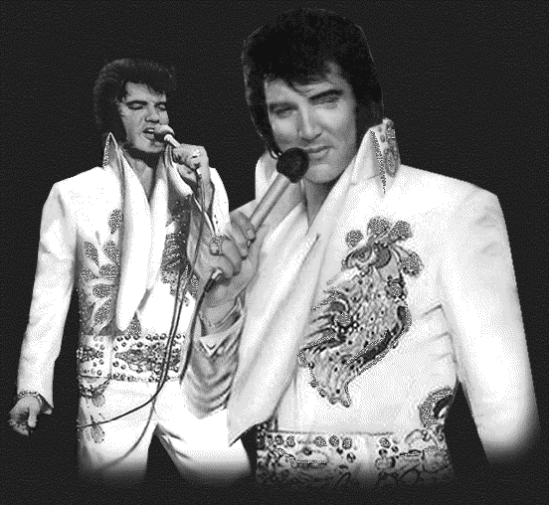
Maybe I didn't hold you
All those lonely, lonely times
And I guess I never told you
I'm so happy that you're mine
If I make you feel second best
Girl, I'm so sorry I was blind

Slide 5
You were always on my mind
You were always on my mind

Slide 6

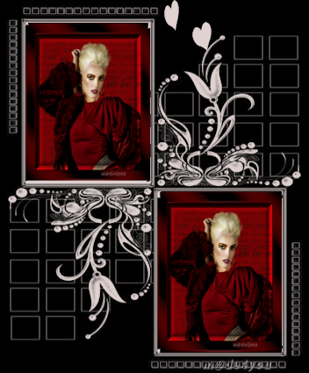
Tell me, tell me that your sweet love hasn't died
Give me, give me one more chance
To keep you satisfied, satisfied
Little things I should have said and done
I just never took the time

Slide 7
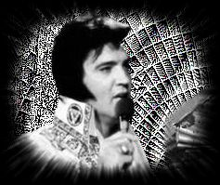
You were always on my mind
You were always on my mind
You were always on my mind

Slide 8
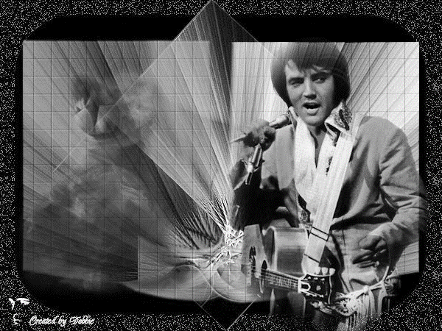
Maybe I didn't treat you
Quite as good as I should have
Maybe I didn't love you
Quite as often as I could have
Maybe I didn't hold you
All those lonely, lonely times
And I guess I never told you
I'm so happy that you're mine
Maybe I didn't treat you
Quite as good as I should have
http://blog.seniorennet.nl/hanspowerpoint/
Druk op Esc voor uit

Slide 9







¿Te ha gustado?
Puedes ver más entrando
Aquí
Además puedes recibir powerpoints en tu correo electrónico suscribiéndote aquí:

