Slide 1


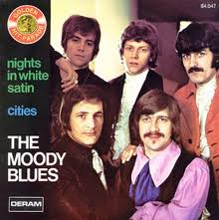

Canción: Noches de blanco satén
Interpretes: The Moody Blues
NOCHES DE BLANCO SATÉN
AUTOMATICO

Slide 2
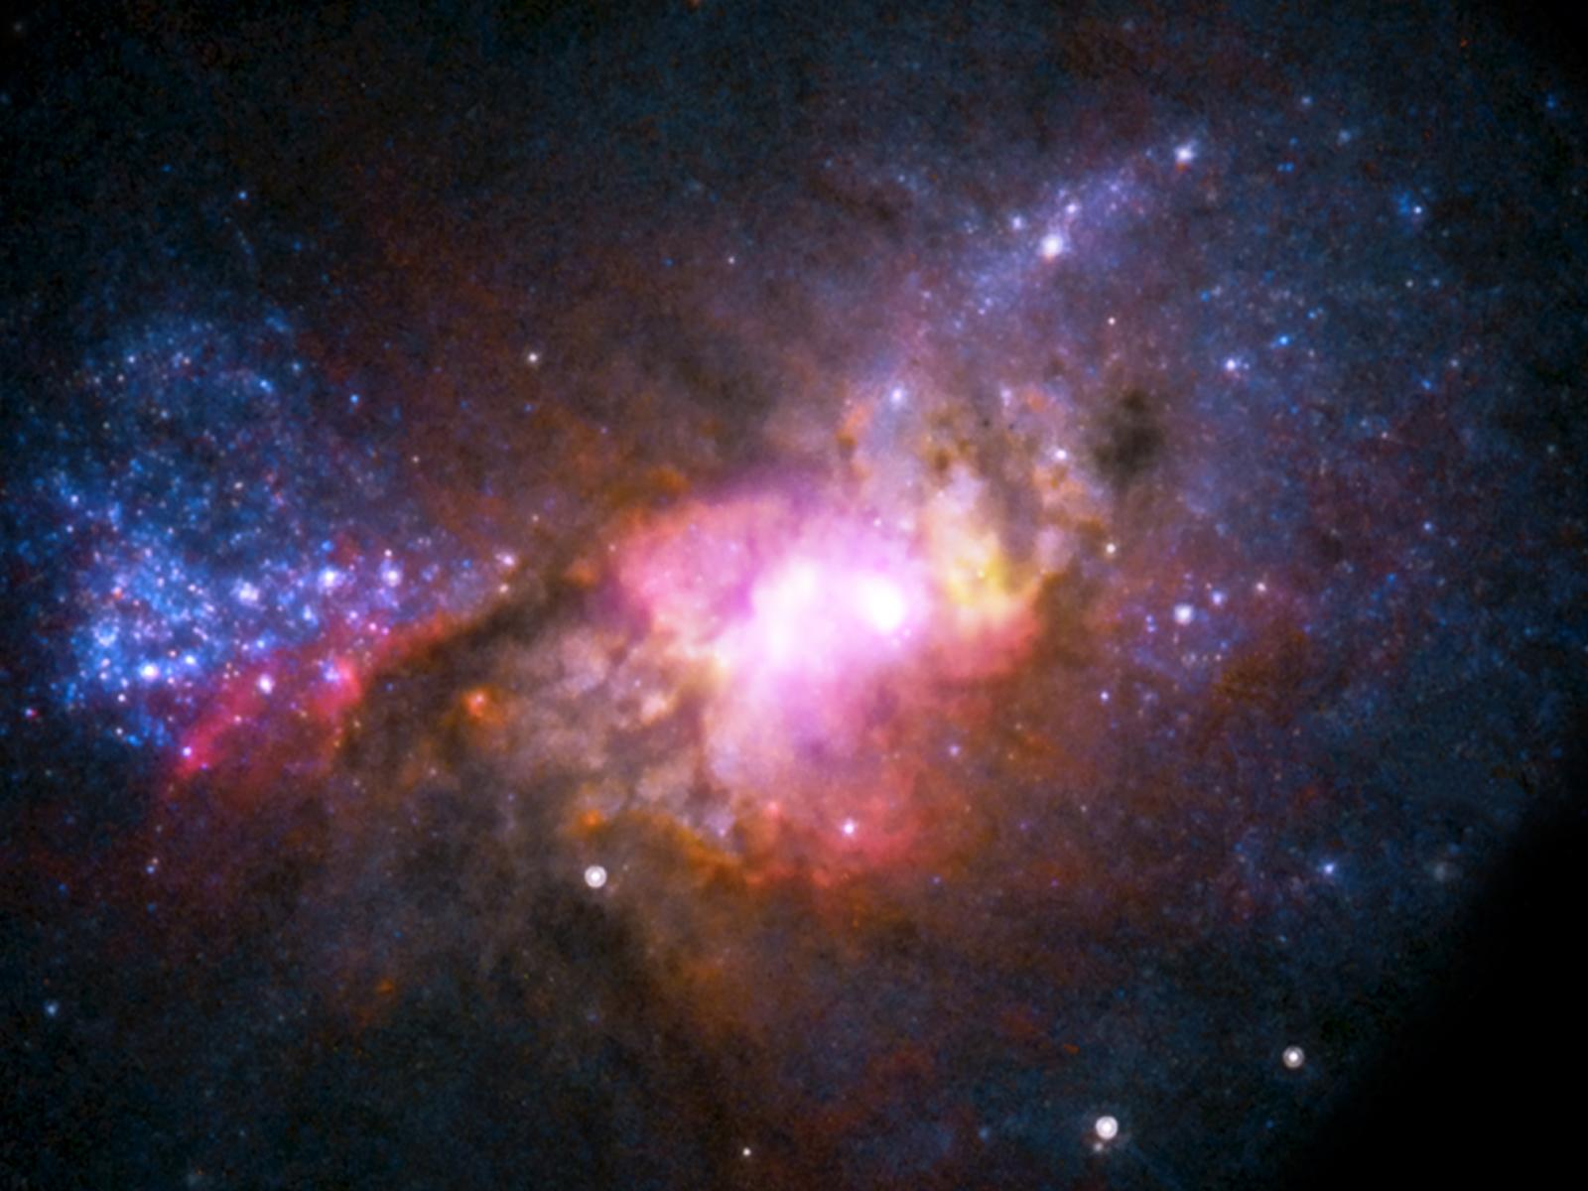


NIGHTS IN WHITE SATIN, NEVER REACHING THE END, LETTERS I´VE WRITTEN, NEVER MEANING TO SEND.

Slide 3

BEAUTY I´D ALWAYS MISSED, WITH THESE EYES BEFORE, JUST WHAT THE TRUTH IS, I CAN´T SAY ANYMORE.

Slide 4


´CAUSE I LOVE YOU, YES, I LOVE YOU, OH, HOW, I LOVE YOU.

Slide 5


GAZING AT PEOPLE, SOME HAND IN HAND, JUST WHAT I´M GOING THRU THEY CAN UNDERSTAND.

Slide 6

SOME TRY TO TELL ME, THOUGHTS THEY CANNOT DEFEND, JUST WHAT YOU WANT TO BE YOU WILL BE IN THE END,

Slide 7

AND I LOVE YOU, YES, I LOVE YOU, OH, HOW, I LOVE YOU. OH, HOW, I LOVE YOU.

Slide 8


Slide 9


NIGHTS IN WHITE SATIN, NEVER REACHING THE END, LETTERS I´VE WRITTEN,NEVER MEANING TO SEND.

Slide 10
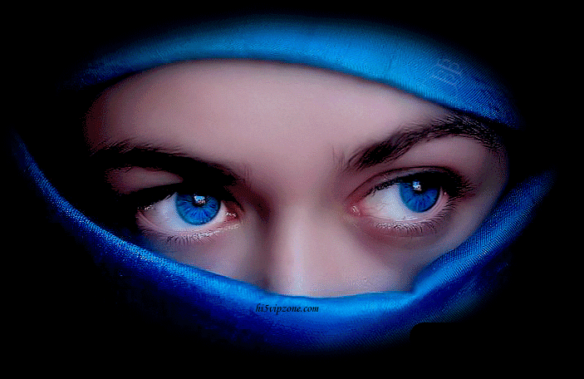
BEAUTY I´D ALWAYS MISSED, WITH THESE EYES BEFORE, JUST WHAT THE TRUTH IS, I CAN´T SAY ANYMORE.

Slide 11

´CAUSE I LOVE YOU, YES, I LOVE YOU, OH, HOW, I LOVE YOU. OH, HOW, I LOVE YOU.

Slide 12

´CAUSE I LOVE YOU, YES, I LOVE YOU, OH, HOW, I LOVE YOU. OH, HOW, I LOVE YOU.

Slide 13



Accede a la sección que desees desde aquí:
Propia Creación
De la Red
Dedicatorias | Fechas Especiales | Graciosos
Historia y Arte | Lugares | Musicales
Naturaleza y Ciencias | Política | Reflexión
Religiosos | Románticos | Salud
Dedicatorias | Fechas Especiales | Graciosos
Historia y Arte | Lugares | Musicales
Naturaleza y Ciencias | Política | Reflexión
Religiosos | Románticos | Salud
Si deseas recibir pps periódicamente en tu correo electrónico subscríbete aquí:

