Slide 1






Canción : I believe in you
Interpretes Celine Dion e Il Divo

Slide 2

Lonely , The path you have chosen , A restless road , No turning back , One day you Will find you light again , Don't you know , Don't let go , Be strong

Slide 3

Follow you heart , Let you love lead through the darkness , Back to a place you once knew , I believe,
I believe, I believe , In you

Slide 4
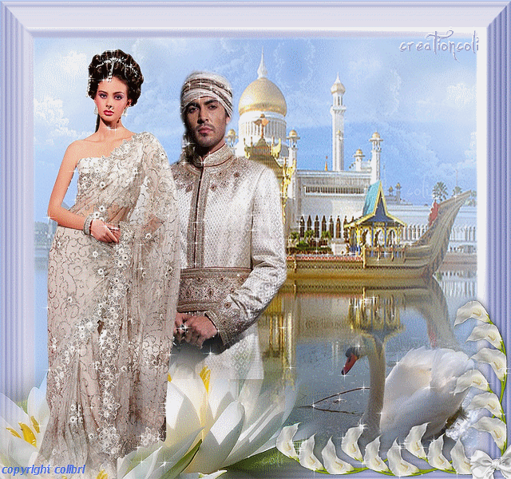
Follow your dreams , Be yourself, an angel of kindness , There's nothing that you can not do I believe, I believe, I believe , In you.

Slide 5

Tout seul , Tu t'en iras tout seul , Coeur ouvert , A L'univers , Poursuis ta quete , Sans regarder derriere , N'attends pas , Que le jour , Se leve, Suis ton etoile

Slide 6


Va jusqu'ou ton reve t'emporte , Un jour tu le toucheras , Si tu croix si tu croix si tu, croix , En toi , Suis la lumiere , N‘ eneins pas la flamme que tu portes , Au fonds de toi souviens-toi , Que je croix que je croix que je croix , Que je croix , En toi

Slide 7

Someday I'll find you , Someday you'll find me to , And when I hold you close , I'll know that is true

Slide 8

Follow your heart , Let you love lead through the darkness , Back to a place you once knew I believe, I believe, I believe in you

Slide 9

Follow your dreams , Be yourself, an angel of kindness , There's nothing that you can not do I believe, I believe, I believe In you. ,
I believe, I believe, I believe In you. I believe, I believe In you.

Slide 10



Accede a la sección que desees desde aquí:
Propia Creación
De la Red
Dedicatorias | Fechas Especiales | Graciosos
Historia y Arte | Lugares | Musicales
Naturaleza y Ciencias | Política | Reflexión
Religiosos | Románticos | Salud
Dedicatorias | Fechas Especiales | Graciosos
Historia y Arte | Lugares | Musicales
Naturaleza y Ciencias | Política | Reflexión
Religiosos | Románticos | Salud
Si deseas recibir pps periódicamente en tu correo electrónico subscríbete aquí:

