Slide 1






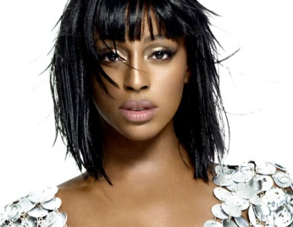





Slide 2
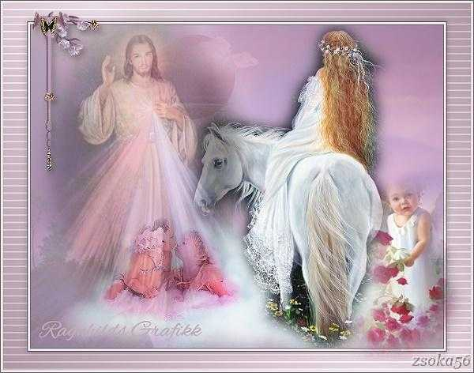

I heard there was a secret chord, That David played and it pleased the Lord But you don't really care for music, do ya?

Slide 3

Well it goes like this, the fourth, the fifth, The minor fall and the major lift, The baffled king composing, Hallelujah

Slide 4
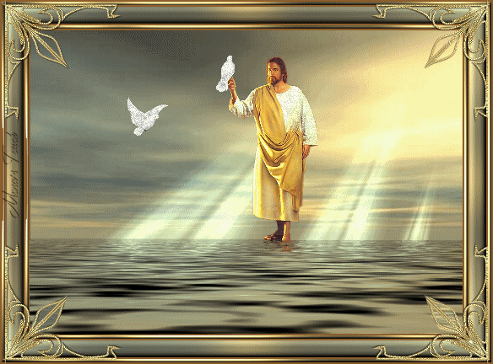
Hallelujah, Hallelujah
Hallelujah, Hallelujah

Slide 5
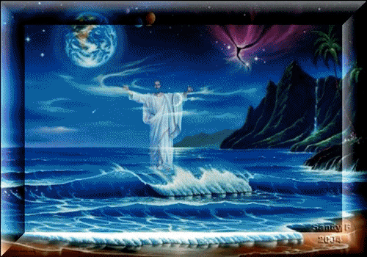
Your faith was strong but you needed proof, You saw her bathing on the roof, Her beauty and the moonlight overthrew ya

Slide 6
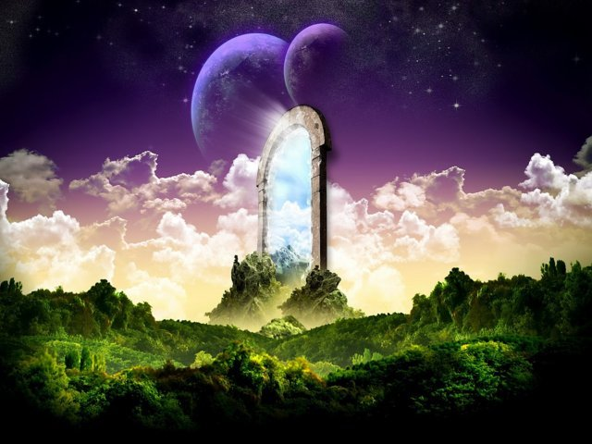

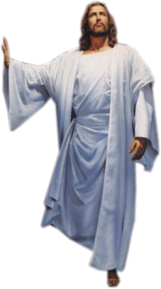
She tied you to her kitchen chair, She broke your throne and she cut your hair, And from your lips she drew the , Hallelujah

Slide 7

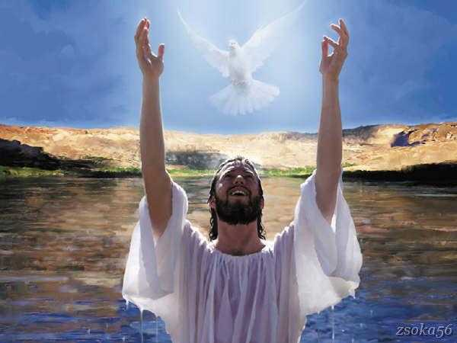
Hallelujah, Hallelujah
Hallelujah, Hallelujah

Slide 8
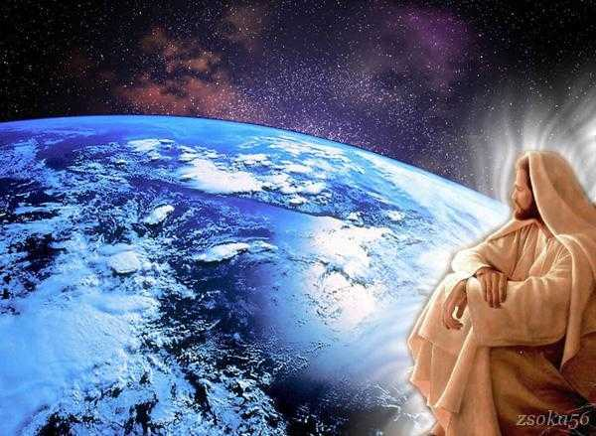
Maybe there's a God above, But all I've ever learned from love, Is how to shoot somebody who outdrew ya

Slide 9



It's not a cry that you hear at night, It's not someone who's seen the light, It's a cold and it's a broken, Hallelujah

Slide 10
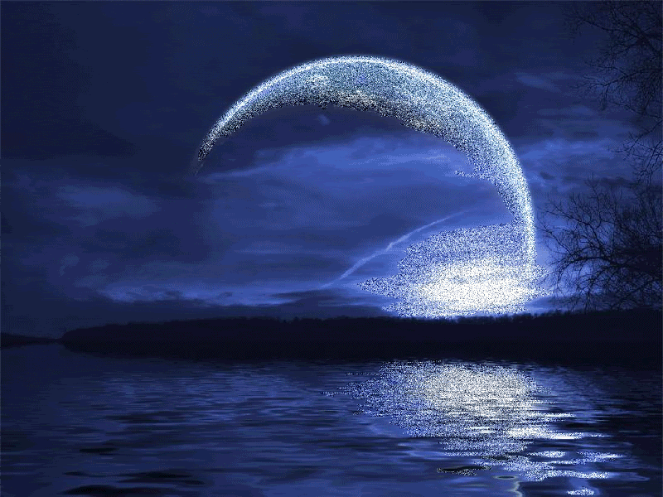
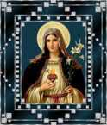
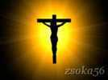
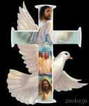
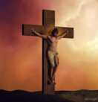
Hallelujah, Hallelujah
Hallelujah, Hallelujah

Slide 11

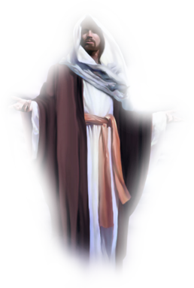
Hallelujah, Hallelujah
Hallelujah, Hallelujah

Slide 12
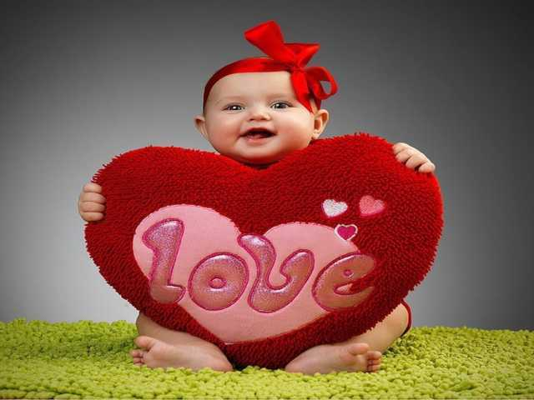
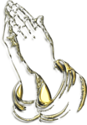
Hallelujah, Hallelujah

Slide 13



Accede a la sección que desees desde aquí:
Propia Creación
De la Red
Dedicatorias | Fechas Especiales | Graciosos
Historia y Arte | Lugares | Musicales
Naturaleza y Ciencias | Política | Reflexión
Religiosos | Románticos | Salud
Dedicatorias | Fechas Especiales | Graciosos
Historia y Arte | Lugares | Musicales
Naturaleza y Ciencias | Política | Reflexión
Religiosos | Románticos | Salud
Si deseas recibir pps periódicamente en tu correo electrónico subscríbete aquí:

