Slide 1










Slide 2
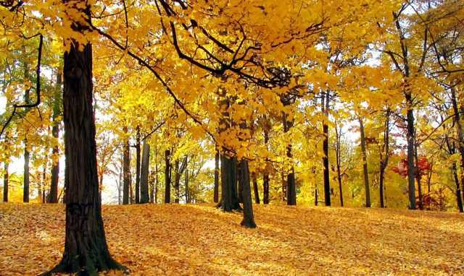

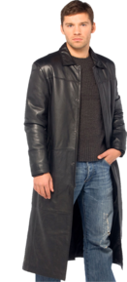

All the Leaves Are Brown, (All the leaves are brown), And The Sky Is Grey, (And the sky is grey) I´ve Been For A Walk, (I´ve been for a walk ), On A Winter Day, (On a winter day)

Slide 3
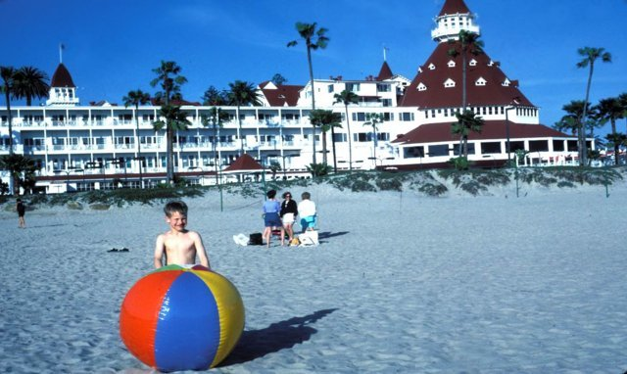



I´d Be Safe and Warm, (I´d be safe and warm), If I Was In the L.A, (If I was in the L.A) California is Dream, (California is dream), On Such a Winter Day

Slide 4
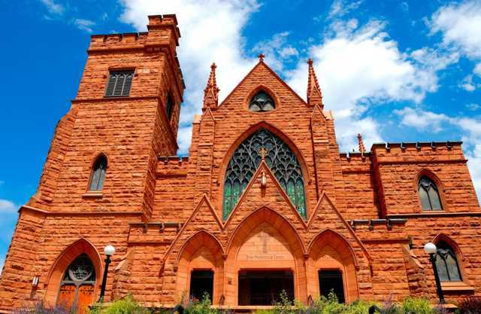

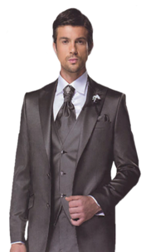


Stopped Into a Church, I Passed Along the Way, Well I Got Down On My Knees, (Got down on my knees), And I Pretend To Pray

Slide 5
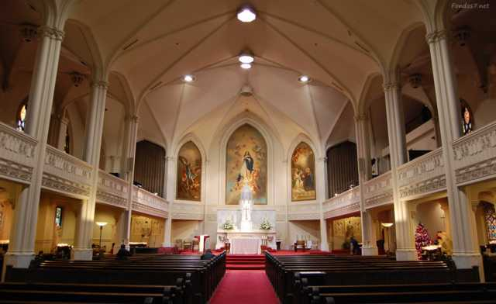

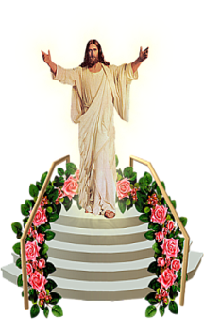


(I pretend to pray), You Know the Preacher Likes To the Could (Preacher likes the could) He knows I´m Gonna Stay (Knows I´m gonna stay) California is Dream (California is dream) On Such on Winter Day

Slide 6

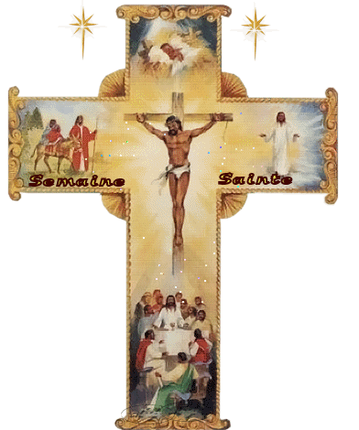

Slide 7



Slide 8
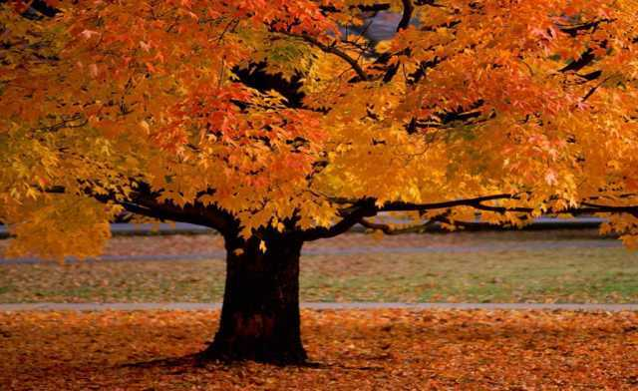

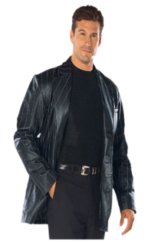

All the Leaves Are Brown, All the leaves are brown) And The Sky Is Grey (and the sky is grey) I´ve Been For A Walk, (I´ve been for a walk) On A Winter Day (On a winter day)

Slide 9
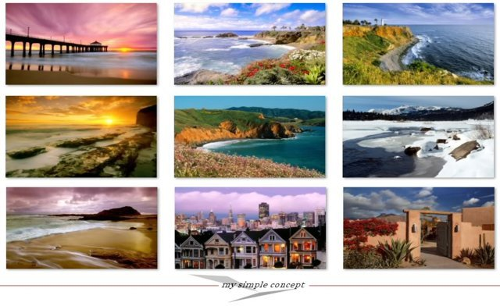


If I Didn’t Tell Her (If I Didn’t Tell Her) I Could Leave Today (I could leave today) California is Dream (California is dream) On Such on Winter Day(California is dream) On Such on Winter Day.

Slide 10


Slide 11



Accede a la sección que desees desde aquí:
Propia Creación
De la Red
Dedicatorias | Fechas Especiales | Graciosos
Historia y Arte | Lugares | Musicales
Naturaleza y Ciencias | Política | Reflexión
Religiosos | Románticos | Salud
Dedicatorias | Fechas Especiales | Graciosos
Historia y Arte | Lugares | Musicales
Naturaleza y Ciencias | Política | Reflexión
Religiosos | Románticos | Salud
Si deseas recibir pps periódicamente en tu correo electrónico subscríbete aquí:

