Slide 1







Slide 2
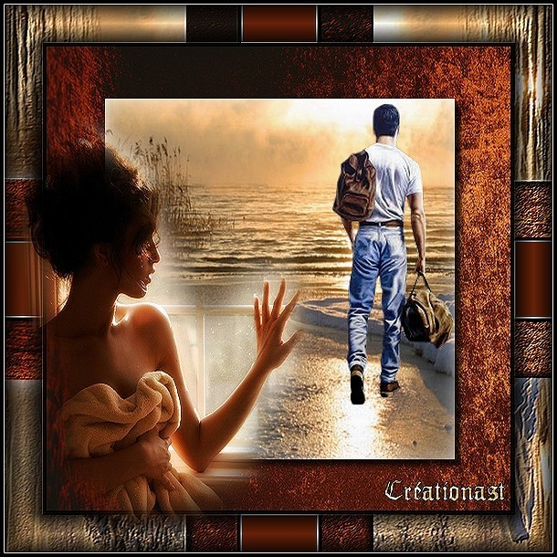
No i can't forget this evening, or your face as you were leaving but i guess that's just the way the story goes

Slide 3


you always smile, but in your eyes
your sorrow shows yes, it shows

Slide 4




no i can't forget tomorrow when i think of all my sorrow when i had you there but then i let you go

Slide 5



and now it's only fair that i should let you know what you should know

Slide 6

I can't live, if living is without you, i can't live i can't give anymore

Slide 7

i can't live, if living is without you, i can't give, i can't give anymore

Slide 8
Well, i can't forget this evening or your face as you were leaving
but i guess that's just the way the story goes

Slide 9

you always smile, but in your eyes, your sorrow shows, yes, it shows

Slide 10

I can't live, if living is without you, i can't live i can't give anymore

Slide 11

if living is without you, i can't give, i can't give anymore

Slide 12


I can't live, if living is without you, i can't live, i can't give anymore, i can't live

Slide 13




Accede a la sección que desees desde aquí:
PPS Exclusivos
Dedicatorias | Fechas Especiales | Graciosos | Historia y arte | Lugares | Musicales
Naturaleza y Ciencias | Política | Reflexión | Religiosos | Románticos | Salud
Si deseas recibir pps periódicamente en tu correo electrónico subscríbete aquí:

