Slide 1
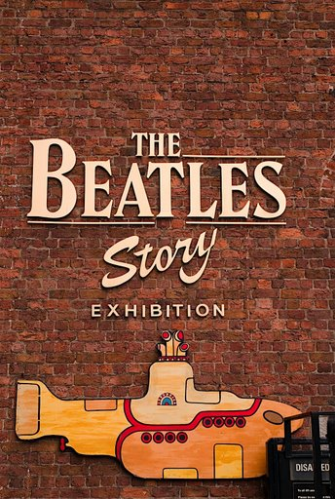


Slide 2
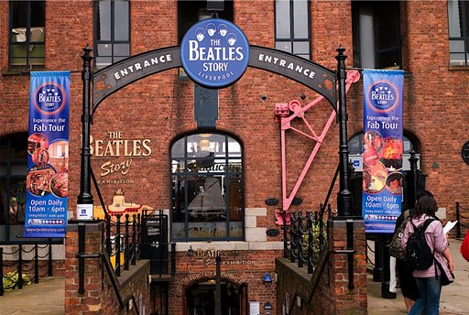

Slide 3
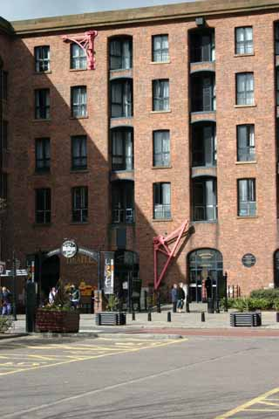

Slide 4
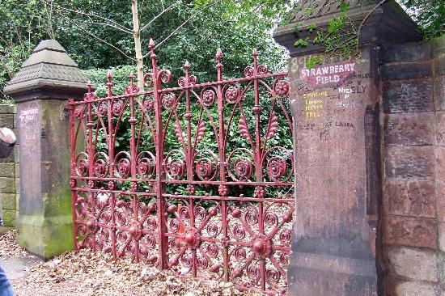

Slide 5
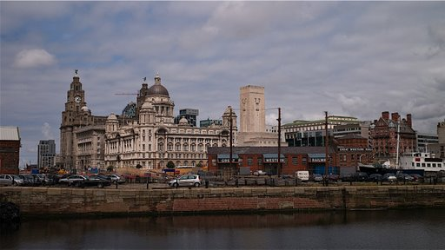

Slide 6
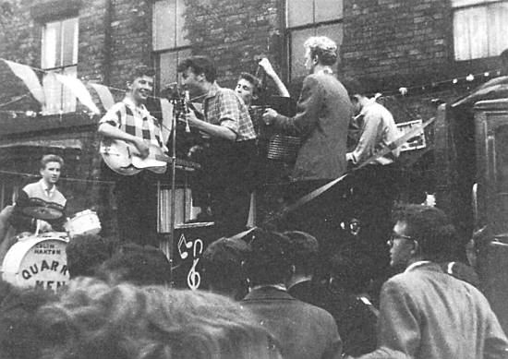
A kezdet….
John Lennon and The Quarry Men play in Rosebery Street, 22 June 57.

Slide 7
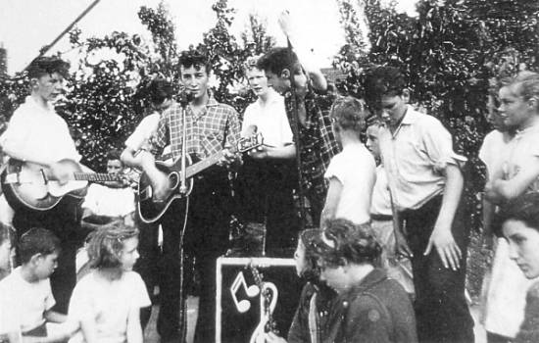
1957. Julius
Paul McCartney meets John Lennon and The Quarry Men at Woolton's Fête on July 6th.
From left to right: Eric Griffiths, Colin Hanton, Rod Davis, John Lennon, Pete Shotton & Len Garry

Slide 8
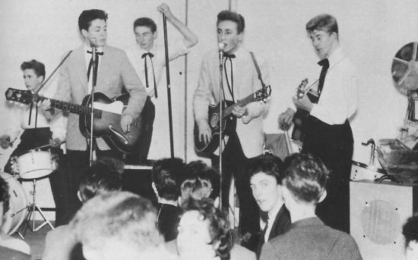
1957. november
This shot was taken on 23rd November during another performance at New Clubmoor Hall.
From left to right: Colin Hanton, Paul McCartney, Len Garry, John Lennon, Eric Griffiths.

Slide 9
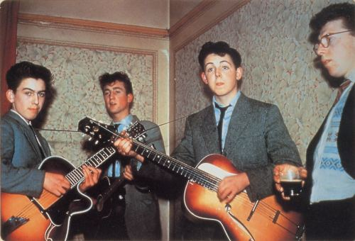
1958. The Quarry Men George Harrison joins the Quarry Men in early 1958. He plays here with John and Paul at Auntie Gin's house for a wedding (Auntie Gin was Paul's aunt). (ők is milyen gyerekek voltak hmm…)

Slide 10
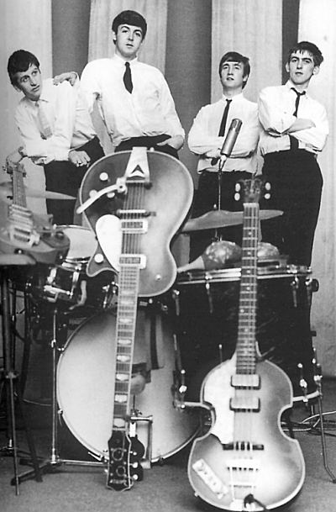
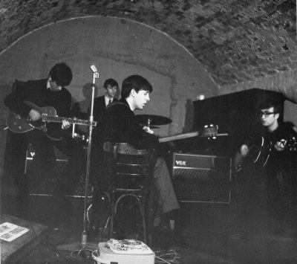
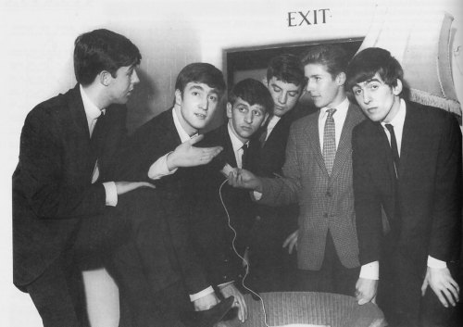

Slide 11
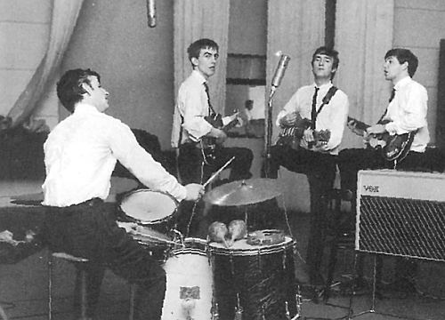
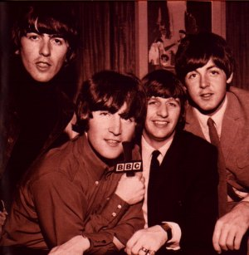
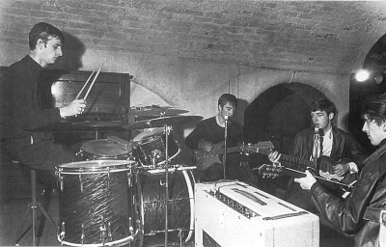
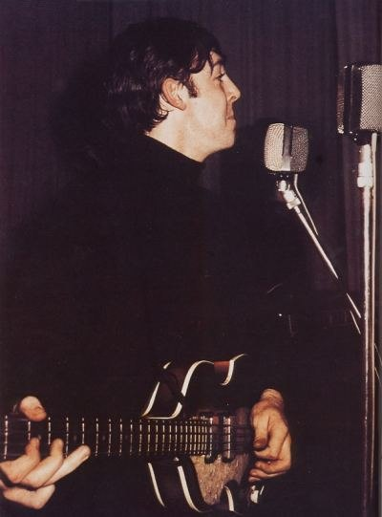
1
9
6
2

Slide 12
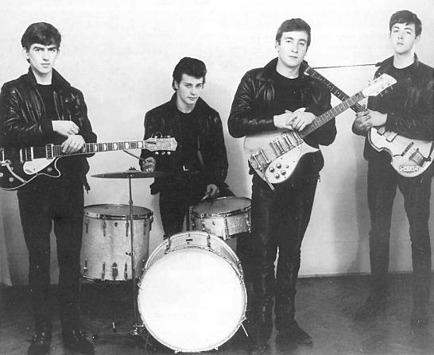

Slide 13
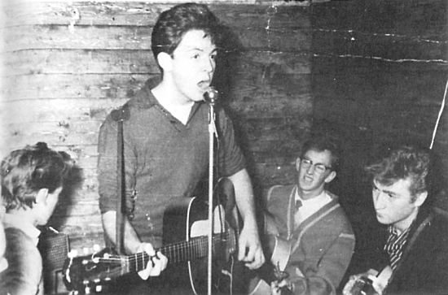

Slide 14
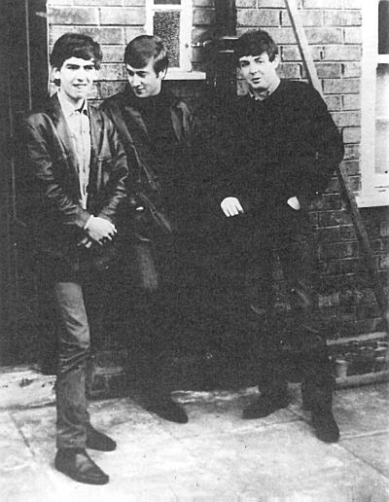
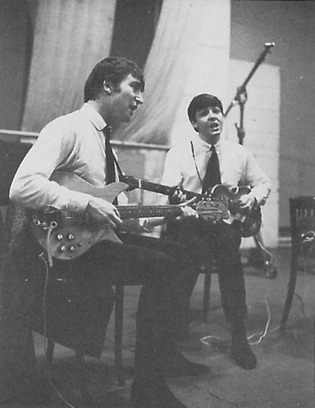

Slide 15
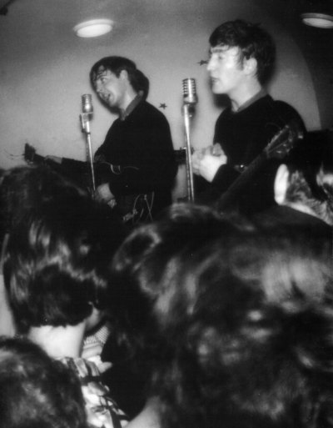
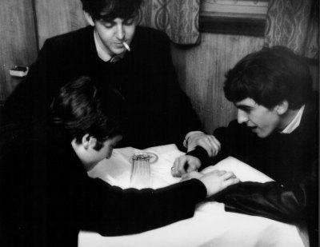
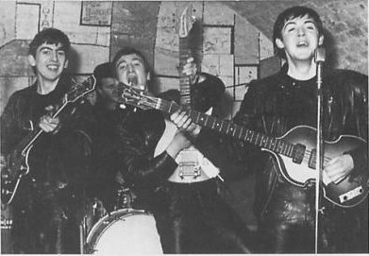

Slide 16
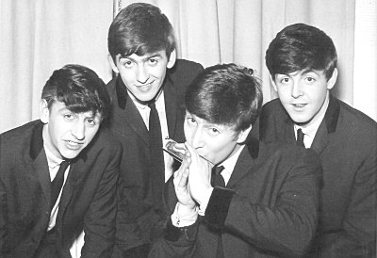
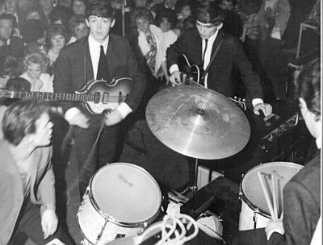
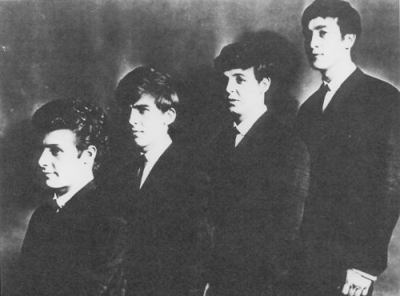
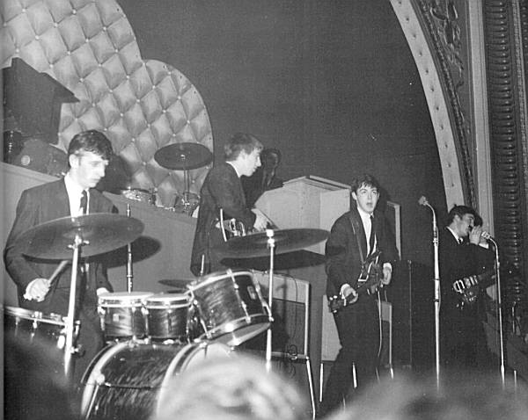

Slide 17
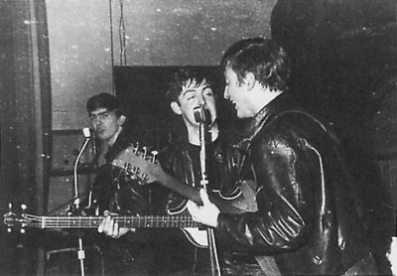

Slide 18
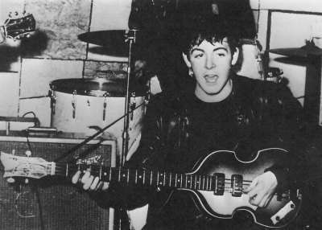

Slide 19
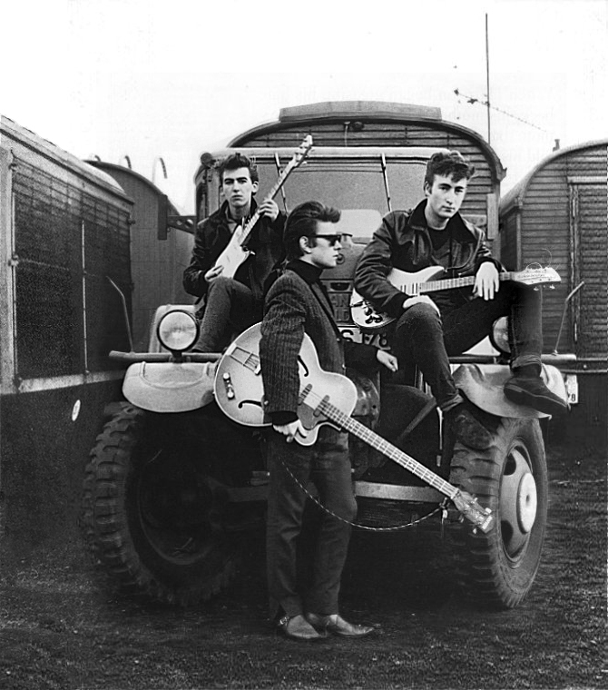
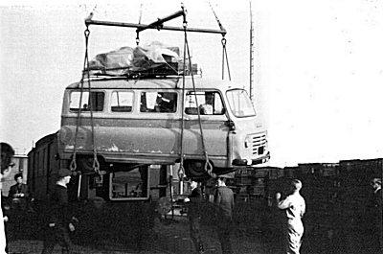
16 August 1960, The Beatles' van loading for Hamburg. Lower left, John looks on.
16 August 1960, The Beatles' van loading for Hamburg. Lower left, John looks on.
A Beatles furgonrakodás közben, Hamburgban. Alacsonyabb baloldalon, John nézelődik.

Slide 20
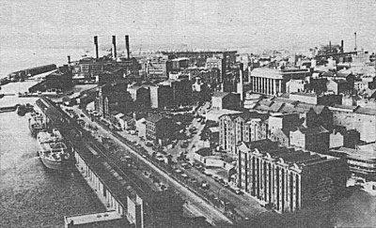

Slide 21
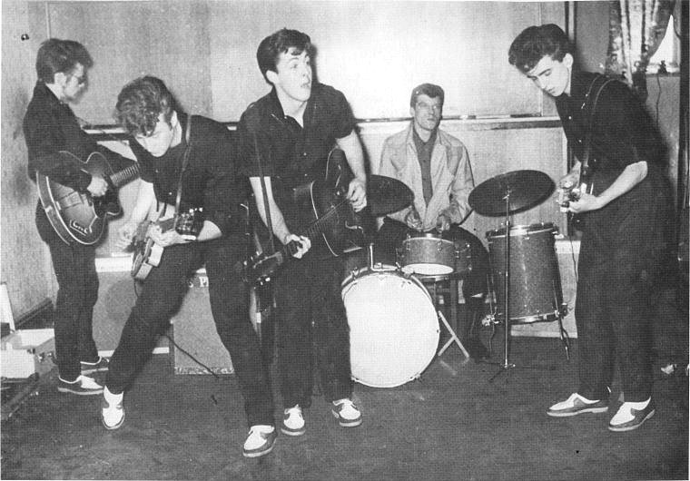

Slide 22
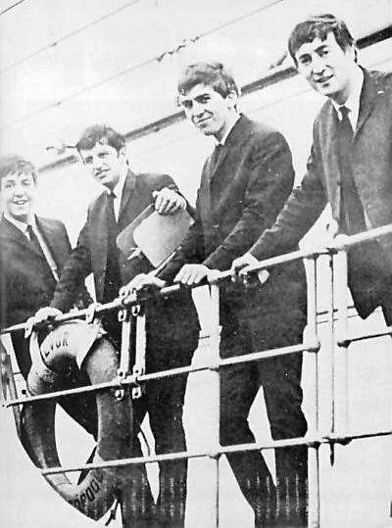
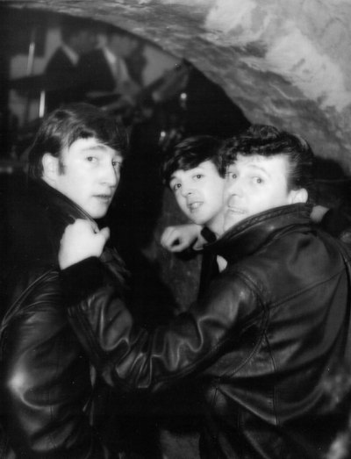

Slide 23
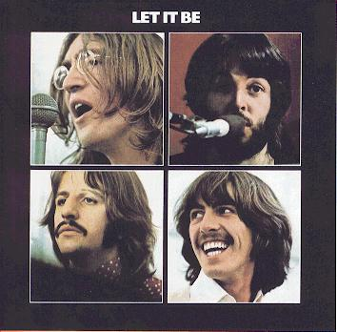
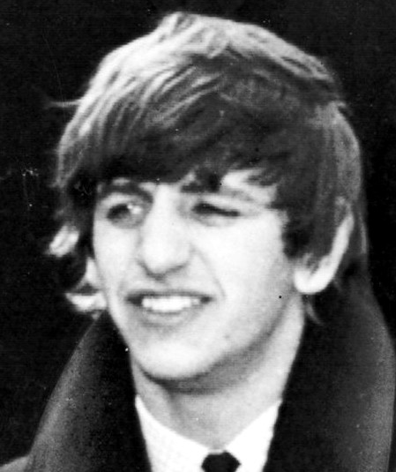
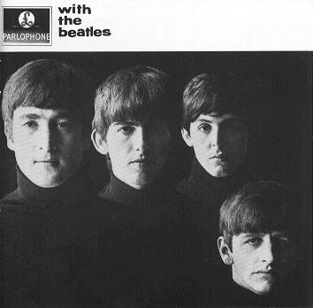

Slide 24
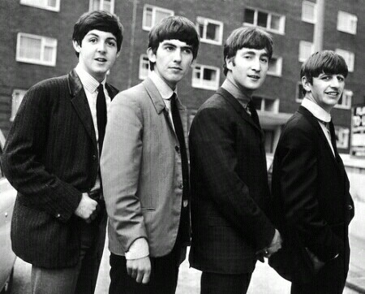

Slide 25
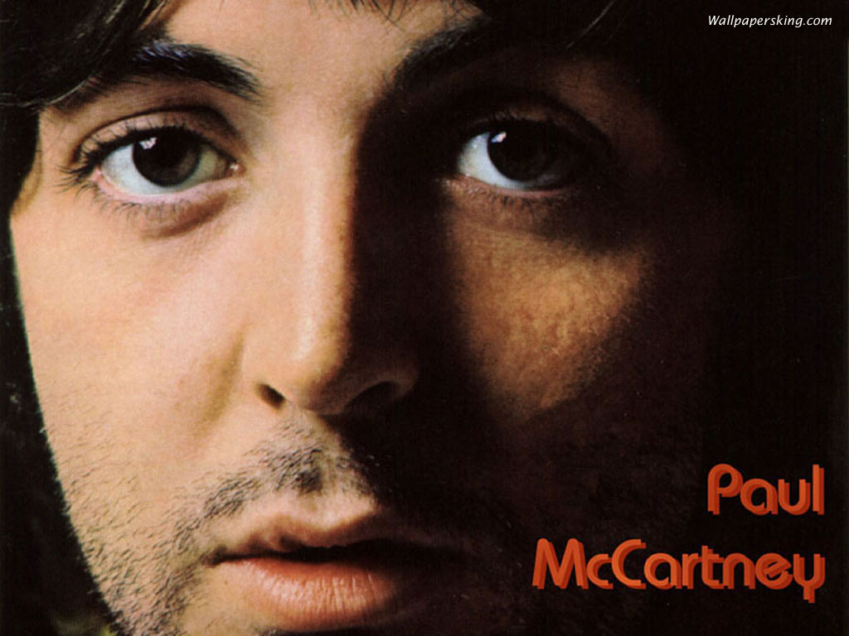
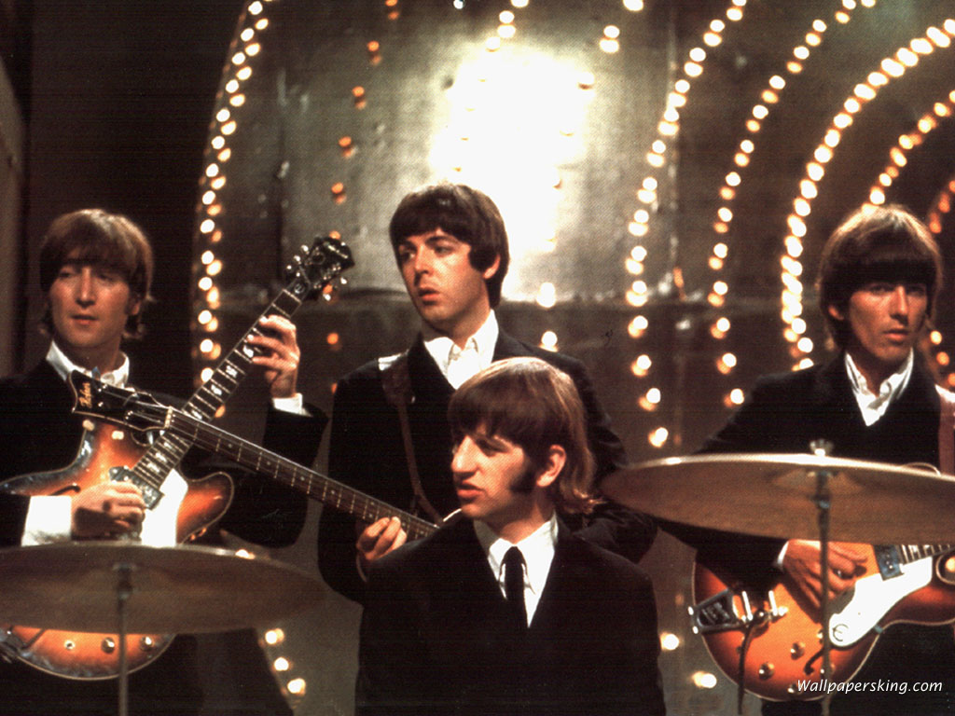
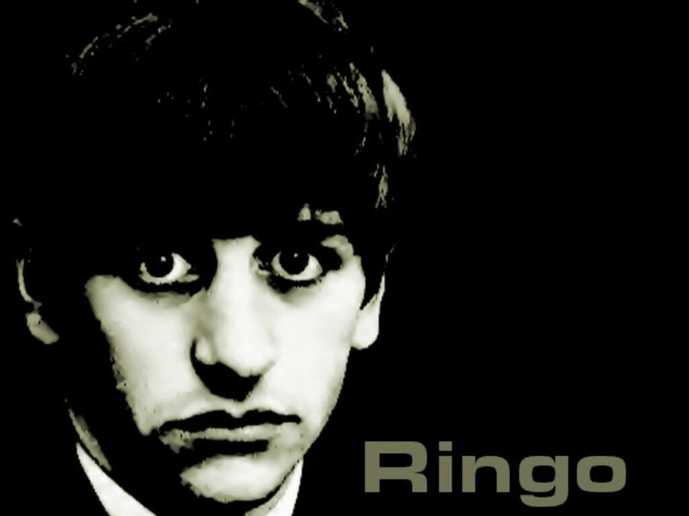
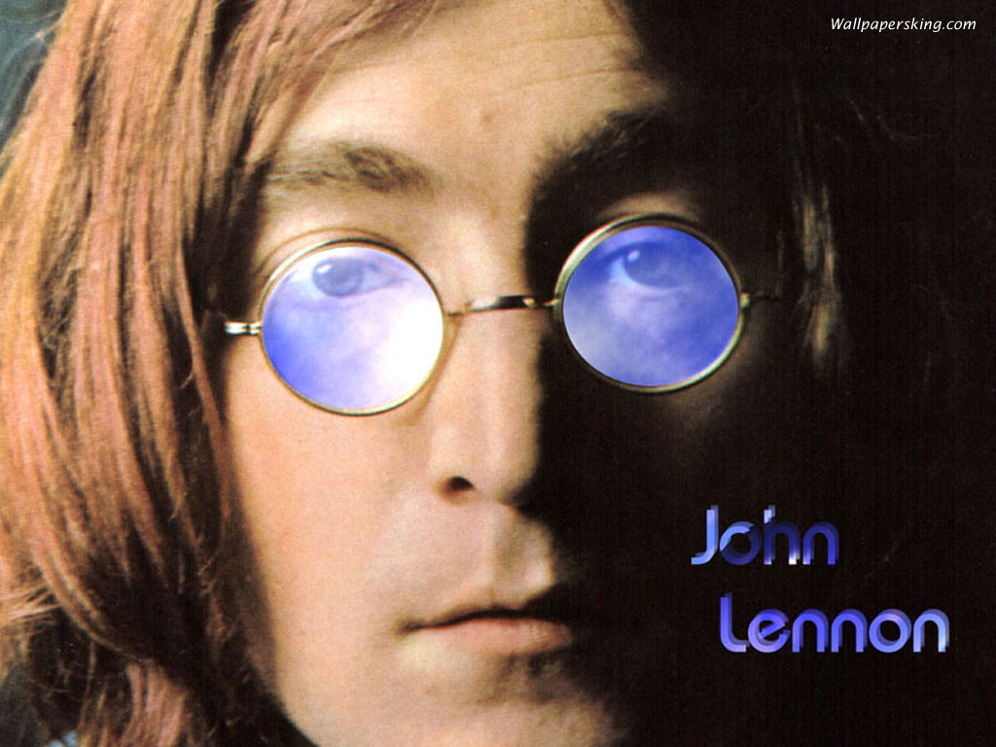

Slide 26
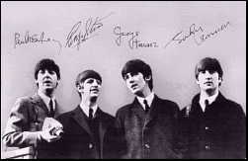

Slide 27
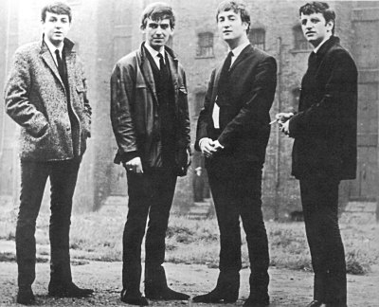

Slide 28
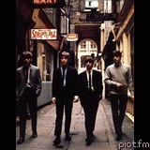

Slide 29
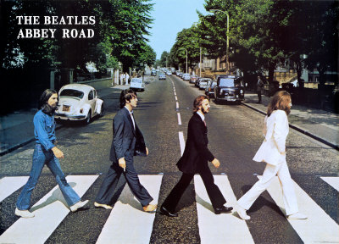

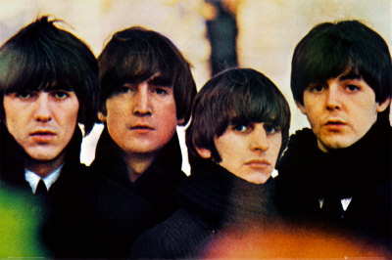
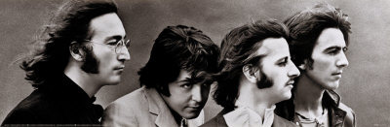


Slide 30
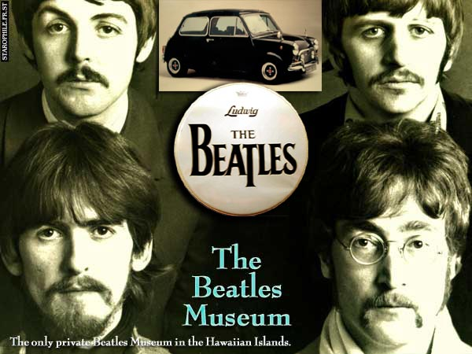

Slide 31


Slide 32


Slide 33



Slide 34


Slide 35



Slide 36


Slide 37


Slide 38



Slide 39


Slide 40


Slide 41



„L
O
V
A
G
O
K”

Slide 42

John Winston Lennon
1940. október 9. – 1980. december 8.

Slide 43


Slide 44


Slide 45


Slide 46


Slide 47



Slide 48






Slide 49

Eternally Beatles
K.Moni
www.deruselet.hu

Slide 50







¿Te ha gustado?
Puedes ver más entrando
Aquí
Además puedes recibir powerpoints en tu correo electrónico suscribiéndote aquí:

