Slide 1

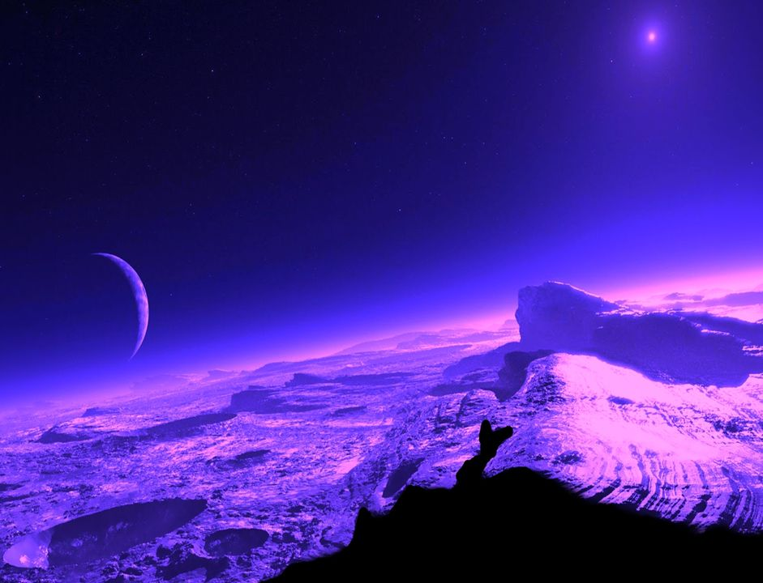









GAMMAPOLIS
Music :
kisspista
OMEGA

Slide 2
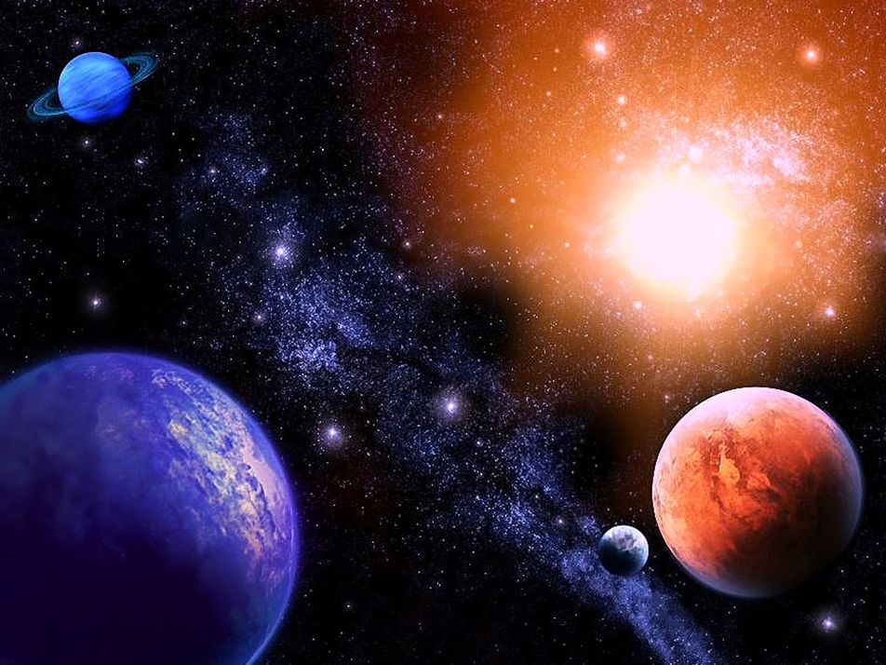
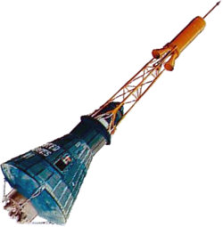
Now it's more
than thirtyfive long years,

Slide 3
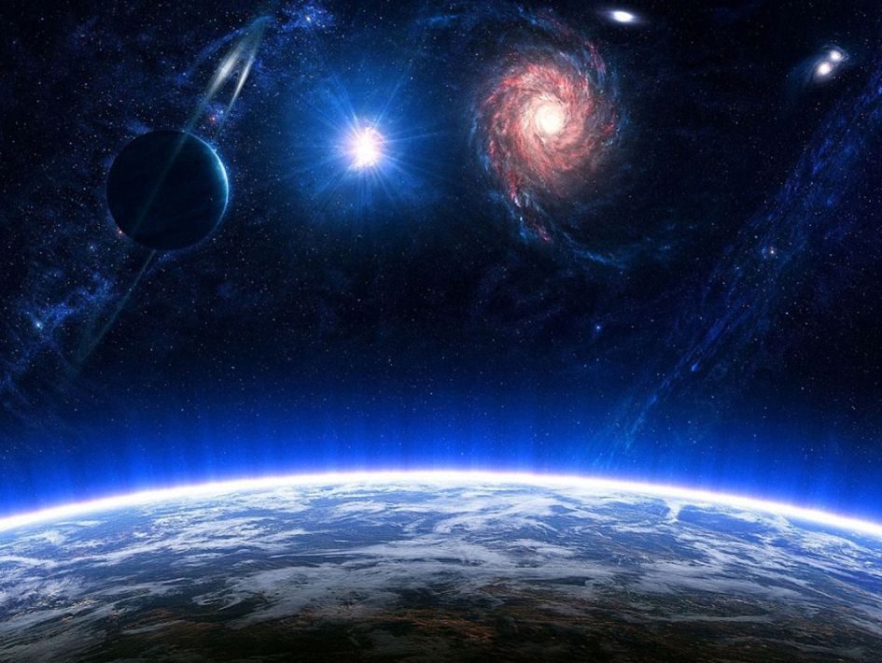


That on this be,
Earth
I had to be

Slide 4
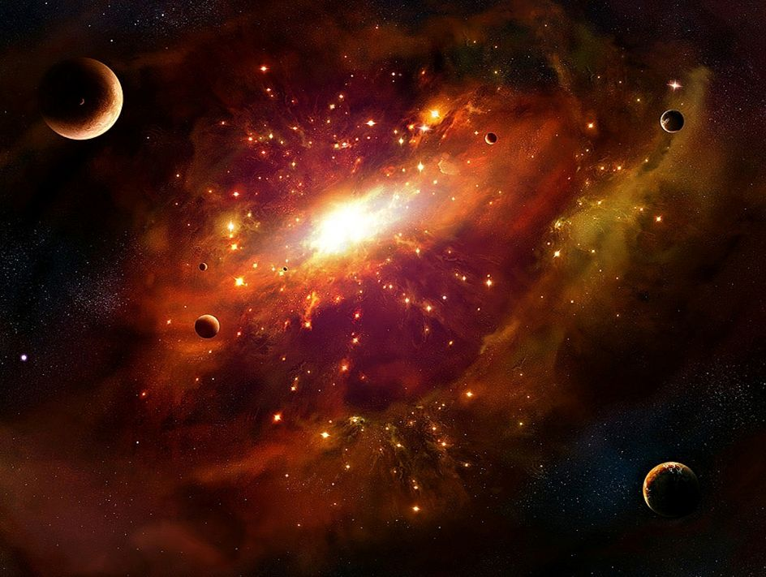


It's time to leave
for another world,

Slide 5
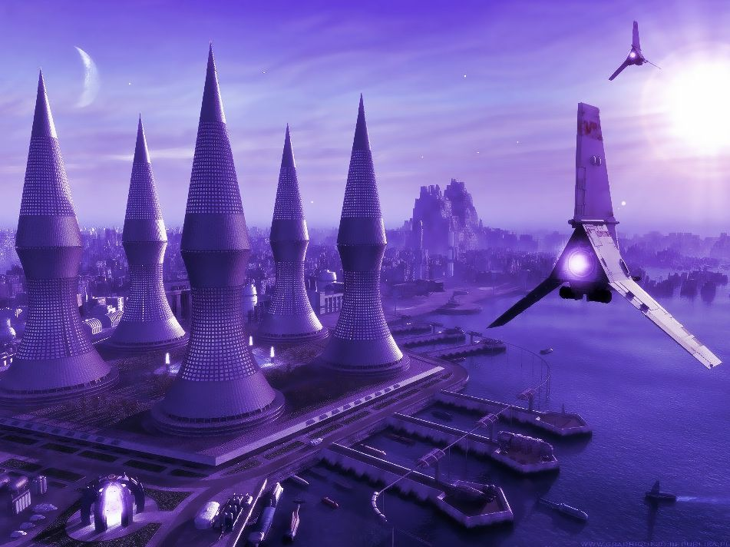
And Gammapolis waits for me.
.
Γ

Slide 6

Goodbye my friends,
I'm going on my way,

Slide 7
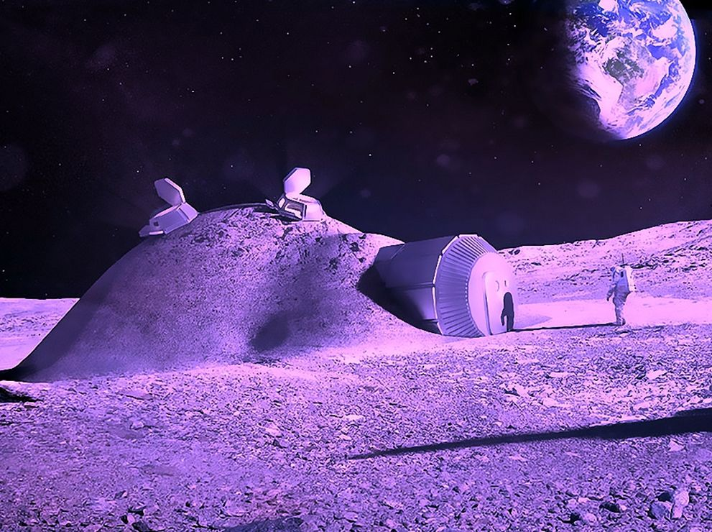
I tried to teach you
how to see,

Slide 8
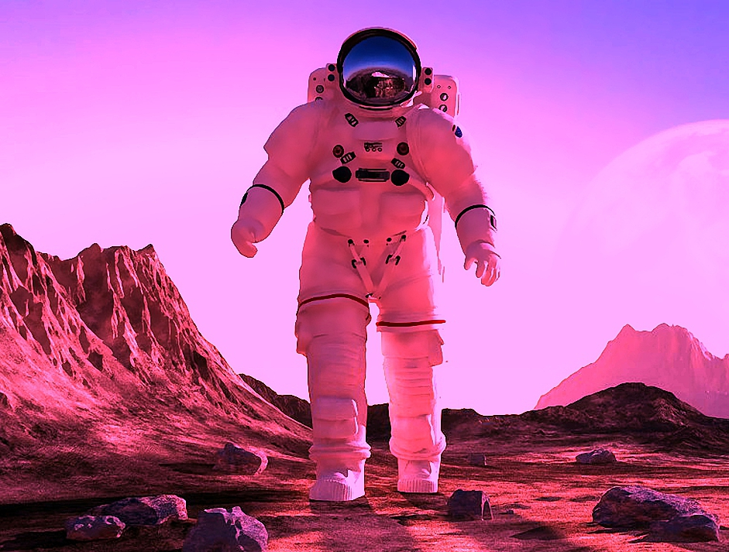
But I know
I never
make you understand,

Slide 9
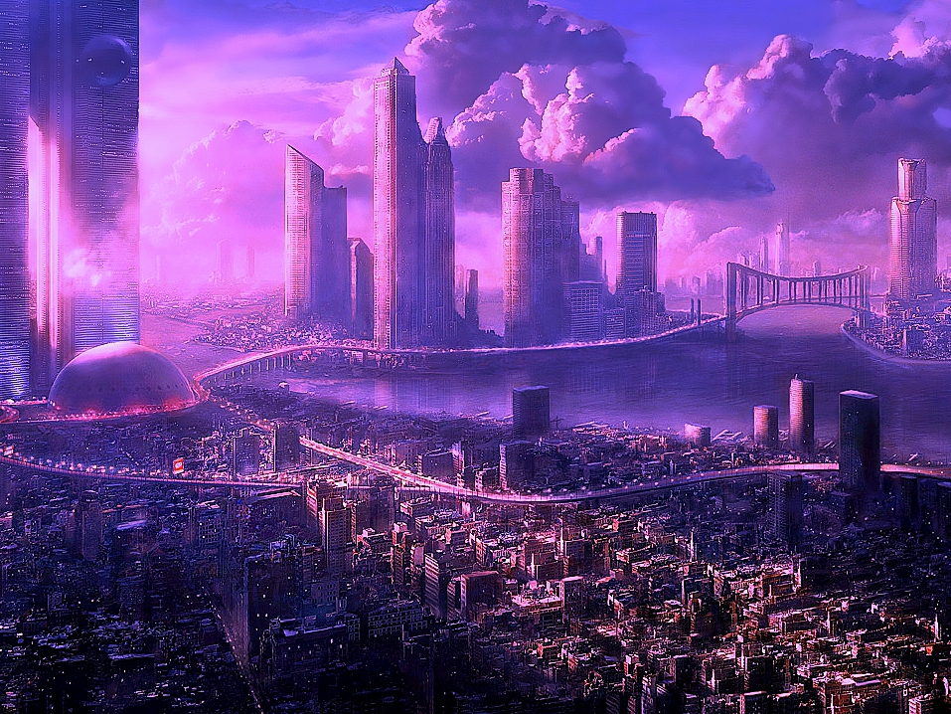
That Gammapolis waits for me.
.

Slide 10
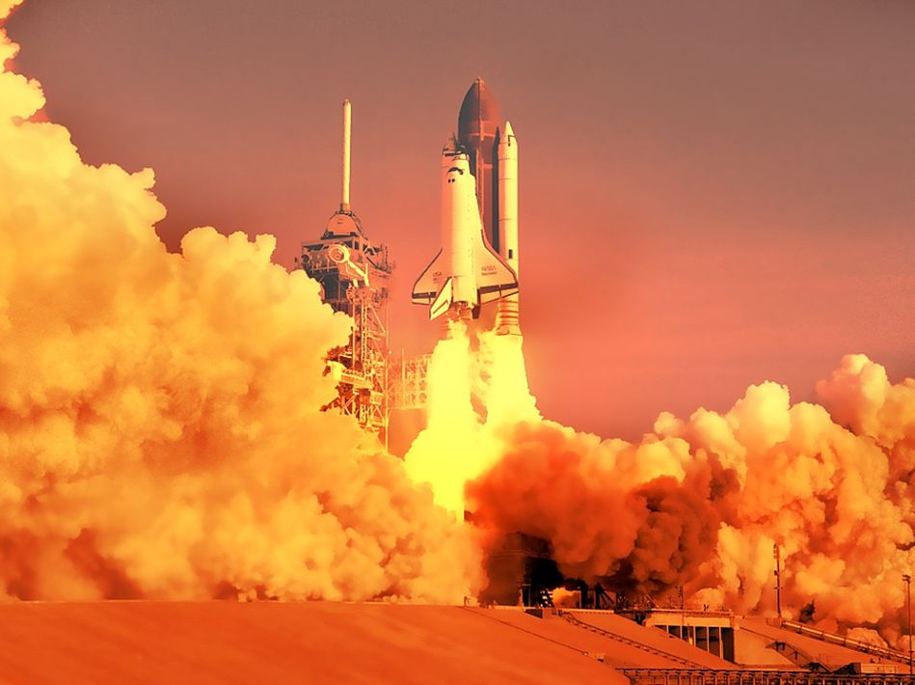
2

Slide 11
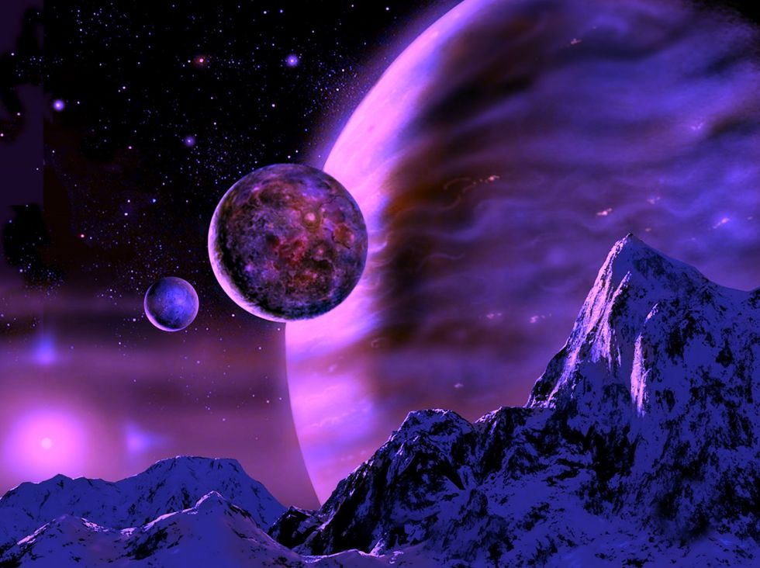
1

Slide 12


4

Slide 13
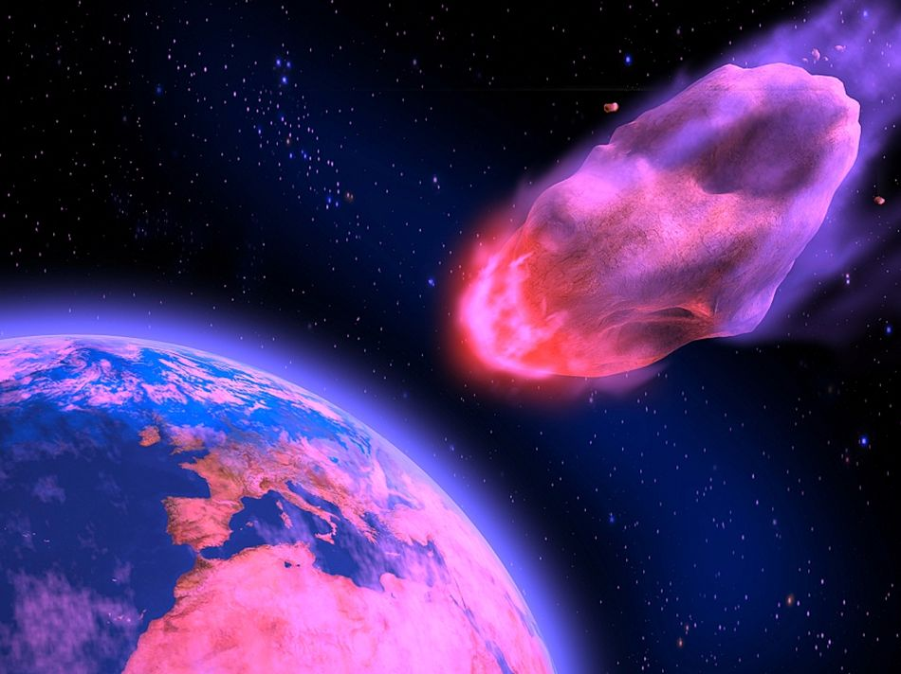
3

Slide 14

So long my love,
you shared my earthly life,

Slide 15
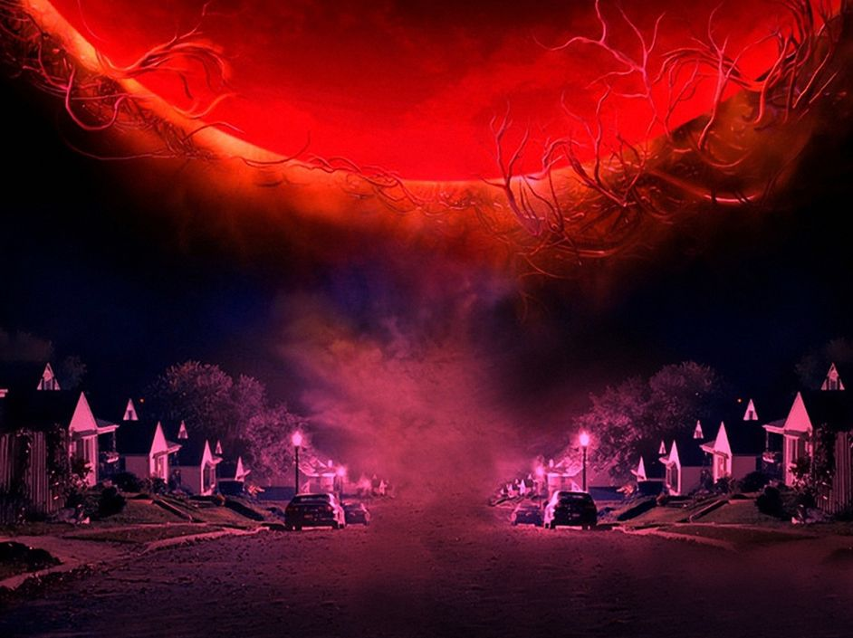


You tried to make
it good for me,

Slide 16
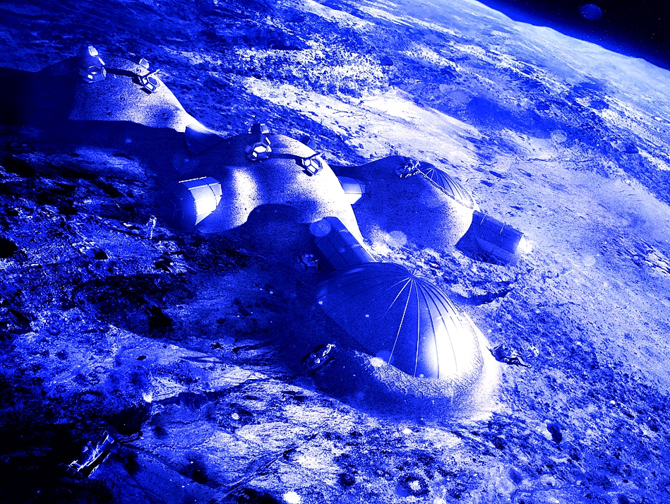
But you thought I was crazy
when I used to say,

Slide 17
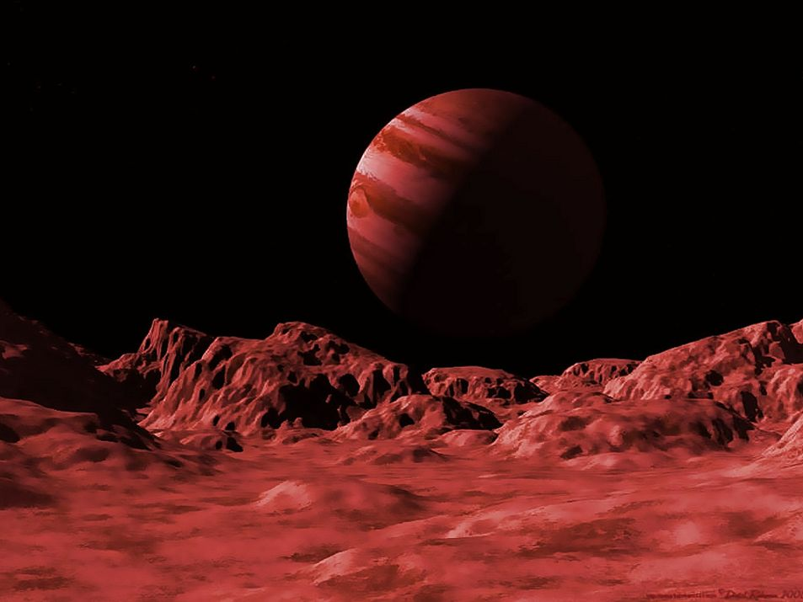
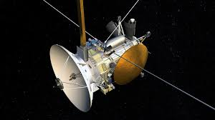
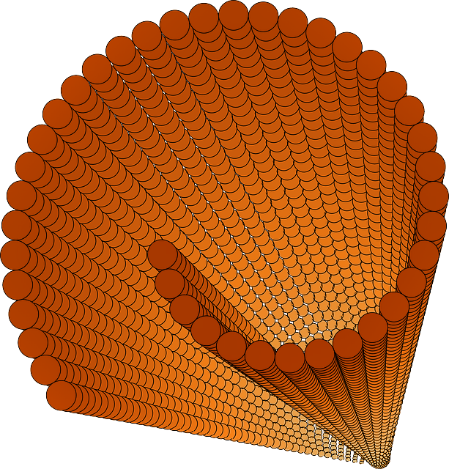
That Gammapolis waits for me.

Slide 18
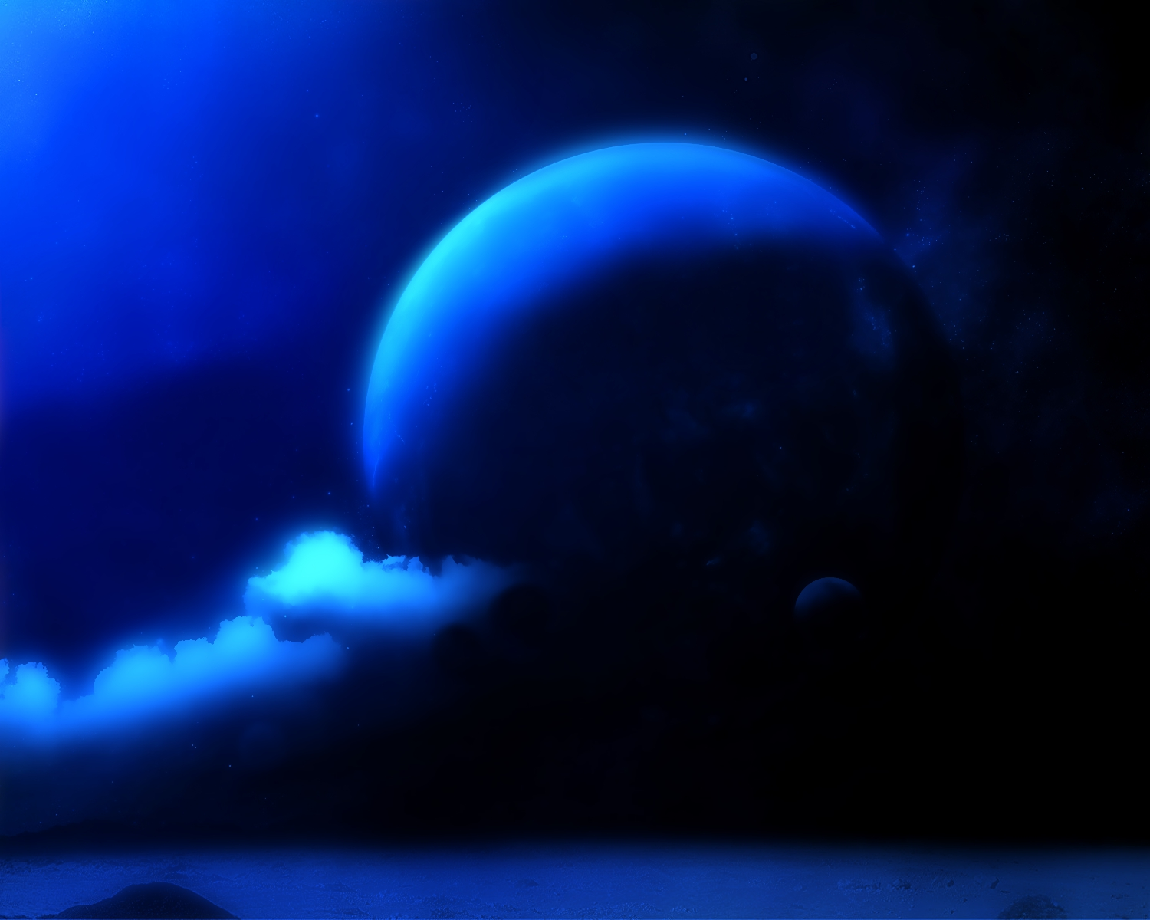

When you gaze out
at the midnight sky,

Slide 19
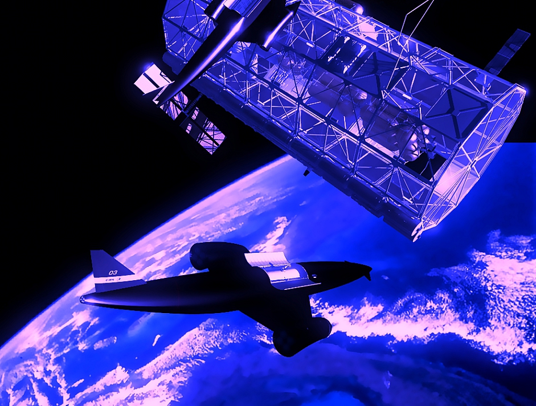
Far above reality,

Slide 20
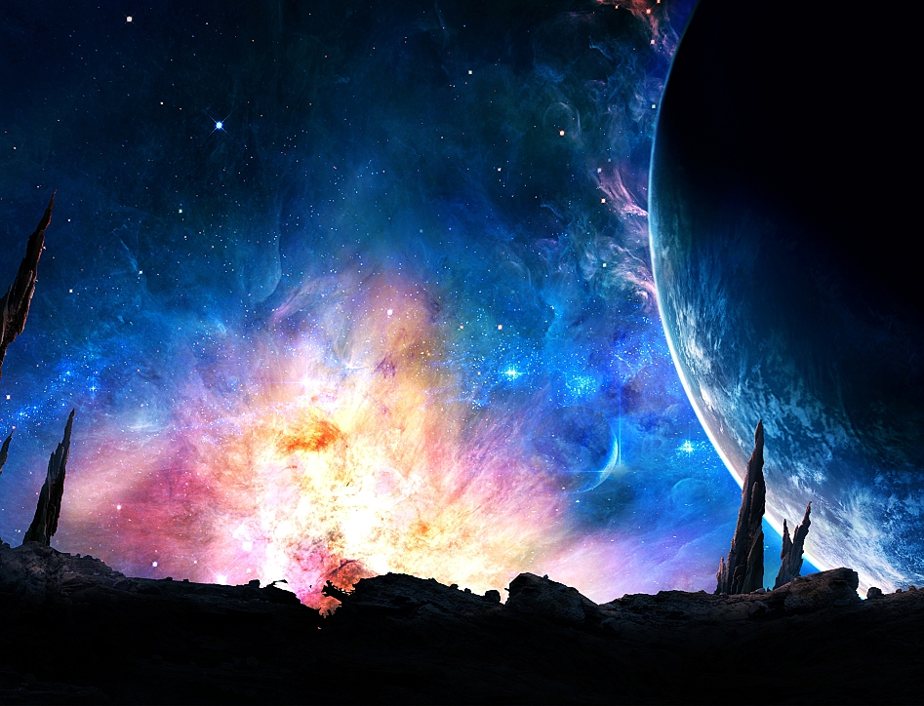
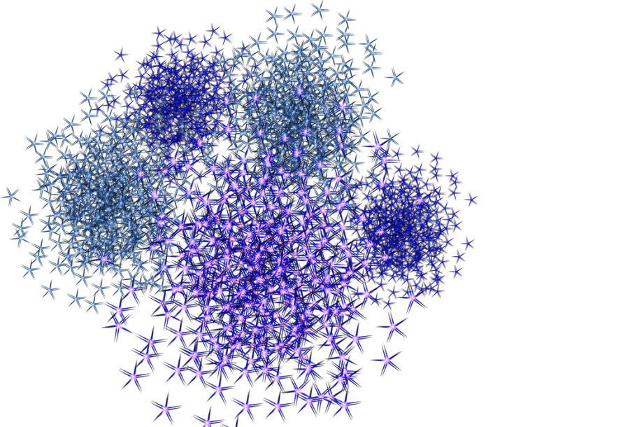


And you can see
with heavenly eyes,

Slide 21

For Gammapolis waits for me.

Slide 22
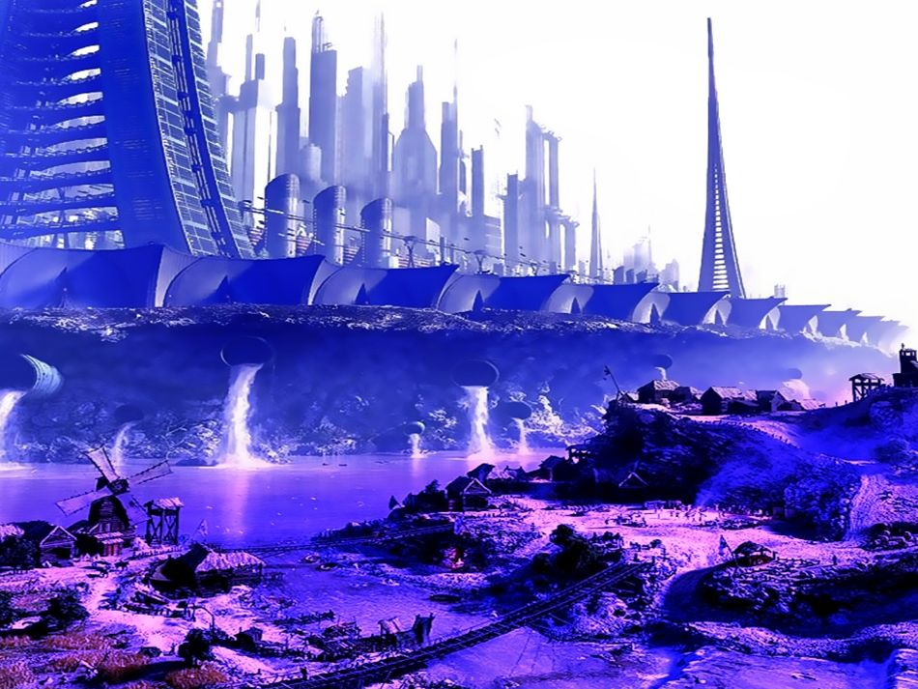

Slide 23
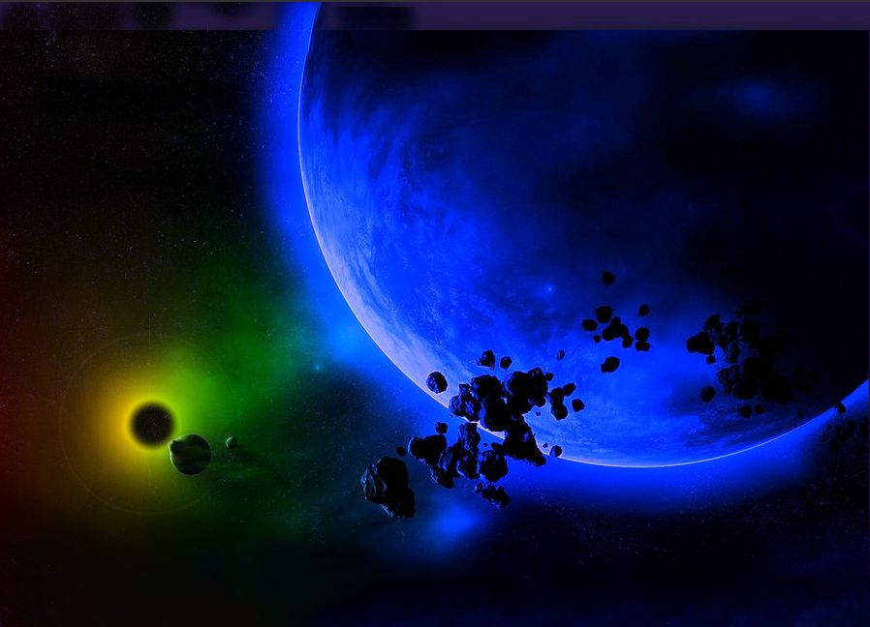


Slide 24
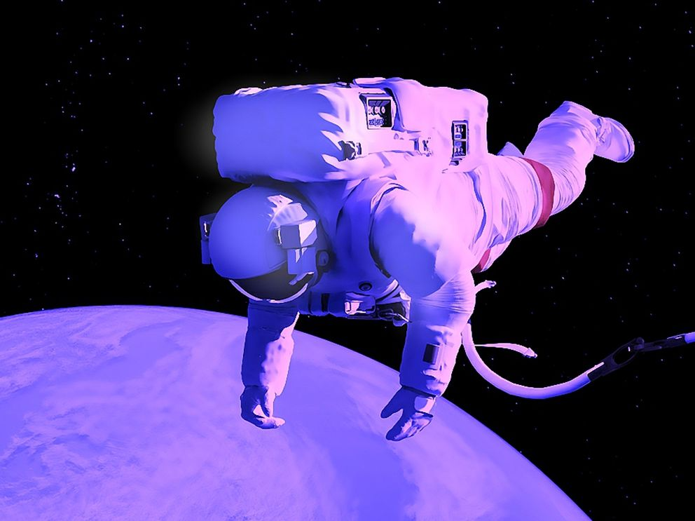


Slide 25
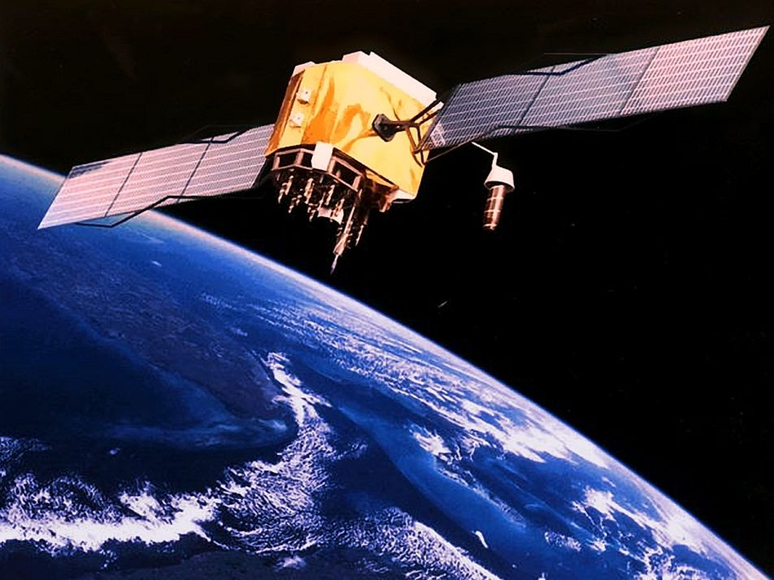

Slide 26



Slide 27
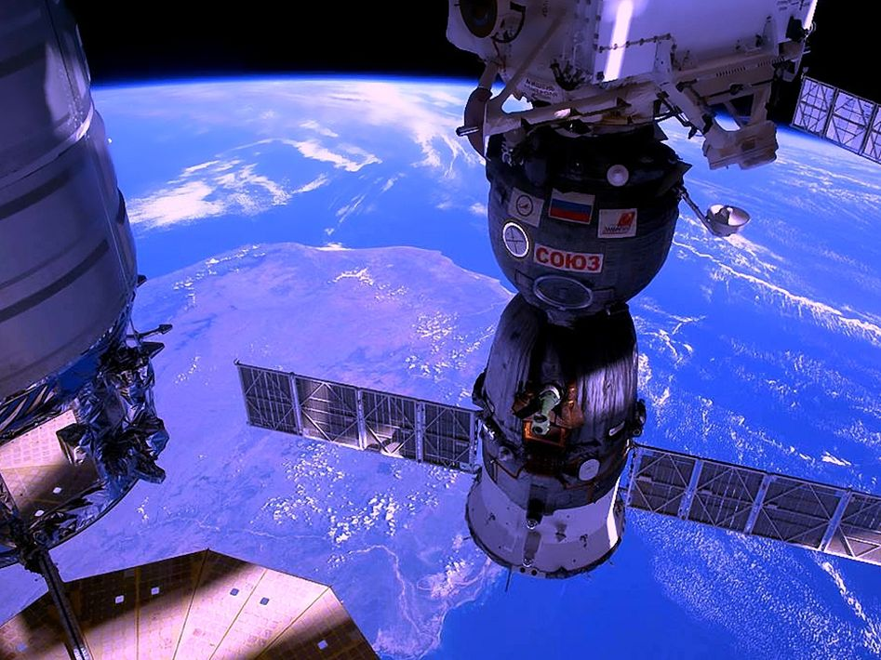

Slide 28
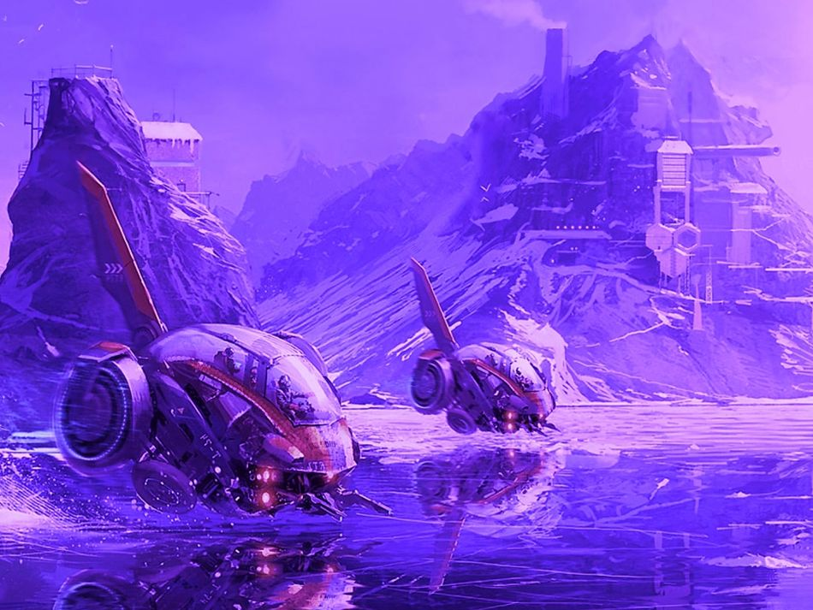

Slide 29

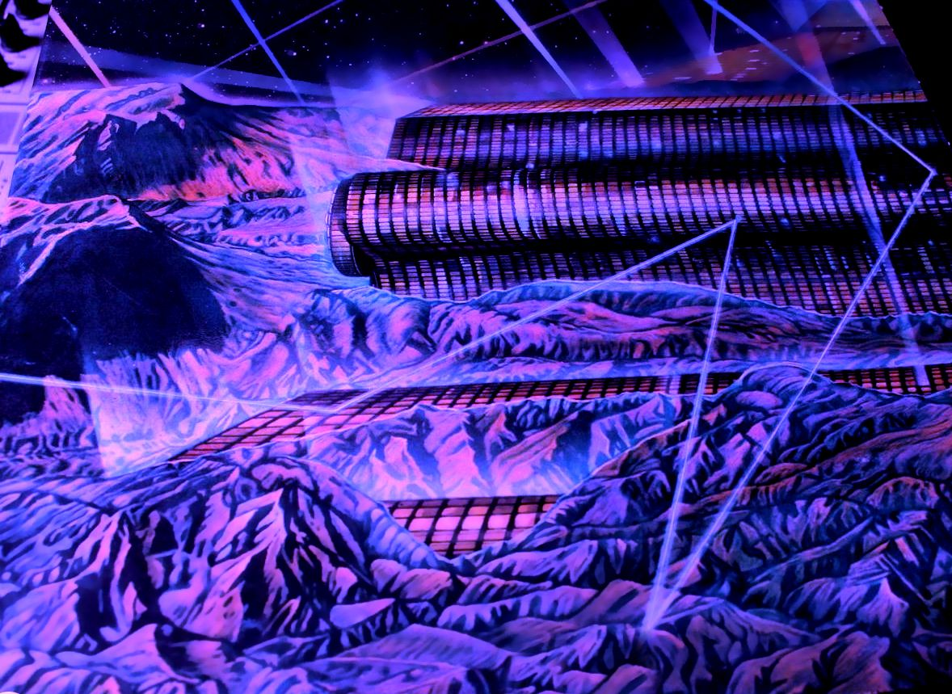



END

Slide 30







¿Te ha gustado?
Puedes ver más entrando
Aquí
Además puedes recibir powerpoints en tu correo electrónico suscribiéndote aquí:

