Slide 1


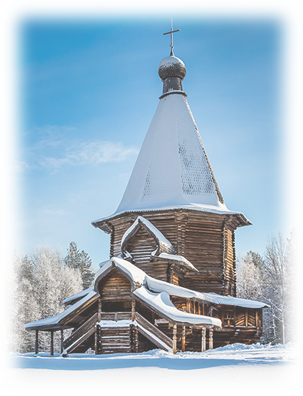
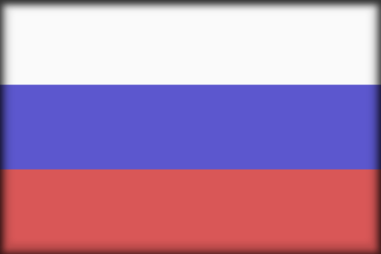
VER EL MUNDO CONMIGO
SALVA LA TIERRA
RUSIA
Norte
Malye Kopely
08
Tommy55
2017

Slide 2
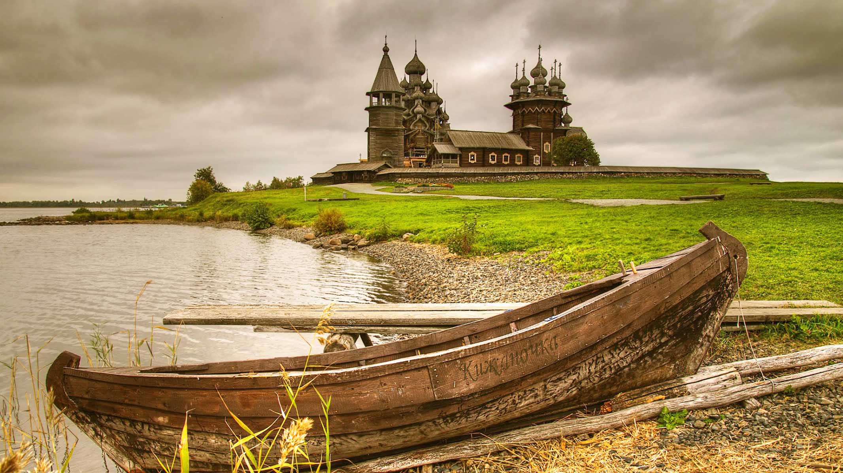

Kizhi
(Zastavki)
ORIGIN

Slide 3
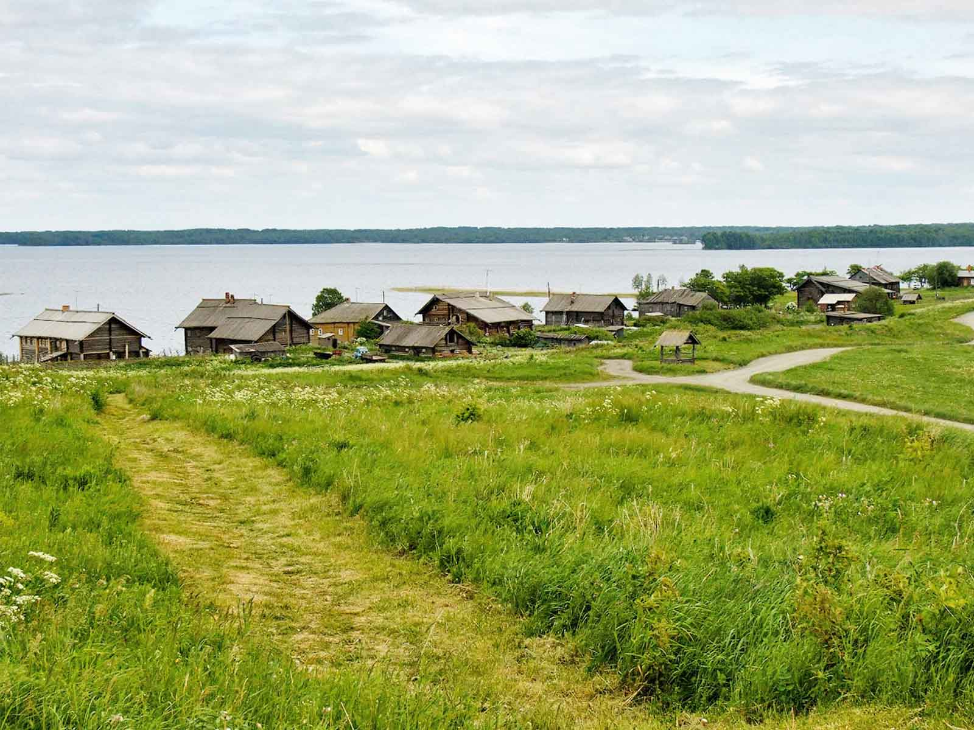
Kizhi
Vladimir Kezling
ORIGIN

Slide 4
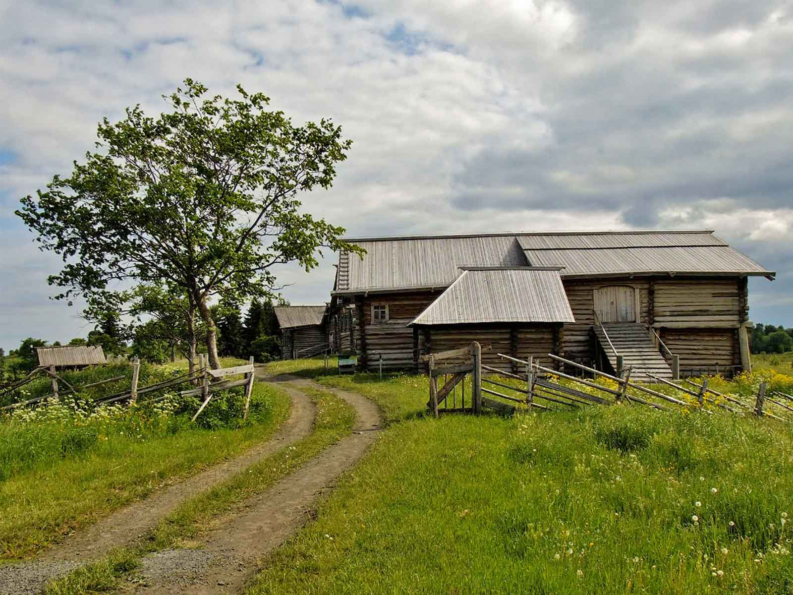
Kizhi
Vladimir Kezling
ORIGIN

Slide 5
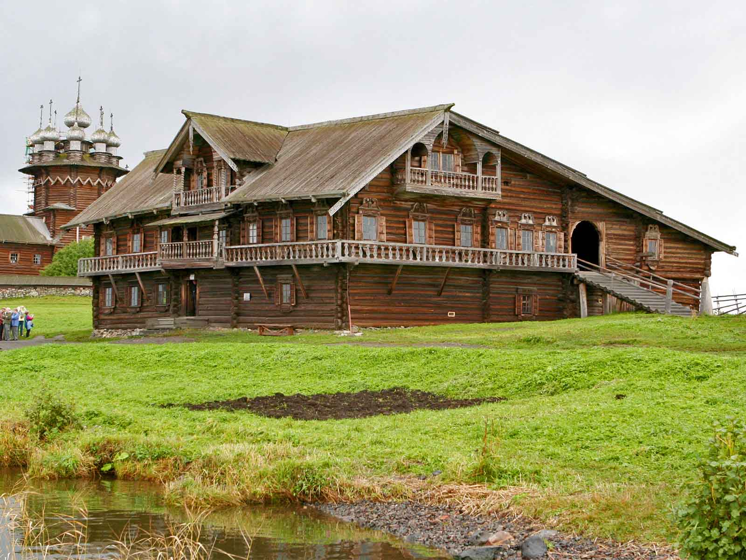
Kizhi
R.Melgar
ORIGIN

Slide 6
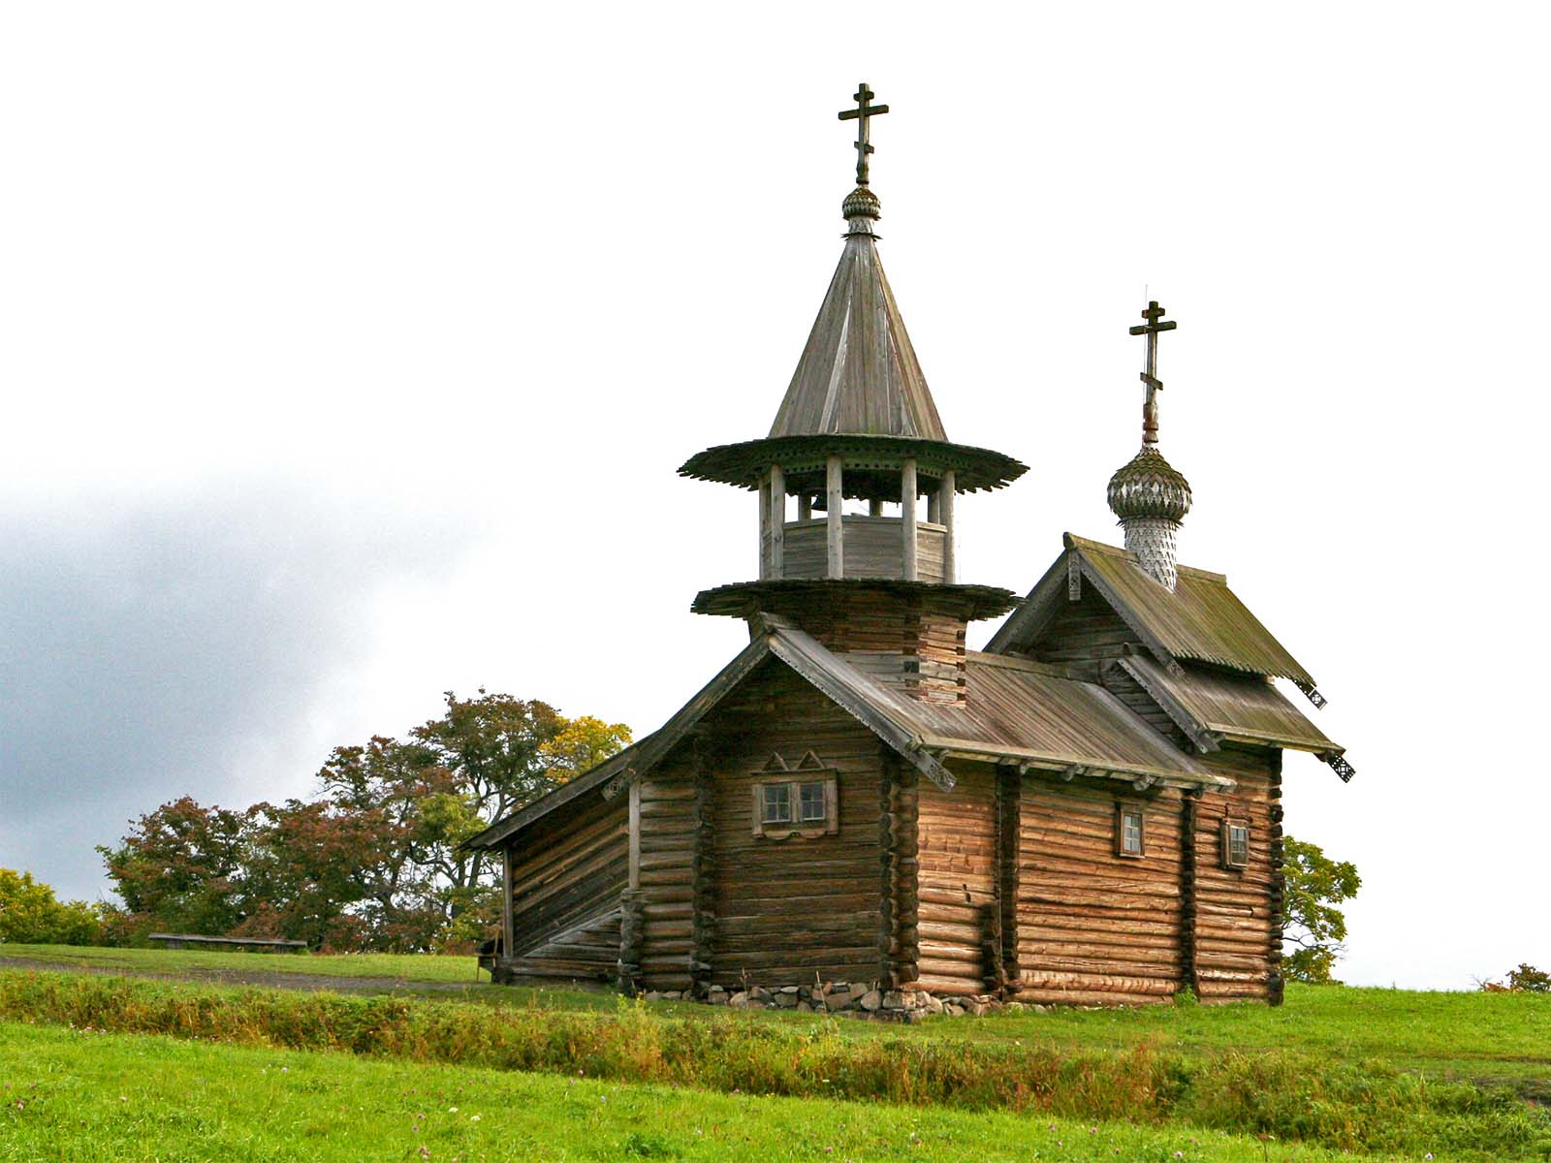
Kizhi
R.Melgar
ORIGIN

Slide 7
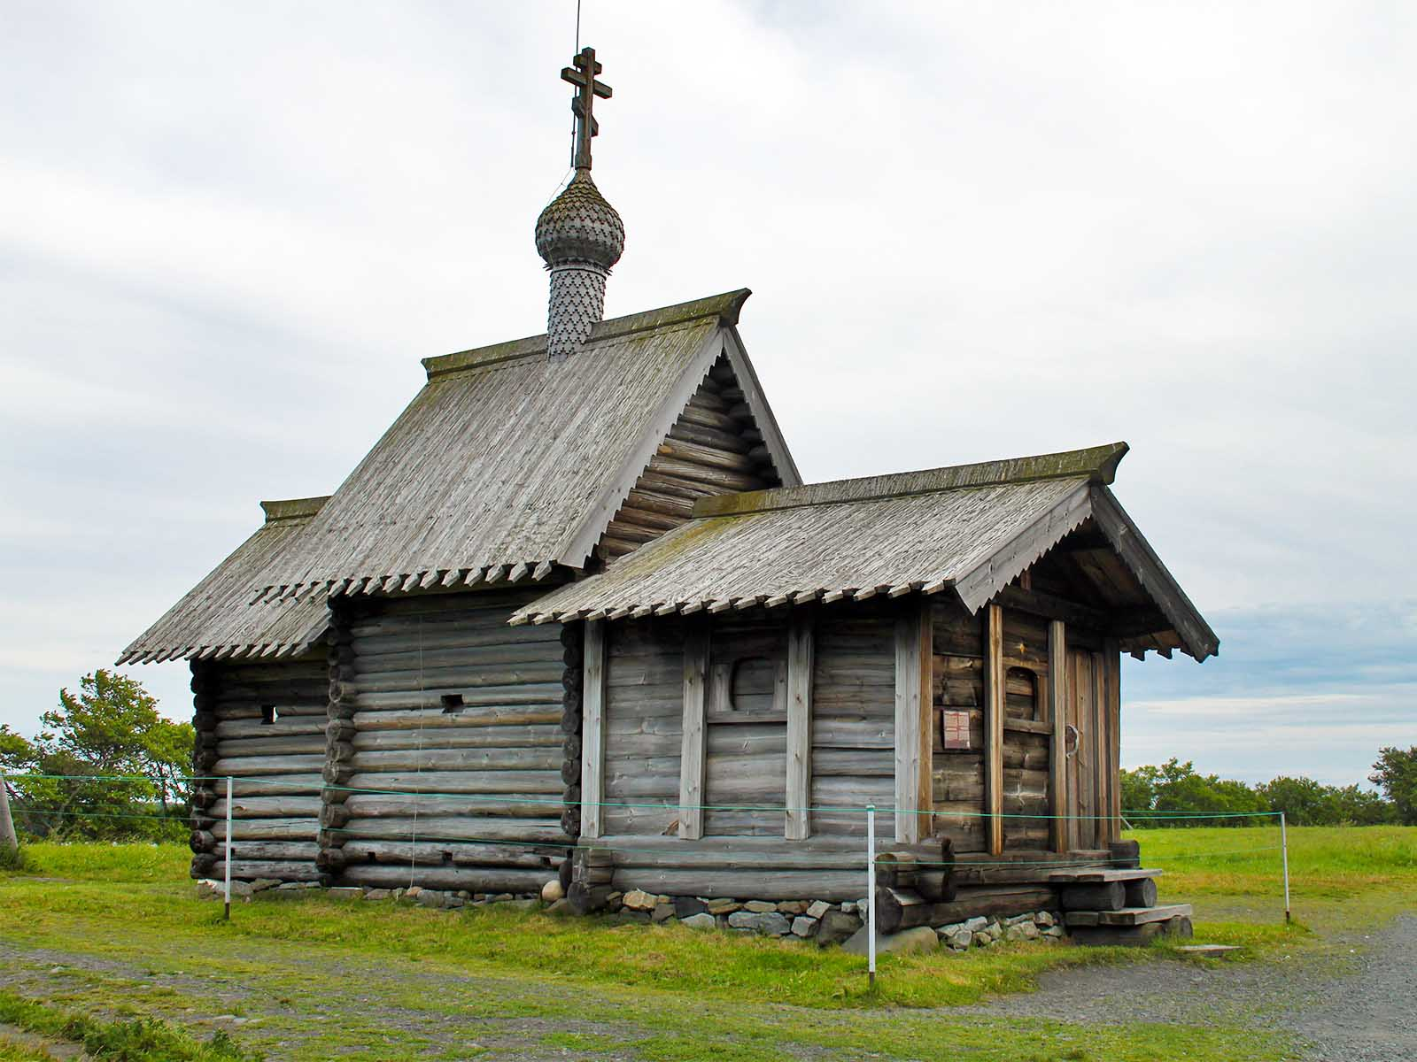
Kizhi
(Flowcomm)
ORIGIN

Slide 8
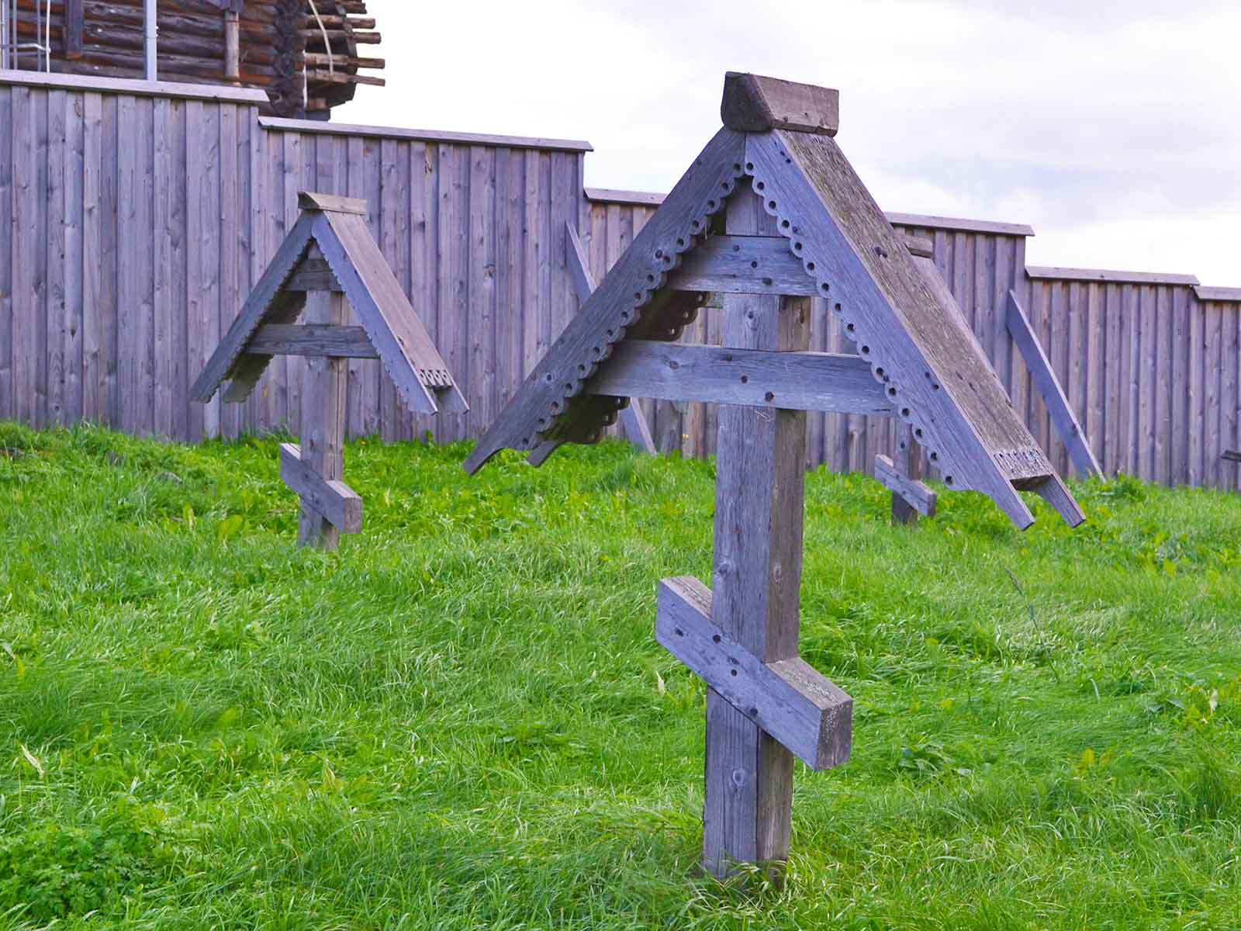
Kizhi
Larry Koester
ORIGIN

Slide 9
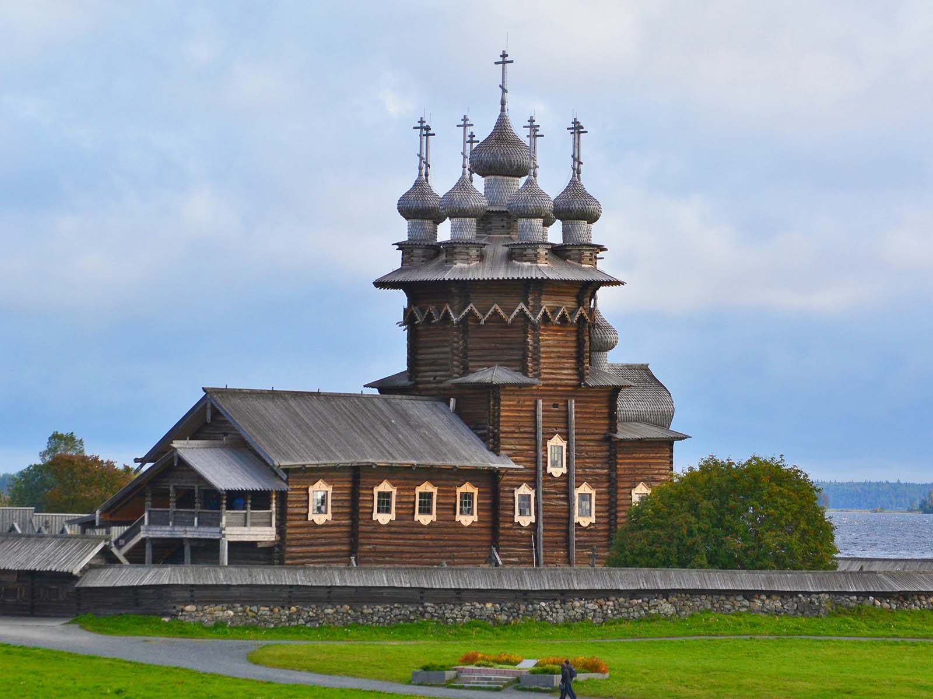
Kizhi
Larry Koester
ORIGIN

Slide 10
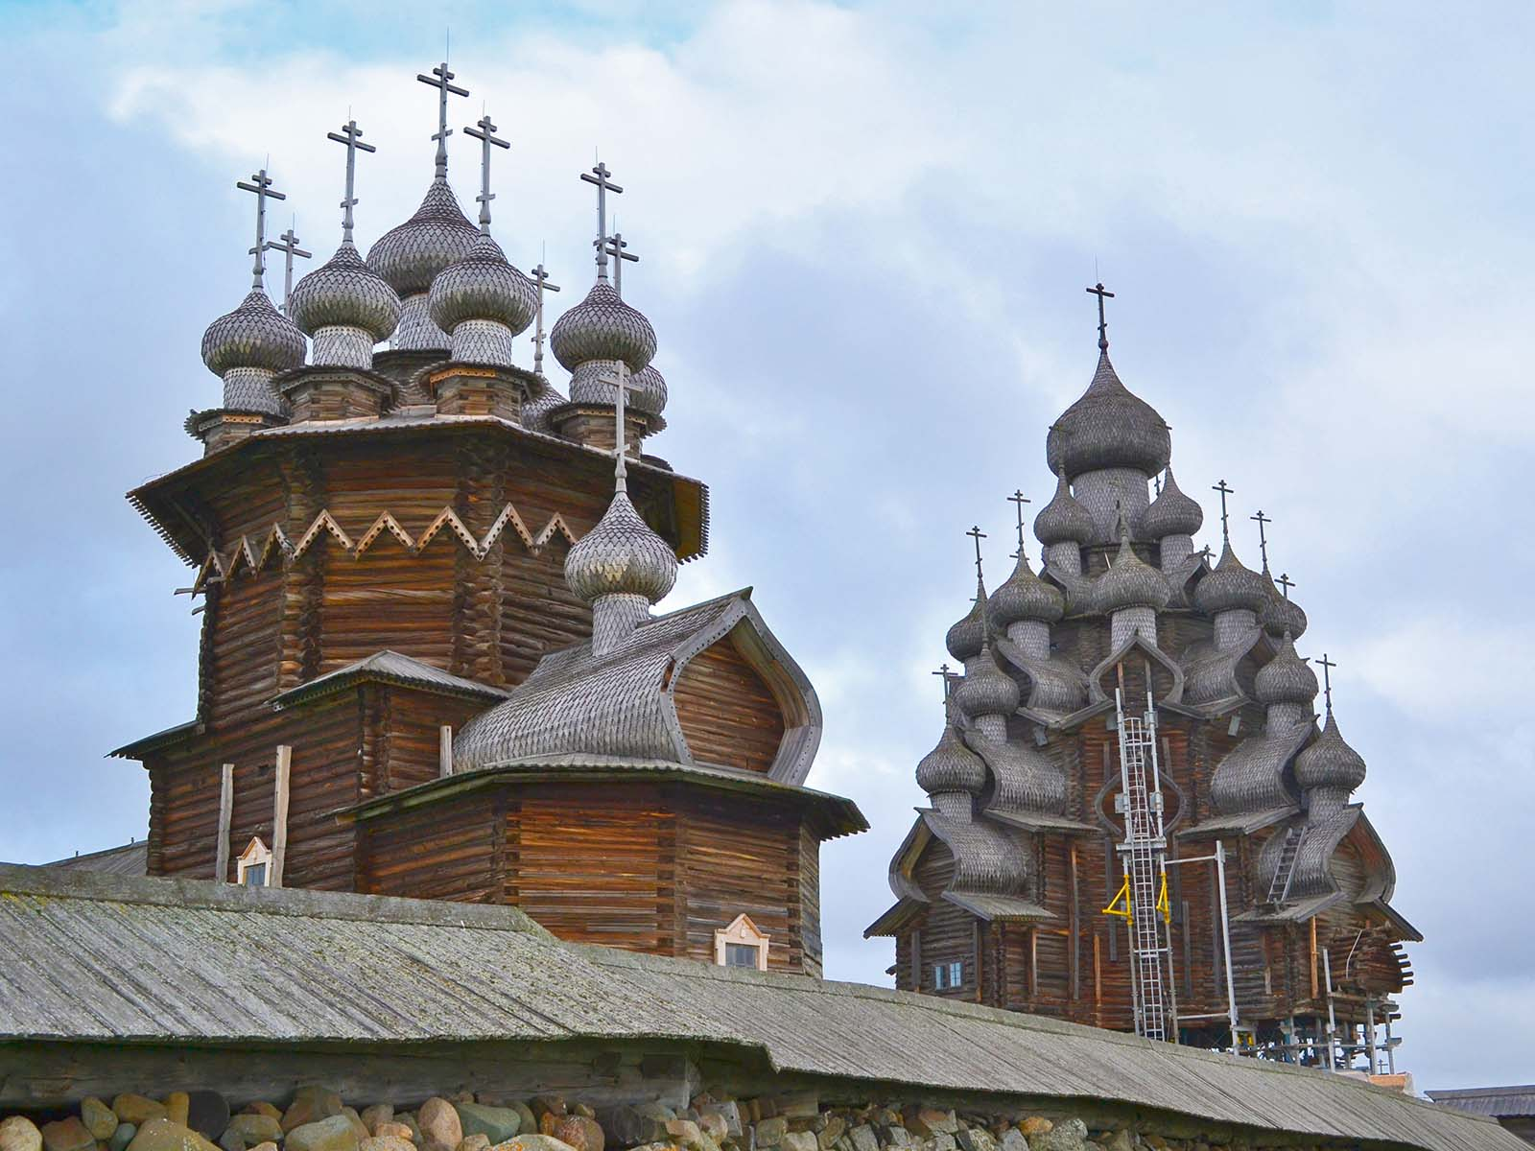
Kizhi
Larry Koester
ORIGIN

Slide 11
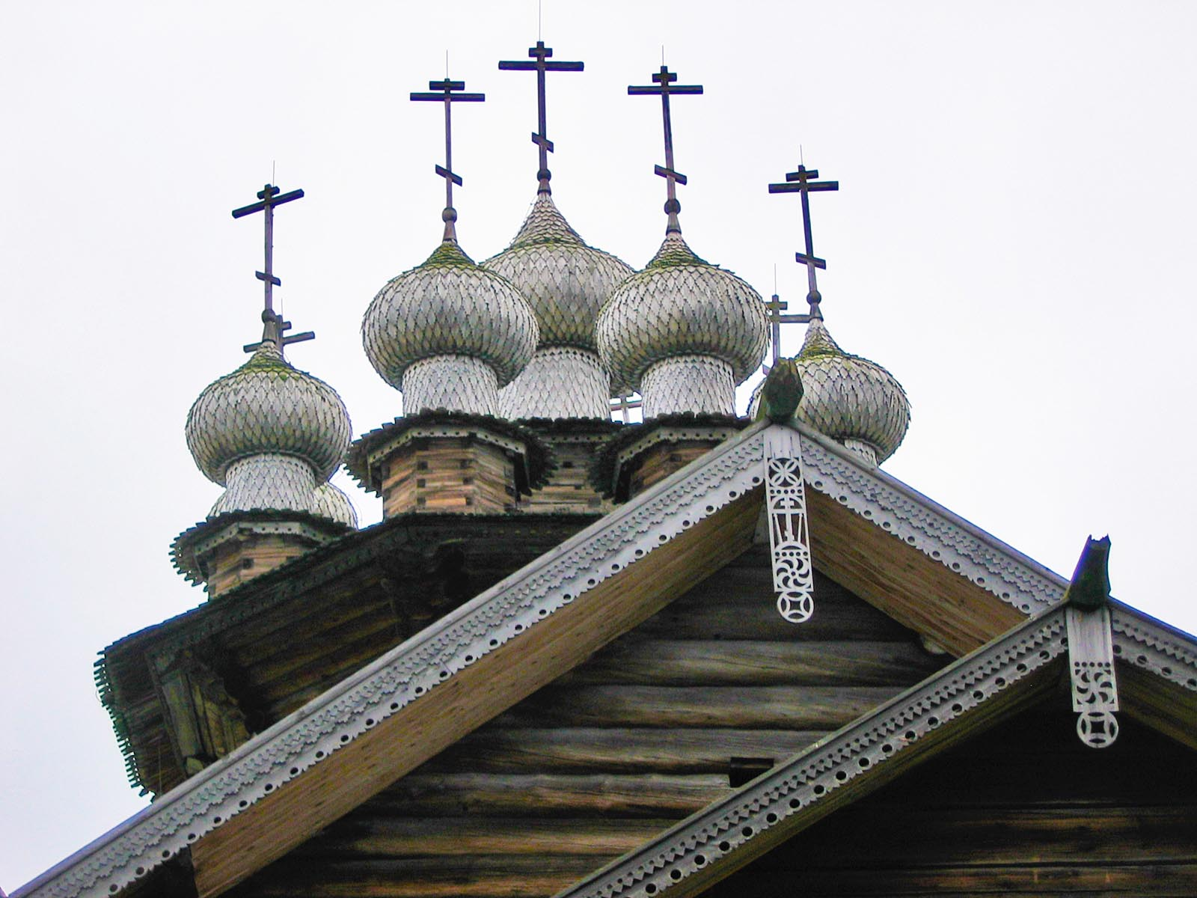
Kizhi
Calude Springer
ORIGIN

Slide 12
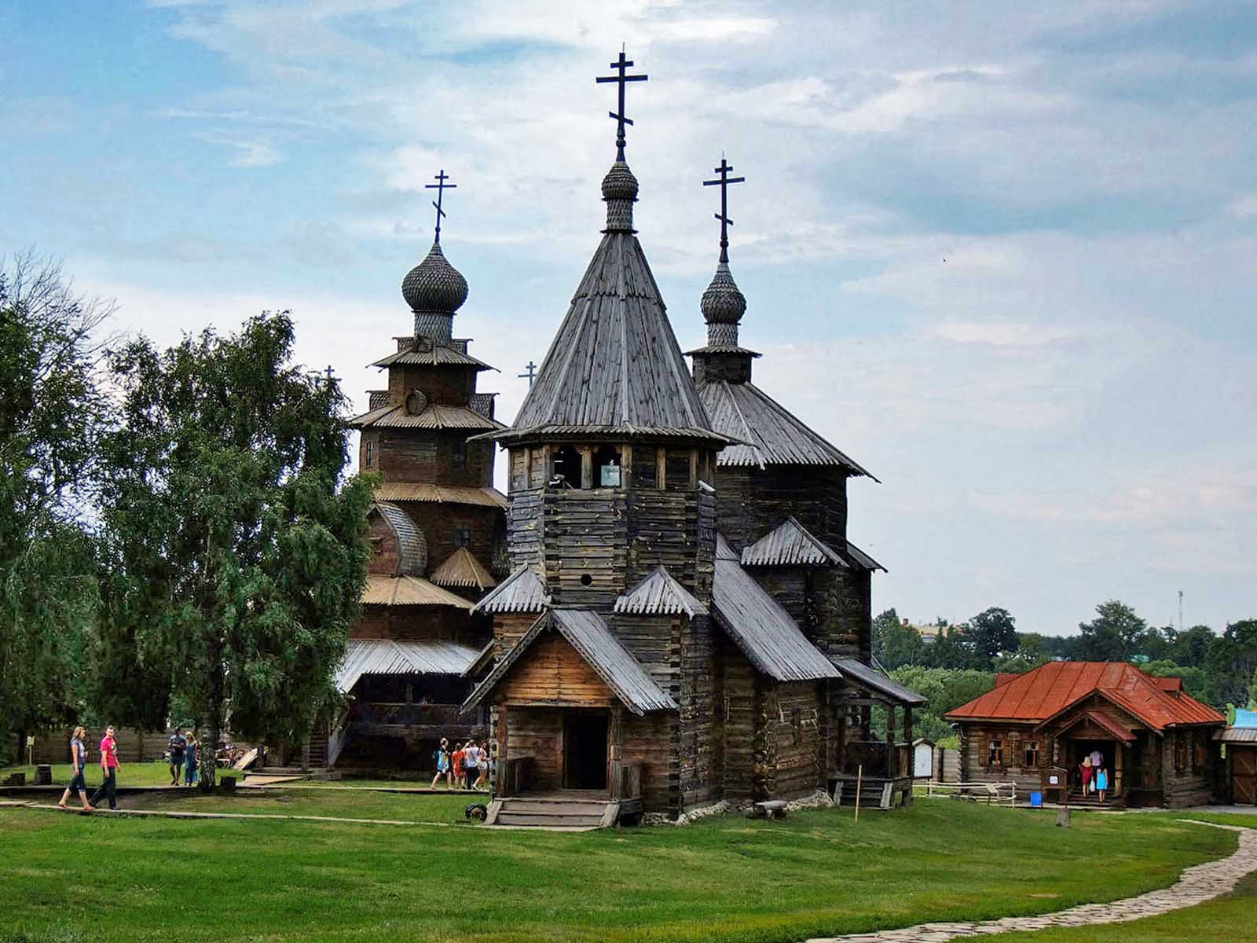
Suzdal
Vladimir Kezling
ORIGIN

Slide 13
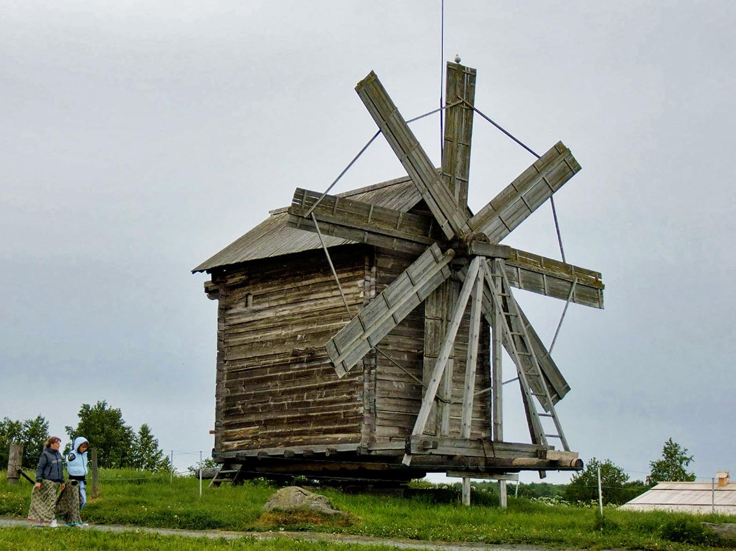
Kizhi
Vladimir Kezling
ORIGIN

Slide 14
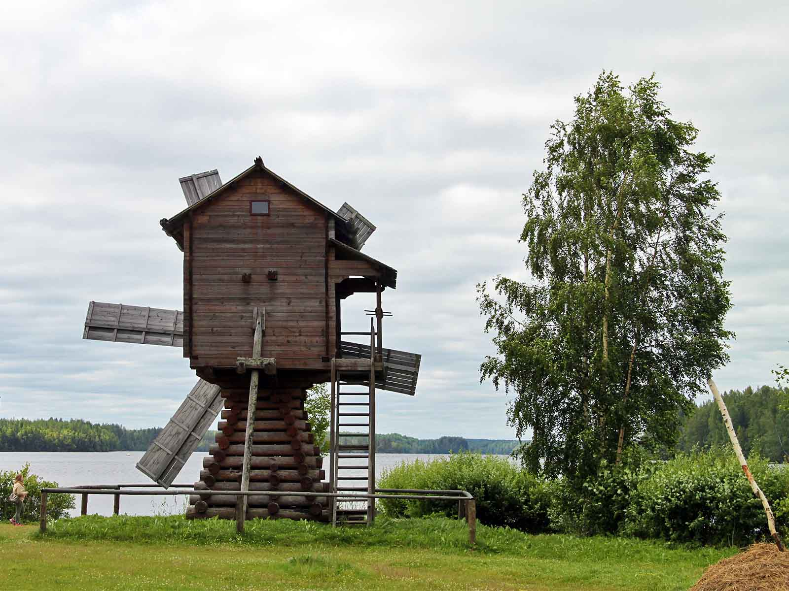
Mandrogy
(Flowcomm)
ORIGIN

Slide 15
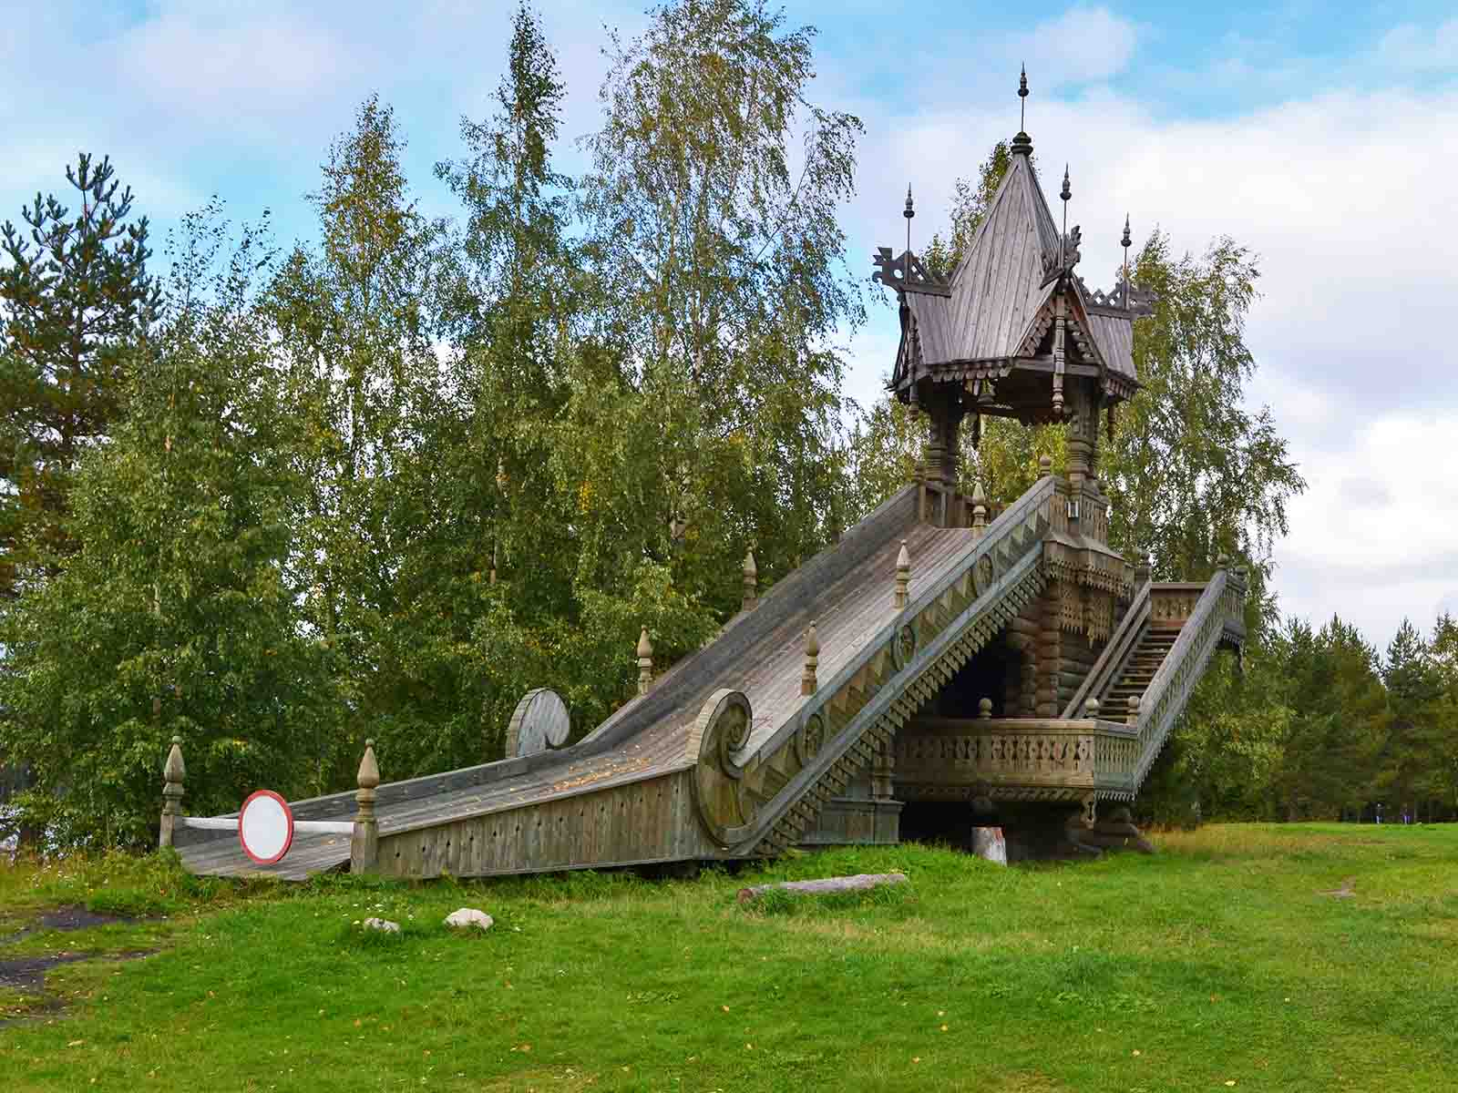
Mandrogy
Larry Koester
ORIGIN

Slide 16
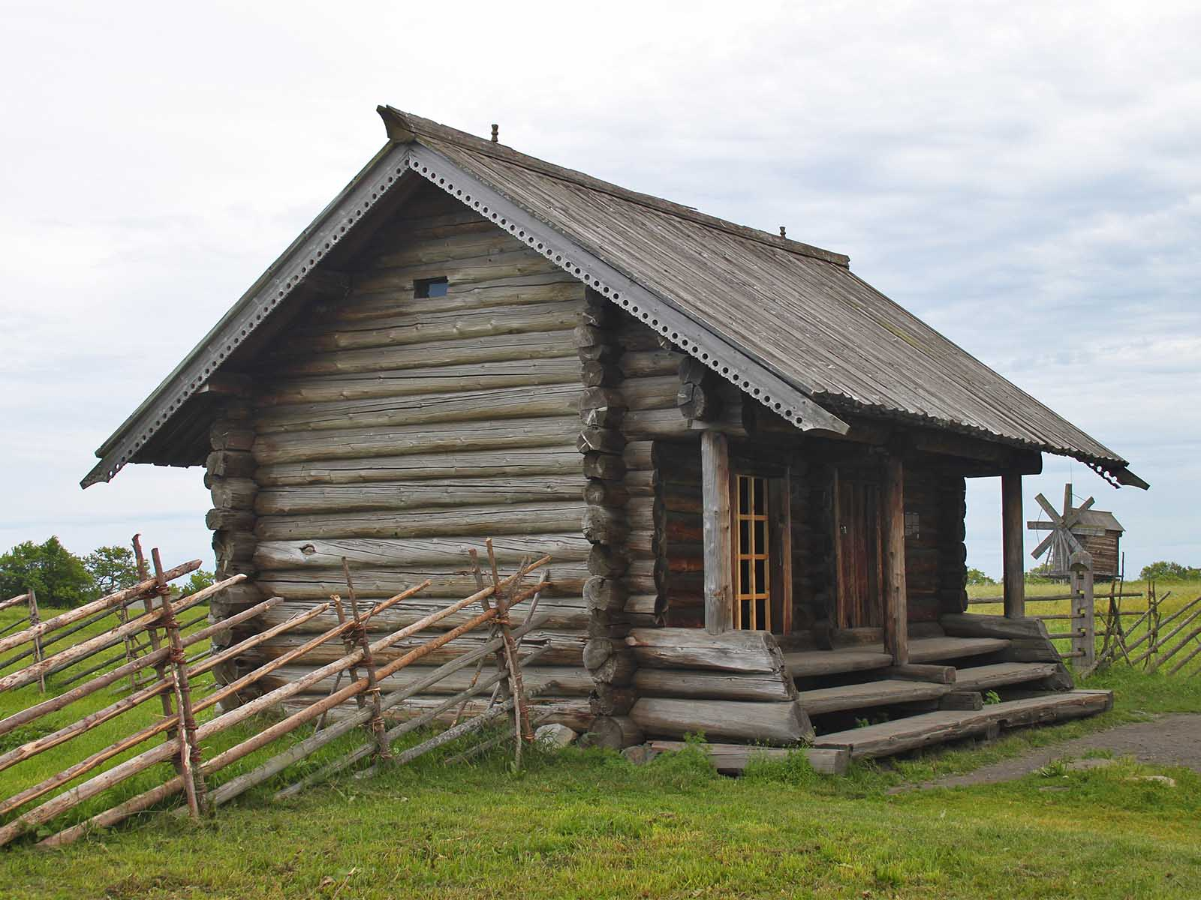
Kizhi
(Flowcomm)
ORIGIN

Slide 17
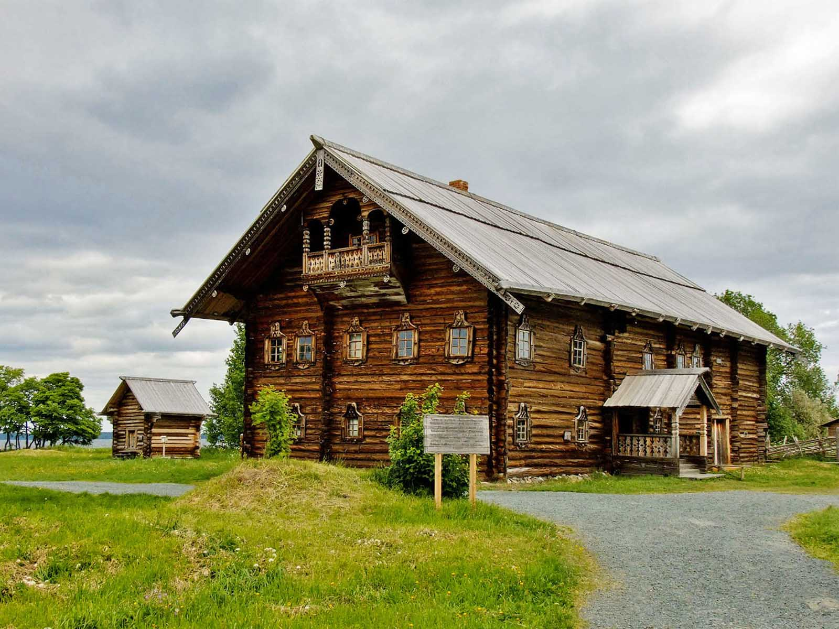
Kizhi
Vladimir Kezling
ORIGIN

Slide 18
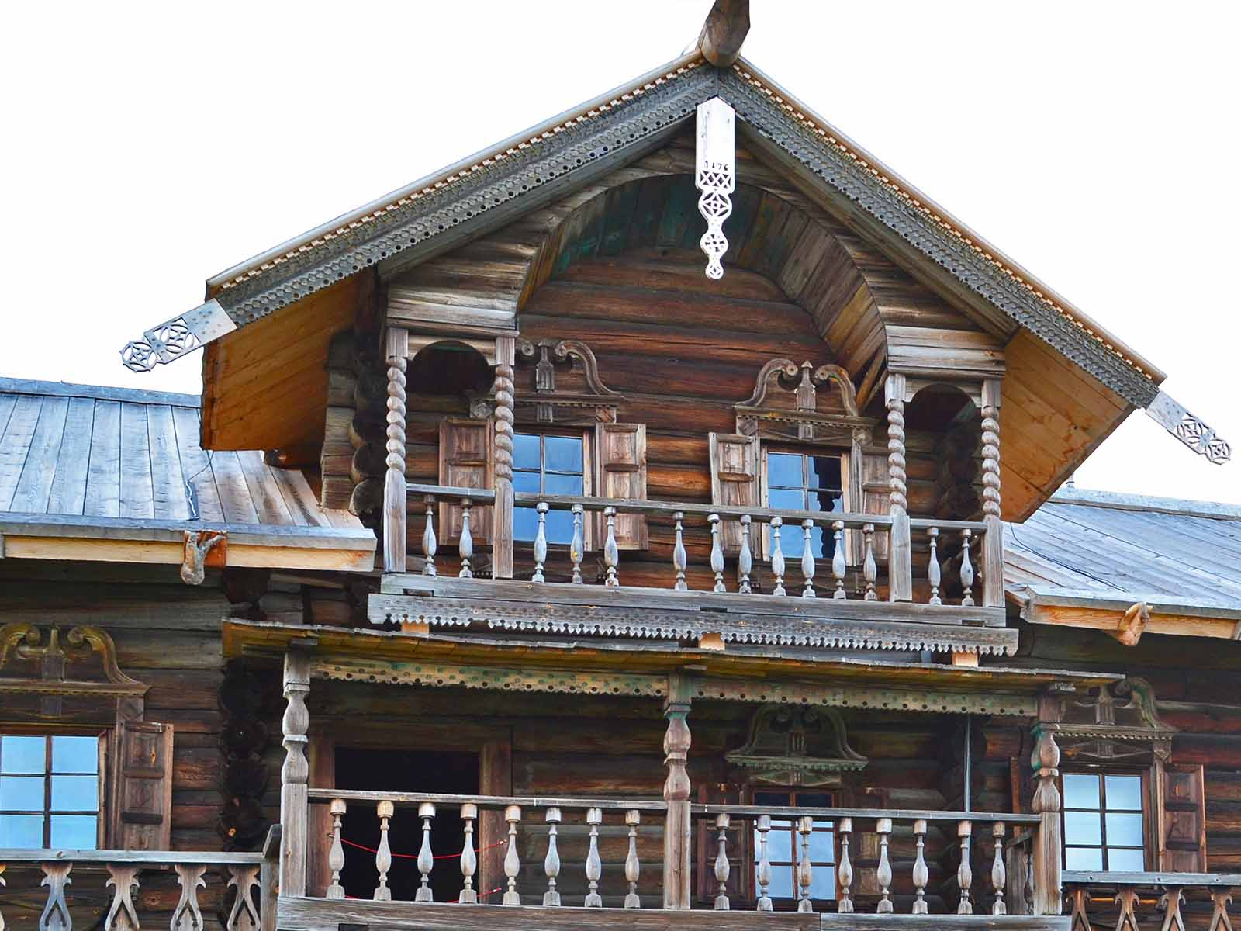
Kizhi
Larry Koester
ORIGIN

Slide 19
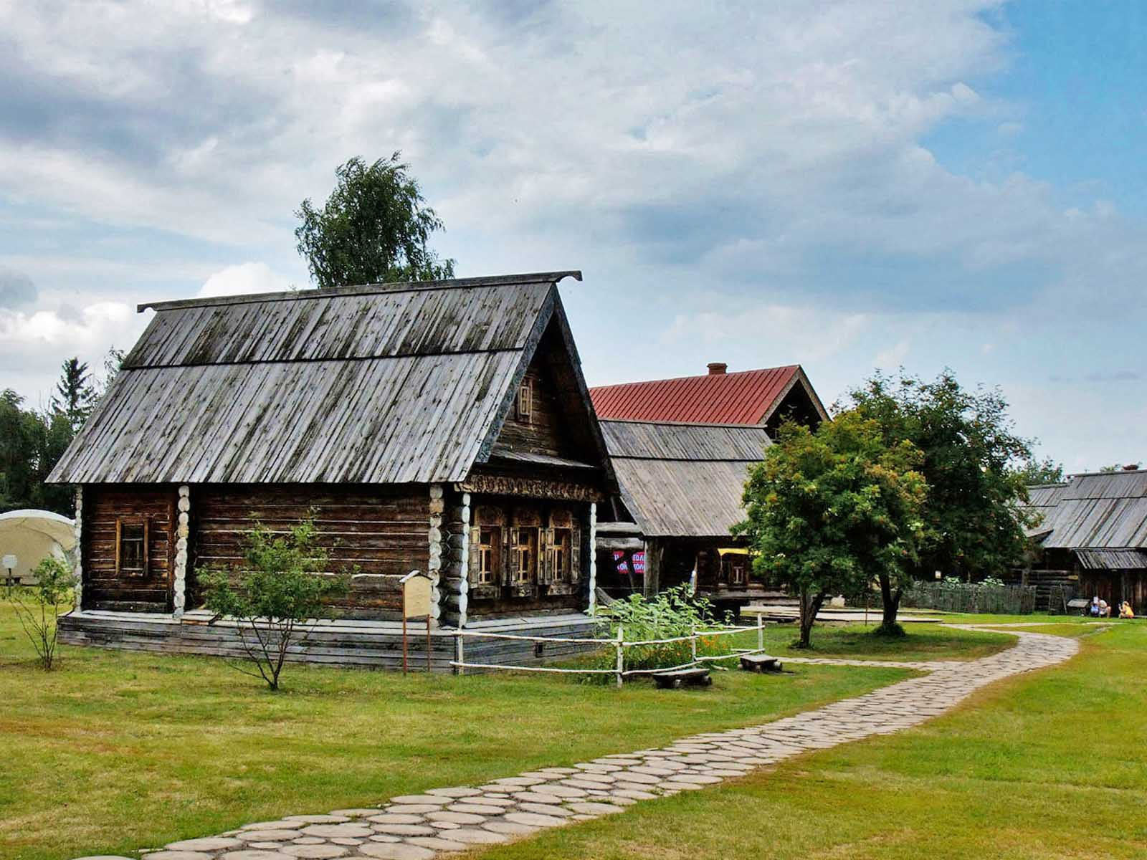
Suzdal
Vladimir Kezling
ORIGIN

Slide 20
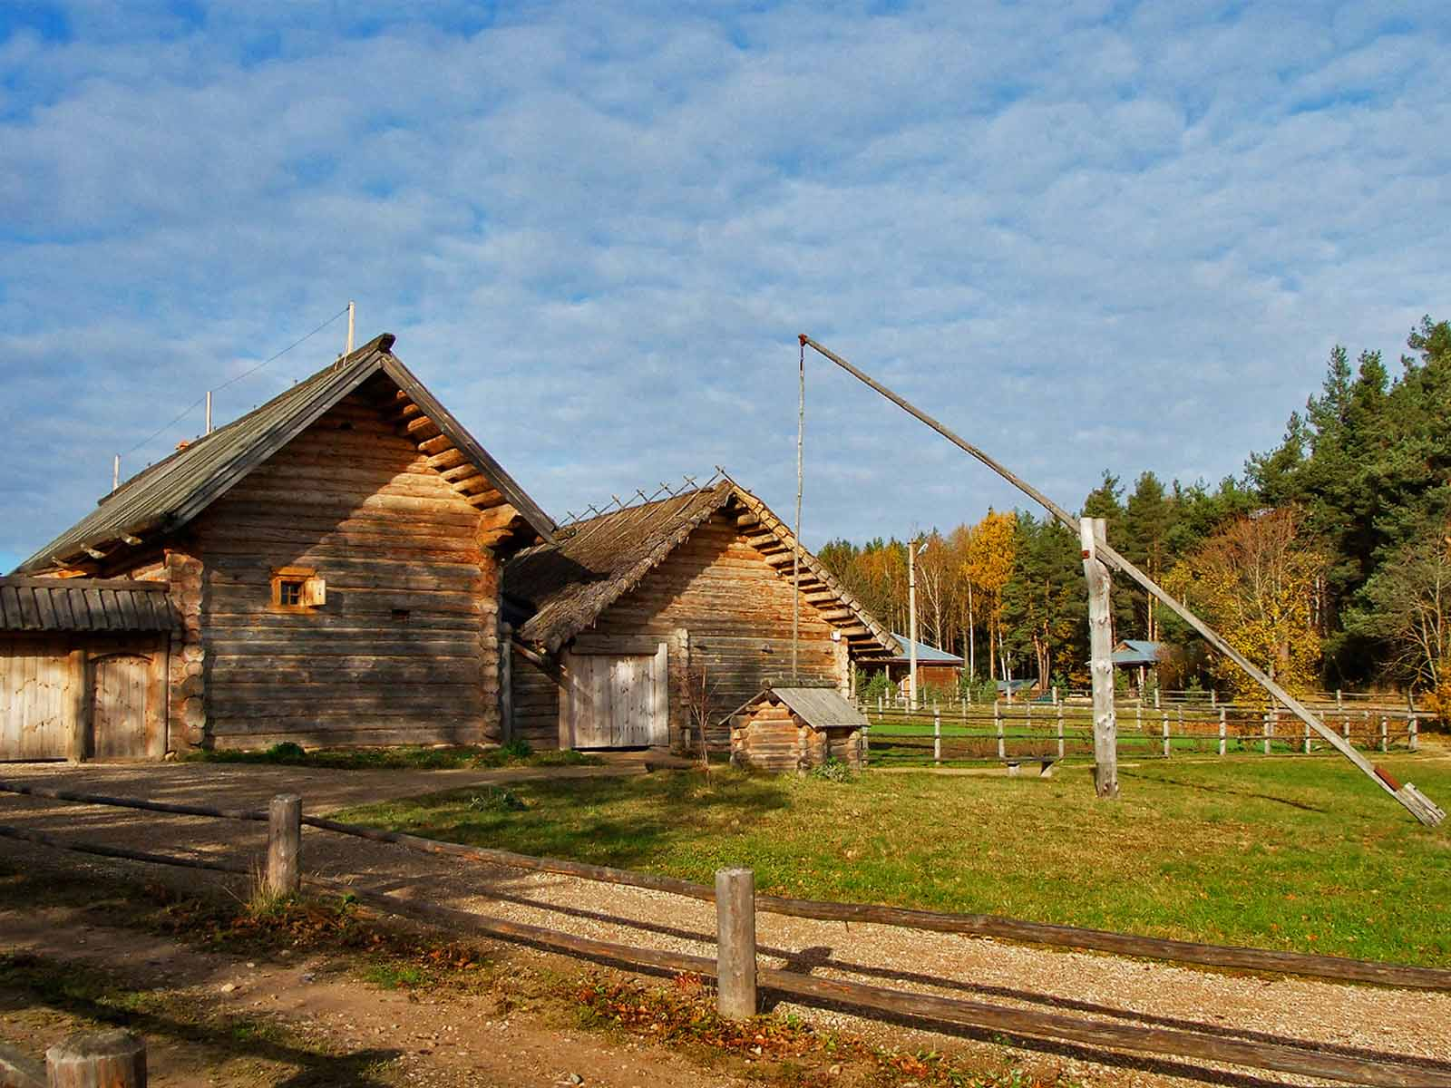
Bugrovo
Vladimir Kezling
ORIGIN

Slide 21
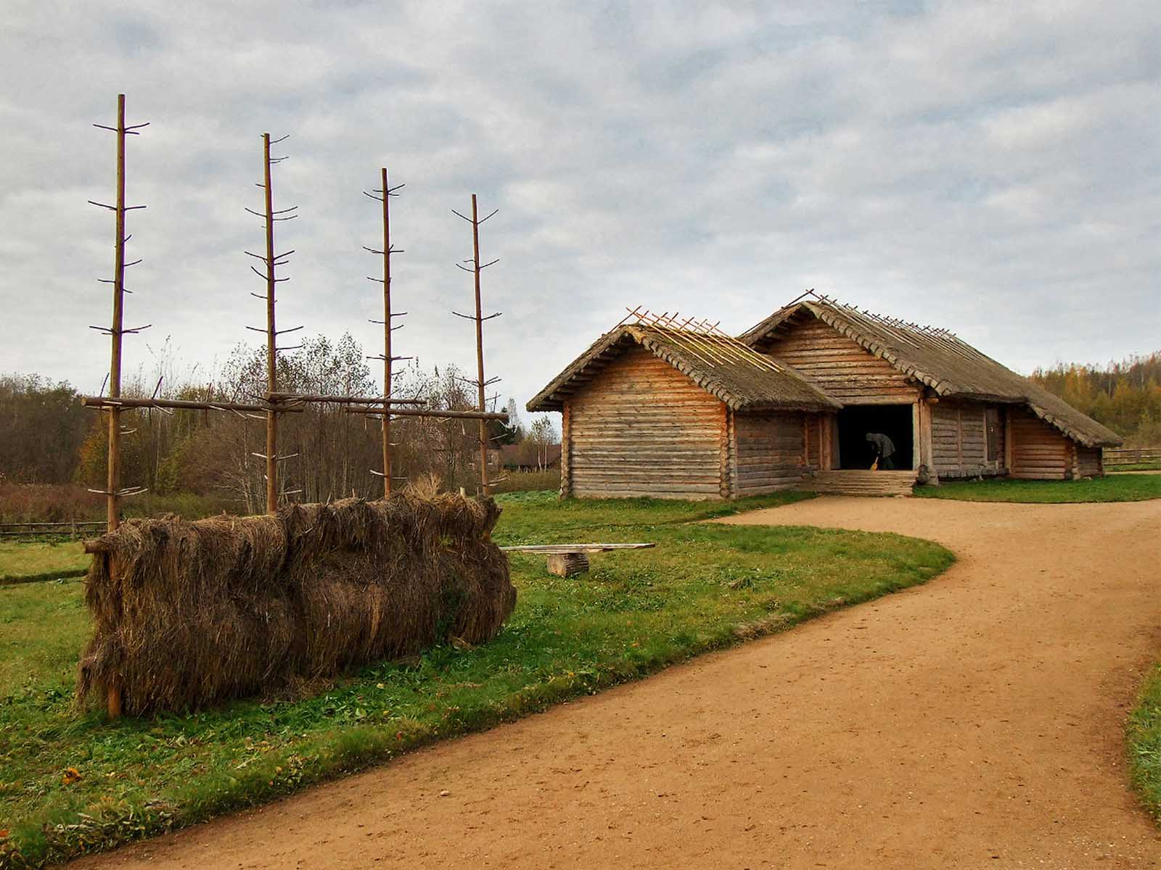
Bugrovo
Vladimir Kezling
ORIGIN

Slide 22
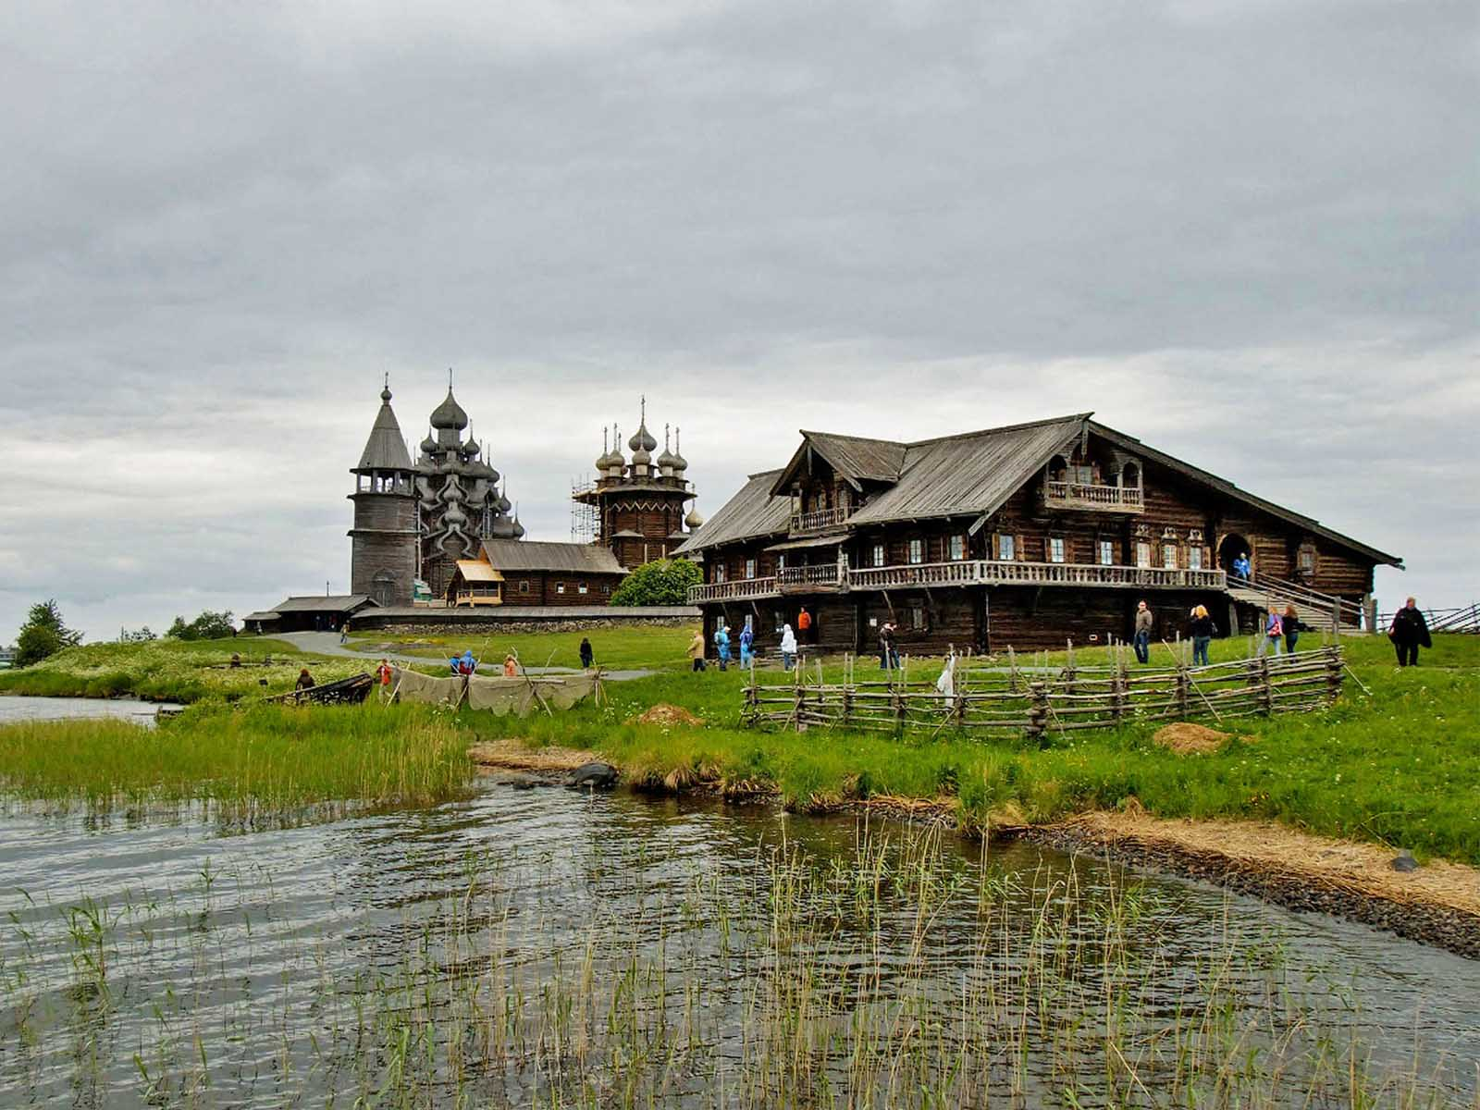
Kizhi
Vladimir Kezling
ORIGIN

Slide 23
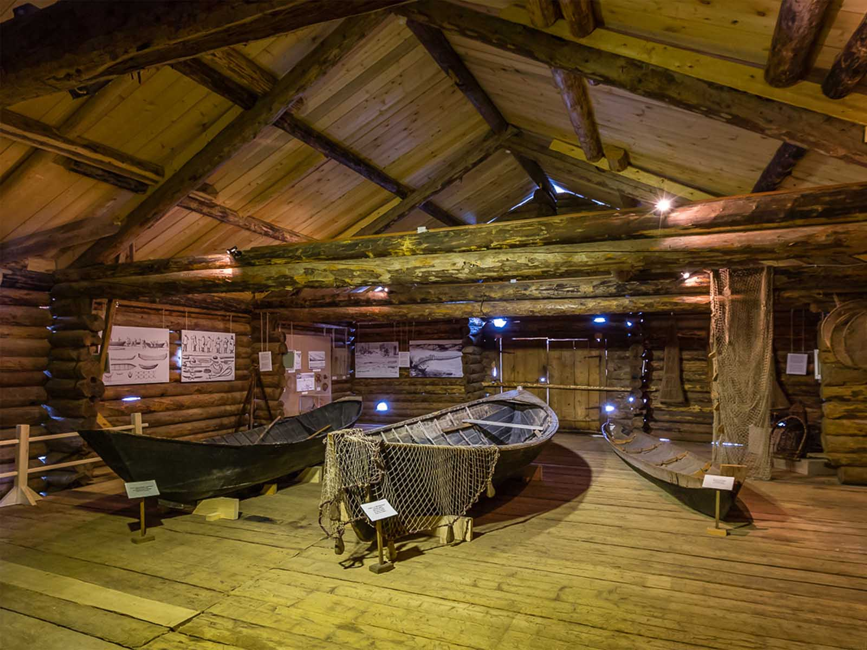
Malye Korely
Anton Ermachkov
ORIGIN

Slide 24
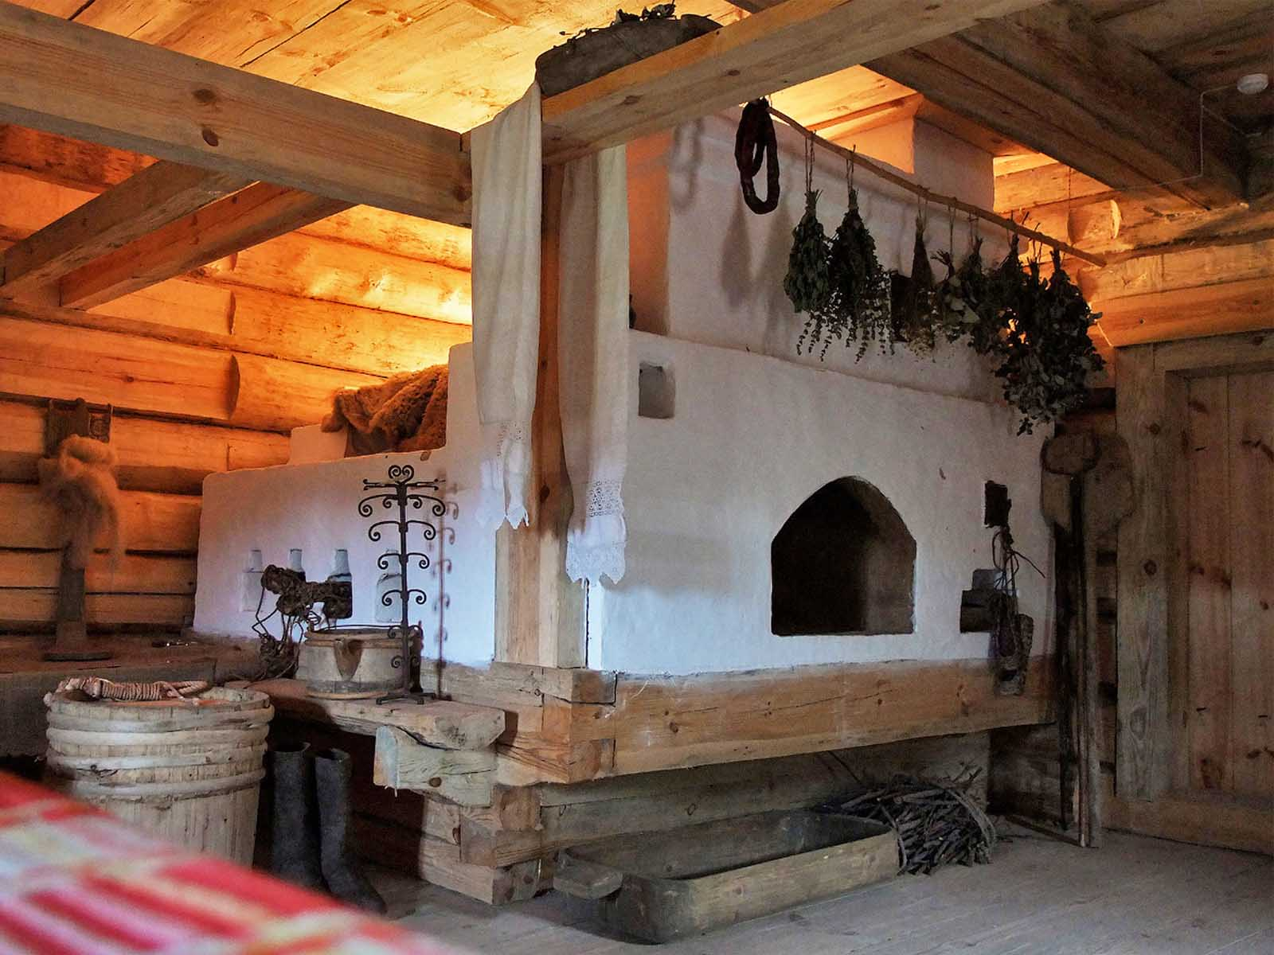
Bugrovo
Vladimir Kezling
ORIGIN

Slide 25
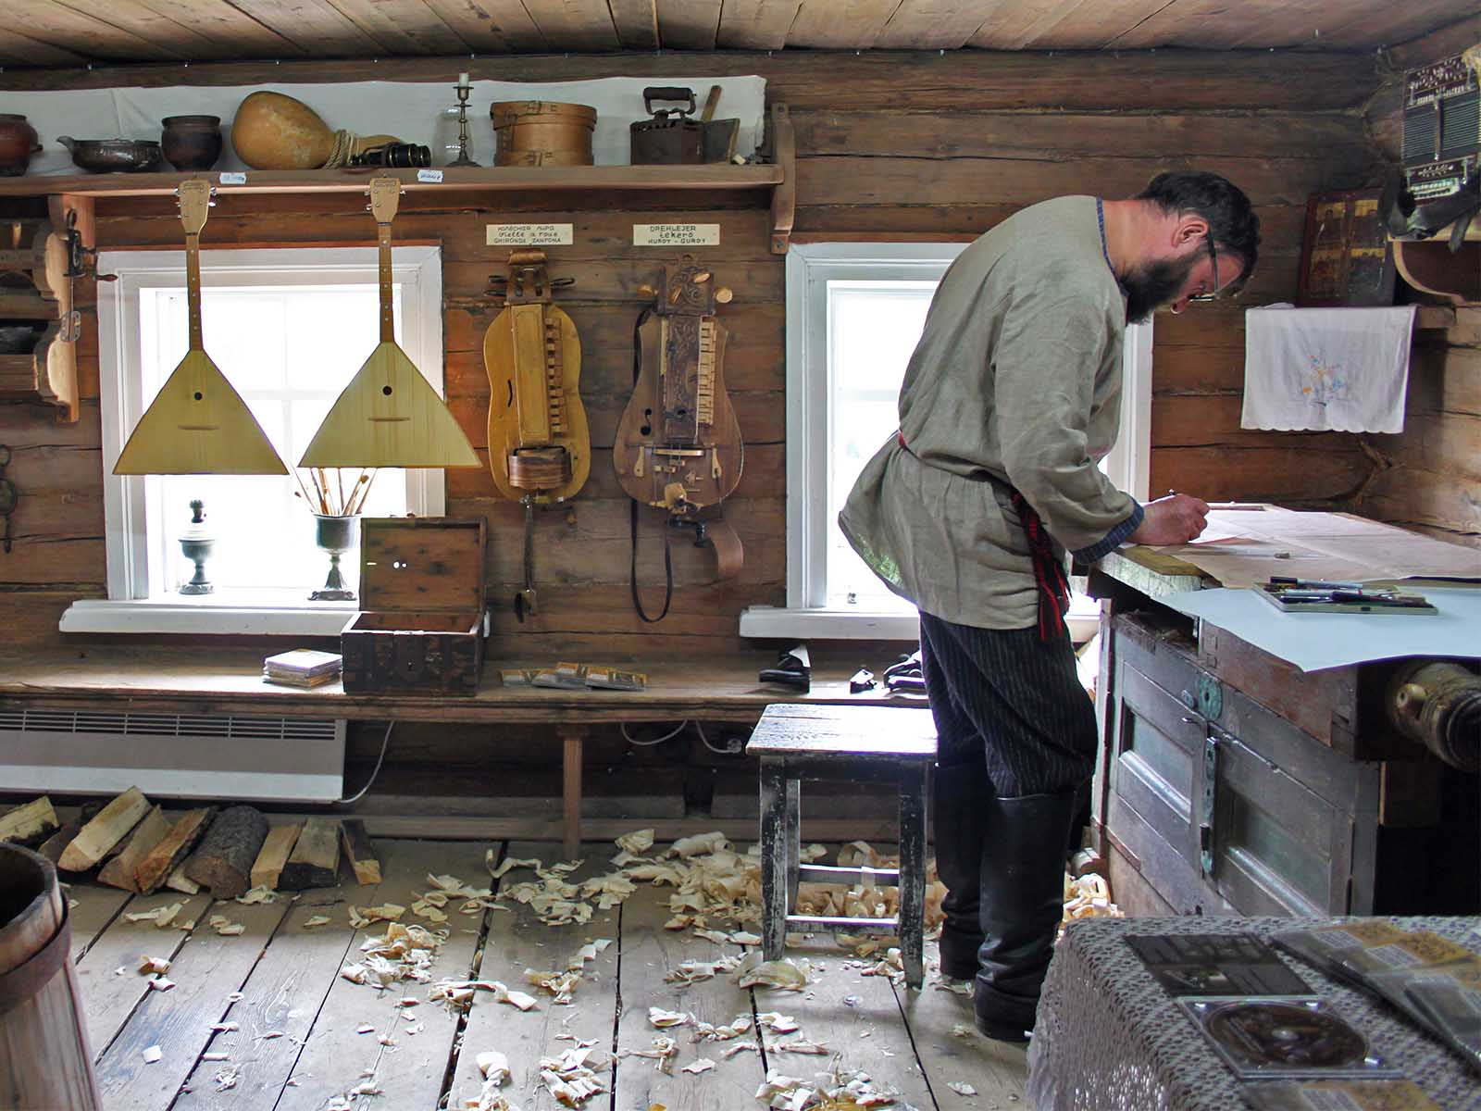
Mandrogy
(Flowcomm)
ORIGIN

Slide 26
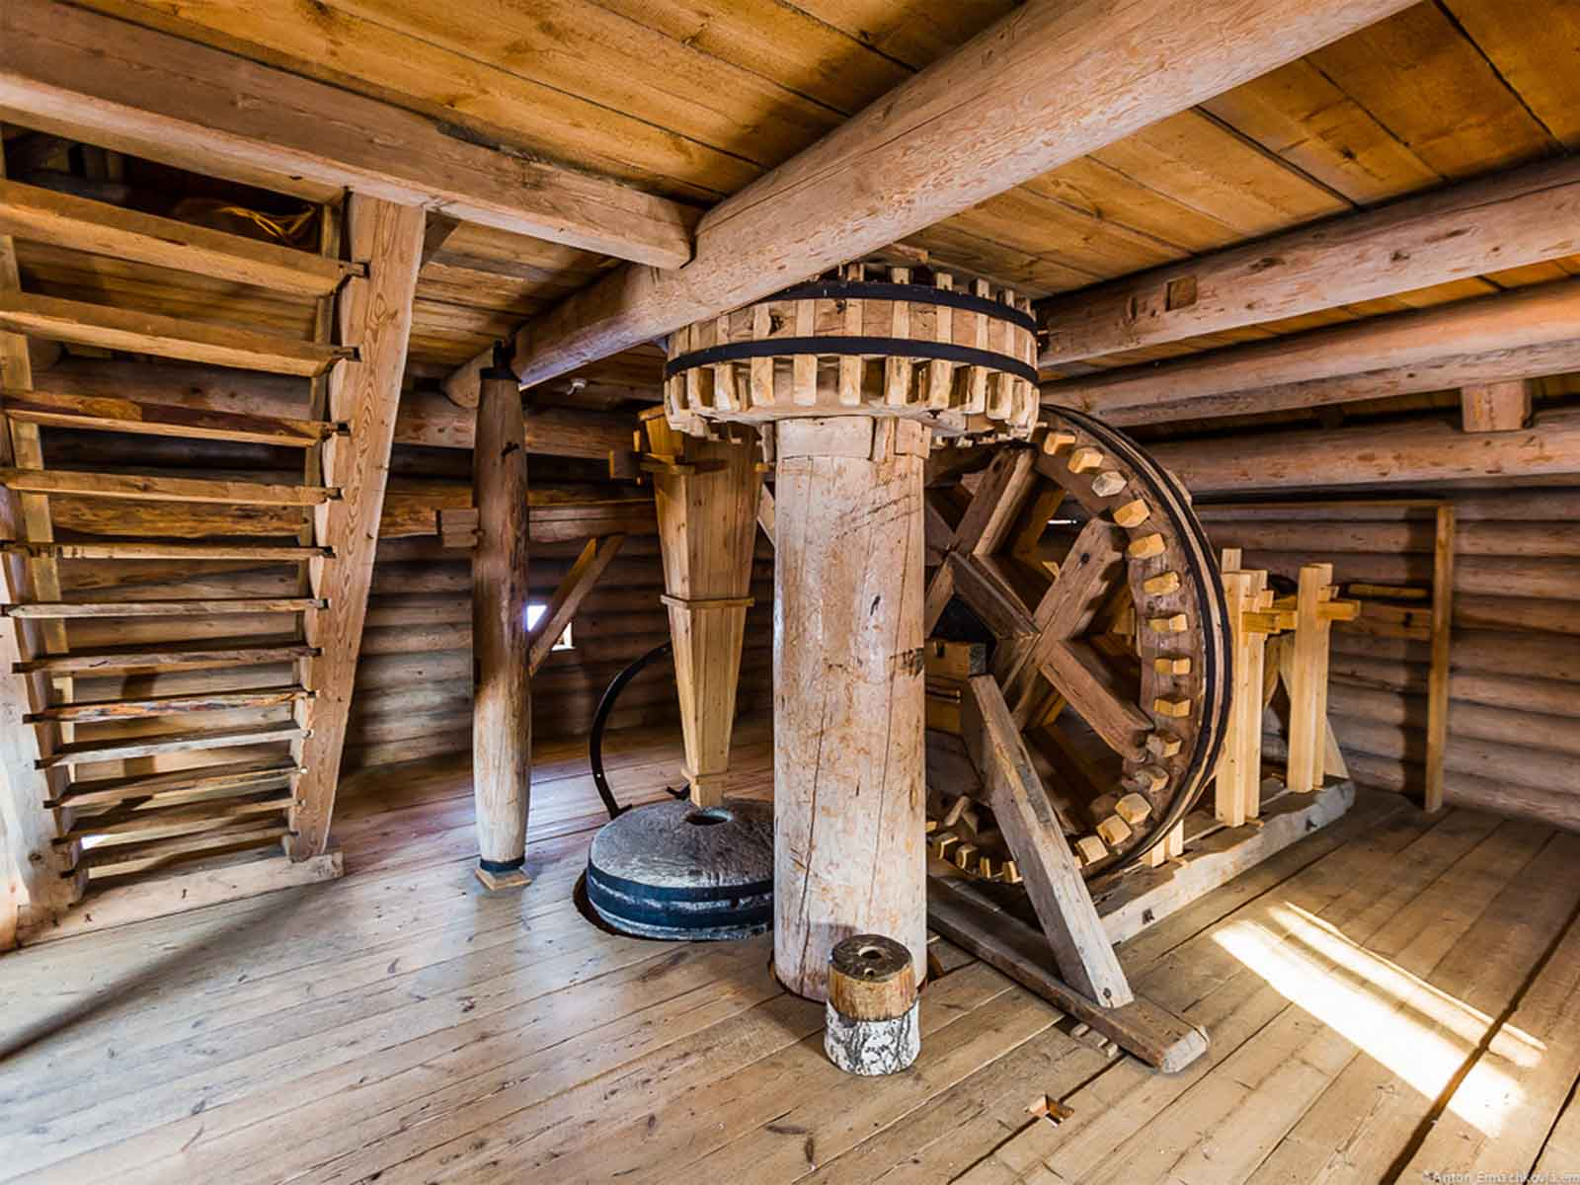
Malye Korely
Anton Ermachkov
ORIGIN

Slide 27
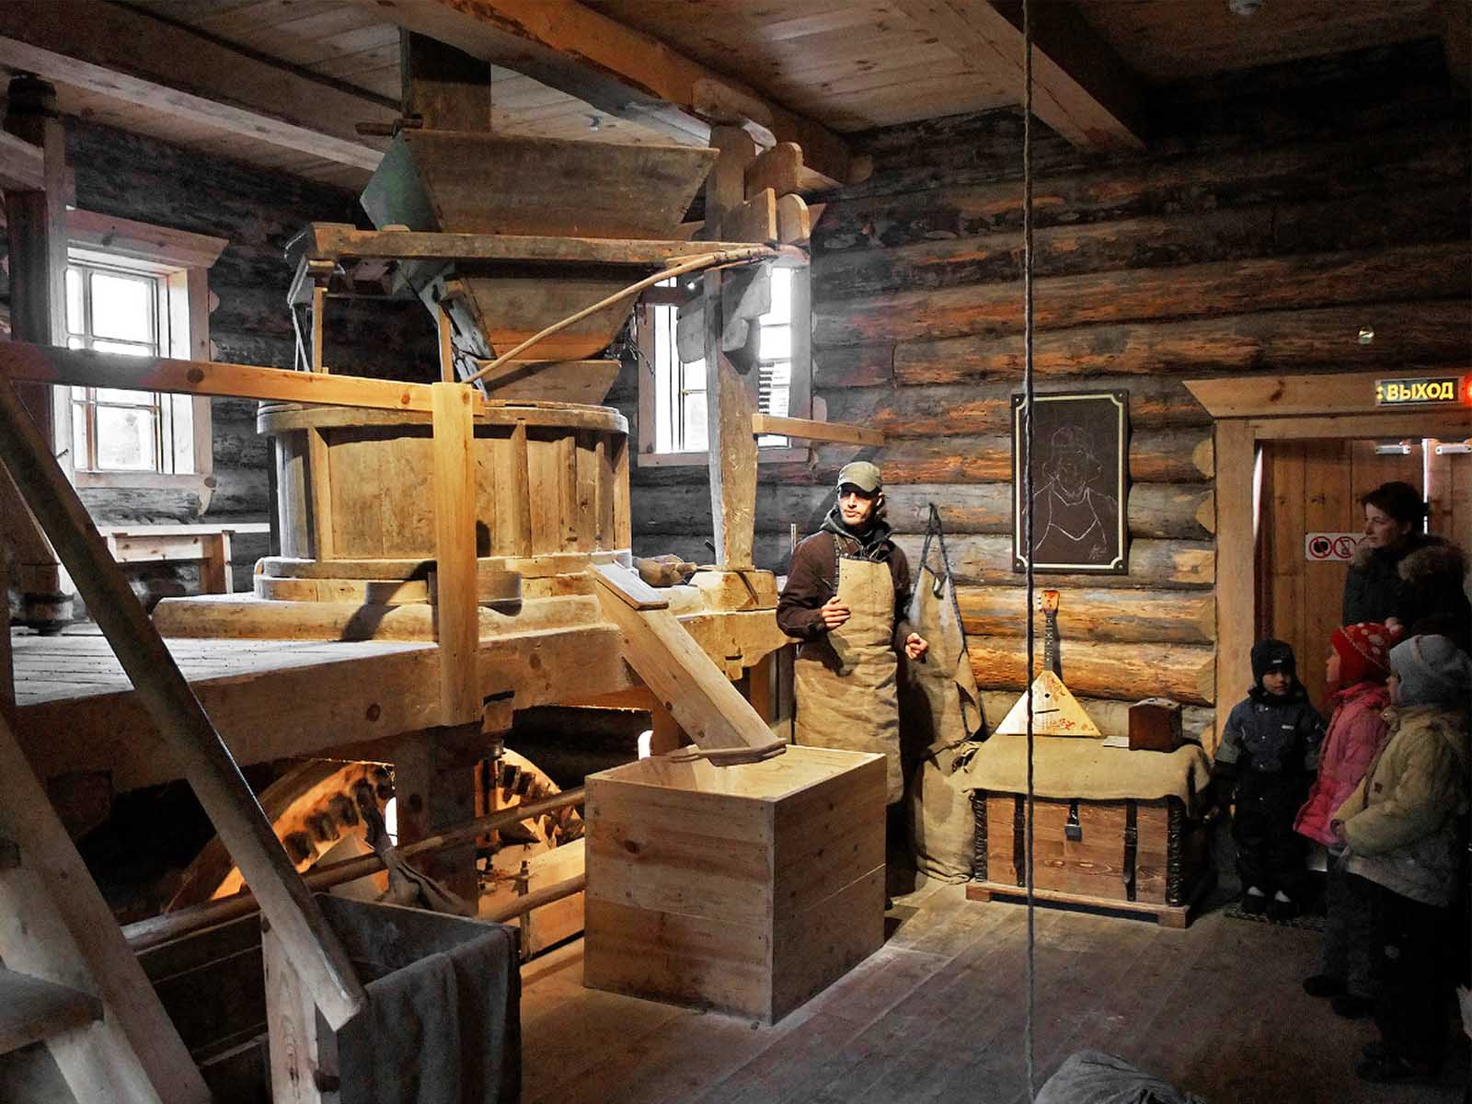
Bugrovo
Vladimir Kezling
ORIGIN

Slide 28
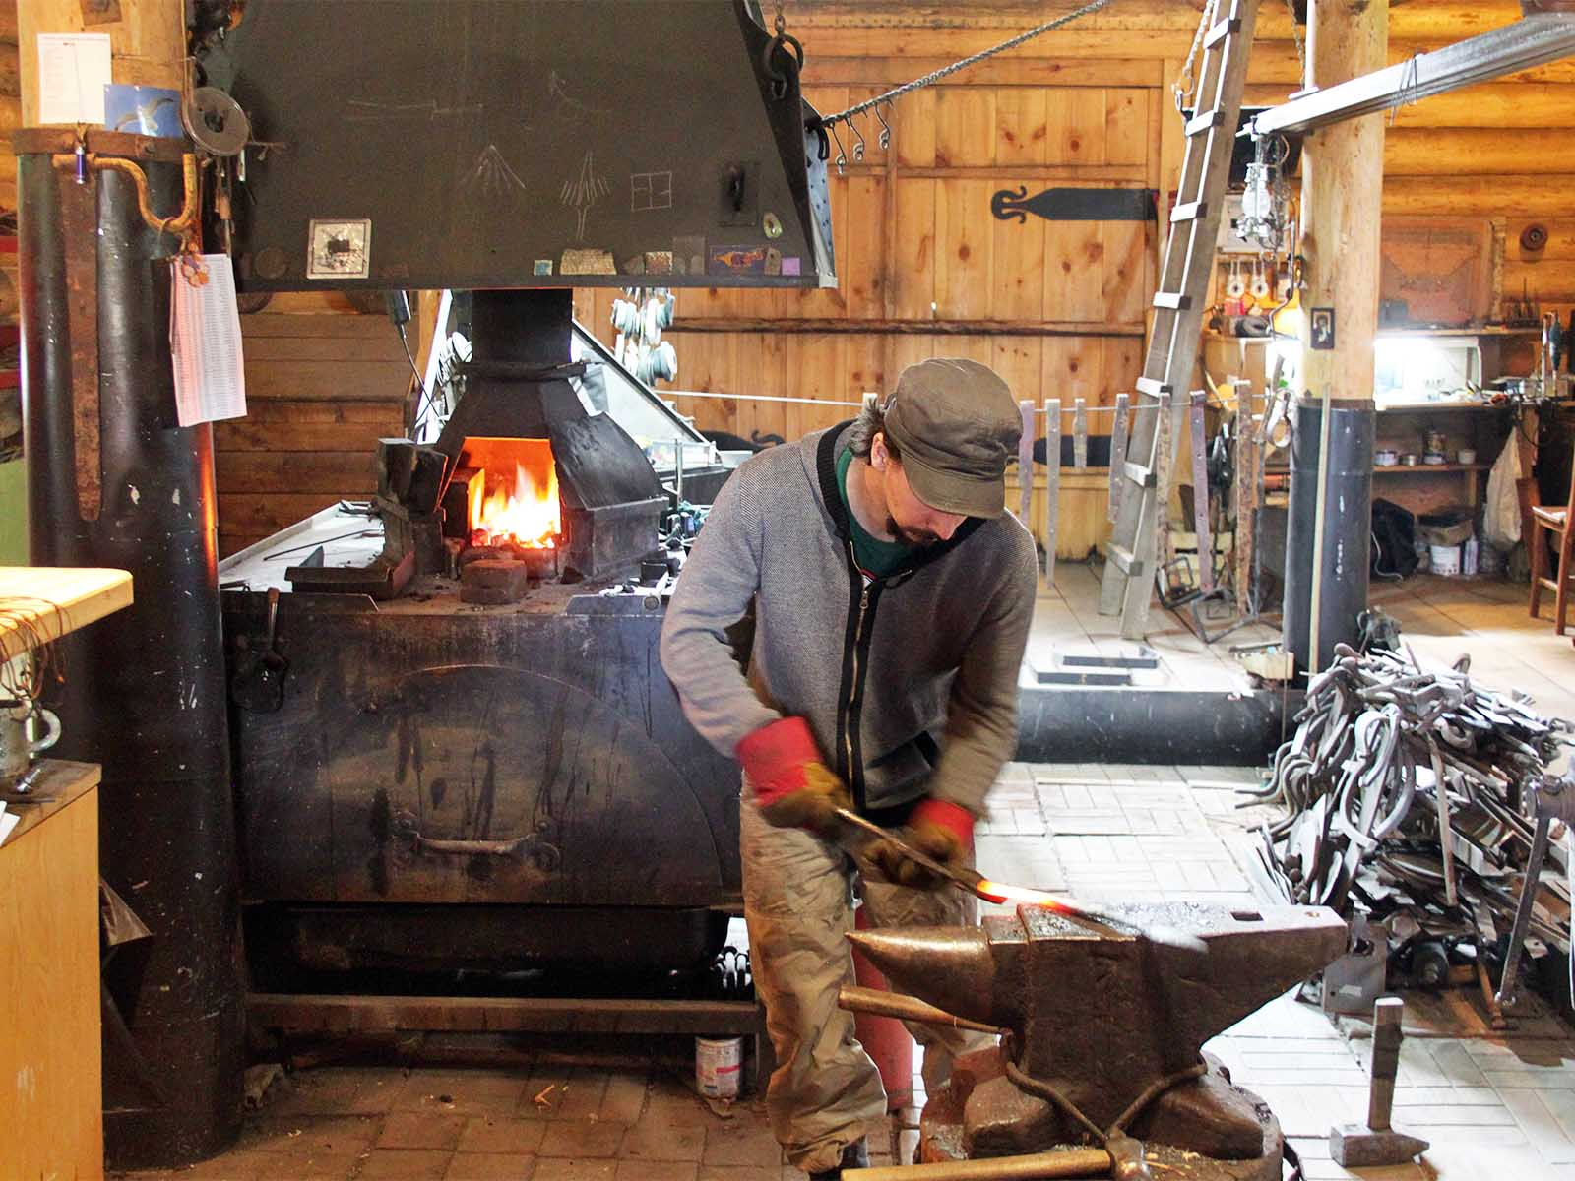
Mandrogy
(Flowcomm)
ORIGIN

Slide 29
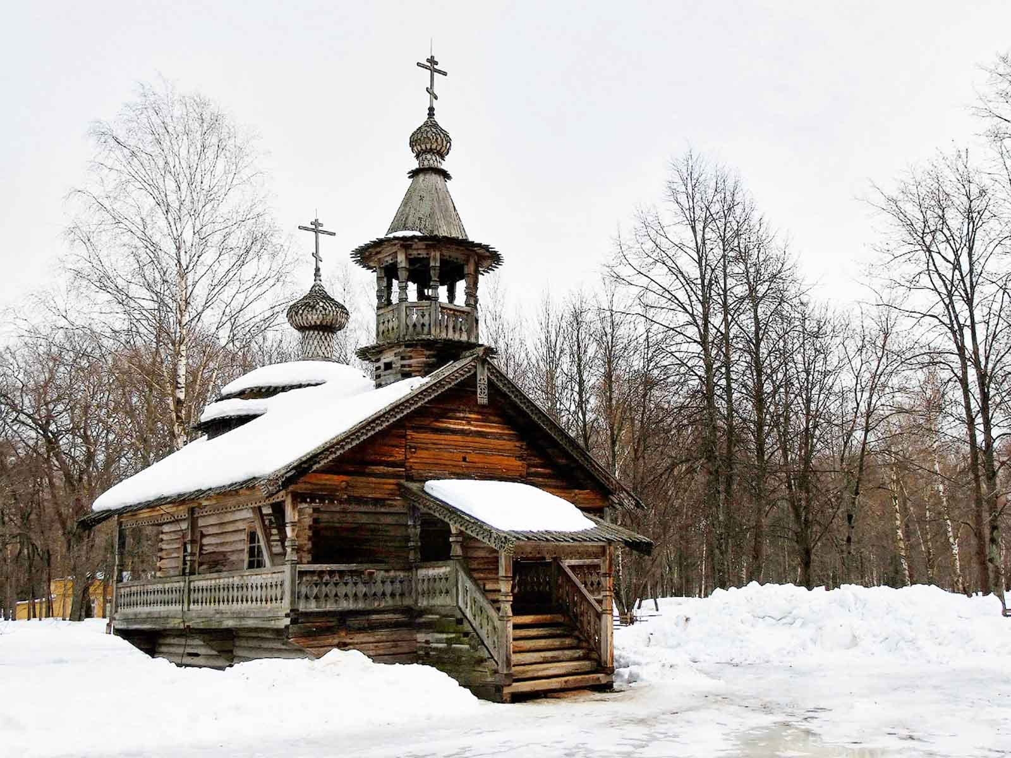
Vitoslavlitsy
Vladimir Kezling
ORIGIN

Slide 30
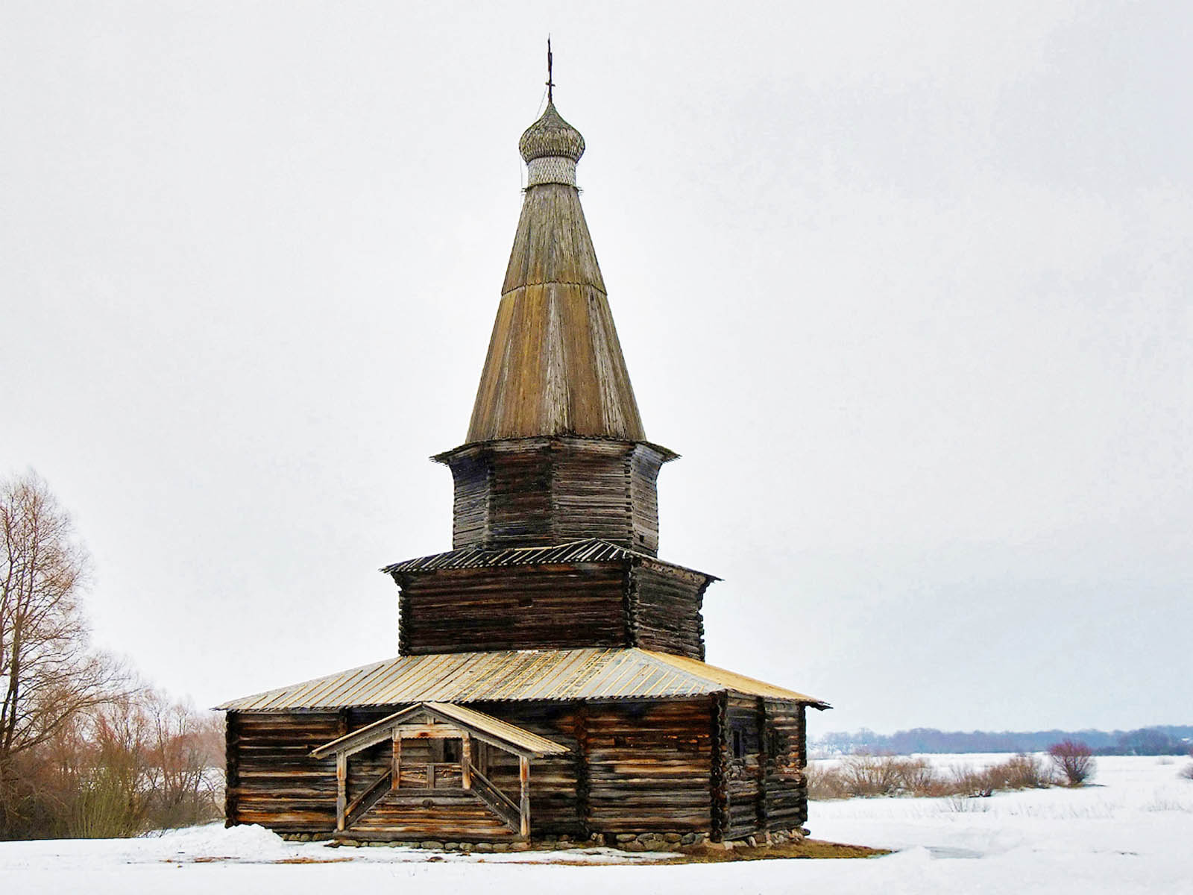
Vitoslavlitsy
Vladimir Kezling
ORIGIN

Slide 31
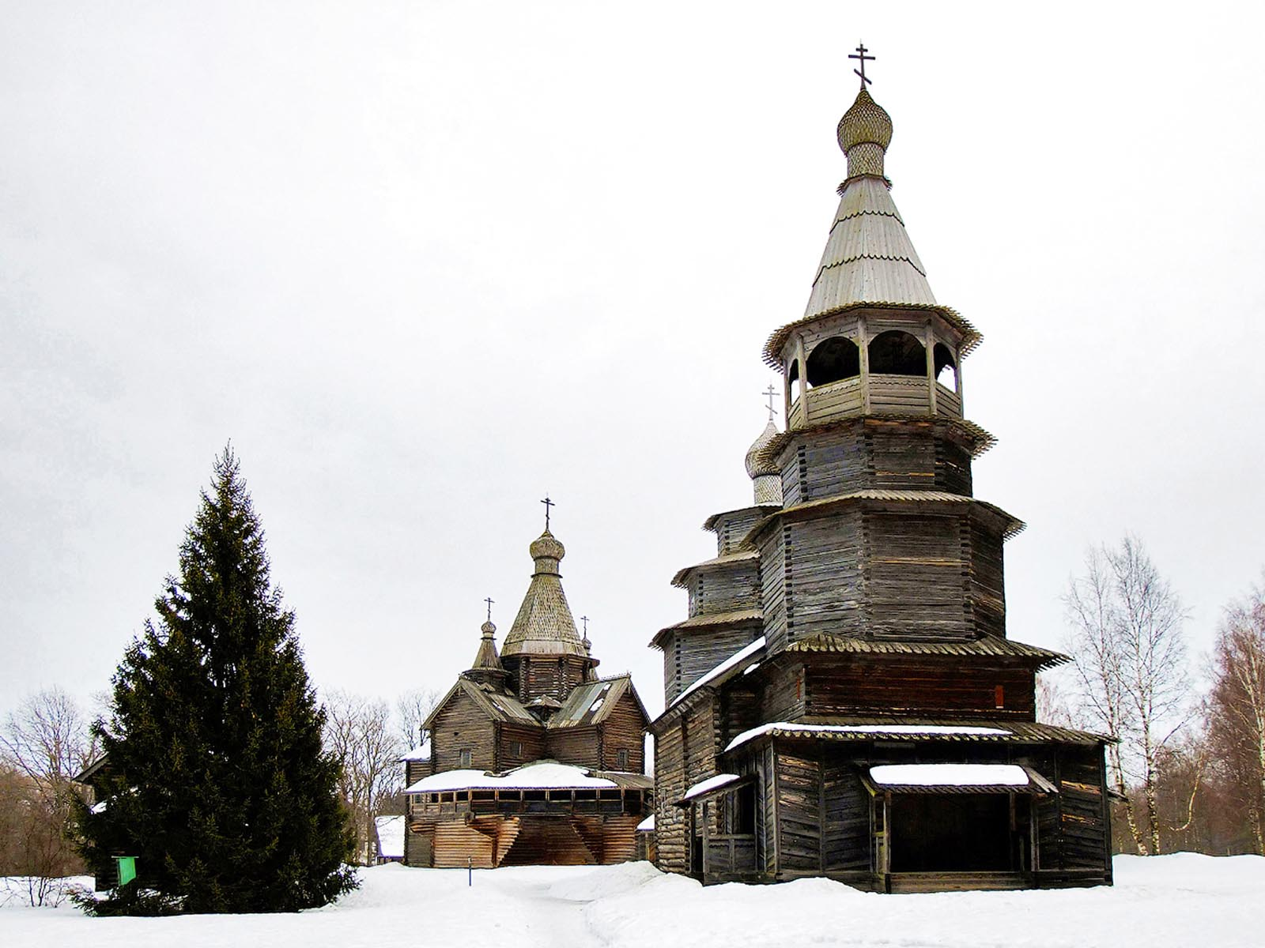
Vitoslavlitsy
Vladimir Kezling
ORIGIN

Slide 32
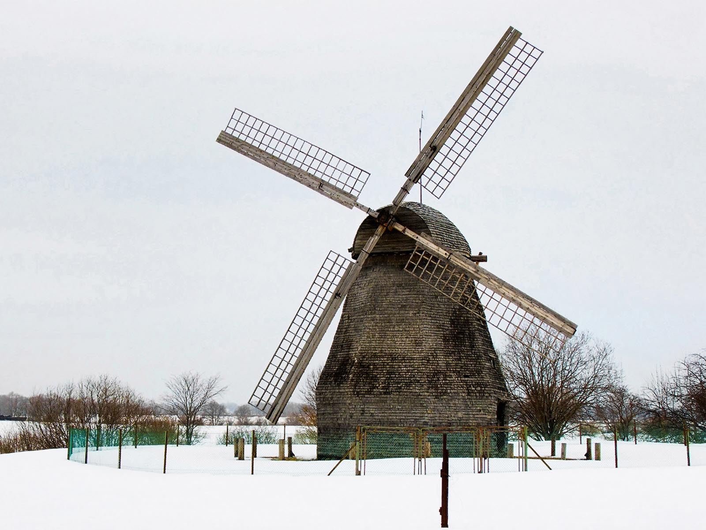
Vitoslavlitsy
Vladimir Kezling
ORIGIN

Slide 33
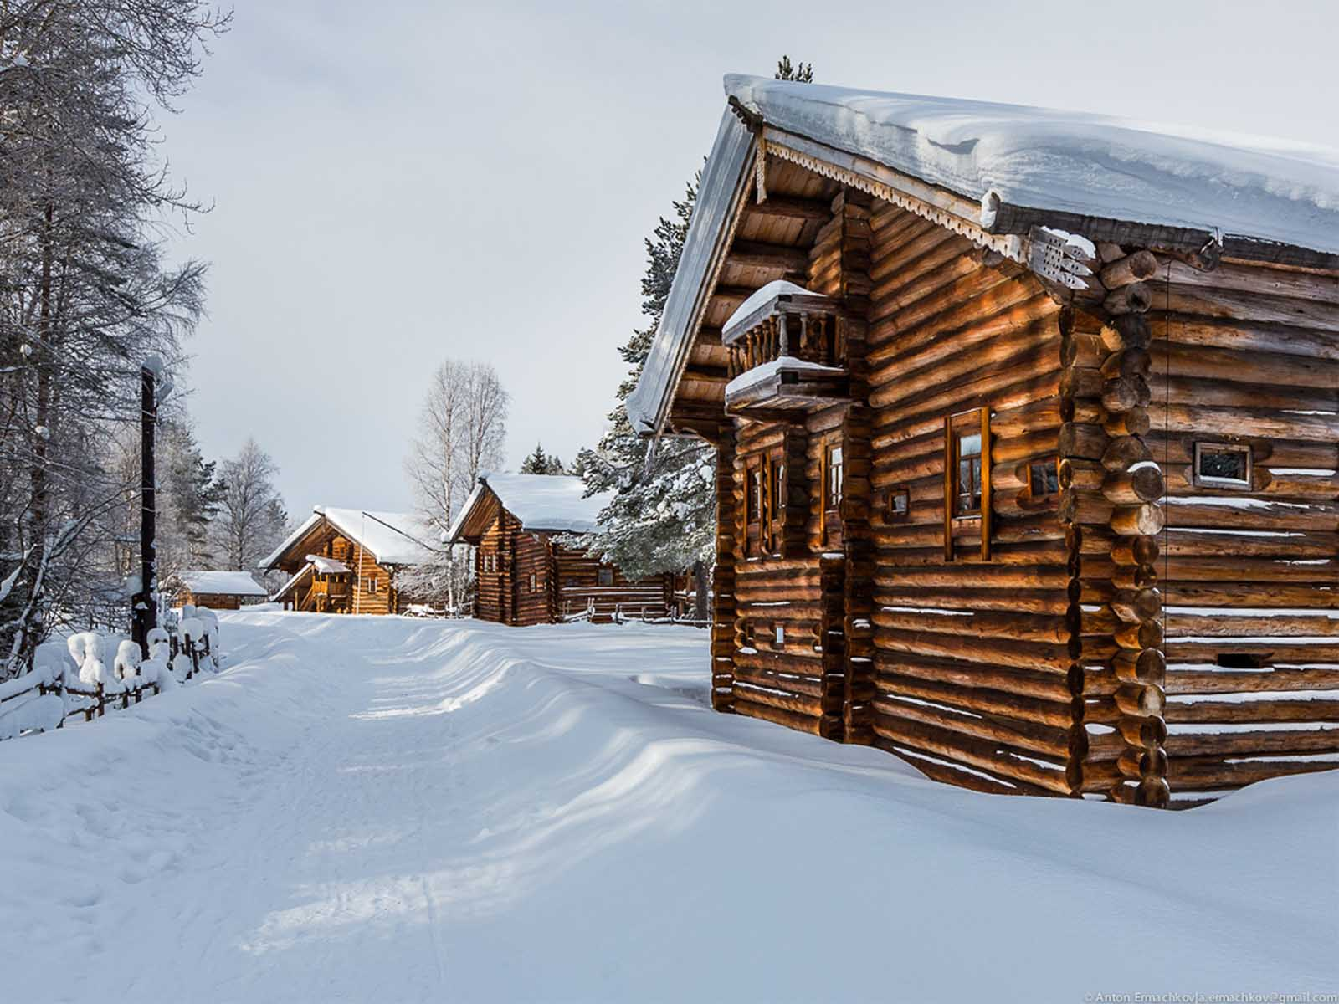
Malye Korely
Anton Ermachkov
ORIGIN

Slide 34
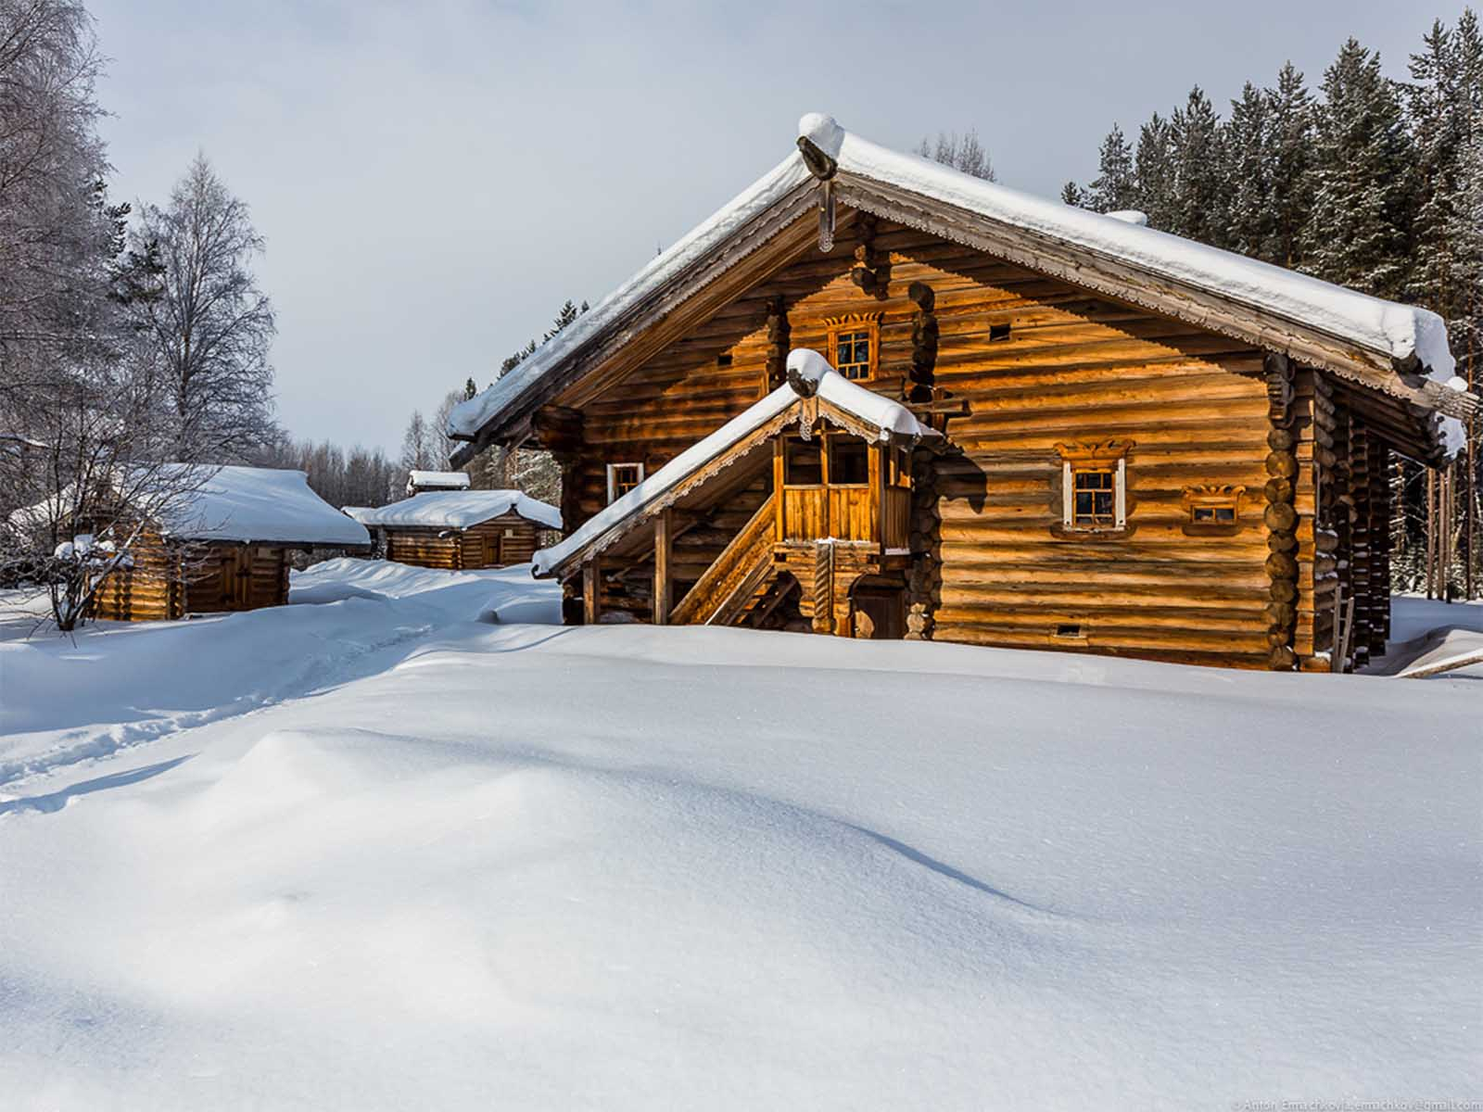
Malye Korely
Anton Ermachkov
ORIGIN

Slide 35
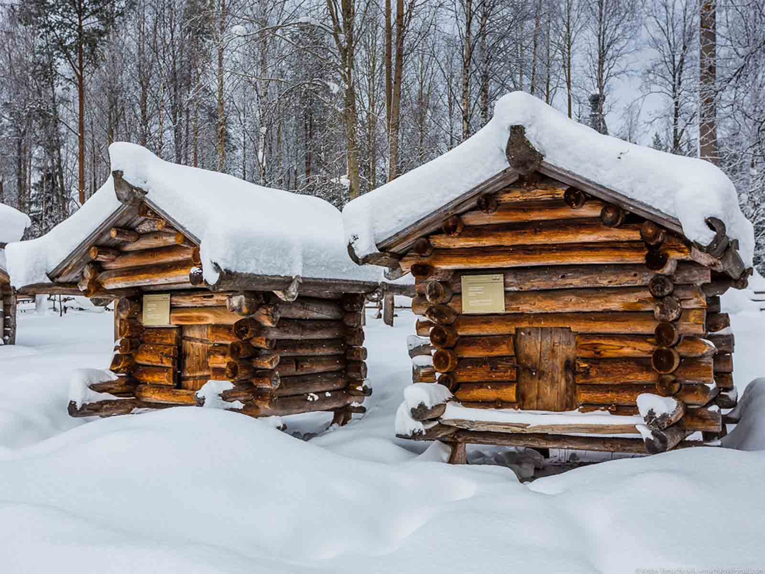
Malye Korely
Anton Ermachkov
ORIGIN

Slide 36
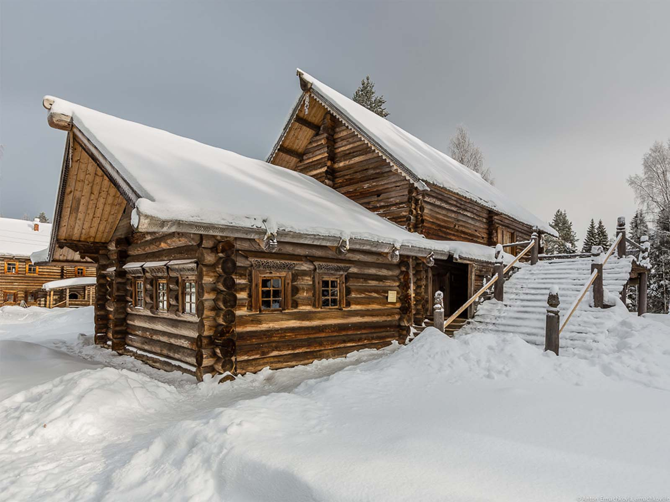
Malye Korely
Anton Ermachkov
ORIGIN

Slide 37
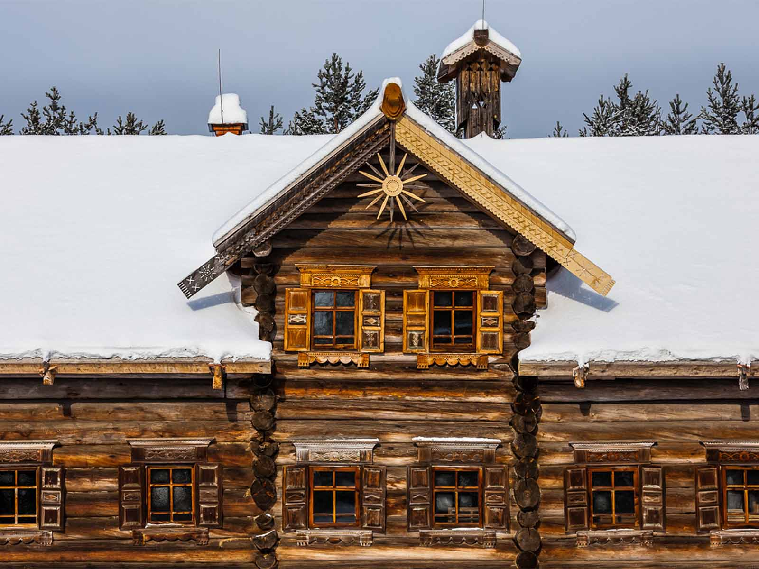
Malye Korely
Anton Ermachkov
ORIGIN

Slide 38
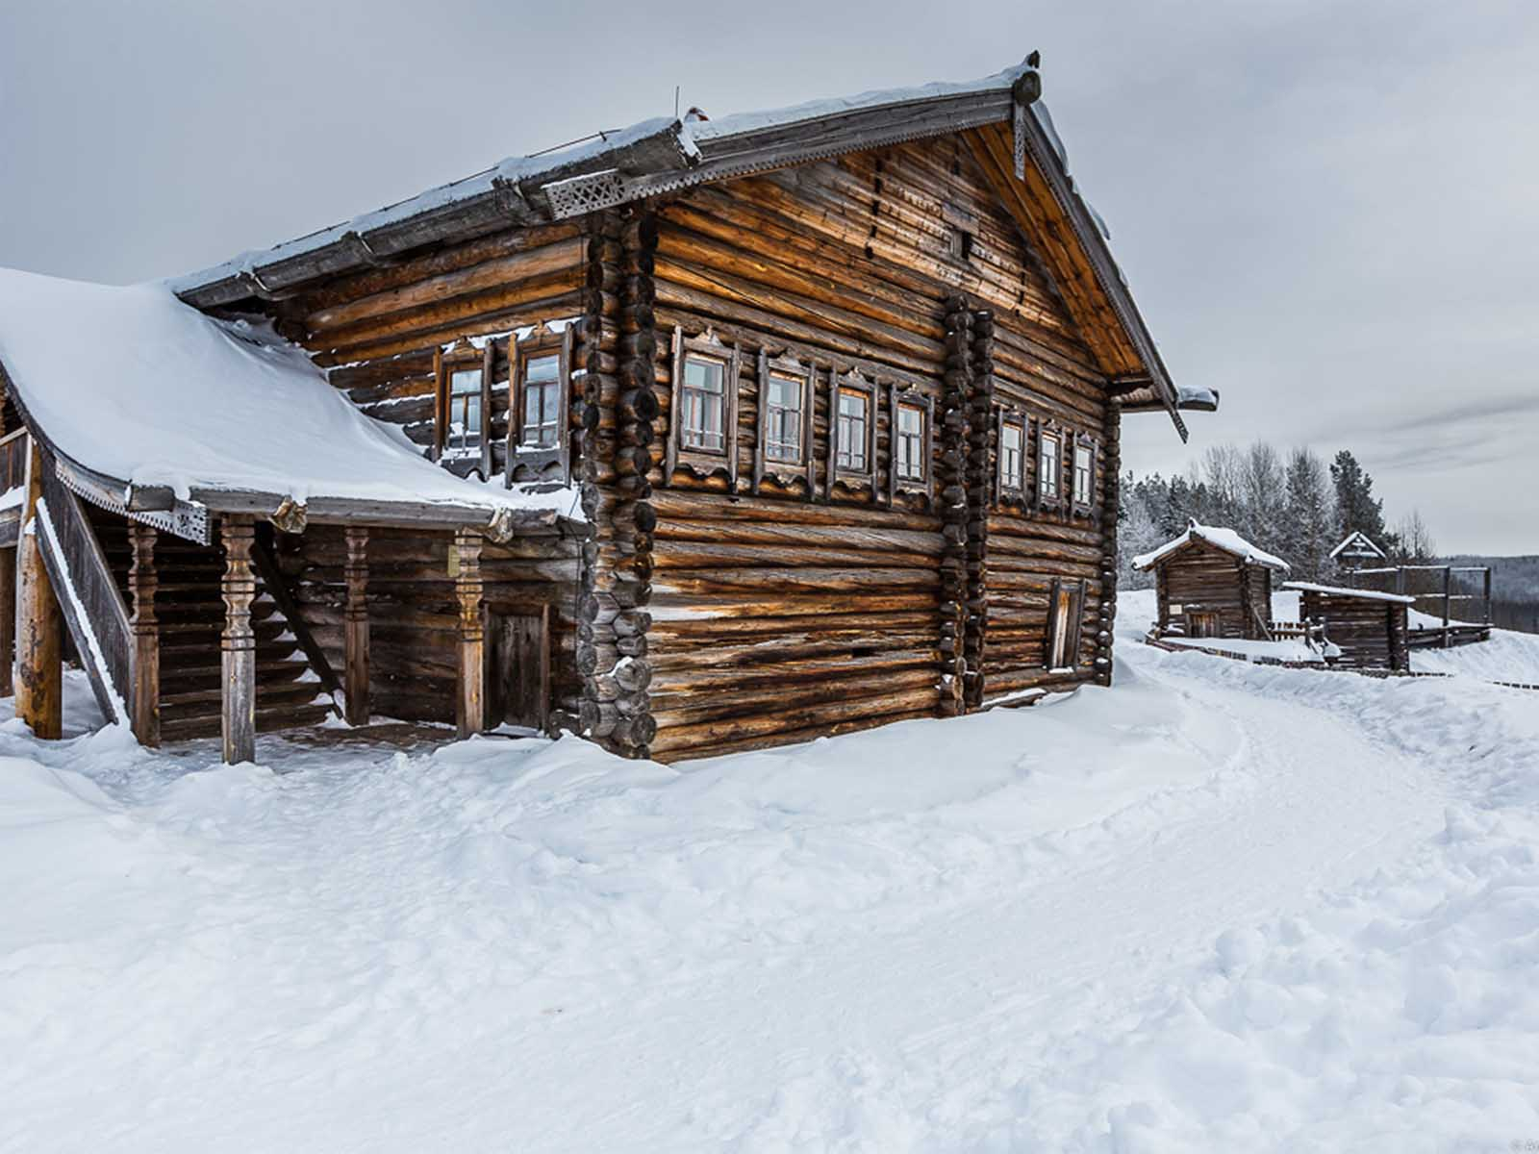
Malye Korely
Anton Ermachkov
ORIGIN

Slide 39
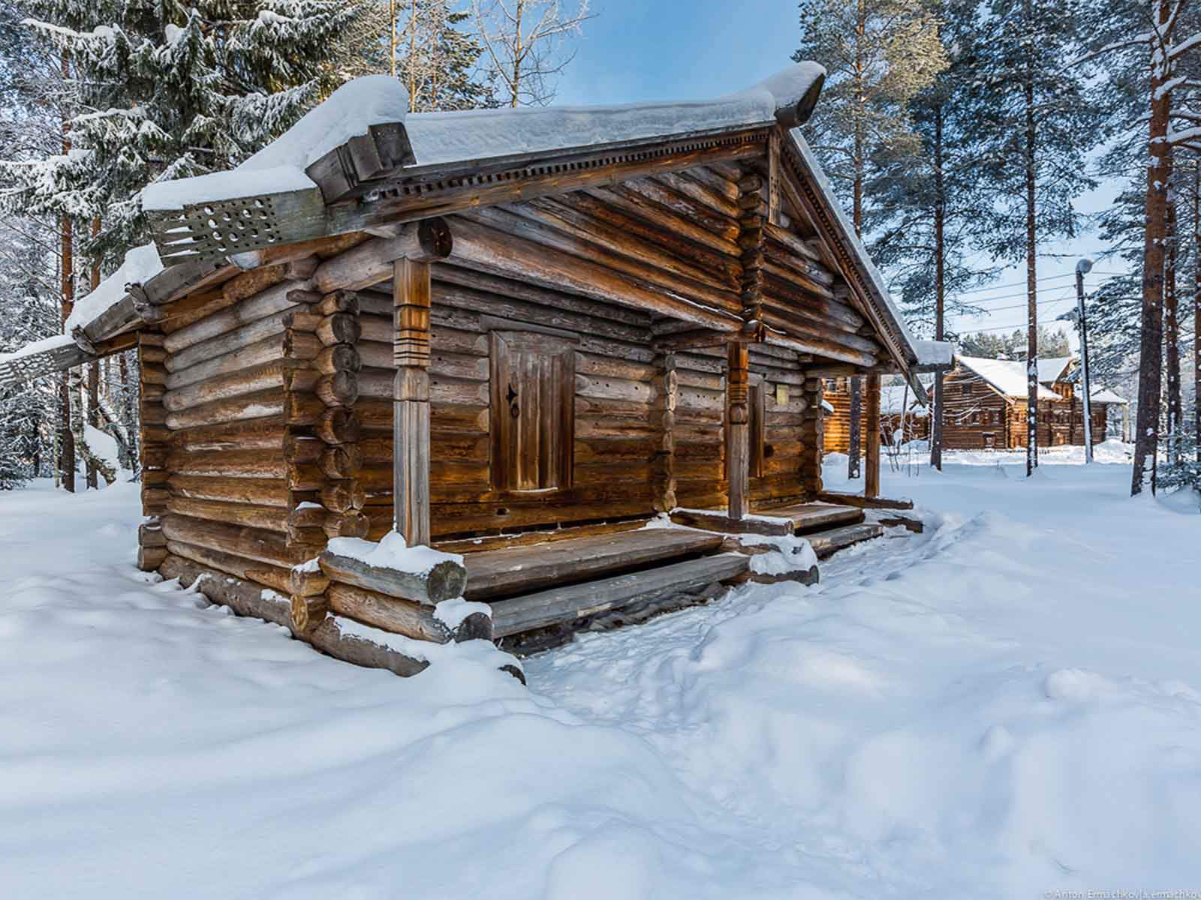
Malye Korely
Anton Ermachkov
ORIGIN

Slide 40
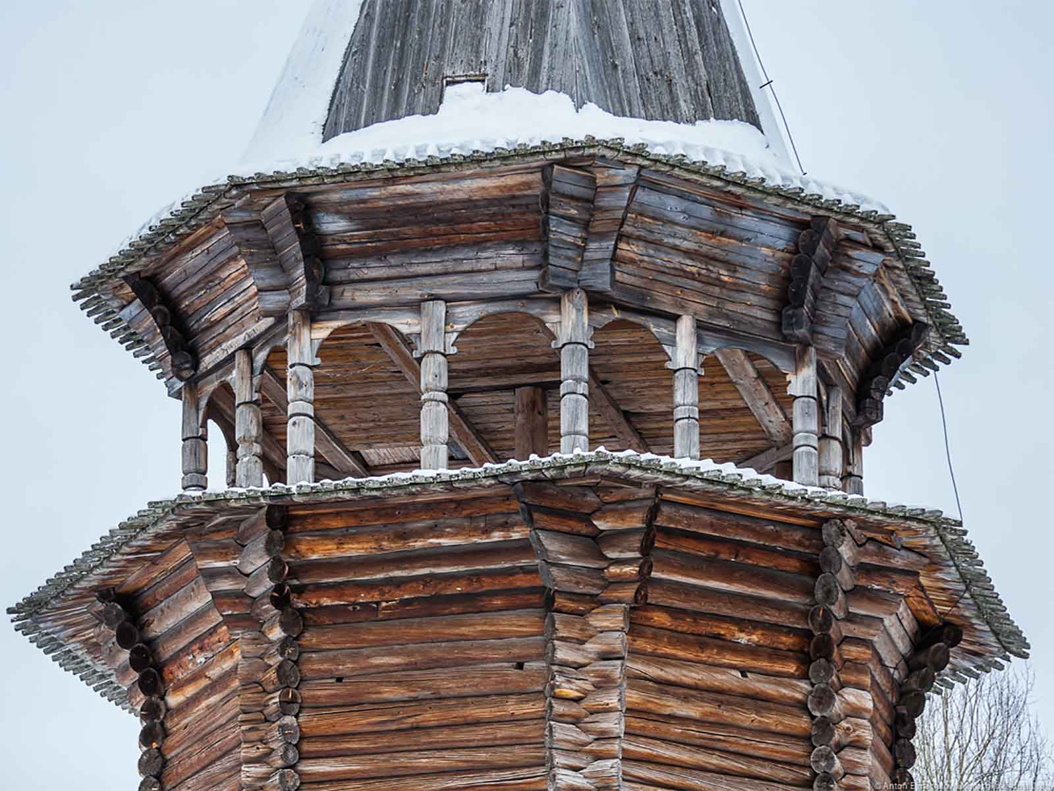
Malye Korely
Anton Ermachkov
ORIGIN

Slide 41
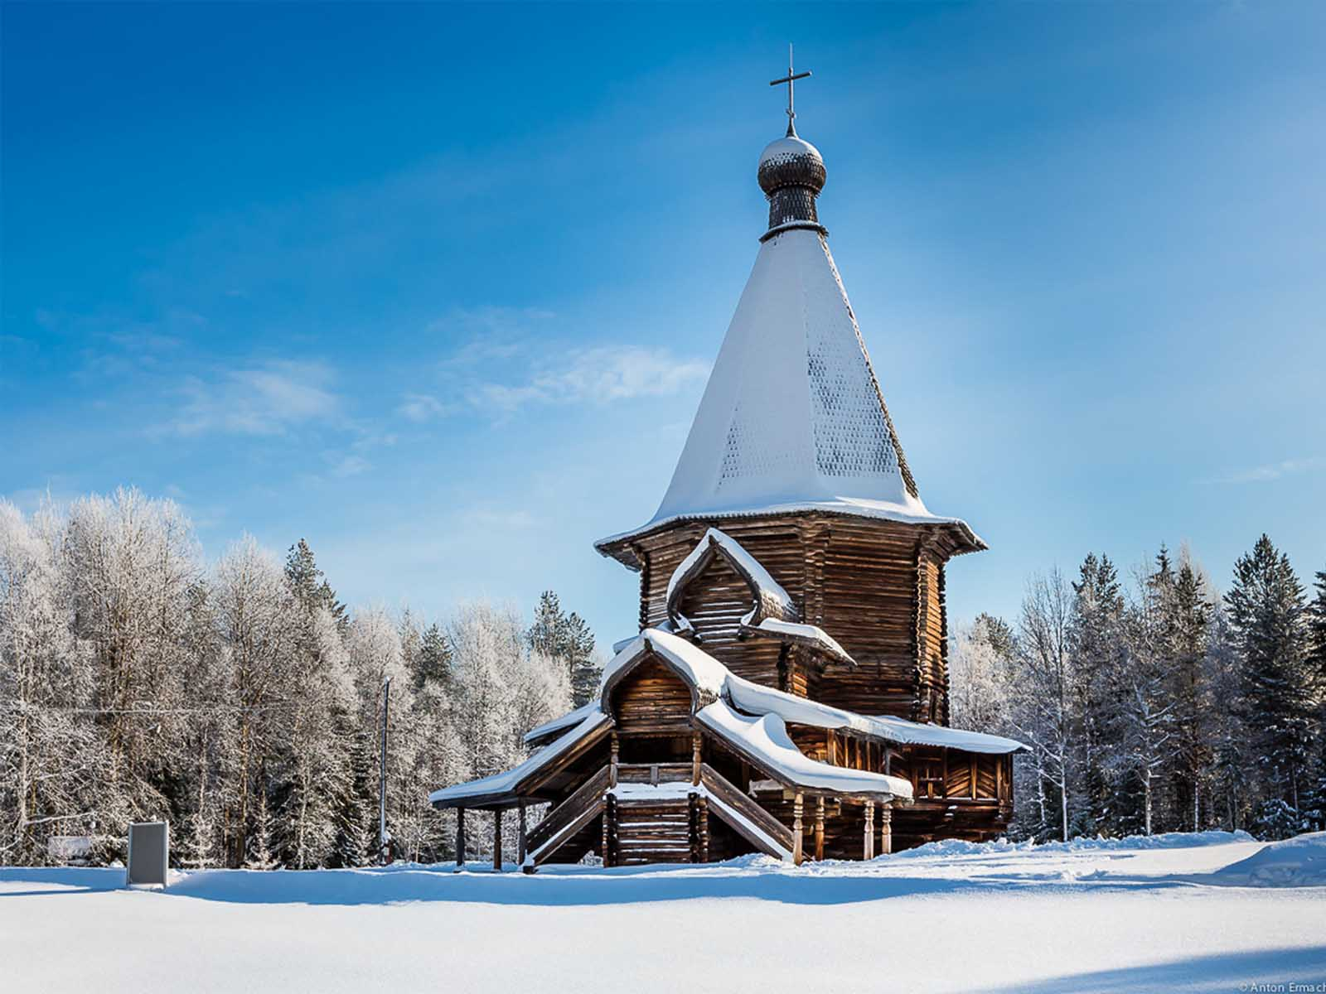
Malye Korely
Anton Ermachkov
ORIGIN

Slide 42

HASTA LA PRÓXIMA
SALVA LA TIERRA
CONTINUAR
F I N A L
No para propósitos comerciales! / Fotografías de Internet / Música : Russian Folk
tomi55jutt@mail.com

Slide 43







¿Te ha gustado?
Puedes ver más entrando
Aquí
Además puedes recibir powerpoints en tu correo electrónico suscribiéndote aquí:
F I N

