Slide 1


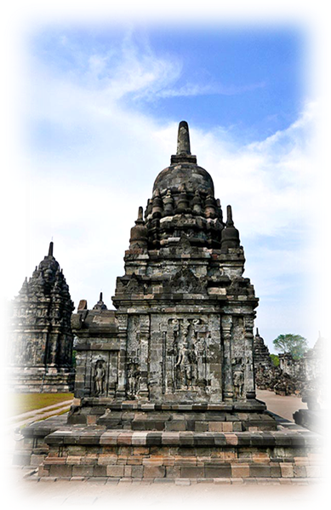

VER EL MUNDO CONMIGO
SALVA LA TIERRA
INDONESIA
Candi Sewu
Candi Sewu (Java)
04
Tommy55
2016

Slide 2
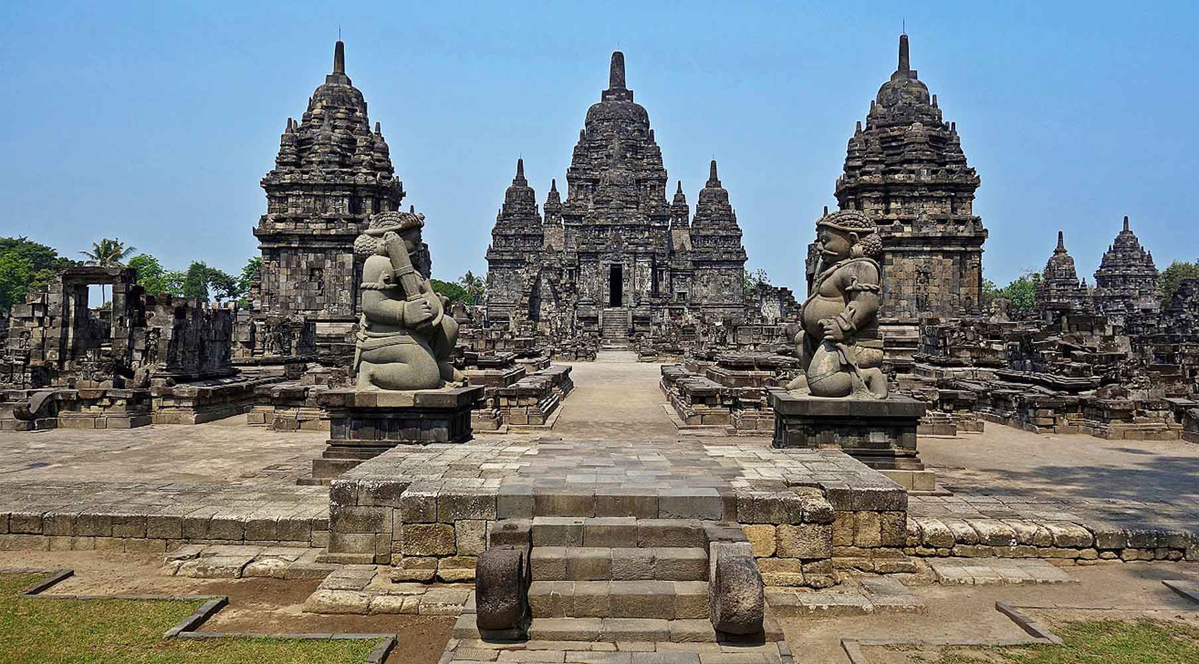

ORIGIN
Jean-Claude Latombe

Slide 3
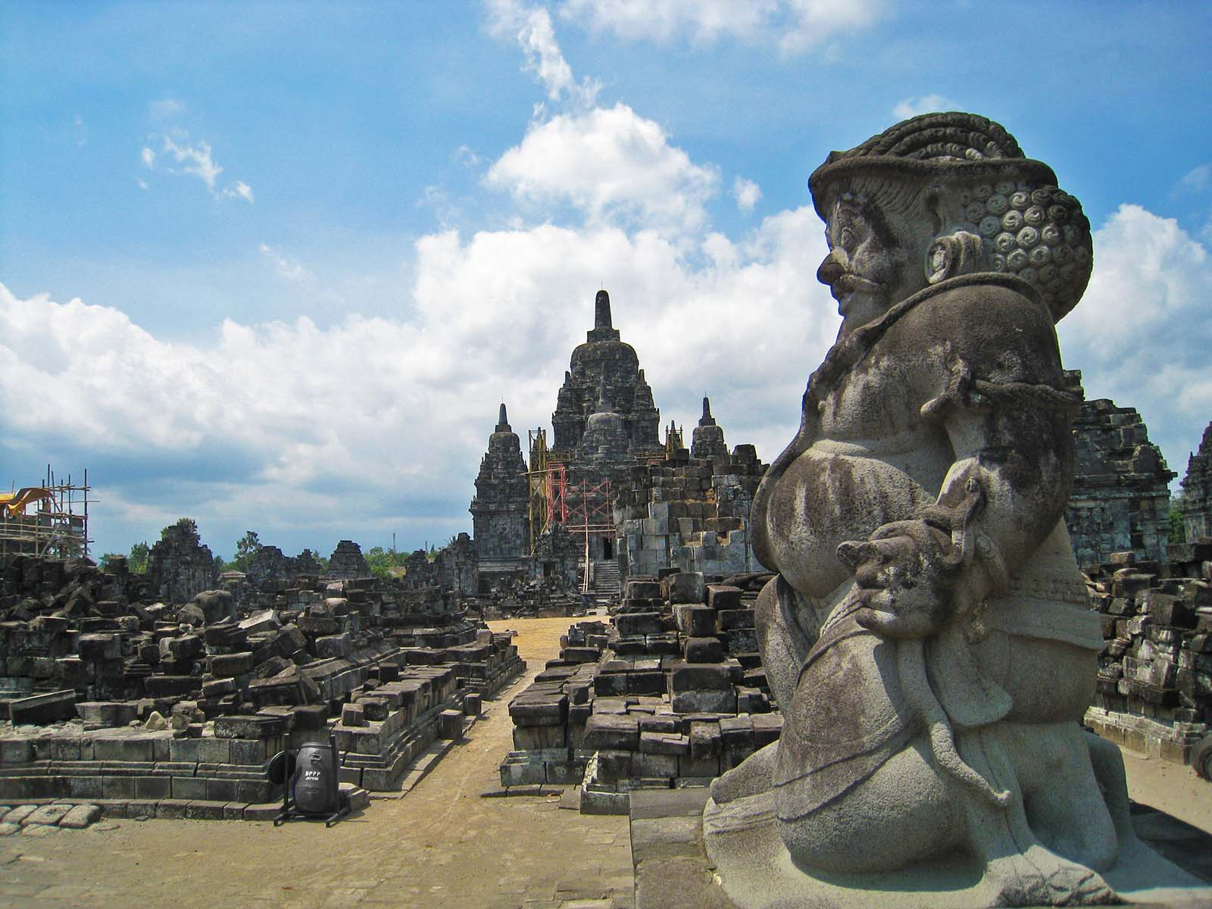
ORIGIN
(Photo Darma)

Slide 4
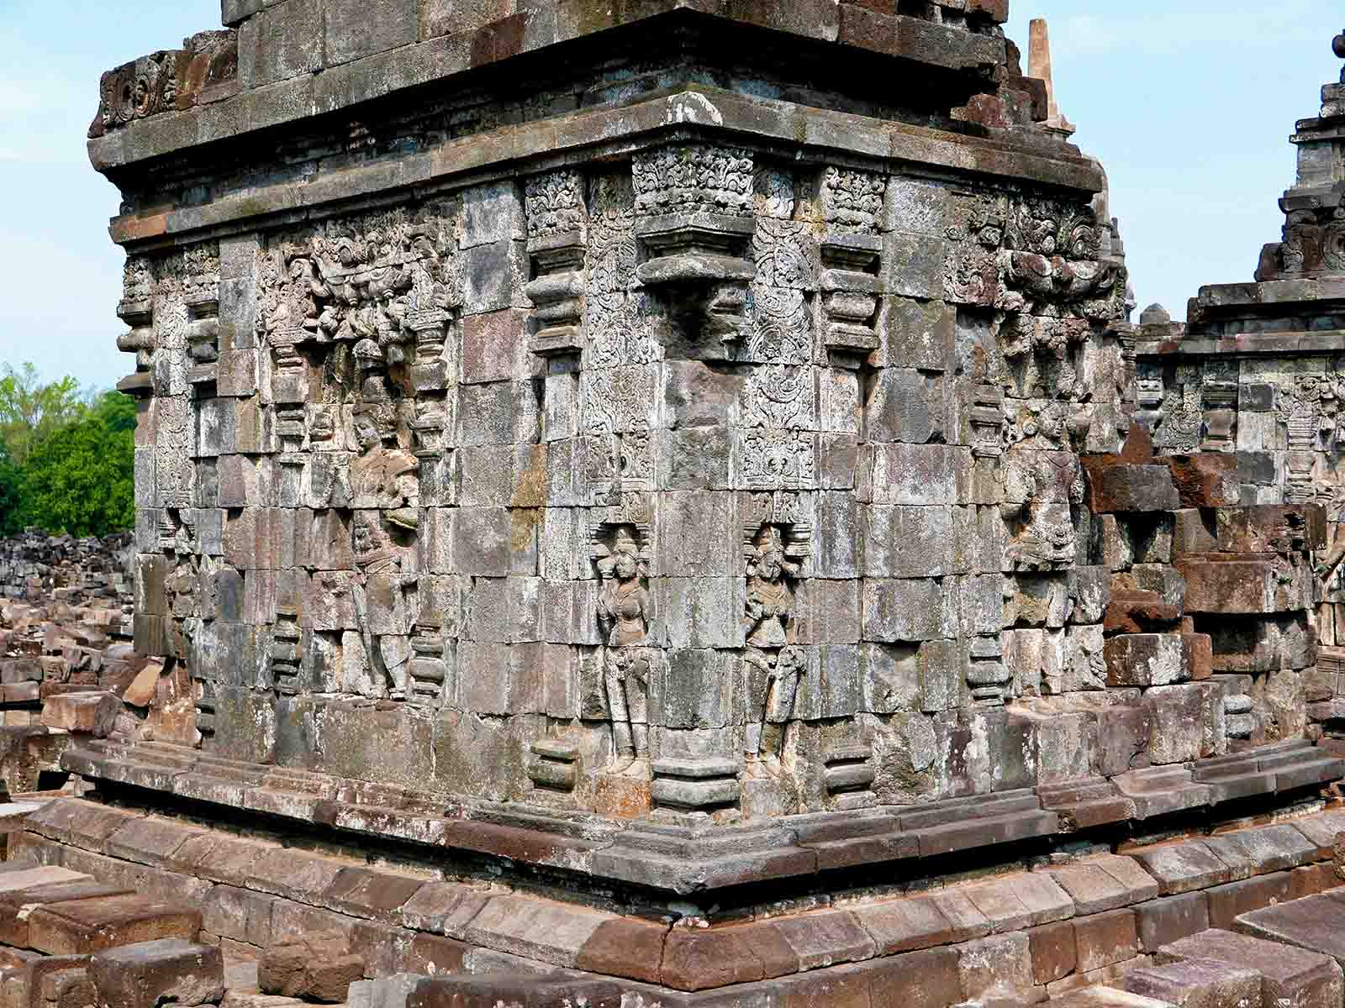
ORIGIN
Anandajoti Bhikkhu (Photo Dharma)

Slide 5
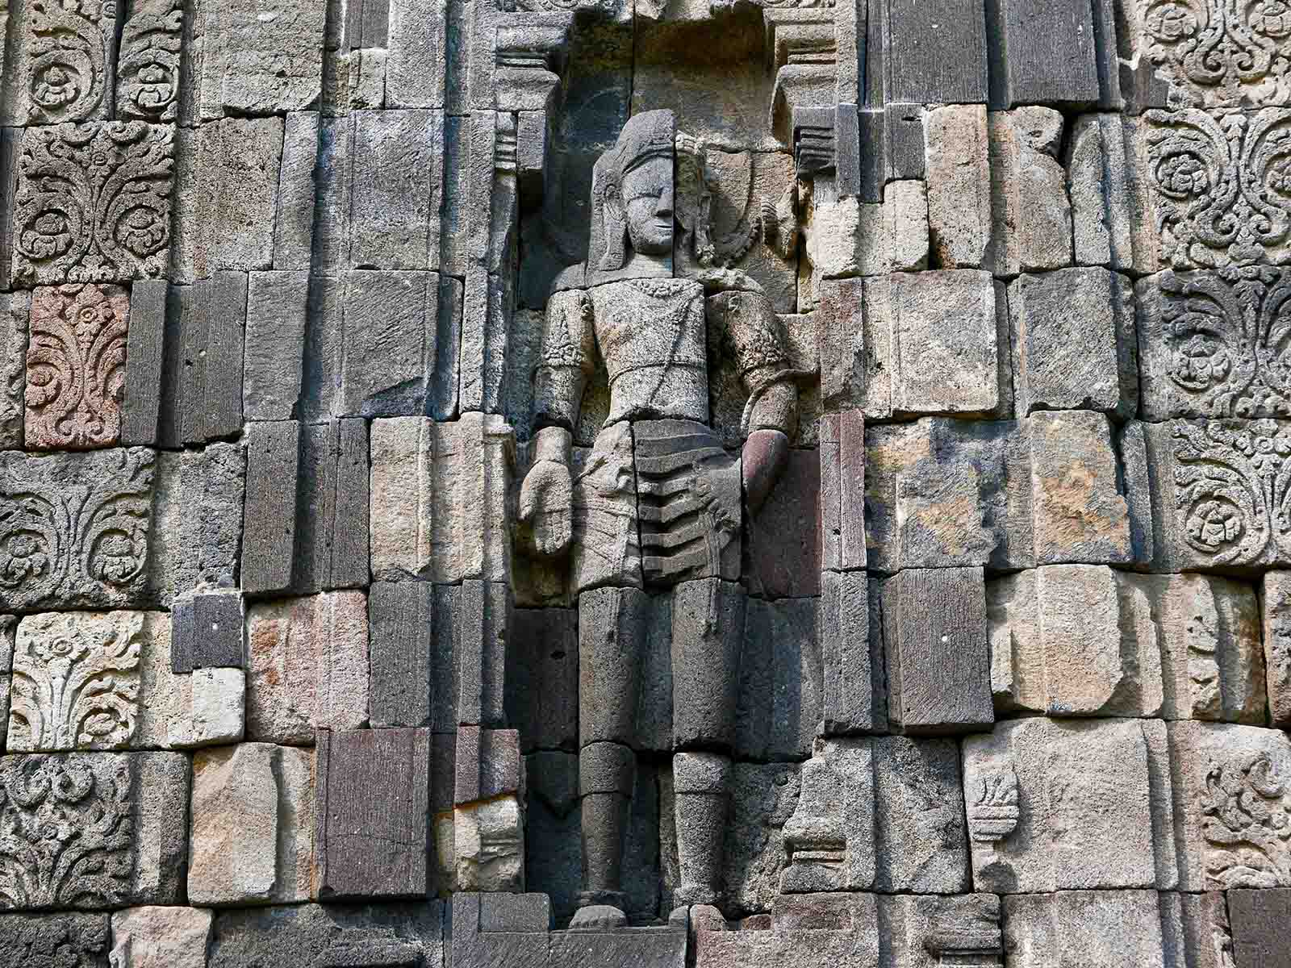
ORIGIN
Anandajoti Bhikkhu (Photo Dharma)

Slide 6

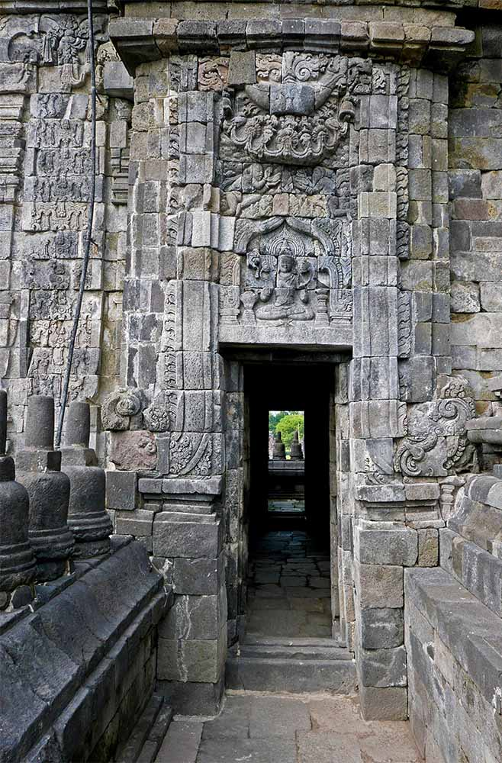
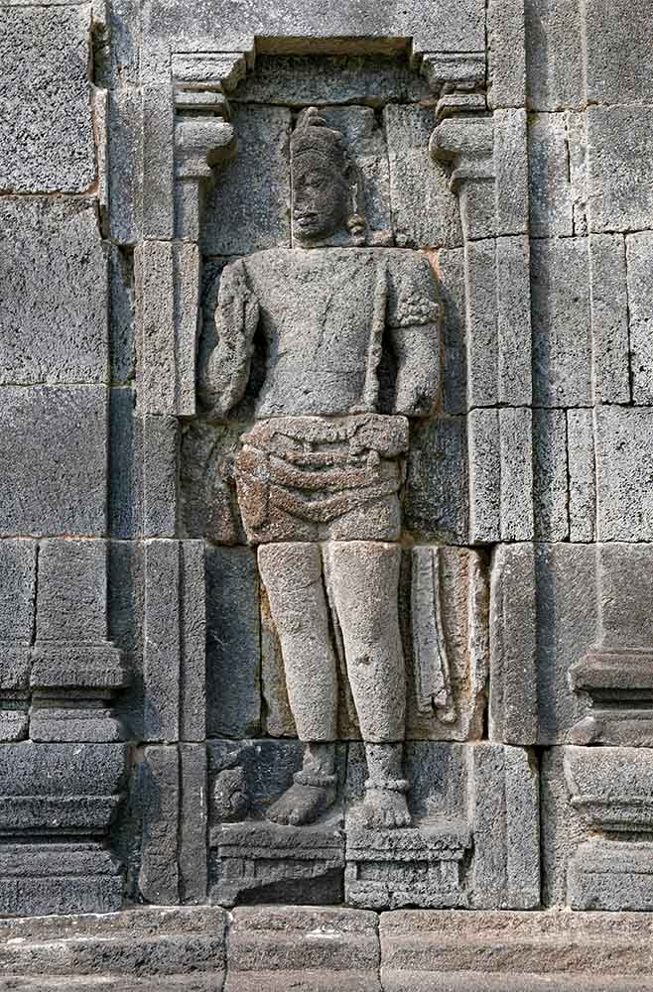
ORIGIN
ORIGIN
Anandajoti Bhikkhu (Photo Dharma)
Anandajoti Bhikkhu (Photo Dharma)

Slide 7
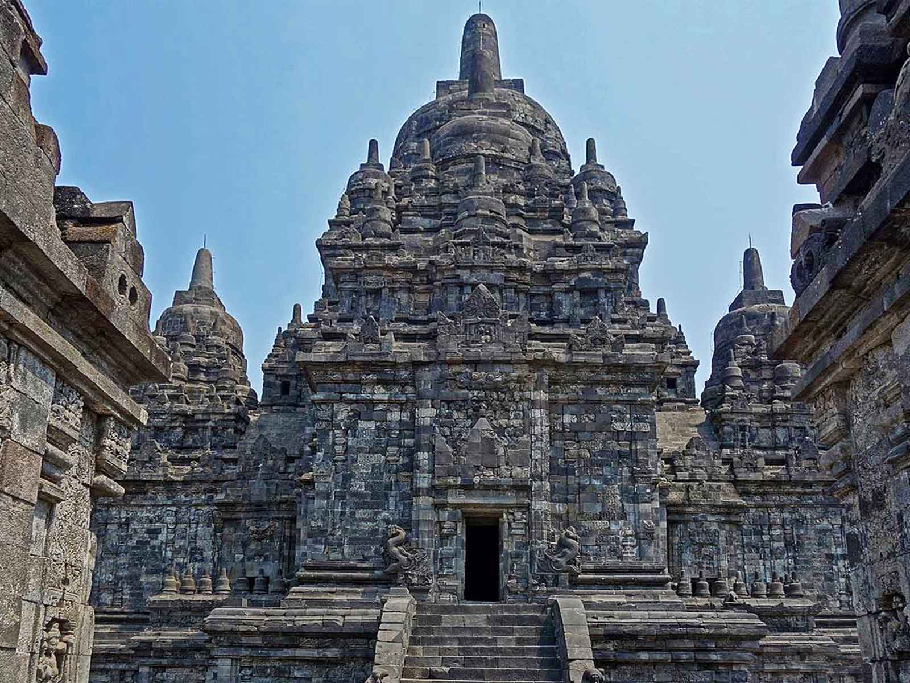
ORIGIN
Jean-Claude Latombe

Slide 8
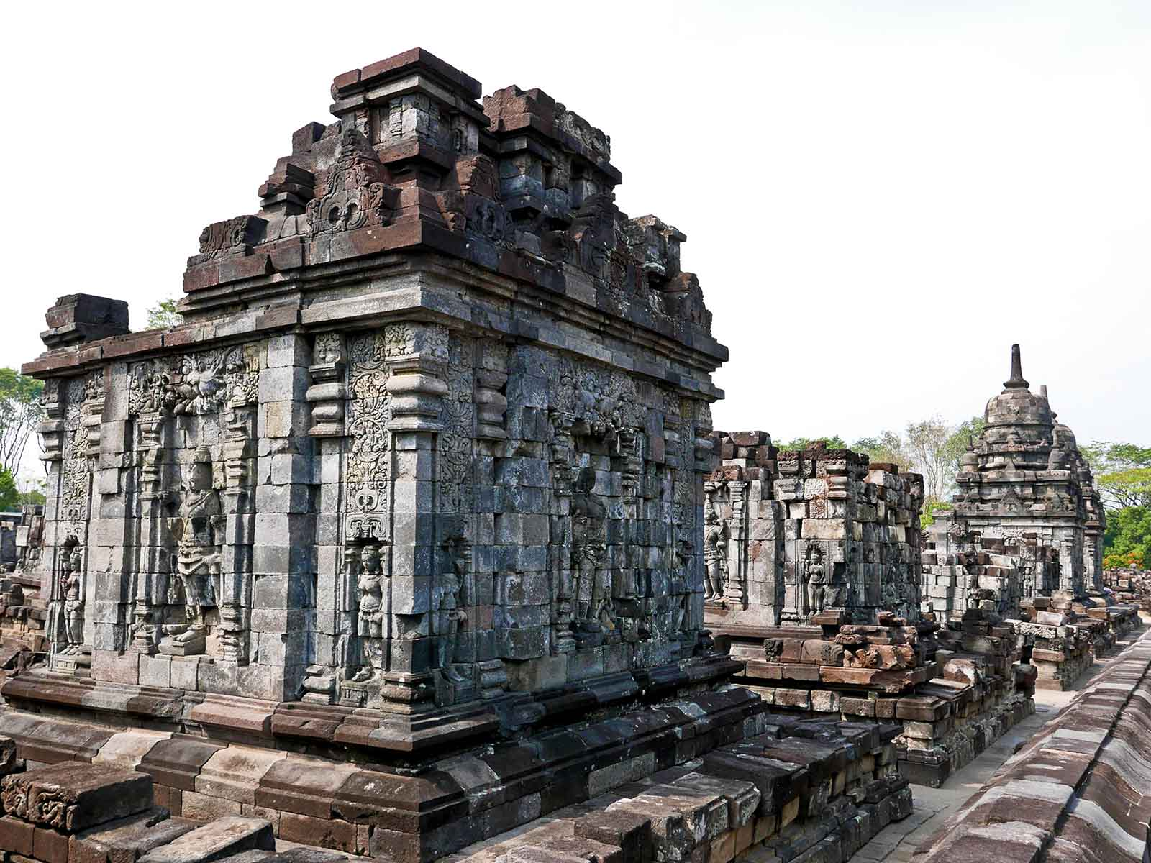
ORIGIN
Anandajoti Bhikkhu (Photo Dharma)

Slide 9
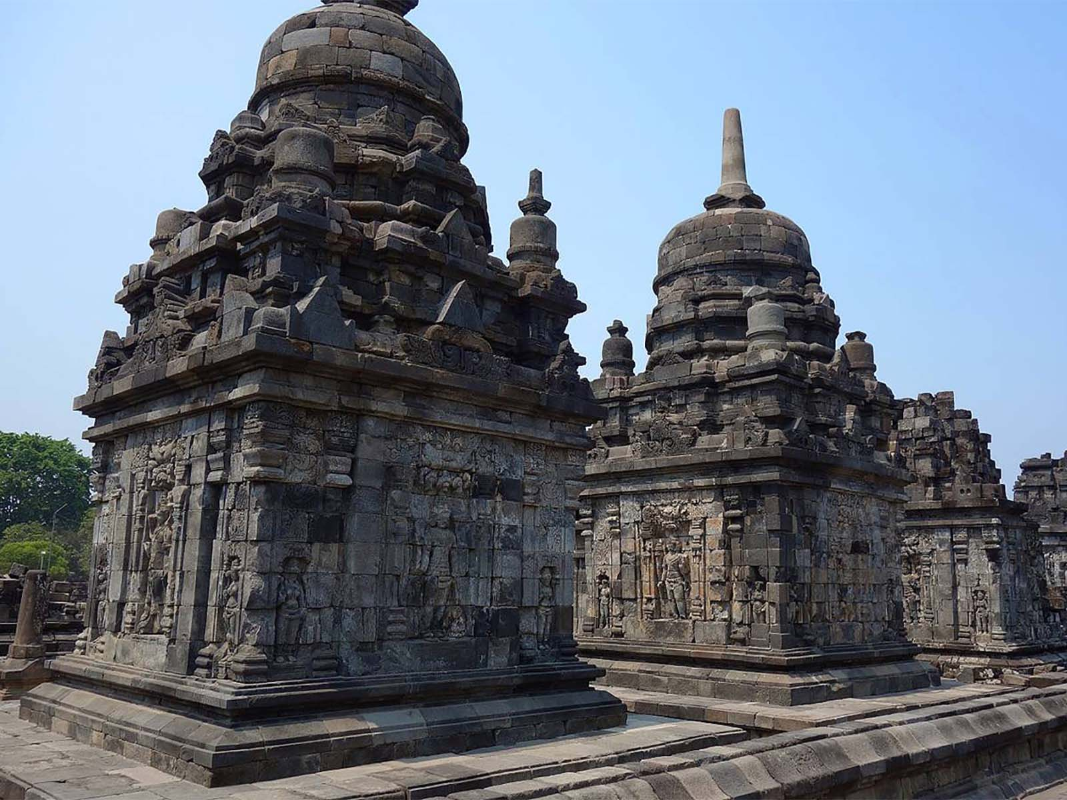
ORIGIN
Jean-Claude Latombe

Slide 10
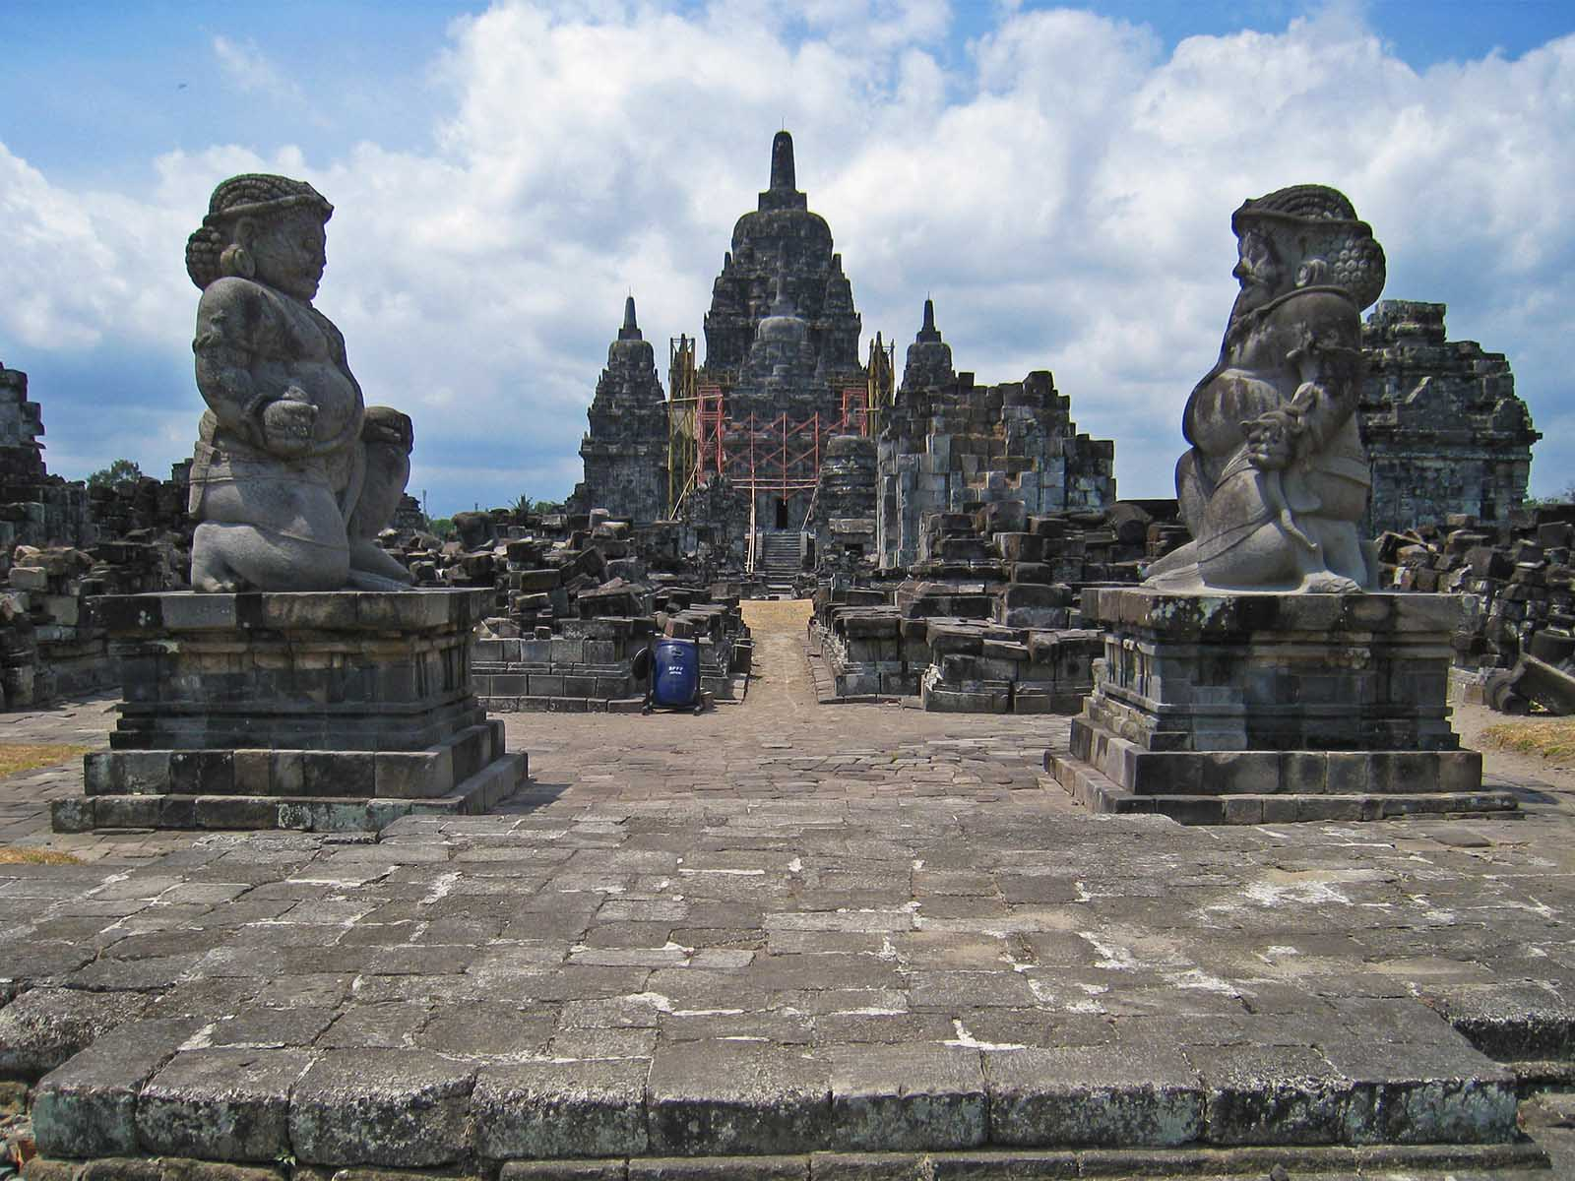
ORIGIN
(Photo Darma)

Slide 11
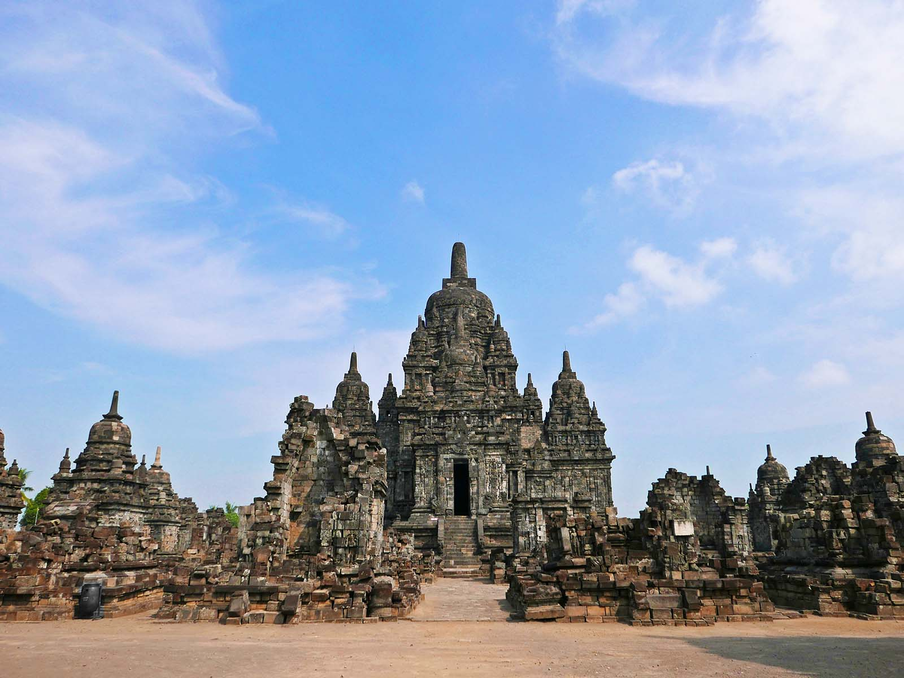
ORIGIN
Anandajoti Bhikkhu (Photo Dharma)

Slide 12
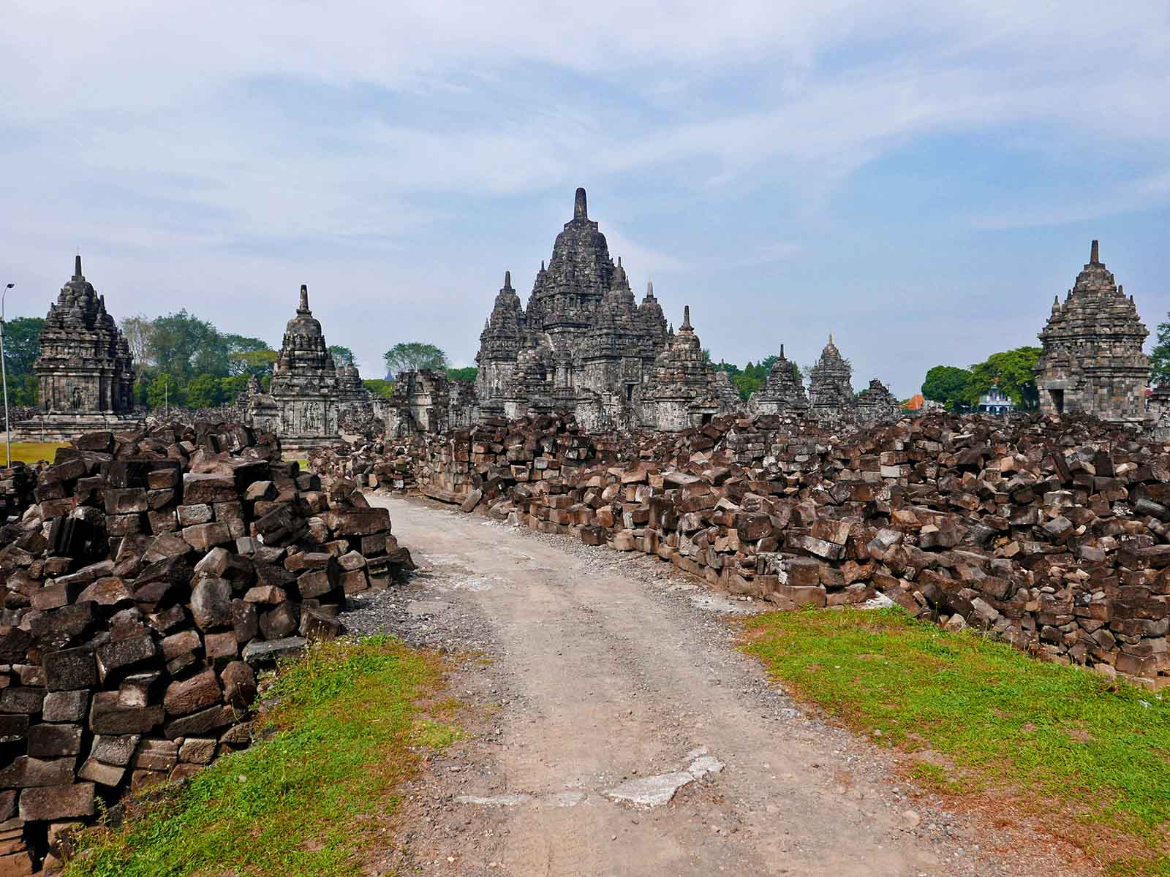
ORIGIN
Anandajoti Bhikkhu (Photo Dharma)

Slide 13
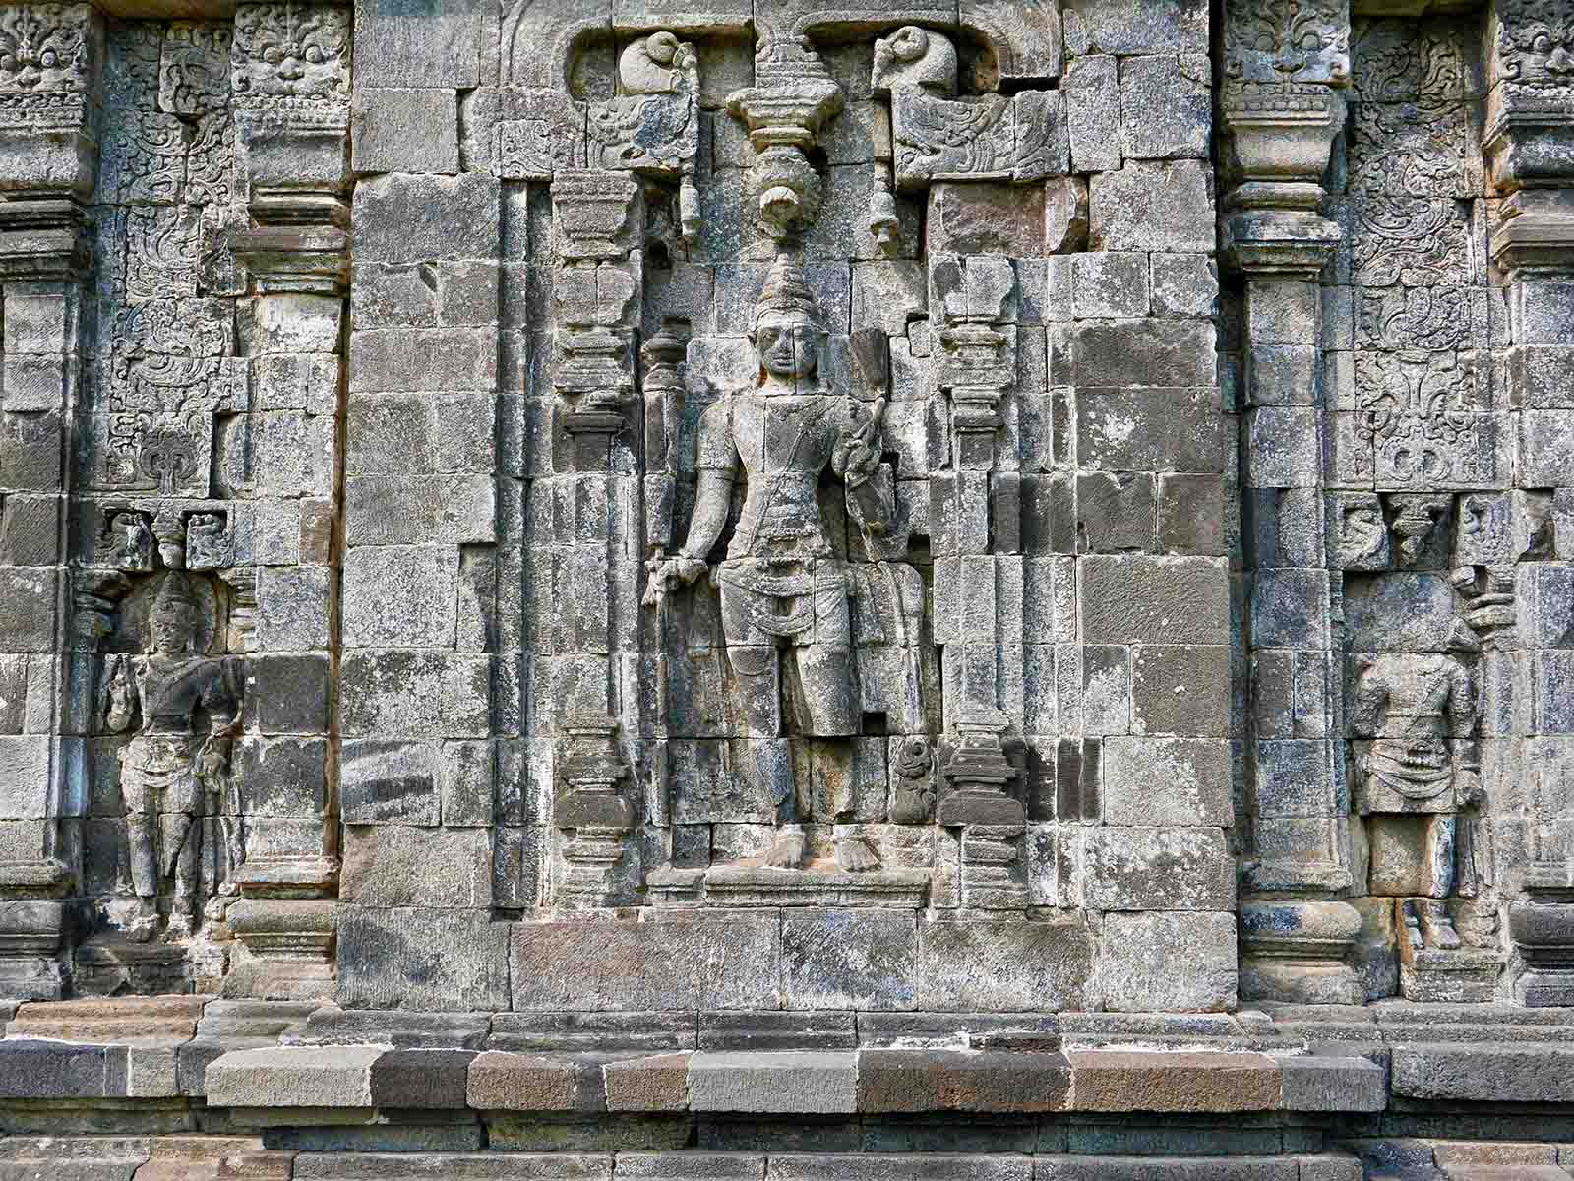
ORIGIN
Anandajoti Bhikkhu (Photo Dharma)

Slide 14
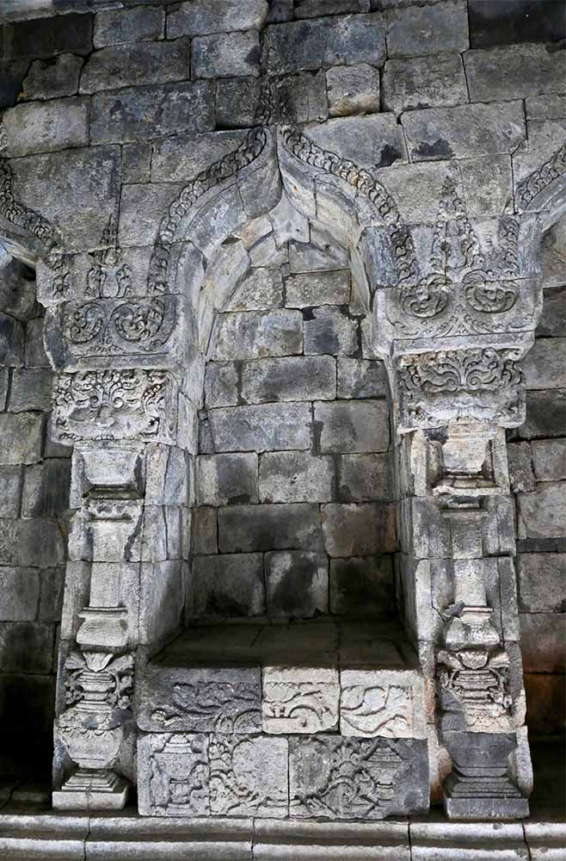
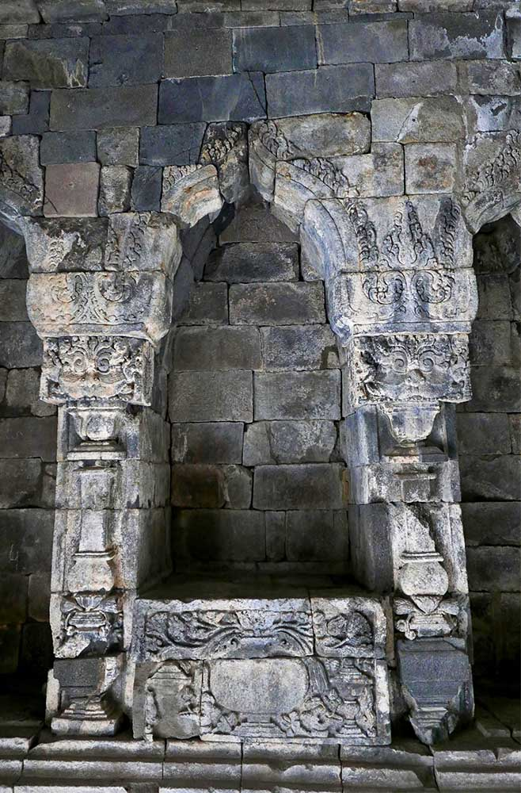
ORIGIN
ORIGIN
Anandajoti Bhikkhu (Photo Dharma)
Anandajoti Bhikkhu (Photo Dharma)

Slide 15
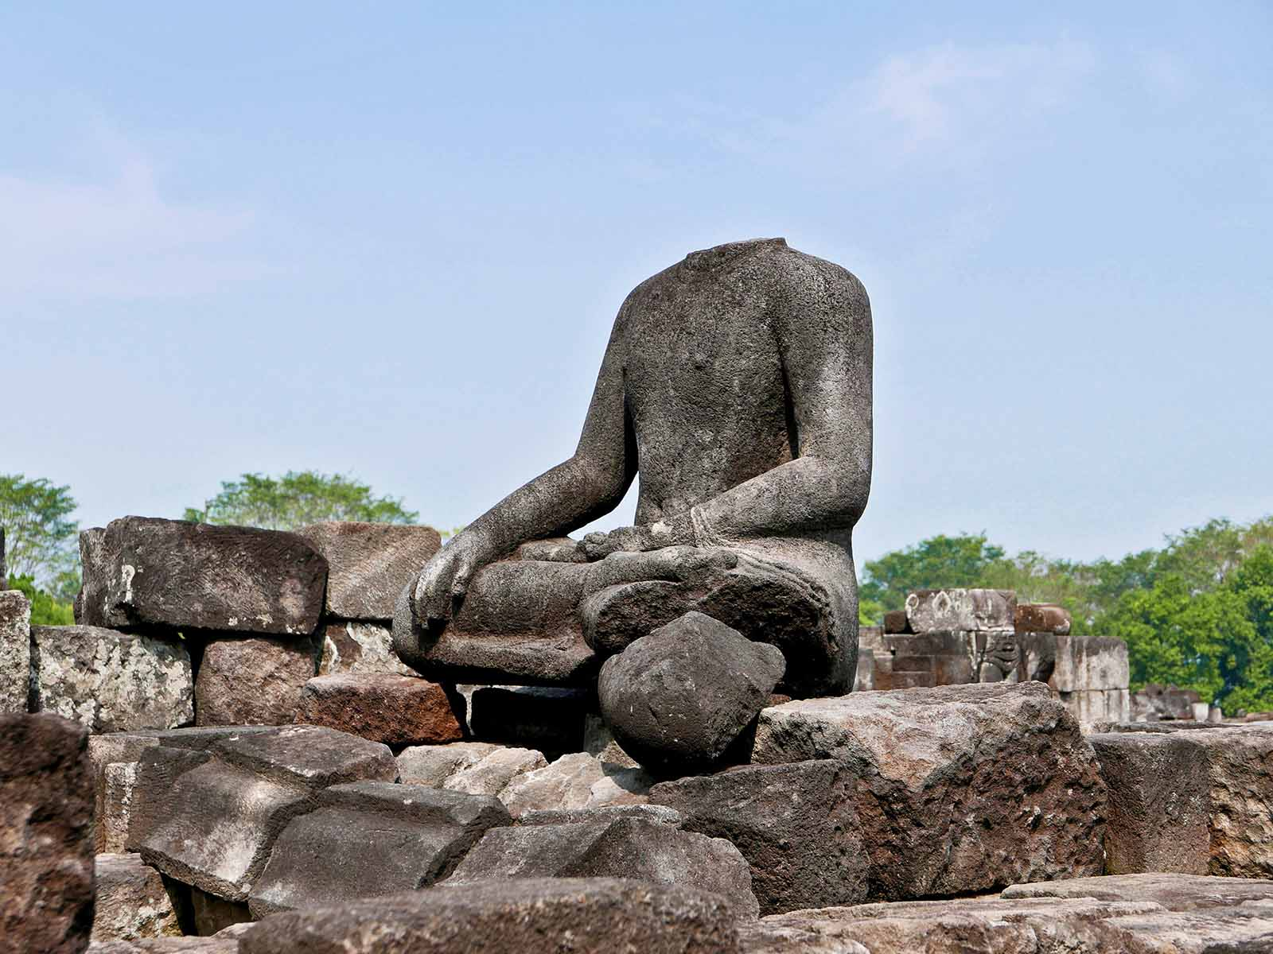
ORIGIN
Anandajoti Bhikkhu (Photo Dharma)

Slide 16
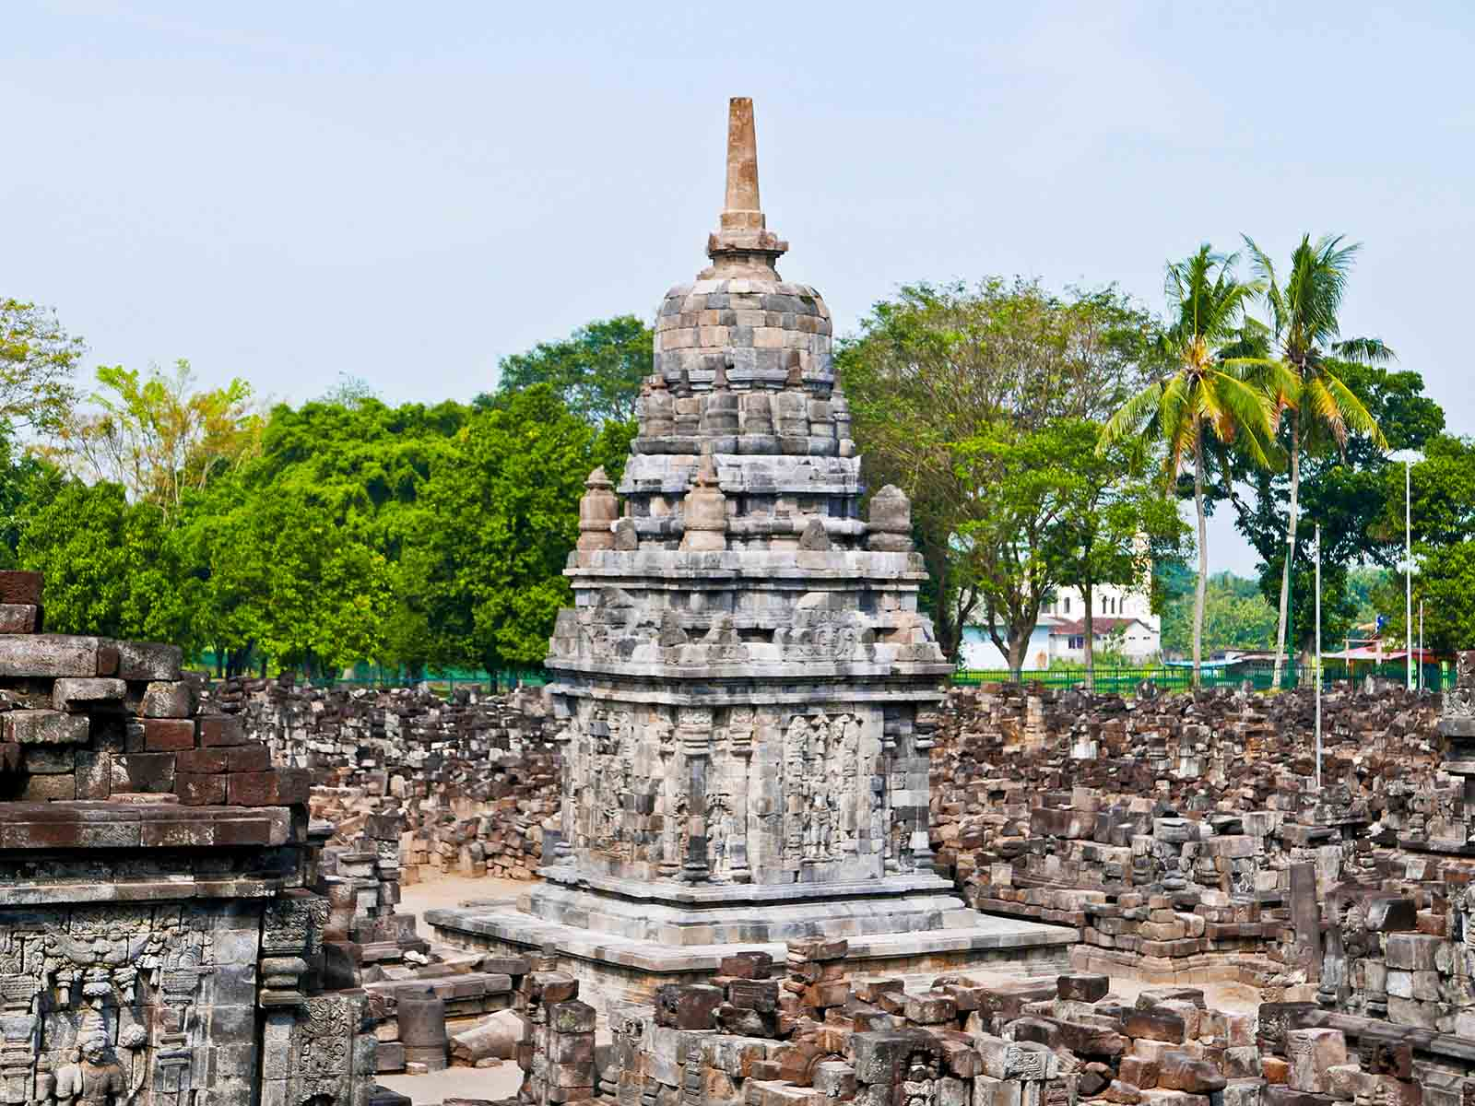
ORIGIN
Anandajoti Bhikkhu (Photo Dharma)

Slide 17
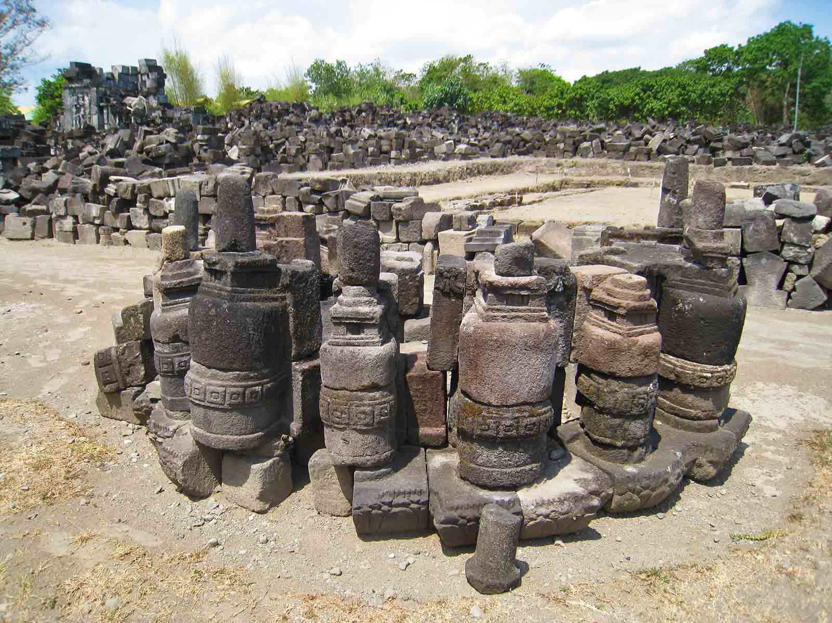
ORIGIN
Anandajoti Bhikkhu (Photo Dharma)

Slide 18
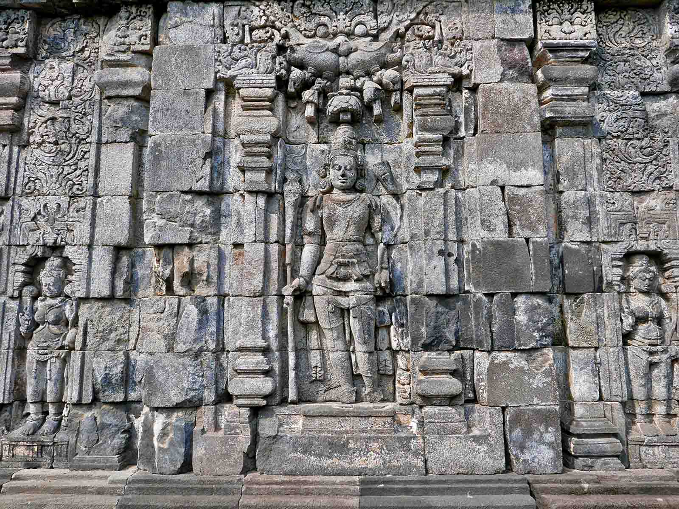
ORIGIN
Anandajoti Bhikkhu (Photo Dharma)

Slide 19
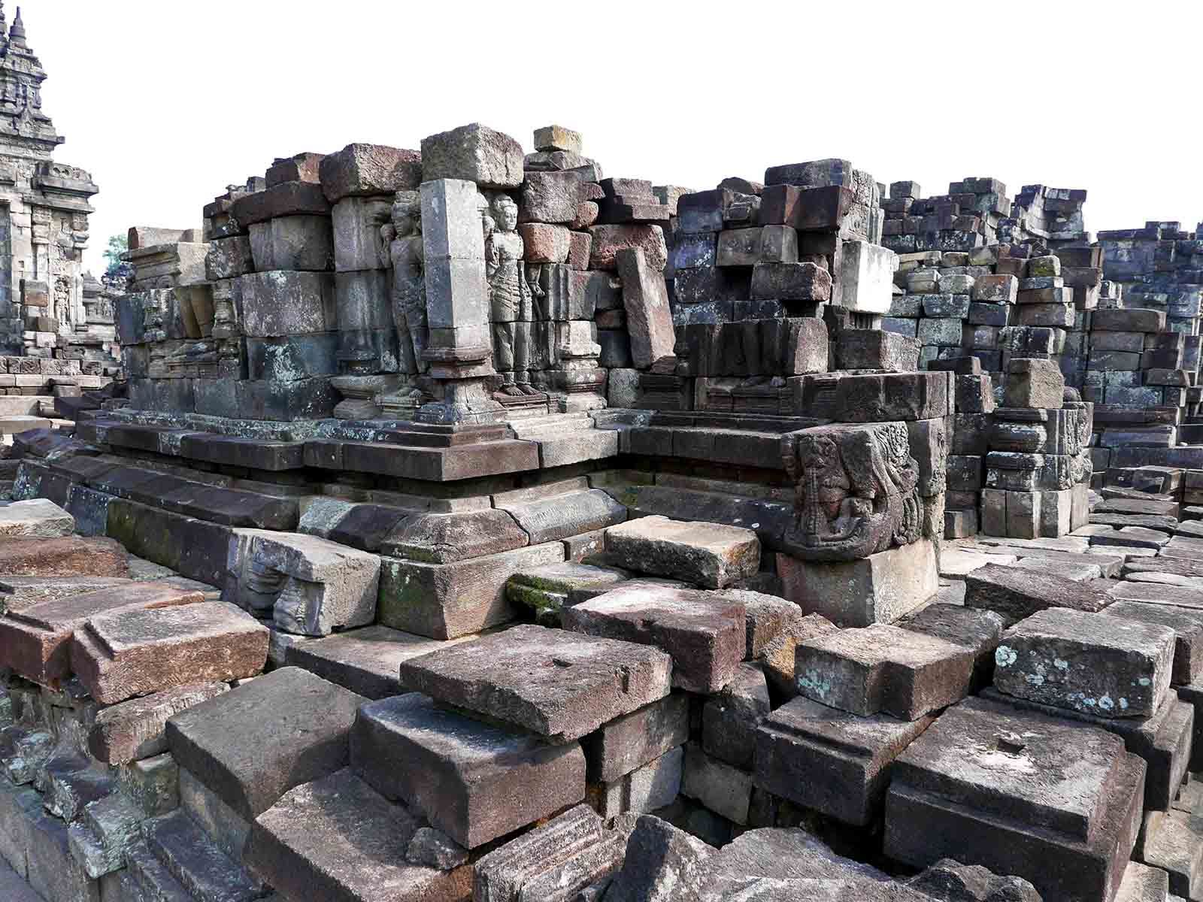
ORIGIN
Anandajoti Bhikkhu (Photo Dharma)

Slide 20
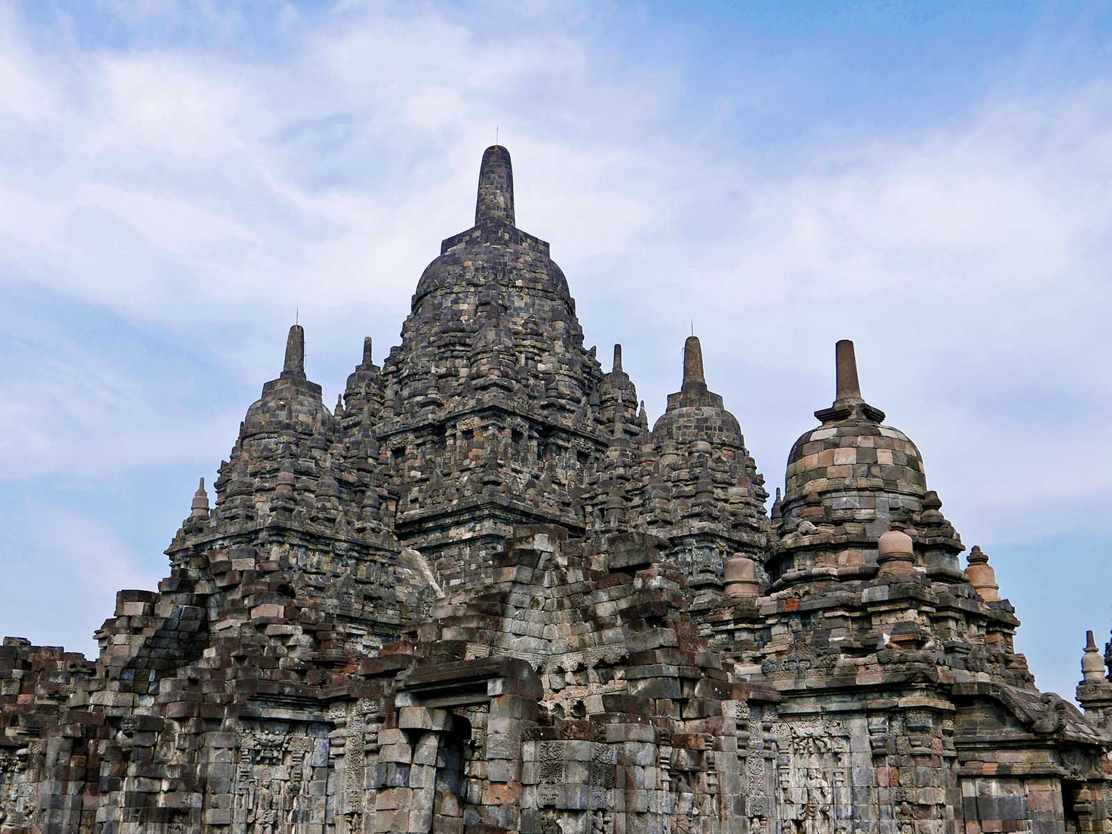
ORIGIN
Anandajoti Bhikkhu (Photo Dharma)

Slide 21
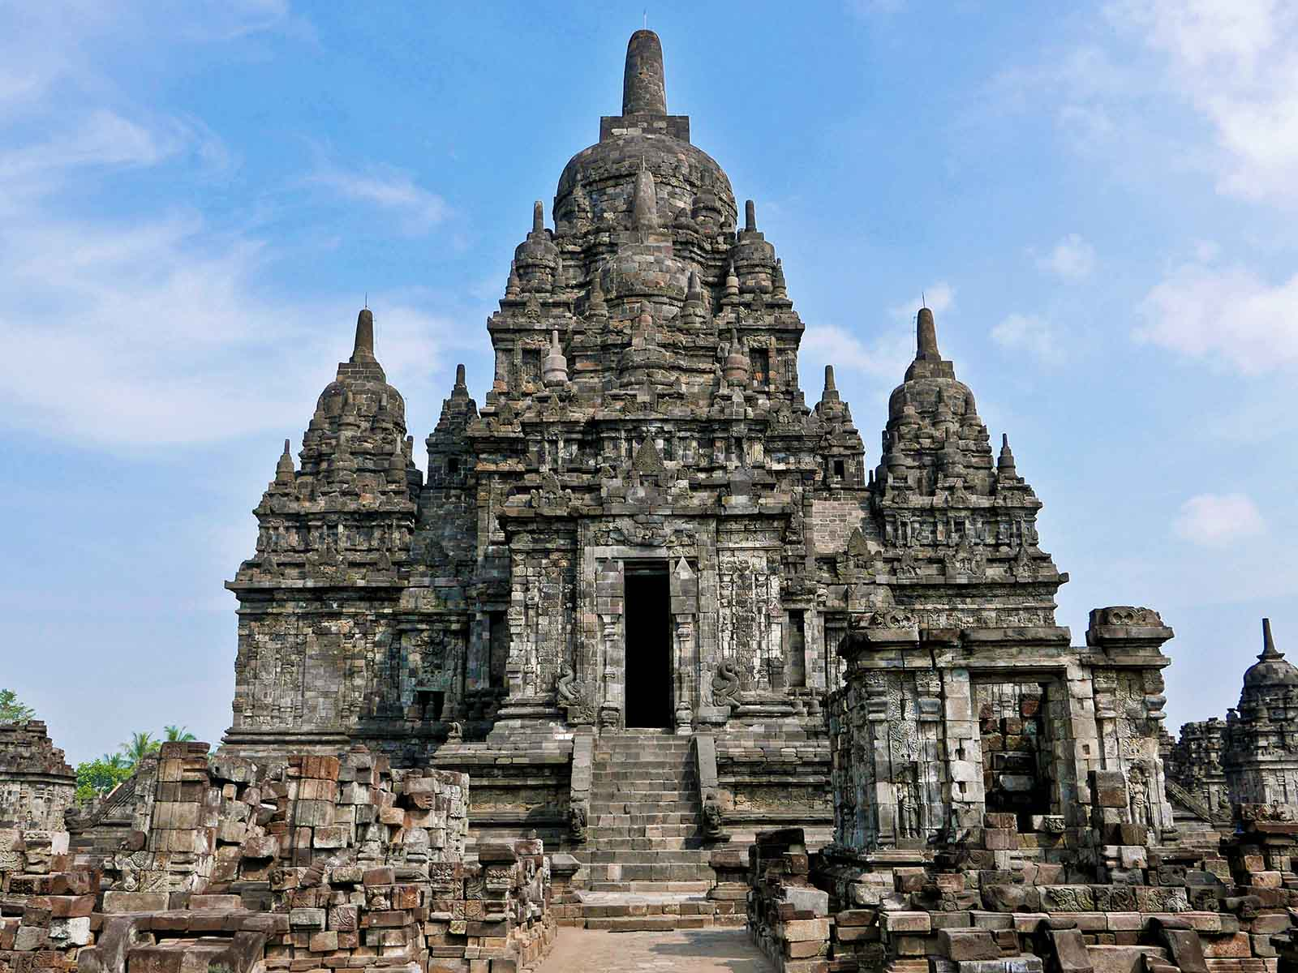
ORIGIN
Anandajoti Bhikkhu (Photo Dharma)

Slide 22
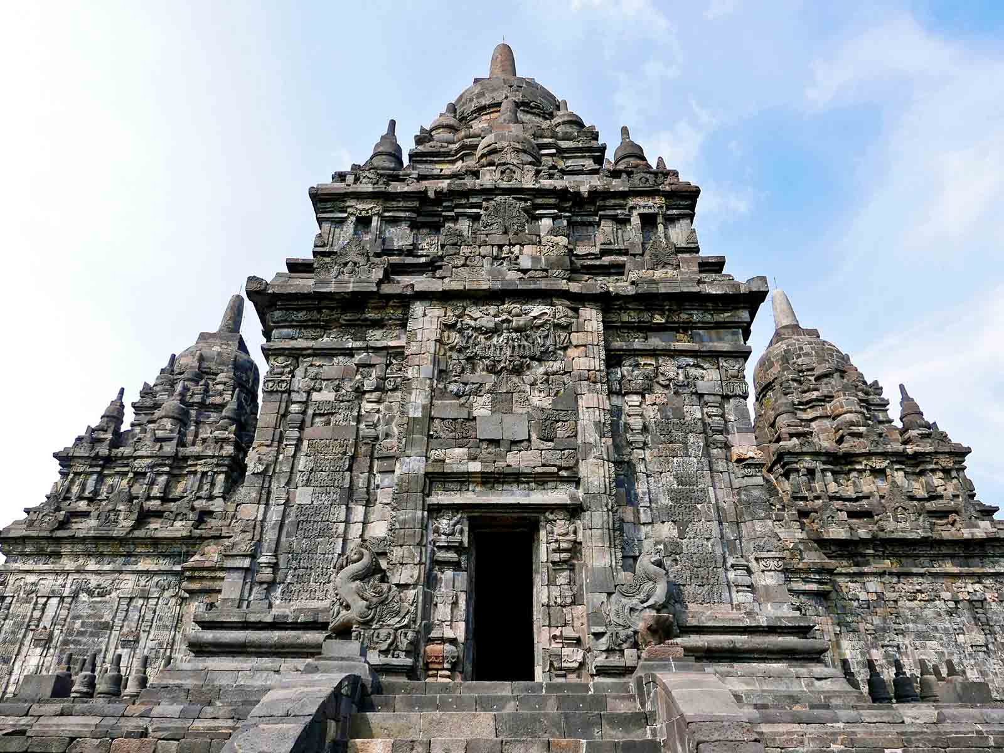
ORIGIN
Anandajoti Bhikkhu (Photo Dharma)

Slide 23
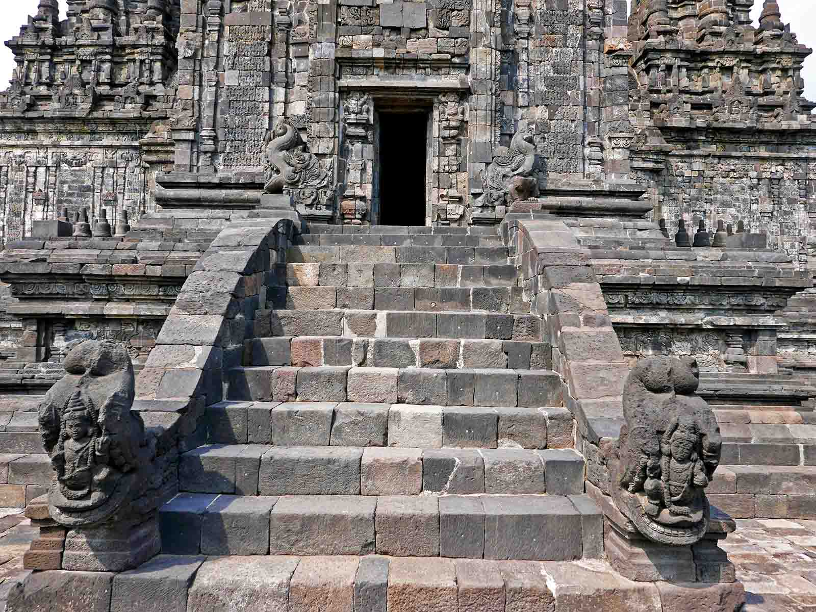
ORIGIN
Anandajoti Bhikkhu (Photo Dharma)

Slide 24
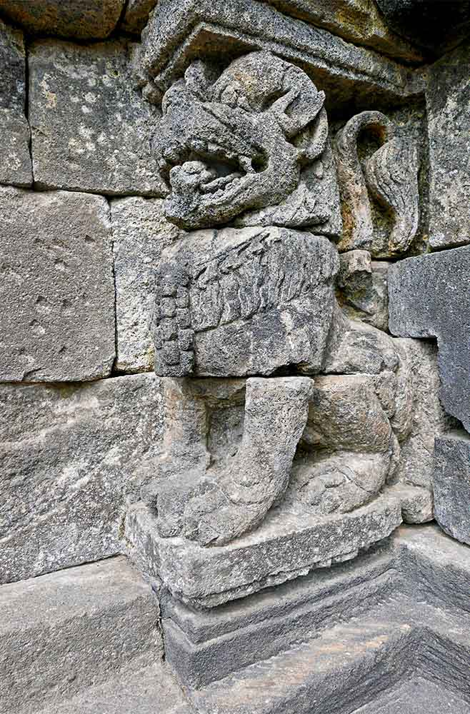
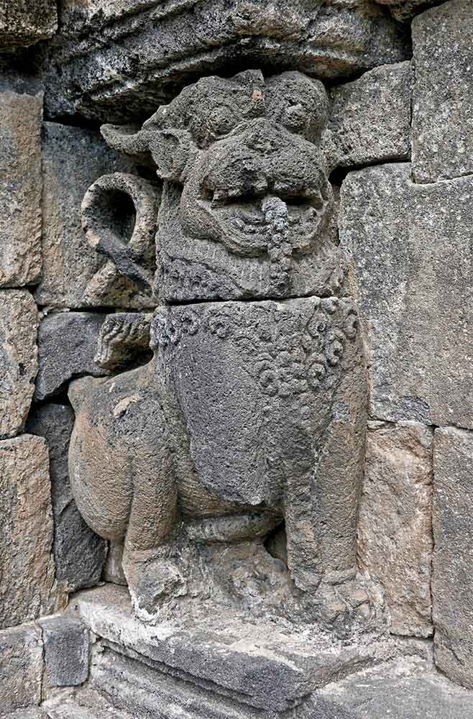
ORIGIN
ORIGIN
Anandajoti Bhikkhu (Photo Dharma)
Anandajoti Bhikkhu (Photo Dharma)

Slide 25
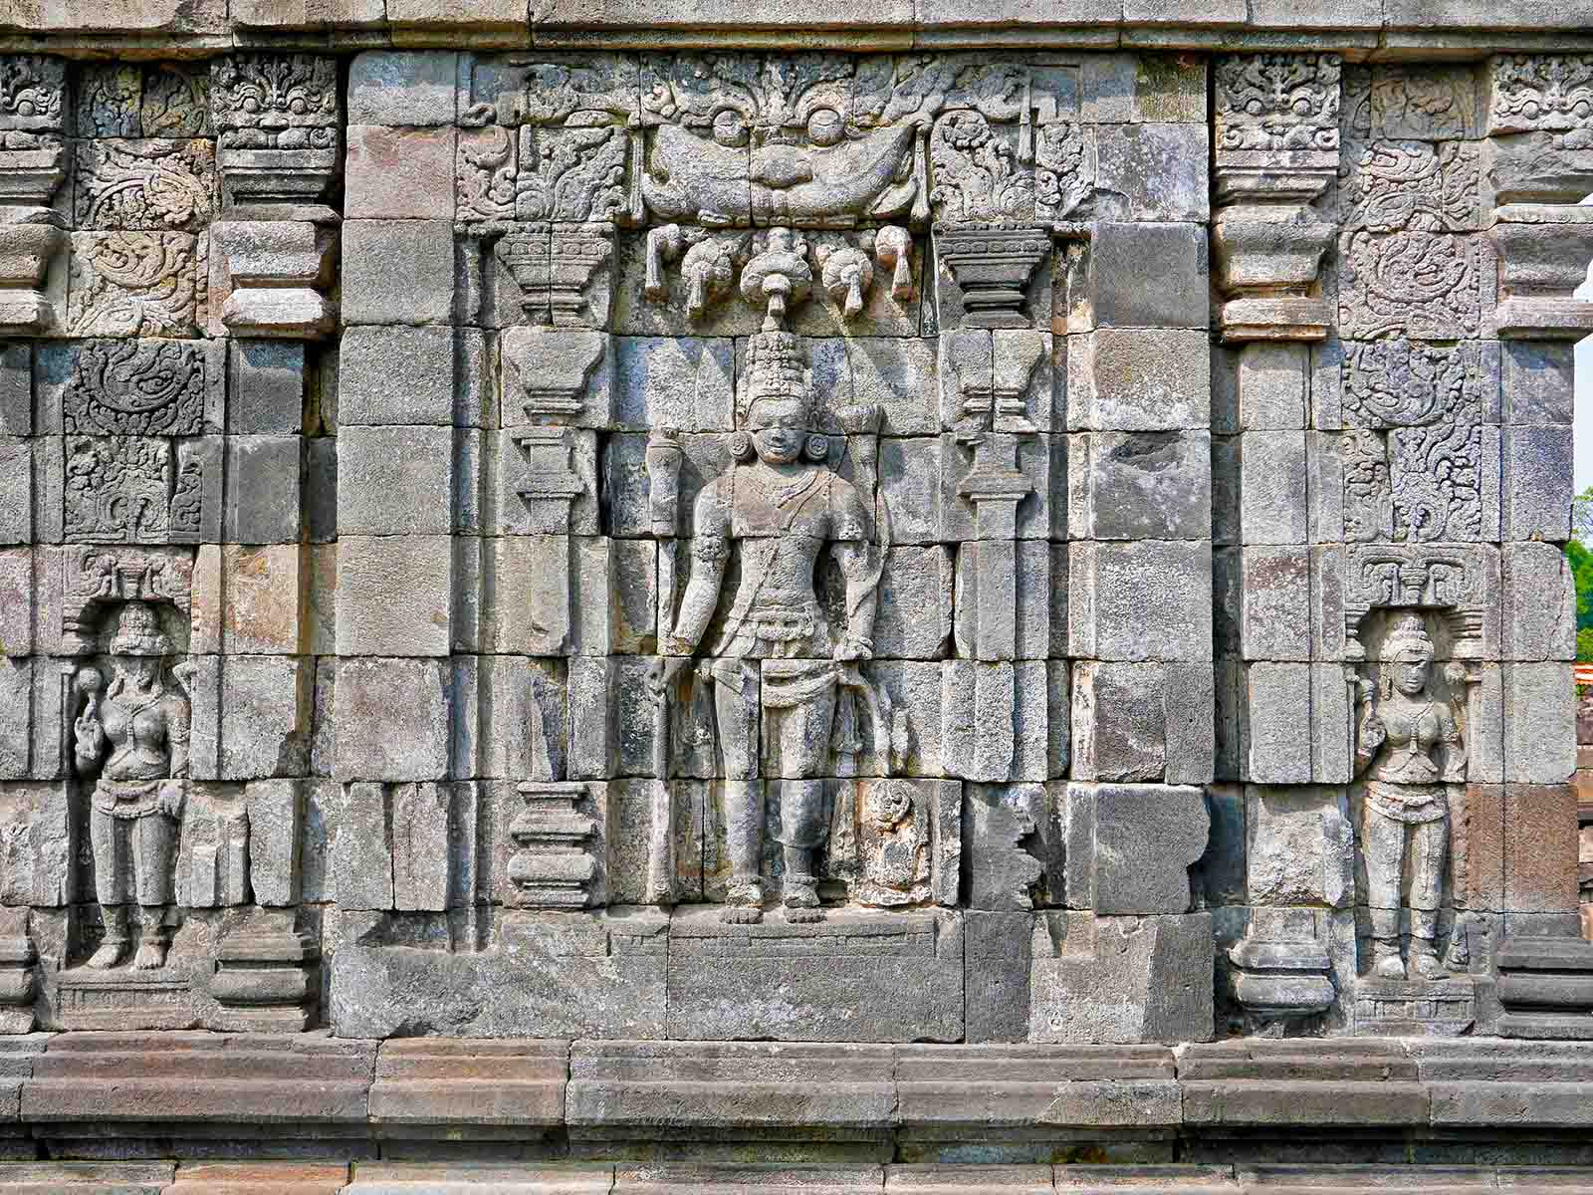
ORIGIN
Anandajoti Bhikkhu (Photo Dharma)

Slide 26
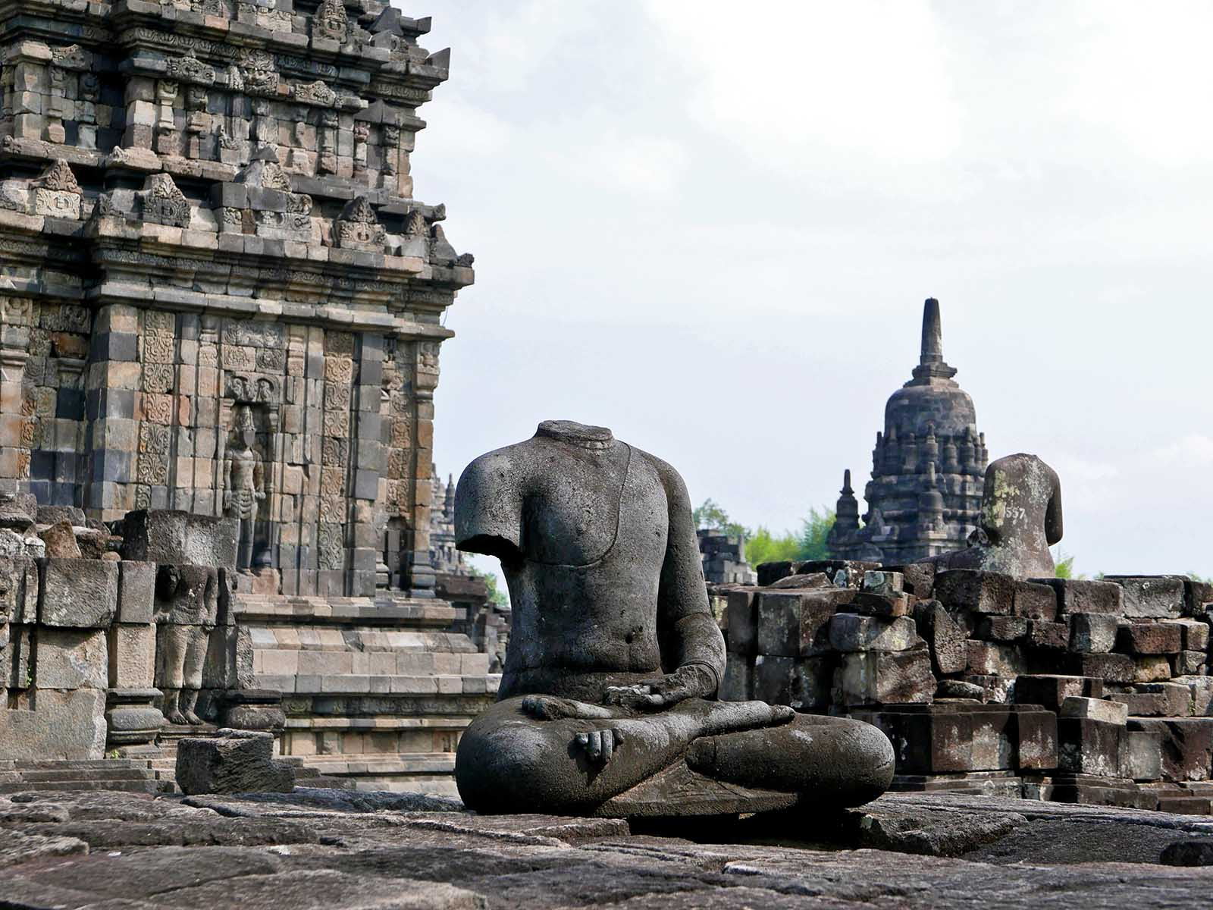
ORIGIN
Anandajoti Bhikkhu (Photo Dharma)

Slide 27
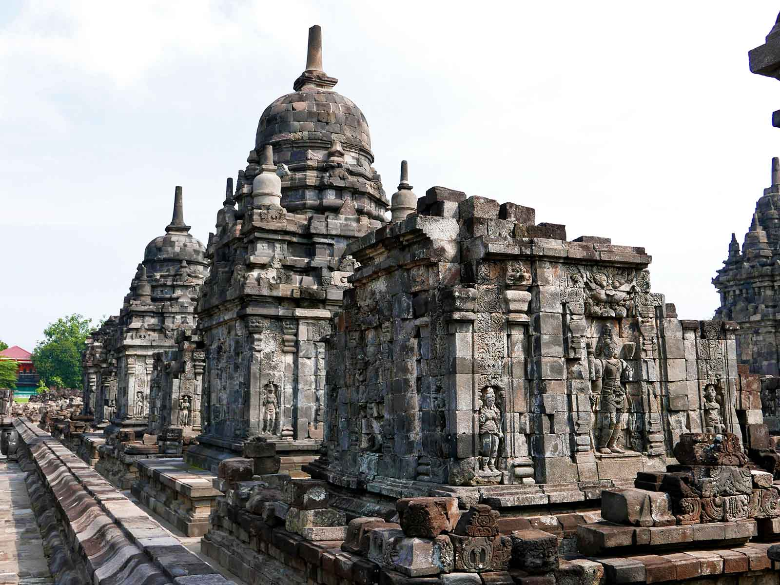
ORIGIN
Anandajoti Bhikkhu (Photo Dharma)

Slide 28
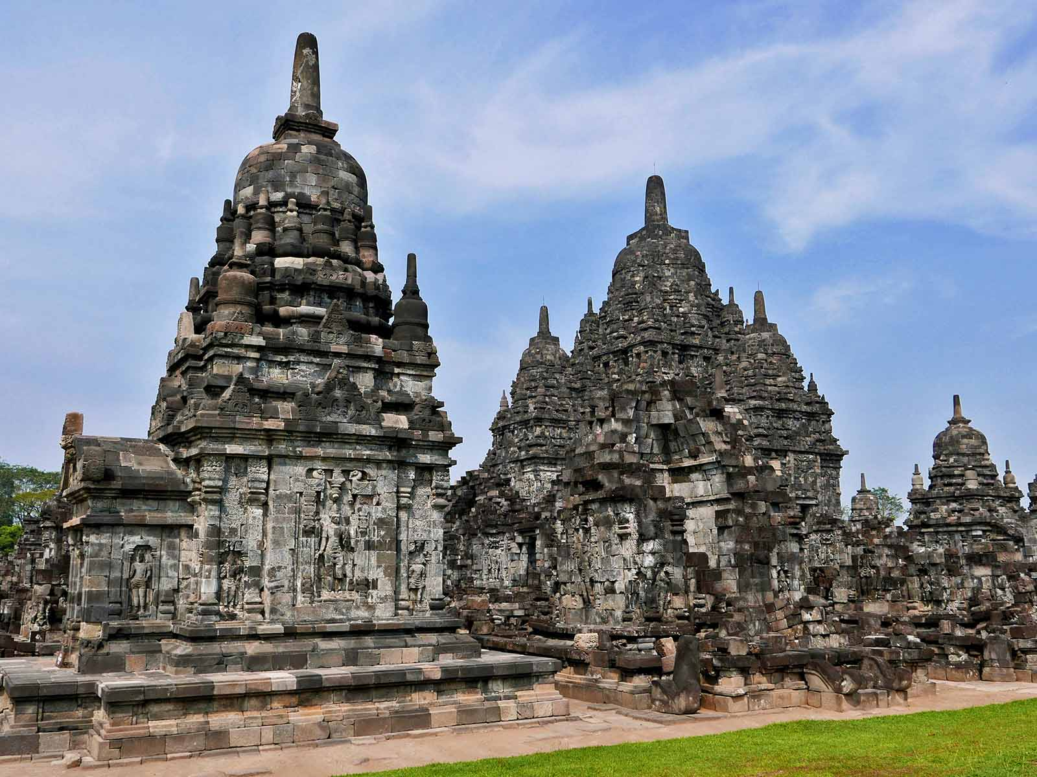
ORIGIN
Anandajoti Bhikkhu (Photo Dharma)

Slide 29
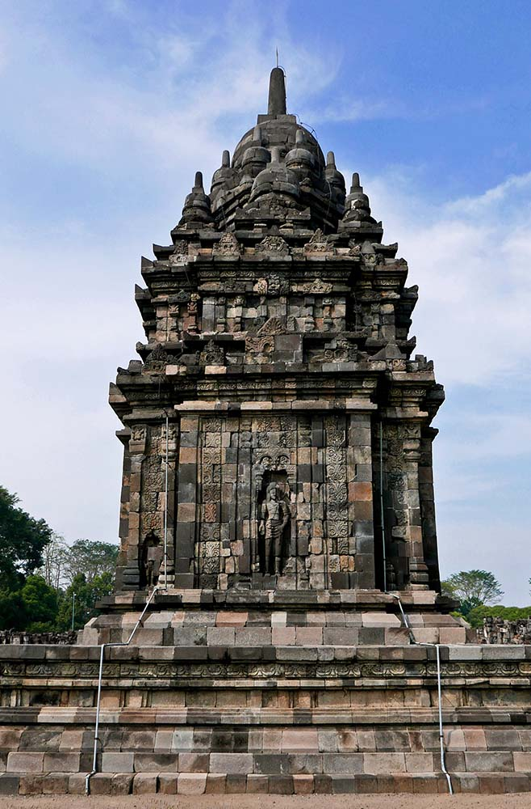
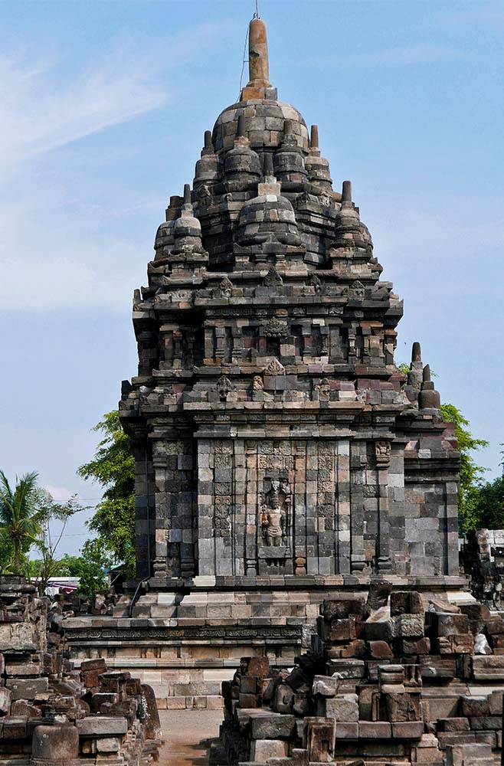
ORIGIN
ORIGIN
Anandajoti Bhikkhu (Photo Dharma)
Anandajoti Bhikkhu (Photo Dharma)

Slide 30
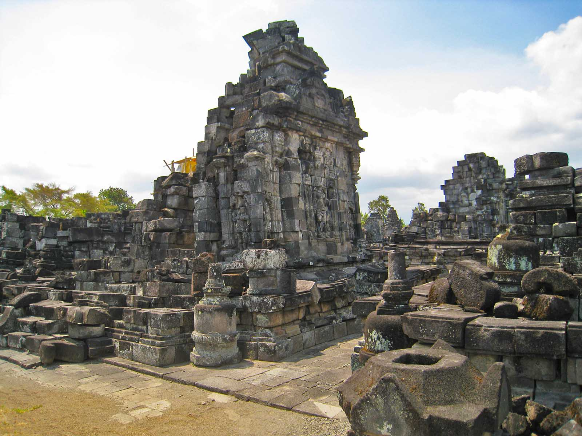
ORIGIN
Anandajoti Bhikkhu (Photo Dharma)

Slide 31
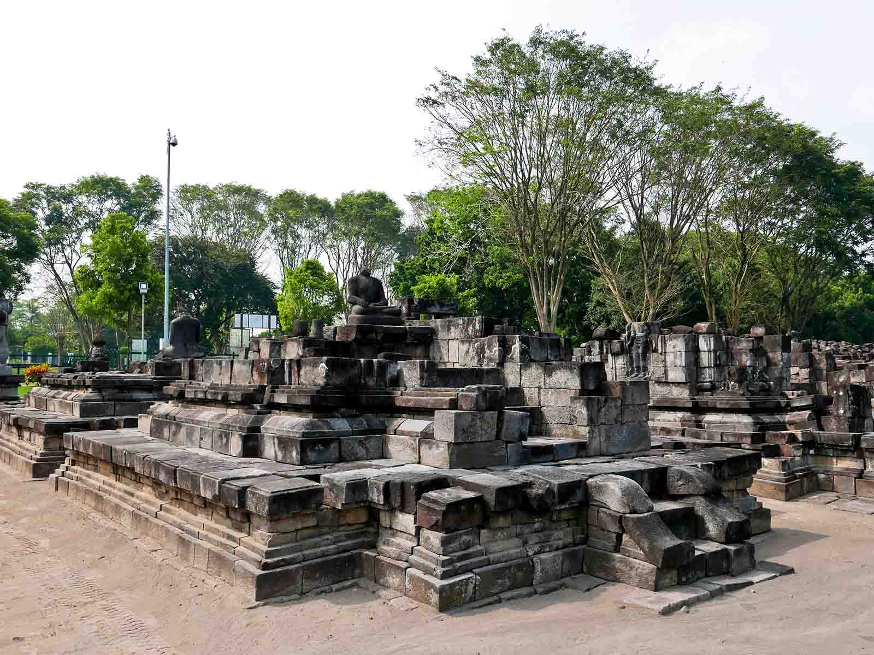
ORIGIN
Anandajoti Bhikkhu (Photo Dharma)

Slide 32
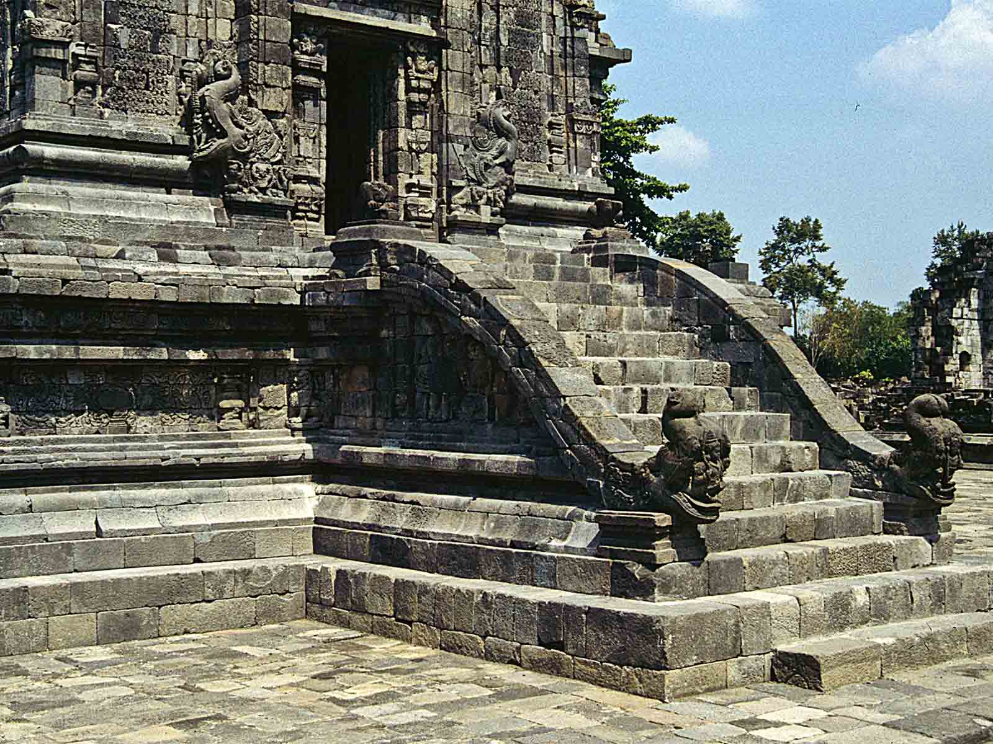
ORIGIN
Ziegler 175

Slide 33
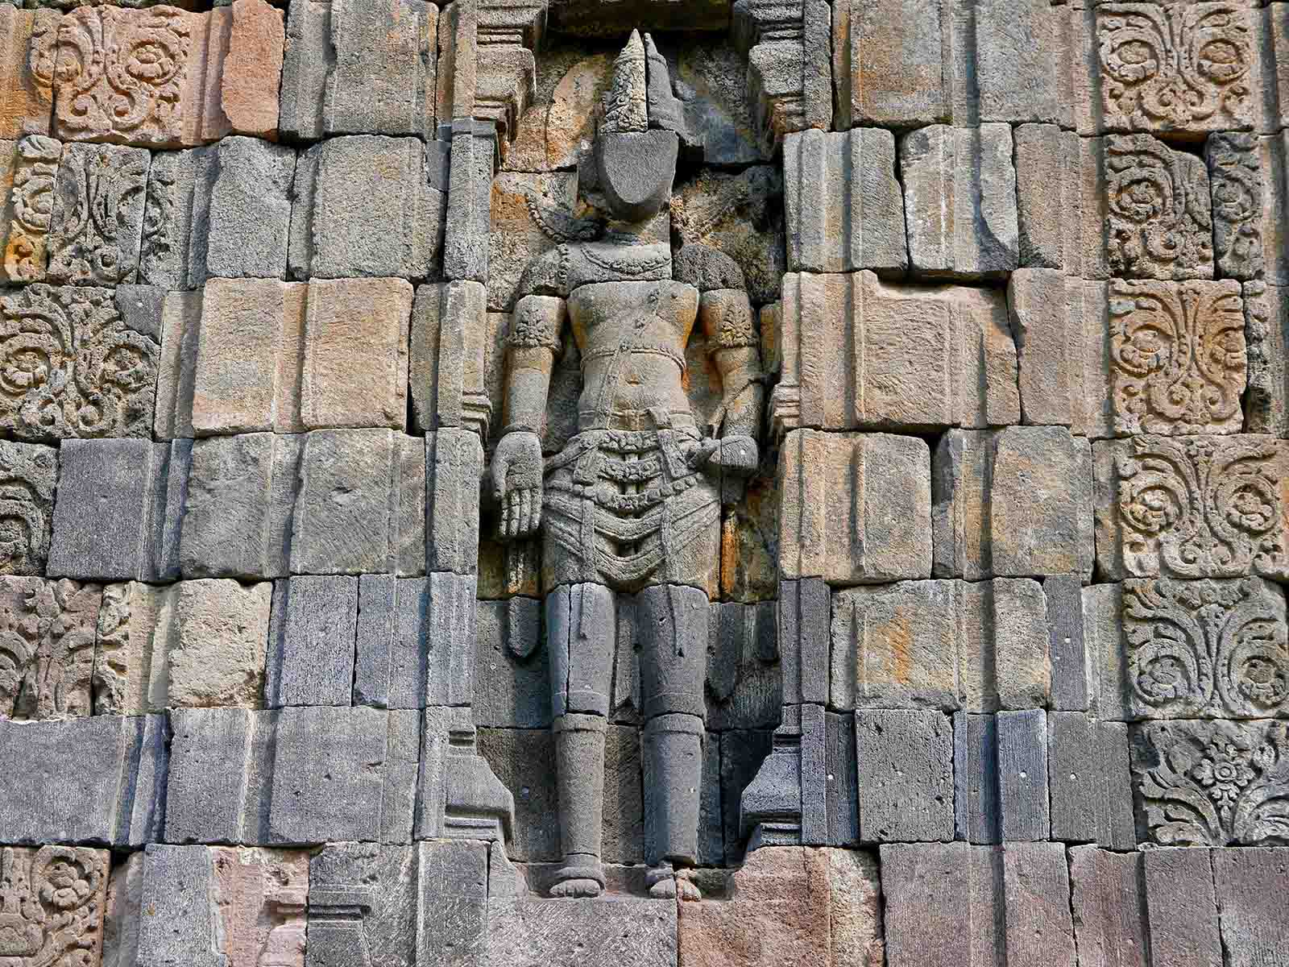
ORIGIN
Anandajoti Bhikkhu (Photo Dharma)

Slide 34
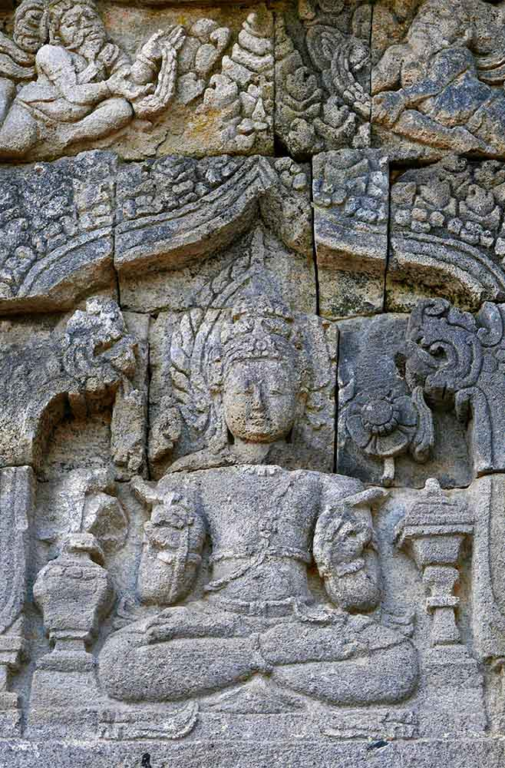
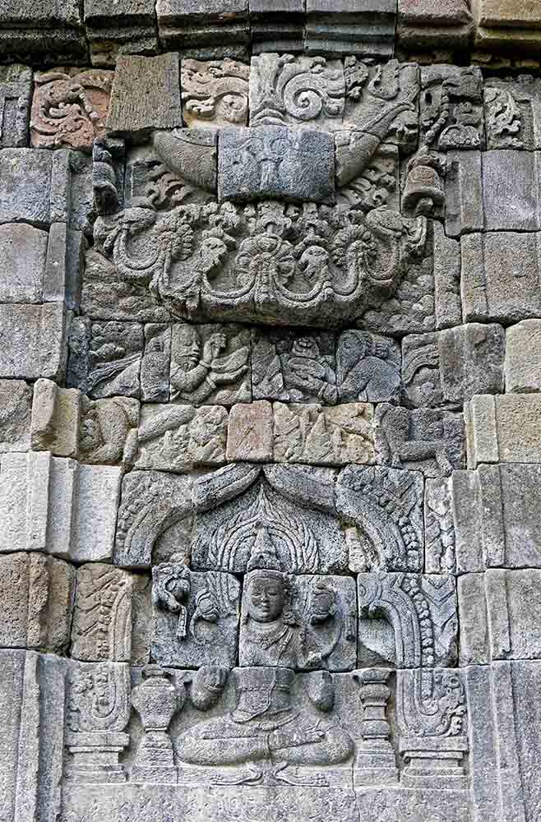
ORIGIN
ORIGIN
Anandajoti Bhikkhu (Photo Dharma)
Anandajoti Bhikkhu (Photo Dharma)

Slide 35
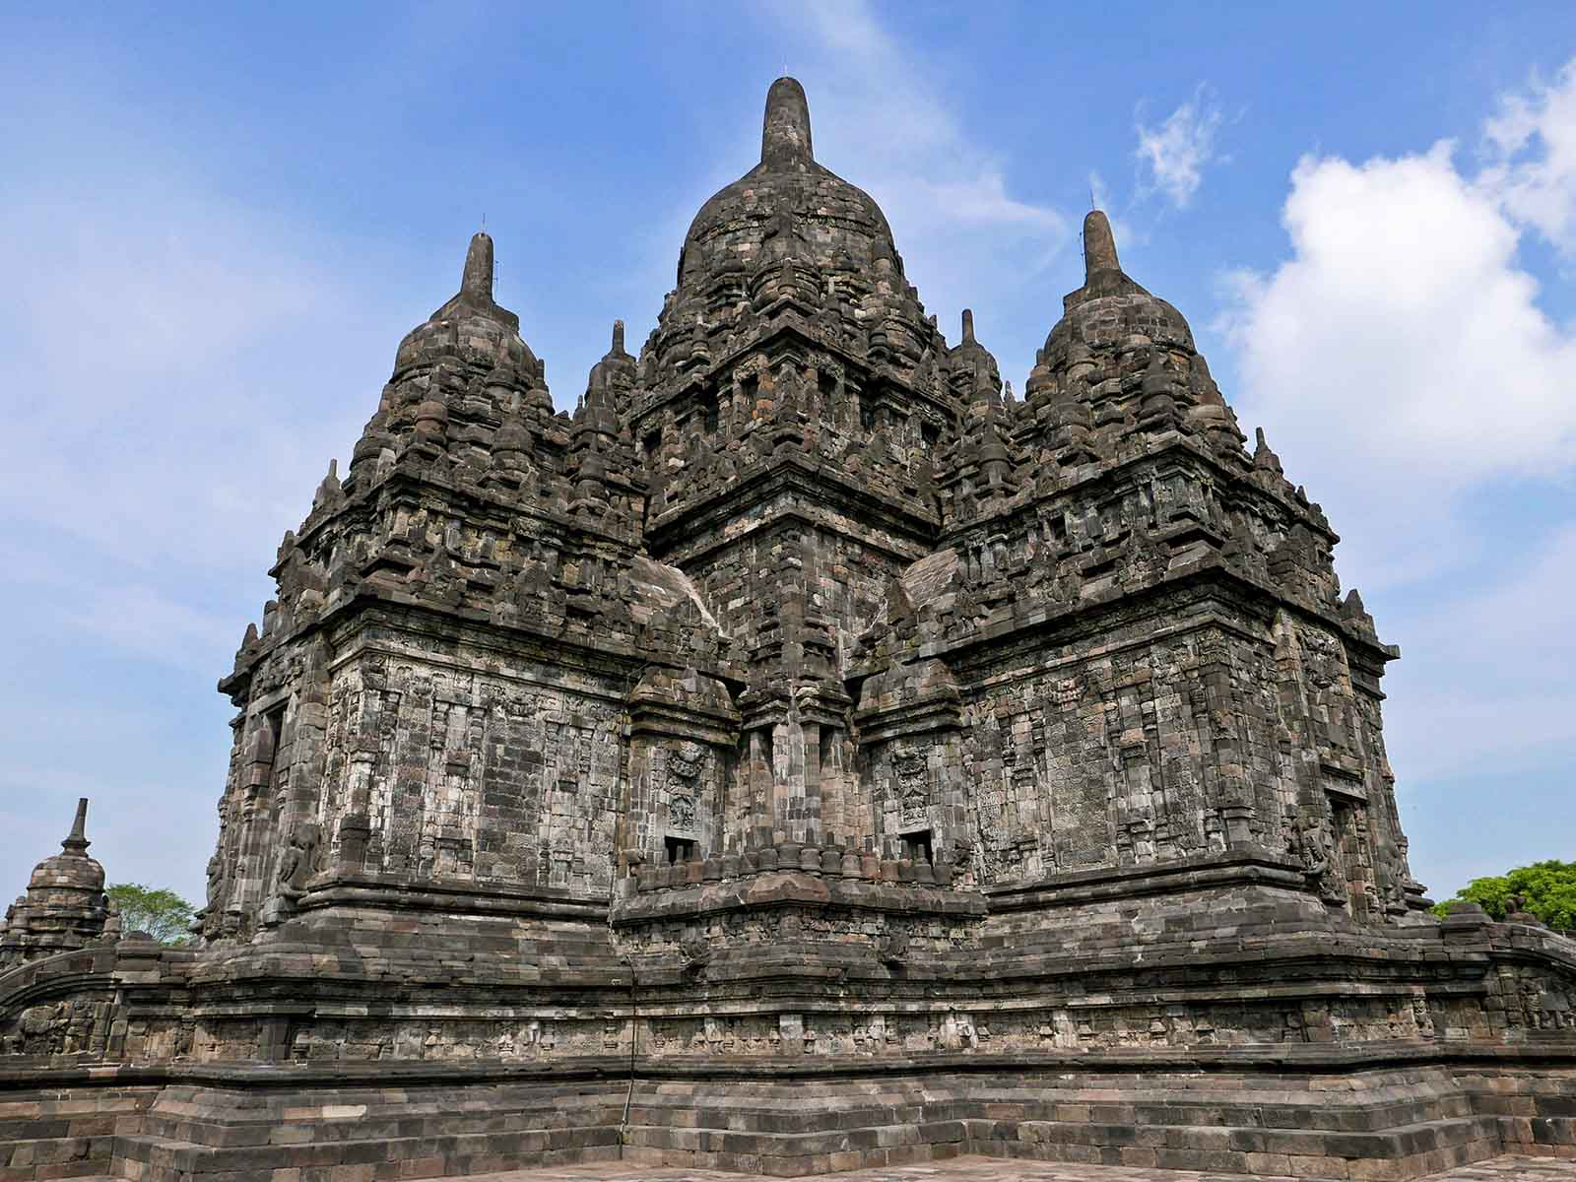
ORIGIN
Anandajoti Bhikkhu (Photo Dharma)

Slide 36
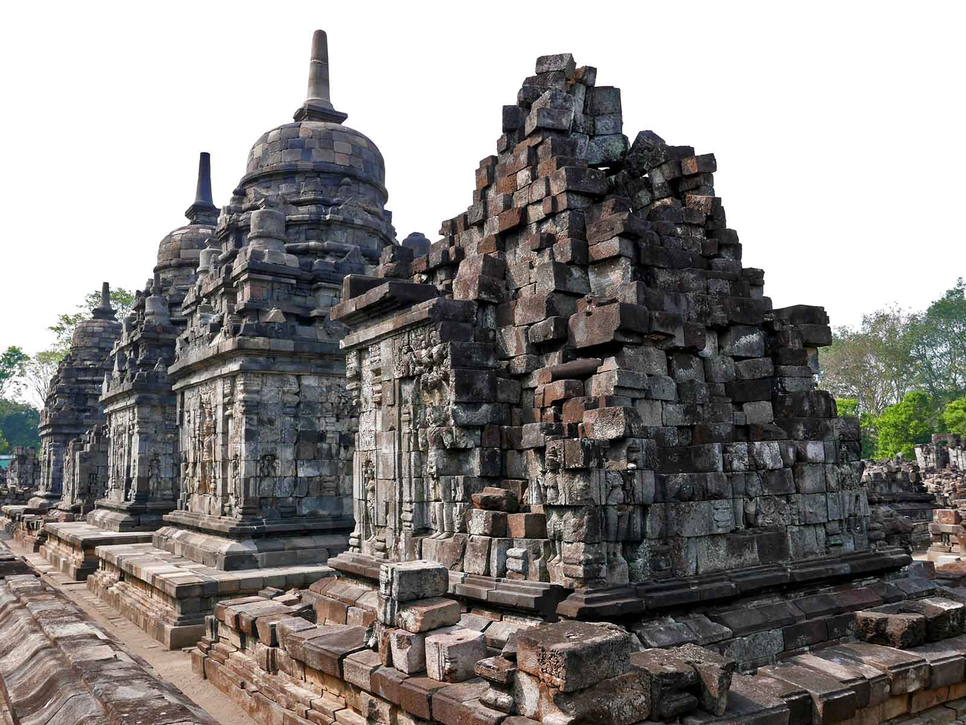
ORIGIN
Anandajoti Bhikkhu (Photo Dharma)

Slide 37
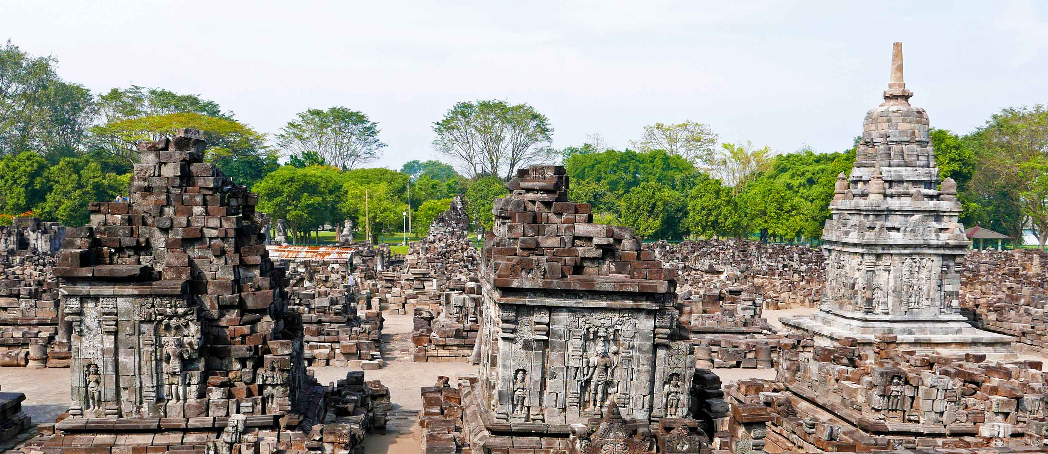
ORIGIN
Anandajoti Bhikkhu (Photo Dharma)

Slide 38
HASTA LA PRÓXIMA
SALVA LA TIERRA
CONTINUAR
F I N A L
No para propósitos comerciales! / Fotografías de Internet / Música : Gus Teja
tomi55jutt@mail.com

Slide 39







¿Te ha gustado?
Puedes ver más entrando
Aquí
Además puedes recibir powerpoints en tu correo electrónico suscribiéndote aquí:
F I N

