Slide 1


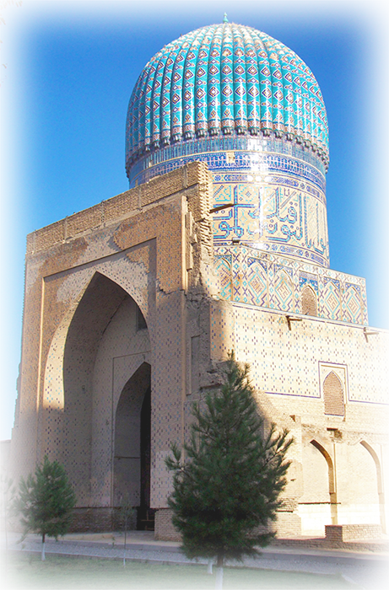


VER EL MUNDO CONMIGO
SALVA LA TIERRA
UZBEKISTÁN
Samarcanda
Samarcanda
03
Tommy55

Slide 2

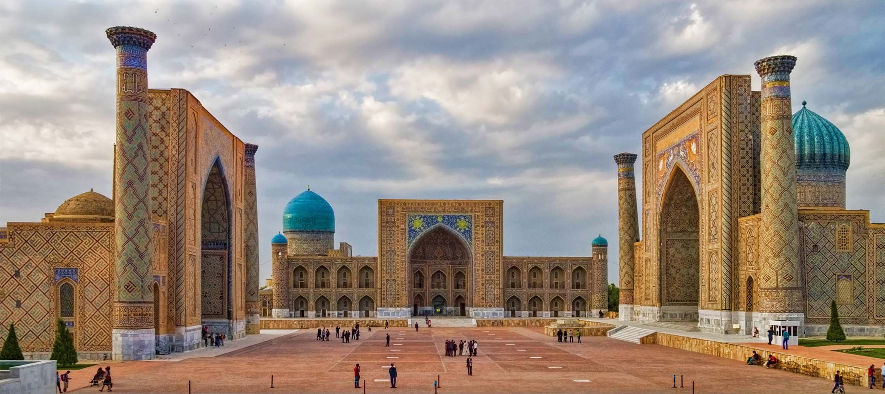
Registan
Dan Lundberg
ORIGIN

Slide 3
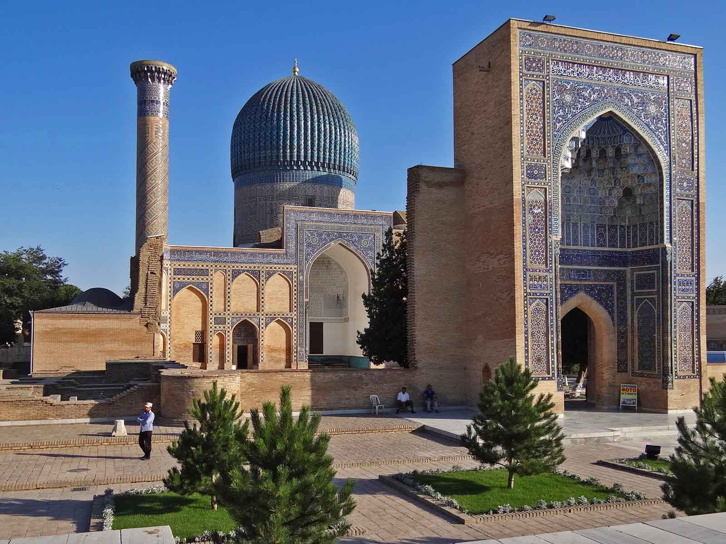
Amir Timur Mausoleum
Adam Jones
ORIGIN

Slide 4
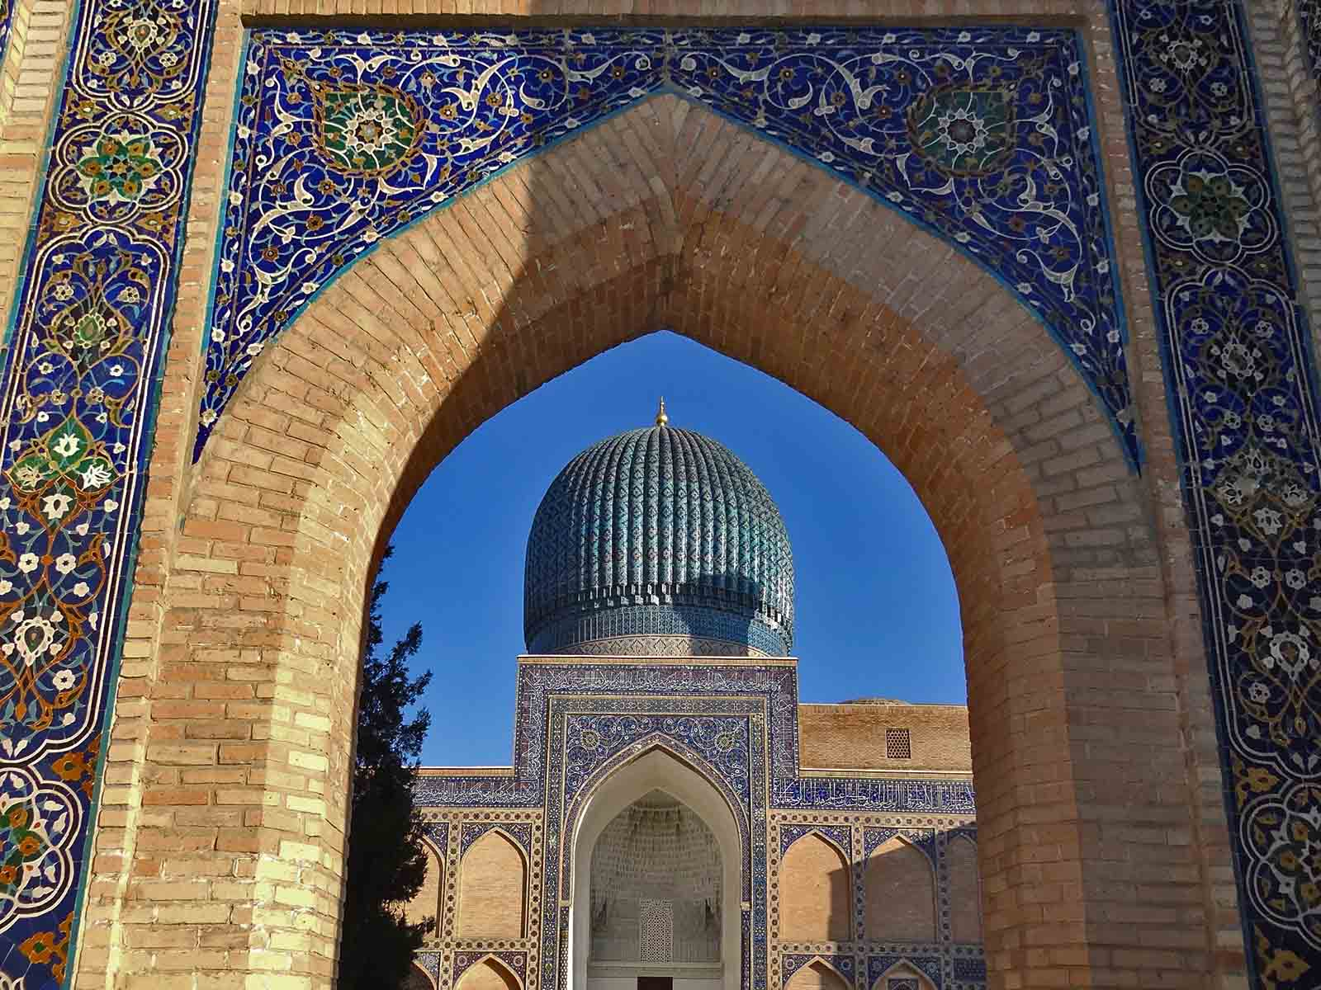
Amir Timur Mausoleum
Adam Jones
ORIGIN

Slide 5
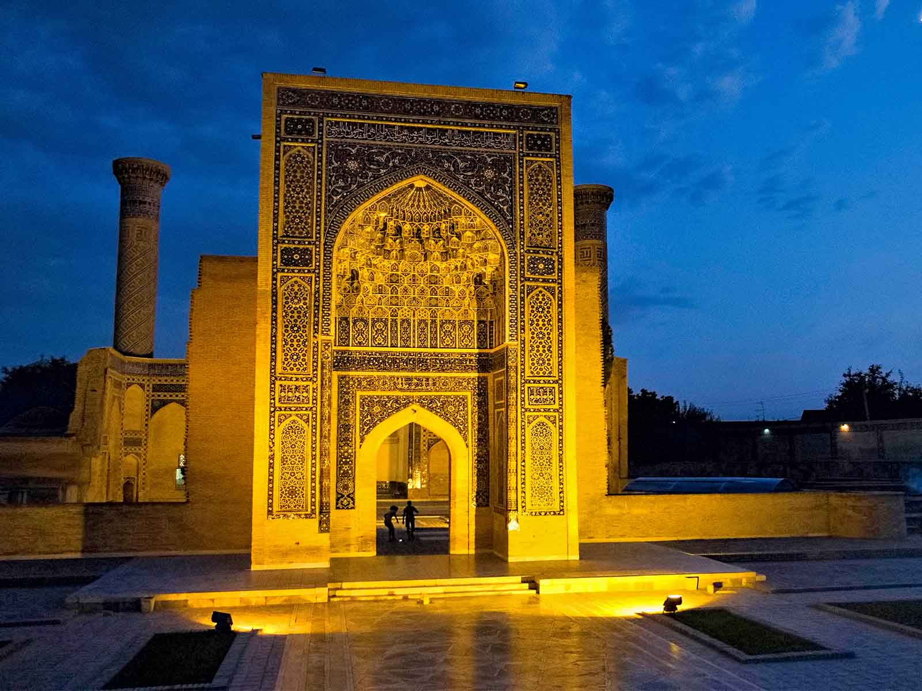
Amir Timur Mausoleum
Dan Lundberg
ORIGIN

Slide 6
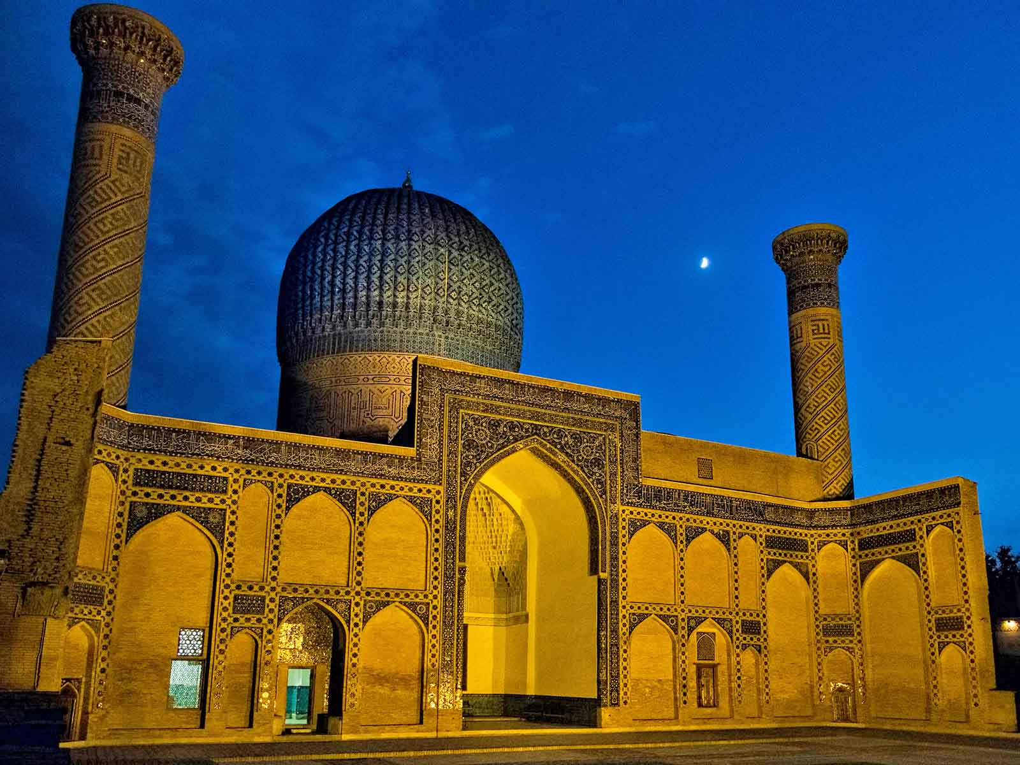
Amir Timur Mausoleum
Dan Lundberg
ORIGIN

Slide 7
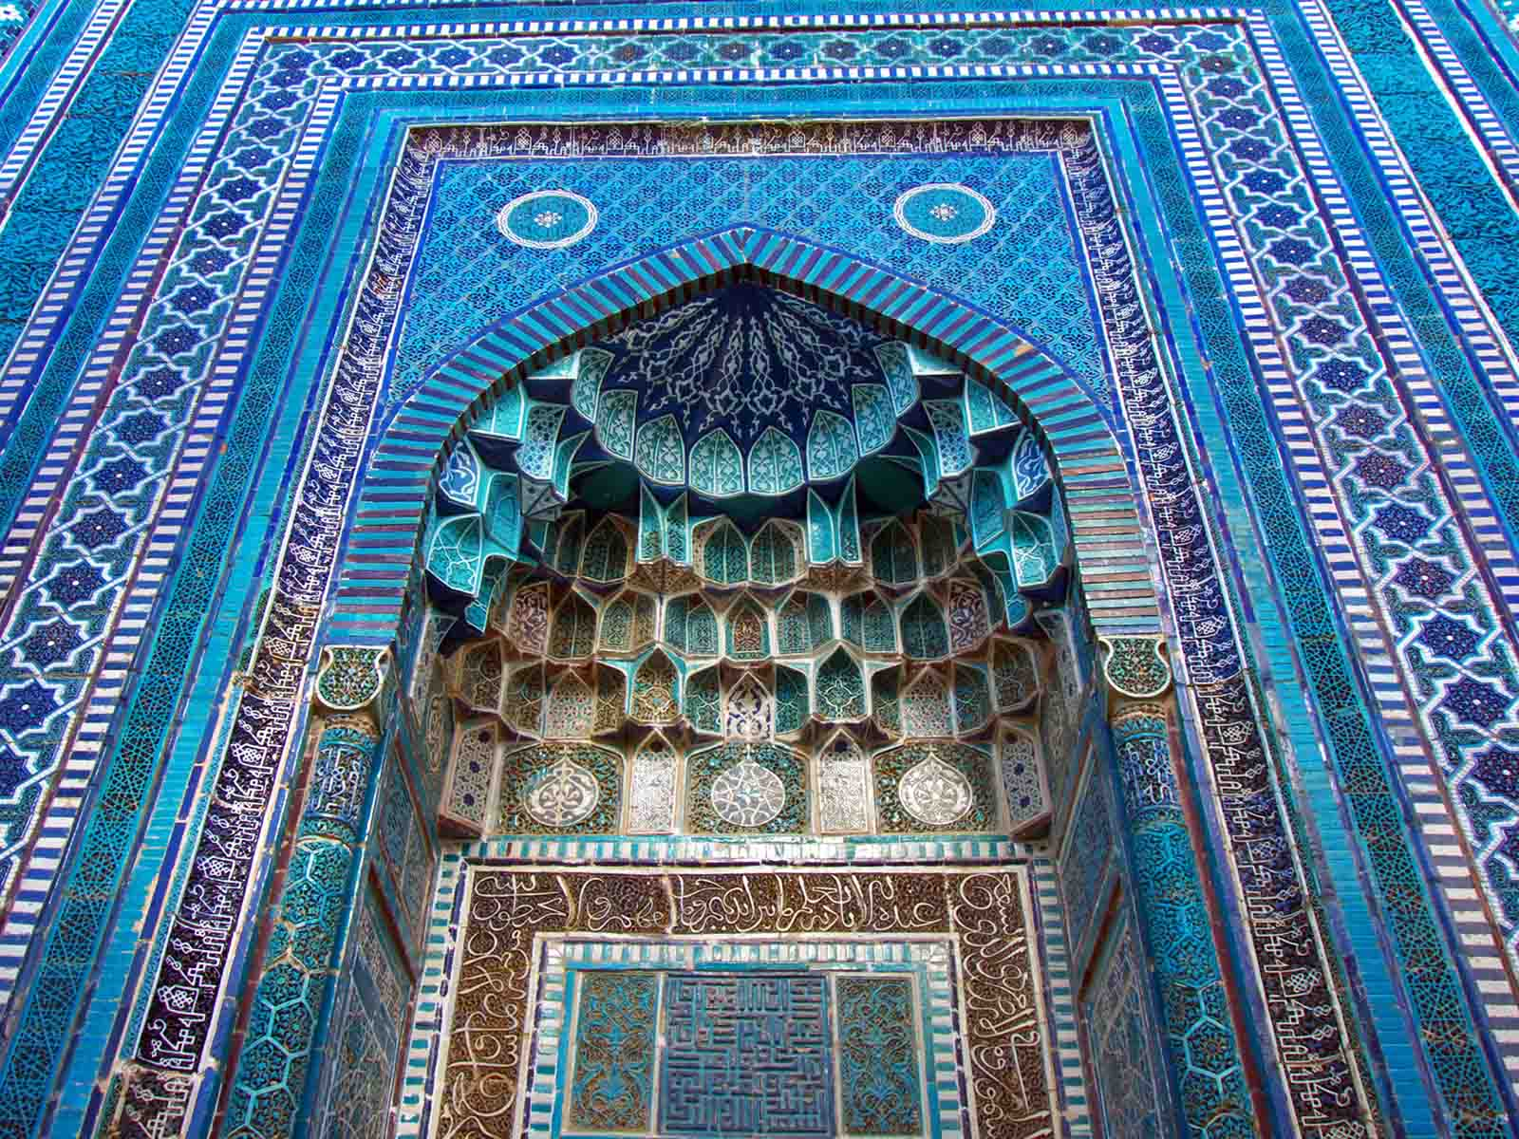
Amir Timur Mausoleum
Fulvio Spada
ORIGIN

Slide 8
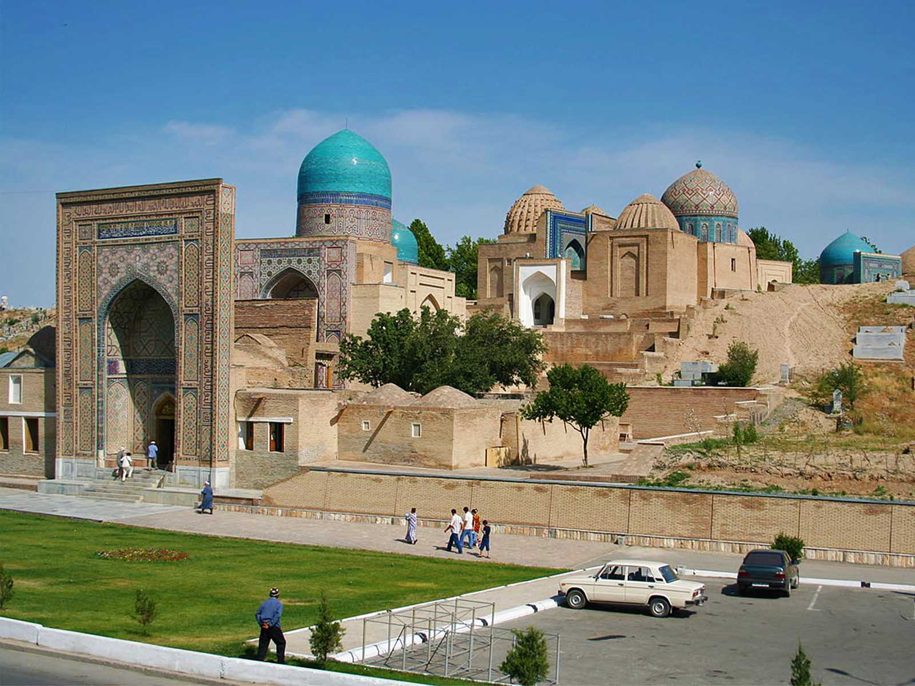
Complex Shakhi Zinda
Patrick Ringgenberg
ORIGIN

Slide 9
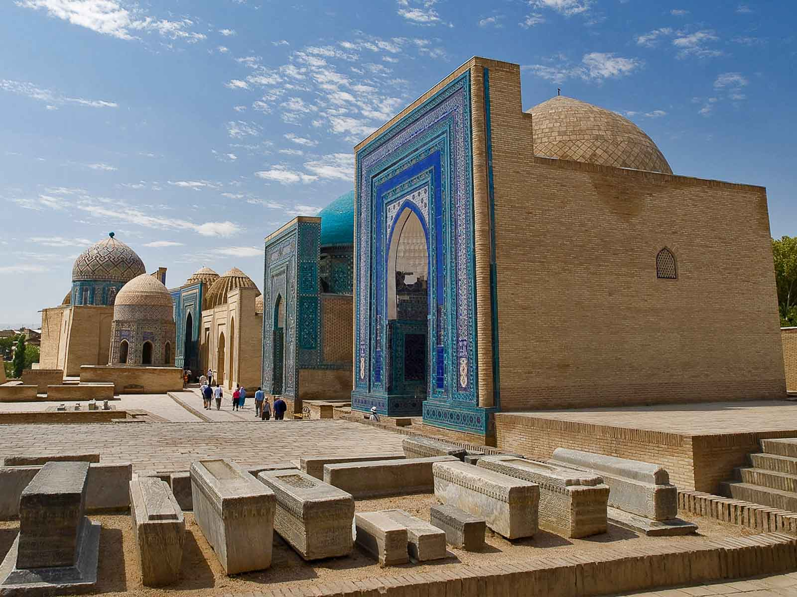
Complex Shakhi Zinda
Gustavo Jeronimo
ORIGIN

Slide 10
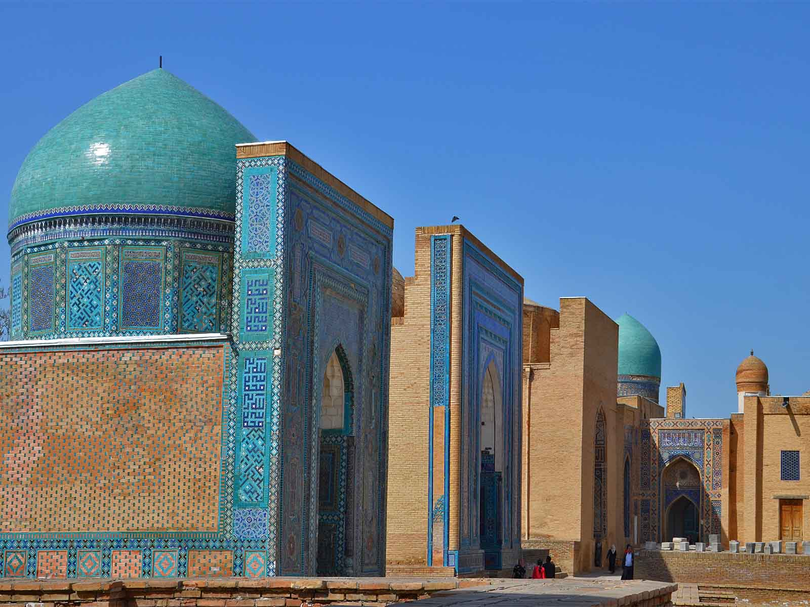
Complex Shakhi Zinda
Bobyrr
ORIGIN

Slide 11
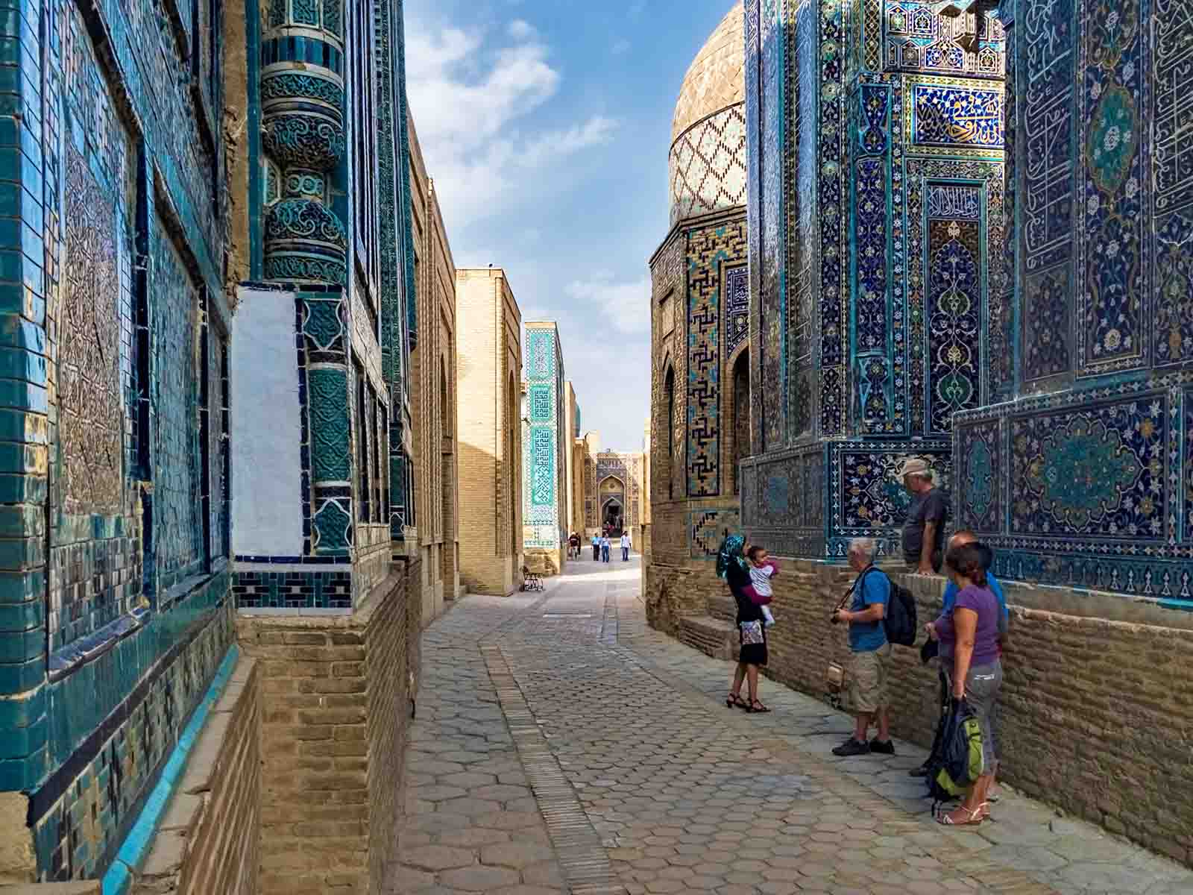
Complex Shakhi Zinda
Dan Lundberg
ORIGIN

Slide 12
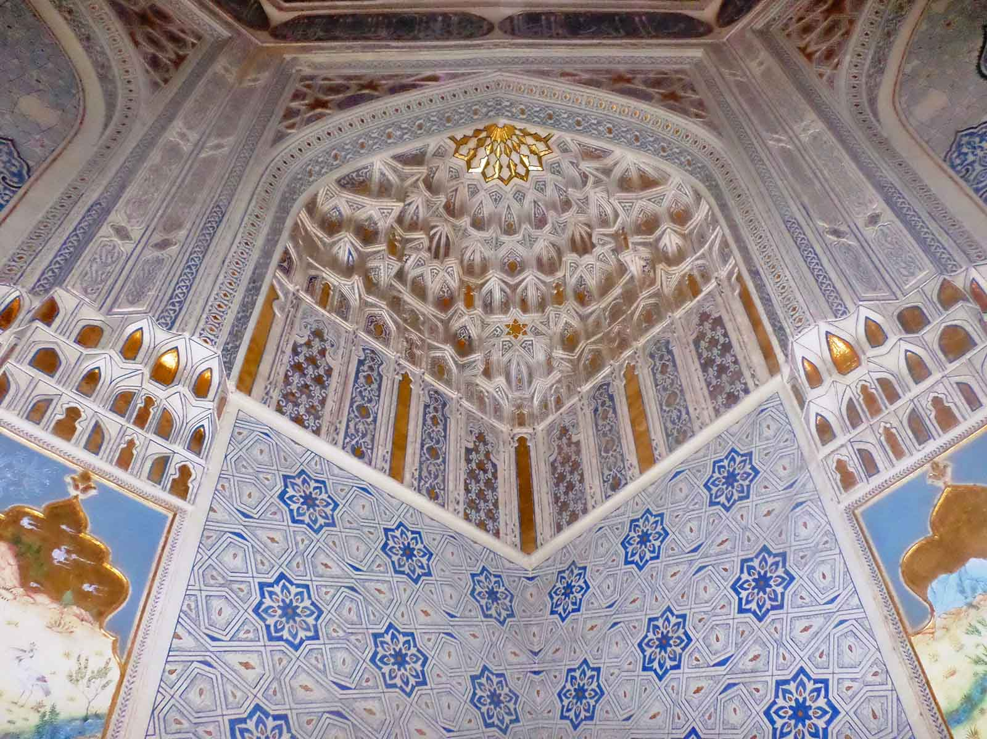
Complex Shakhi Zinda
Shuhrat Sadiyev
ORIGIN

Slide 13
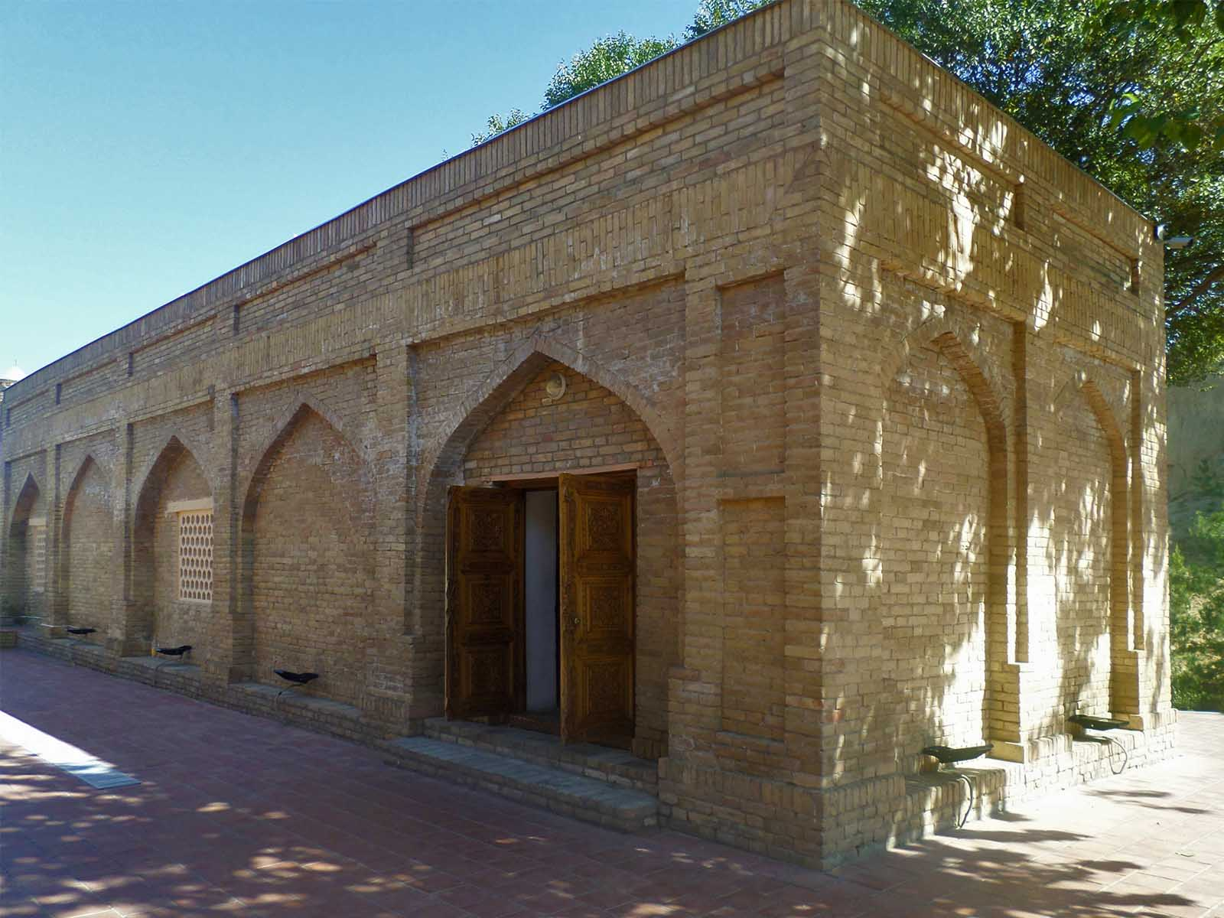
Mausoleum Khoja Daniyar
Bobyrr
ORIGIN

Slide 14
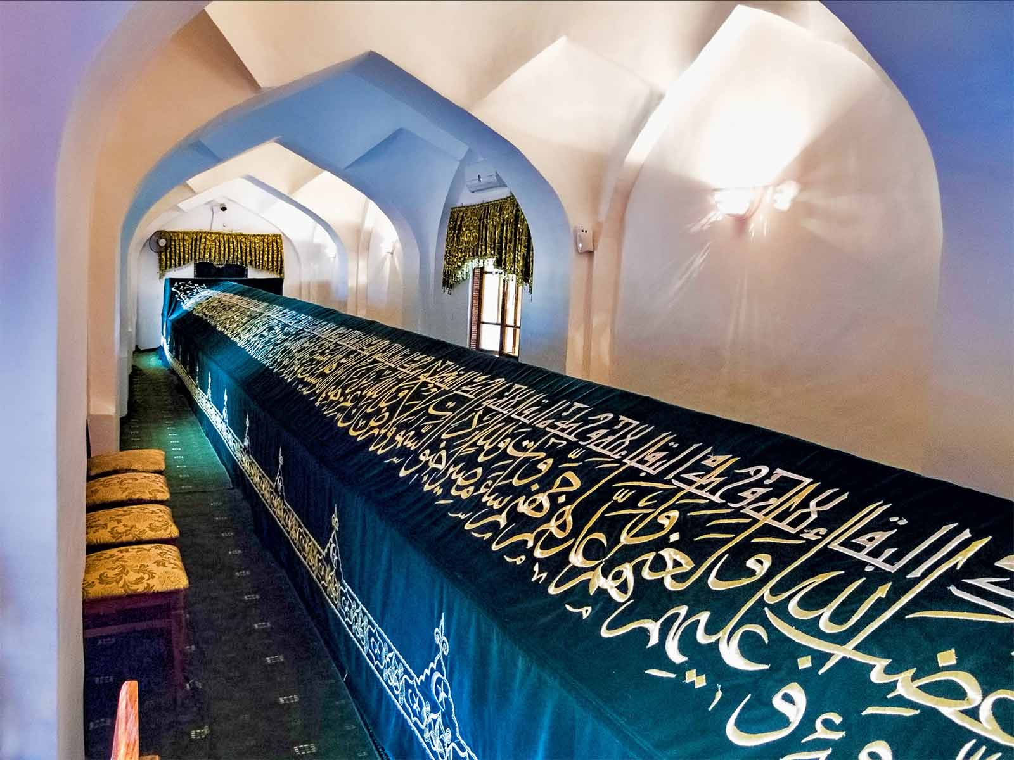
Mausoleum Khoja Daniyar
Dan Lundberg
ORIGIN

Slide 15
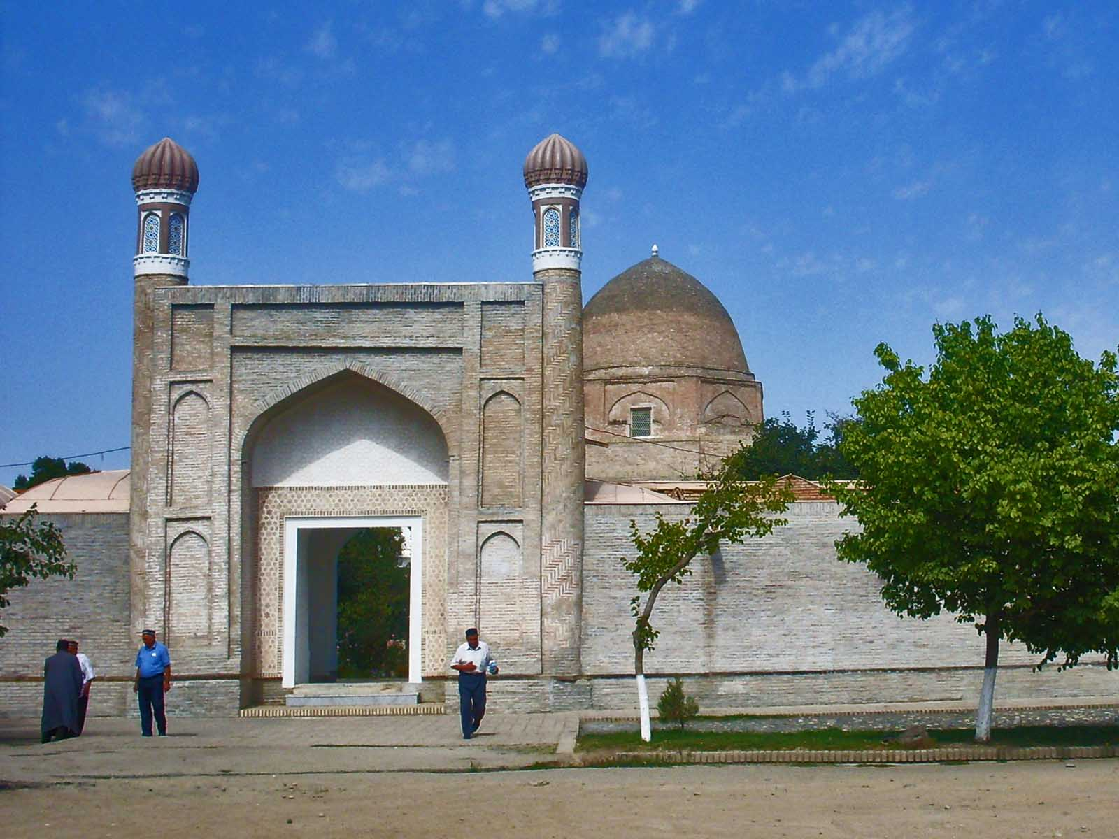
Mausoleum Ruhabad
Bobyrr
ORIGIN

Slide 16
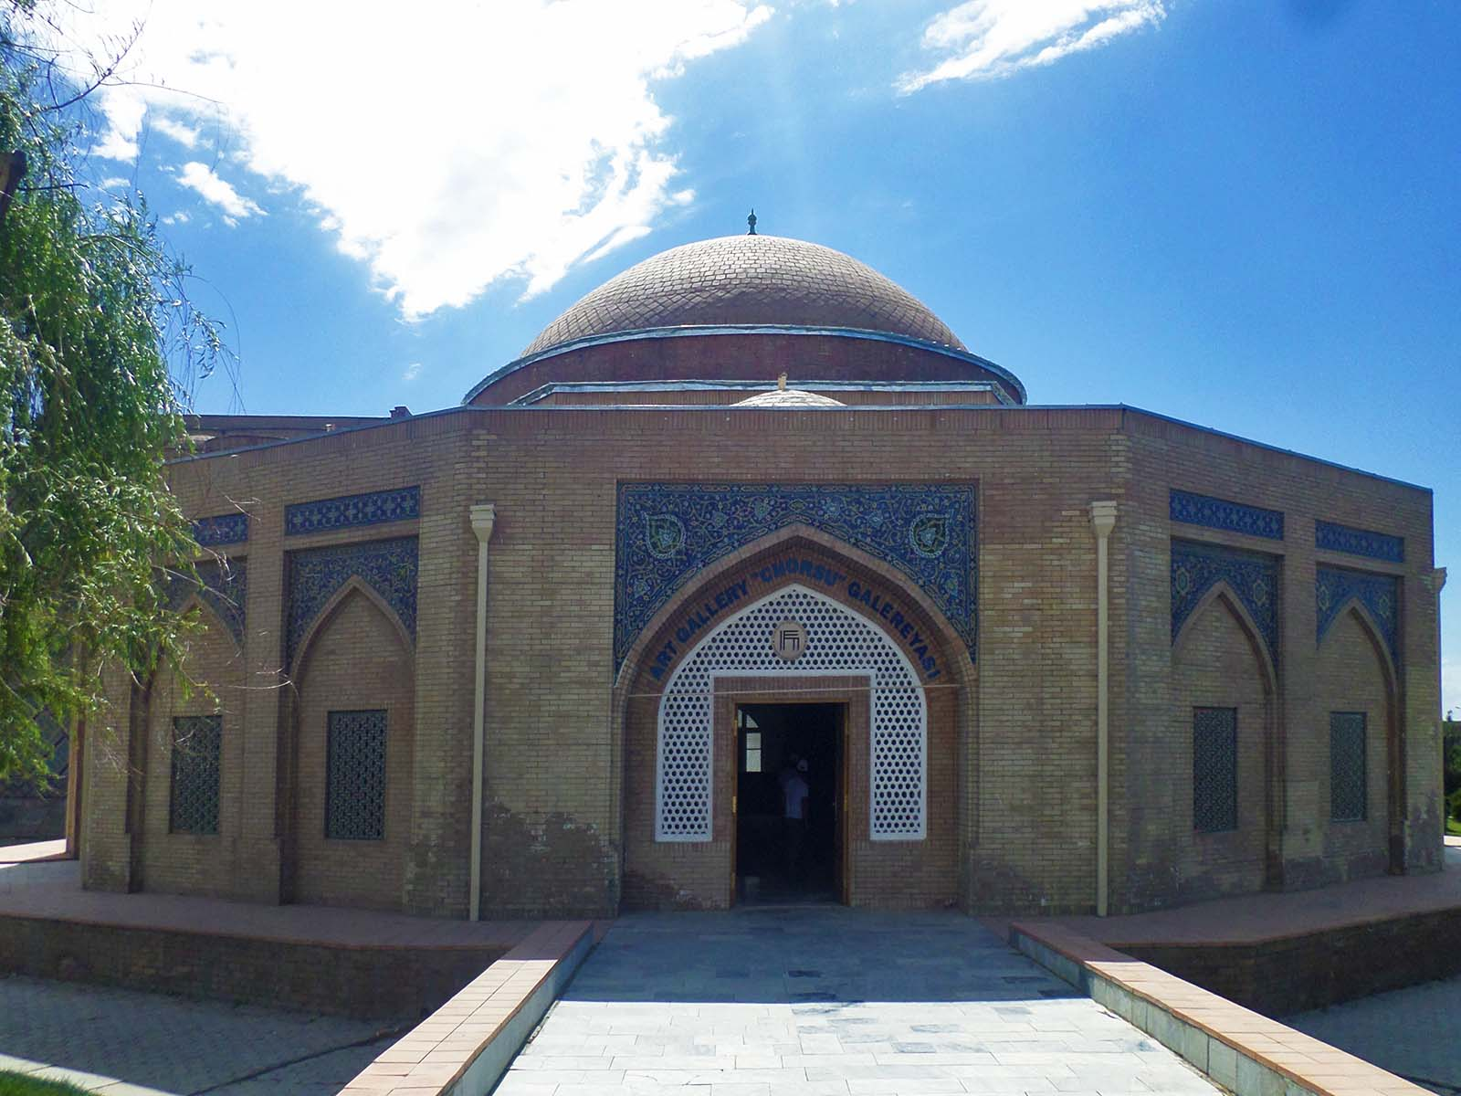
Chorsu
Bobyrr
ORIGIN

Slide 17
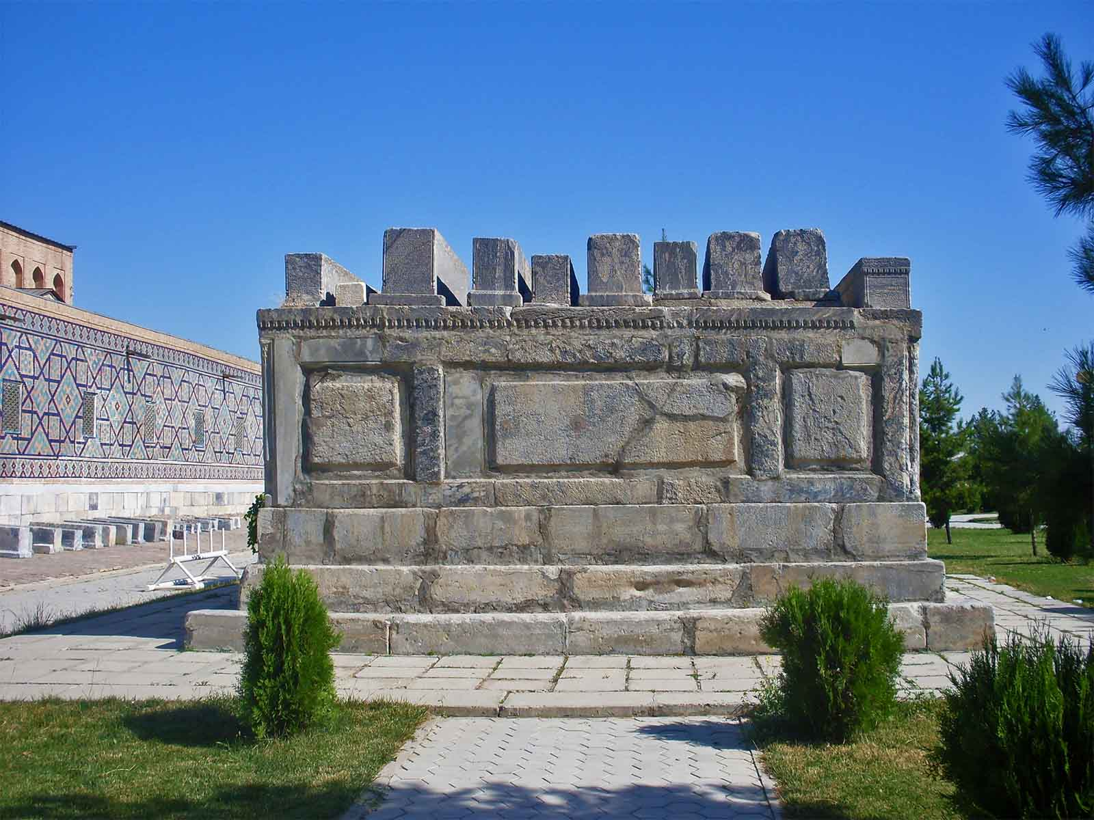
Mausoleum Sheibanids
Bobyrr
ORIGIN

Slide 18
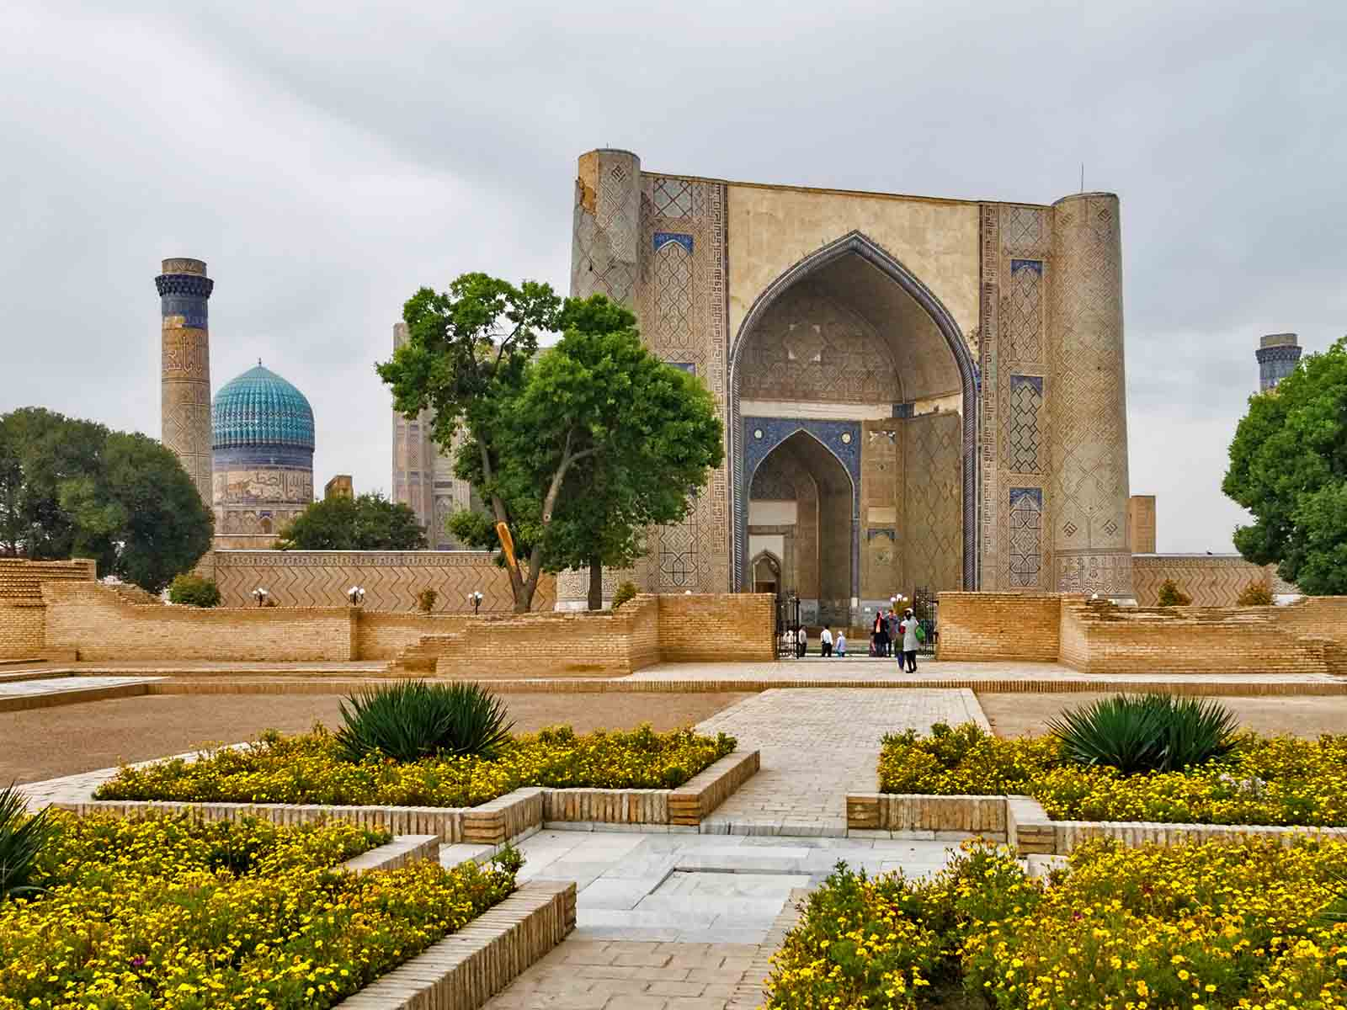
Mosque Bibi Khanum
Dan Lundberg
ORIGIN

Slide 19
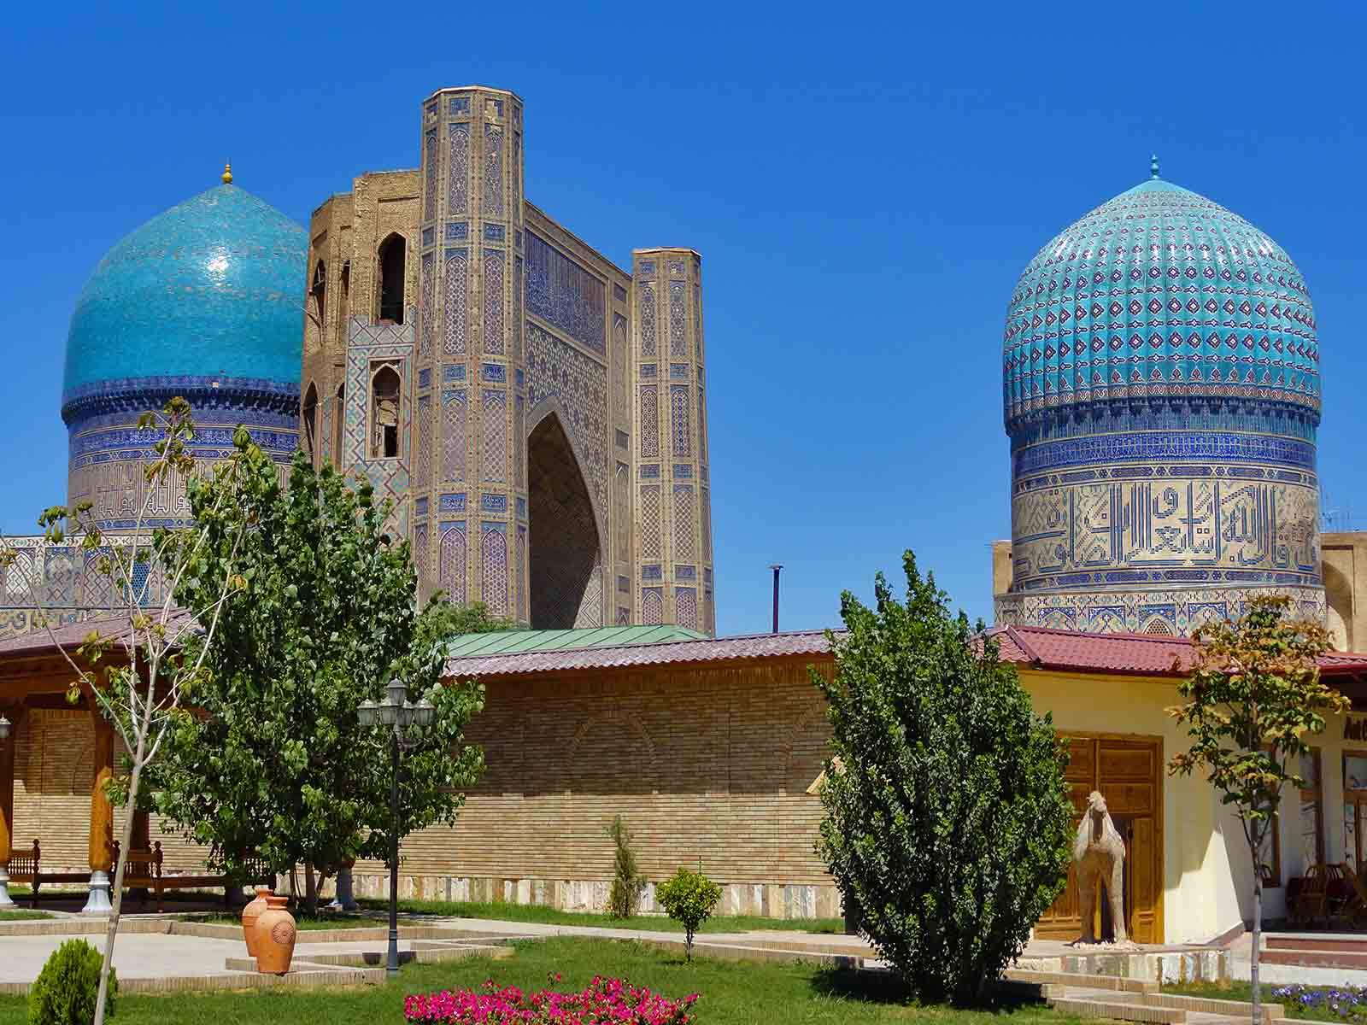
Mosque Bibi Khanum
Fabio Achilli
ORIGIN

Slide 20
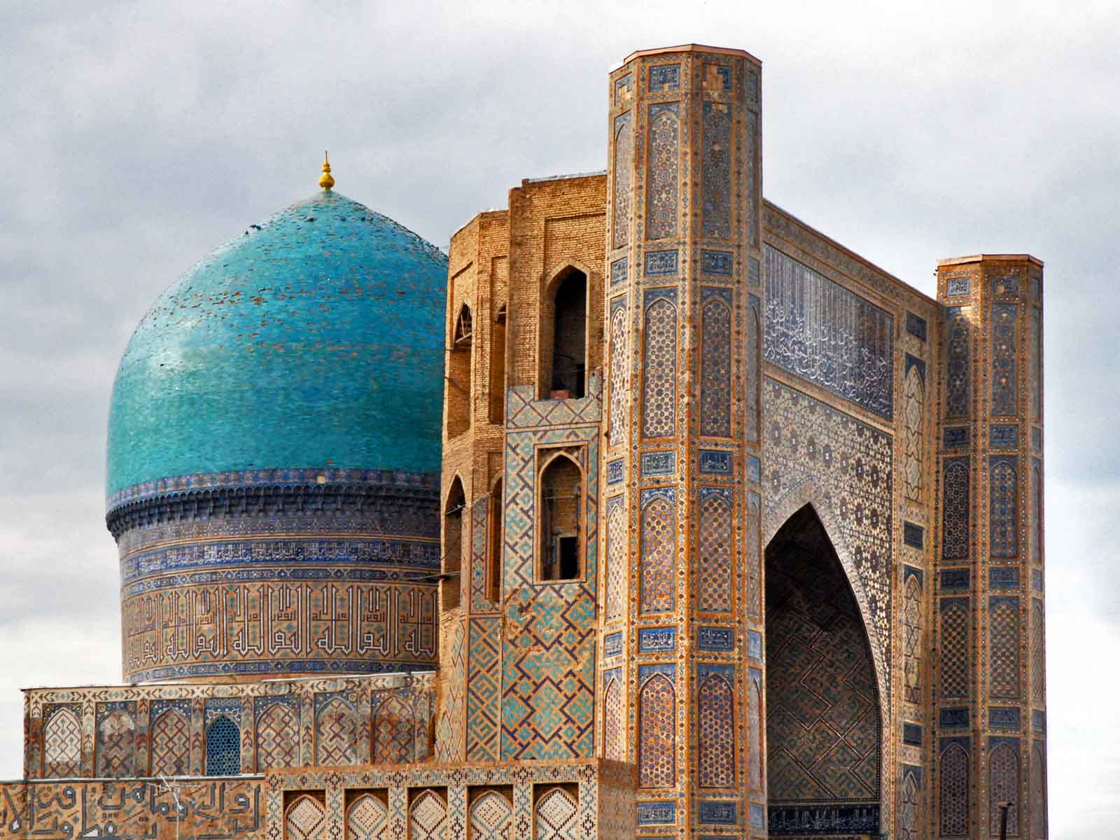
Mosque Bibi Khanum
Jean-Piérre Dalbéra
ORIGIN

Slide 21
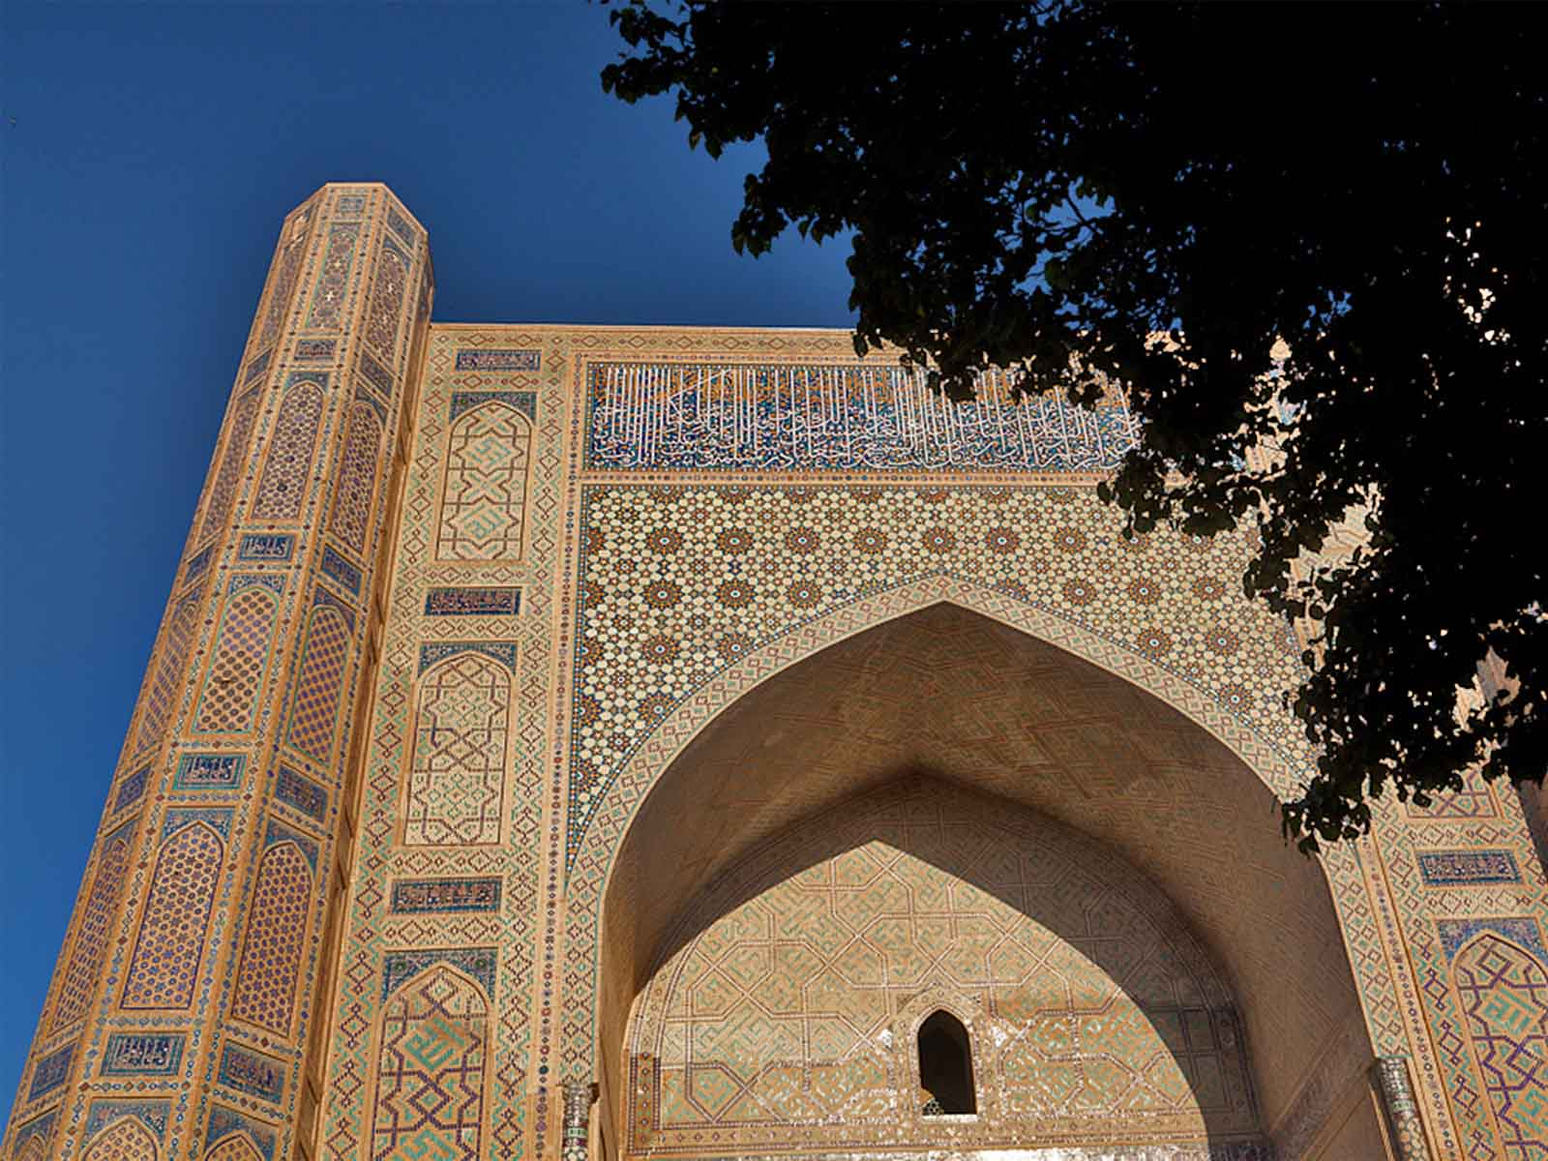
Mosque Bibi Khanum
Mike Moss
ORIGIN

Slide 22
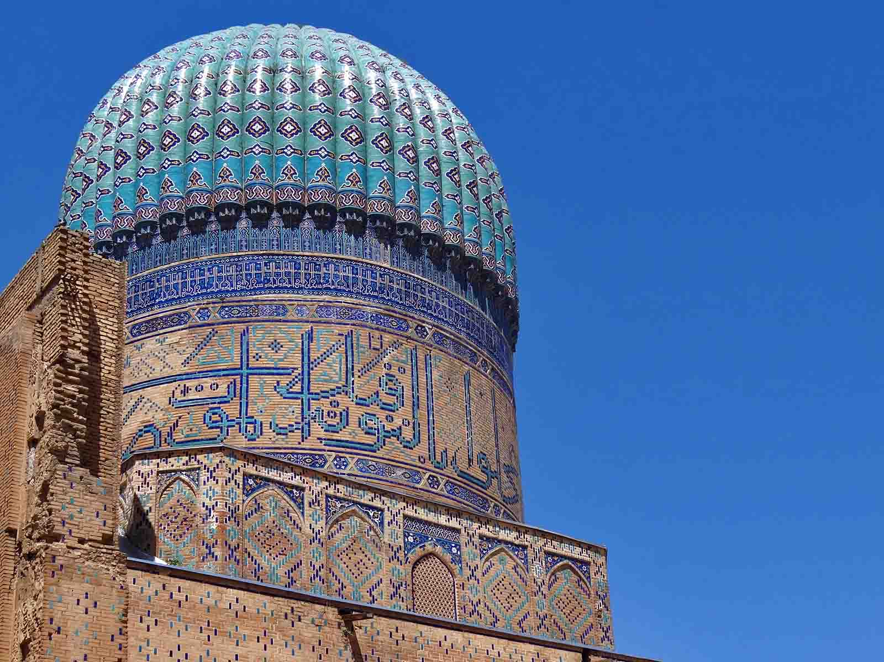
Mosque Bibi Khanum
Adam Jones
ORIGIN

Slide 23
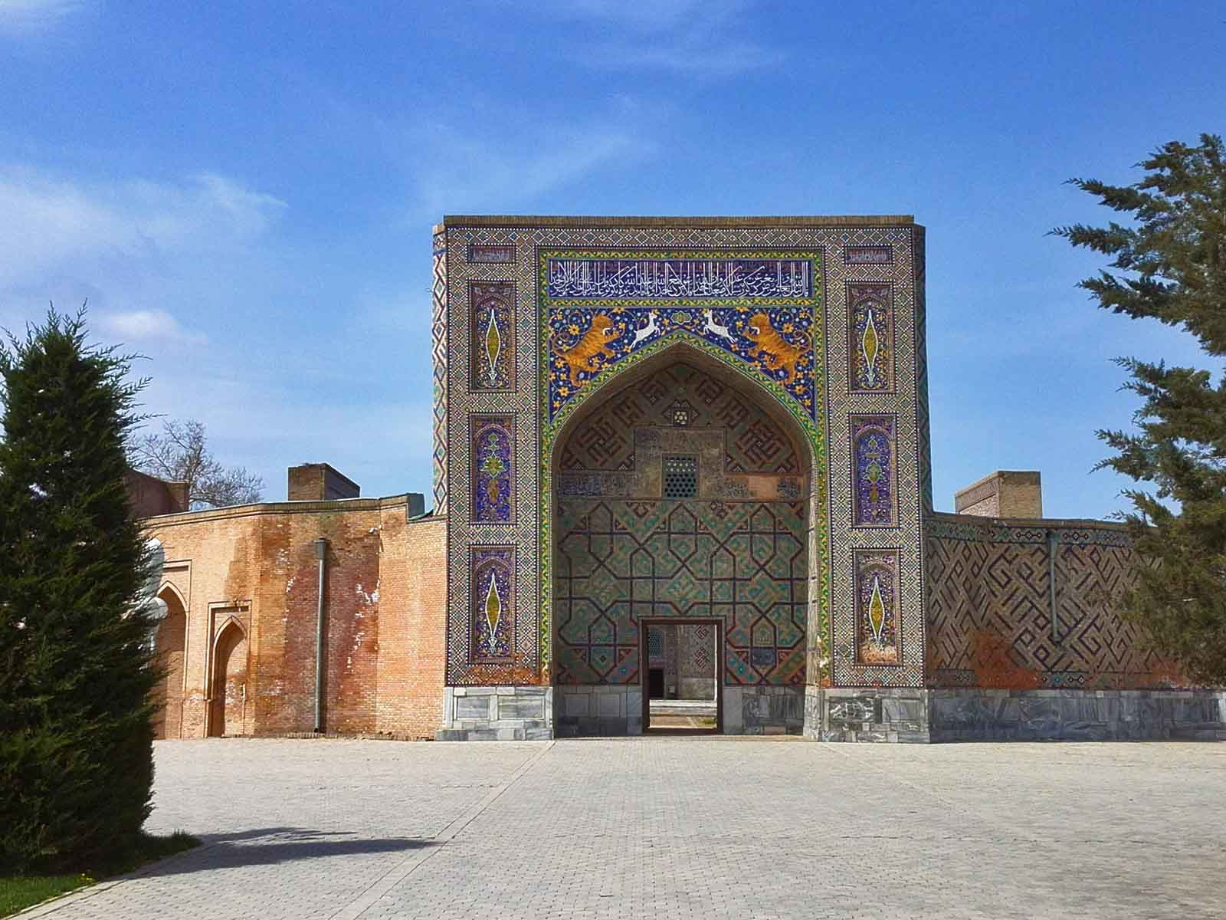
Mosque Khoja Ahrar
Bobyrr
ORIGIN

Slide 24
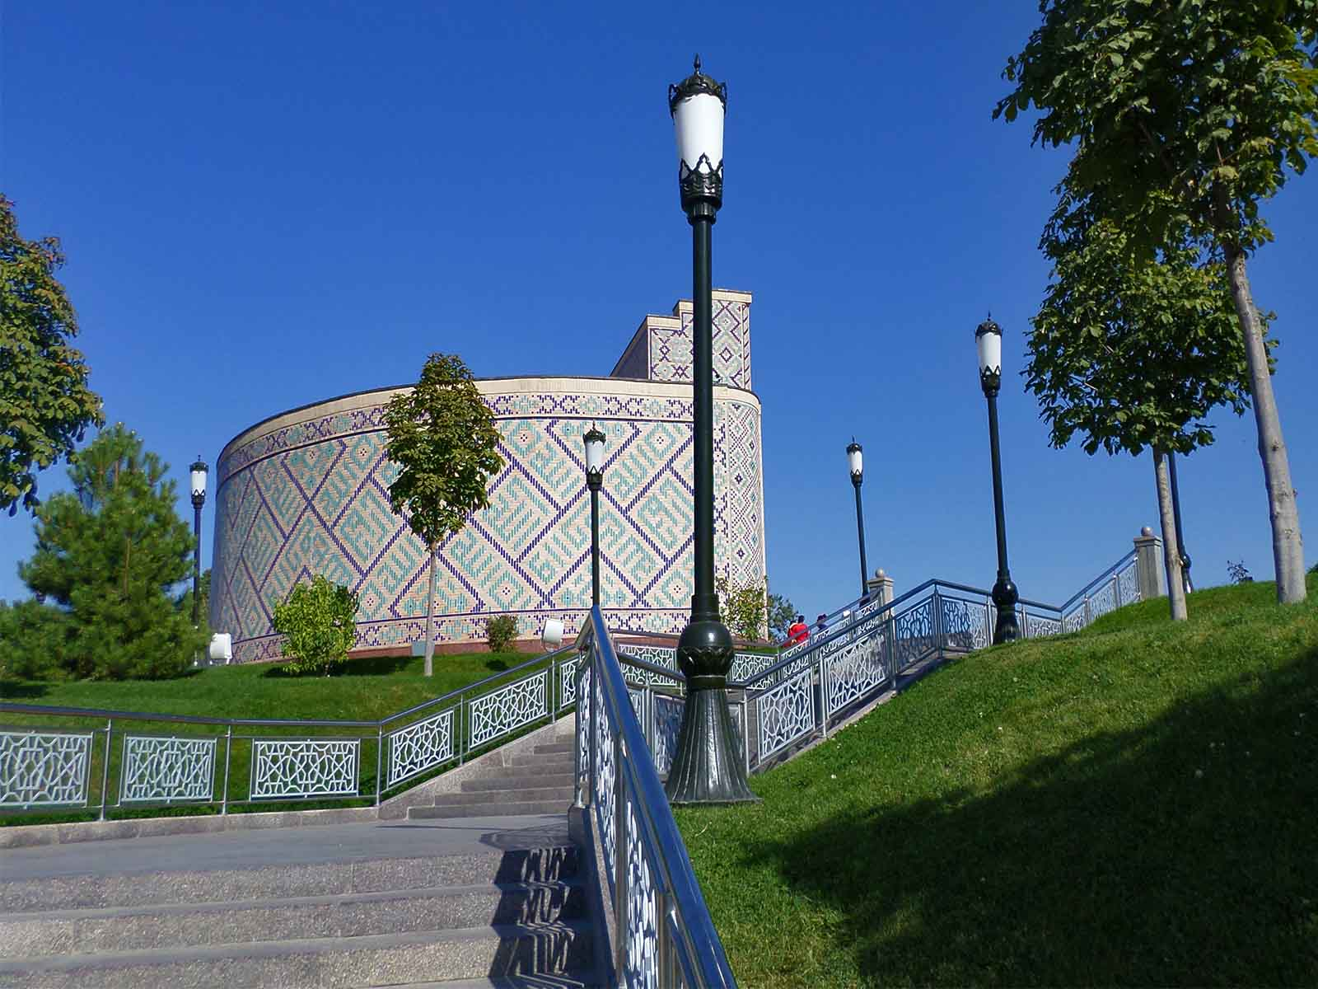
Observatie Ulugbek Museum
Bobyrr
ORIGIN

Slide 25
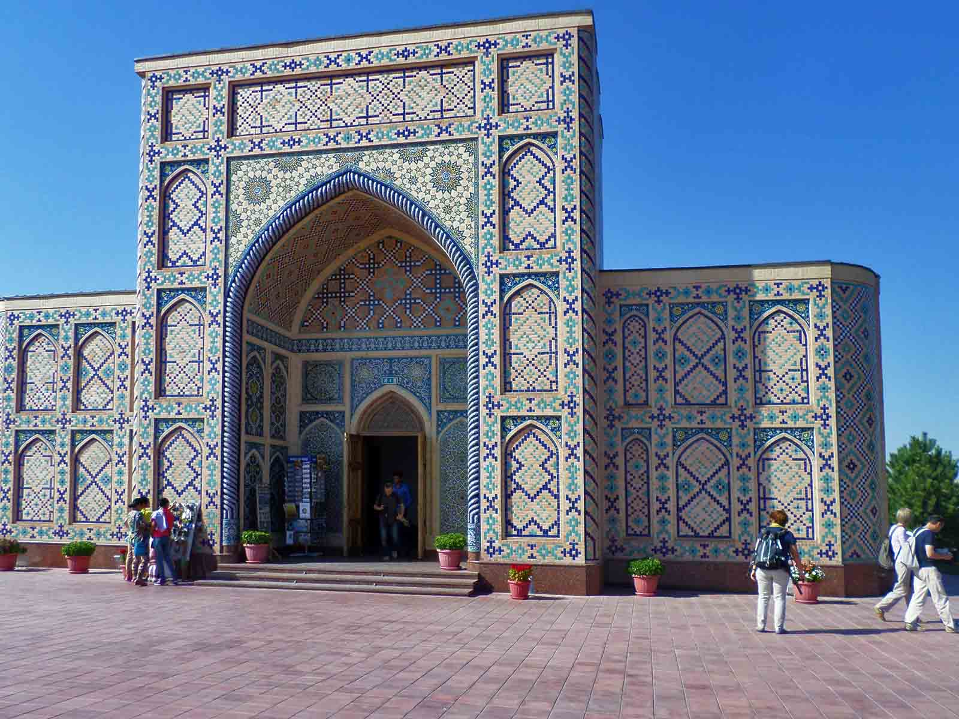
Observatie Ulugbek Museum
Bobyrr
ORIGIN

Slide 26
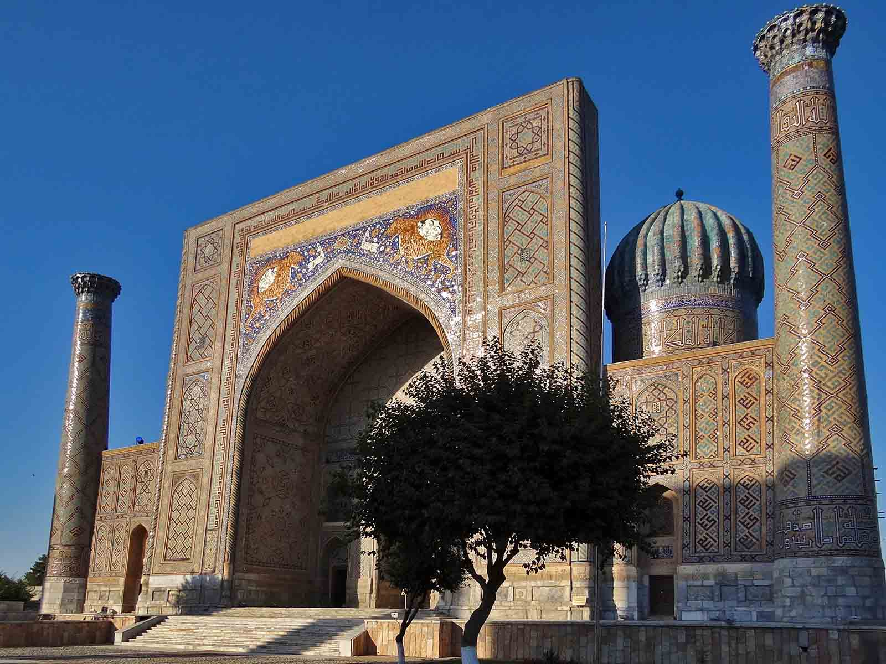
Sher Dor Mosque
Adam Jones
ORIGIN

Slide 27
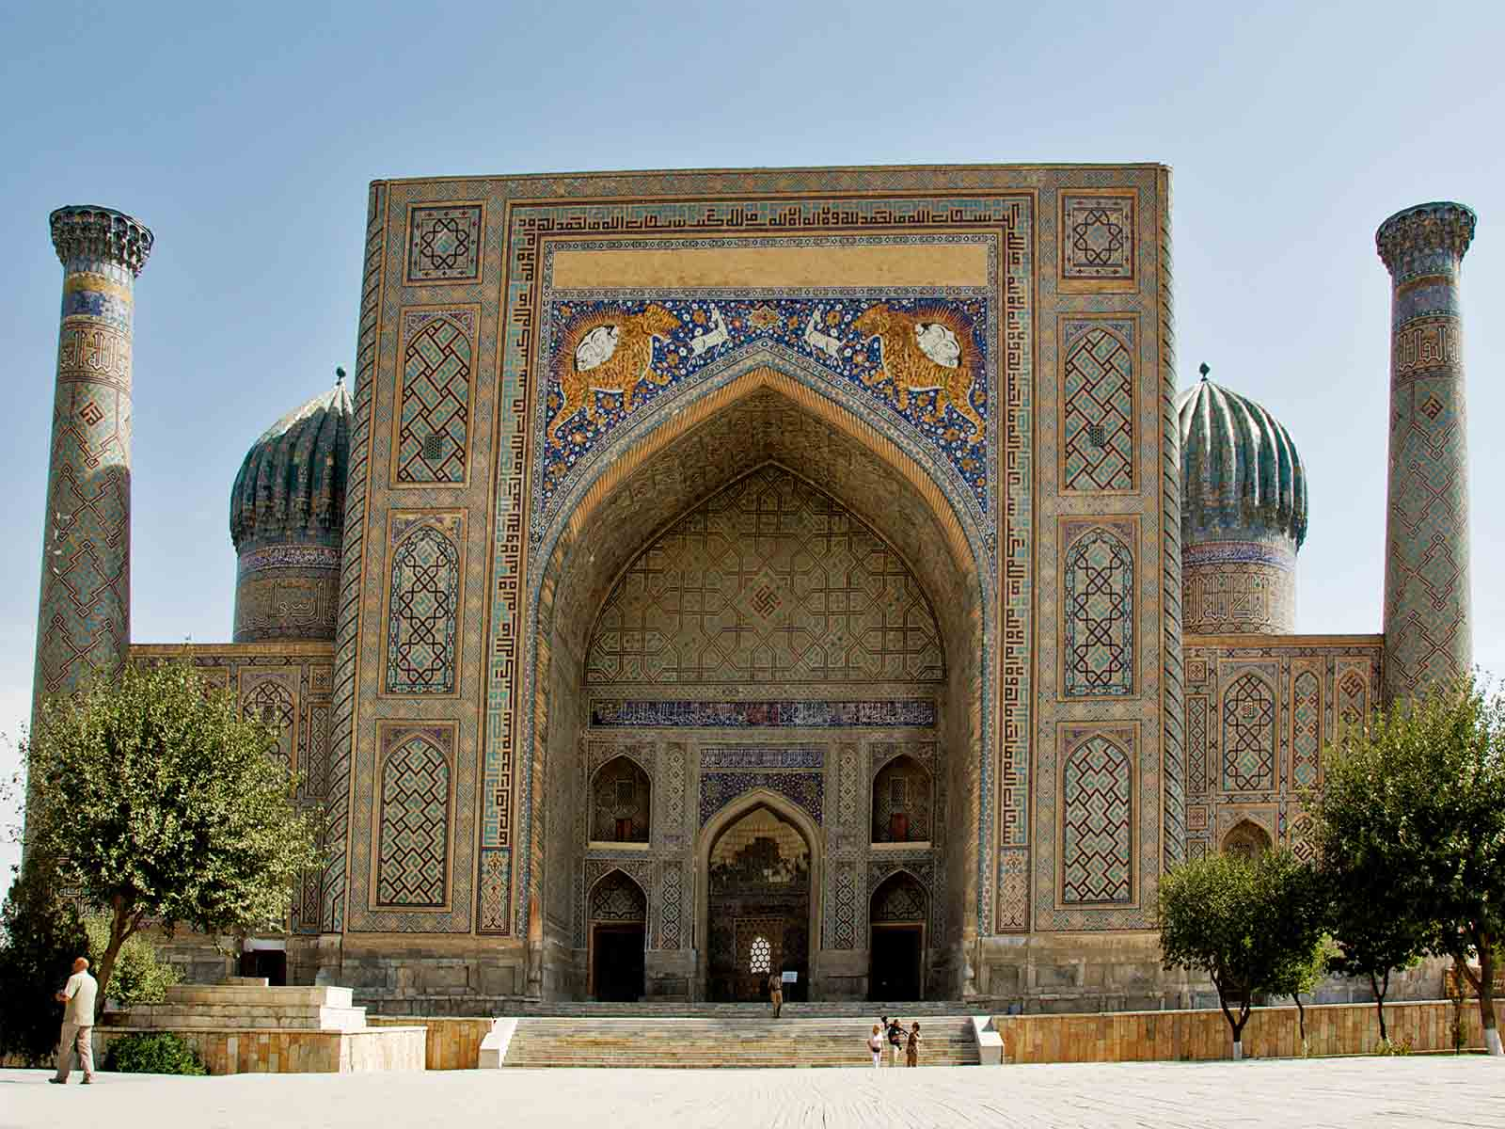
Sher Dor Mosque
Dave Proffer
ORIGIN

Slide 28
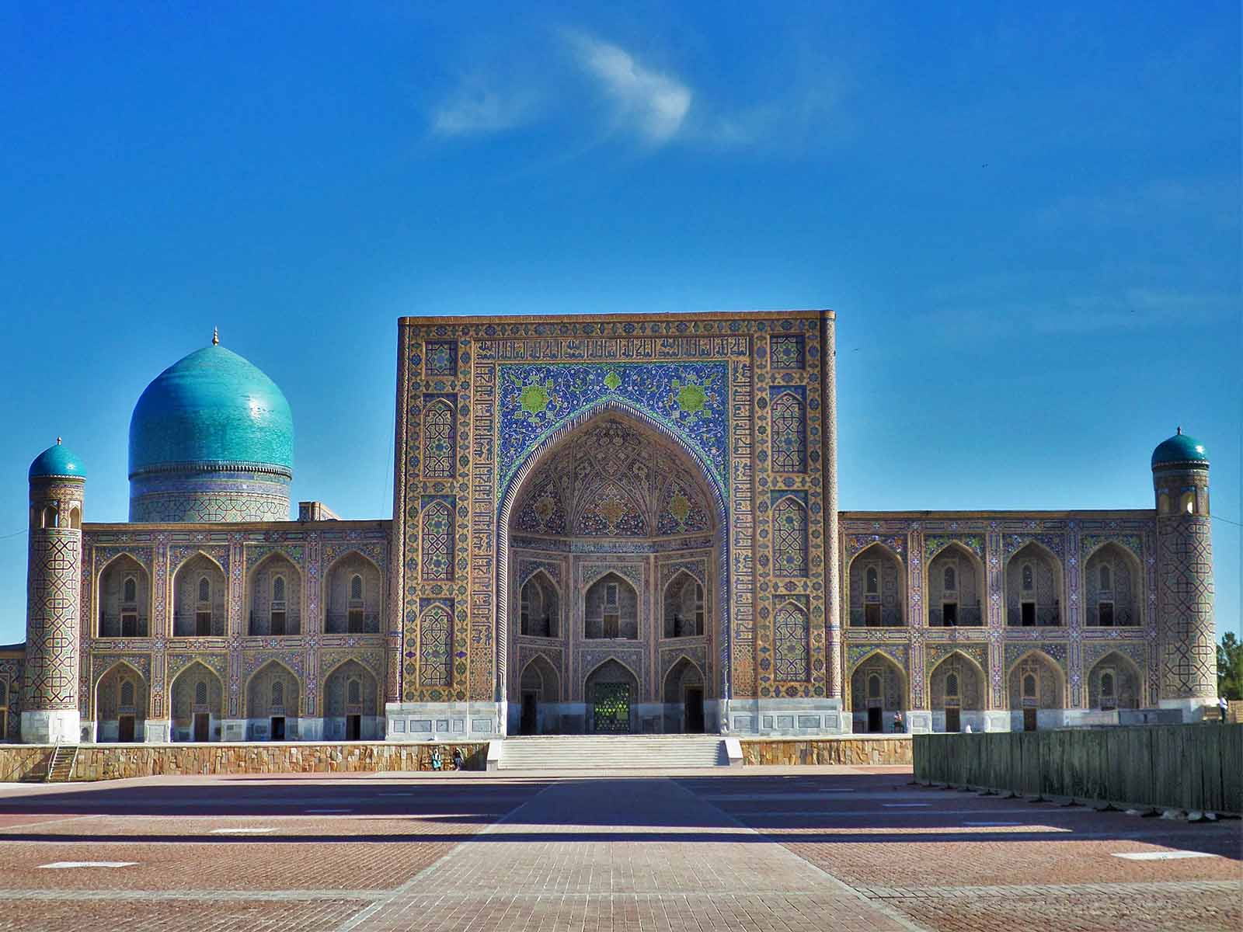
Tilla Kari Mosque
Bobyrr
ORIGIN

Slide 29
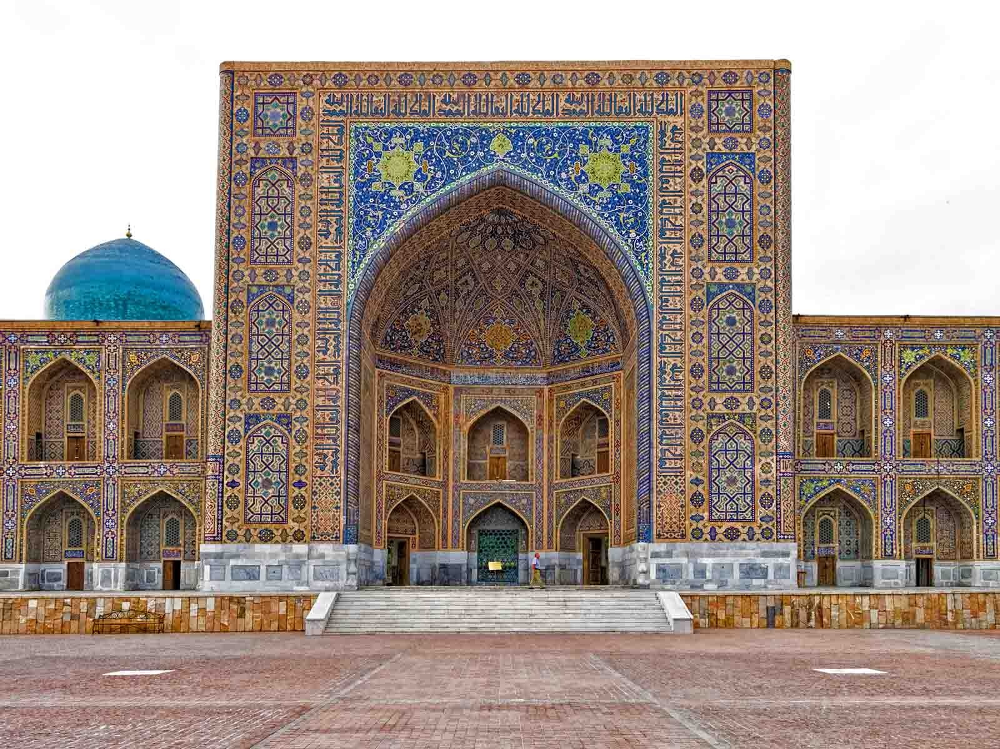
Tilla Kari Mosque
Dan Lundberg
ORIGIN

Slide 30
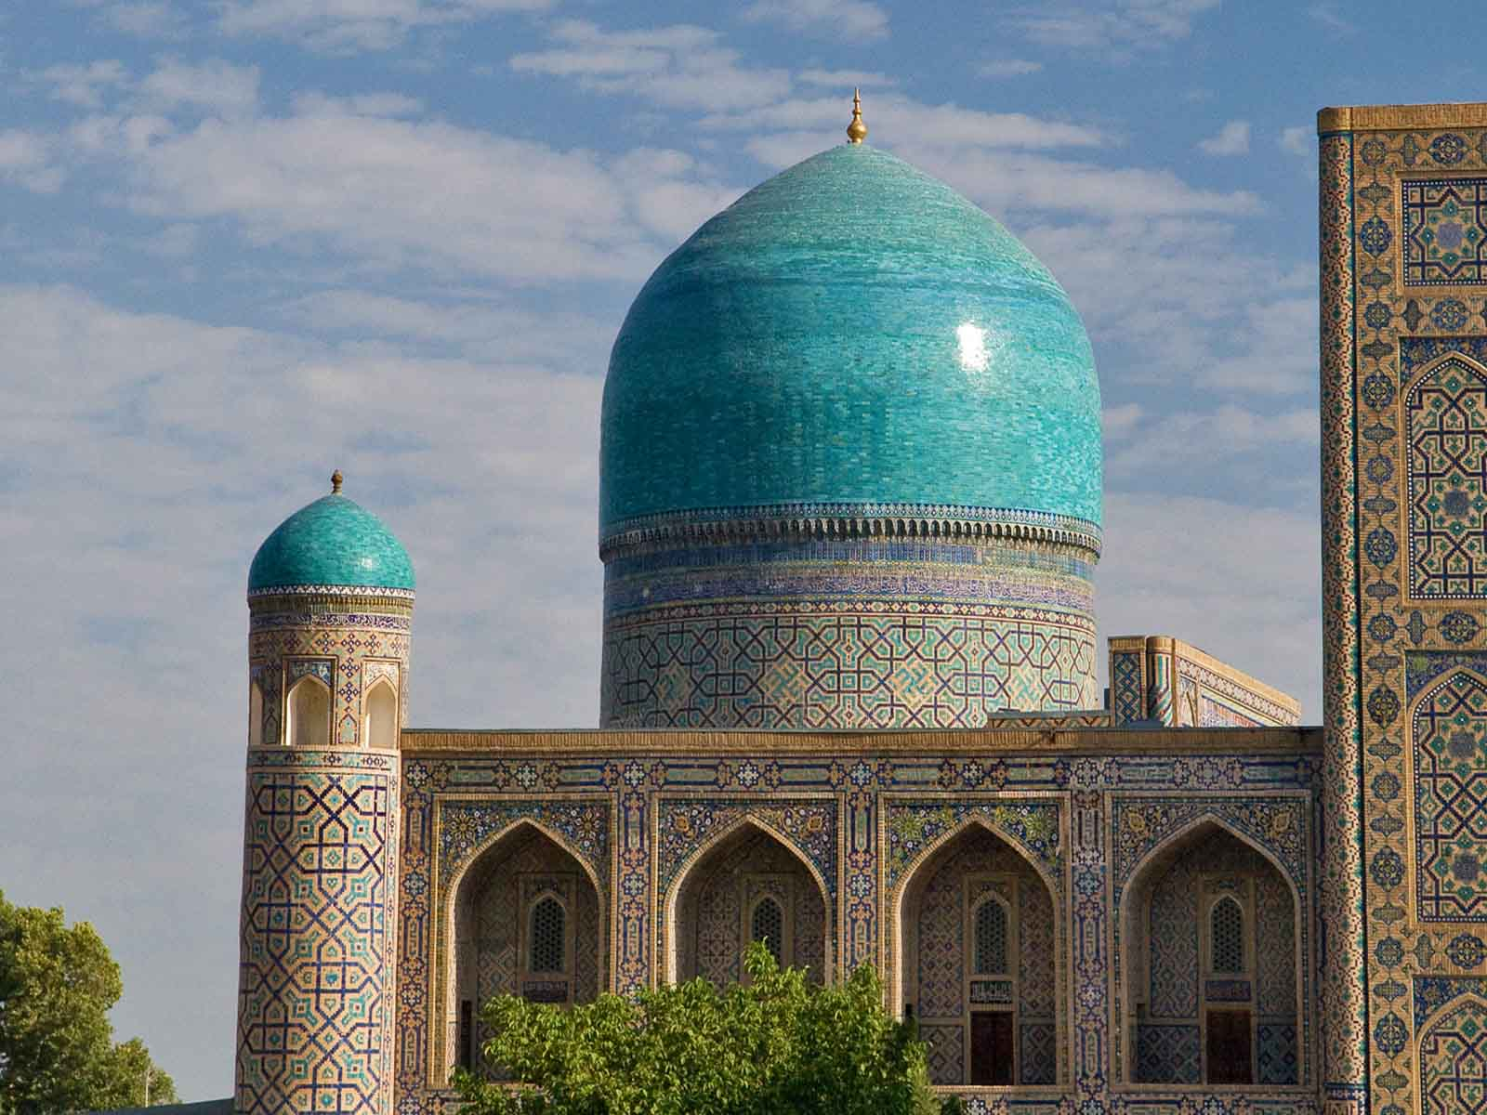
Tilla Kari Mosque
Gustavo Jeronimo
ORIGIN

Slide 31
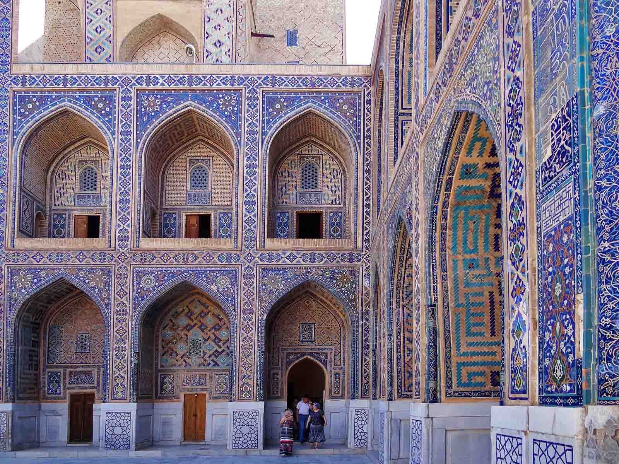
Tilla Kari Mosque
Adam Jones
ORIGIN

Slide 32
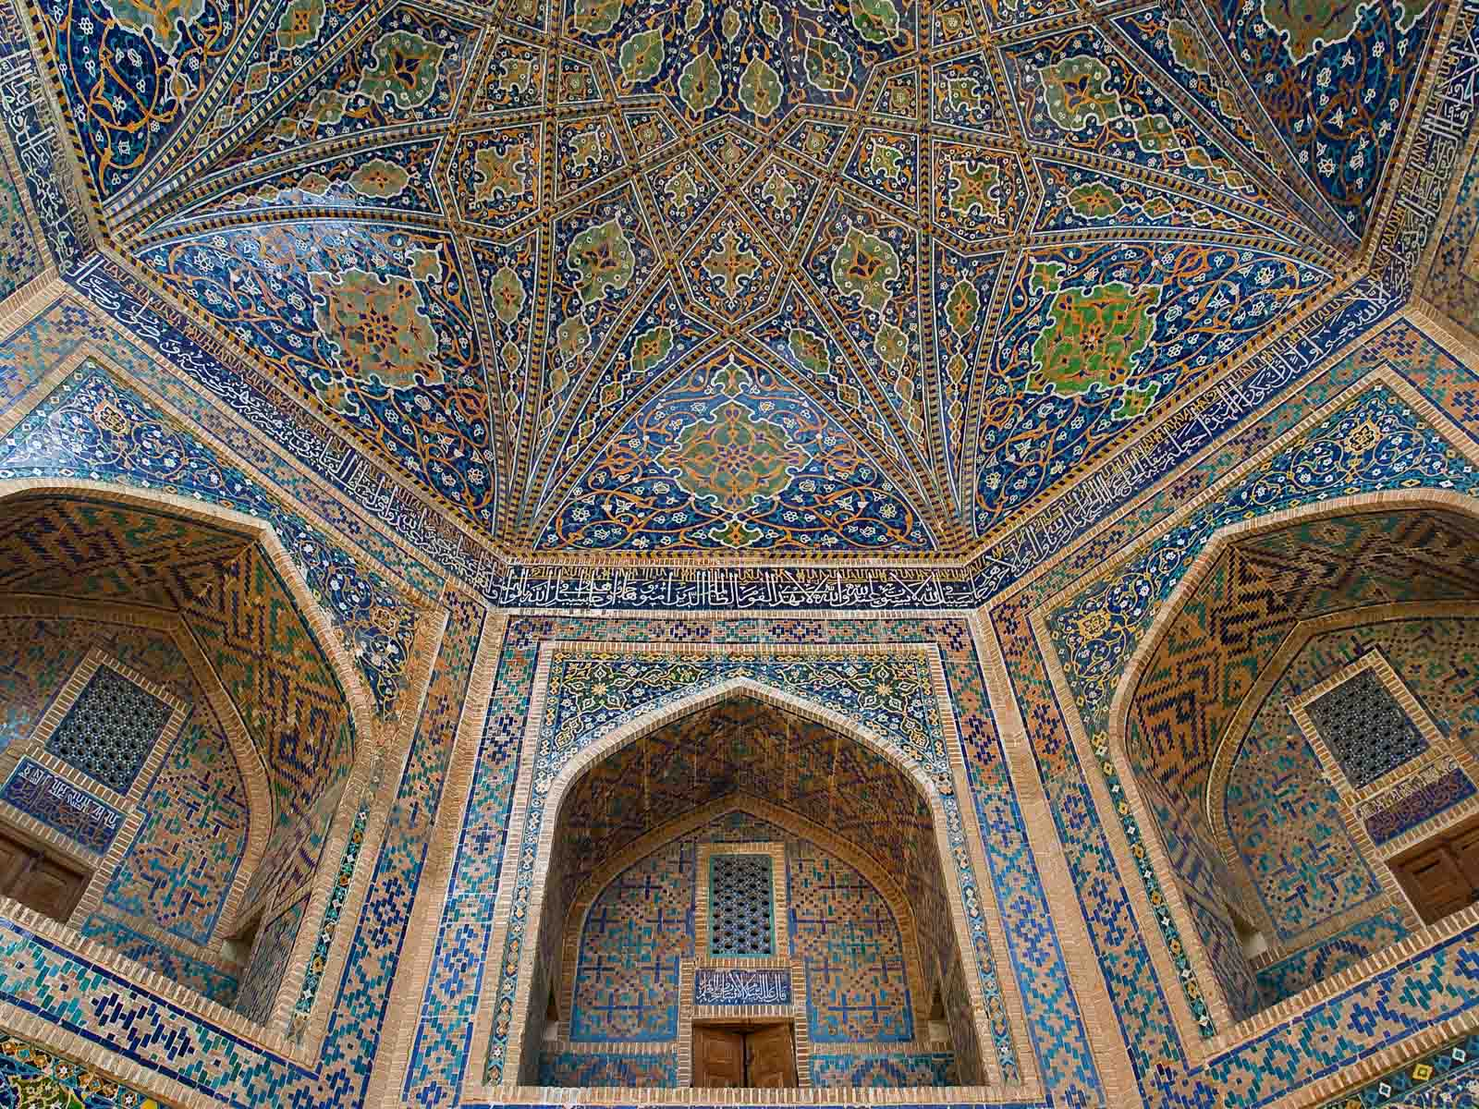
Tilla Kari Mosque
Gustavo Jeronimo
ORIGIN

Slide 33
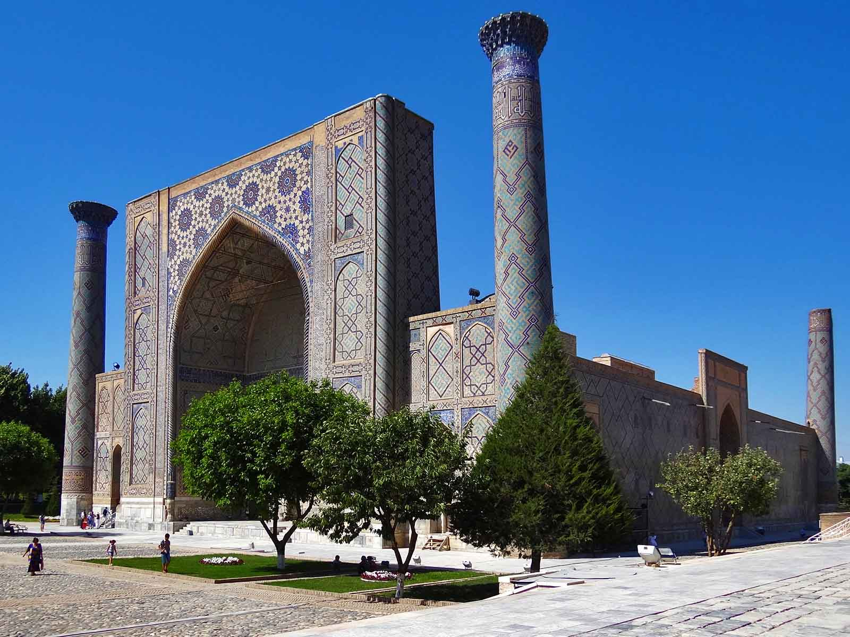
Ulugh Beg Mosque
Adam Jones
ORIGIN

Slide 34
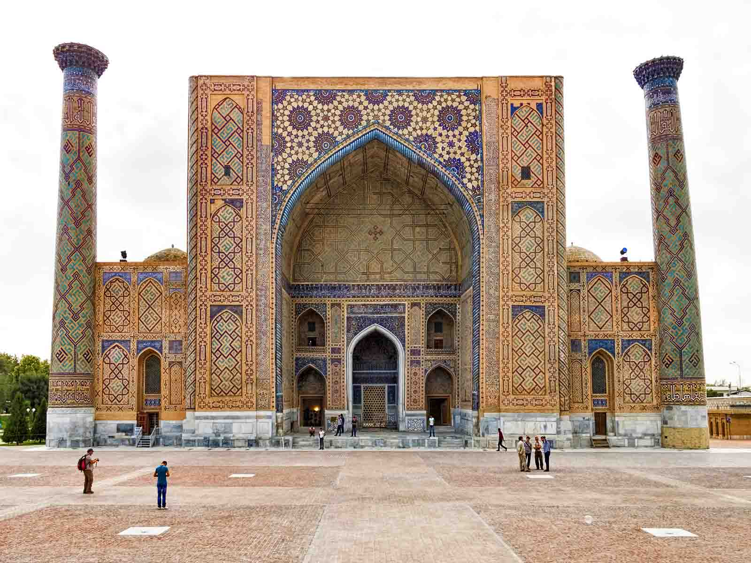
Ulugh Beg Mosque
Dan Lundberg
ORIGIN

Slide 35
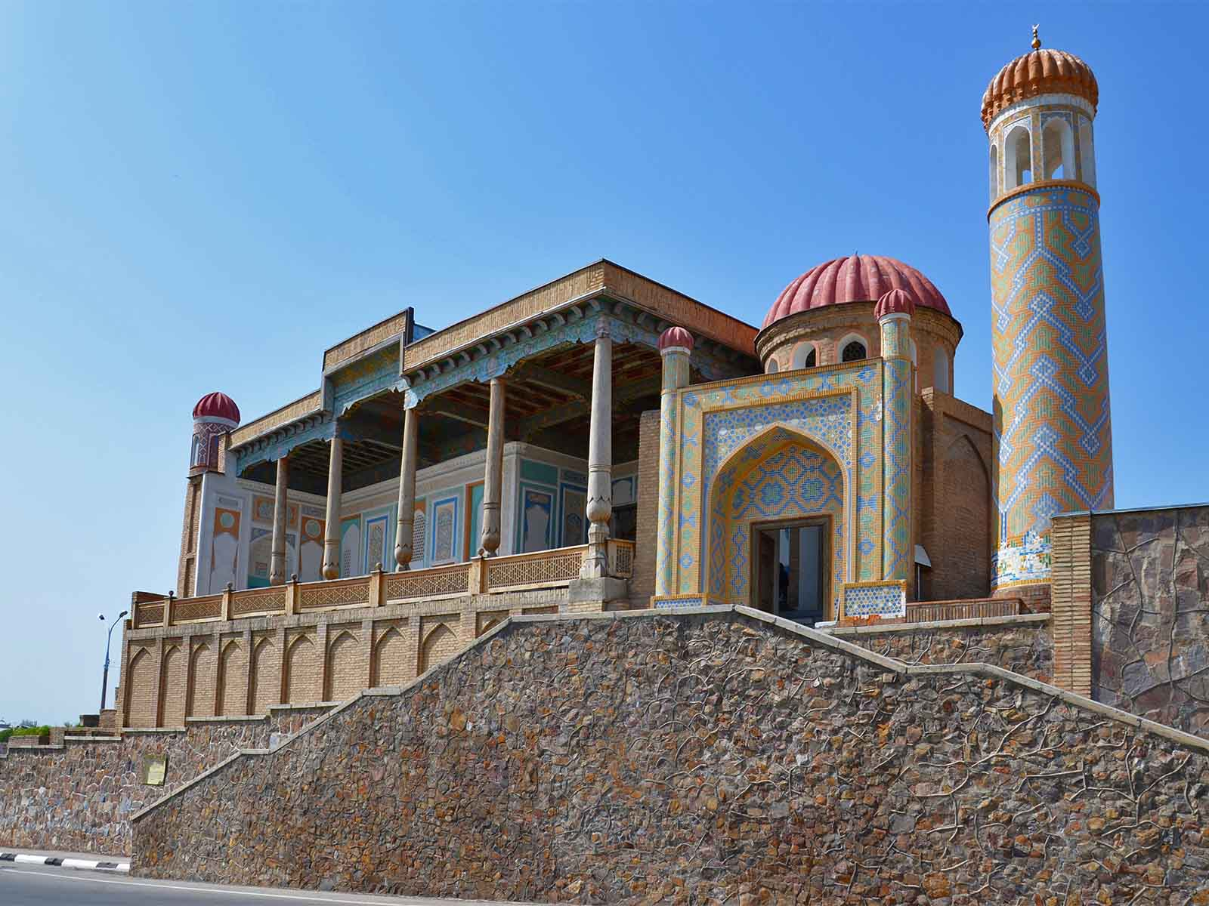
Mosque Hazrat Hyzr
Bobyrr
ORIGIN

Slide 36
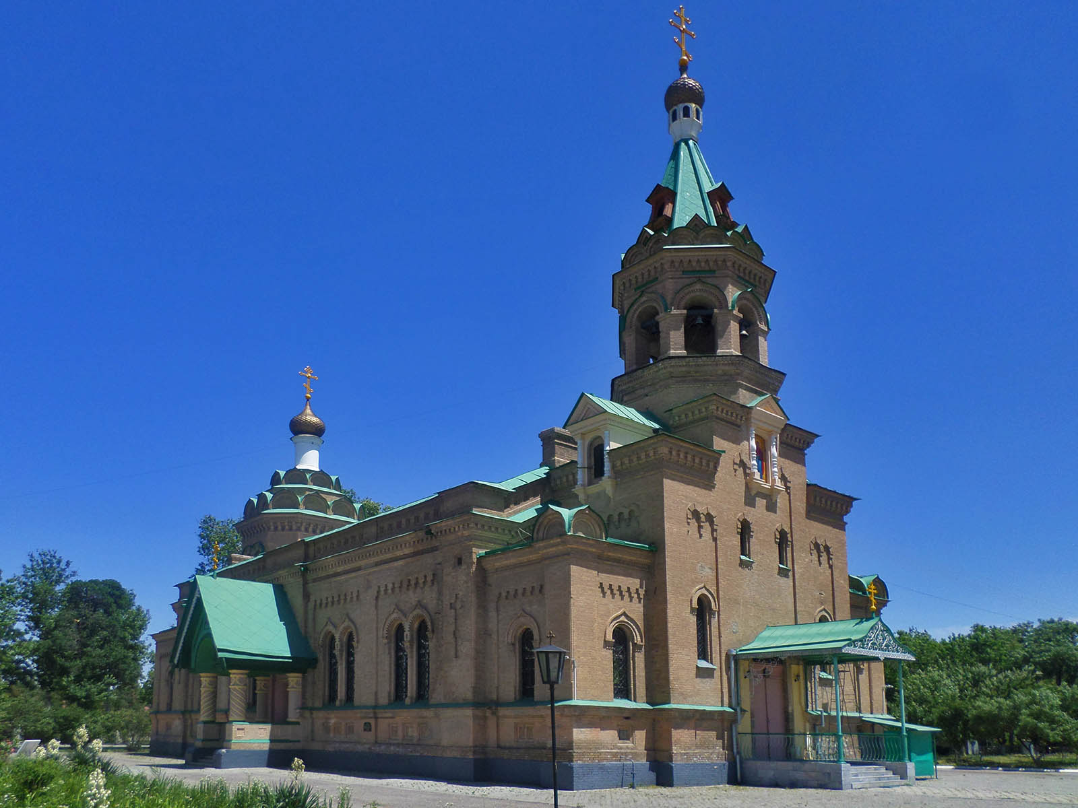
Orthodox Church
Bobyrr
ORIGIN

Slide 37
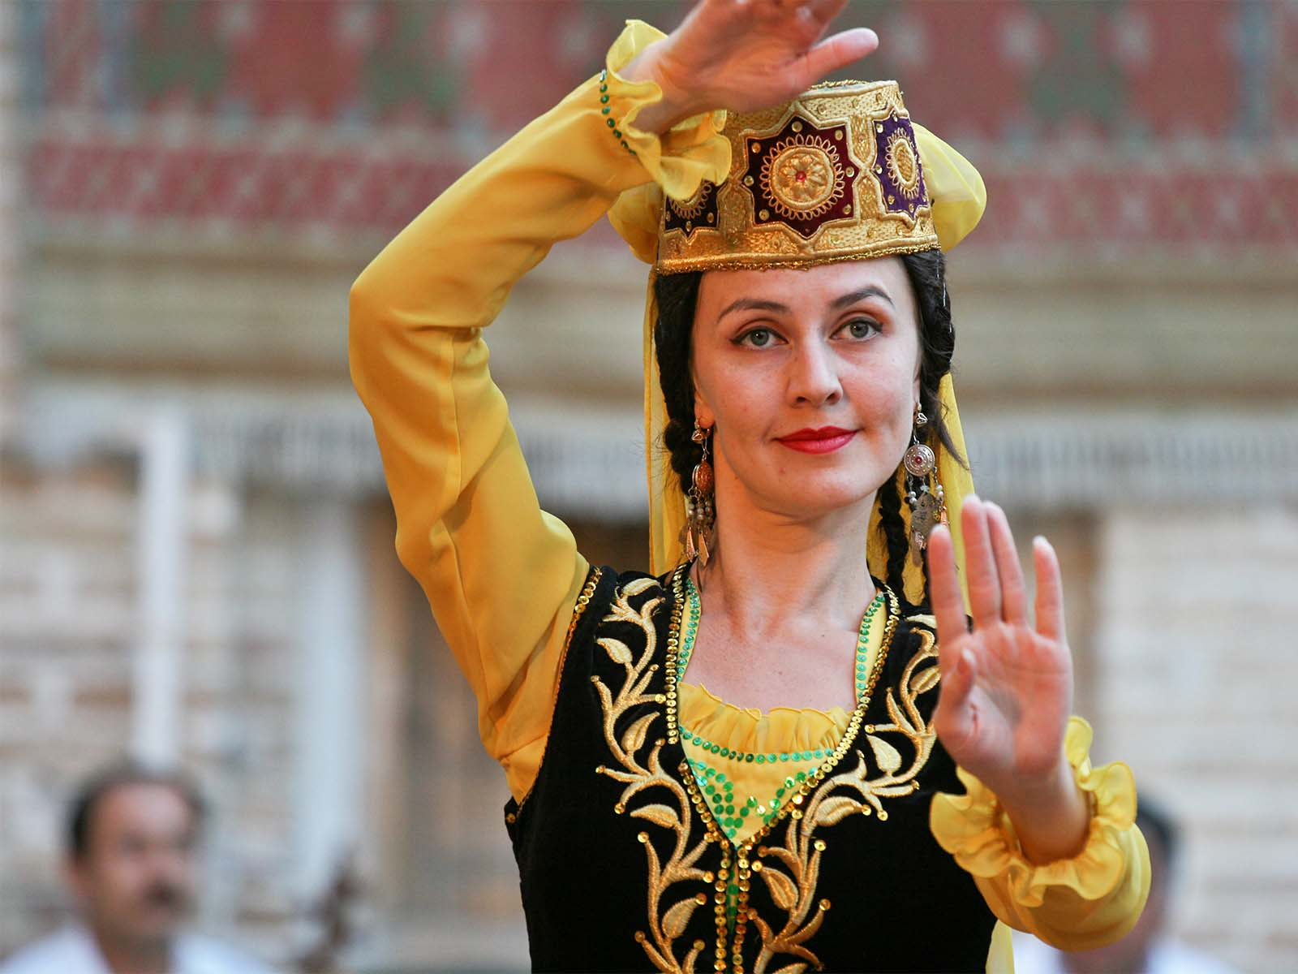
People
Giorgio Montersino
ORIGIN

Slide 38
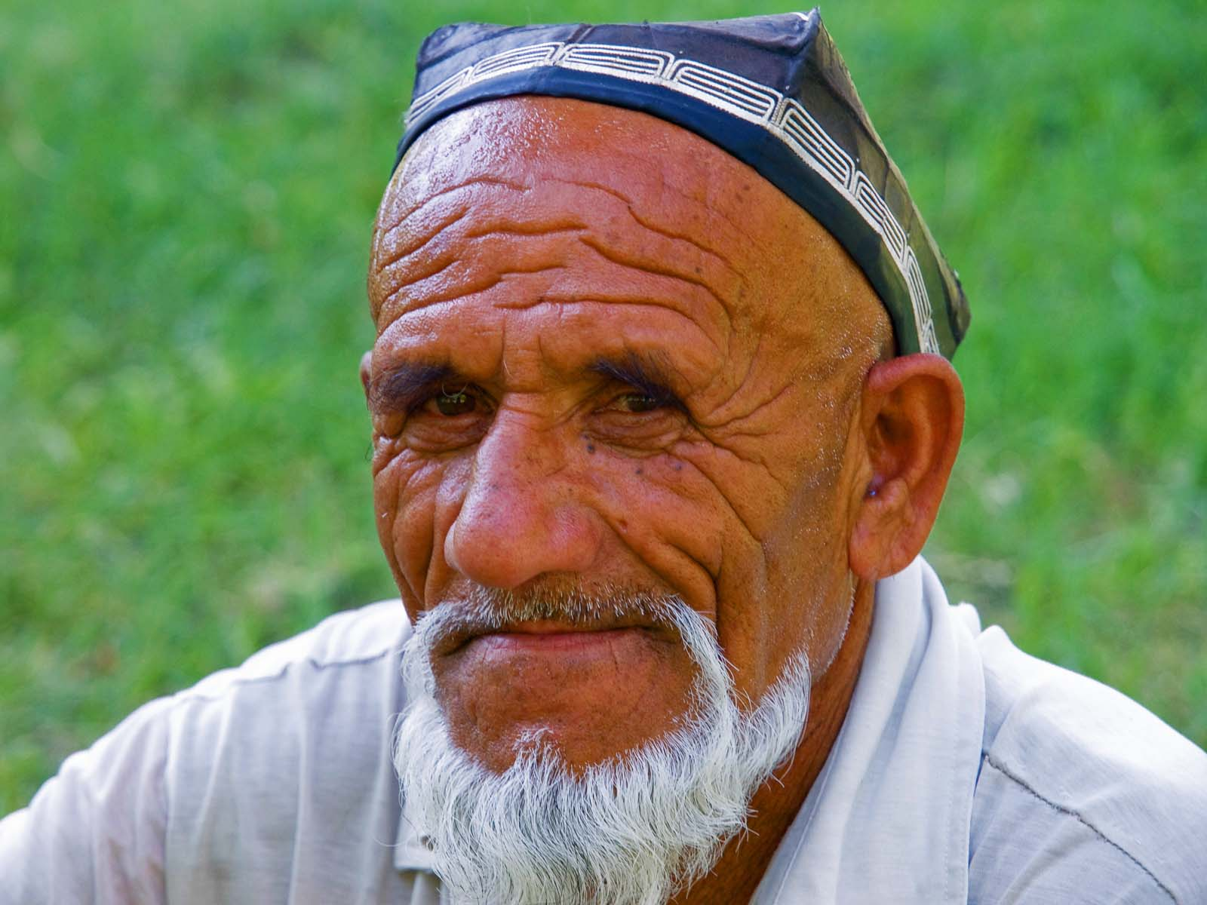
People
Gustavo Jeronimo
ORIGIN

Slide 39
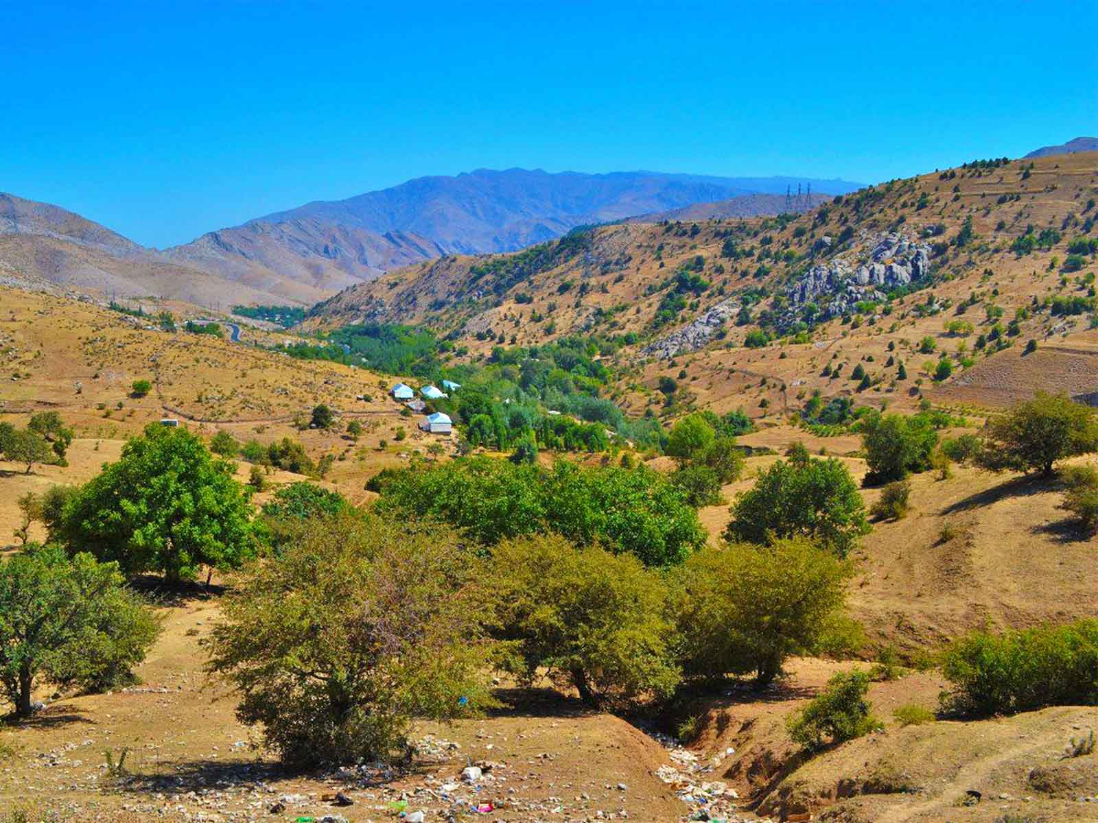
Miranqul Mountains
Farsizabon
ORIGIN

Slide 40
HASTA LA PRÓXIMA
SALVA LA TIERRA
CONTINUAR
F I N A L
No para propósitos comerciales! / Fotografías de Internet / Música : (artista desconocido)
tomi55jutt@mail.com

Slide 41







¿Te ha gustado?
Puedes ver más entrando
Aquí
Además puedes recibir powerpoints en tu correo electrónico suscribiéndote aquí:
F I N

