Slide 1
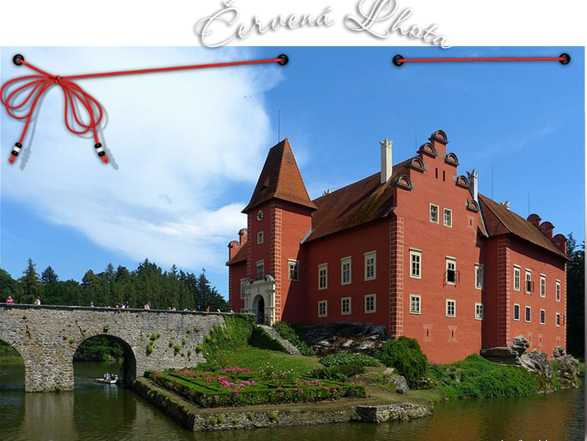

Slide 2
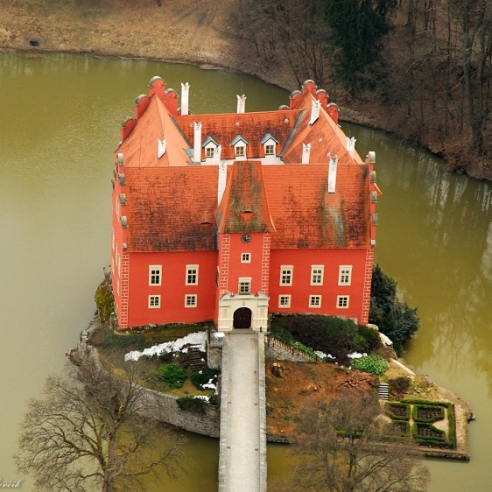

Červená Lhota
Castle

Slide 3
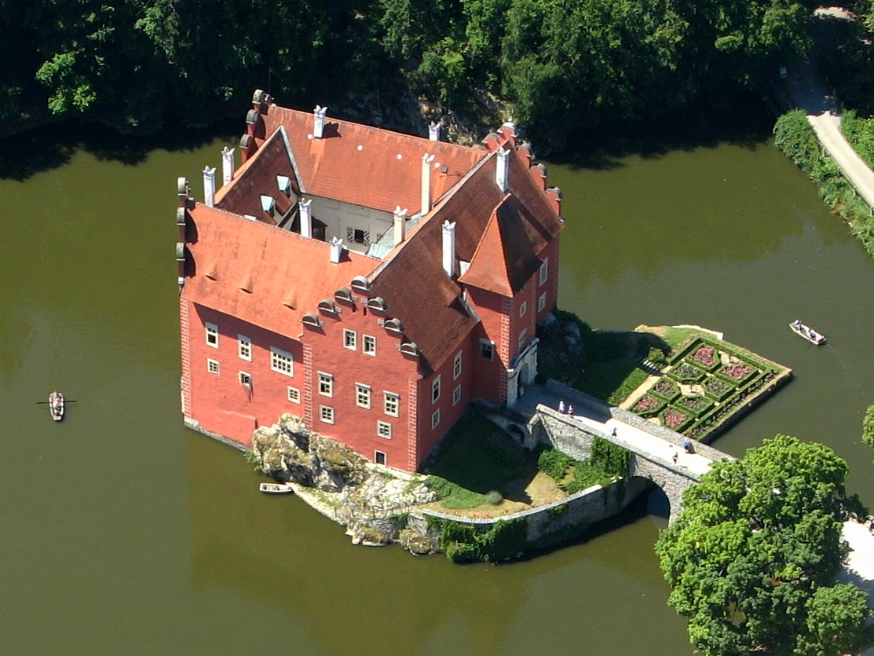

Slide 4
Červená Lhota is a château situated about 20 km north-west of Jindřichův Hradec in south Bohemia, Czech Republic. It stands at the middle of a lake on a rocky island.
Its picturesque Renaissance building is a destination of thousands of tourists every year. Its name Červená Lhota meaning „Red Lhota" can be explained by the colour of the château's bright-red roof tiles.
There is also a park, where the Chapel of The Holy Trinity (Nejsvětější Trojice) is located.

Slide 5
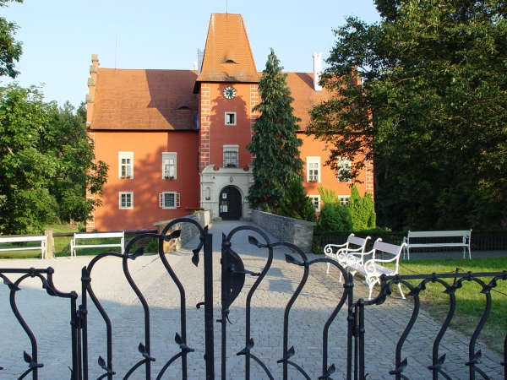

Slide 6
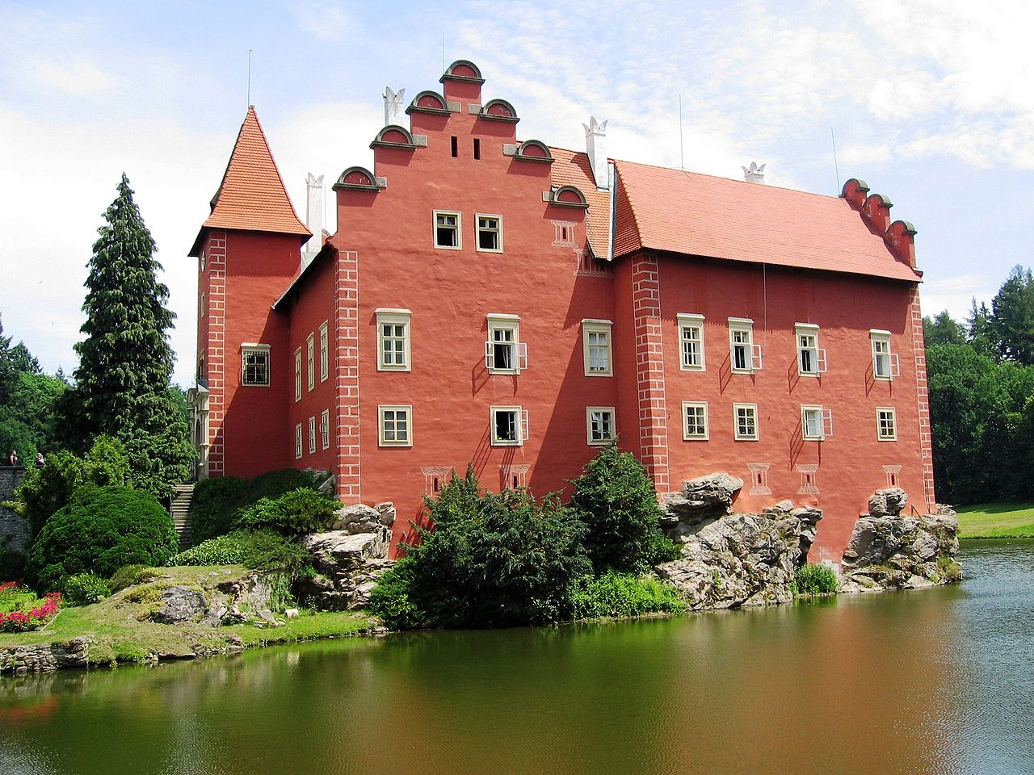

Slide 7
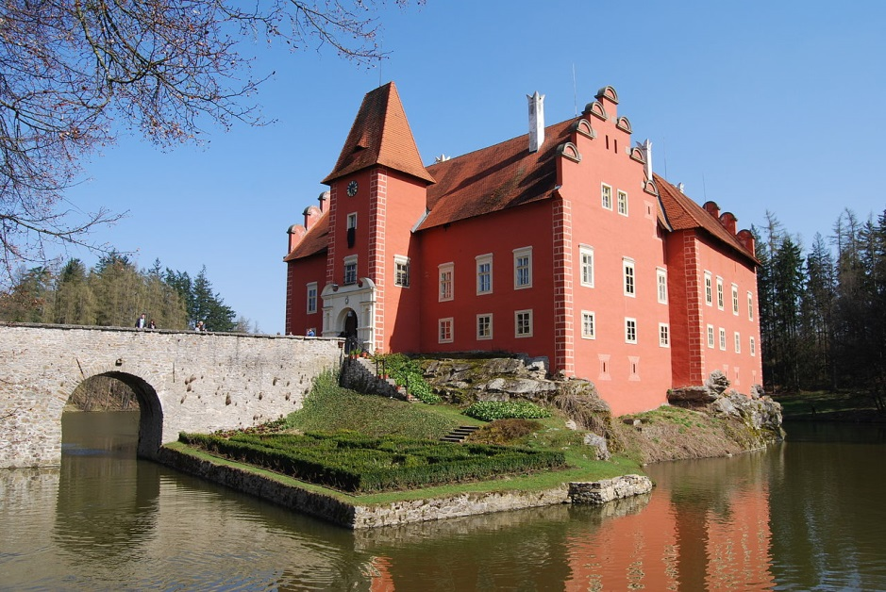

Slide 8
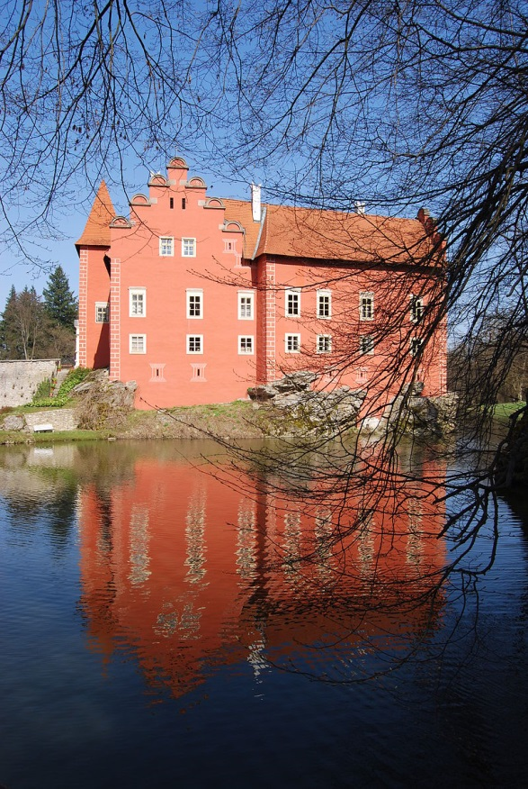

Slide 10
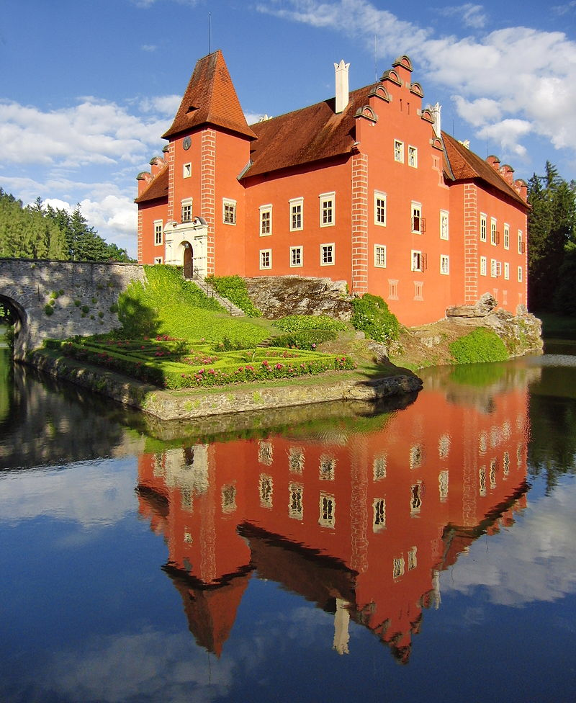

Slide 11
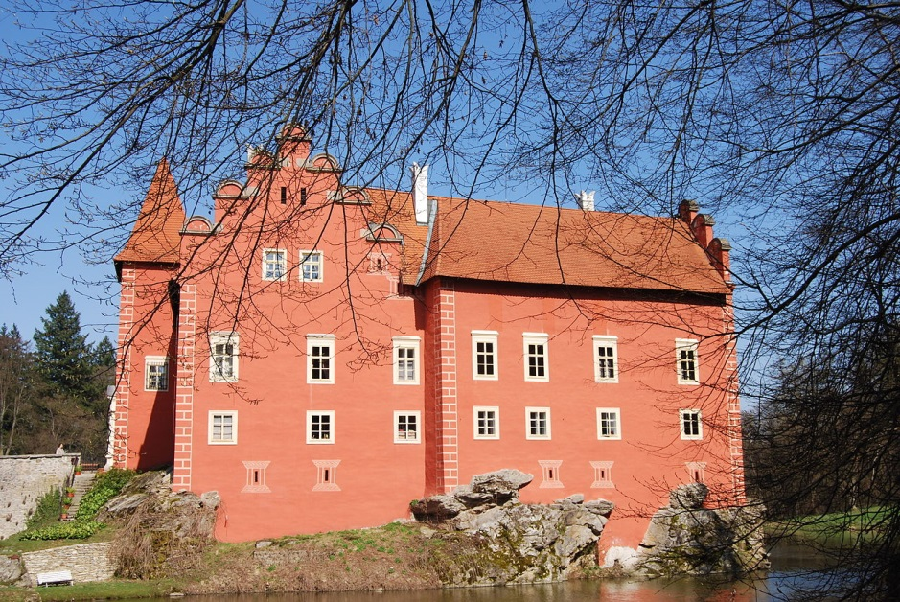

Slide 12
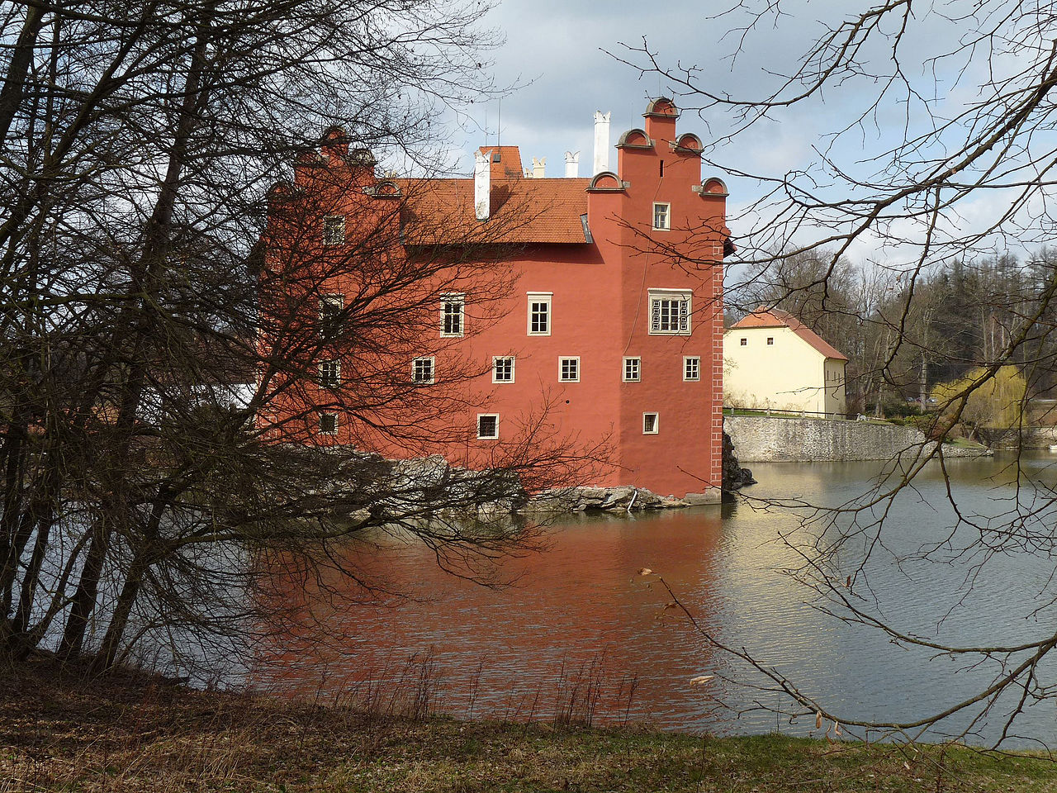

Slide 13
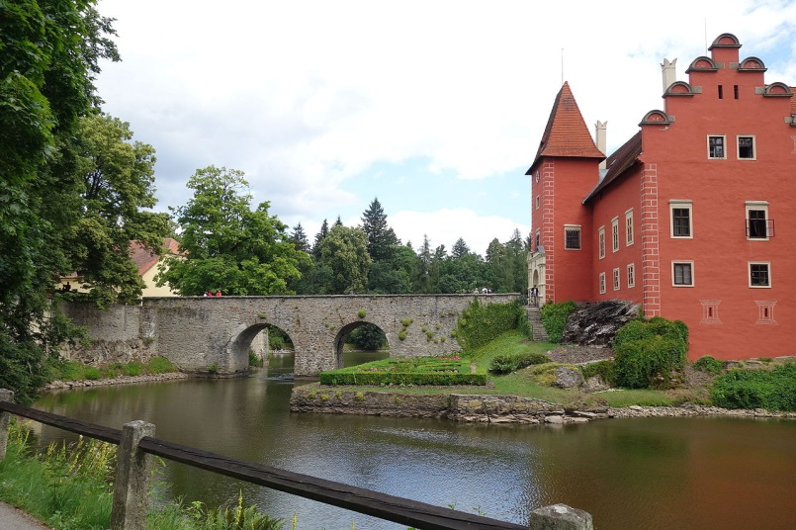

Slide 14
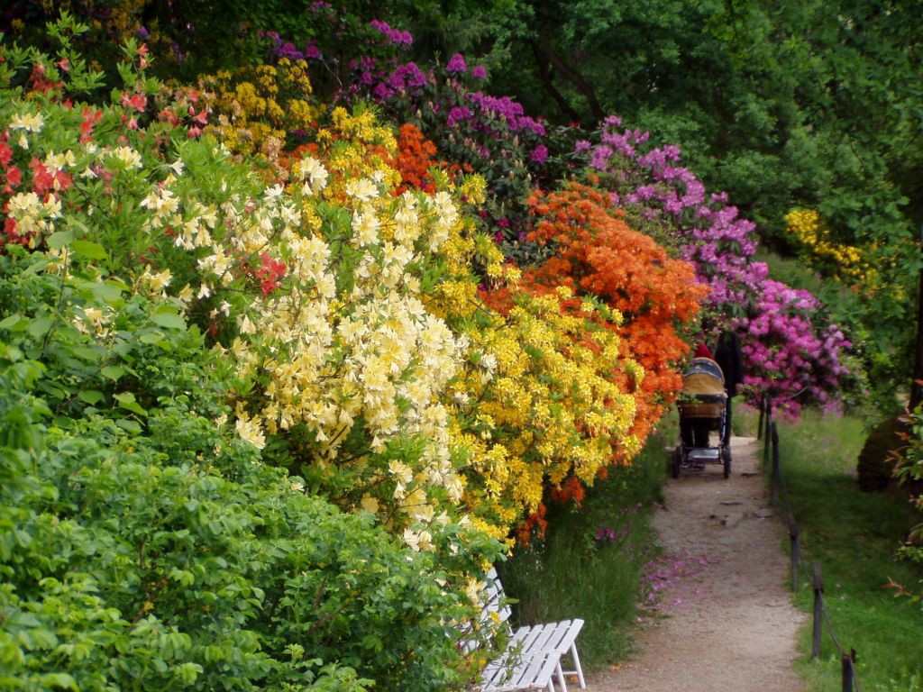

Slide 15
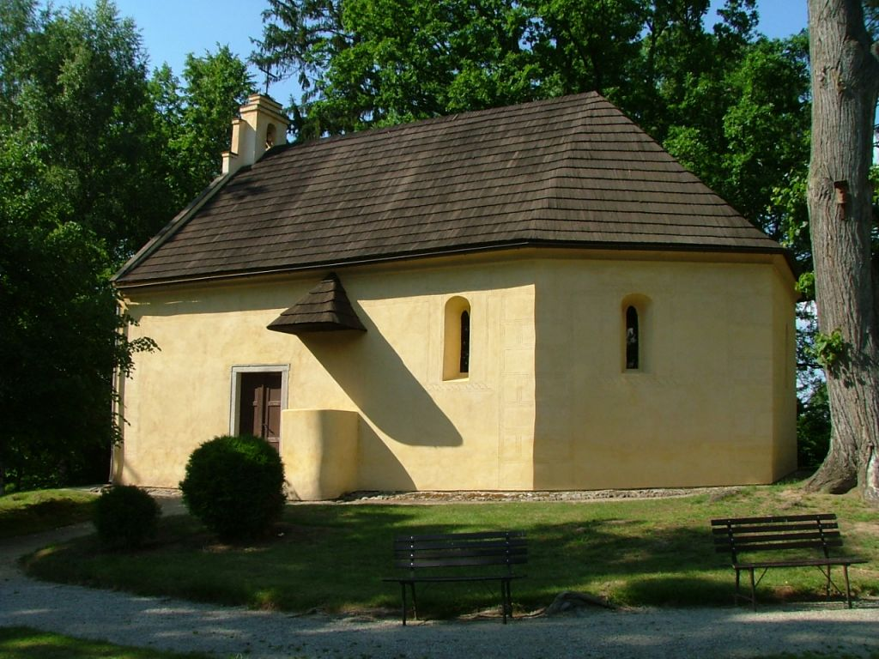

Slide 16
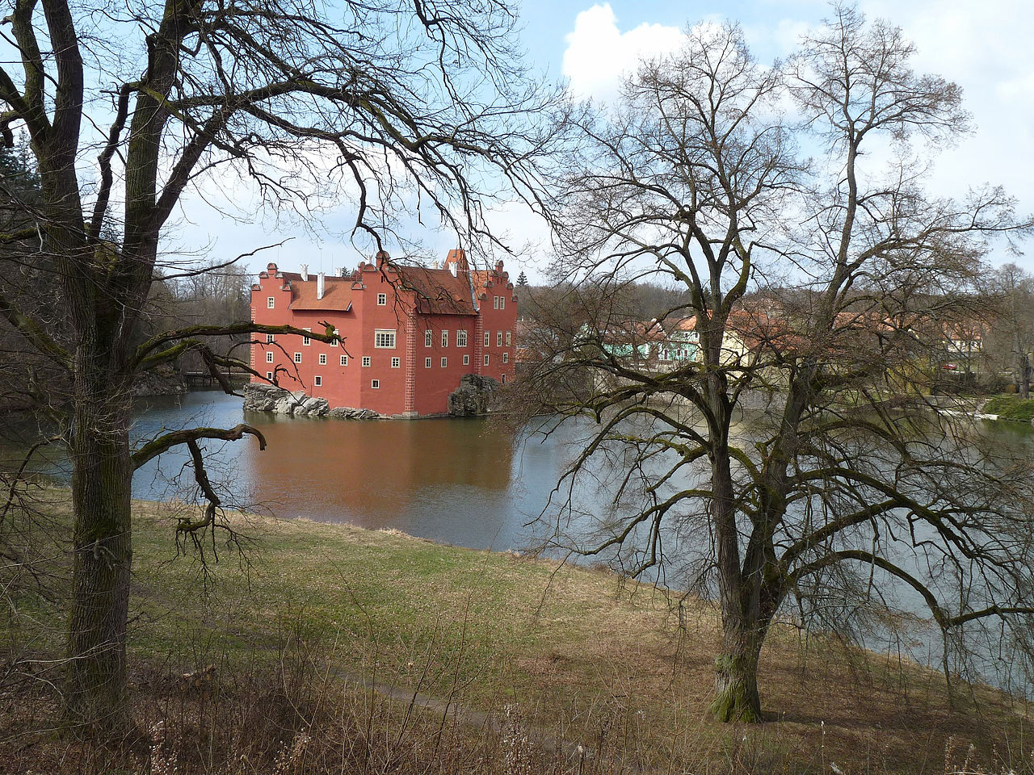

Slide 17
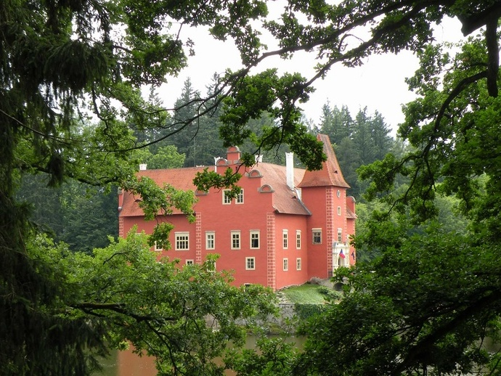

Slide 18
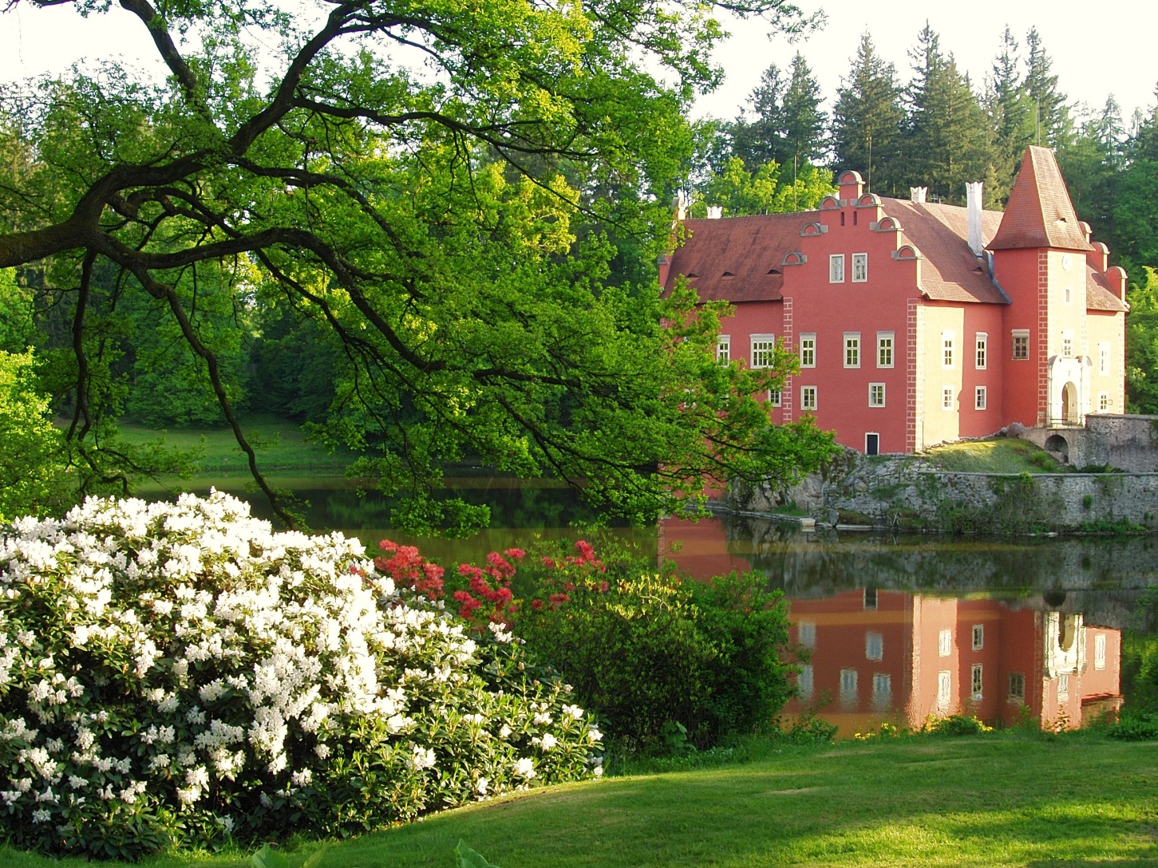

Slide 19
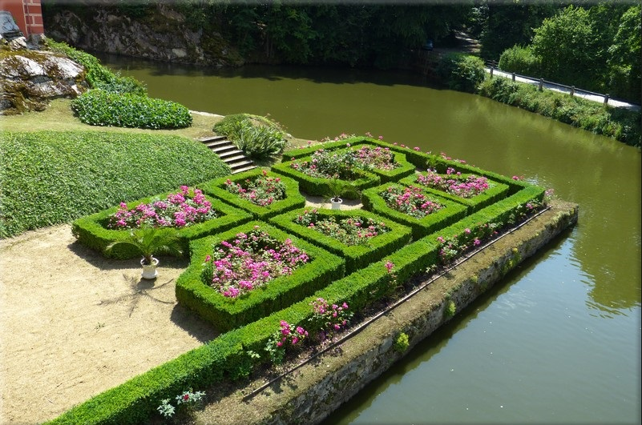

Slide 20
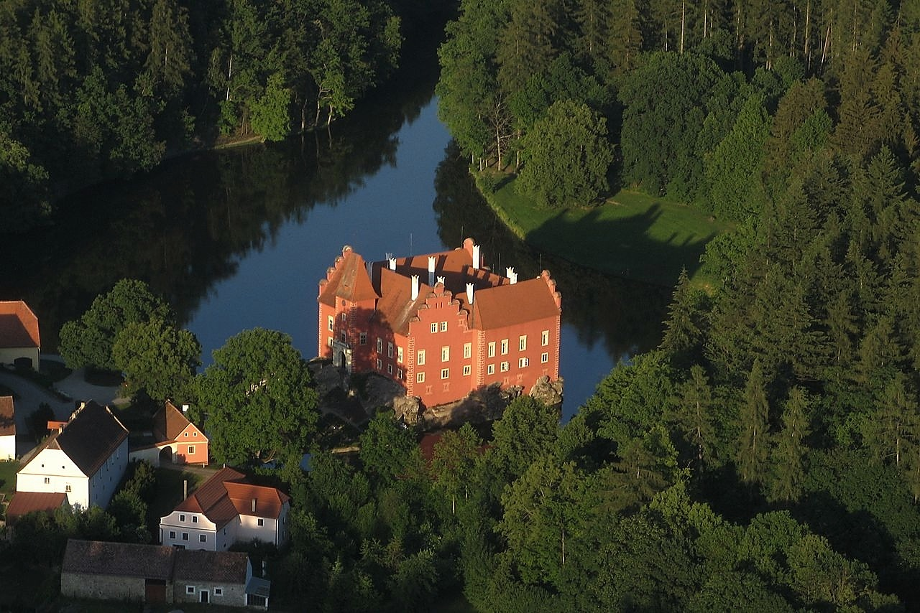
FIN
Yveta
Yveta
The End

Slide 21







¿Te ha gustado?
Puedes ver más entrando
Aquí
Además puedes recibir powerpoints en tu correo electrónico suscribiéndote aquí:
EXIT

