Slide 1


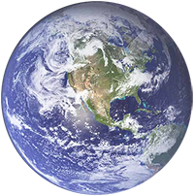

Magical villages of the world
We all love the cities in which our daily lives take place. There are many of them all over the world and they are remarkably similar. There are skyscrapers in them, the streets are crowded with busy people.
One of the best ways to experience a fundamentally different culture is to discover smaller remote villages. In this presentation, we will present some truly unique and beautiful villages, where people have adapted to challenging but beautiful natural sites. They are often fully synchronized with the natural and surrounding landscape.
If you are a lover of travel, remember that the villages reflect the culture and eating habits of the region and the nation. Keep this in mind as you prepare for the journey of getting to know foreign countries.
With regards,
Tony Chacko and Steve Rumpler
Magical Villages
of the World

Slide 2
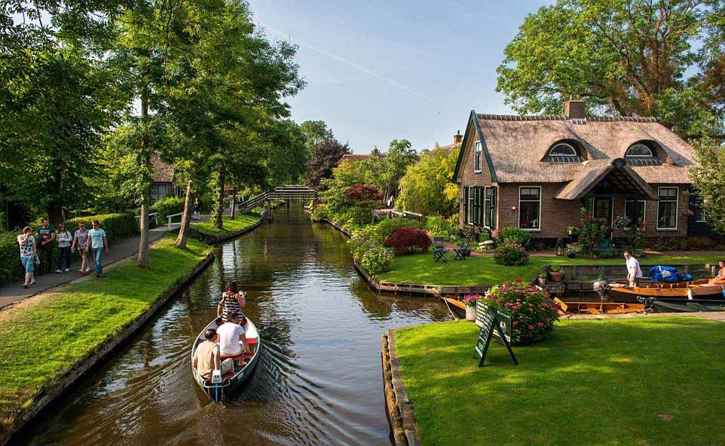
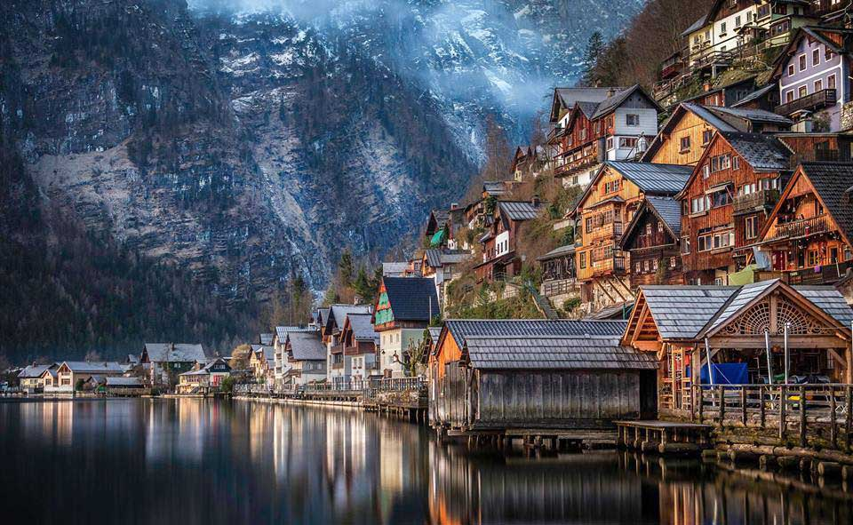
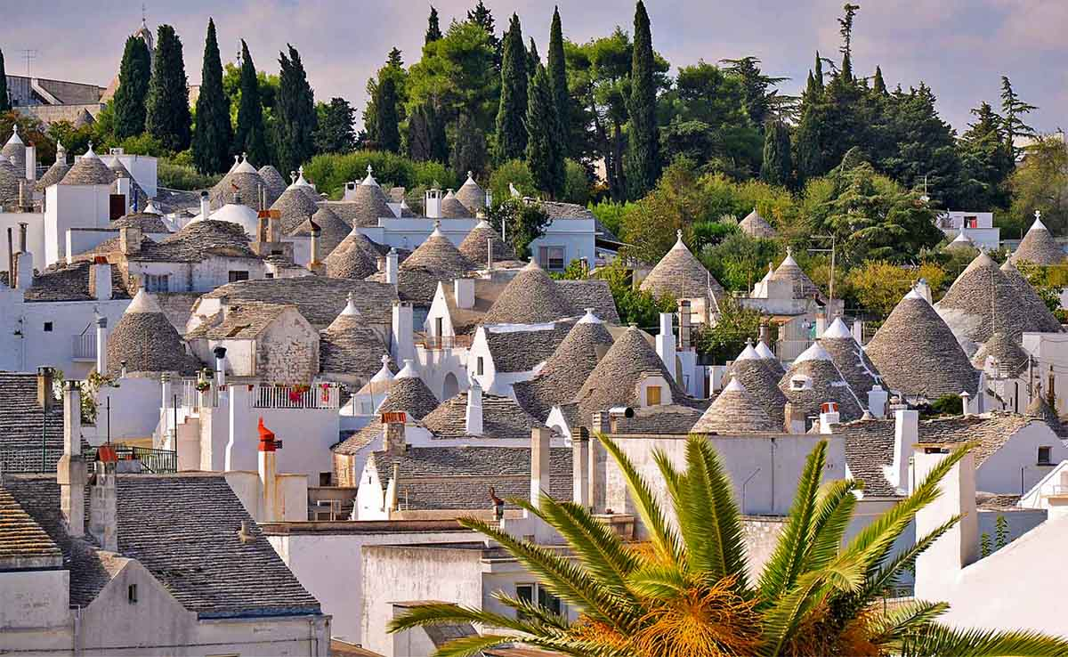
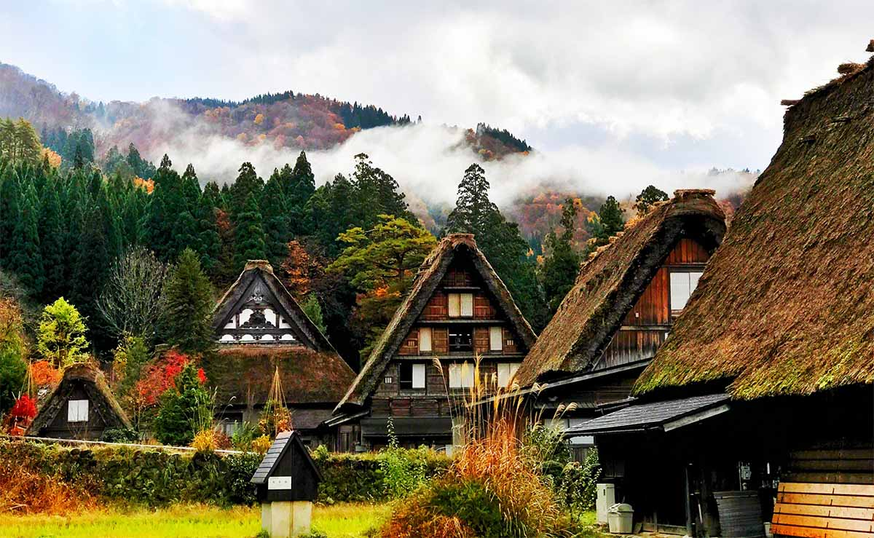

Slide 3
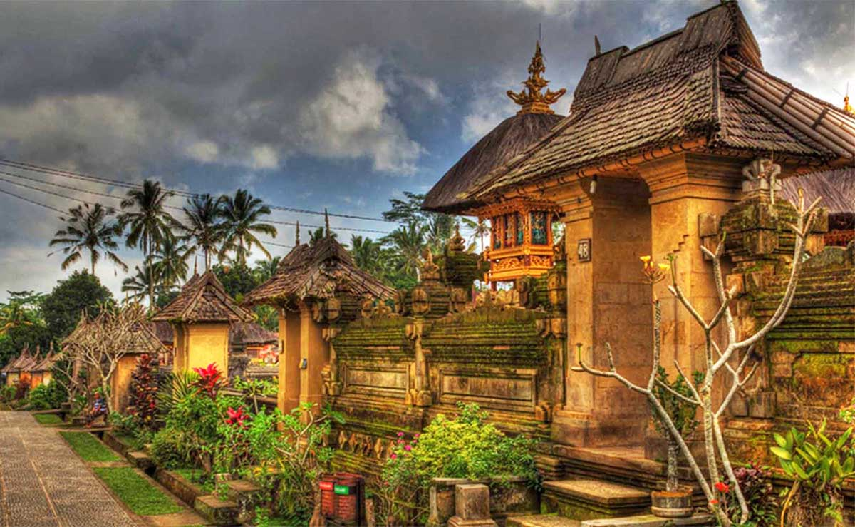

Penglipuran Village, Bali, Indonesia

Slide 4
Shirakawa-go Village, Japan

Slide 5
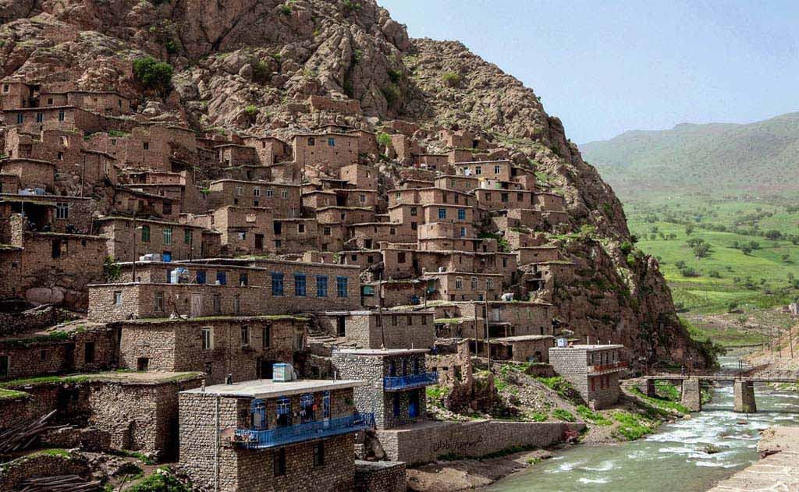
Palangan, Iran

Slide 6
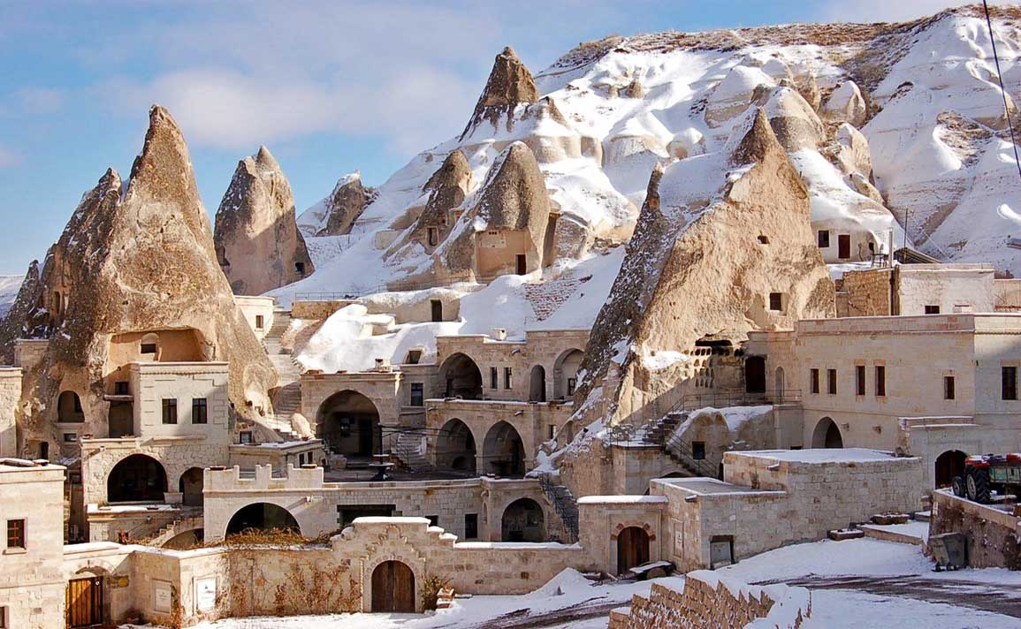
Göreme, Cappadocia, Turkey

Slide 7
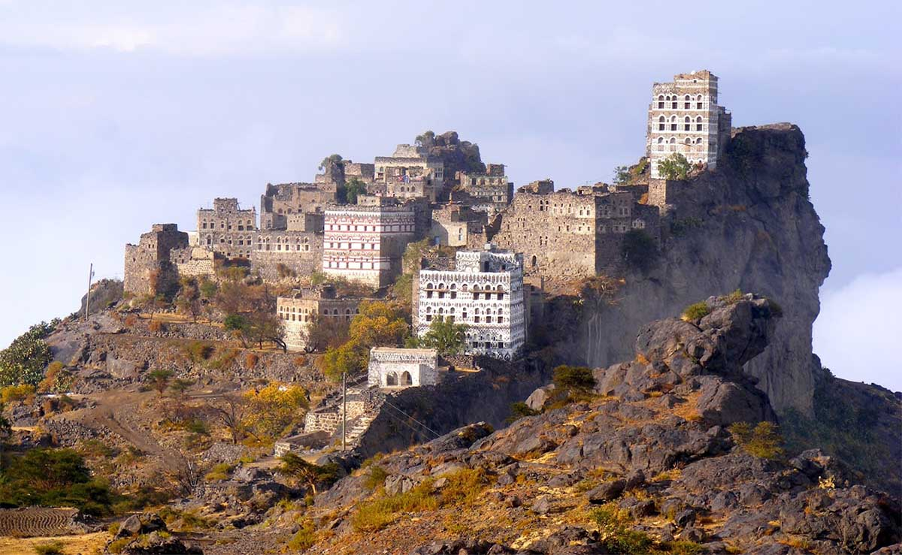
Jabal Haraz, Yemen

Slide 8
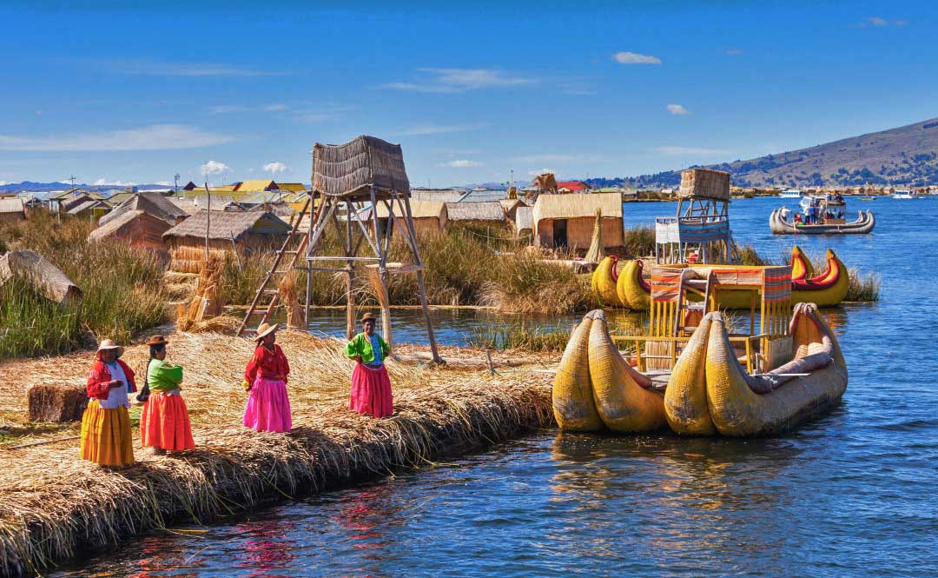
Lake Titicaca, Peru

Slide 9
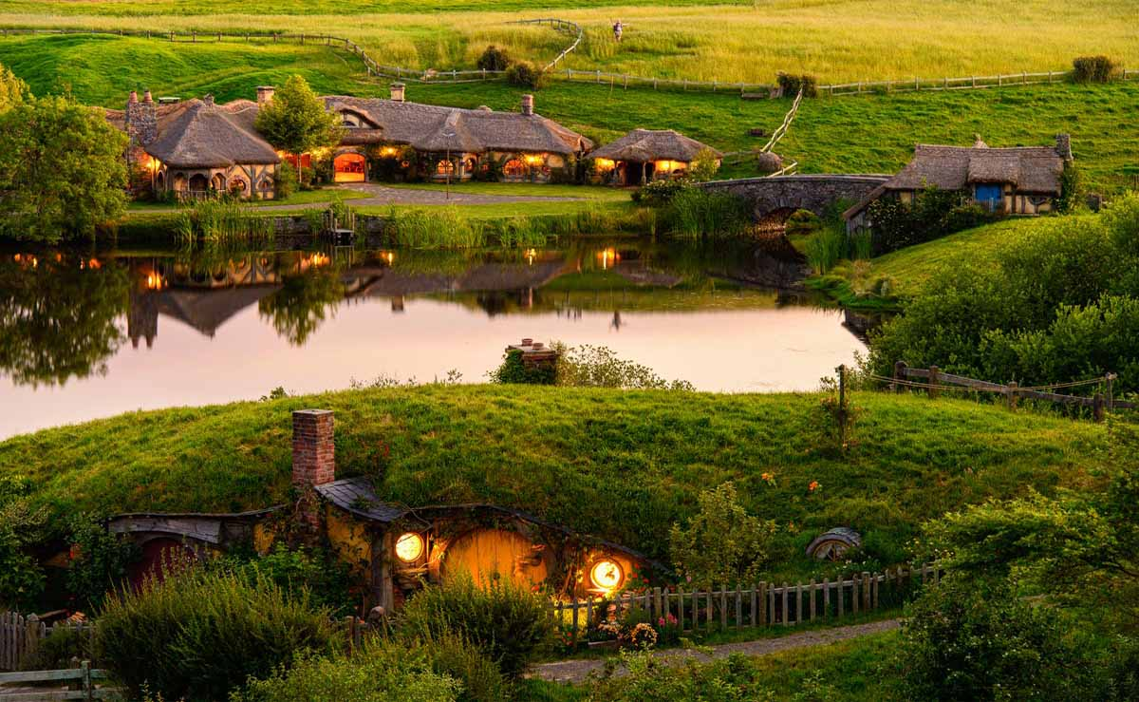
Hobbiton Village, New Zealand

Slide 10
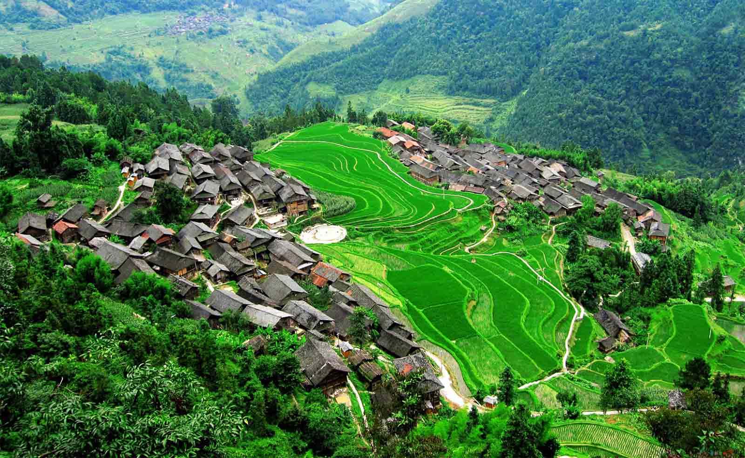
Sandu Village, Guizhou province, China

Slide 11
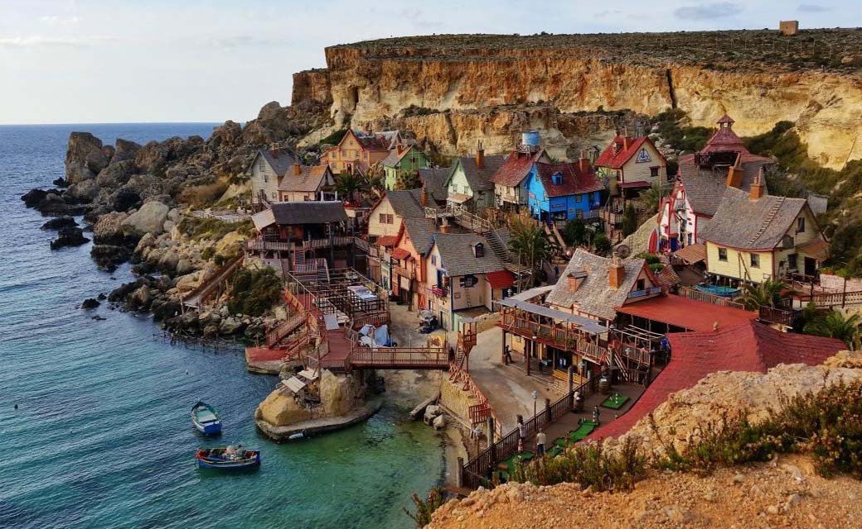
Popeye Village, Anchor Bay, Malta

Slide 12
Alberobello, Italy

Slide 13
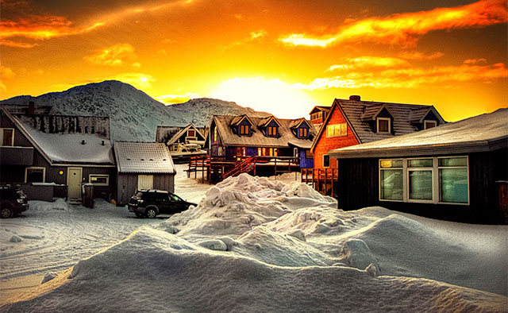
Myggedalen Village, Greenland

Slide 14
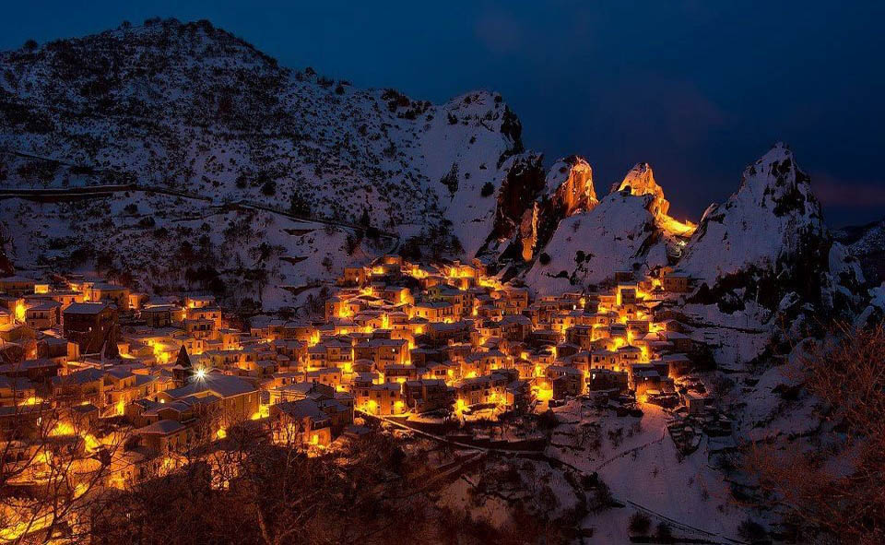
Castelmezzano, Italy

Slide 15
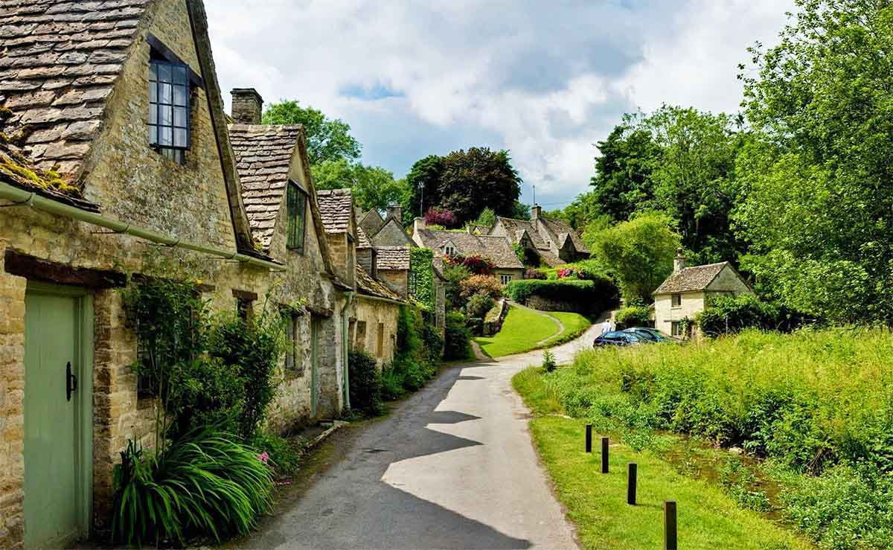
Bibury, England

Slide 16
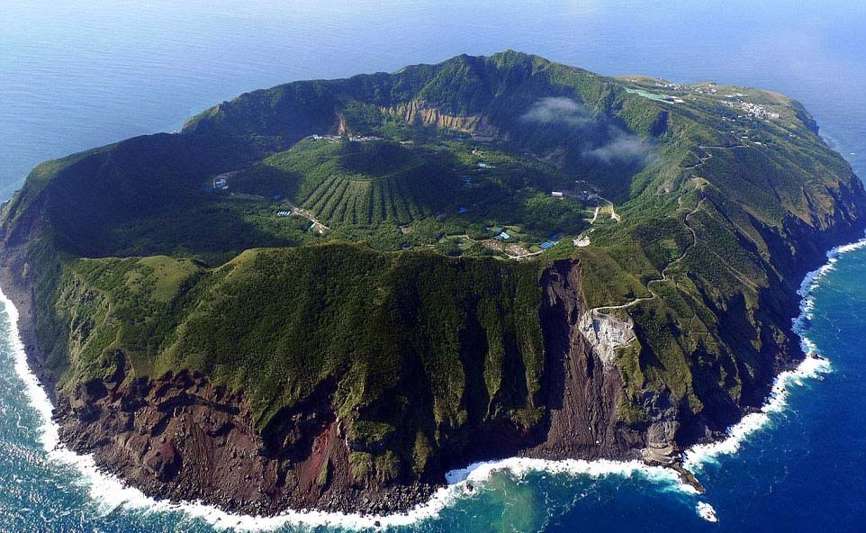
Aogashima Island, Japan

Slide 17
Hallstatt, Austria

Slide 18
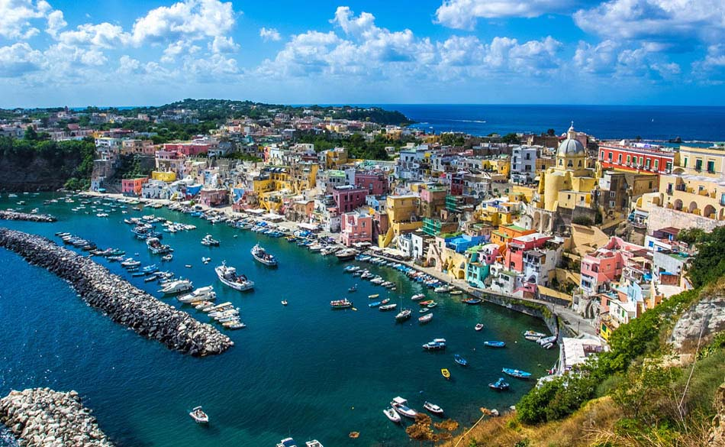
Procida Village, Napoli, Italy

Slide 19
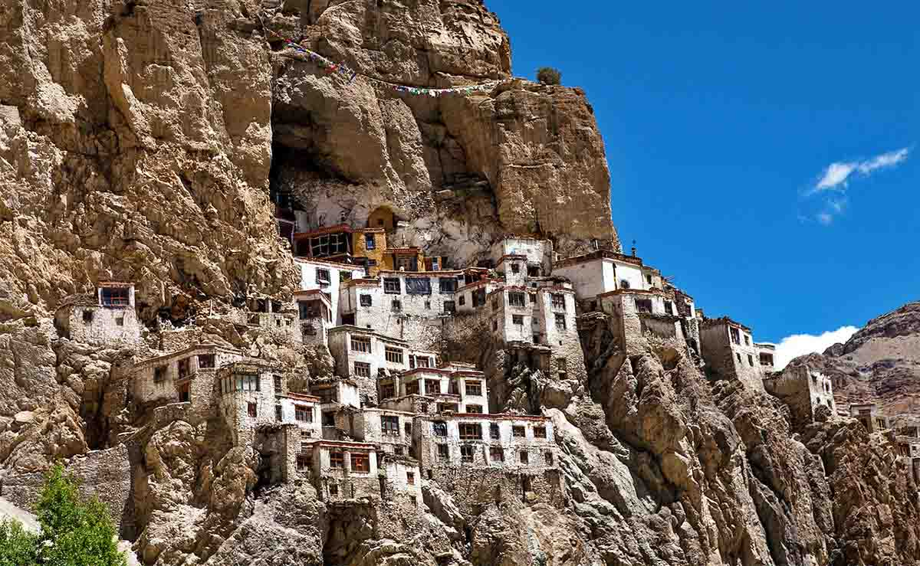
Village Phuktal, Ladakh district, India

Slide 20
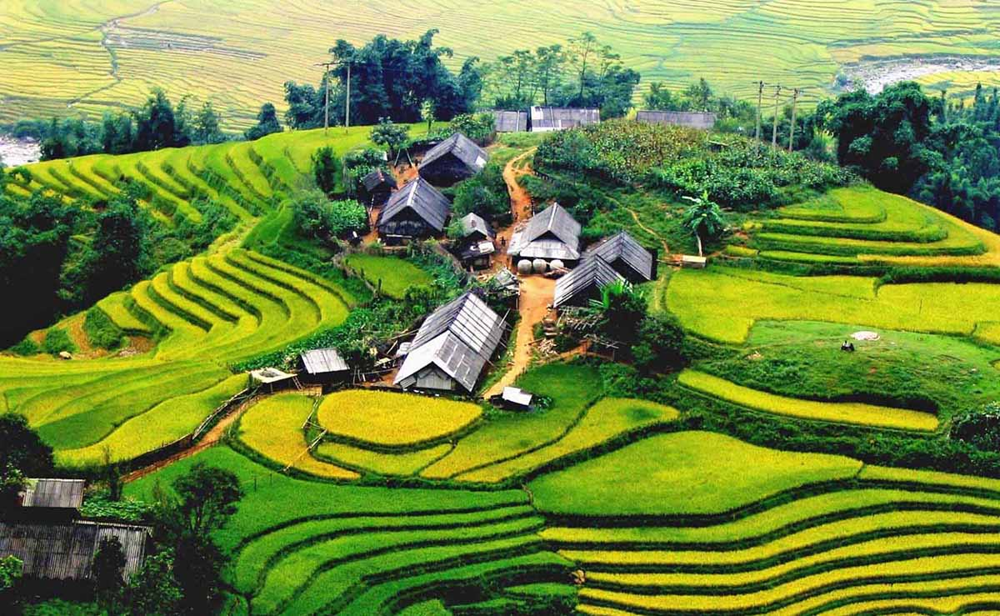
Sapa, Vietnam

Slide 21
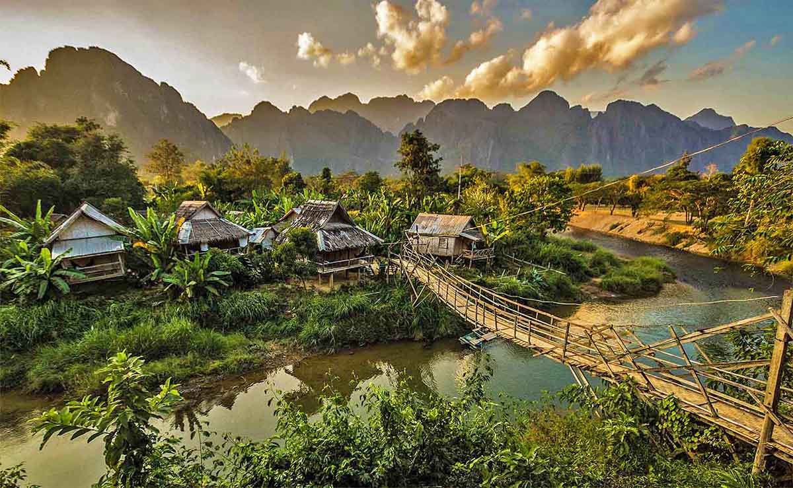
Van Vieng Village, Laos

Slide 22
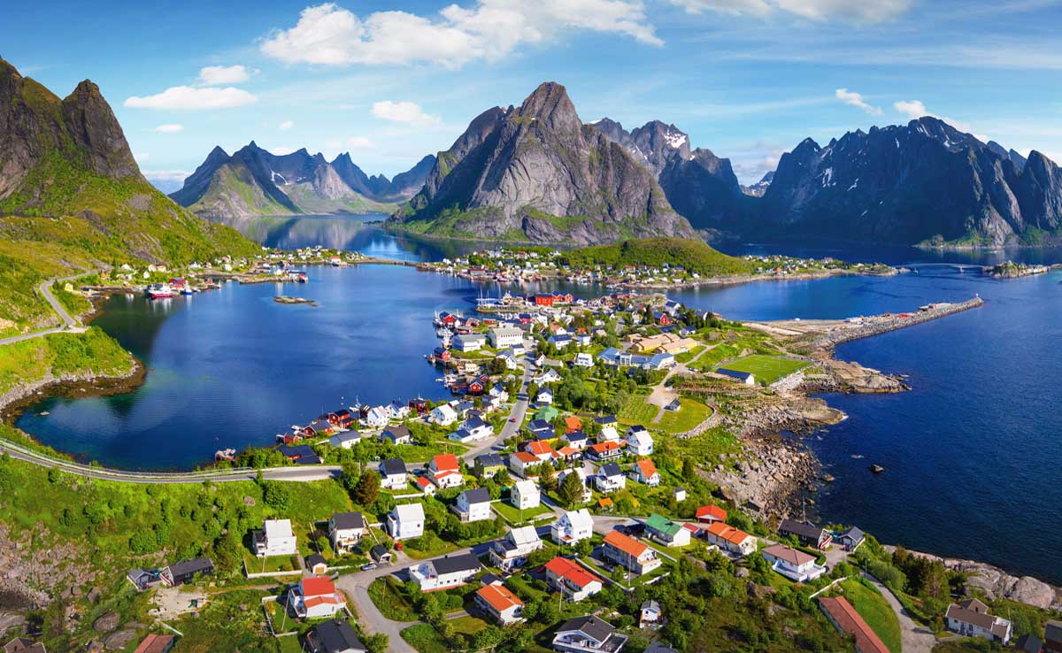
Reine, Lofoten, Norway

Slide 23
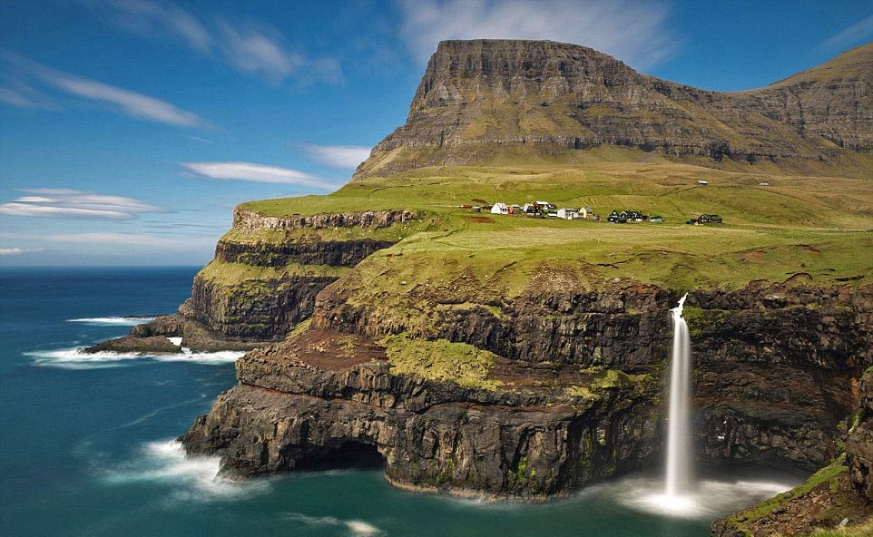
Gásadalur Village, Faroe Islands

Slide 24
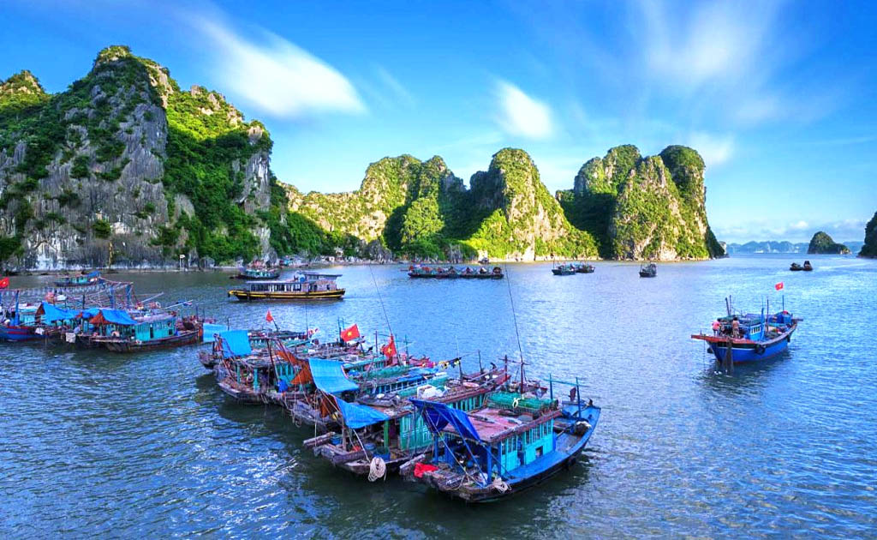
Floating boat villages, Halong Bay, Vietnam

Slide 25
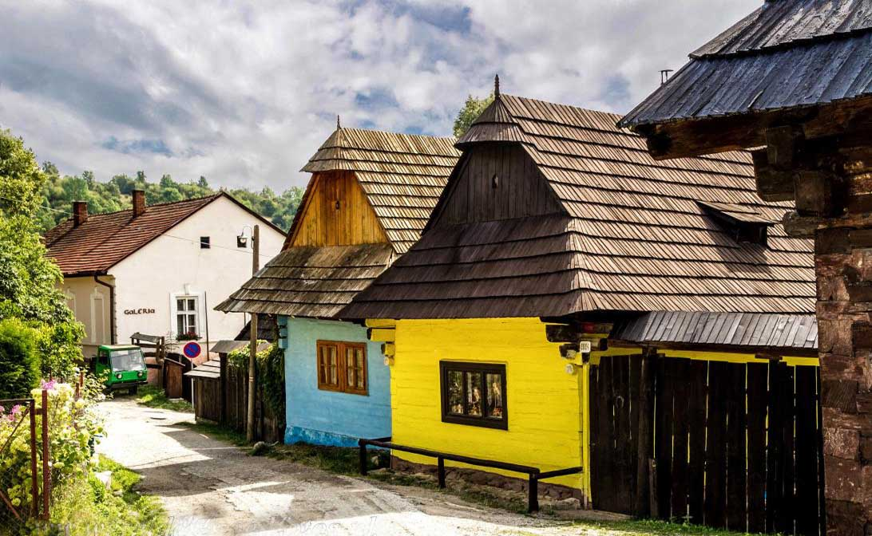
Vlkolínec, Slovakia

Slide 26
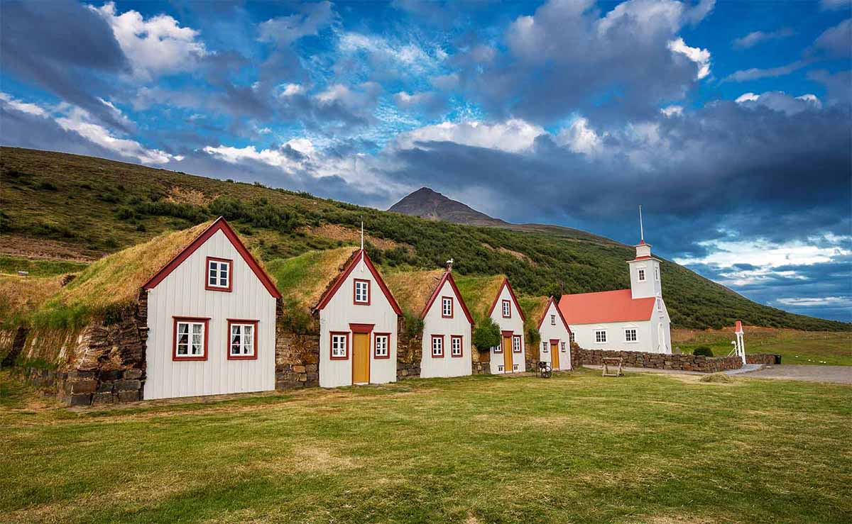
Laufáskirkja, Iceland

Slide 27
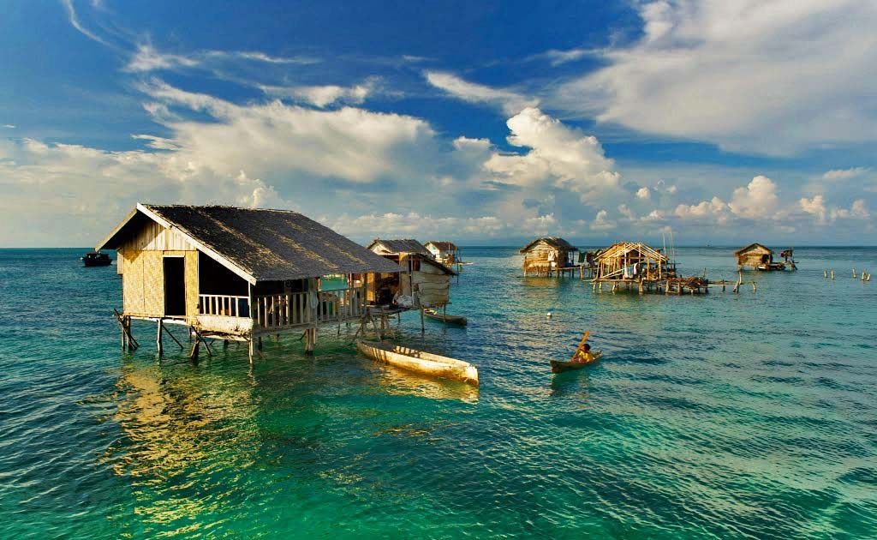
Bodgaya Island, Semporna, Sabah, Malaysia

Slide 28
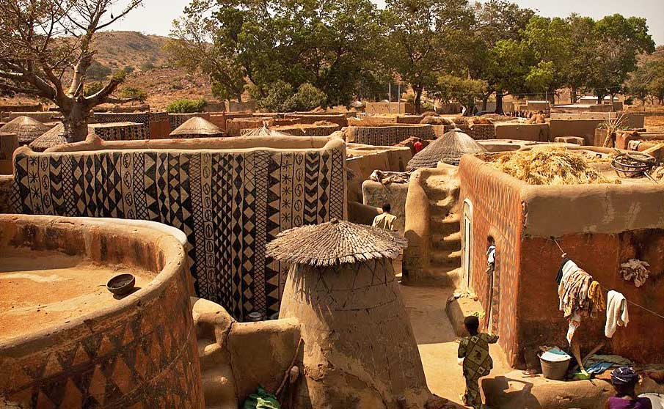
Tiebele, Burkina Faso, Africa

Slide 29
Giethoorn, Netherlands

Slide 30
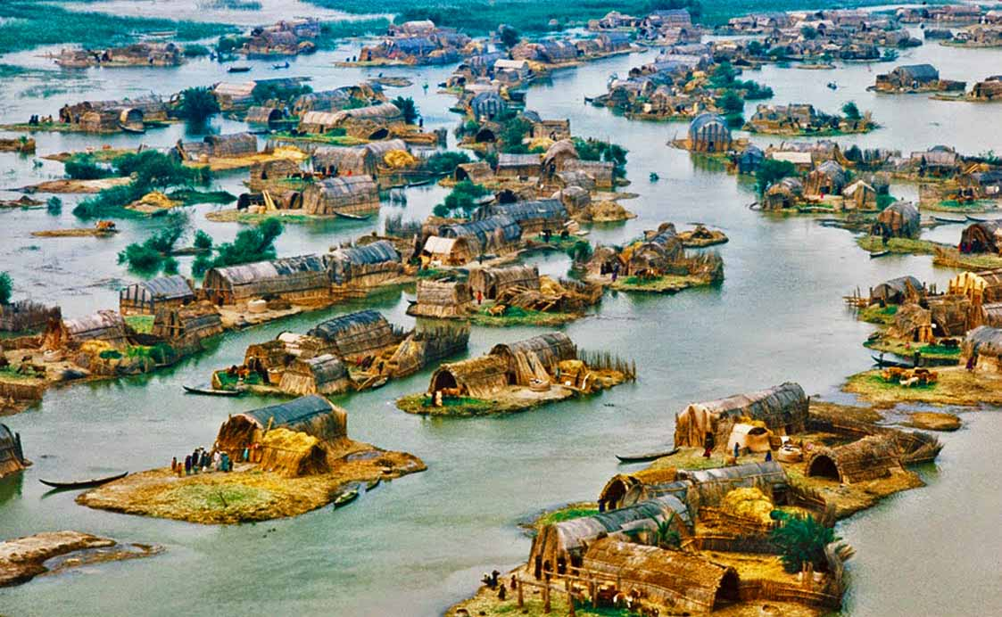
Al Qabab Village, Iraq

Slide 31
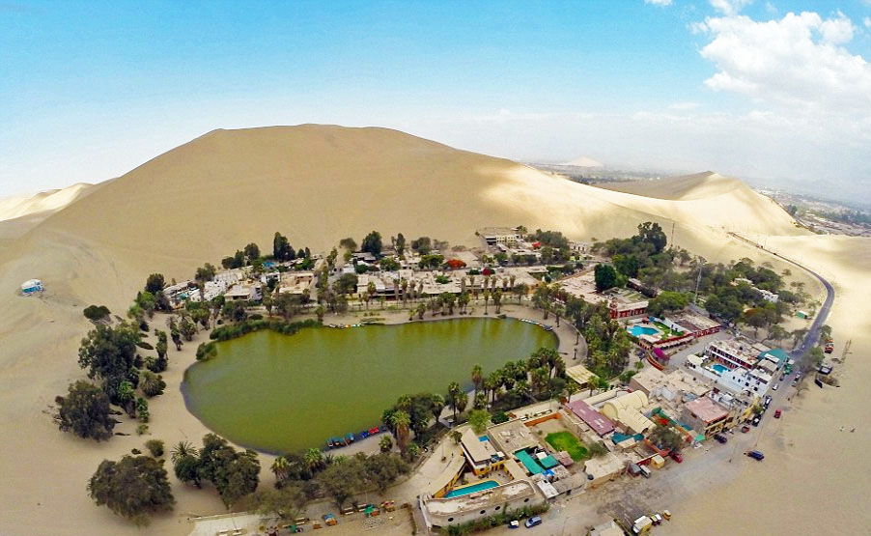
Huacachina, Peru.

Slide 32
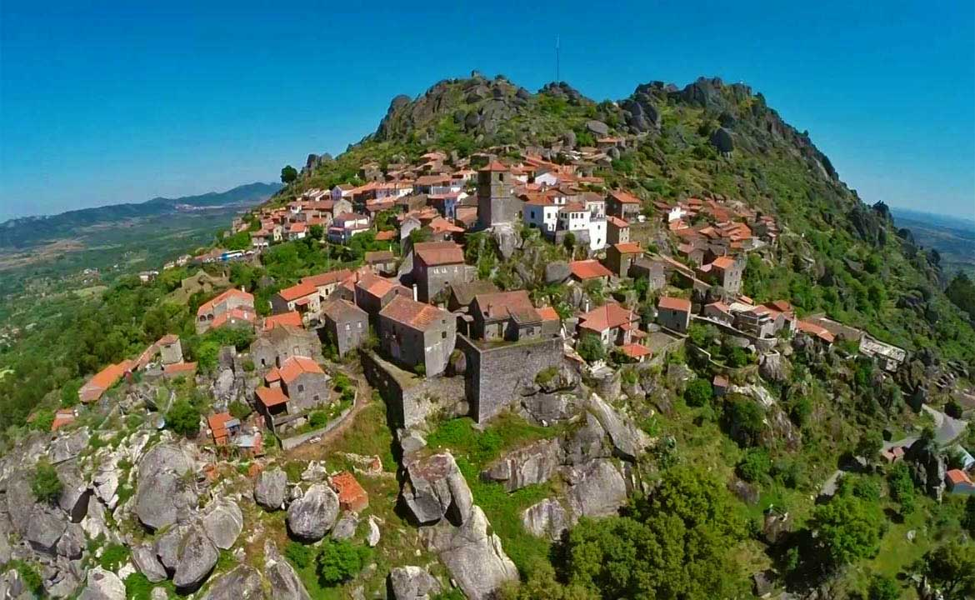
Monsanto, Portugal

Slide 33
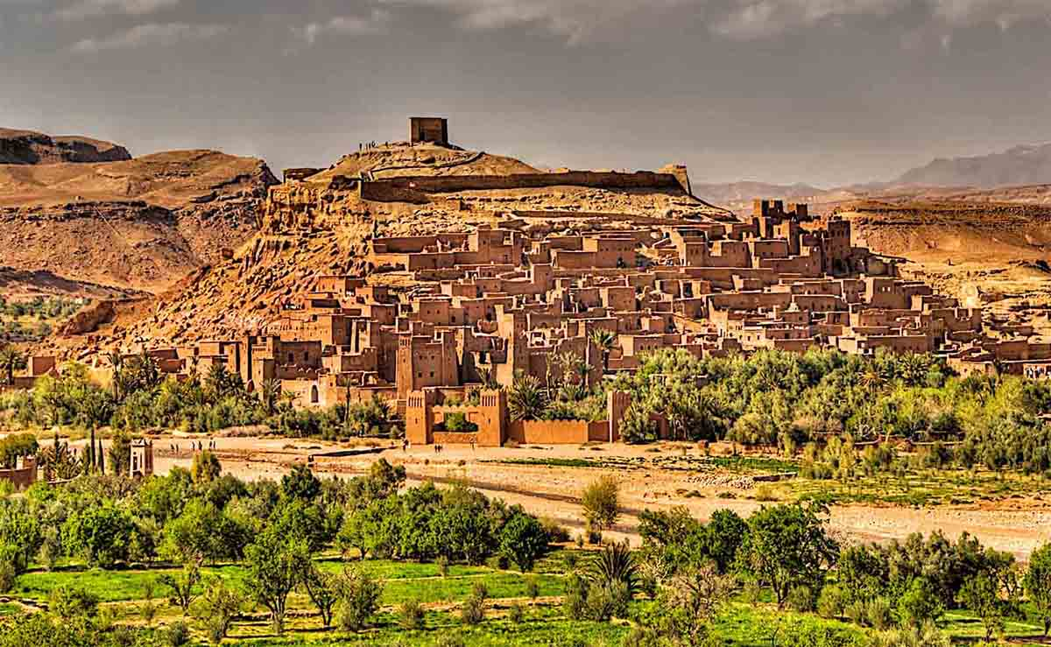
Ait Ben-Haddou, Morocco

Slide 34
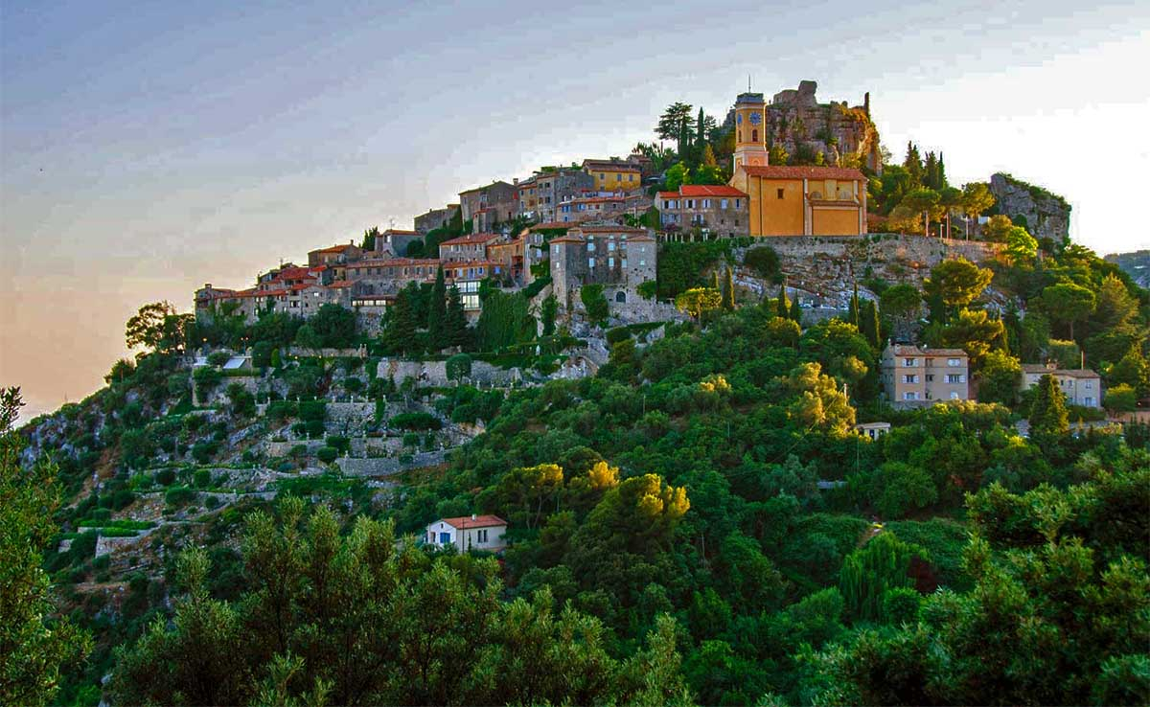
Eze, France

Slide 35
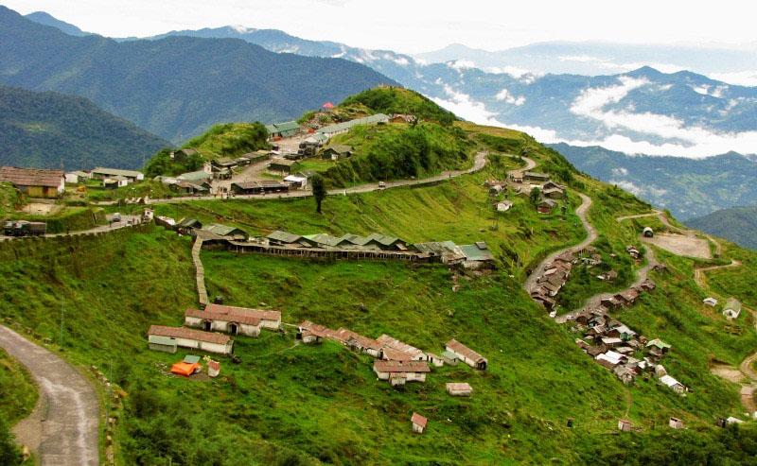
Zuluk Village, Sikkim, India

Slide 36
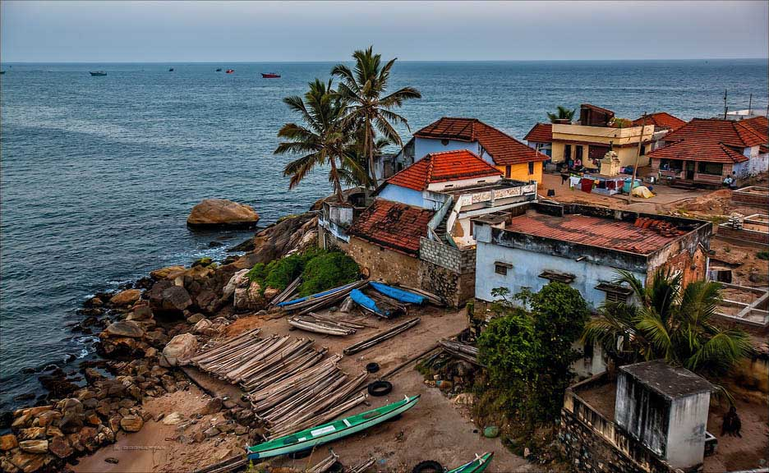
Seaside village, Kanyakumari, India

Slide 37
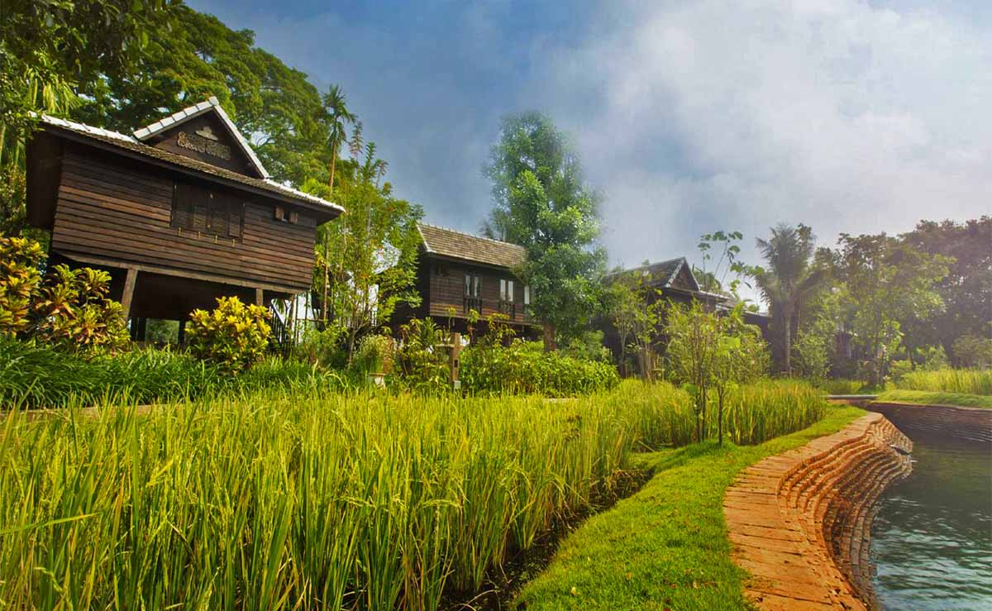
Marndadee Village, Chiangmai, Thailand

Slide 38
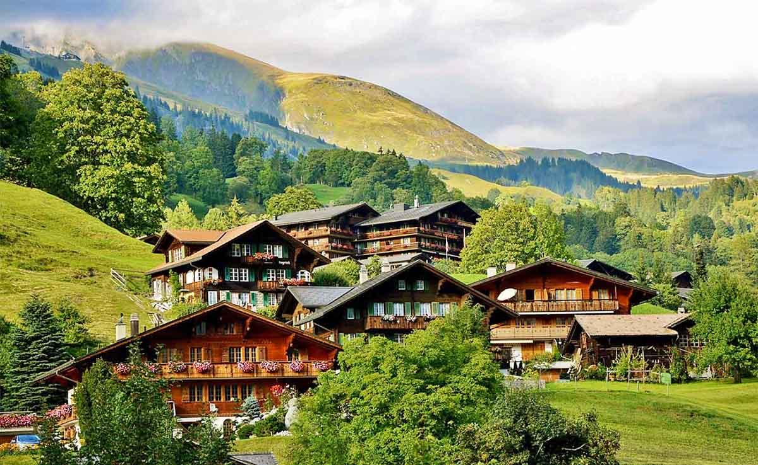
Grindelwald, Switzerland

Slide 39
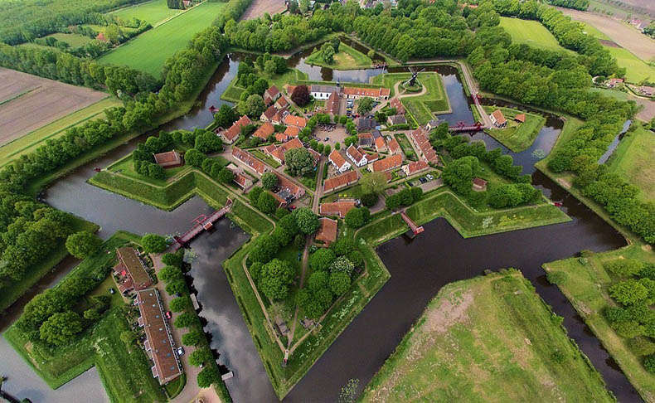
Fort Bourtanger Village, Groningen, Netherlands

Slide 40
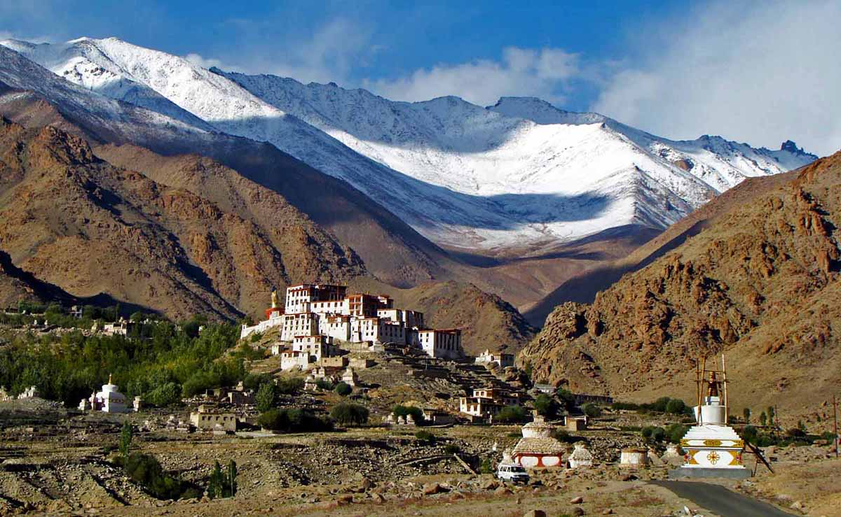
Alchi village of Leh, Jammu Kashmir, India

Slide 41
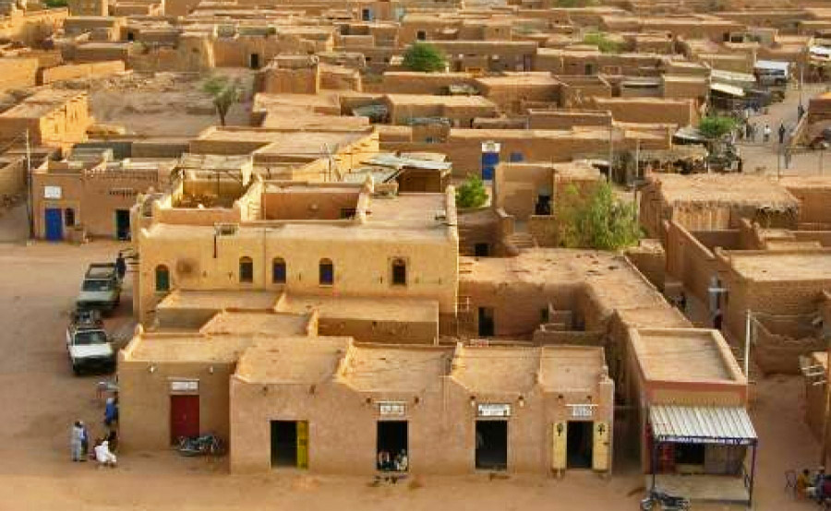
Tipical Village, Niger, Africa

Slide 42
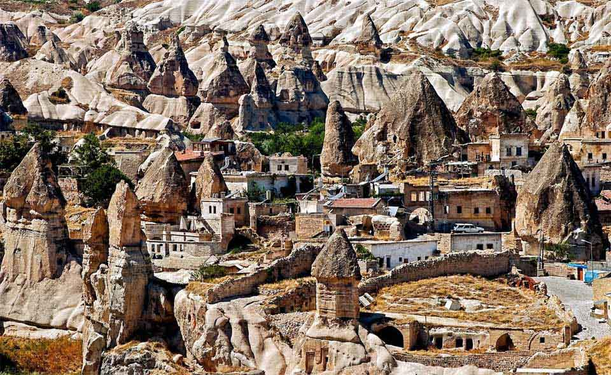
Abi Barak Village, Afghanistan

Slide 43
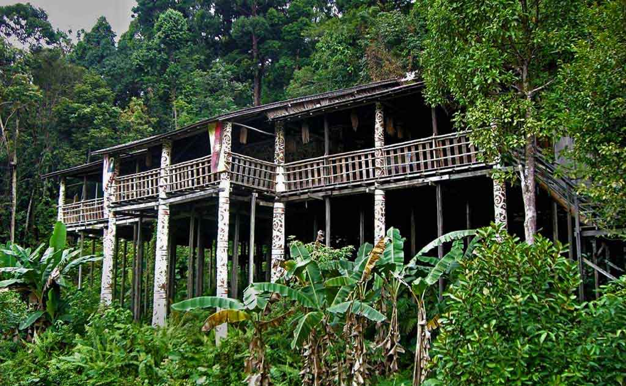
Orang Ulu Longhouse village, Sarawak, Borneo, Malaysia

Slide 44
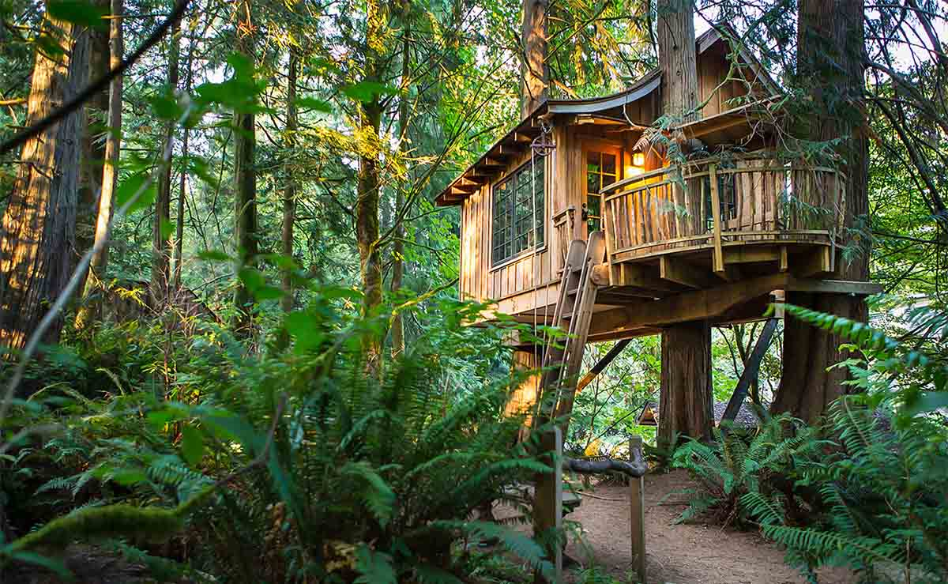
We wish you a pleasant holiday in this tree house...

Slide 45




Hope you have enjoyed viewing this presentation
Have a nice day
Music : Moreza - Tell Me Why
With regards - Tony Chacko and Steve Rumpler
(tonychacko2000@gmail.com / pista2011@gmail.com)

Slide 46







¿Te ha gustado?
Puedes ver más entrando
Aquí
Además puedes recibir powerpoints en tu correo electrónico suscribiéndote aquí:

