Slide 1

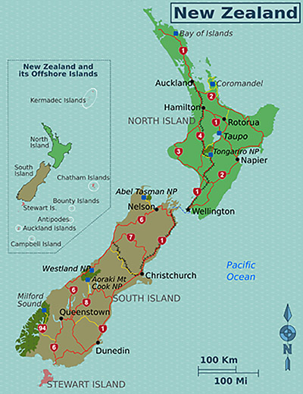

NEW ZEALAND
Capital City - Wellington
Commercial City - Auckland
Population - 4.88 million (2017)
Land Area - 268,021 km²
New Zealand is a very diverse country with many regions that are worth seeing, but at a high level
it‘s easiest to break it down according to its two main islands and the smaller offshore islands.
- North Island
- South Island
- Stewart Island
- Chatham Islands
- Sub-antarctic Islands
New Zealand is one of the most beautiful countries in the world, a country of stunning and diverse natural beauty: jagged mountains, rolling pasture land, steep fjords, pristine trout-filled lakes, raging rivers, scenic beaches, and active volcanic zones. These islands form a unique bioregion inhabited by flightless birds seen nowhere else, such as kakapo and kiwi. New Zealanders have adopted the kiwi as a national symbol, and have even taken the word Kiwi as a name for themselves.
The islands are not densely populated, the South Island even less so than the North Island, but they are easily accessible. The country has modern visitor facilities and transport networks that are reasonably well developed. New Zealand often adds an adventurous twist to nature. It is the original home of jet boating through shallow gorges as well as bungee jumping off anything high enough to give a thrill.
Māori culture continues to play an important part in everyday life and the identity of the nation. Government and corporate New Zealand is full of Māori symbolism. There are abundant opportunities for visitors to understand and experience the history and present-day forms of Māori life.
Compiled by - TONY CHACKO Technical cooperation - STEVE RUMPLER

Slide 2

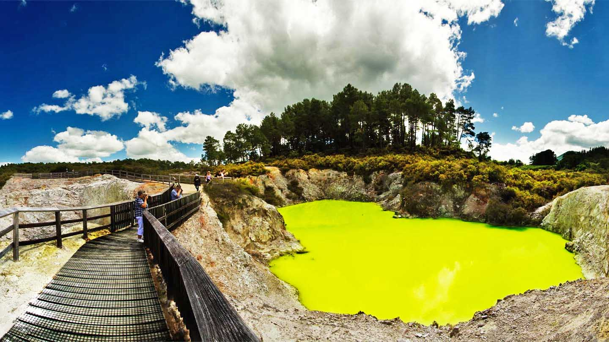
The Wai-o-Tapu Geo Thermal Park. This active geothermal area is just north of the Reporoa caldera, in New Zealand's Taupo Volcanic Zone. It is 27 kilometres south of Rotorua. Due to dramatic geothermal conditions beneath the earth, the area has many hot springs.

Slide 3
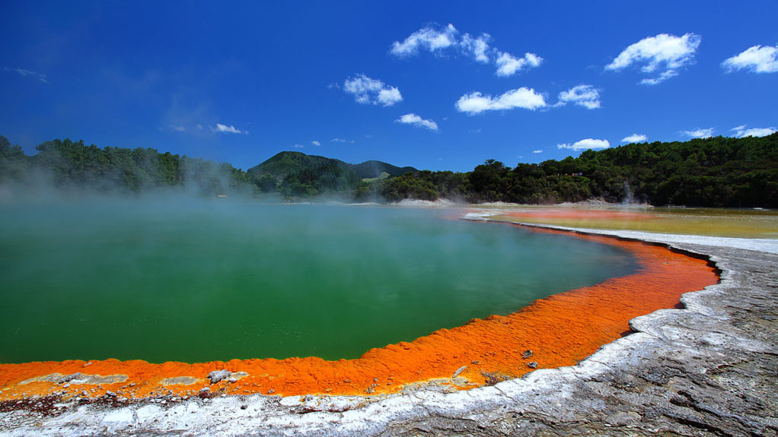
The Champagne Pool - another thermal lake of The Wai-o-Tapu Geo Thermal Park.

Slide 4
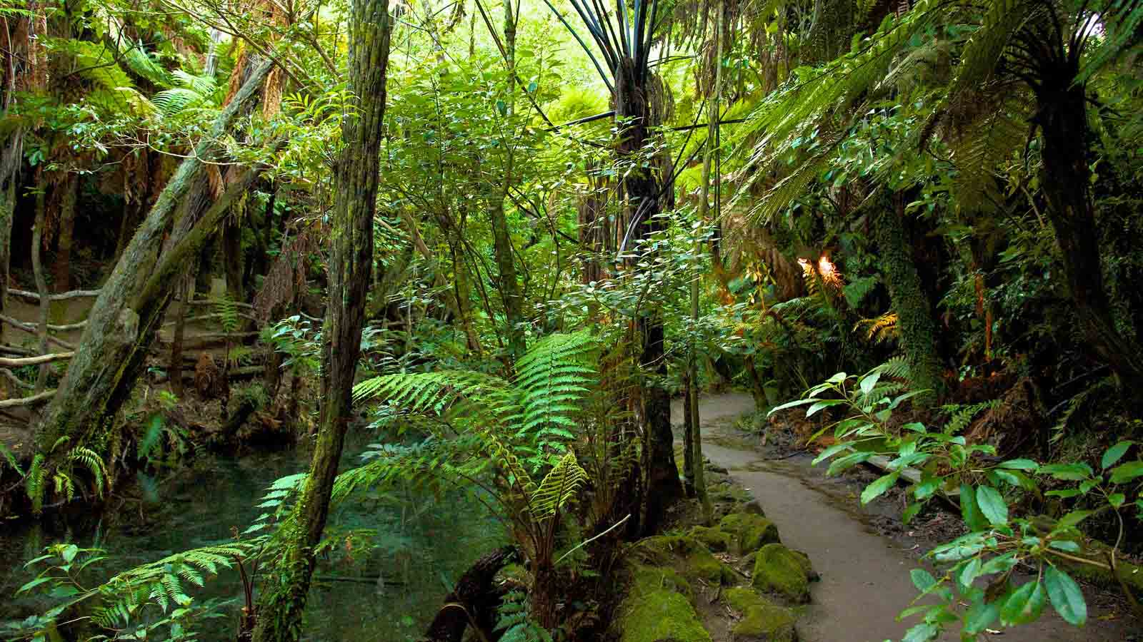
Kawaha Point - Mitai Maori Village

Slide 5
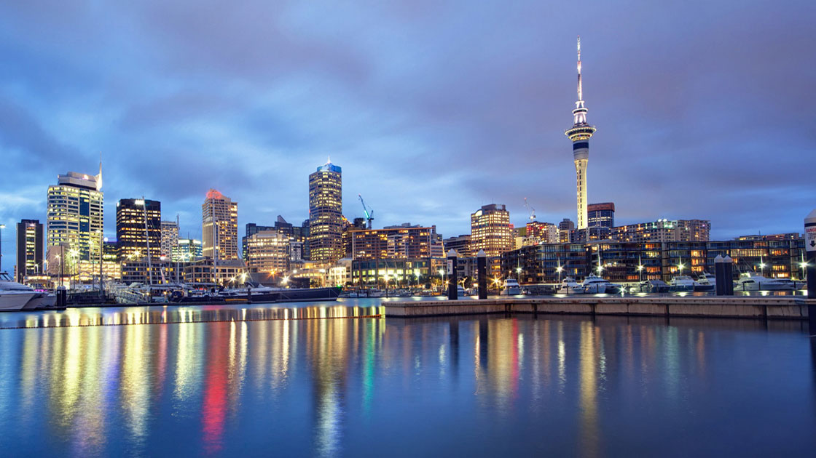
The Sky Tower is an observation and telecommunications tower in Auckland. It is 328 metres (1,076 ft) tall, making it the tallest freestanding structure in the Southern Hemisphere and the 23rd tallest tower in the world. It is an iconic landmark in Auckland's skyline due to its height and unique design.

Slide 6
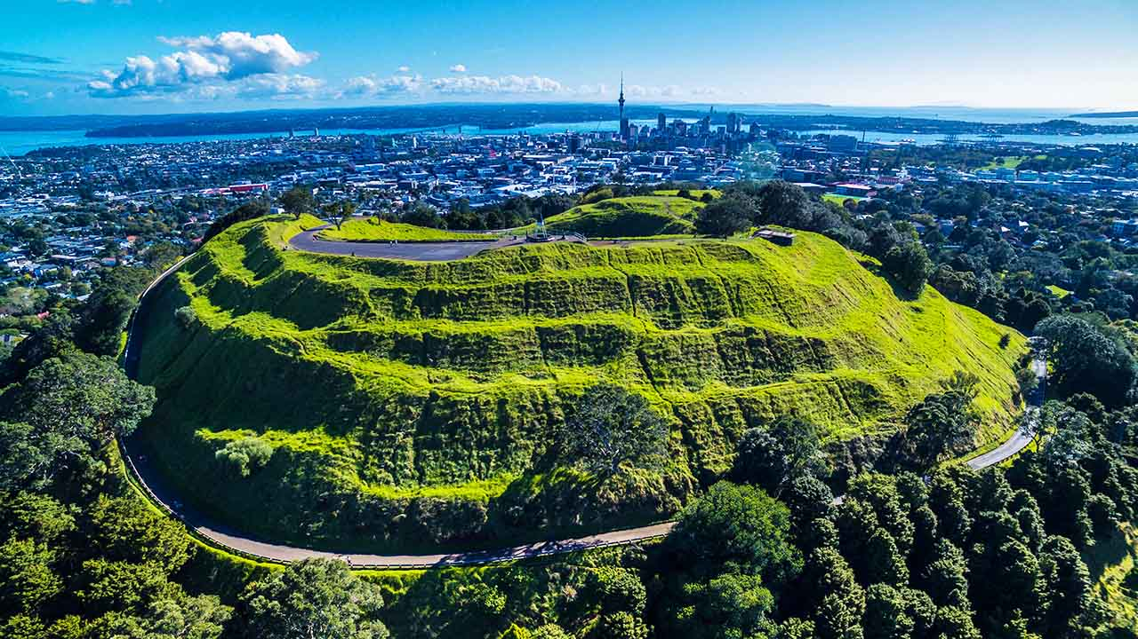
Mt. Eden - panoramic view of Auckland City from the mountain.

Slide 7
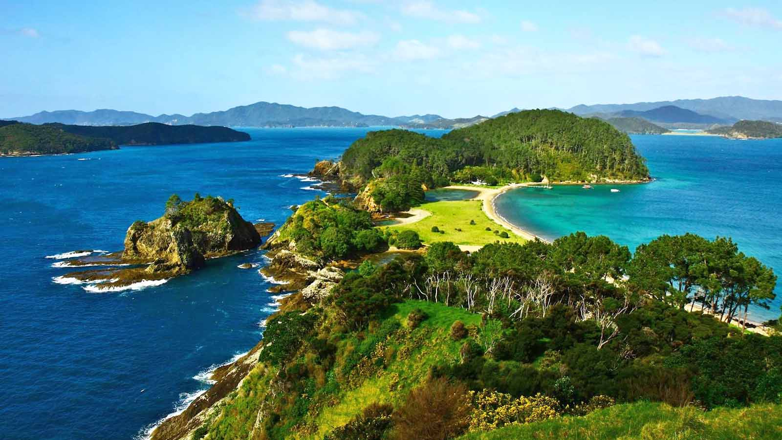
The Bay of Islands is a New Zealand enclave encompassing more than 140 subtropical islands next to the country's North Island. It’s known for its undeveloped beaches, big-game fishing and Maori cultural artefacts.

Slide 8
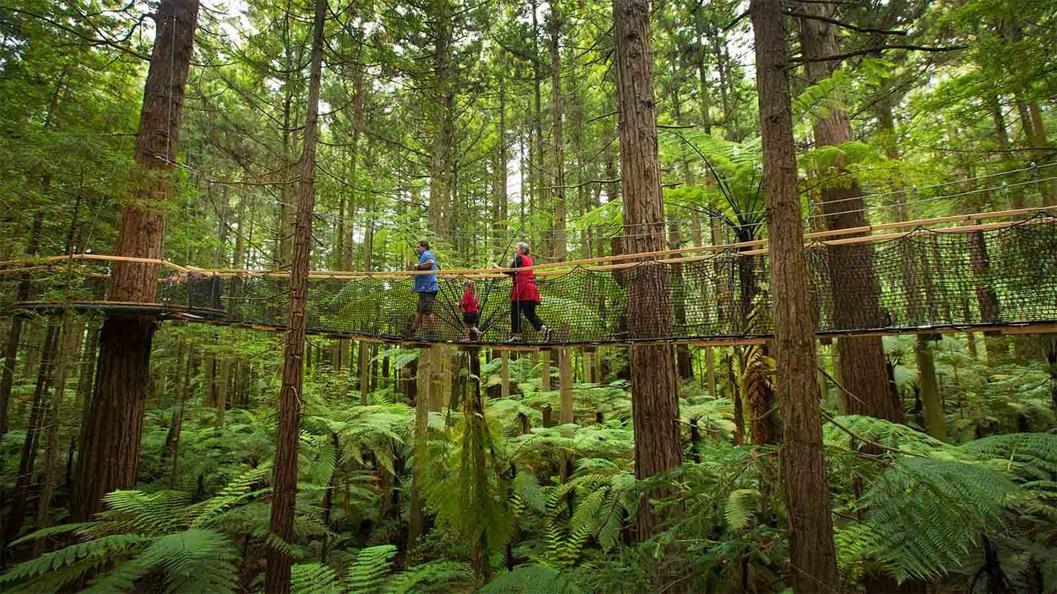
Adventure Forest Tree-mendous. Located between Whangarei Falls and Tutukaka Coast. Adventure Forest offers high thrill activities packed with fun - a family-friendly must do in Northland.

Slide 9
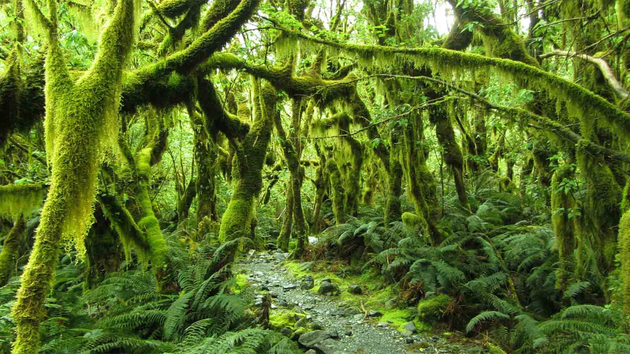
Forest along the Milford Track on South Island. The 53 kilometre journey leads you across suspension bridges, board walks and a mountain pass. It will take you to feel the misty breath of Sutherland Falls, the tallest waterfall in New Zealand.

Slide 10
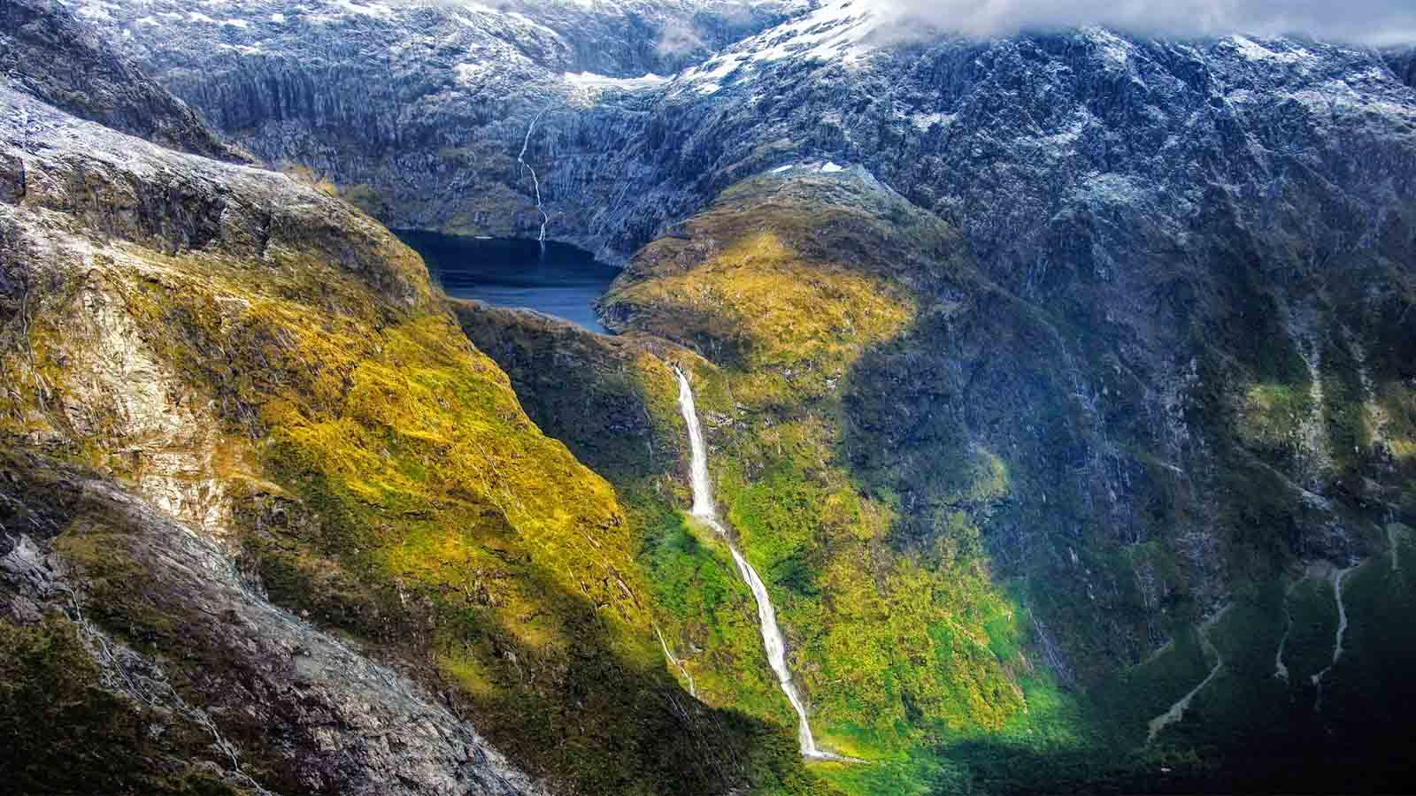
Sutherland Falls is a waterfall near Milford Sound in New Zealand's South Island.

Slide 11
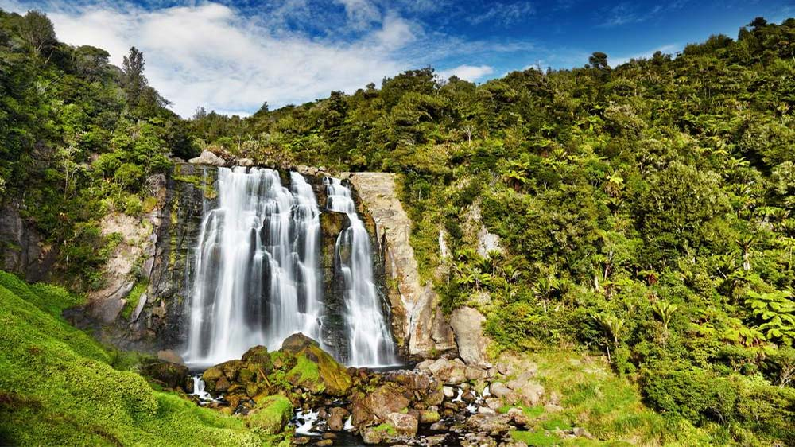
Stunning Marakopa Falls near Waitomo

Slide 12
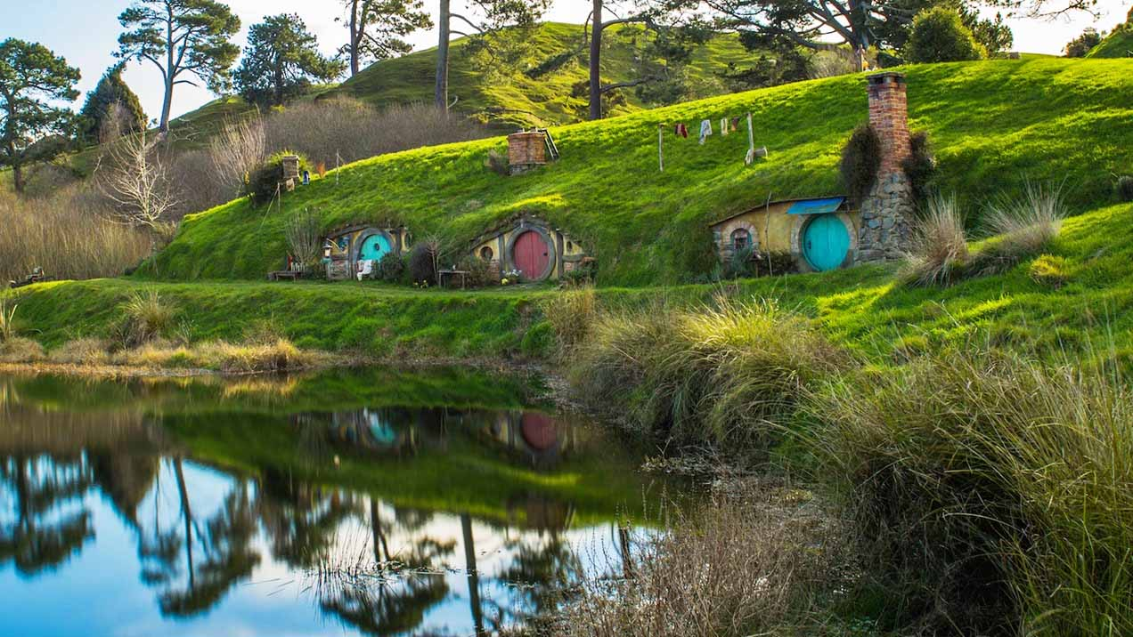
The Hobbiton Movie Set was a significant location used for The Lord of the Rings film trilogy and The Hobbit film series. It is situated on a family run farm in Waikato.

Slide 13
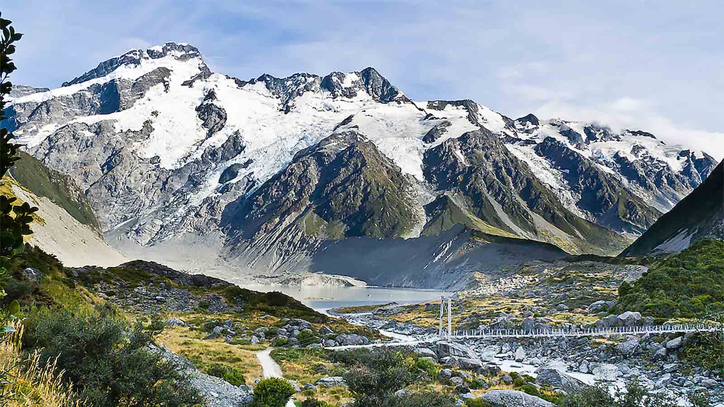
The Hooker Valley Track is the most popular short walking track within the Aoraki / Mount Cook National Park in New Zealand.

Slide 14
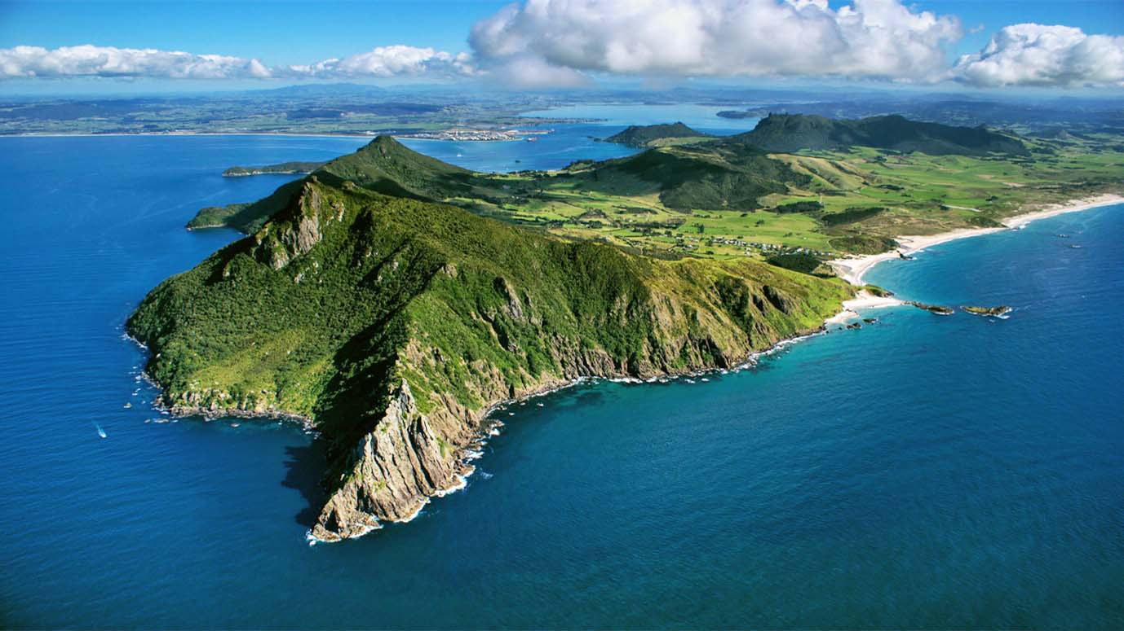
The Whangarei Heads Peninsula. Whangarei Heads and Bream Head Coast is ideal for Long Walks.

Slide 15
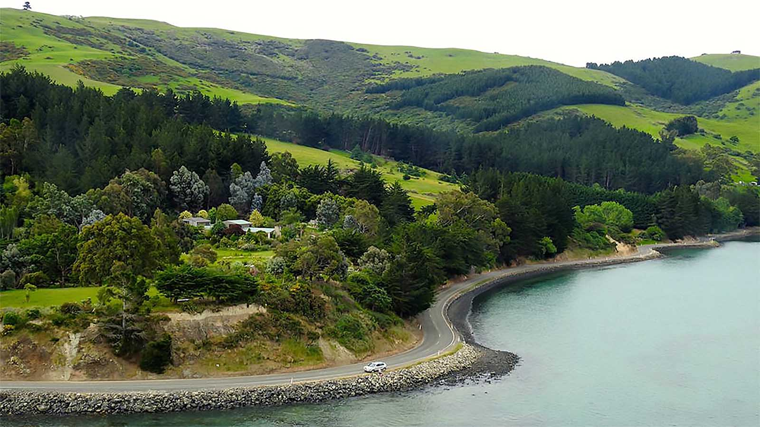
Breathtaking countryside drives of Dunedin

Slide 16
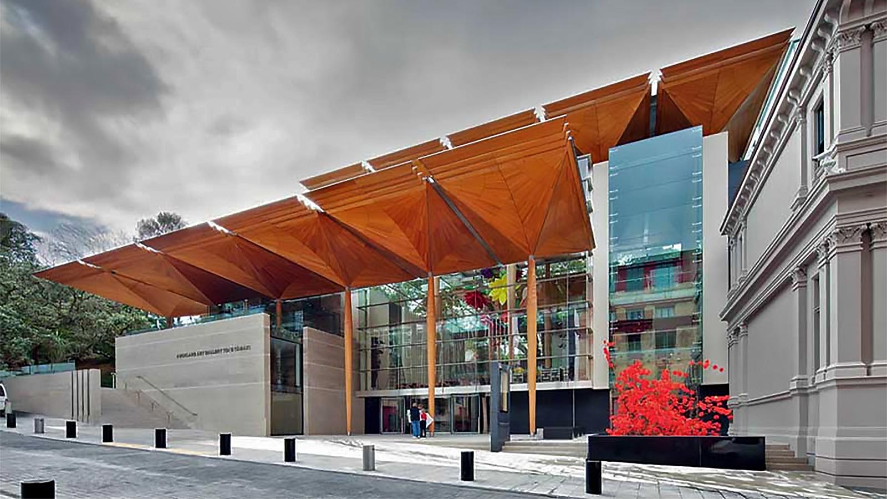
Auckland Art Gallery Building (Toi o Tāmaki)

Slide 17
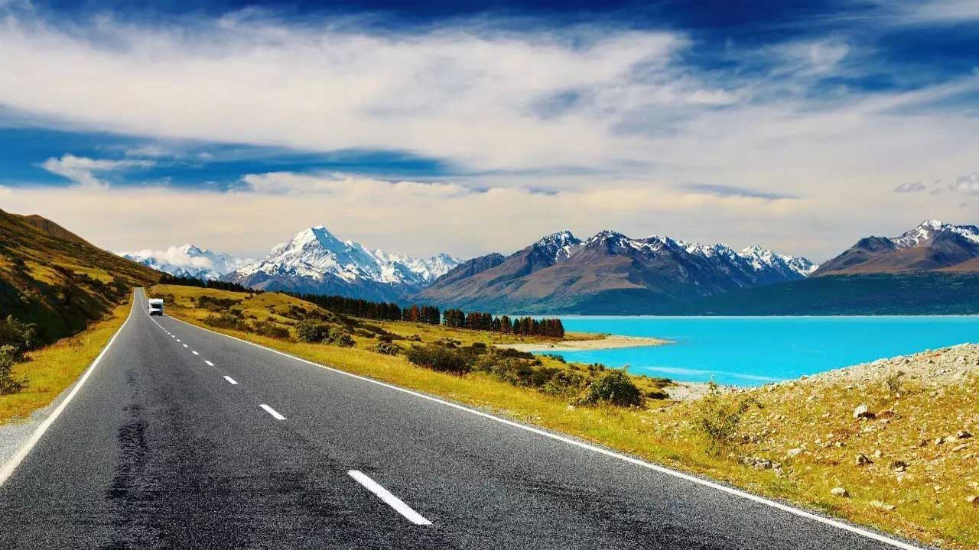
Road Trip New Zealand Lake Tekapo, South island

Slide 18
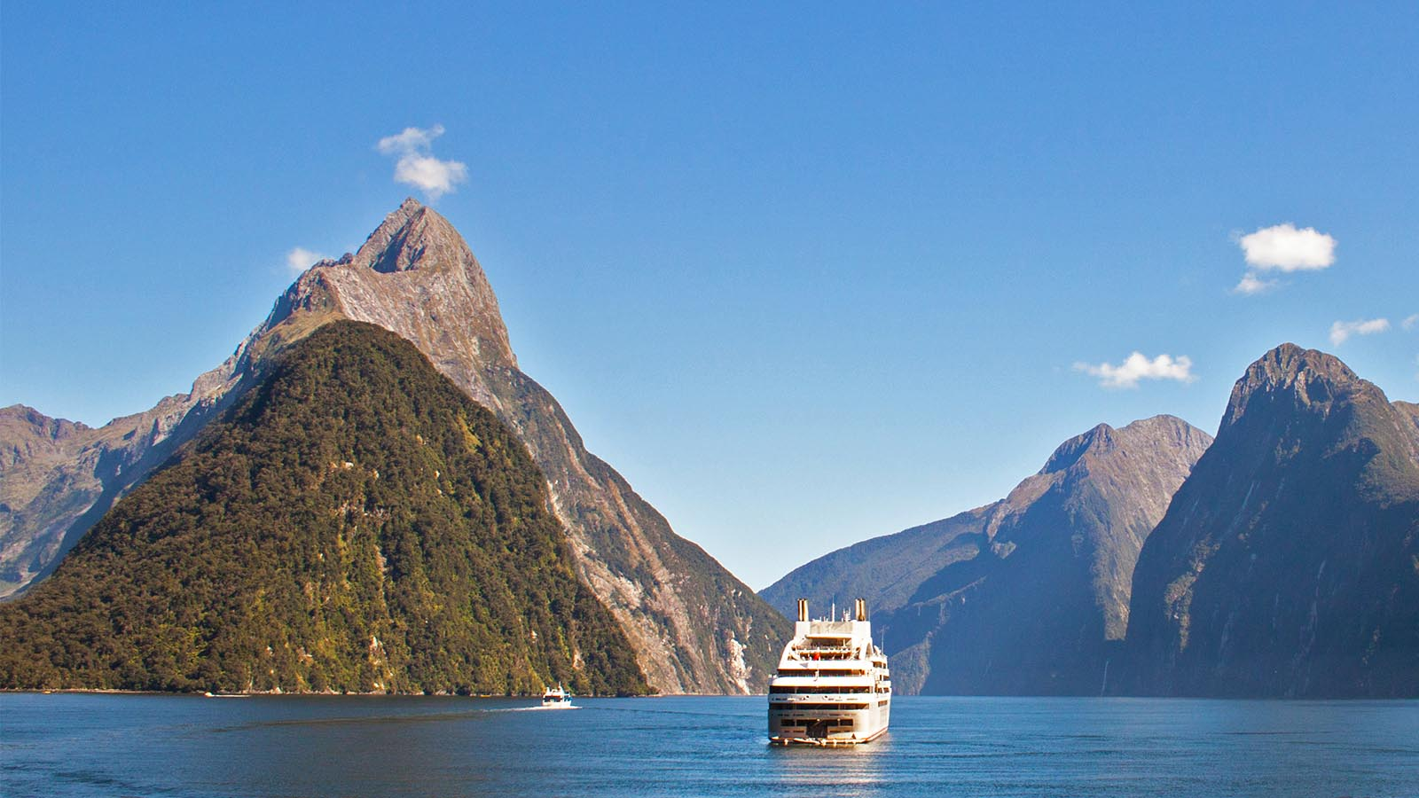
Fiordland National Park, Milford Sound, South Island

Slide 19
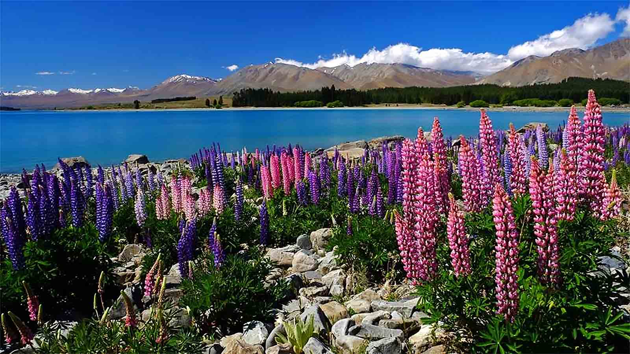
Blooming Lupins by the shores of Lake Tekapo

Slide 20
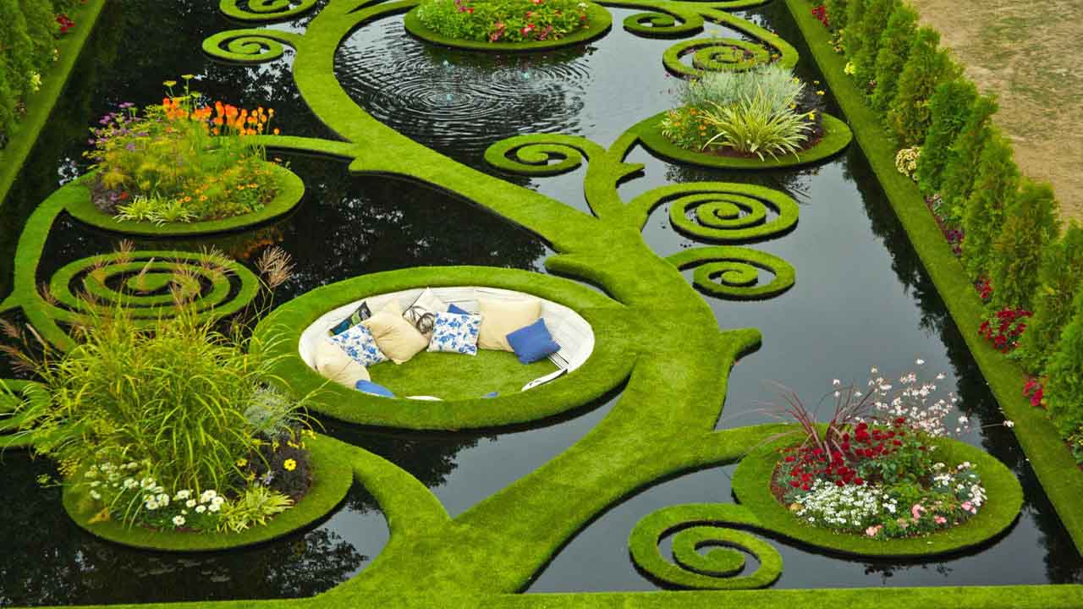
Ellerslie International Flower Show, Christchurch. A floating garden fantasy. Wow!

Slide 21
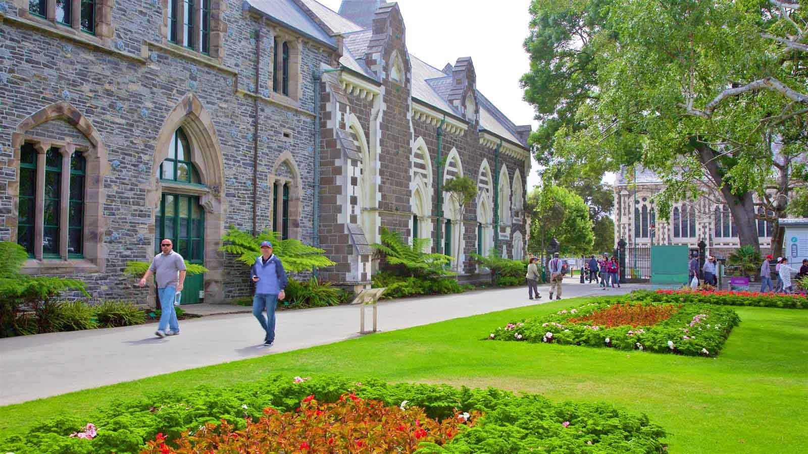
Canterbury Museum at Christchurch, South Island which includes a park and heritage architecture.

Slide 22
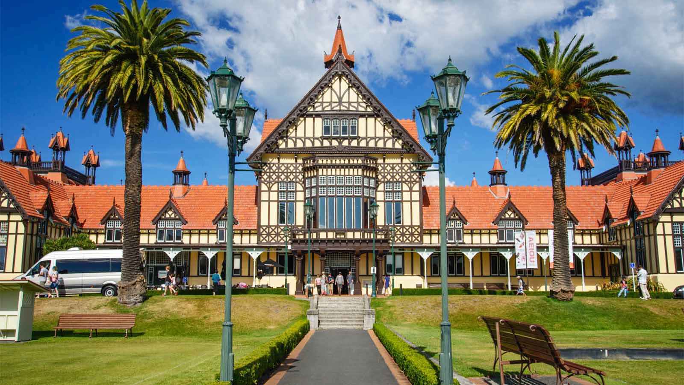
Te Puia, situated in Rotorua is home to the New Zealand Māori Arts and Crafts Insitute and the world famous Pohutu geyser.

Slide 23
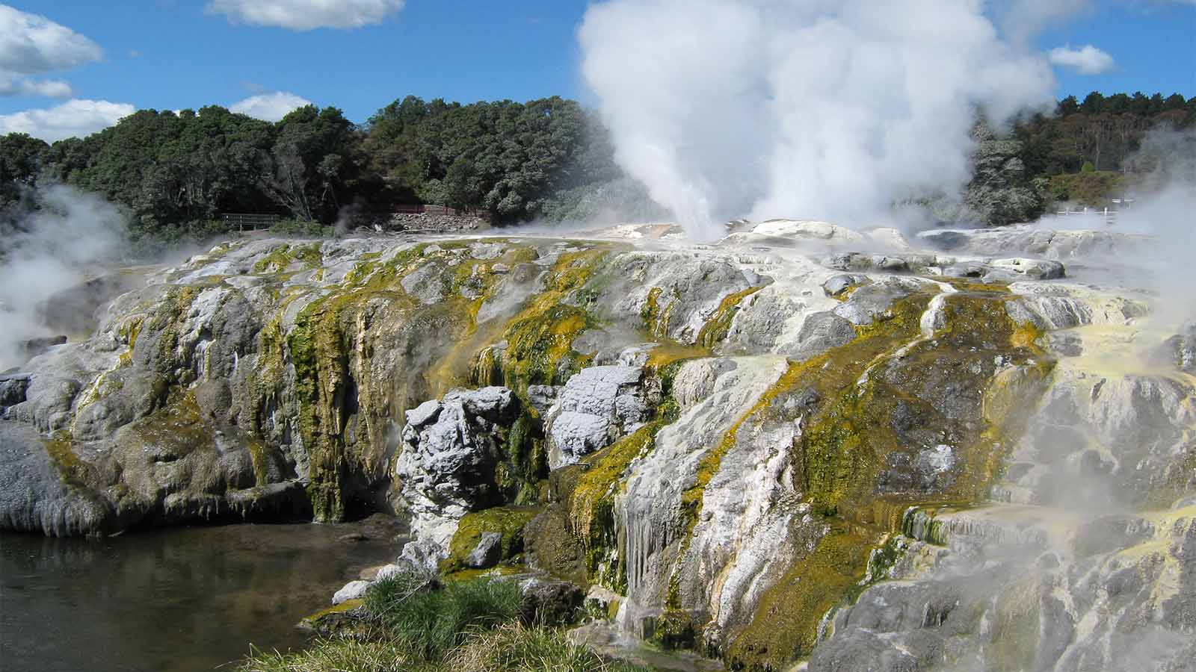
Pohutu Geyser of Rotorua

Slide 24
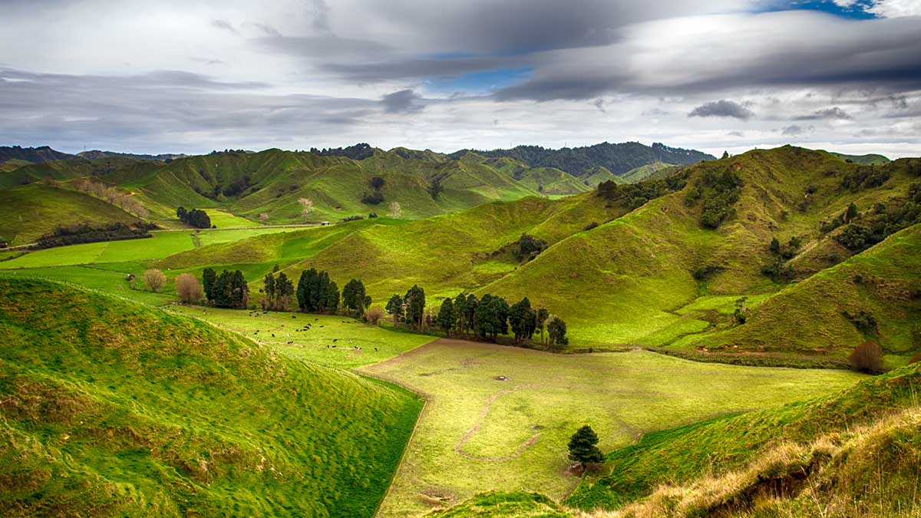
Taranaki to Taumarunui, a 158 km journey of hills, valleys and farmlands is indeed a heavenly nature travel drive.

Slide 25
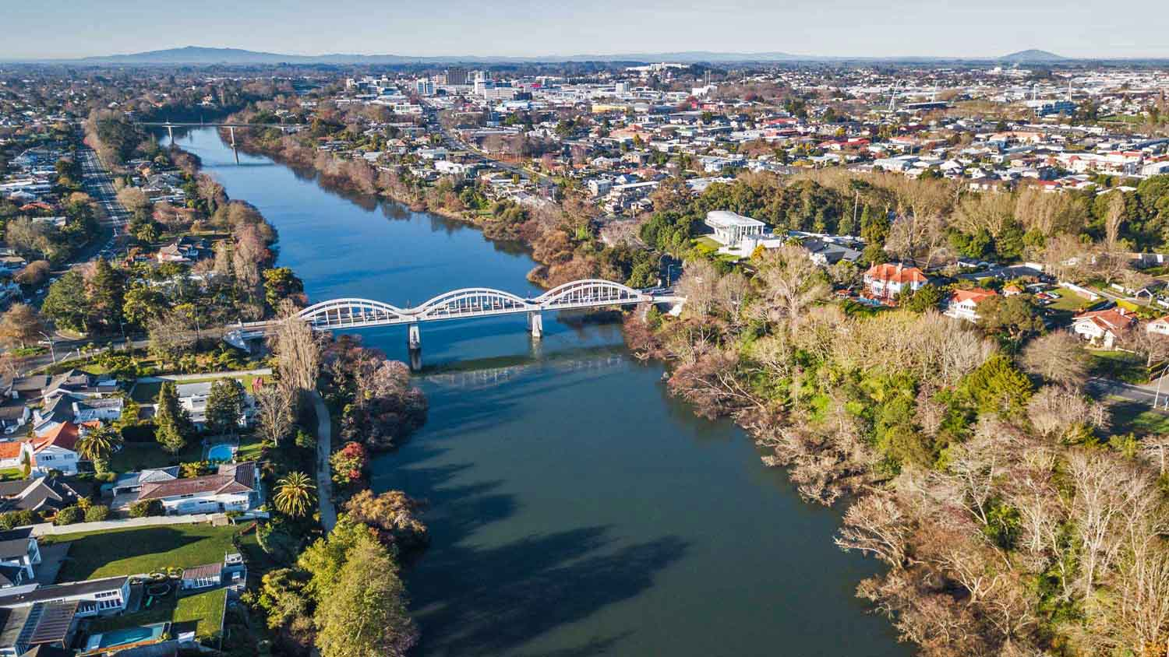
Invercargill - the southernmost city in South Island. This is a scene with the Oteri River passing through the city.

Slide 26
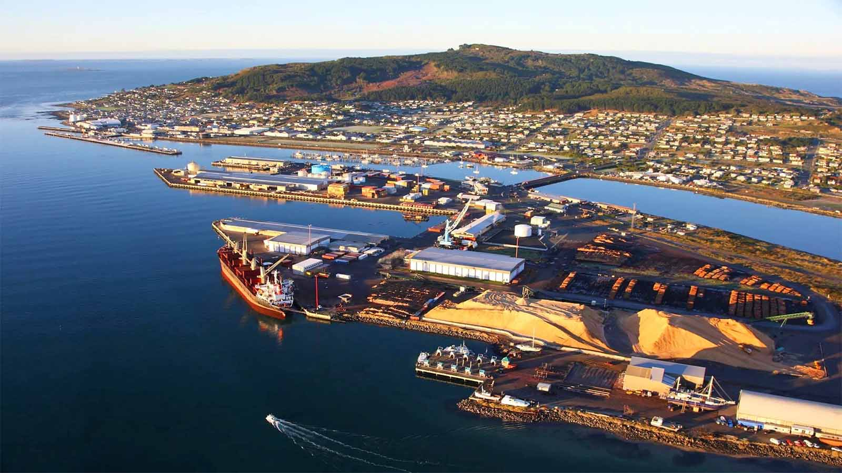
Bluff also one of Southernmost towns of New Zealand.

Slide 27
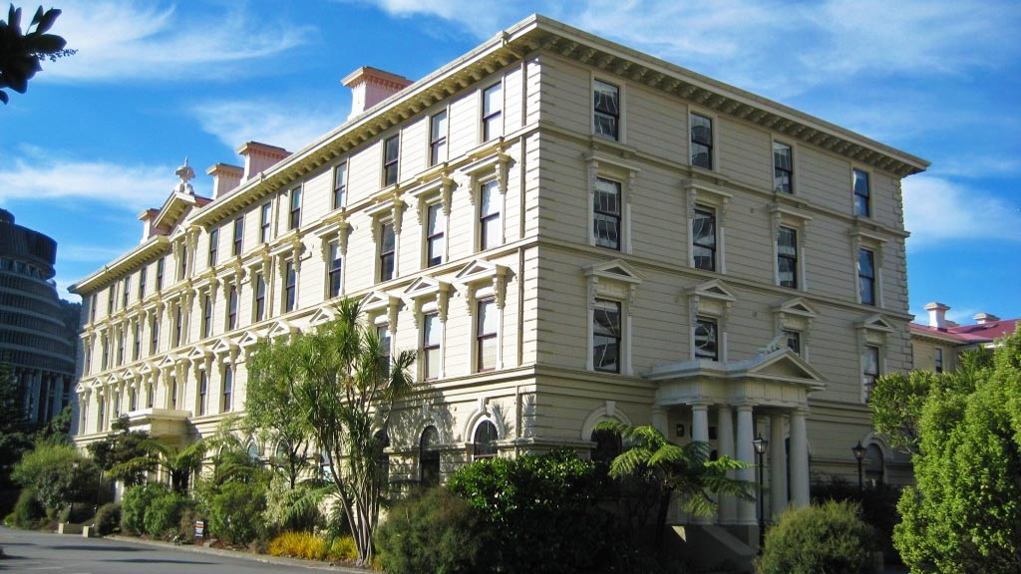
Wellington City, the capital of New Zealand with “the Old Government Building“, on Lambton Quay. This building is one of the largest wooden building in the world.

Slide 28
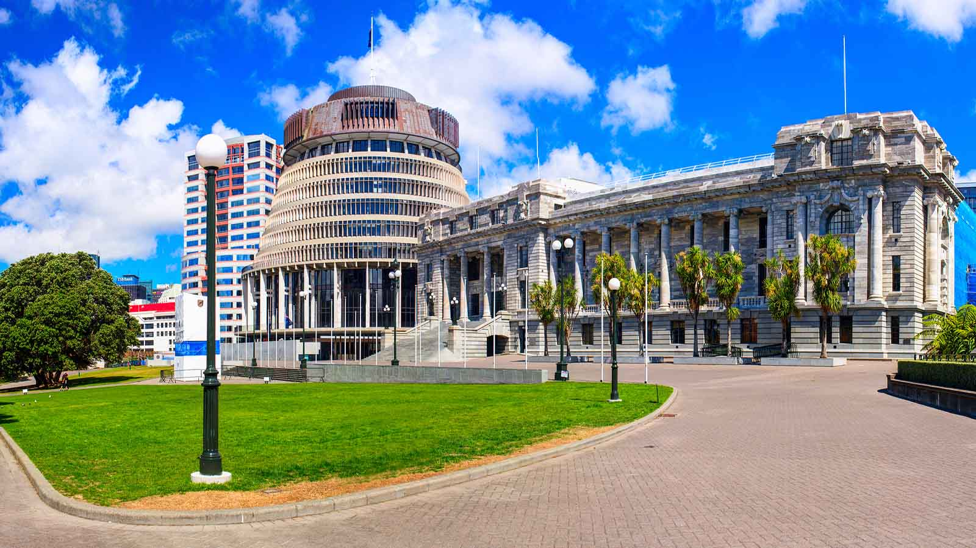
The Beehive is the name for the Executive Wing of the New Zealand Parliament Buildings, located at the corner of Molesworth Street and Lambton Quay, Wellington.

Slide 29
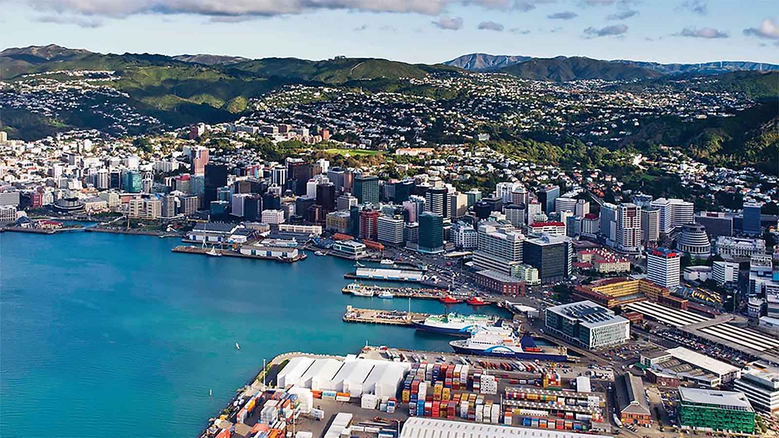
Aerial view of Wellington City

Slide 30
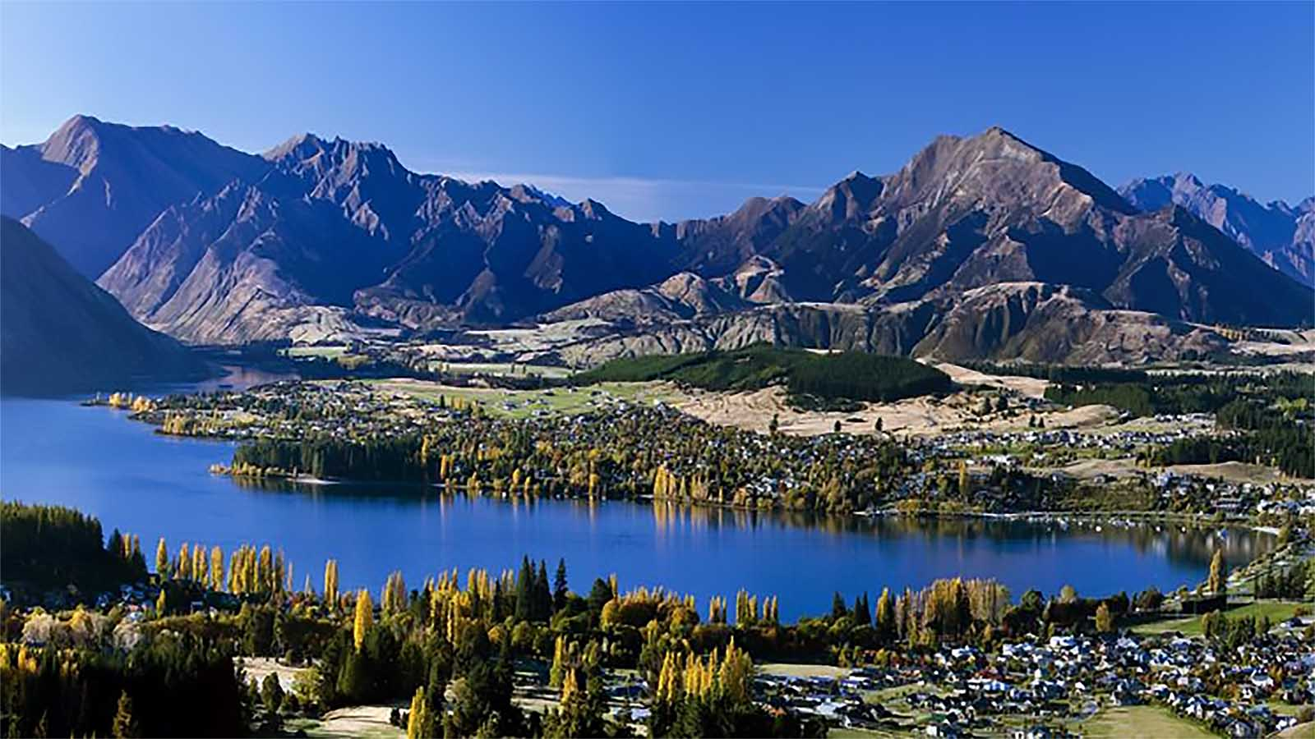
Lake Wanaka located in the Otago region, at an altitude of 300 meters covers an area of 192 km². It is New Zealand's fourth largest lake, estimated to be more than 300 m deep.

Slide 31
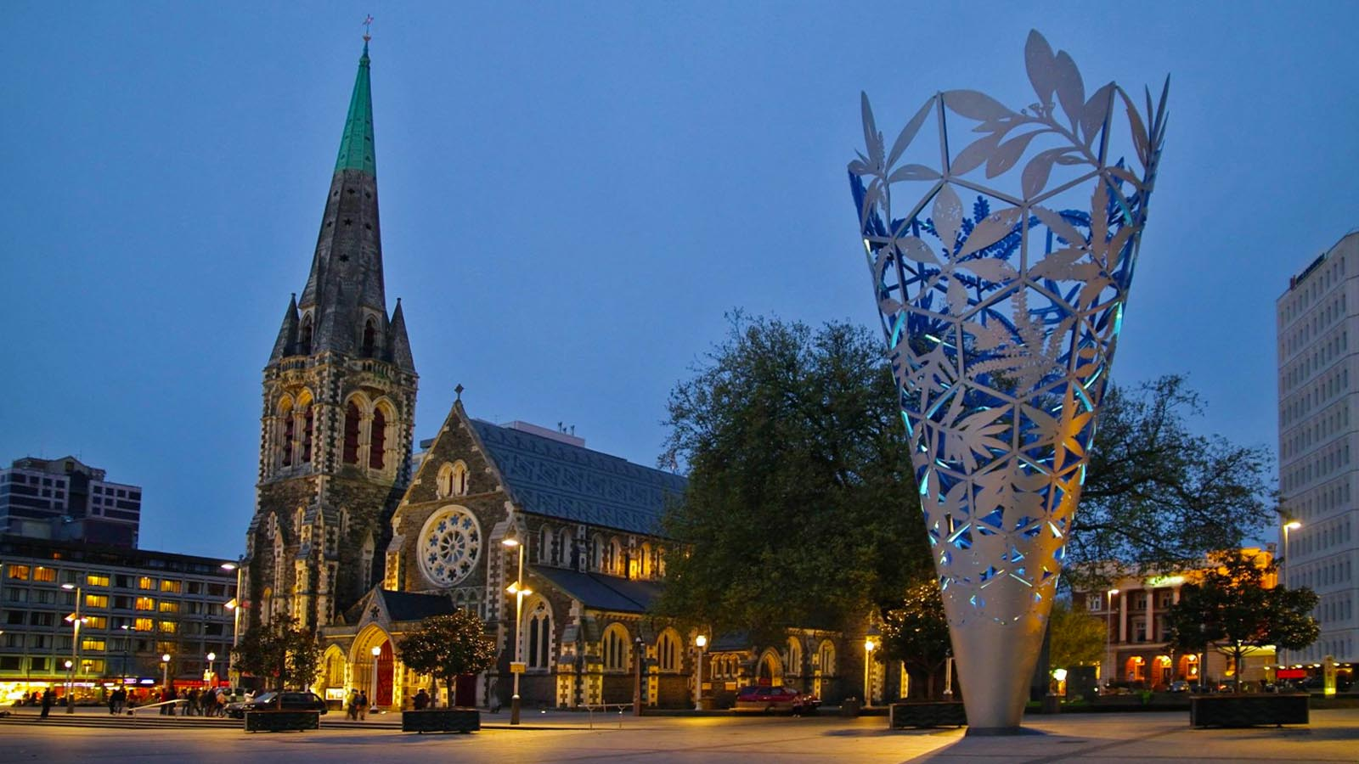
Christchurch the largest city in South Island. This is the famous Cathedral and Chalice Square.

Slide 32
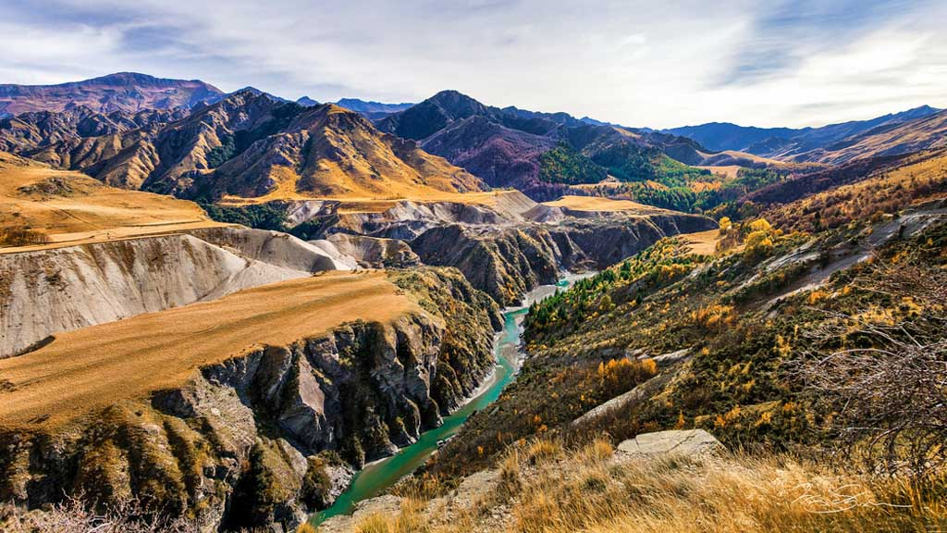
The Skippers Canyon, located in the south-west of New Zealand's South Island, is one of New Zealand's scenic places

Slide 33
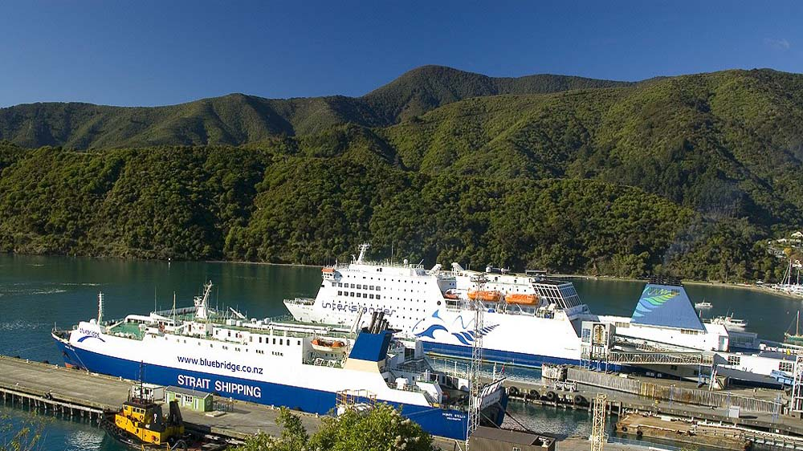
Picton of Marlborough Region on South Island.

Slide 34
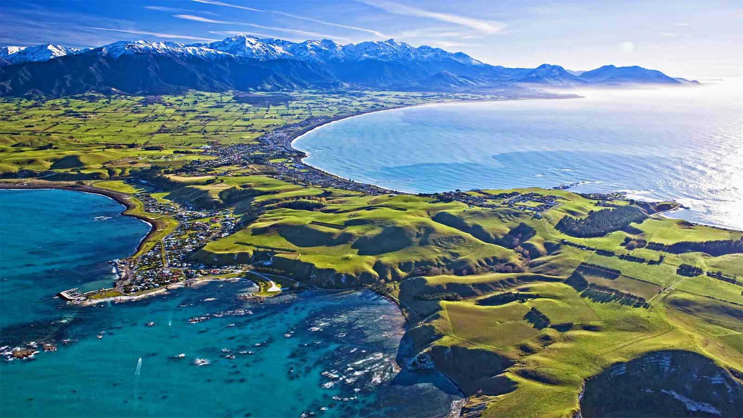
Kaikoura - the coastal town of South Island

Slide 35
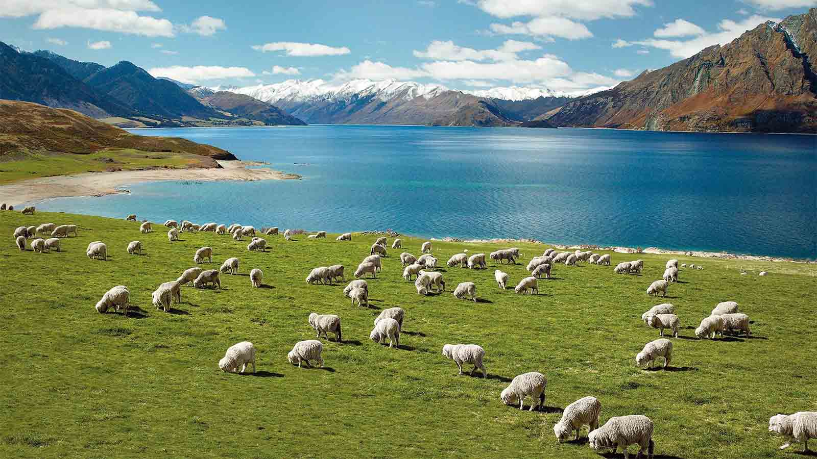
Sheep grazing in some fields of Rotorua

Slide 36
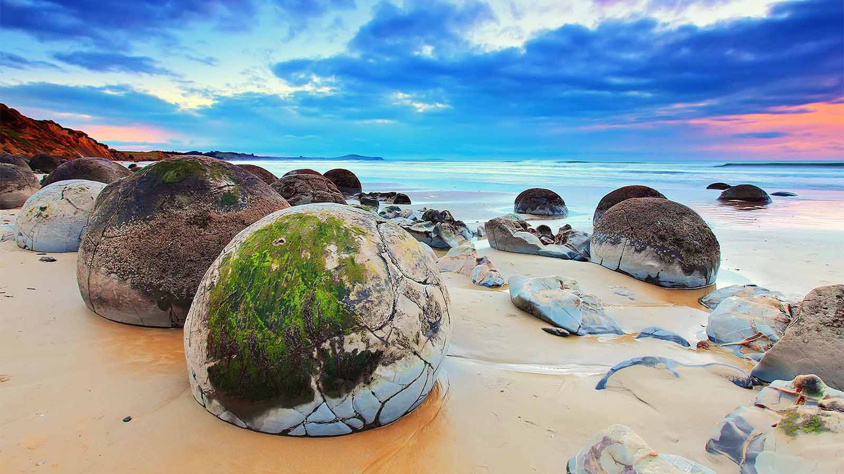
Moeraki Boulders of Otago, South Islands

Slide 37
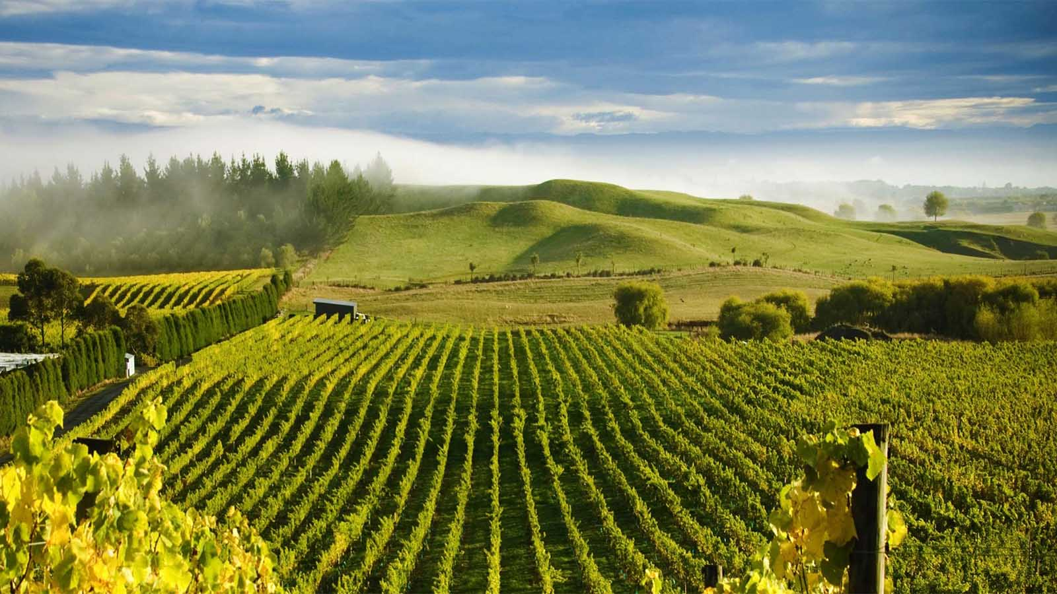
Millar Road Winery, Tuki Tuki Hills, near Napier, Hawkes Bay

Slide 38
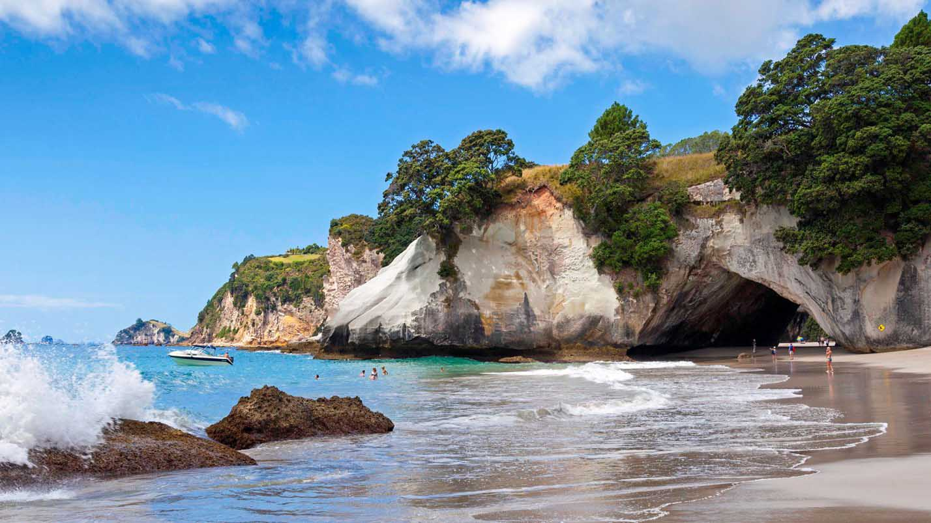
Raglan is a coastal town in the Waikato region of New Zealand’s North Island. It’s known for black-sand Ngarunui Beach.

Slide 39
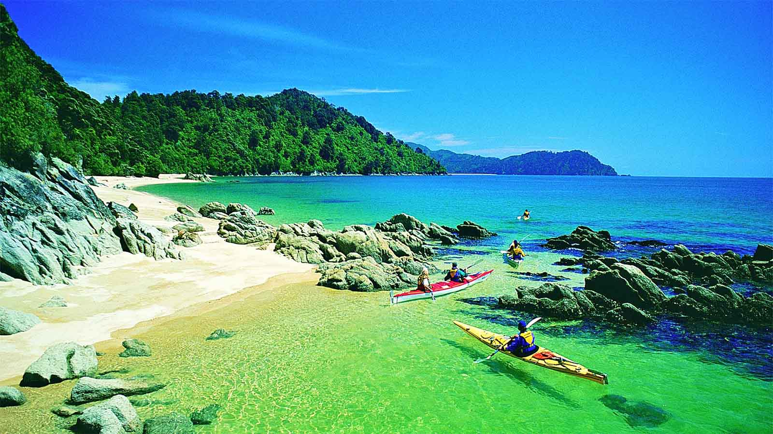
Abel Tasman National Park and the Abel Tasman Coast Track, South Island

Slide 40
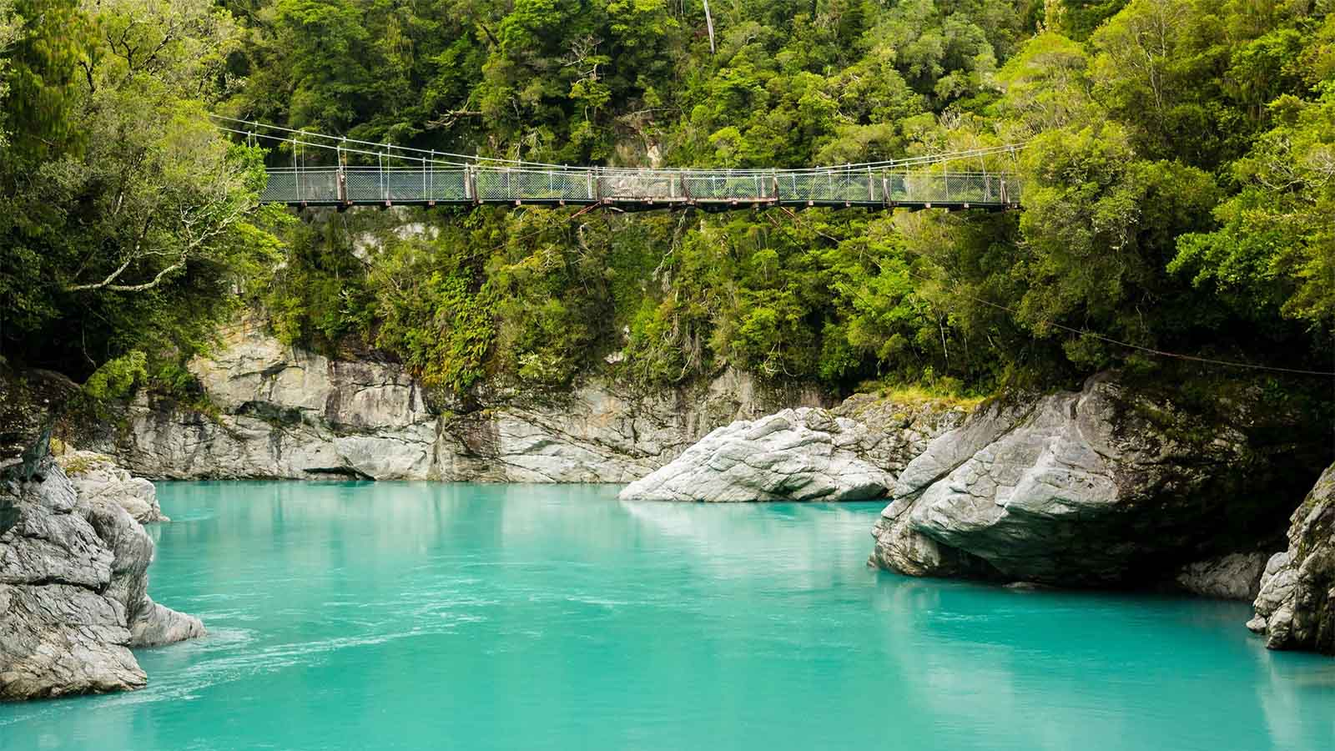
Hokitika is a township in the West Coast region of New Zealand's South Island.

Slide 41
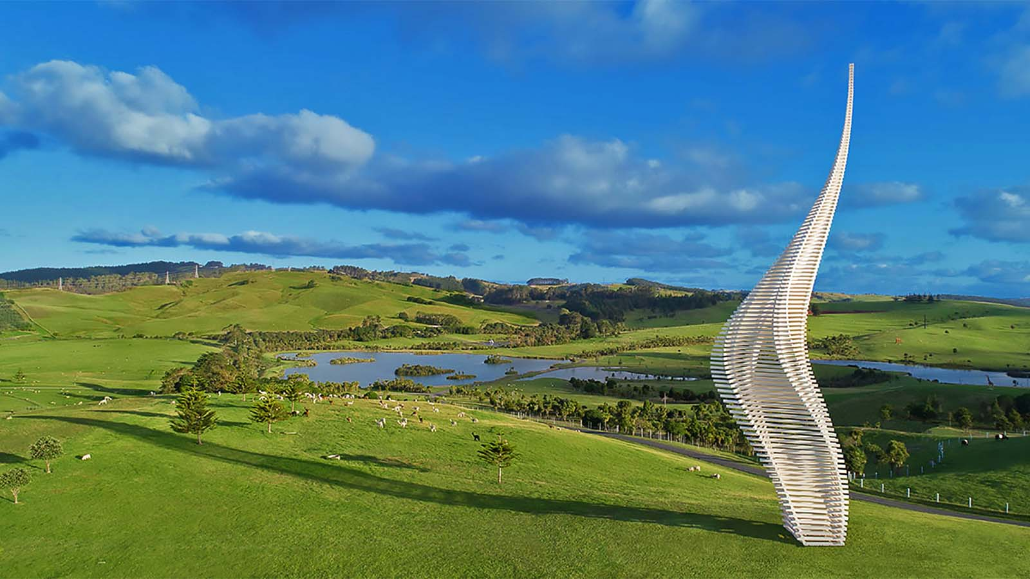
Gibbs Farm - open-air sculpture park located in Kaipara Harbour, 47 kilometres north of Auckland

Slide 42
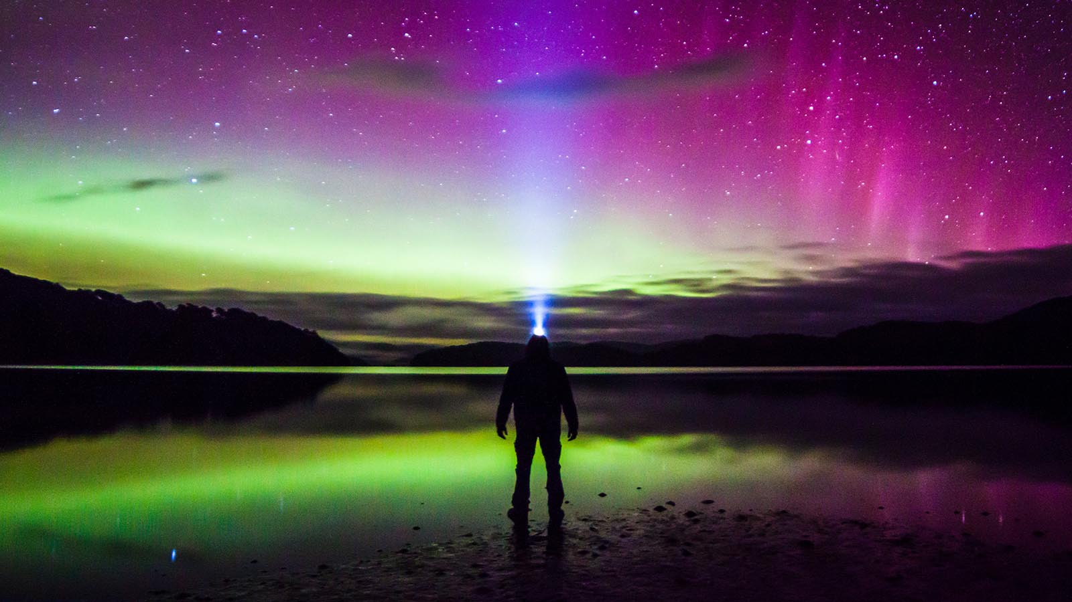
The spectacular Southern Lights (Aurora Australis) at the Stewart Islands of New Zealand.

Slide 43
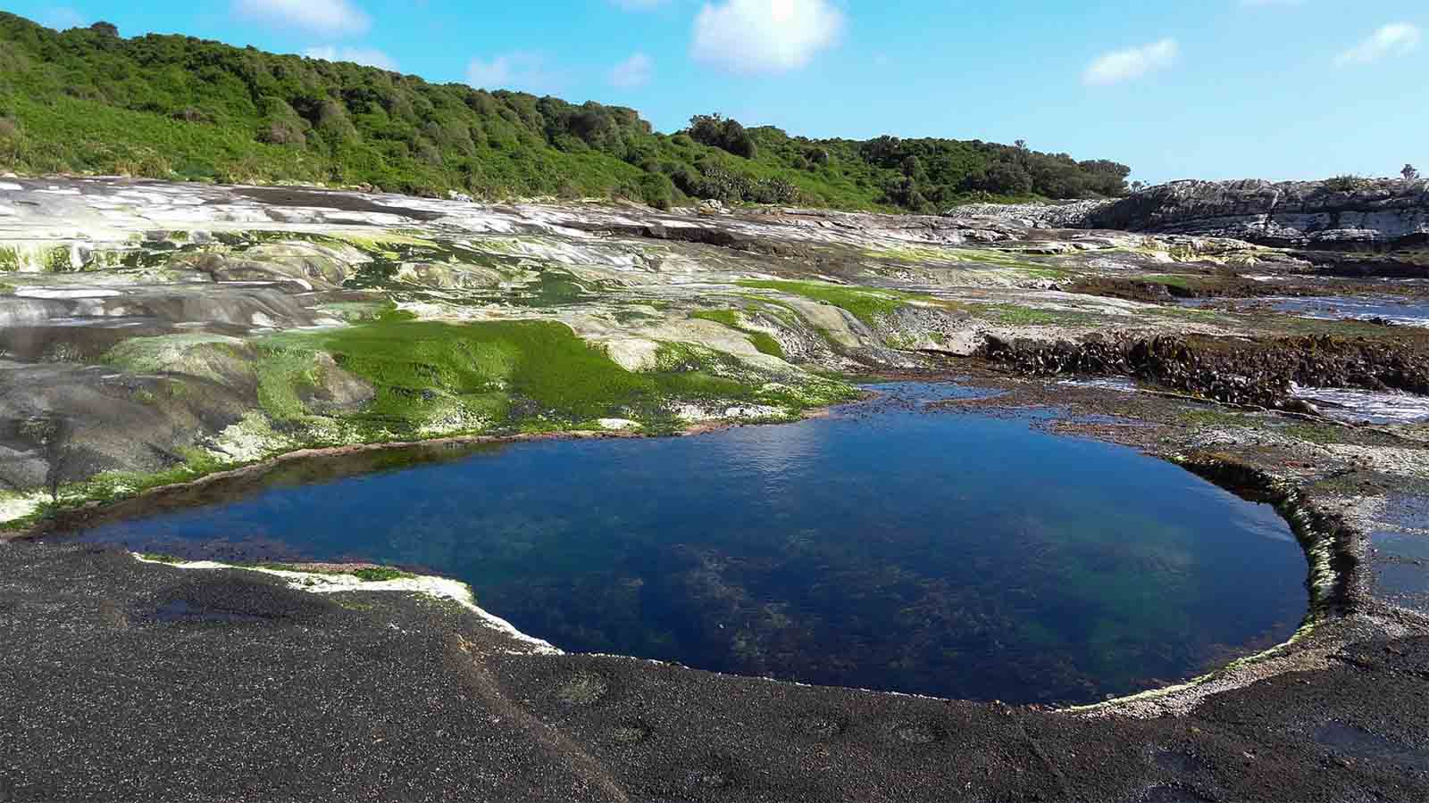
Chatham Island

Slide 44
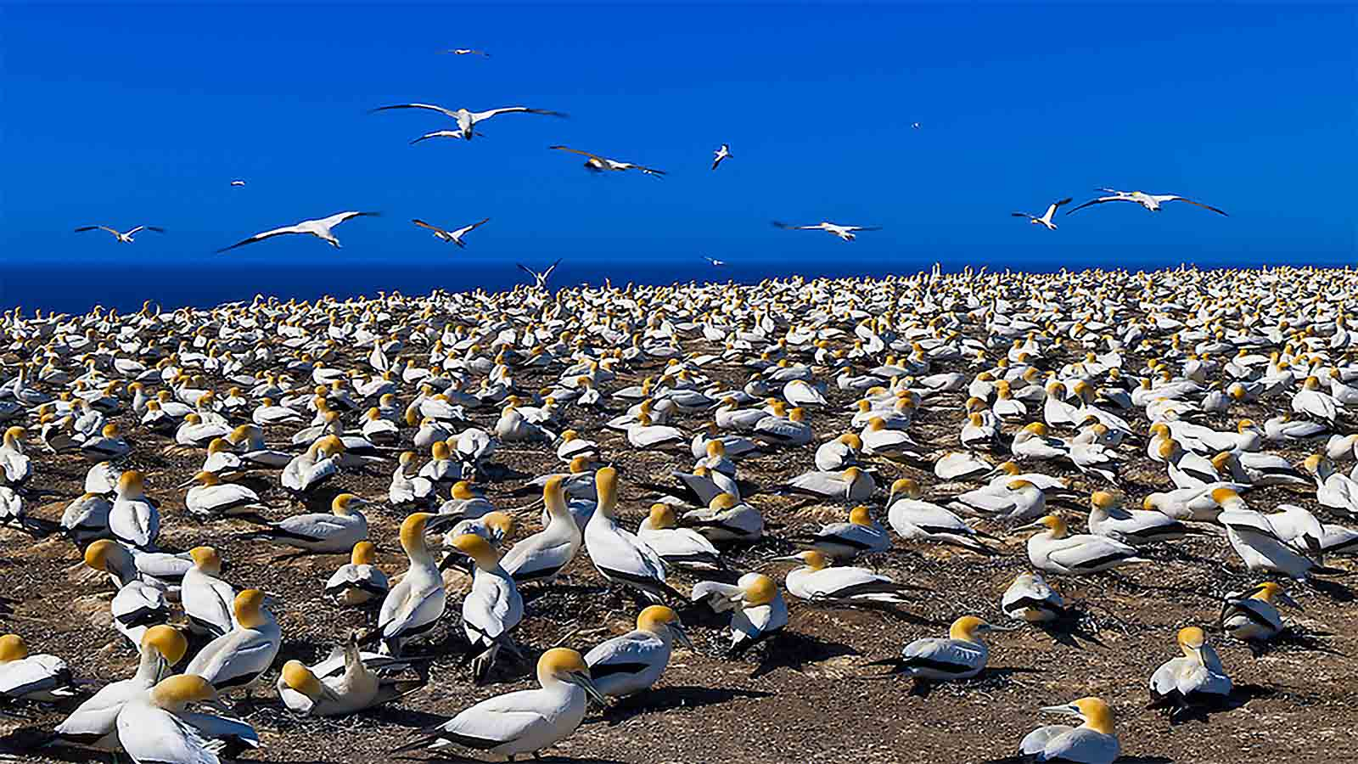
Cape Kidnappers Gannet Reserve at Hawke’s Bay is home to two gannet colonies.

Slide 45
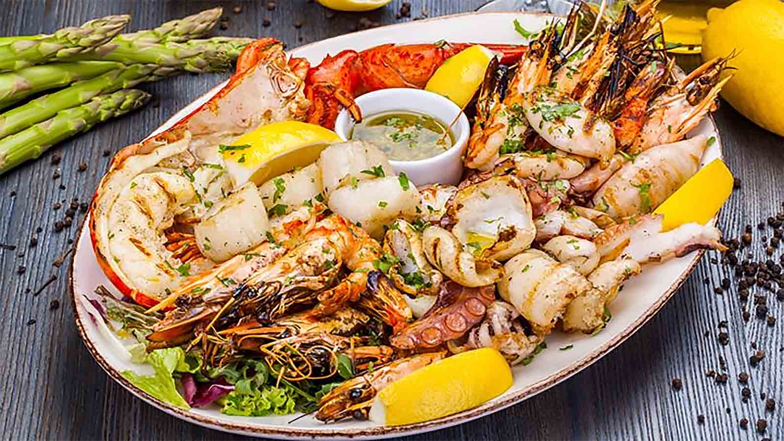
Are you ready for some seafood delights from New Zealand?

Slide 46


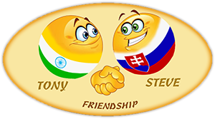
Hope you have enjoyed viewing this presentation
Have a nice day
Music : Jesse Cook - Turning
With regards - Tony Chacko and Steve Rumpler
(tonychacko2000@gmail.com / pista2011@gmail.com)

Slide 47







¿Te ha gustado?
Puedes ver más entrando
Aquí
Además puedes recibir powerpoints en tu correo electrónico suscribiéndote aquí:
F I N

