Slide 1

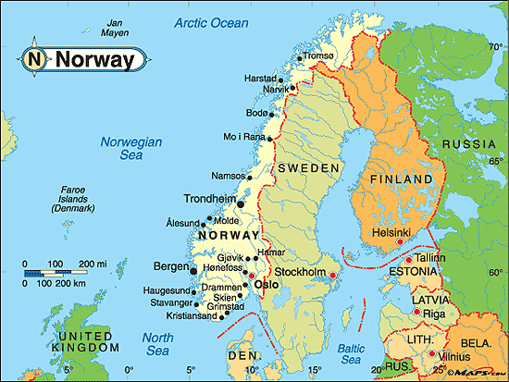


Norway
Norway is a Scandinavian country encompassing mountains, glaciers and deep coastal fjords. Oslo, the capital, is a city of green spaces and museums. Preserved 9th-century Viking ships are displayed at Oslo’s Viking Ship Museum. Bergen, with colorful wooden houses, is the starting point for cruises to the dramatic Sognefjord. Norway is also known for fishing, hiking and skiing, notably at Lillehammer’s Olympic resort.
Capital City - Oslo
Area - 385,252 km²
Population - 5.3 million
Compiled by - TONY CHACKO
Technical cooperation - Steve Rumpler

Slide 2
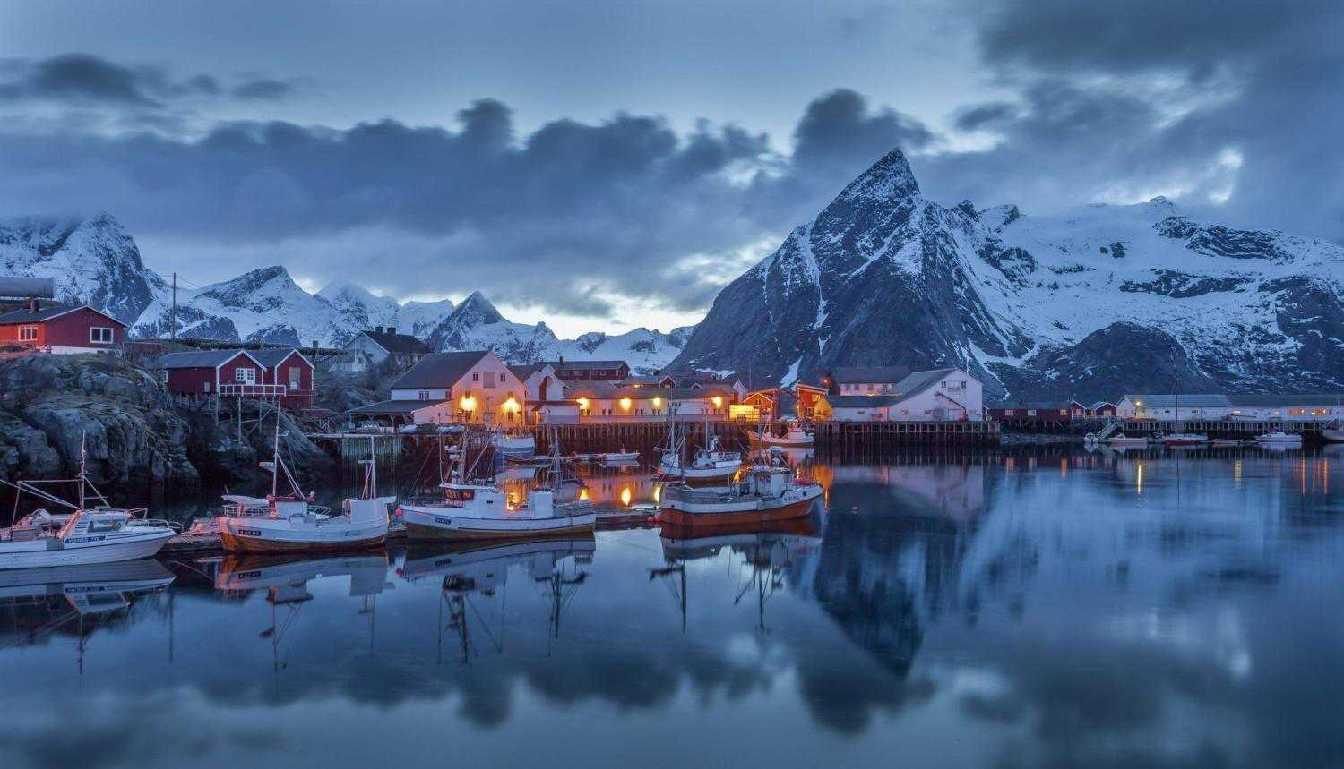


Slide 3
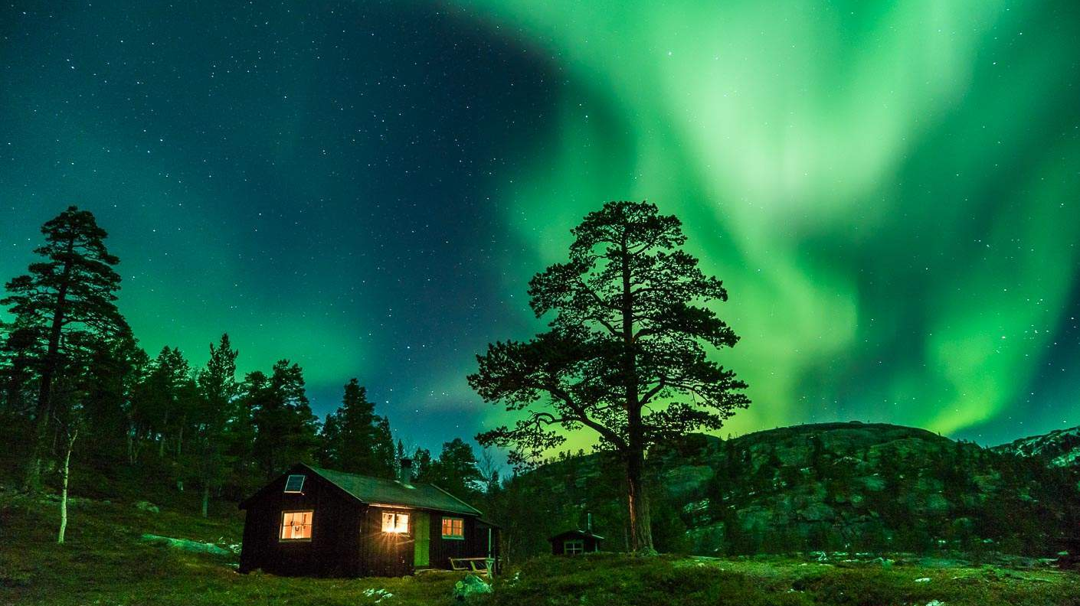
Northern Lights over Norway

Slide 4
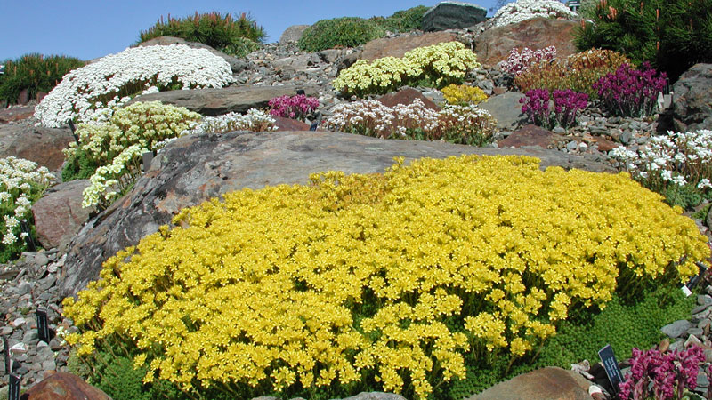
The Arctic Botanic Garden of Tromso

Slide 5
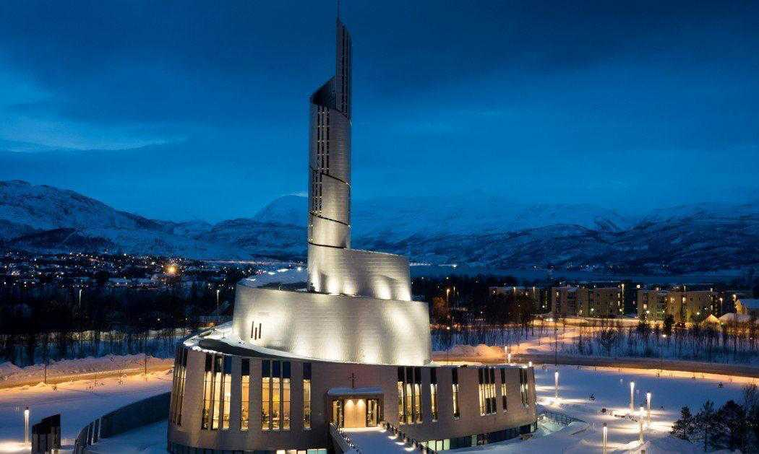
Northern Lights Cathedral in Alta

Slide 6
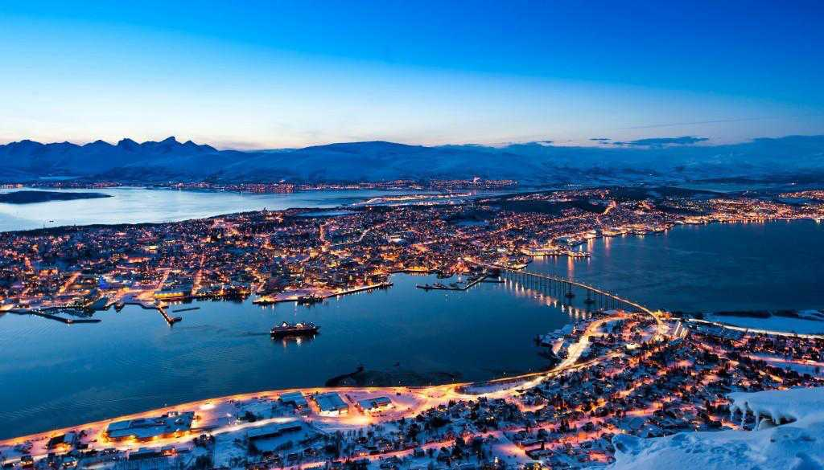
Night view of Tromso City

Slide 7
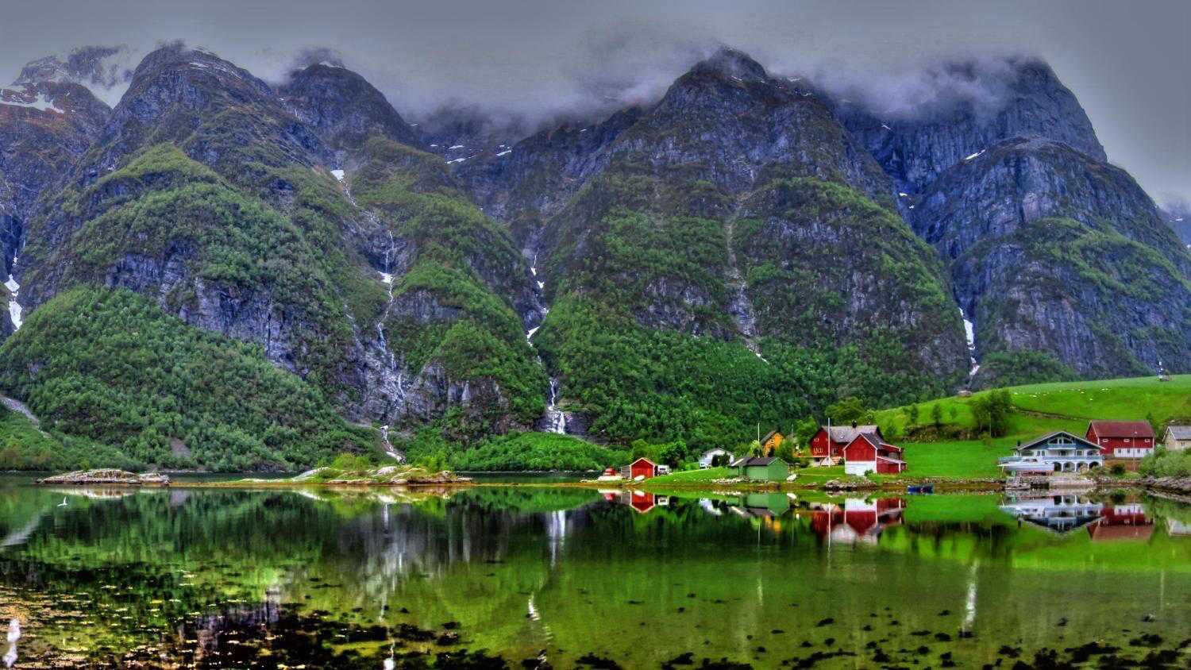
A Fjord village between Flåm to Gudvangen

Slide 8
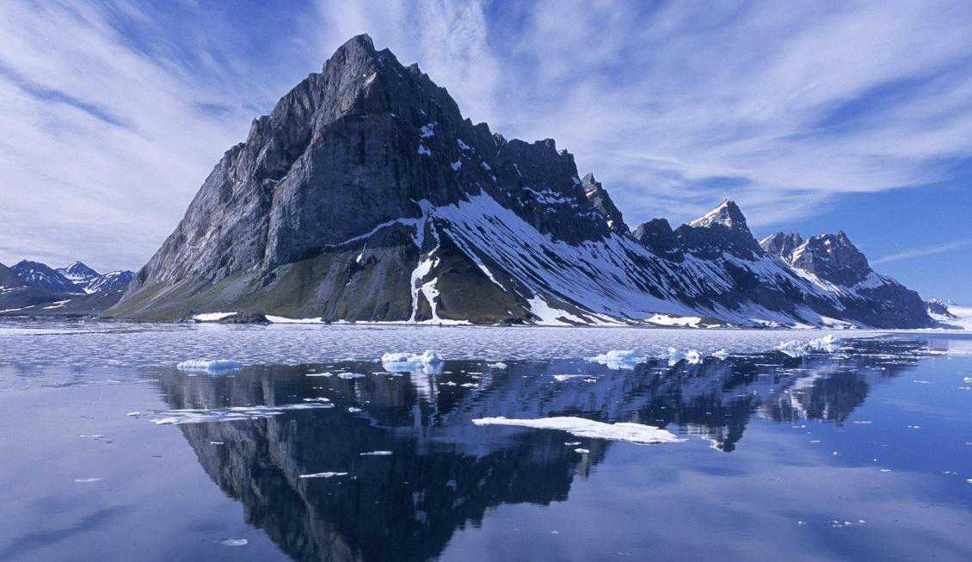

Slide 9
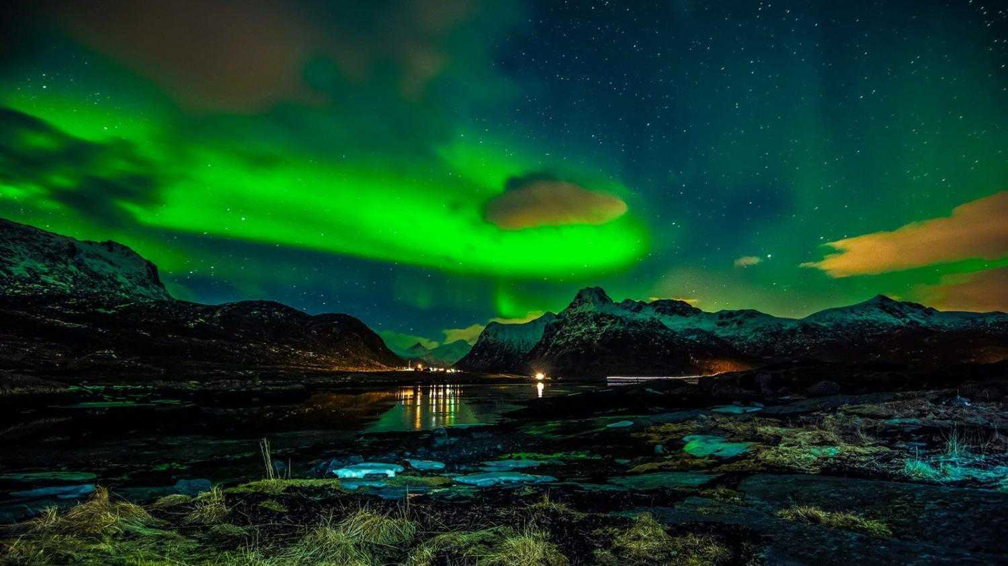

Slide 10
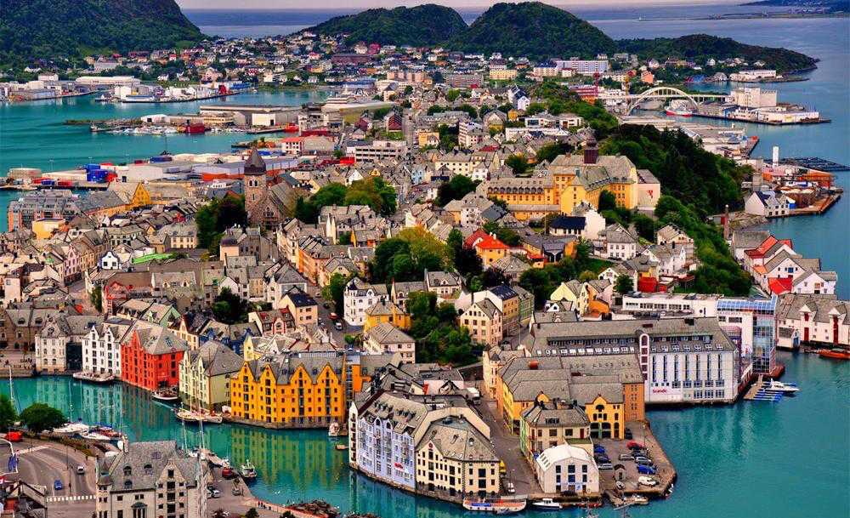
Ålesund, Sunnmøre District, Northern Norway

Slide 11
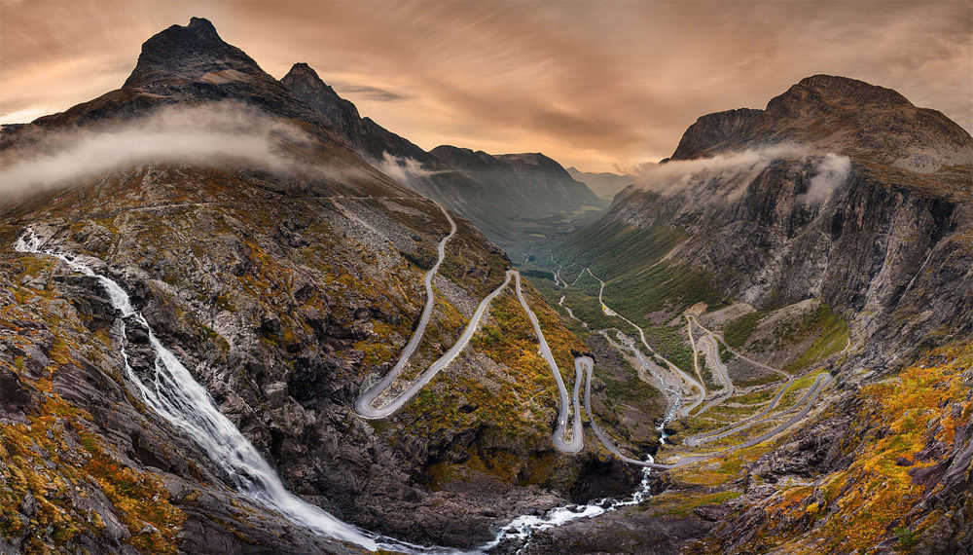
Trollstigen the mountain road in Rauma Municipality, Ramsdal County

Slide 12
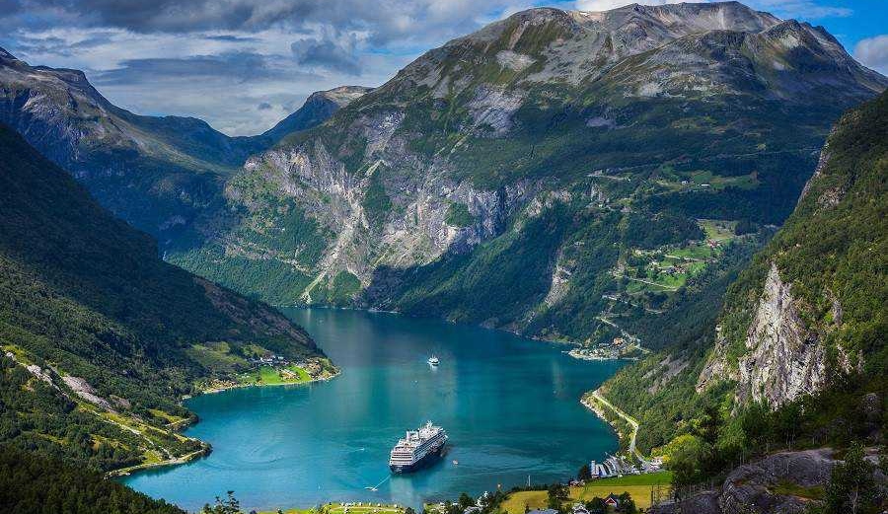
Geirangerfjord – Norway

Slide 13
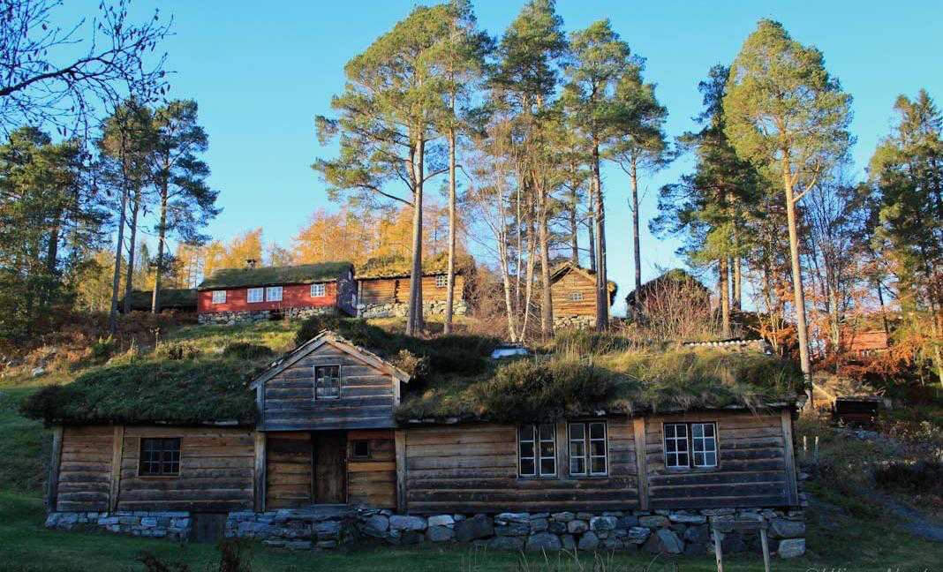
Sunnmore open air museum with 55 old and distinct old cultural houses.

Slide 14
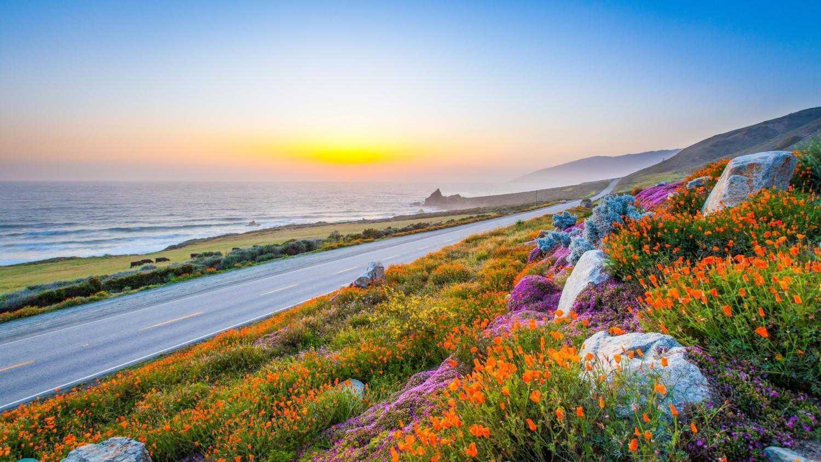

Slide 15
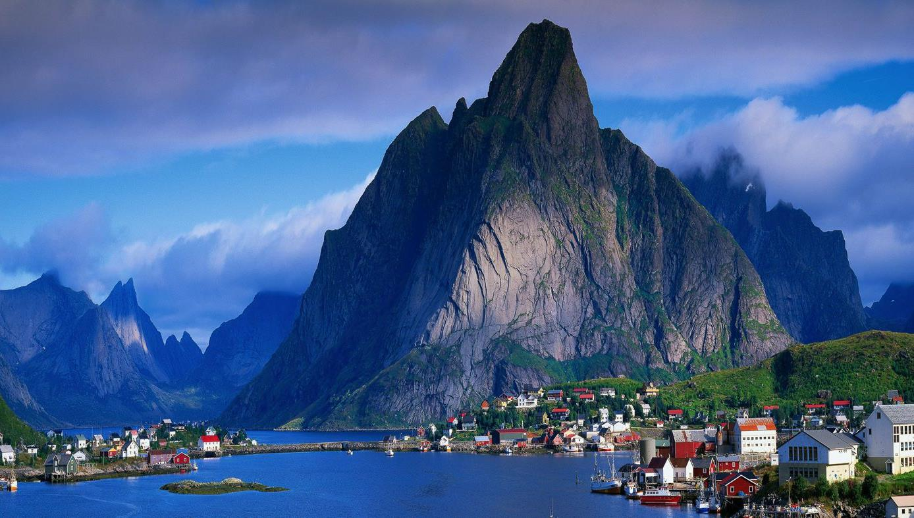
The Lofoten Archipelago in Norway

Slide 16
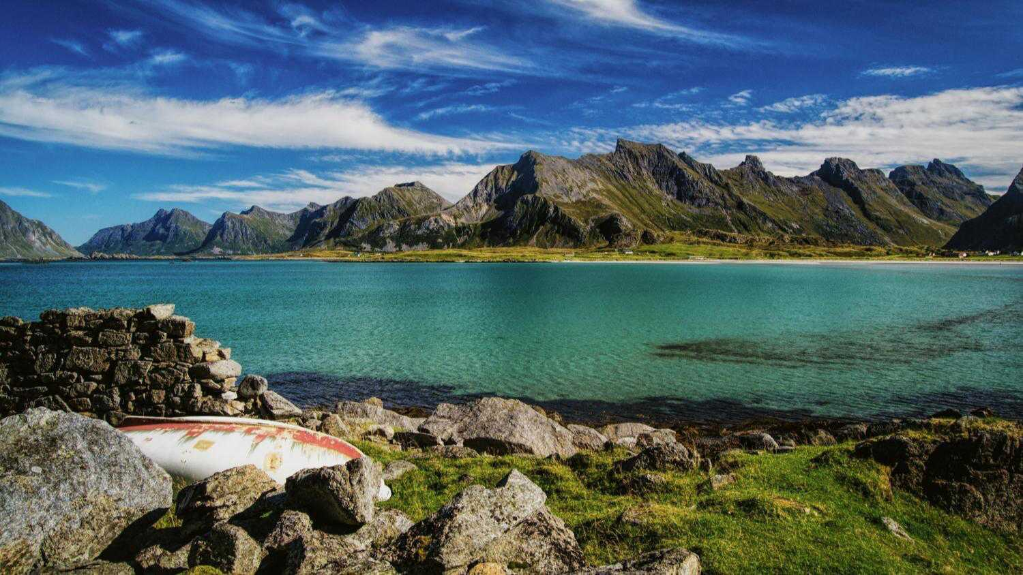
Scenic Lofoten

Slide 17
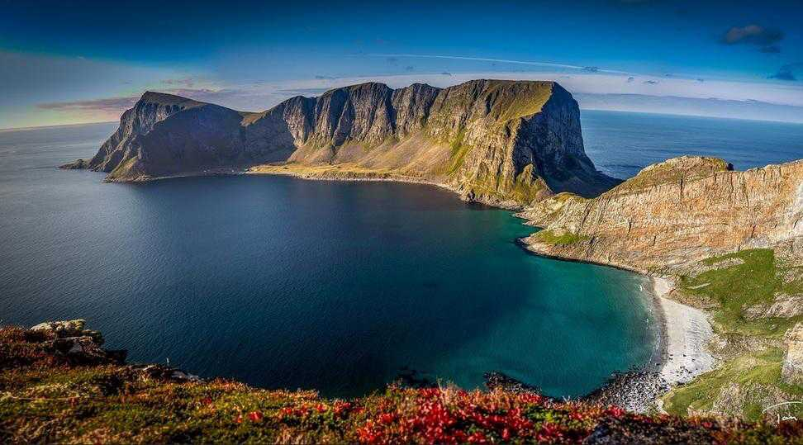
Vaeroy island, Lofoten, Norway

Slide 18
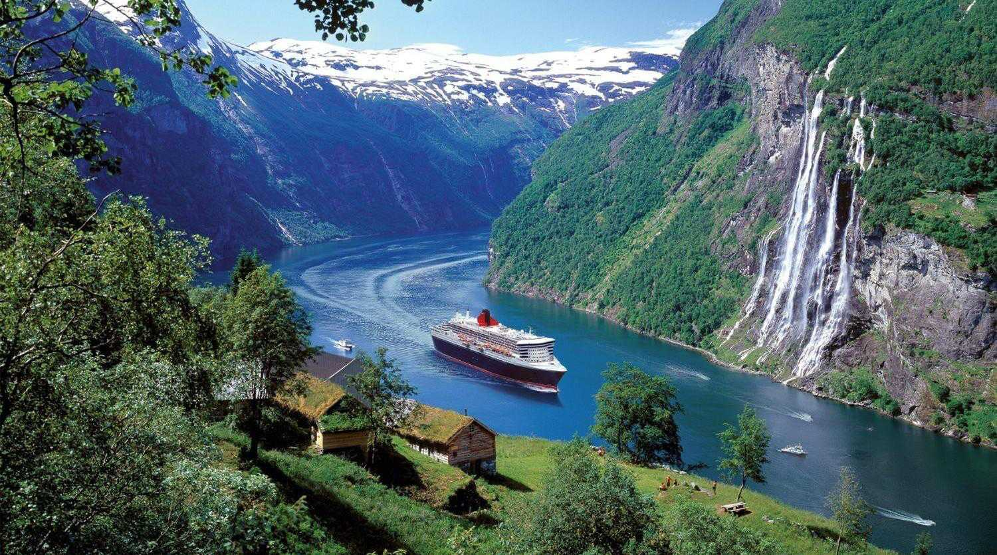
The Geirangerfjord area with the 7 Sisters Waterfalls

Slide 19
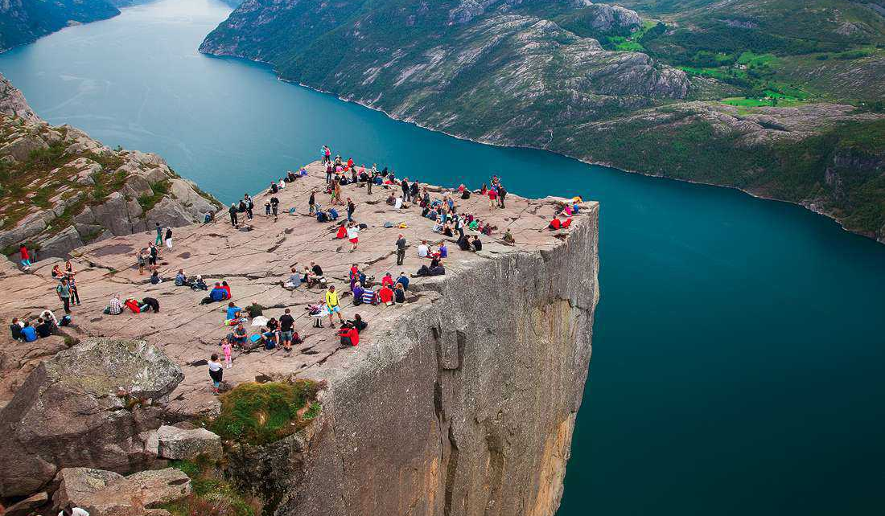
Preikestolen Pulpit Rock, Lysefjord Norway

Slide 20
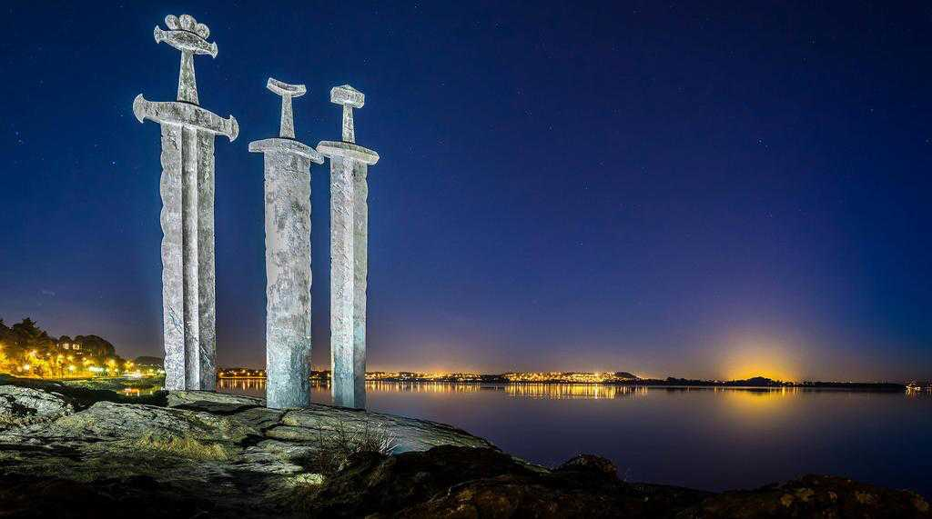
Sverd i fjell (Swords in Mountain Rock Monument), Stavanger, Norway

Slide 21
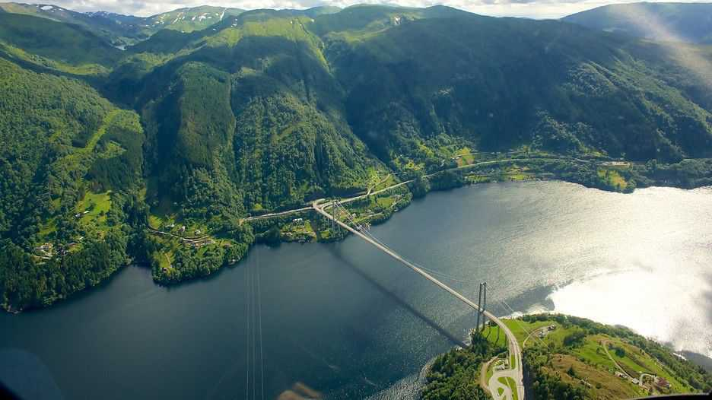
Bergen Hordaland

Slide 22
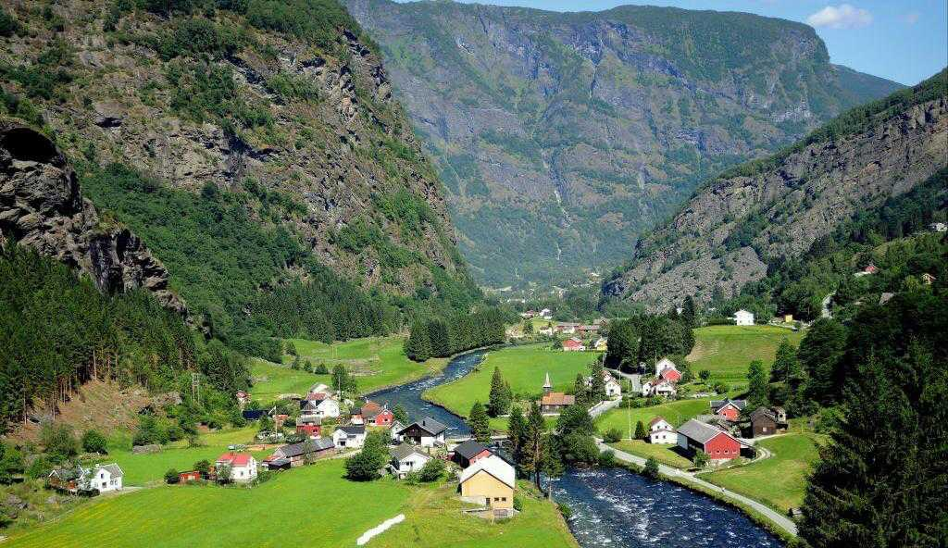
Flam, Norway

Slide 23
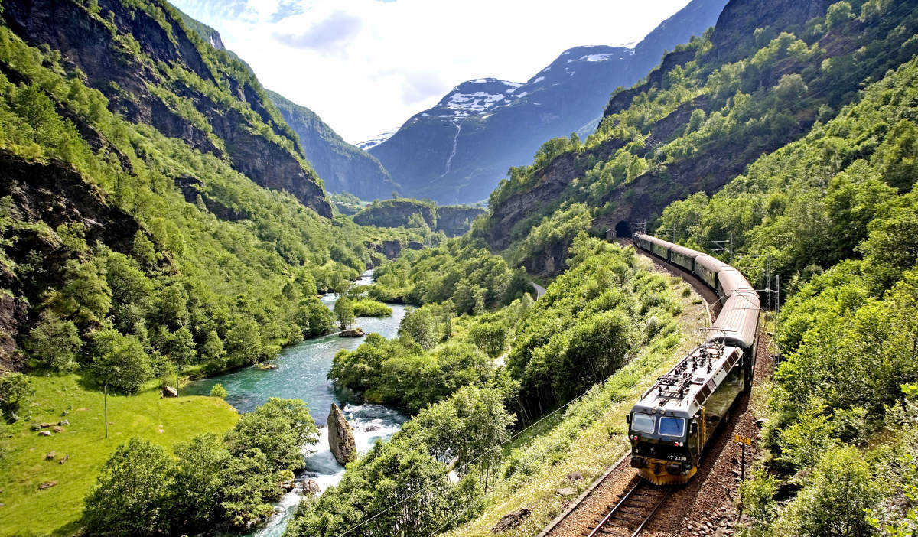
The Flåm Railway runs from Aurlands Fjord to Myrdal Station.

Slide 24
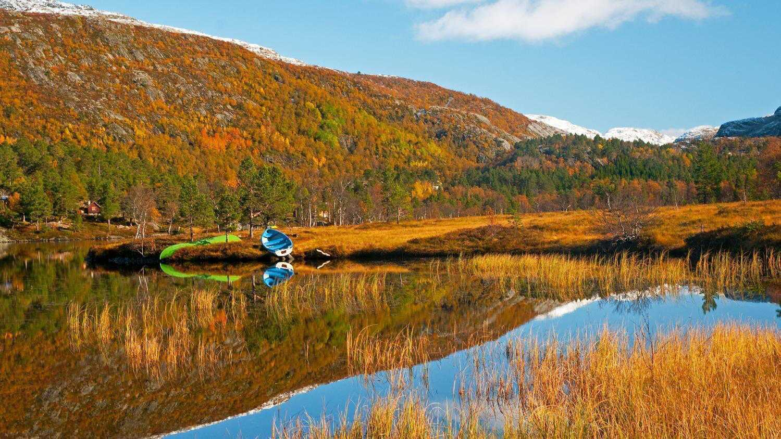
Autumn in Hordaland, Rogaland

Slide 25
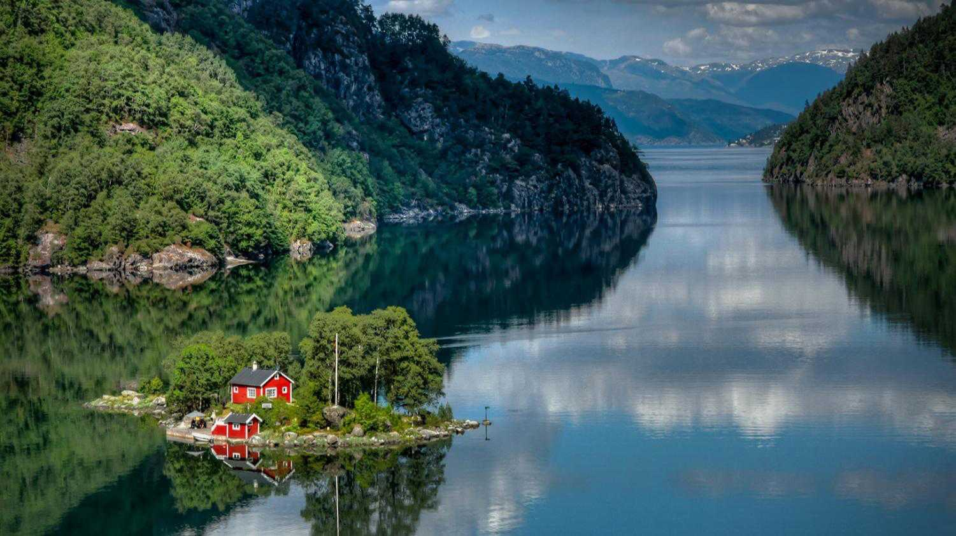
Little red house on an island, Lovrafjorden

Slide 26
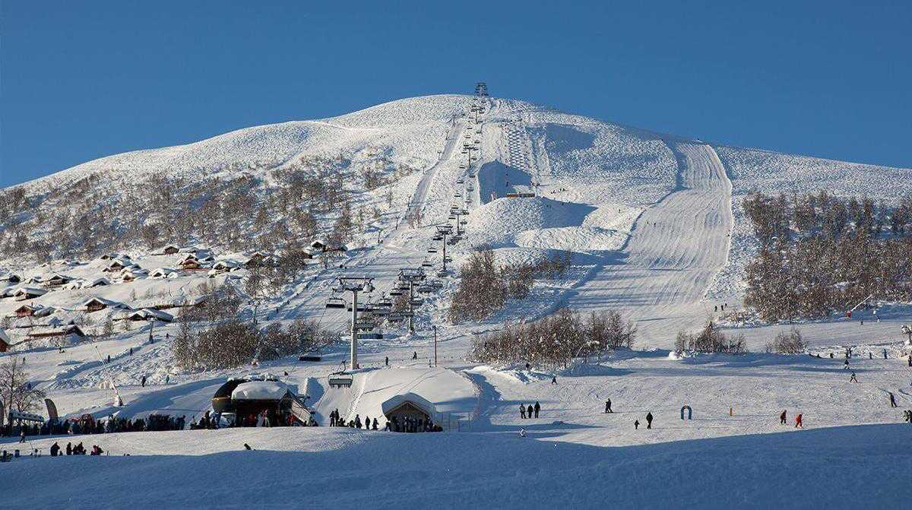
Voss Ski Resort

Slide 27
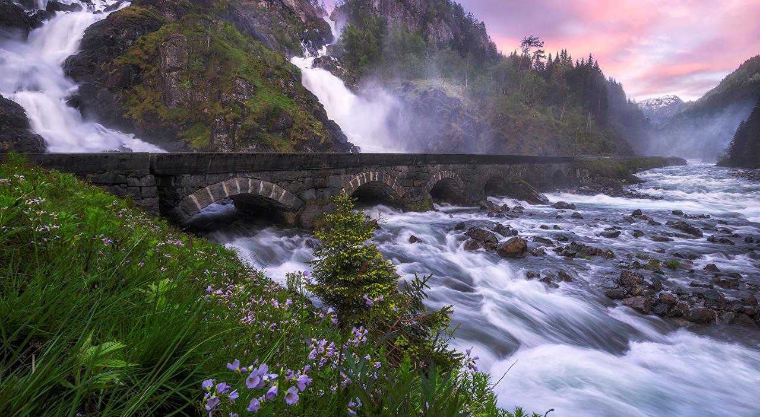
Latefossen Twin Waterfalls

Slide 28
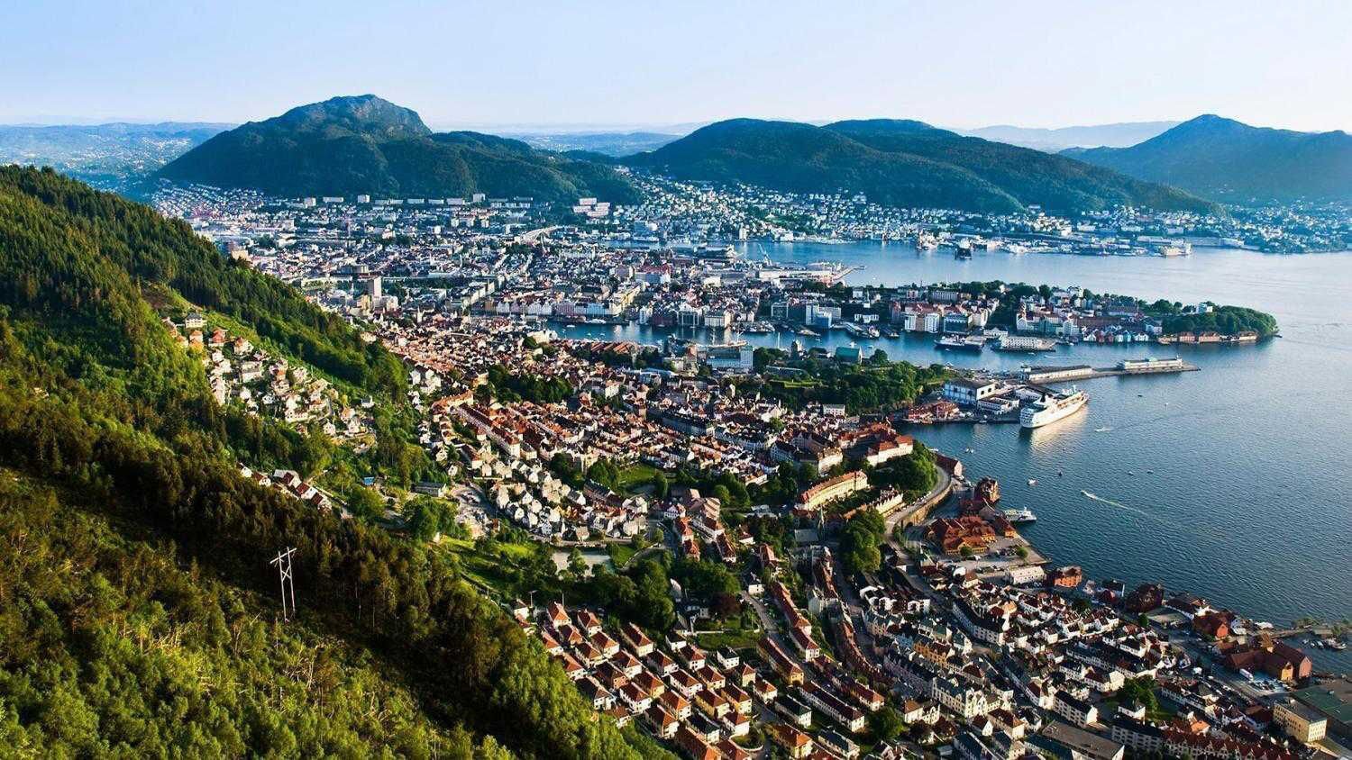
Bergen a city and municipality in Hordaland on the southwestern coast of Norway.

Slide 29
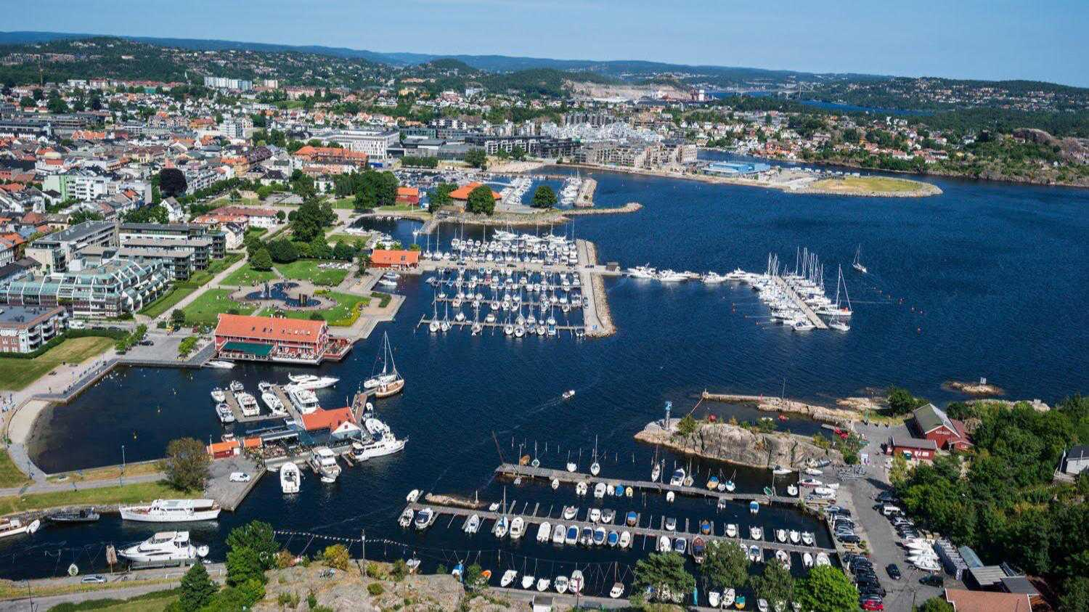
Kristiansand, South Norway

Slide 30
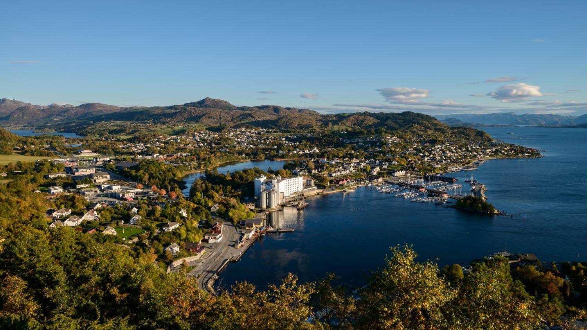
Tau Rogaland - The Hardangerfjord Region

Slide 31
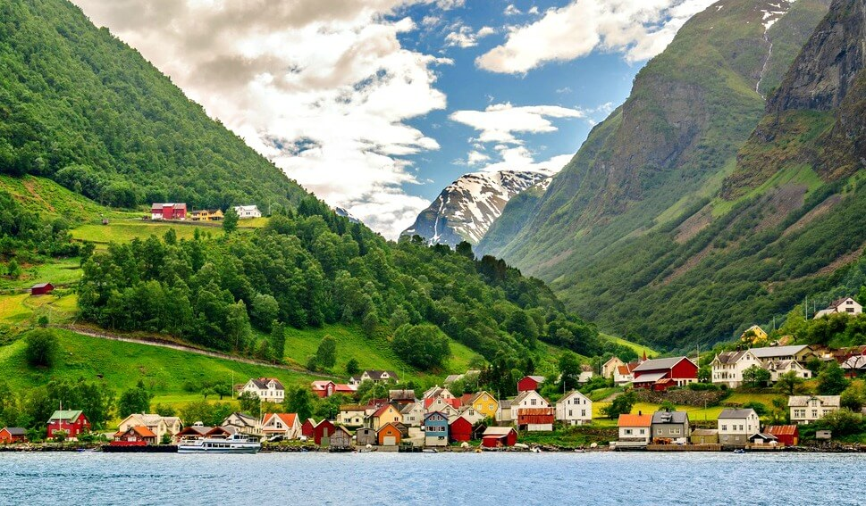

Slide 32
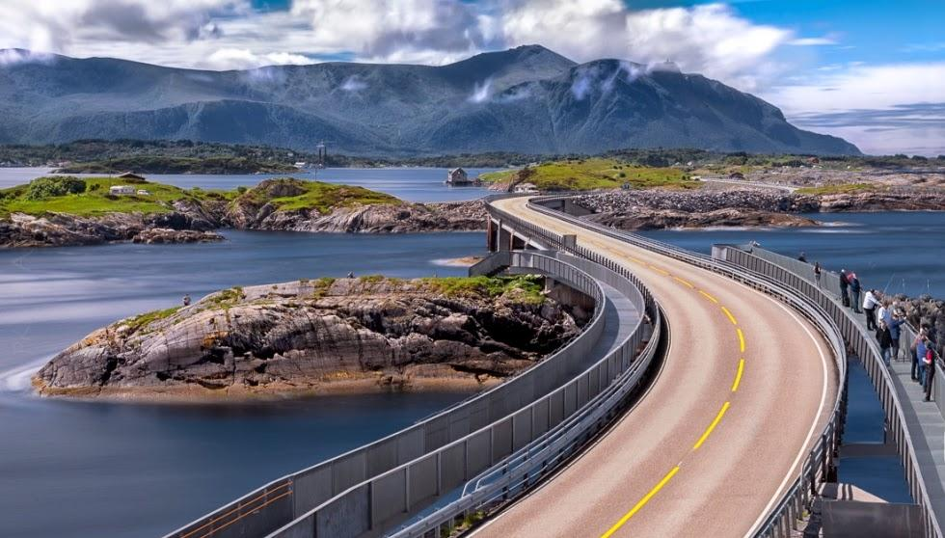
The North Atlantic Road through an archipelago in Eide and Averøy, Ramsdal, Norway

Slide 33
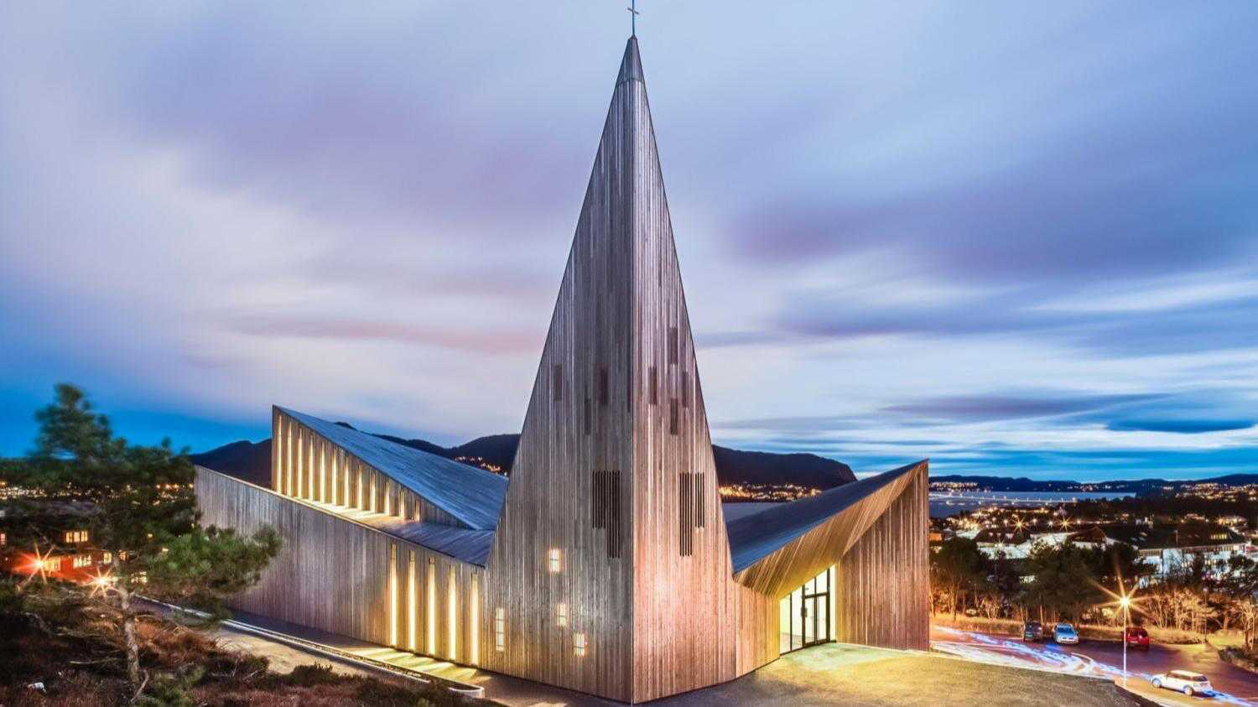
Norway has some of the best designed churches - here is a church at Knarvick in Norway.

Slide 34
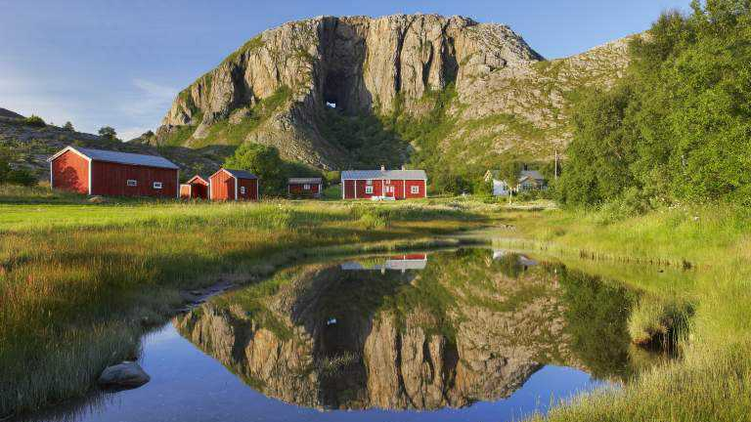
Kystriksveien - a great naturescape

Slide 35
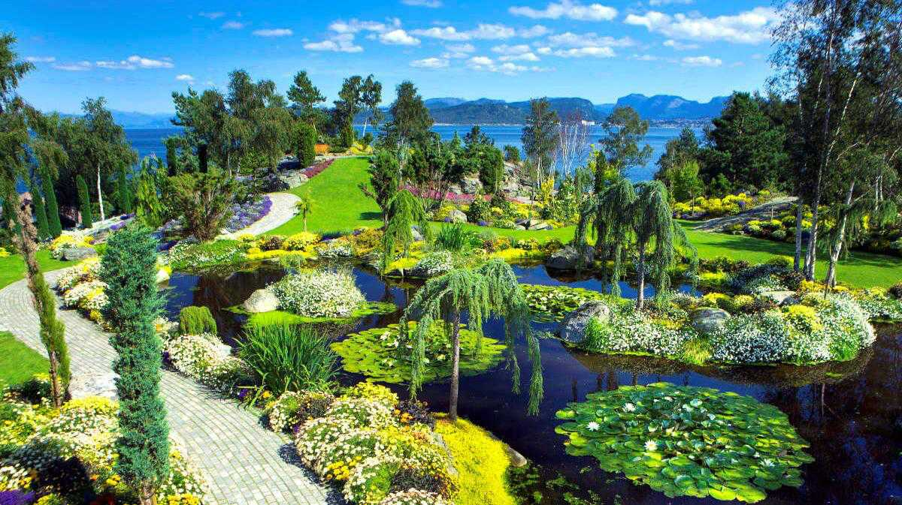
Stavanger Nature Park

Slide 36
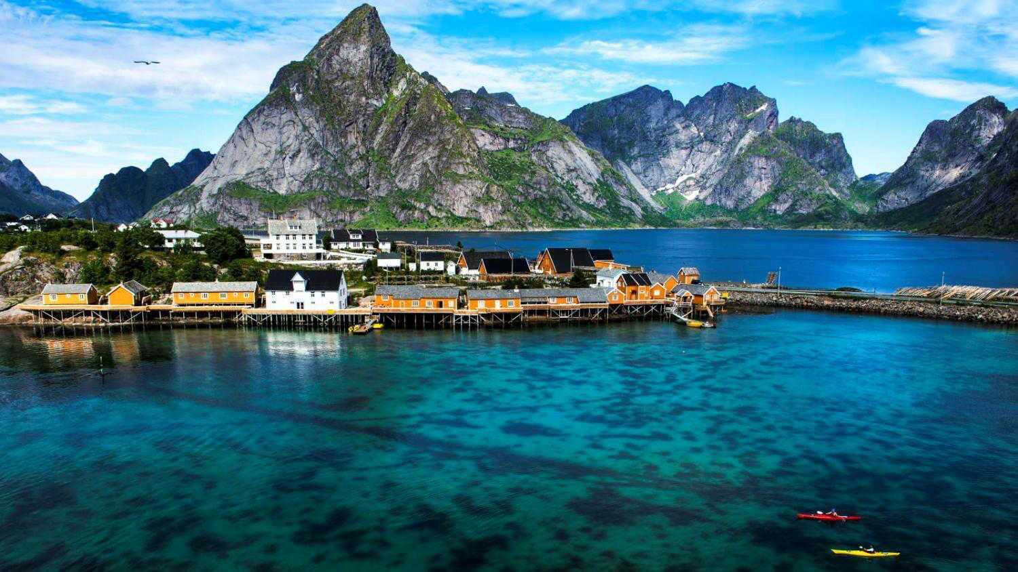
Panoramic scenery of Stavanger

Slide 37
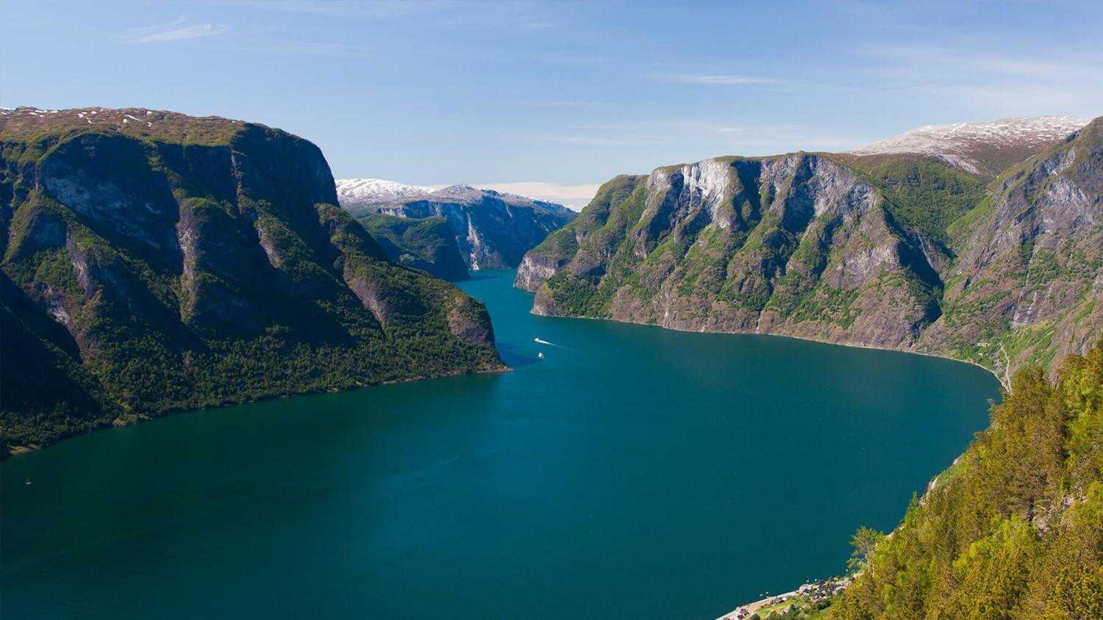
The Bergen Fjord

Slide 38
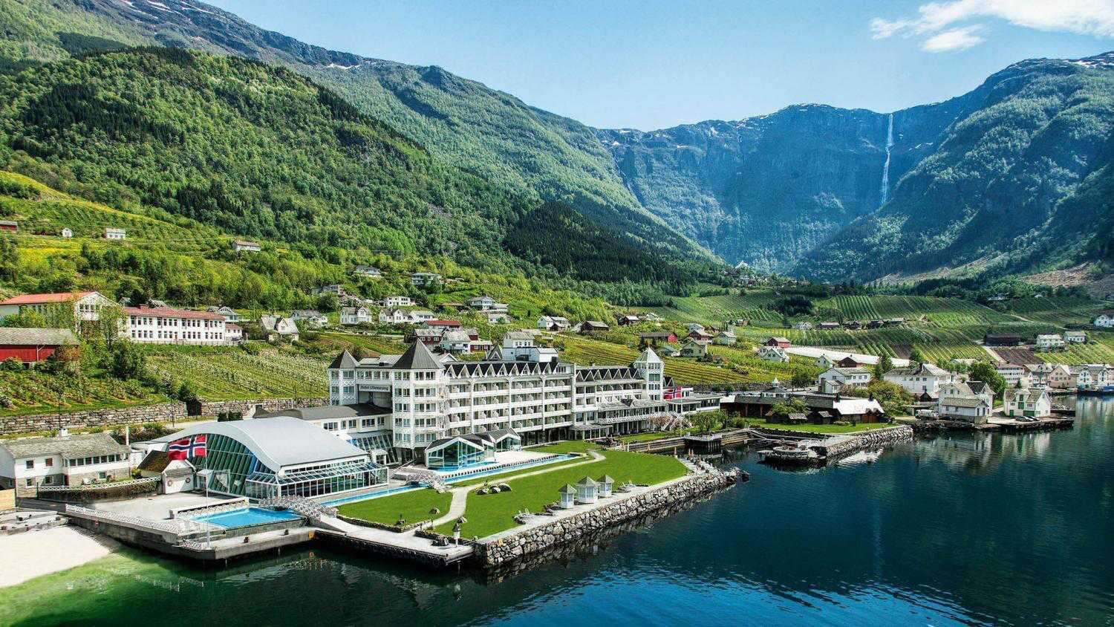
Sognefjord

Slide 39
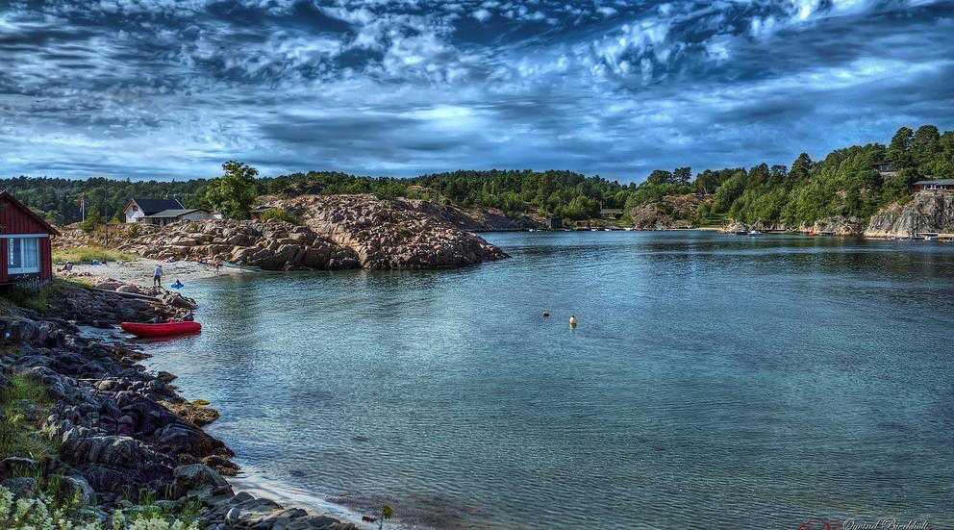
Arendal, South Norway

Slide 40
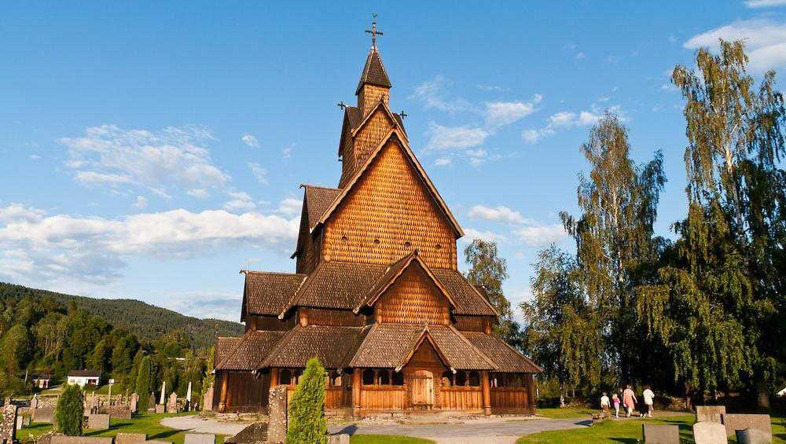
Heddal stave church is Norway's largest stave church

Slide 41
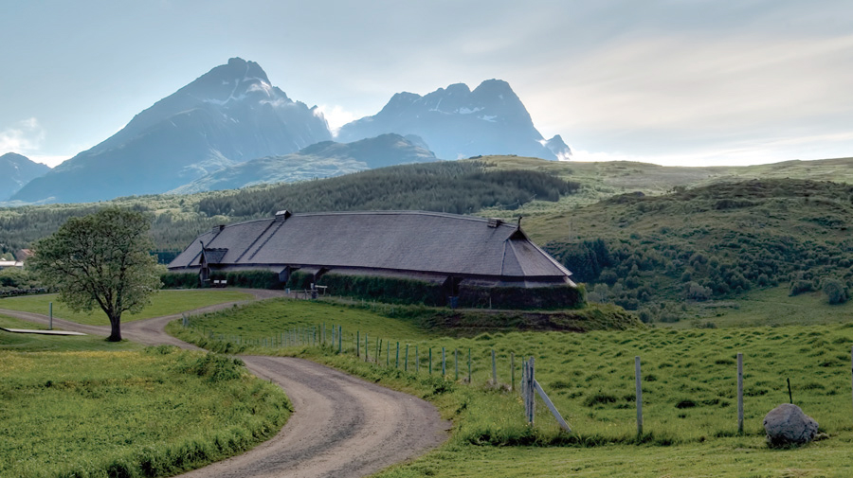
Lofotr Viking Museum Longhouse, Vestvågøya in Lofoten

Slide 42
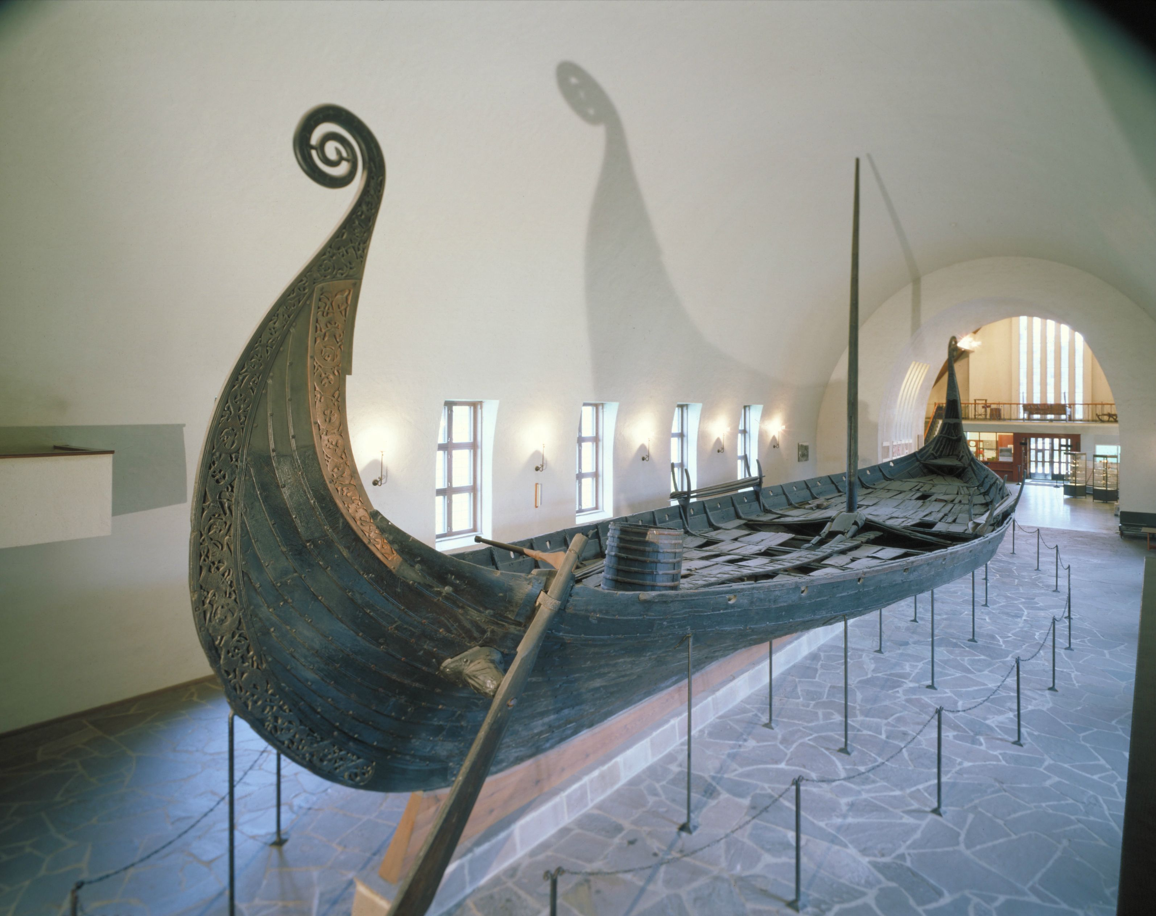
The display of Oseberg Viking ship at the Oslo Museum

Slide 43
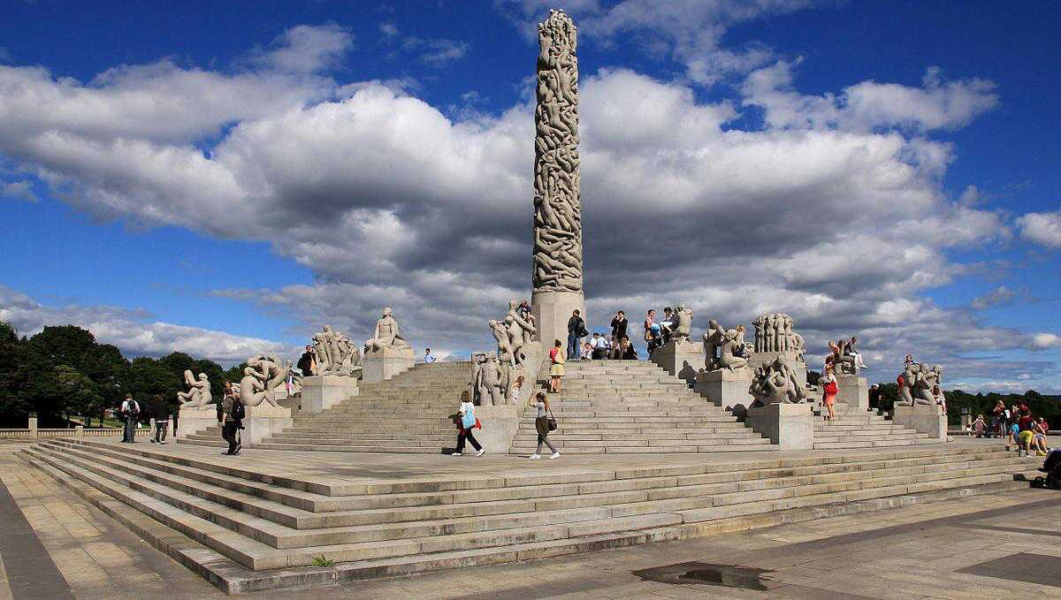
Oslo’s famous Vigeland Sculpture Park

Slide 44
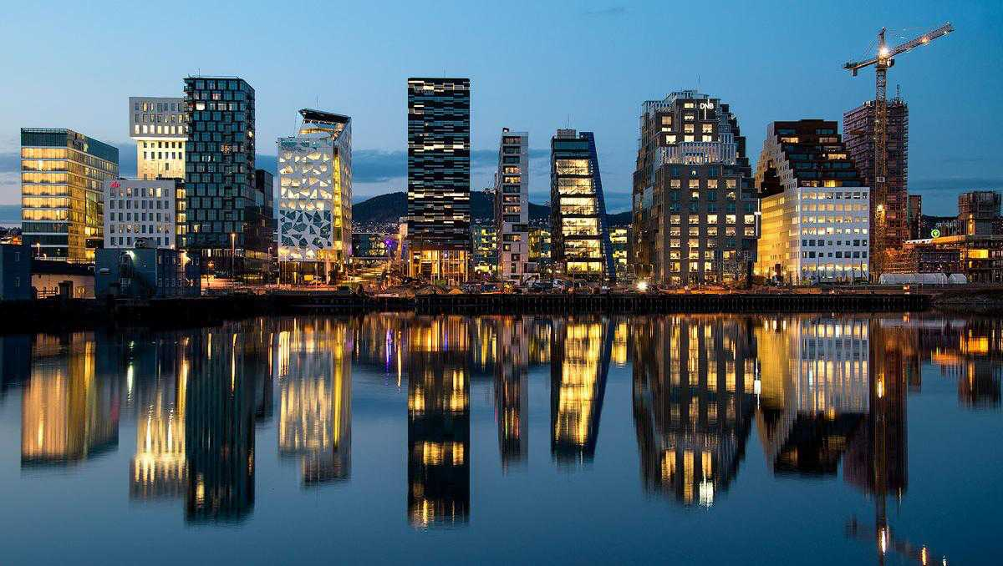
Night skyline of Oslo, the capital city of Norway.

Slide 45
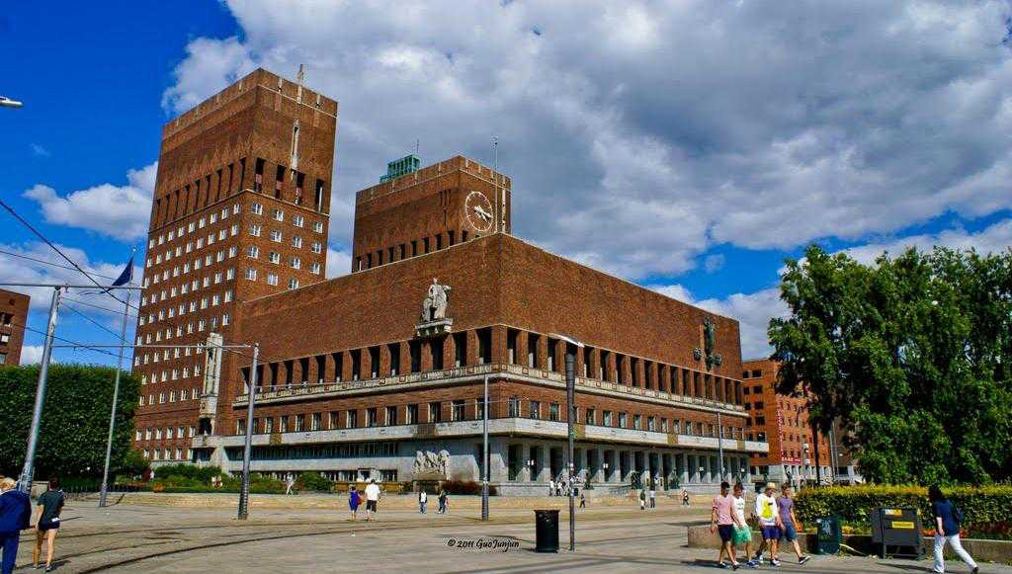
Oslo Radhus (City Hall) - The center where the annual Nobel Prizes are announced internationally.

Slide 46
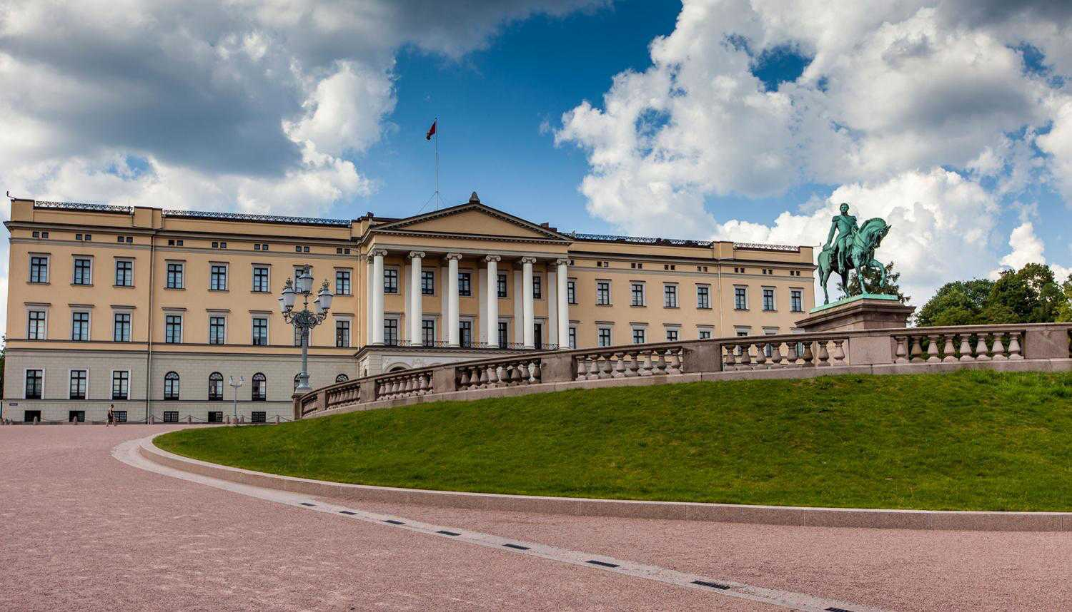
Royal Palace of Oslo

Slide 47
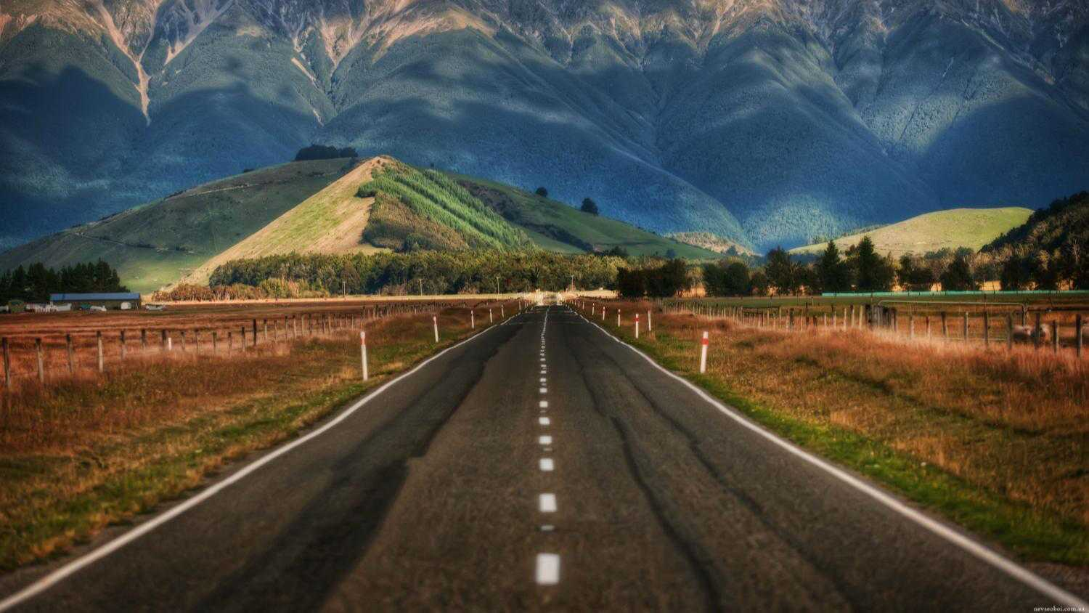

Hope you have enjoyed viewing this presentation.
Have a nice day
With regards
Tony Chacko Steve Rumpler
(tonychacko2000@gmail.com) (pista2011@gmail.com)
The Indo-Slovakian Friendship

Slide 48







¿Te ha gustado?
Puedes ver más entrando
Aquí
Además puedes recibir powerpoints en tu correo electrónico suscribiéndote aquí:
F I N

