Slide 1

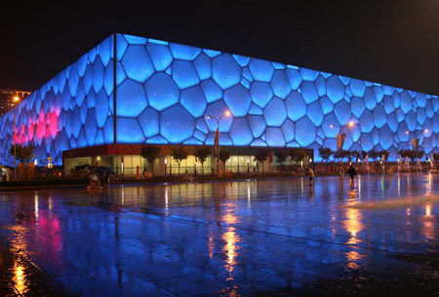

Greatest Architectural Marvels On Earth
(A very special compilation)
This presentation of architectural marvels in the world includes homes, buildings, bridges, structures and monuments of the greatest modern designs. Only the most exceptional examples of modern architecture buildings have been included in this list.
They include the best of modern architecture that contemporary engineers and architects have to offer. From the famous Burj Khalifa (the tallest building in the world) to the Sapporo Dome (which touts a moving field) to theShanghai Railway Station, there is no shortage of amazing architecture among these modern architectural feats. Go ahead and let me know which amongst them is the very best.
TONY CHACKO
tonychacko2000@gmail.com

Slide 2
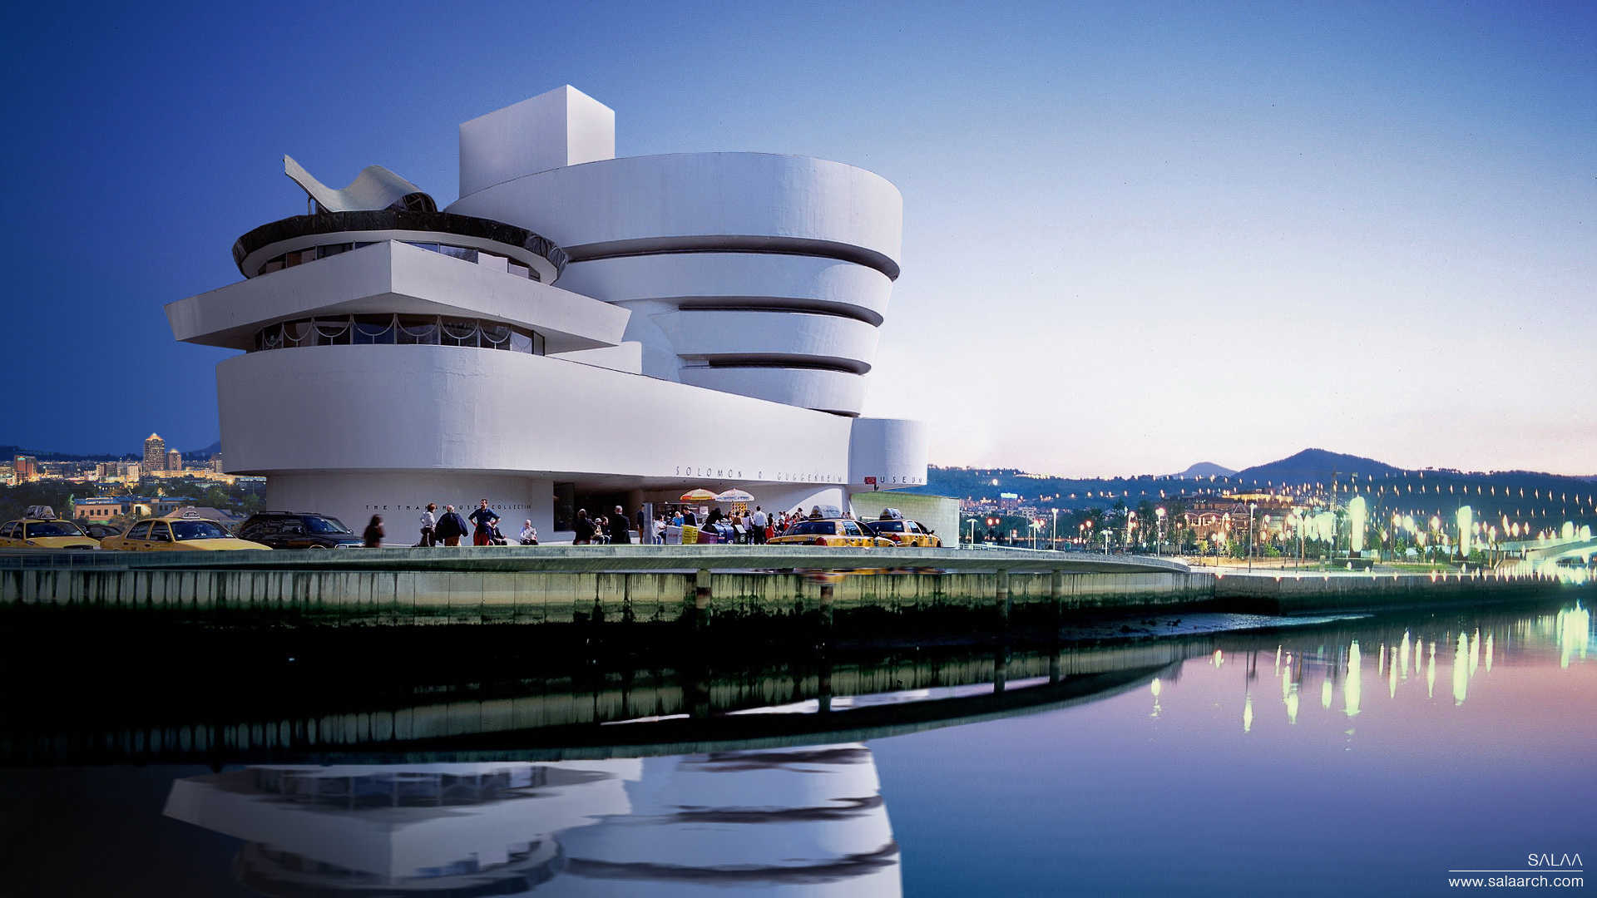

The Guggenheim Museum Bilbao is a museum of modern and contemporary art, designed by Canadian-American architect Frank Gehry, and located in Bilbao, Basque Country, Spain.

Slide 3
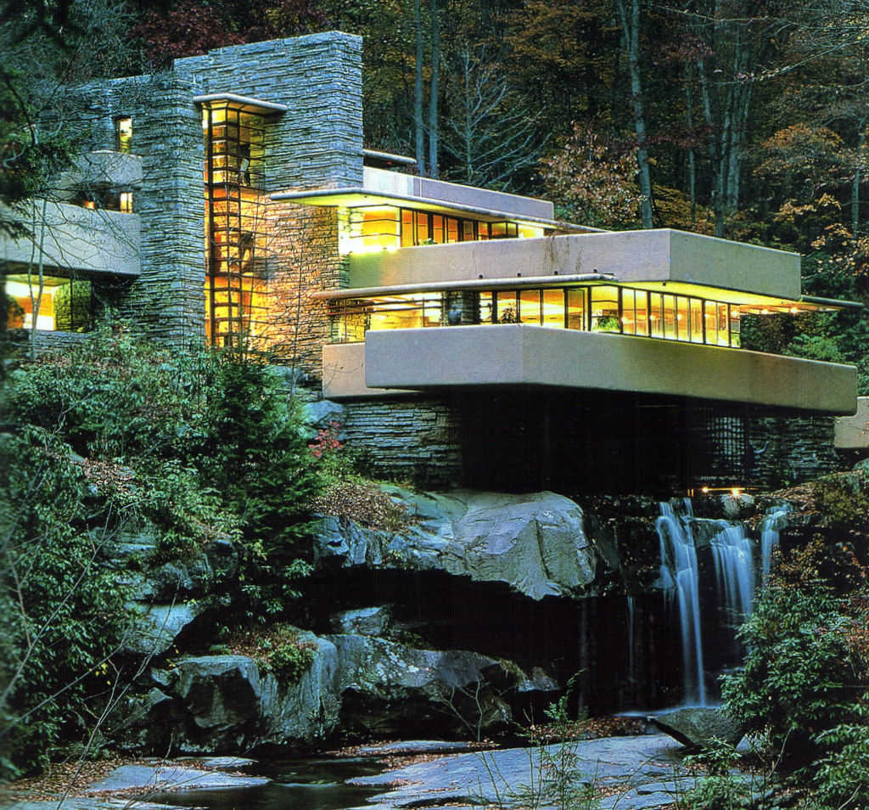
Fallingwater or Kaufmann Residence is a house designed by architect Frank Lloyd Wright (Considered to be the founder of Modern Architecture) in 1935 in South Western Pennsylvania, 43 miles of Pittsburgh. The home was built partly over a waterfall on Bear Run in Stewart Township, Fayette County, Pennsylvania, USA

Slide 4
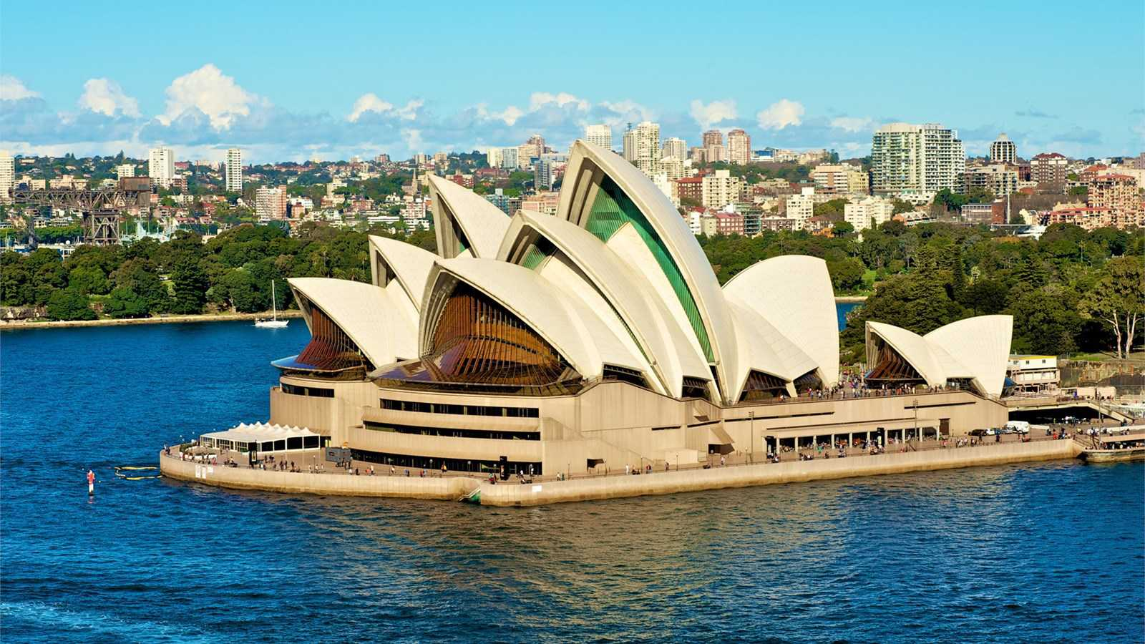
Sydney Opera House is a multi-venue performing arts centre in Sydney, New South Wales, Australia.

Slide 5
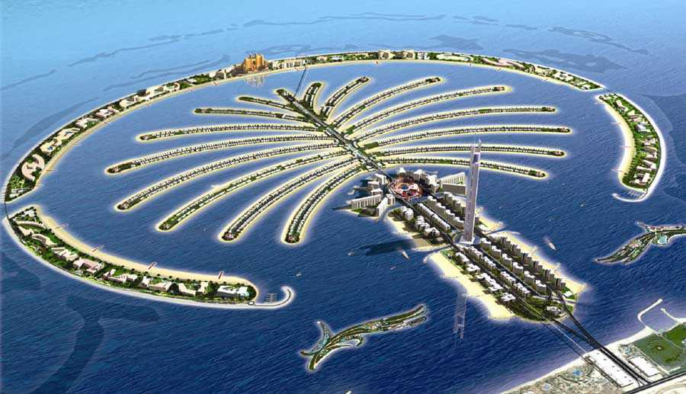
The Palm Jumeirah is an artificial archipelago in United Arab Emirates, created using land reclamation by Nakheel, a company owned by the Dubai government, and designed and developed by Helman Hurley Charvat Peacock/Architects, Inc.

Slide 6
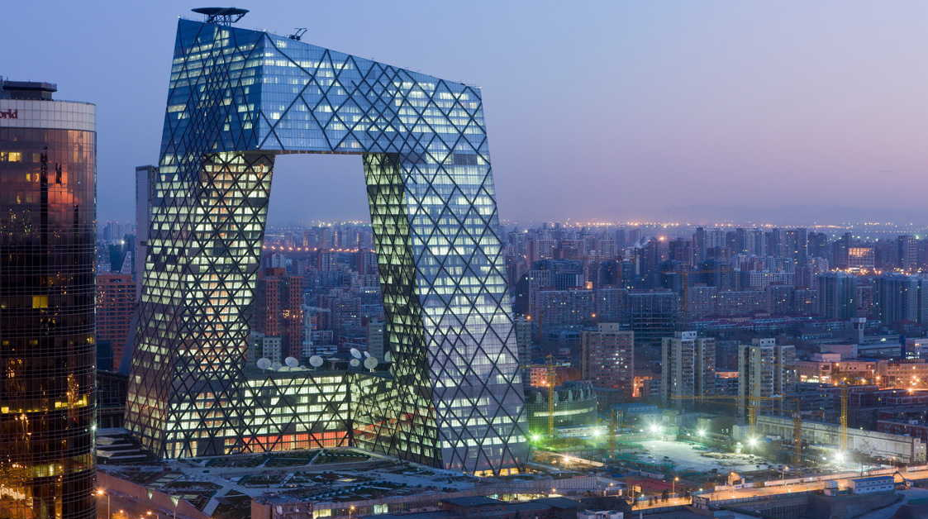
The CCTV Headquarters is a 234 m, 44-story skyscraper on East Third Ring Road, Guanghua Road in the Beijing Central Business District, China.

Slide 7
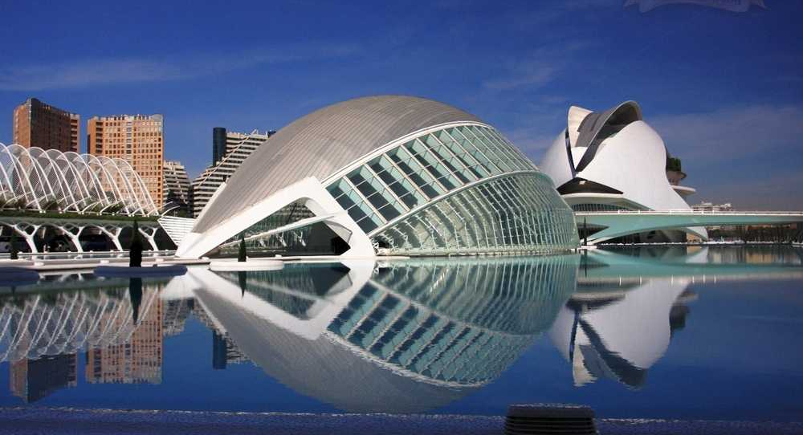
"Reina (Queen) Sofía Palace of the Arts") is an opera house and cultural centre in Valencia, Spain. It opened on 8 October 2005; its first opera staging was of Beethoven's Fidelio on 25 October 2006.

Slide 8
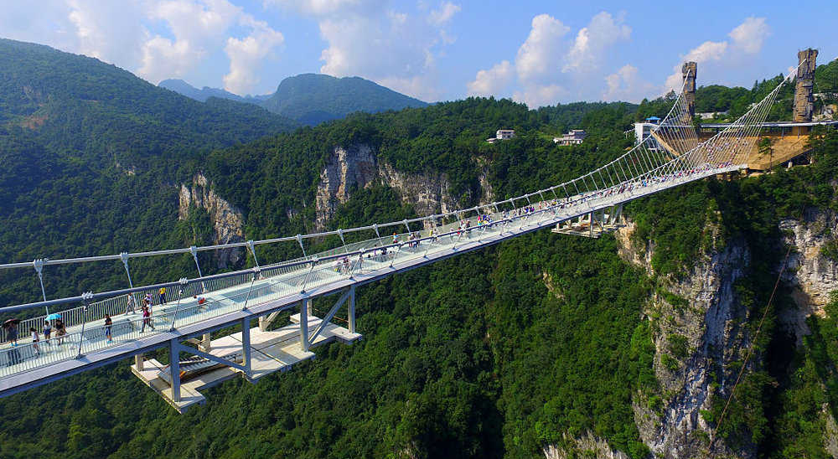
The "world's highest and longest" glass-bottomed bridge has opened to visitors in central China ..An aerial photo shows tourists visiting the glass-bottom bridge at Zhangjiajie Grand Canyon in China. The 430m-long bridge cost $3.4m (£2.6m) to build and stands 300m above ground.

Slide 9
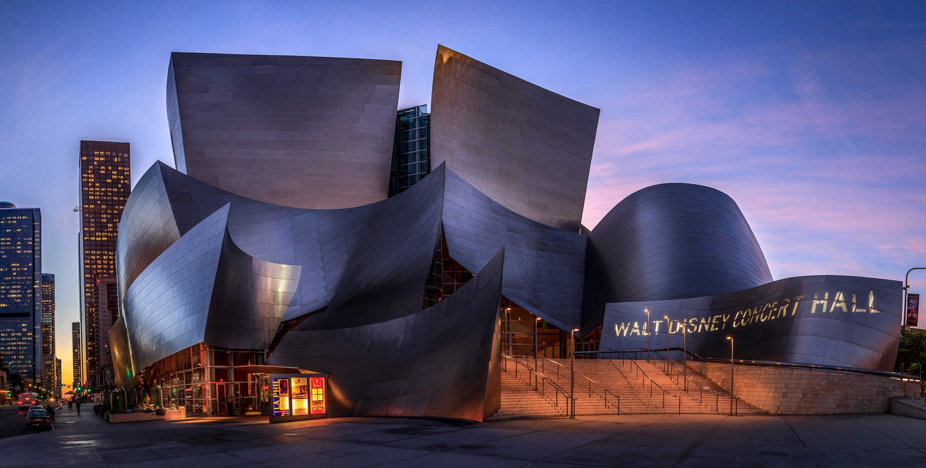
The Walt Disney Concert Hall of Los Angeles, California was designed by Frank Gehry. It opened on October 24, 2003. It seats 2,265 people and serves, among other purposes, as the home of the Los Angeles Philharmonic orchestra and the Los Angeles Master Chorale.

Slide 10
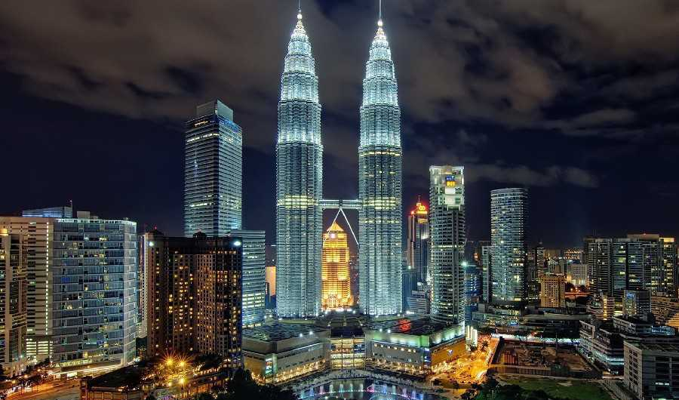
The Petronas Twin Towers, are twin skyscrapers in Kuala Lumpur, Malaysia. According to the Council on Tall Buildings and Urban Habitat's official definition and ranking, they were the tallest buildings in the world from 1998 to 2004 and remain the tallest twin towers in the world.

Slide 11
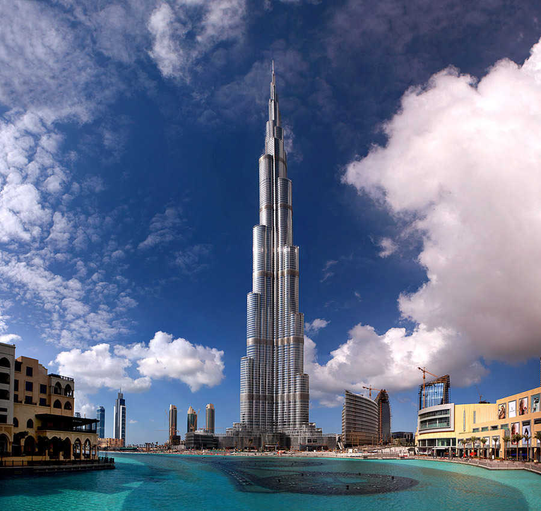
Burj Khalifa, known as Burj Dubai before its inauguration, is a skyscraper in Dubai, United Arab Emirates. It is the tallest man-made structure in the world, standing at 829.8 m.

Slide 12
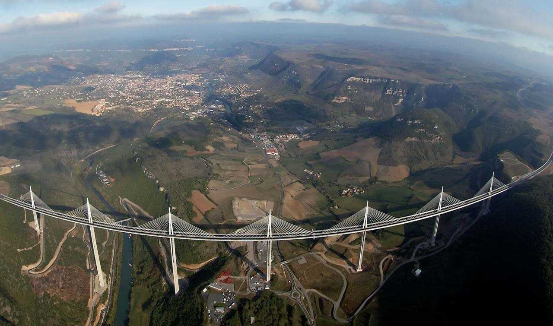
The Millau Viaduct is a cable-stayed bridge that spans the valley of the River Tarn near Millau in southern France. Designed by the French structural engineer Michel Virlogeux and British architect Norman Foster, it is the tallest bridge in the world with one mast's summit at 343.0 metres above the base of the structure. It is a 2500 metre (8200ft) long viaduct.

Slide 13
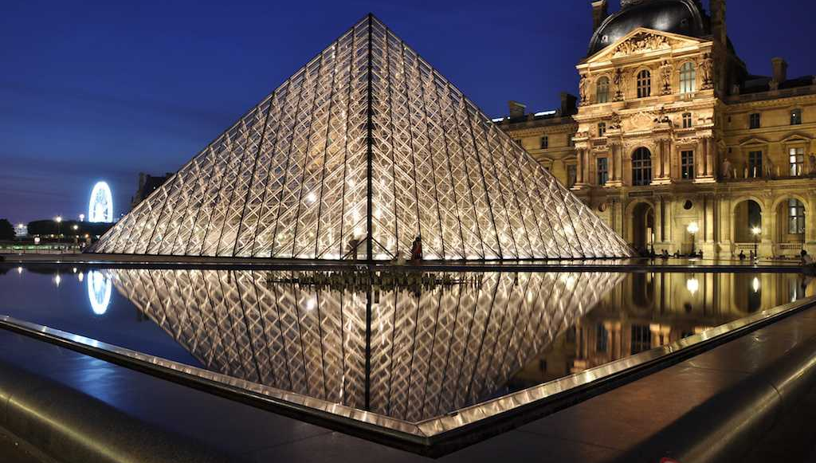
The Louvre Museum is the world's largest museum and a historic monument in Paris, France. The Louvre is the world's second most visited museum after the Palace Museum in China, receiving more than 9.26 million visitors in 2014.

Slide 14
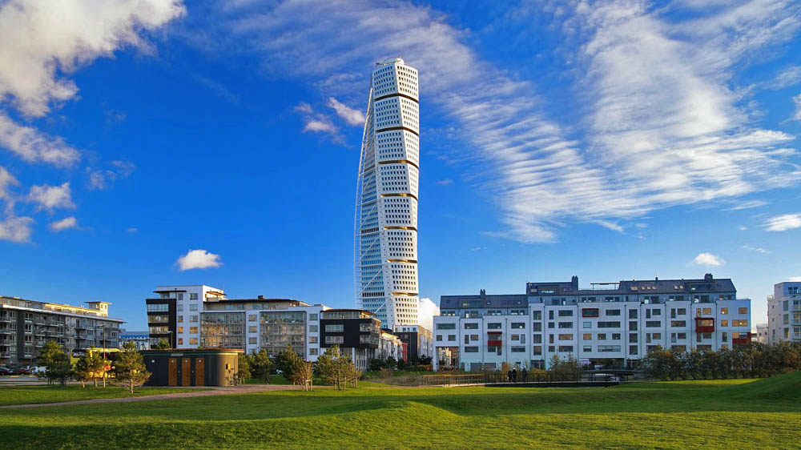
HSB Turning Torso is the tallest skyscraper in Sweden and the Nordic countries, situated in Malmö, Sweden. Designed by Spanish architect Santiago Calatrava and officially opened on 27 August 2005, the tower reaches a height of 190 metres with 54 stories - 147 apartments, relax/lounge/spa/gym, wine cellar followed by around-the-clock concierge.

Slide 15
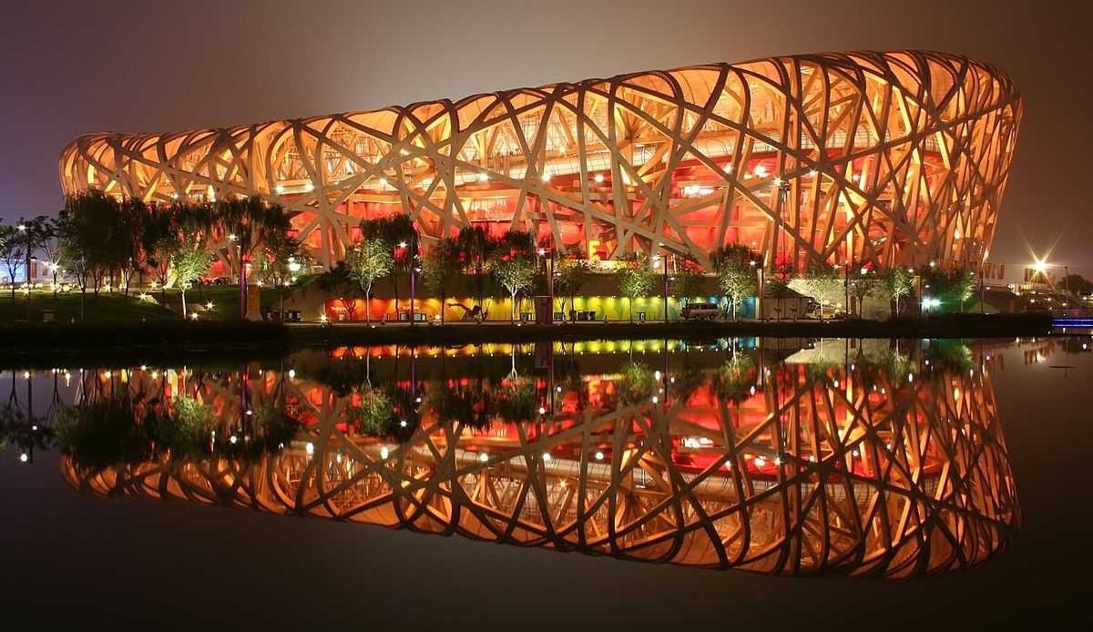
Beijing National Stadium, (BNS) was a joint venture among architects Jacques Herzog and Pierre de Meuron of Herzog & de Meuron, project architect Stefan Marbach, artist Ai Weiwei, and CADG which was led by chief architect Li Xinggang. The stadium was designed for use throughout the 2008 Summer Olympics

Slide 16
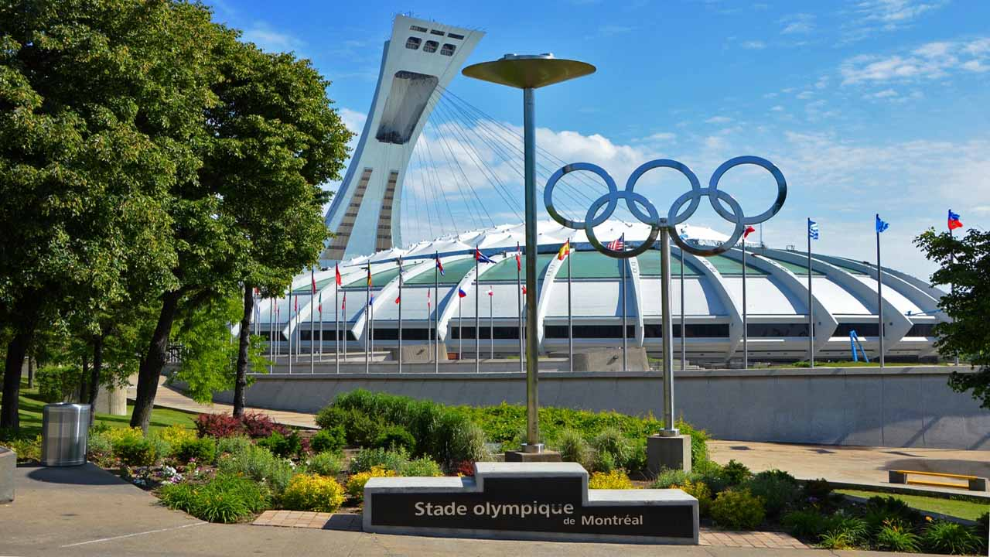
Olympic Stadium (French: Stade olympique) is a multi-purpose stadium in Canada, located at Olympic Park in Montreal. Built in the mid-1970s as the main venue for the 1976 Summer Olympics, it is nicknamed "The Big O“.

Slide 17
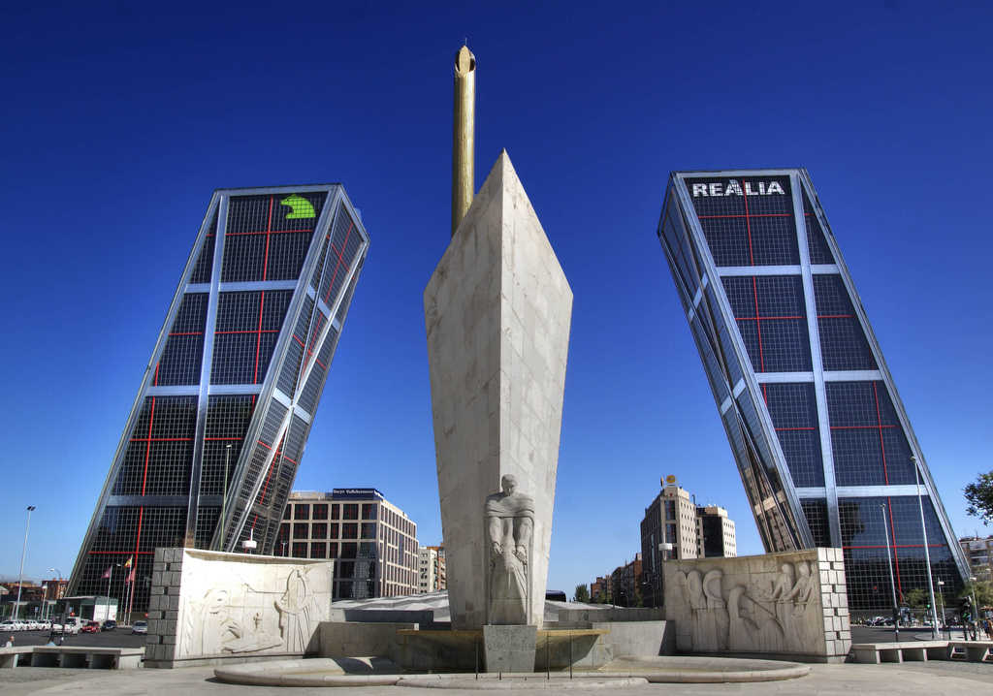
The Plaza de Castilla (English: Castile Square) is a great plaza in the north of Madrid, Spain.

Slide 18
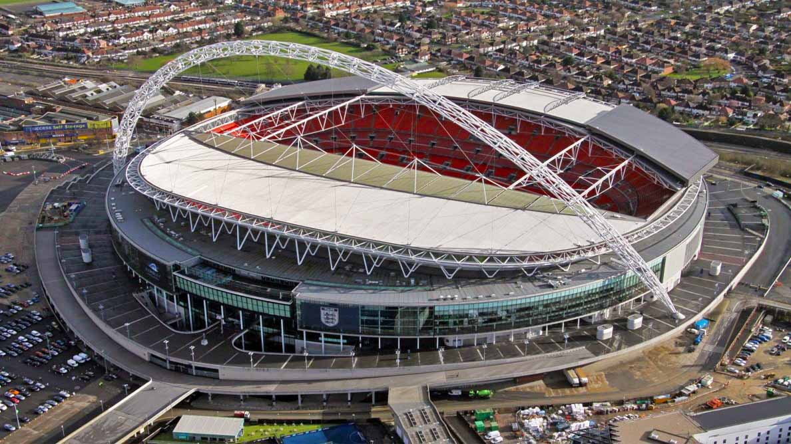
Wembley Stadium is a football stadium in Wembley, London, England, which opened in 2007, on the site of the original Wembley Stadium, which was demolished from 2002–2003. It has a capacity for 90000 spectators.

Slide 19
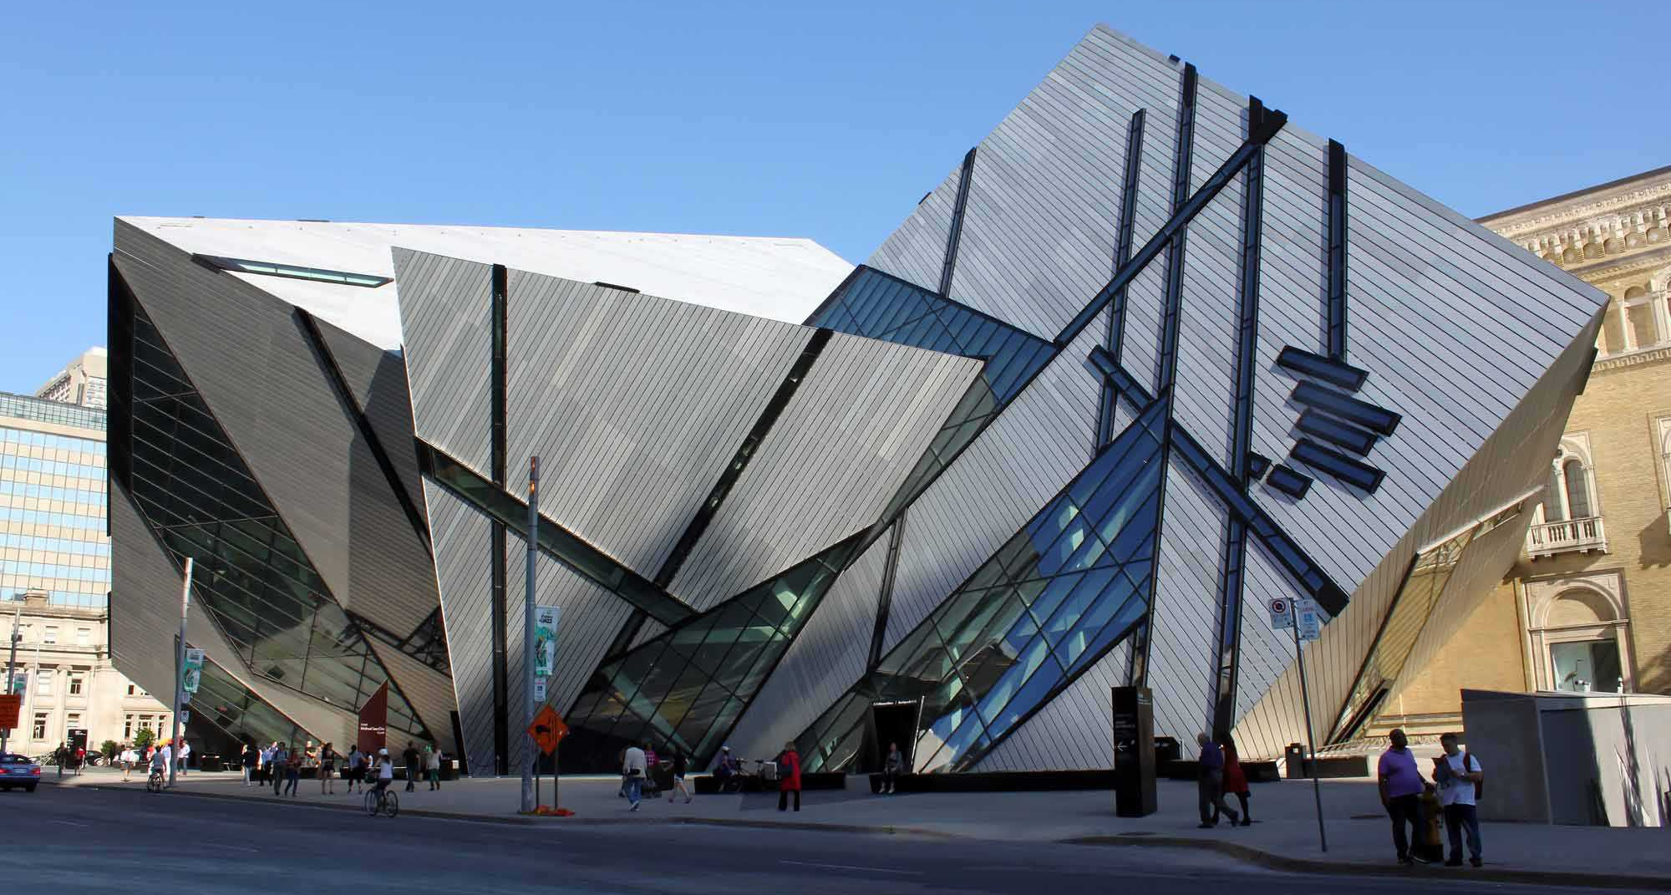
The Royal Ontario Museum is a museum of art, world culture and natural history in Toronto, Canada. It is one of the largest museums in North America, the largest in Canada, and attracts more than one million visitors every year.

Slide 20
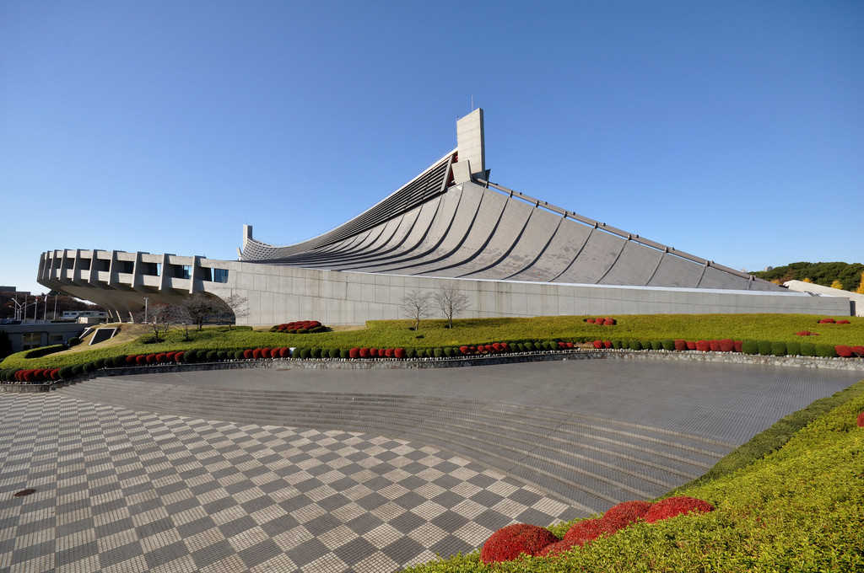
Yoyogi National Gymnasium is an arena located in Yoyogi Park, Tokyo, Japan which is famous for its suspension roof design. It was designed by Kenzo Tange and built between 1961 and 1964 to house swimming and diving events in the 1964 Summer Olympics.

Slide 21
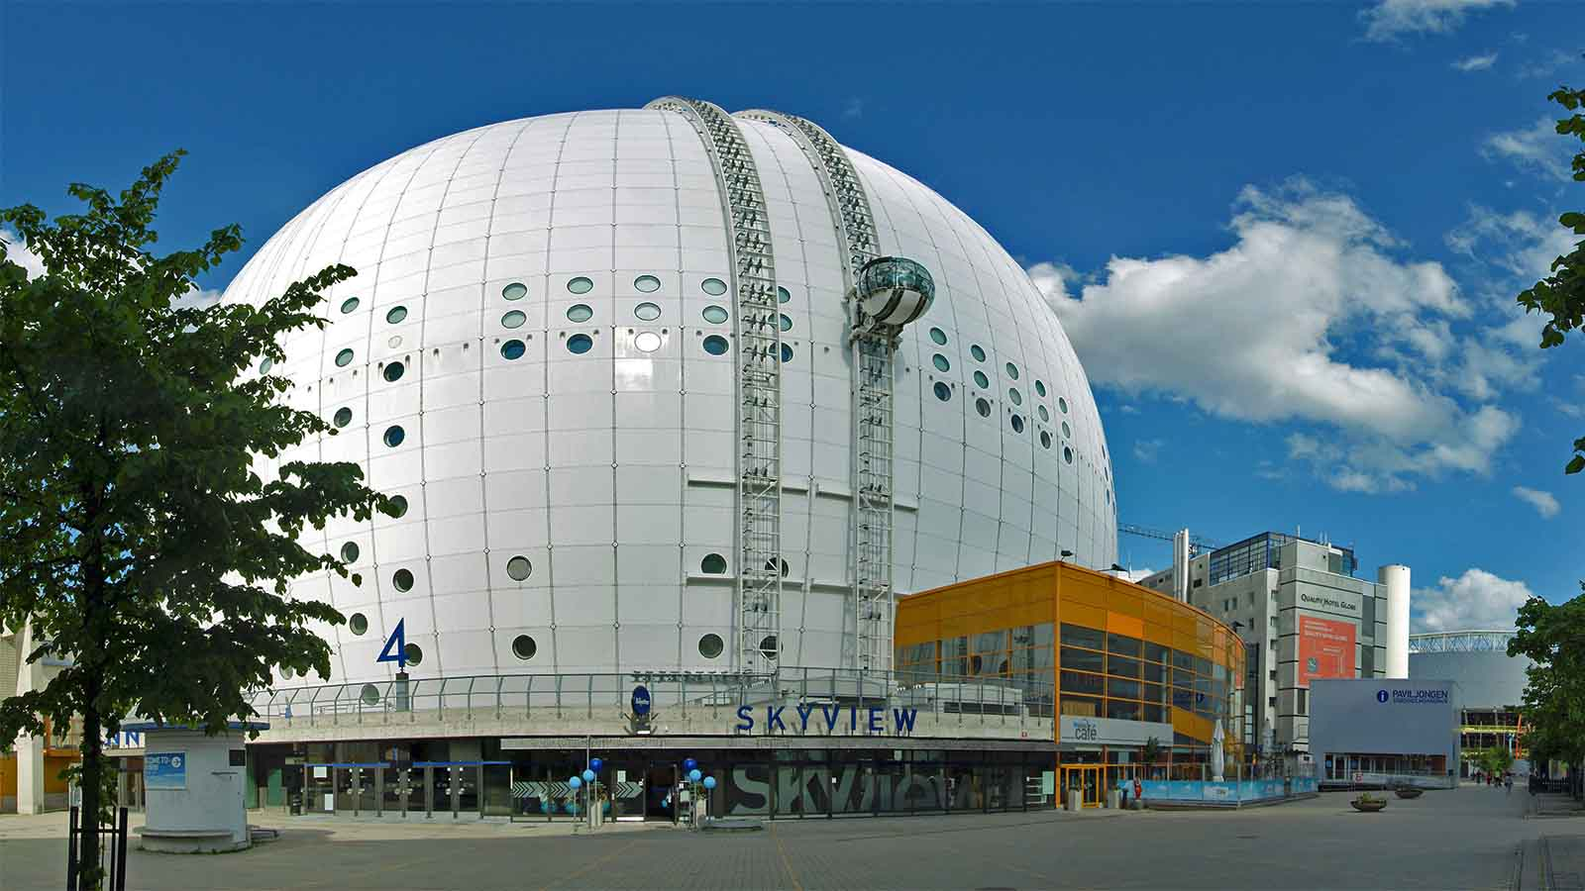
Ericsson Globe commonly referred to as Globen (The Globe)) is an indoor arena located in Stockholm, Sweden. The Ericsson Globe is the largest hemispherical building on Earth and took two and a half years to build. Shaped like a large white ball, it has a diameter of 110 metres (361 feet) and an inner height of 85 metres (279 feet) with a seating capacity of 16,000 spectators for shows and concerts, and 13,850 for ice hockey.

Slide 22
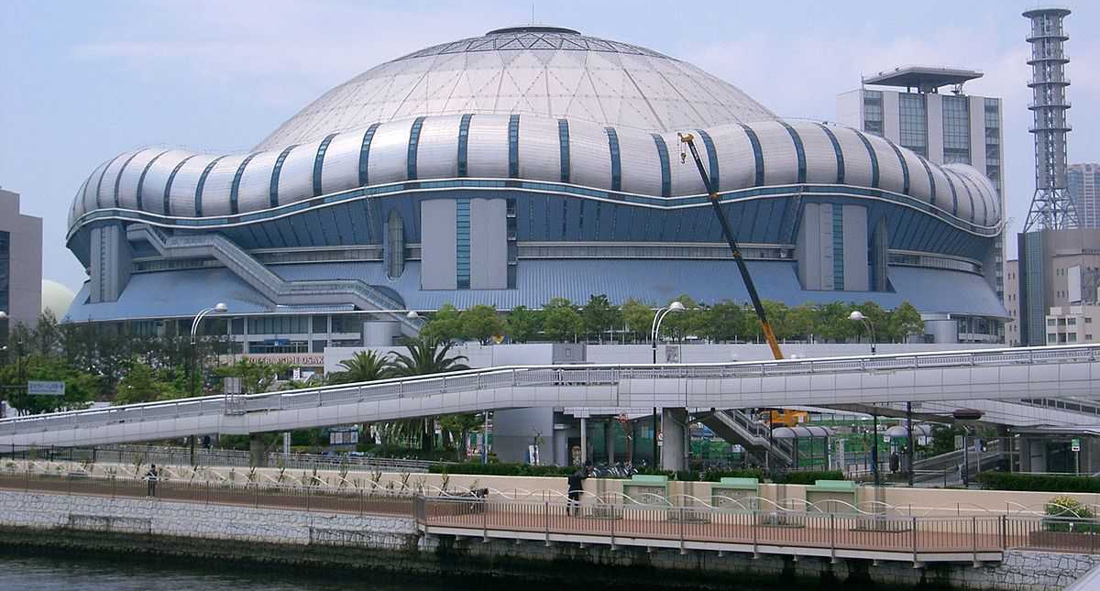
The Osaka Dome is a baseball stadium located in Osaka, Japan. Opened in 1997with a seating capacity for 50000 spectators.

Slide 23
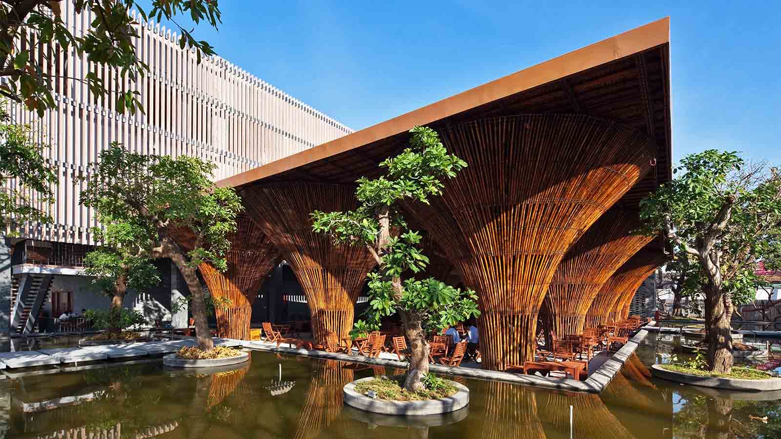
The Kontun Indo-Chine Café at Kontun, Vietnam made of Bamboo.

Slide 24
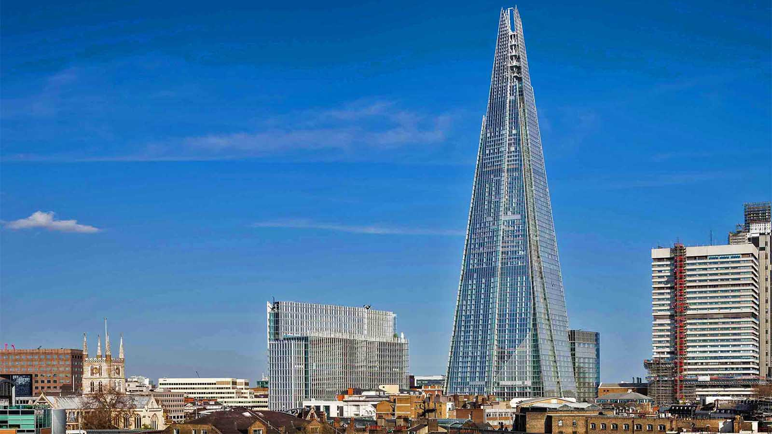
The Shard. The tallest building in London and the European Union the Shard is a marvel of modern engineering boasting 95 stories offering the finest views of fast-paced London.

Slide 25
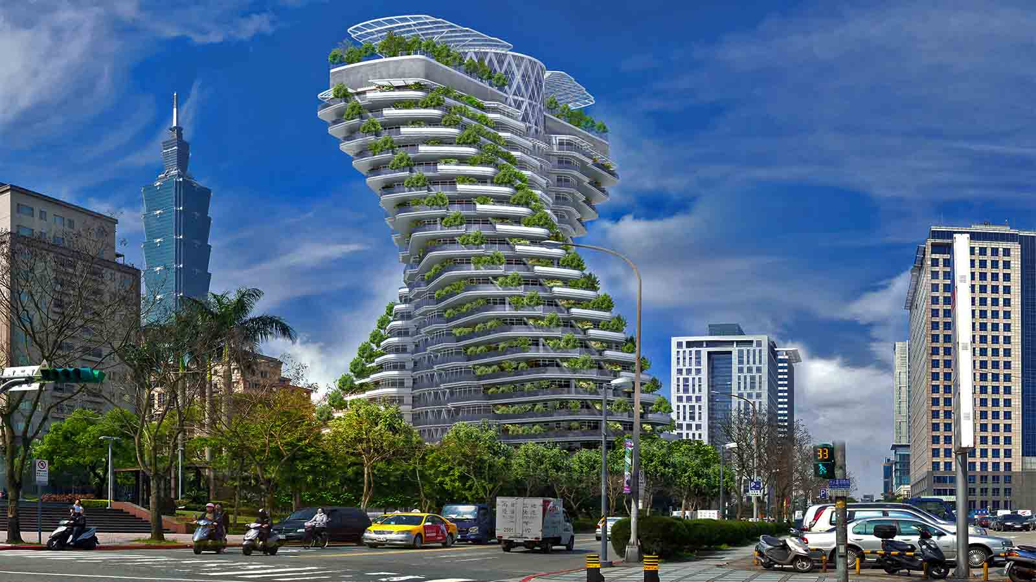
AgoraTower. Taipei just broke ground on a twisting skyscraper that is wrapped with a jungle of vertical gardens! Designed by Vincent Callebaut Architecture, the 42,355-square-meter (455,000-square-foot) Agora Tower will have an orchard, a vegetable garden, space for aromatic and medicinal plants, and a compost and rainwater capture system

Slide 26
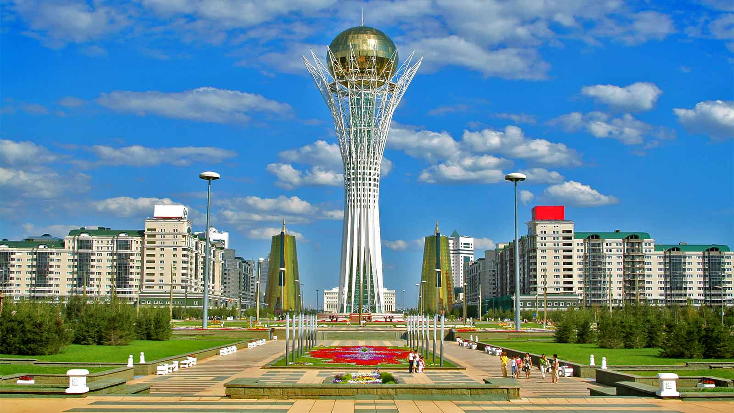
Bayterek, is a monument and observation tower in Astana City, the capital of Kazakhstan. A tourist attraction popular with foreign visitors and native Kazakhs alike, it is emblematic of the city

Slide 27
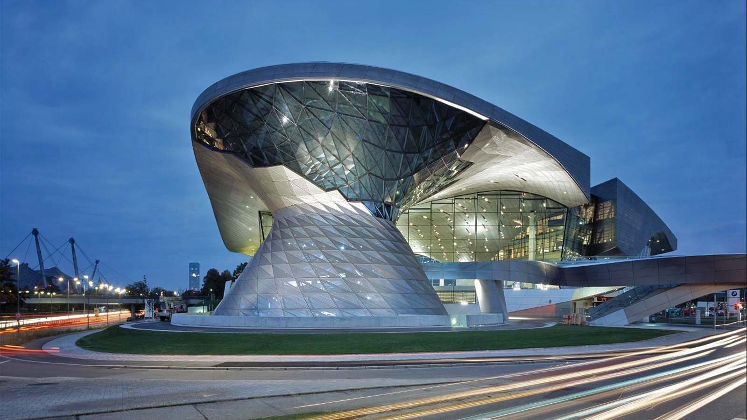
BMW Welt is a multi-use exhibition center used for meetings and promotional events, and where buyers take delivery of BMW vehicles. It is in the district of Am Riesenfeld in Munich, Germany

Slide 28
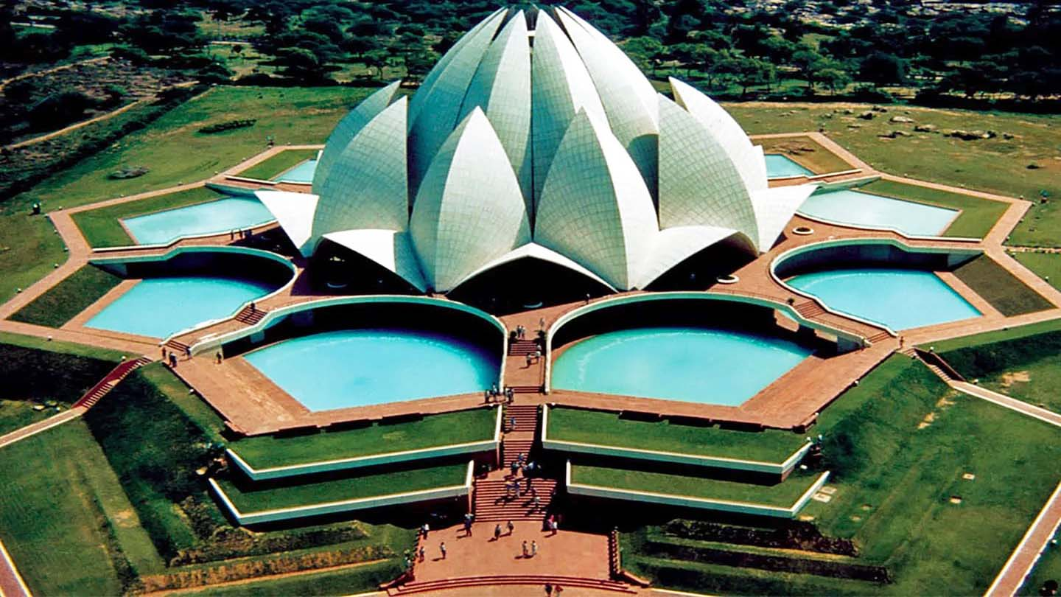
The Lotus Temple, located in Delhi, India, is a Bahá'í House of Worship completed in 1986. Notable for its flowerlike shape, it serves as the Mother Temple of the Indian subcontinent and has become a prominent attraction in the city.

Slide 29
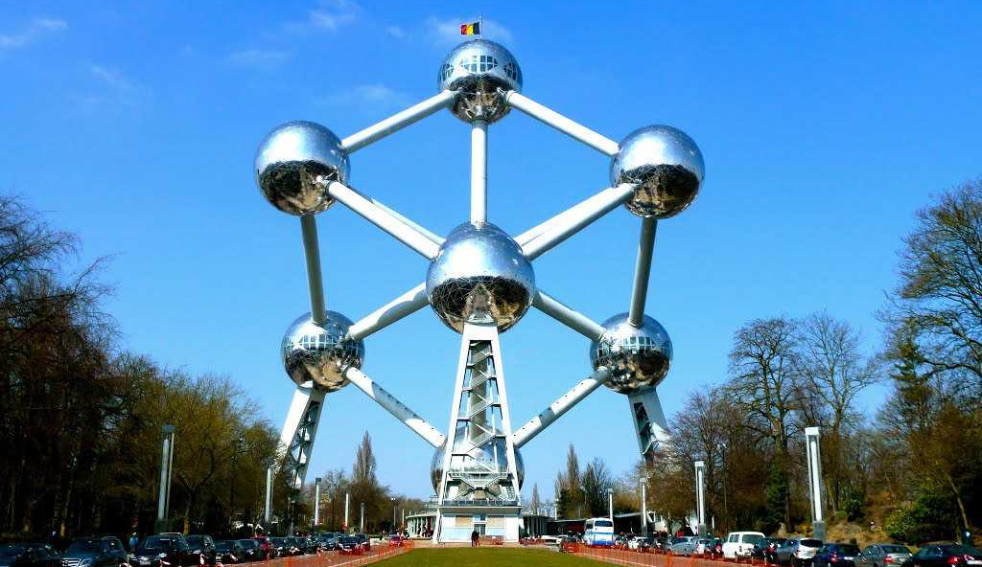
The Atomium is a building in Brussels originally constructed for Expo 58, the 1958 Brussels World's Fair. Designed by the engineer André Waterkeyn and architects André and Jean Polak, it stands 102 m tall.

Slide 30
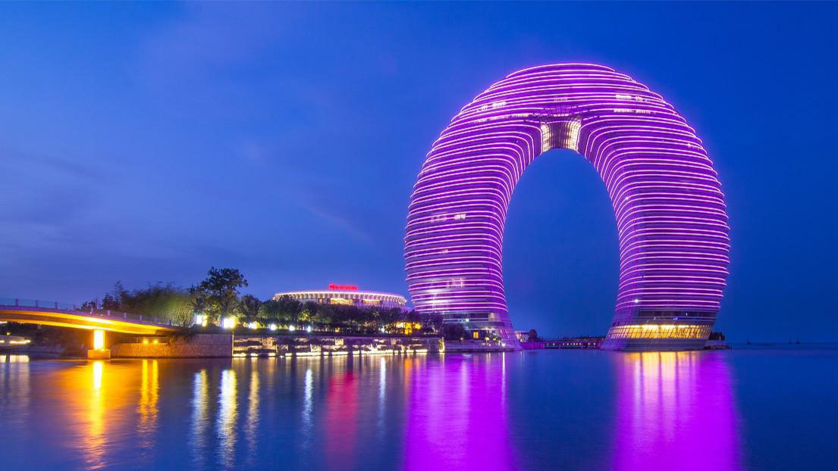
Sheraton Huzhou Hot Spring Resort is a luxury hotel and resort located in Huzhou, China. It has nicknames such as "Horseshoe Hotel" and "Doughnut Hotel" due to its shape. The horseshoe-shaped hotel, 27-storey structure lies on Lake Tai between Nanjing and Shanghai. It has 321 rooms, 37 villas, 40 suites, a presidential suite,and all luxury facilities. The design was conceived by architect Yansong Ma. It belongs to the Sheraton Hotels and Resorts chain.

Slide 31
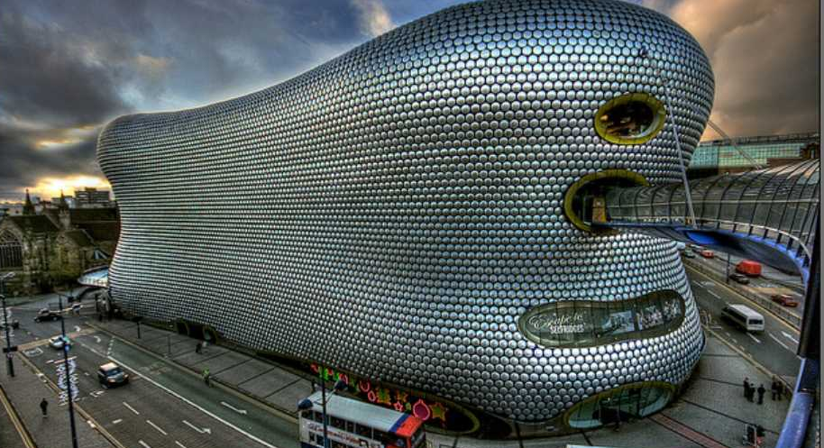
Selfridges is an upscale department store in landmark building, stocking designer and popular brands, plus food hall. It is located in: Bullring, Birmingham, England.

Slide 32
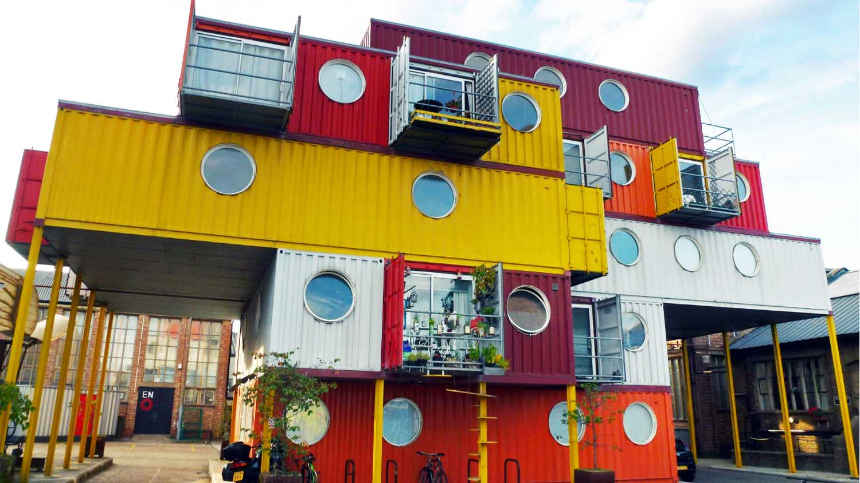
Container City is the name given to two pieces of shipping container architecture in east London. It is principally a means of utilising standard forty-foot equivalent unit shipping containers, at the end of their life, to produce flexible accommodation and offices at low cost.

Slide 33
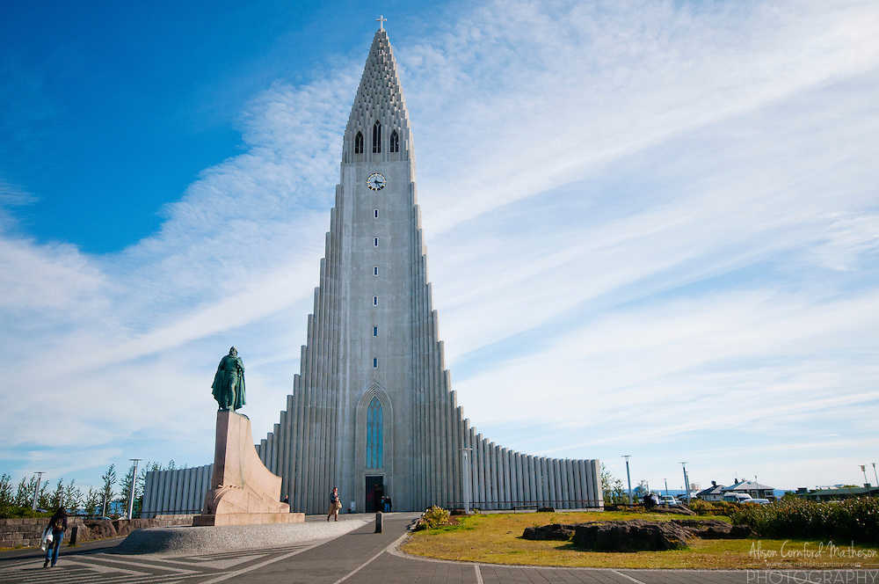
Hallgrímskirkja is a Lutheran parish church in Reykjavík, Iceland. At 73 metres high, it is the largest church in Iceland.

Slide 34
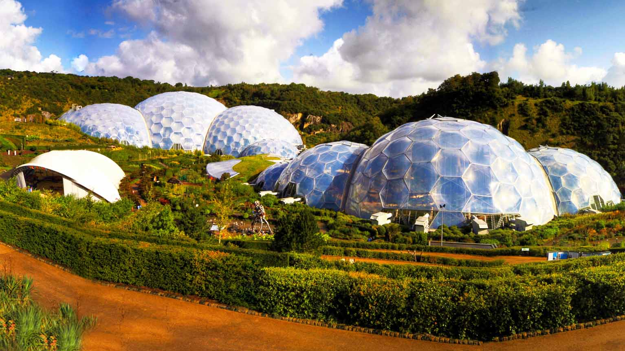
The Eden Project is a popular visitor attraction in Cornwall, England. Inside the two biomes are plants that are collected from many diverse climates and environments from around the world.

Slide 35
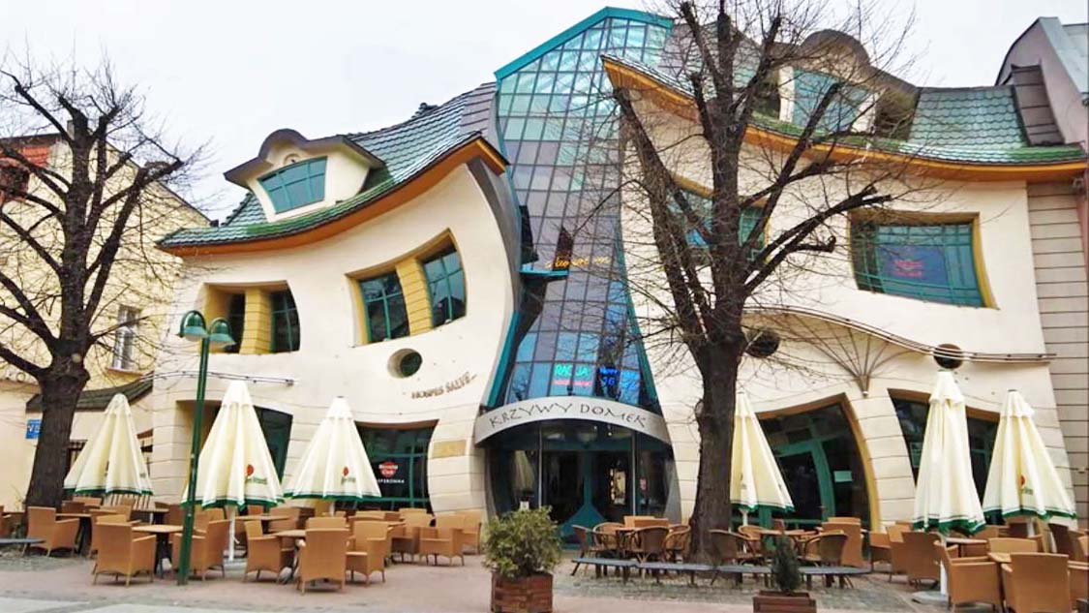
'Crooked House' In Sopot, Poland Is Like A Children's Book Come To Life.

Slide 36
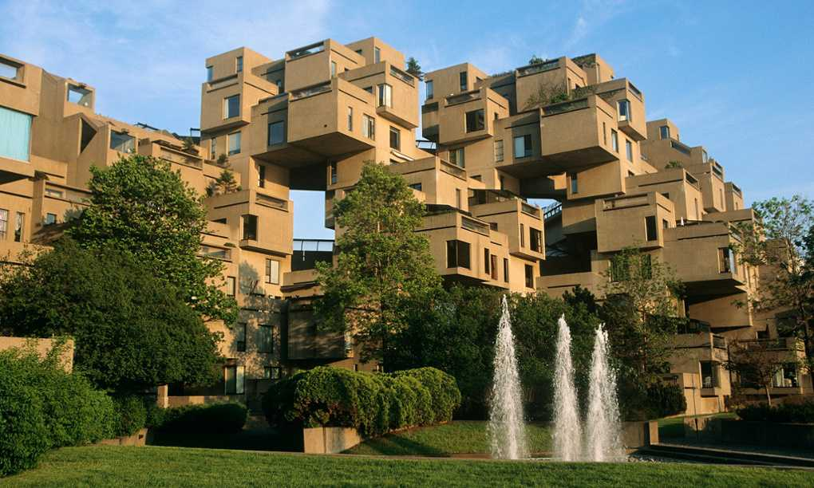
It was one of the theme buildings at the 1967 world exposition at Montreal. Habitat 67 in Montreal Canada comprises of 354 cubes of a magnificent grey-beige build up one on the other to form 146 apartment residences nestled between sky and earth, between city and river, between greenery and light.

Slide 37
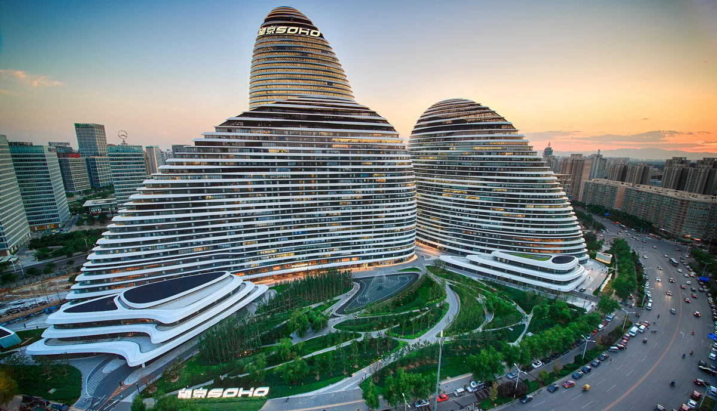
Wangjing SOHO is a complex of three curvilinear asymmetric skyscrapers in Wangjing, a suburb of Beijing, China . According to Zaha Hadid who isconsidered one of the greatest world architects today, the project's architect, it is a "welcome and farewell to Beijing".

Slide 38
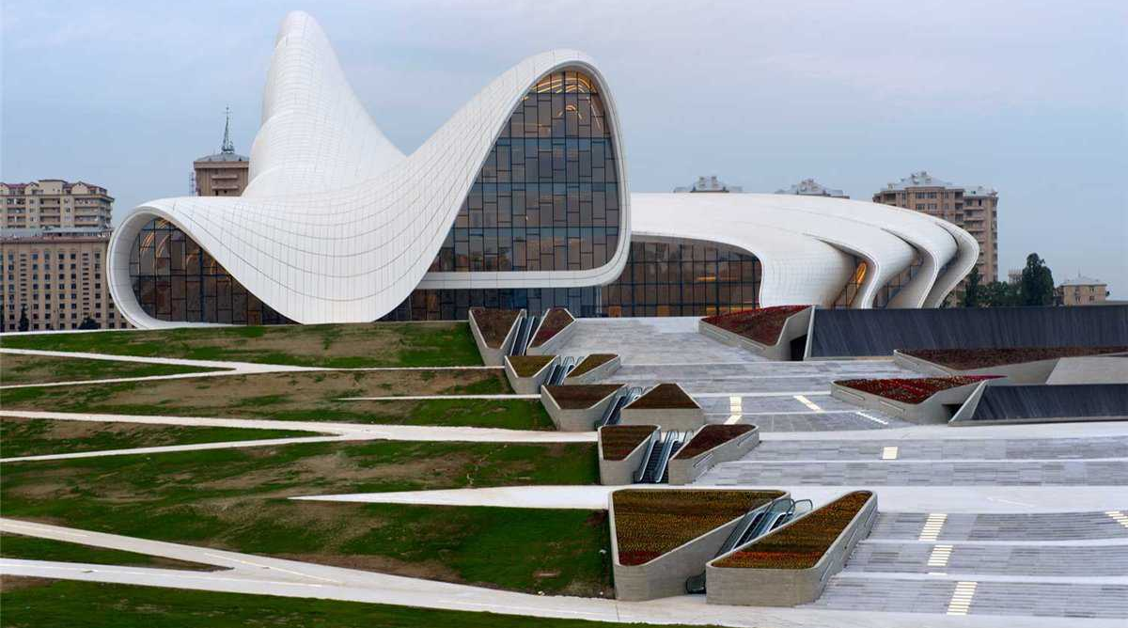
The Heydar Aliyev Center is a 57,500 m² building complex in Baku, Azerbaijan designed by Iraqi-British architect Zaha Hadid and noted for its distinctive architecture and flowing, curved style that eschews sharp angles.

Slide 39
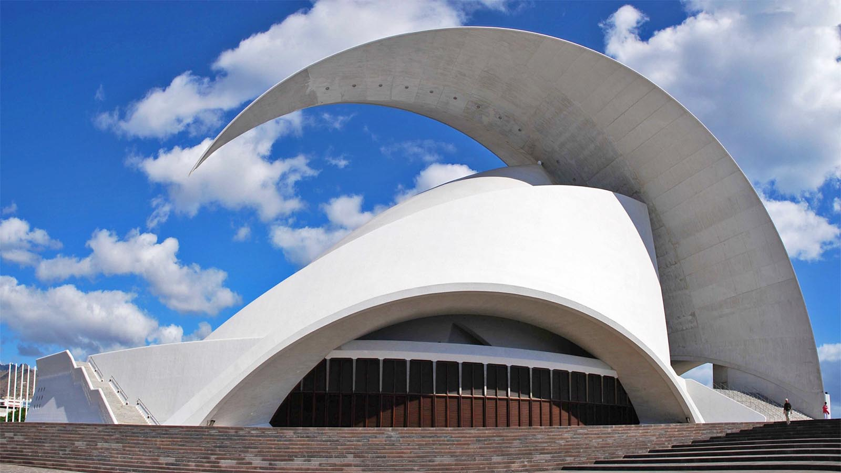
Tenerife Concert Hall, Canary Island, Spain.

Slide 40
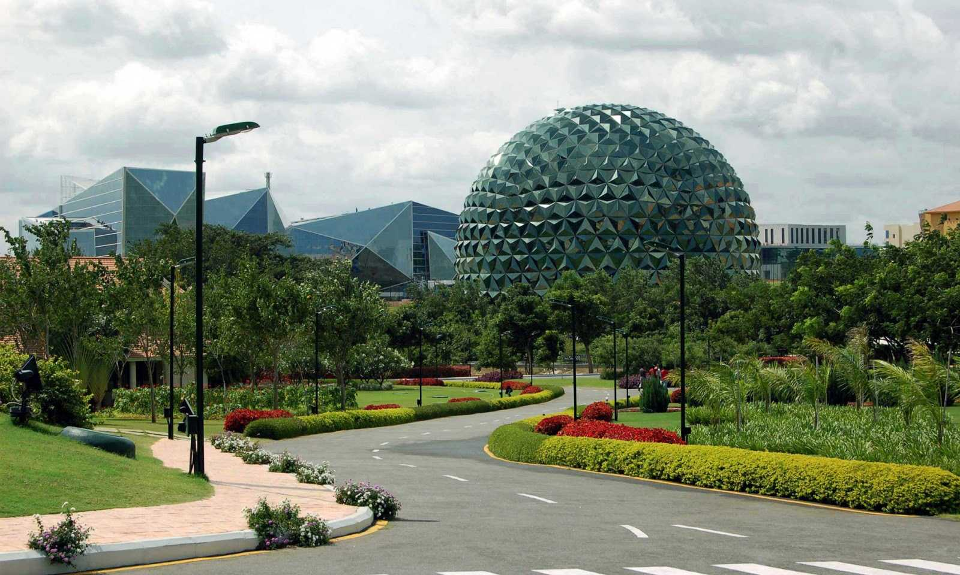
Infosys, one of the renowned IT company, has built the world’s biggest corporate training facility in Mysore. Infosys Mysore Campus is also known by several names as: “Heaven on Earth” and “A Paradise”. Infosys Mysore Campus is the epitome of the real infrastructure art.

Slide 41
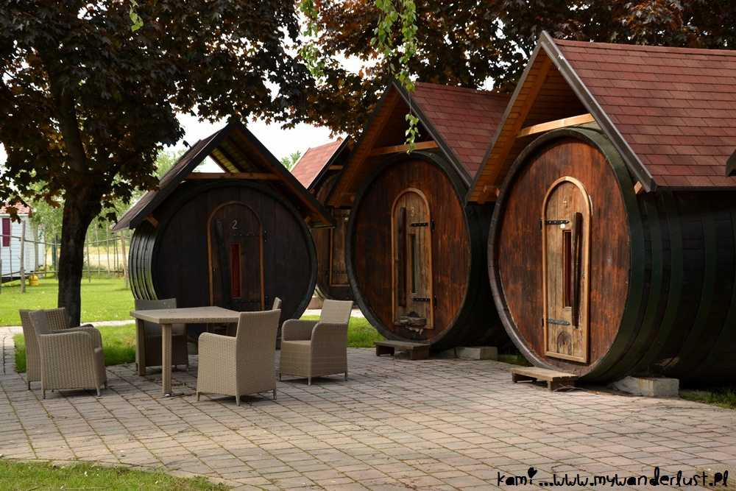
Terme Ptuj Wine Barrel Village - Ptuj, Slovenia. Though this does not fit into high class architecture, I am inviting all of you to join me for TC’s friends get-together in a wonderful European country. Won’t you come ???
With regards, your pal : TONY CHACKO

Slide 42



Hope you have enjoyed viewing this presentation
Have a nice day
Music : Peter White - Chasing the DawnSun
With regards - Tony Chacko and Steve Rumpler
(tonychacko2000@gmail.com / bubenikx22@gmail.com)

Slide 43







¿Te ha gustado?
Puedes ver más entrando
Aquí
Además puedes recibir powerpoints en tu correo electrónico suscribiéndote aquí:
F I N

