Slide 1


MALAYSIA
Asia‘s Wonderland

Slide 2

Malaysia is a Southeast Asian country occupying most of the Malay Peninsula and the Northern Part of the island of Borneo covering a total landmass of 330,803 square kilometres (127,720 sq mi). It consists of thirteen states and three federal territories. The country is multi-ethnic and multi-cultural, which plays a large role in politics. About half the population is ethnically Malay, with large minorities of Malaysian Chinese, Malaysian Indians, and indigenous peoples. It is known for its beaches, rainforests and mix of Malay, Chinese, Indian and European cultural influences. The capital, Kuala Lumpur, is home to colonial buildings, busy shopping districts such as Bukit Bintang and skyscrapers such as the iconic 451m-tall Petronas Twin Towers.
Despite it having the best natural resources, paradise beaches and jungles, it still lags behind Thailand and Singapore in tourism - perhaps due to the lethargic Malay attitude and only enabling Malays to hold senior government portfolios with Islamic rules which hinders modern tourism development. But believe me friends it is really the best tourist destination in Asia. If you want a really unique tour you have to make your own itinery of so many remote hill stations, islands, jungle and seaside resorts and not to blindly accept the tour operator's hotspots package tour.
Basic Facts
Area: 329,847 km²
Population: 30,513,848 (2015)
Median age: 27.9 years
Capital: Kuala Lumpur
Ethnic Groups: Malay 50.1%, Chinese 22.6%, Indigenous 11.8%, Indian 6.7%, Non-Citizens 8.2% (2010)
Prepared and compiled by TONY CHACKO (tonychacko2000@gmail.com)
Technical cooperation STEVE RUMPLER (pista2011@gmail.com

Slide 3
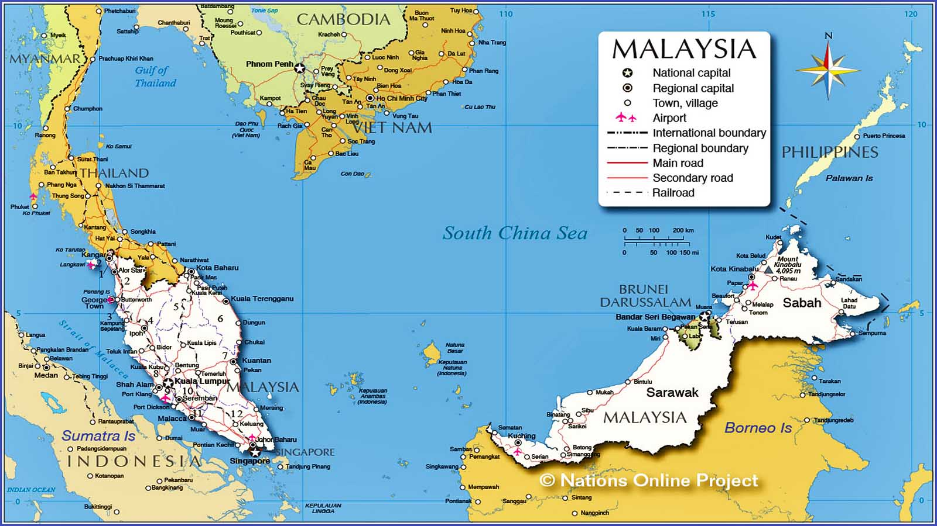


Slide 4
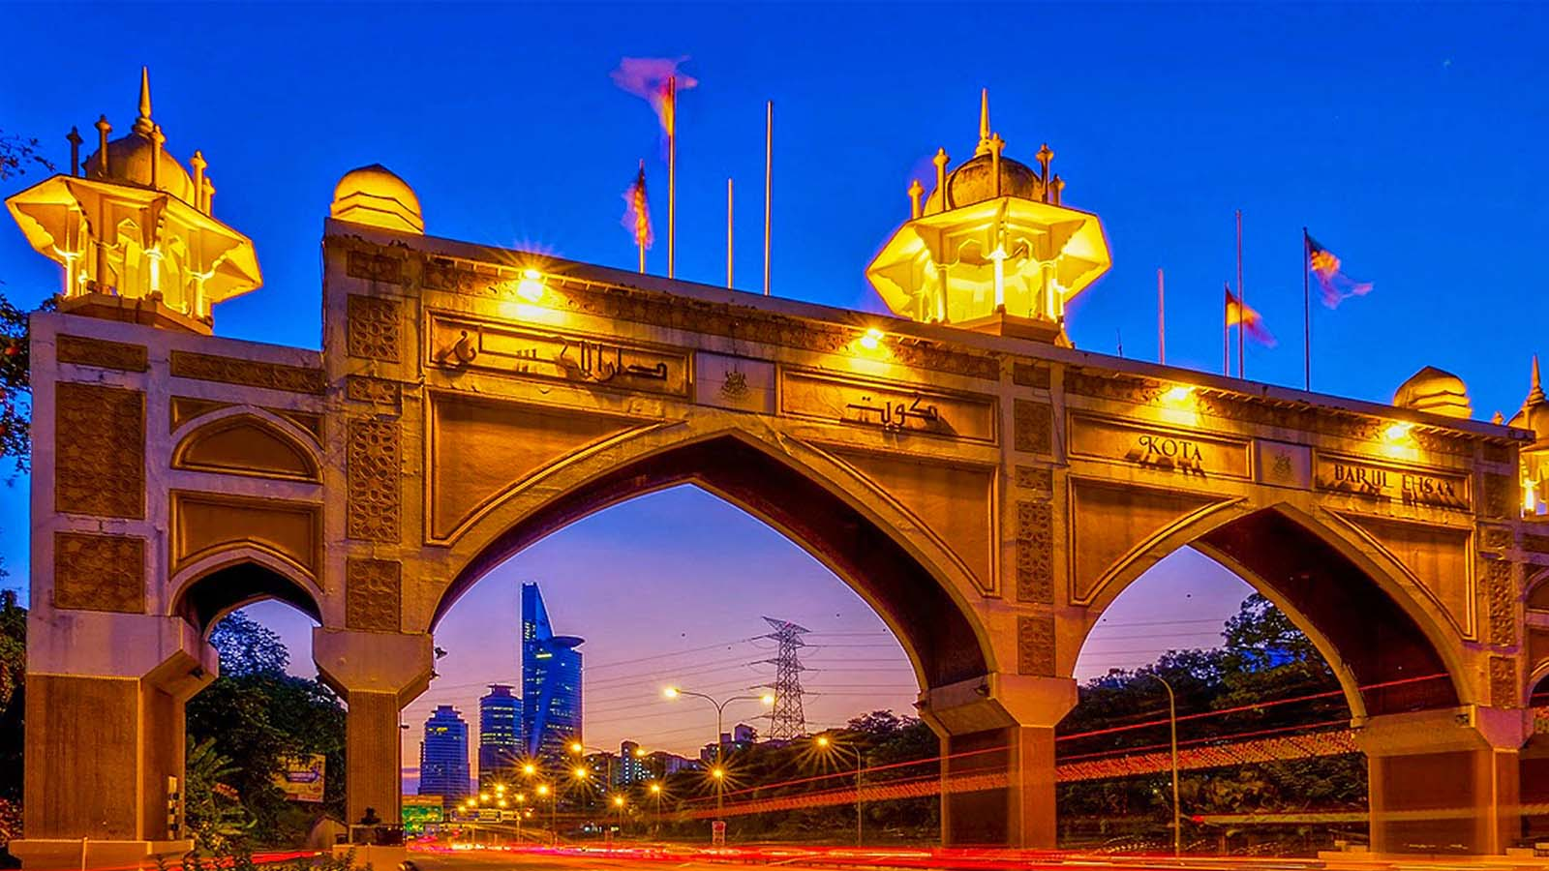

Kota Darul Ehsan Arch the entrance to Kuala Lumpur.

Slide 5
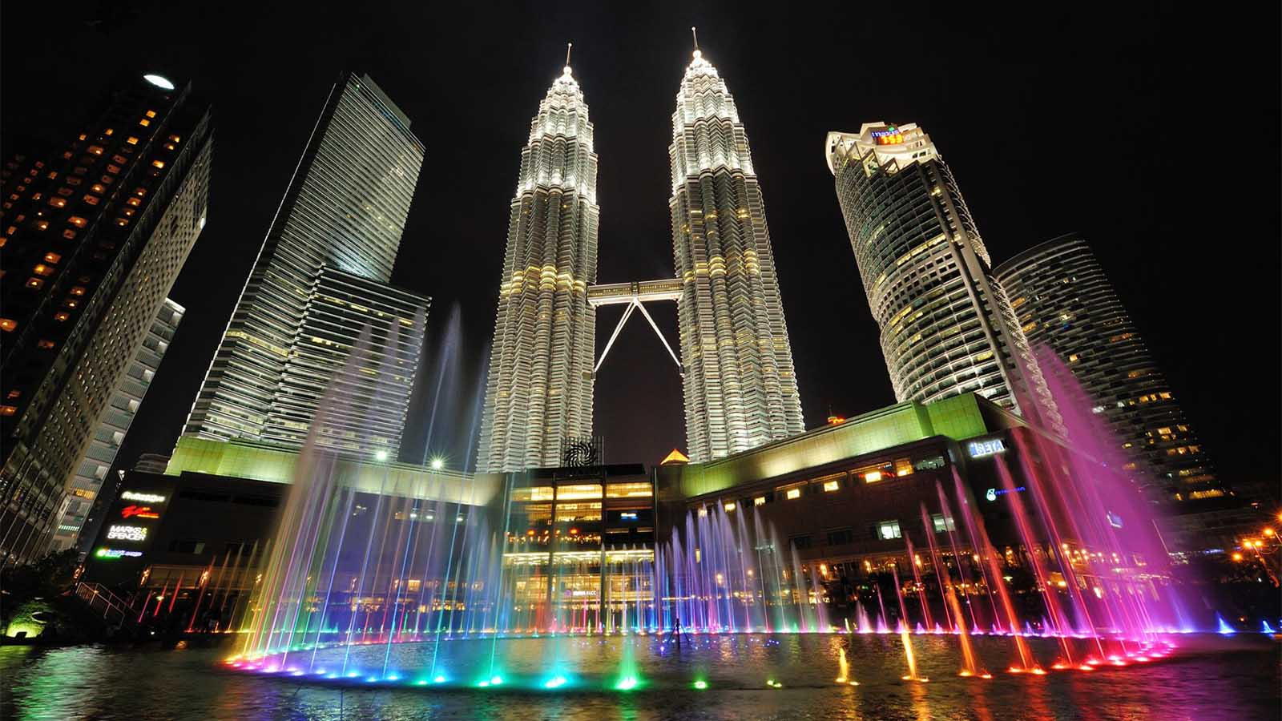
Petronas Twin Towers, Kuala Lumpur

Slide 6
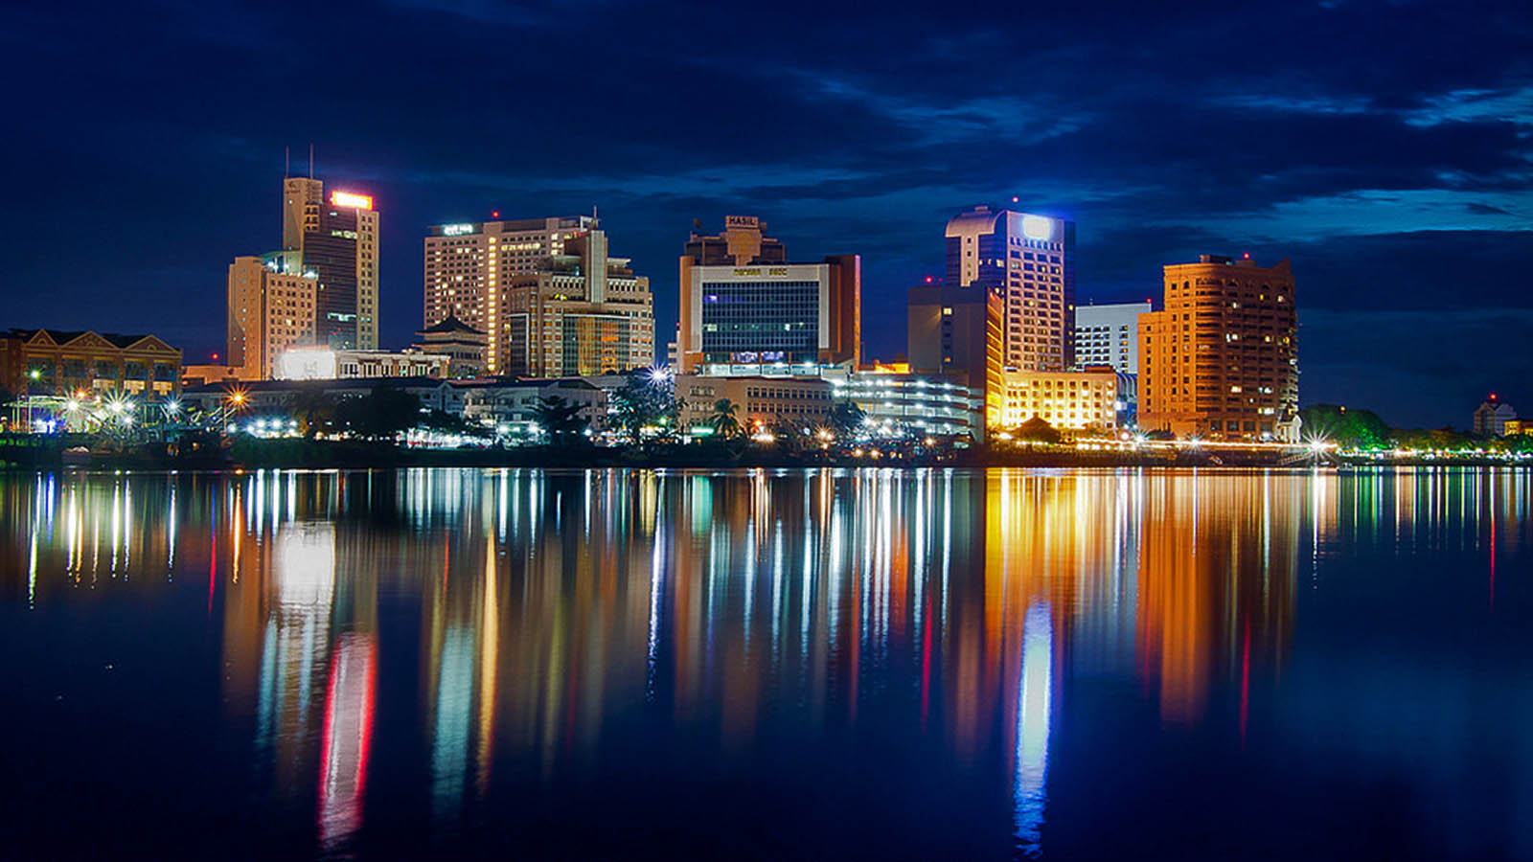
Kuching, capital of Sarawak State, Borneo

Slide 7
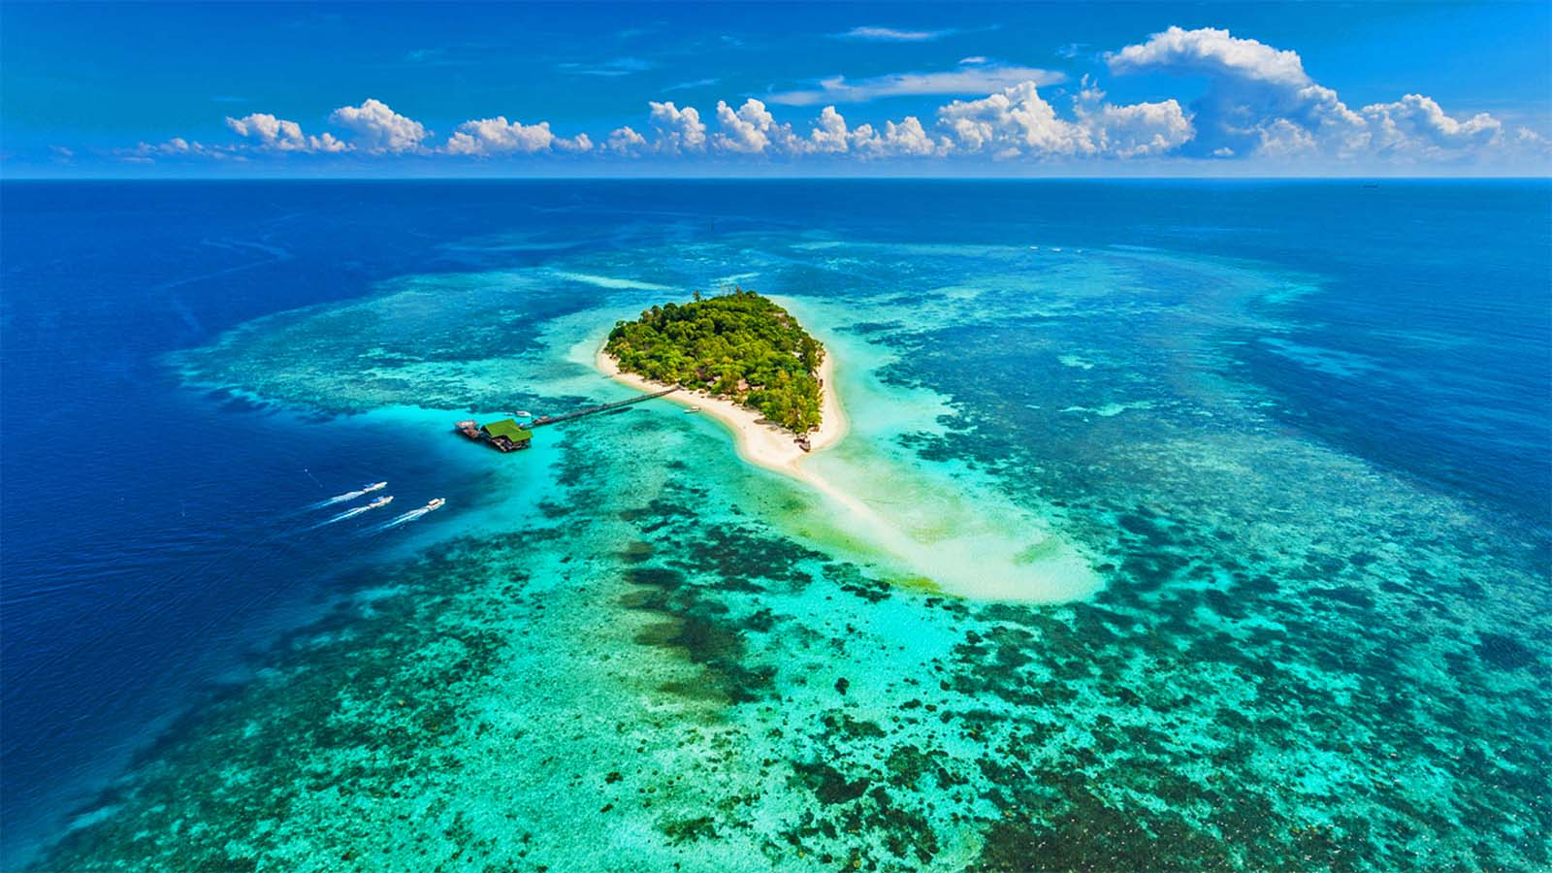
Lankayan Island

Slide 8
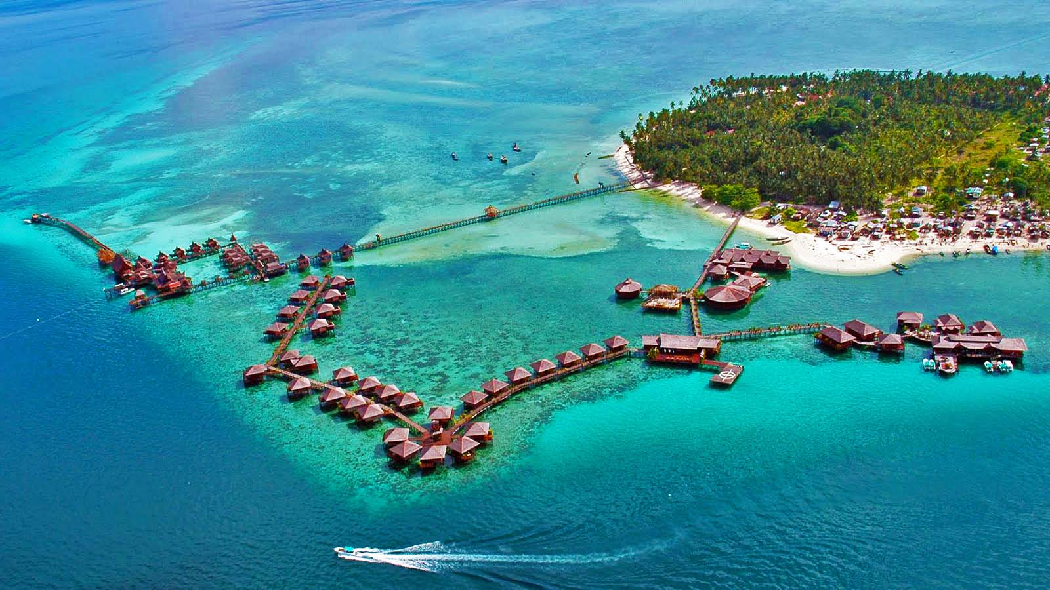
Sipadan Island in Sabah State

Slide 9
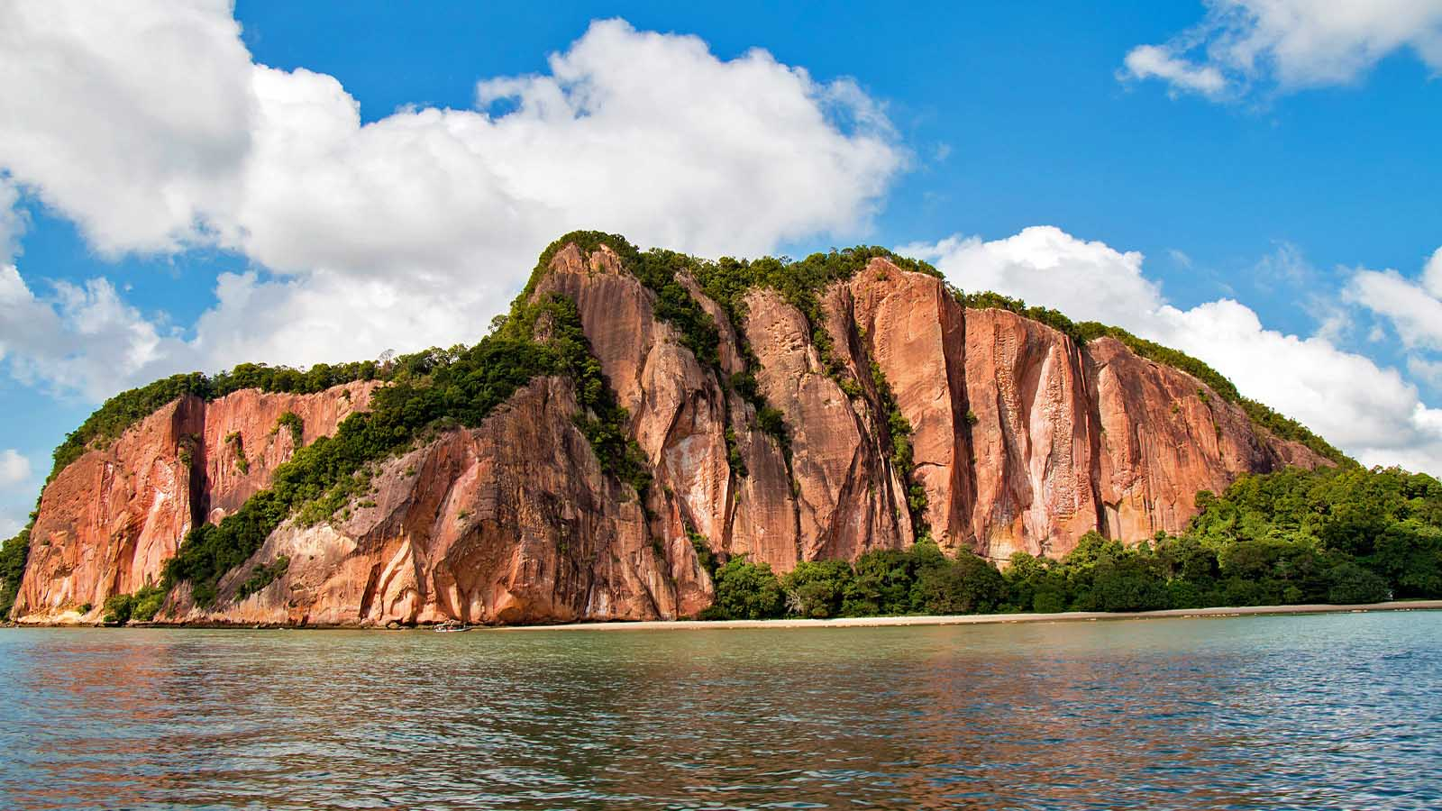
Red cliff face of Berhala Island

Slide 10
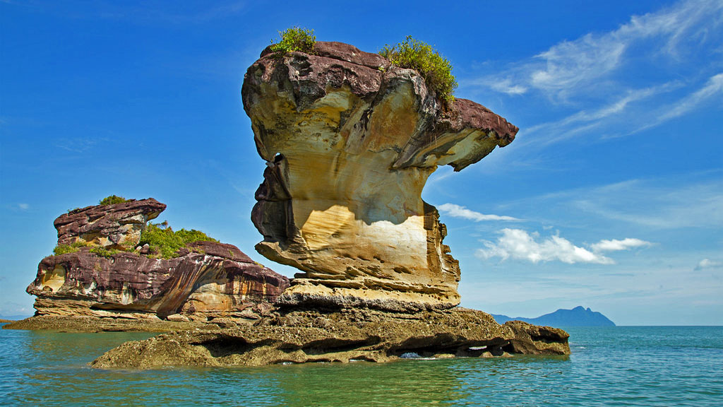
Bako National Park, Sarawak

Slide 11
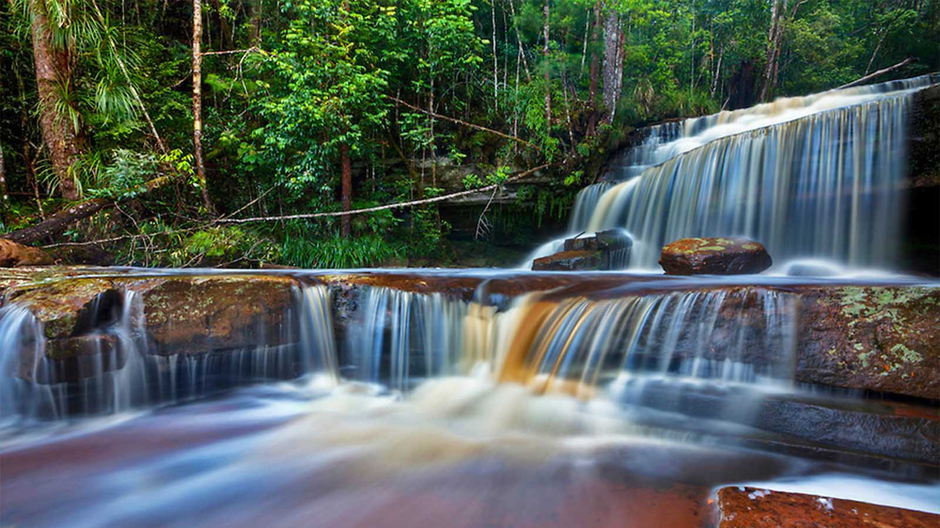
Giluk Falls at Maliau Conservation Forest, Sabah

Slide 12
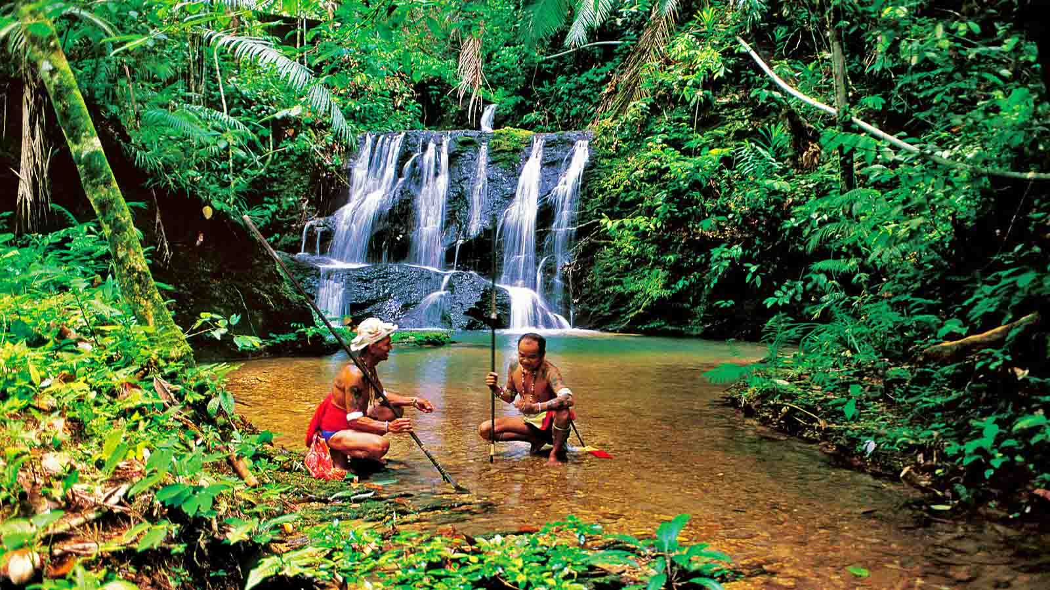
Taman Negara Jungles in Pahang

Slide 13
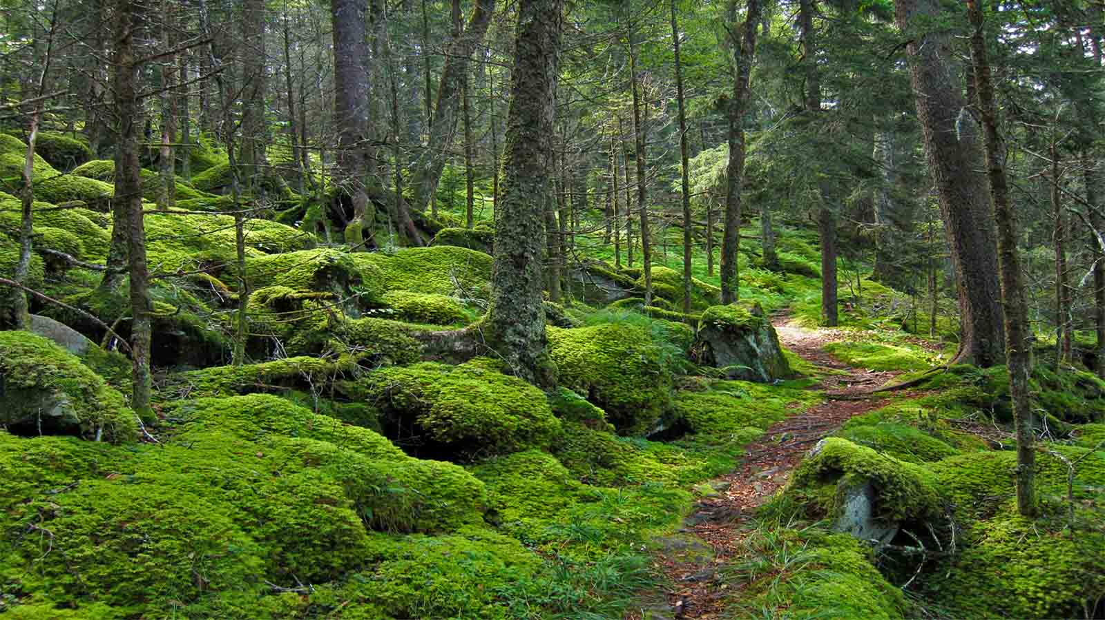
Gunung Mulung Mossy Forest, Pahang

Slide 14
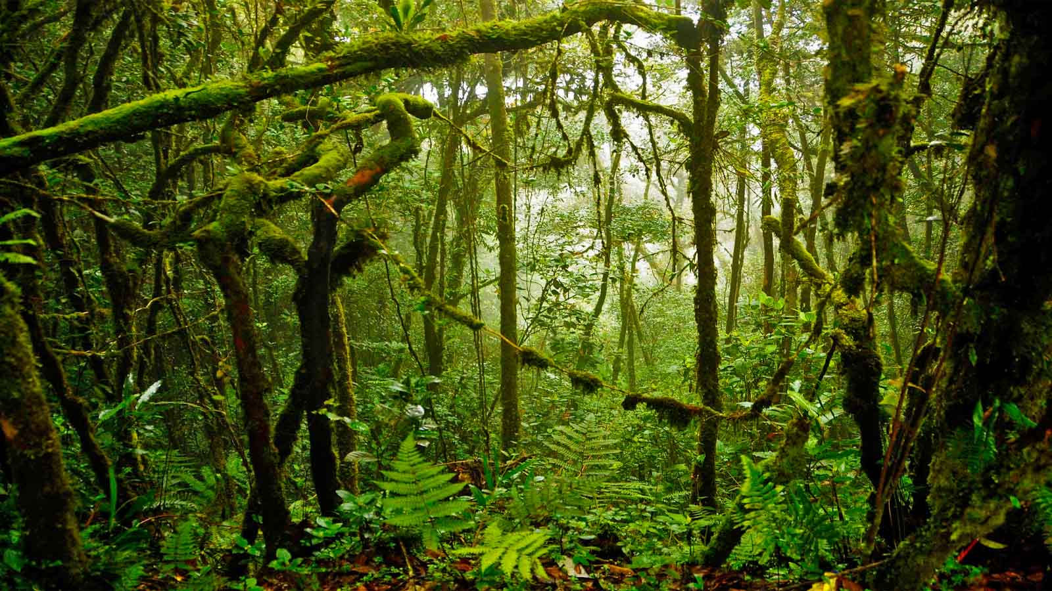
Rainforest in Sabah State

Slide 15
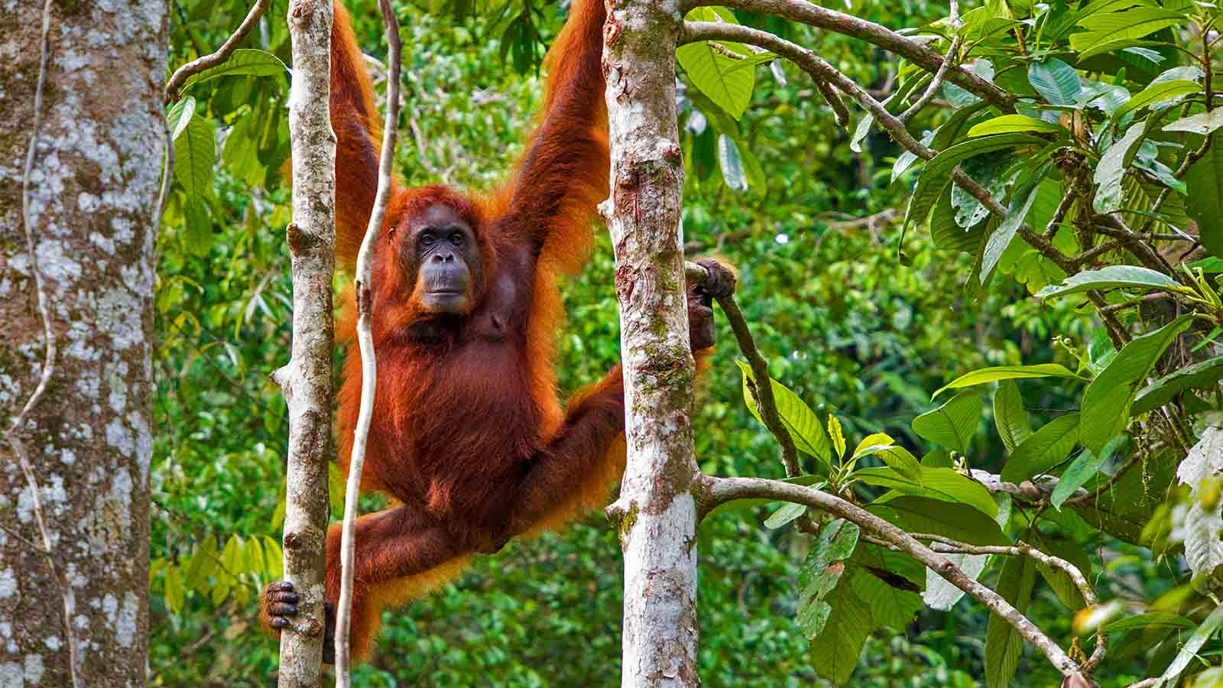
Orangutan at Semenggoh Wildlife Centre, Sarawak

Slide 16
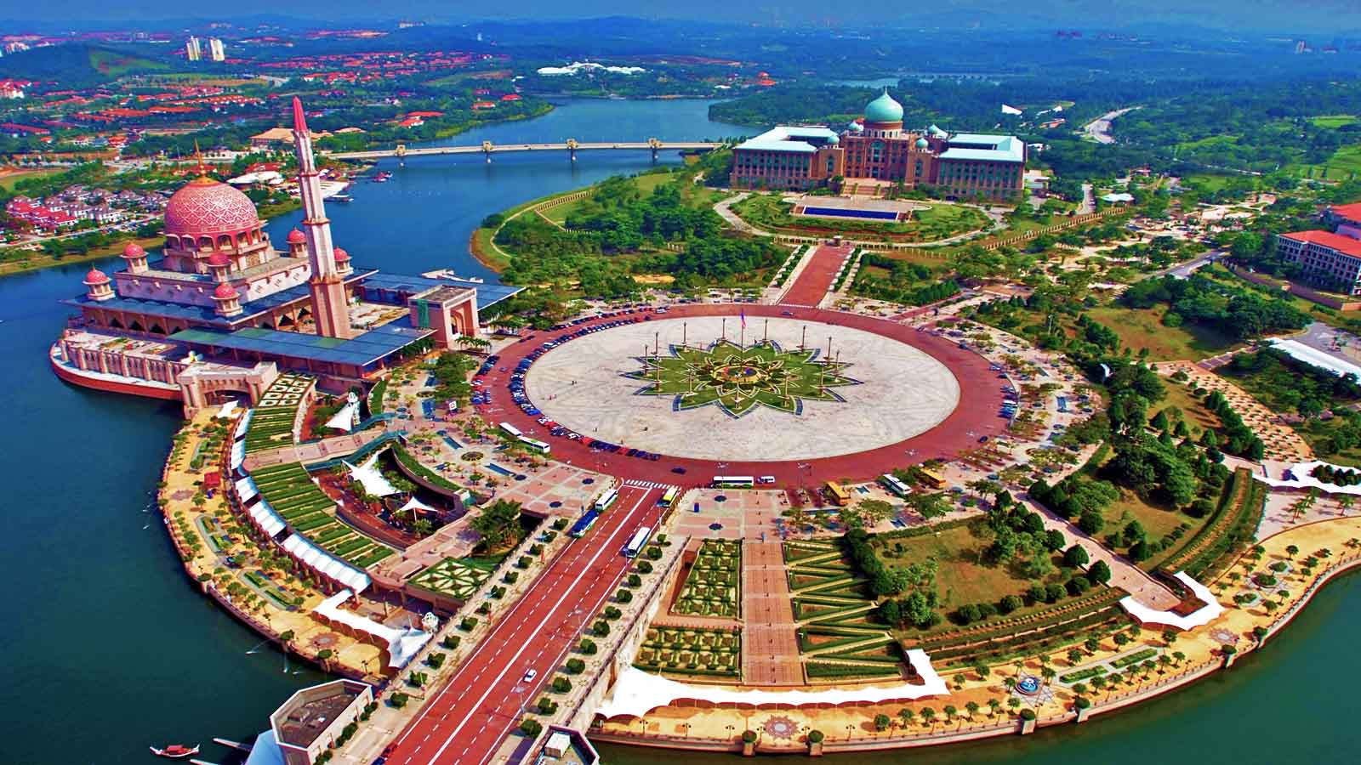
Putrajaya, the federal administrative centre of Malaysia, Selangor State

Slide 17
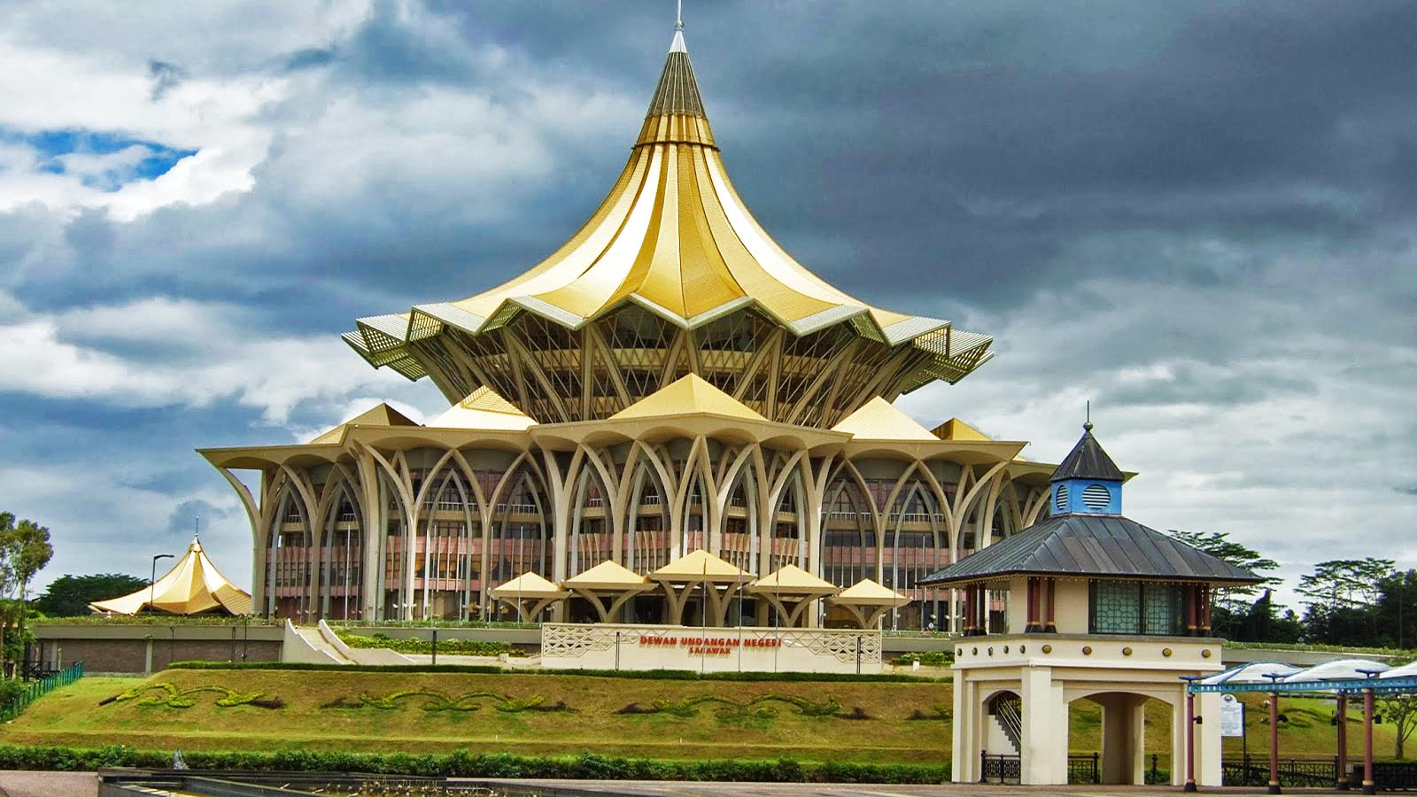
Sarawak Legislative Assembly Building at Kuching

Slide 18
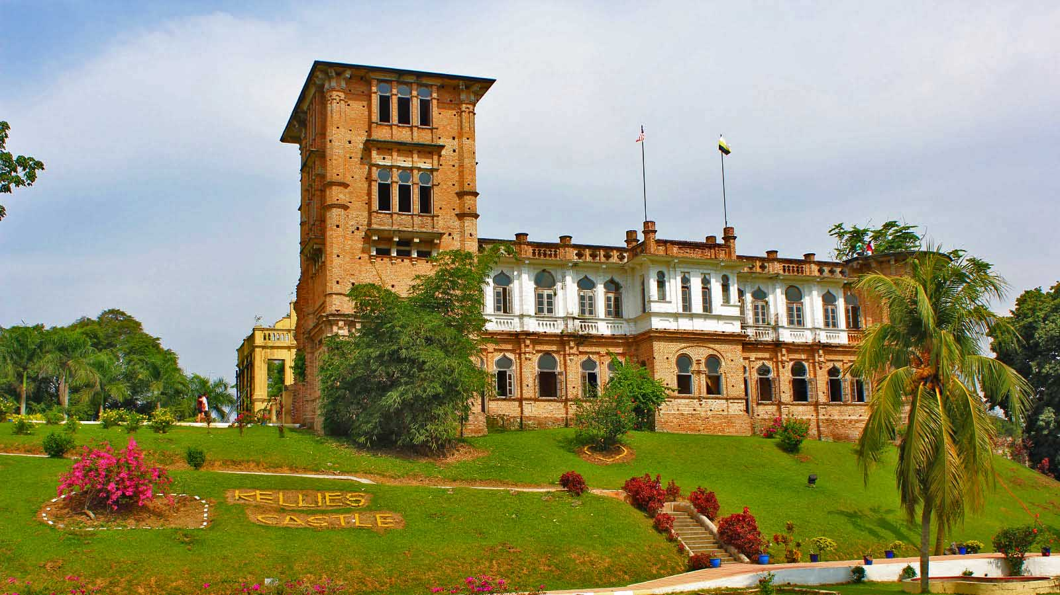
Kellie’s Castle (past colonial structure), Perak

Slide 19
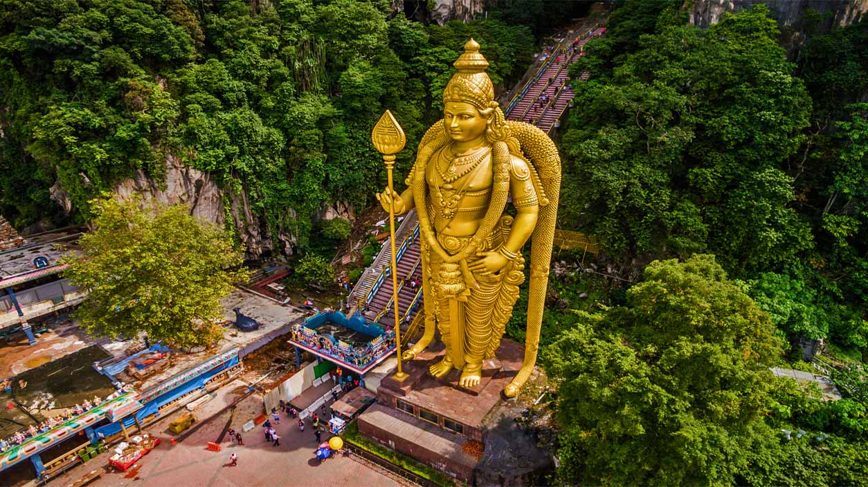
Batu Caves with series of caves and cave temples in Gombak, Selangor

Slide 20
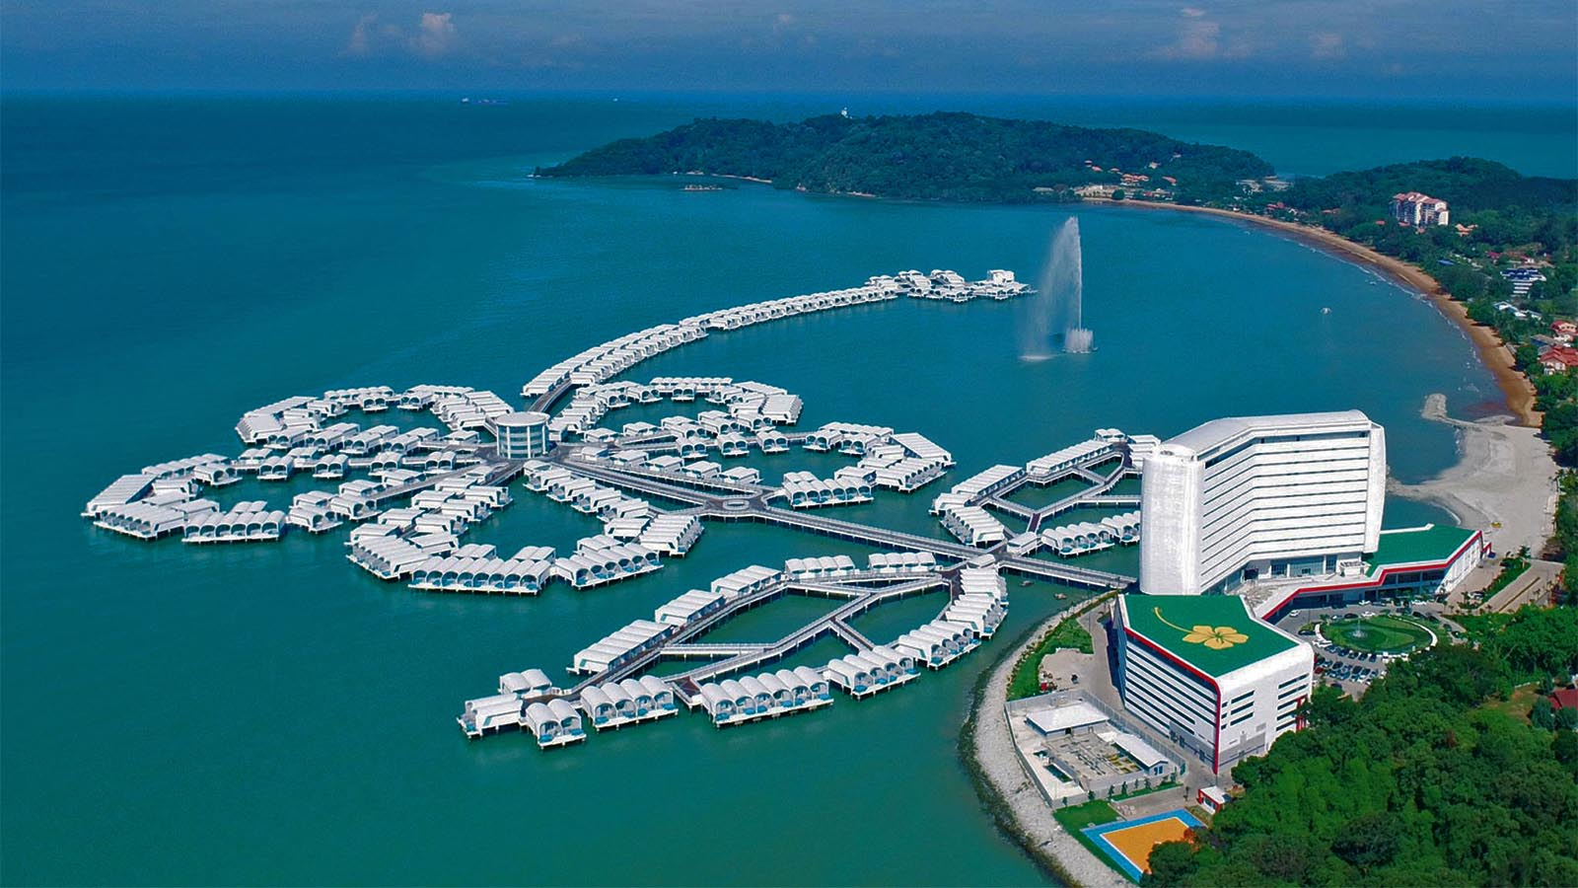
Lexis Hibiscus Port Dickson Hotel in the state of Negeri Sembilan

Slide 21
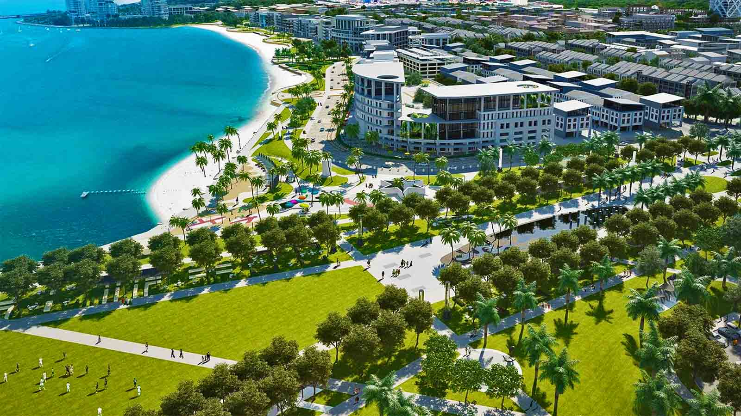
Miri, a coastal city in northeastern Sarawak State, Borneo

Slide 22
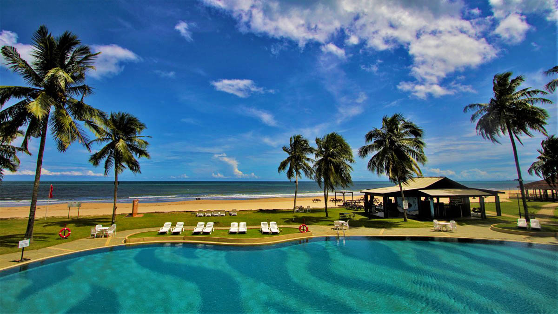
Tioman Island in Rompin District, Pahang

Slide 23
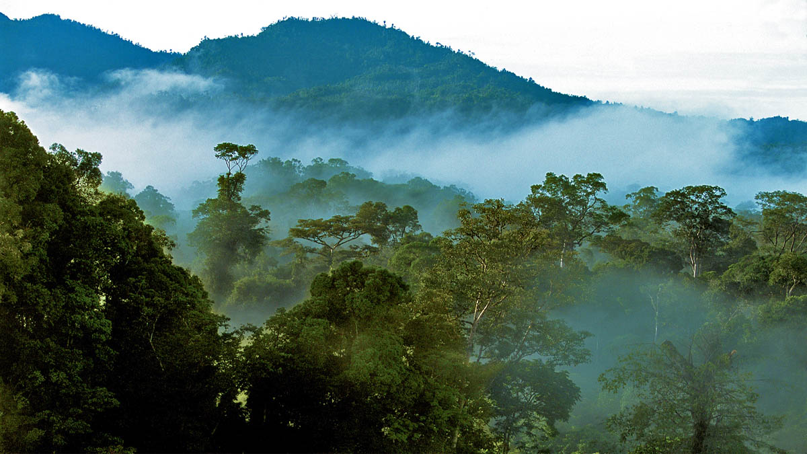
Rainforest of Sarawak

Slide 24
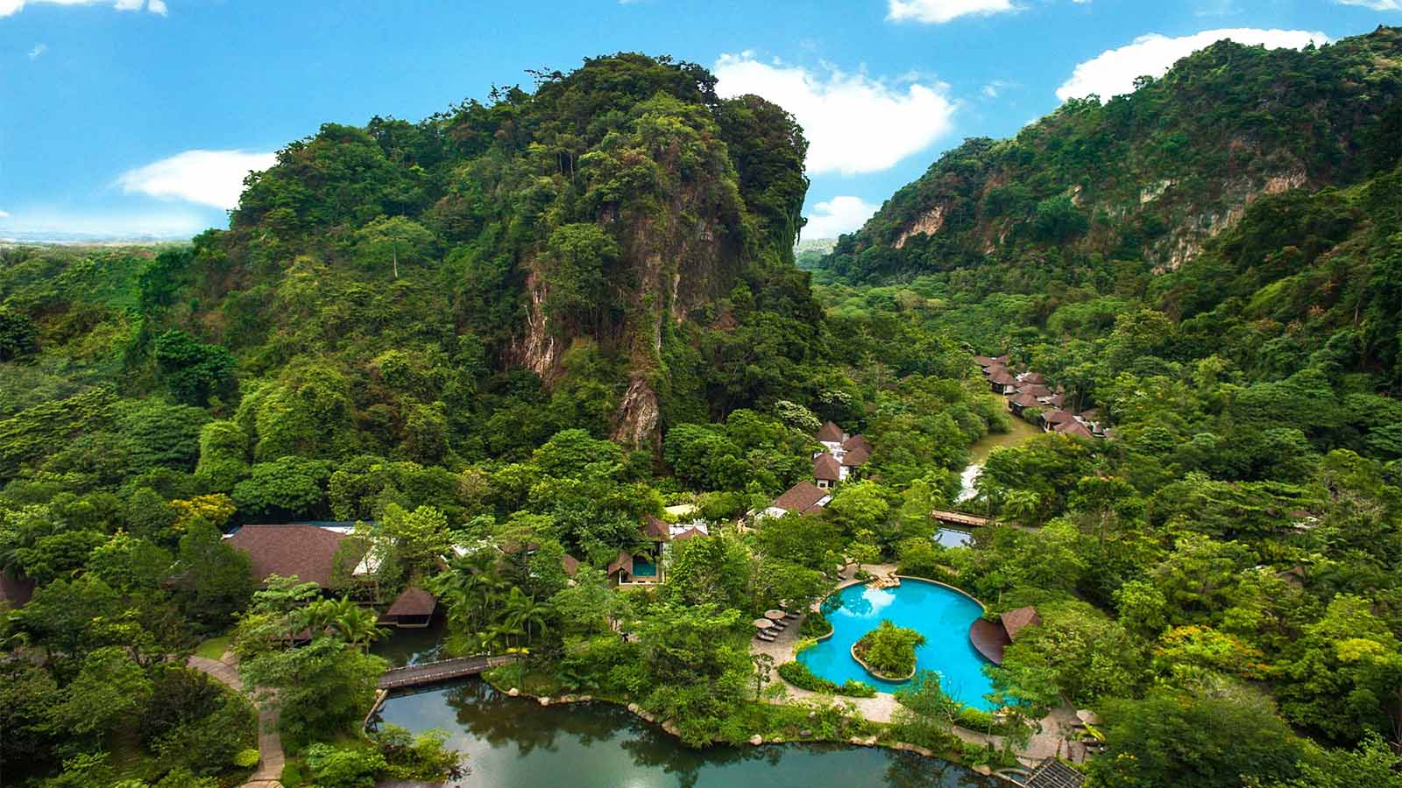
Banjrang Hotsprings Retreat, Perak

Slide 25
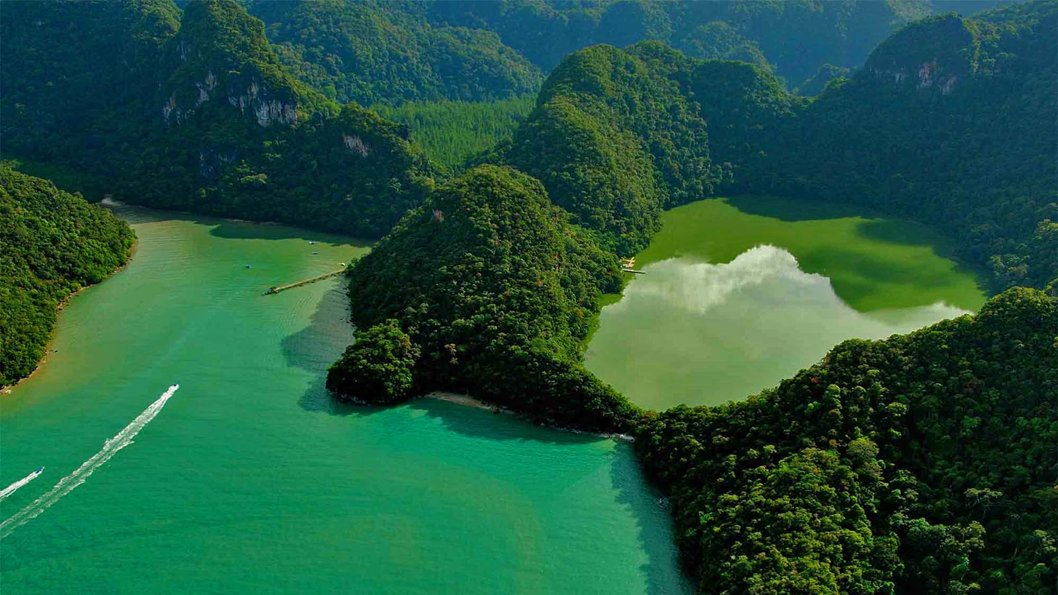
Archipelago Langkawi the Jewel of Kedah

Slide 26
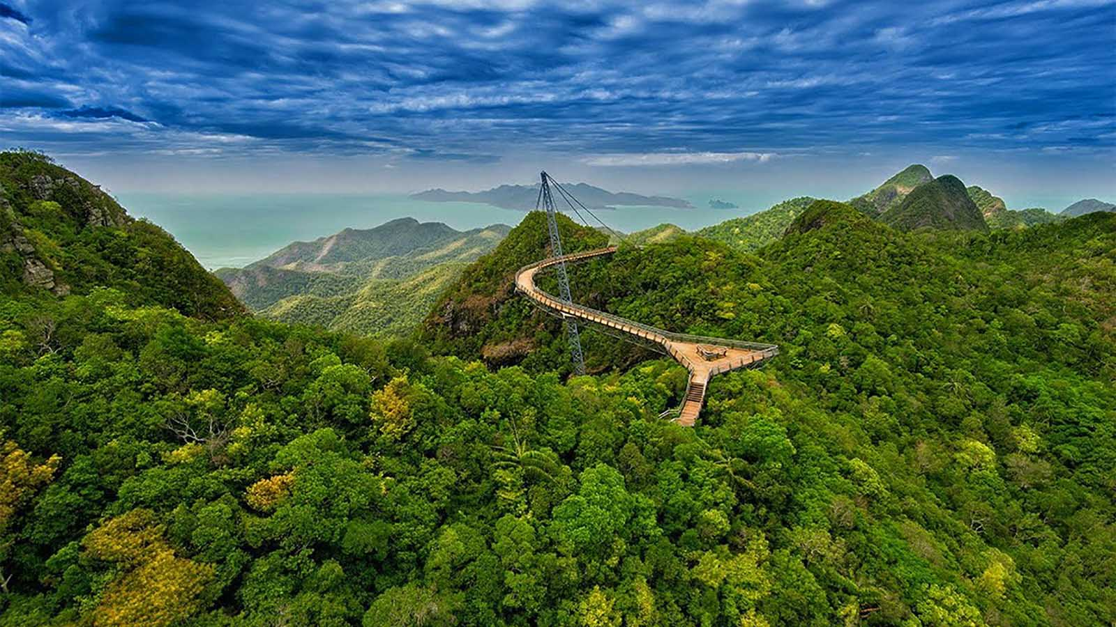
Langkawi Sky Bridge

Slide 27
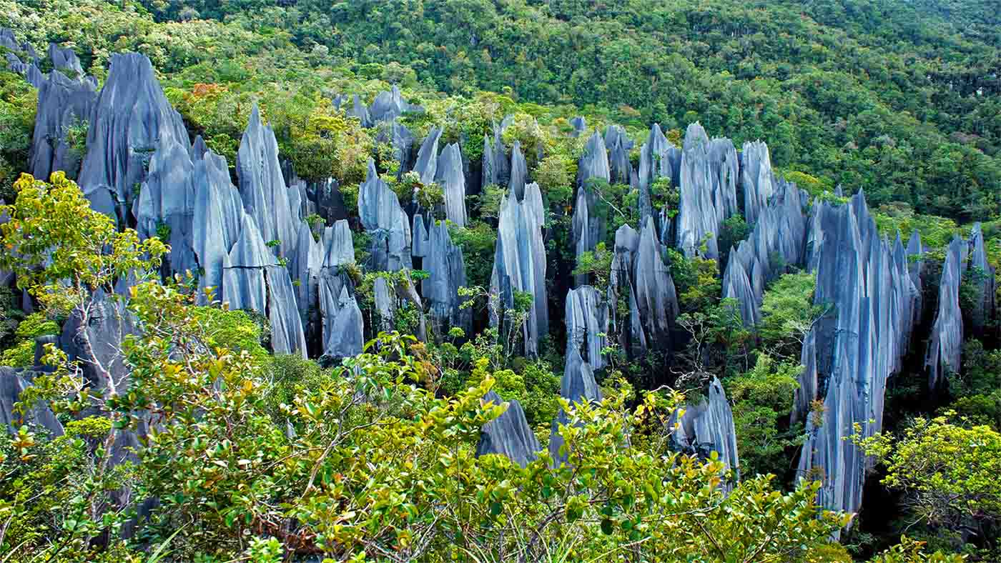
Gunung Mulu National Park, Sarawak

Slide 28
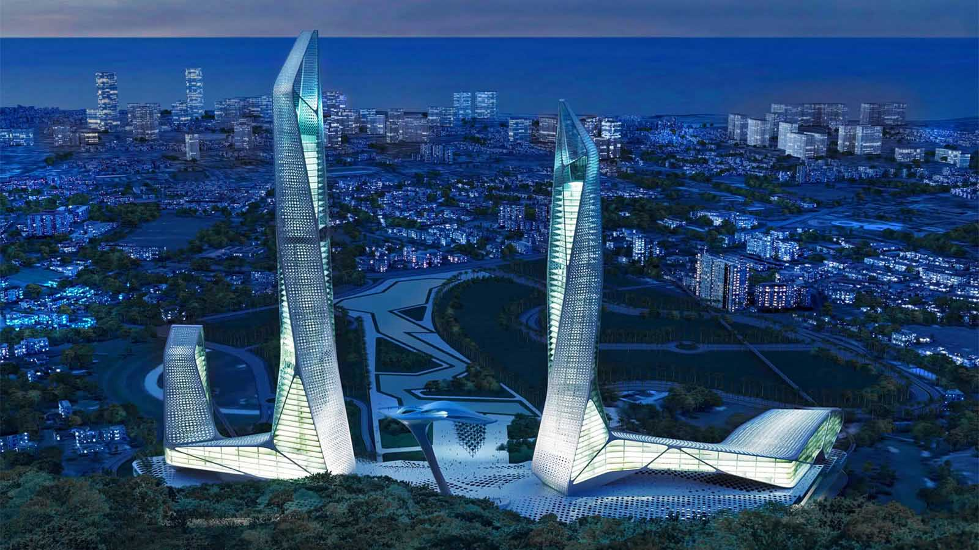
Penang Global City Centre

Slide 29
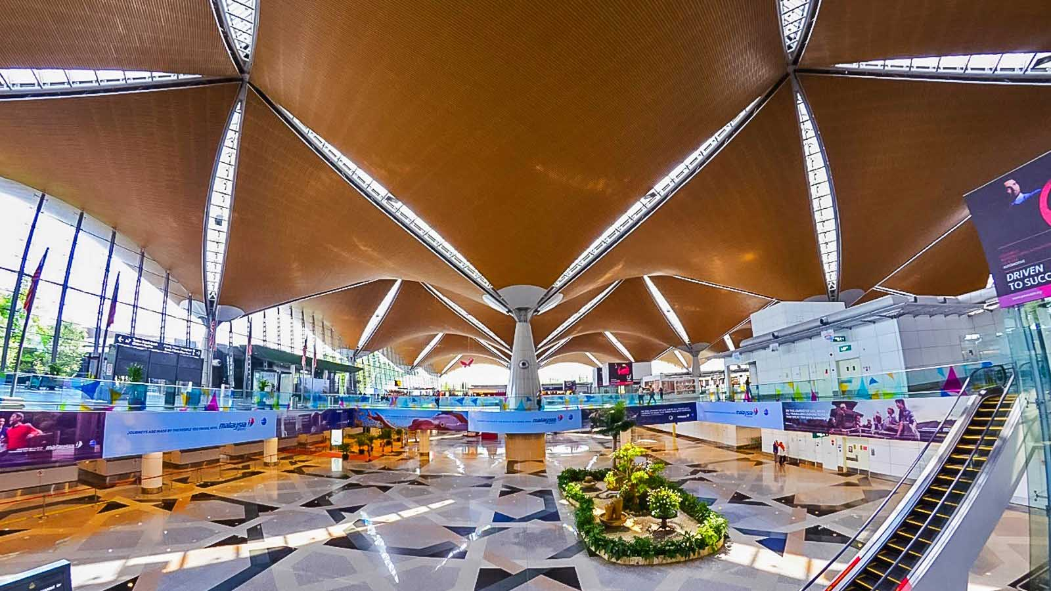
Airport in Kuala Lumpur

Slide 30
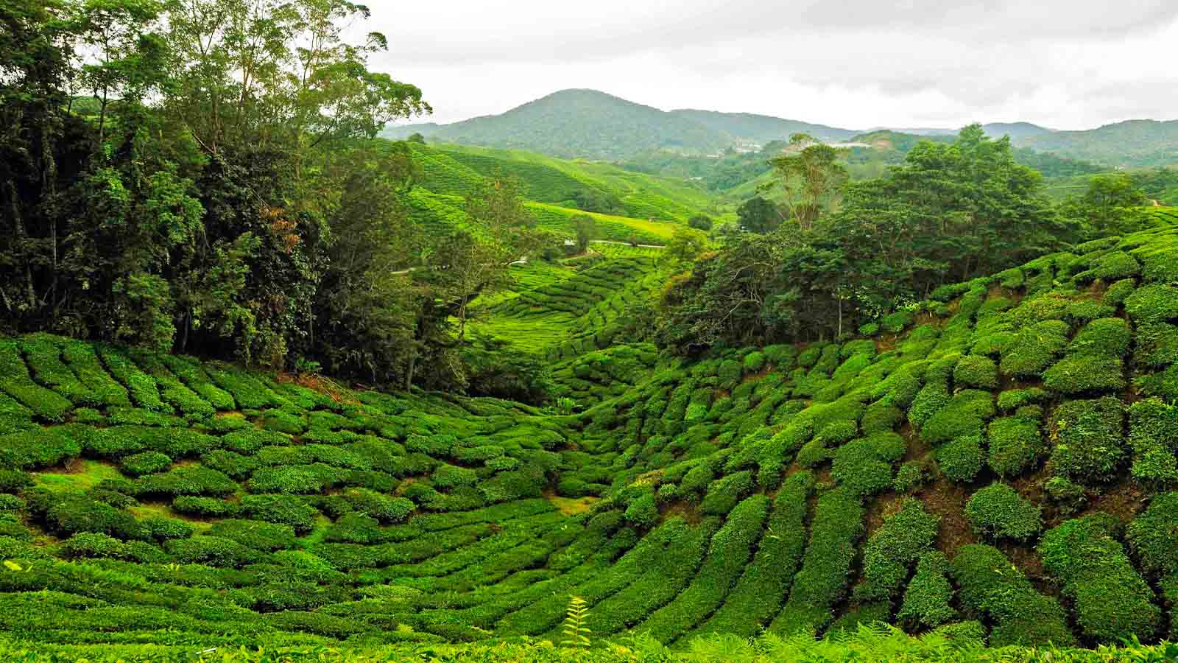
The srawling hilly tea estates of Cameron Highlands, Pahang

Slide 31
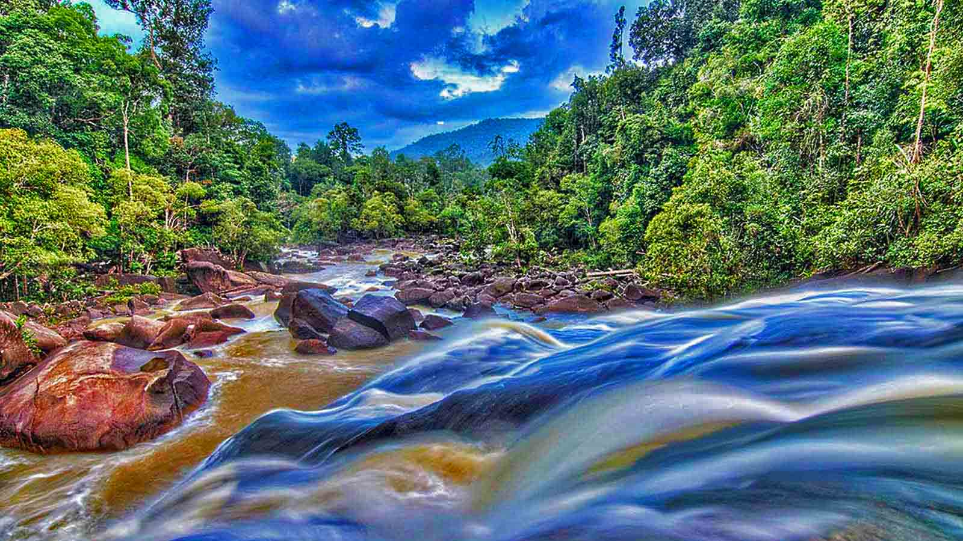
Rompin Endau National Park, Pahang

Slide 32
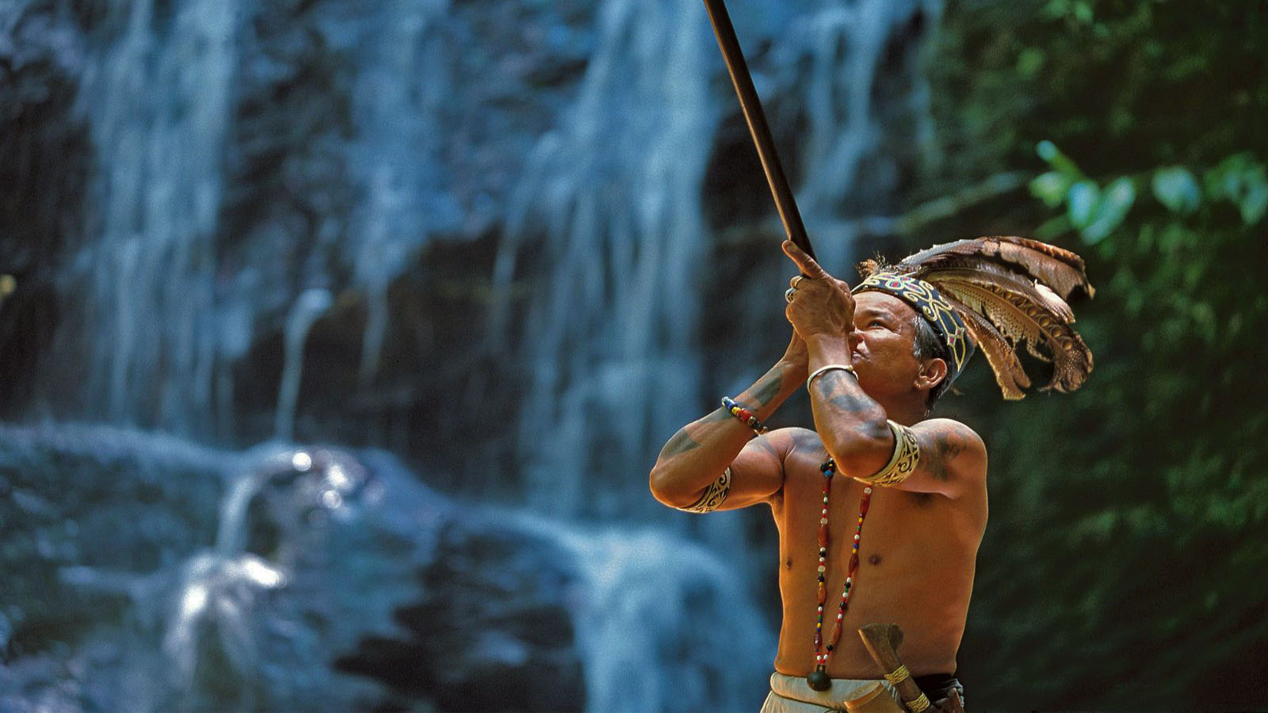
Tribal life in Borneo

Slide 33
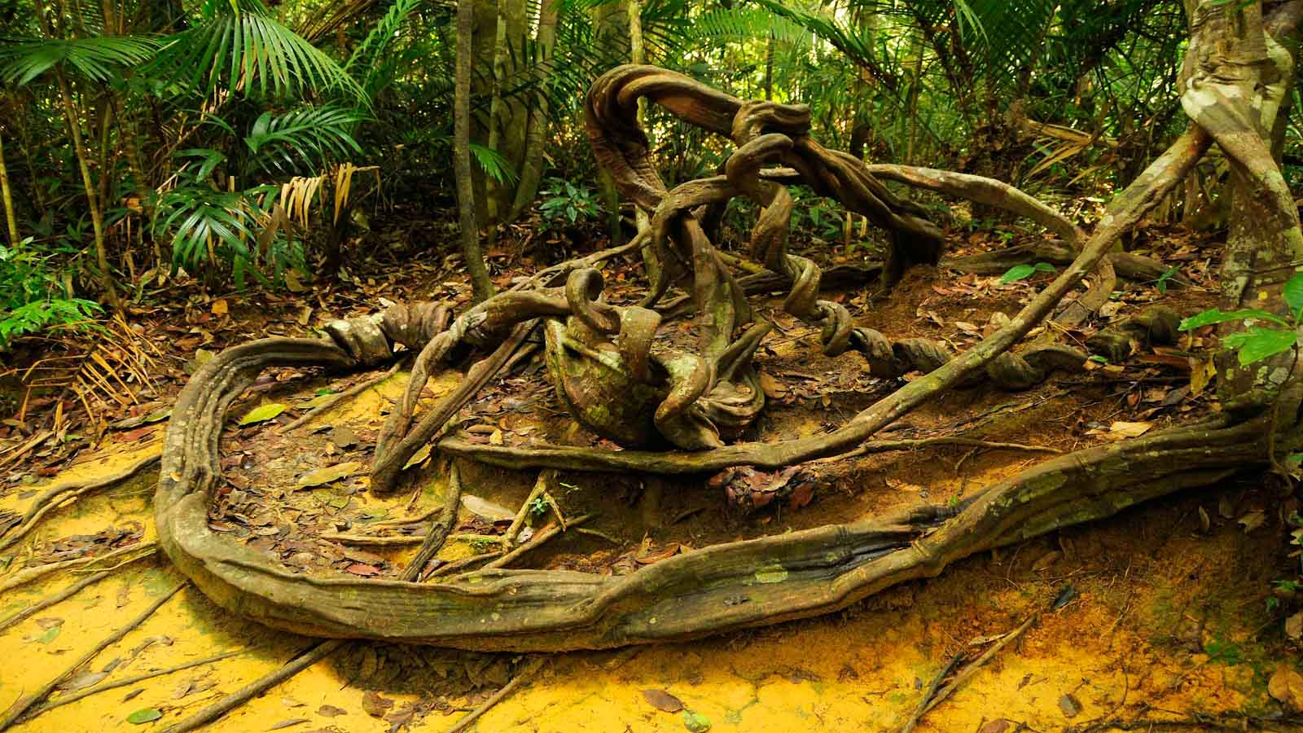
Taman Negara National Park

Slide 34
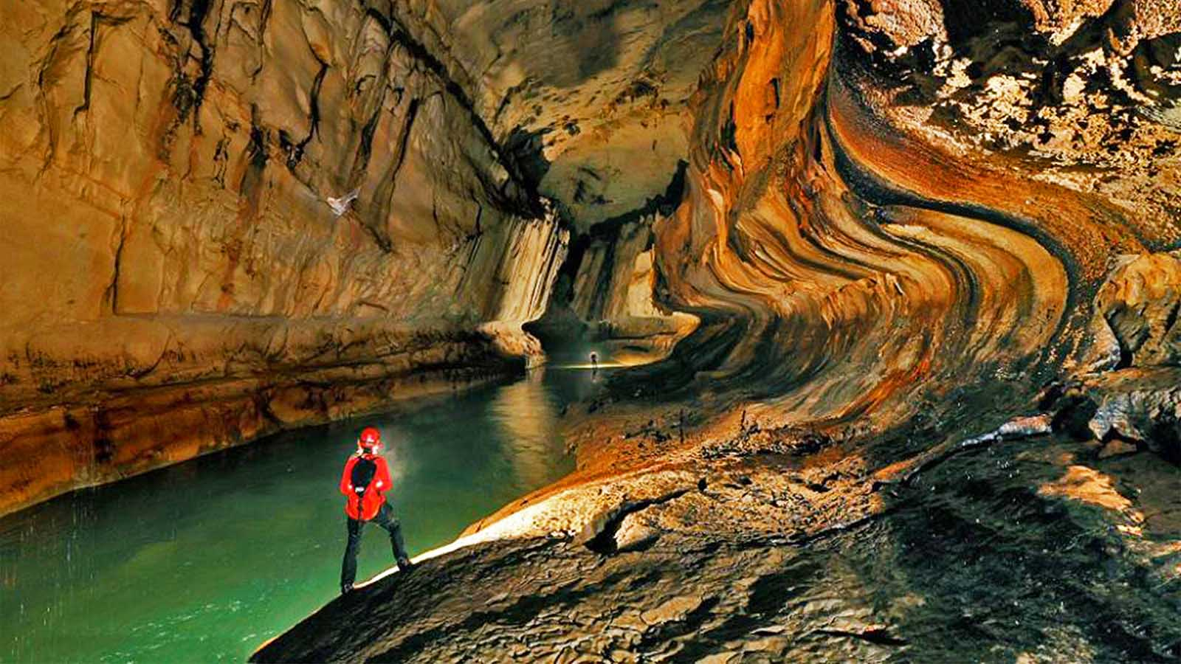
Clearwater Cave at the Gunu Mulu National Park in Sarawak

Slide 35
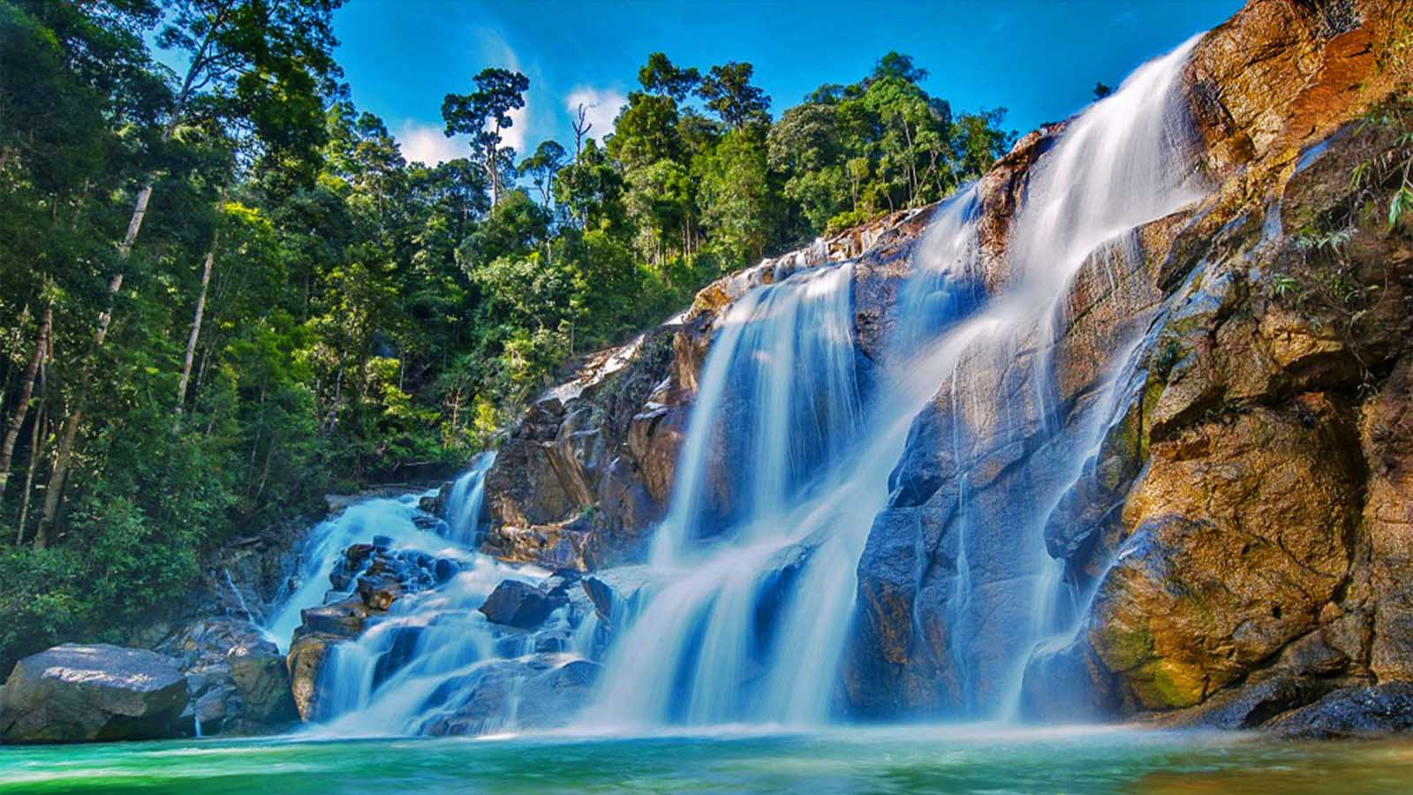
Chiling Waterfall near Kuala Kubu Baru, Selangor State

Slide 36
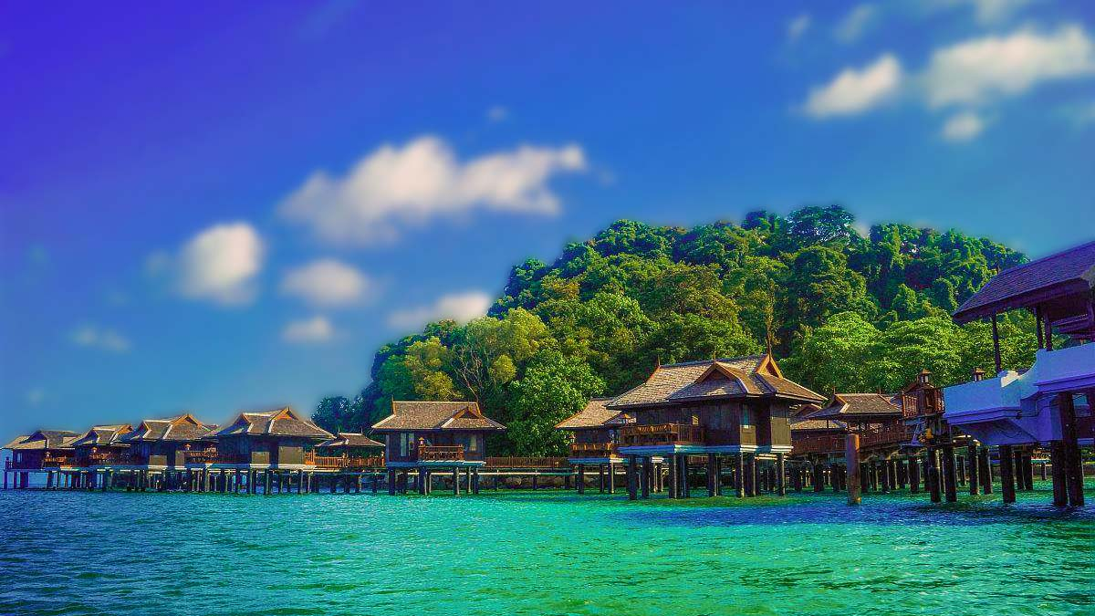
Pulau Pangkor island in Perak

Slide 37
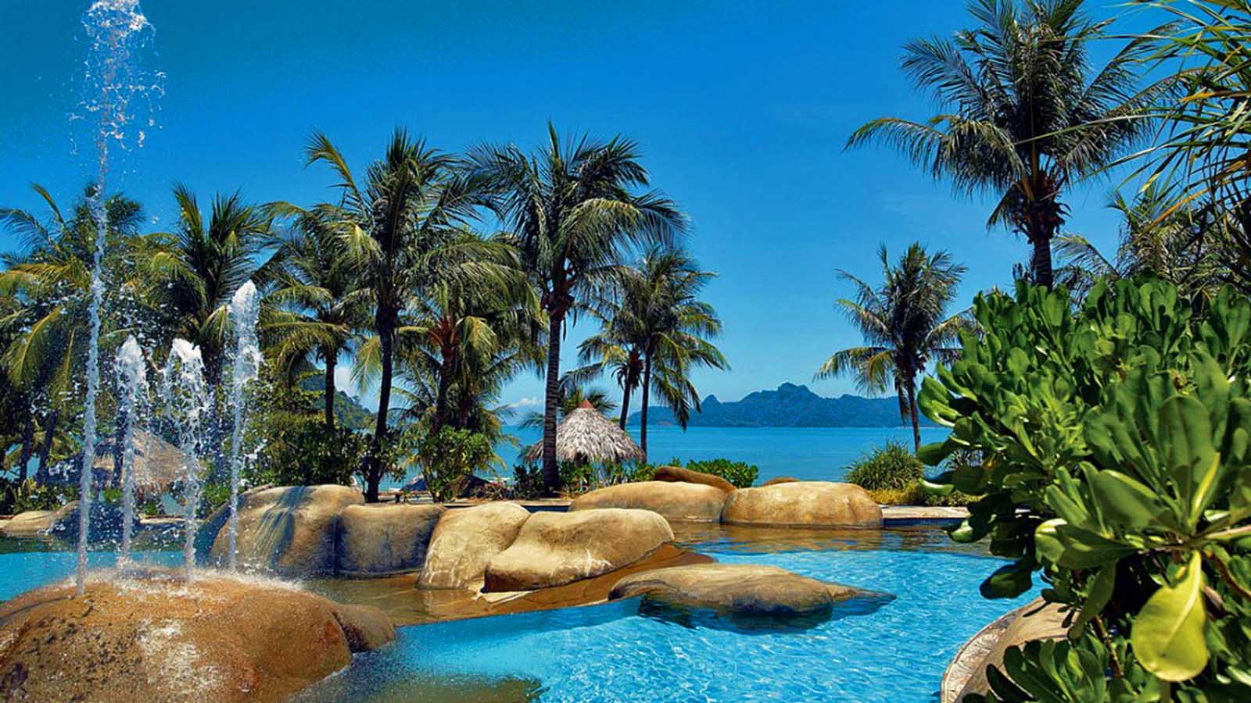
Westin Langkawi Resort

Slide 38
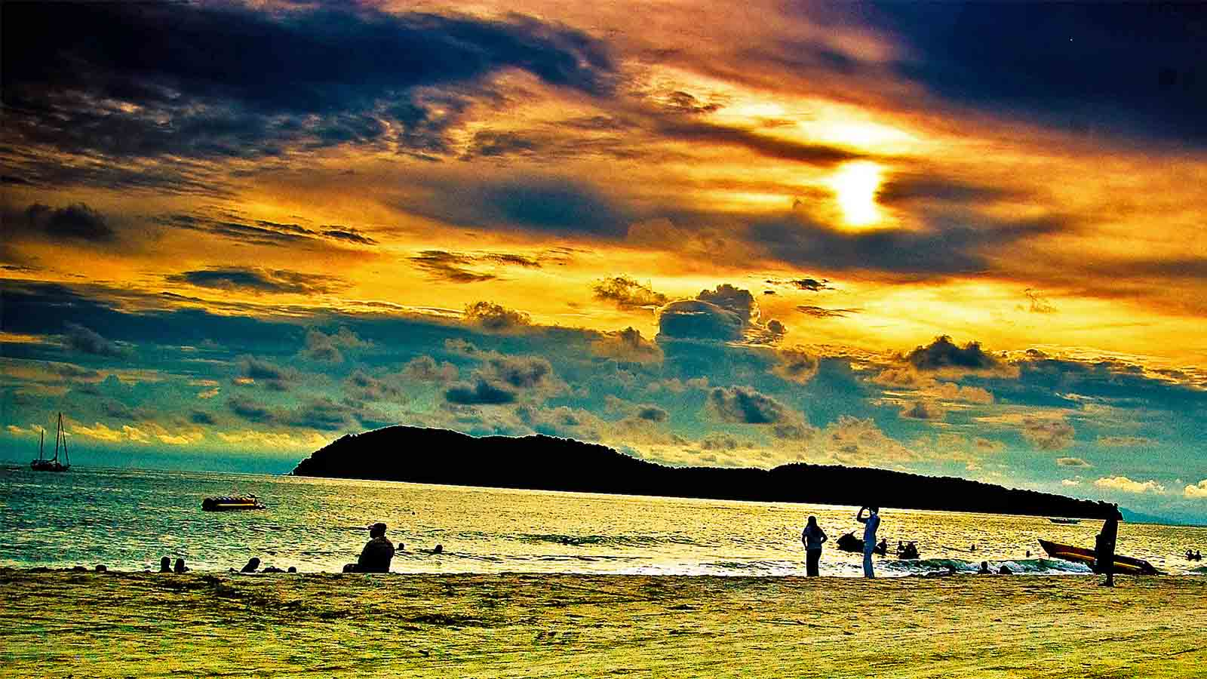
Sunset at Langkawi

Slide 39
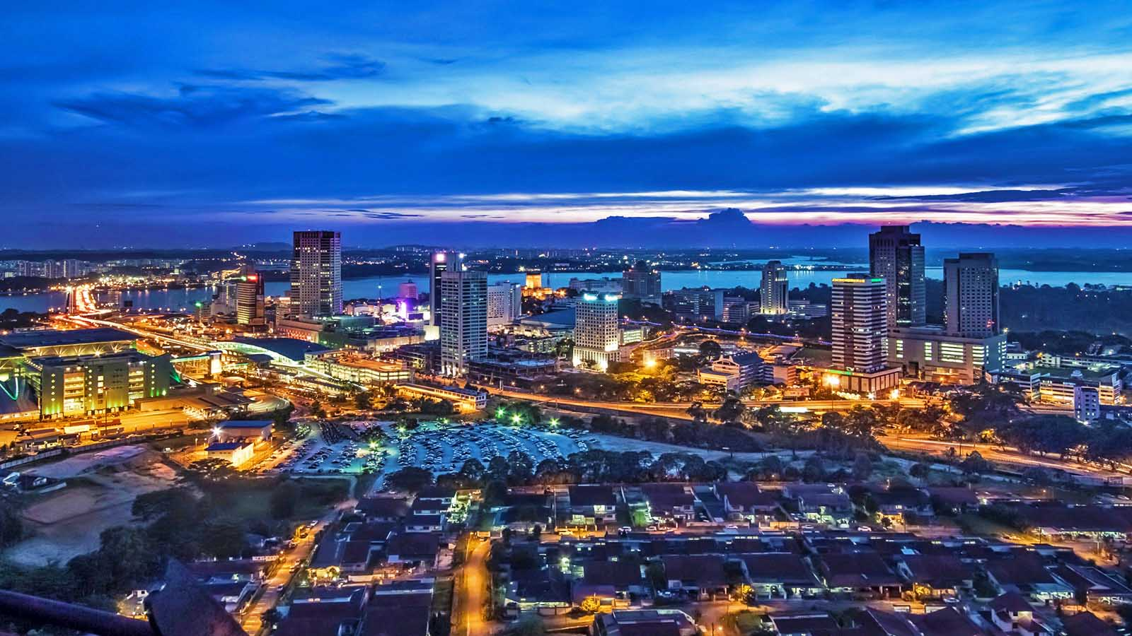
Bharu City, the capital of the State Johor

Slide 40
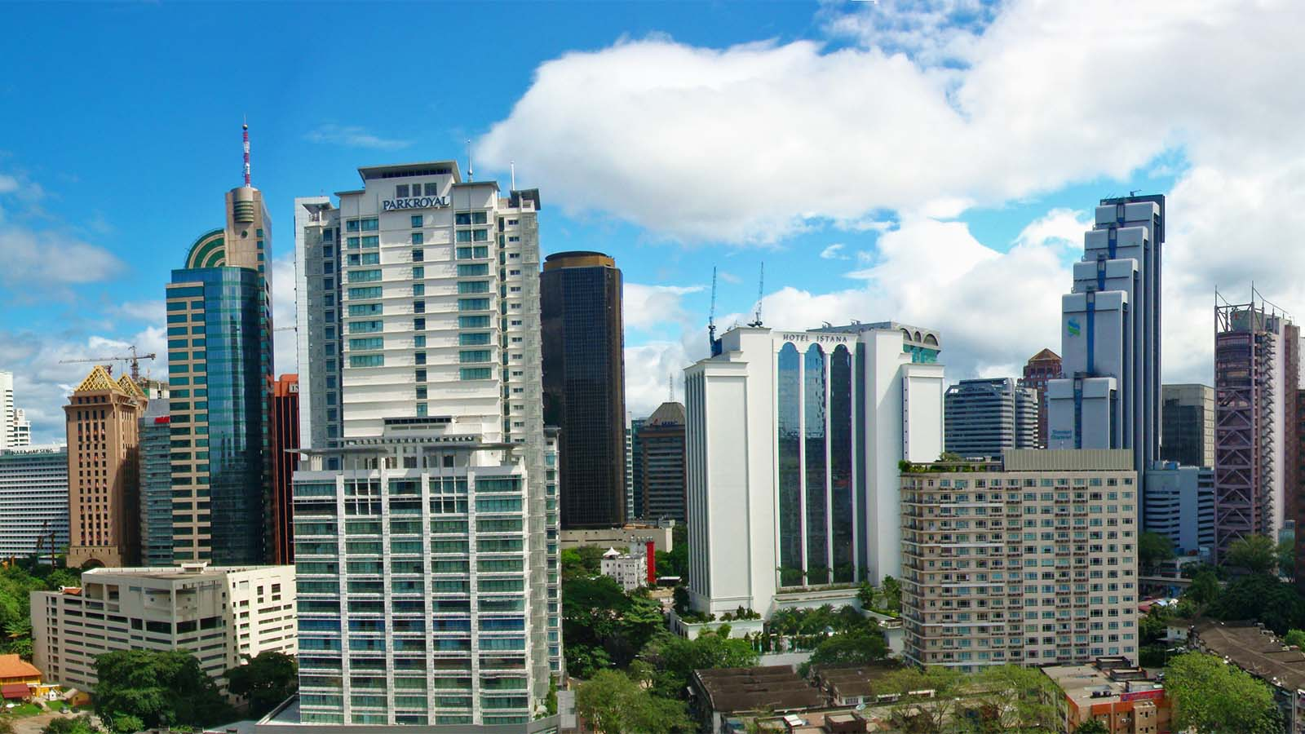
Downtown, Kuala Lumpur

Slide 41
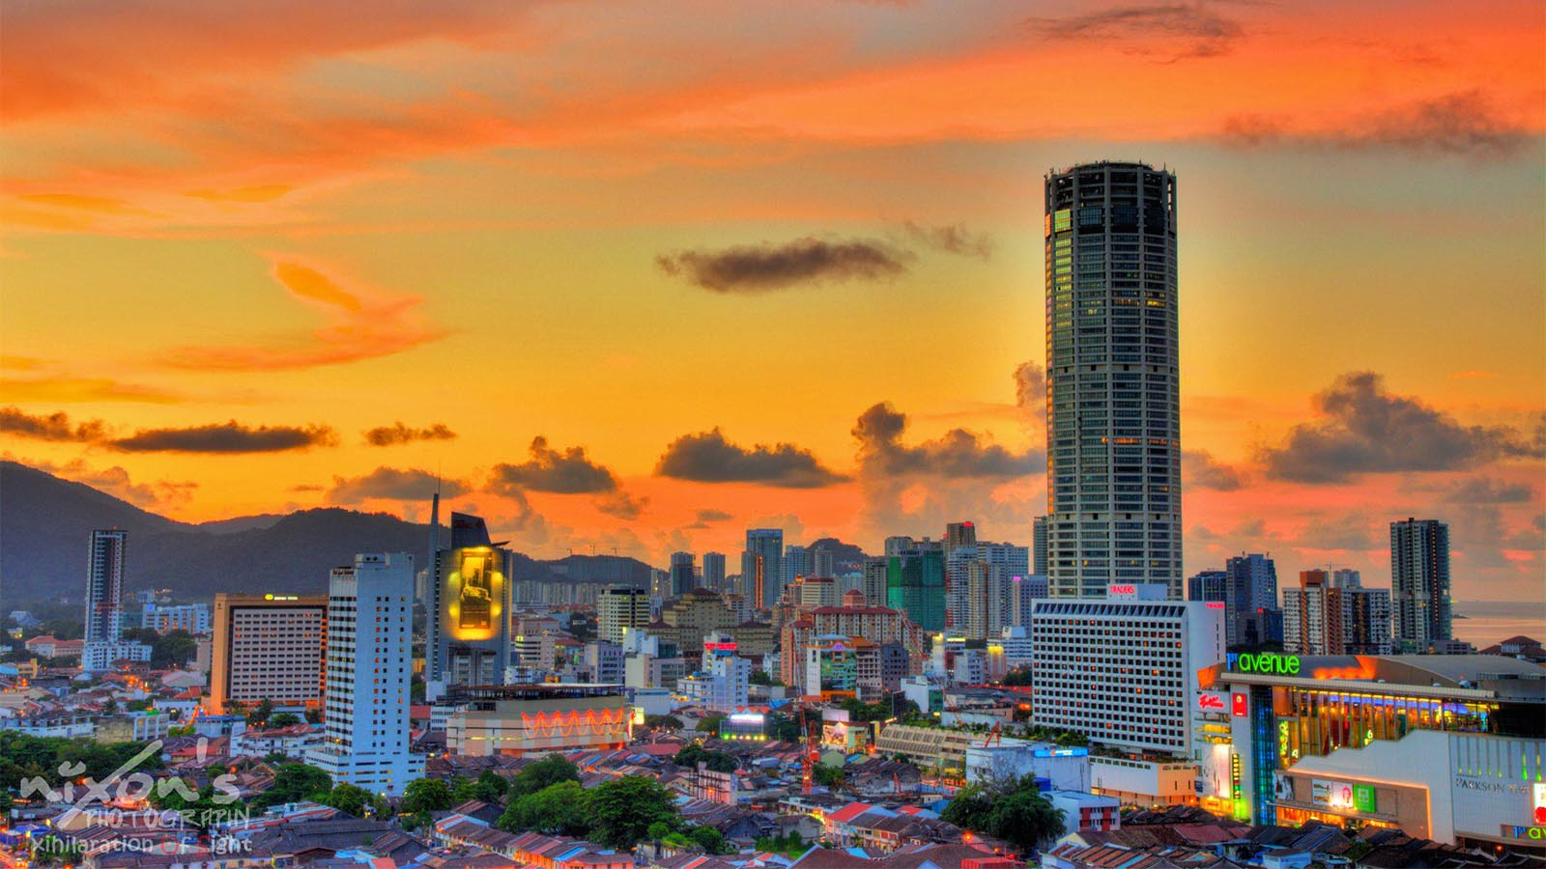
George Town, the capital of the Malaysian island of Penang

Slide 42
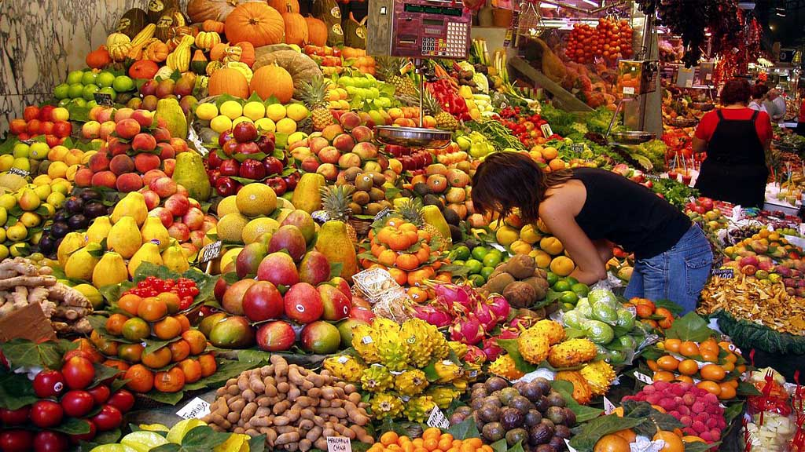
Kea Farm Market, Cameron Highlands, Pahang

Slide 43
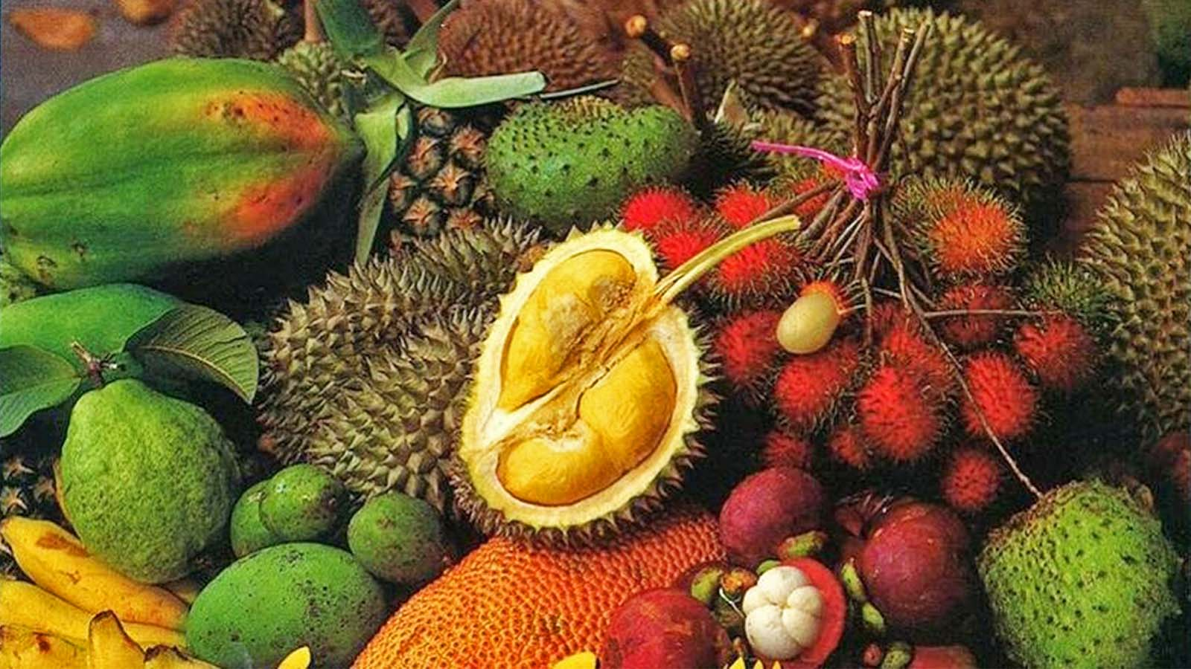
Exotic tropical fruits of Malaysia

Slide 44
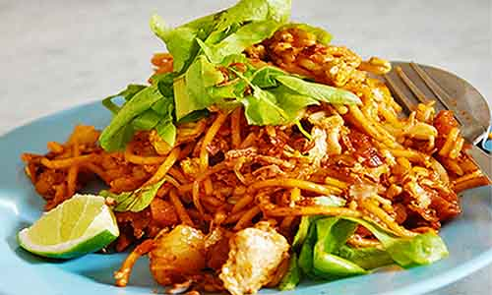
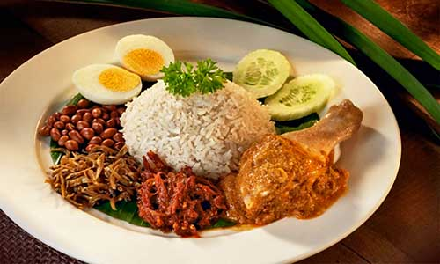
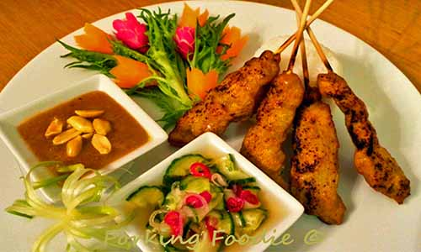
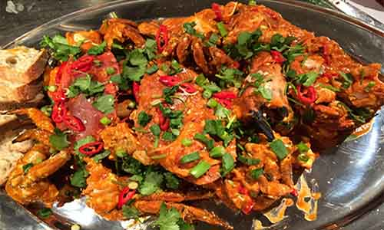
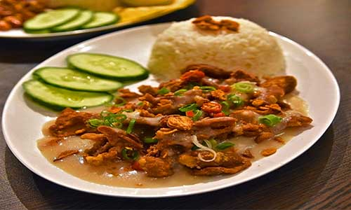
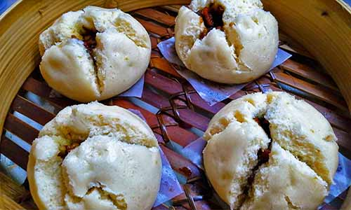
Mee Goreng
(Malaysian Fried Noodles)
Nasi Lemak
(Fried Rice with Anchovy gravy and Chicken)
Chicken Satay
with Peanut Sauce and Chillie Salad
Delicious Chillie Crab
Rojak or Pasembar
Char Siu Bau (Steamed Pork Buns)
SOME EXOTIC CULINARY DISHES FROM MALAYSIA

Slide 45
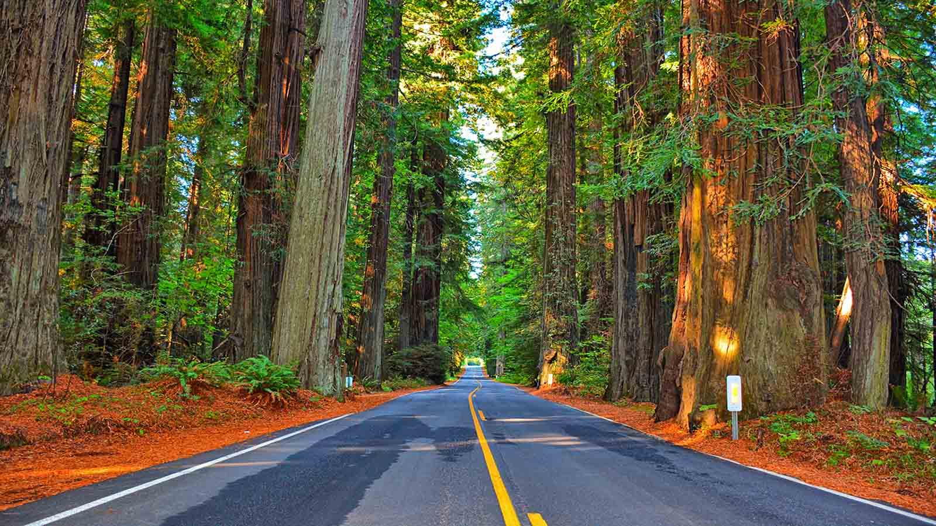

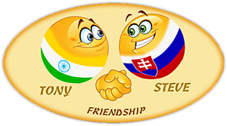
Thank you for viewing our presentation.
Your feedback and opinions are most welcome.
Have a nice day dear friends.
TONY CHACKO and STEVE RUMPLER
tonychacko2000@gmail.com / pista2011@gmail.com

Slide 46







¿Te ha gustado?
Puedes ver más entrando
Aquí
Además puedes recibir powerpoints en tu correo electrónico suscribiéndote aquí:
F I N

