Slide 1


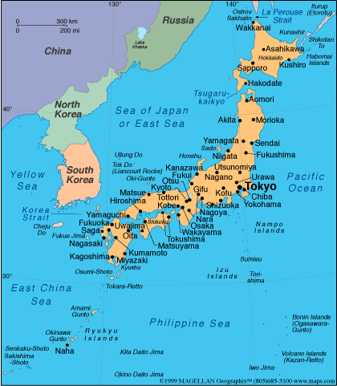

JAPAN - A great tourist destination
With so many amazing destinations to choose from, and so much information on the Internet, narrowing down your ideal destinations can seem daunting (whether it’s your first time, or a return visit). Japan has so many incredible places to visit (and bucket list-worthy Japan experiences), that you basically can’t go wrong. The “bad” news (if there is any) is that there’s no such thing as a true “best places in Japan” list, since so much comes down to personal preferences and interests.
Presented by
Tony Chacko
(tonychacko2000@gmail.com)
Technical cooperation
Steve Rumpler
(pista2011@gmail.com)

Slide 2
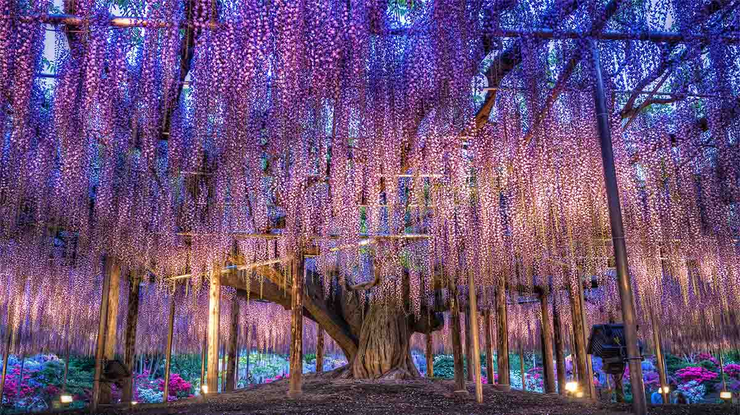

The oldest Wisteria tree in the world (144 years old), located in Ashikaga Flower Park.

Slide 3
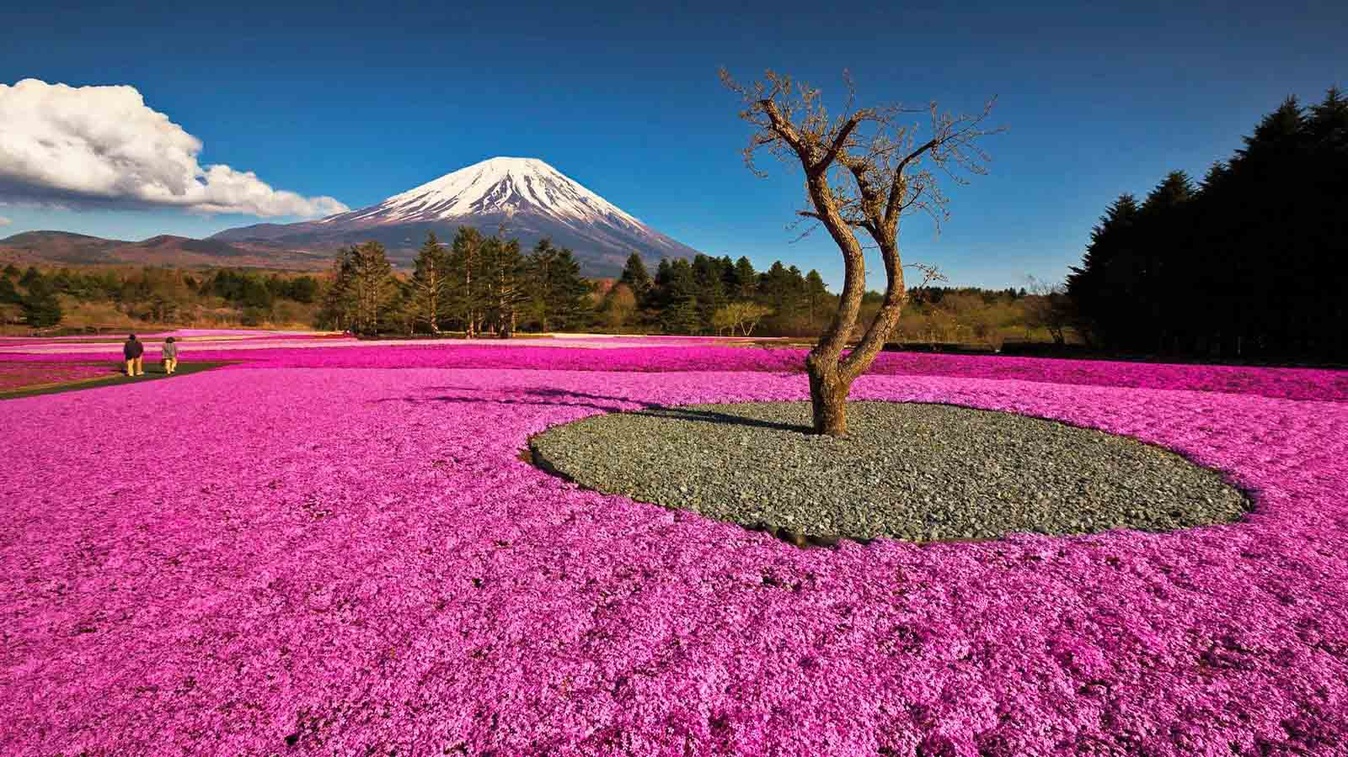
Hitsujiyama Park, Ibaraki Perfecture

Slide 4
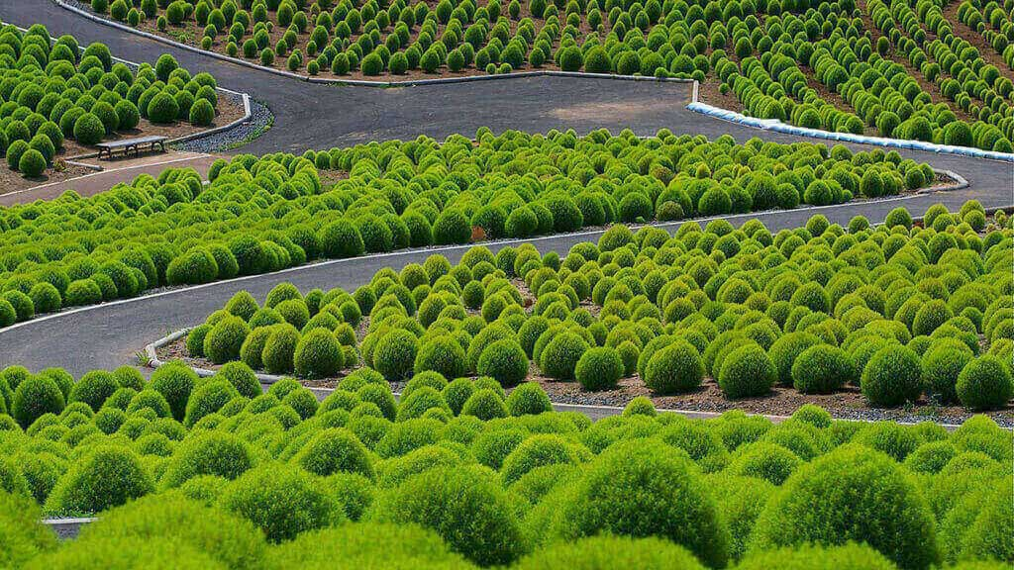
Green Cochia Blooms of Hitachi Park

Slide 5
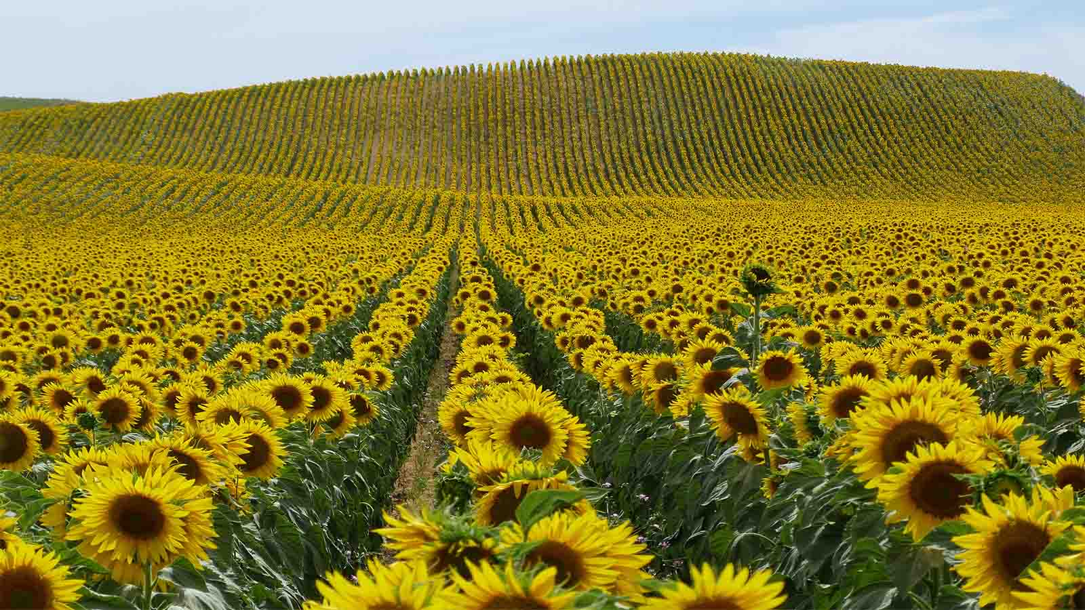
In summer it is the season for sunflowers in Japan.

Slide 6
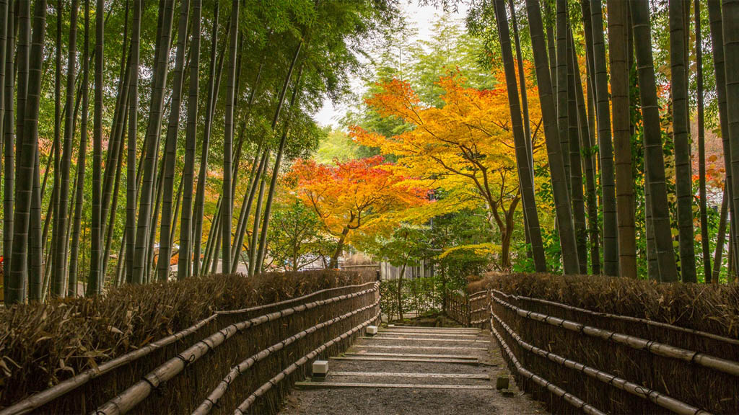
The Bamboo forest of Sagano in Kyoto

Slide 7
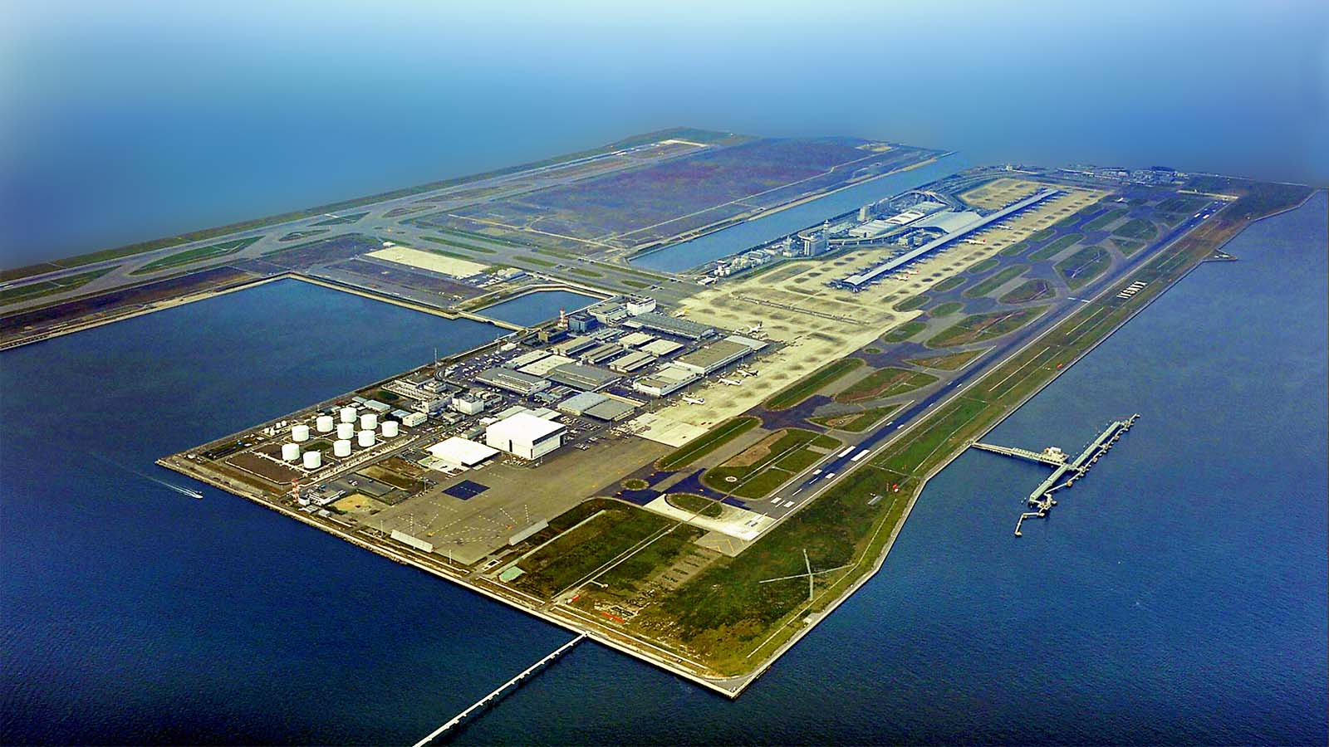
Kansai International Airport located on an artificial island in the middle of Osaka Bay

Slide 8
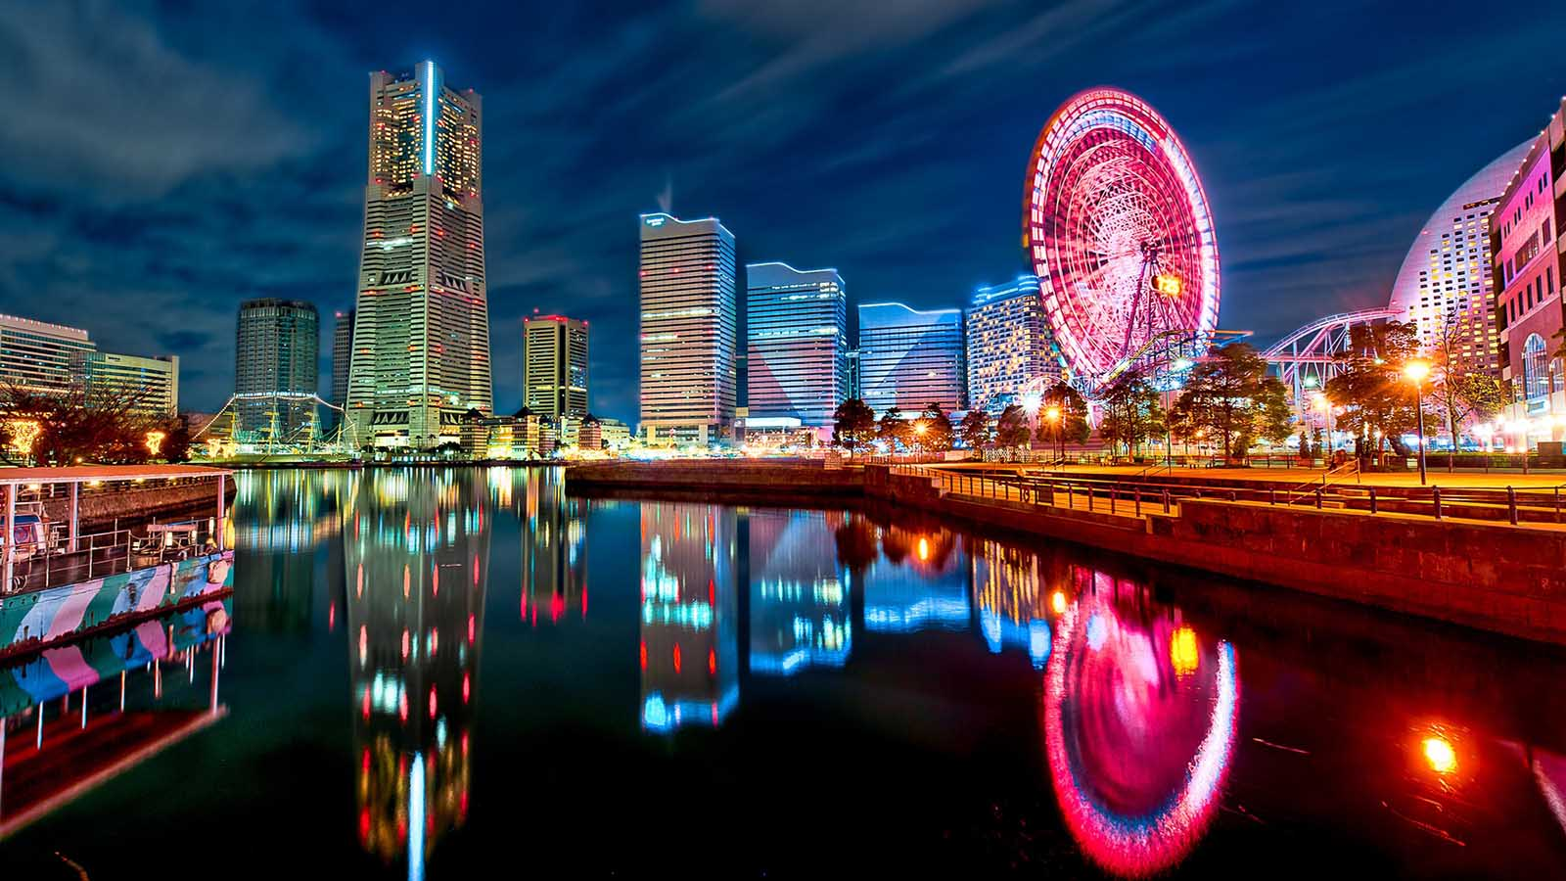
Yokohama by night

Slide 9
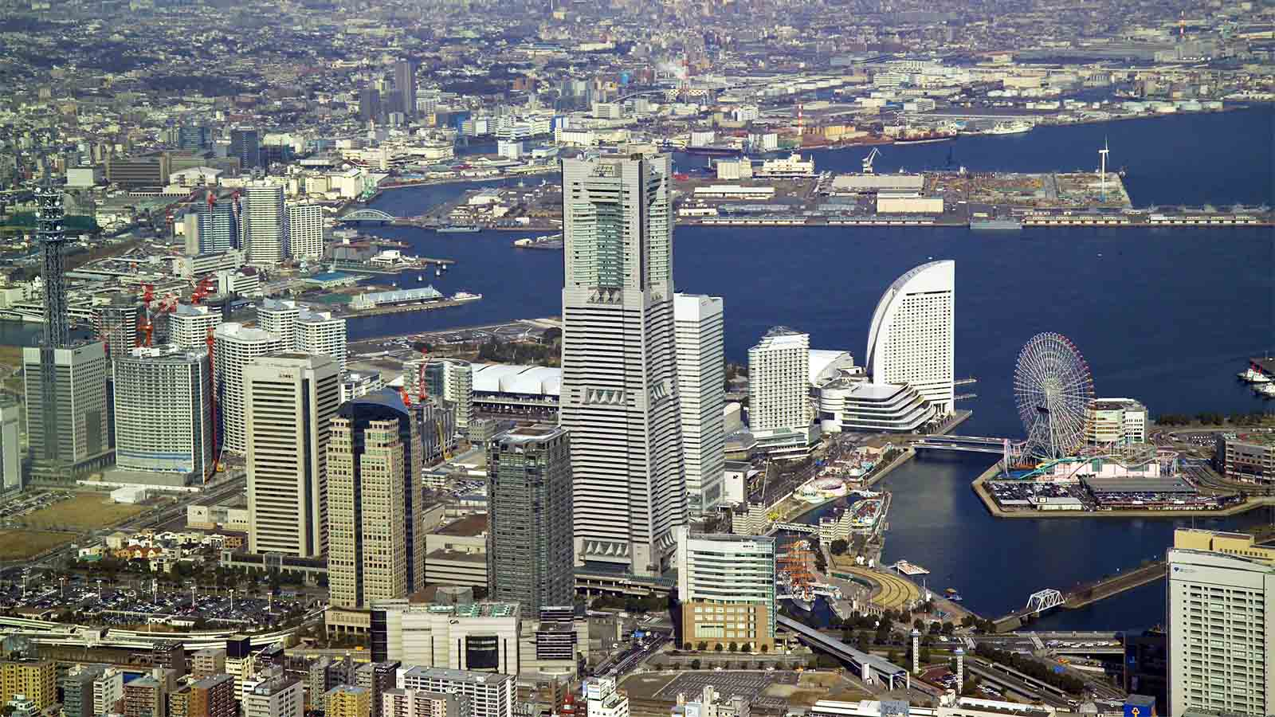
Yokohama Aerial view

Slide 10
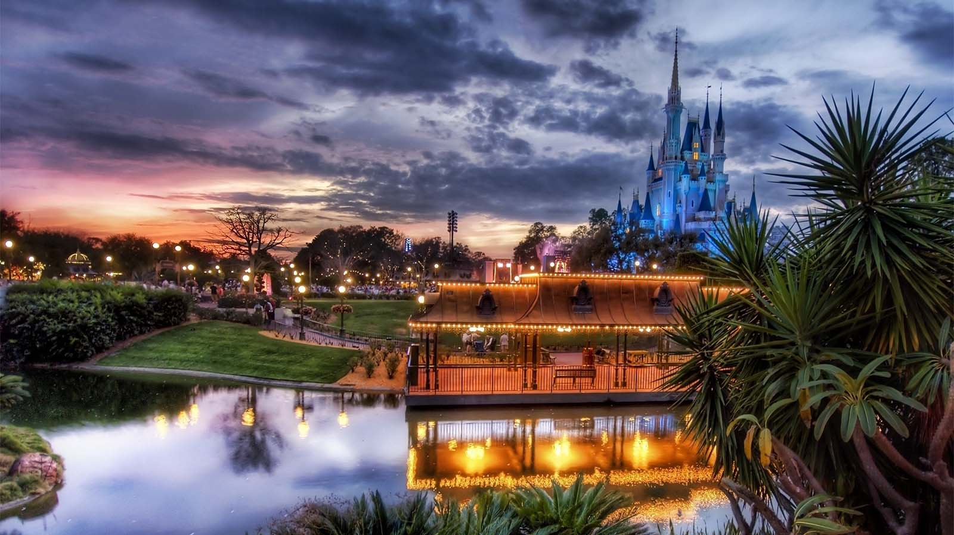
Tokyo Disneyland

Slide 11
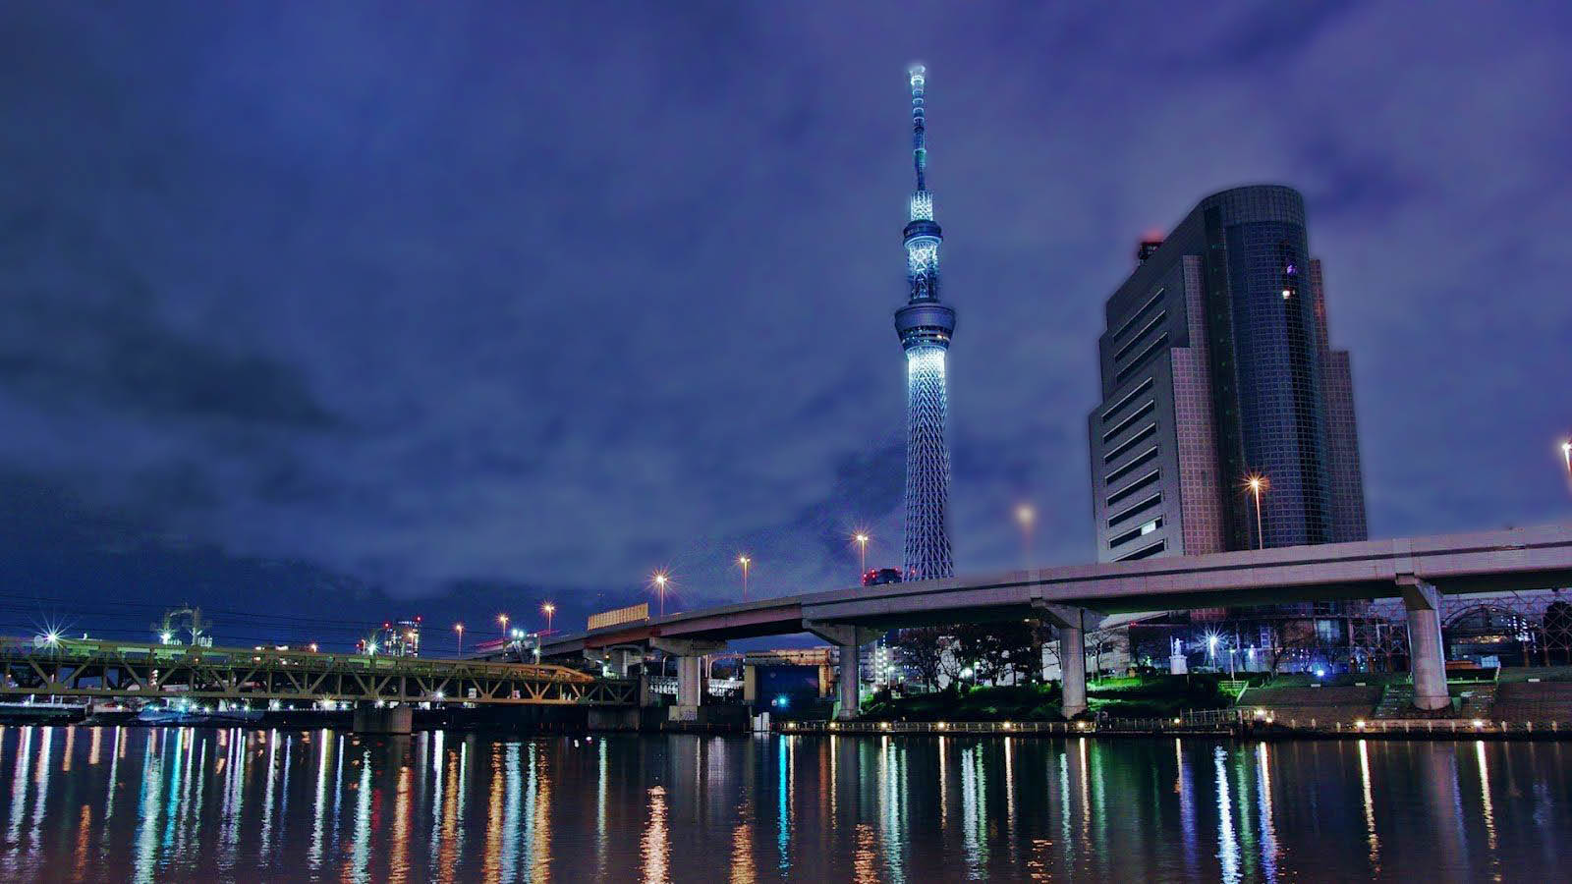
Tokyo Sky Tree overlooking the Sumida river at night

Slide 12
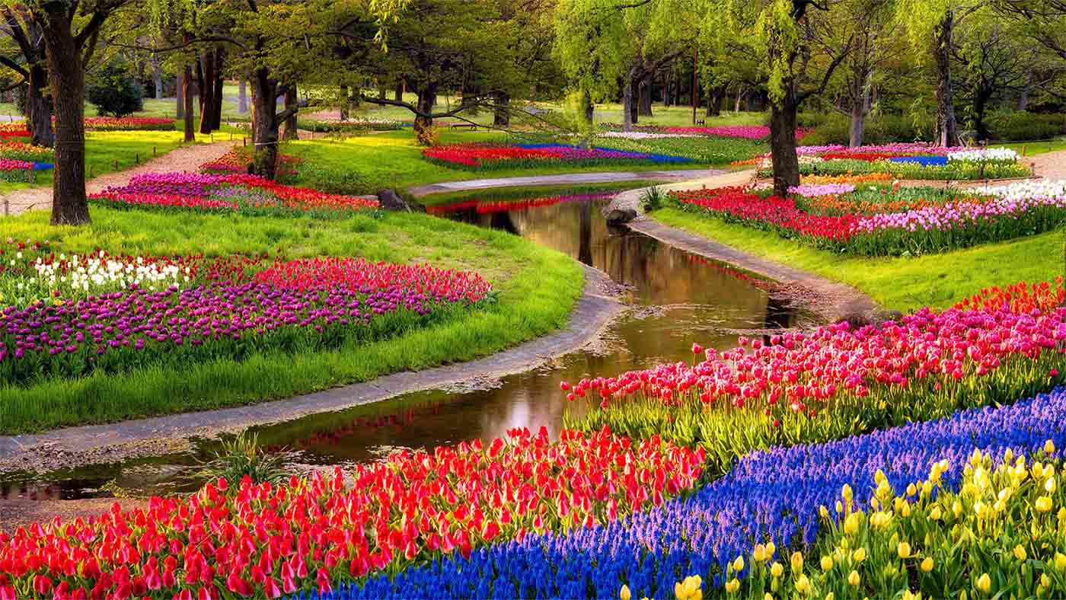
Showa Memorial Park, Tokyo

Slide 13
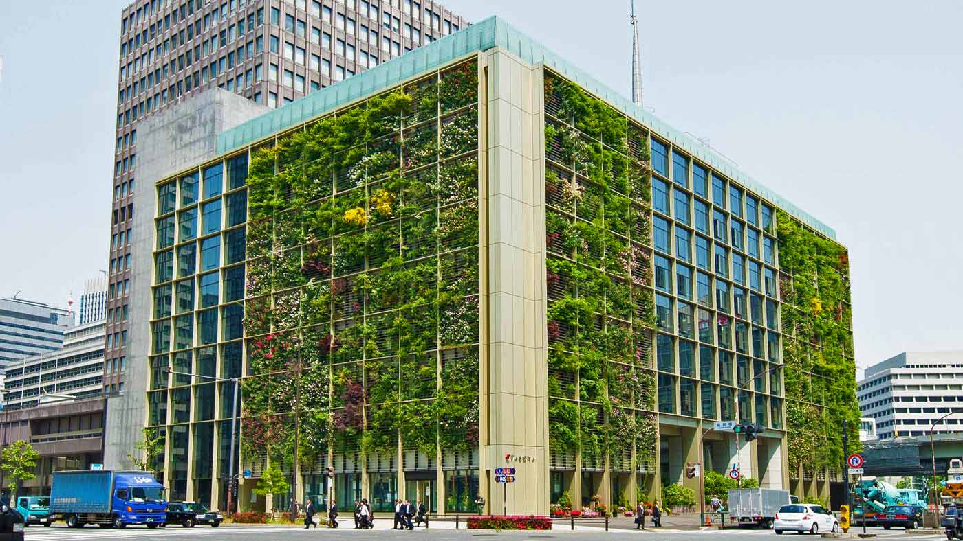
The Pasona Urban Farm in Tokyo

Slide 14
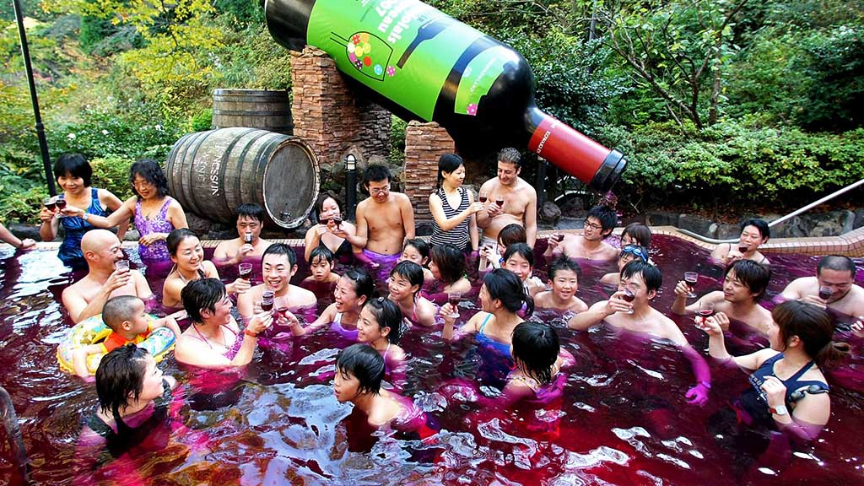
The famous Yunessun Spa Resort in Hakone where it allows guests to take a dip in pools of coffee, wine, or ramen broth.

Slide 15
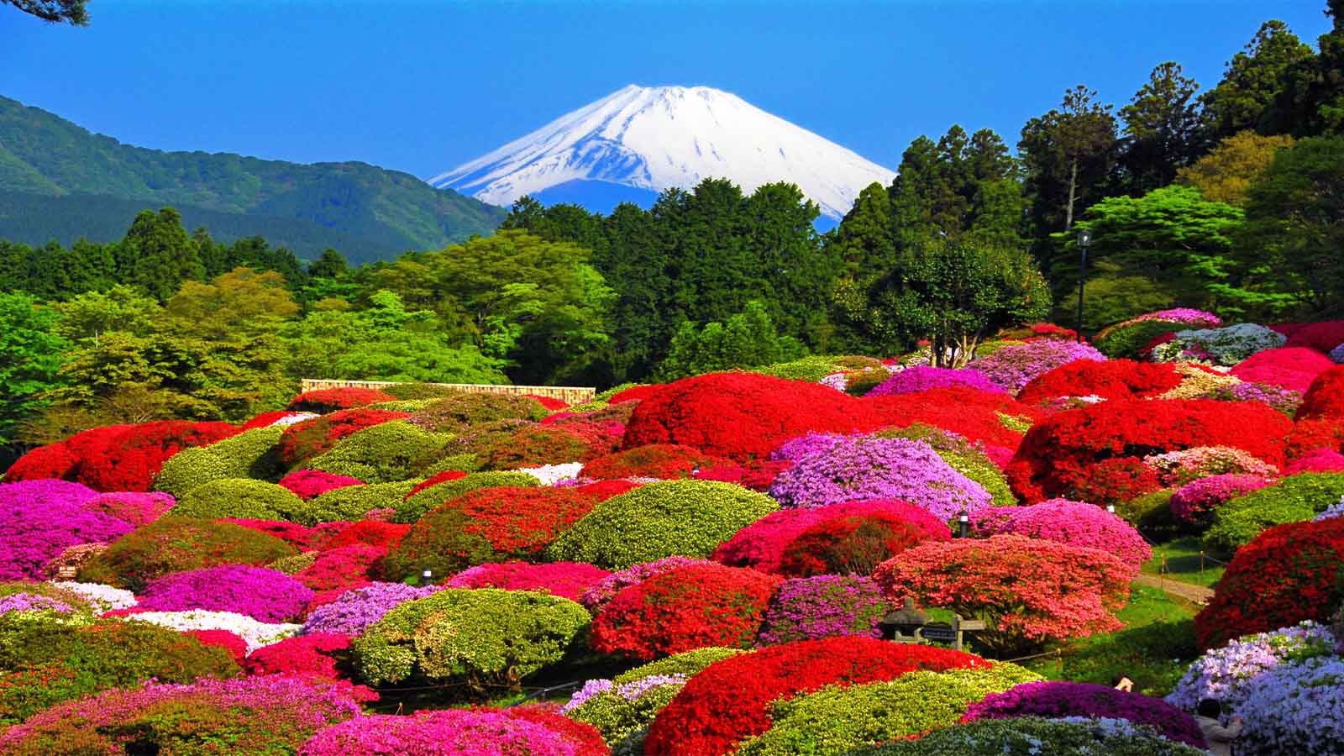
Hakone Lakeside, Hotel de Yama

Slide 16
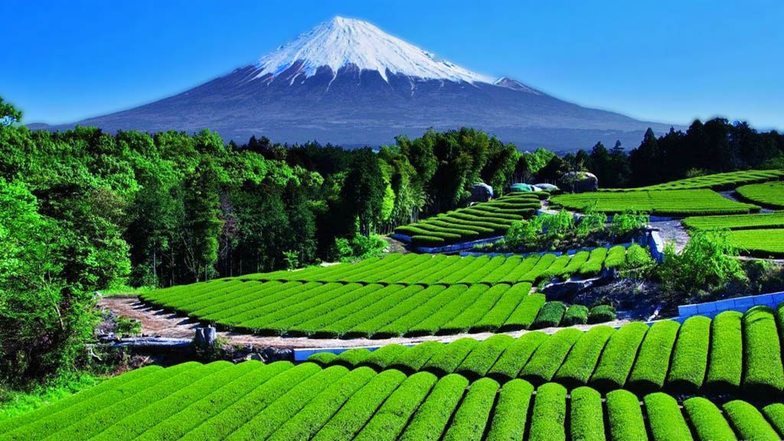
Rolling fields of a Japanese tea field near Mount Fuji in Shizuoka

Slide 17
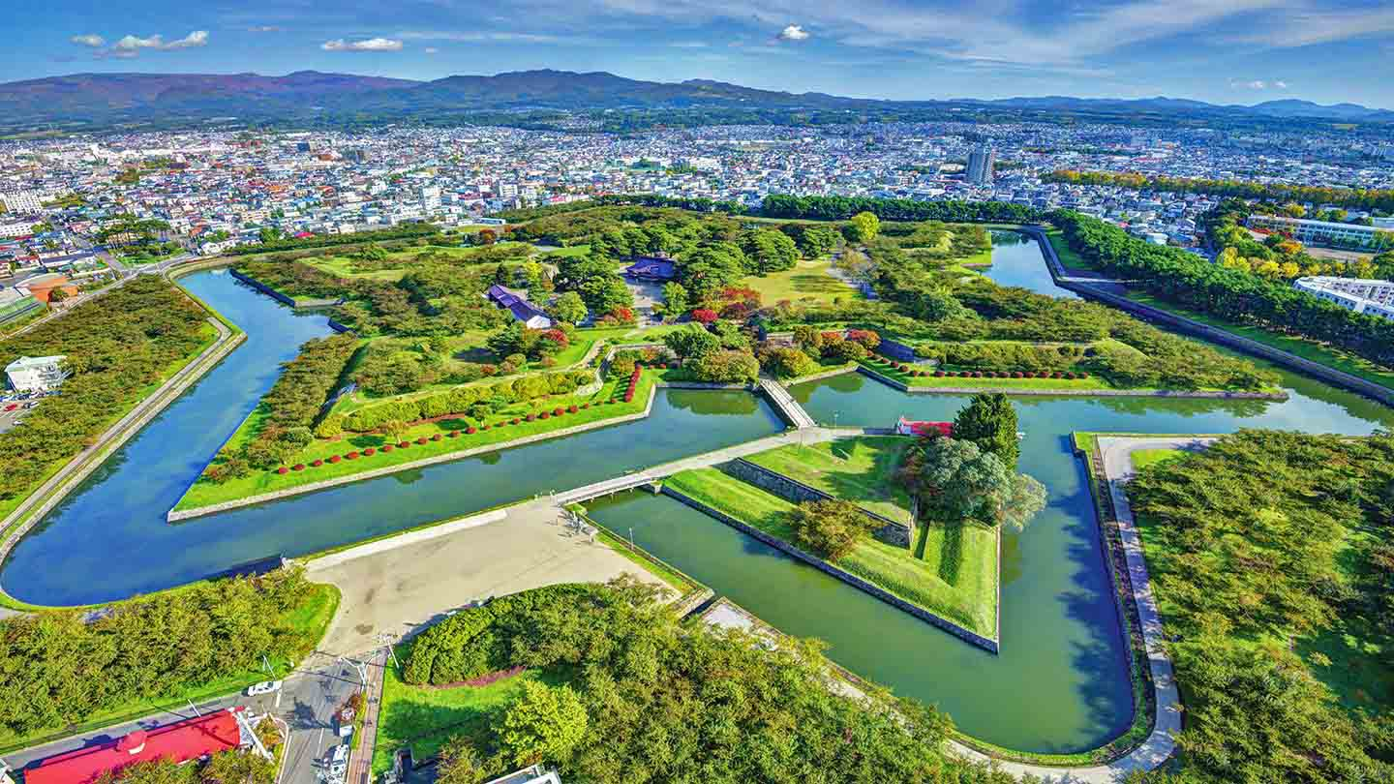
Hakodate is one of the main cities on Hokkaido, Japan's northernmost island

Slide 18
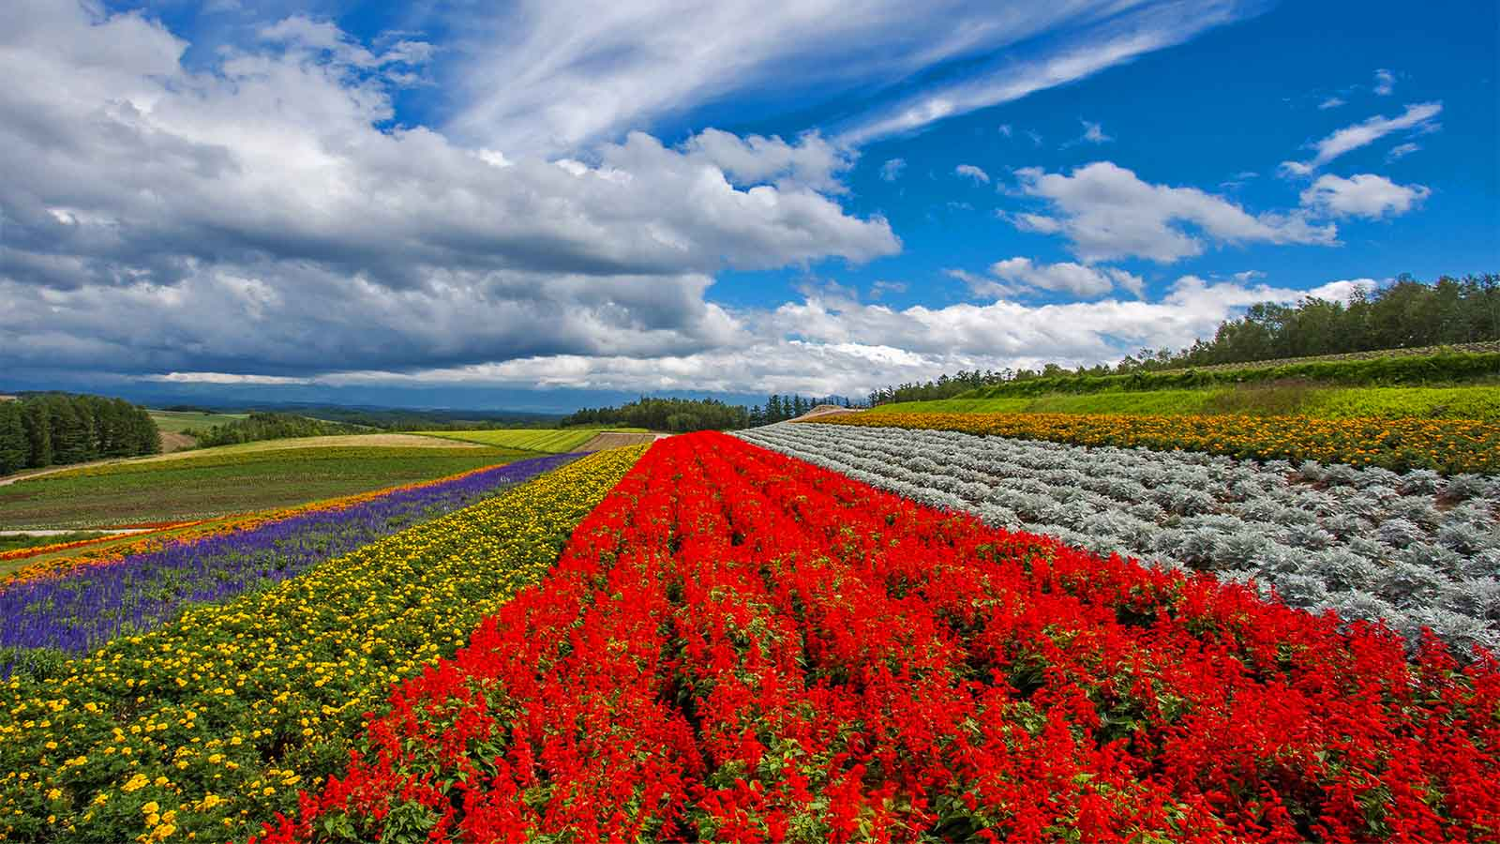
The Rainbow Flowerfields of Furano in Hokkaido

Slide 19
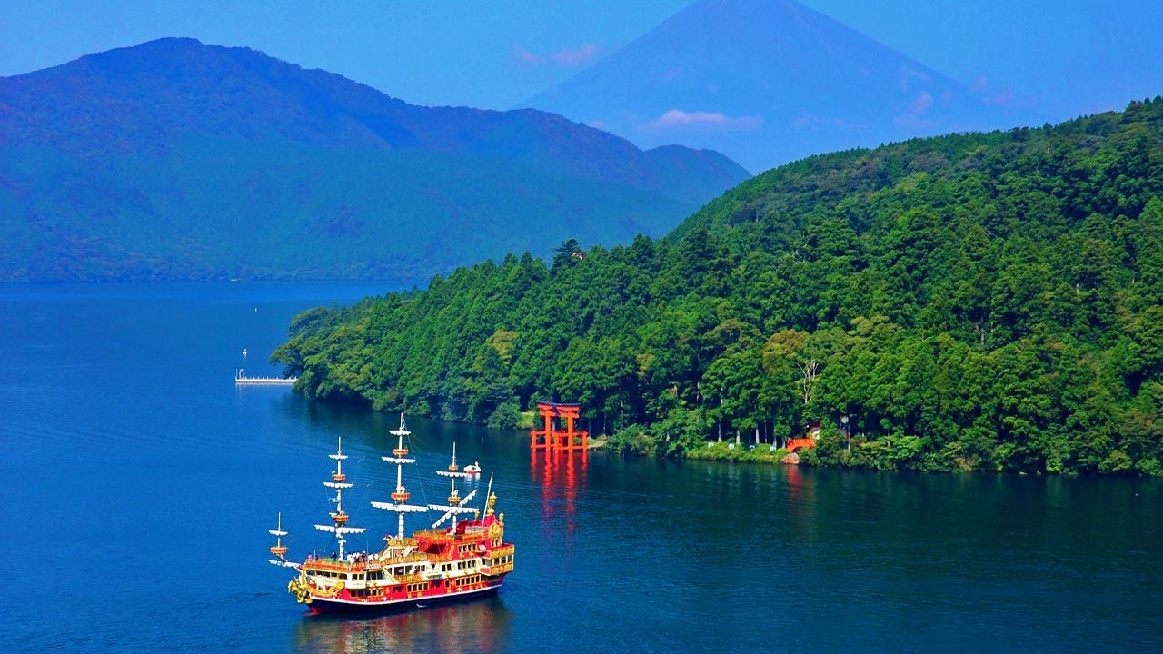
The floating Torii Gate at Miyajima Island, Hiroshima Prefecture

Slide 20
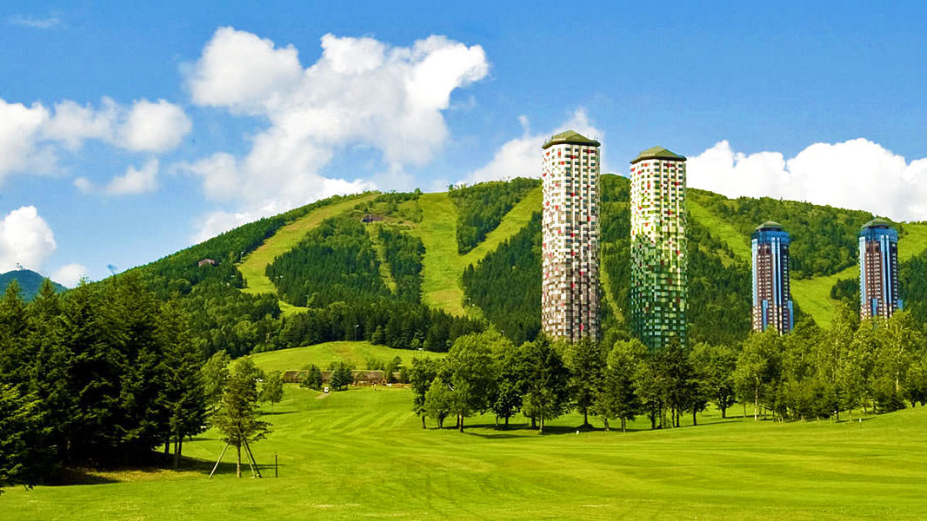
Hoshino Tomamo Resort in the center of Hokkaido Island

Slide 21
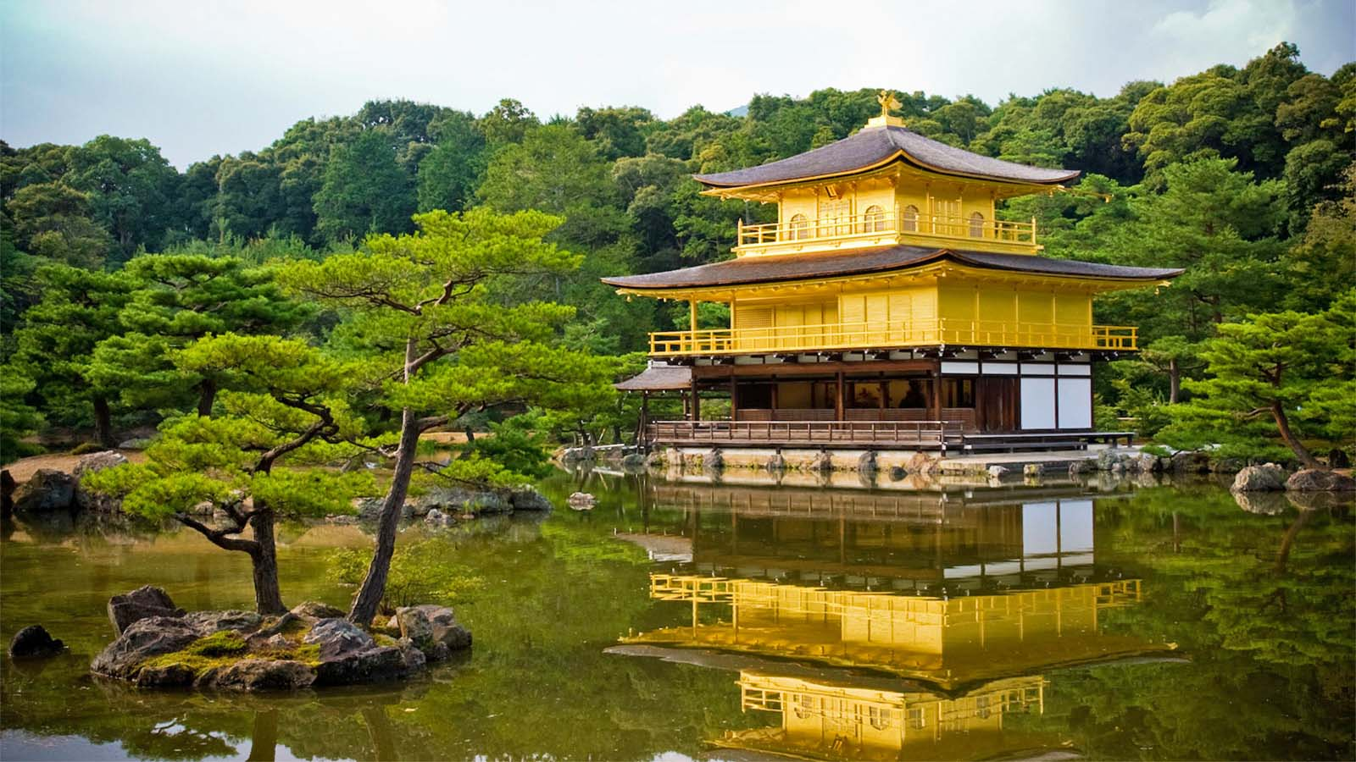
Kinkakuji Temple is Rokuonji (Golden Pavilion), Kyoto

Slide 22
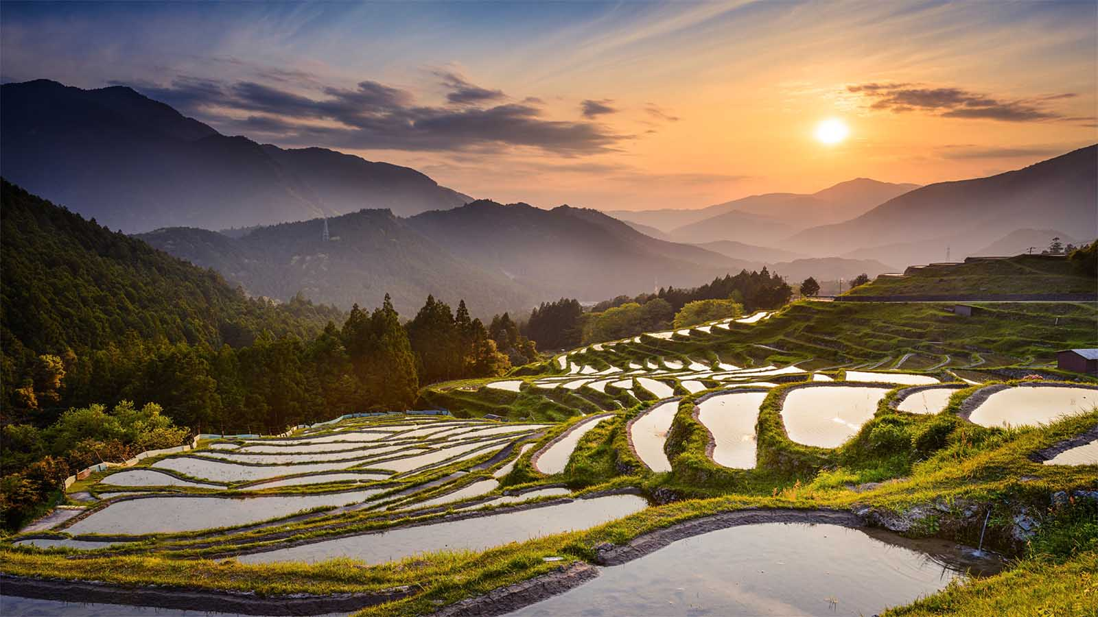
Rice Terraces at Mie Prefecture

Slide 23
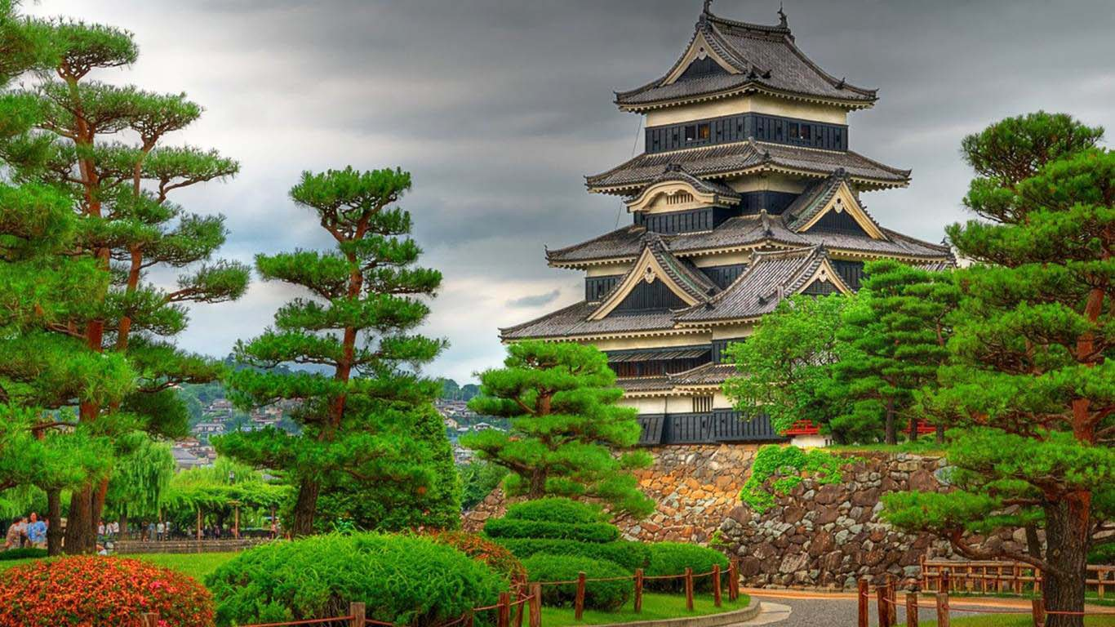
Himeji Castle is a hilltop Japanese castle complex located in the city of Himeji, Hyōgo Prefecture

Slide 24
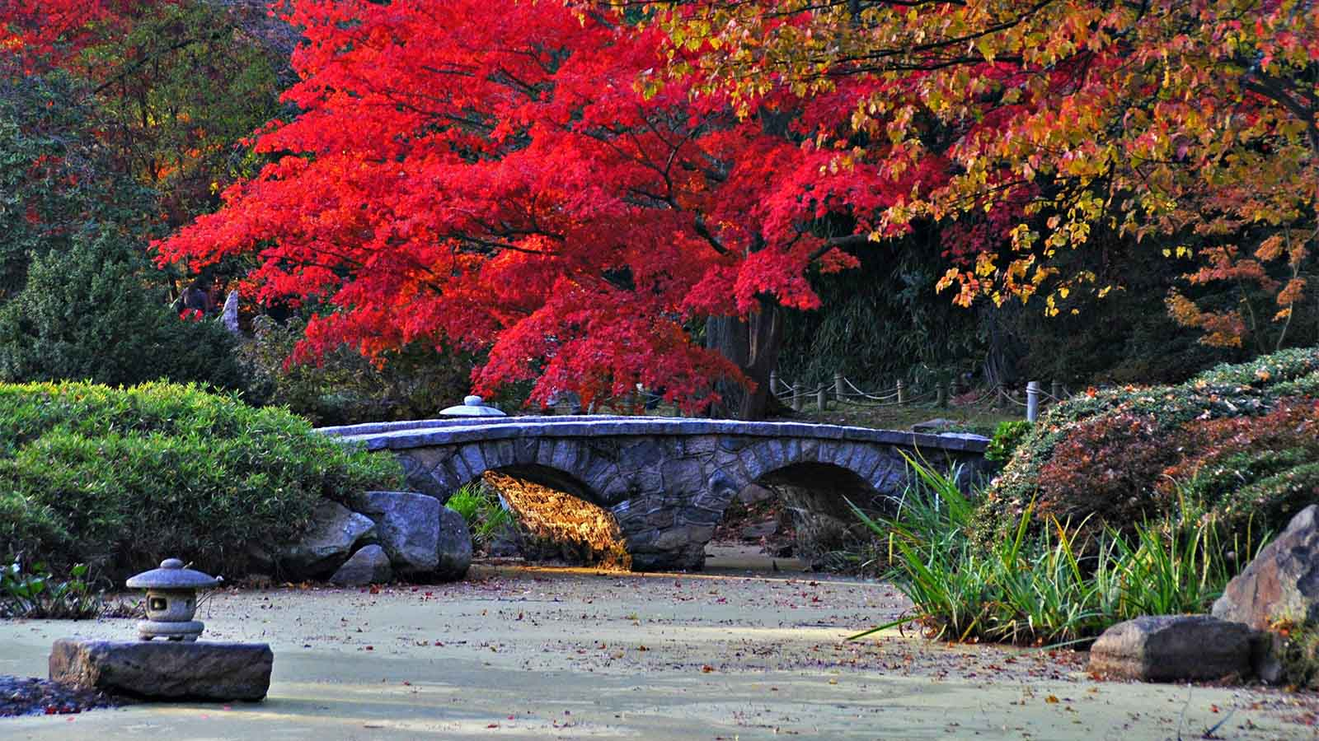
Scenic Arashiyama on the western outskirts of Kyoto

Slide 25
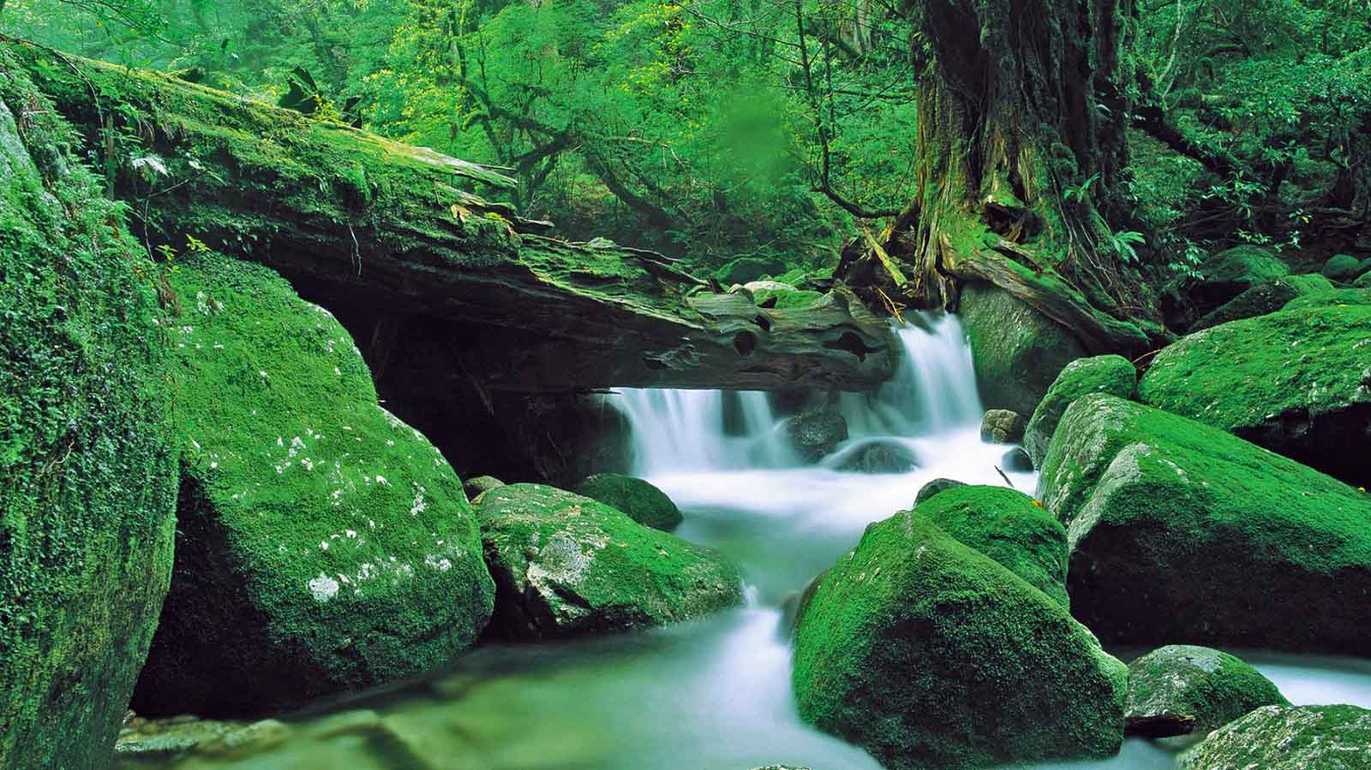
Shiratani Unsuikyo Gorge, Yakushima Island, Kagoshima

Slide 26
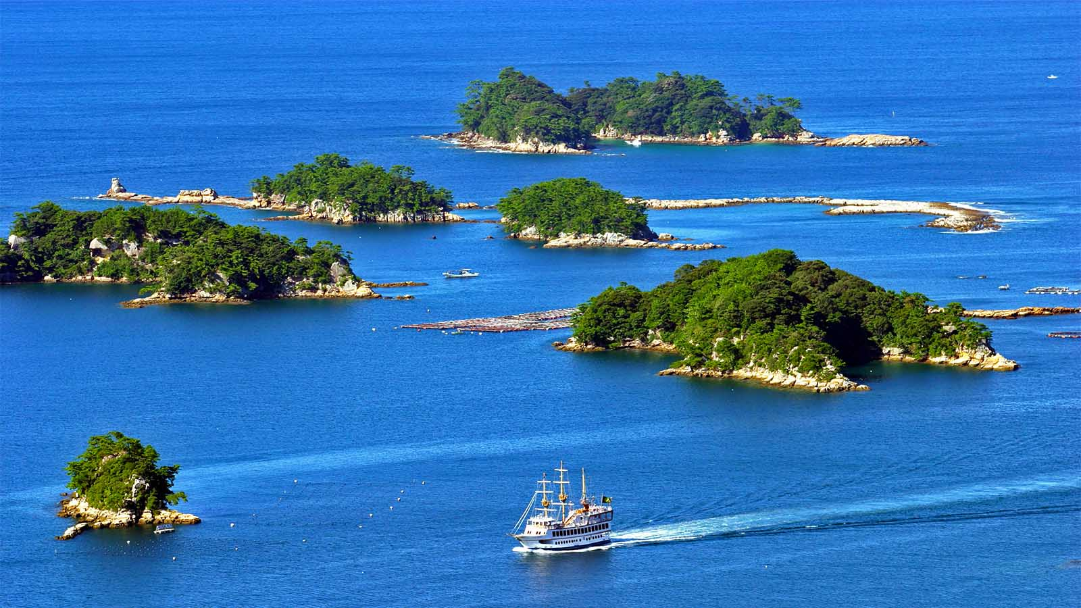
Kujuku-Shima (Ninety-Nine Islands) in the western Nagasaki

Slide 27
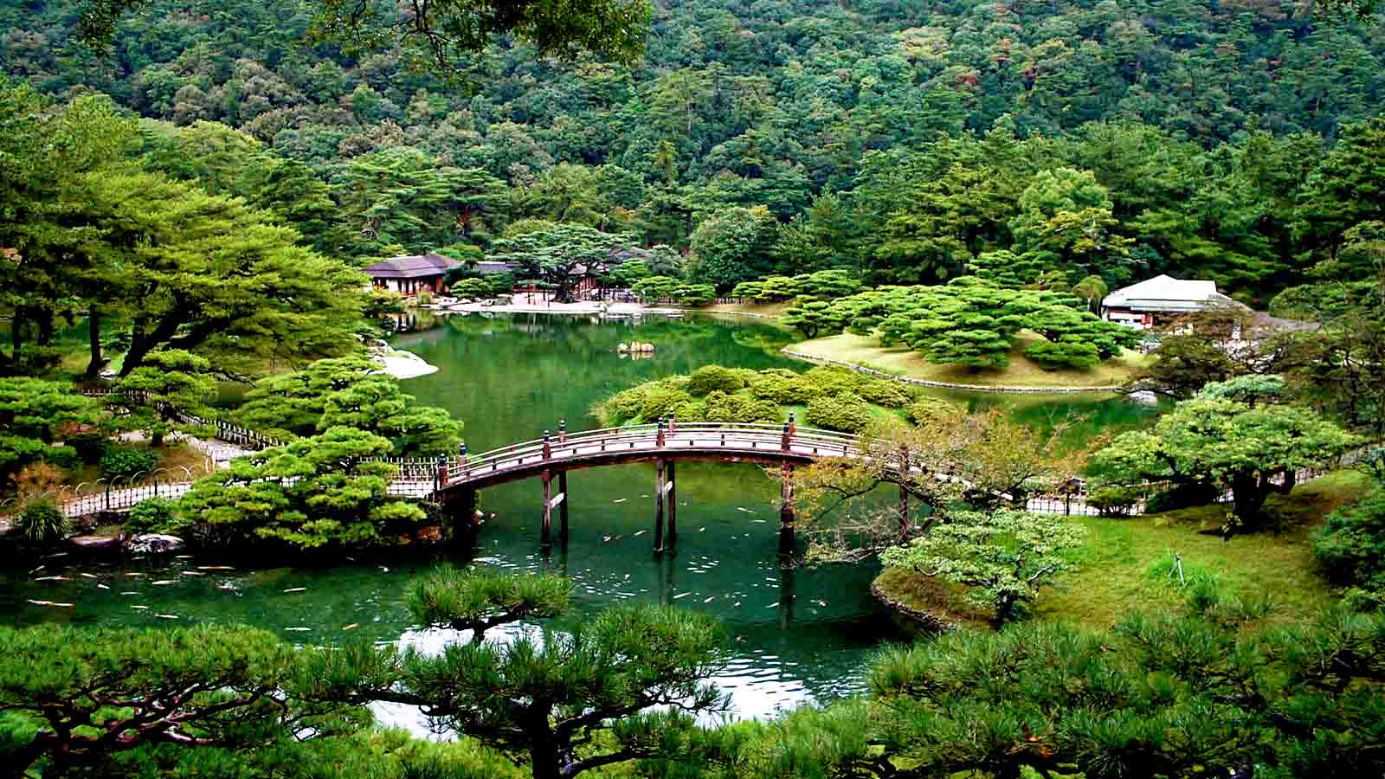
Takamatsu Gardens, Shikoku Prefecture

Slide 28
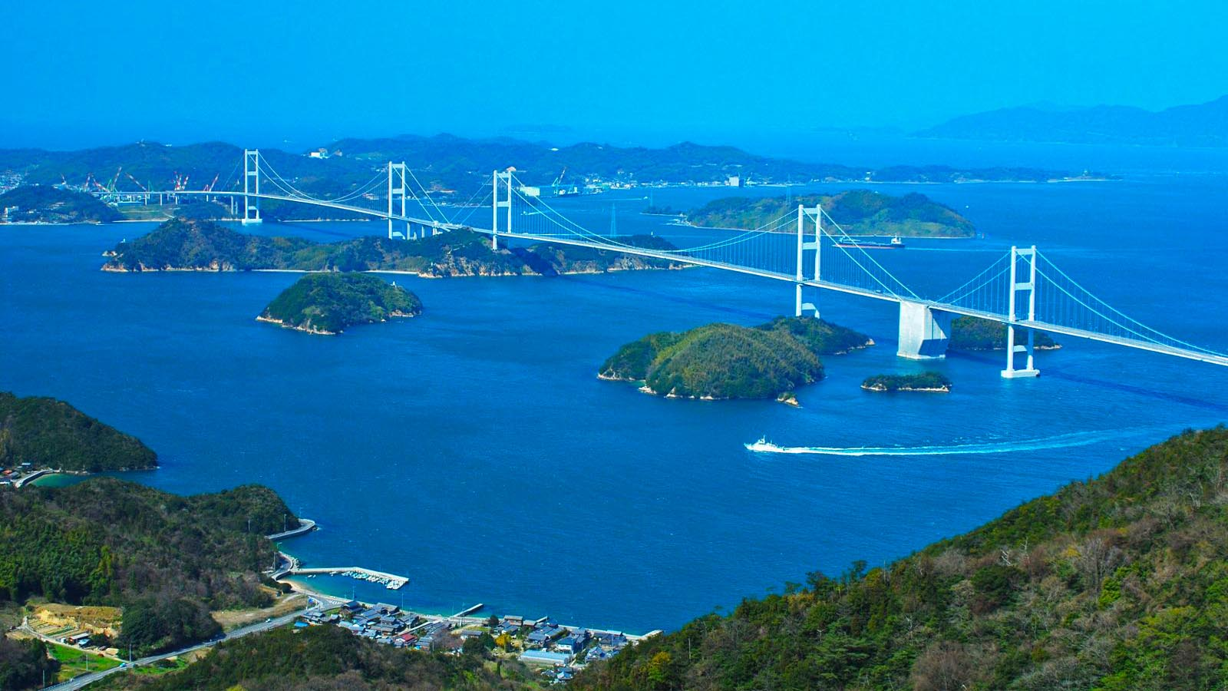
Kurushima-kaikyō Bridge in Hiroshima Prefecture

Slide 29
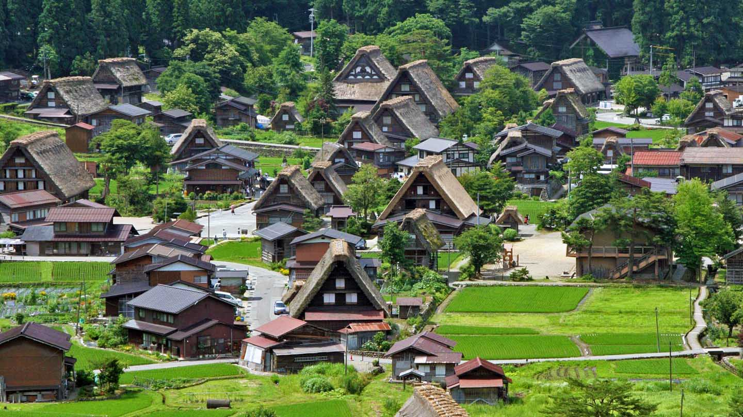
Historic Villages of Shirakawa-gō and Gokayama

Slide 30
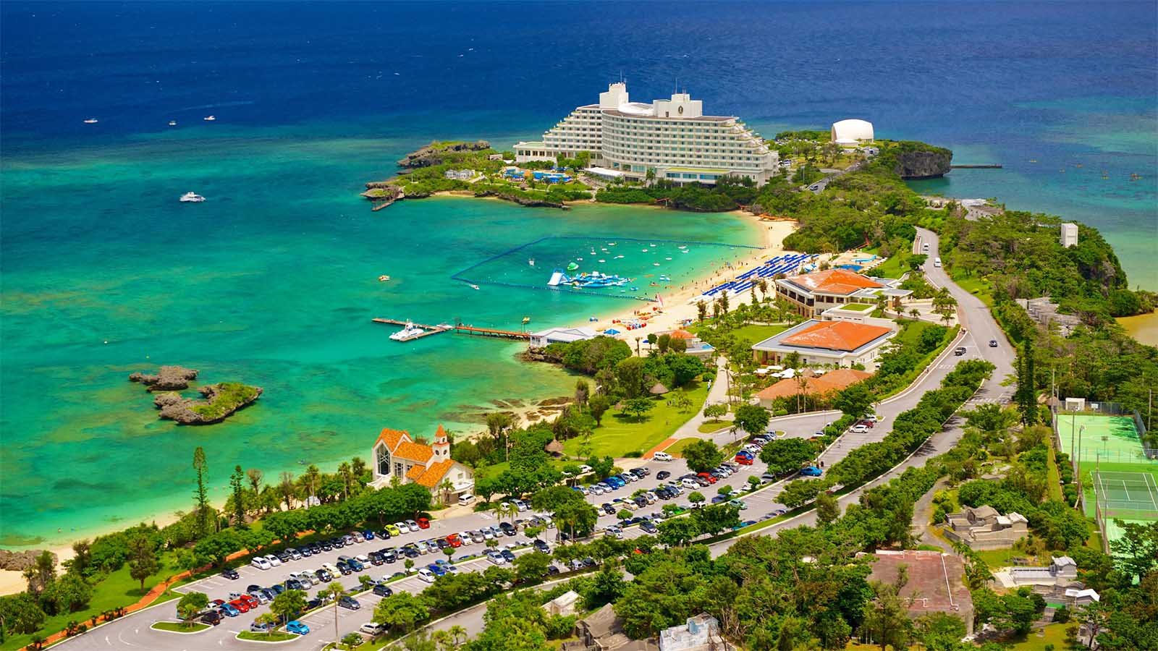
A beautiful Resort at Cape Manza, Okinawa Island in South Japan

Slide 31
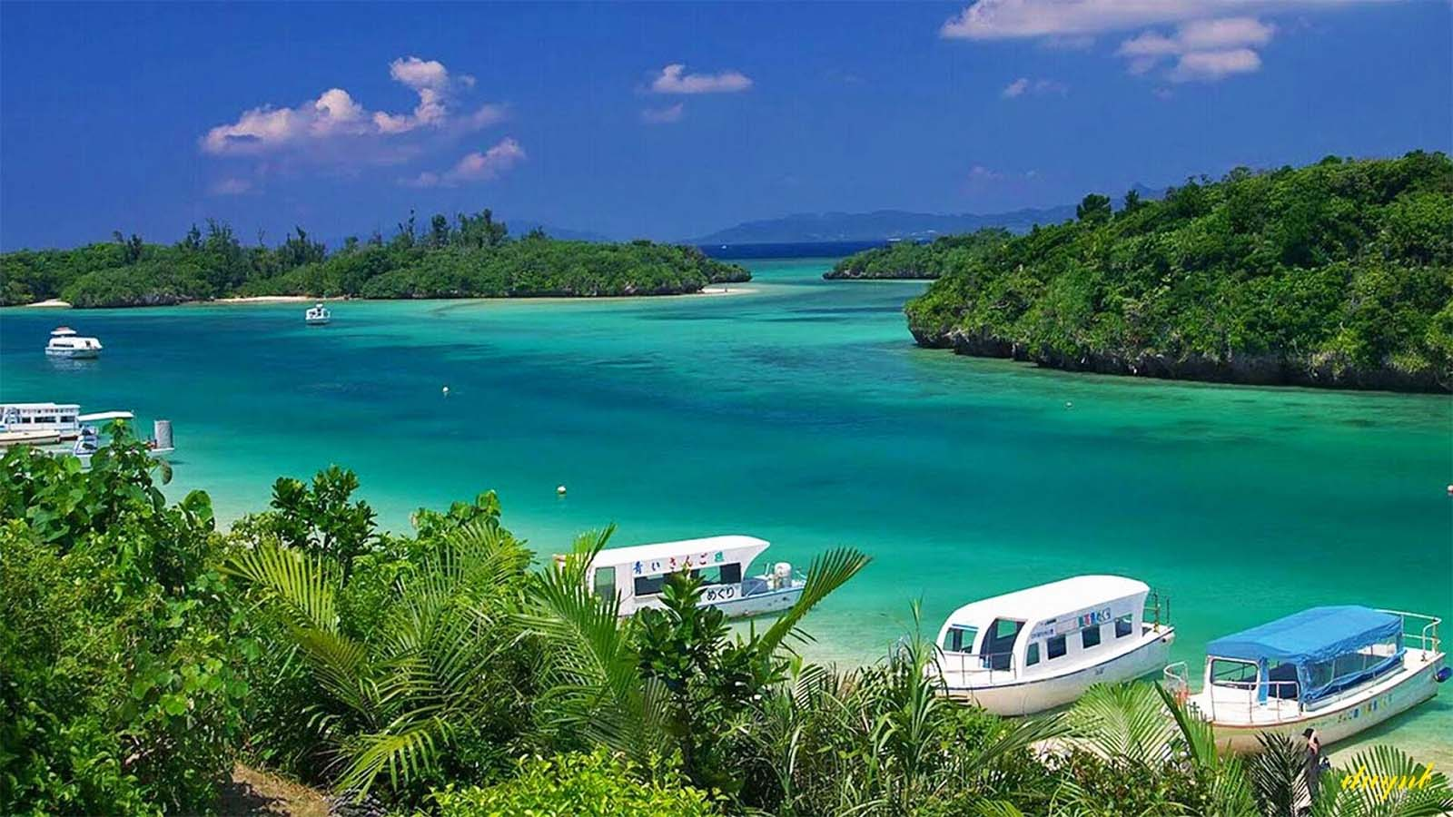
Paradise Beaches of Okinawa Islands

Slide 32
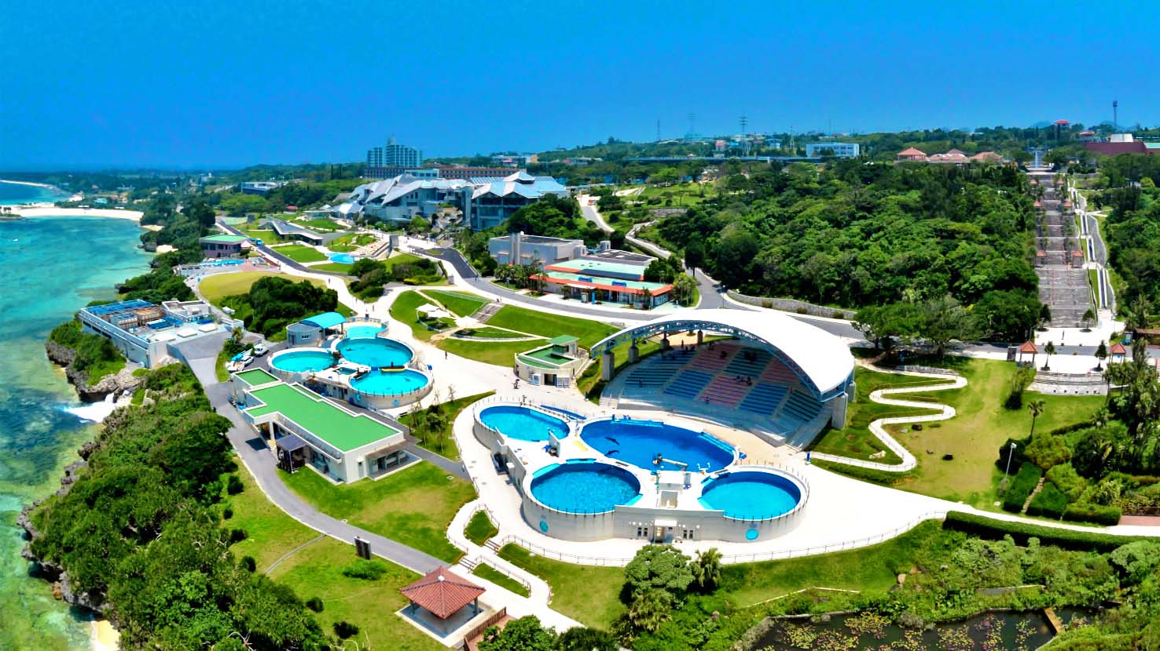
Churaumi Aquarium at Okinawa

Slide 33
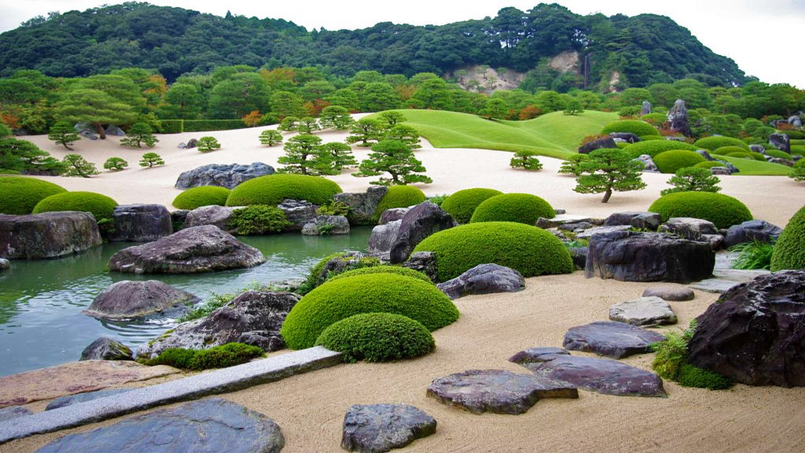
The Adachi Museum of Art is in Yasugi, Shimane Prefecture

Slide 34
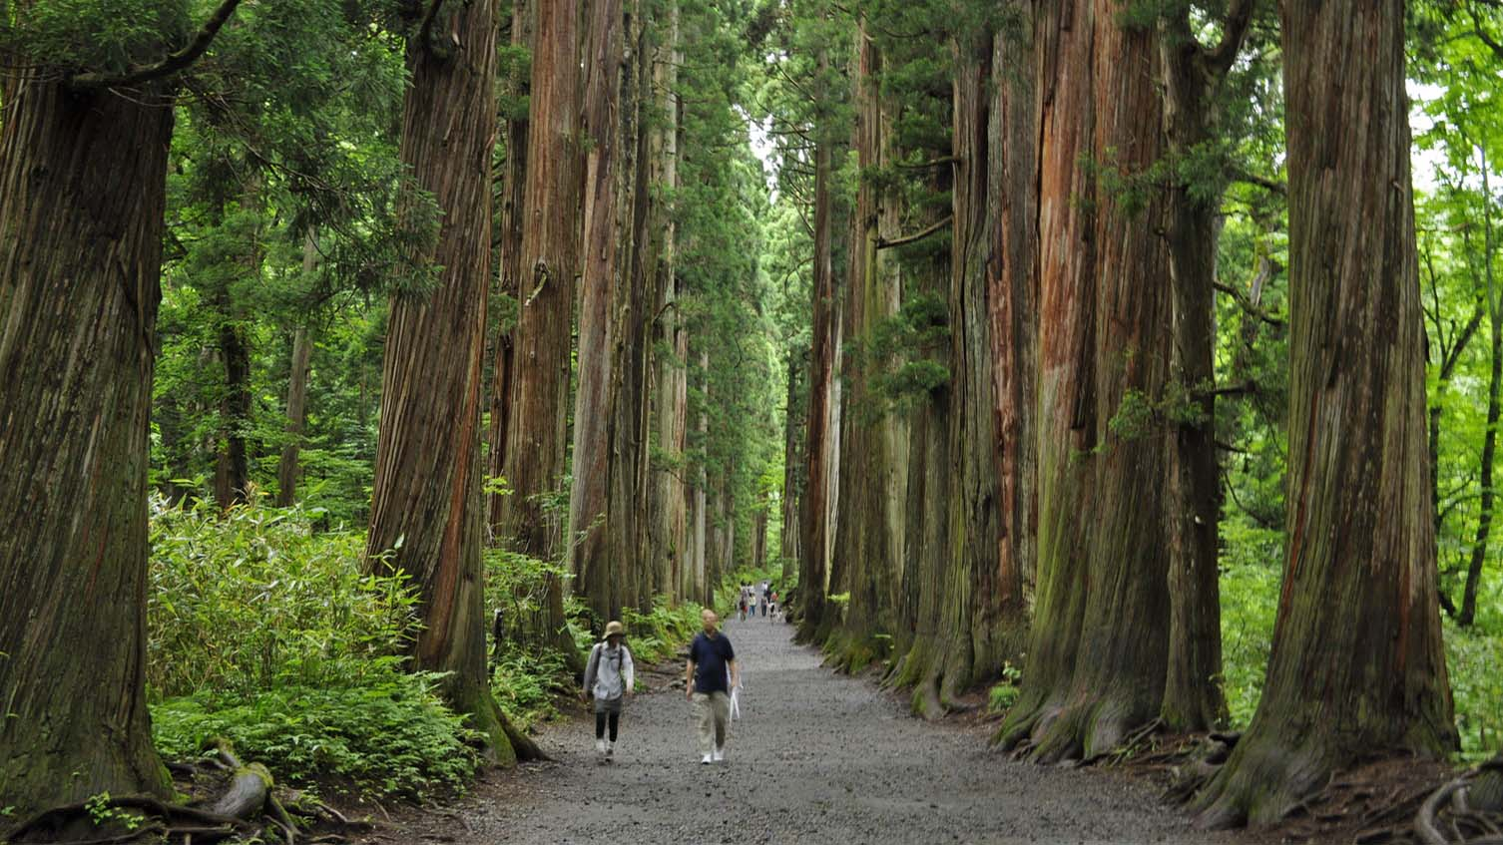
The path to Togakushi's Inner Shrine near Nagano is lined with cedar trees that are 400+ years old.

Slide 35
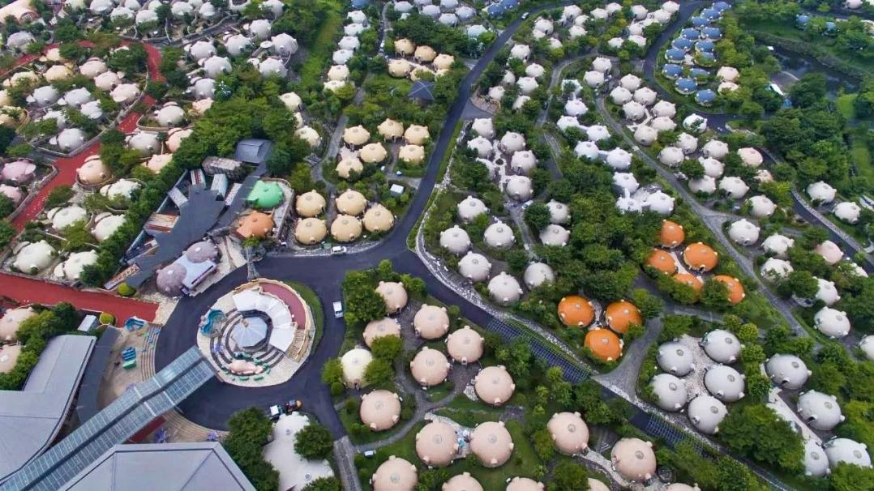
These hemispherical cottages form part of 'Farmland’ called as the Aso Solar Village in Kyushu.

Slide 36
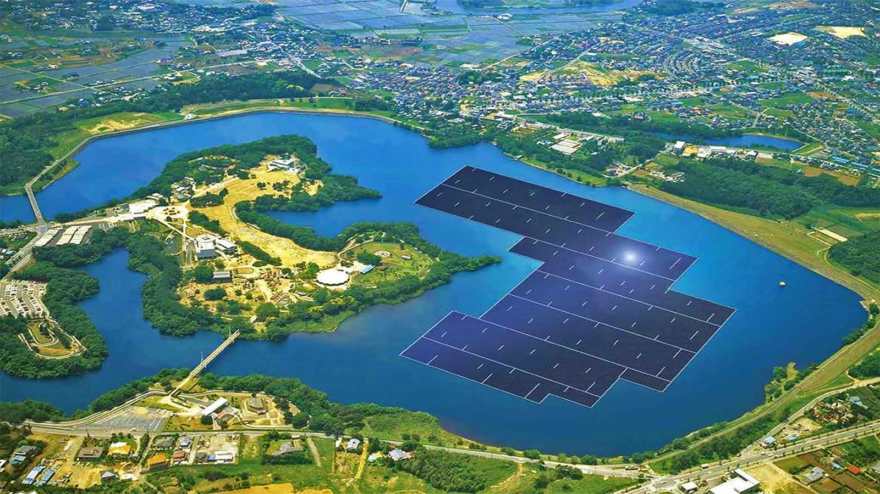
Solar Power Plant, Yamakura Dam reservoir in Chiba Prefecture

Slide 37
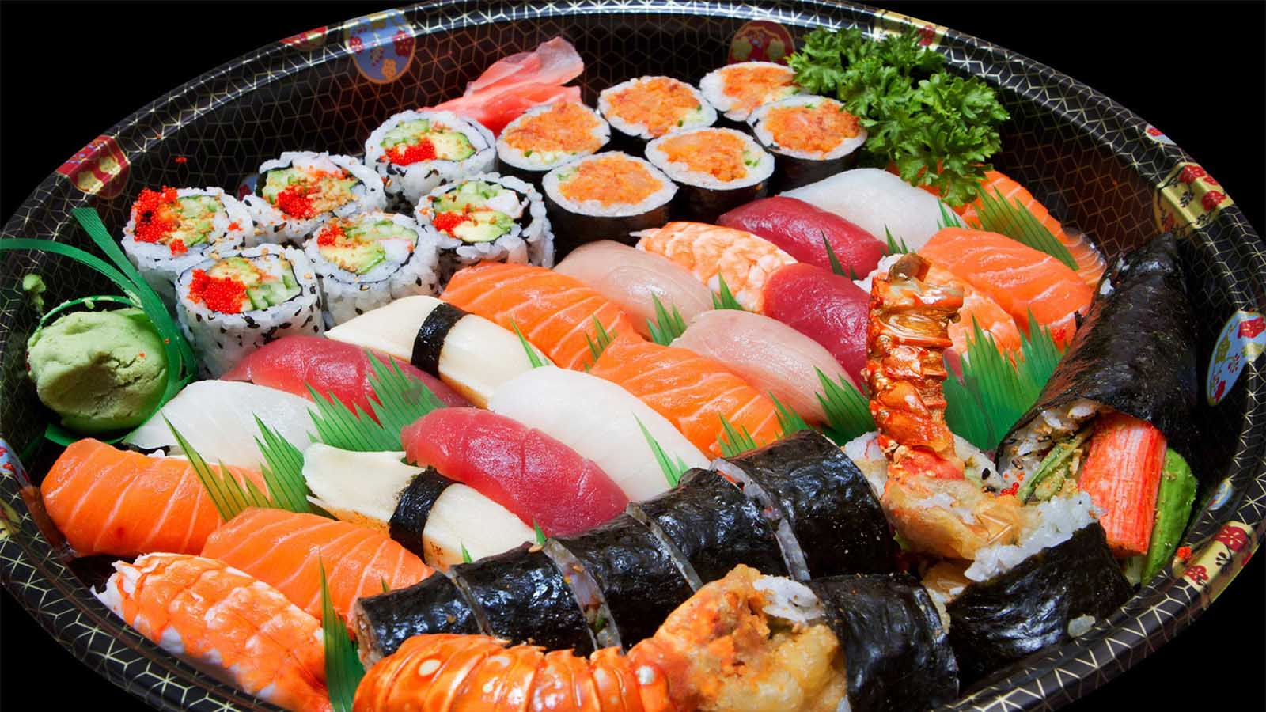
You are invited to try Japan’s famous food – ‘Sushi’, an ancient dish from the Tang dynasty. It consists of fermented fish and rice, and the word sushi means something that tastes sour. Sushi is raw fish or seaweed covered with ‘vinegared rice pastry. cover’.

Slide 38
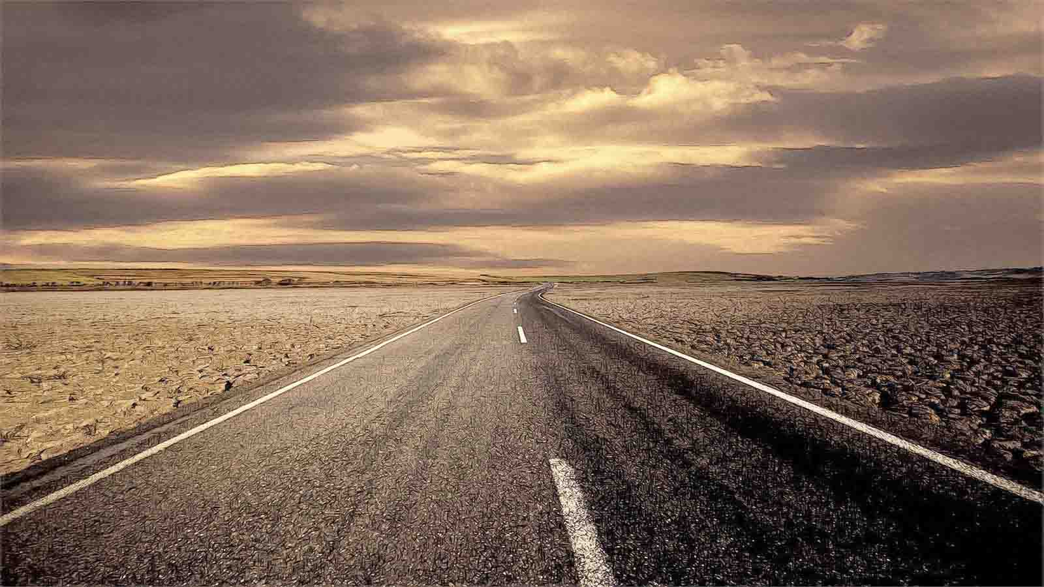

Regards
Tony CHACKO & Steve RUMPLER
tonychacko2000@gmail.com pista2011@gmail.com
The Indo-Slovakian friendship)
Thanks for viewing our presentation.
Your comments and opinions are most welcome.

Slide 39







¿Te ha gustado?
Puedes ver más entrando
Aquí
Además puedes recibir powerpoints en tu correo electrónico suscribiéndote aquí:
F I N

