Slide 1




United States
of America
The U.S. is a country of 50 states covering a vast swath of North America, with Alaska in the northwest and Hawaii extending the nation’s presence into the Pacific Ocean. Major Atlantic Coast cities are New York, a global finance and culture center, and capital Washington, DC. Midwestern metropolis Chicago is known for influential architecture and on the west coast, Los Angeles' Hollywood is famed for filmmaking. It’s capital city is Wahington D.C. and it has a population of 327 million (2018) covering an area of 9,826,675km².
With its history of mass immigration dating from the 17th century, it is a "melting pot" of cultures from around the world and plays a dominant role in the world's cultural landscape and world political issues. It's home to a wide array of popular tourist destinations, ranging from the skyscrapers of Manhattan and Chicago to the natural wonders of Yellowstone and Alaska, to the warm, sunny beaches of Florida, Hawaii and Southern California.
Compiled by TONY CHACKO tonychacko2000@gmail.com
Technical cooperation STEVE RUMPLER pista2011@gmail.com

Slide 2
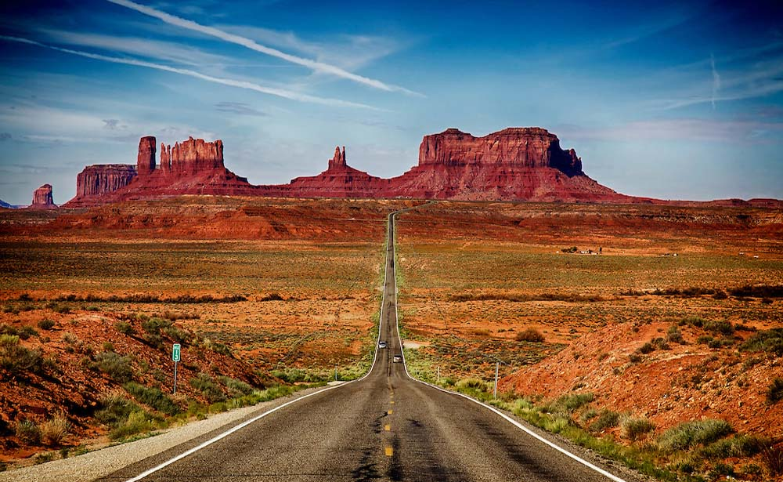

Route 163 running through famous Monument Valley in Utah

Slide 3
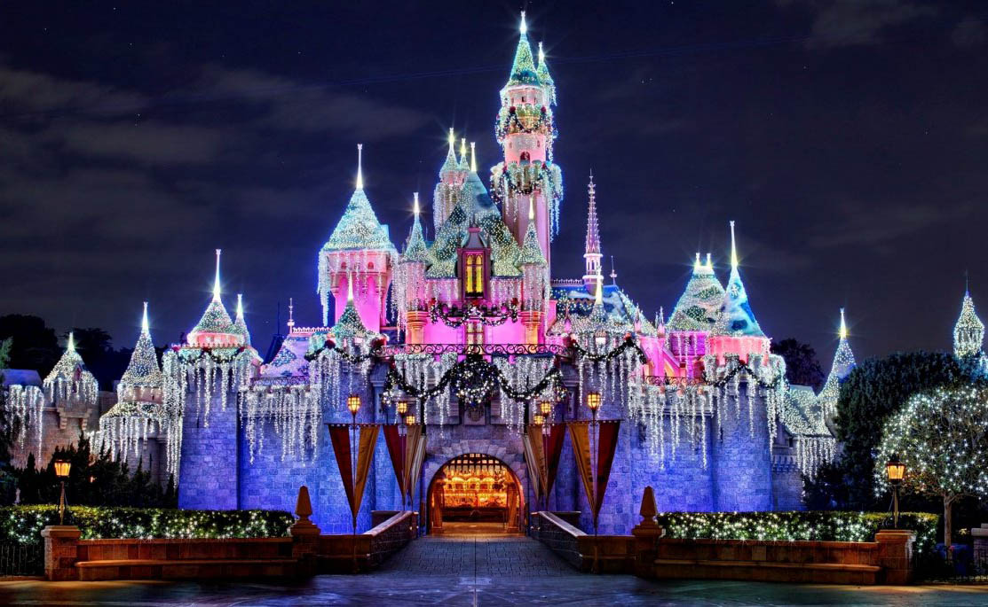
Disneyland Adventure Park in Los Angeles, California

Slide 4
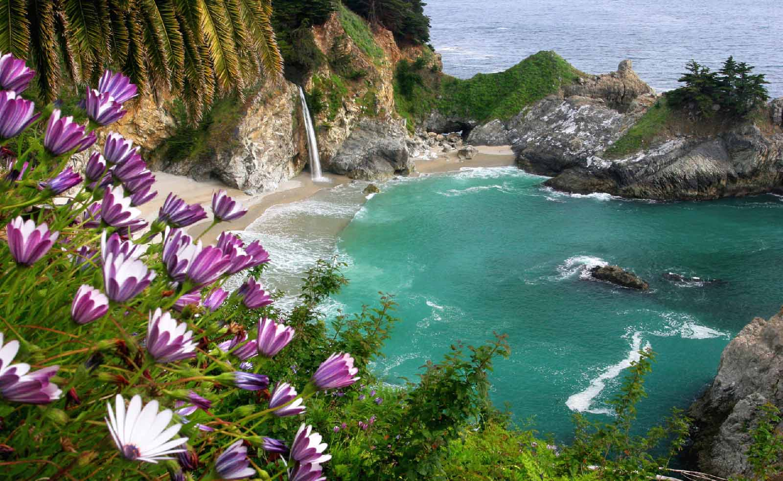
Mcway Falls Beachside, Big Sur at California

Slide 5
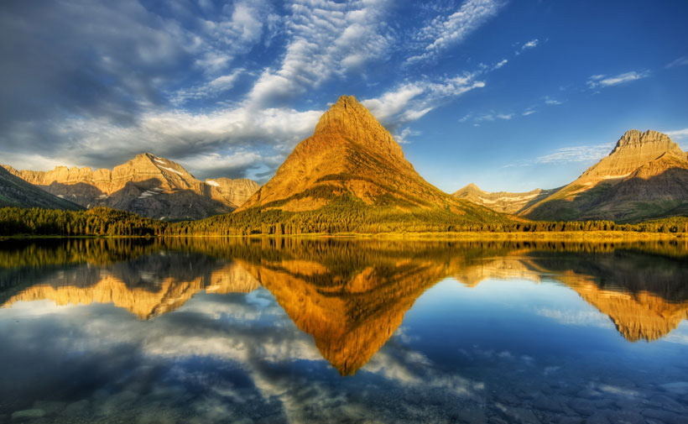
The Glacier National Park, Montana, U.S.A.

Slide 6
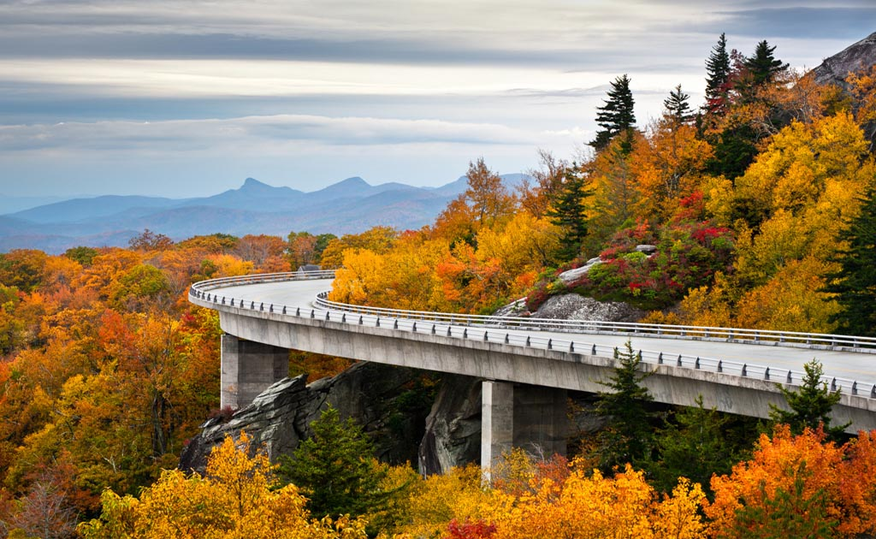
Blue Ridge Parkway in North Carolina and Virginia

Slide 7
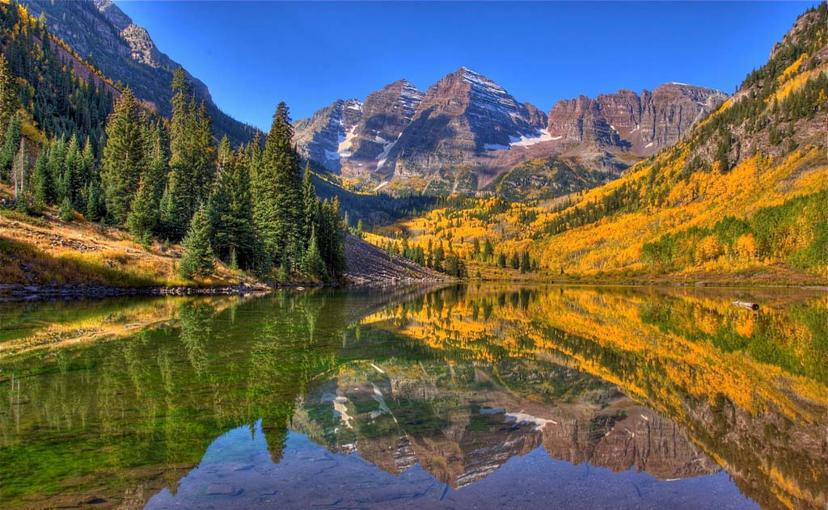
Maroon Bells of Colorado

Slide 8
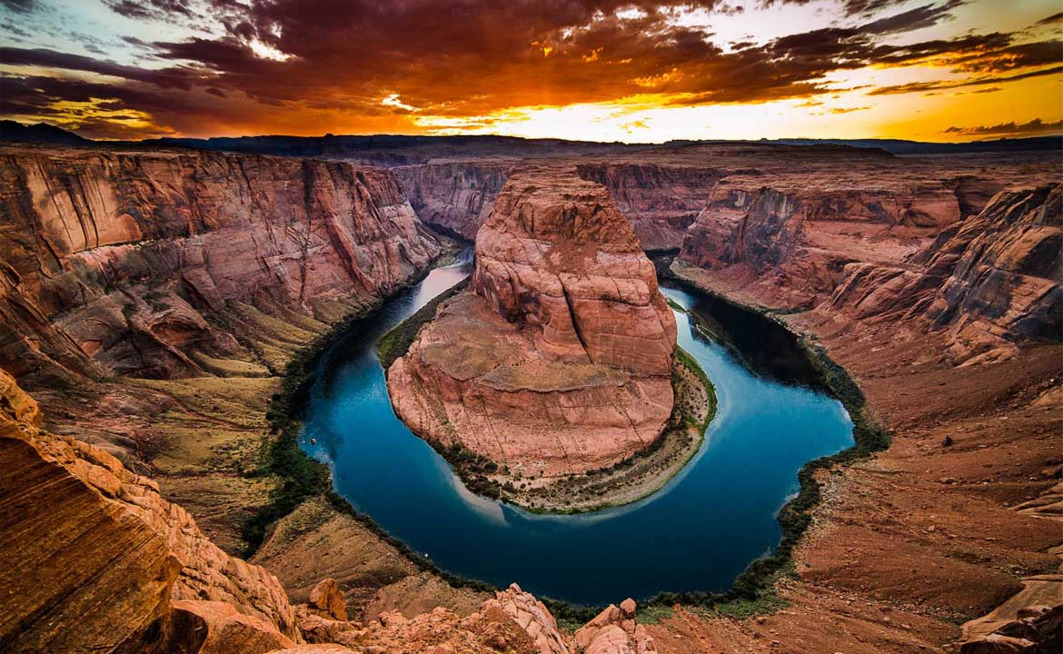
Hoseshoe Bend of the Grand canyon in Arizona

Slide 9
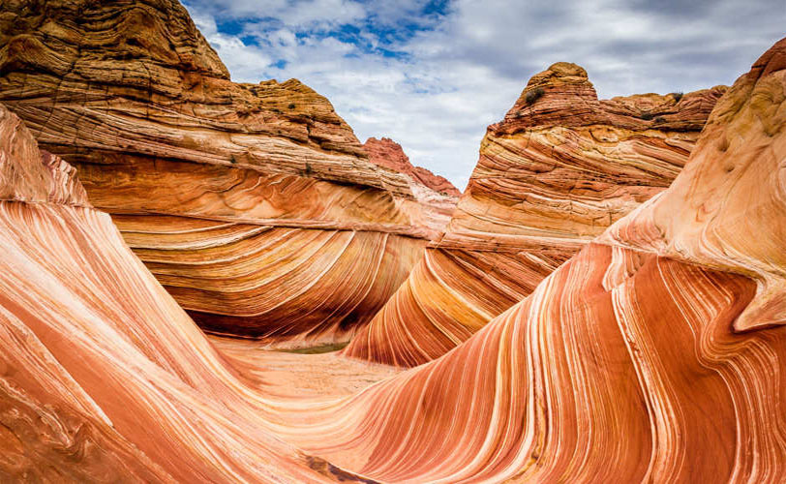
The Coyote Buttes area, on the Utah/Arizona border. Known as The Wave.

Slide 10
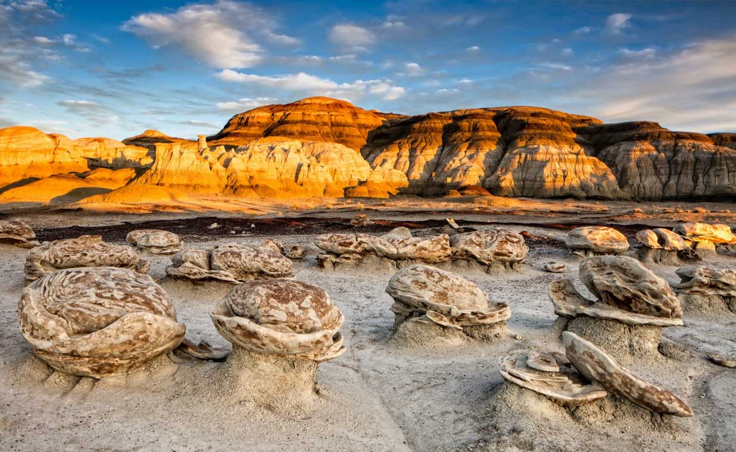
Santa Fe, New Mexico

Slide 11
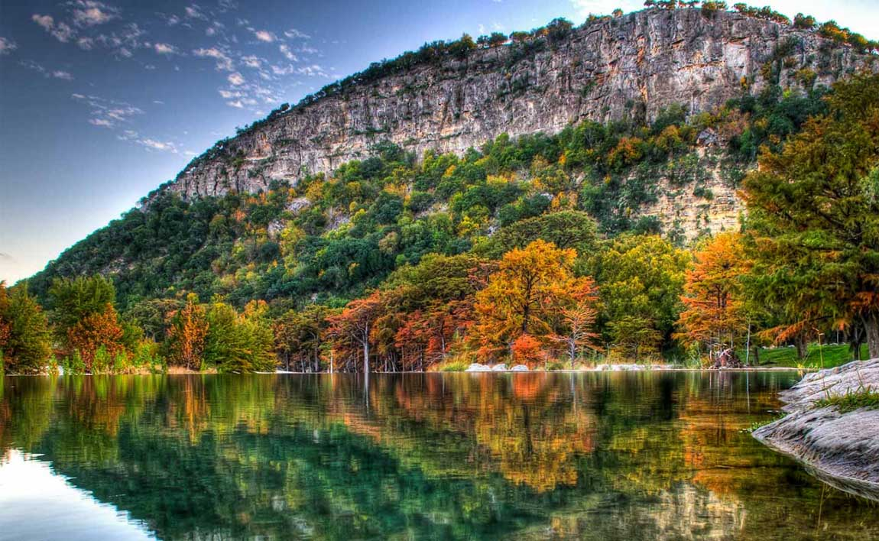
Garner State Park in Austin, Texas

Slide 12
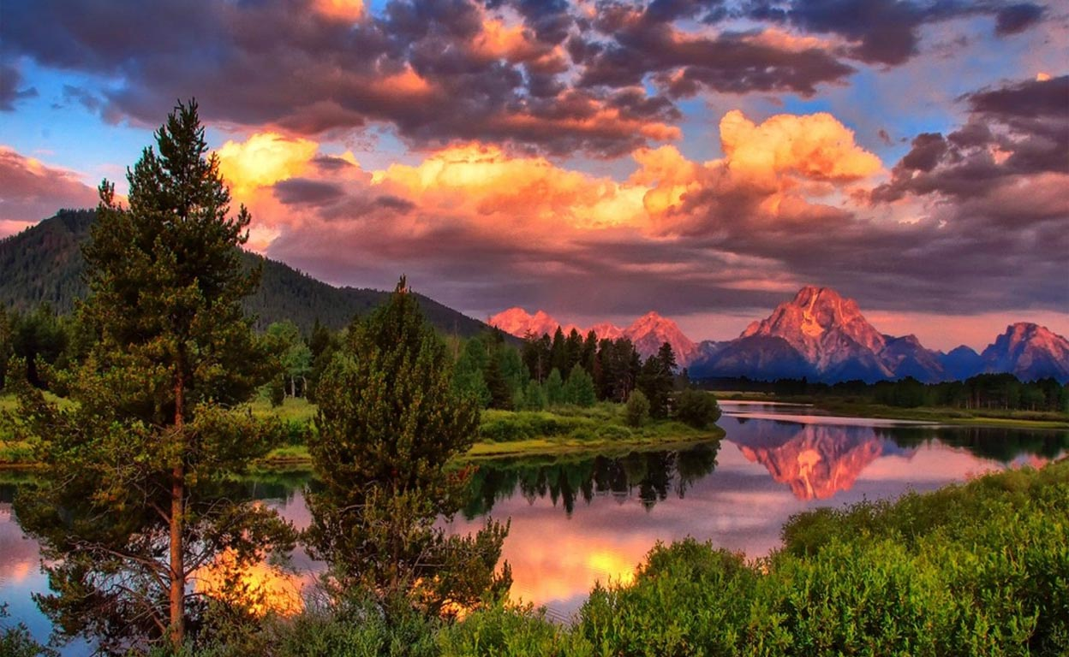
Mount Moran in Grand Teton National Park of western Wyoming

Slide 13
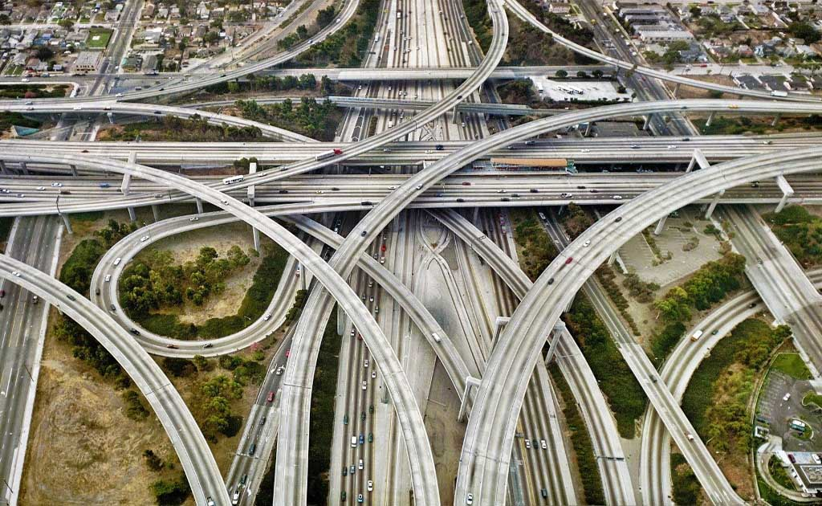
The Judge Harry Pregerson Interchange, Los Angeles

Slide 14
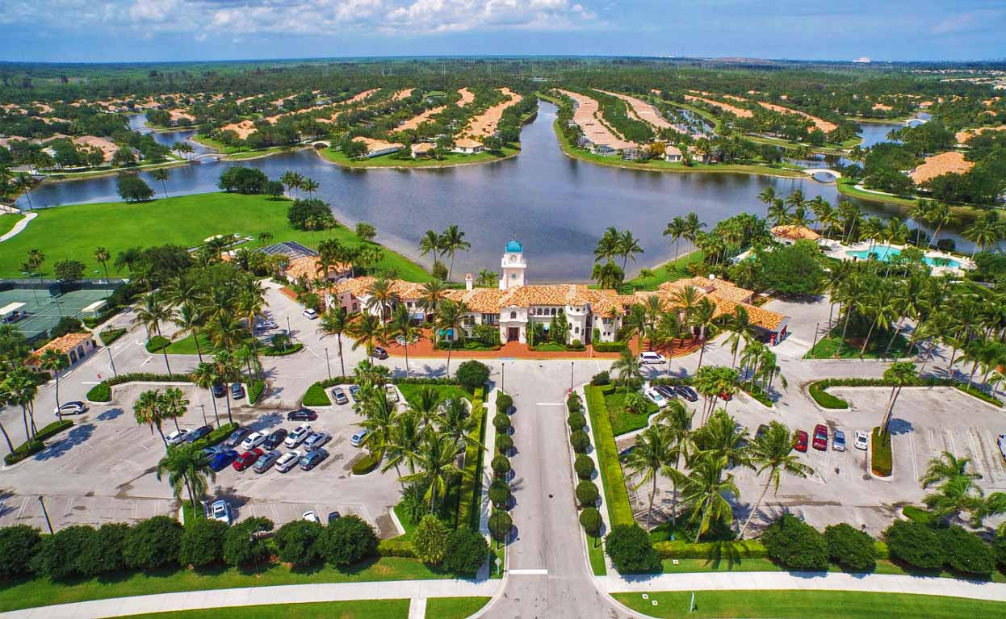
Luxury waterfront homes of West Palm Beach city in South Florida

Slide 15
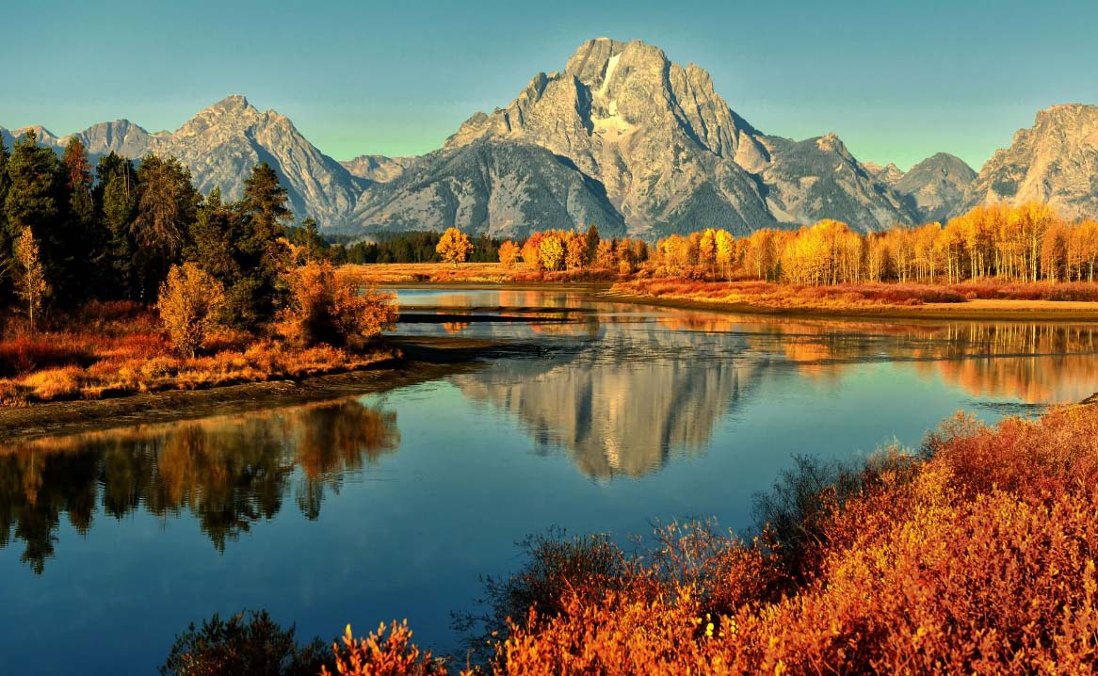
The Grand Teton National Park in autumn at Wyoming

Slide 16
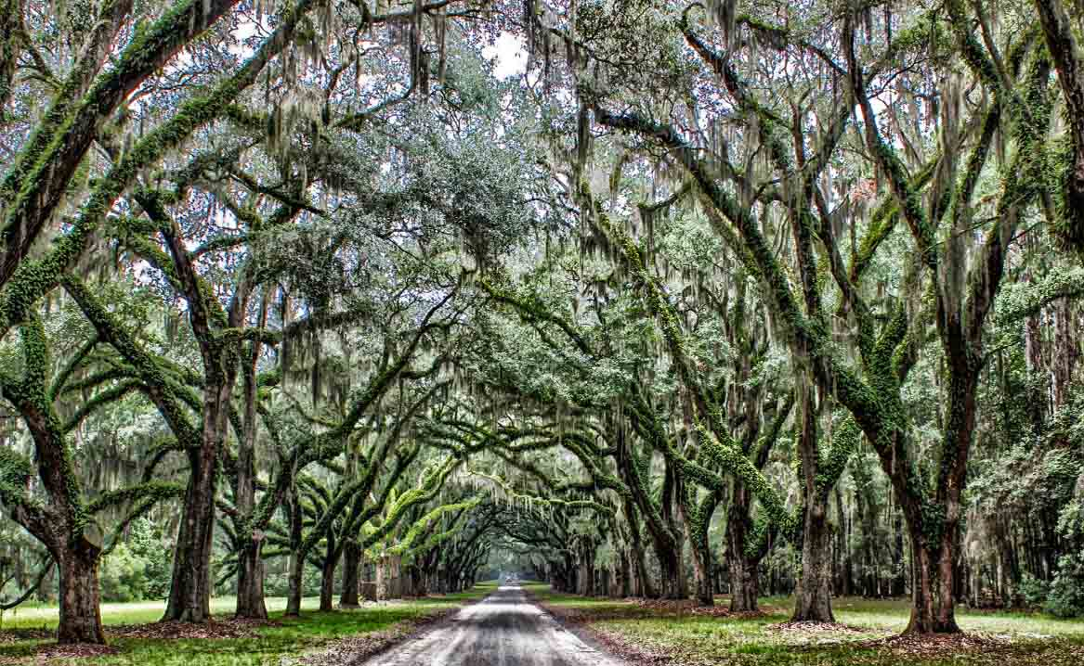
Womsloe Plantation in Savannah, Georgia

Slide 17
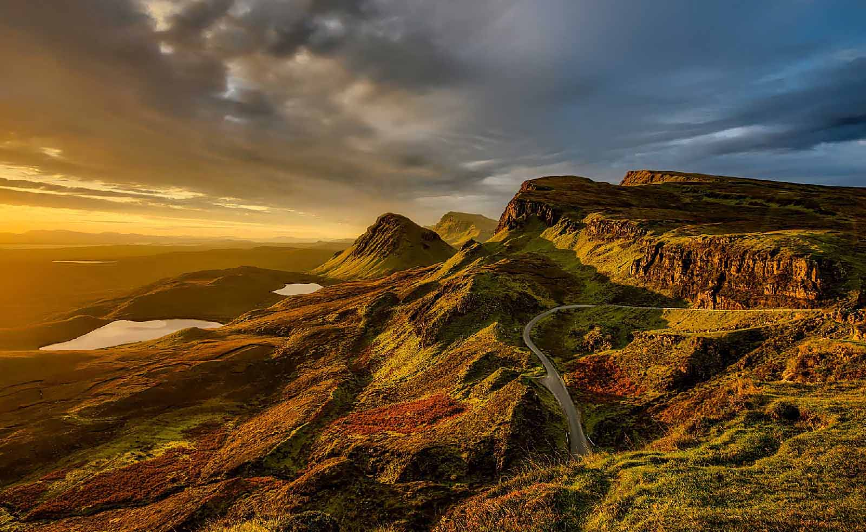
Scenic Colorado Country

Slide 18
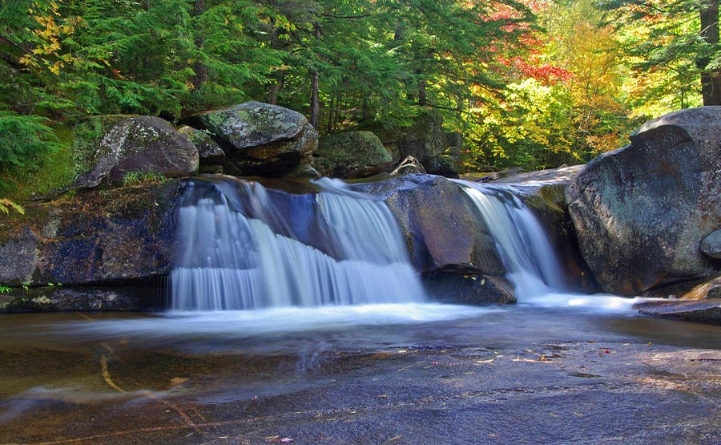
Corkscrew Falls, Hocking Hills, Ohio

Slide 19
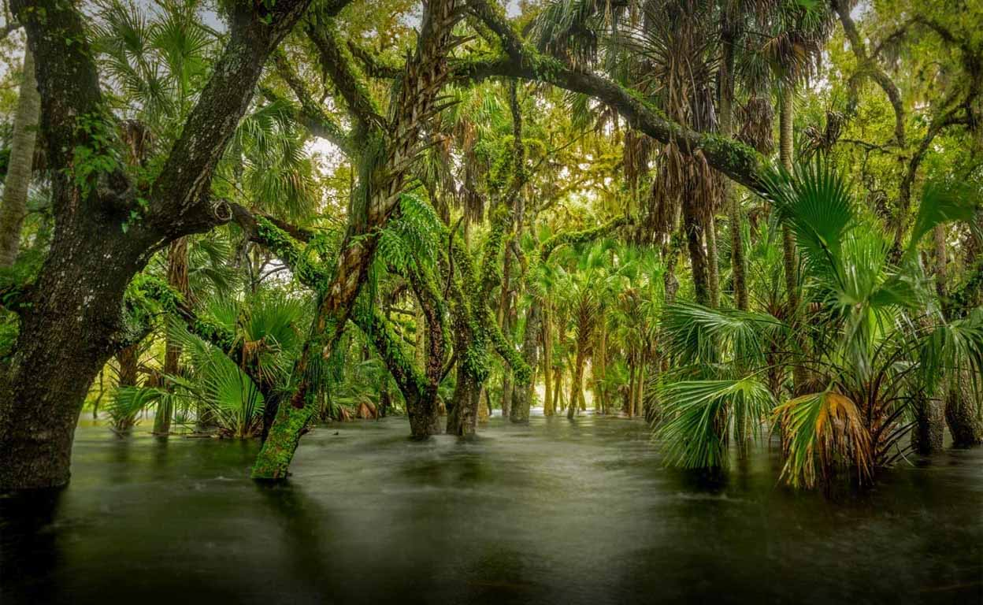
Myakka Riverstate Park in Florida

Slide 20

The 65 acres Bellingrath Gardens of Alabama

Slide 21
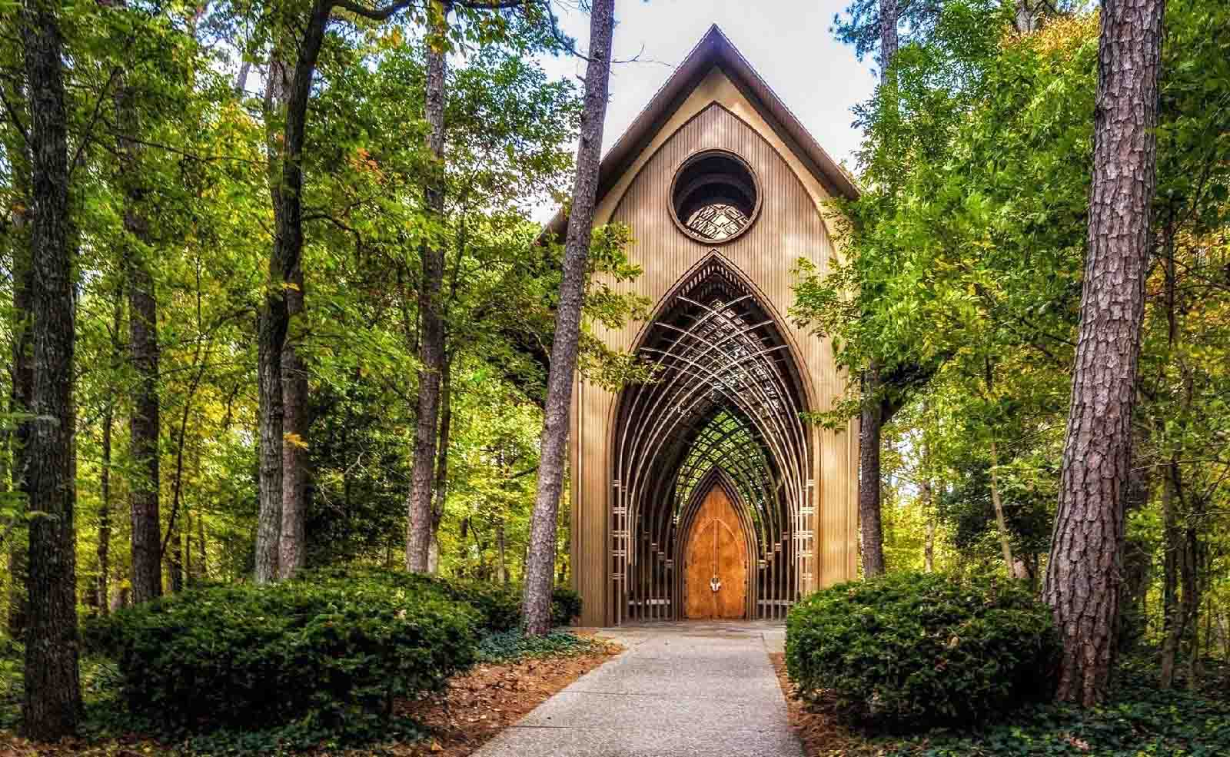
The Mildred B.Cooper Memorial Chapel, BellaVista, Arkansas

Slide 22
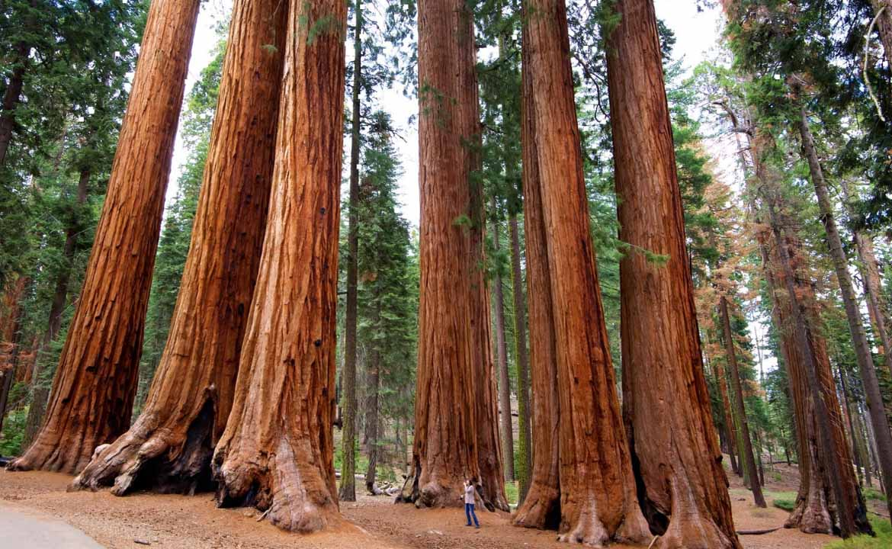
California's Sequoia National Park with its giant Redwood Sequoia Trees.

Slide 23

Mystic, Connecticut. A small seaside village with it’s Seaport Museum.

Slide 24
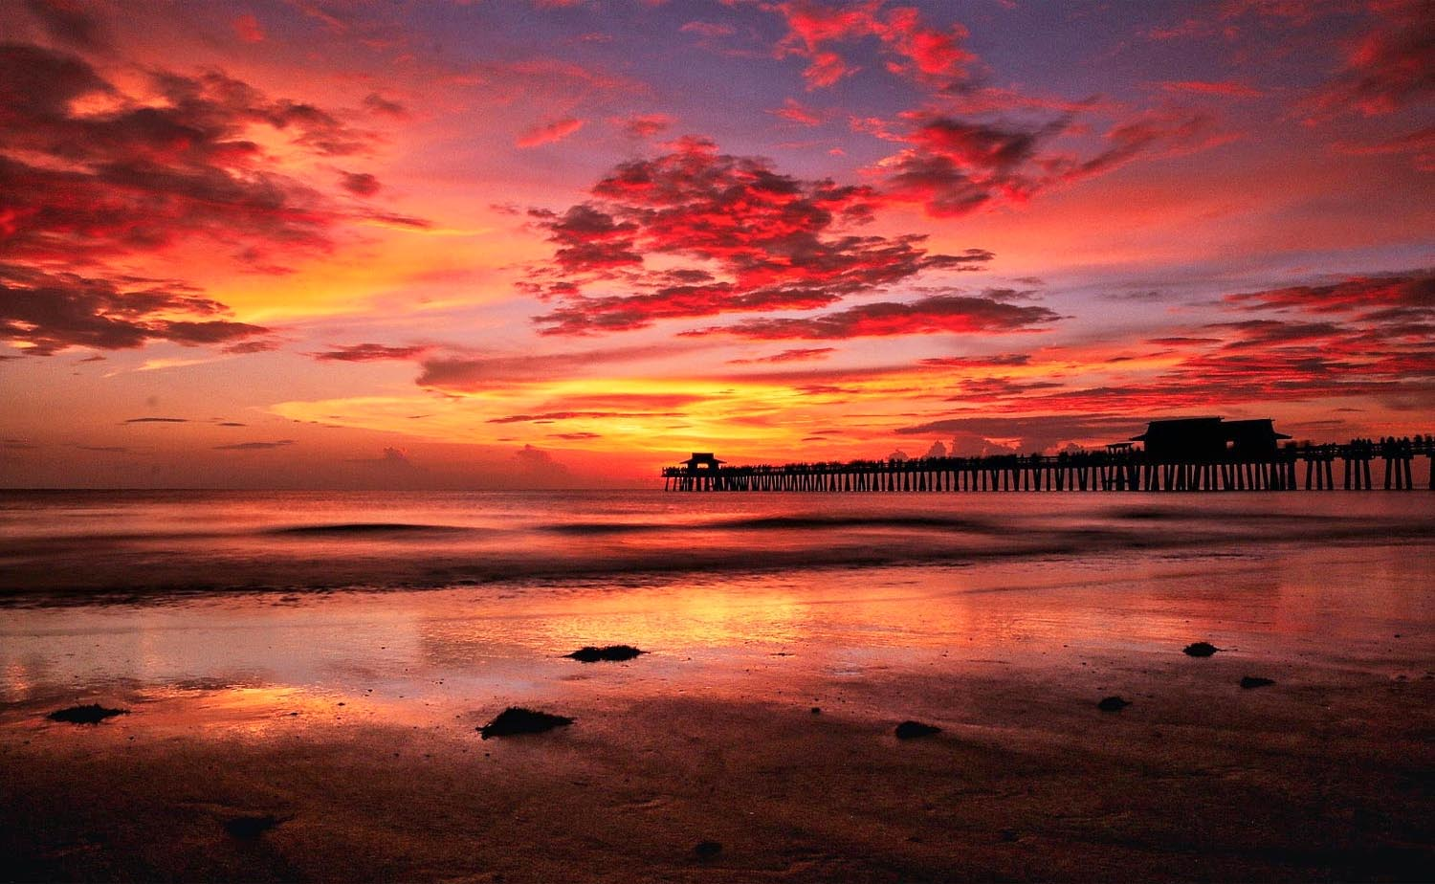
The spellbinding fiery sunset at the Naples Pier, Gulf of Mexico in Naples, Florida

Slide 25
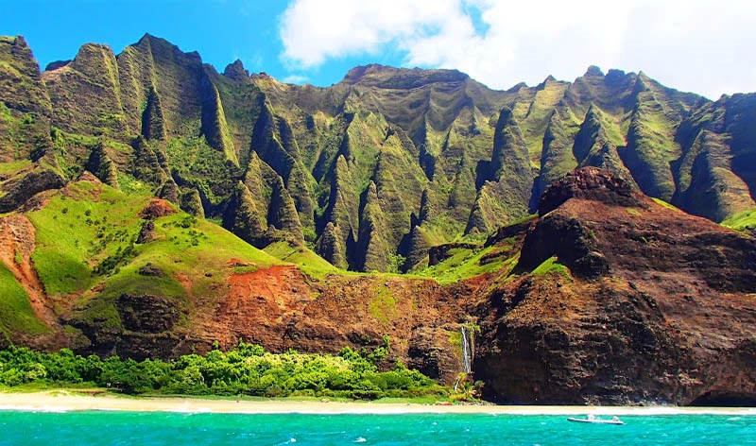
The island of Kauai's Na Pali Coast in Hawaii

Slide 26

Maui Beach and Sun Loungers, Hawaii

Slide 27
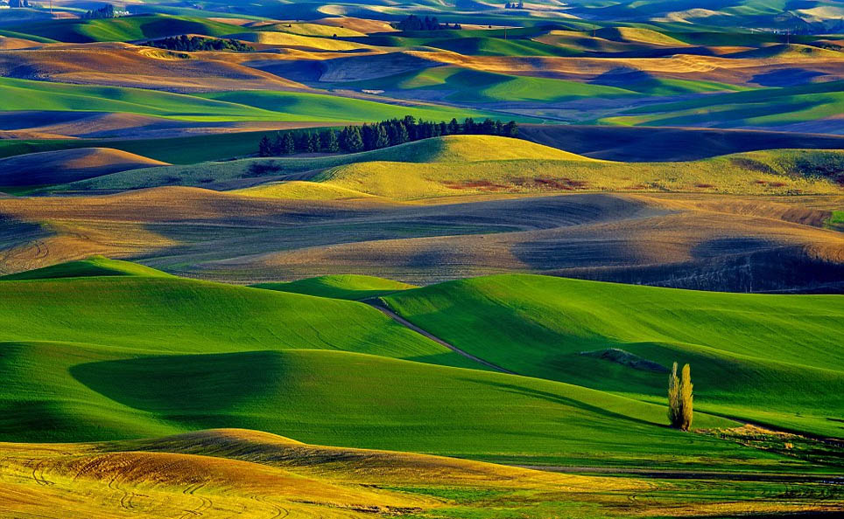
The mesmerizing rolling hills of Palouse in Washington District

Slide 28
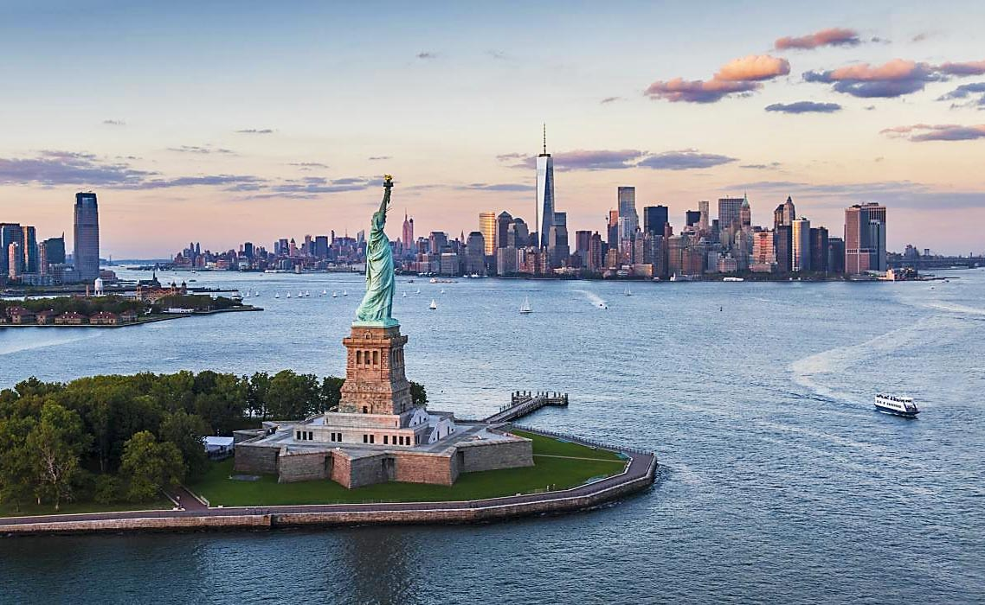
The Statue of Liberty on Liberty Island, New York Harbor, New York City

Slide 29
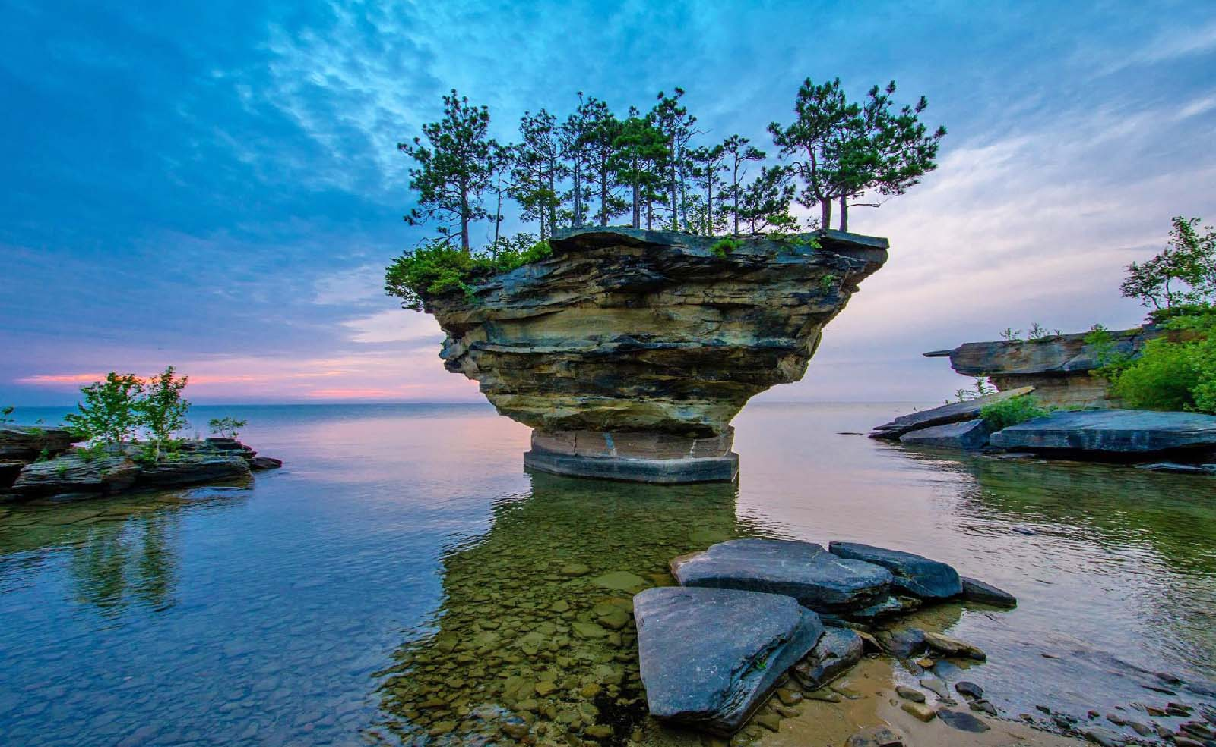
Michigan’s Turnip Rock, coast of Port Austin, Michigan.

Slide 30
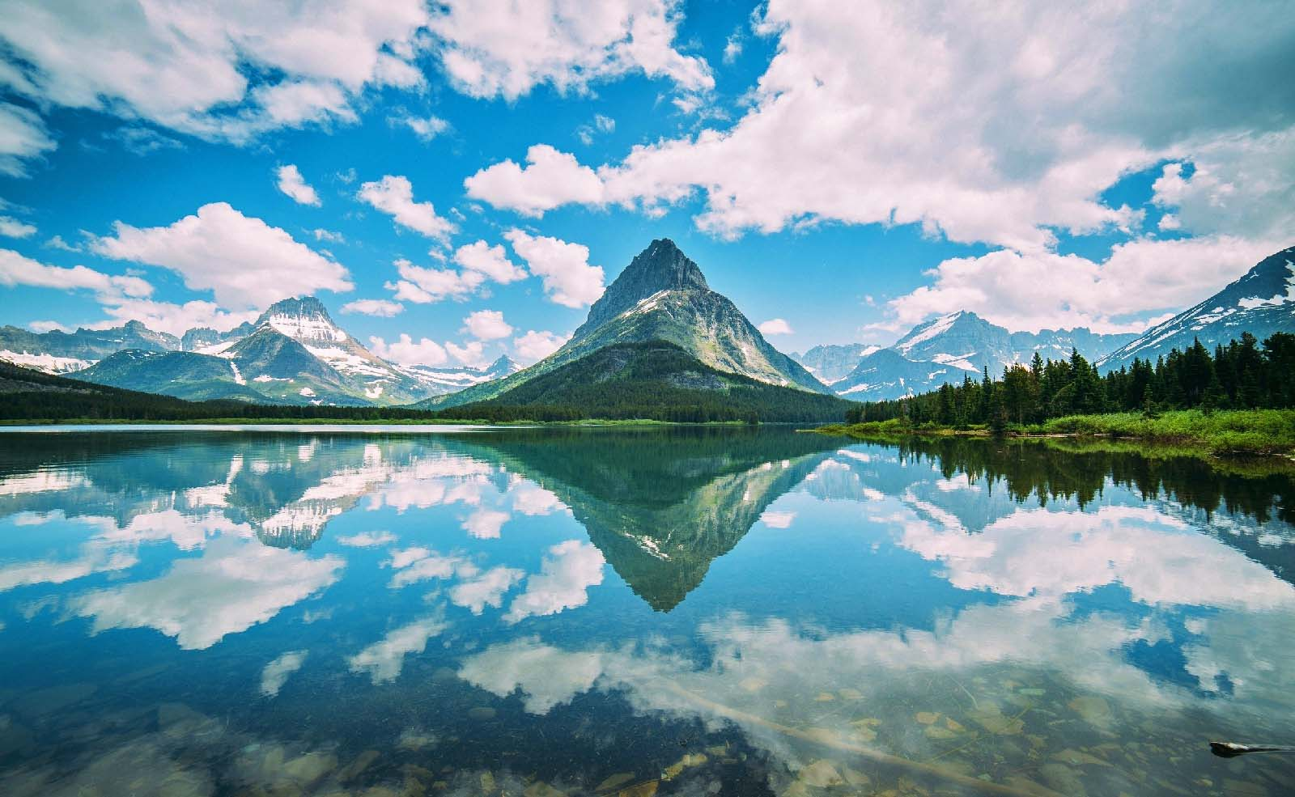
Glacier National Park of Montana

Slide 31
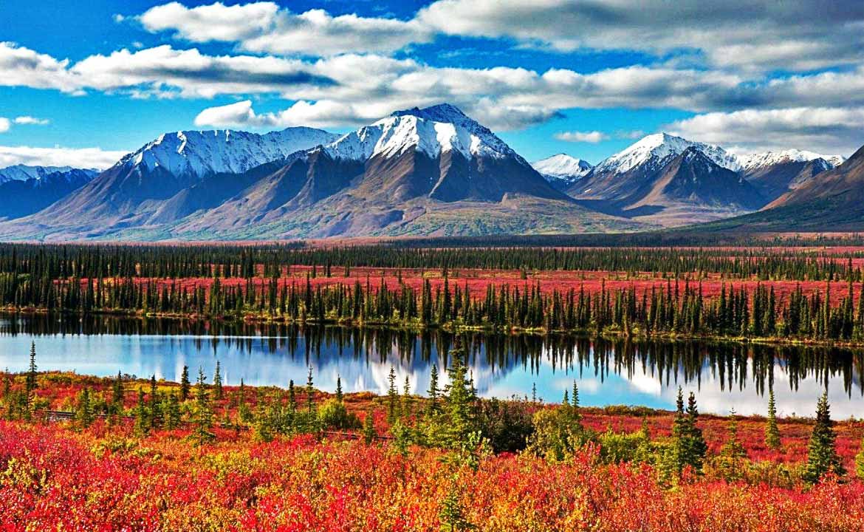
Scenic Alaskan Country

Slide 32
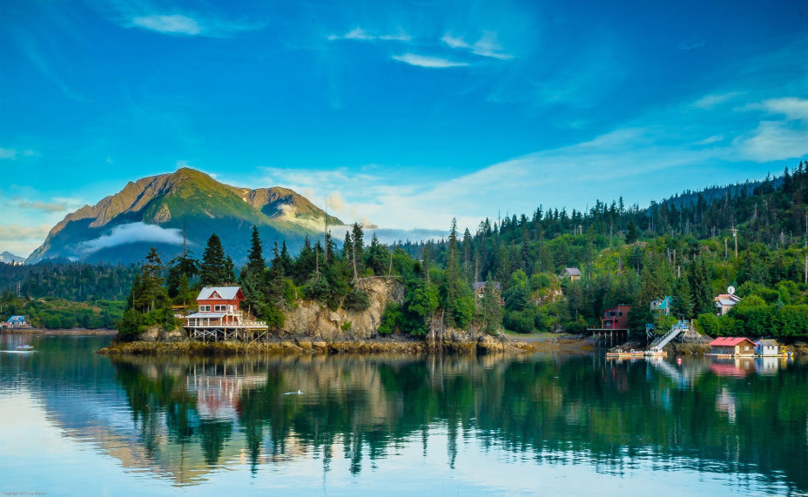
Majestic Mountain at the Halibut Cove Coastline of Alaska

Slide 33
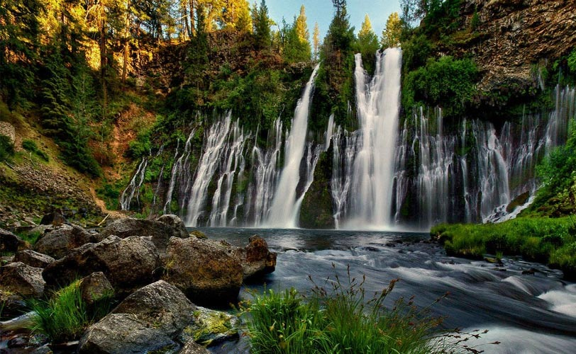
McArthur-Burney Falls Memorial - State Park, California

Slide 34
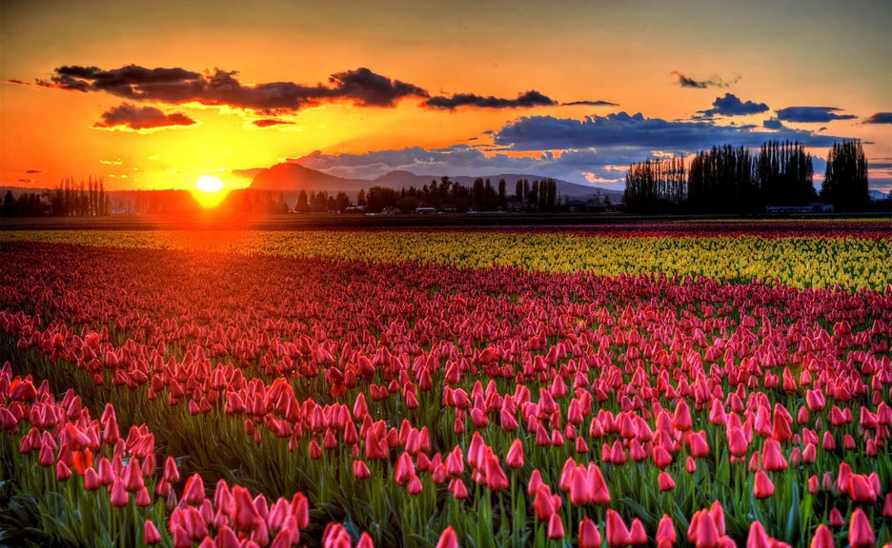
Skagit Valley Tulip Fields at Mt Vernon in Washington State

Slide 35
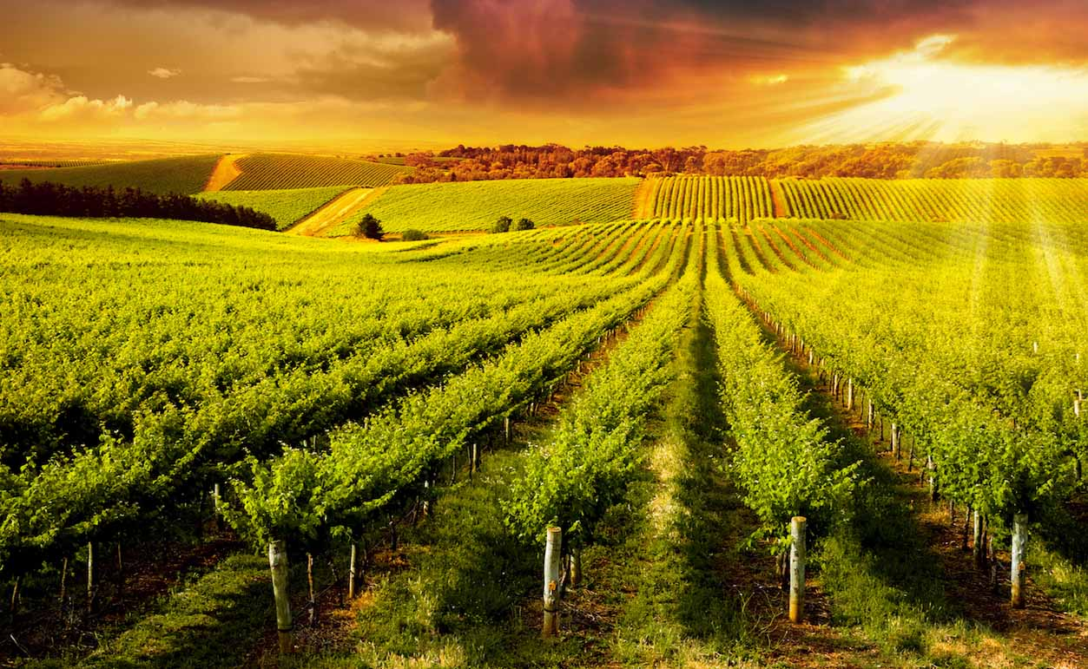
Vineyard Farms of Napa Valley in California

Slide 36
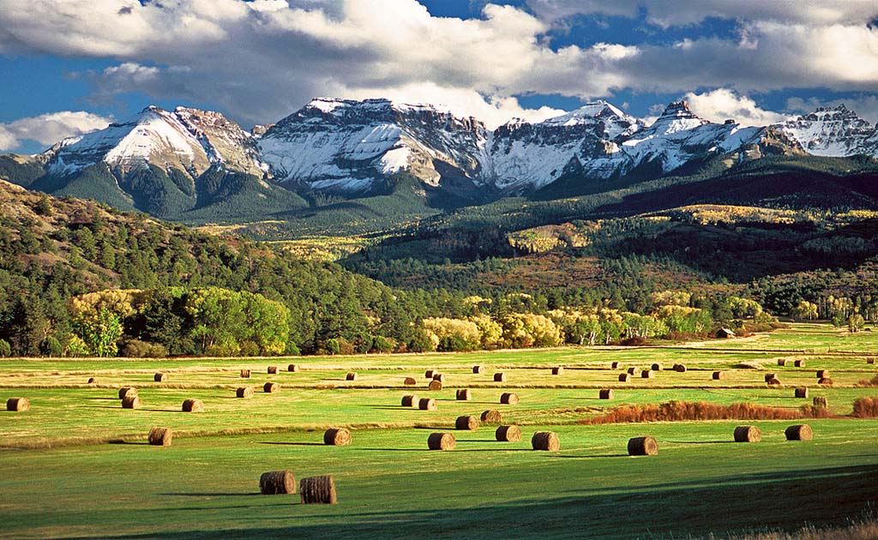
Haybales of Colorado after the wheat harvest

Slide 37
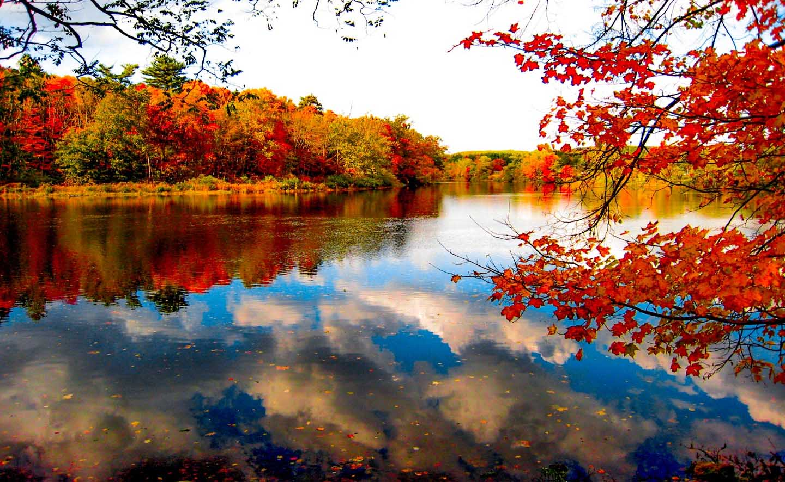
Farmington River, Collinsville, Connecticut

Slide 38
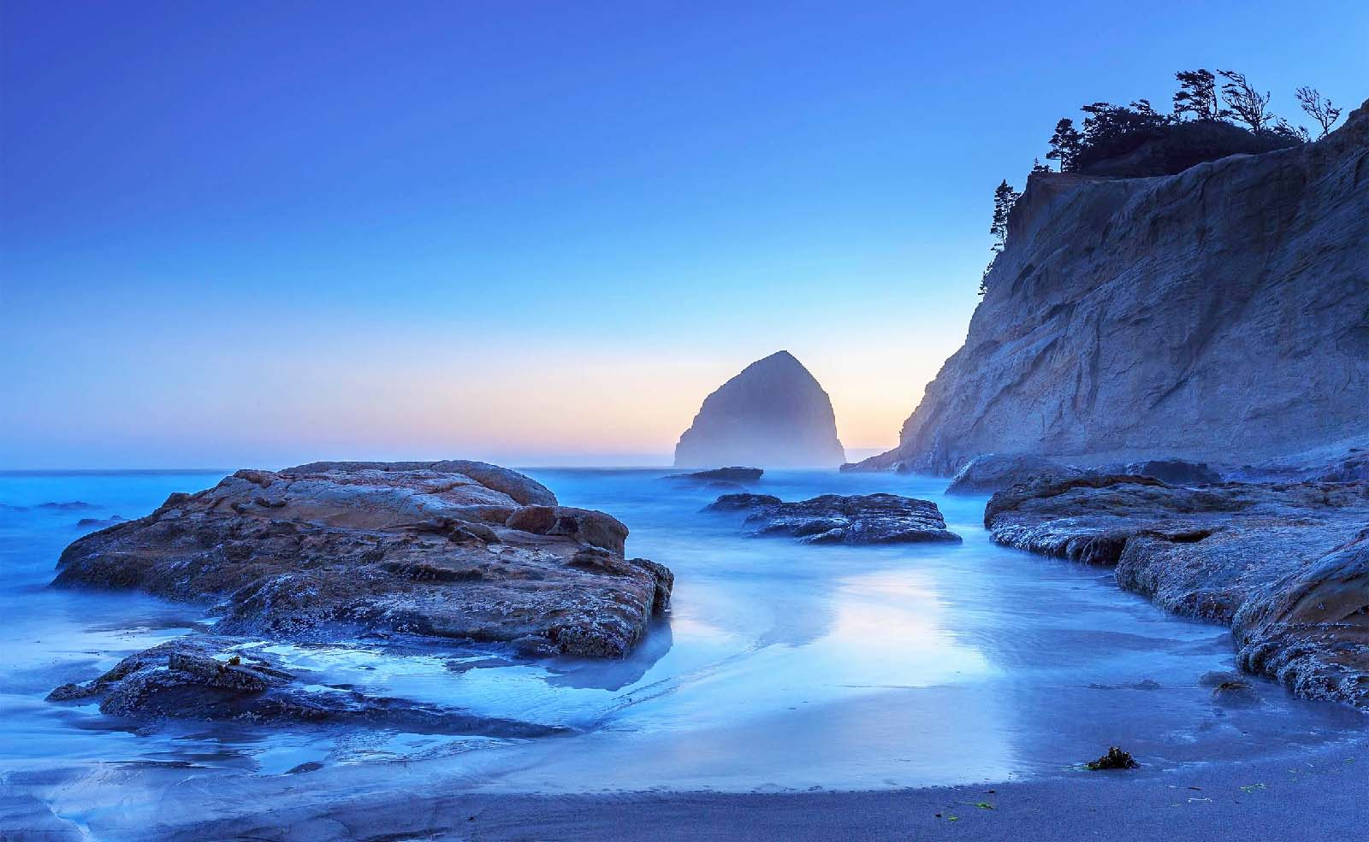
Haystack Rock, Cannon Beach, Oregon

Slide 39
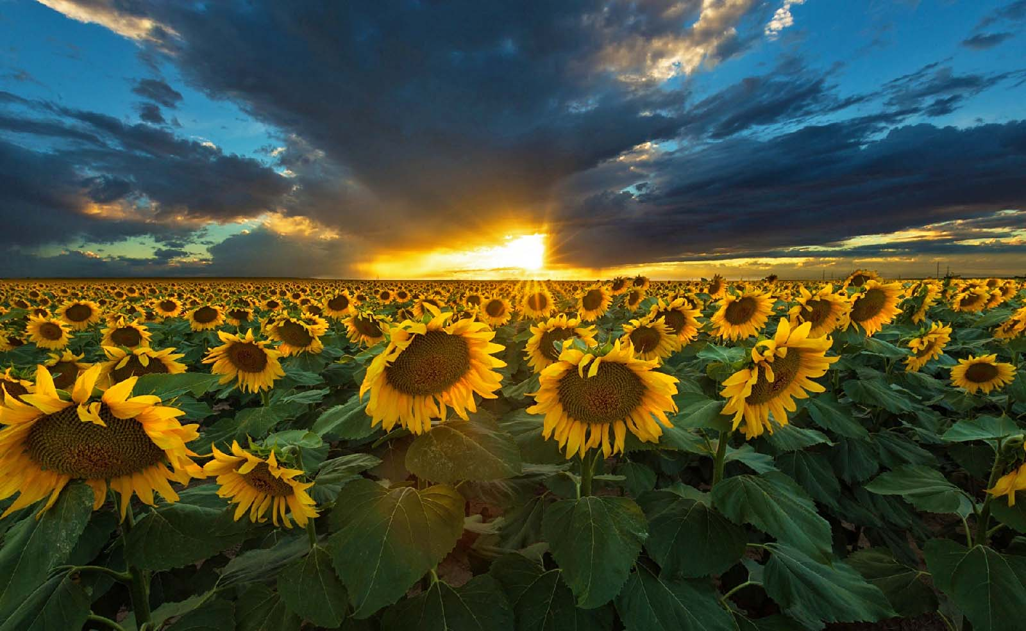
Sunflower fields of Iowa

Slide 40
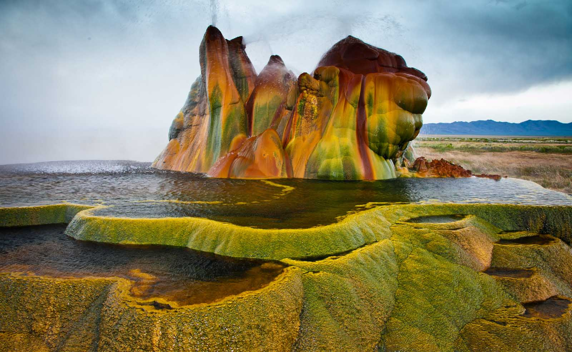
Fly Geyser Rock of Nevada

Slide 41
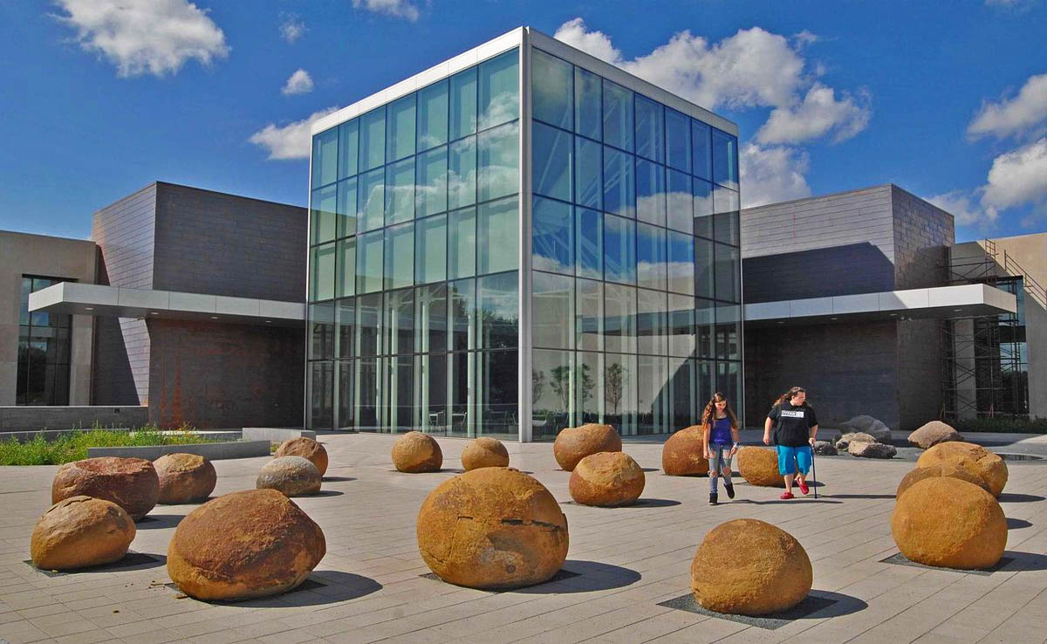
Heritage Museum Center of North Dakota

Slide 42
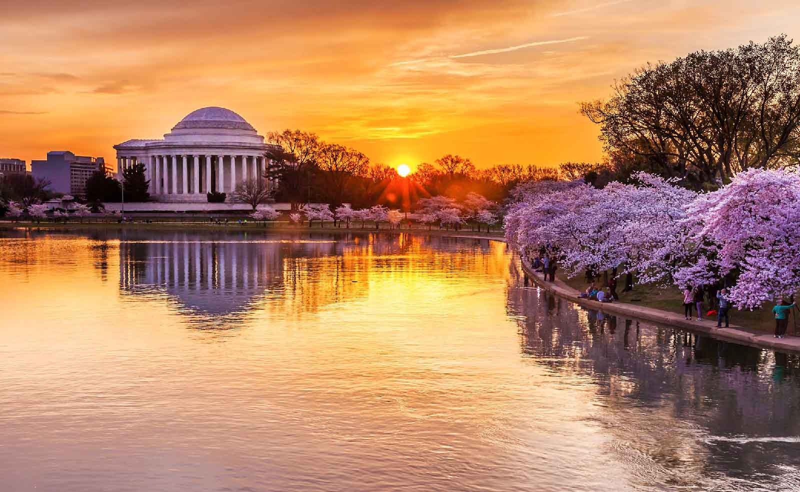
Cherry Blossoms along Washington D.C’s Tidal Basin

Slide 43
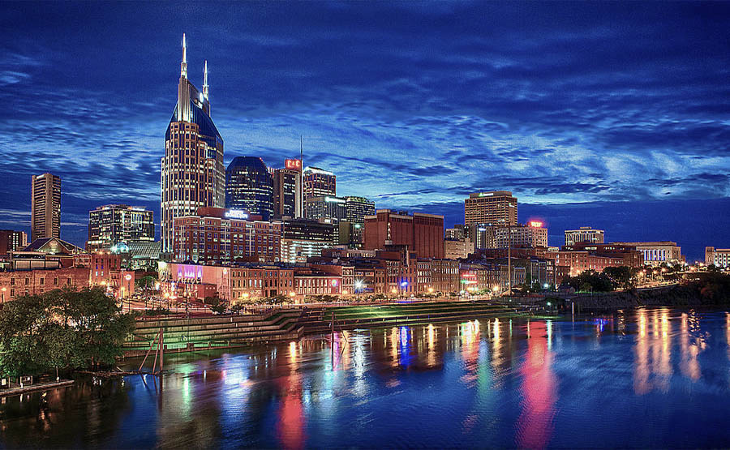
Nashville City in Tennessee - the capital of Country and Western Music

Slide 44
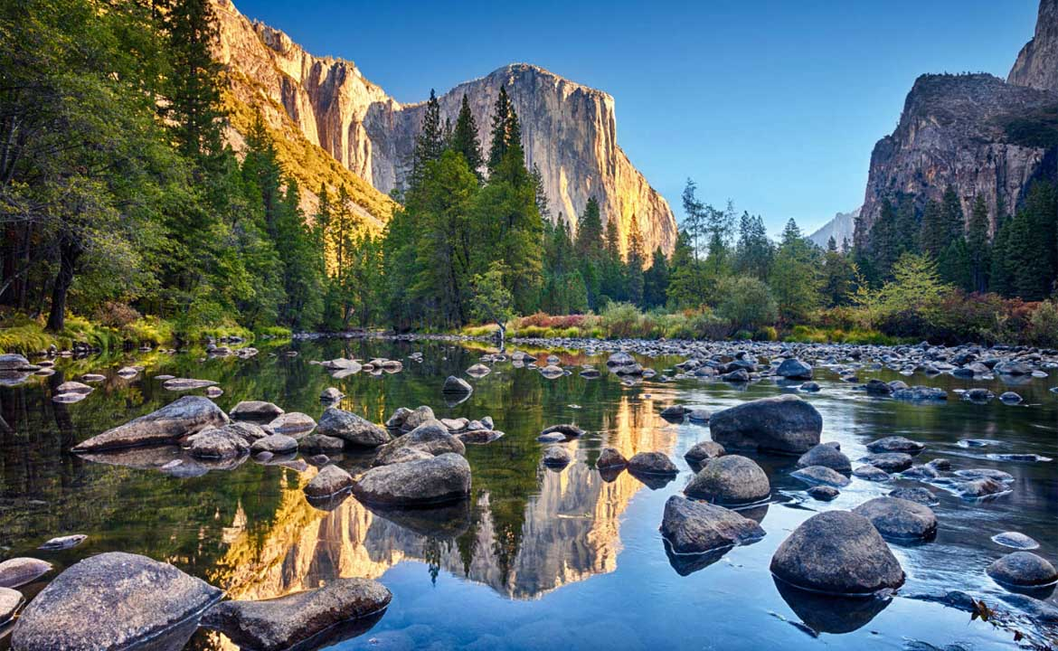
Yosemite National Park, California

Slide 45
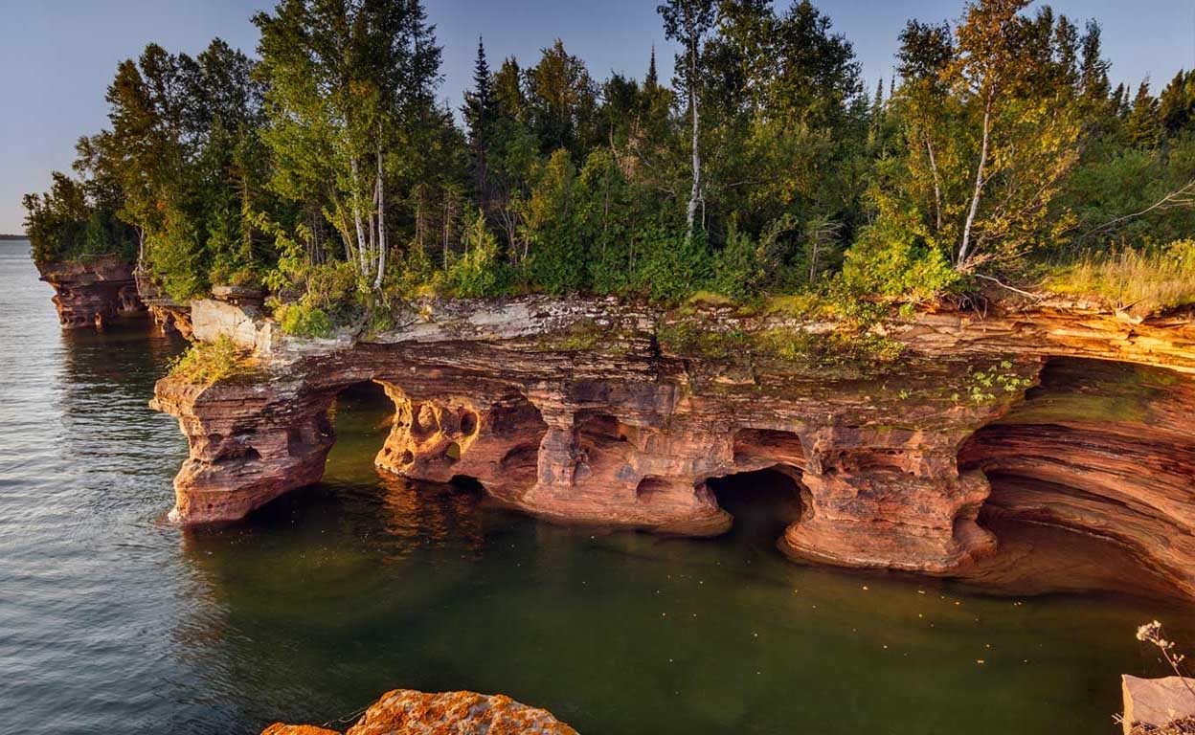
Apostle Islands National Lakeshore, Wisconsin

Slide 46
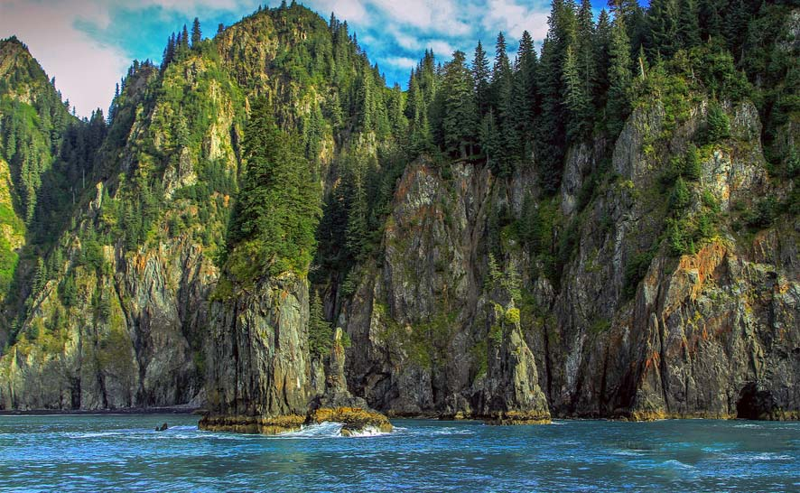
Kenai Fjords National Park, Alaska

Slide 47
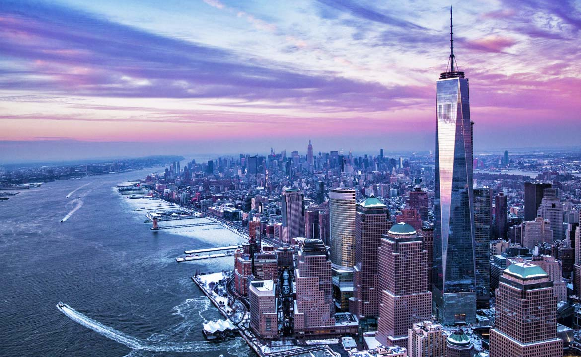
New York City view with it’s new One Trade Center Skyscraper

Slide 48
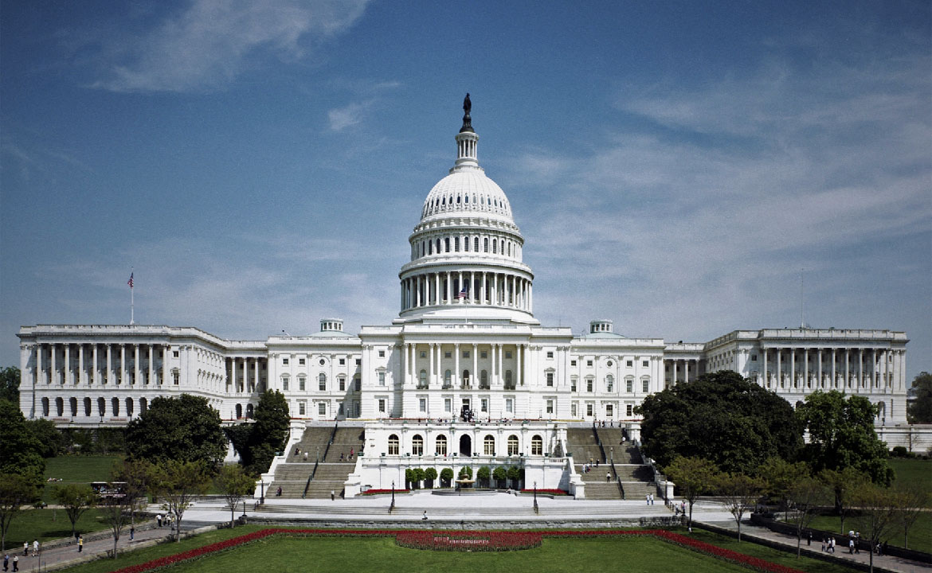
The White House - the U.S. President’s home and Parliament House, Washington, D.C.

Slide 49


Hope you have enjoyed viewing this presentation
Have a nice day
Music : David Arkenstone - Sunset Highway
With regards - Tony Chacko and Steve Rumpler
(tonychacko2000@gmail.com / pista2011@gmail.com)
United States
of America
2018

Slide 50







¿Te ha gustado?
Puedes ver más entrando
Aquí
Además puedes recibir powerpoints en tu correo electrónico suscribiéndote aquí:
F I N

