Slide 1
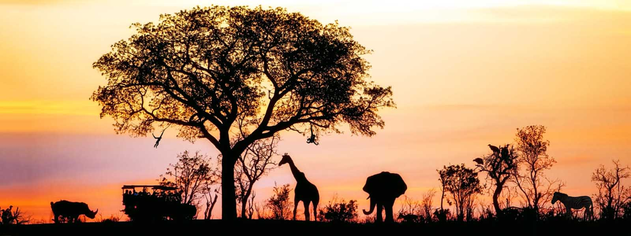


AFRICA
Daily Life

Slide 2
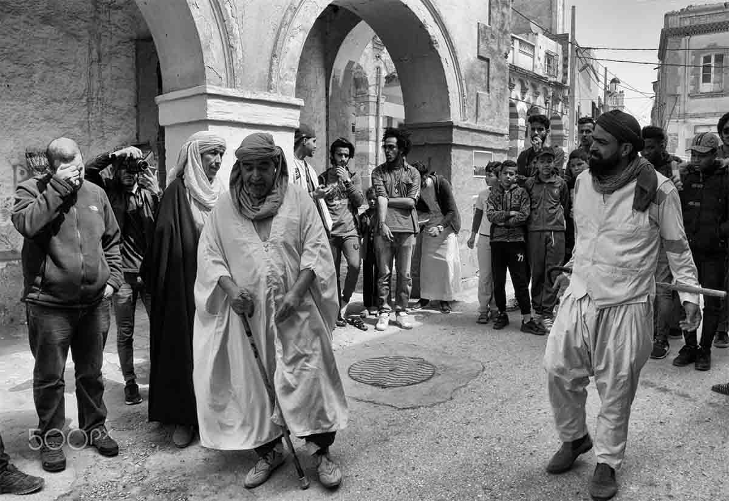
Algeria
Street theater
Prestation of members of the drama association "Ad-darb Al-Assil" during the days "Atlas Story", Laghouat, Algeria.
Photography © by Mohamed Bentireche on 500px

Slide 3
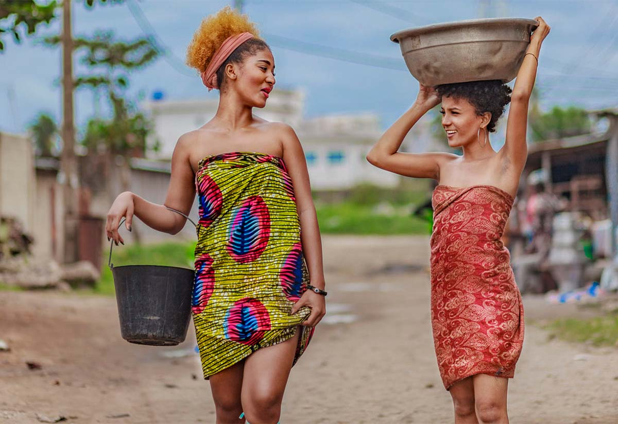
Benin
Two sister go Marigot fetch water.in Africa this scene iscommemorative of the connection between people.

Slide 4
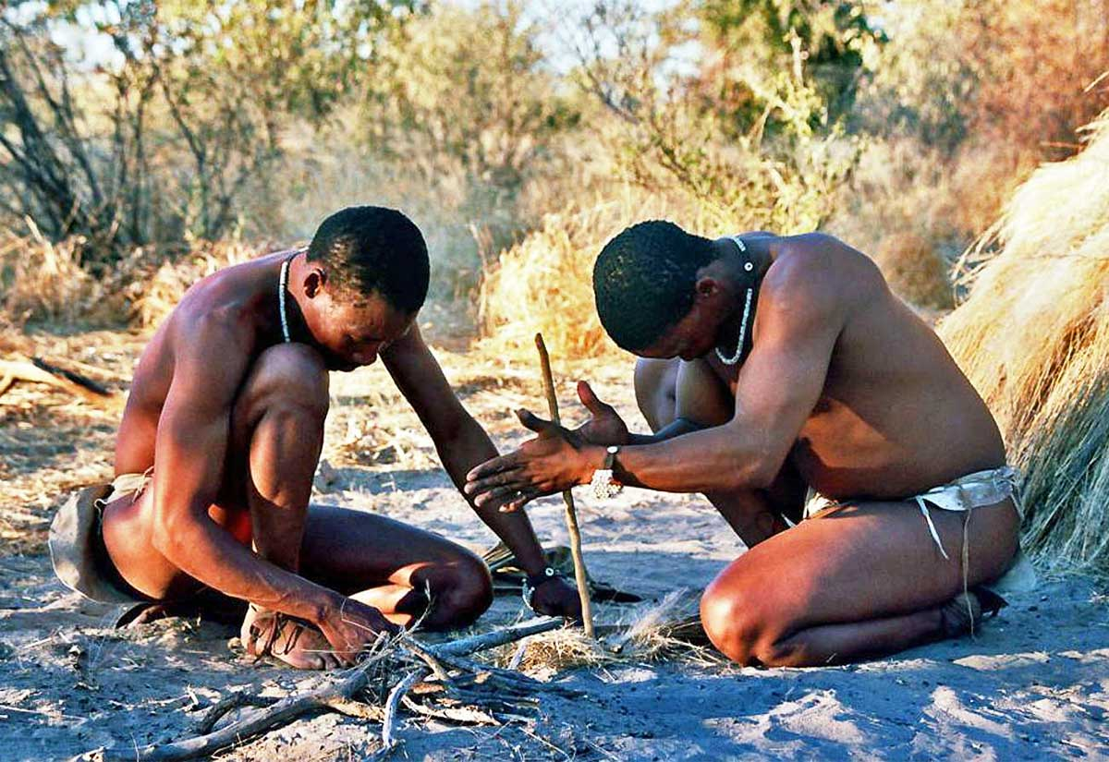
Botswana
Firemaking

Slide 5
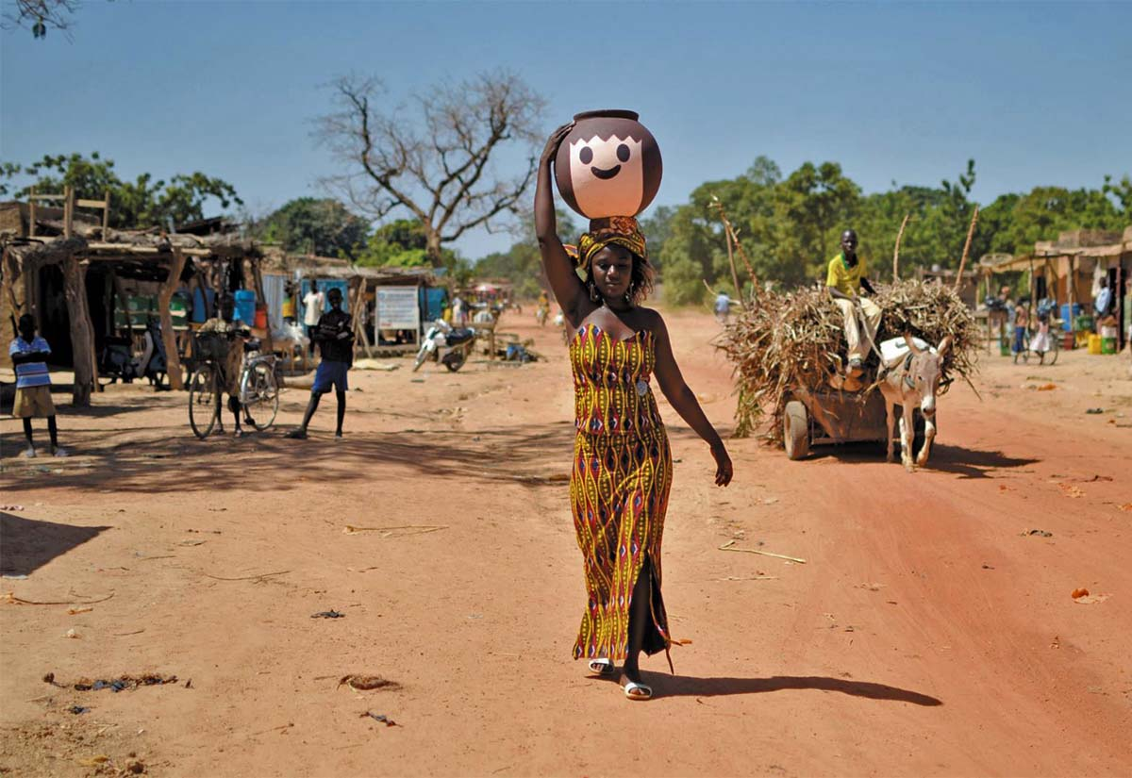
Burkina Faso
A daily water trip

Slide 6
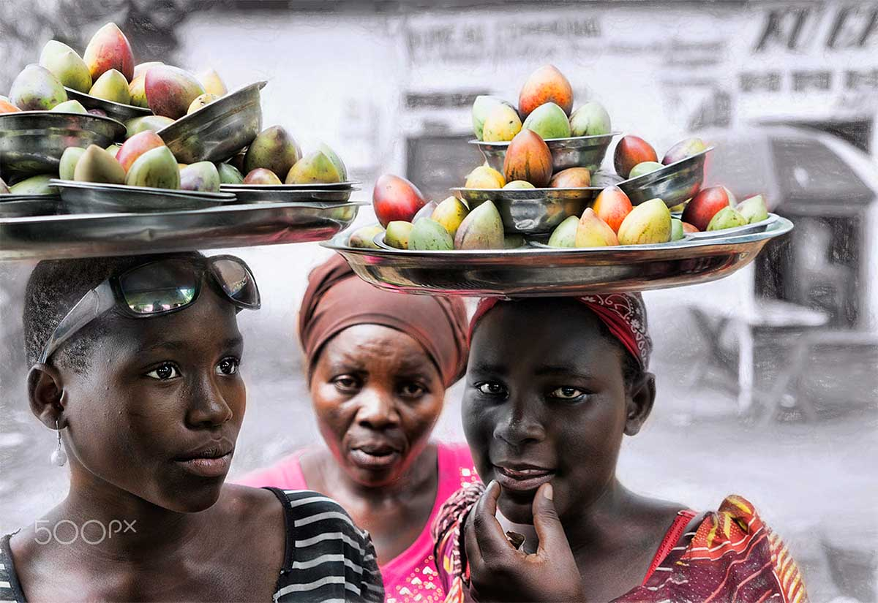
Burundi
Three Lady's
They all want to sell me fruits
Bujumbura, Burundi
Photography © by Ester Gísladóttir

Slide 7
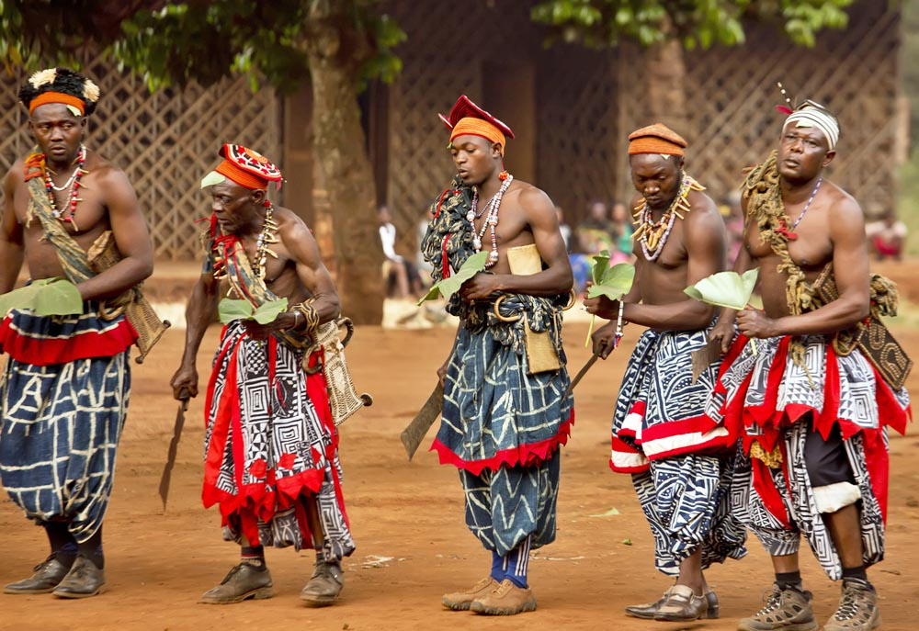
Cameroon
Folk dance group

Slide 8
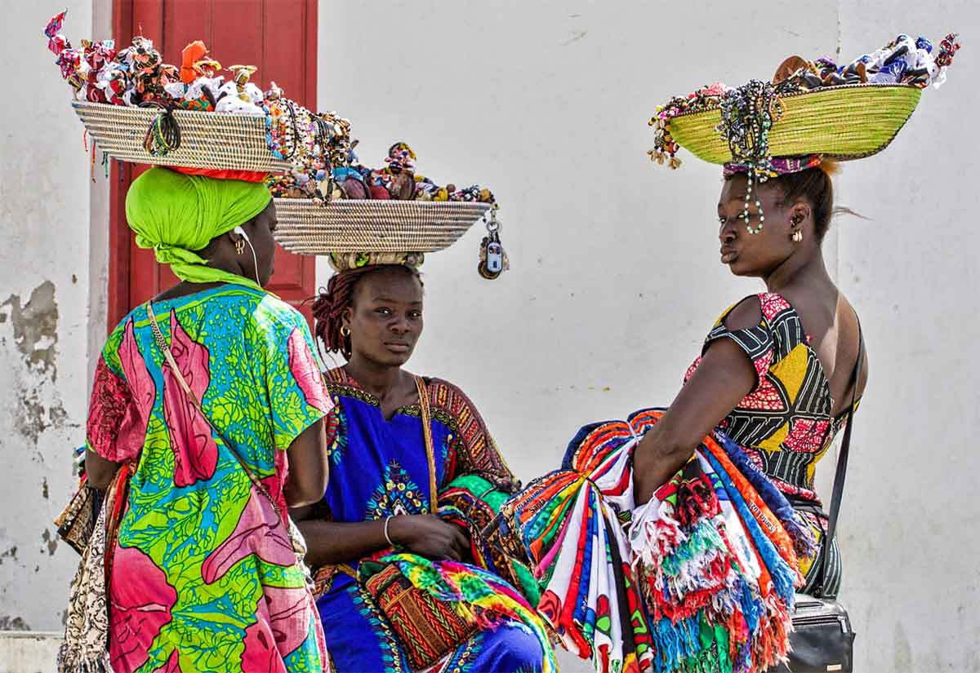
Cape Verde
Trinket sellers
Photography © by Steve Bailey on 500px

Slide 9
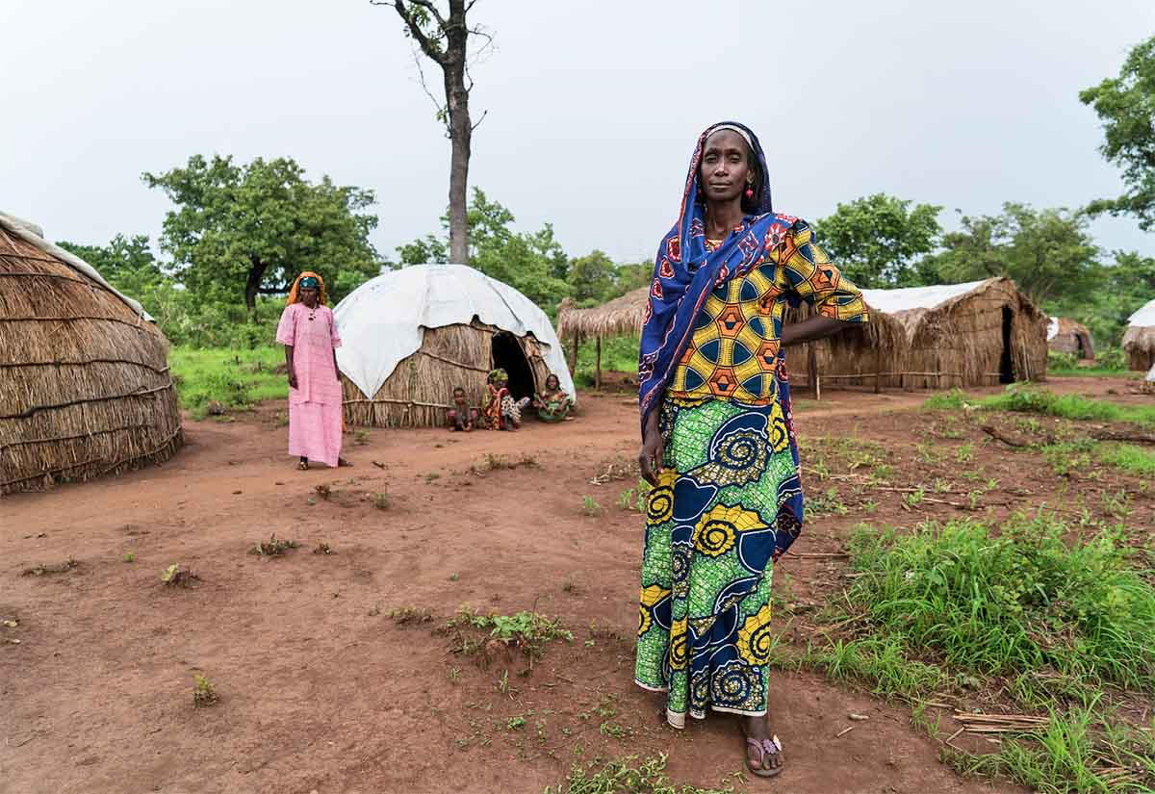
Central
African
Republic
Batangafo, Central African Republic
Displaced in Central African Republic
Internally displaced in Central African Republic. Some 600,000 people are internally displaced, more than 2 million people are food insecure and hundreds of thousands are refugees in the neighbouring countries. And the conflict in Central African Republic doesn't seem to end anytime.
Photography © by Sorin Furcoi on 500px

Slide 10
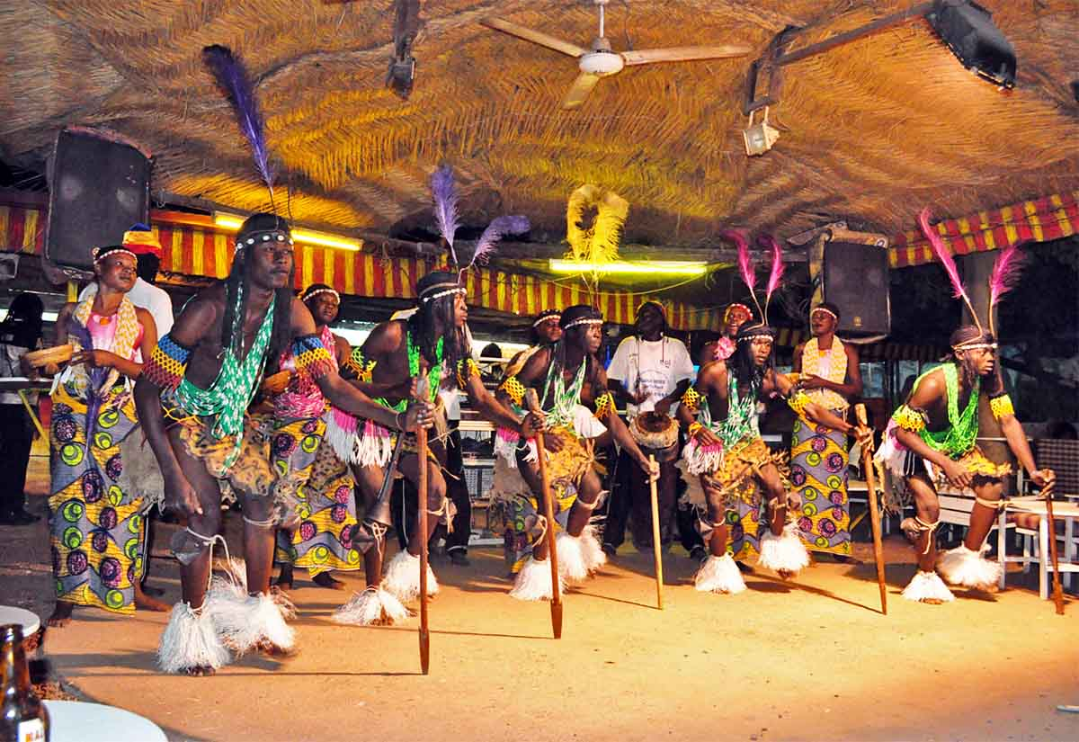
Chad
Traditional dances
Photography © by Dzmitry Aleinik on 500px

Slide 11
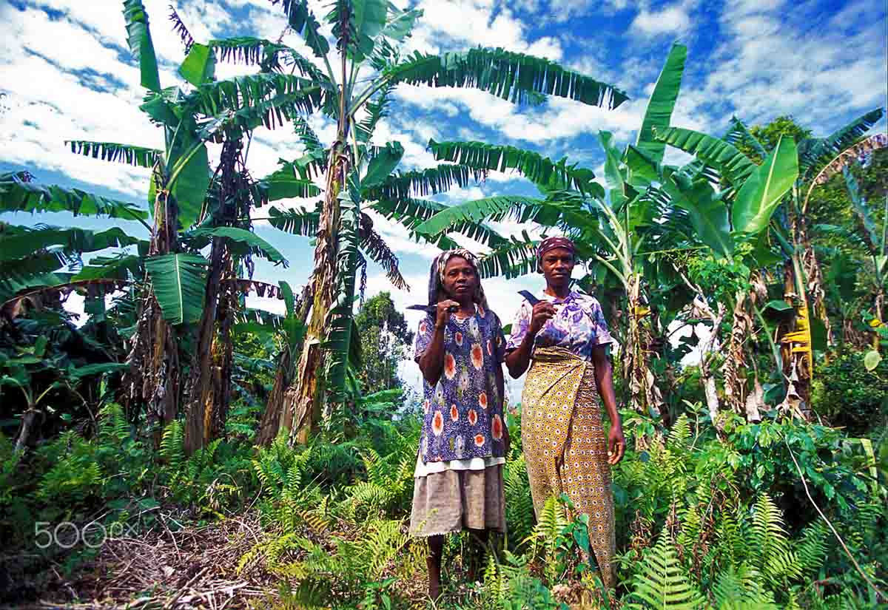
Comoros
A women in the city of Moutsamudu on the Island of Anjouan on the Comoros Ilands in the Indian Ocean in Africa.
Photography © by amnat on 500px

Slide 12
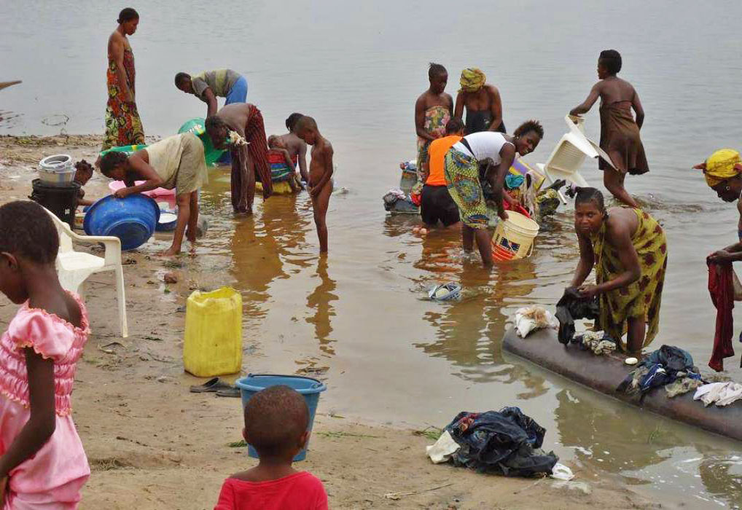
Dem.Rep.
of the Congo
Wash laundry on the river bank.

Slide 13
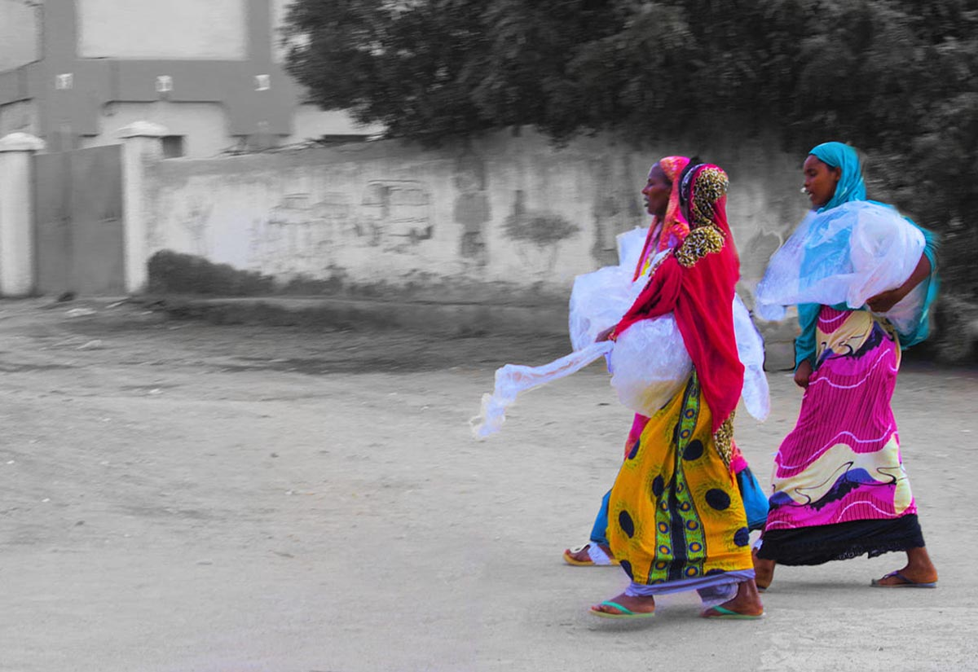
Djibouti
Gone for a stroll
Photography © by Michael Napoleone on 500px

Slide 14
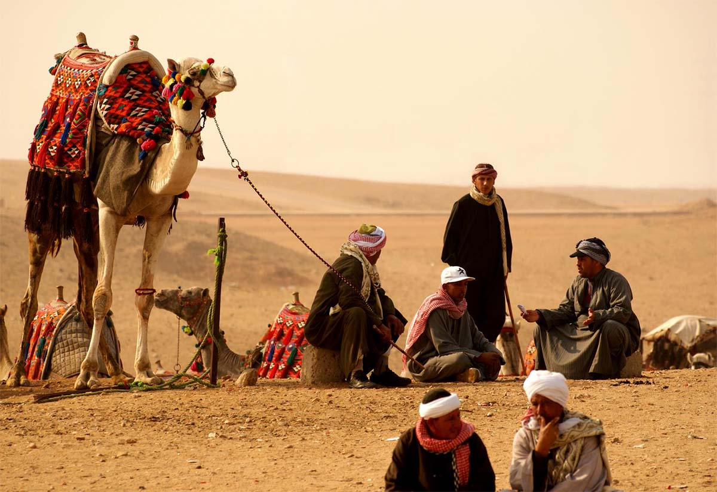
Egypt
Chat in the desert

Slide 15
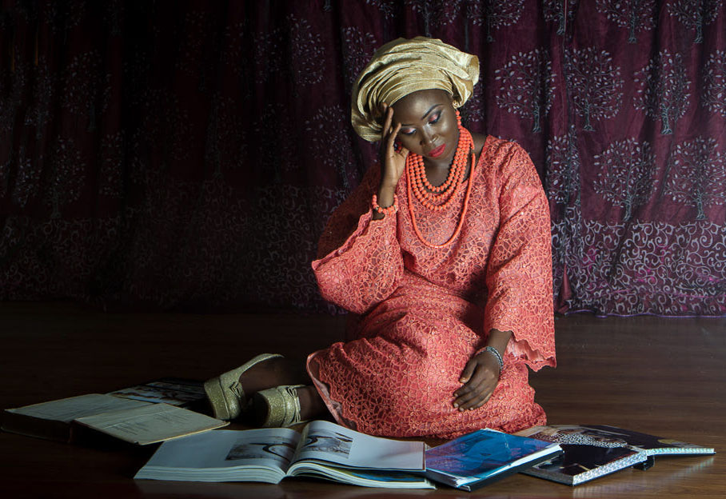
Equatorial
Guinea
Owambe Freak
So here is a story of a yoruba lady gorgeously dressed for a party. She has an exam she has not read for the next day but she would rather...
Photography © by Michael Imomoh on 500px

Slide 16
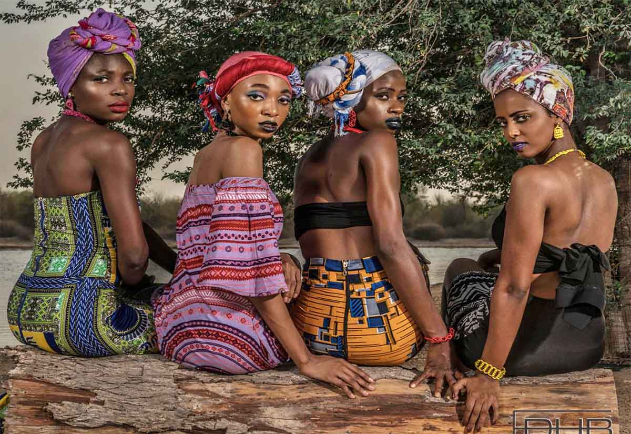
Eritrea
African Queens
Photography © by Eric Wilson on 500px

Slide 17
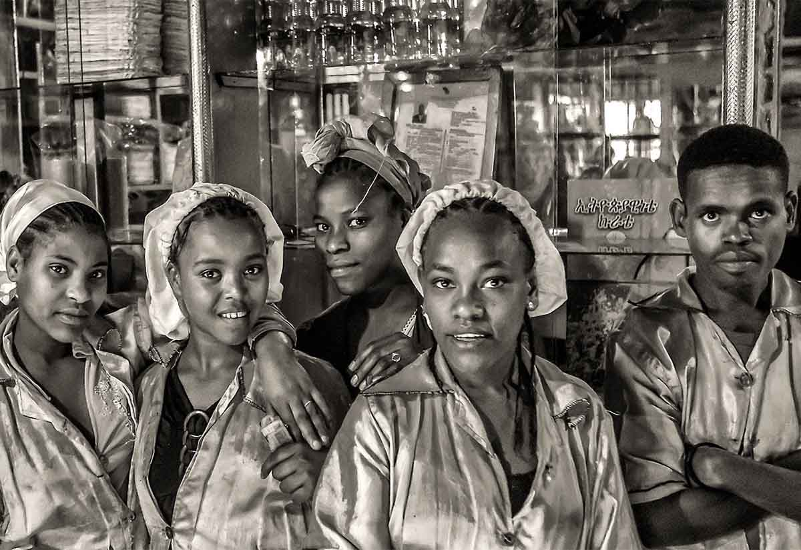
Ethiopia
Ten eyes, five looks.
Photography © by Fernando de Silva on 500px

Slide 18
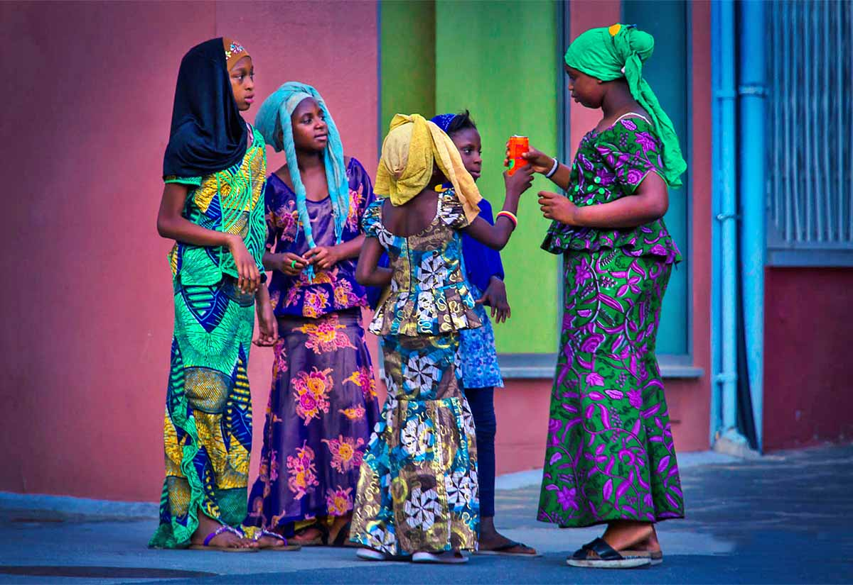
Gambia
Banjul. Gambia
Street scene

Slide 19
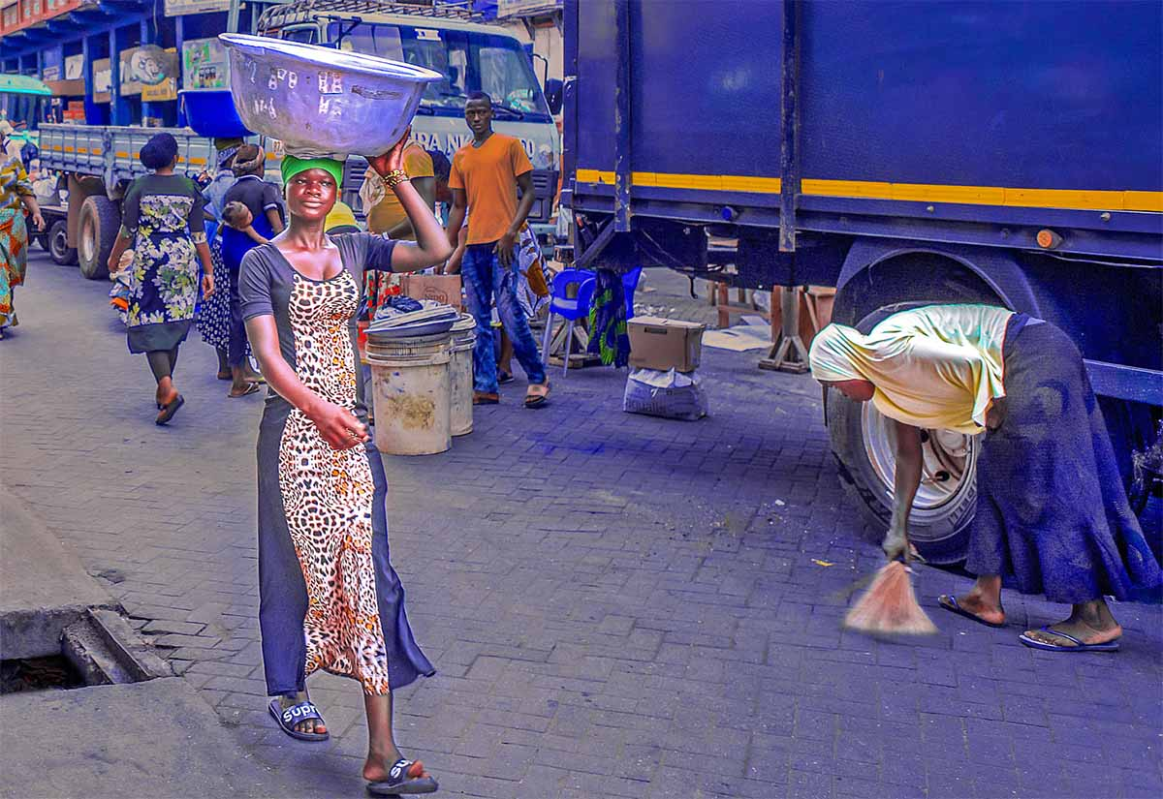
Ghana
Work Day
Early morning highs and lows in central Accra, Ghana
Photography © by Steven Strasser on 500px

Slide 20
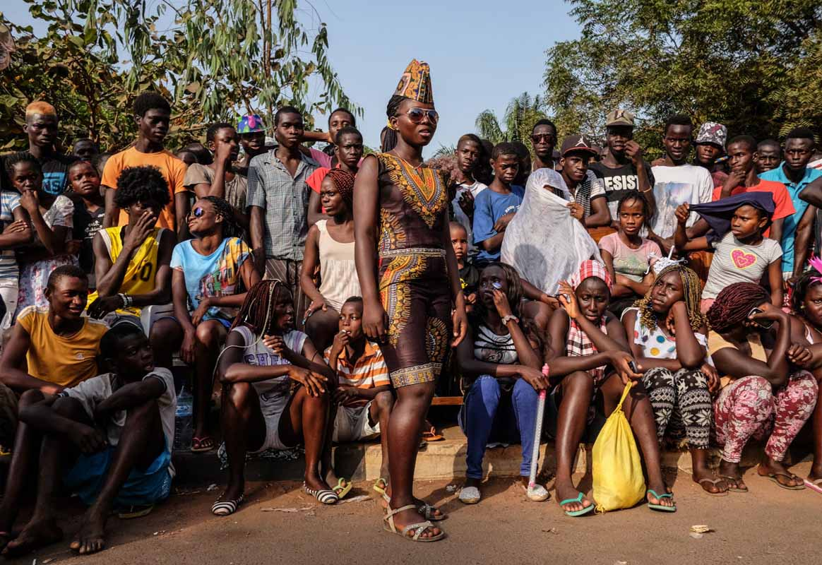
Guinea Bissau
Members of the Iris Carnival group in Bissau wait while their team mates prepare to practice their dance for the big party.

Slide 21
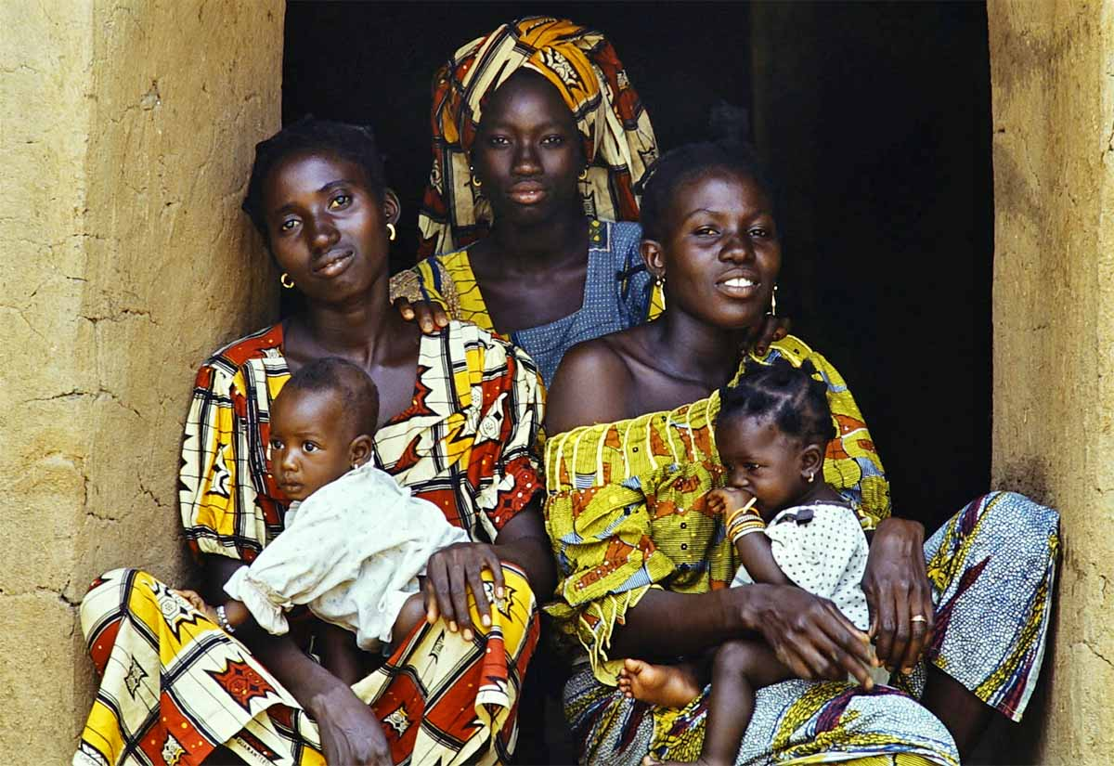
Ivory Coast
Women with kids, Katiola, Ivory Coast
Photography © by Marco Casiraghi on 500px

Slide 22
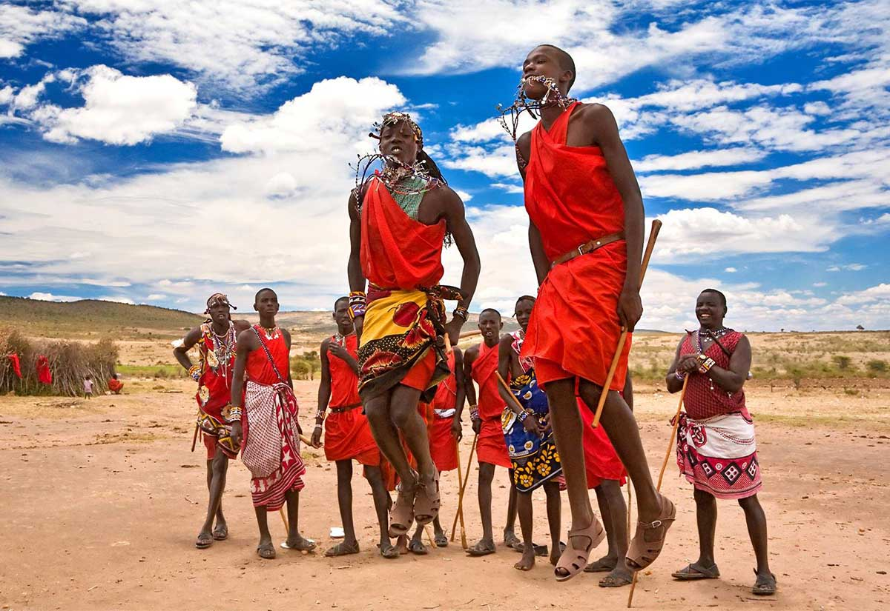
Kenya
Legs as elastic as strings

Slide 23
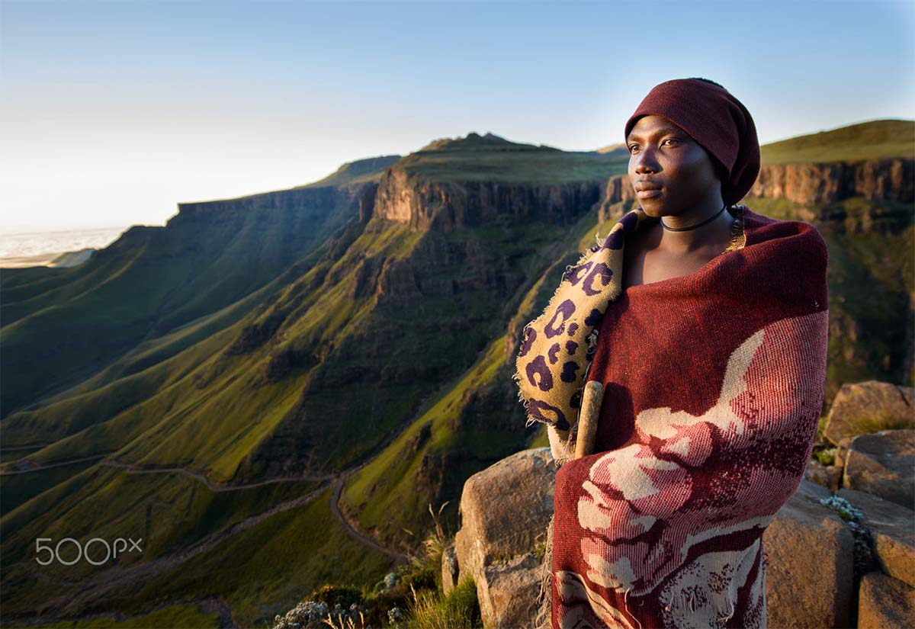
Lesotho
Contemplating sunrise
A basotho shepherd of Lesotho, overlooking Sani Pass. Drankensberg range, Lesotho
Photography © by Nicolas Marino

Slide 24
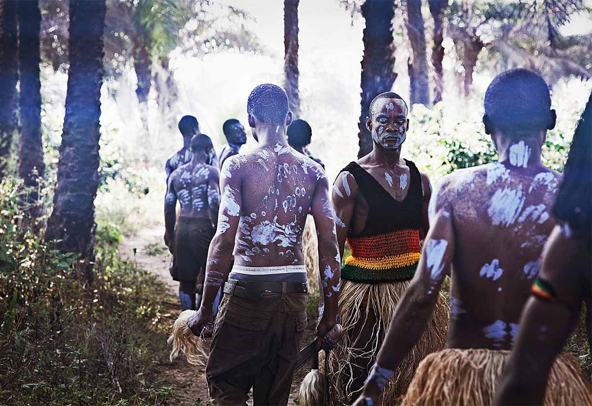
Liberia
The Dancers
Jungle dance performers in Monrovia
Photography © by Jan Wellmann on 500px

Slide 25
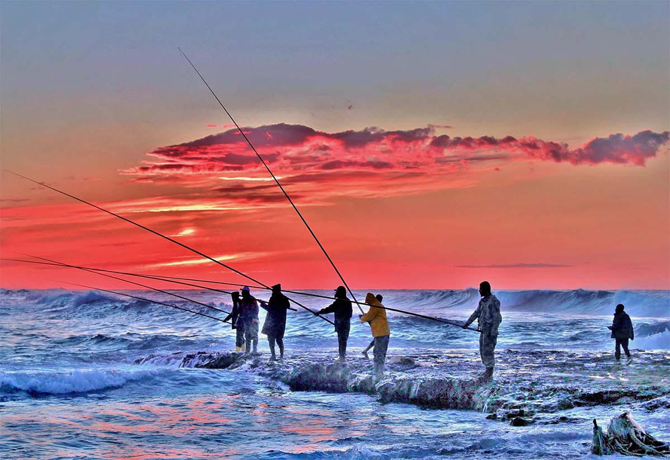
Libya
Never give up.
"Real fisherman never give up"....
Syahia area, Tripoli, Libya

Slide 26
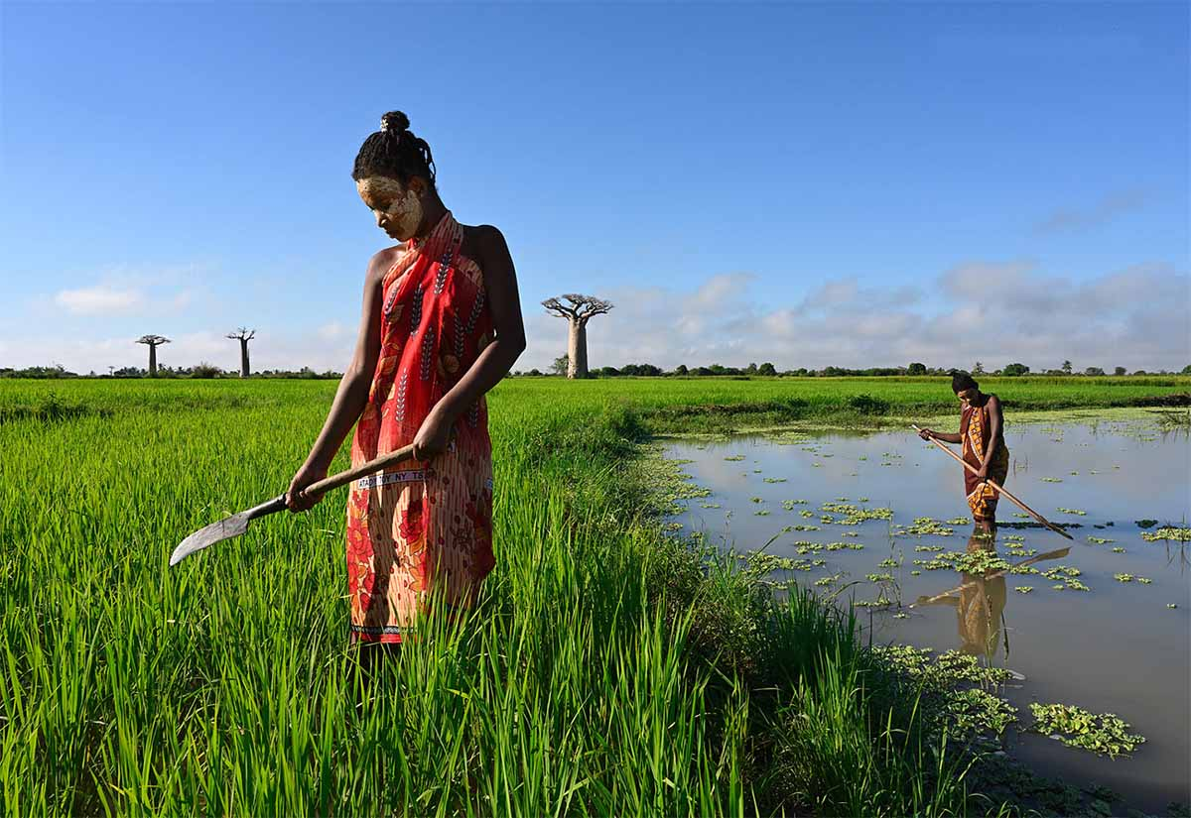
Madagascar
This was shot just after sunset in a rice field. Both girls have put yellow paint on their faces that's made from a special tree and meant to offer protection against the sun and insects, and to keep the skin in good condition.

Slide 27
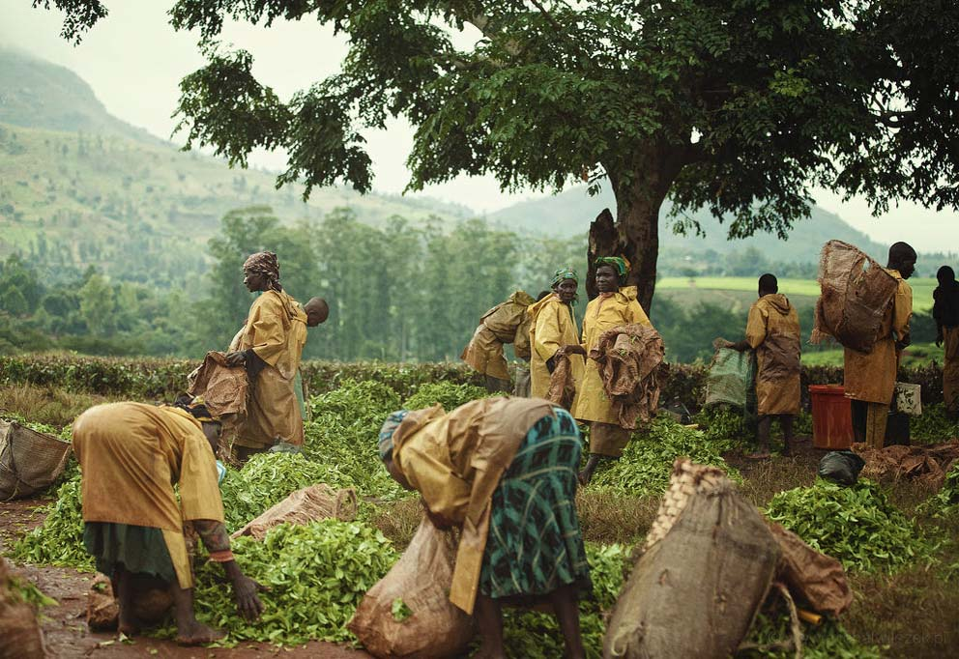
Malawi
Where tea comes from.
Lilongwe, Malawi
Photography © by Star&Ring on 500px

Slide 28
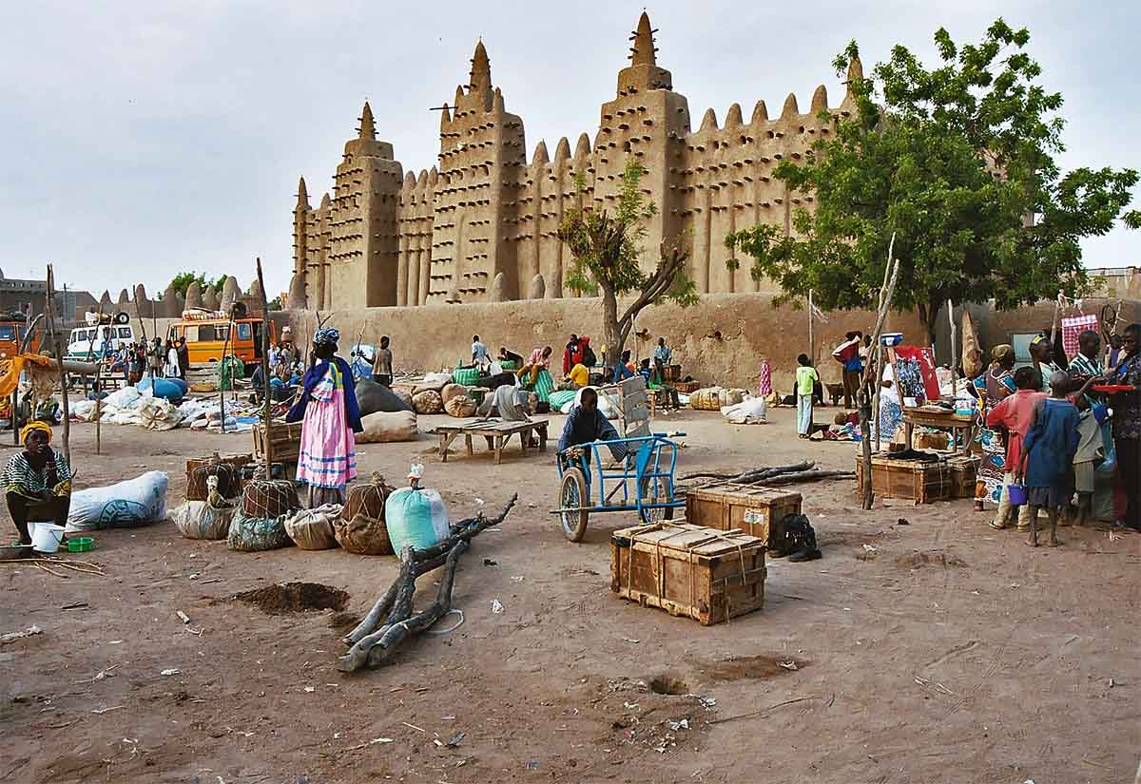
Mali
Market in Djenné, Mali

Slide 29
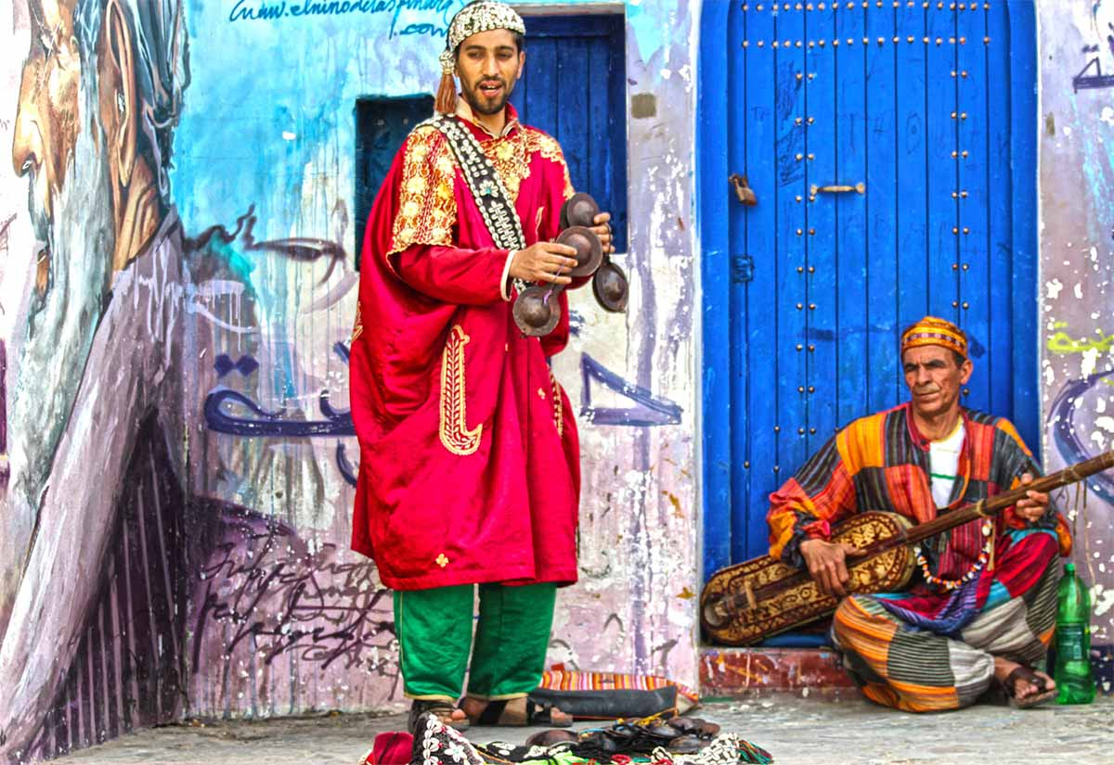
Morocco
The Gnawa people originated from North and West Africa; to be precise the ancient Ghana Empire of Ouagadougou (present day Mauritania, Senegal, Gambia, Burkino Faso and 85% of Mali (pre Gnawi/Mali Wars)).
This name Gnawa is taken from one of the indigenous languages of the Sahara desert called Tamazight. The Gnawa are an ethnic group whom, with the passing of time became a part of the Sufi order in Maghreb.
Asilah, Morocco
Photography © by Hamza Al Hajji on 500px

Slide 30
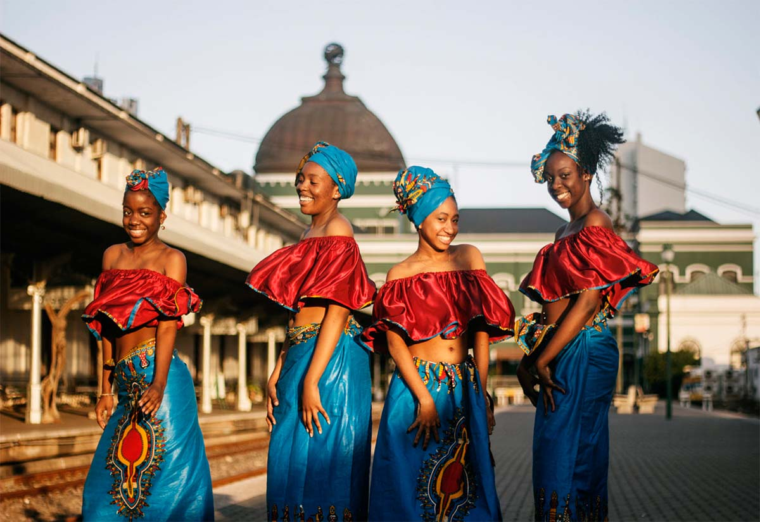
Mozambique
Dancers in Maputo, Mozambique
Photography © by silvestre suluda on 500px

Slide 31
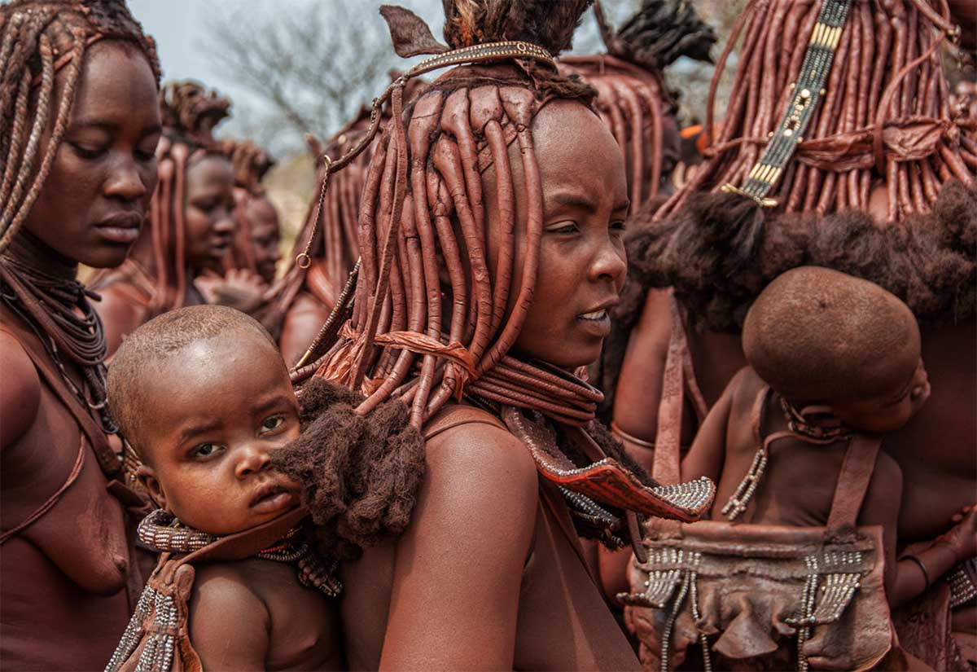
Namibia
Himba babies
Married Himba women wear headdresses with many streams of braided hair and a kind of turban made of goat leather. They carry their baby’s and young children on their back in a kind of leather baby backpack carrier.
The Himba are the last semi-nomadic tribe in Namibia. They live in the Kunene/Kaokoland region in northern Namibia near the border with Angola. They are hunters and gatherers and they breed cattle, sheeps and goats but also farm some crops.
Women and girls perform more labor-intensive work than men and boys. The men's main task is herding the livestock.
Photography © by Stefan Cruysberghs on 500px

Slide 32
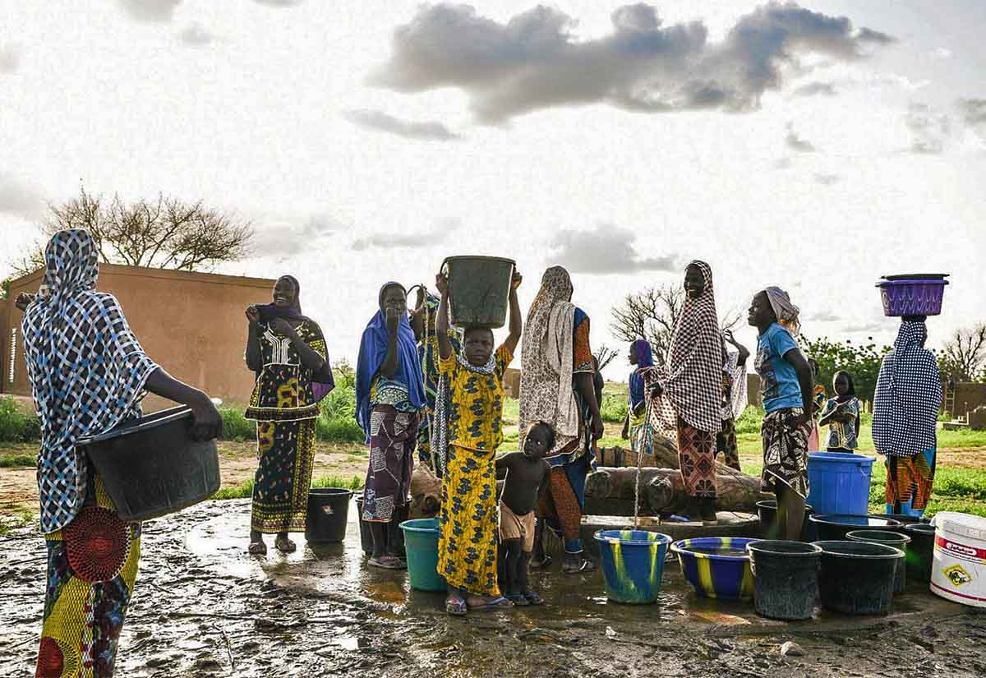
Niger
Appointment at the water fountain.
Photography © by Jinwon Suh

Slide 33
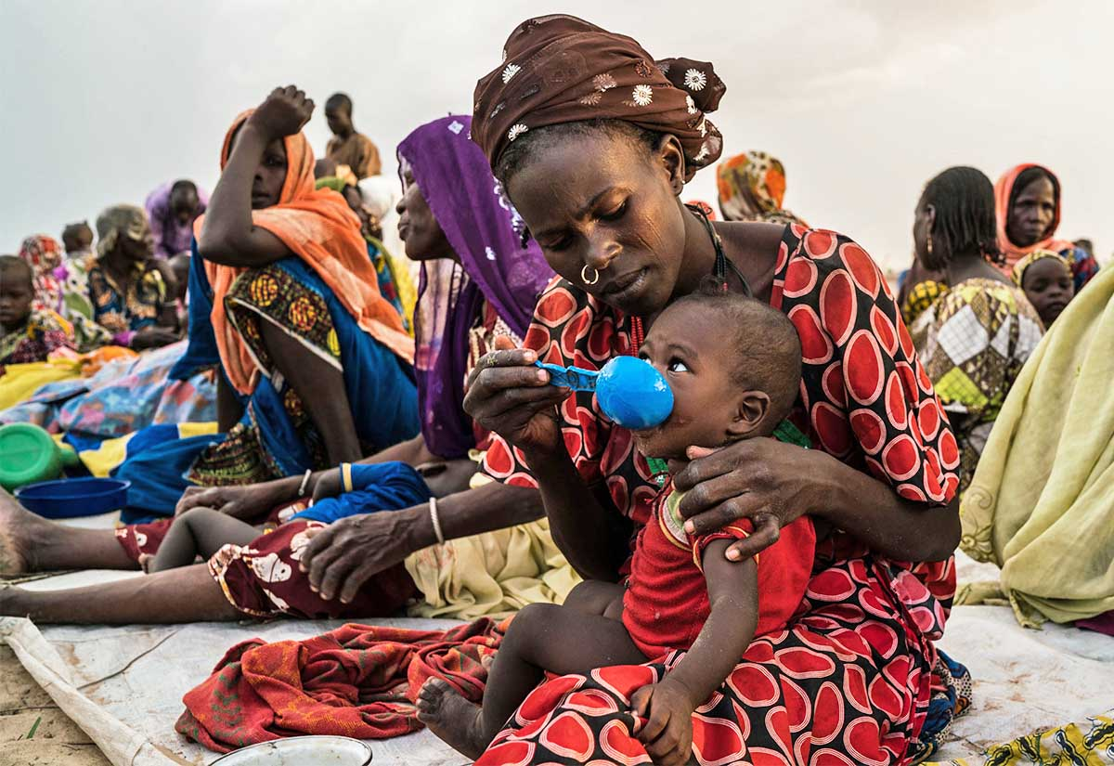
Nigeria
Mothers with children

Slide 34
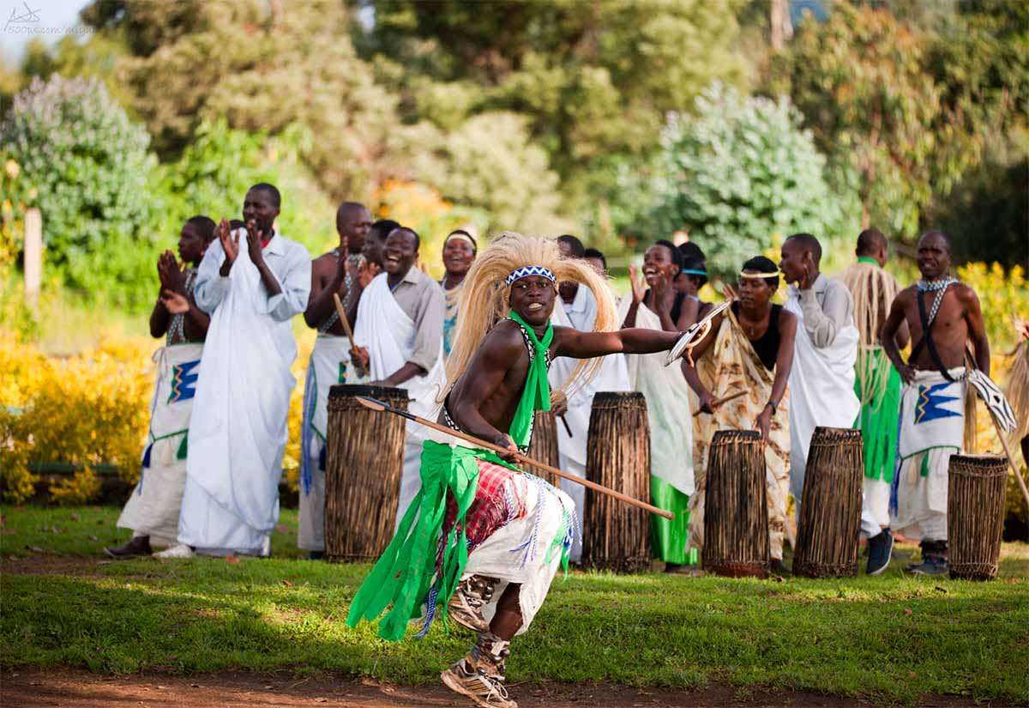
Rwanda
Intore dancers performing a tribal dance in the Gorilla's Trekking starting point. Ruhengeri, Rwanda
Photography © by Miguel Rodríguez on 500px

Slide 35
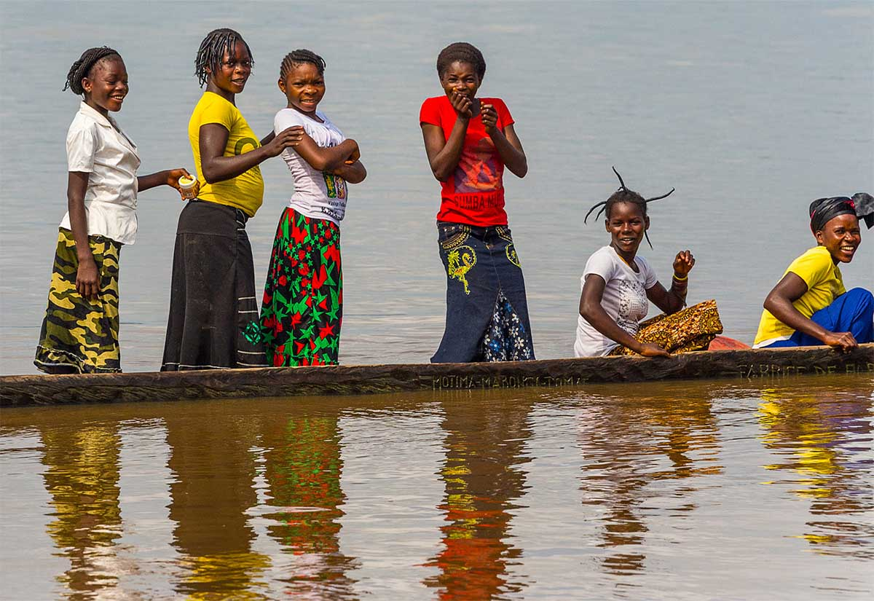
Republic
of the Congo
Six girls in one boat.
Photography © by John Downey on 500px

Slide 36
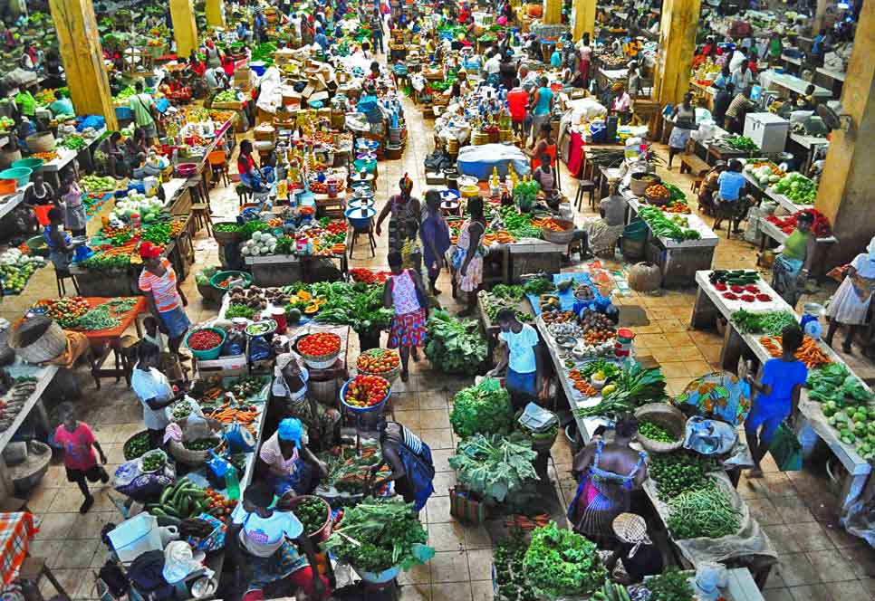
São Tomé
and Príncipe
The market in São Tomé, capital city of Sao Tome and Principe, second smallest country in Africa.
Photography © by Ricardo Ribeiro on 500px

Slide 37
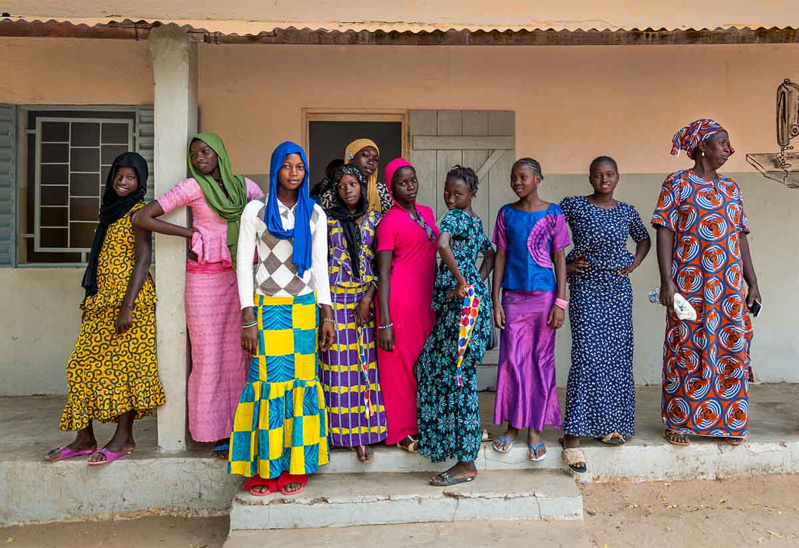
Senegal
Young models and their cook, M'bour, Senegal
Photography © by Stefan Radi on 500px

Slide 38
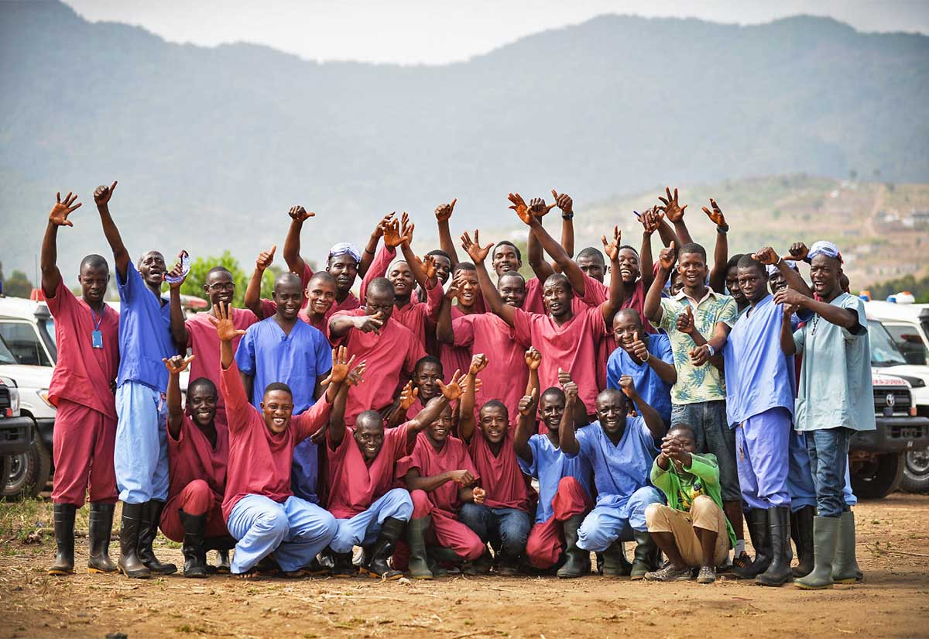
Sierra Leone
Drivers and Decontamination Team staff from the Hastings Decontamination Centre in Sierra Leone.
The Hastings Decontamination Centre is responsible for the cleaning of vehicles and ambulances used in the fight against ebola. The sight is also used to conduct building decontamination training and acts as a depot for the ambulance drivers.
The Hastings Decontamination Centre is located approximately Thirty minutes South East of Freetown in Sierra Leone.
Photography © by Paul Shaw on 500px

Slide 39
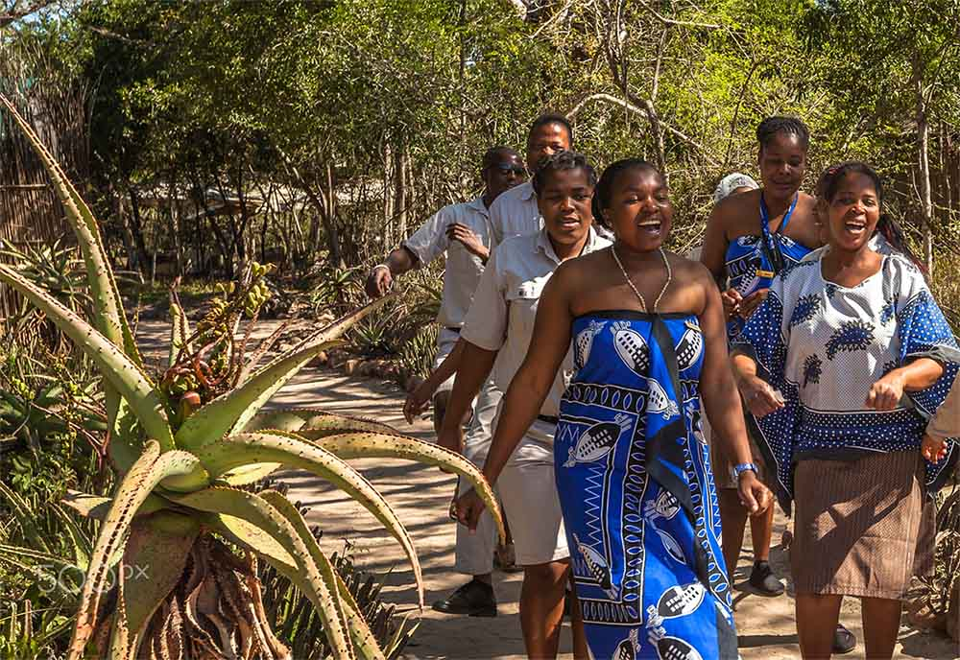
South Africa
Tembe Elephant Park: accommodation staff singing a folk song while dancing welcoming visitors. Tembe is a remote park near Mozambique, home to largest African elephants.
Photography © by Alberto Mazza

Slide 40
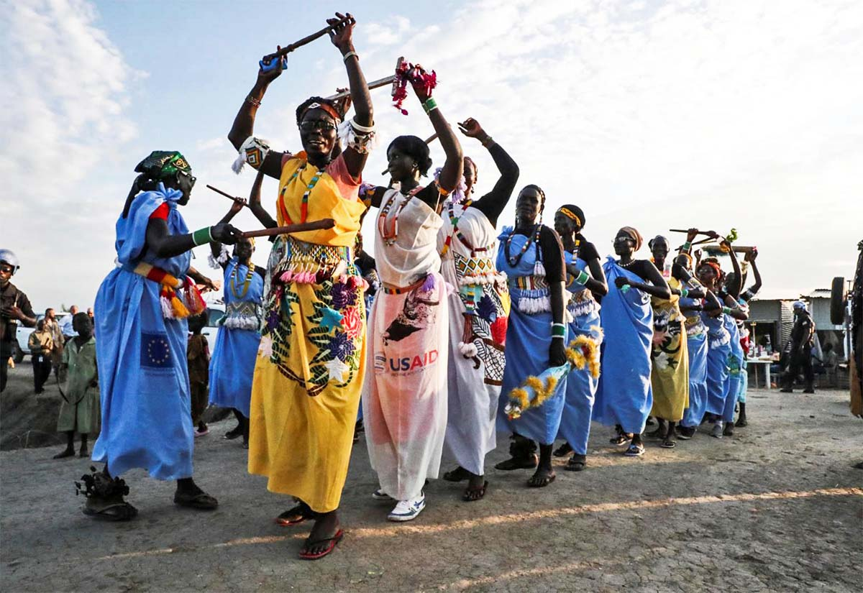
South Sudan
Thanks for helping ...

Slide 41
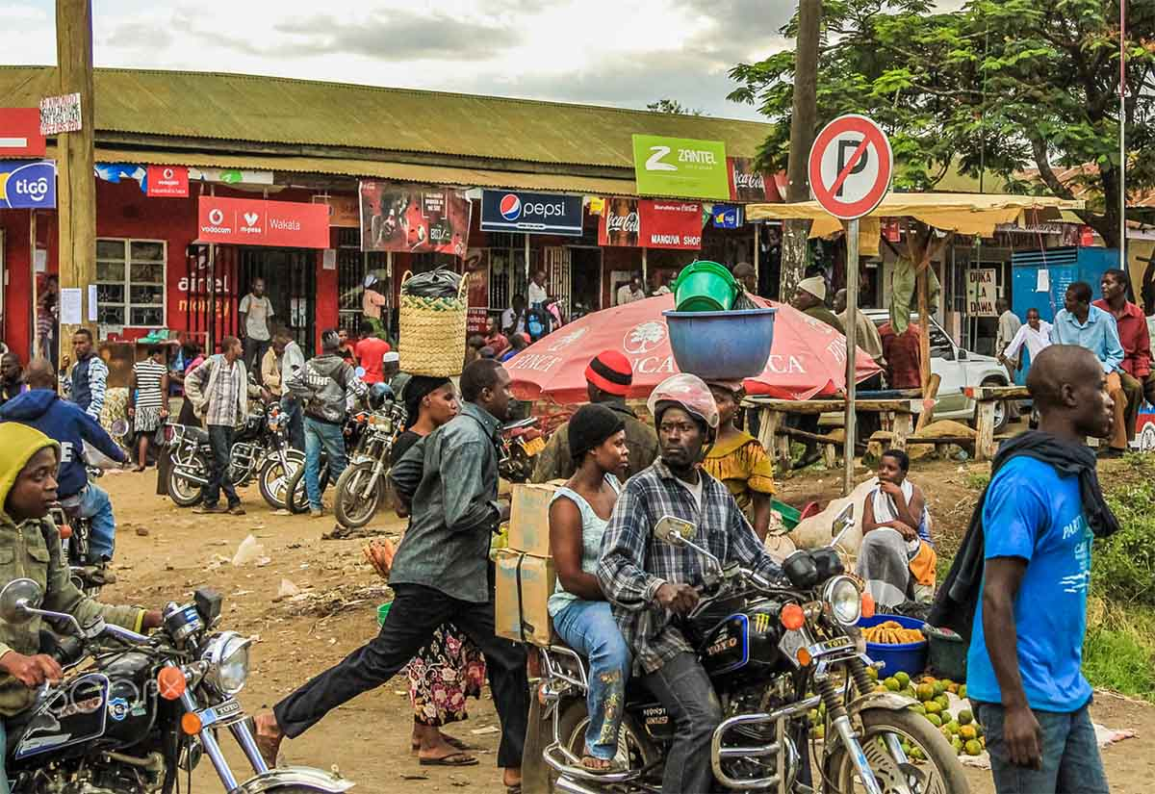
Tanzania
Arusha Town: A group of bikes parked in front of the local shops..
Lack of transports in the area, force the people.
Photography © by Alberto Mazza on 500px

Slide 42
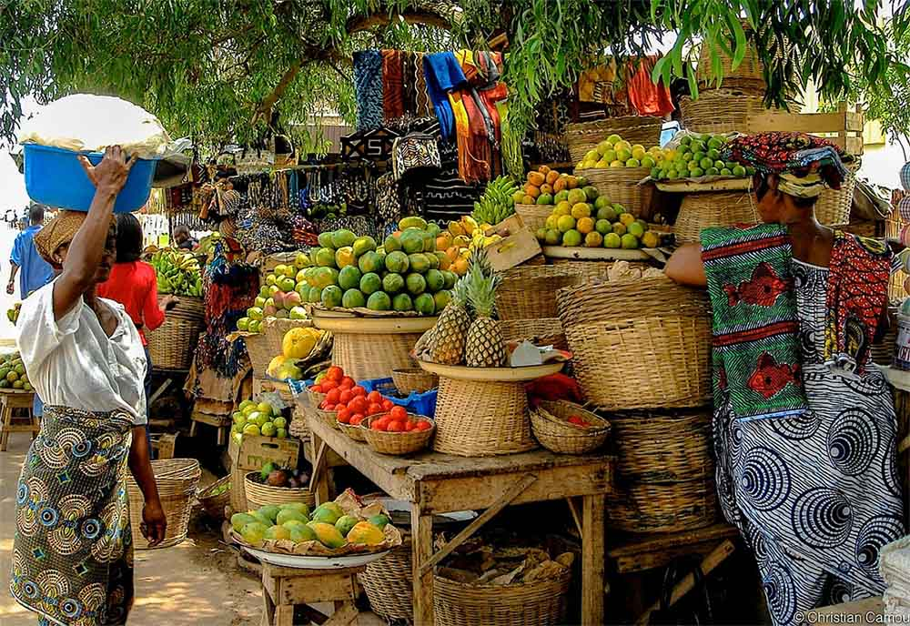
Togo
Market in Lomé, Togo

Slide 43
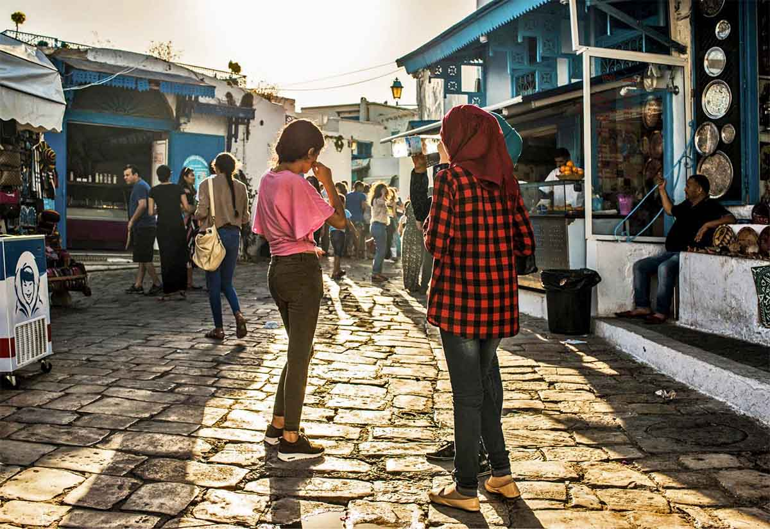
Tunisia
Walk in Tunisia
Photography © by Patrick Petitjean on 500px

Slide 44
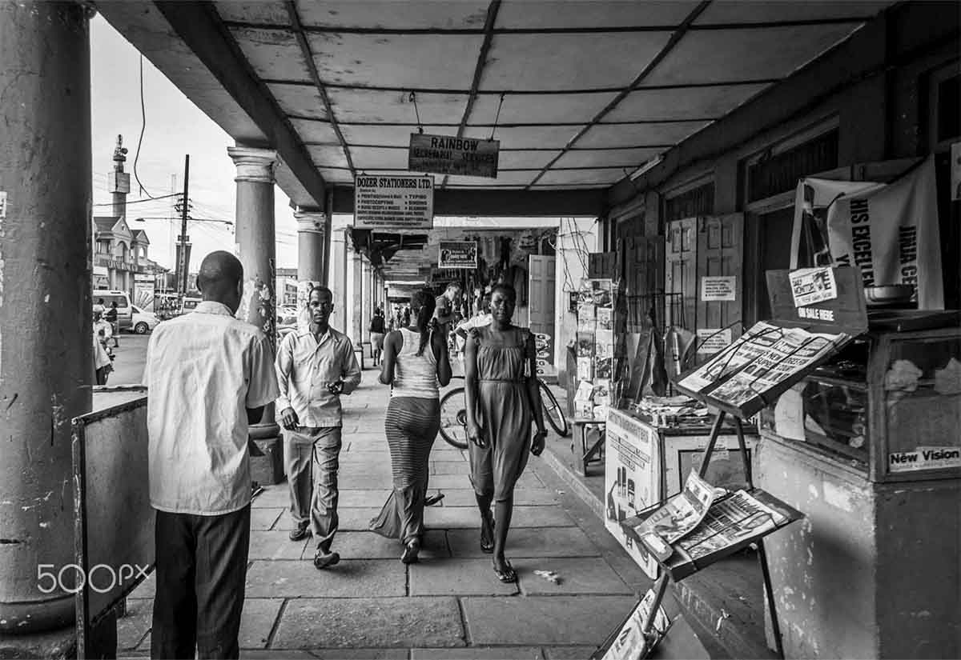
Uganda
Candid
A street scene in Uganda's eastern town of Jinja.
Photography © by Owach Manshur on 500px

Slide 45
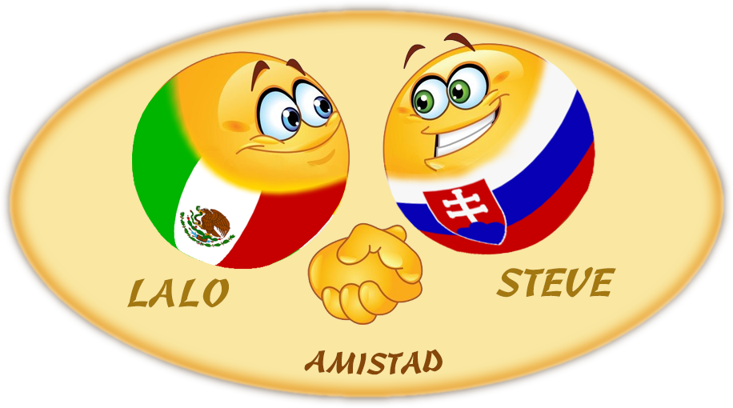



Thanks for your interest
and see you soon...
Lalo from Mexico
Steve from Slovakia

Slide 46







¿Te ha gustado?
Puedes ver más entrando
Aquí
Además puedes recibir powerpoints en tu correo electrónico suscribiéndote aquí:

