Slide 1


KERALA
Kerala, historically known as Keralam, is an Indian State in South India on the Malabar coast. It was formed on 1st November 1956 following the States Re-organisation Act by combining Malayalam-speaking regions. Spread over 38,863 km² (15,005 sq mi), it is bordered by Karnataka to the north and northeast, Tamil Nadu to the east and south and the Lakshadweep Sea to the west. With 33,387,677 inhabitants as per the 2011 Census, Kerala is the thirteenth-largest state by population and is divided into 14 districts with the capital being Thiruvananthapuram. Malayalam is the most widely spoken language and is also the official language of the state. The Government is actively advertising the State as “God’s Own Country”.
It is one of the best adventure destination for the world traveller with many unique places to visit. For a tour of this State, in addition to any tour operator’s itinery, please feel free to stop at a brook or water stream during your taxi or van trip to have the feel of nature’s unspoilt country feel. One advise I used to tell my friends is to come to Alleppey City and hop into any of the Kerala State Water Transport Boats which ply upto Changanassery. Oh yeah just watching the life of people along the rivers, canal banks and the scenery is enough to enable one to have a unique peaceful experience of Kerala.
a special compilation by
TONY CHACKO
tonychacko2000@gmail.com

Slide 2
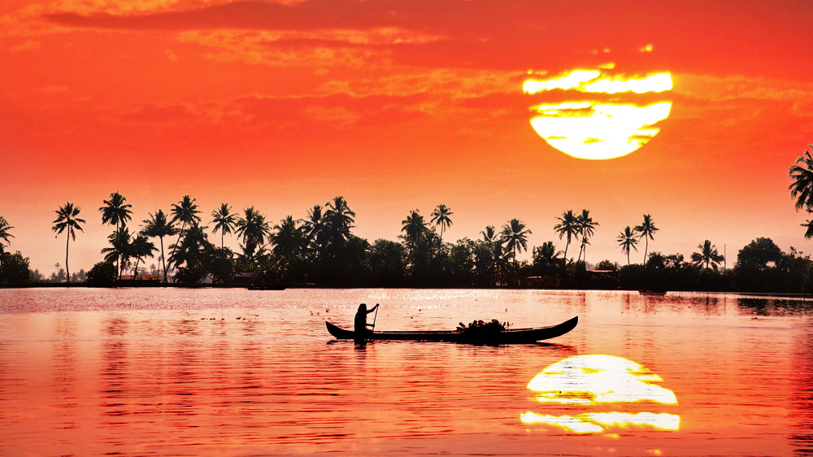
A spell binding sunset along the backwaters of Alleppey in Kerala.

Slide 3
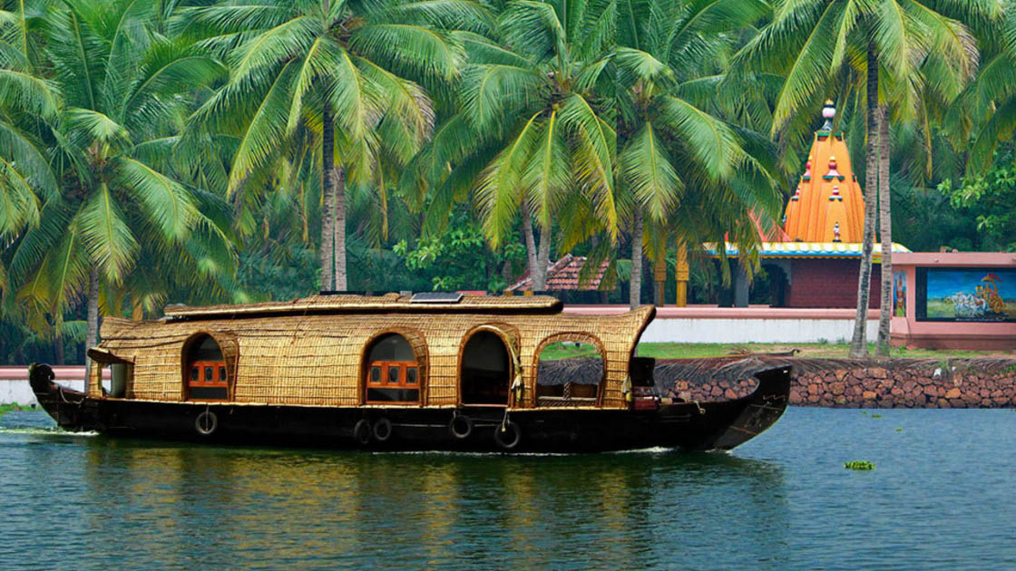
Cruising through the rivers of Kumarakom in Kottayam, Kerala

Slide 4
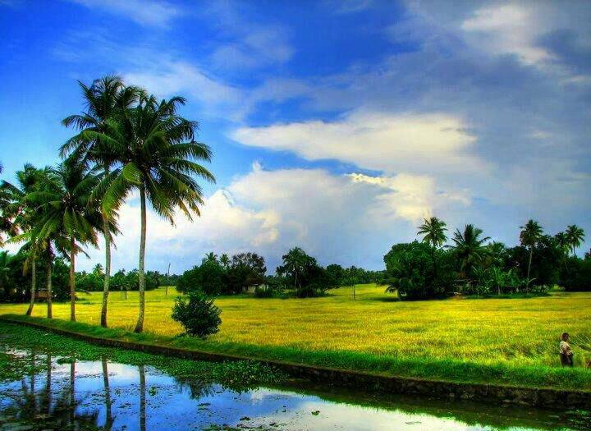
Kuttanad in Alleppey – It’s scenic paddyfields.

Slide 5
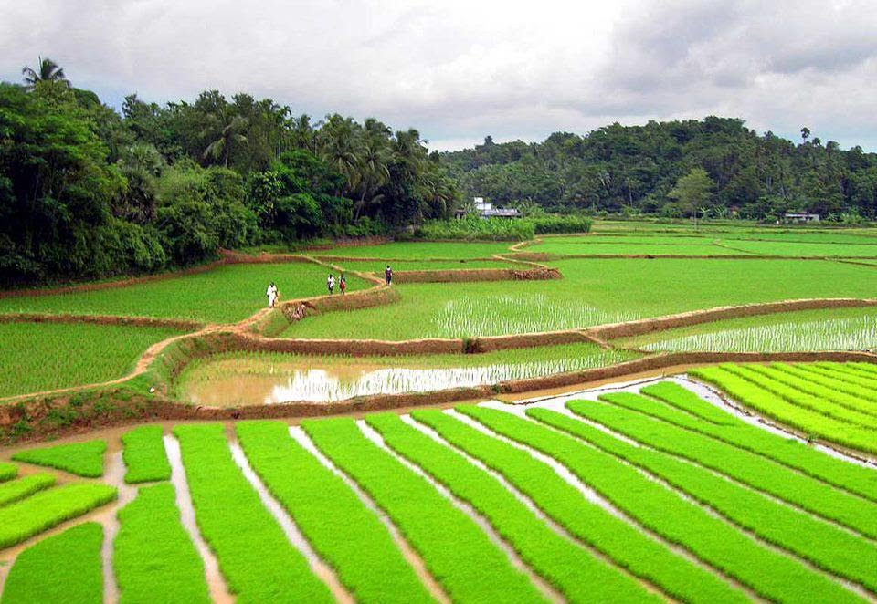

Slide 6
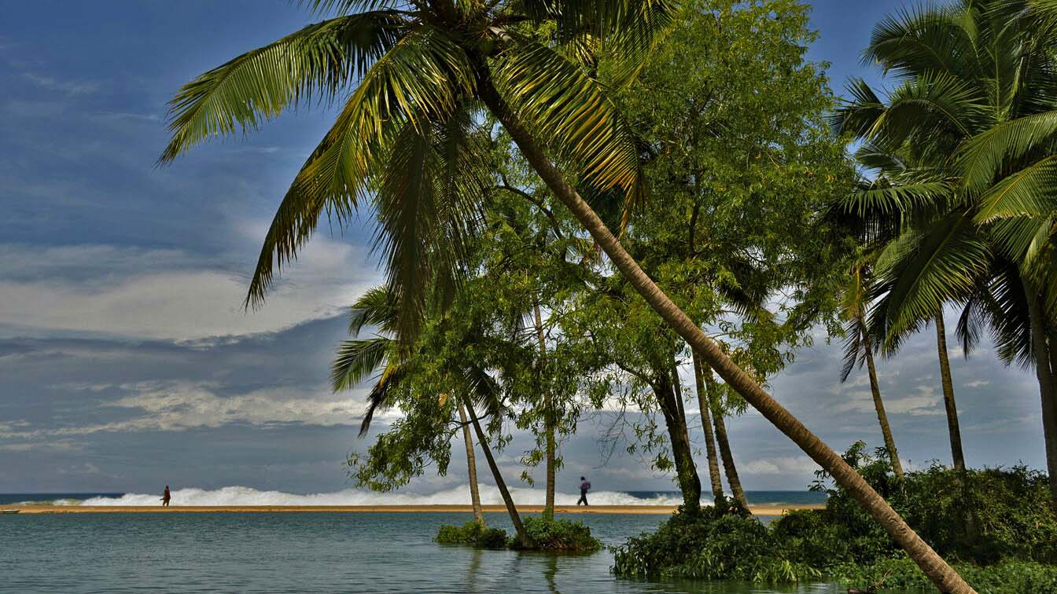
Beaches of Poovar Island Estuary Resort

Slide 7
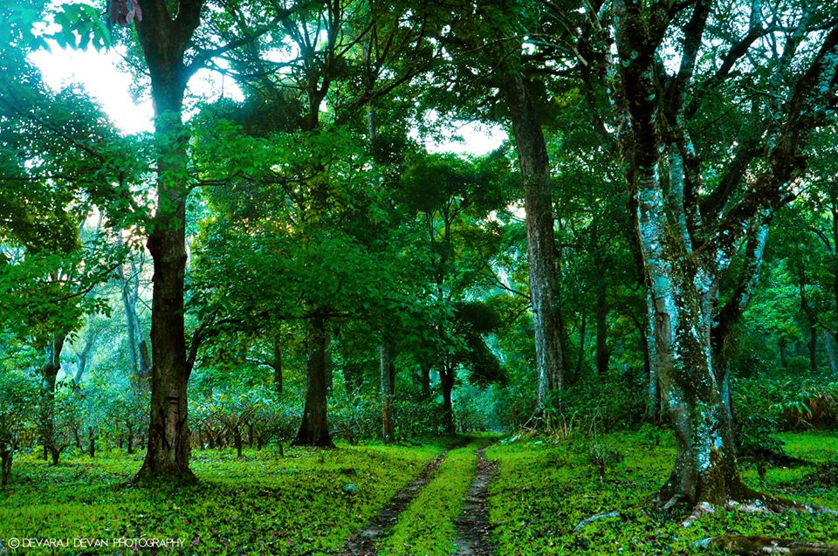
Pampadum Shol Forest Drive, Munnar, Kerala

Slide 8
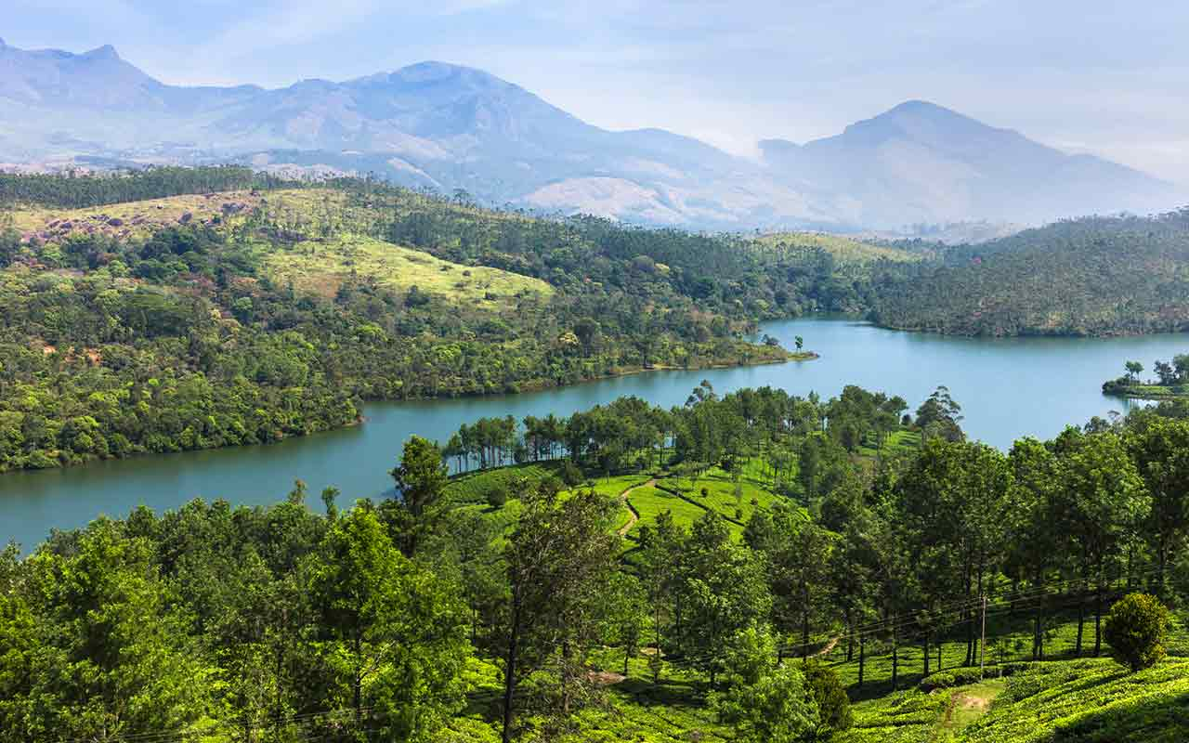
Munnar Naturescape

Slide 9
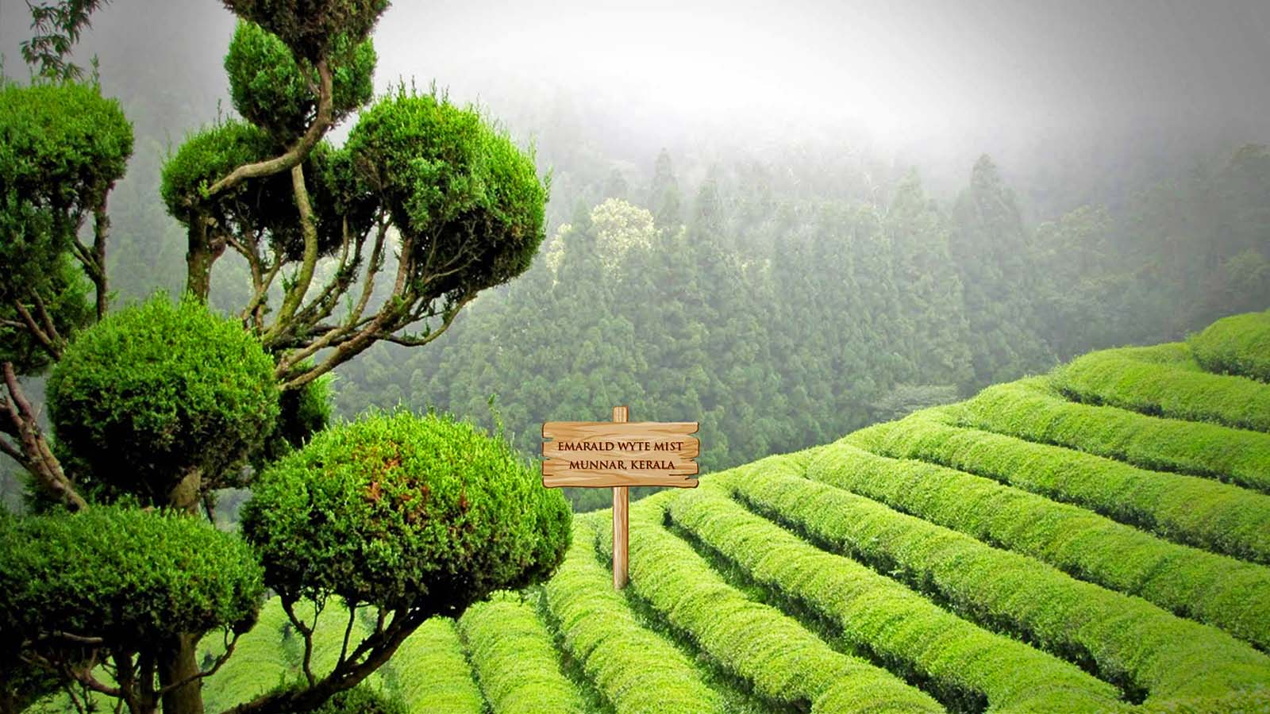

Slide 10
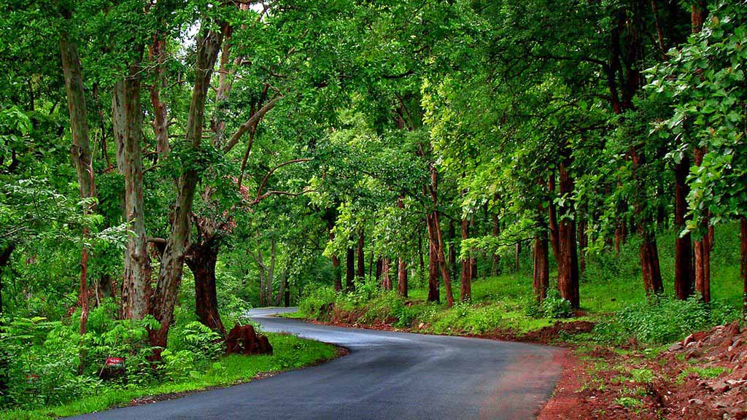
Wayanad Wildlife sanctuary, Tholpetty

Slide 11
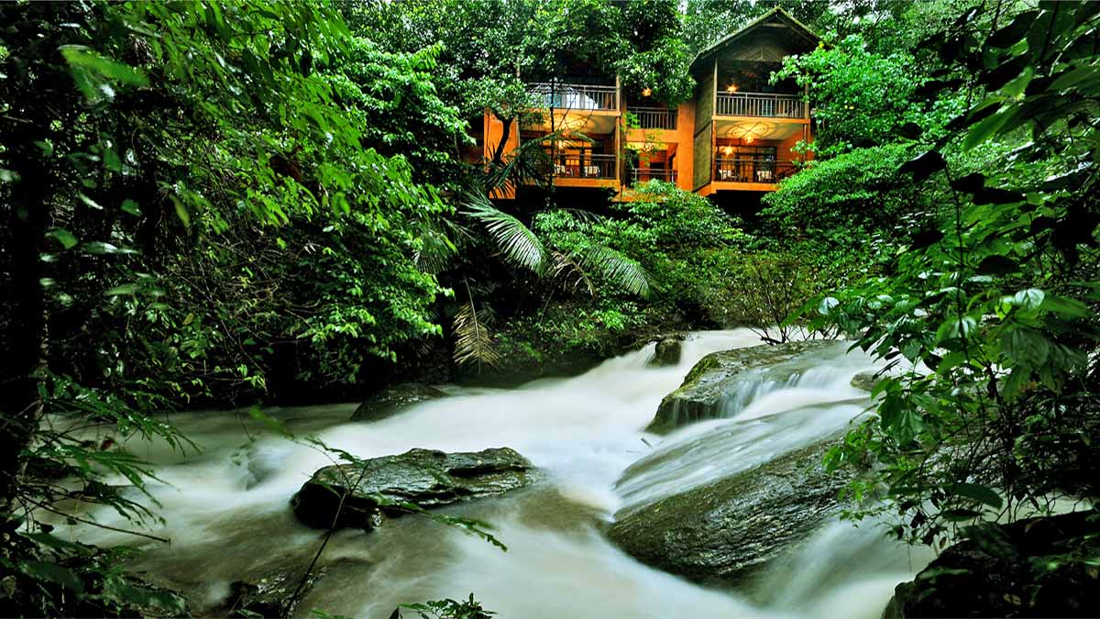
The Vythiri Resort within the forest of Wayanad.

Slide 12
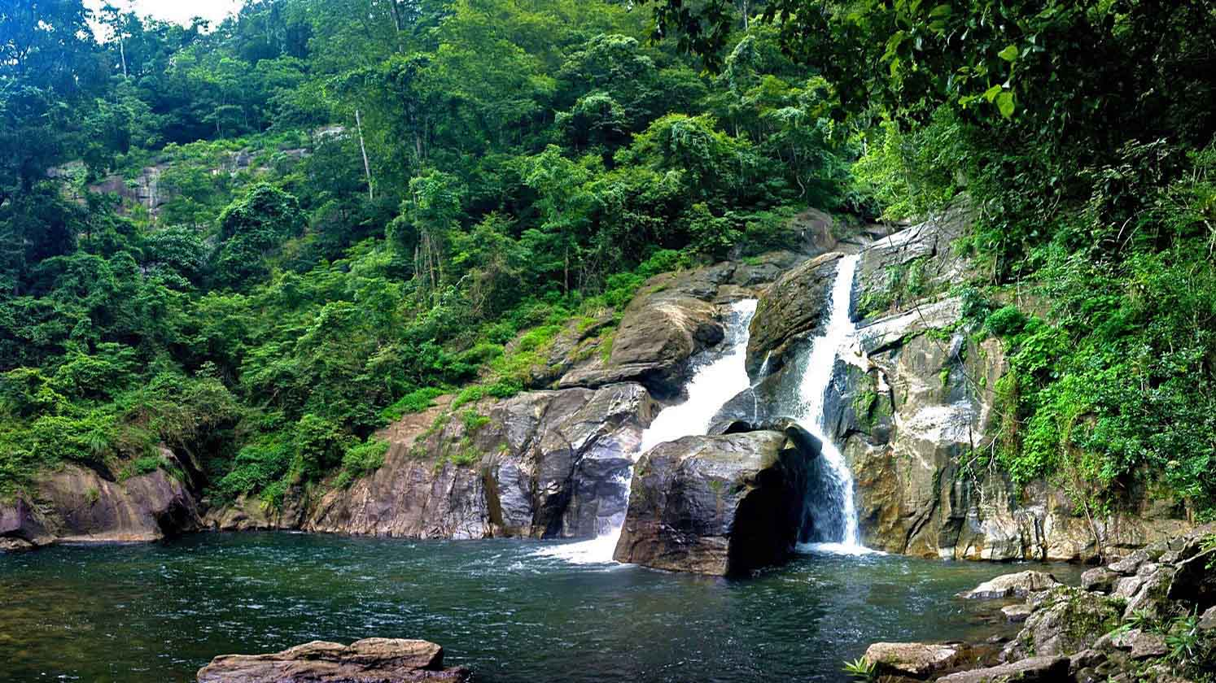
A waterfall near Wayanad

Slide 13
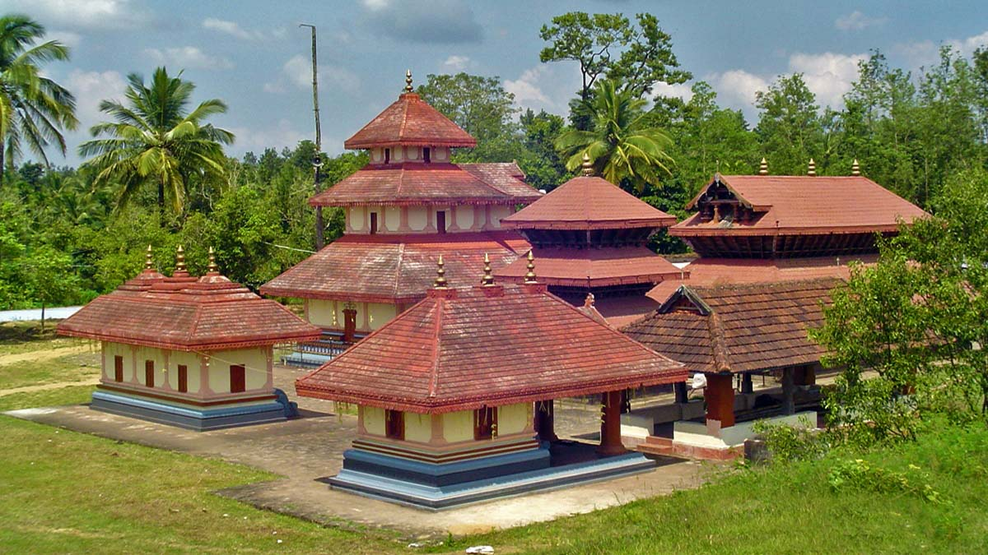
Seetha Lava-Kusha Temple, Kalpetta, Wayanad

Slide 14
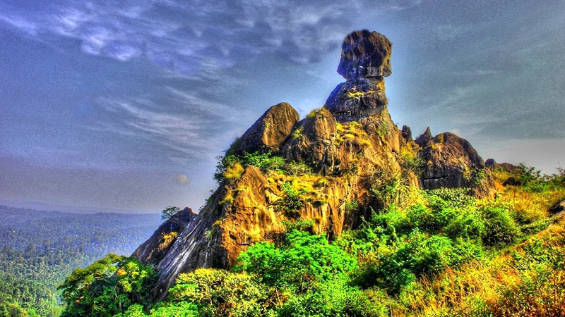
Phantom Rock at Wayanad

Slide 15
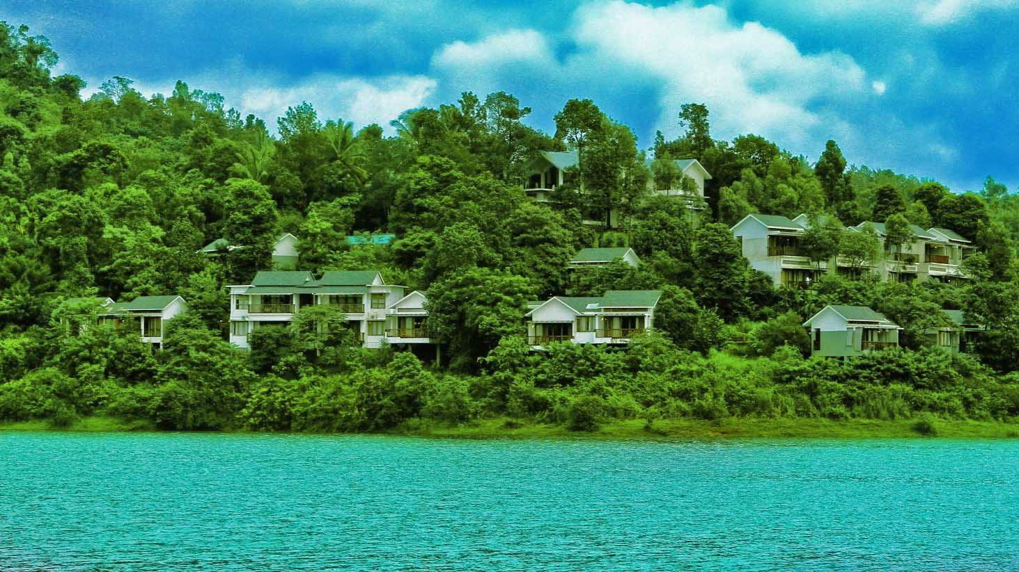
Silverwood Riverside Resorts, Wayanad

Slide 16
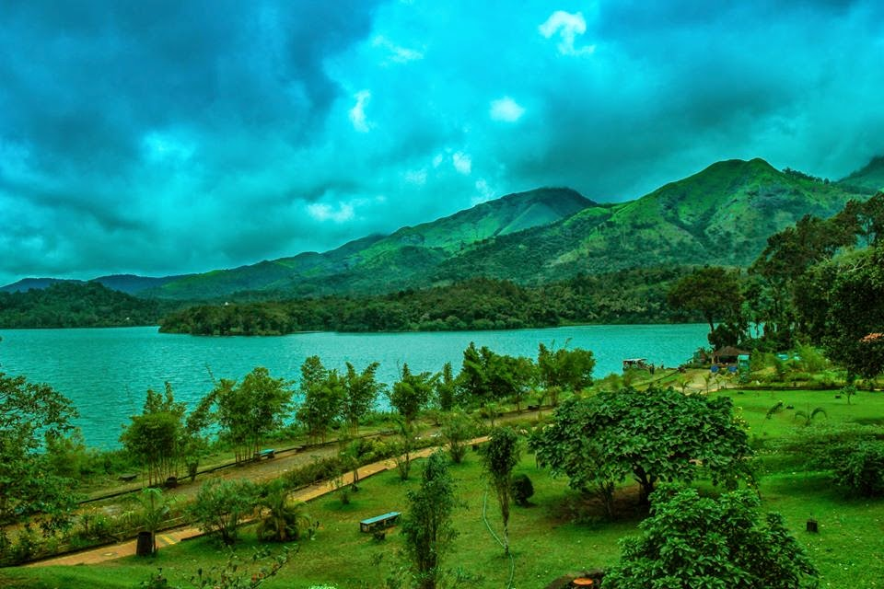
Banasura Sagar Dam, Wayanad

Slide 17
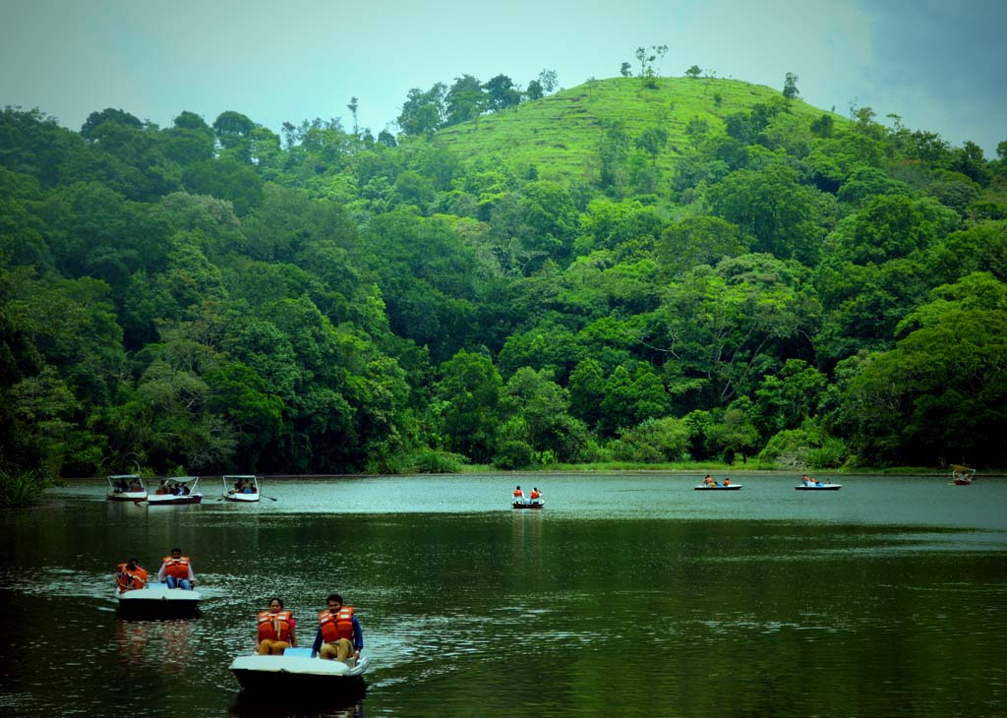
Pukkote Lake in Wayanad

Slide 18
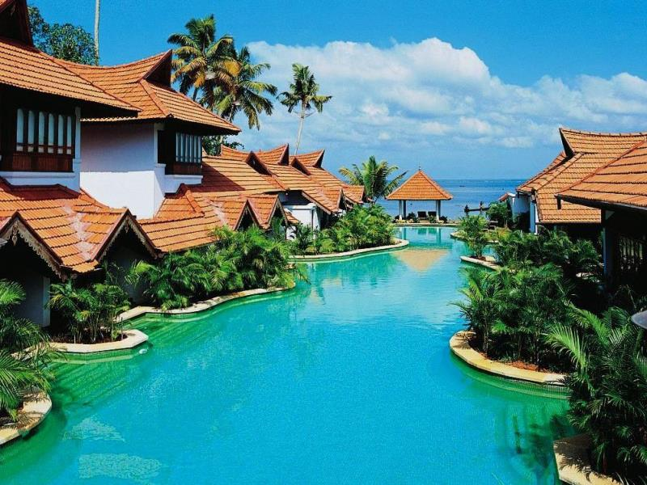
The World Class Kumarakom Lake Resort Hotel in Kottayam

Slide 19
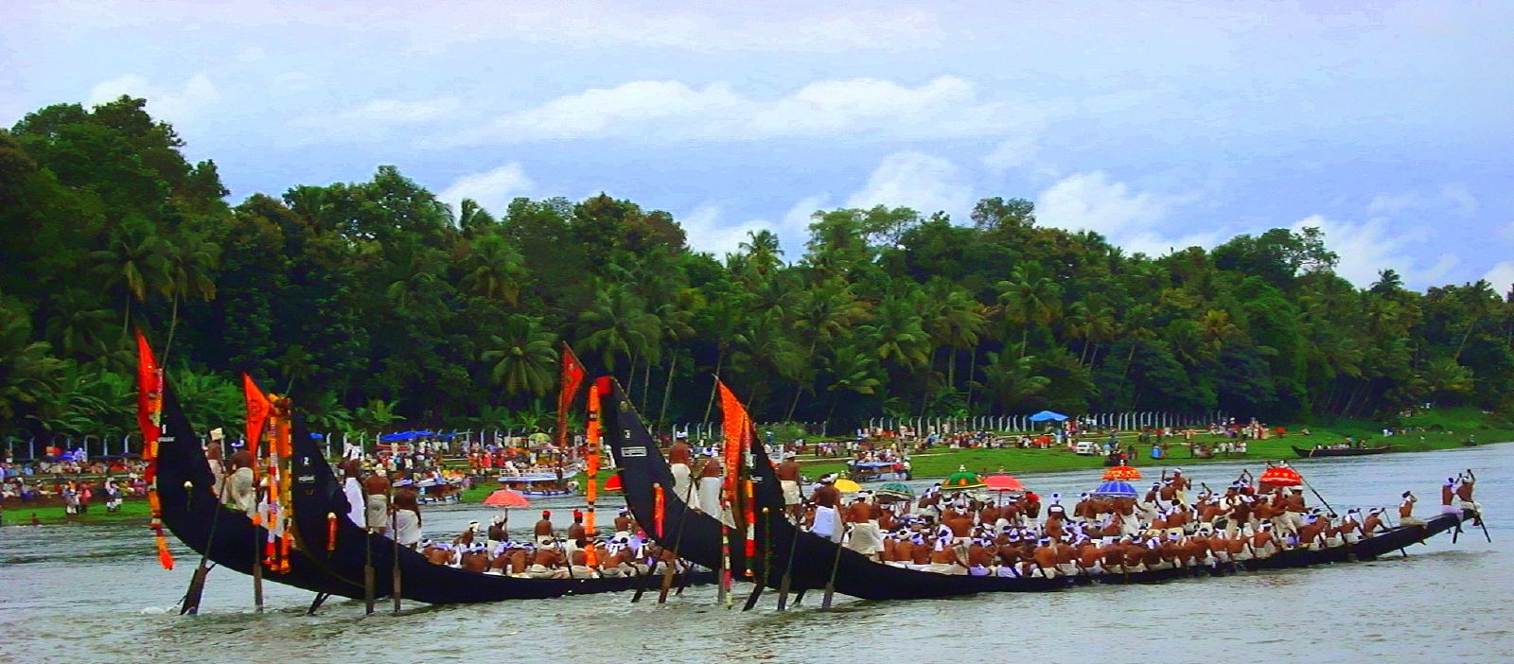
The famous Nehru Snakeboat Race at the Punamada Lake near Alleppey.

Slide 20
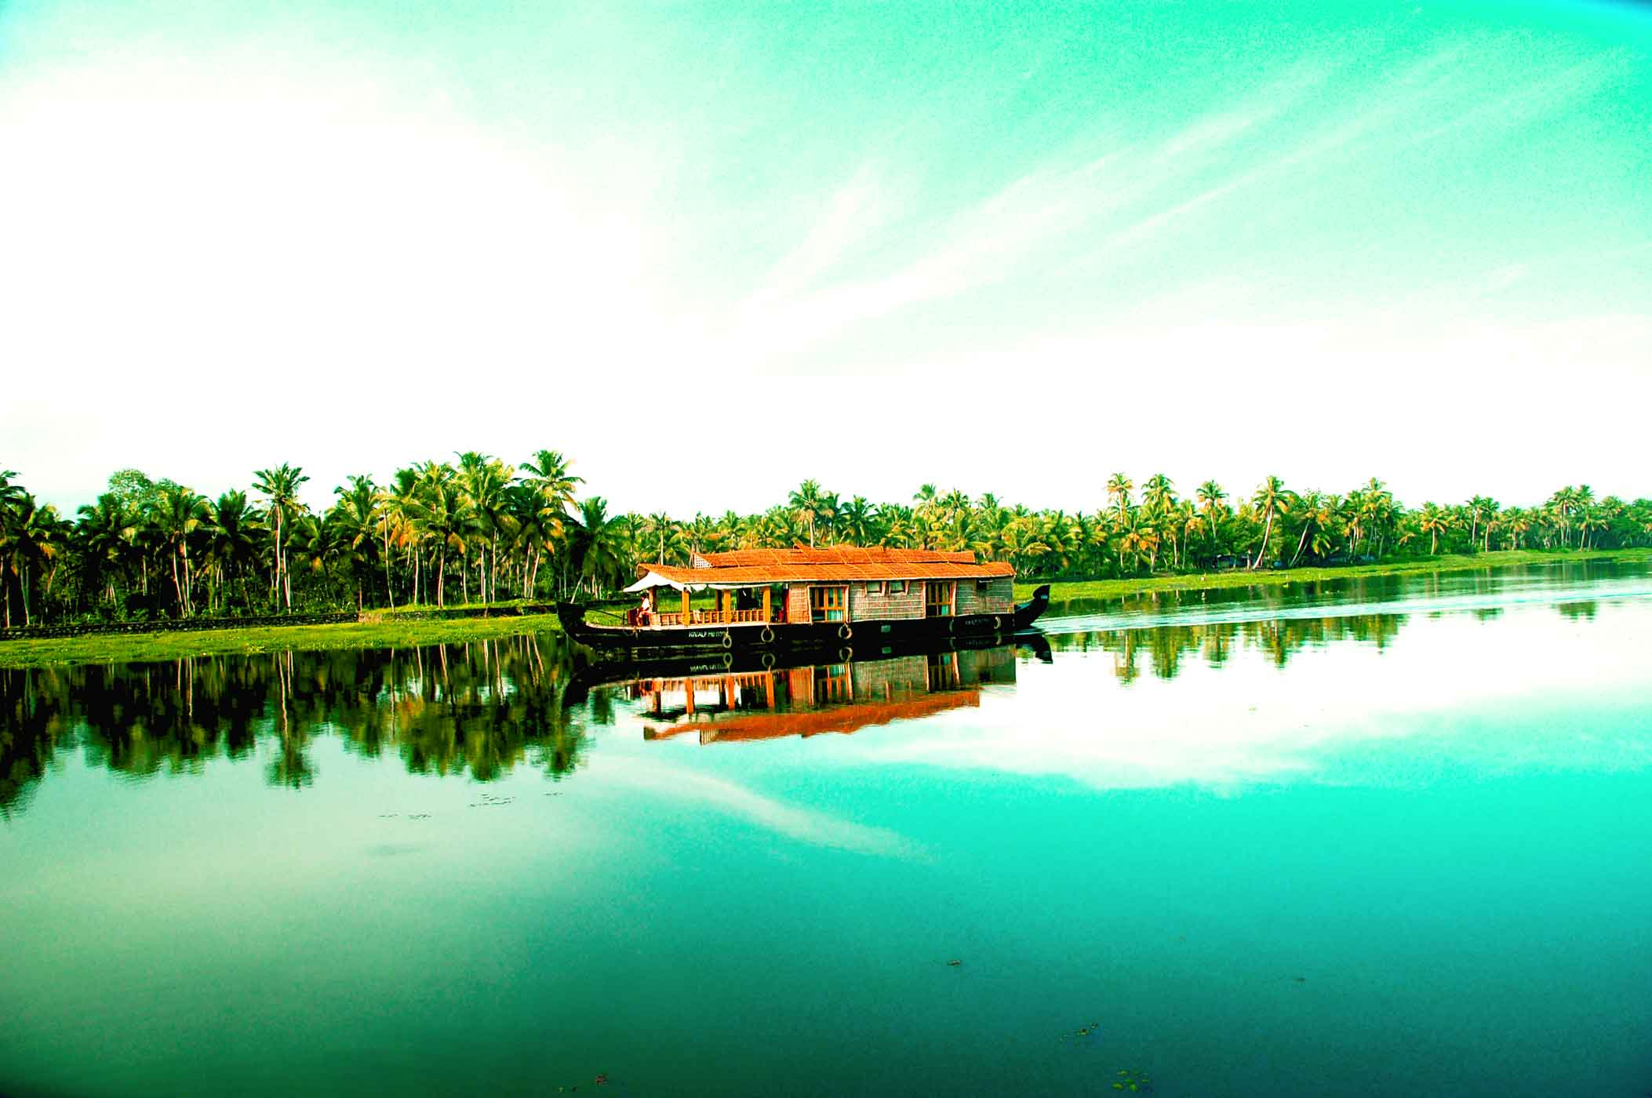
Cruising through the backwaters of Alleppey in a private houseboat.

Slide 21
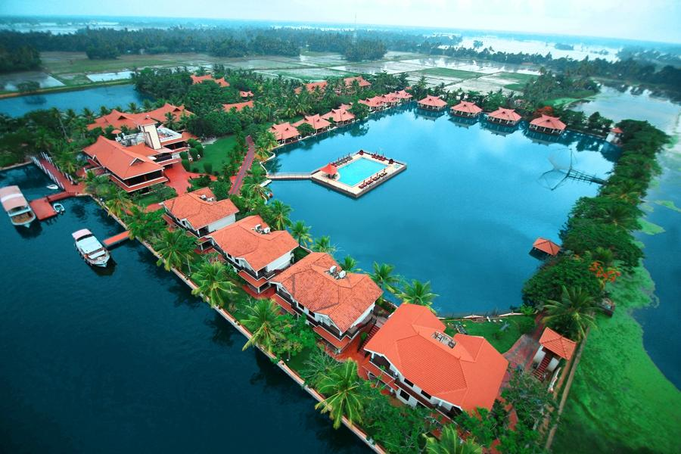
The Lake Palace Resort in Alleppey

Slide 22
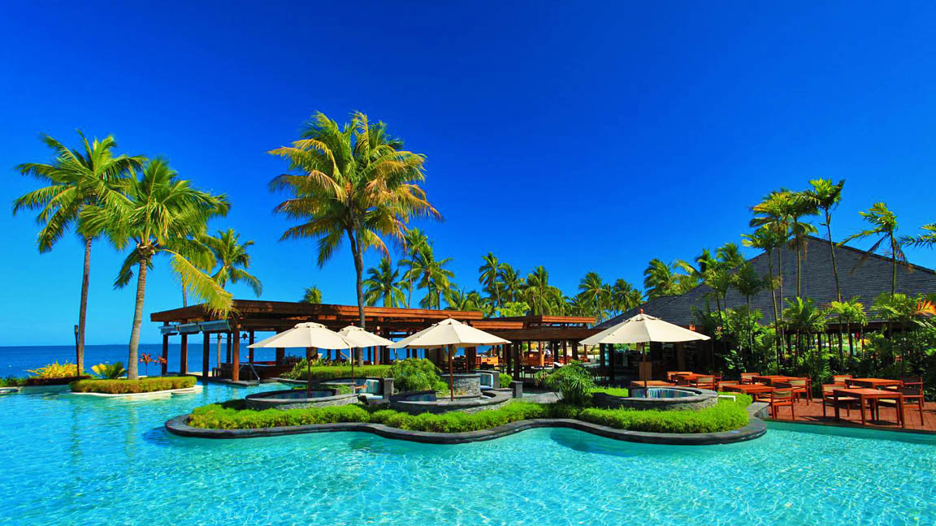
A Luxury Resort in Cochin

Slide 23
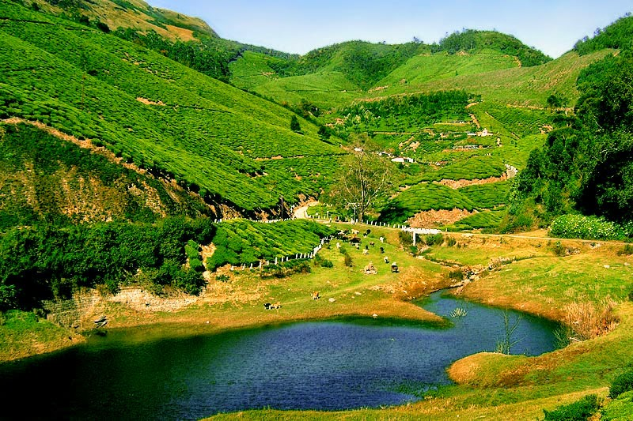
Aryakavu Village, Kollam

Slide 24
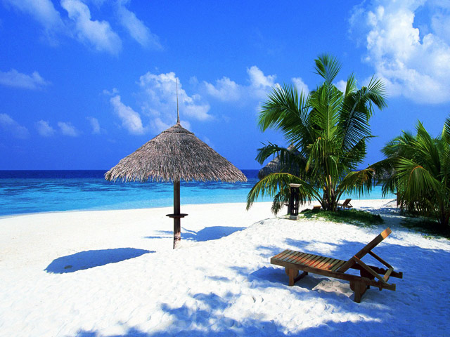
The Marari Village Beach in Alleppey

Slide 25
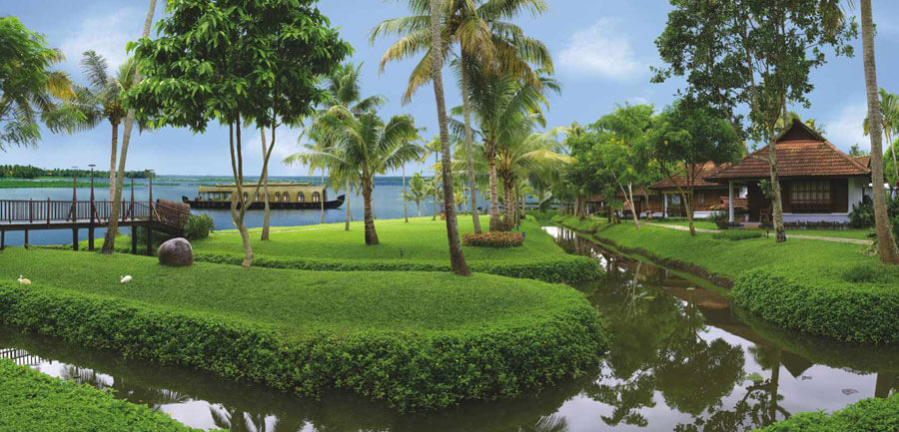
Lake Resort at Kumarakom near Kottayam

Slide 26
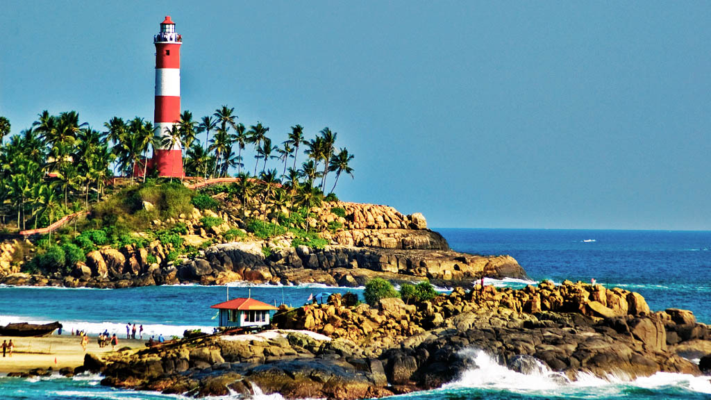
Kovalam Beach near Thiruvananthapuram

Slide 27
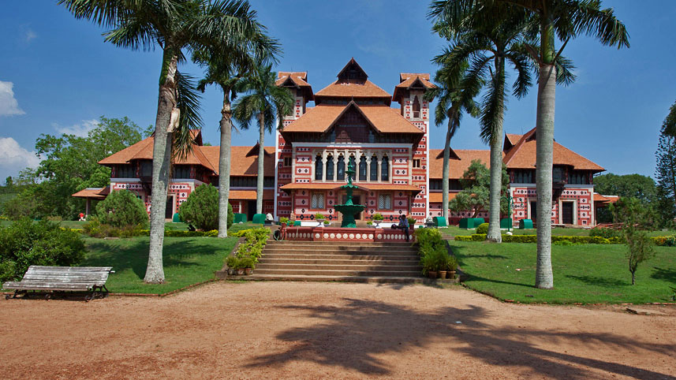
Famous Napier Museum in Thiruvananthapuram

Slide 28
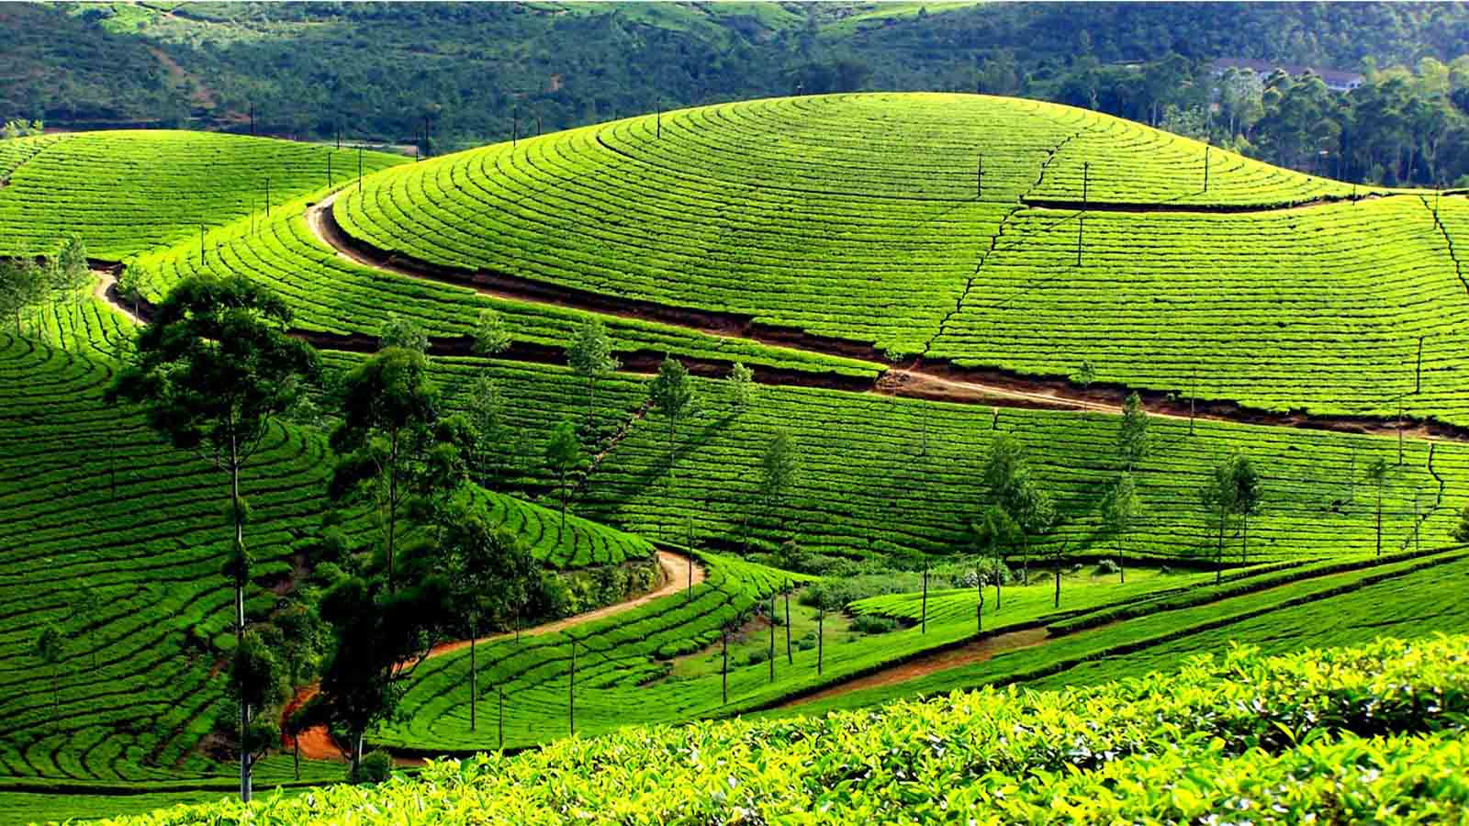
Tea Estates of Munnar, Kerala

Slide 29
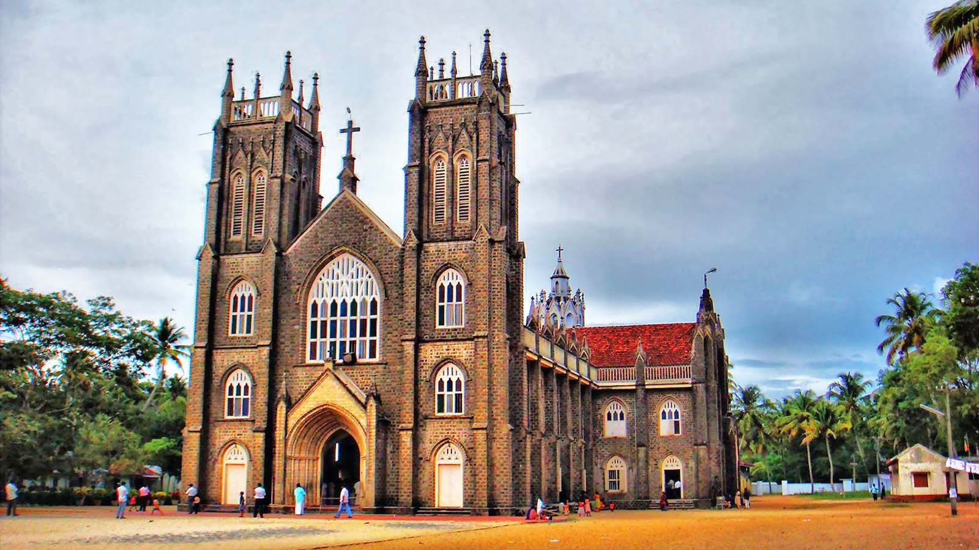
St. Andrew’s Basilica, Arthunkal, near Cochin

Slide 30
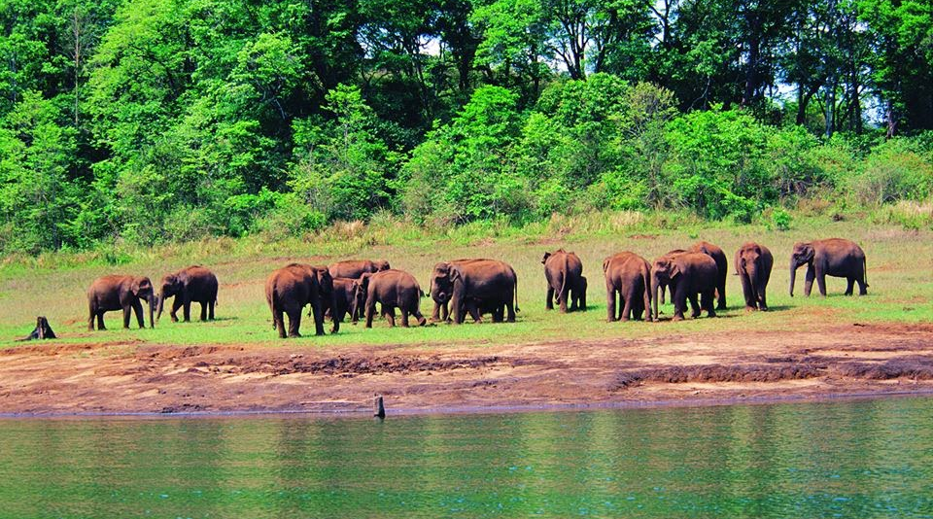
The Wildlife Reserve of Thekkady

Slide 31
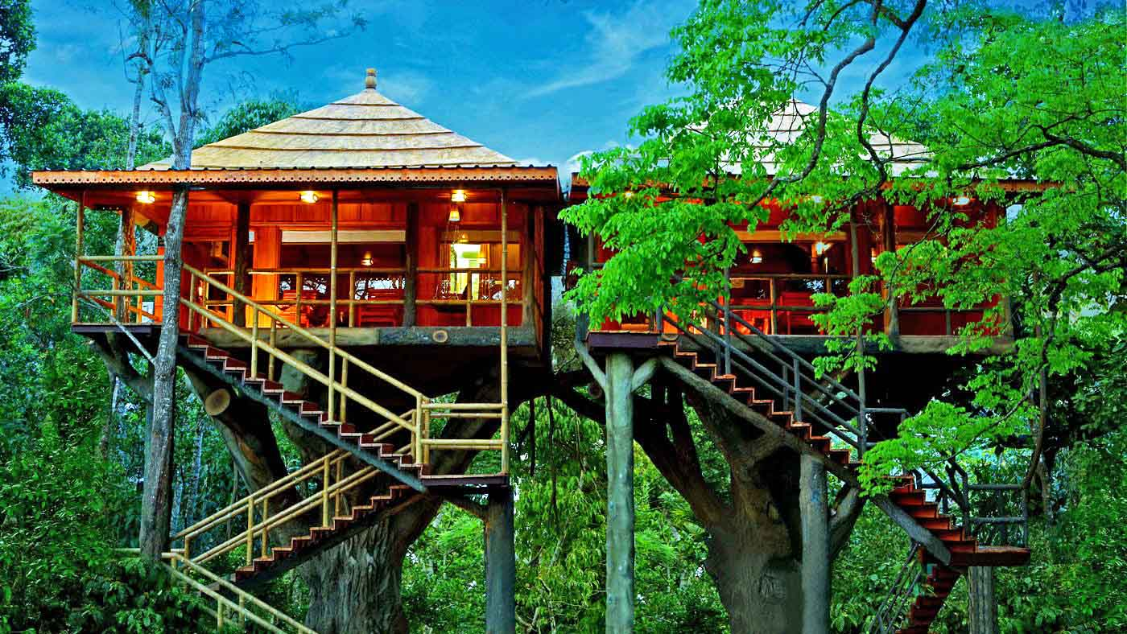
The Rangerwood Tree House Resort of Thekaddy

Slide 32
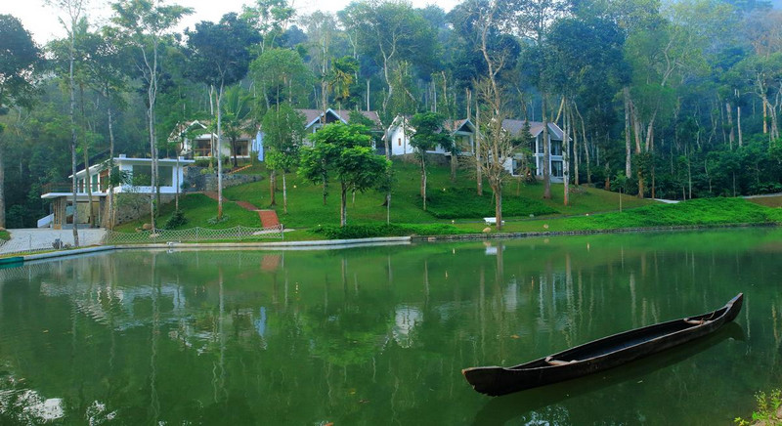
The Aamana Plantation Resort in Thekaddy

Slide 33
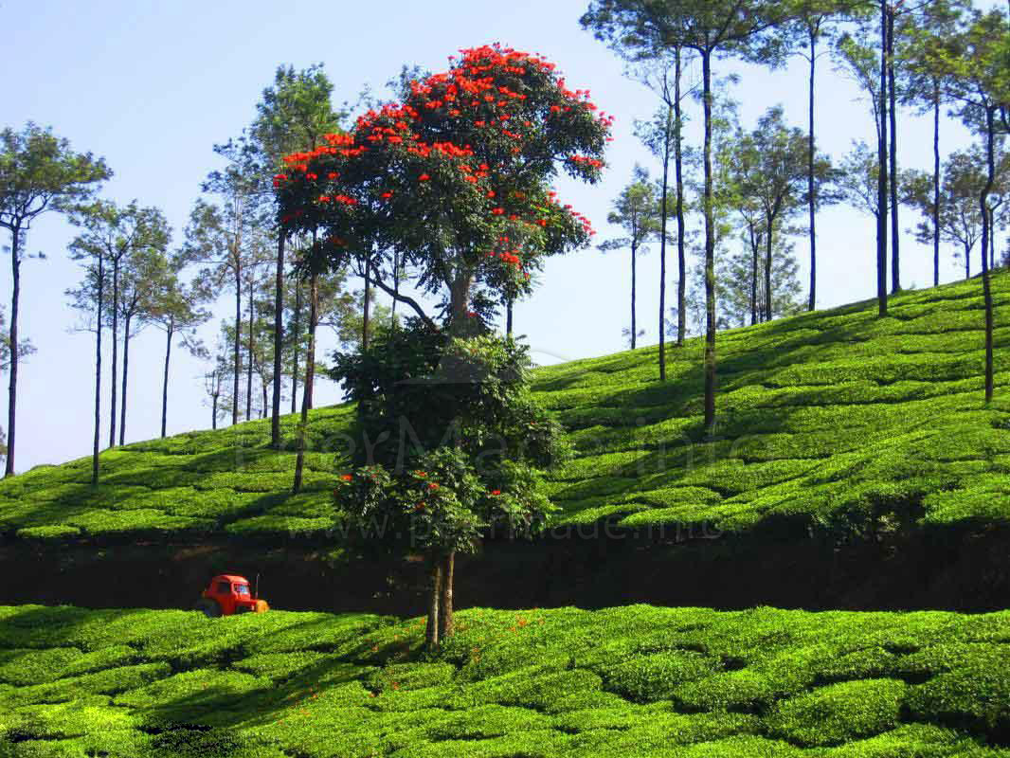
Peermade, Thekkady

Slide 34
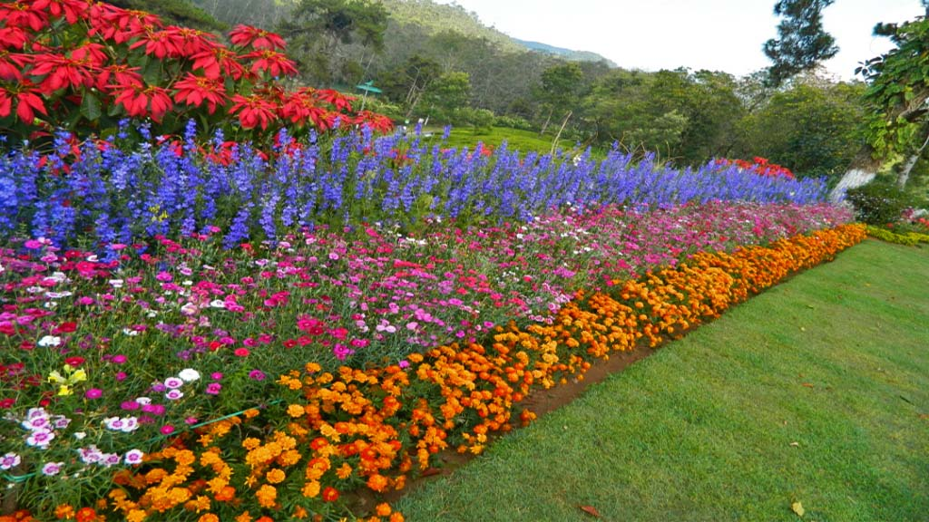
Flower Garden of Thekaddy

Slide 35
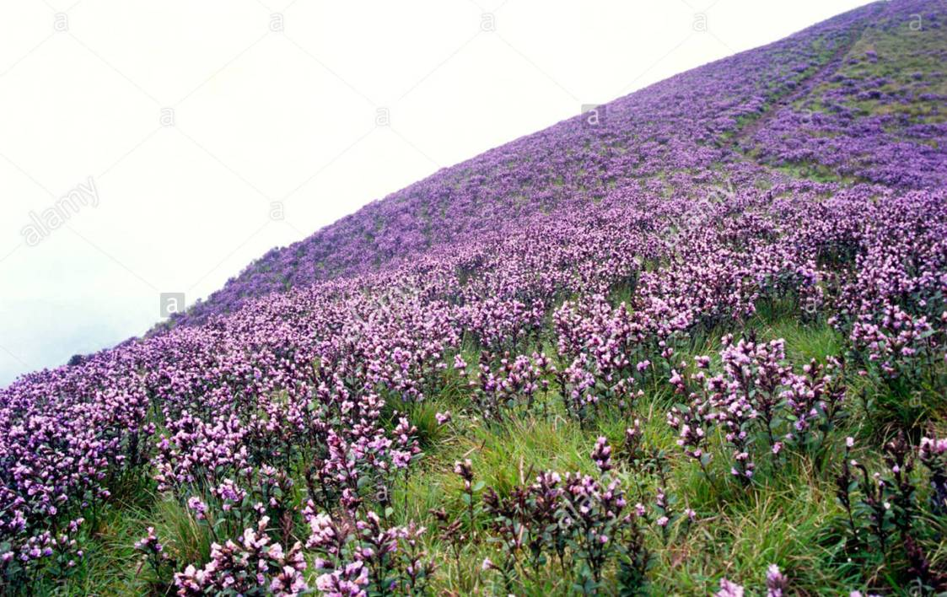
The Neelakurinji Wildflowers of Munnar. They bloom only once in 12 years.

Slide 36
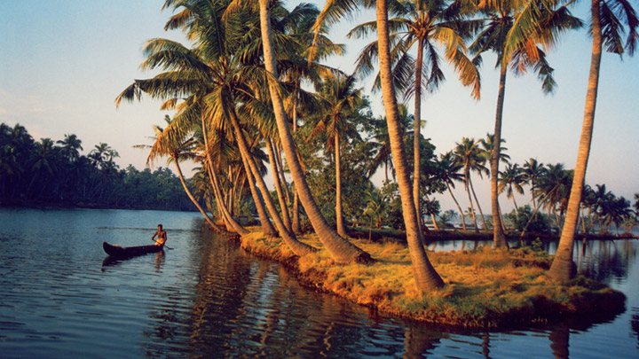
Ashtamudi Lake with surrounding coconut trees, this is near Kollam.

Slide 37
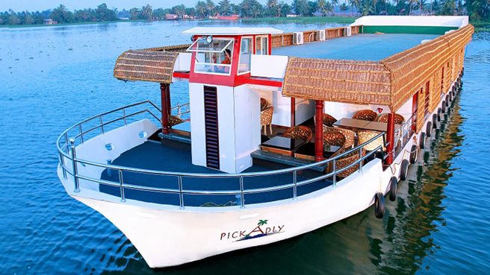
A super Luxury Houseboat of Kerala.

Slide 38
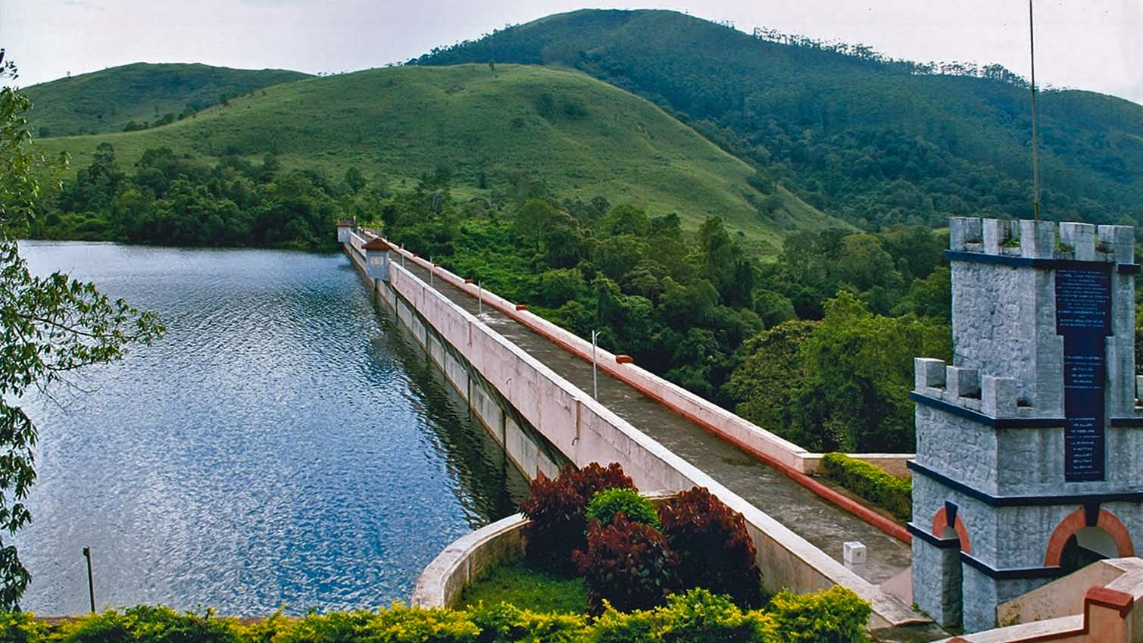
The Famous Mullaiperiyar Dam in Thekaddy, Idukki District

Slide 39
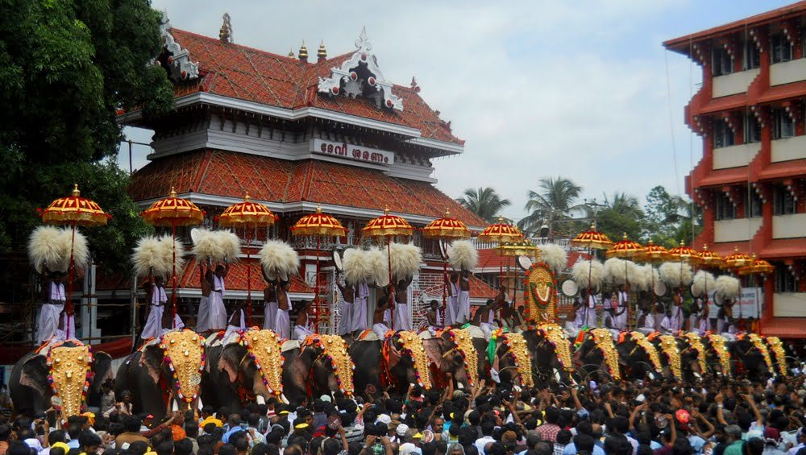
The Great Thrissur Puram Festival where 15 elephants are adorned in front of the Temple.

Slide 40
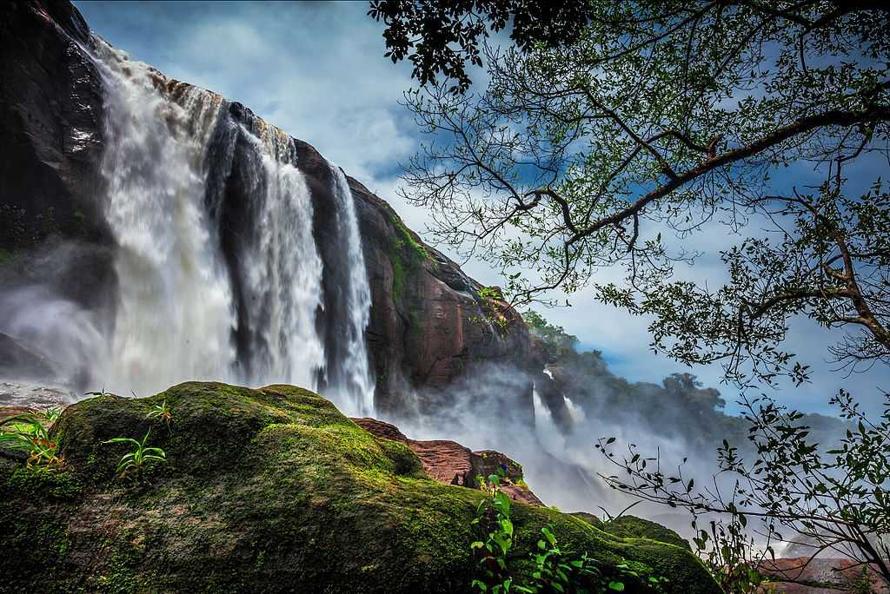
Famous Athirapalli Falls in Thrissur

Slide 41
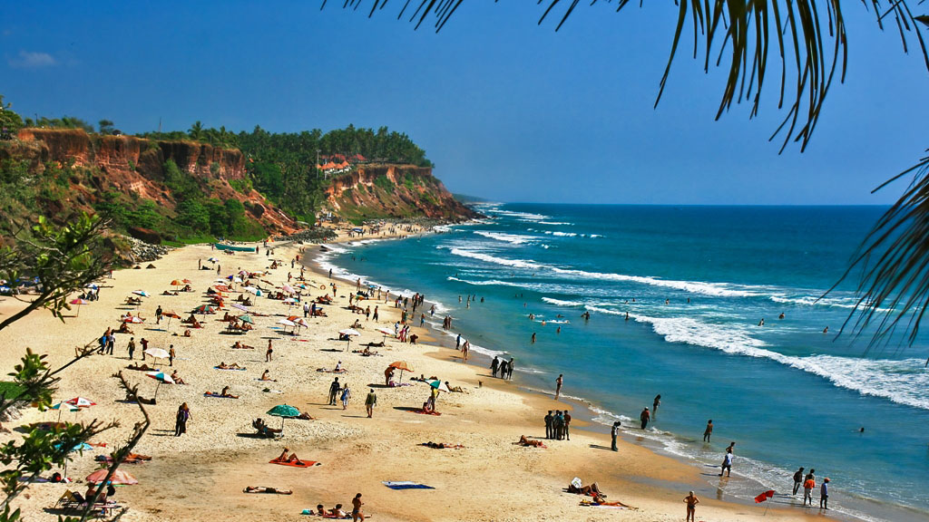
Varkala Cliff End Beach near Thiruvananthapuram

Slide 42
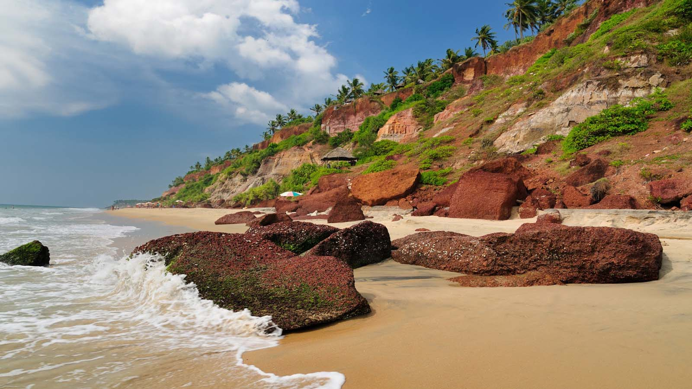
A natural rocky edge beach near Varkala.

Slide 43
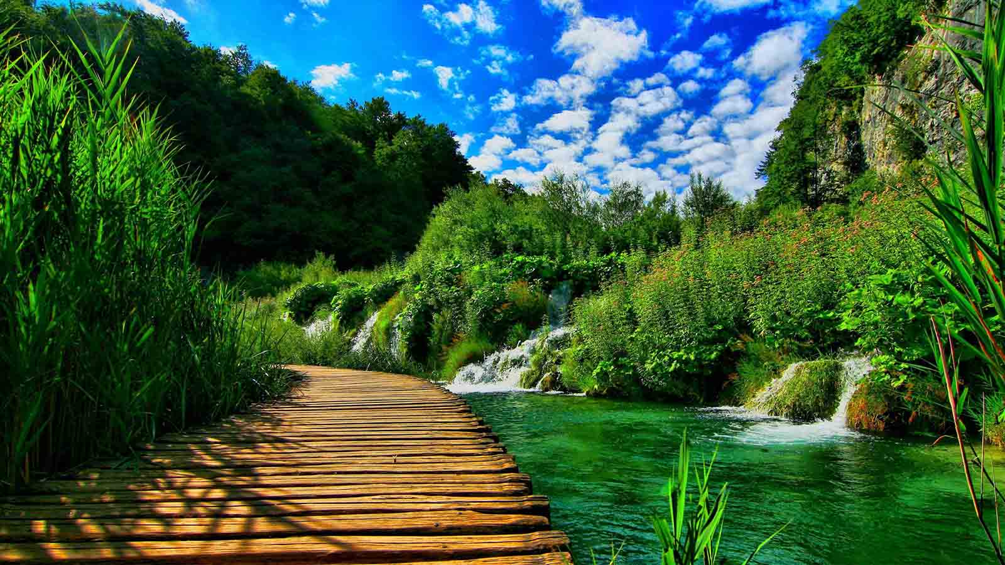
Naturescape somewhere in Kerala.

Slide 44
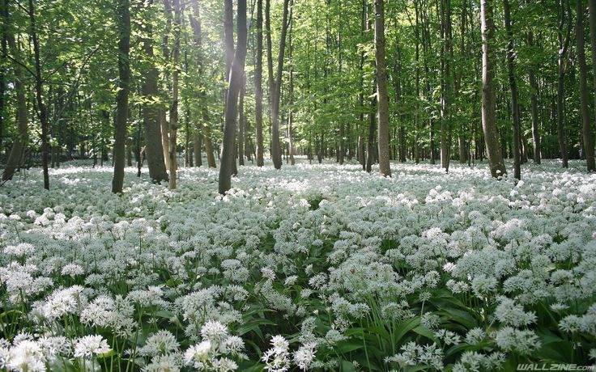
Sandal wood and BamForest Flower at the sandalwood Forest in Marayoor.

Slide 45
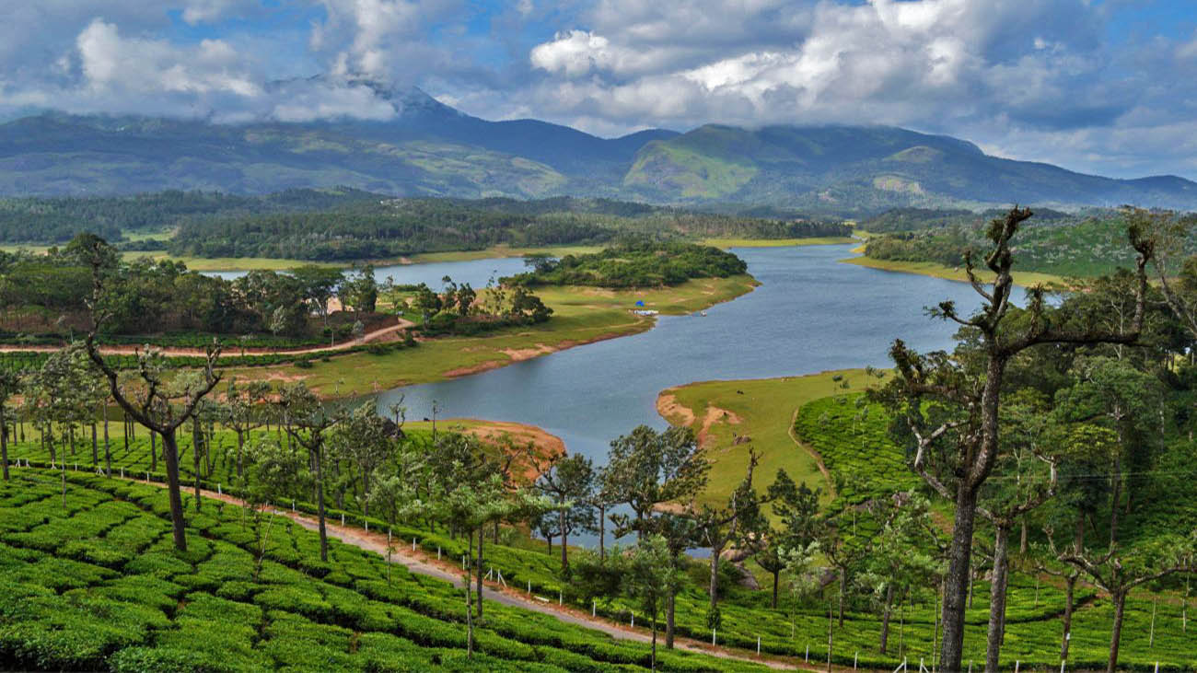
Munnar’s most picturesque view at the Devikulam Lake end.

Slide 46
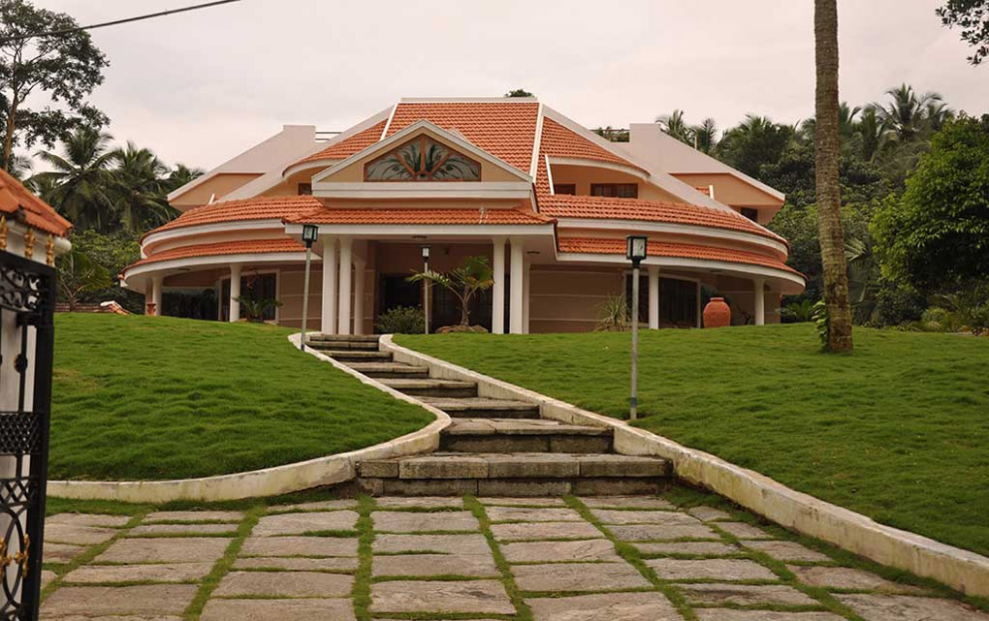
One of the many aesthetically architectured Homes of Kerala. This is from Kannur.

Slide 47
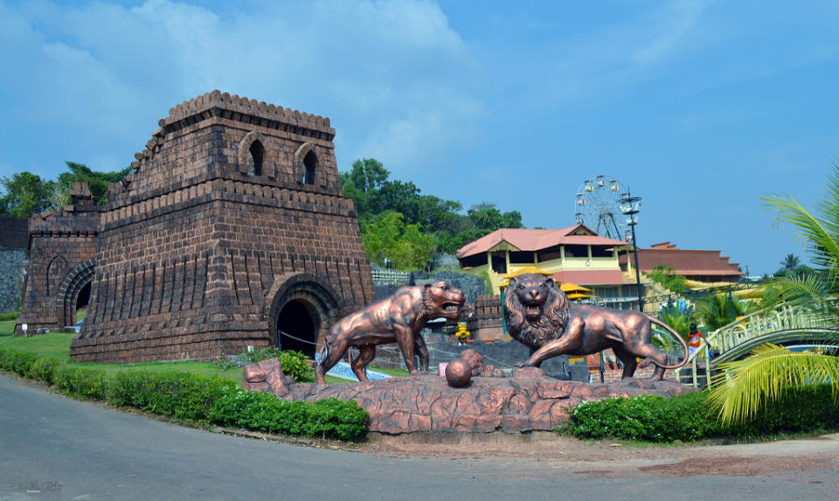
An Amusement Park in Kannur (North Kerala)

Slide 48
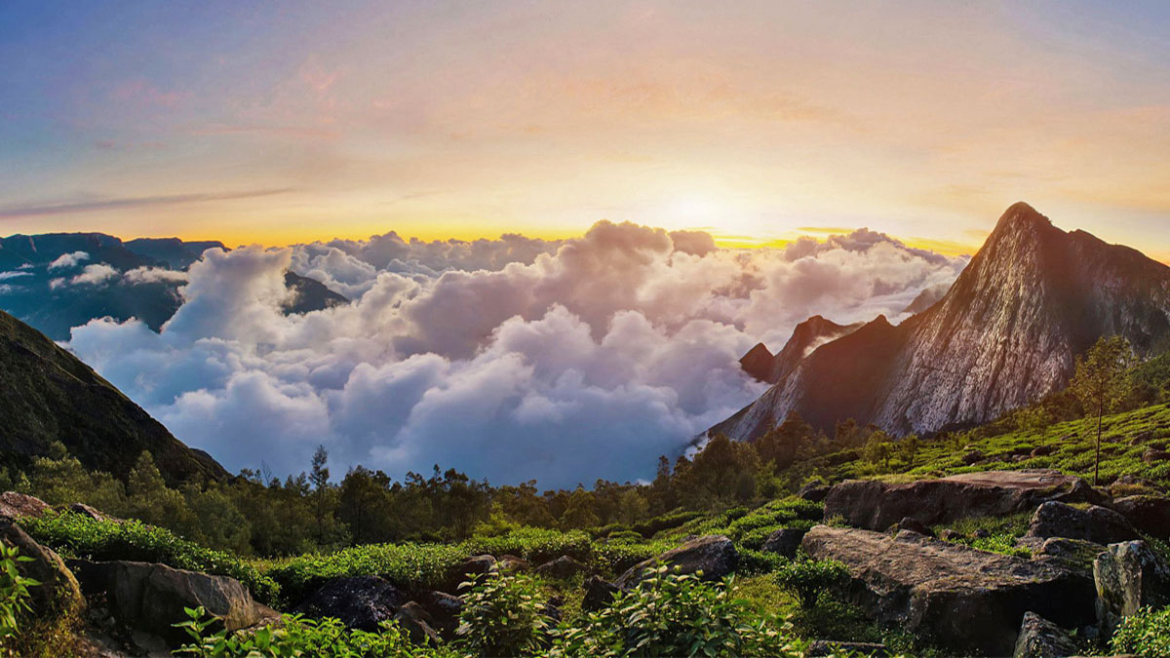
Hill station in Kerala

Slide 49
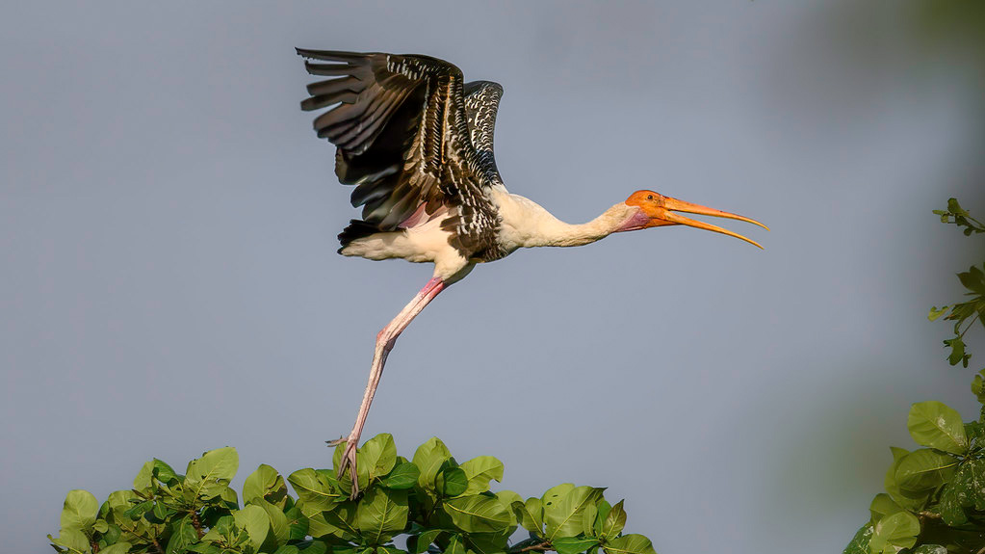
Painted Stork at the Kumarakom Bird Sanctuary.

Slide 50
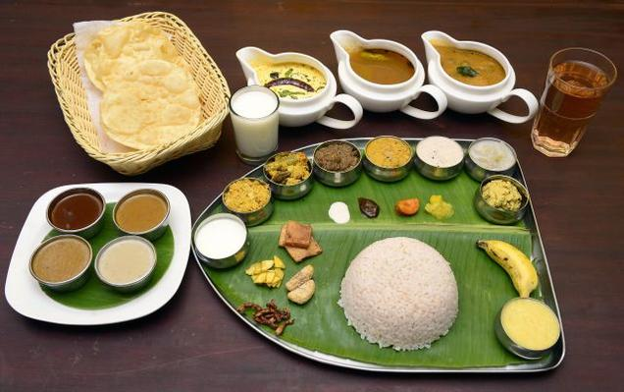
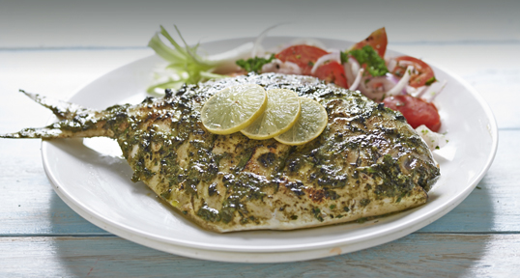



Okay guys and ladies may I now present to you some lip smacking special cuisine from Kerala my beloved Home State in India - Tony Chacko (tonychacko2000@gmail.com) - Processed and edited by my great friend Steve Rumpler.

Slide 51







¿Te ha gustado?
Puedes ver más entrando
Aquí
Además puedes recibir powerpoints en tu correo electrónico suscribiéndote aquí:
F I N

