Slide 1



Russian
Federation
3
Compiled by - Tony and Steve
2017

Slide 2

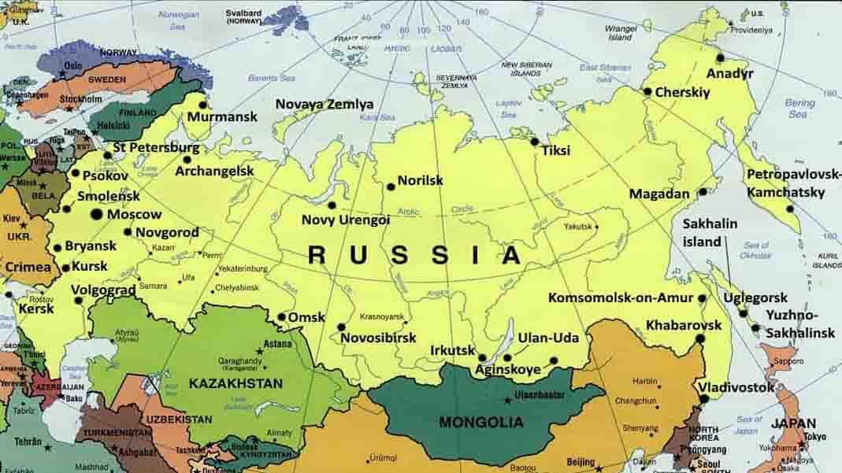

General Geographic Map of Russia

Slide 3
Russia
Russia - is a country that is mostly in Asia and partly in Eastern Europe. It is the largest country in the world, covering more than one-eighth of the Earth's inhabited land area.There are indeed many interesting tourist attractions in Russia and here are some highlighted places.
The federal subjects of Russia are the constituent entities of Russia. It consists of republics, krais, oblasts, cities of federal importance, an autonomous oblast, and autonomous okrugs, all of which are equal subjects of the Russian Federation. The Russian Federation constitutionally consists of 83 (2008) federal subjects..
Russia's capital and the biggest city is Moscow. The second biggest city is Saint Petersburg, which was the capital of Russia in the 18th and 19th centuries.
Area : 17,075 million km²
Population : 144.5 million (2015)
Ethnic groups (2010) : Russian (80,9 %), Tatar (3,9 %), Ukrainian (1,4 %), Bashkirs (1,2 %), Chuvash (1,1 %),
Chechen (1,0 %), Armenians (0,9 %), other / unspecified (9,8 %)
Wikipedia

Slide 4

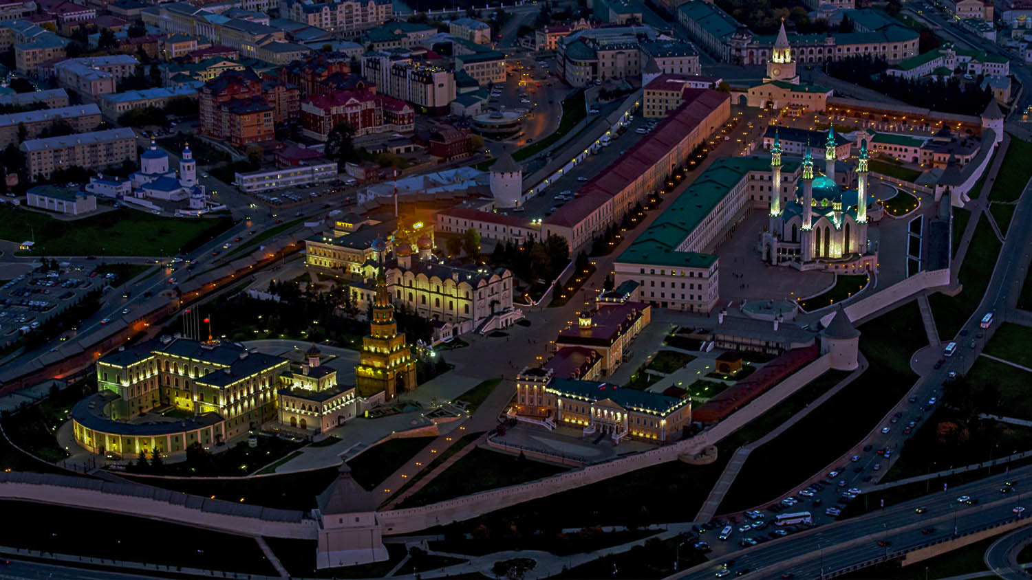
Kazan (Tatarstan)

Slide 5
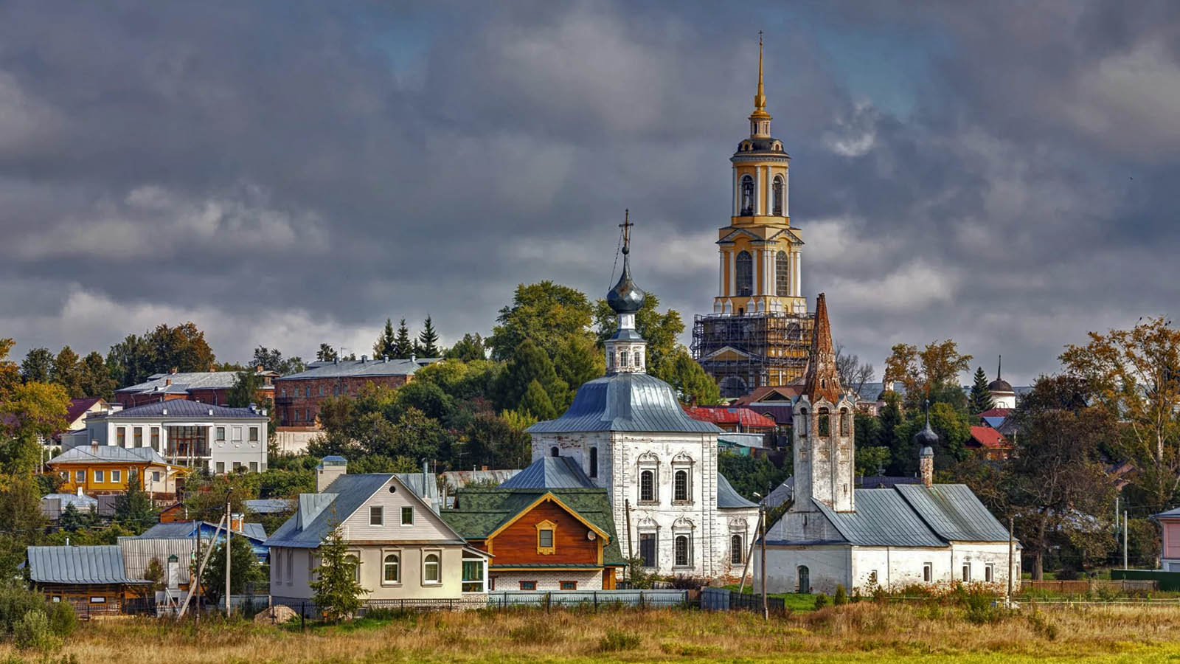
Kideksha (Suzdal)

Slide 6
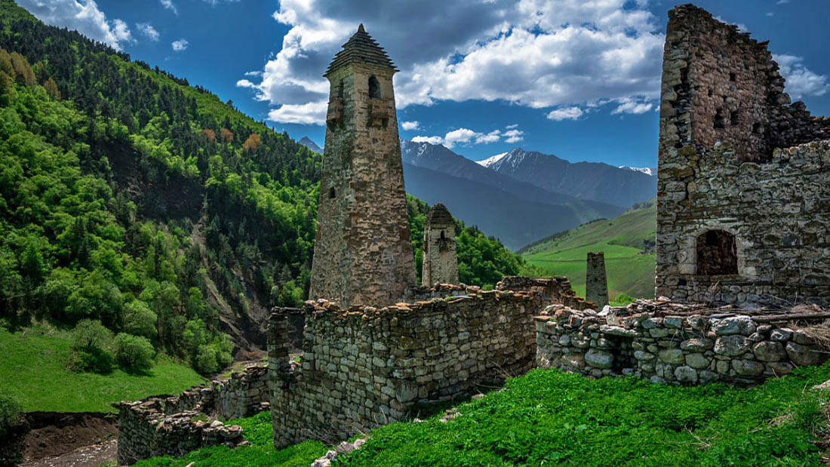
Hyani (Ingushetia)

Slide 7
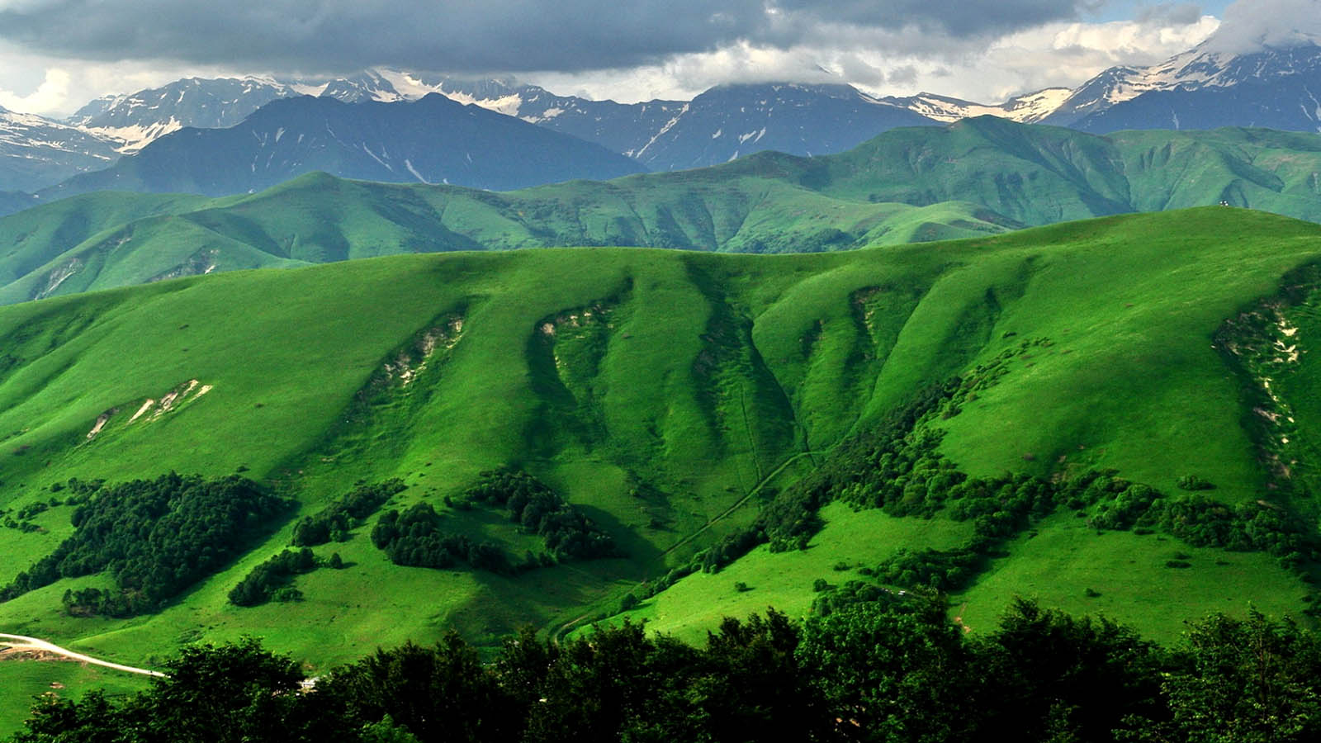
Caucasus (South Ossetia)

Slide 8
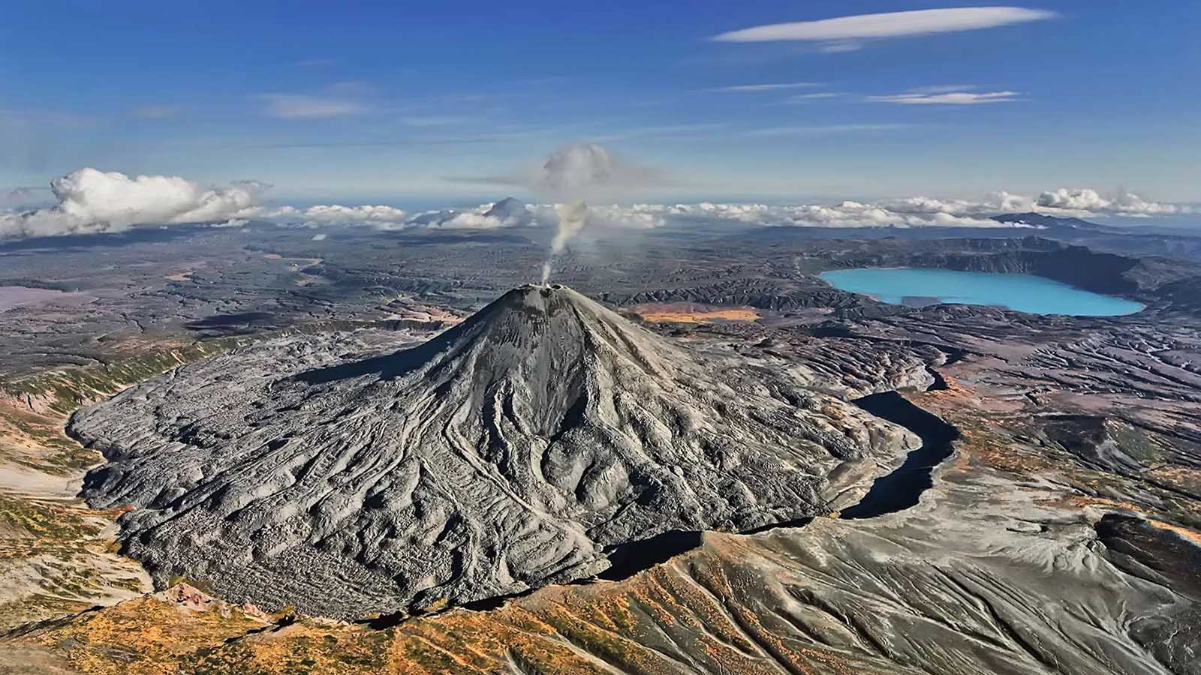
Kamchatka Peninsula

Slide 9
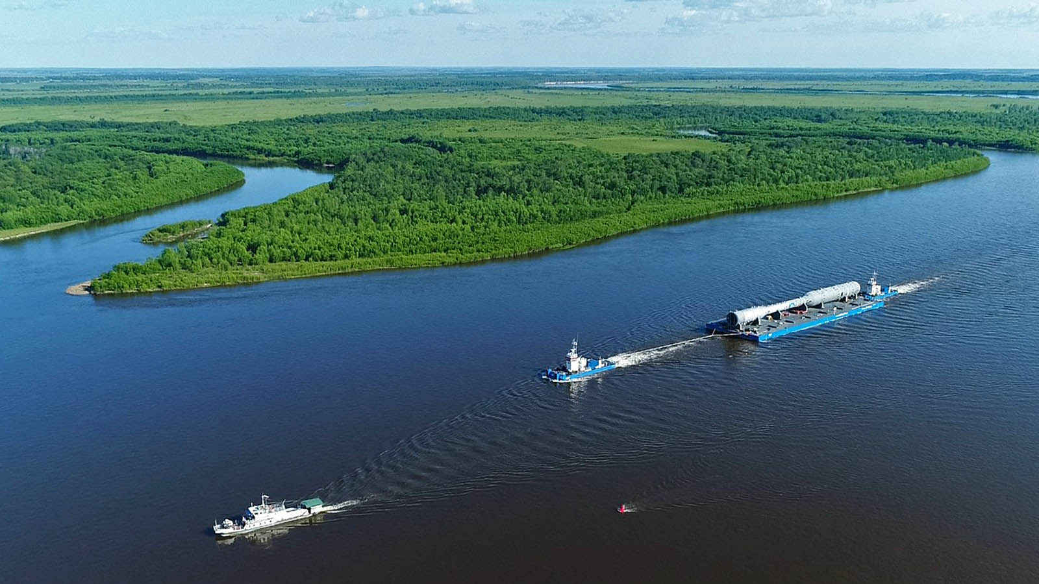
Amur river

Slide 10
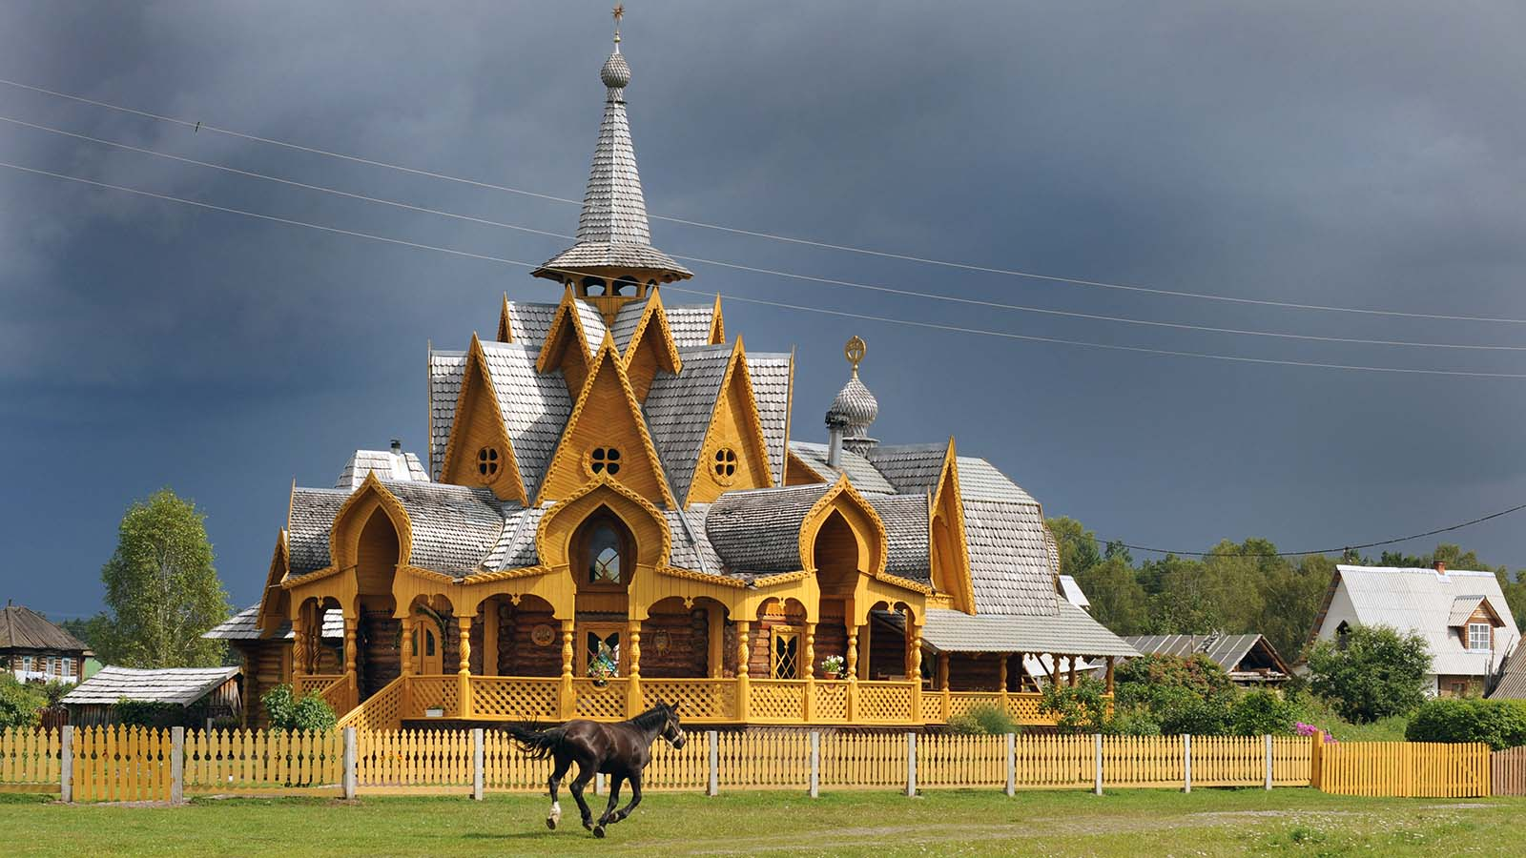
Abakan (Siberia)

Slide 11
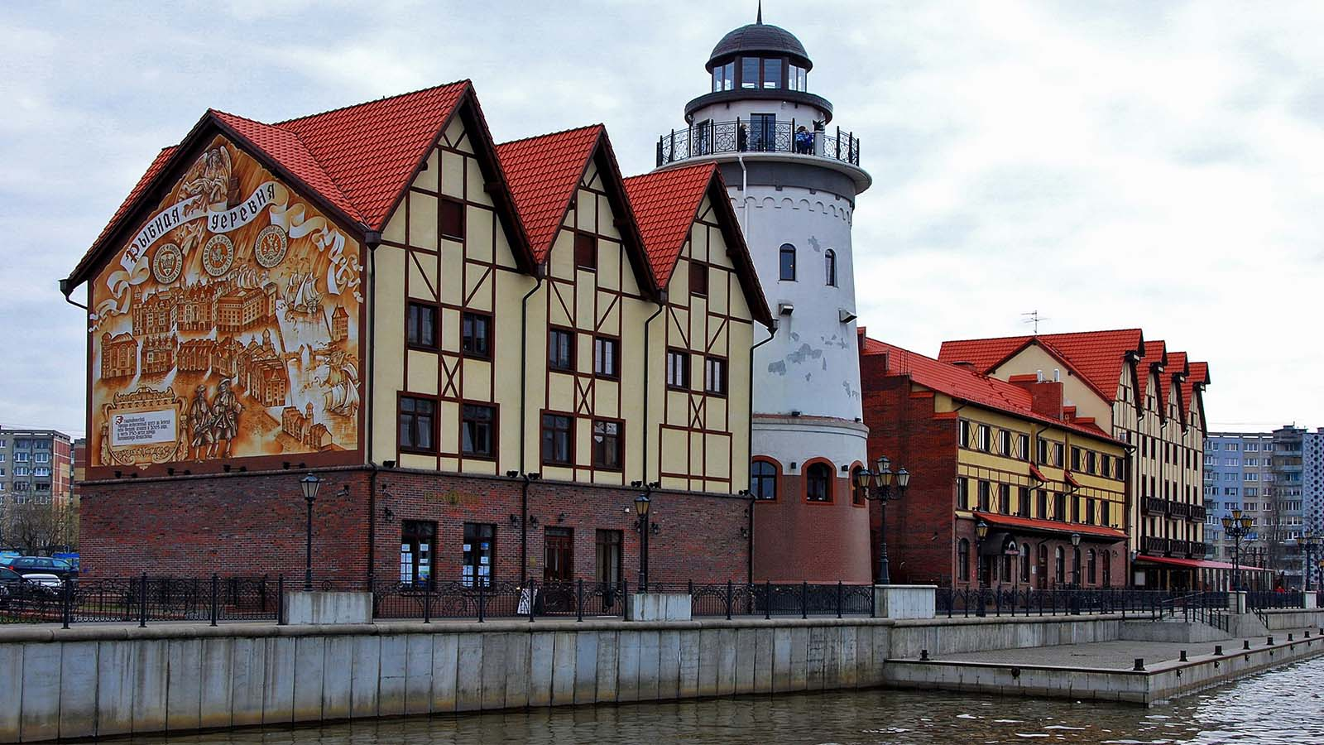
Kaliningrad

Slide 12
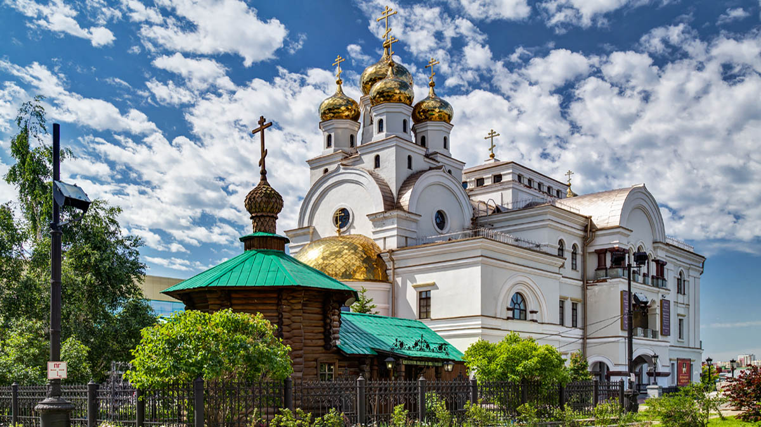
Yekaterinburg

Slide 13
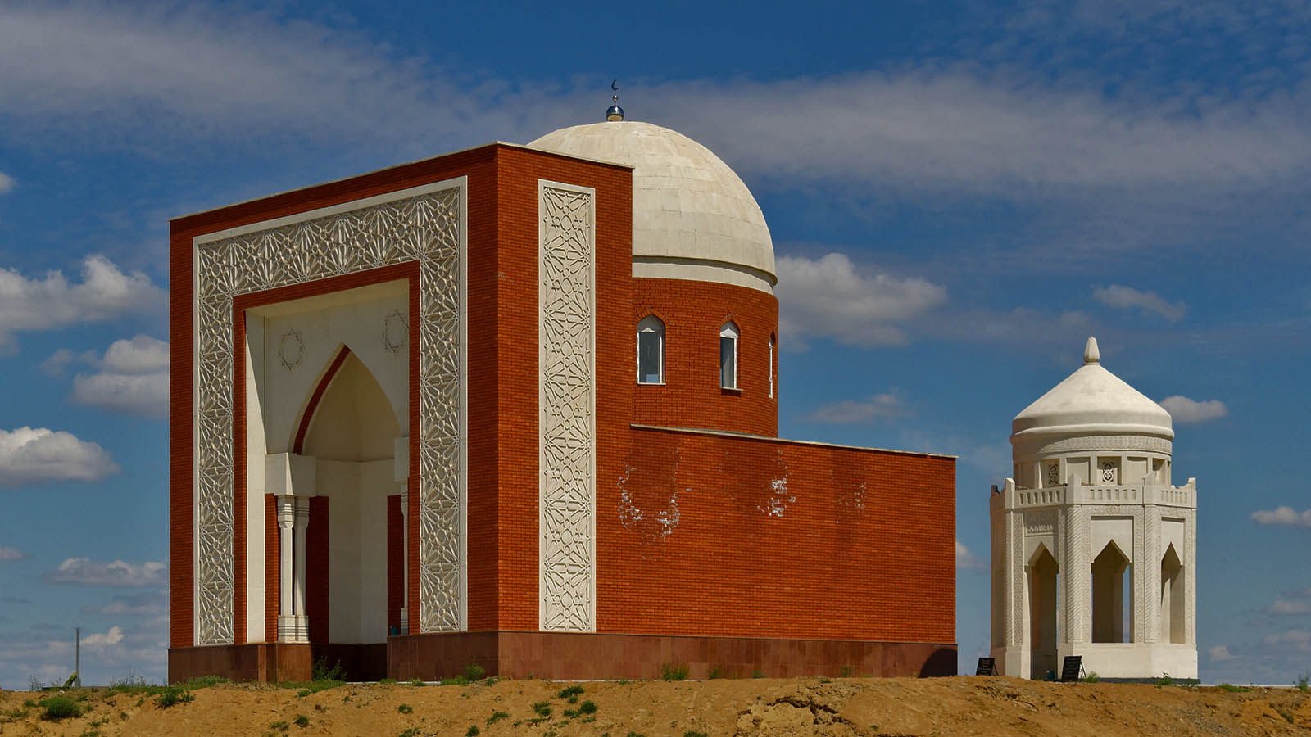
Astrakhan

Slide 14
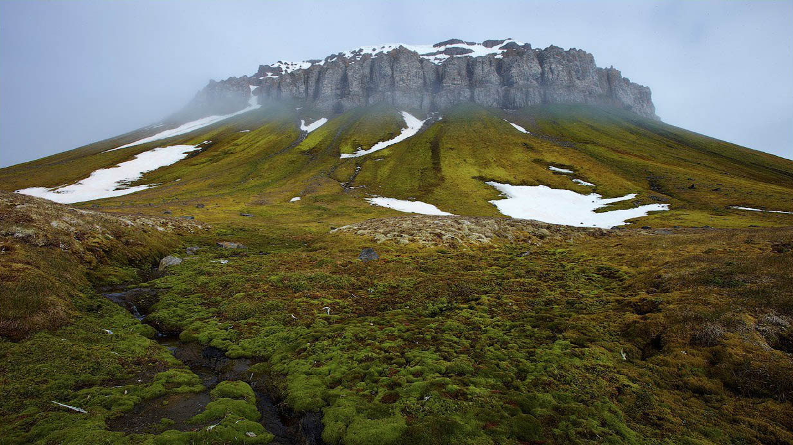
Franz Josef Land (Arkhangelsk)

Slide 15
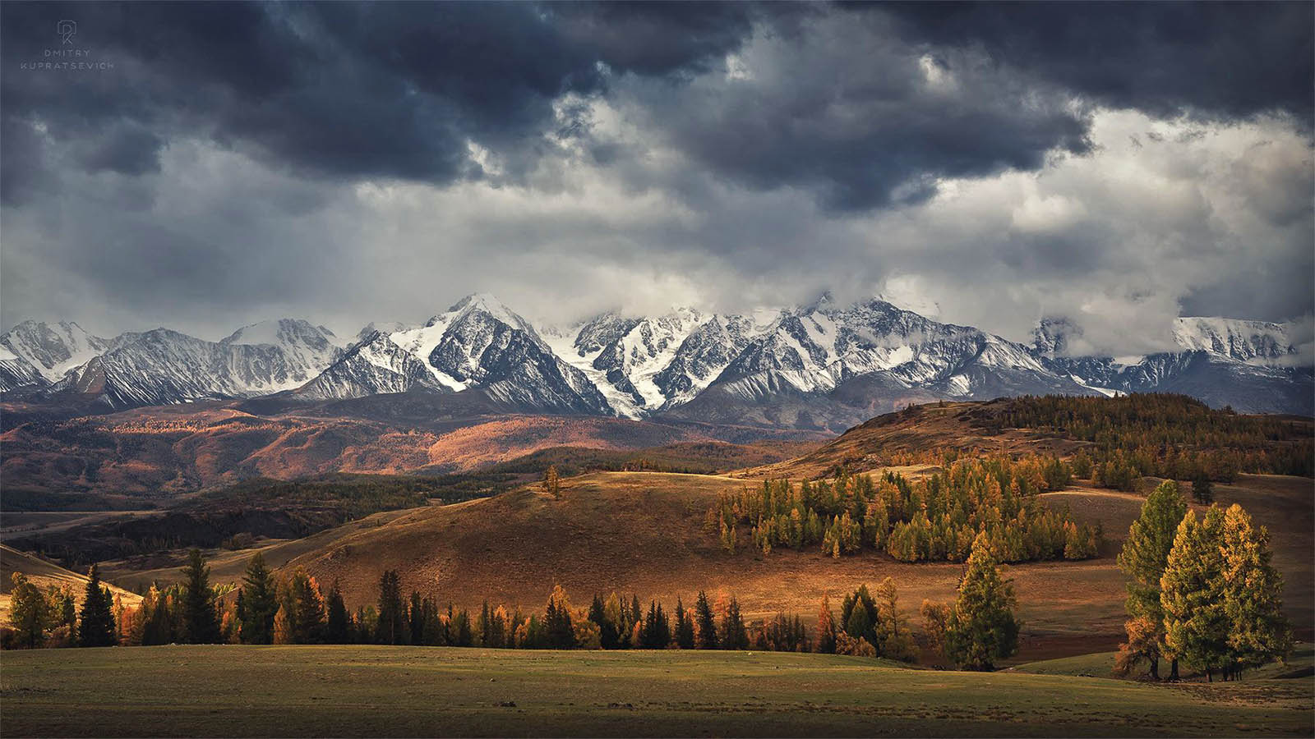
Altai Mountains

Slide 16
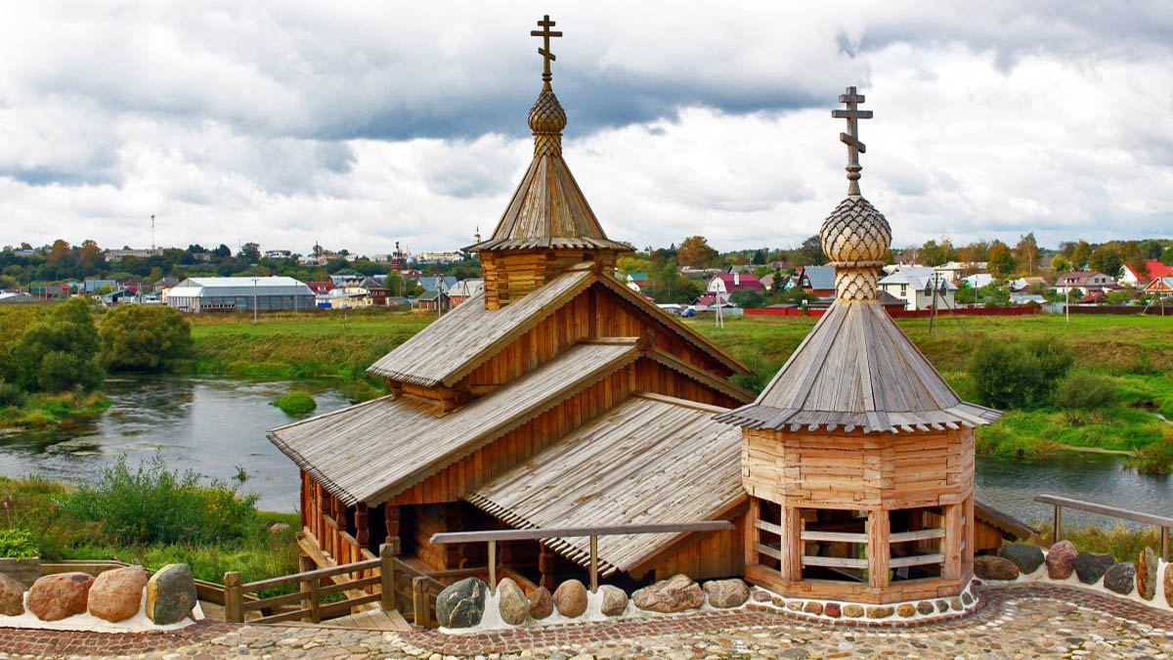
Borovsk (Kaluga)

Slide 17
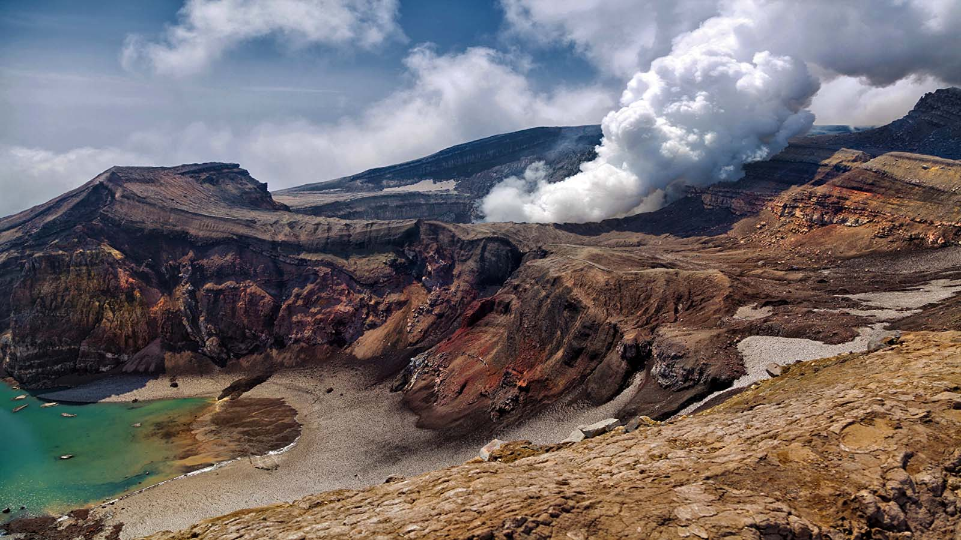
Kamchatka Peninsula

Slide 18
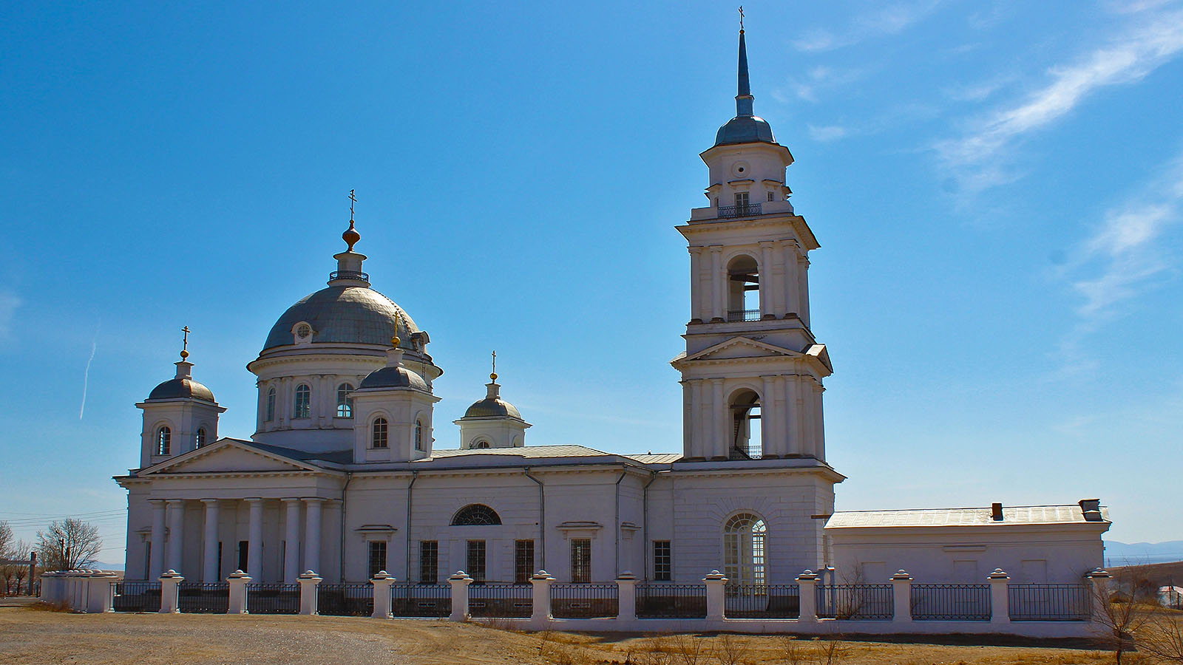
Kakhta (Burjatia)

Slide 19
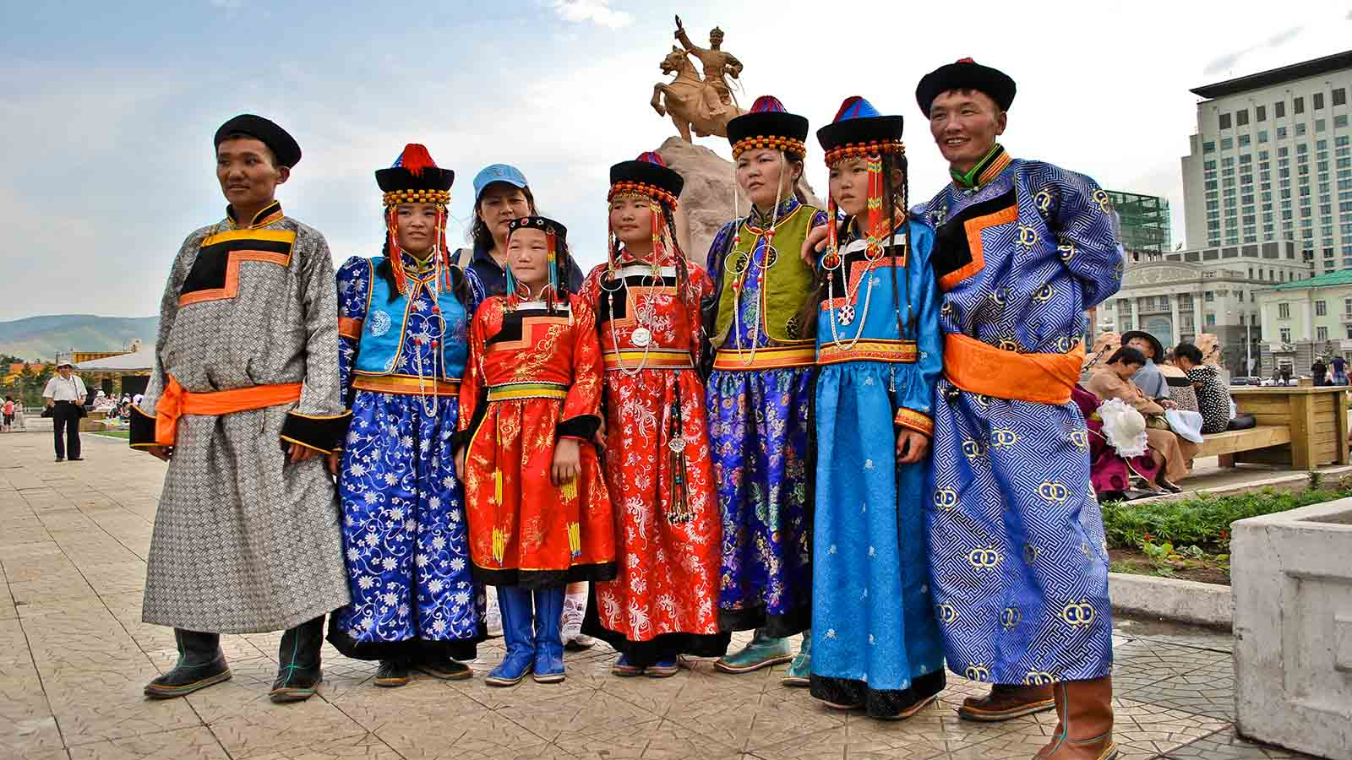
Buryat people

Slide 20
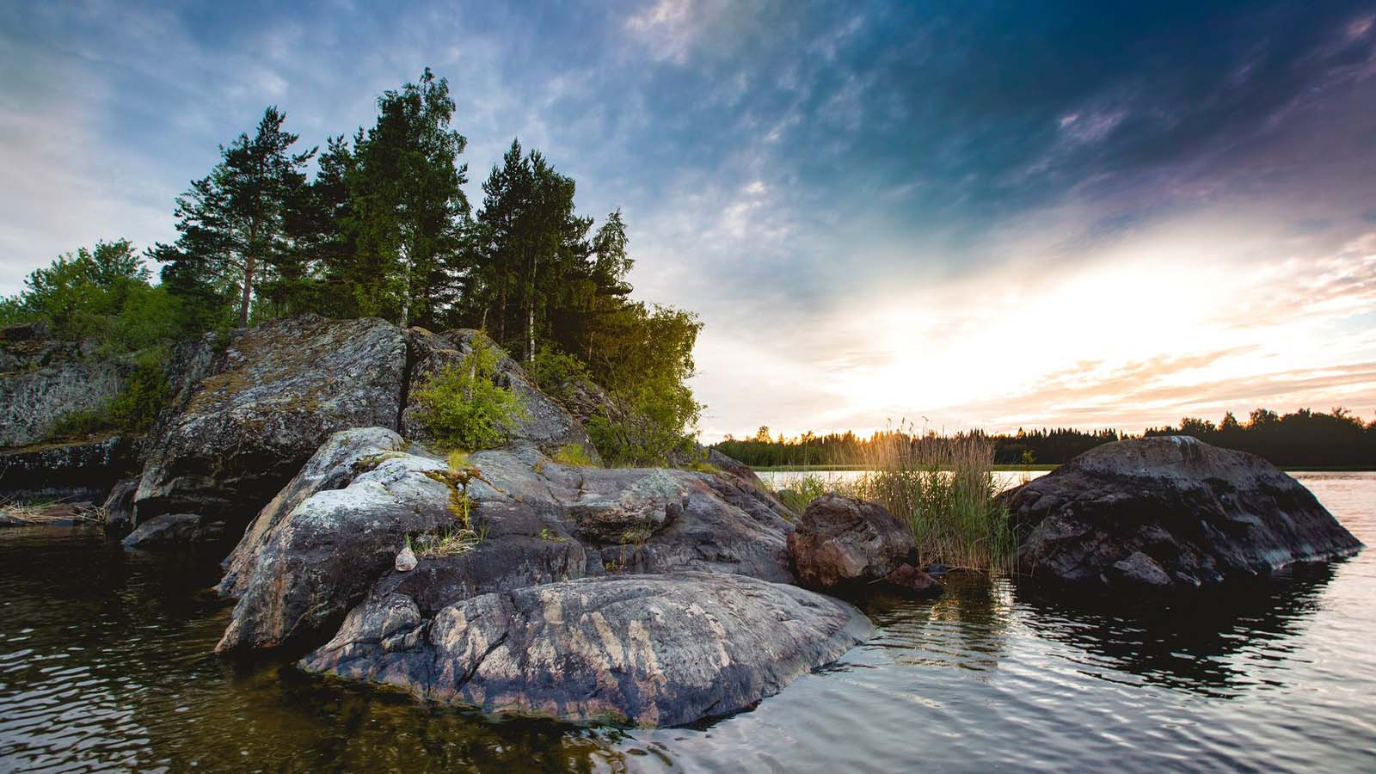
Karelia

Slide 21
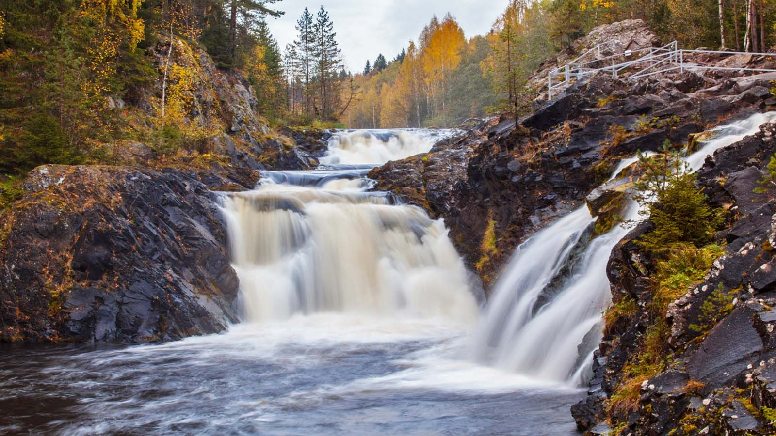
Kivach Falls (Karelia)

Slide 22
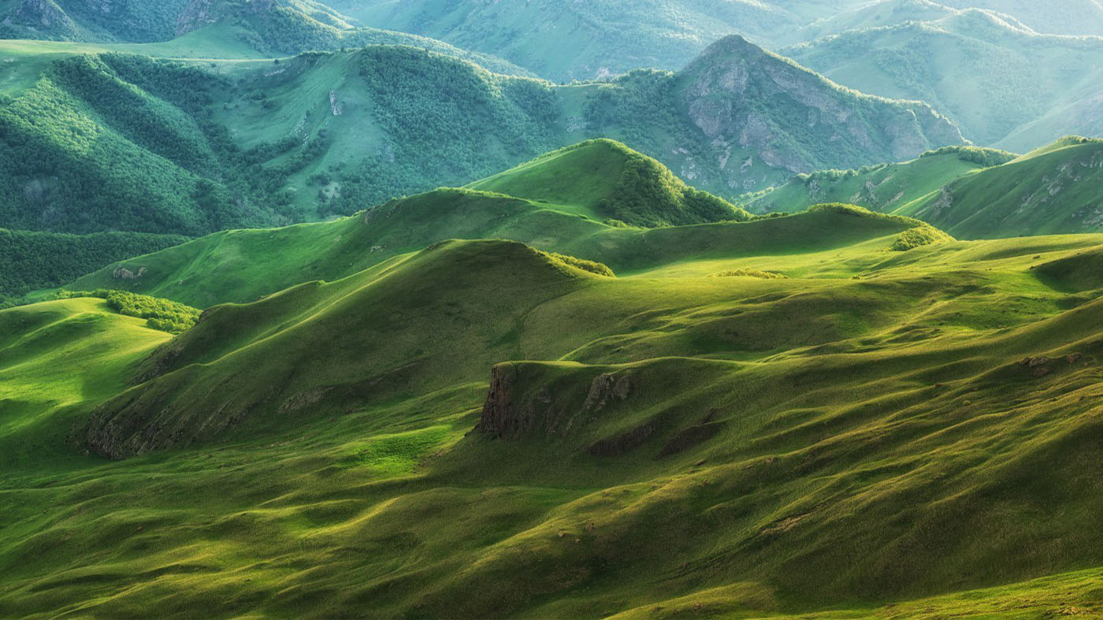
Karachay-Cherkessia

Slide 23
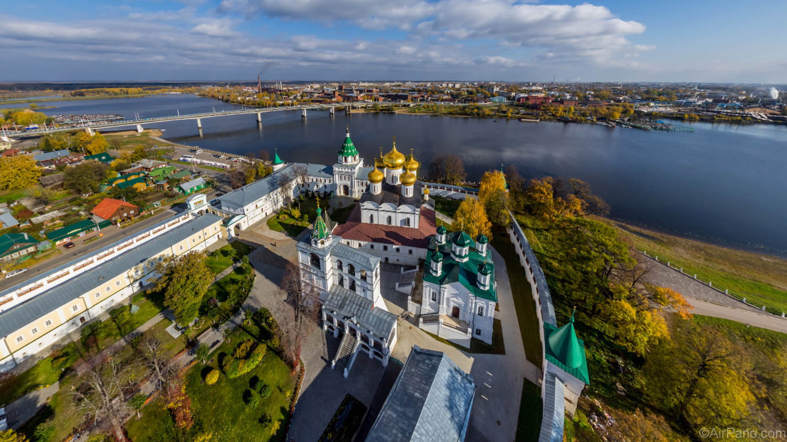
Kostroma

Slide 24
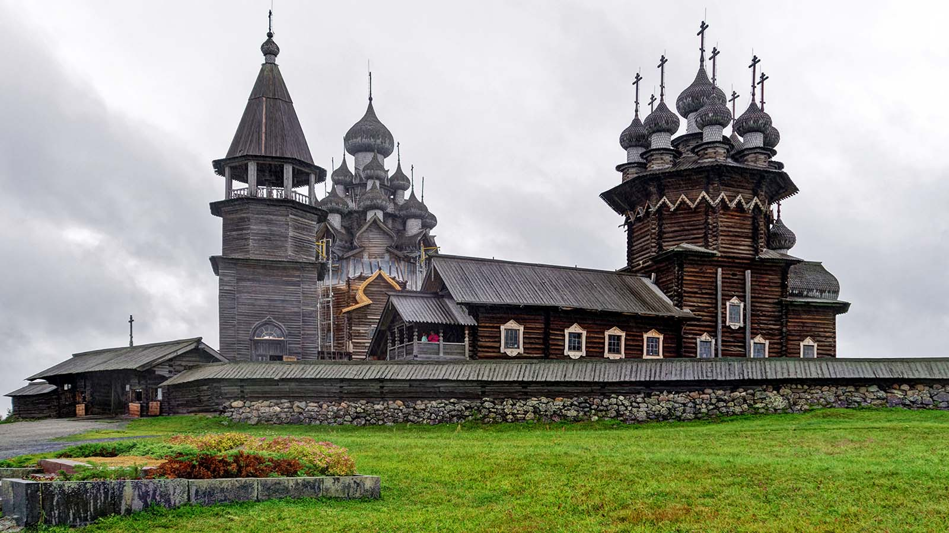
Kizhi Island (Karelia)

Slide 25
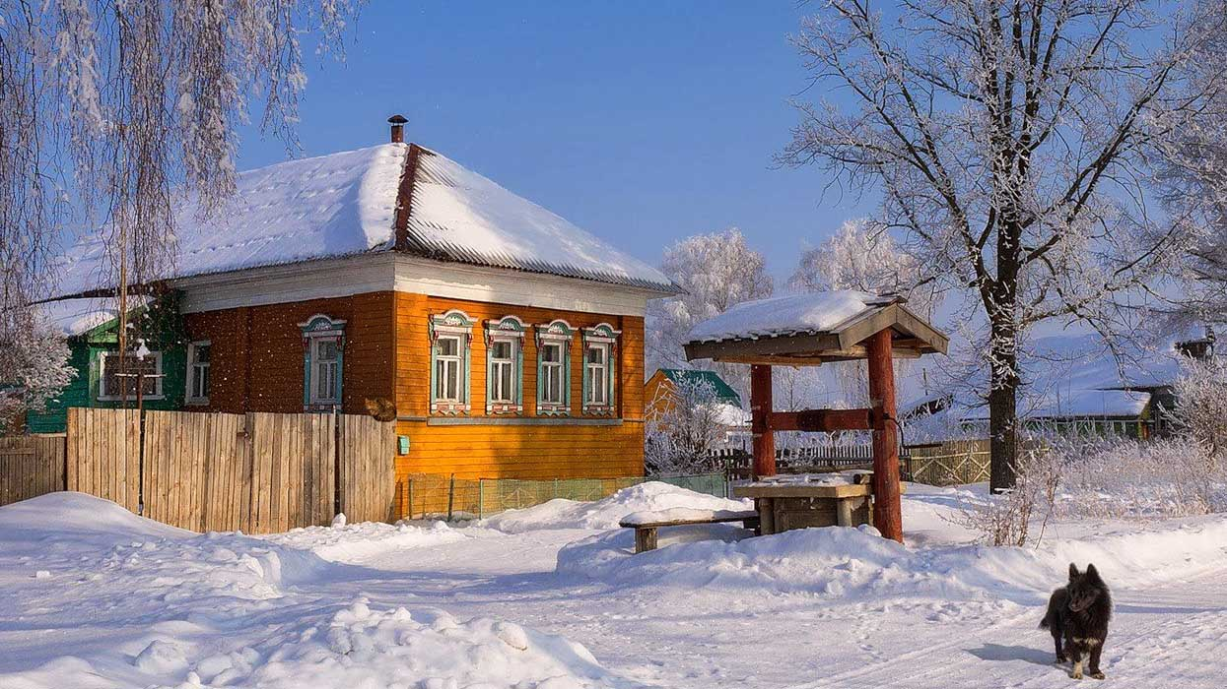
Russian village

Slide 26
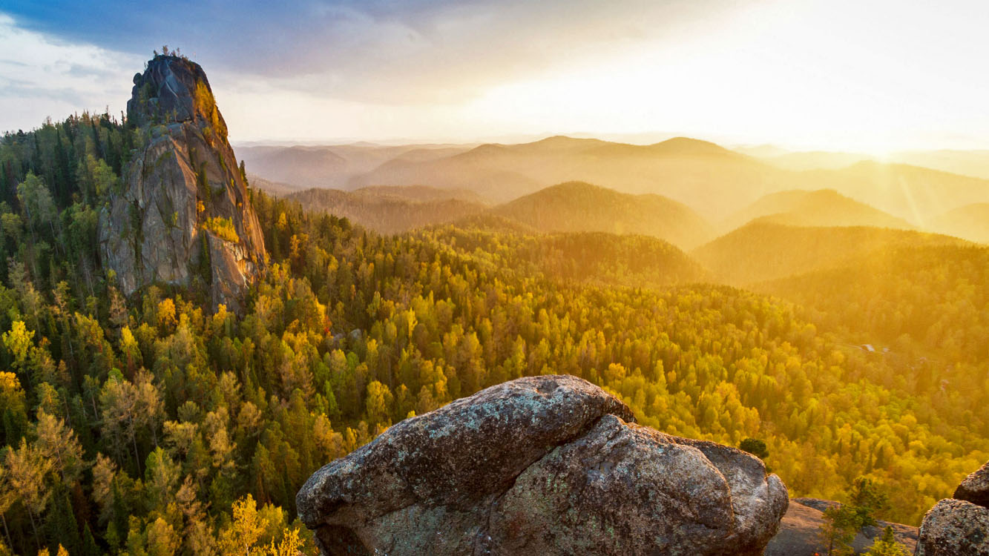
Krasnojarsk

Slide 27
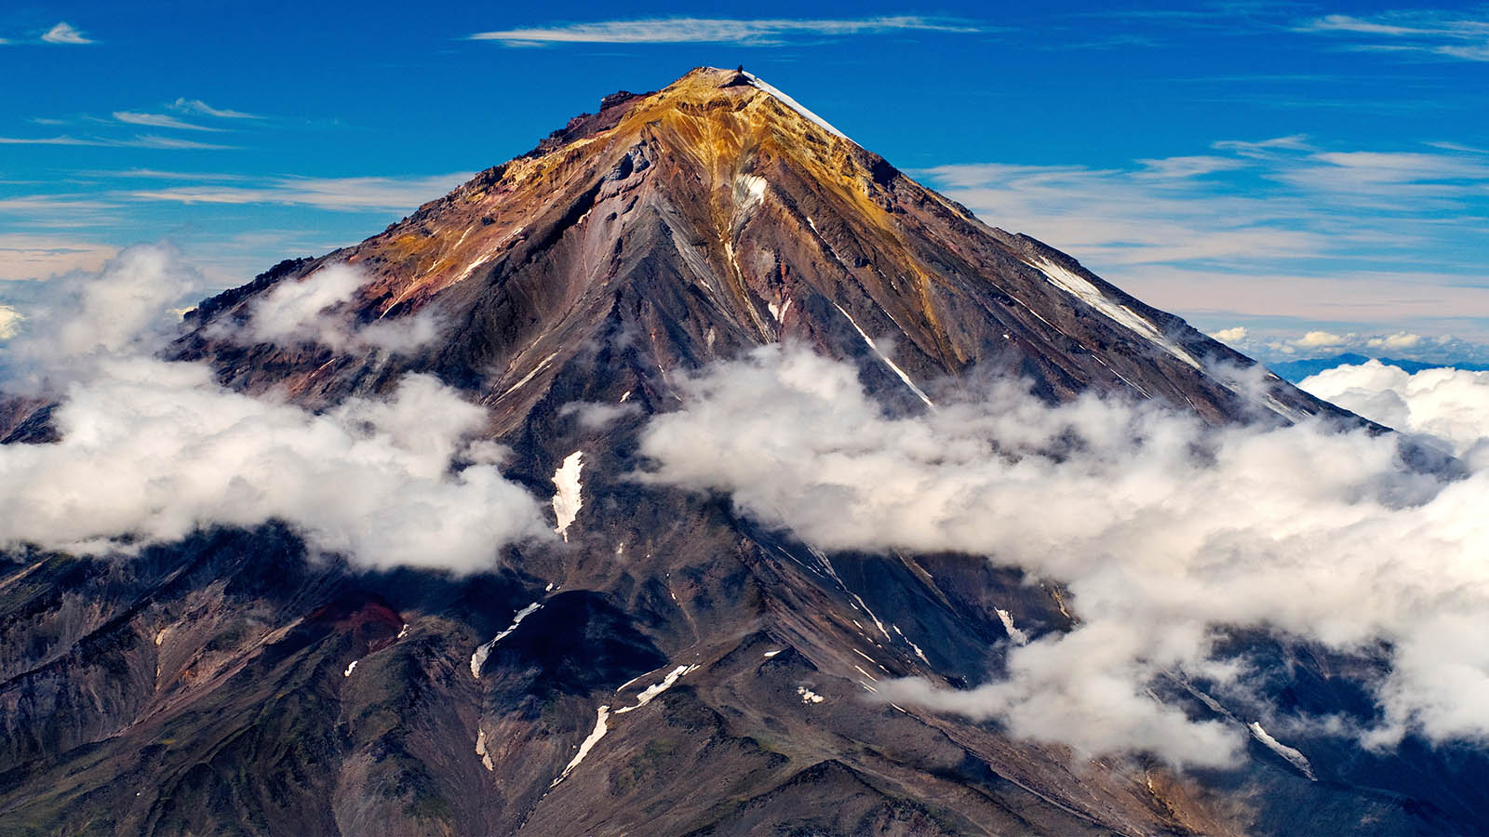
Koriakski Volcano (Kamchatka)

Slide 28
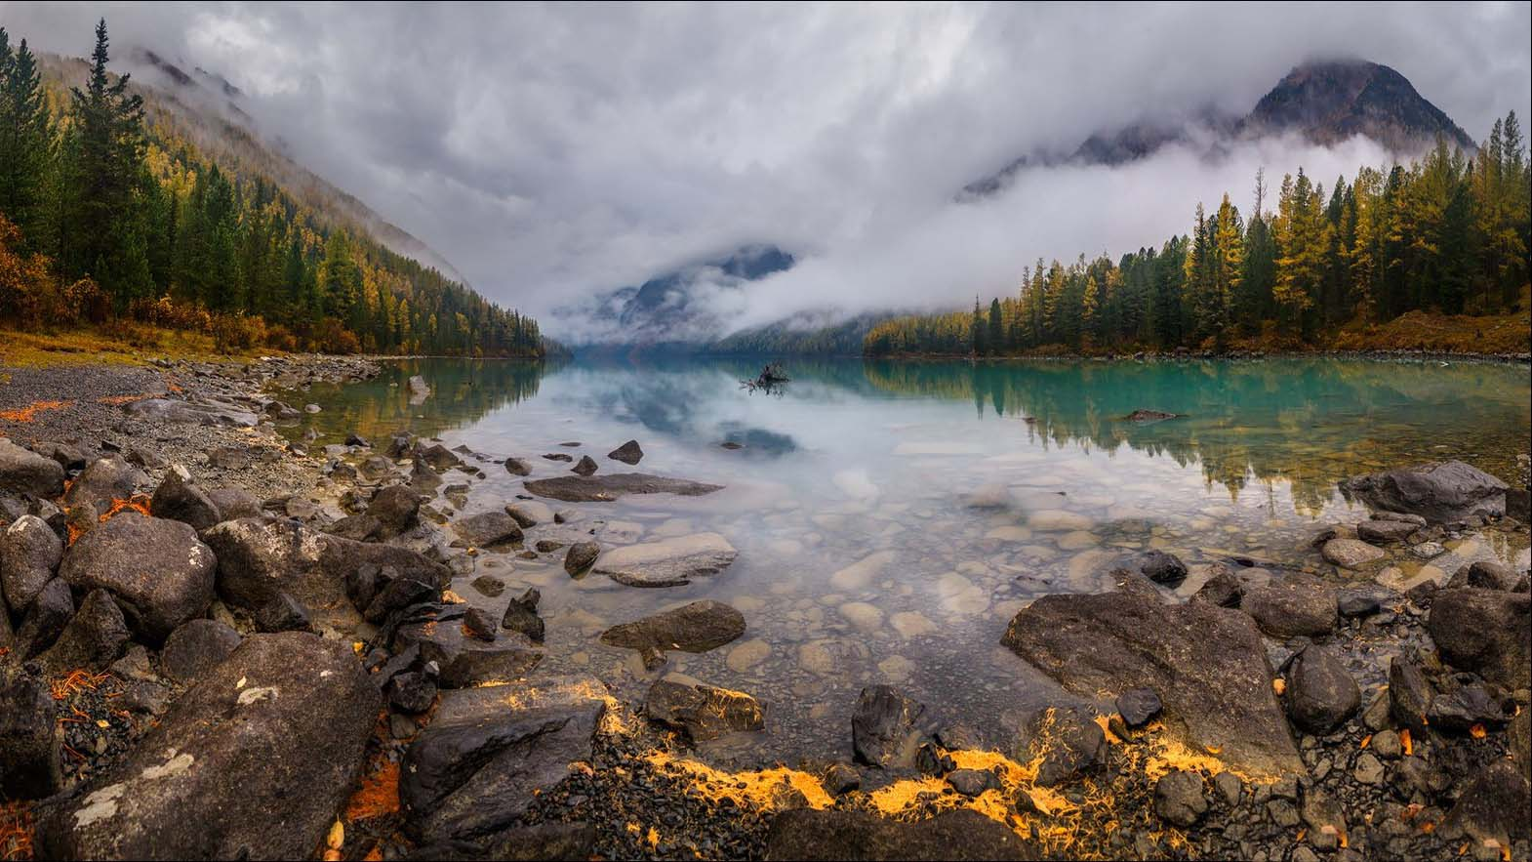
Lake Kucherla (Altai)

Slide 29
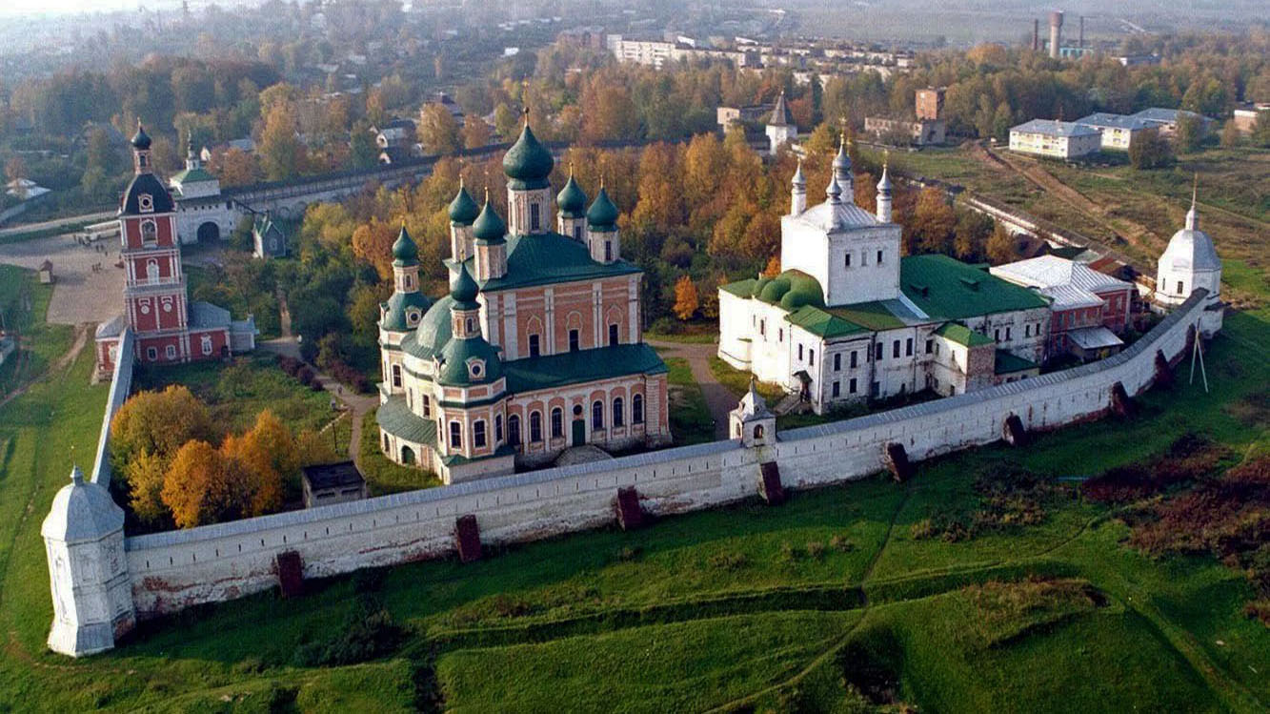
Pereslavl-Zalessky (Yaroslavl)

Slide 30
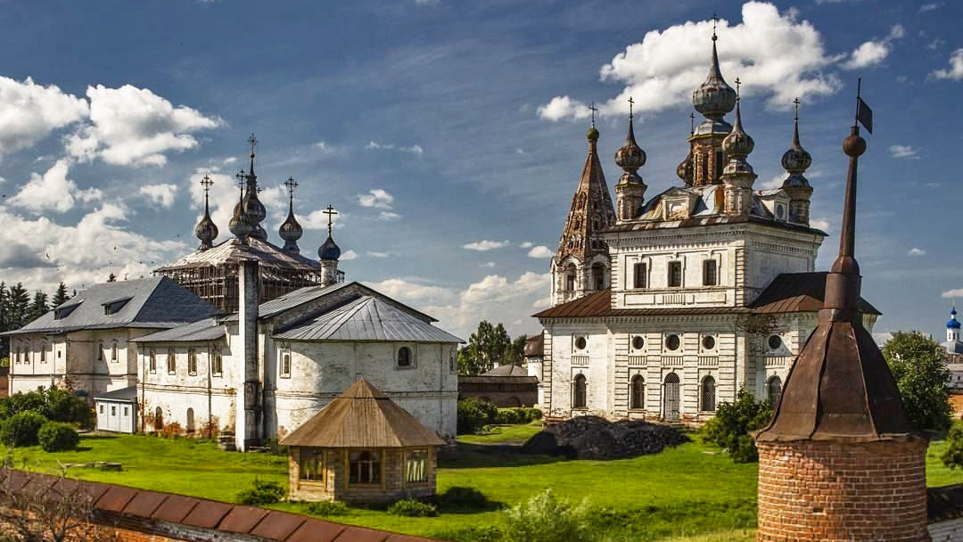
Mikhailo-Arkhangelsk Monastery (Arkhangelsk)

Slide 31
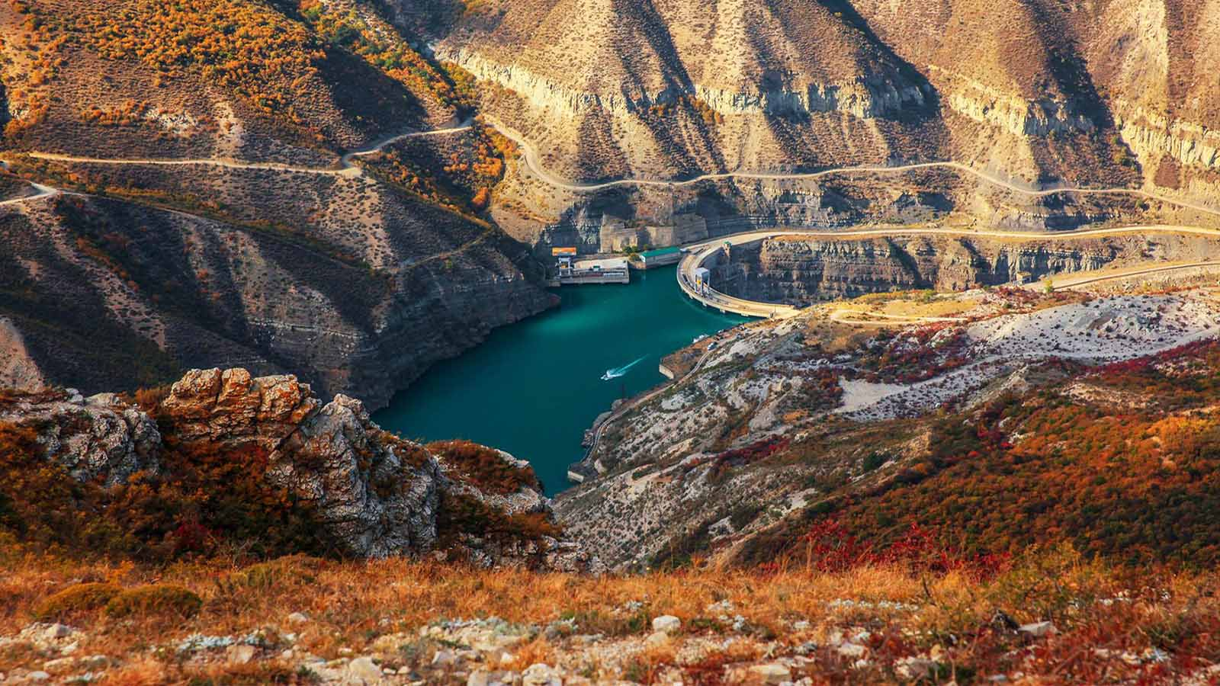
Sulak Canyon (Dagestan)

Slide 32
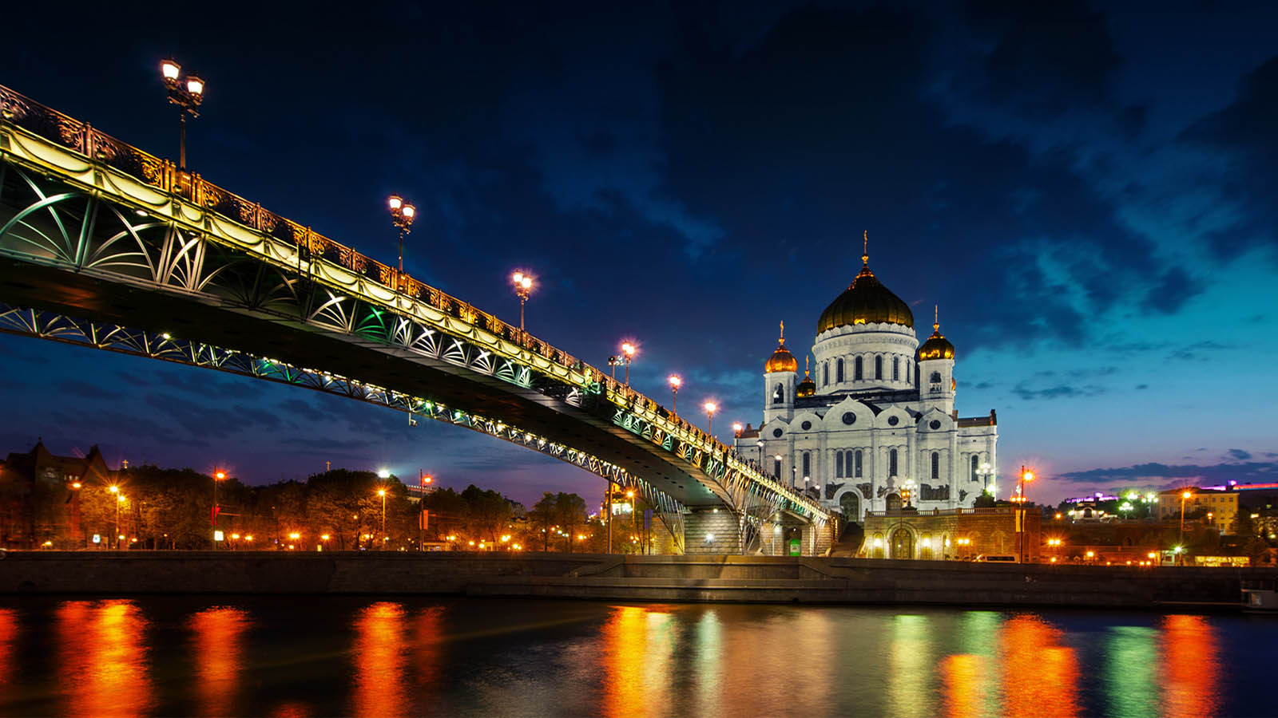
Moscow

Slide 33
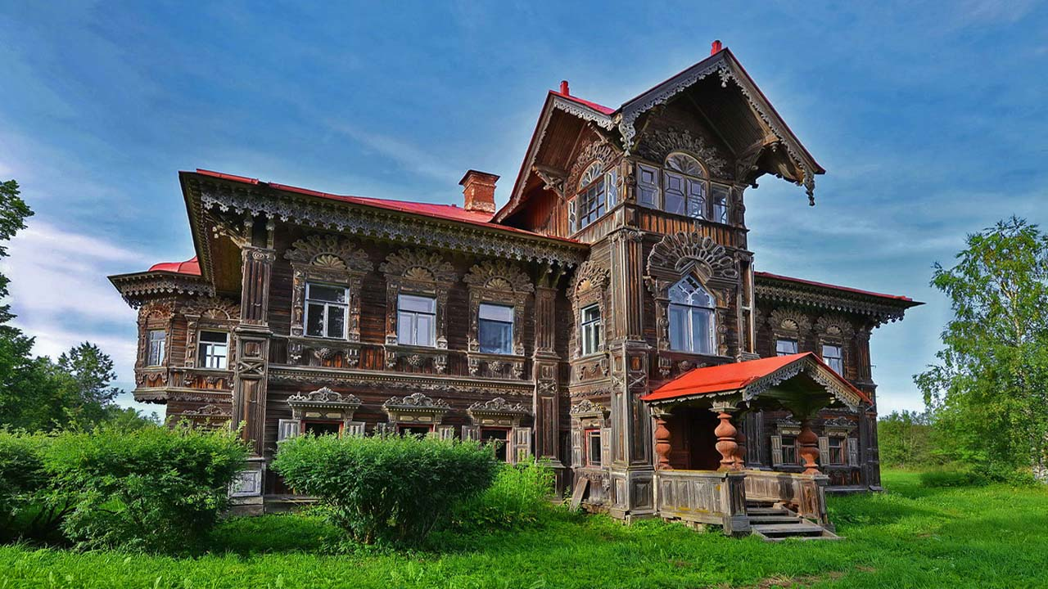
Pogorelovo (Kostroma)

Slide 34
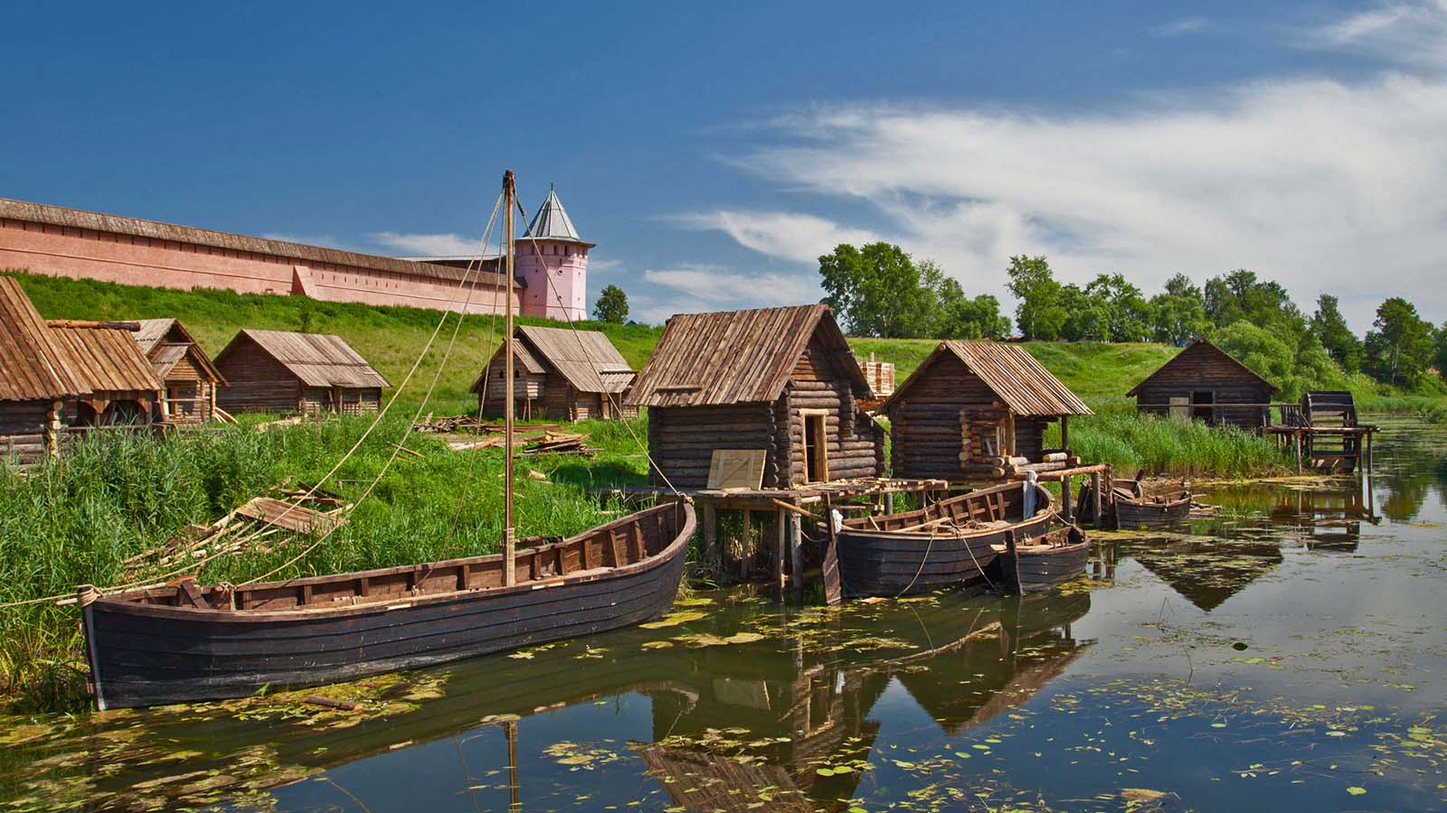
Suzdal

Slide 35
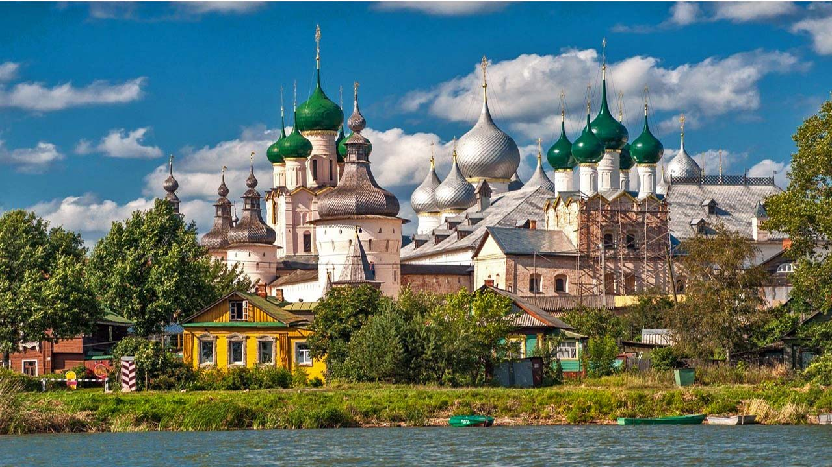
Rostov

Slide 36
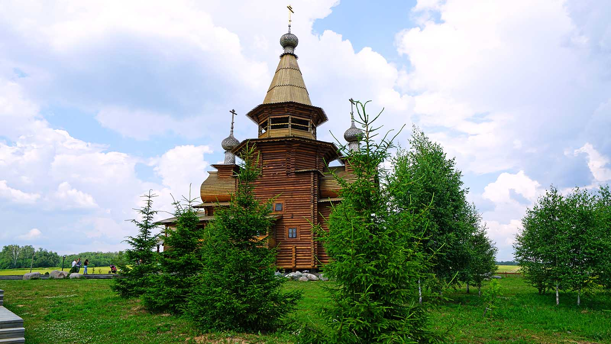
Sergiyev Posad

Slide 37
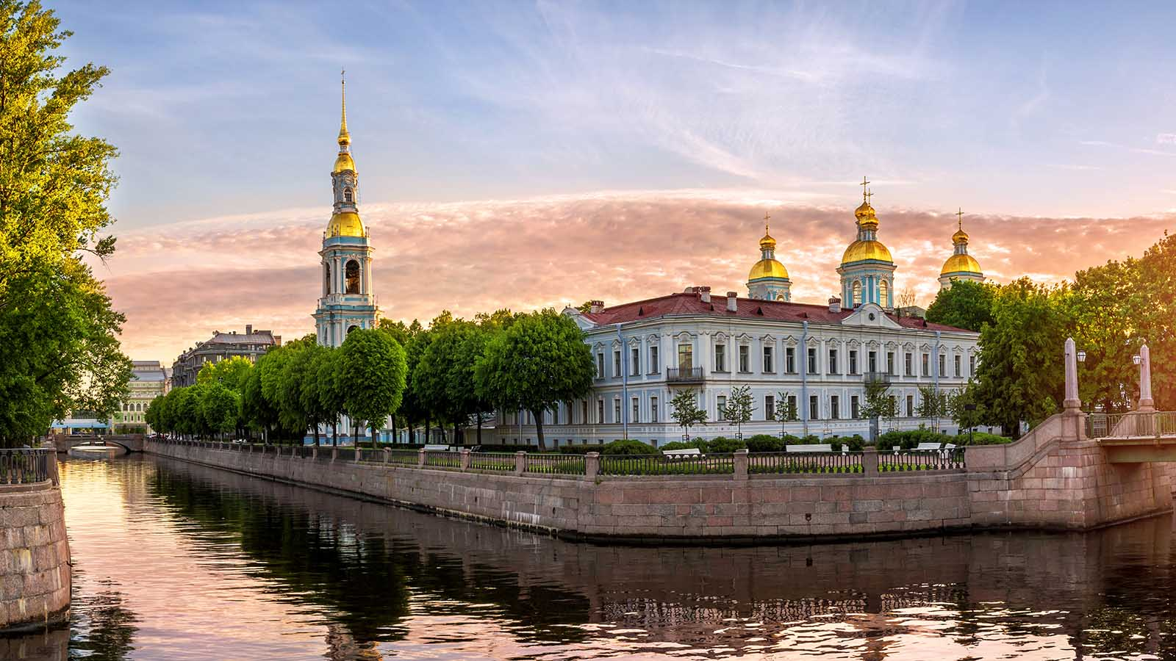
St.Petersburg

Slide 38
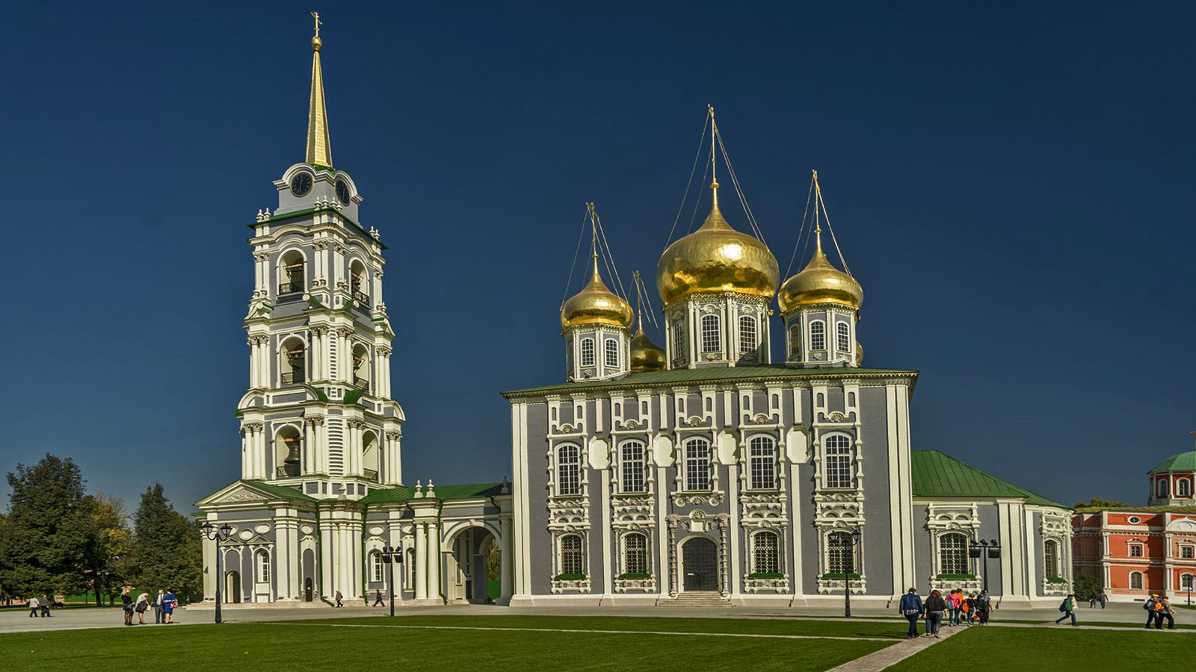
Tula

Slide 39
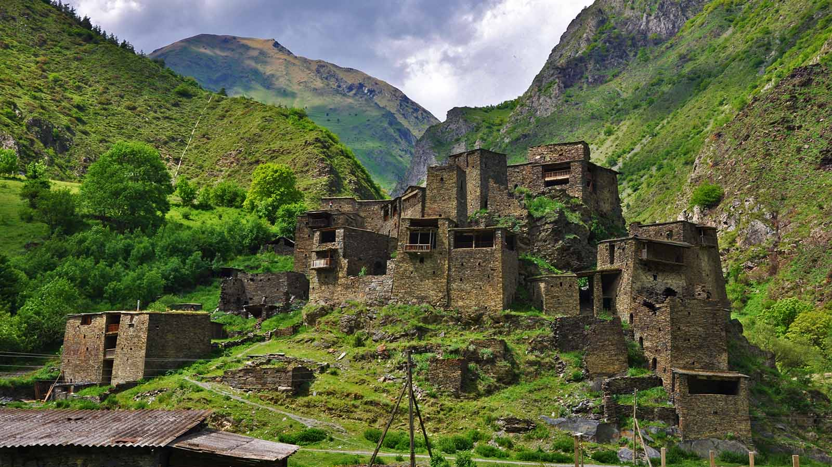
Tusheti, Khevsureti (Georgia)

Slide 40
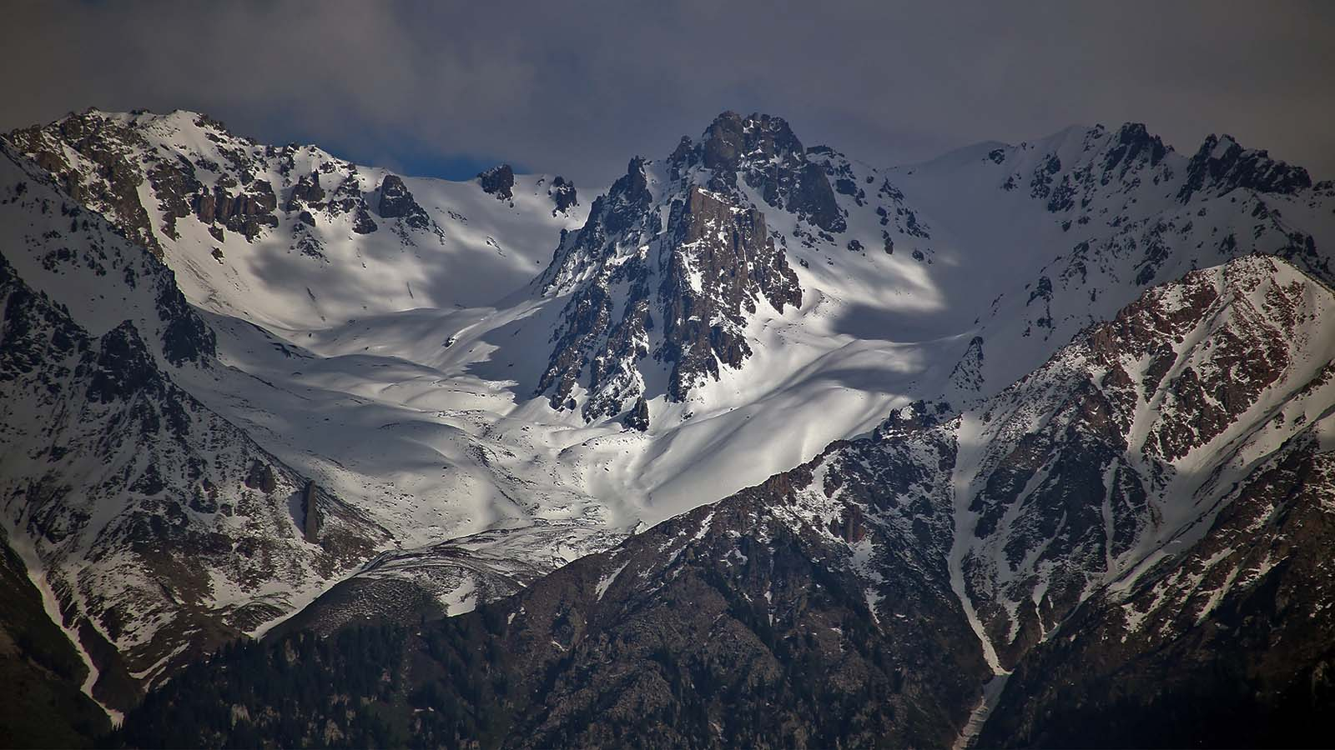
Trans-Ili Alatau (Tian Shan)

Slide 41
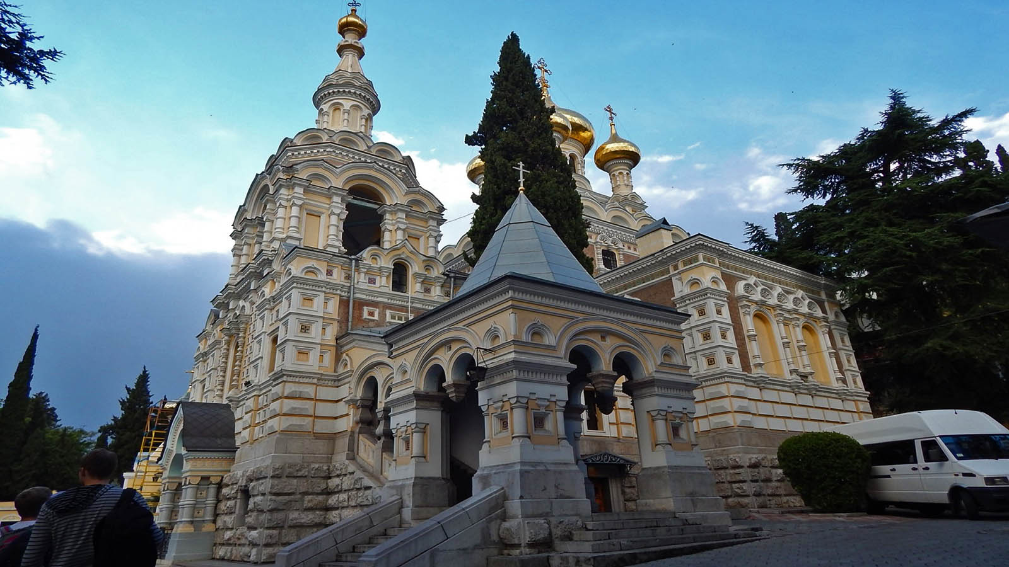
Yalta (Crimea Peninsula)

Slide 42
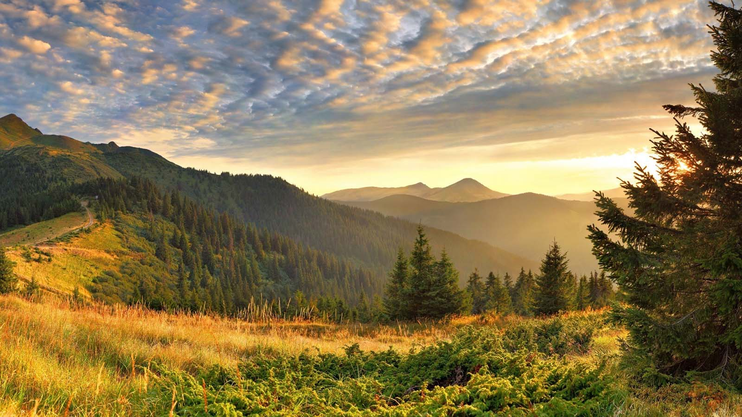
Ural Mountains

Slide 43
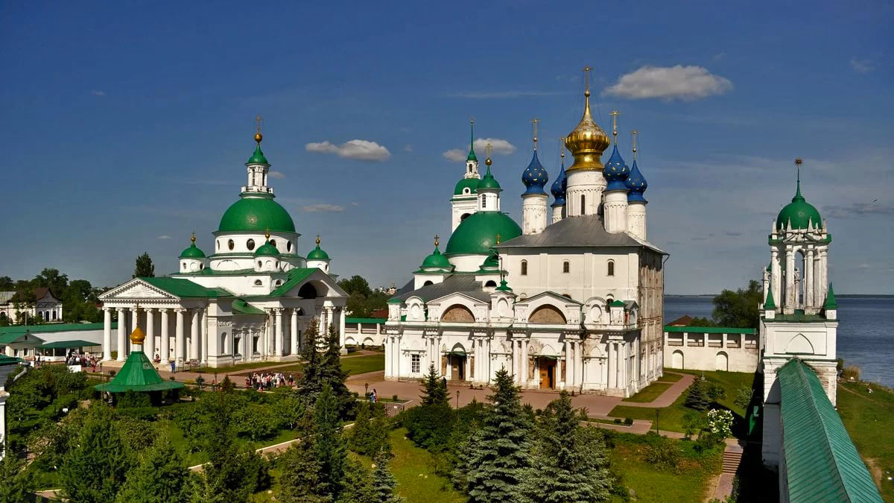
Yaroslavl

Slide 44
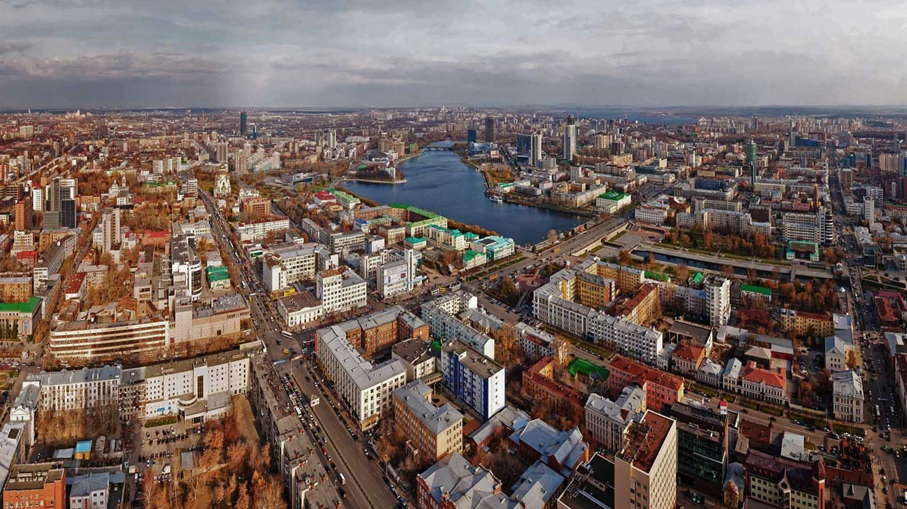
Yekaterinburg

Slide 45
Hope you have enjoyed viewing this presentation
Have a nice day
With regards - Tony Chacko and Steve Rumpler
tonychacko2000@gmail.com pista2011@gmail.com
Music : P.Farina - Volga
2017

Slide 46







¿Te ha gustado?
Puedes ver más entrando
Aquí
Además puedes recibir powerpoints en tu correo electrónico suscribiéndote aquí:
F I N

