Slide 1
El paso del huracán Sandy
El Huracán Sandy fue el decimoctavo ciclón tropical de la temporada de huracanes 2012 y el décimo en alcanzar el nivel de huracán. Afectó a Haití, República Dominicana, Jamaica, Cuba, Bahamas, Bermudas, Estados Unidos y Canadá.
Dejó 69 muertos en el Caribe antes de girar hacia el norte y golpear a la costa este de Estados Unidos el lunes pasado, con vientos de 130 kilómetros por hora (kph) y una enorme marea de tormenta. El número de muertos en Estados Unidos se ha elevado a 113 como mínimo.
Una semana después todas las ciudades luchan por volver a la normalidad.
Avance manual

Slide 2
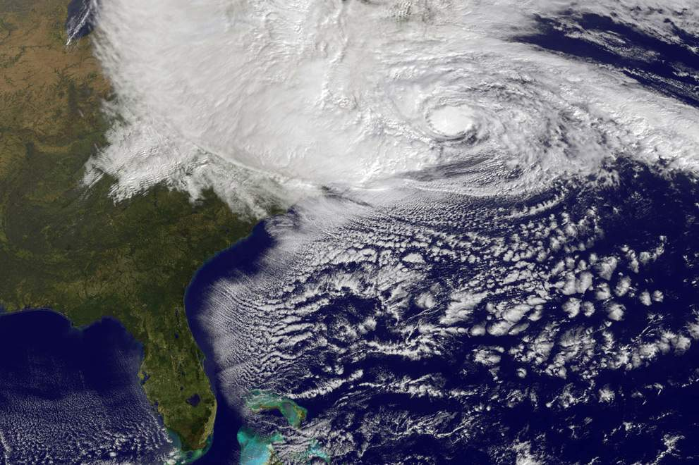
Huracán Sandy, a ( 10:40 am hora del este) el 29 de octubre de 2012 por la NASA satélite GOES, frente a la costa este en el Océano Atlántico.

Slide 3
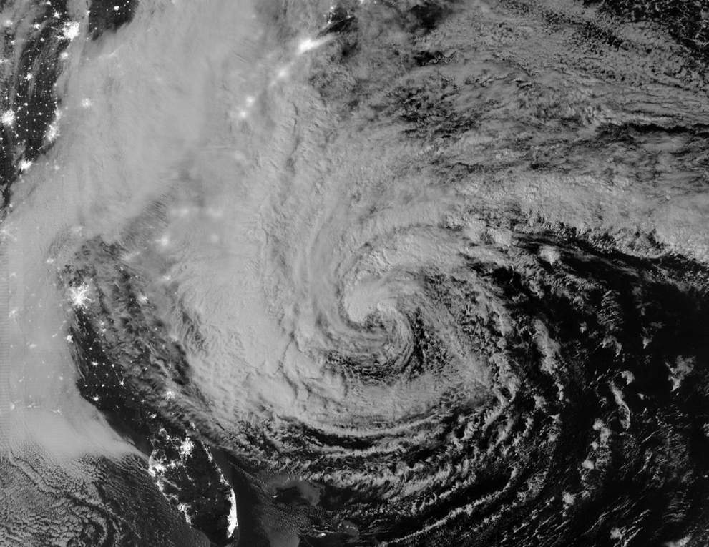
imagen nocturna de playa tomada por satélite del huracán Sandy,
el día 28 de octubre de 2012.
Imaging Radiometer Suite (VIIRS) on the Suomi NPP satellite around 2:42 a.m. Eastern Daylight Time.

Slide 4
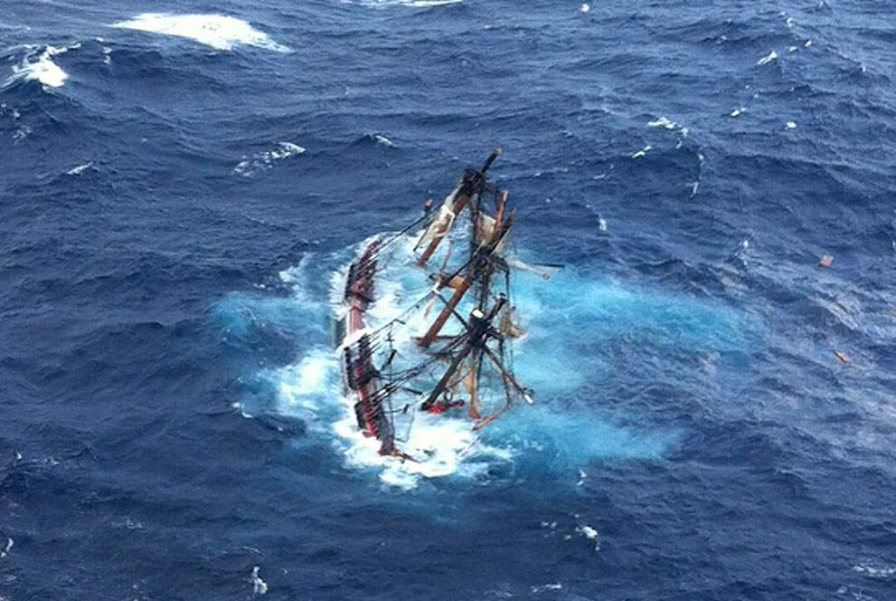
Océano Atlántico, Carolina del Norte, un velero en el que iban 16 personas.
Rescataron a 14, aún siguen buscando al capitán.

Slide 5
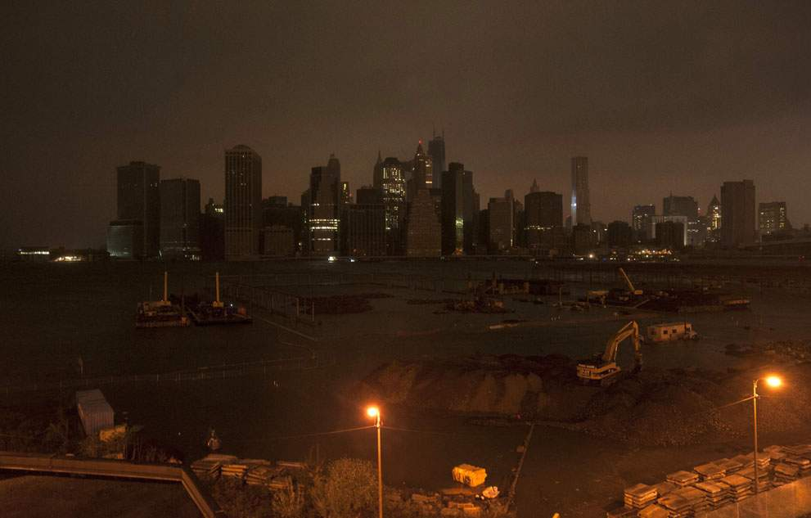
Manhattan , New York.

Slide 6
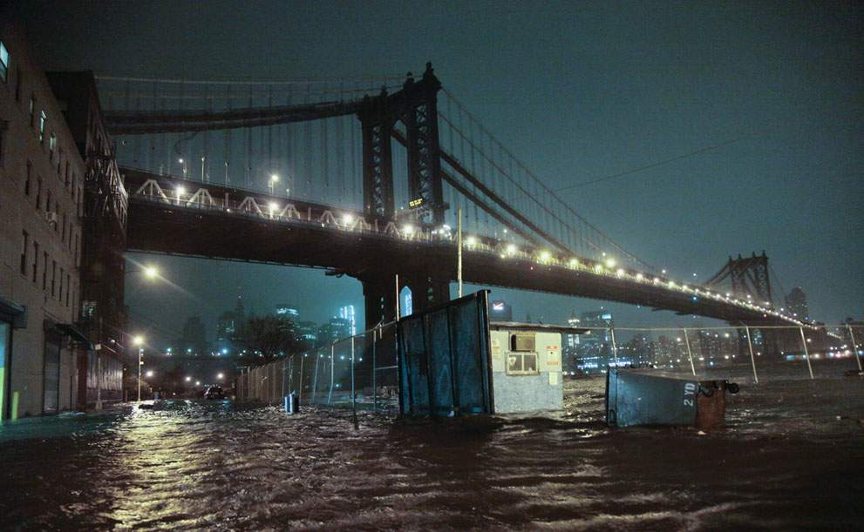
Brooklyn.

Slide 7
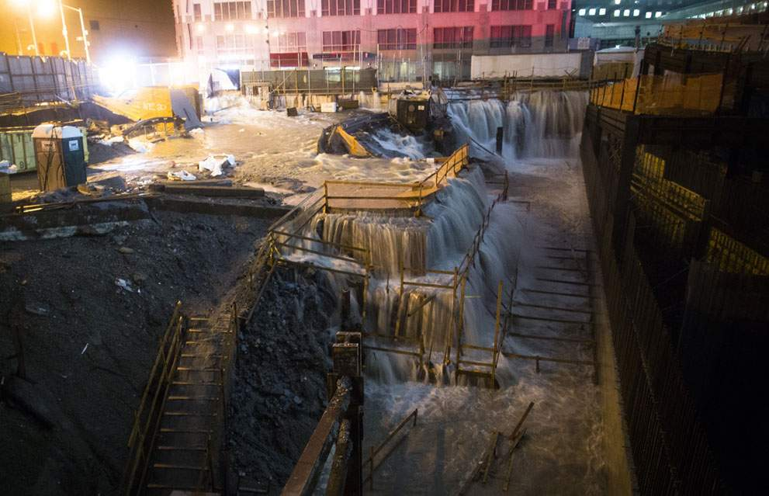
New York.

Slide 8
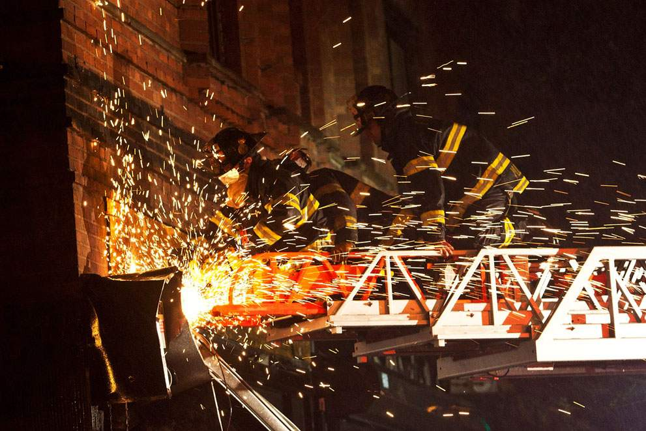
New York.

Slide 9
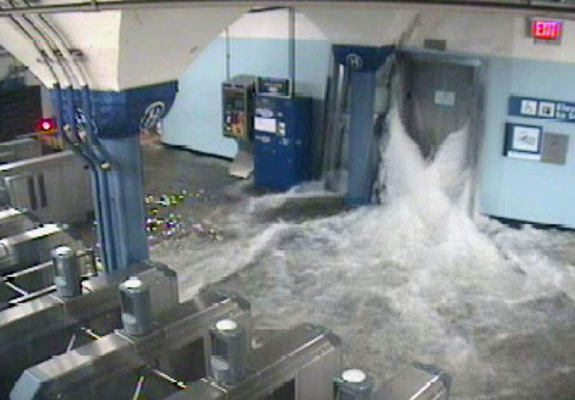
Station in Hoboken, New Jersey.

Slide 10
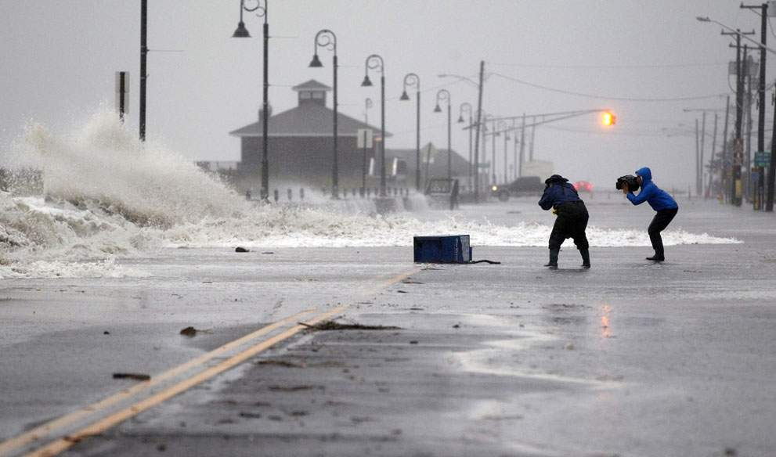
Beach Avenue, 29 de octubre , 2012, en Cape May, New Jersey.

Slide 11
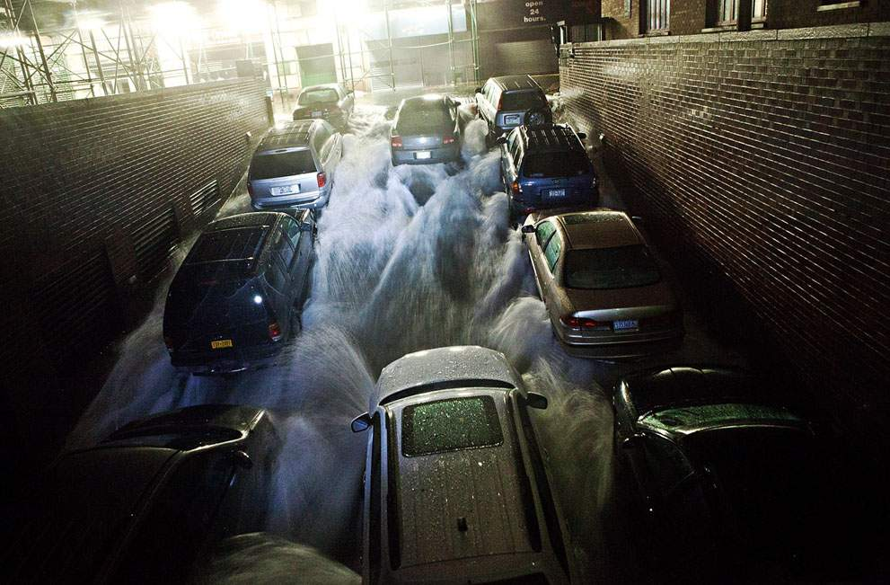
Parking subterráneo 29 de octubre, 2012, en New York's Financial District.

Slide 12
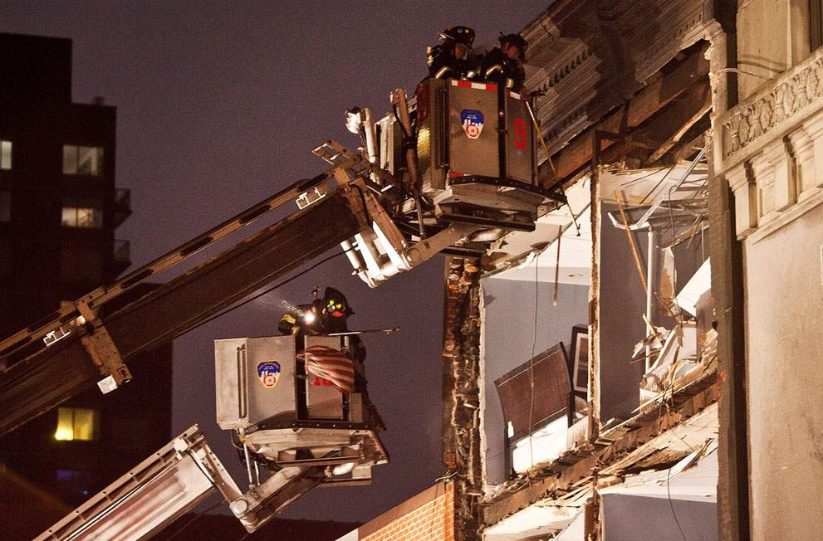
New York.,

Slide 13
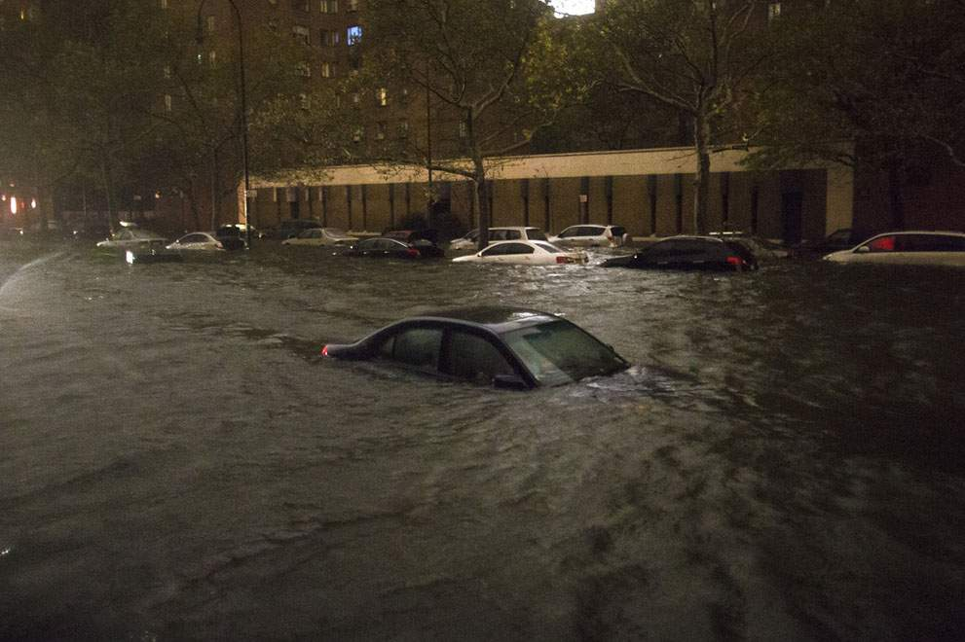
A vehicle sits submerged on 14th Street near the Consolidated Edison power plant in New York, on October 29, 2012. Sandy knocked out power to at least 3.1 million people, and New York's main utility said large sections of Manhattan.

Slide 14
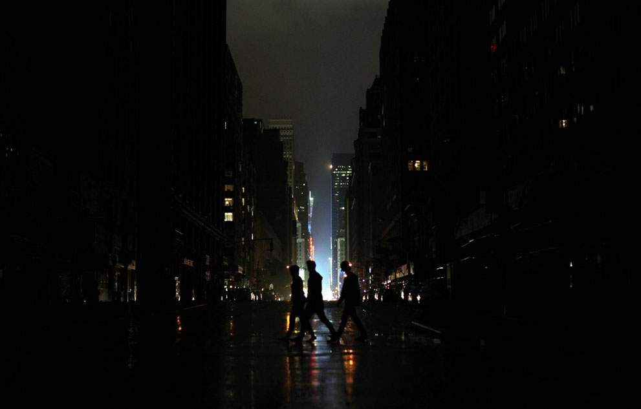
Blackout conditions in Manhattan, after Hurricane Sandy hit, on October 29, 2012..

Slide 15
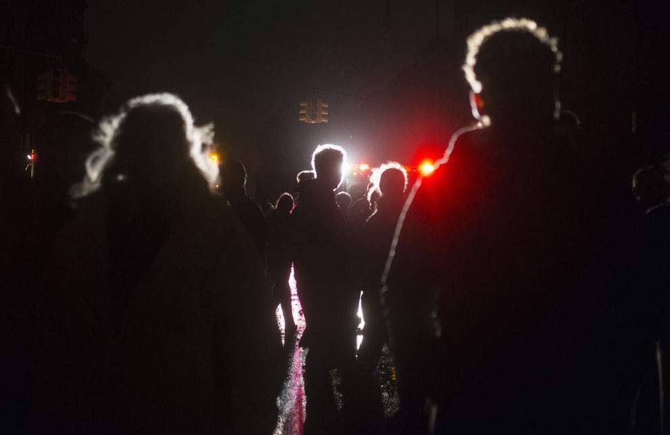
Residents, lit by police vehicles, stand outside their homes during a power outage in Lower Manhattan, on October 29, 2012. New York

Slide 16
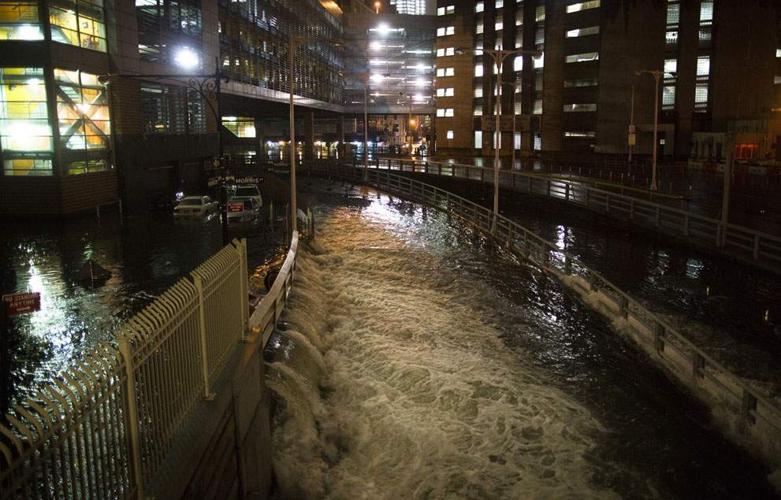
Seawater floods the entrance to the Brooklyn Battery Tunnel in New York.

Slide 17
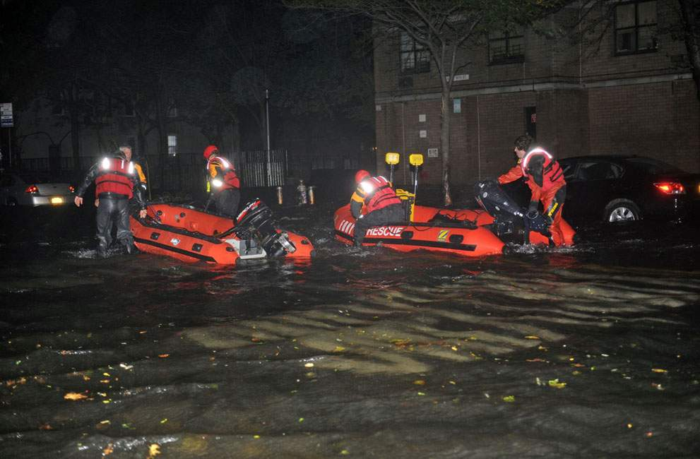
New York Fire Department rescue boats, along 14th street, heading toward the East River on a rescue mission .

Slide 18
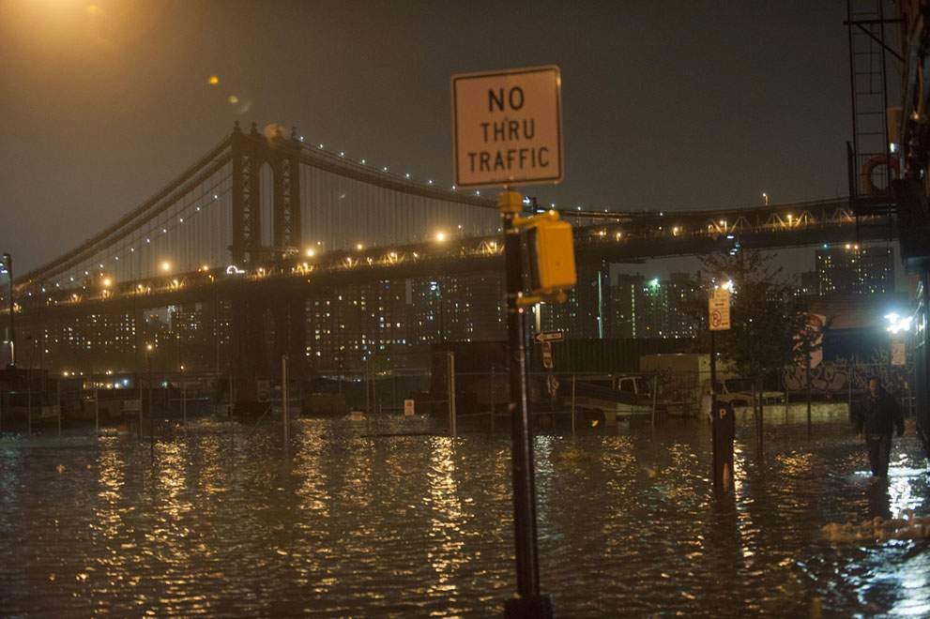
A man makes his way through floodwaters on the Brooklyn waterfront in New York.

Slide 19
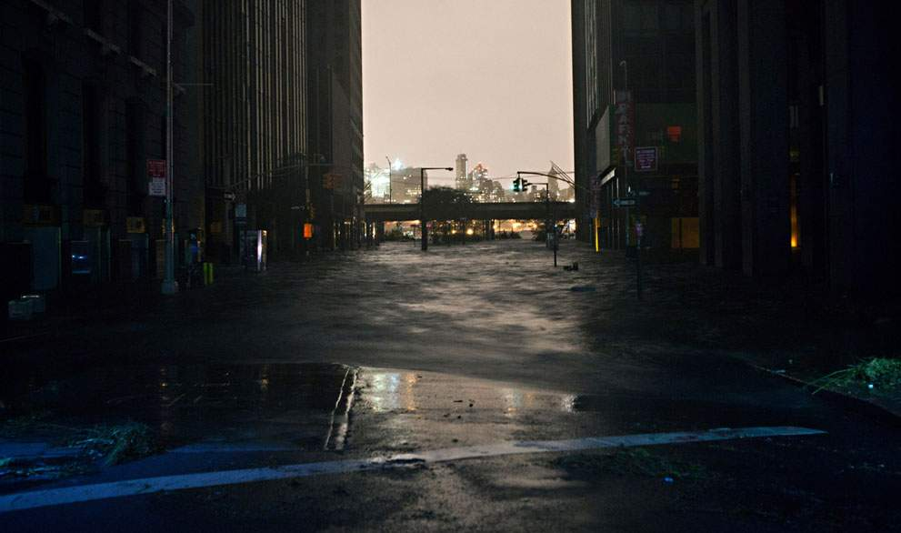
A flooded street in New York's Financial District.

Slide 20
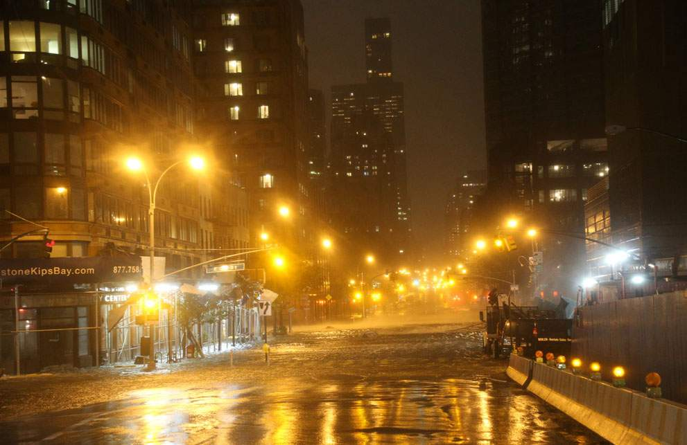
A view of the corner of 34th Street and 1st Street in Manhattan.

Slide 21

Medical workers assist a patient into an ambulance during an evacuation of New York University's Tisch Hospital, on October 29, 2012. The hospital is moving out more than 200 patients after its backup generator failed when the power was knocked out by Sandy.

Slide 22
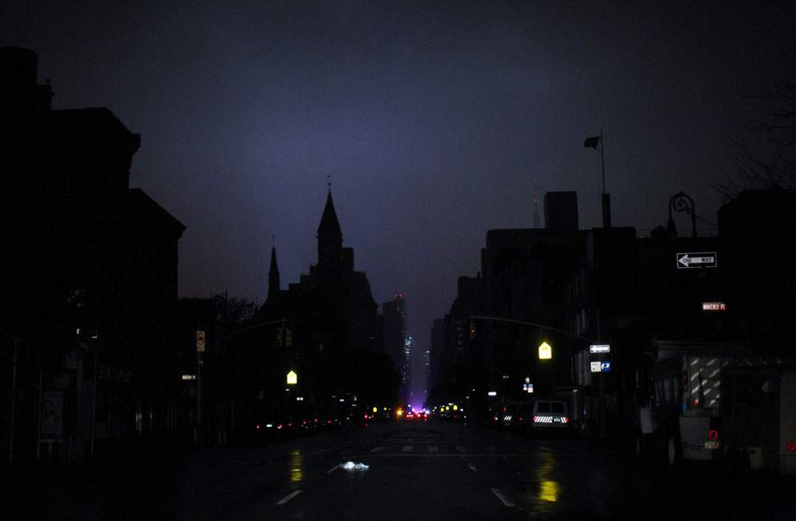
Power outage, caused by Hurricane Sandy, on October 29, 2012 in Manhattan, New York.

Slide 23
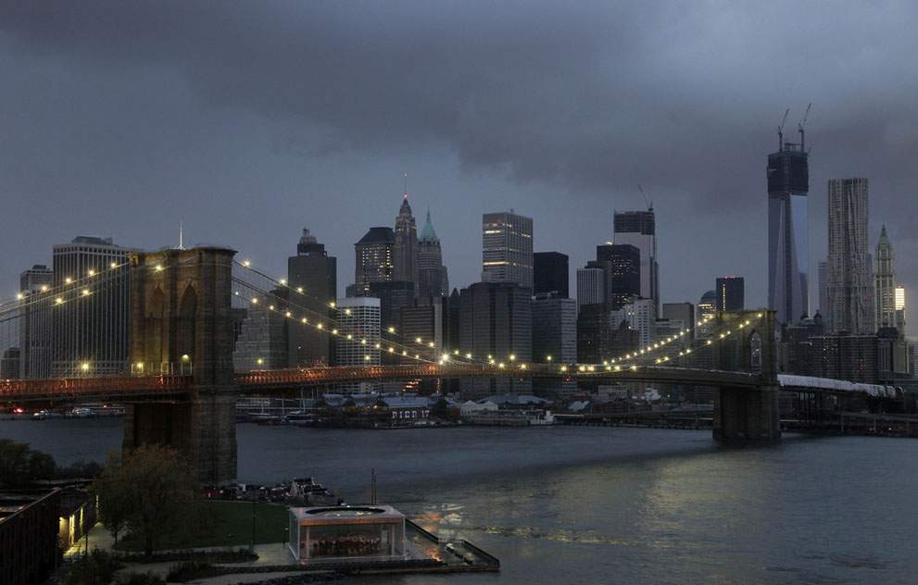
The lights on the Brooklyn Bridge stand in contrast to the lower Manhattan skyline which has lost its electrical supply, early on Tuesday, October 30, 2012, after megastorm Sandy swept through New York.

Slide 24
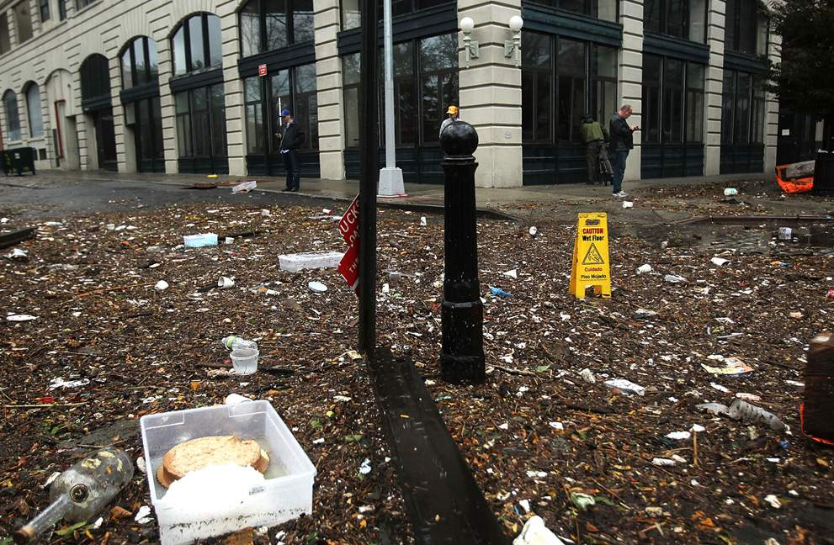
Debris litters a flooded street in the Dumbo section of Brooklyn after the city awakens to the affects of Hurricane Sandy.

Slide 25
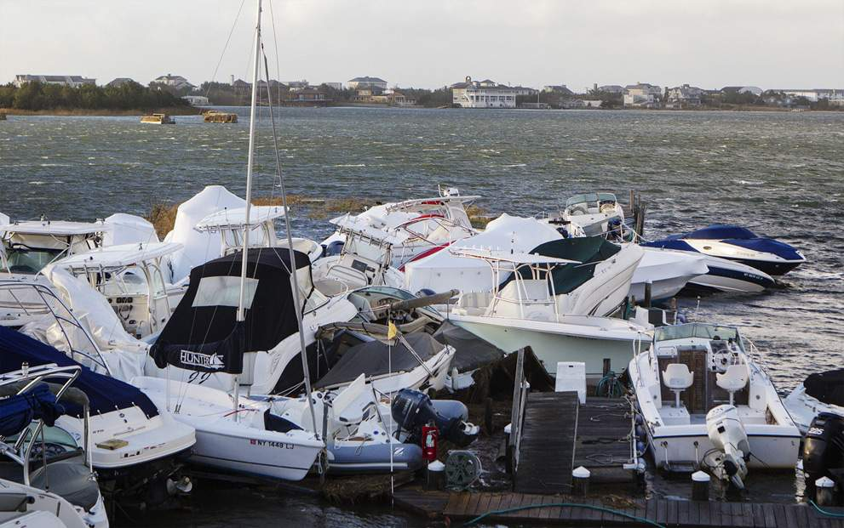
Boats piled up by storm surge and the high tide lie in a pile at a marina in East Quogue, New York.

Slide 26
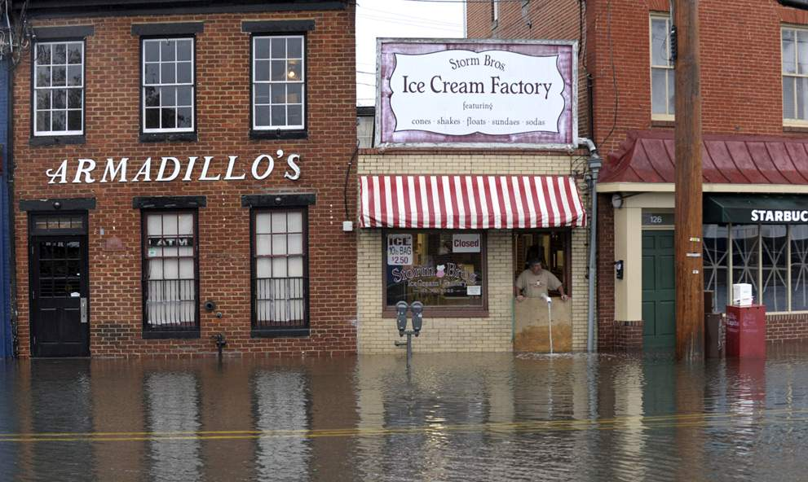
Sveinn Storm, owner of Storm Bros. Ice Cream Factory, looks at flood water outside his store in Annapolis, Maryland,

Slide 27
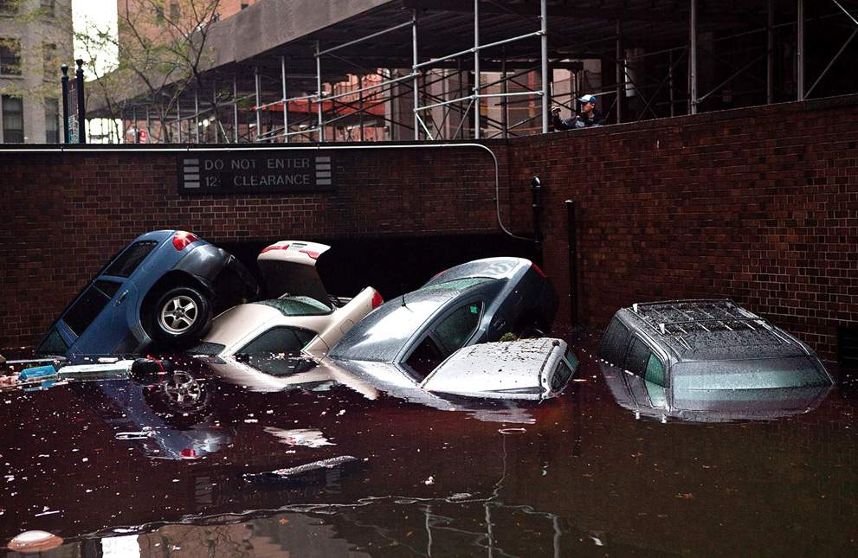
Cars floating in a flooded parking garage entrance, on October 30, 2012 in the Financial District of New York.

Slide 28
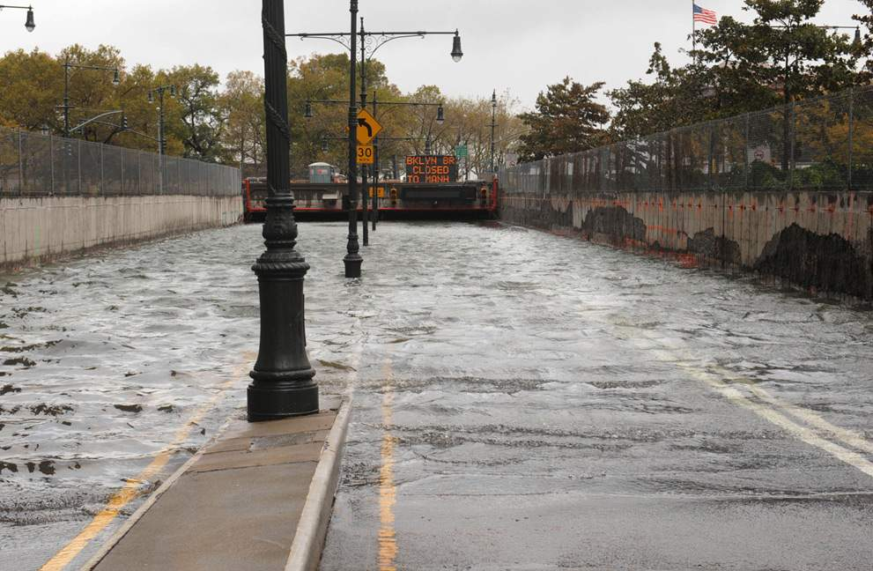
Water reaches street level at the West Street entrance to the Battery Park Underpass.

Slide 29
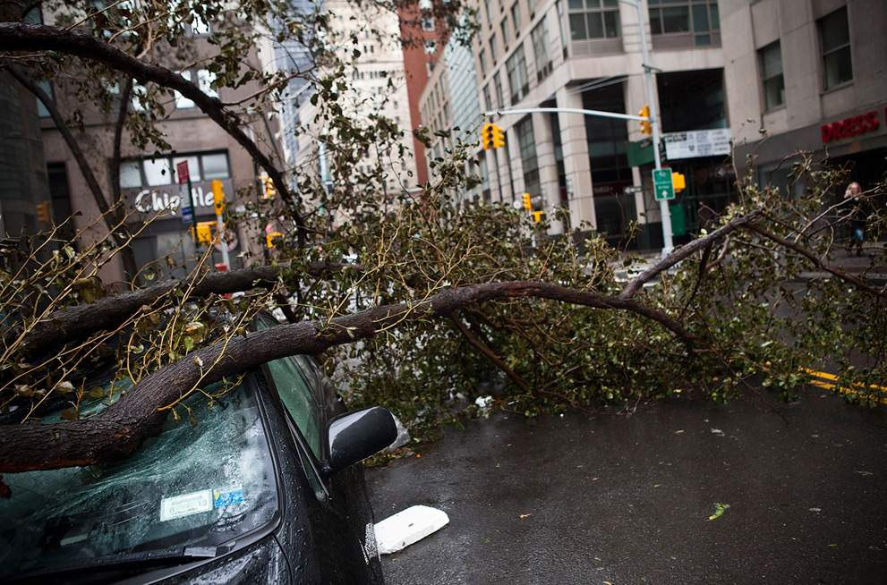
A car crushed by a tree following Hurricane Sandy on October 30, 2012 in New York's Financial District.

Slide 30
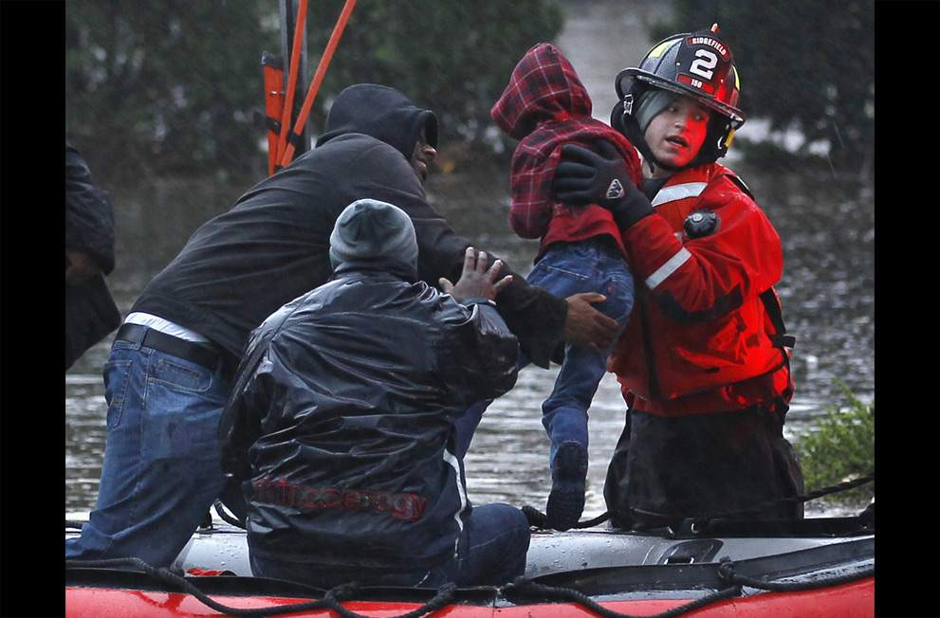
A young child is rescued by emergency personnel in Little Ferry, New Jersey.

Slide 31
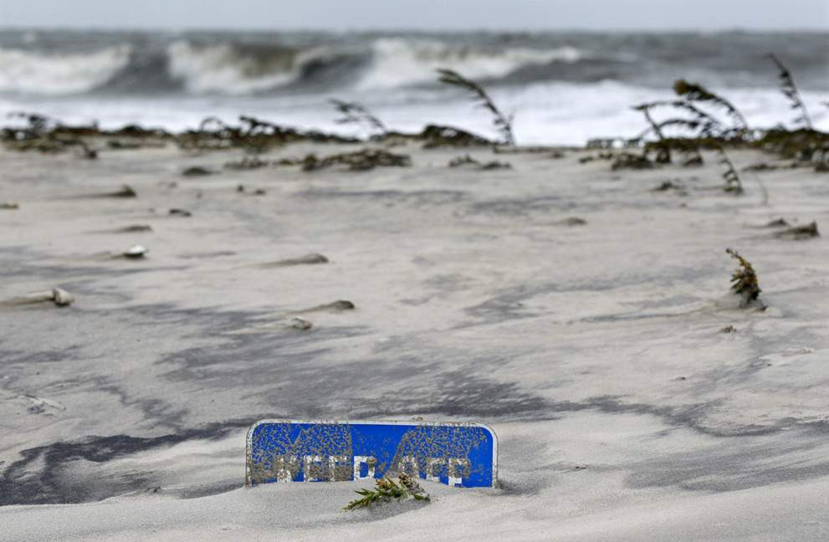
A "keep off the dunes" sign, buried Tuesday morning in Cape May, New Jersey.

Slide 32
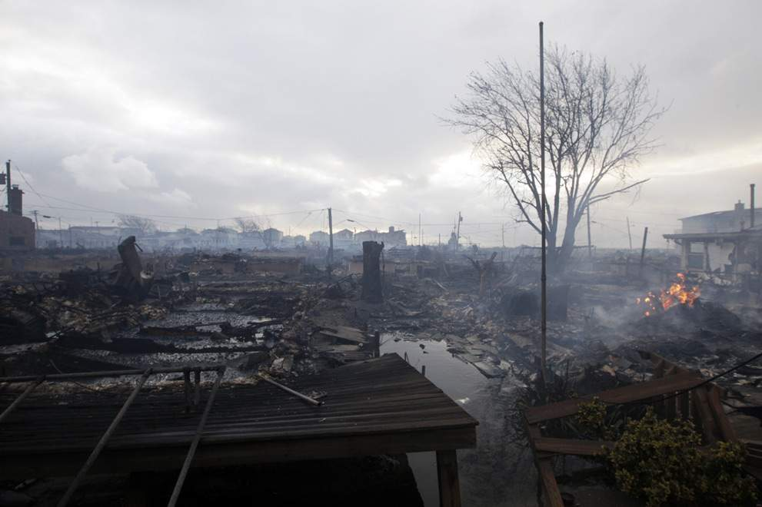
Damage caused by a fire at Breezy Point is shown in the New York City borough of Queens, on October 30, 2012. The fire destroyed between 80 and 100 houses Monday night in the flooded neighborhood.

Slide 33
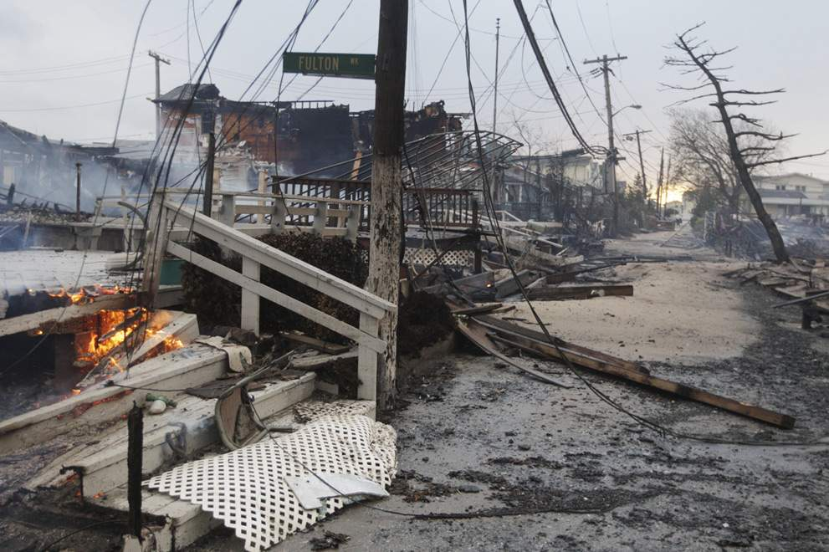
Widespread damage caused by a multi-structure fire at Breezy Point, in Queens, New York.

Slide 34
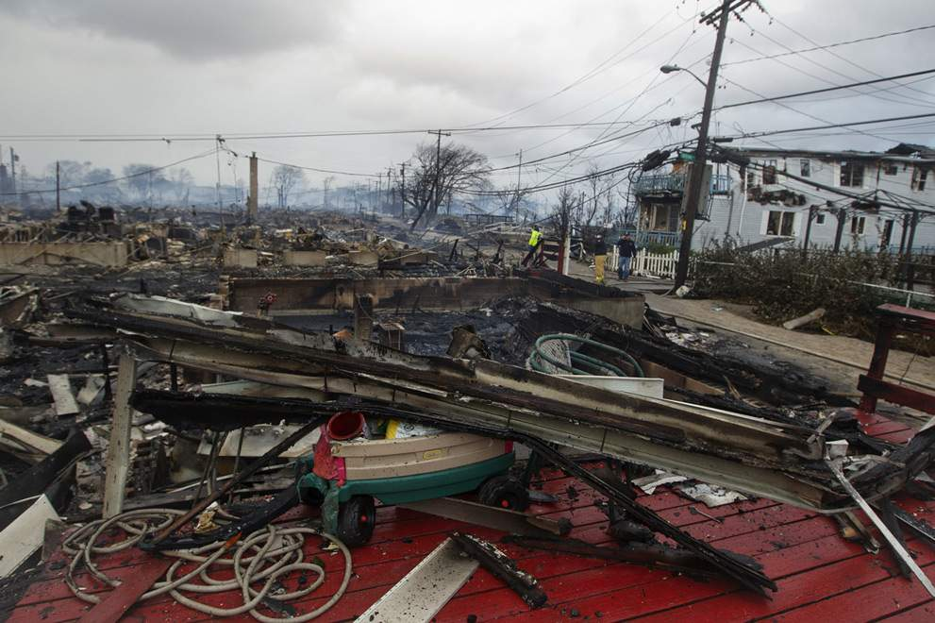
Homes, devastated by fire and the effects of Hurricane Sandy, in the Breezy Point section of Queens, New York.

Slide 35
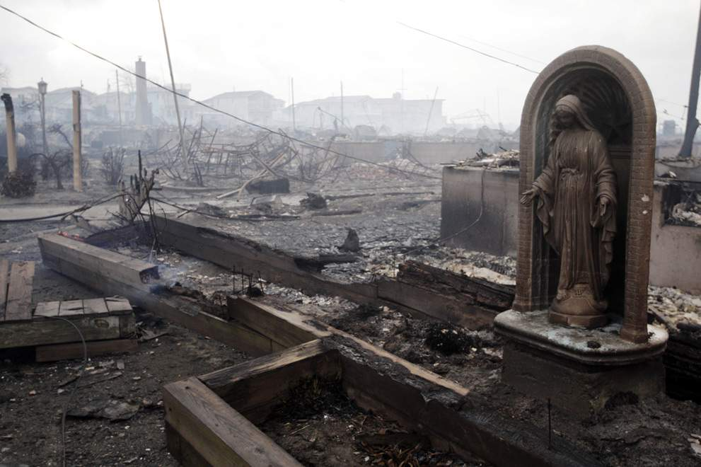
Damage caused by a fire at Breezy Point, photographed on October 30, 2012, in New York.

Slide 36
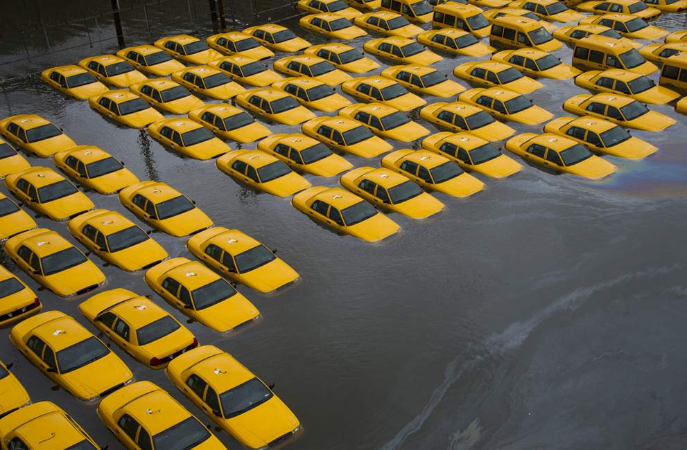
A parking lot full of yellow cabs sits flooded as a result of Hurricane Sandy on Tuesday, October 30, 2012 in Hoboken, New Jersey.

Slide 37
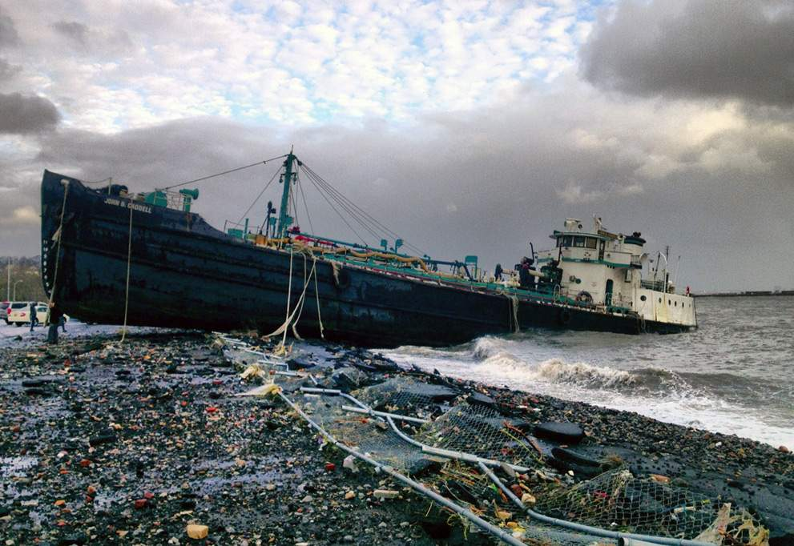
A 168-foot water tanker, the John B. Caddell, sits on the shore Tuesday morning, October 30, 2012 where it ran aground on Front Street in the Stapleton neighborhood of New York's Staten Island.

Slide 38
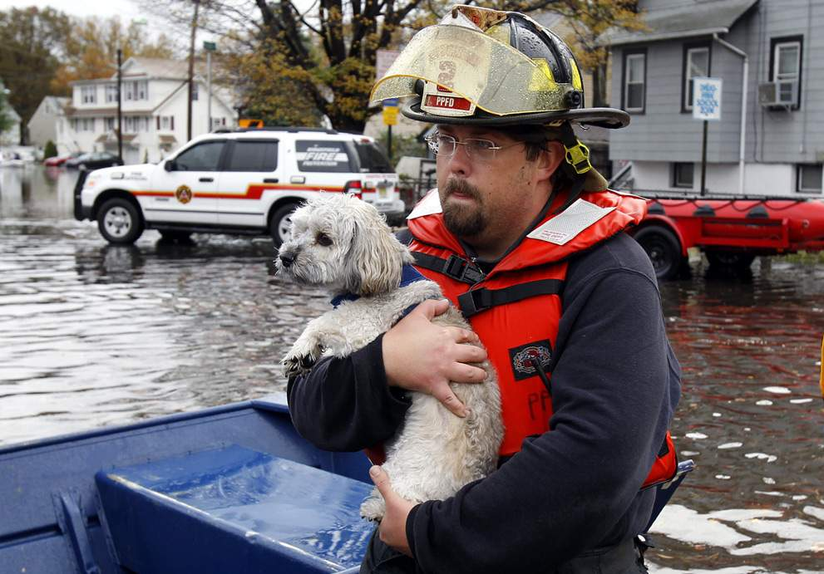
A fireman carries a dog to safety from floodwaters brought on by Hurricane Sandy in Little Ferry, New Jersey.

Slide 39
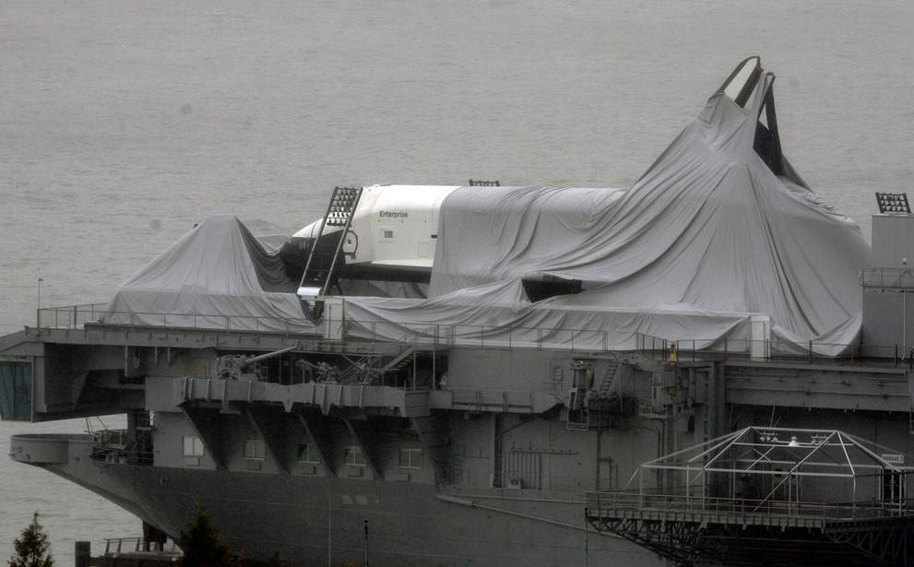
The space shuttle Enterprise is draped with torn fabric that had protected it before Sandy passed though, leaving the spacecraft shrouded on the deck of the Intrepid Sea, Air & Space Museum, on the Hudson River in New York.

Slide 40
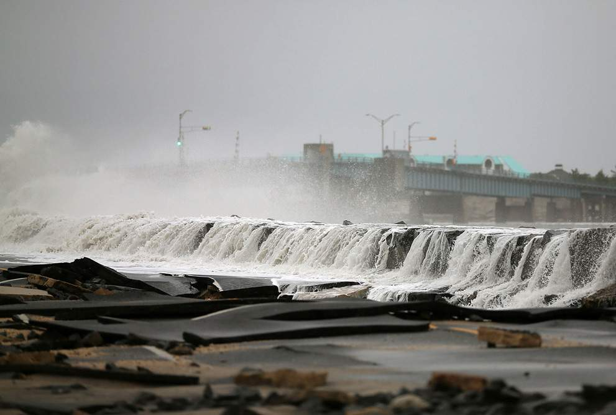
Heavy surf caused by Hurricane Sandy buckled and tore up Ocean Avenue on October 30, 2012 in Avalon, New Jersey.

Slide 41
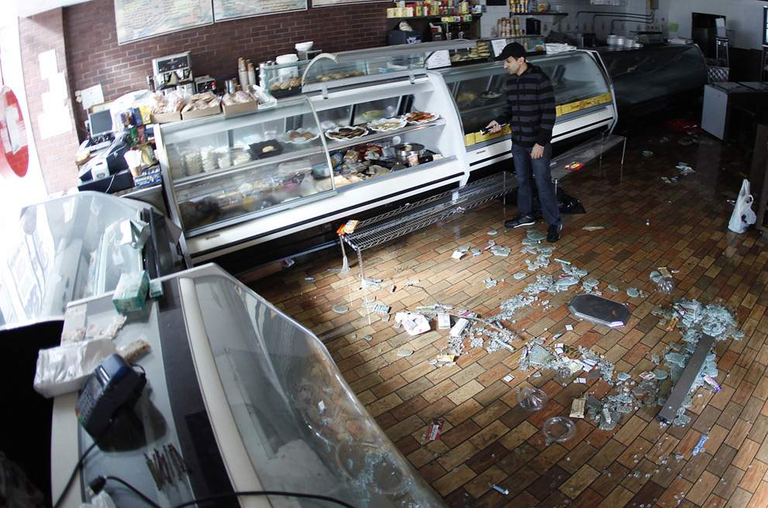
Rod Zindani surveys the damage to his Best Of New York Food Deli in the aftermath of Hurricane Sandy in New York

Slide 42
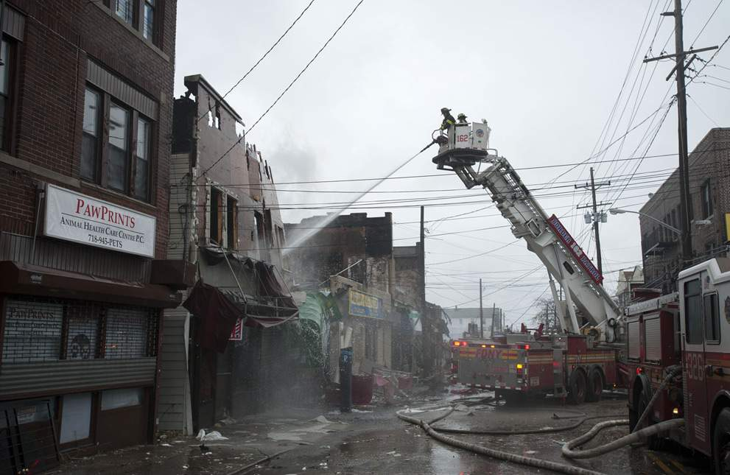
irefighters work to extinguish a fire in the Rockaways section of New York.

Slide 43
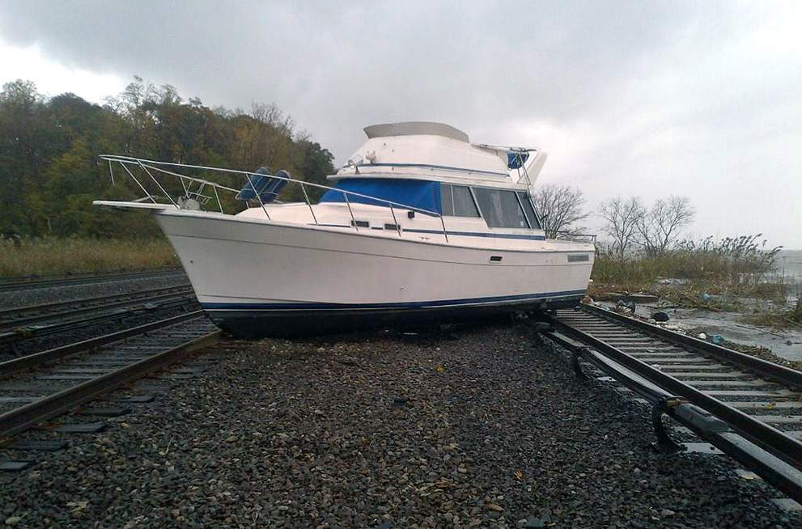
A boat rests on the tracks at Metro-North's Ossining Station on the Hudson Line in the aftermath of Hurricane Sandy, in New York.

Slide 44
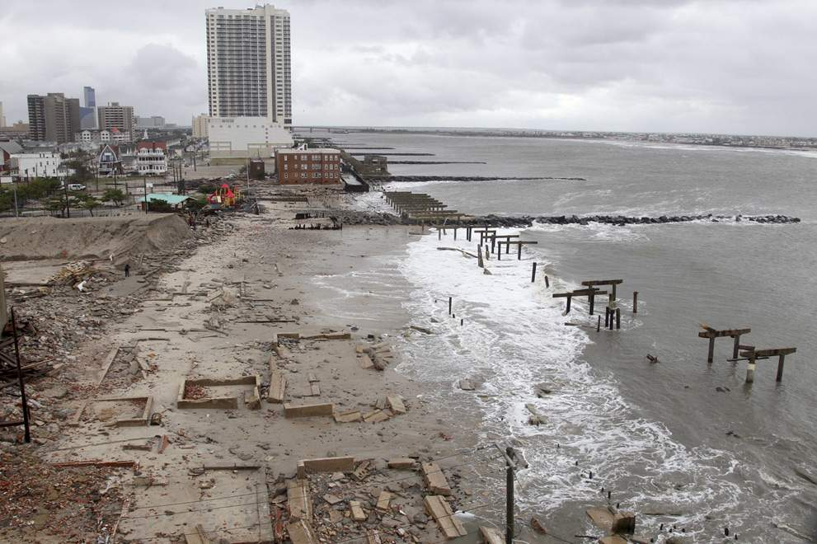
Foundations and pilings are all that remain of brick buildings and a boardwalk in Atlantic City, New Jersey

Slide 45
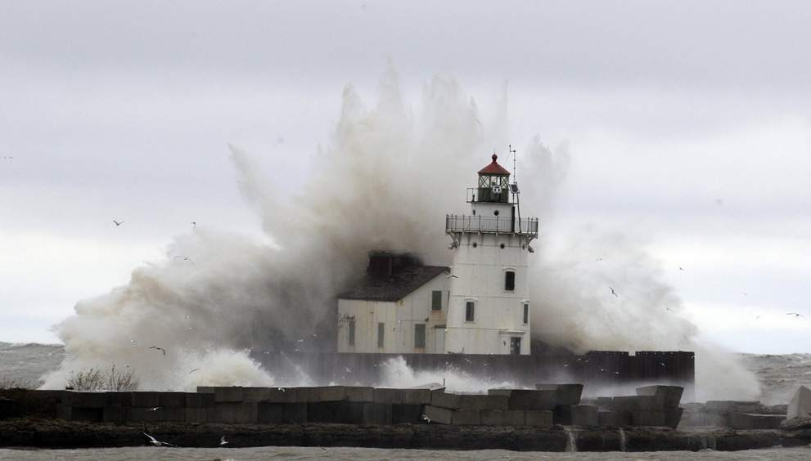
As Sandy moves inland, waves pound a lighthouse on the shores of Lake Erie, near Cleveland, Ohio.

Slide 46
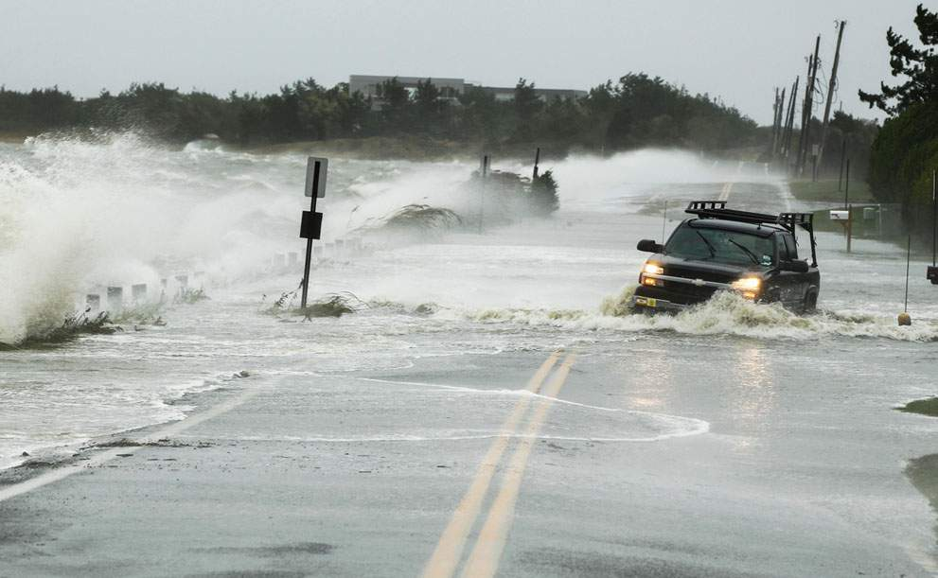
Truck drives through water pushed over a road by Hurricane Sandy in Southampton, New York, on October 29, 2012.

Slide 47
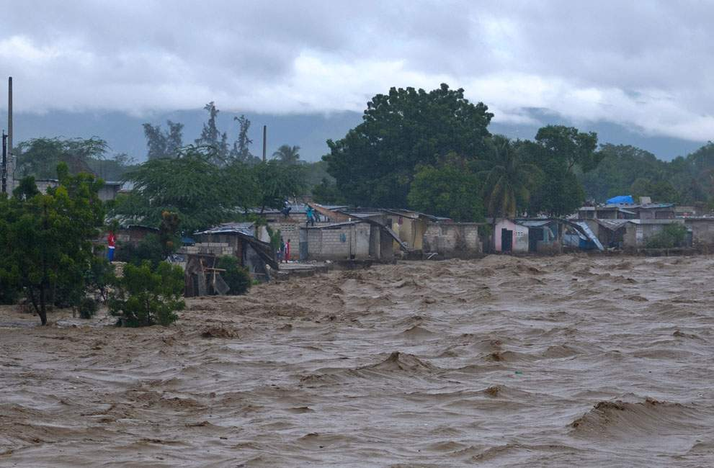
Heavy rains from Hurricane Sandy caused the Croix de Mission river to swell and threaten homes along its bank in Port-au-Prince, Haiti, on October 25, 2012.

Slide 48
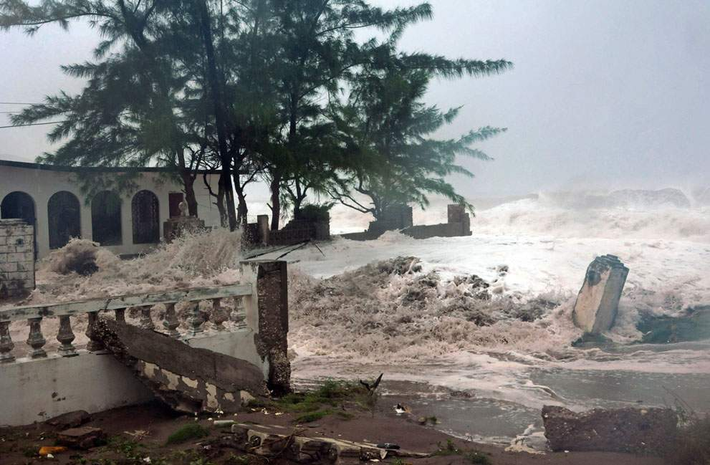
Waves, brought by Hurricane Sandy, crash on a house in the Caribbean Terrace neighborhood in eastern Kingston, Jamaica, on October 24, 2012.

Slide 49
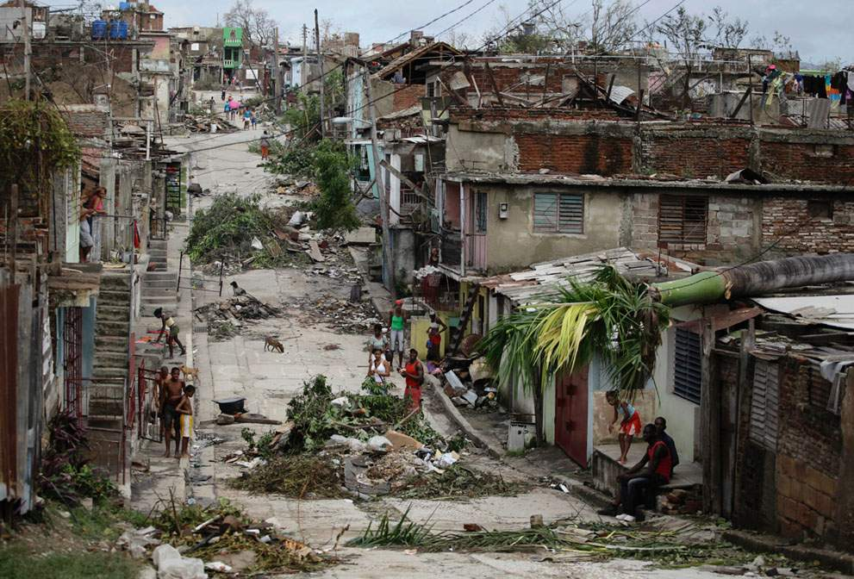
People walk on a street littered with debris after Hurricane Sandy hit Santiago de Cuba, on October 26, 2012.

Slide 50
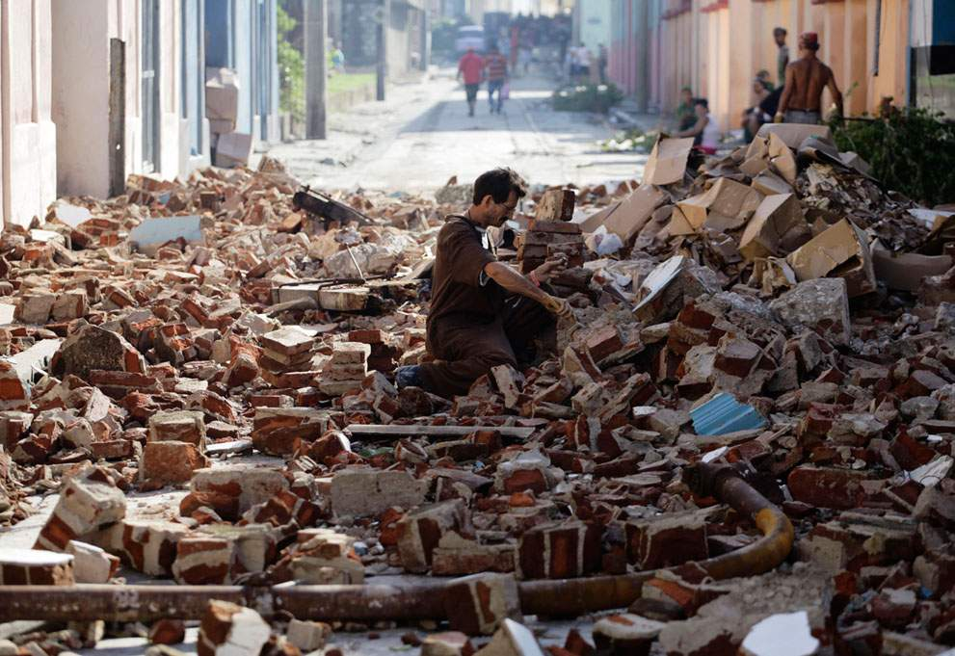
Santiago de Cuba.

Slide 51
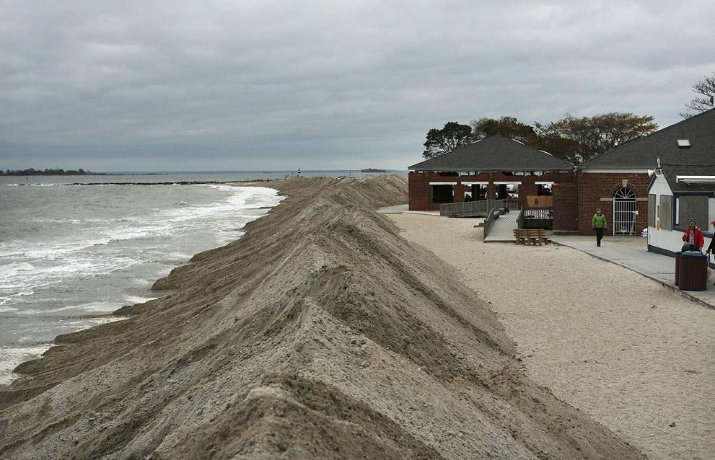
Protective berms line Compo Beach, as the first signs of Hurricane Sandy approach on October 28, 2012, in Westport, Connecticut.

Slide 52
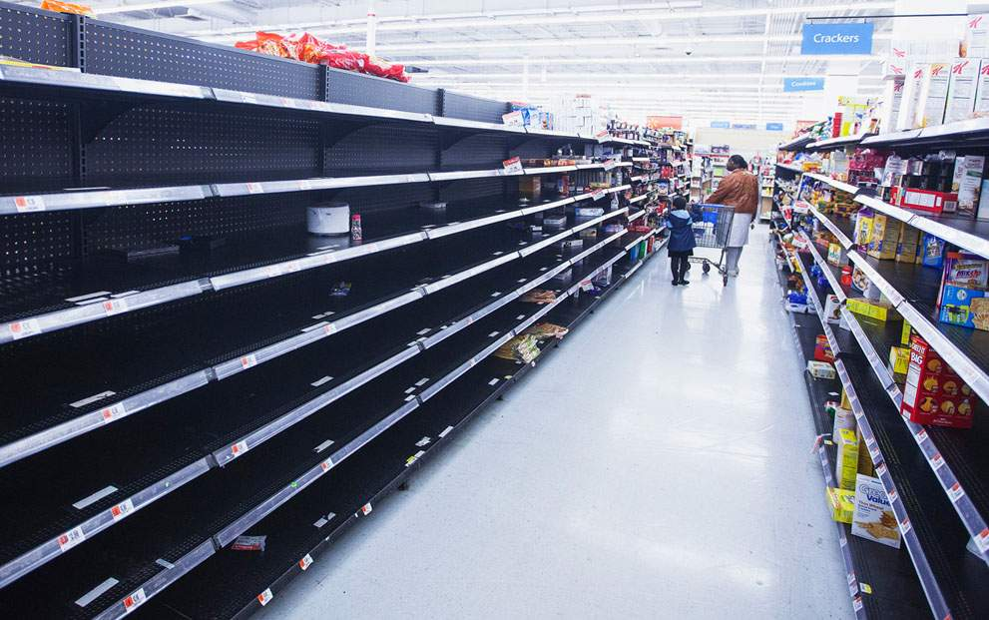
During preparations for Hurricane Sandy, a woman and child walk through an emptied aisle in a Wal-Mart store in Riverhead, New York, on October 28, 2012.

Slide 53

New York's empty Hugh L. Cary Tunnel (formerly the Brooklyn-Battery Tunnel), which will be closed at 2 p.m. on October 29, 2012.

Slide 54

The New York City Subway system suspended service at 7 p.m. on October 28, 2012.

Slide 55

Bill Ryan, of Inwood, New York, comforts his cat Amy before leaving her at a pet shelter at Mitchell Park's Field House, run by the Nassau County Office of Emergency Management and Pet Safe Coalition in Uniondale, New York, on October, 28, 2012.

Slide 56

A sailboat smashes on the rocks after breaking free from its mooring on City Island, on October 29, 2012 in New York.

Slide 57

Ocean waves kick up near homes along Peggoty Beach in Scituate, Massachusetts, on October 29, 2012.

Slide 58

High tide begins to flood a street on the shoreline area of Milford, Connecticut as Hurricane Sandy approaches on October 29, 2012.

Slide 59

U.S. Route 30, the White Horse Pike, one of three major approaches to Atlantic City, New Jersey, covered with water from Absecon Bay in this view looking west, during the approach of Hurricane Sandy, on October 29, 2012.

Slide 60

Waters flood Ocean Avenue in Sea Bright, New Jersey, on October 29, 2012.

Slide 61

Waves crash over Winthrop Shore Drive as Hurricane Sandy comes up the coast on October 29, 2012 in Winthrop, Massachusetts.

Slide 62

Part of a crane boom is seen hanging off a building under construction on West 57th Street above Manhattan, on October 29, 2012.

Slide 63

Sailboats rock in choppy water at a dock along the Hudson River Greenway during a storm, on October 29, 2012, in New York.

Slide 64

Firefighters respond at the scene where the facade of a four-story building on 14th Street and 8th Avenue collapsed onto the sidewalk in New York, on October 29, 2012.

Slide 65

Caleb Lavoie, 17, of Dayton, Maine, front, and Curtis Huard, 16, of Arundel, Maine, leap out of the way as a large wave crashes over a seawall on the Atlantic Ocean during the early stages of Hurricane Sandy in Kennebunk, Maine, on October 29, 2012.

Slide 66

Joseph Leader, Metropolitan Transportation Authority Vice President and Chief Maintenance Officer, walks around massive fallen beams and other debris in the hurricane-damaged South Ferry 1 train station in New York, on October 31, 2012.

Slide 67

Homes, flooded after Hurricane Sandy made landfall on the southern New Jersey coastline, on October 30, 2012 in Tuckerton, New Jersey.

Slide 68

Through destruction from superstorm Sandy on Route 35 in Seaside Heights, New Jersey, on October 31, 2012.

Slide 69

Homes, surrounded by sand washed in by Hurricane Sandy in Seaside Heights, New Jersey, on October 31, 2012.

Slide 70

Several feet of sand covers Tradewinds Lane after being deposited there by Hurricane Sandy in Sea Bright,
New Jersey, on October 31, 2012.

Slide 71

October 31, 2012 in the Queens borough of New York City.

Slide 72

A pedestrian surveys fallen trees on top of parked cars in Queens, New York, on October 30, 2012.

Slide 73

The remains of homes and businesses burned down during Hurricane Sandy in the Rockaway neighborhood of Queens, still smoldering on October 31, 2012.

Slide 74

Burnt houses side-by-side with others that survived in Breezy Point, Queens, after it was devastated by Hurricane Sandy, on October 31, 2012.

Slide 75

The remains of burned homes in the Breezy Point neighborhood of Queens, with the Manhattan skyline in the distance after Superstorm Sandy, on October 31, 2012.

Slide 76

Damage to an amusement park left in the wake of superstorm Sandy in Seaside Heights, New Jersey, on October 31, 2012.

Slide 77

Destroyed homes left in the wake of superstorm Sandy in Seaside Heights, New Jersey, on October 31, 2012.

Slide 78

Storm damage over the Atlantic Coast, seen from a helicopter behind Marine One with US President Barack Obama and Governor Christie as they view the hurricane damage in New Jersey, on October 31, 2012.

Slide 79

Smoking ruins, seen in the aftermath of Hurricane Sandy in Seaside Heights, New Jersey, on October 31, 2012.

Slide 80

A dog named Shaggy is handed from a National Guard truck to National Guard personnel after the dog and his owner left a flooded building in Hoboken, New Jersey, on October 31, 2012.

Slide 81

A man checks his car as oil-filled floodwaters continue to fill streets in Hoboken, New Jersey, on October 31, 2012.

Slide 82

People examine the wreckage of a boat washed ashore in Great Kills, Staten Island, following Hurricane Sandy in New York, on October 31, 2012.

Slide 83

A man looks at a damaged house in Seagate Association, a gated community, after Hurricane Sandy in New York, on October 30, 2012.

Slide 84

A view shows boats piled next to a house, where they were washed ashore during Hurricane Sandy, near Monmouth Beach, New Jersey, on October 31, 2012.

Slide 85

Freddie Nocella, Jr., left, hands a vase to his grandfather Bill Schmith, as Schmith works to salvage belongings from his heavily damaged home, on October 31, 2012, in Babylon Village, New York.

Slide 86

Captain Charles Bodien Jr. posts a condemned sign on a summer camp on Webster Lake, in Franklin, New Hampshire, on October 31, 2012.

Slide 87

A canoe sits in the lobby of an apartment building in the aftermath of Hurricane Sandy in Sheepshead Bay, Brooklyn, on October 30, 2012.

Slide 88

Homes wrecked by Superstorm Sandy sit among sand washed ashore on October 31, 2012 in Seaside Heights, New Jersey.

Slide 89

A largely unlit downtown Manhattan stands under a night sky, darkened by a power blackout caused by Hurricane Sandy, on October 30, 2012.

Slide 90

Lisa Kravchenko, in her Halloween costume, stands among flood debris in the Staten Island borough of New York, on October 31, 2012.

Slide 91

New York's Grand Central Station begins to fill with travelers shortly before Metro North commuter train service was to resume for the first time since October 28, following Hurricane Sandy, on October 31, 2012.

Slide 92

The atmosphere begins to return to normal in Times Square on October 31, 2012 in New York City.

Slide 93

Imágenes y texto Google.
Presentación:

Slide 94



Accede a la sección que desees desde aquí:
Propia Creación
De la Red
Dedicatorias | Fechas Especiales | Graciosos
Historia y Arte | Lugares | Musicales
Naturaleza y Ciencias | Política | Reflexión
Religiosos | Románticos | Salud
Dedicatorias | Fechas Especiales | Graciosos
Historia y Arte | Lugares | Musicales
Naturaleza y Ciencias | Política | Reflexión
Religiosos | Románticos | Salud
Si deseas recibir pps periódicamente en tu correo electrónico subscríbete aquí:

