Slide 1


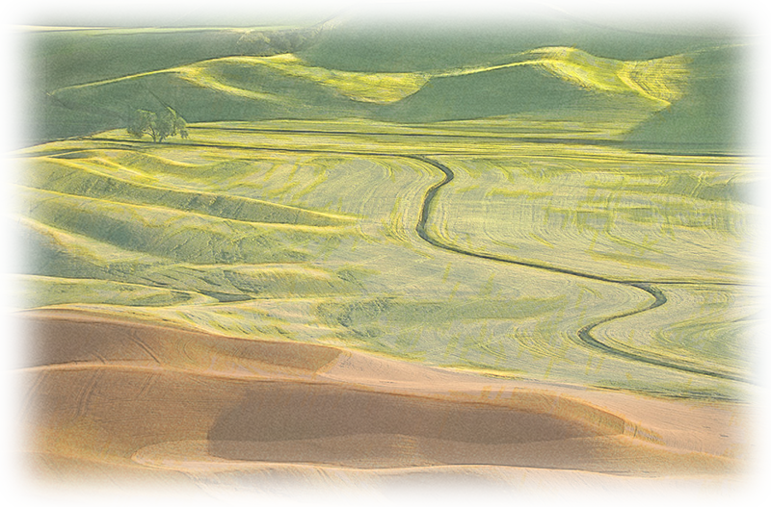
Stunning Nature Photography
by Chip Phillips
Tony 2016
Palouse and Canada

Slide 2
Palouse
The Palouse is a region of the northwestern United States, encompassing parts of southeastern Washington, north central Idaho and, by some definitions, parts of northeast Oregon. It is a major agricultural area, primarily producing wheat and legumes. Situated about 160 miles (260 km) north of the Oregon Trail, the region experienced rapid growth in the late 19th century and was once Washington's most populous region, surpassing even the Puget Sound area.
Music : Dave Koz
Photos : Chip Phillips
Arranged by : Tony
Year : 2016
No Commecial Presentation
Tony 2016
CLICK

Slide 3
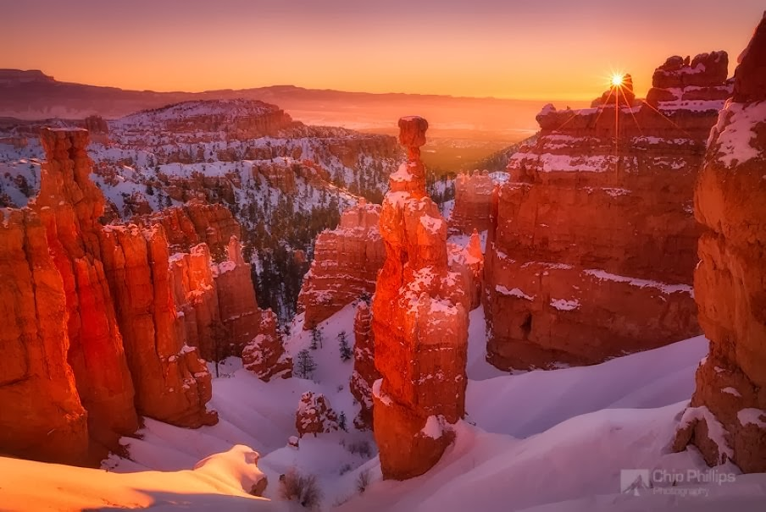
Bryce Canyon Sunrise

Slide 4
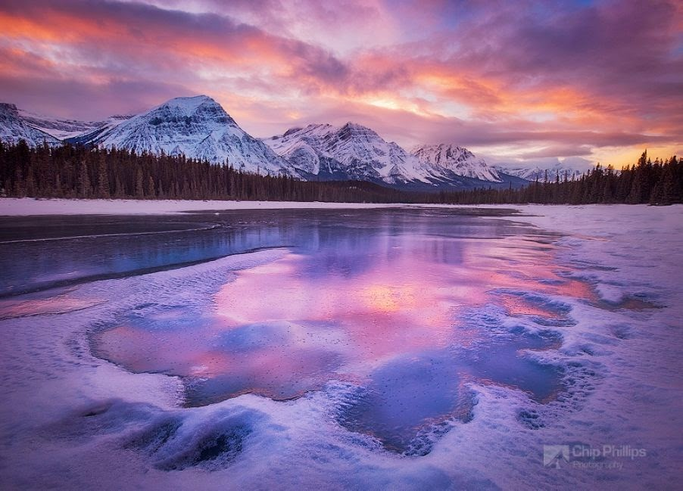
Jasper Sunset

Slide 5
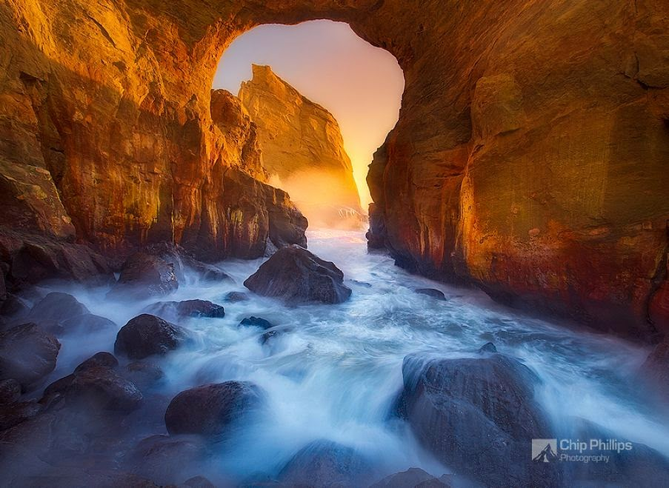
Cape Kiwanda Keyhole

Slide 6
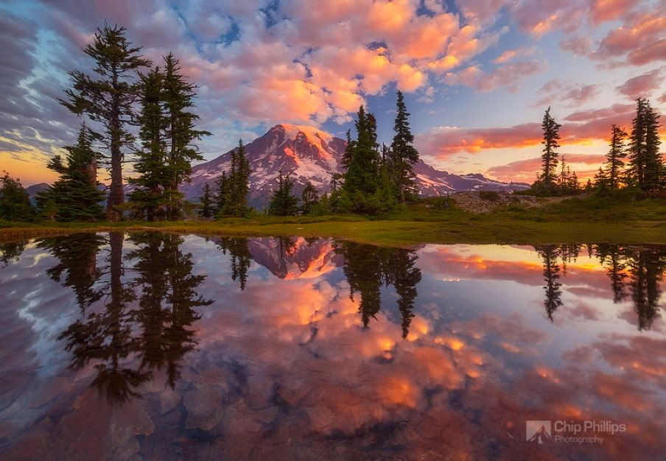
Mount Rainier Tarn at Sunrise

Slide 7
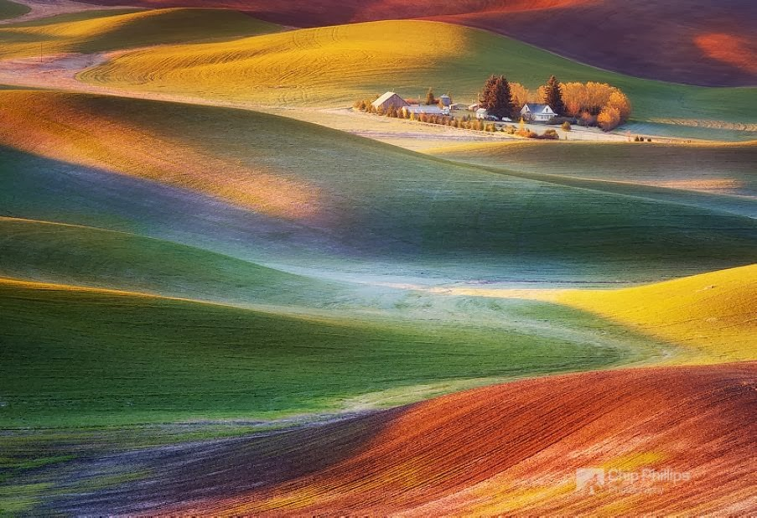
Frosty Morning, Palouse

Slide 8
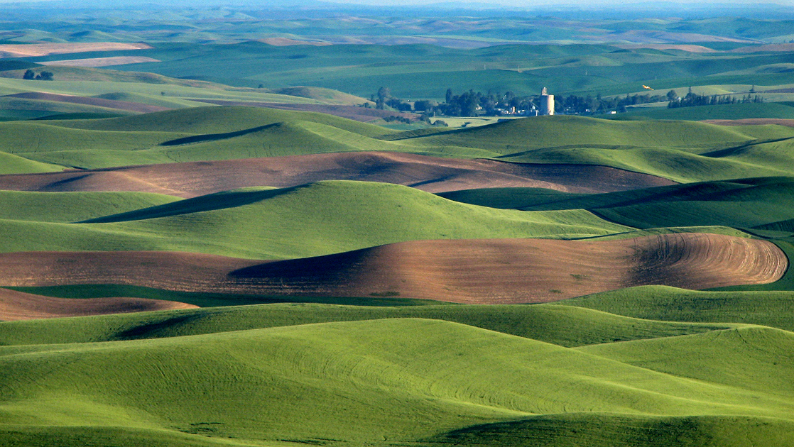
Palouse Hills Northeast of Walla Walla

Slide 9
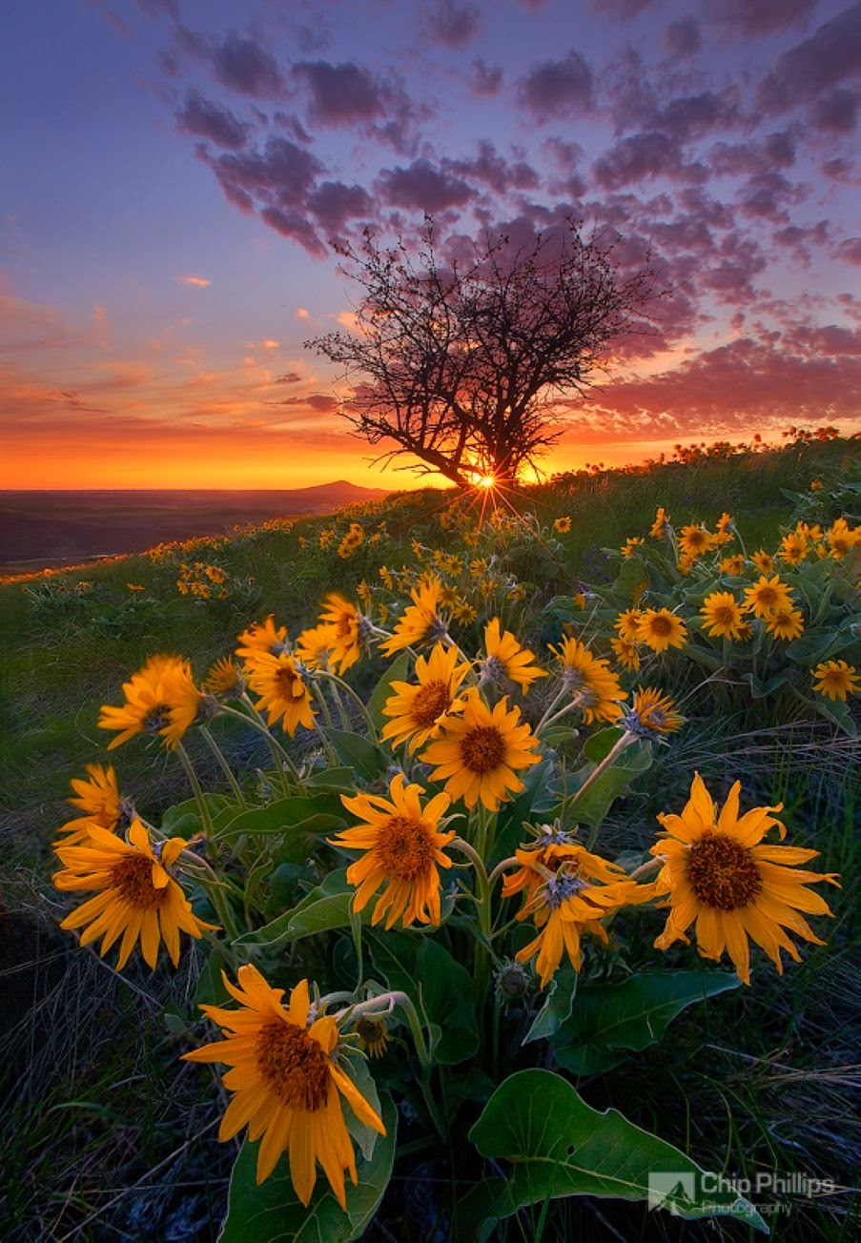
Balsam Root and Tree, Palouse

Slide 10
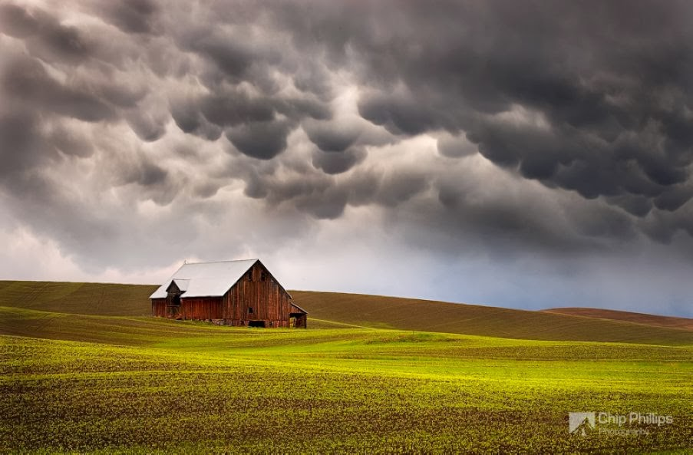
Mammatus Clouds and Barn, Palouse

Slide 11
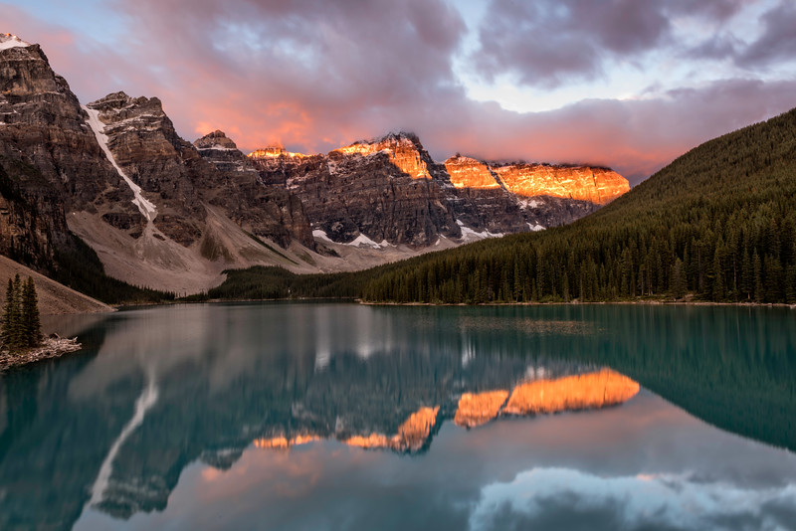
Calgary Landscape

Slide 12
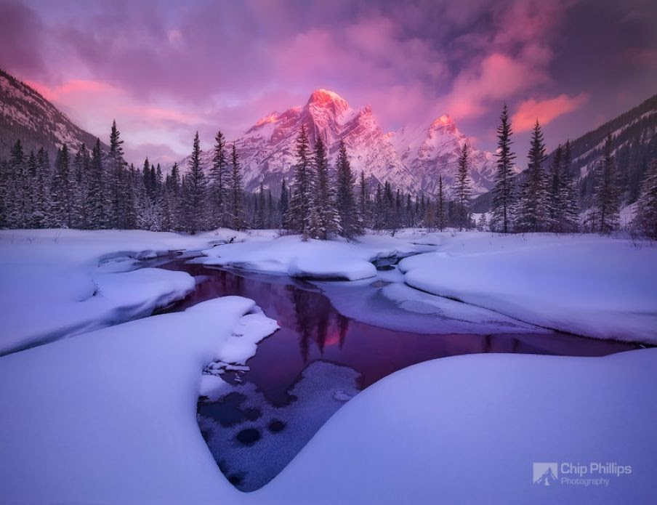
Mount Kidd Reflecting Pools Winter

Slide 13
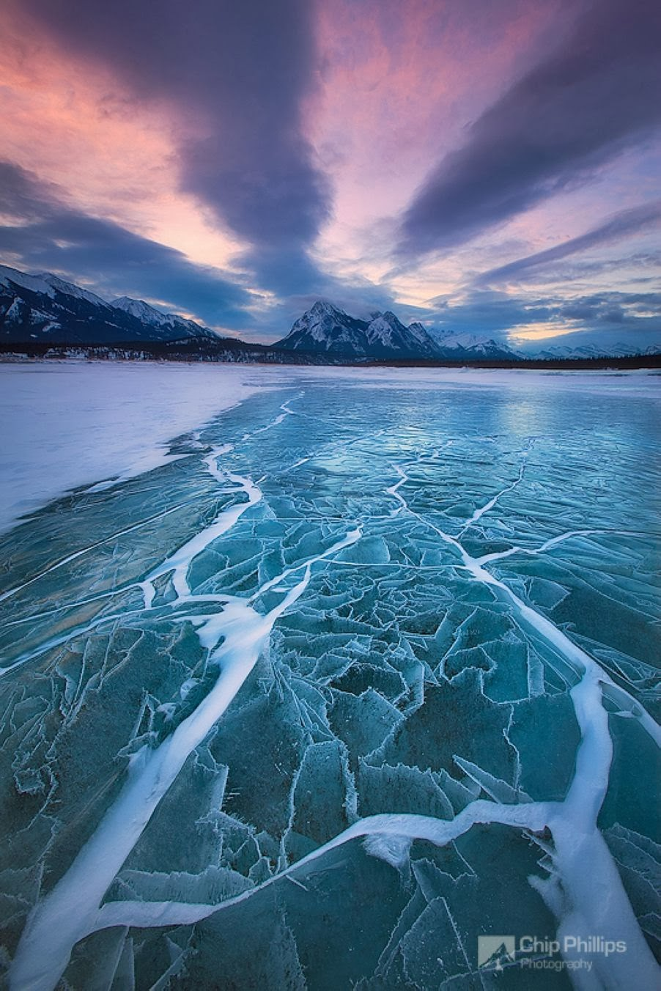
Abraham Lake Winterscape

Slide 14
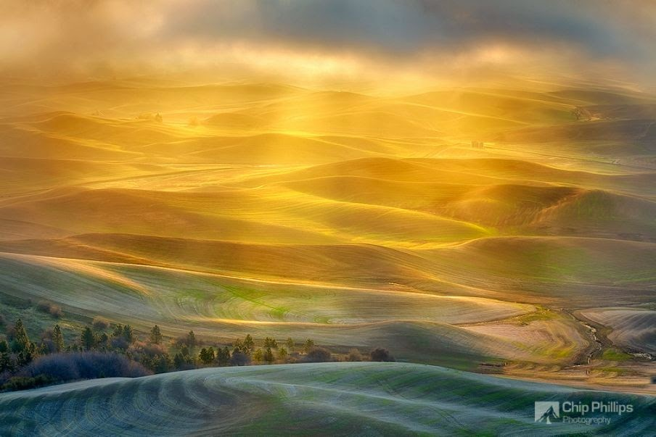
Golden Light, Palouse

Slide 15
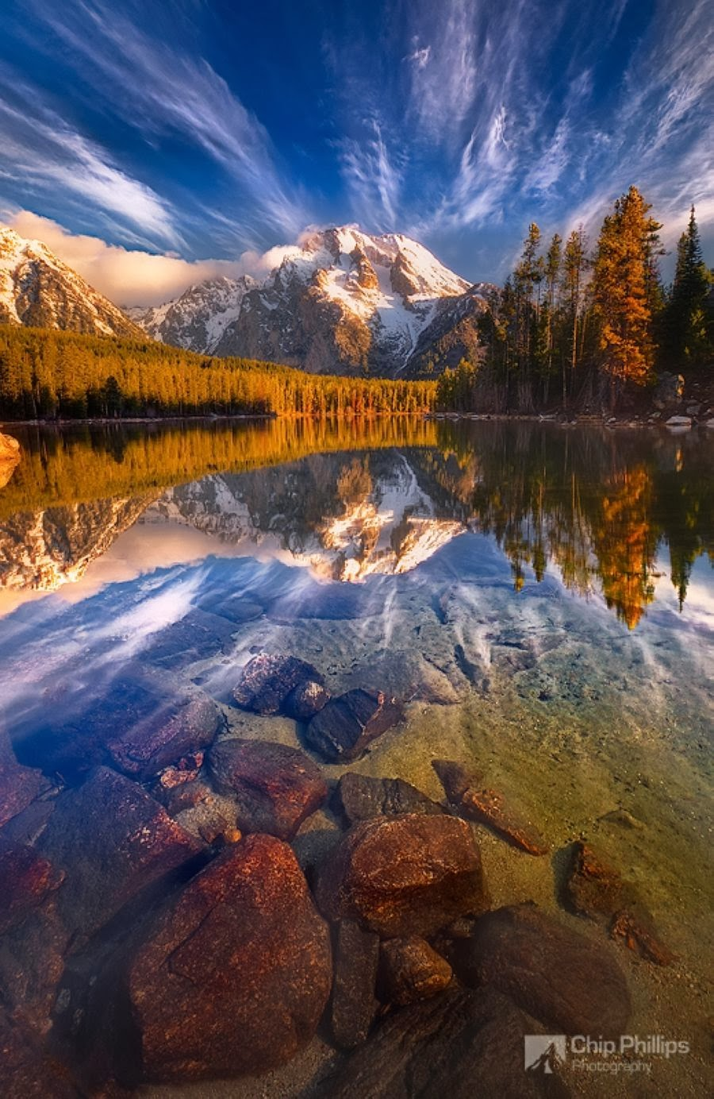
Leigh Lake Reflections

Slide 16
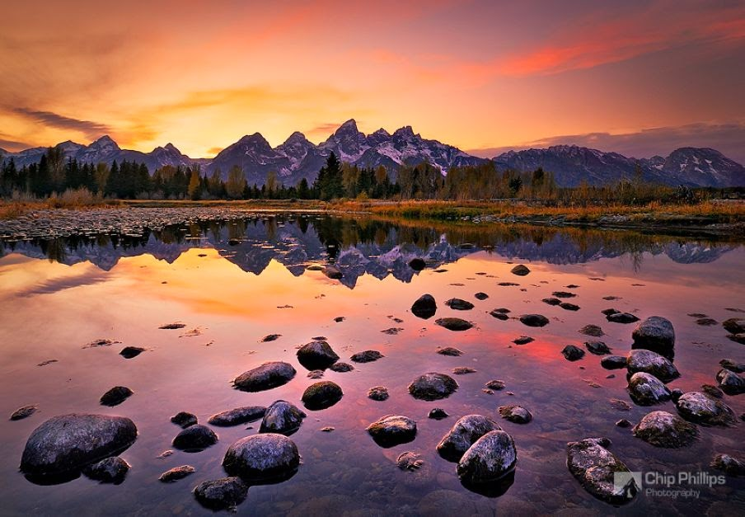
Grand Teton Sunset

Slide 17
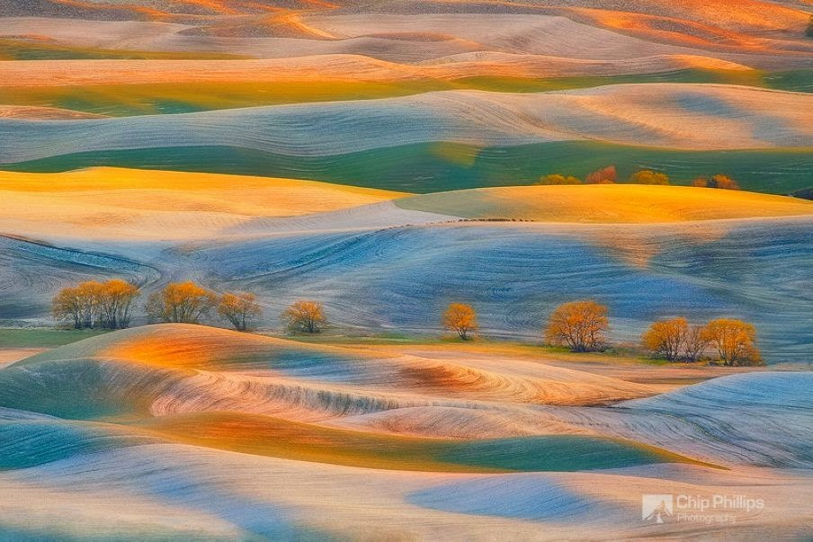
Spring Snow, Palouse

Slide 18
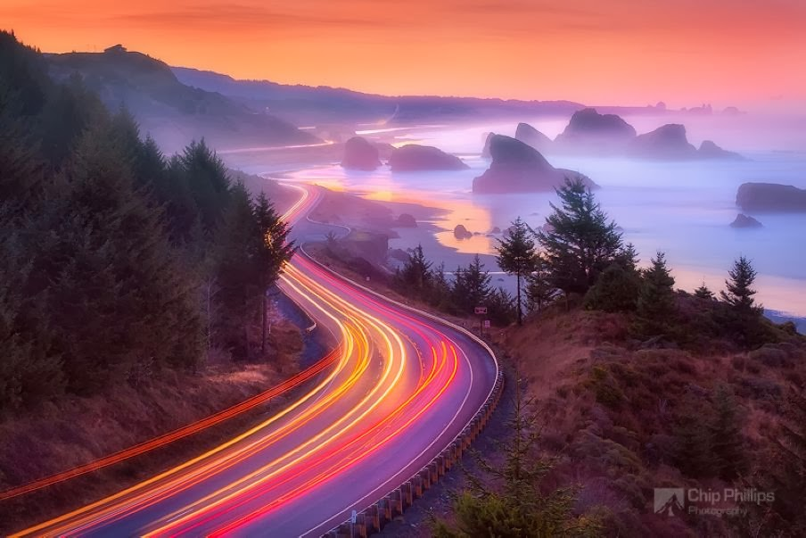
Pistol River Sunrise

Slide 19
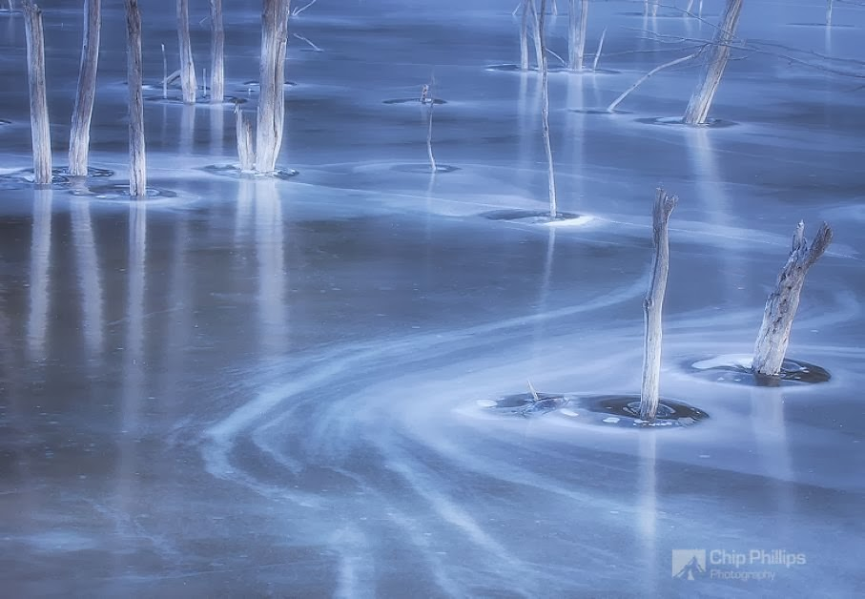
Frozen Pond, Jasper Alberta

Slide 20
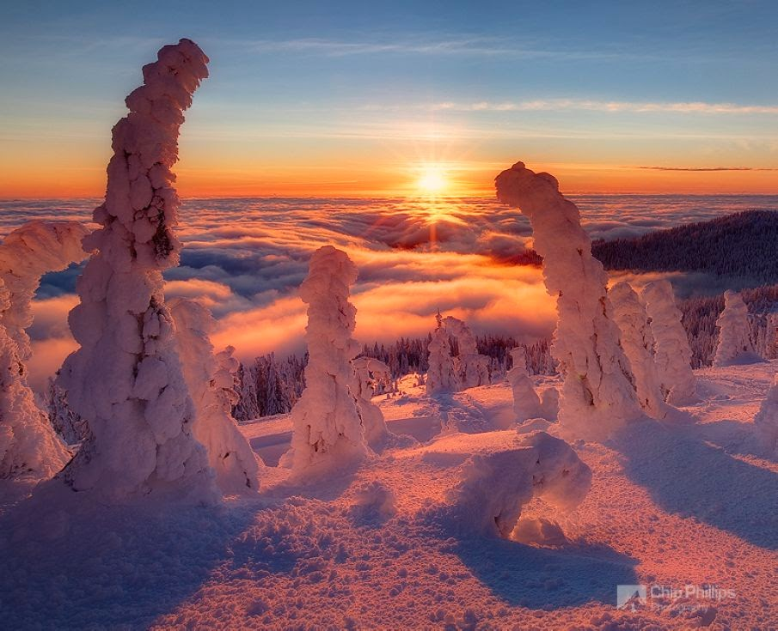
Tree Henge

Slide 21
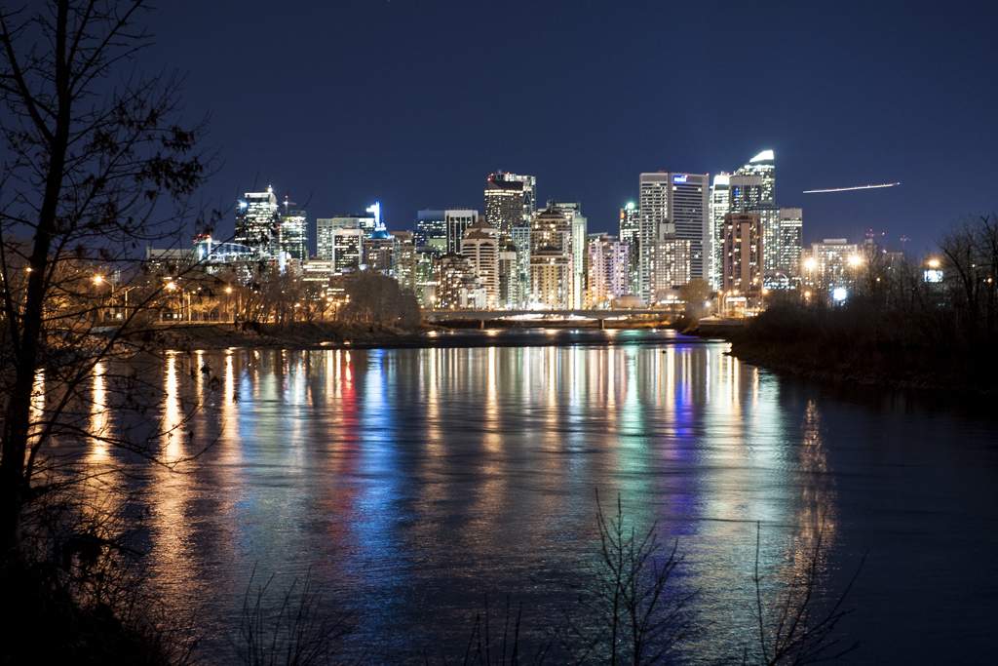
THe End
Calgary

Slide 22







¿Te ha gustado?
Puedes ver más entrando
Aquí
Además puedes recibir powerpoints en tu correo electrónico suscribiéndote aquí:

