Slide 1

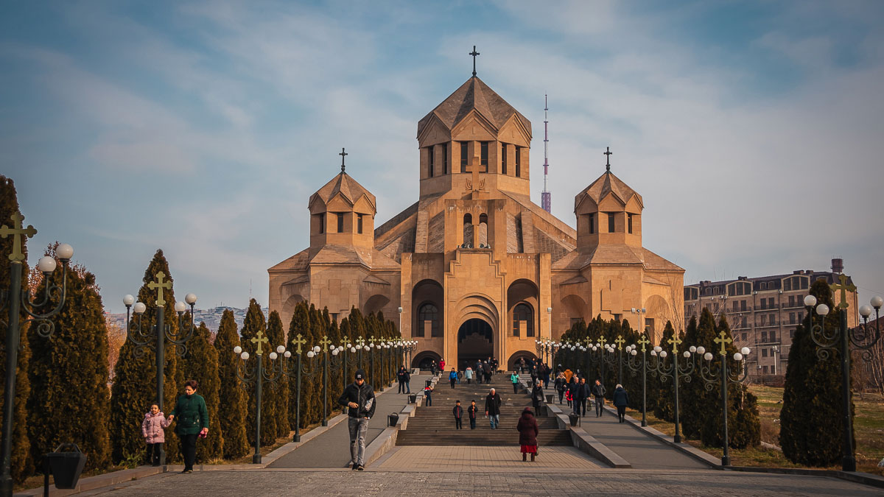
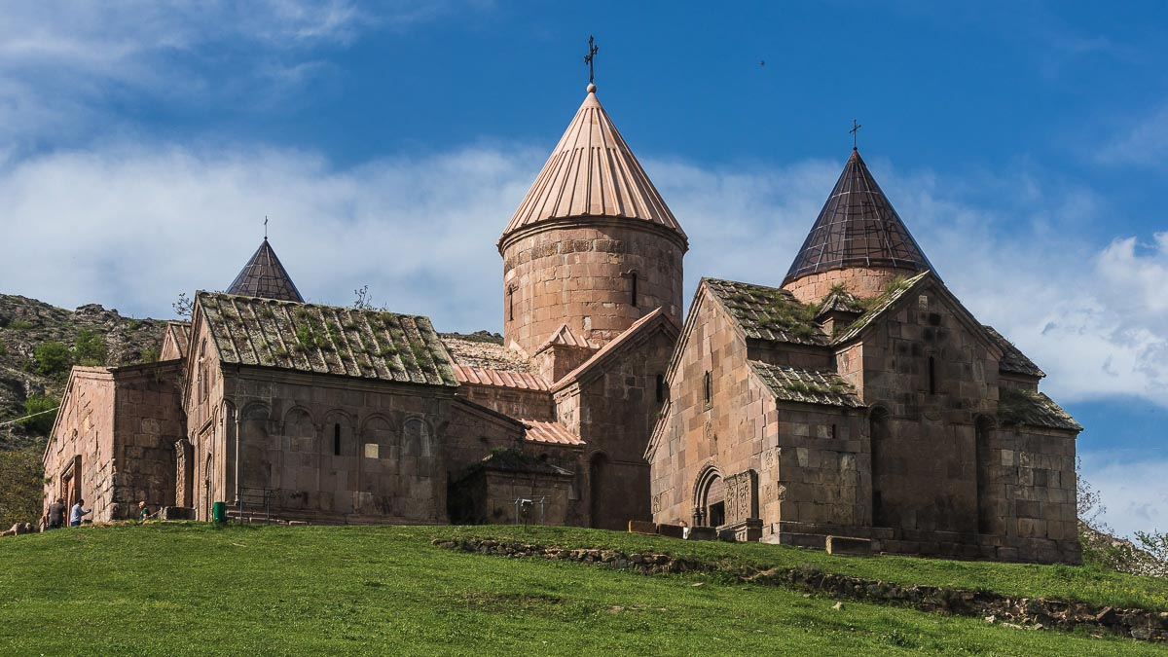
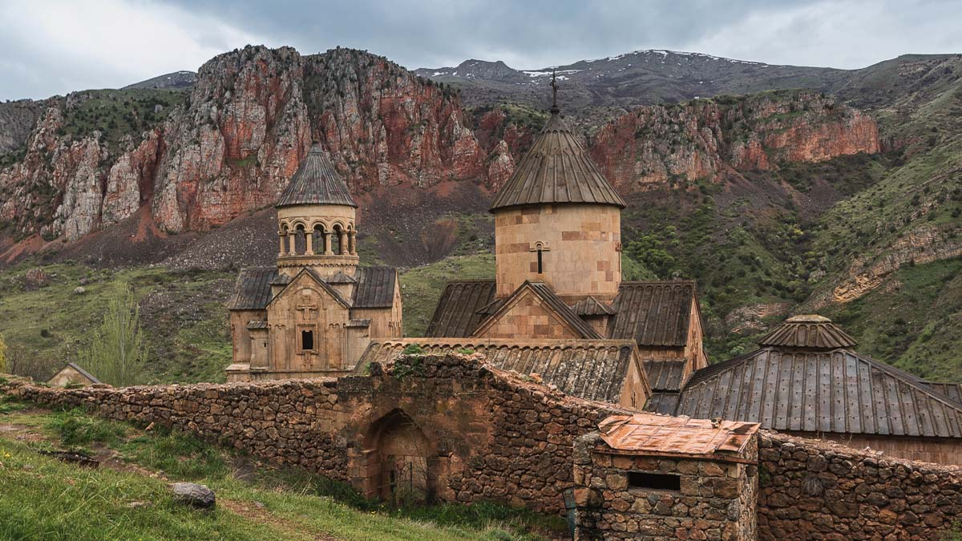
73
The world in the lens
Svet objektívom
El mundo en la lente
2022
Elena, Steve

Slide 2
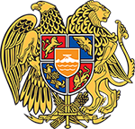
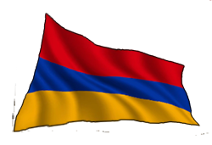
MONASTERIES
AND CHURCHES
ARMENIA

Slide 3
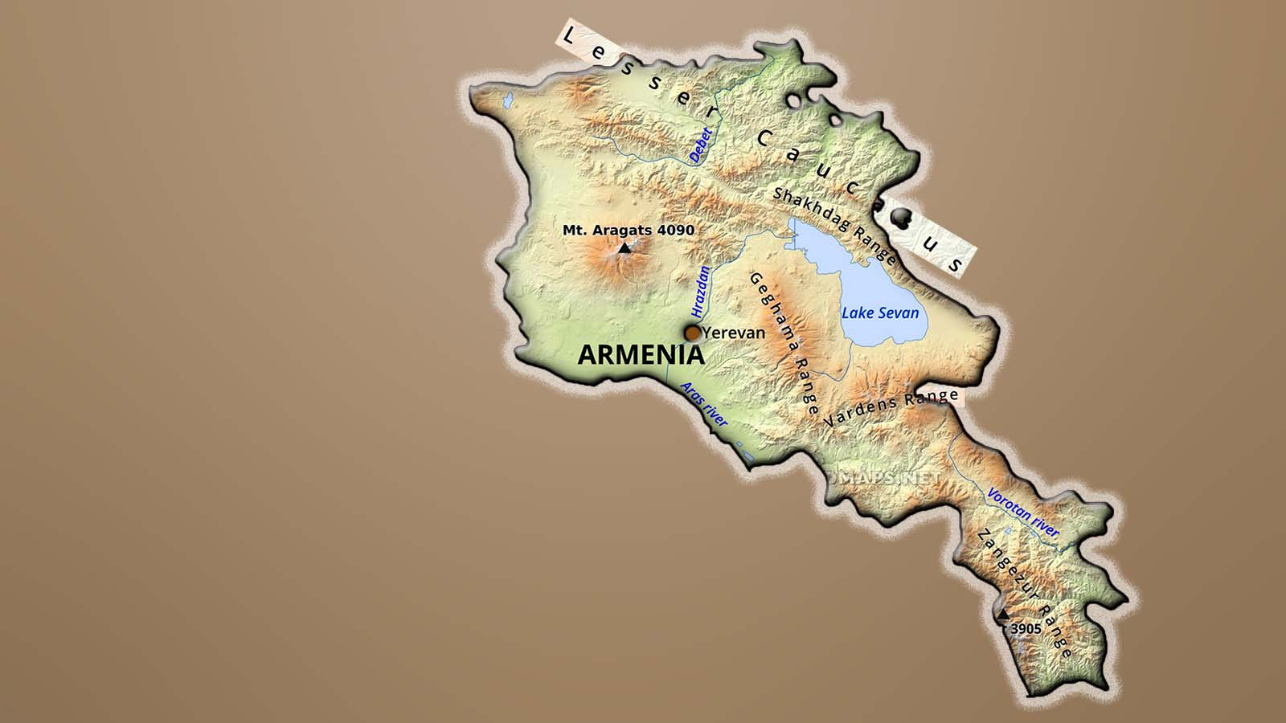
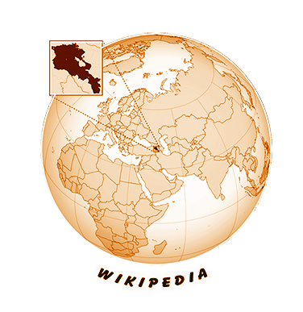
ARMENIA
ARMENIA
ՀԱՅԱՍՏԱՆ

Slide 4




Armenia is a mountainous country in Southwest Asia. The majority of the population adheres to Orthodox Christianity. Tradition says that the apostles Thaddeus and Bartholomew brought Christianity to the land of Armenians in the first century. The Kingdom of Armenia was the first in the world to adopt Christianity as its official religion in 301 AD, two decades before the Roman Empire. This heritage is embodied in more than 4,000 Armenian Apostolic churches and monasteries scattered throughout the country. Armenia is a country of churches with unique architecture. Churches were primarily built high up to withstand earthquakes. An important part of Armenian architecture are chachkar stones – carved tablets built into church walls or scattered around the courtyard. The most important buildings are part of the UNESCO world heritage.
Armenia es un país montañoso en el suroeste de Asia. La mayoría de la población se adhiere al cristianismo ortodoxo. La tradición dice que los apóstoles Tadeo y Bartolomé trajeron el cristianismo a la tierra de los armenios en el primer siglo. El Reino de Armenia fue el primero en el mundo en adoptar el cristianismo como religión oficial en el año 301 dC, dos décadas antes del Imperio Romano. Este patrimonio está plasmado en más de 4.000 iglesias y monasterios apostólicos armenios repartidos por todo el país. Armenia es un país de iglesias con una arquitectura única. Las iglesias se construían principalmente en altura para resistir los terremotos. Una parte importante de la arquitectura armenia son las piedras chachkar - tabletas talladas construidas en las paredes de la iglesia o esparcidas por el patio. Los edificios más importantes son parte del patrimonio mundial de la UNESCO.
Arménsko je hornatá krajina v juhozápadnej Ázii. Väčšina obyvateľstva sa hlási k ortodoxnému kresťanstvu. Tradícia hovorí, že apoštoli Tadeáš a Bartolomej priniesli kresťanstvo do krajiny Arménov v prvom storočí. Arménske kráľovstvo ako prvé na svete prijalo kresťanstvo za svoje oficiálne náboženstvo v roku 301 nášho letopočtu, dve desaťročia pred Rímskou ríšou. Toto dedičstvo zhmotňuje viac ako 4 000 arménskych apoštolských kostolov a kláštorov roztrúsených po celej krajine. Arménsko je krajina kostolov s jedinečnou architektúrou. Kostoly sa stavali predovšetkým do výšky, aby odolali zemetraseniam. Dôležitou súčasťou arménskej architektúry sú kamene chachkar – vyrezávané tabuľky zabudované do kostolných múrov alebo roztrúsené po nádvorí. Najvýznamnejšie stavby sú súčasťou svetového dedičstva UNESCO.

Slide 6
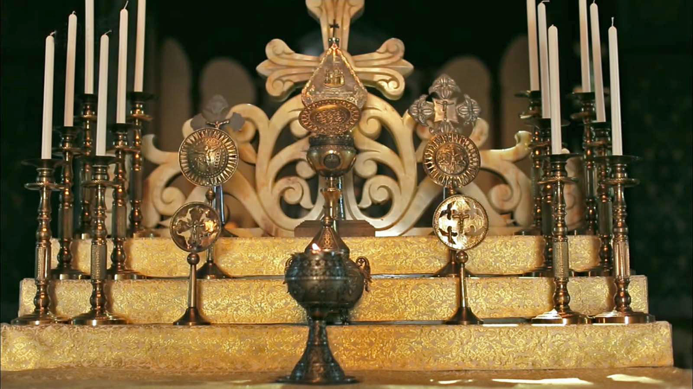
Photo © David Stanley

Slide 7
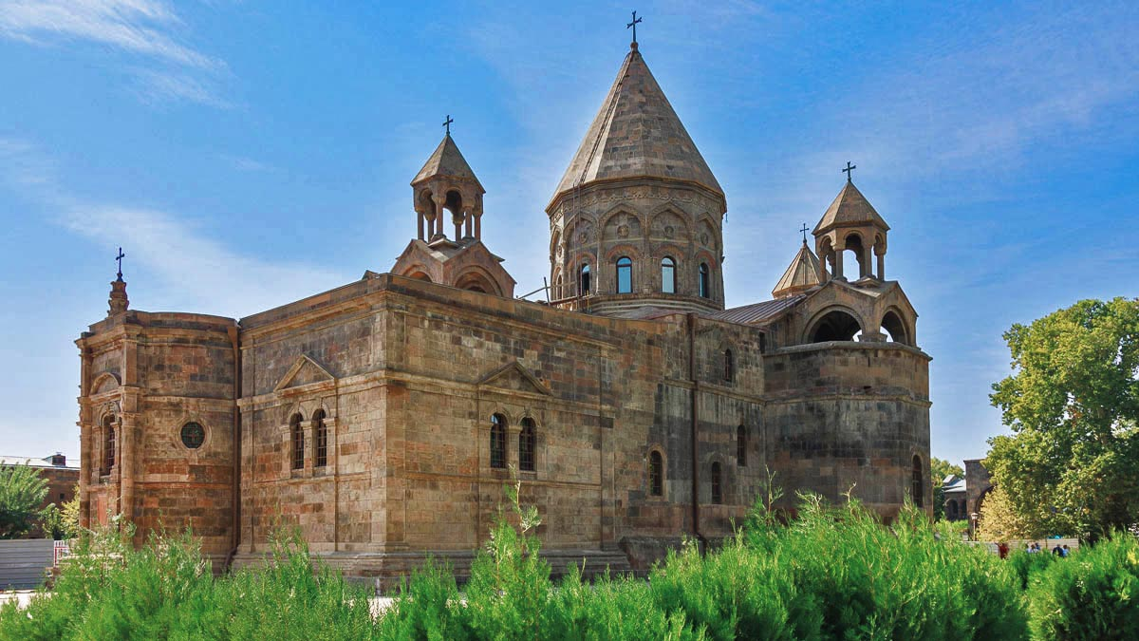
Mother See of Holy Etchmiadzin
Echmiadzin
IV. century
Photo © Elena Stambulyan

Slide 8
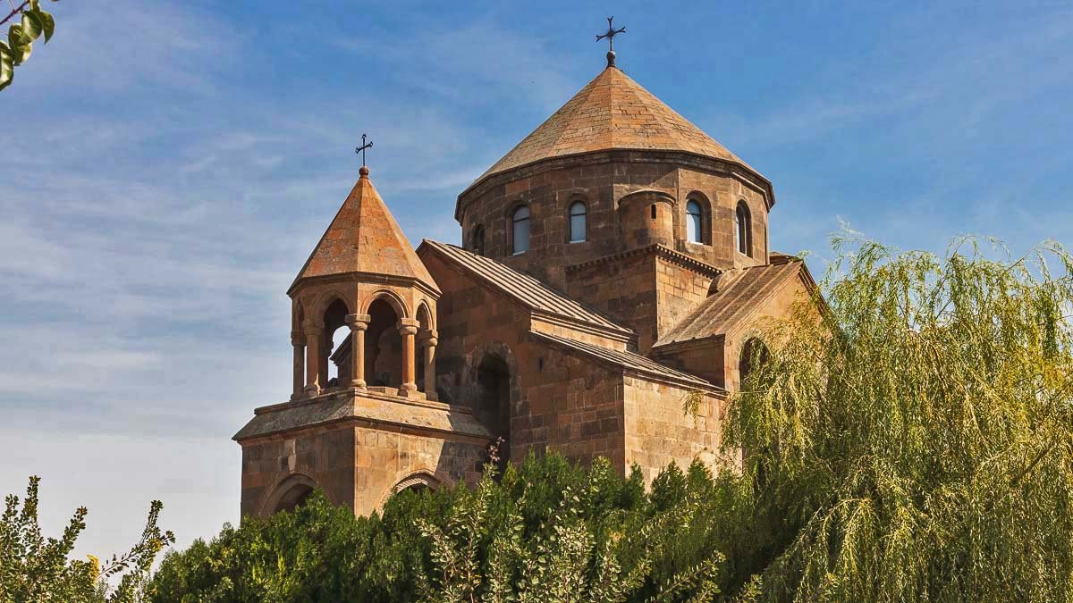
St. Hripsime Church
Echmiadzin
VII. century
Photo © Elena Stambulyan

Slide 9
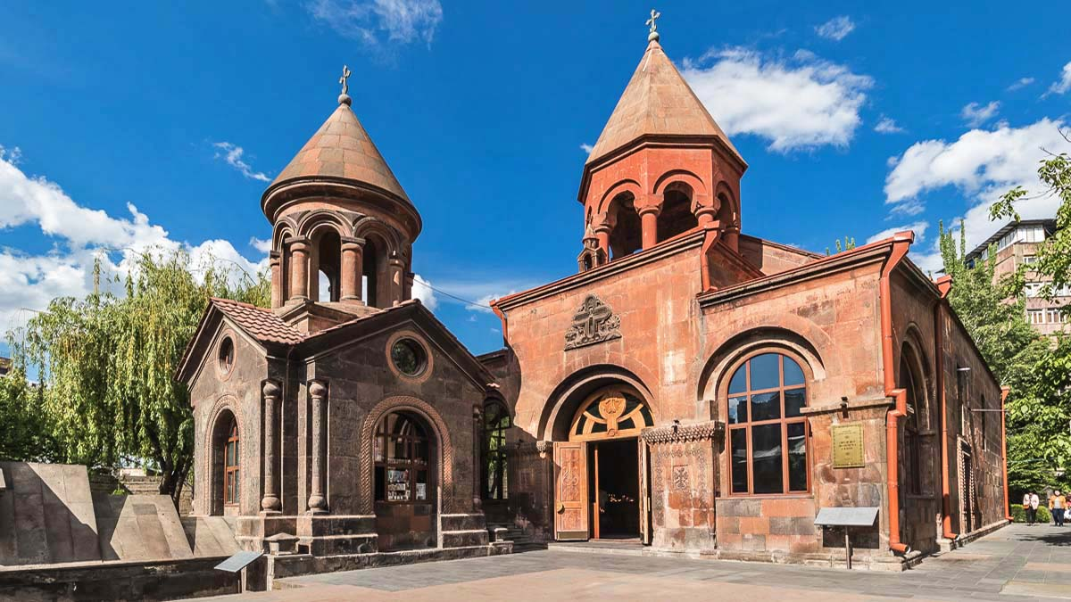
Zoravor Surb Astvatsatsin Church
Yerevan
XVII. century
Photo © Elena Stambulyan

Slide 10
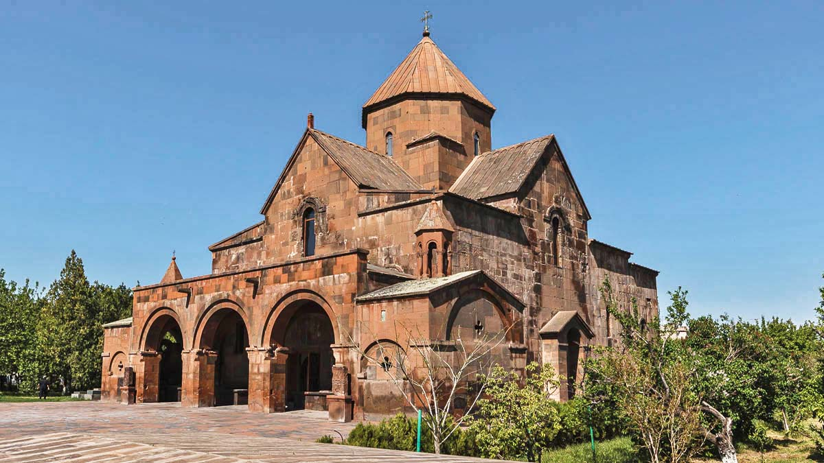
St. Gayane Church
Echmiadzin
VII. century
Photo © Elena Stambulyan

Slide 11
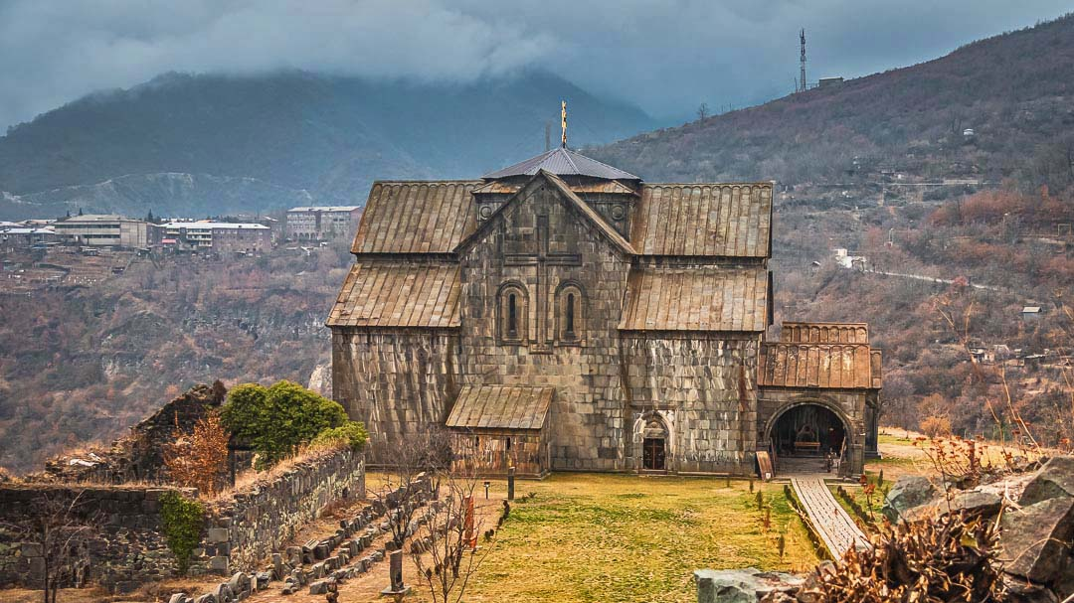
Akhtala Monastery
Akhtala
X. century
Photo © Elena Stambulyan

Slide 12
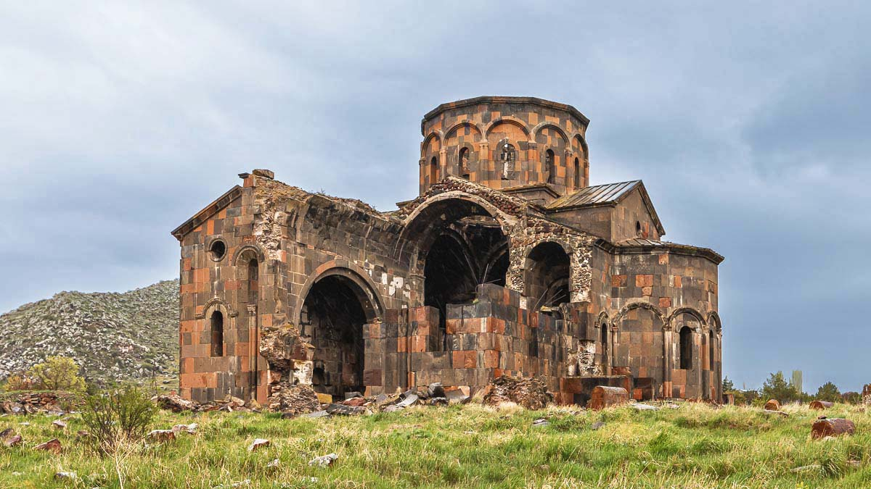
Katoghike Talin Church
Talin
VII. century
Photo © Elena Stambulyan

Slide 13
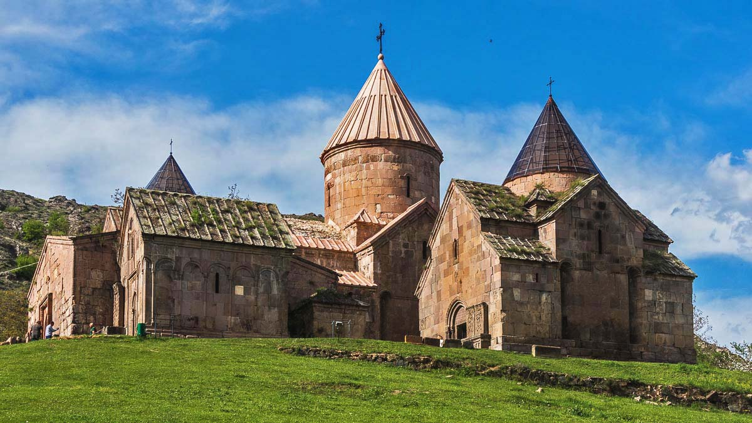
Goshavank Monastery
Gosh
XII. century
Photo © Elena Stambulyan

Slide 14
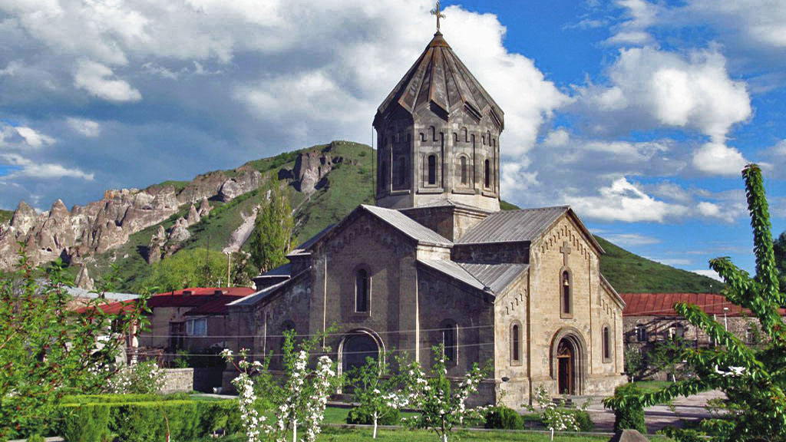
St. Gregory Church
Goris
XIX. century
Photo © David Stanley

Slide 15
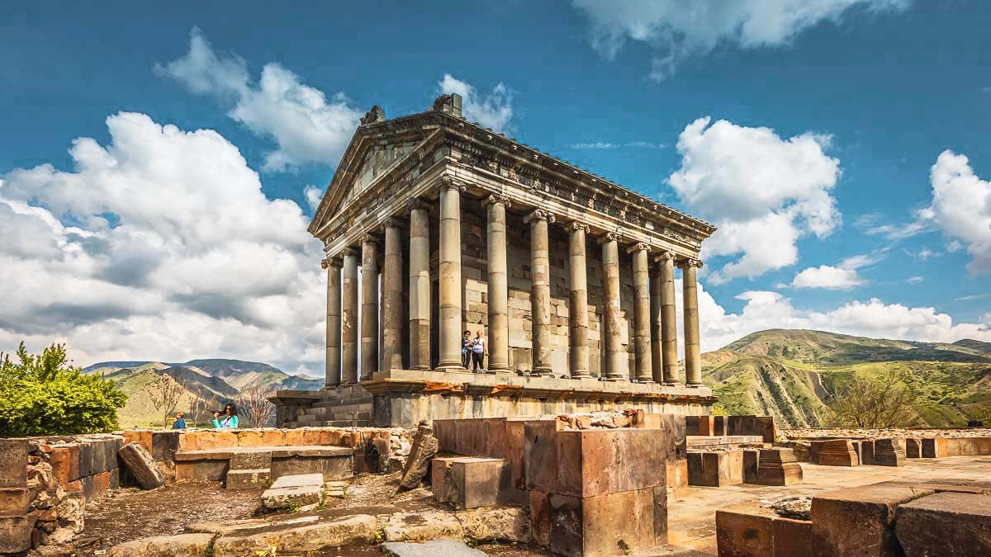
Garni Temple
Garni
I. century
Photo © Elena Stambulyan

Slide 16
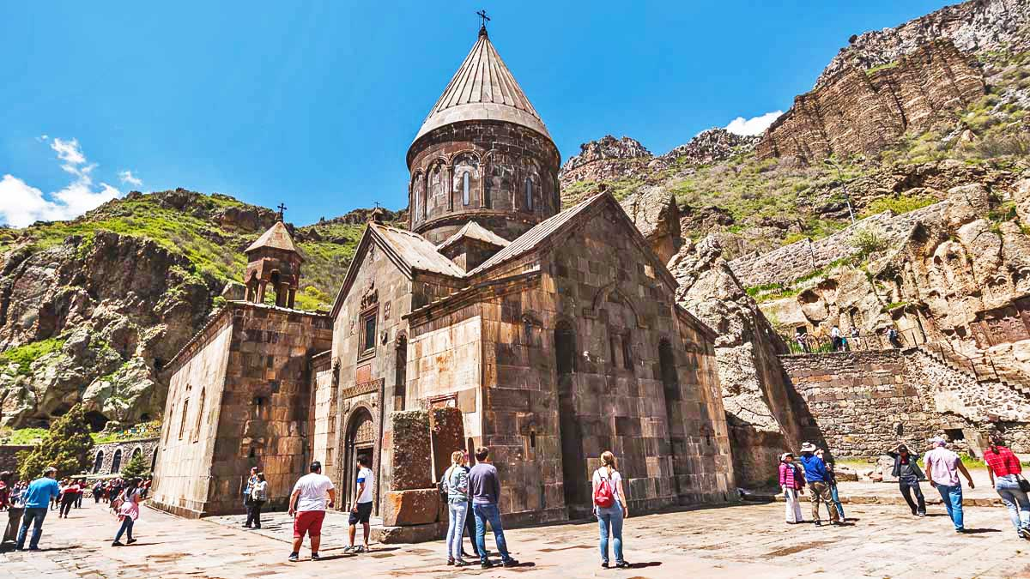
Geghard Monastery
Geghard
XIII. century
Photo © Elena Stambulyan

Slide 17
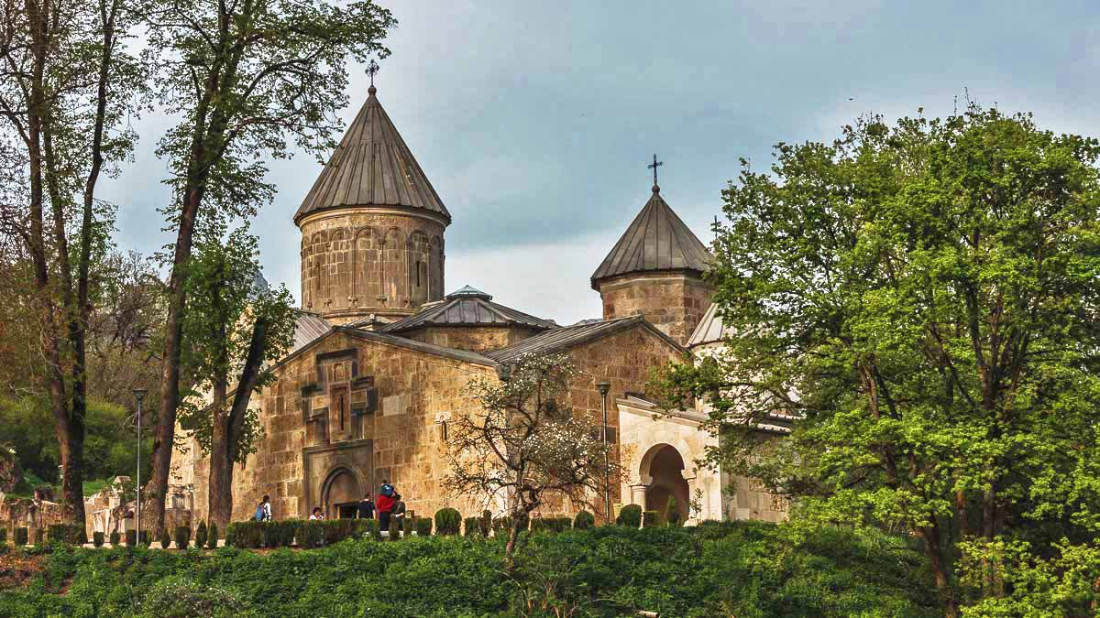
Haghartsin Monastery
Dilijan
XIII. century
Photo © Elena Stambulyan

Slide 18
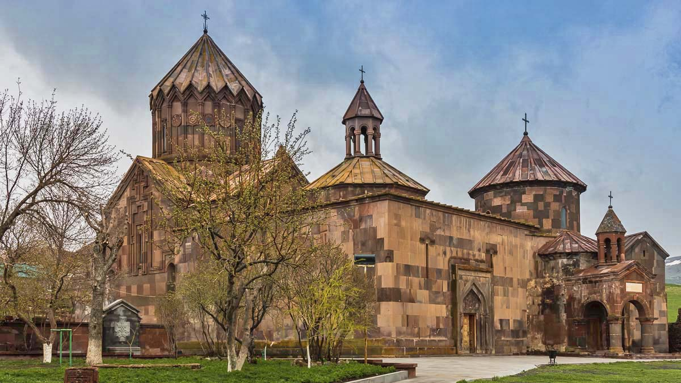
Harichavank Monastery
Harich
VII. century
Photo © Elena Stambulyan

Slide 19
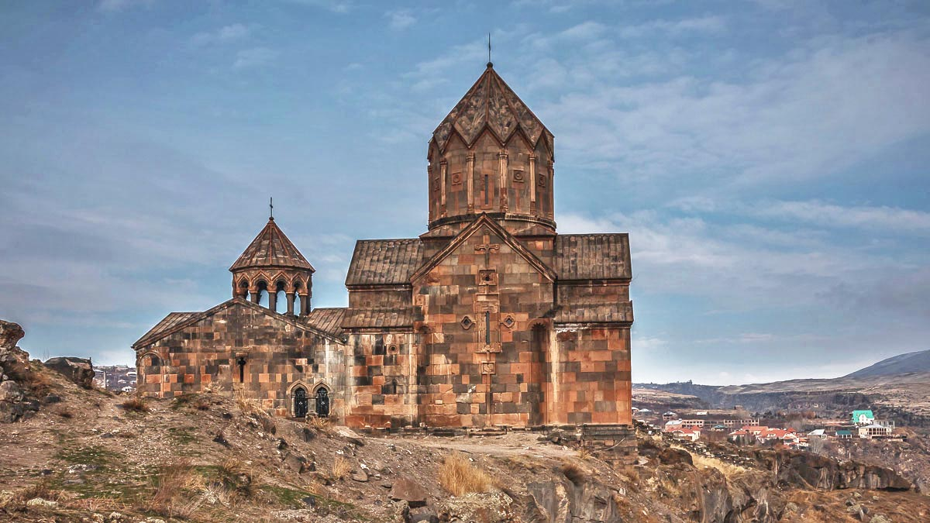
Hovhannavank Monastery
Ohanavan
XIII. century
Photo © Elena Stambulyan

Slide 20
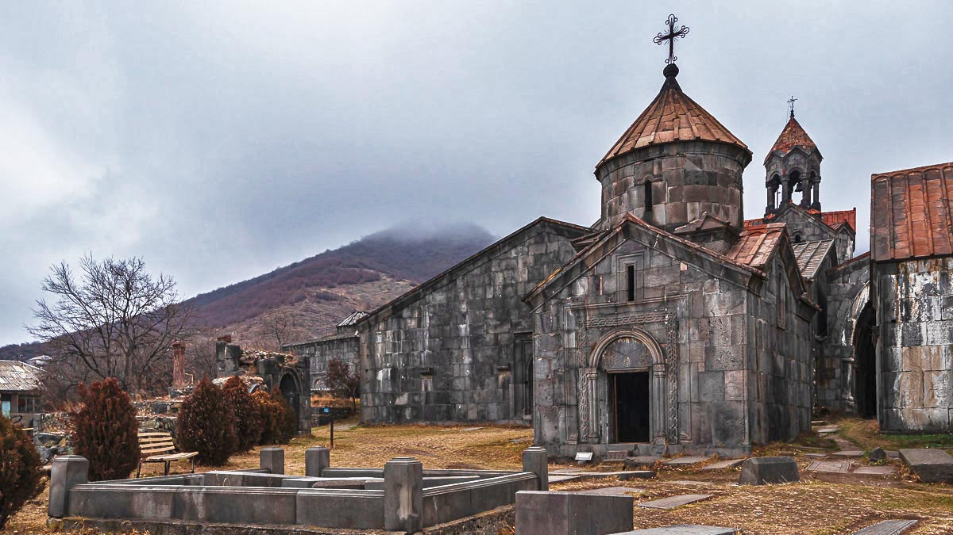
Haghpat Monastery
Haghpat
X. century
Photo © Elena Stambulyan

Slide 21
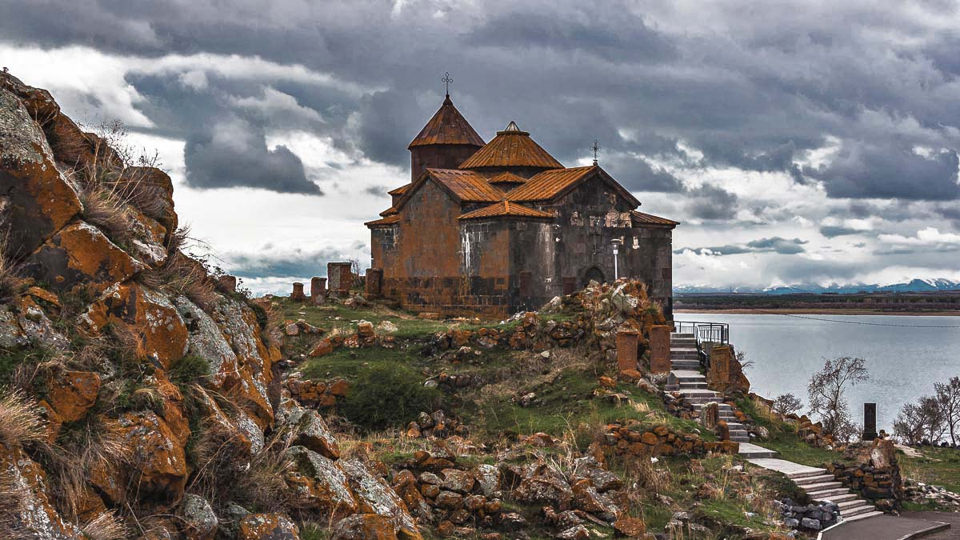
Hayravank Monastery
Hayravank
IX. century
Photo © Elena Stambulyan

Slide 22
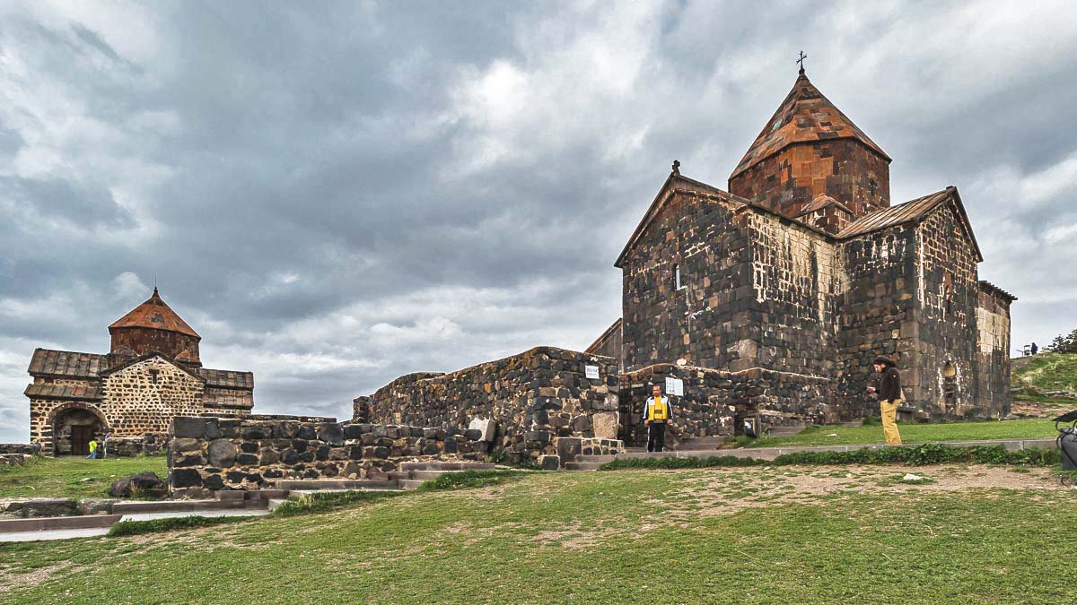
Sevanavank Monastery
Sevan
IX. century
Photo © Elena Stambulyan

Slide 23
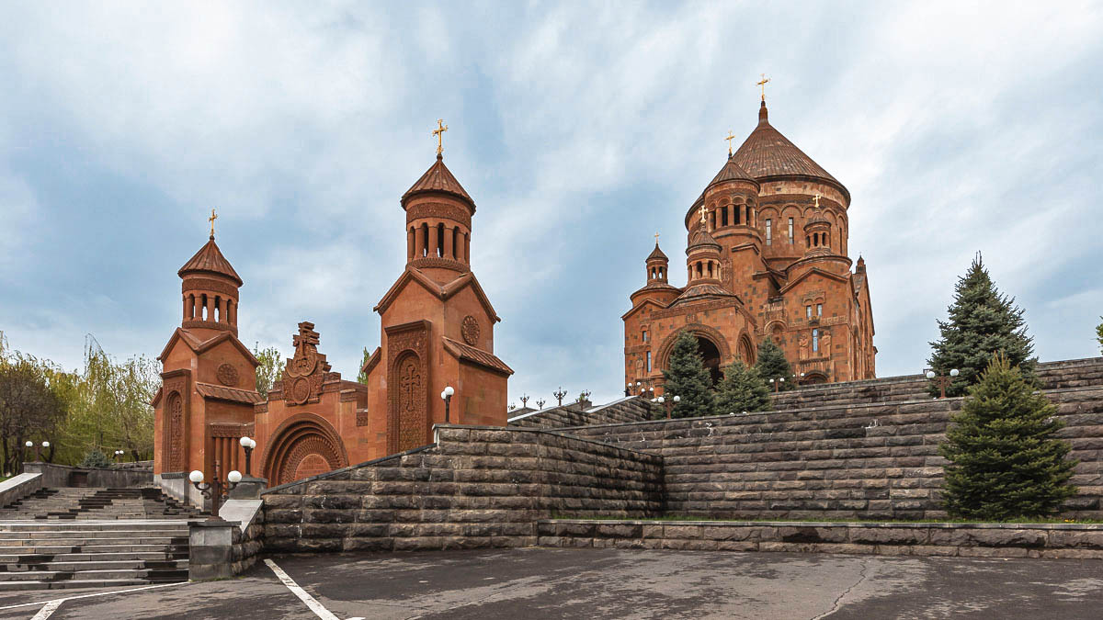
St. Hovhannes Church
Abovyan
XXI. century
Photo © Elena Stambulyan

Slide 24
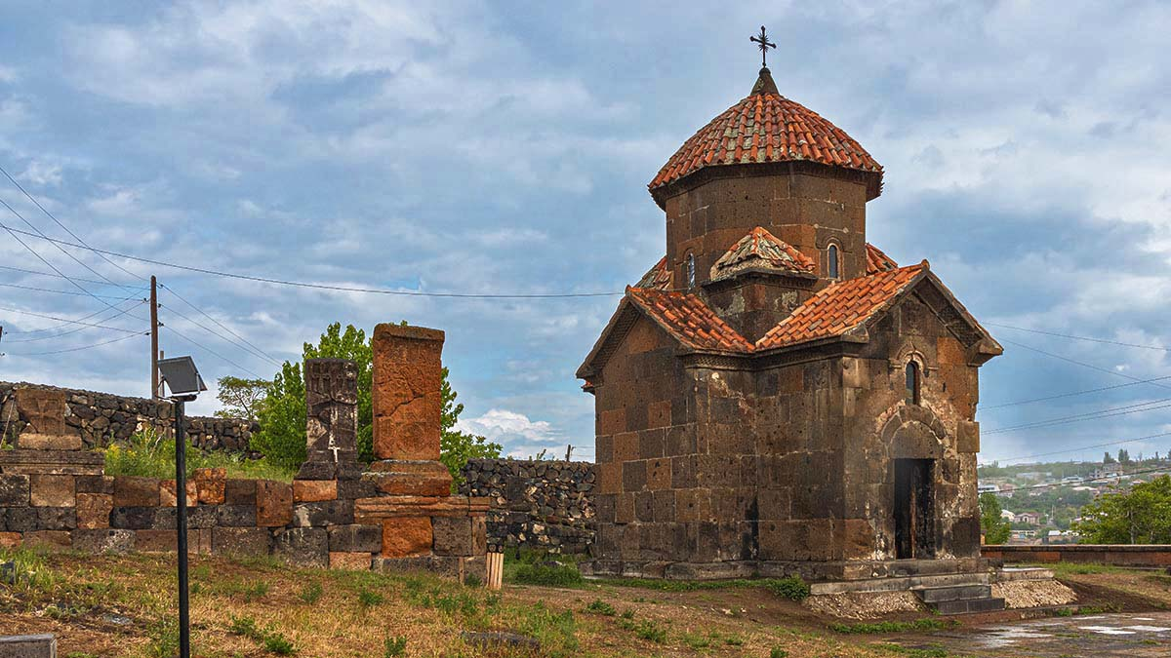
Karmravor Church
Ashtarak
VII. century
Photo © Elena Stambulyan

Slide 25
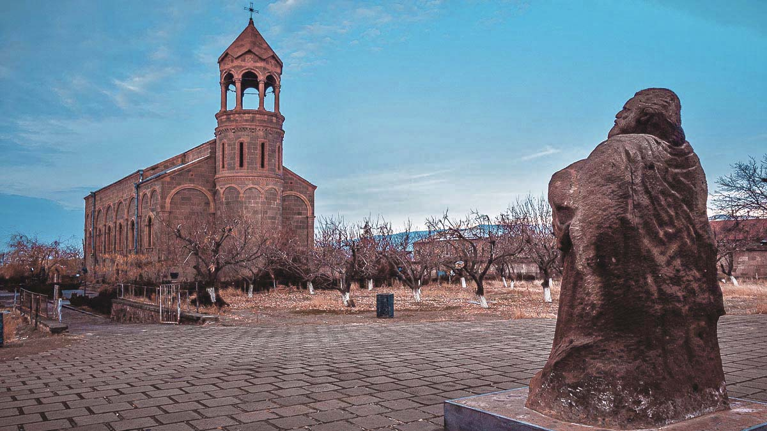
St. Mesrop Mashtots Church
Oshakan
XIX. century
Photo © Elena Stambulyan

Slide 26
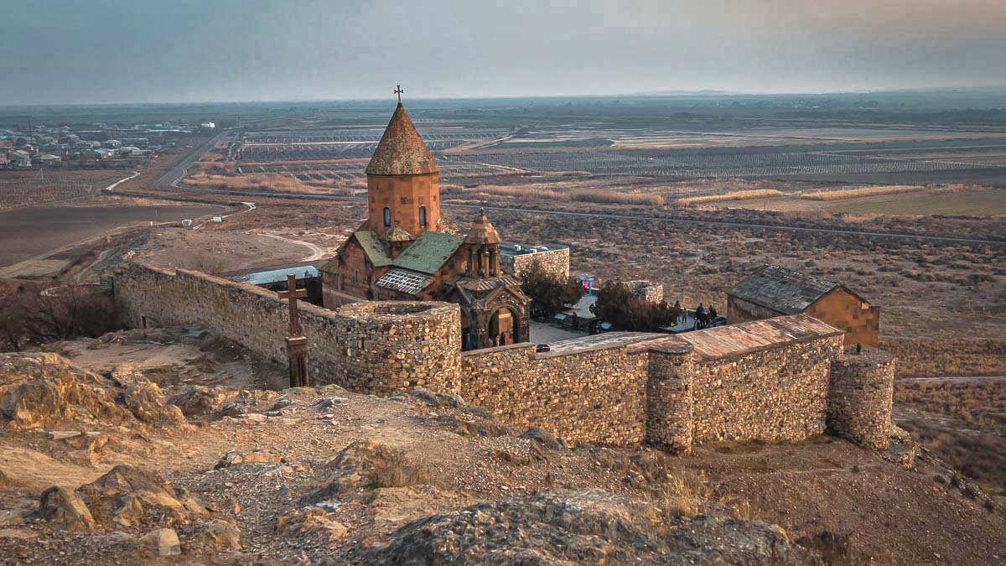
Khor Virap Monastery
Pokr Vedi
VII. century
Photo © Elena Stambulyan

Slide 27
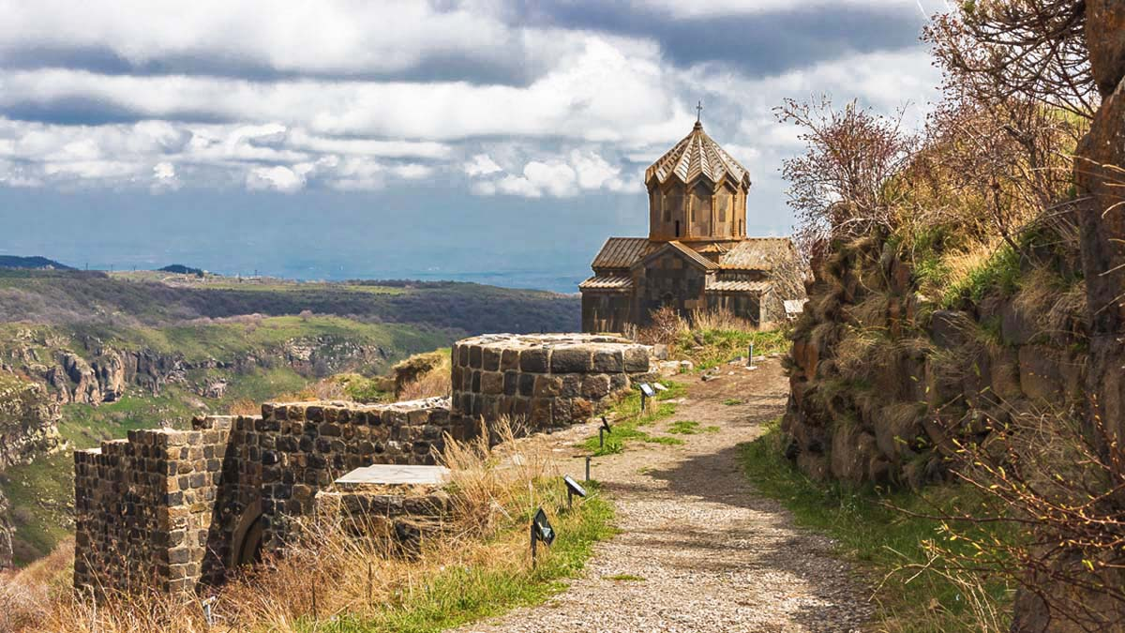
Vahramashen Church
Amberd Road
XI. century
Photo © Elena Stambulyan

Slide 28
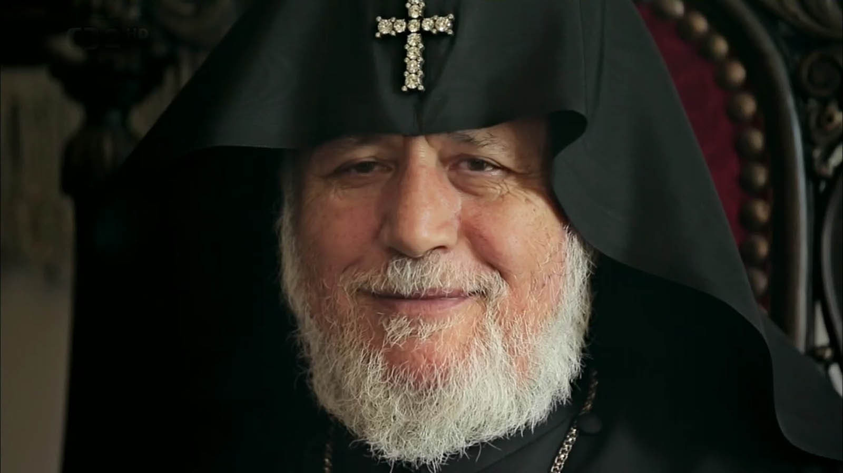
Photo © David Stanley

Slide 29
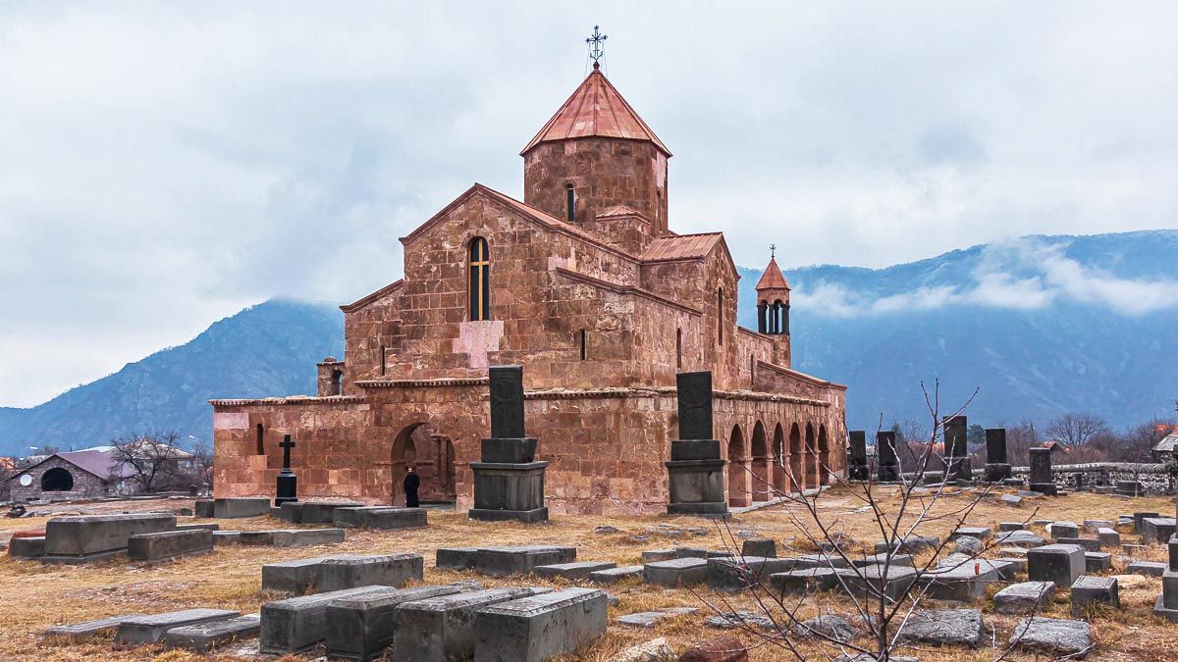
Odzun Church
Odzun
V. century
Photo © Elena Stambulyan

Slide 30
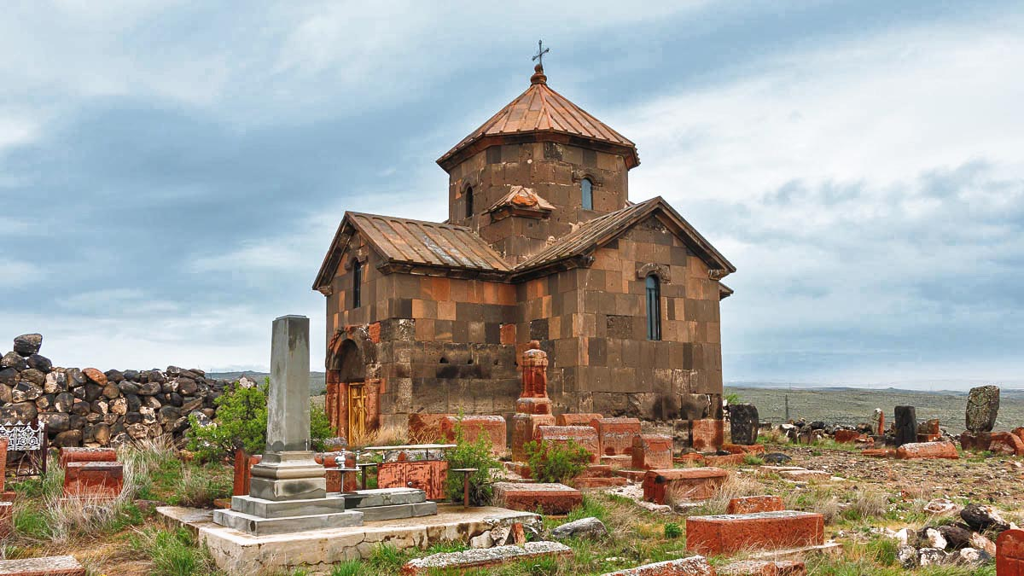
Kristapor Church
Dashtadem
VII. century
Photo © Elena Stambulyan

Slide 31
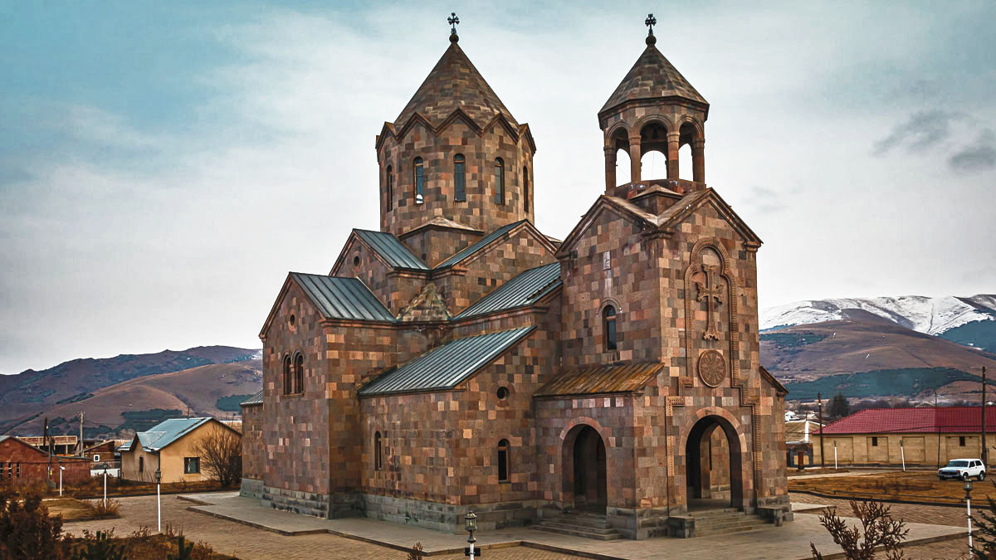
St. Harutyun Church
Spitak
XX. century
Photo © Elena Stambulyan

Slide 32
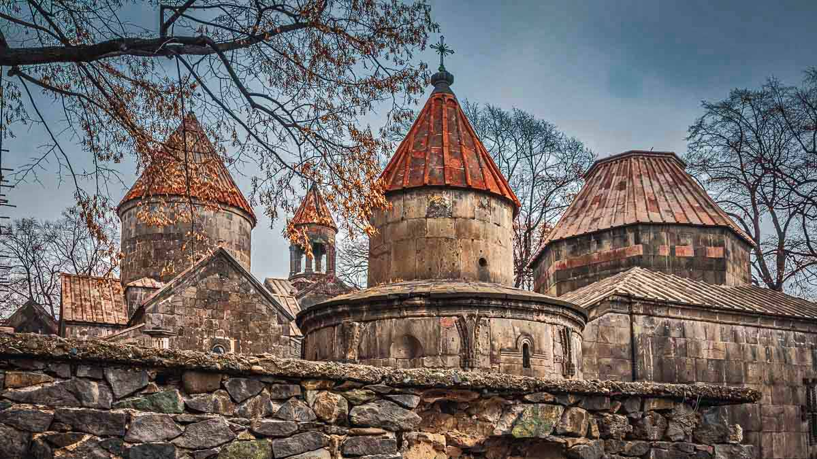
Sanahin Monastery
Alaverdi
X. century
Photo © Elena Stambulyan

Slide 33
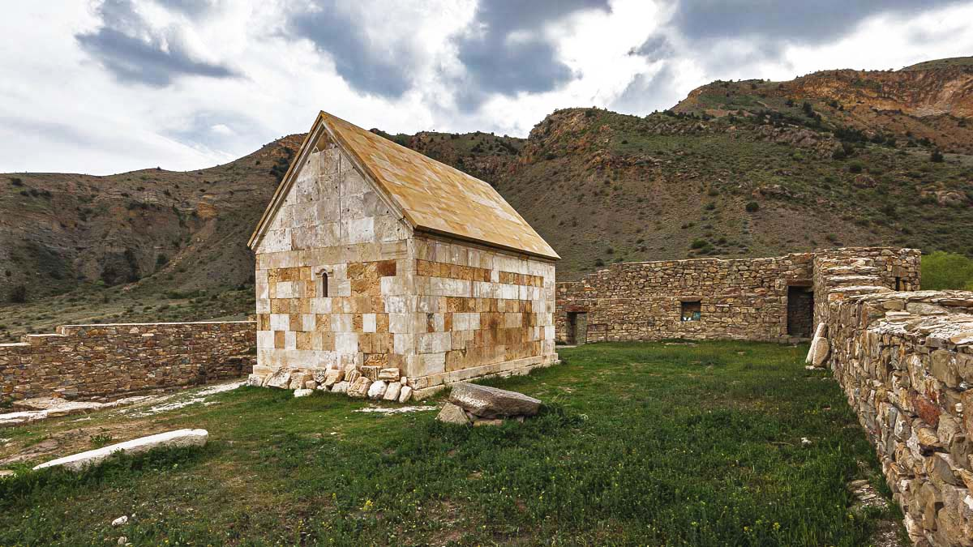
Church of Gevorg Marzpetuni Castle
Urtsadzor
XIII. century
Photo © Elena Stambulyan

Slide 34
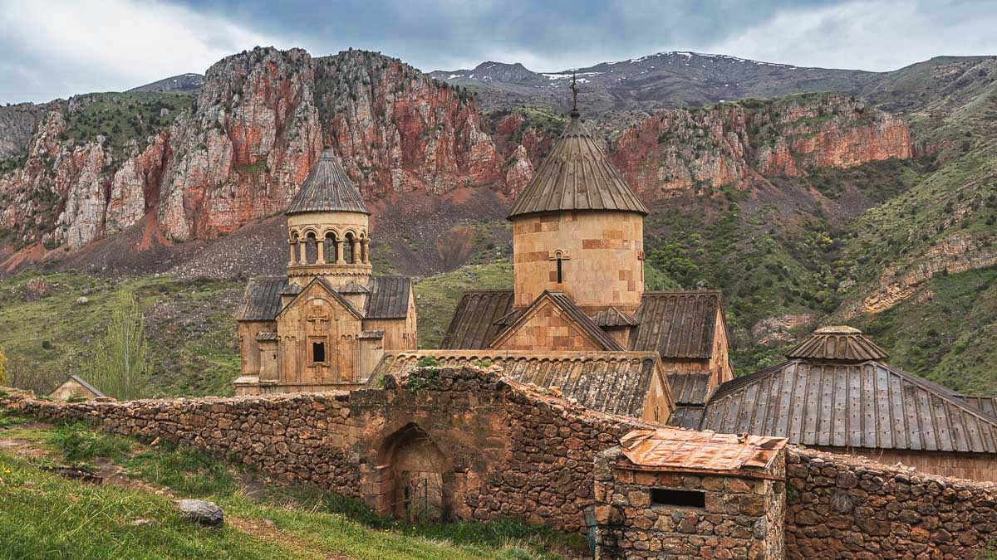
Noravank Monastery
Areni
XIII. century
Photo © Elena Stambulyan

Slide 35
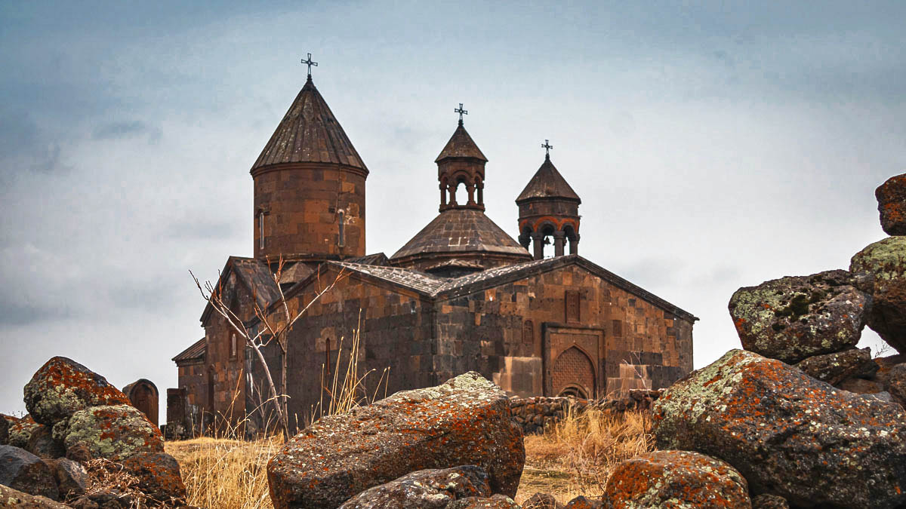
Saghmosavank Monastery
Saghmosavan
XIII. century
Photo © Elena Stambulyan

Slide 36
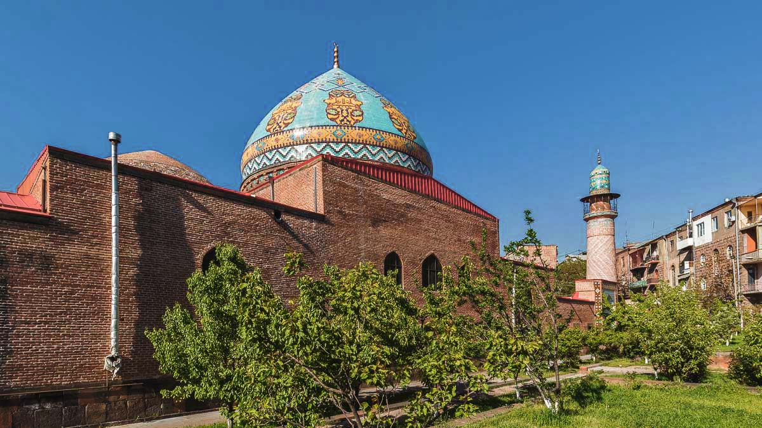
Blue Mosque
Yerevan
XX. century
Photo © Elena Stambulyan

Slide 37
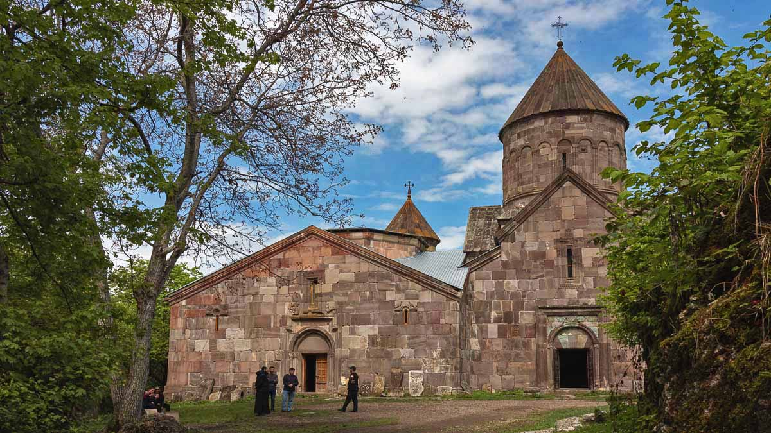
Makaravank Monastery
Achajur
X. century
Photo © Elena Stambulyan

Slide 38
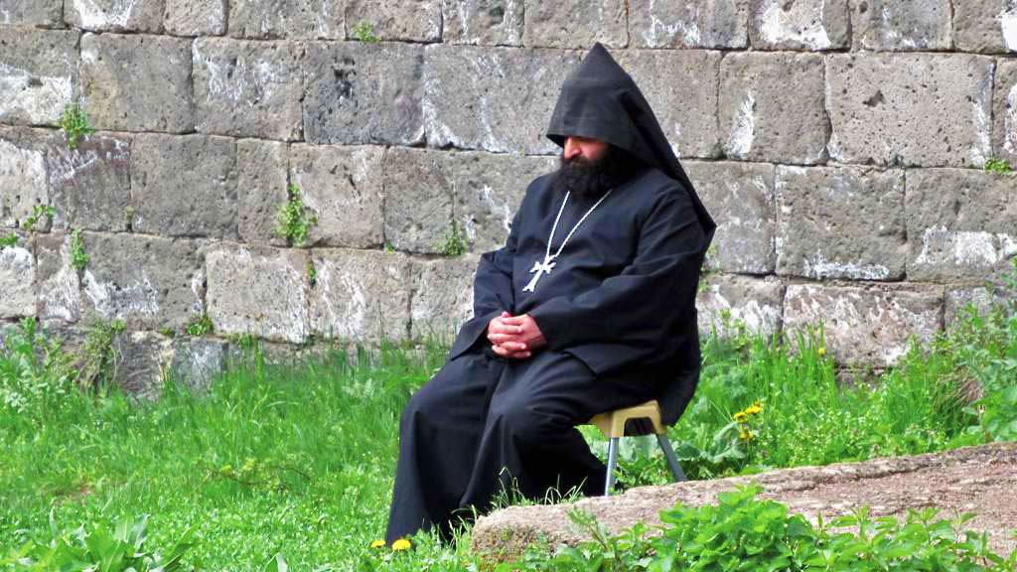
Photo © David Stanley

Slide 39
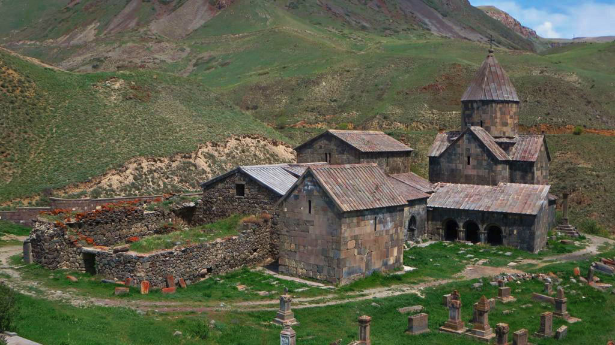
Vorotnavank Monastery
Vaghatin
XI. century
Photo © David Stanley

Slide 40
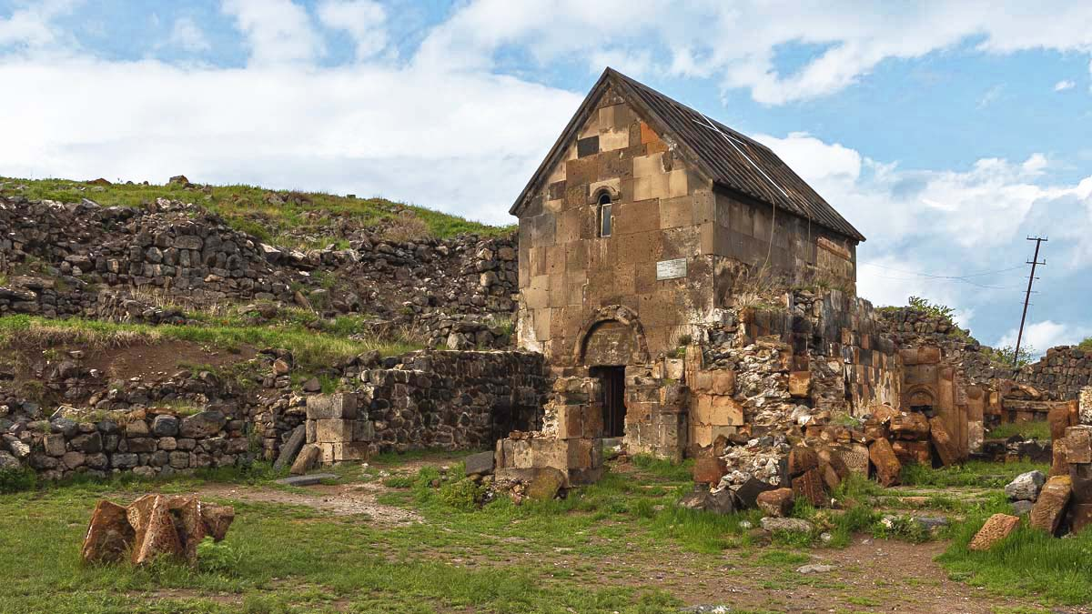
St. Sarkis Monastery
Ushi
X. century
Photo © Elena Stambulyan

Slide 41
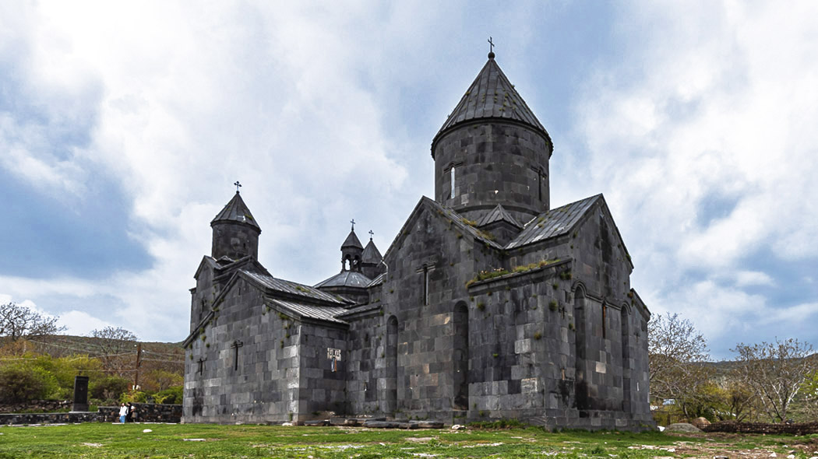
Tegher Monastery
Tegher
XIII. century
Photo © Elena Stambulyan

Slide 42
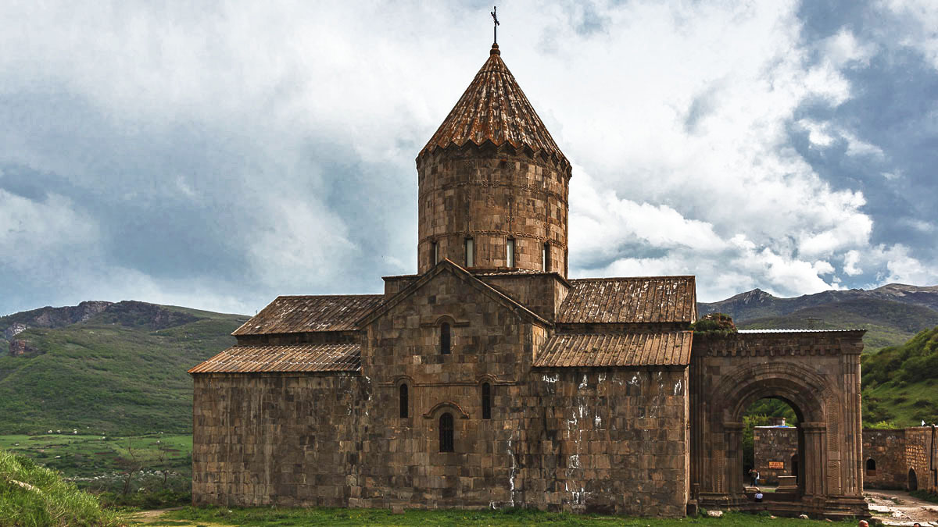
Tatev Monastery
Tatev
IX. century
Photo © Elena Stambulyan

Slide 43
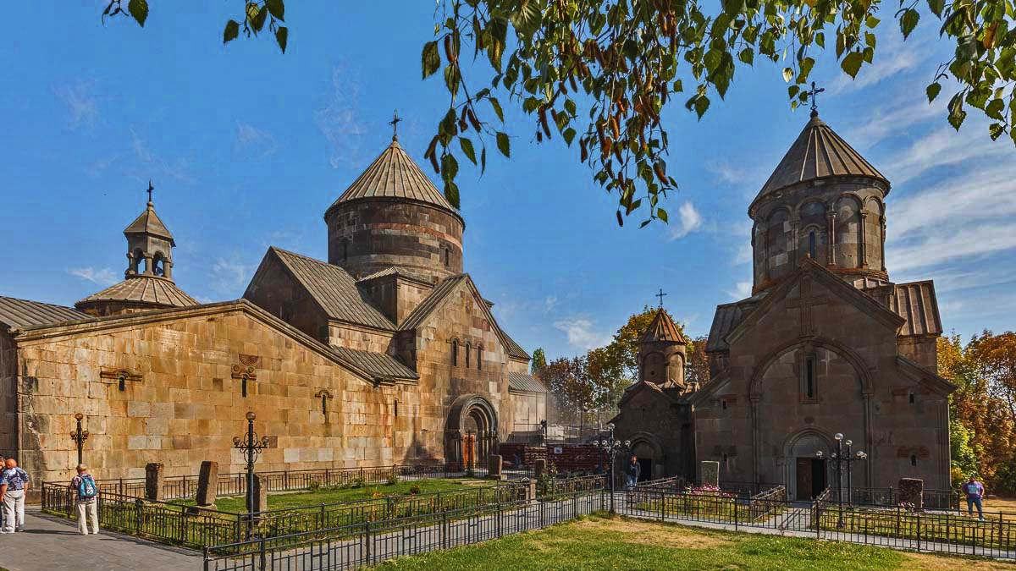
Kecharis Monastery
Tsaghkadzor
XI. century
Photo © Elena Stambulyan

Slide 44
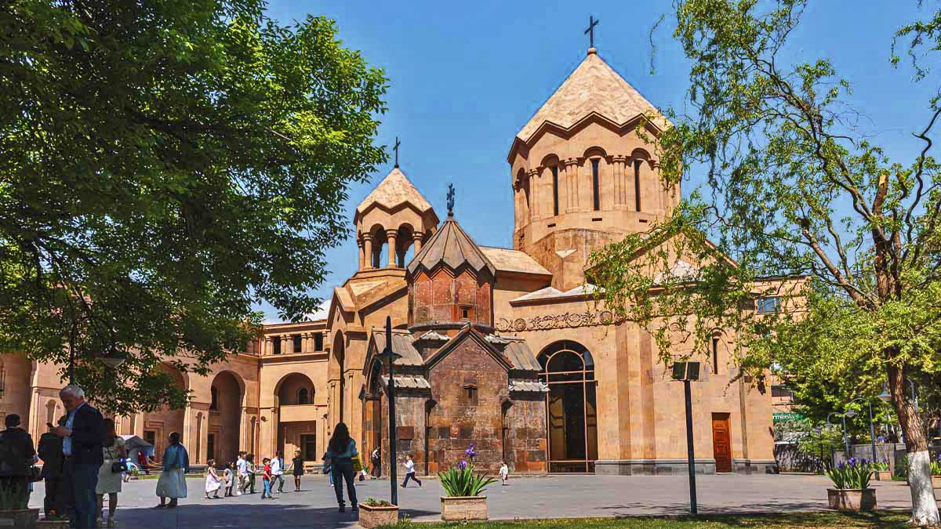
Holy Mother of God Kathoghike Church
Yerevan
XXI. century
Photo © Elena Stambulyan

Slide 45
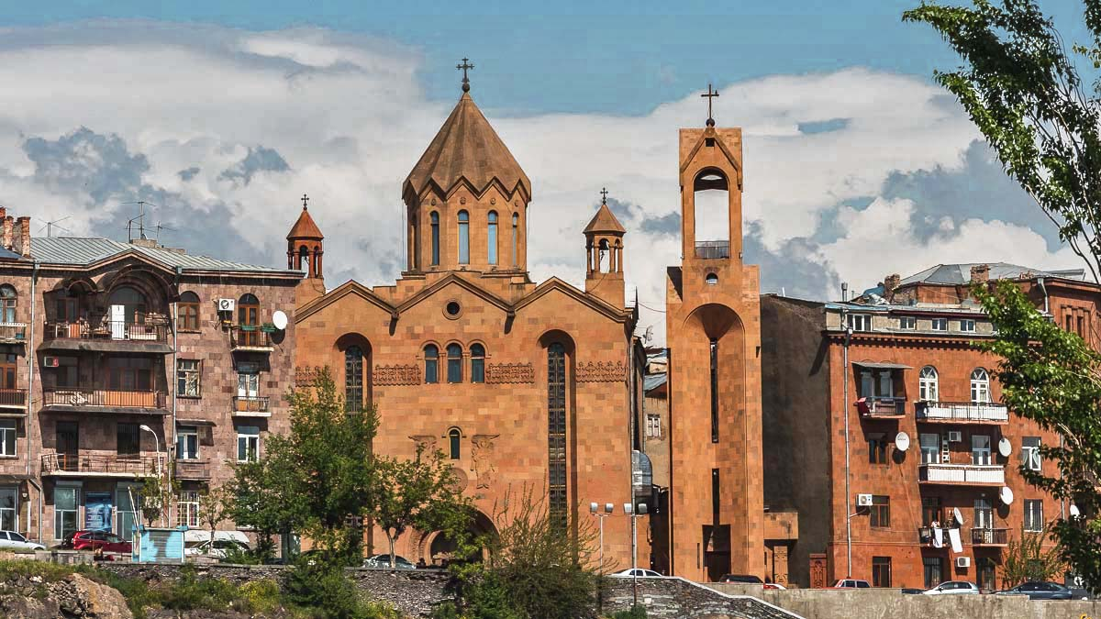
St. Sarkis Church
Yerevan
XIX. century
Photo © Elena Stambulyan

Slide 46
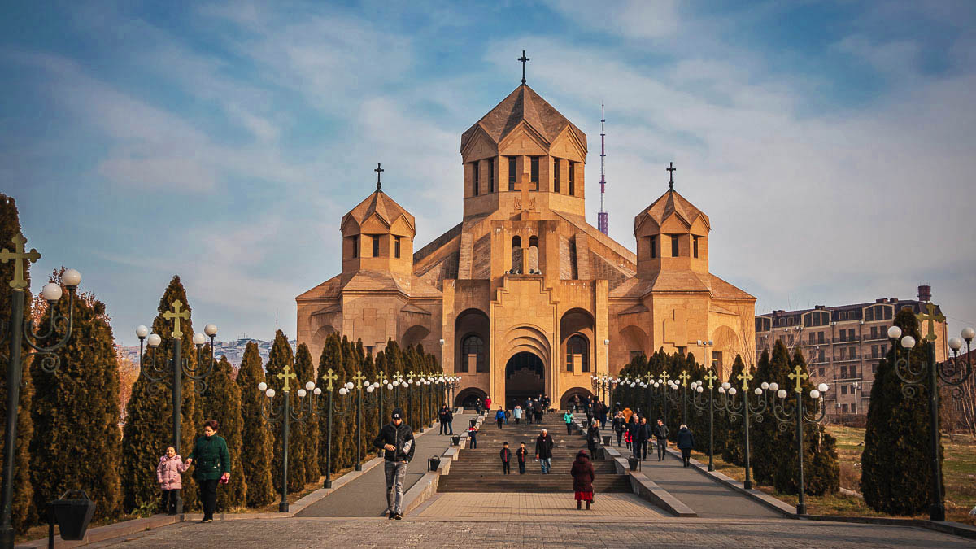
St. Gregory Сhurch
Yerevan
XXI. century
Photo © Elena Stambulyan

Slide 47


2022
Music : Ara Gevorkyan - Ter Voghormea
Photos : Elena Stambulyan (Russia)
Thanks to all photo owners for the cooperation.
Created by : Rumpler Štefan (Slovakia)
Contact: pista2011@gmail.com

Slide 48


Welcome in all languages!
I can translate your mails!
pista2011@gmail.com
CLICK for my VIDEOS
CLICK for my PPSX
Thank you for your feedback
Steve

Slide 49







¿Te ha gustado?
Puedes ver más entrando
Aquí
Además puedes recibir powerpoints en tu correo electrónico suscribiéndote aquí:

