Slide 1

Çelebi Grubu
(Grupo Celebi)

Slide 2

U S A

Slide 3
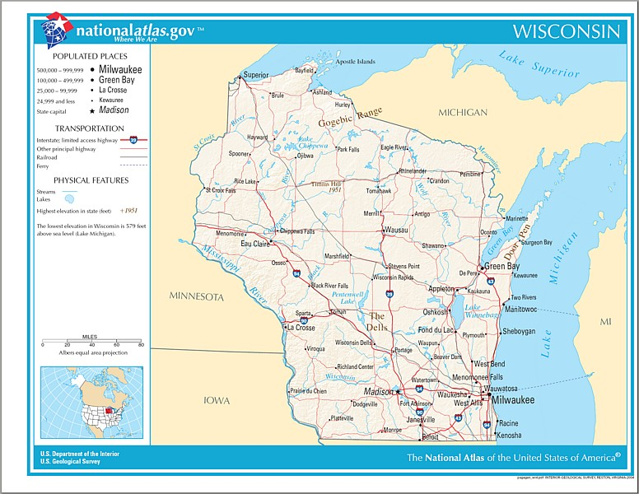

Slide 4
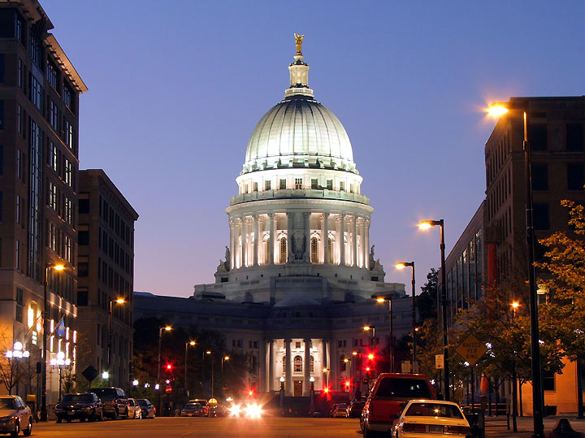
Madison - Wisconsin State Capitol

Slide 5
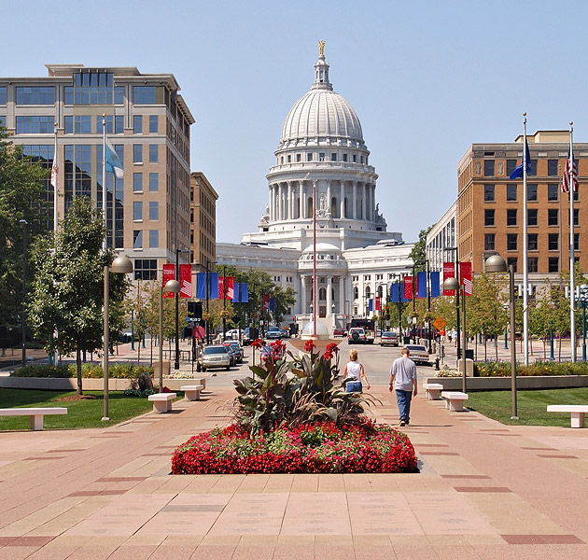
Madison - Wisconsin State Capitol

Slide 6
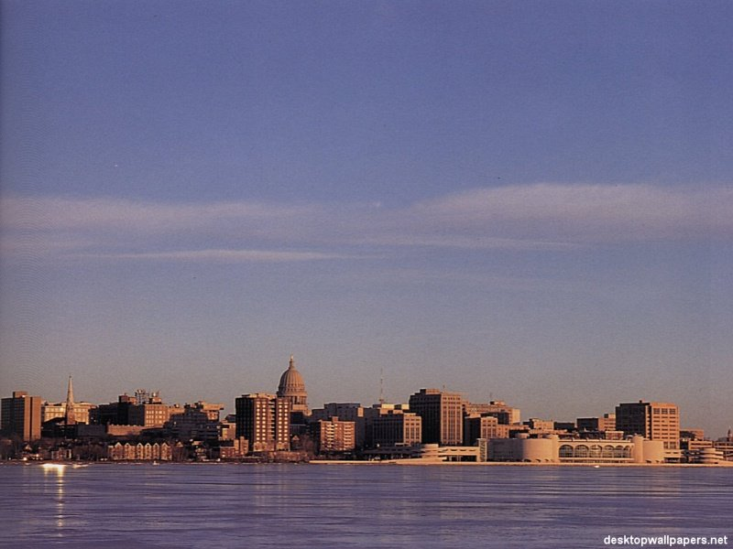
Madison

Slide 7
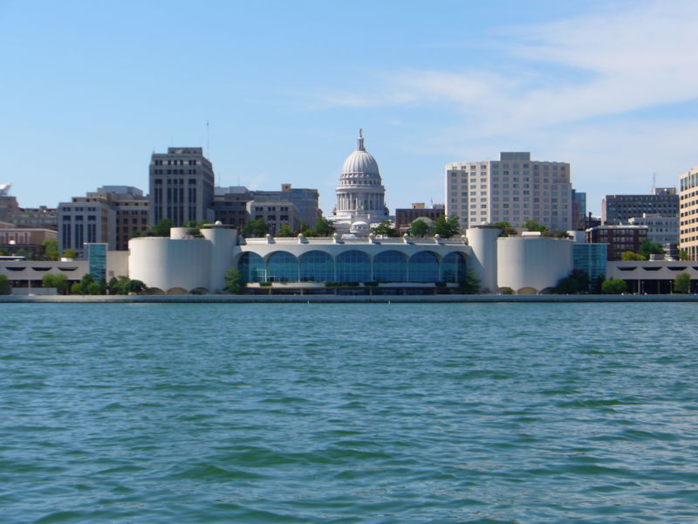
Madison

Slide 8
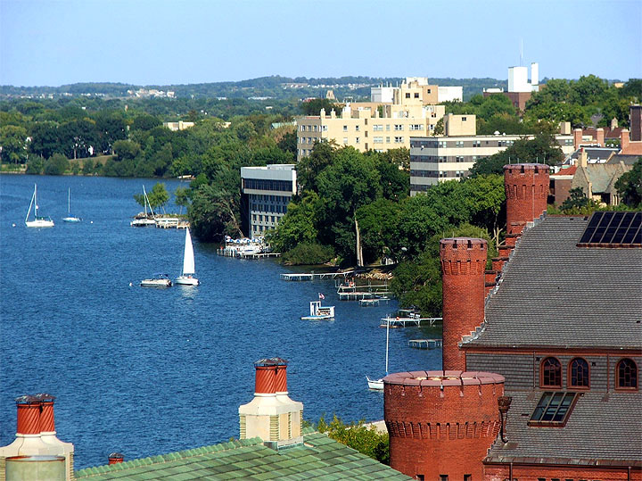
Madison

Slide 9
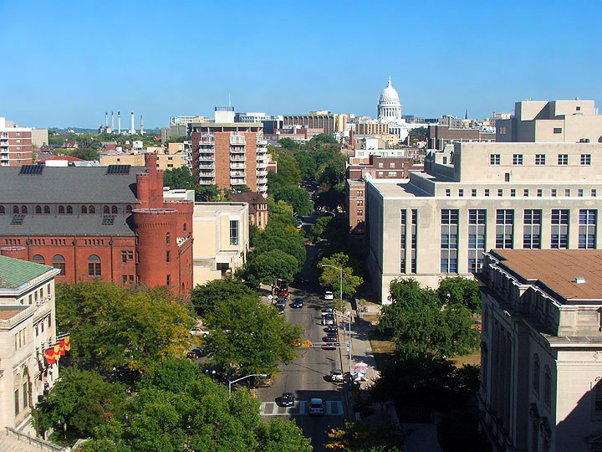
Madison

Slide 10
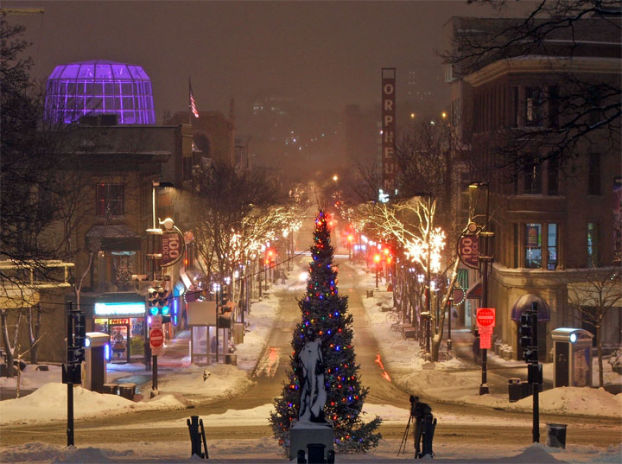
Madison

Slide 11
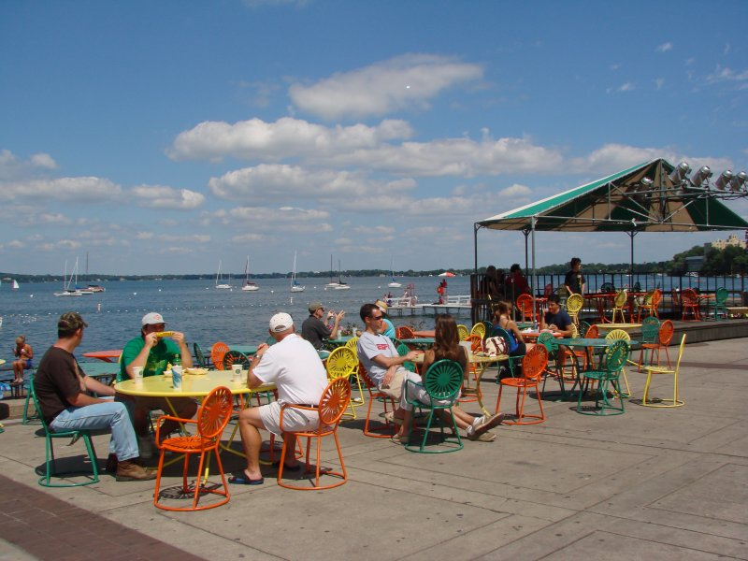
Madison – Lake Mendota

Slide 12
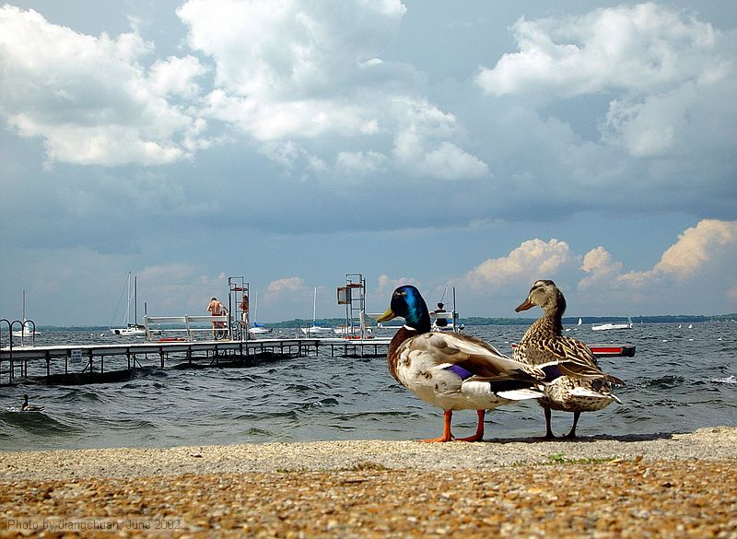
Madison – Lake Mendota

Slide 13
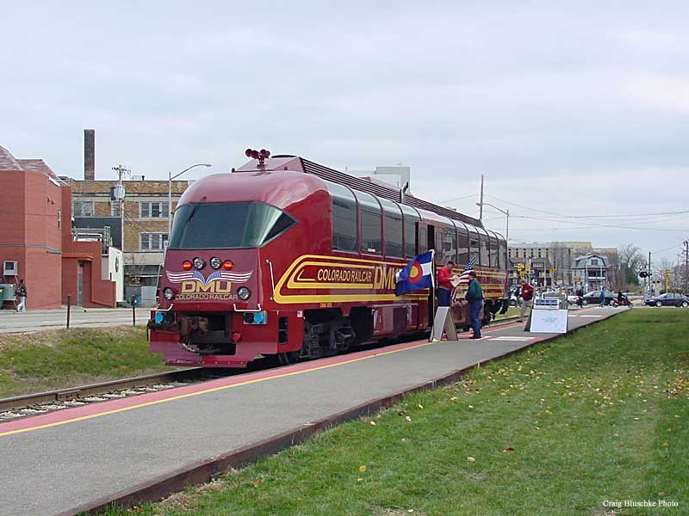
Madison – Rail

Slide 14
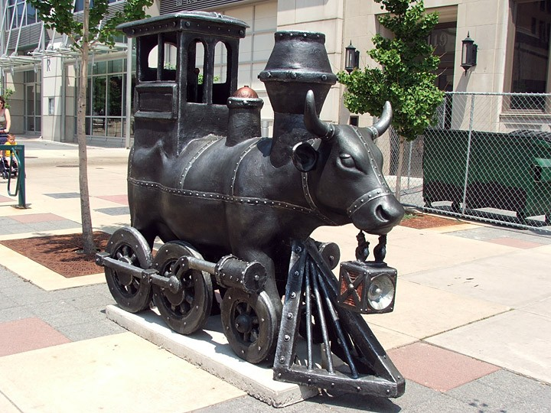
Madison

Slide 15
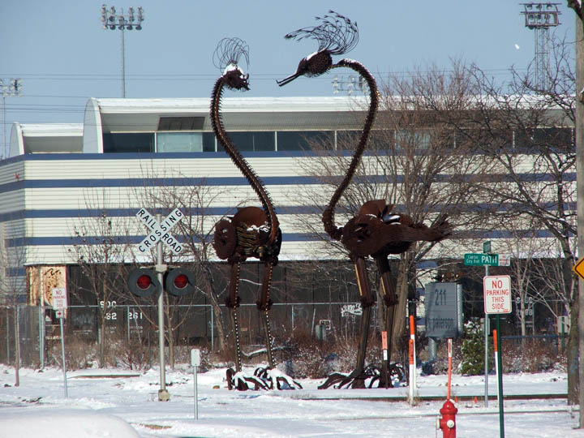
Madison

Slide 16
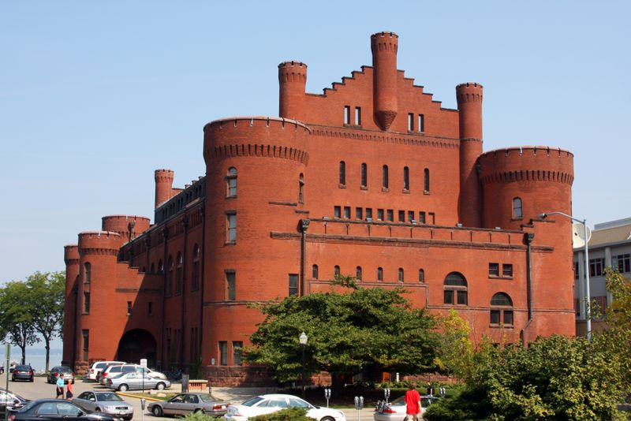
Madison - University of Wisconsin

Slide 17
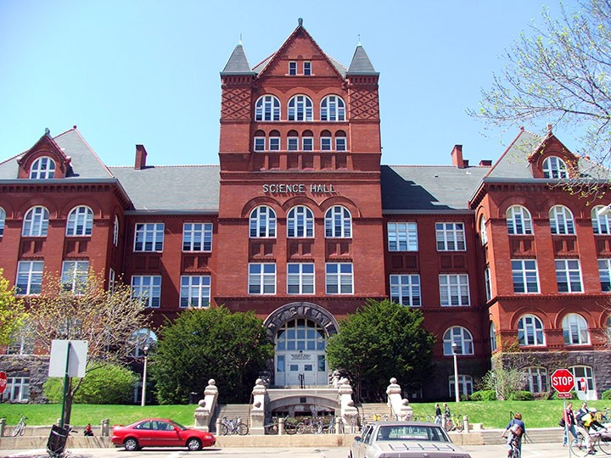
Madison - University of Wisconsin

Slide 18
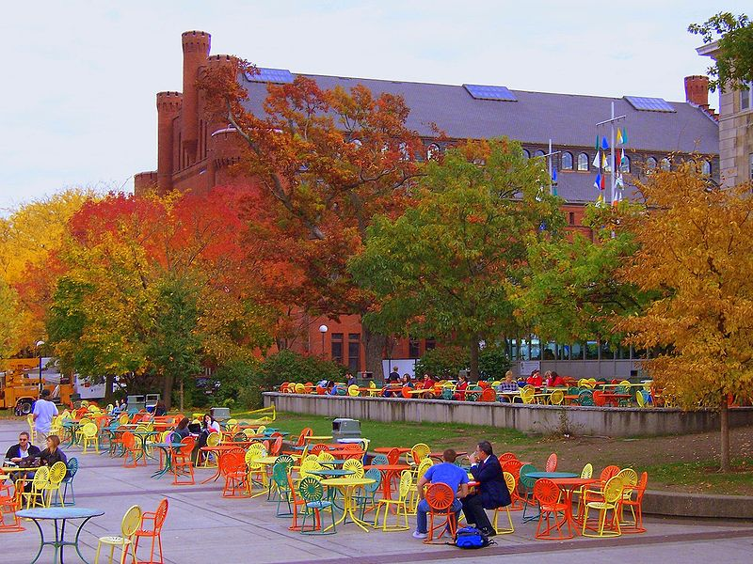
Madison

Slide 19
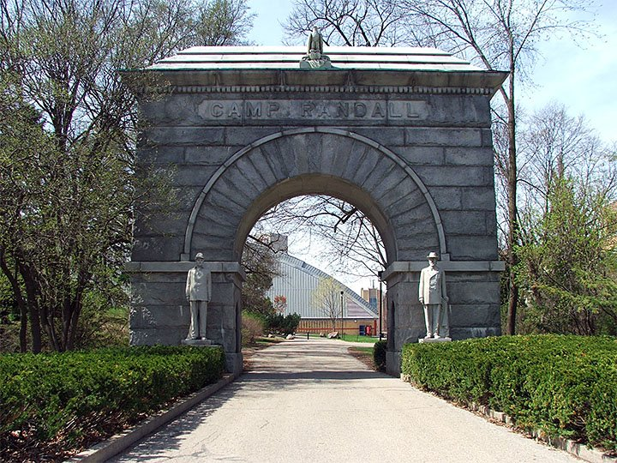
Madison - University of Wisconsin

Slide 20
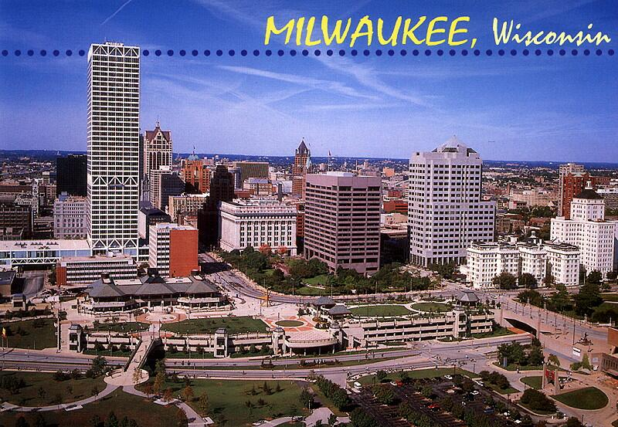
Milwaukee

Slide 21
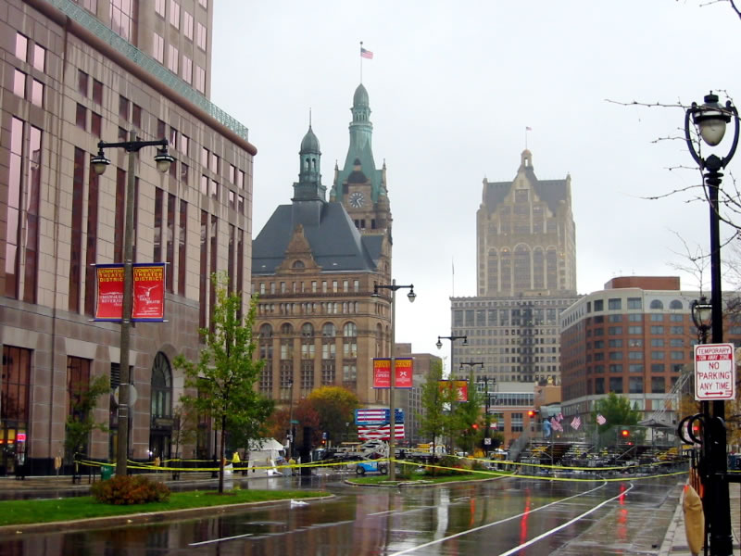
Milwaukee

Slide 22
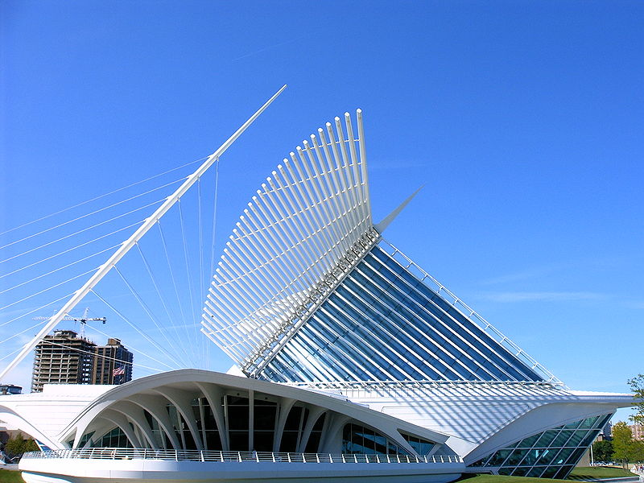
Milwaukee – Art Museum

Slide 23
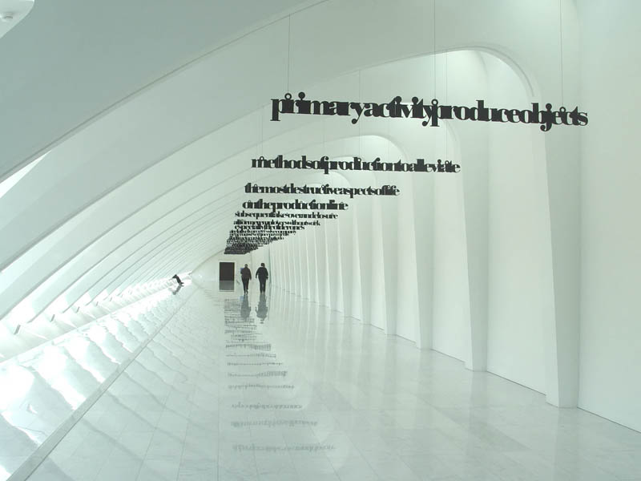
Milwaukee – Art Museum

Slide 24
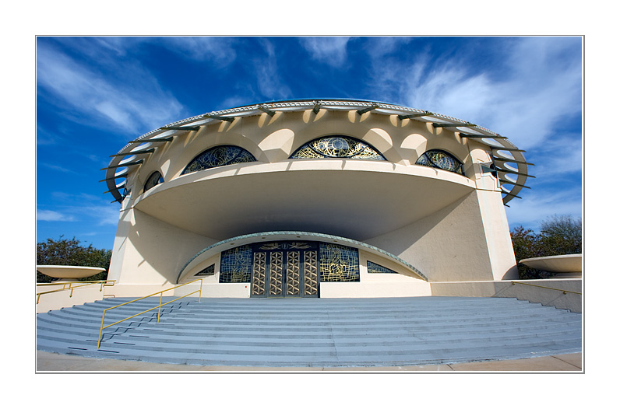
Milwaukee - Greek Church

Slide 25
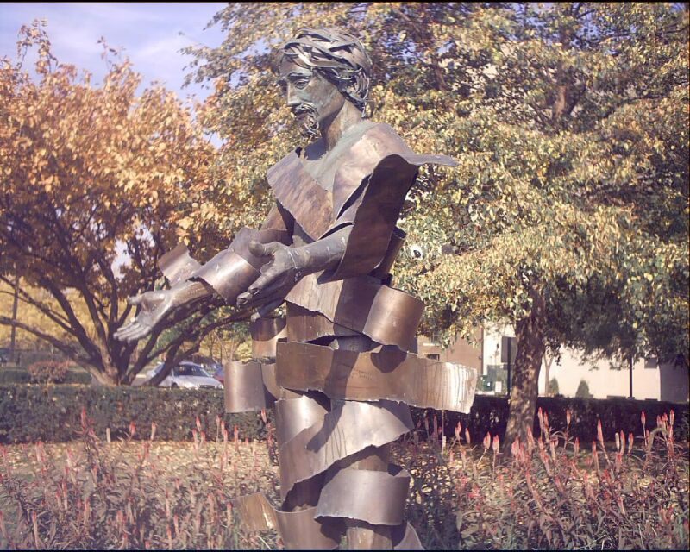
Milwaukee

Slide 26
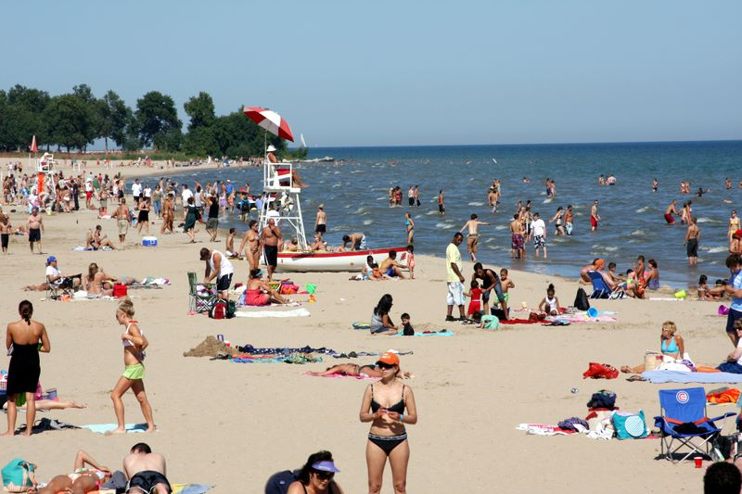
Milwaukee - Bradford beach

Slide 27
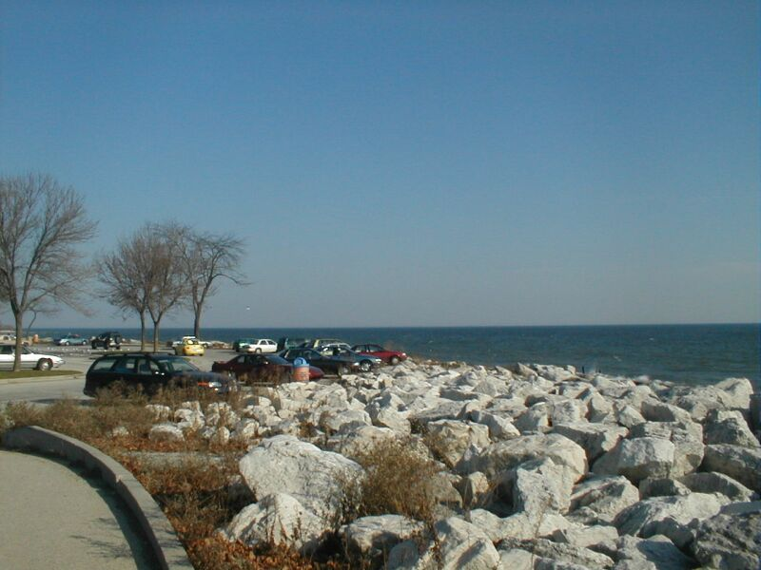
Milwaukee

Slide 28
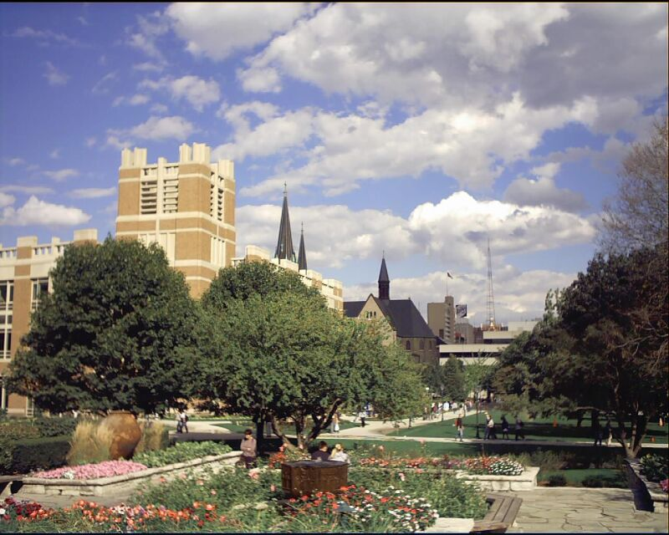
Milwaukee

Slide 29
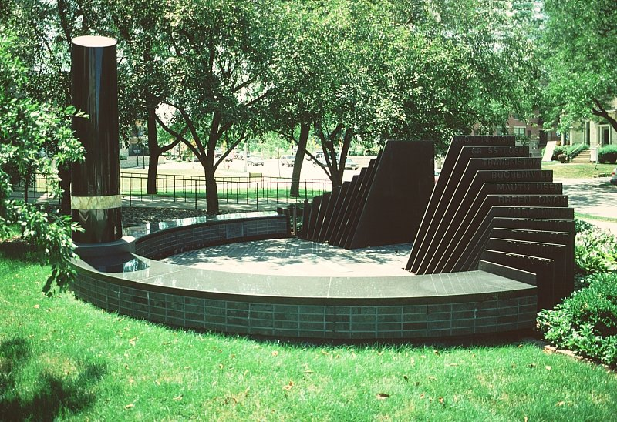
Milwaukee – Holocaust Memorial

Slide 30
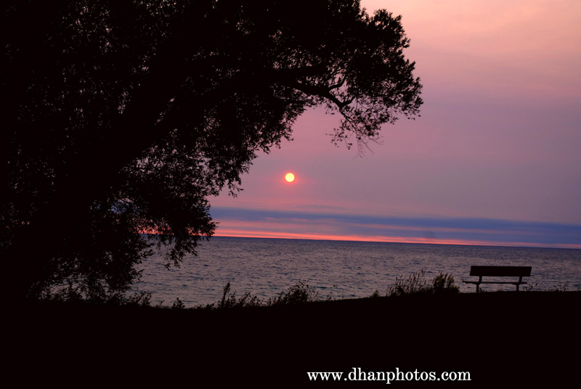
Milwaukee

Slide 31
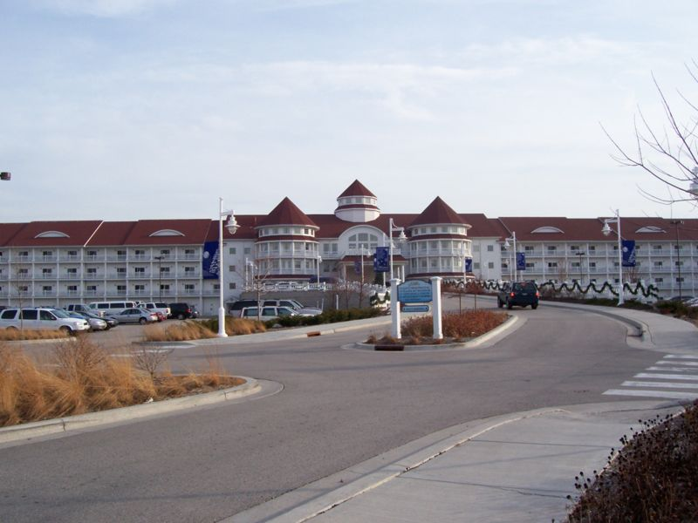
Blue Harbor Resort

Slide 32
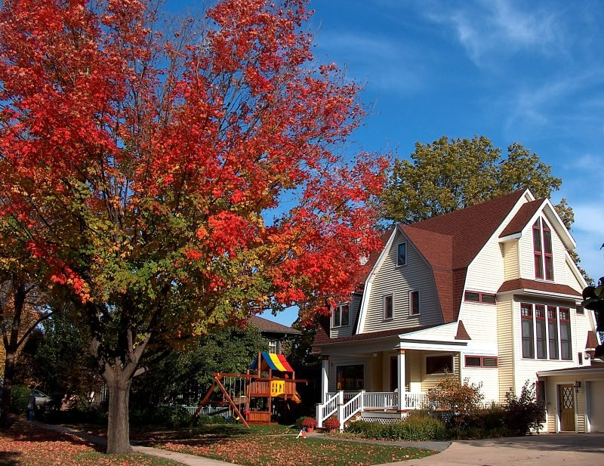

Slide 33
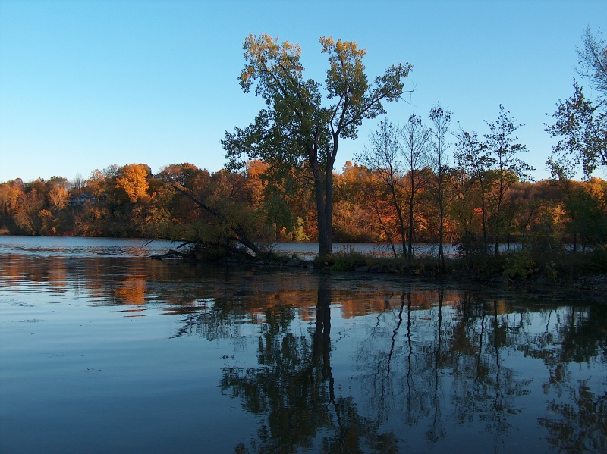

Slide 34
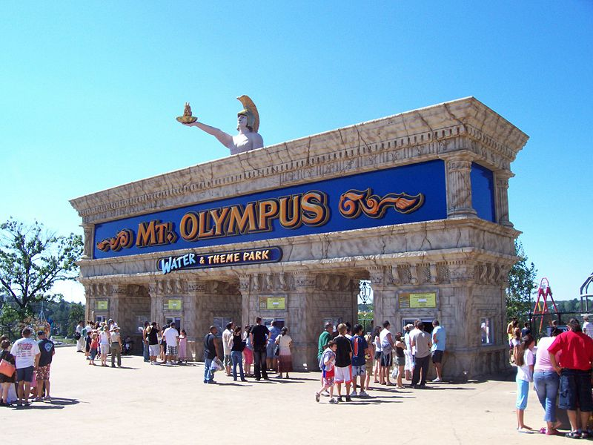

Slide 35
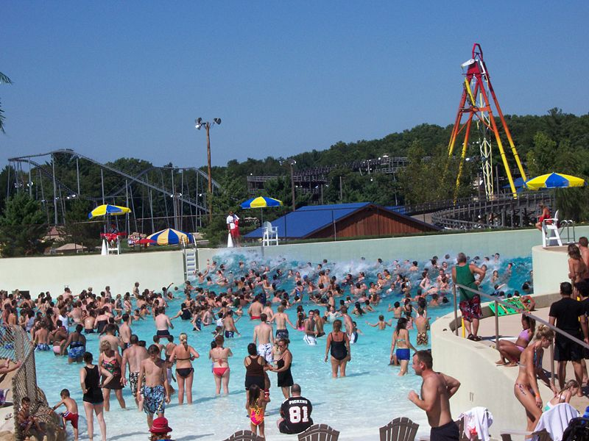

Slide 36
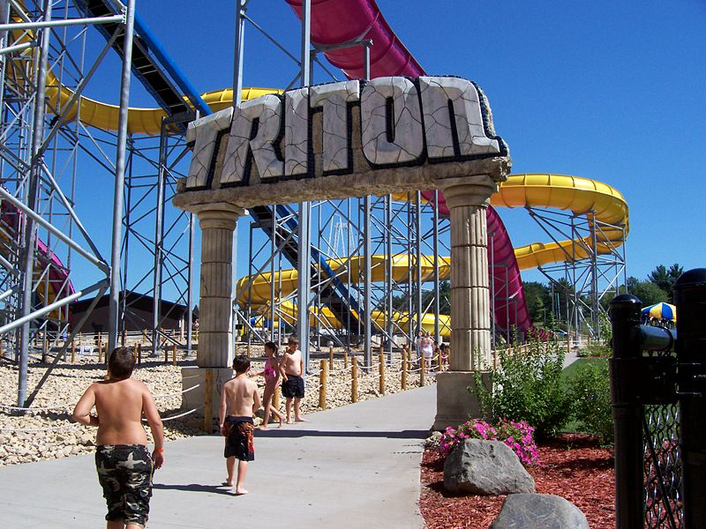

Slide 37
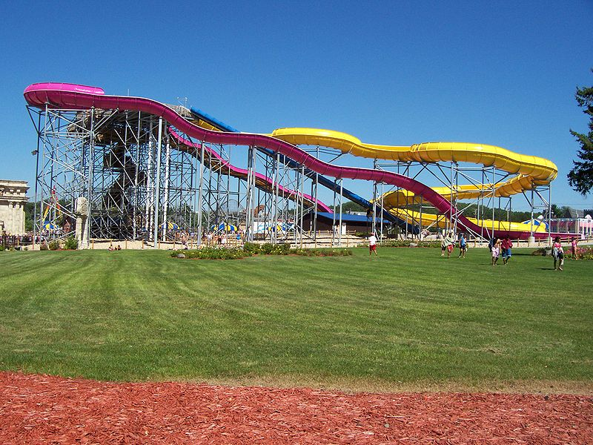

Slide 38
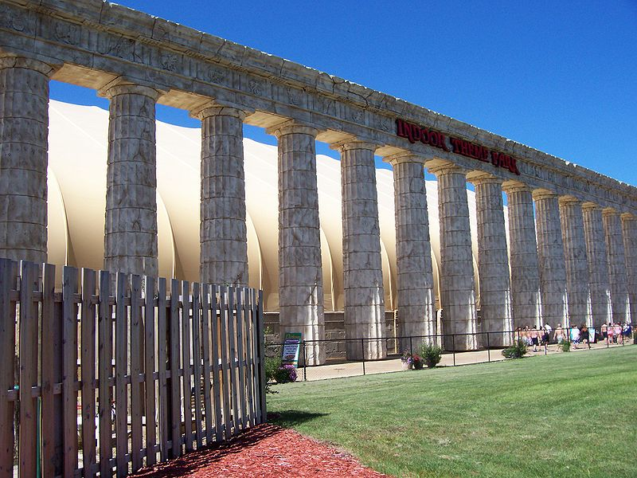

Slide 39
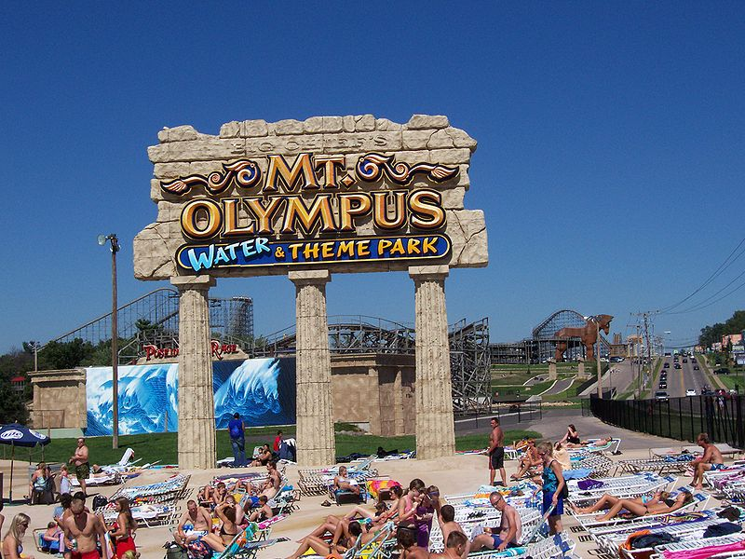

Slide 40
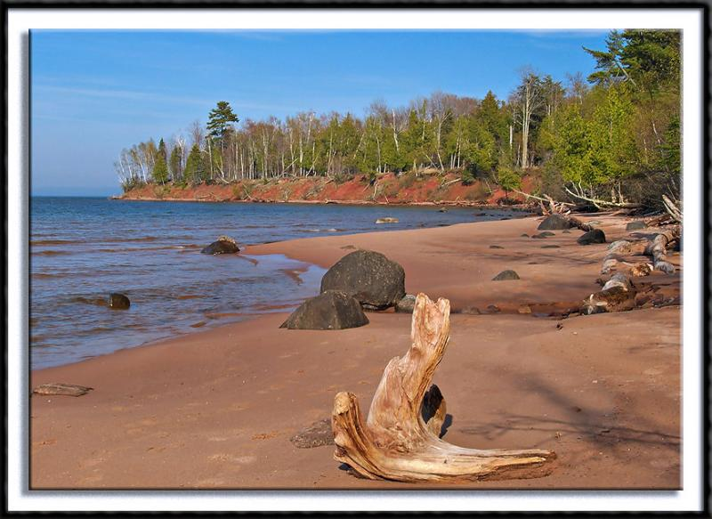

Slide 41
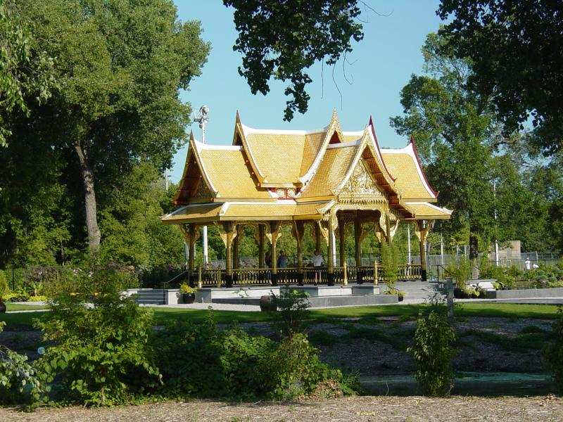
Thai Pavilion in Olbrich Gardens

Slide 42
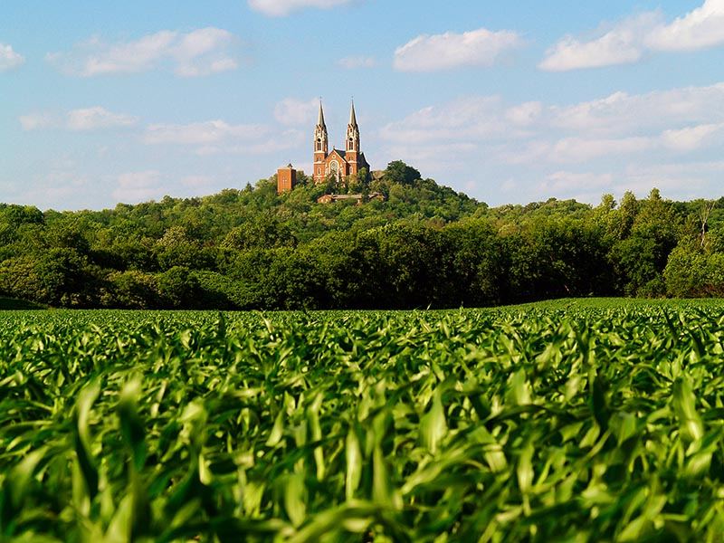
Erin - Cathedral

Slide 43
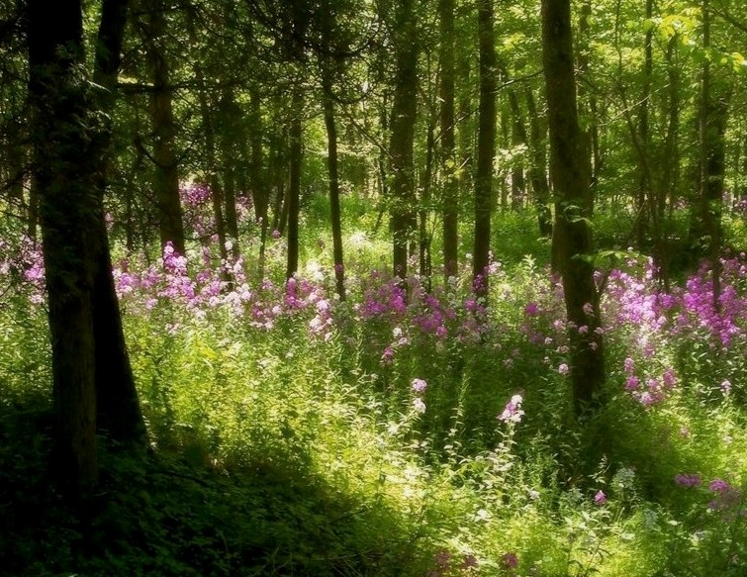
Forest Flowers

Slide 44
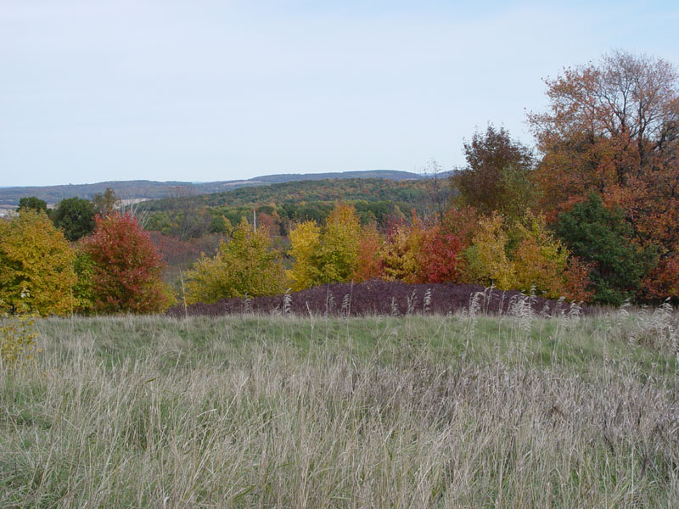

Slide 45
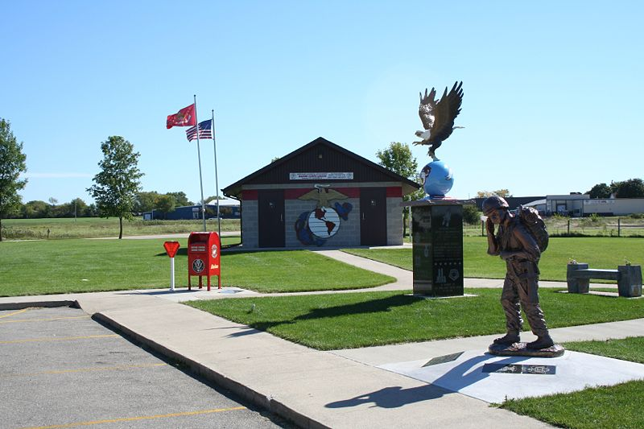
Watertown – Aero Park Monuments

Slide 46
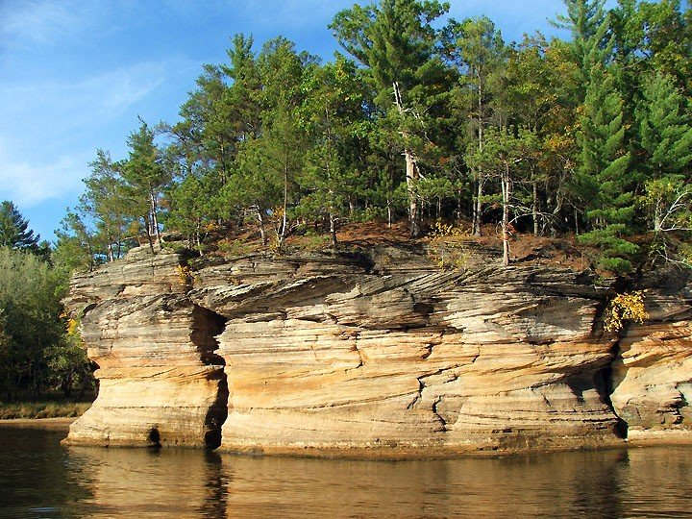
Wisconsin River

Slide 47
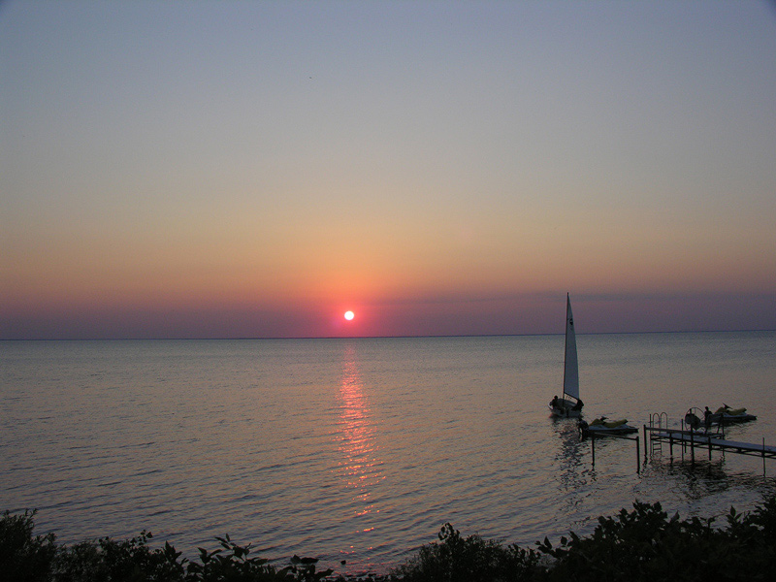
END
Author : kangur06
Images from the Internet
Sings: Dean Martin

Slide 48
Çelebi Grubu
(Grupo Celebi)

Slide 49







¿Te ha gustado?
Puedes ver más entrando
Aquí
Además puedes recibir powerpoints en tu correo electrónico suscribiéndote aquí:

